Slide 1


Monthly TV viewing report
April 2026
Frijj – Moos in Unexpected Places: Dinosaur

Slide 2
April linear TV facts & figures
Total TV weekly reach %
Total TV viewed per day
Commercial TV viewed per day
Impacts
Individuals
70.6 | 42.2bn | 1h 54m | 1h 15m
74.0 | 41.2bn | 2h 10m | 1h 26m
72.8 | 16.1bn | 1h 41m | 1h 1m
50.5 | 2.1bn | 26m | 18m
73.1 | 18.5bn | 2h 6m | 1h 22m
74.8 | 22.8bn | 2h 14m | 1h 29m
69.0 | 2.2bn | 54m | 36m
Adults
ABC1 adults
16-34
Men
Women
Housepersons with children
Sources: Barb April 2026, industry standard TV viewing in-home on a TV set. Reach 3min+. 30” equivalent impacts.
Notes:
April linear TV figures for weekly reach, impacts, total TV viewing hours and commercial TV viewing hours

Slide 3




Some notable TV moments in April
On 6 April, ITV1 launched I'm a Celebrity... South Africa to an average audience of 4.01m.
On 2 April, Channel 4 aired A Woman of Substance to an pre-broadcast audience of 1.44m, live audience of 0.67m and time-shifted audience of 0.77m.
On 13 April, Channel 5 aired the first episode of Missed Call to an average audience of 2.11m.
On 1 April, U&Drama aired The Marlow Murder Club to a pre-broadcast audience of 0.45m, live audience of 0.35m and time-shifted audience of 0.27m.
Source: Barb, April 2026, individuals. Average audience figures, TV set and devices viewing 1-7 days (includes pre-broadcast figures, if applicable).

Slide 4

Top 5 ITV1 programmes
Britain’s Got Talent (4 April)
4.45 million viewers
Coronation Street (13 April)
4.13 million viewers
Grace (12 April)
4.06 million viewers
I'm a Celebrity... South Africa (6 April)
4.01 million viewers
Secret Service (27 April)
3.47 million viewers
Britan’s Got Talent – ITV1
Source: Barb, April 2026, individuals. Average audience figures, TV set and devices viewing 1-7 days (includes pre-broadcast figures, if applicable)
Notes:
Top 5 programmes - ITV

Slide 5
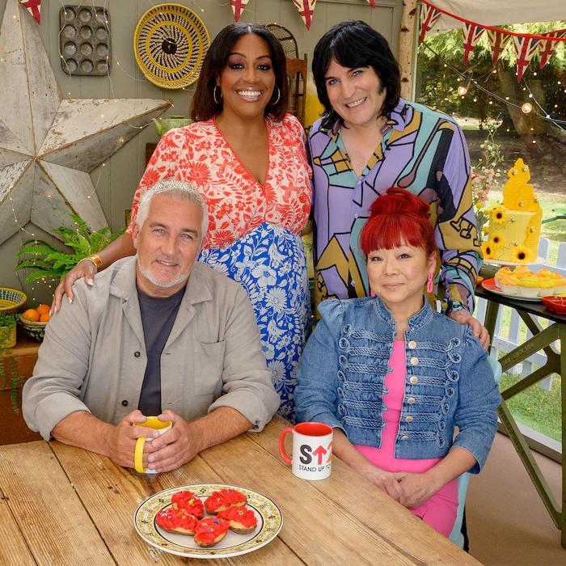
Top 5 Channel 4 programmes
A Woman of Substance (2 April)
2.88 million viewers
Gogglebox (3 April)
2.40 million viewers
24 Hours in Police Custody (13 April)
2.30 million viewers
The Great Celebrity Bake Off for SU2C (5 April)
1.83 million viewers
Taskmaster (9 April)
1.74 million viewers
The Great Celebrity Bake Off for SU2C – Channel 4
Source: Barb, April 2026, individuals. Average audience figures, TV set and devices viewing 1-7 days (includes pre-broadcast figures, if applicable)
Notes:
Top 5 programmes – Channel 4

Slide 6

Top 5 Channel 5 programmes
Missed Call (13 April)
2.11 million viewers
Murder in Shetland: Trial By Jury (27 April)
1.34 million viewers
China with Ben Fogle (6 April)
1.29 million viewers
The Teacher (1 April)
1.27 million viewers
Warship: Life in the Royal Navy (1 April)
0.95 million viewers
Murder in Shetland: Trial By Jury – Channel 5
Source: Barb, April 2026, individuals. Average audience figures, TV set and devices viewing 1-7 days (includes pre-broadcast figures, if applicable)
Notes:
Top 5 programmes – Channel 5

Slide 7

Top 5 commercial non-PSB* programmes (non-sport)
Married at First Sight Australia, E4 (8 April)
1.89 million viewers
The Marlow Murder Club, U&Drama (1 April)
1.06 million viewers
I’m a Celebrity… Unpacked (South Africa), ITV2 (24 April)
1.01 million viewers
Bergerac, U&Drama (30 April)
0.83 million viewers
The Wrap With Anna Botting, Sky News (1 April)
0.72 million viewers
Bergerac – U&Drama
Source: Barb, April 2026, individuals. Average audience figures, TV set and devices viewing 1-7 days (includes pre-broadcast figures, if applicable)
Notes:
Top 5 programmes – commercial non-public service broadcasting channels

Slide 8

Top 5 Netflix programmes
Thrash (10 April)
1.87 million viewers
Apex (24 April)
1.79 million viewers
At Home With The Furys (12 April)
1.67 million viewers
Unchosen (21 April)
1.54 million viewers
Trust Me: The False Prophet (8 April)
1.36 million viewers
Thrash – Netflix
Source: Barb, April 2026, individuals. Average audience achieved during the first seven days of their availability. Only includes TV set viewing.
Notes:
Top 5 programmes – Netflix

Slide 9

Top 5 Amazon Prime Video programmes
LOL: Last One Laughing UK (2 April)
4.43 million viewers
The Boys (8 April)
1.26 million viewers
UEFA Champions League: LFC v PSG (14 April)
0.94 million viewers
UEFA Champions League: PSG v FCB (28 April)
0.93 million viewers
Greenland 2: Migration (24 April)
0.59 million viewers
The Boys – Prime Video
Source: Barb, April 2026, individuals. Average audience achieved during the first seven days of their availability. Only includes TV set viewing. *Only viewing in April.
Notes:
Top 5 programmes – Amazon Prime Video

Slide 10
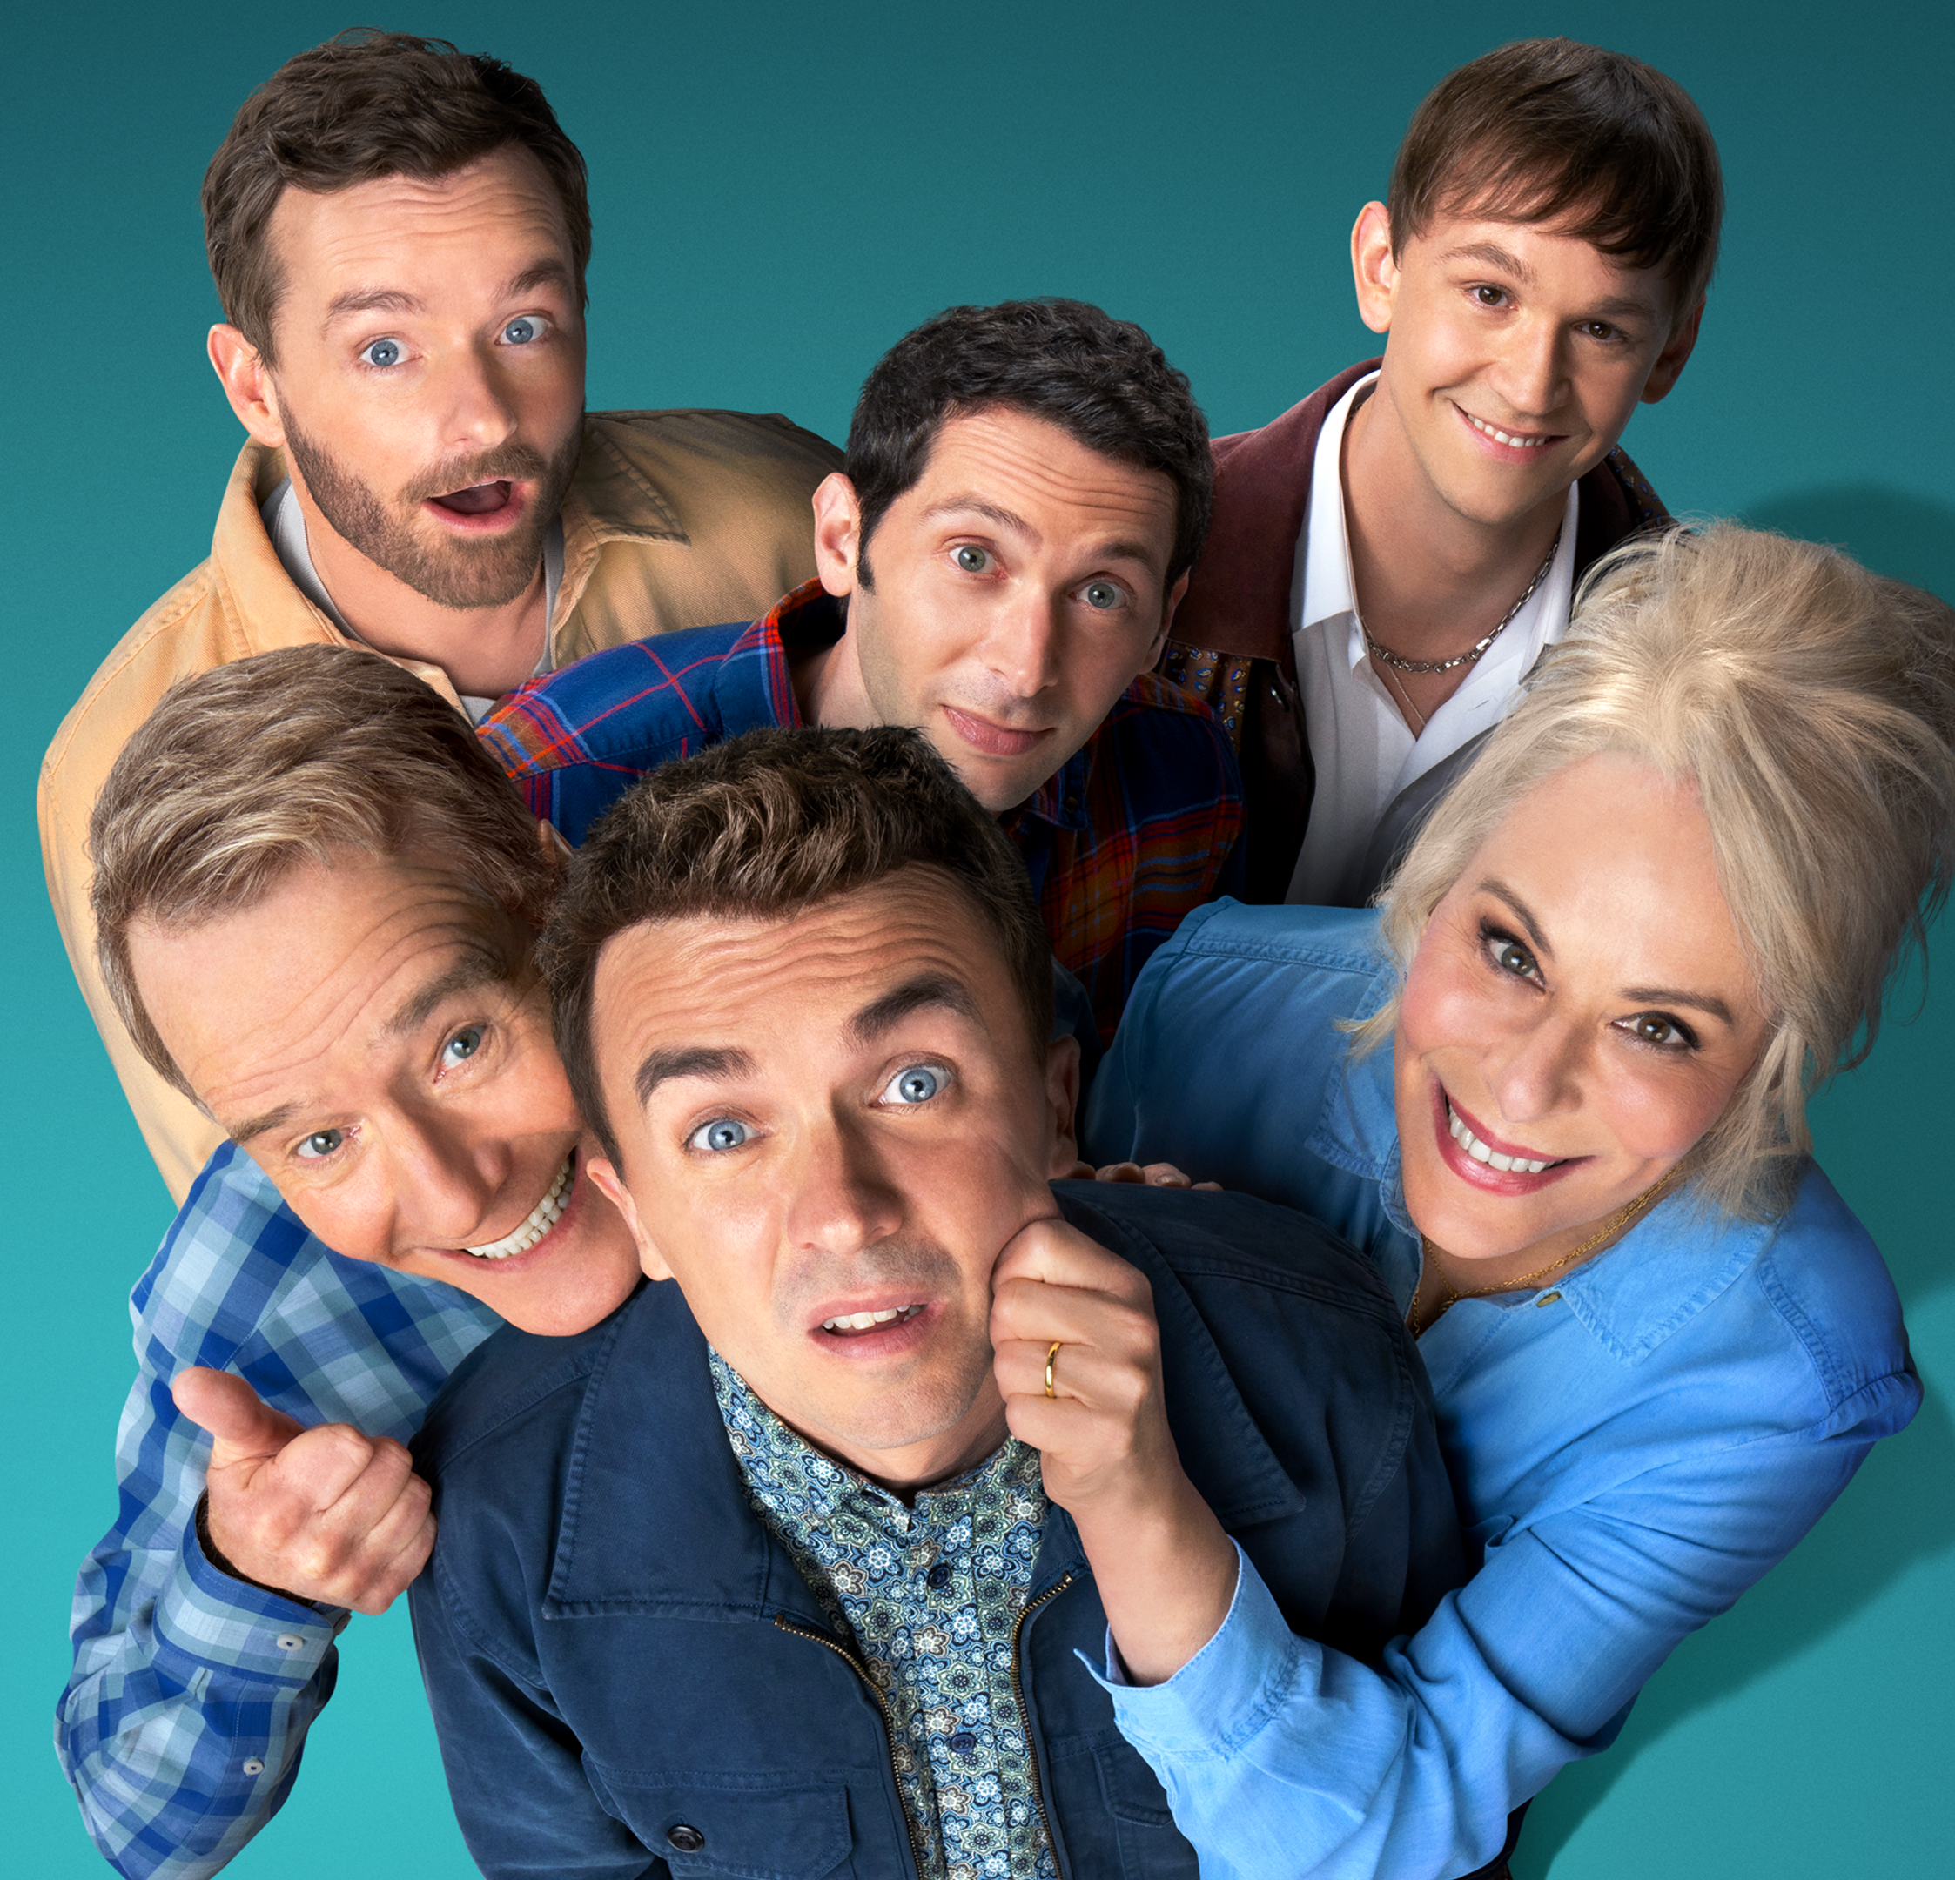
Top 5 Disney+ programmes
High Potential (8 April)
0.84 million viewers
Malcolm in the Middle (10 April)
0.72 million viewers
Scrubs (16 April)
0.52 million viewers
The Testaments (22 April)
0.49 million viewers
Daredevil: Born Again (1 April)
0.39 million viewers
Malcolm in the Middle – Disney+
Source: Barb, April 2026, individuals. Average audience achieved during the first seven days of their availability. Only includes TV set viewing.
Notes:
Top 5 programmes – Disney+

Slide 11
Top commercial programmes with largest proportion of device viewing
Total audience
1.59m
1.01m
4.01m
2.30m
2.88m
Source: Barb, April 2026, individuals. Average audience figures, TV set and devices viewing up to 7 days post-broadcast. Based on programmes with 1 million+ total TV viewers
Notes:
Top commercial programmes with largest proportion of device viewing

Slide 12
Top commercial programmes with largest proportion of pre-broadcast boxset BVOD viewing
Total audience
2.88m
1.06m
1.21m
1.63m
2.73m
Source: Barb, April 2026, individuals. Average audience figures, TV set and devices viewing up to 7 days post-broadcast. Based on programmes with 1 million+ total TV viewers
Notes:
Top commercial programmes with largest proportion of pre-broadcast boxset BVOD viewing

Slide 13
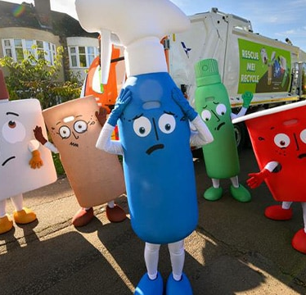
Key new to linear TV advertisers in April
GoodGym
Grand Prix winner of the 2025 Sky Zero Footprint Fund, launched its first ever TV ad to amplify their sustainability mission.
esure
Insurance provider esure returned to screens after over a decade away with a new campaign that reimagines their historic ‘Calm Down, Dear’ brand campaign
WRAP
Global environmental action non-governmental organisation (NGO), WRAP, is bringing circular living into homes across the UK with its debut TV ad.
WRAP – Rescue Me
Notes:
New to TV advertisers in April.

