Slide 1


Monthly TV viewing report
August 2026
Barclays - Stickers

Slide 2
August linear TV facts & figures
Total TV weekly reach %
Total TV viewed per day
Commercial TV viewed per day
Impacts
Individuals
65.2 | 39.7bn | 1h 43m | 1h 8m
69.0 | 39.0bn | 1h 57m | 1h 18m
67.5 | 15.3bn | 1h 31m | 56m
43.4 | 1.9bn | 20m | 15m
67.9 | 17.7bn | 1h 54m | 1h 16m
70.0 | 21.3bn | 2h 1m | 1h 19m
61.6 | 1.7bn | 42m | 28m
Adults
ABC1 adults
16-34
Men
Women
Housepersons with children
Sources: Barb August 2026, industry standard TV viewing in-home on a TV set. Reach 3min+. 30” equivalent impacts.
Notes:
August linear TV figures for weekly reach, impacts, total TV viewing hours and commercial TV viewing hours

Slide 3



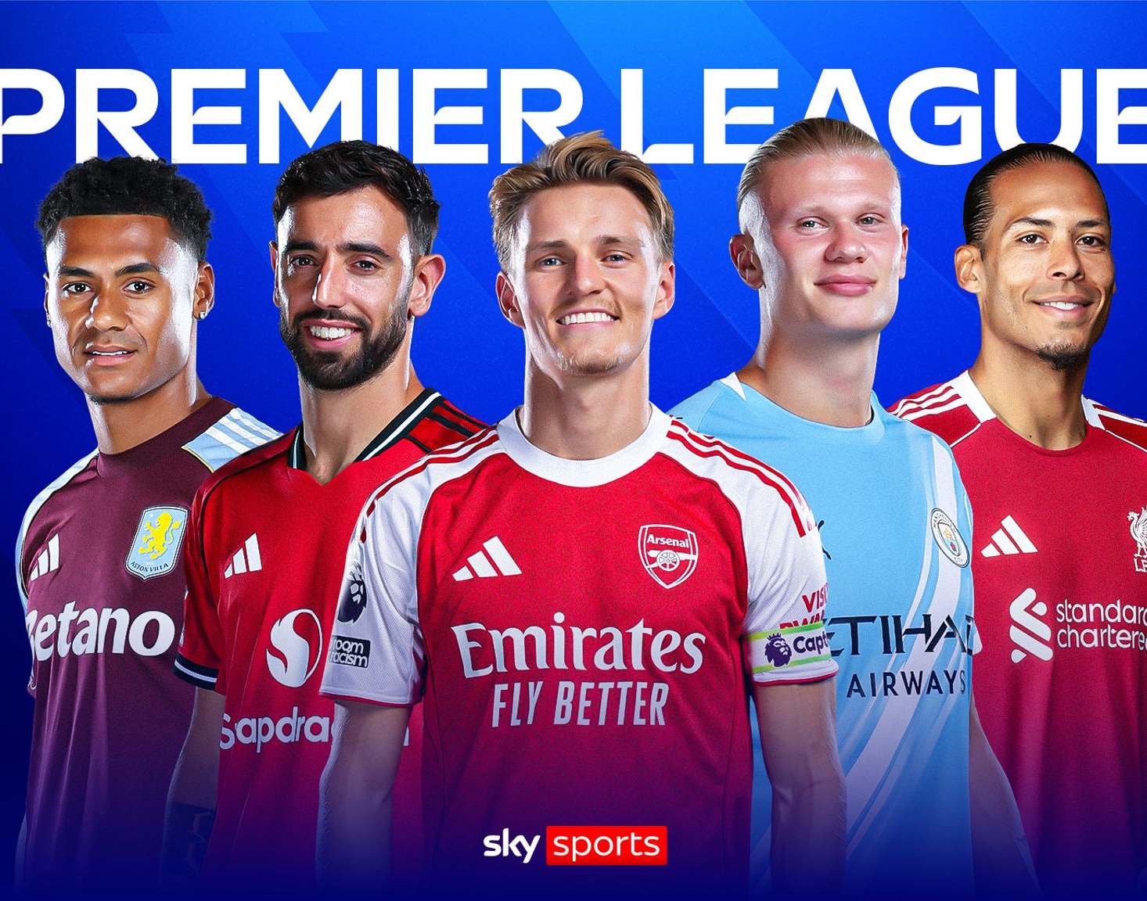
Some notable TV moments in August
On 31 August, ITV1 aired Trigger Point to an average audience of 4.3m.
On 5 August, Channel 4’s The Undeclared War reached 595k pre-broadcast, 121k live and 348k time-shifted viewers.
On 6 August, 5 aired Benidorm is Murder to an average audience of 1.43m.
On 30 August, Sky Sports aired Man United V Ipswich to a TV set audience of 984k and a device audience of 46k.
Source: Barb, August 2026, individuals. Average audience figures, TV set and devices viewing 1-7 days (includes pre-broadcast figures, if applicable).

Slide 4

Top 5 ITV1 programmes
Trigger Point (31 August)
4.25 million viewers
Coronation Street (24 August)
3.89 million viewers
Emmerdale (27 August)
3.47 million viewers
Van der Valk (2 August)
2.86 million viewers
Professor T (19 August)
2.70 million viewers
Van der Valk – ITV1
Source: Barb, August 2026, individuals. Average audience figures, TV set and devices viewing 1-7 days (includes pre-broadcast figures, if applicable)
Notes:
Top 5 programmes - ITV

Slide 5

Top 5 Channel 4 programmes
24 Hours in Police Custody (30 August)
2.41 million viewers
Love You to Death (19 August)
1.72 million viewers
The Piano (9 August)
1.62 million viewers
Celebrity Hunted (3 August)
1.45 million viewers
The Great ADHD Myth? (18 August)
1.28 million viewers
The Piano – Channel 4
Source: Barb, August 2026, individuals. Average audience figures, TV set and devices viewing 1-7 days (includes pre-broadcast figures, if applicable)
Notes:
Top 5 programmes – Channel 4

Slide 6
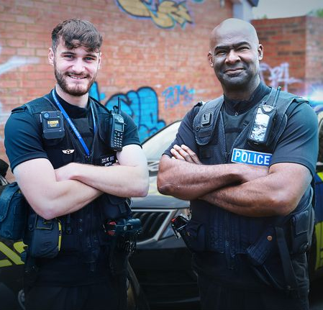
Top 5 Channel 5 programmes
Benidorm is Murder (6 August)
1.43 million viewers
9/11: The Unseen Footage (29 August)
1.34 million viewers
Motorway Cops: Catching Britain's Speeders (18 August)
0.93 million viewers
Fare Dodgers: At War with the Law (3 August)
0.93 million viewers
Street Cops: Catching the Yobs (17 August)
0.92 million viewers
Street Cops: Catching the Yobs – Channel 5
Source: Barb, August 2026, individuals. Average audience figures, TV set and devices viewing 1-7 days (includes pre-broadcast figures, if applicable)
Notes:
Top 5 programmes – Channel 5

Slide 7
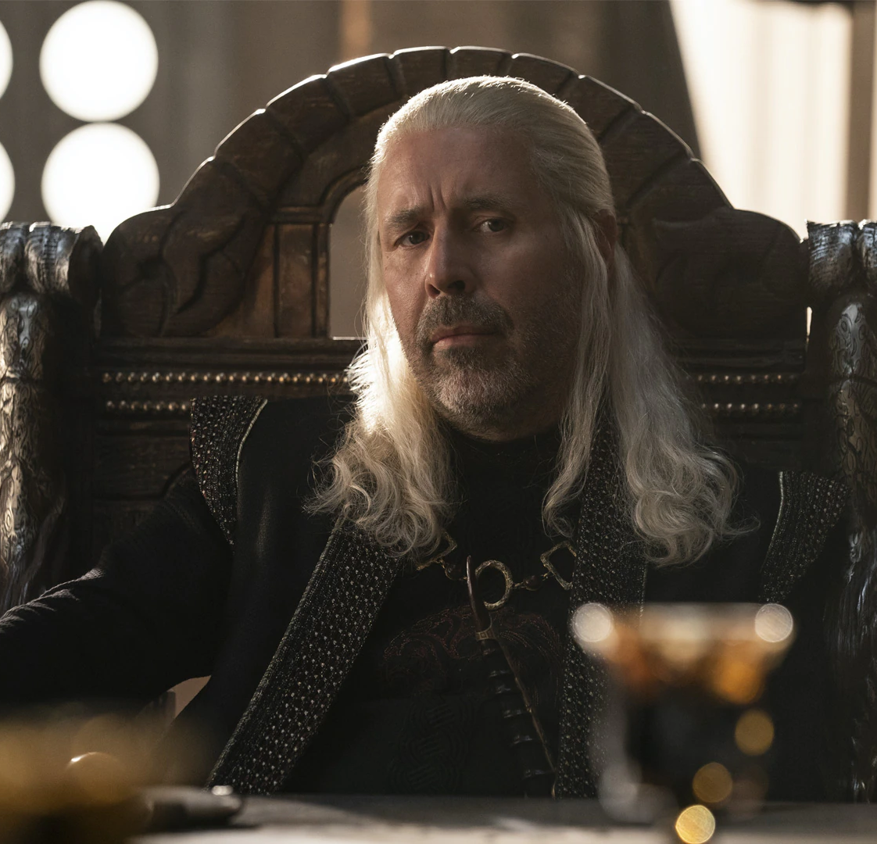
Top 5 commercial non-PSB* programmes (non-sport)
House of the Dragon, Sky Atlantic (9 August)
0.90 million viewers
Bookish, U&Alibi (26 August)
0.69 million viewers
Solar Eclipse Live, Sky News (12 August)
0.56 million viewers
The Five Star Weekend, Sky Atlantic (6 August)
0.54 million viewers
Home and Away, 5STAR (26 August)
0.53 million viewers
House of the Dragon, Sky Atlantic
Source: Barb, August 2026, individuals. Average audience figures, TV set and devices viewing 1-7 days (includes pre-broadcast figures, if applicable)
Notes:
Top 5 programmes – commercial non-public service broadcasting channels

Slide 8

Top 5 Netflix programmes
The Last House (7 August)
1.78 million viewers
The Whisper Man (28 August)
1.66 million viewers
Death of the Pastor's Wife (26 August)
1.48 million viewers
Alley Cats (7 August)
1.21 million viewers
Grand Theft Auto VI: An Extended Look (27 August)
1.18 million viewers
Death of the Pastor’s Wife – Netflix
Source: Barb, August 2026, individuals. Average audience achieved during the first seven days of their availability. Only includes TV set viewing.
Notes:
Top 5 programmes – Netflix

Slide 9

Top 5 Amazon Prime Video programmes
Reacher (26 August)
2.31 million viewers
Shelter (8 August)
0.76 million viewers
Masters of The Universe (31 July*)
0.57 million viewers
Meet the Owens (28 August)
0.35 million viewers
The Last Sunrise (26 August)
0.24 million viewers
Reacher – Prime Video
Source: Barb, August 2026, individuals. Average audience achieved during the first seven days of their availability. Only includes TV set viewing. *Only viewing in August.
Notes:
Top 5 programmes – Amazon Prime Video

Slide 10

Top 5 Disney+ programmes
The Devil Wears Prada 2 (29 July*)
0.95 million viewers
Camp Rock 3 (14 August)
0.49 million viewers
Furious (17 August)
0.31 million viewers
Disney Princess: The Ultimate Concert Celebration (16 August)
0.20 million viewers
Will Trent (5 August)
0.18 million viewers
Furious – Disney+
Source: Barb, August 2026, individuals. Average audience achieved during the first seven days of their availability. Only includes TV set viewing. *Only viewing in August.
Notes:
Top 5 programmes – Disney+

Slide 11
Top commercial programmes with largest proportion of device viewing
Total audience
1.24m
2.41m
1.03m
1.21m
3.35m
Source: Barb, August 2026, individuals. Average audience figures, TV set and devices viewing up to 7 days post-broadcast. Based on programmes with 1 million+ total TV viewers
Notes:
Top commercial programmes with largest proportion of device viewing

Slide 12
Top commercial programmes with largest proportion of pre-broadcast boxset BVOD viewing
Total audience
1.06m
2.60m
4.25m
1.08m
1.07m
Source: Barb, August 2026, individuals. Average audience figures, TV set and devices viewing up to 7 days post-broadcast. Based on programmes with 1 million+ total TV viewers
Notes:
Top commercial programmes with largest proportion of pre-broadcast boxset BVOD viewing

Slide 13
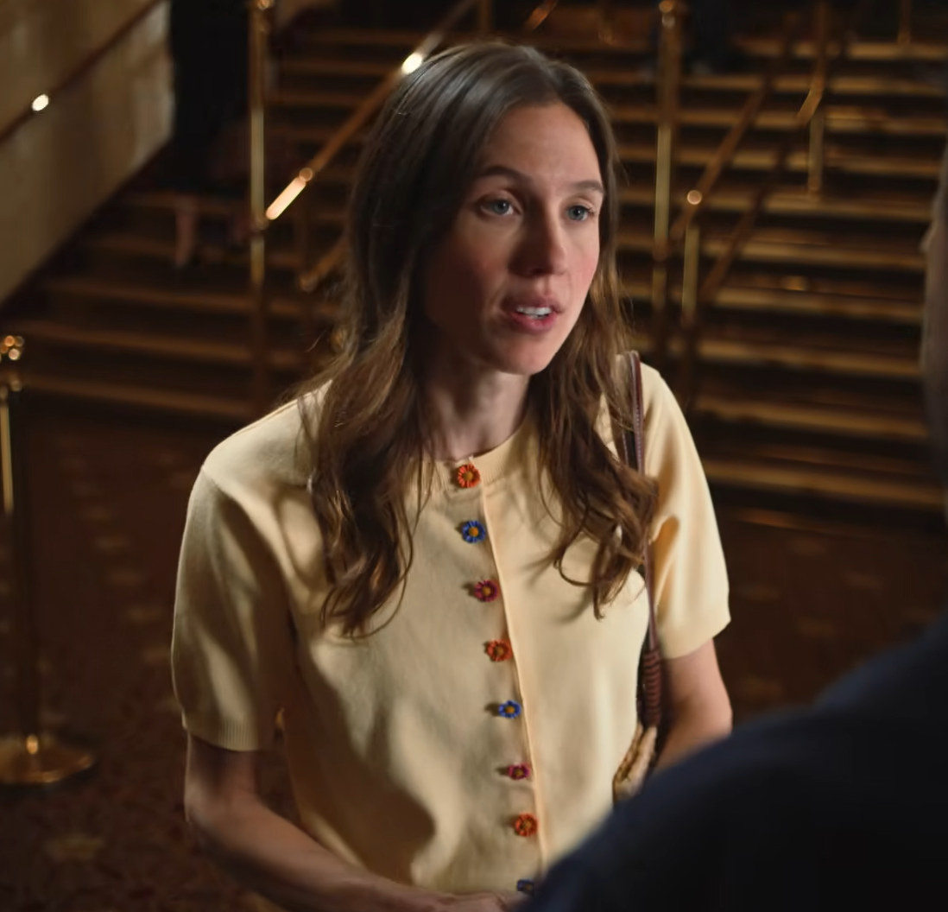
Key new to linear TV advertisers in August
Yorkshire Building Society
Yorkshire Building Society returns to TV advertising for the first time in 10 years.
Lepas
Chery International unveils new electric car brand Lepas with a TV campaign.
National Disability Card
National Disability Card launched it first-ever TV ad to raise awareness for the simple way to show you have a disability.
National Disability Card – No Need To Explain
Notes:
New to TV advertisers in August.

