Slide 1
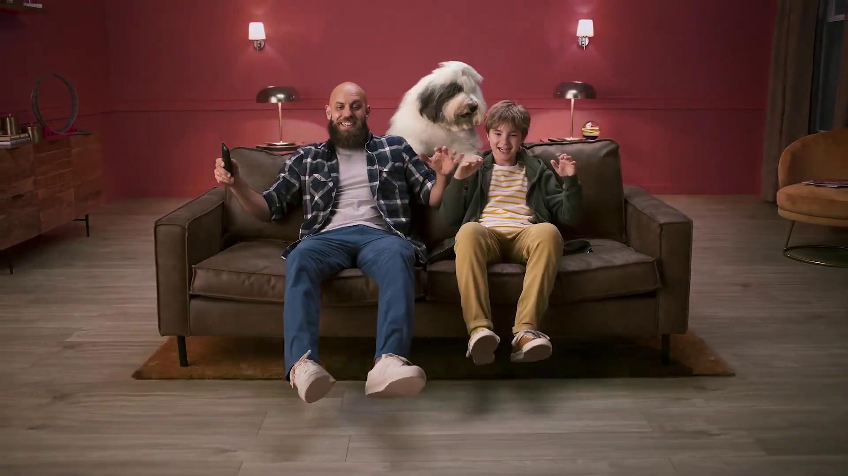

The importance of branding & emotion in TV advertising
Dulux – Change Starts Here

Slide 2
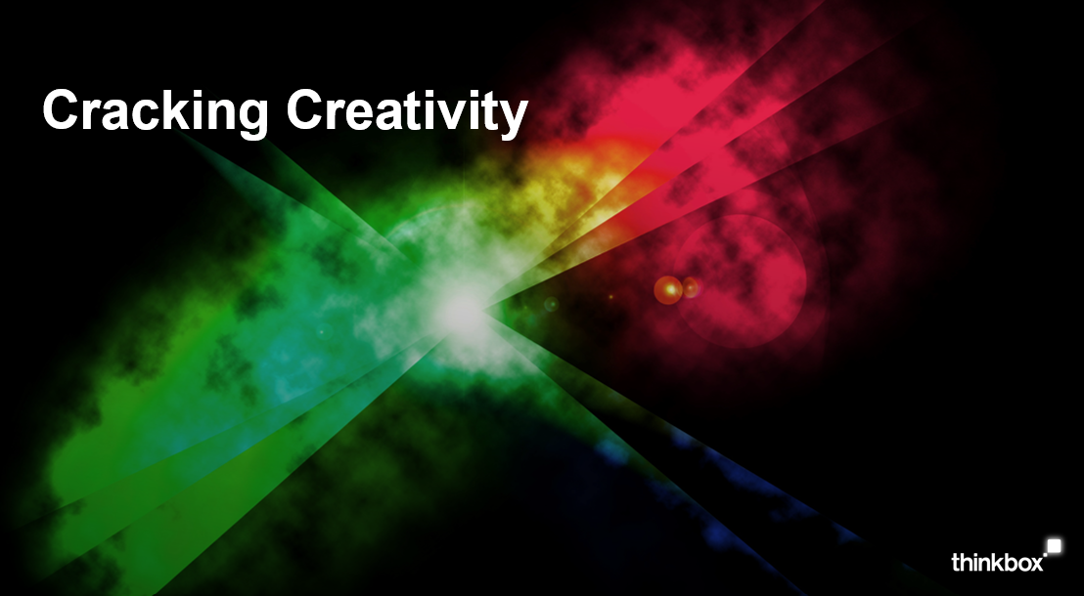

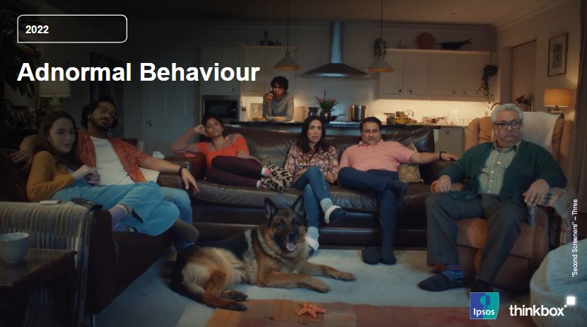

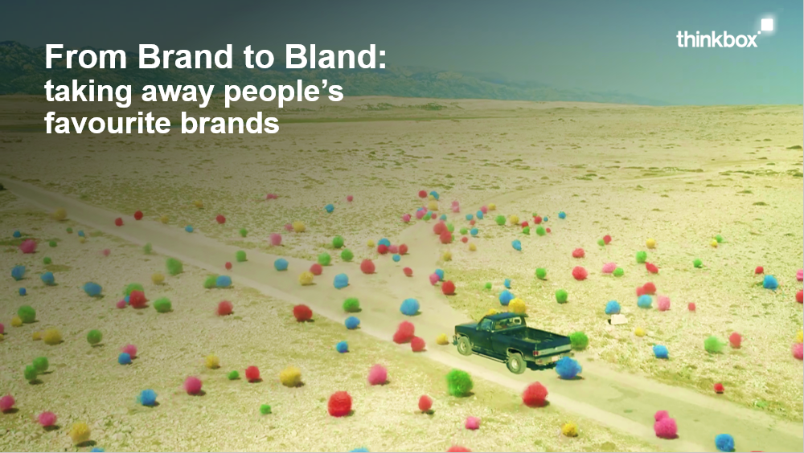
Just as it turns people into stars,
TV turns brands into household names
Research has repeatedly shown that emotive advertising campaigns are by far the most effective
Drawn from Thinkbox’s catalogue of research studies, let’s take a look at how emotion and branding work in TV advertising…

Slide 3

Agenda
WHY BRANDS MATTER
THE IMPORTANCE OF EMOTION, FAME & TRUST
MEMORY & STORYTELLING
BOOSTING THE EFFECTS OF BRANDING
Barclaycard – Cost Controllers

Slide 4

Brands are important as they provide a sense of: connection stability identity
Oddbox - Neighbours

Slide 5

Connection
Brands bring colour into people’s lives
They build deep, often subconscious connections which can impact our behaviour & attitudes
Provide important mental shortcuts (heuristics)
H&M – fall in Love
Notes:
Brands provide hugely important mental shortcuts (heuristics) and can convey rich brand heritage through nothing more than a logo.
For example: in Thinkbox’s “From Brand to Bland” study, we witnessed a respondent talk at length about the heritage of Yorkshire Tea. They spoke of the evocative imagery that the brand conveys through its packaging and described it as a ‘proper brew’, which is the language used in the ads.
We also witnessed high levels of commitment bias where brands had built deep behavioural connections around their brand. One example of this was with Heinz Ketchup, where people mentioned the ‘need’ to put it on their ‘beige food’ and how a substitute ketchup is inherently less attractive; “it has to be Heinz”.
Advertising - and particularly TV advertising - creates these heuristics and gives the brand a host of positive attributes that can set it well apart from its competitors.

Slide 6

Stability
Brands bring stability to people’s lives
They give us a sense of permanence, familiarity, comfort
Provide a crucial ‘anchor’ for snap judgements & future decisions
We have an innate desire to combat loss aversion
Easyjet – get Out There
Notes:
People don’t like change, whatever they say – we like the status quo – and in our subconscious, brands give us this sense of permanence, familiarity and comfort.
Brands bring stability to people’s lives in a time when they are often less physically connected to their friends and family. Behavioural economics also demonstrate that people generally prefer to avoiding losses to acquiring equivalent gains – when brands are taken away, a perceived level of stability is removed alongside them.
Brands provide an ‘anchor’ for consumers. People make snap judgements and ‘anchor’ their decisions based on the initial information they receive.

Slide 7

Identity
Brands become part of our identity
They prime others to see us a certain way
Taps into key behavioural economics wiring, such as authority bias & social norms
Dolmio – Dolmio-Yeah
Notes:
Strong brand identity primes consumers towards a more positive experience and is fundamental in driving the whole brand experience.
For example:
Wear Nike and no one will question your ability on the field, you “look the part” and it primes you to lift your game.
BMW badge appears “authoritative, innovative, successful” like those who drive them – it taps into social norms, authority bias and egocentric bias.
Priming plays a fundamental part in driving the whole brand experience.

Slide 8
Agenda
WHY BRANDS MATTER
THE IMPORTANCE OF EMOTION, FAME & TRUST
MEMORY & STORYTELLING
BOOSTING THE EFFECTS OF BRANDING
Barclaycard – Cost Controllers
McDonalds Trust+ – Happy Readers

Slide 9

TV builds brands through emotional connection
SCS – The Hug of Home

Slide 10

The importance of emotion in advertising
A brand consists of what we feel & what remember about it
Emotive advertising campaigns are 50% more likely to create large business effects, like sales & profit*
Emotional connection drives trust, which is hugely important
Nattwest – Let’s Get Going
*Source: IPA Databank, 2008-2018 creatively awarded cases
Notes:
A brand consists of what we feel and what we remember about it.
Emotive advertising campaigns and those that have fame at their core are by far the most effective at creating large business effects, like sales and profit. In fact, emotive campaigns are 50% more likely to create these effects.
Emotional connection drives trust, which is hugely important.

Slide 11

The importance of emotion in advertising
Emotion is crucial in TV advertising as:
Emotional ads tend to be more creative
Creativity makes us feel something about brands
That drives fame, implicit memory & mental availability
High-performing creatively awarded campaigns are 8 times more effective than their lower-performing peers*
Confused.com – Emmerdale Sponsorship
*Source: ‘Crisis in Creative Effectiveness’; 2019, IPA

Slide 12



TV ads evoke emotion more than those in other media
Social Media
Cinema
YouTube
Newspapers
Radio
TV
Magazines
Search
Outdoor
Direct Mail
Websites
Source: Adnormal Behaviour, 2022, Ipsos / Thinkbox. Q.TN3: In which, if any, of the following places are you most likely to find advertising that...makes them feel emotional
Base: ‘normal’ people (1,158)
Notes:
Thinkbox’s research study ‘Adnormal Behaviour 2022’ (conducted by Ipsos) asked the UK public which forms of advertising makes them feel emotional, 47% of the UK said TV advertising. This dwarfed all other media.
Creating an emotional response is incredibly effective in advertising.

Slide 13

TV advertising sticks in our brain and drives brand fame
Panini – The GOAT of swaps

Slide 14
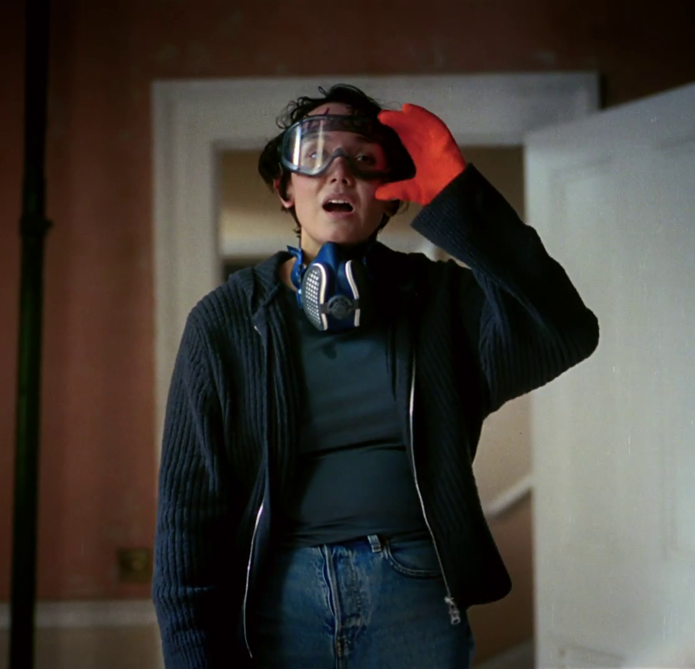
Why is brand fame important?
Brand fame is important because famous brands are memorable
Fame helps create mental availability
Brands that are talked about seem bigger than they really are
This creates ‘top of mind’ awareness & influence
B&Q – You Can Do It
Notes:
Famous brands are powerful, premium and iconic. They’re highly visible, people talk about them and they are seen as being creative.
Fame helps create mental availability, meaning a brand is easily recalled at the moment of choice. People are more likely to buy something if they remember it.
In earning consumers’ attention and building a sense of shared excitement through the power of emotion, brands are able to build brand equity for the long-term and change consumer behaviour.

Slide 15
TV drives fame more than any other media
66%
57%
52%
47%
49%
46%
39%
40%
34%
35%
35%
% AGREE
28%
27%
28%
17%
19%
Source: Adnormal Behaviour, 2022, Ipsos / Thinkbox. Q.TN3: In which, if any, of the following places are you most likely to find advertising that...
Base: ‘normal’ people (1,158)
Notes:
Thinkbox’s ‘Adnormal Behaviour’ study demonstrated that TV advertising is more impactful than other media.
Next best competitors:
“Makes brands famous” – Social media
“Sticks in memory” – Social media
“Makes you laugh” – Social media
“Makes you feel emotional” – Social media
“Draws attention to new brands/products” – Social media
“You like” – Social media
“You talk about (face-to-face/phone)” – Social media
“You trust” – Newspapers
For more information on this study, see the full write up on the Thinkbox website:
https://www.thinkbox.tv/research/thinkbox-research/adnormal-behaviour/

Slide 16
Emotional & fame strategies are the most efficient
1.0
1.3
1.0
0.2
Source: IPA Databank, 2004-2016
Notes:
The IPA have demonstrated that fame is the most efficient media strategy, closely followed by emotion. TV drives fame due to its high levels of reach and frequency. It is also the most emotive advertising medium, as AV stimulates the areas of the brain responsible for feelings and memory.

Slide 17

TV ads are the most trusted form of advertising
35% trust TV than the next best performing advertising medium
Burger King - Climbing

Slide 18
TV advertising is the most trusted
Newspapers
Radio
Magazines
Search
Cinema
TV
Social Media
Outdoor
Direct Mail
YouTube
Websites
Source: Adnormal Behaviour, 2022, Ipsos / Thinkbox. Q.TN3: In which, if any, of the following places are you most likely to find advertising that...you trust
Base: ‘normal’ people (1,158)
Notes:
Thinkbox’s ‘Adnormal Behaviour’ showed that TV ads were the most trusted form of advertising.
For more information on this study, see the full write up on the Thinkbox website:
https://www.thinkbox.tv/research/thinkbox-research/adnormal-behaviour/

Slide 19
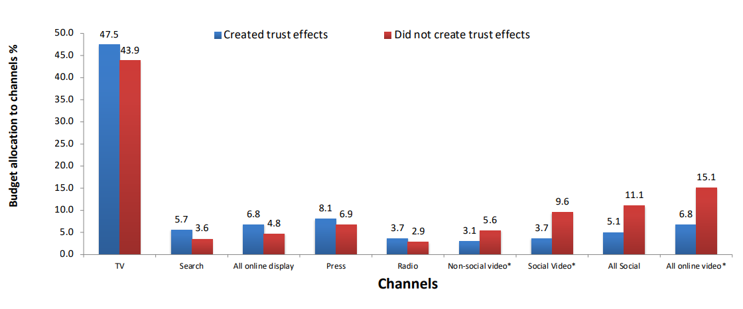


TV is a trusted medium
Source: IPA Databank 2014-2022 for profit cases *data available from 2016
Notes:
Recent years have seen a strengthening relationship between advertising trust and advertising driven profit. Comparing IPA survey data from 2014-2022 with data from 2000-2012, trust jumped from the seventh-highest brand metric linked to profit to the second-highest, just below quality.
Trust is often correlated with quality and has become increasingly important. Consumers are continuously forming assessments of the quality of the brands they may buy, based on whether they trust the brand (and its advertising).
Data showcased by effectiveness expert Peter Field at The Future of TV Advertising Global 2023 suggests that there seems to be a relationship between campaigns that created trust effects and their budget allocation to different media. Field’s work shows that campaigns using TV, search, online display, press, and radio achieved enhanced trust effects; whilst social media, social video, and online video were much less likely to deliver positive trust effects.
Additionally, many previous research studies have emphasised the importance of trust – not least Thinkbox’s ‘Adnormal Behaviour’ (conducted by Ipsos), which revealed how TV outperformed all other media as the leading source of advertising that people trust.

Slide 20
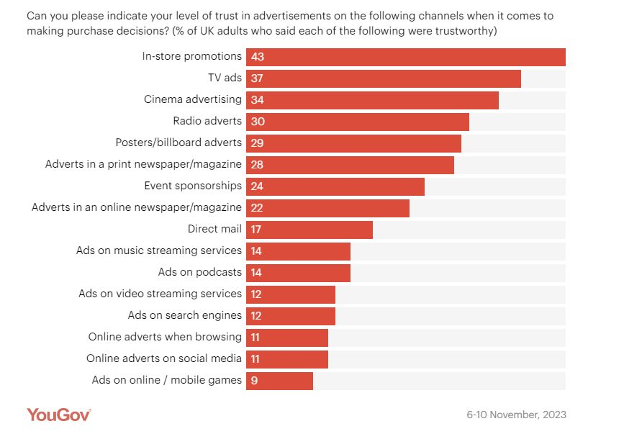
Trust is higher for traditional ad channels
Source: YouGov 2024, 3 big questions for advertisers marketers research
Notes:
Data from YouGov shows how Trust is higher for traditional ad channels such as TV and Cinema.
https://business.yougov.com/content/48911-3-big-questions-for-advertisers-marketers-research-2024

Slide 21

Trust in TV is reflected globally
The 2019 Ipsos Global Advisor study found that globally, consumers are more likely to trust television as a news source
This is particularly true in the UK which has a 32% net trust score for television, a traditional pattern reflecting stronger rules for impartiality on broadcasters than print media
WWF – Watching Grass Grow
Source: ‘Trust: The Truth?’; 2019, Ipsos

Slide 22
Agenda
WHY BRANDS MATTER
THE IMPORTANCE OF EMOTION, FAME & TRUST
MEMORY & STORYTELLING
BOOSTING THE EFFECTS OF BRANDING
Barclaycard – Cost Controllers

Slide 23
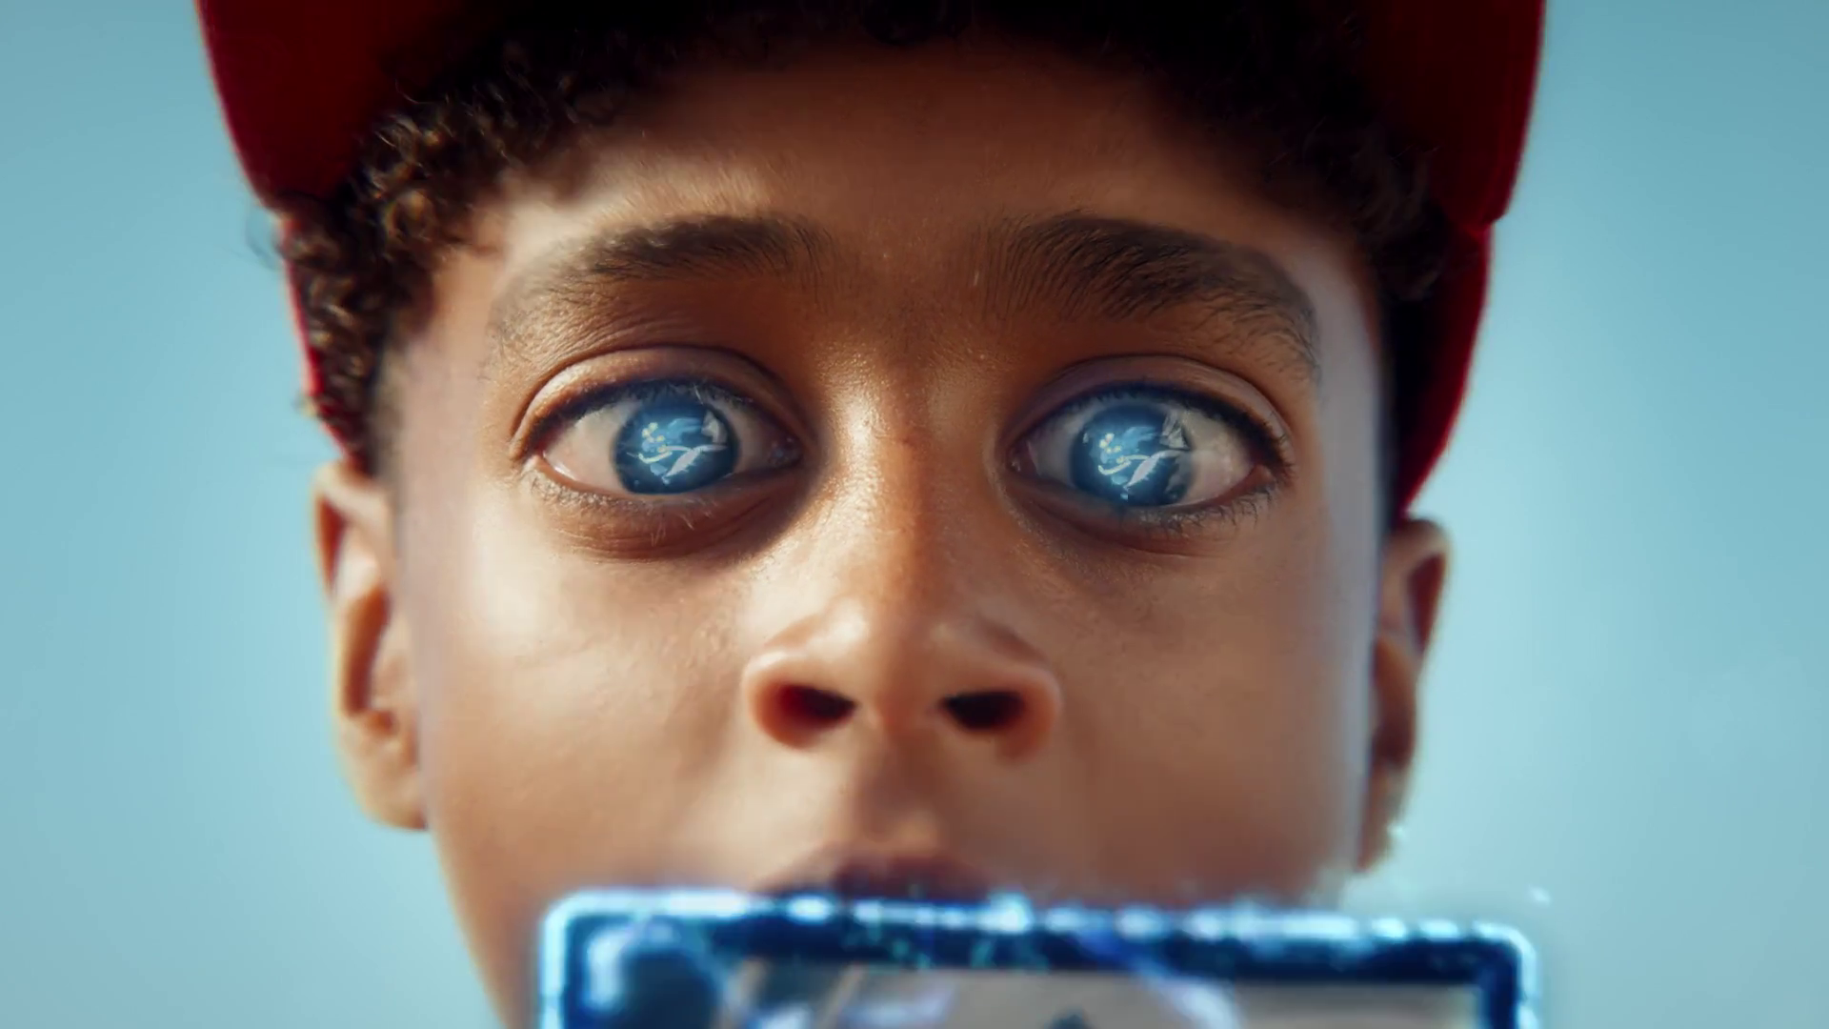
Emotion is a key driver for long-term memory
Pokemon – there’s a Collection in everyone

Slide 24

How does memory work in advertising?
We remember things that evoke strong emotions
Long-term memory is anything longer than a few seconds & can stay with us for a lifetime
Long-term memory encoding is linked to decision making & future behaviour
For advertisers, it is crucial for ads to reach this part of the brain
Material Focus - Hypnocat
Source: ‘Creative Drivers of Effectiveness’, 2016, Thinkbox
Notes:
Emotion is a key driver of long-term memory. We remember things that evoke strong emotions.
Long-term memory encoding is important. There is a wealth of academic evidence that suggests the link between long-term memory encoding (LTME), decision making and future behaviour. We can’t be influenced by messages that haven’t sunk into our long-term memory.
Short-term, or ‘working’ memory, lasts just a few seconds – long enough to jot down a phone number that we quickly forget. LTME is anything longer than that and once information is stored within our long-term memory, it can stay with us for a lifetime.
For advertisers, it is crucial for ads to reach this part of the brain. If an ad doesn’t reach this part of the brain then it serves no purpose as a marketing tool.

Slide 25

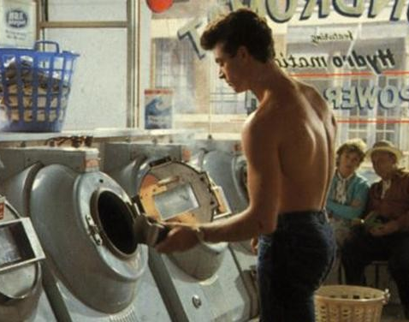
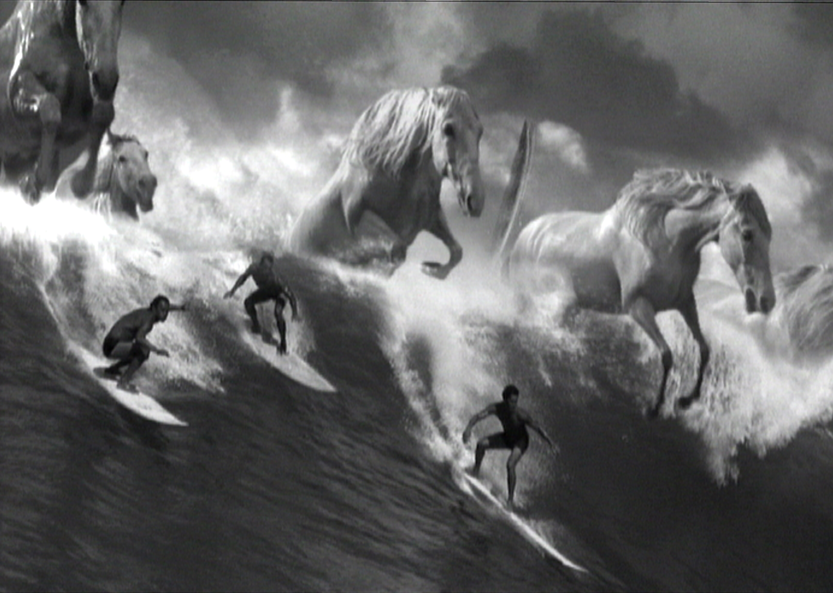
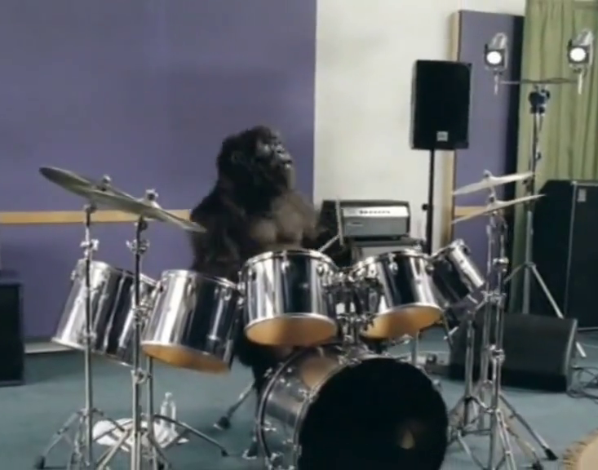
Most of us can remember ads from decades ago
Smash:
Martians
1973
Levi’s:
Launderette
1985
Guinness:
Surfer
1999
Cadbury Dairy Milk:
Gorilla
2007
Notes:
The ads above are just some examples of ads over the years that have stayed in the public conscious and been at the core of long-term brand building campaigns.

Slide 26
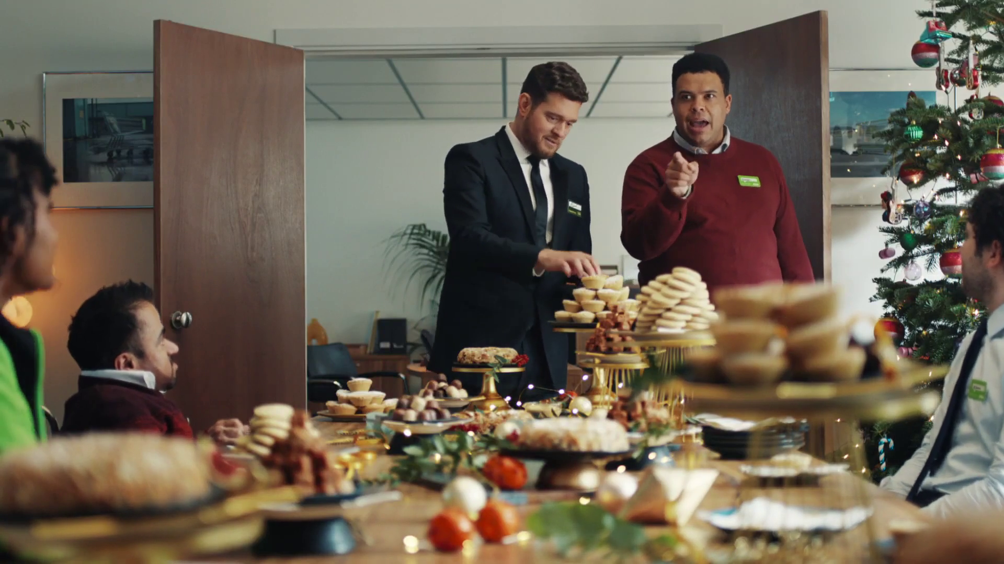
Can you tell a story in a few seconds?
Asda – chief Quality Officer

Slide 27

Our brains don’t work like video cameras…
We evoke memories by storing still snapshots
This is why imagery is so important in building effective brands
Context and narrative are key drivers of brand memory
John Lewis - Snapper
Notes:
Our brains don’t work like video cameras. We evoke memories by storing still snapshots of events. This is why iconic imagery is so crucial to TV advertising and building effective brands. Both context and narrative are key drivers of brand memory and these inherently come from strong brand stories.

Slide 28

The impact of time-lengths in TV advertising
  Storytelling is the cornerstone of TV’s effectiveness
  Longer ads are better at building narratives & are better equipped to drive positive brand perceptions
  They act as memory anchors & increase the effectiveness of shorter executions
  Shorter ads work best when placed after longer executions
Homesense – Mixing Bowls
Source: ‘A Matter of Time’, 2019, Thinkbox
Notes:
We know that there is a place for both long and short executions in TV advertising, but the trick is to utilise the strengths of both.
Longer ads are better at building narratives than shorter ads and storytelling is the cornerstone of TV’s effectiveness. Because of this, they are also better equipped to drive positive brand perceptions – especially implicit associations – than shorter ads.
Longer executions act as effective memory anchors. This increases the effectiveness of shorter executions and affords advertisers have greater control over the way their brands are perceived. Shorter ads therefore work best when placed after longer executions.
We know that brand perceptions are crucially important, not least because brand awareness is the measure that decays the fastest.

Slide 29
Longer ads deliver more explicit brand information
Explicit agreement to brand statements
91%
64%
Source: A Matter of Time, 2019, Work/Walnut/Thinkbox. Based on 3 brands (3 x short ad; 3 x long ad)
Notes:
Longer ads delivered a 42% uplift to explicit brand statements over short ones and were therefore, unsurprisingly, better at delivering a greater volume of information.

Slide 30



Longer ads enhance memory effects
=
+28%
Improvement in explicit brand perception
Short ad
Testing
3-5 days
=
Improvement in explicit brand perception
+9%*
Short ad
Testing
3-5 days
=
Improvement in explicit brand perception
+51%
Long ad
Short ad
Testing
Source: A Matter of Time, 2019, Work/Walnut/Thinkbox. Based on 3 brands (3 x short ad; 3 x long ad) * Based on one test cell for one 10 second ad
Notes:
Thinkbox’s 2019 study ‘A Matter of Time’ found that longer ads act as an ‘anchor’, which provide a basis for positive brand memory leading to significantly enhanced memory effects.
When a short ad is seen after a long ad, there’s a 51% uplift in explicit memory effects versus just 9% for seeing a short ad in isolation. This is including a gap of several days between viewing the ads and testing.

Slide 31

How can we ramp up emotion and brand memory through TV advertising?
eBay – Official Pre-Loved Fashion Partner

Slide 32
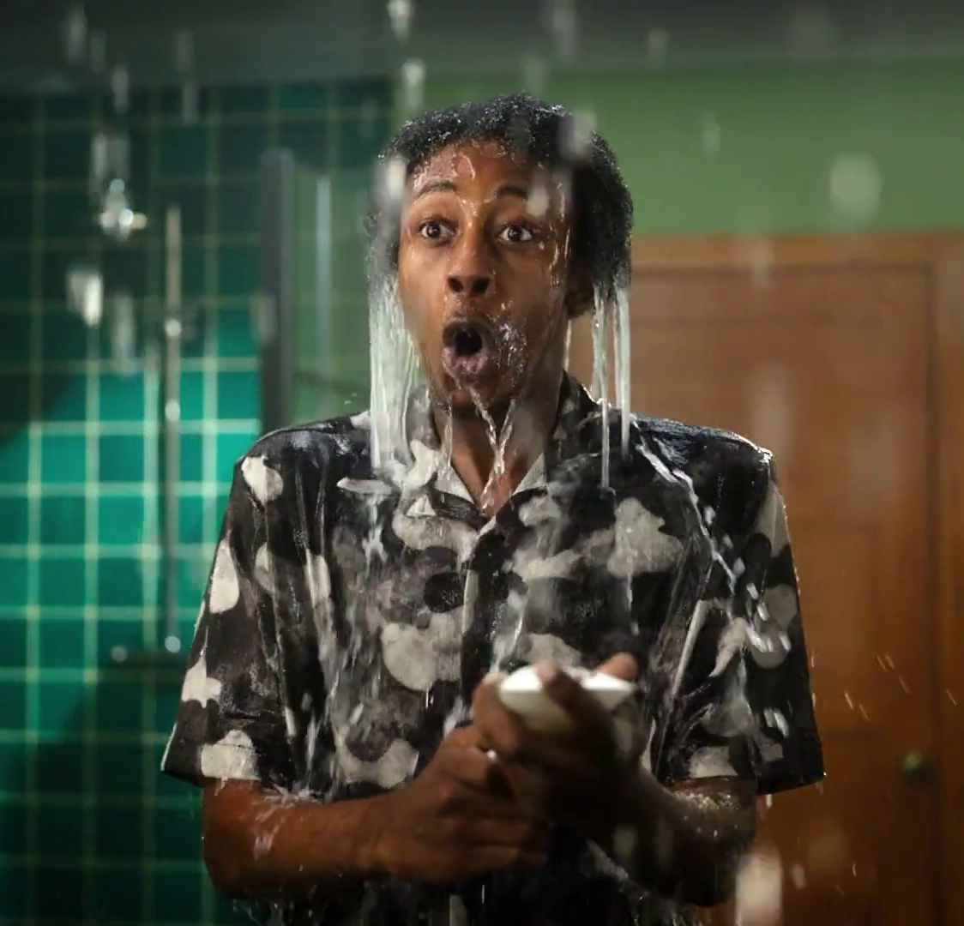
Creating memorable ads
1) Great storytelling leaves a lasting impression
Ads that use storytelling are more noticeable & more memorable, both of which contribute to sales
Make the story enjoyable, easy to understand in the time-lengths available & highlight what differentiates the brand from its competitors
Bulldog - Moisturiser
Source: “5 rules for creating memorable ads”; 2017, Kantar Millward Brown
Notes:
People are fascinated by stories. They present the opportunity to engage audiences, to leave lasting memories, and to provoke emotional (and rational) responses.
Ads that use storytelling are more noticeable and more memorable, both of which contribute to sales. Ads that also feature stories create higher levels of expressiveness, which as a direct linkage to a lift in sales.
One example is John Lewis’s “Buster the Boxer” Christmas ad. The story is enjoyable, easy to understand and differentiates the brand from other retailers. It has the ability to not only generate short-term sales, but also to support the brand’s longer-term equity.

Slide 33
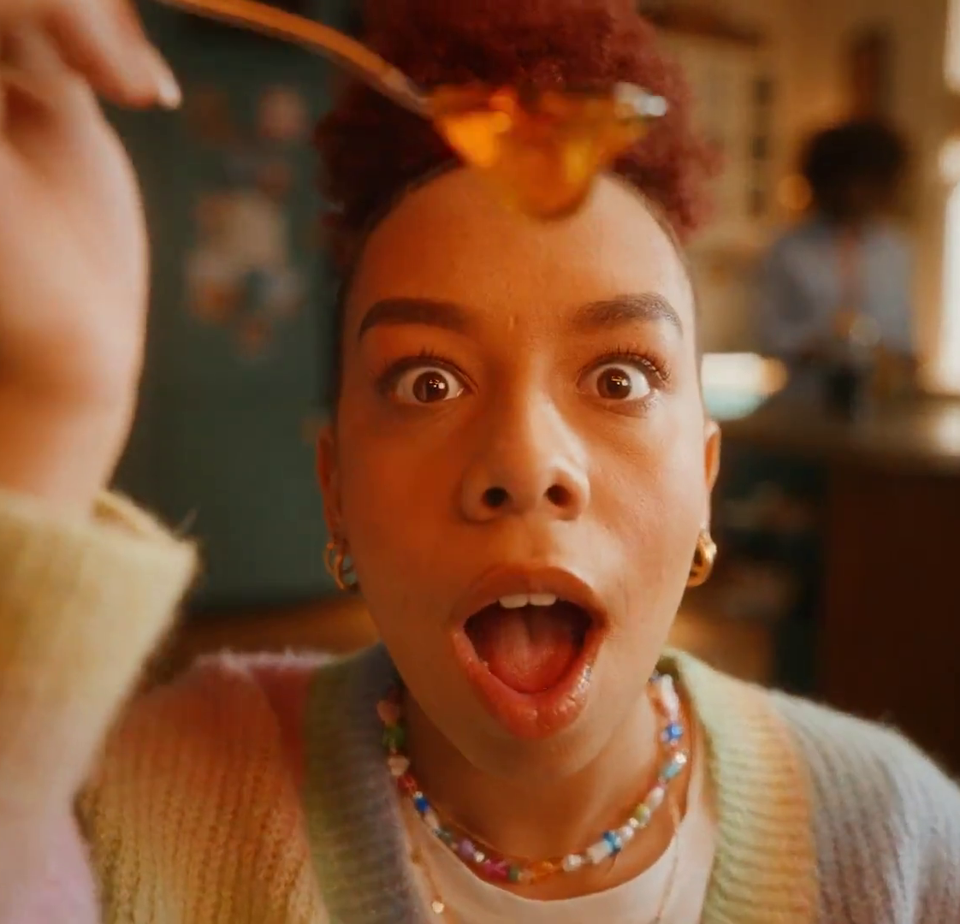
Creating memorable ads
2) Make that impression a meaningful one
Sustainable competitive advantage comes from building a brand’s emotional meaningful difference
Emotional difference is about a brand behaving in a way that makes it seem more dynamic or progressive than other brands
Lyle’s Golden Syrup – Absolutely Golden
Source: “5 rules for creating memorable ads”; 2017, Kantar Millward Brown
Notes:
Brands that are seen as meaningfully different have the greatest chance of financial success. Sustainable competitive advantage comes from building a brand’s emotional meaningful difference.
Emotional meaningfulness is about creating affinity for the brand, and emotional difference is about a brand behaving in a way that makes it seem more dynamic or progressive than other brands.
The way a brand communications can be valuable in conveying meaningful difference. Meaningful impressions are often suggested, or demonstrated, rather than claimed. One powerful solution is to identify a purpose for the brand – one that it can be legitimately linked with – and build creative around that purpose.

Slide 34
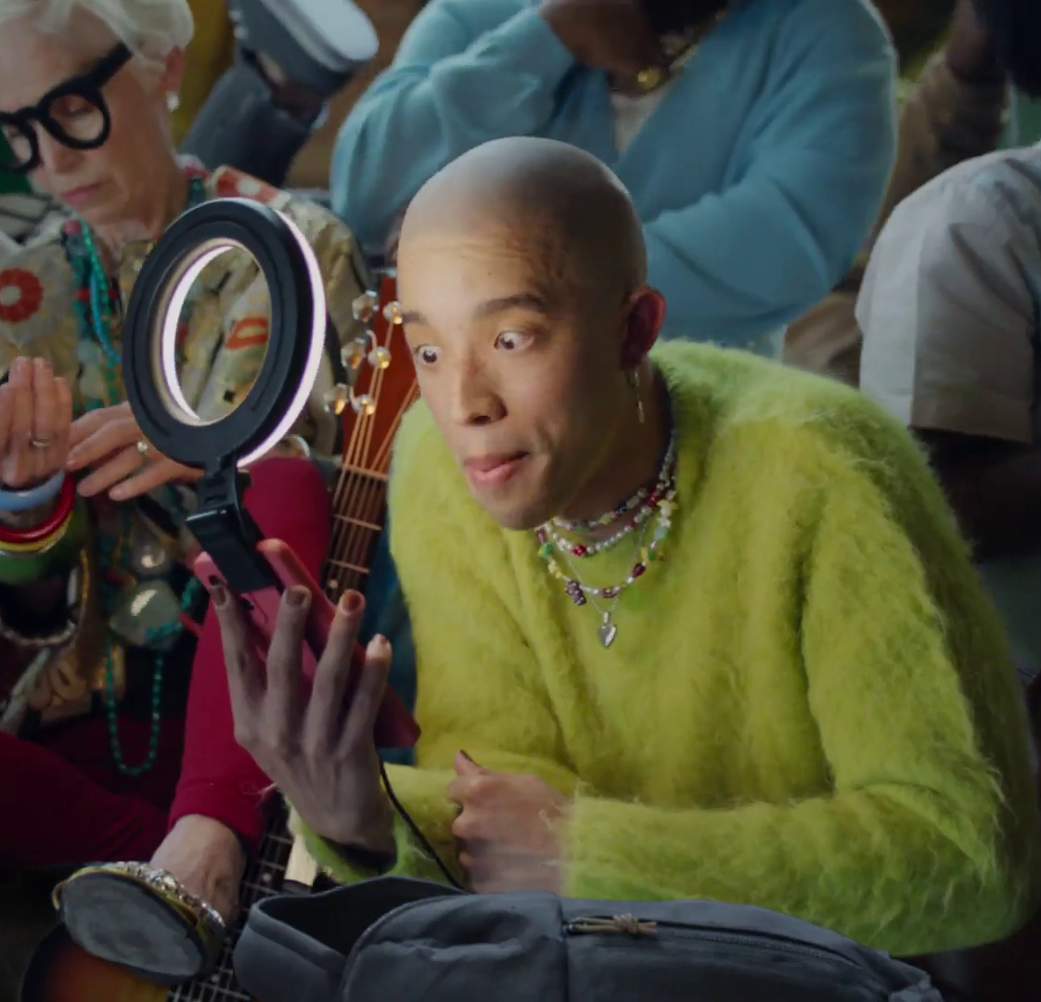
Creating memorable ads
3) Don’t skimp on the branding
The single best predictor of in-market sales effects for ads is branding
This is also consistent with the importance of mental availability
Ads with a strong narrative only result in motivation if they are also well branded
Mailchimp - Clustomers
Source: “5 rules for creating memorable ads”; 2017, Kantar Millward Brown
Notes:
The single best predictor of in-market sales effects for ads is branding. Creating an engaging film without branding simply won’t add value to the brand.
This is consistent with evidence on the importance of ‘mental availability’ for brands. Ads with weak branding have no chance to boost the ease with which brands come to mind at the point of decision. Ads with a strong narrative only result in motivation if they are also well branded.
Make the brand essential to an emotionally powerful storyline, either through use or as a catalyst to an outcome, or through the use of easily recognisable brand cues – visual, aural or stylistic – which require no effort to register with viewers.

Slide 35
Agenda
WHY BRANDS MATTER
THE IMPORTANCE OF EMOTION, FAME & TRUST
MEMORY & STORYTELLING
BOOSTING THE EFFECTS OF BRANDING
Barclaycard – Cost Controllers

Slide 36

What elements of creativity can boost the effects of branding on long-term memory?
Current Account Switch Guarantee - Curatins

Slide 37

Showcase your product, don’t shout
Weaving your product into the narrative elicits more peaks of memory and personal relevance throughout an ad. This technique creates x1.4 more peaks of strong brain responses throughout the ad than when there is an overt focus on the product, enhancing brand recall.
Levis - Fresh
Source: ‘The Creative Drivers of Effectiveness’, 2023, Thinkbox
Notes:
Showcase your product, don’t shout
Whilst we consistently encounter advertising in our daily lives, our brains are not necessarily receptive to everything, nor do they like being advertised to. Essentially, our brain has a built in ‘ad blocker’ which develops during adolescence, it is an evolutionary mechanism that allows us to avoid danger. Therefore, if we feel as though we are being overtly advertised to, this ‘ad blocker’ fires up, making the TV ad less effective and less memorable.
A way to navigate around this ‘blocker’ is to weave the product into the narrative. Analysis found that utilising this technique elicits more peaks of memory and personal relevance throughout an ad. This gives a brand more opportunity to get into the audience’s memory as there are 1.4x more peaks of strong brain response throughout the ad, than when you have an overt focus on the product.
We’ve long known that emotion is an integral part of successful TV advertising, even in very rational categories and the study supported this.

Slide 38
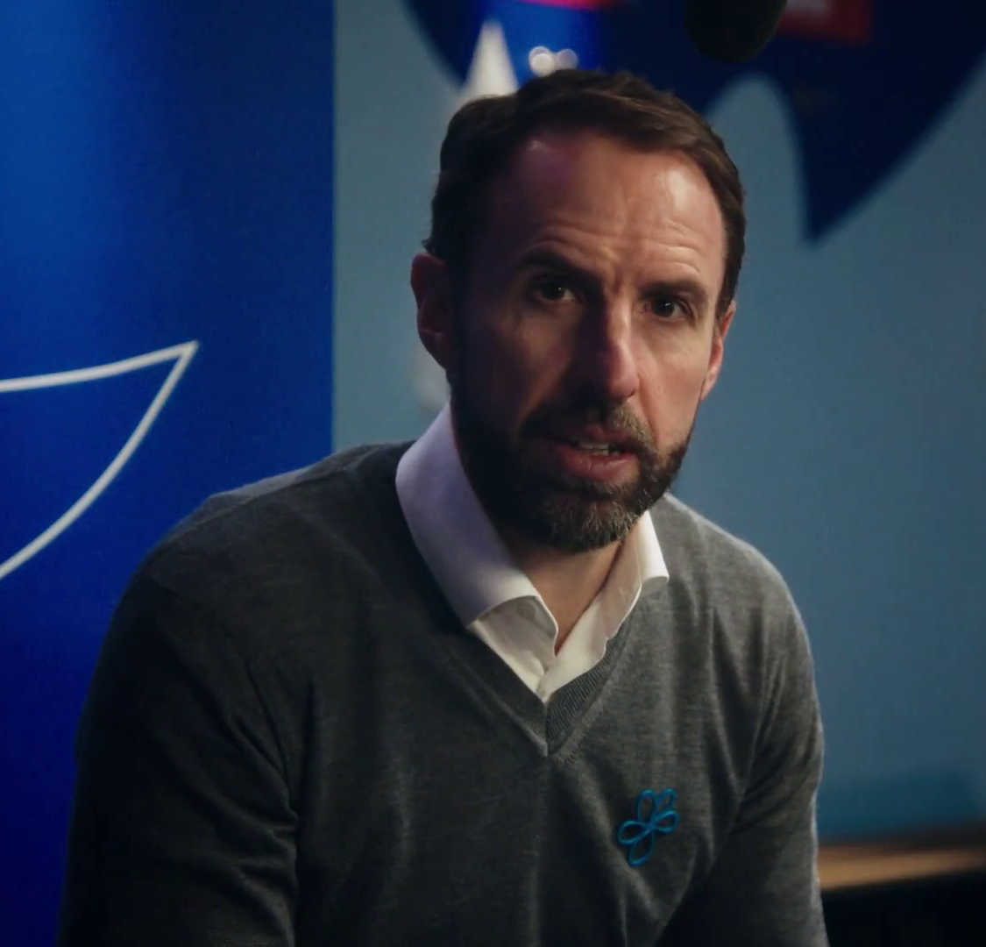
People are paramount
Ads with people generate more impact, consistent with earlier findings. Such ads were 15% more relevant and led to 24% stronger memory encoding during final branding compared to those without people.
Alzheimer’s Society – Football Memories
Source: ‘The Creative Drivers of Effectiveness’, 2023, Thinkbox
Notes:
We’re all human and humans are fundamentally dominated by our emotions and our need to connect with others. The analysis from Neuro-Insight found that human focus is important to ad success and that ads with people present, deliver more impact – reinforcing the findings that were discovered in the first iteration of this study. The ads featuring people were 15% more relevant to the audience and drove 24% higher levels of memory encoding at final branding in comparison to ads with no people.
Making the narrative of an ad revolve around a person allows the audience to create a connection with the on-screen character and provides an opportunity for the audience to become more involved.

Slide 39

Utilise brand assets
For advertising, the brand should be intrinsic to the story of an ad, not incidental to it, with brand cues interspersed throughout the narrative. The analysis discovered that integrating brand colours drove strong emotional impact (+9%).
McDonald’s– Raise Your Arches
Source: ‘The Creative Drivers of Effectiveness’, 2023, Thinkbox

Slide 40
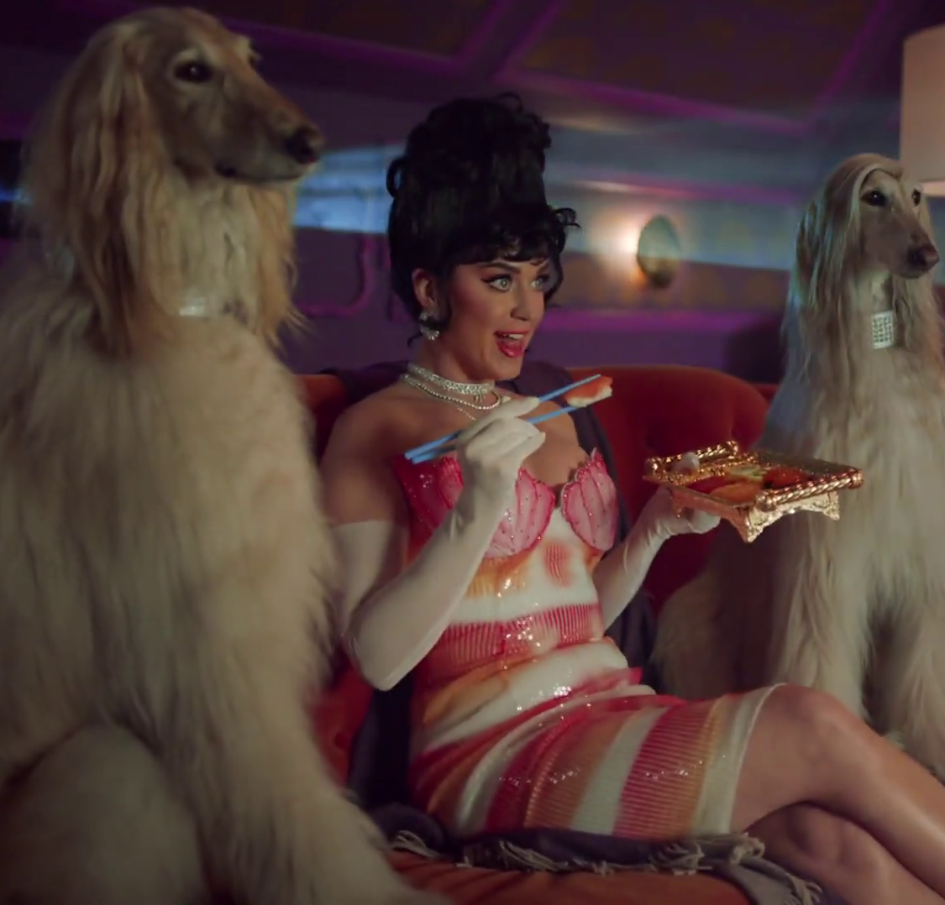
If used, music should drive the action
Ads where music drove the action elicited significantly more peaks of memory and emotional impact throughout the ad.
Just Eat – Katy Perry
Source: ‘The Creative Drivers of Effectiveness’, 2023, Thinkbox
Notes:
People show higher levels of brain response when the music in an ad is driving the action. This describes instances where lyrics in the ad would match what was appearing on screen, as well as where the cadence of the music would match the action on screen.
Interestingly, if the music in an ad was recessive (as in, the music did not offer anything to the action in the ad), levels of brain response at end branding are lower than if there was no music at all. This could be because recessive music only “crowds” the ad and does not help to develop the narrative in the ad (as opposed to music which is driving the ad).

Slide 41

Multiple emotional peaks are key
70% of long-term memory encoding peaks are associated with peaks of emotional intensity
Ireland – Jamie-Lee Donnell & Saoirse-Monica Jacson
Source: “The Science of Memory”; 2018, BBC StoryWorks
Notes:
Emotional intensity refers to the degree of emotional change which determines level of memory encoding strength.
According to research from BBC StoryWorks, delivering multiple emotional peaks is key to making content more memorable – brand films which have 10+ emotional peaks are in the top quartile for memorability.
Using neuroscientific research to explore the relationship between emotion and long-term memory in delivering engaging brand content, it found 70% of long-term memory encoding peaks are associated with peaks of emotional intensity. The research also suggests using intimate personal narratives, with one or two main protagonists, or personally relevant content were most memorable. Films that triggered the highest emotional intensity in the first third of their length were also more memorable.

Slide 42

In summary…
Brands provide a sense of connection, stability and identity
TV is the most powerful means of delivering emotion and fame at scale
Emotion and fame are the best means to grow mental availability
TV creates memorable ads that increase the chance of sales generation
Hillary’s Blinds – For the Window Wise

