Slide 1




Making ads accessible for all - subtitles
Etsy – Don’t Celebrate Birthdays

Slide 2
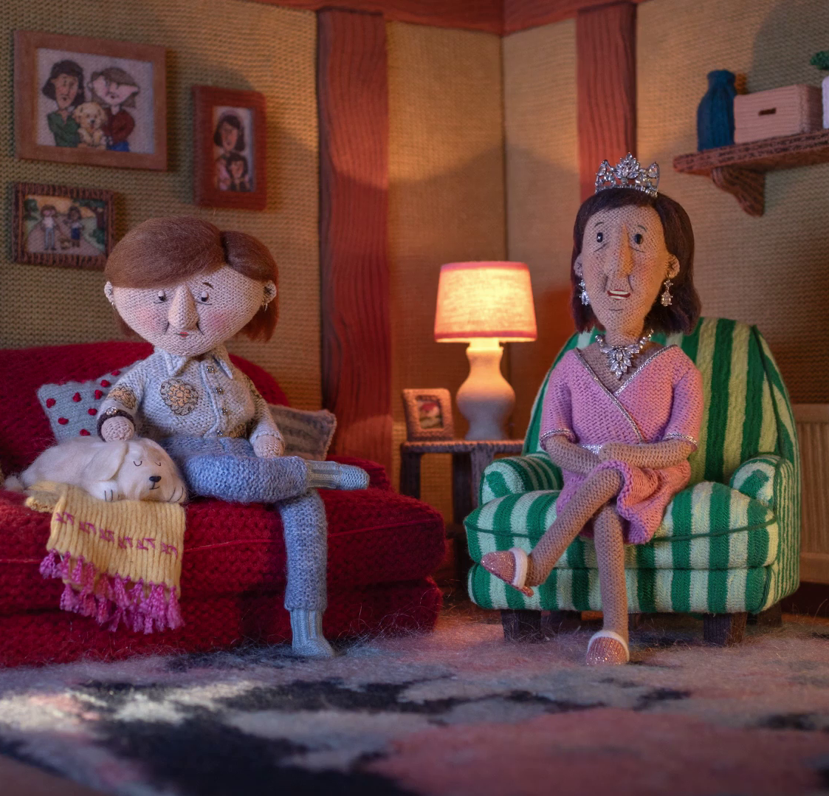
Making ads accessible to all
Advertising should be for everyone, but most ads are not fully accessible to the audience they are reaching.
Most TV ads are not currently designed with accessibility in mind or don’t have access services like subtitles or audio description to help make them more accessible.
Department for Energy Security and Net Zero – Warm and Fuzzy

Slide 3
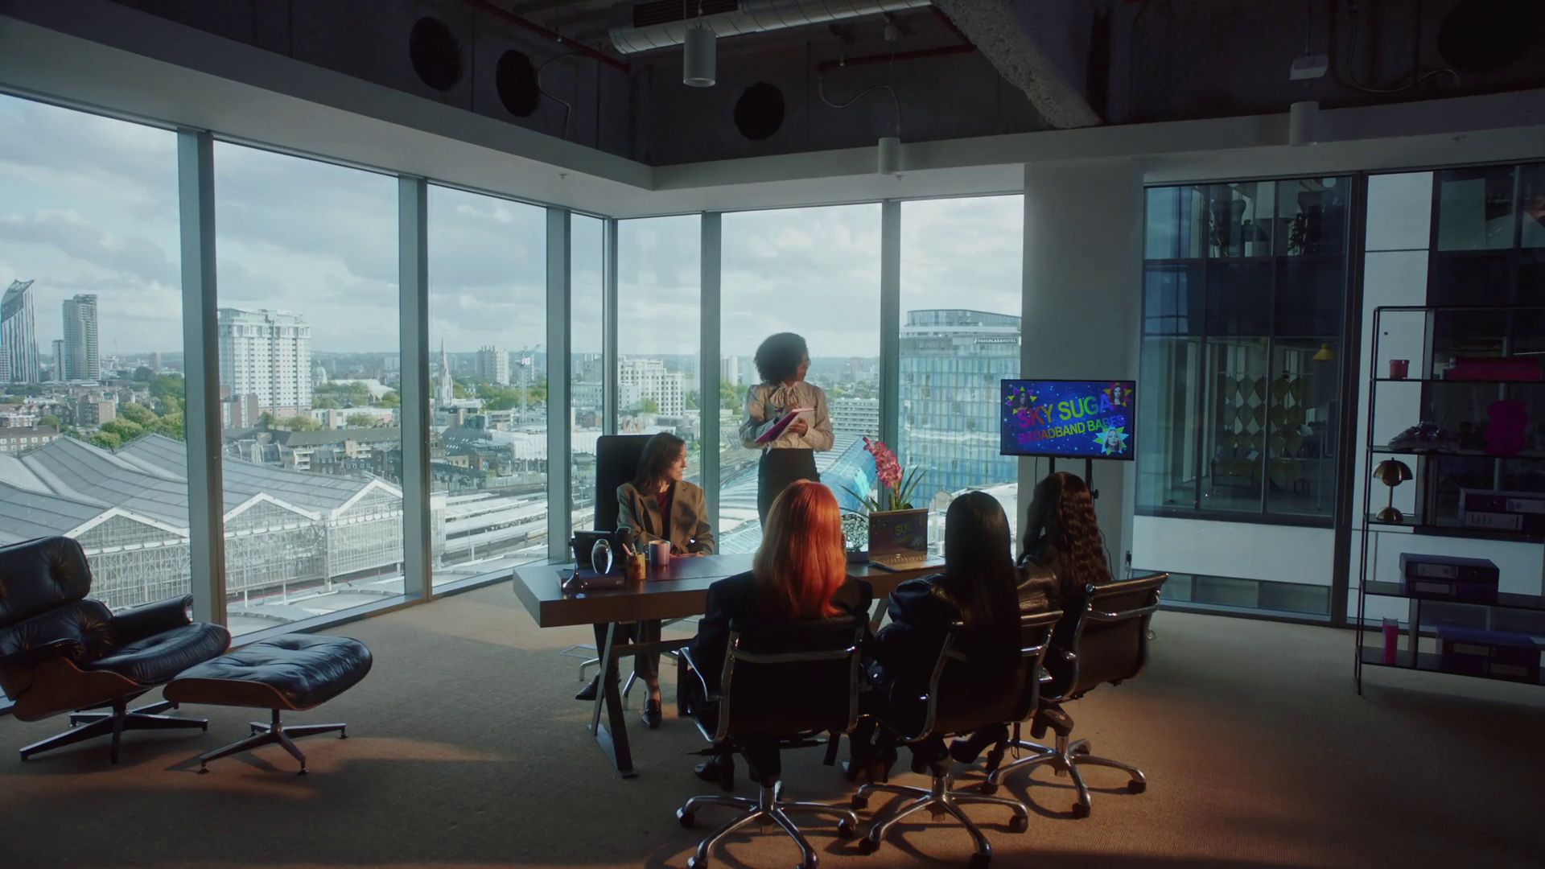
1 in 3 people have a disability or access needs
9 in 10 of them agree brands have a duty to ensure ads are accessible
Source: The Valuable 500
Sky Broadband - Sugababes

Slide 4
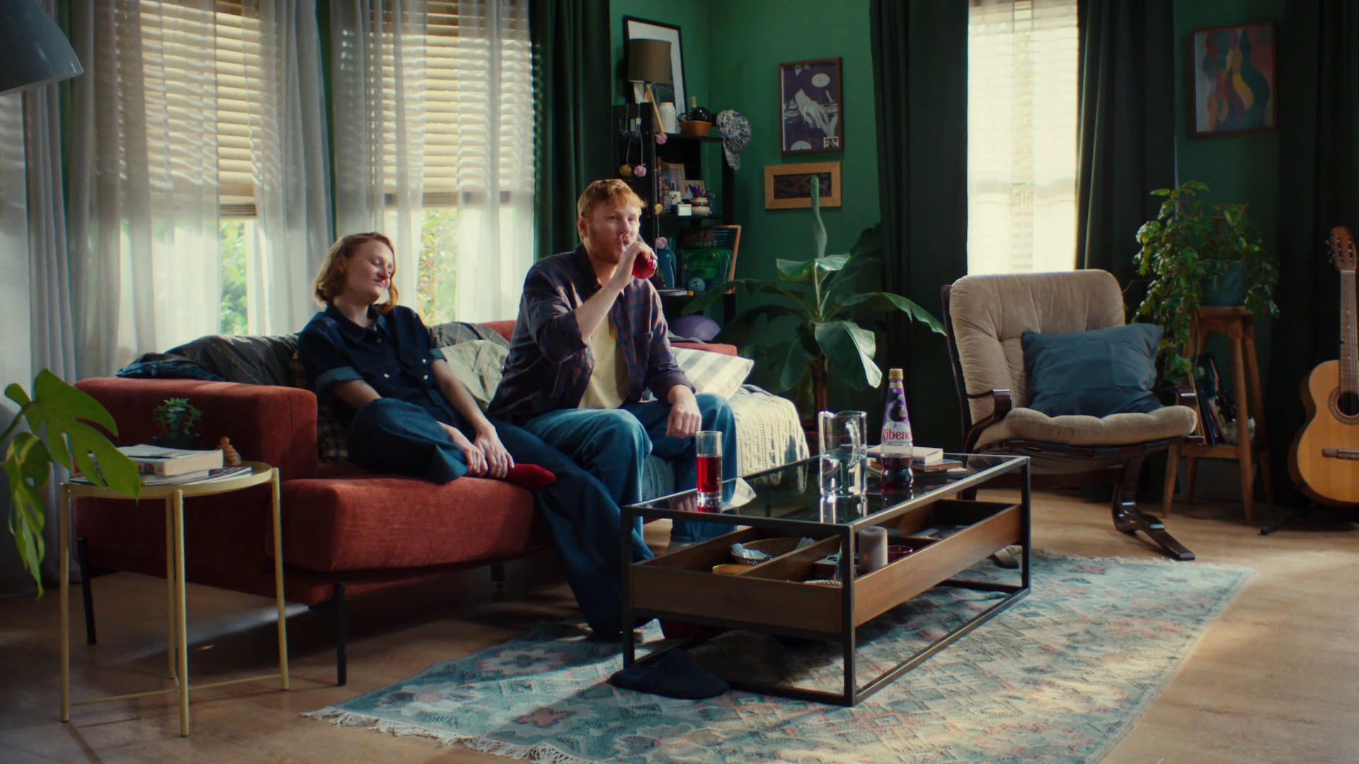
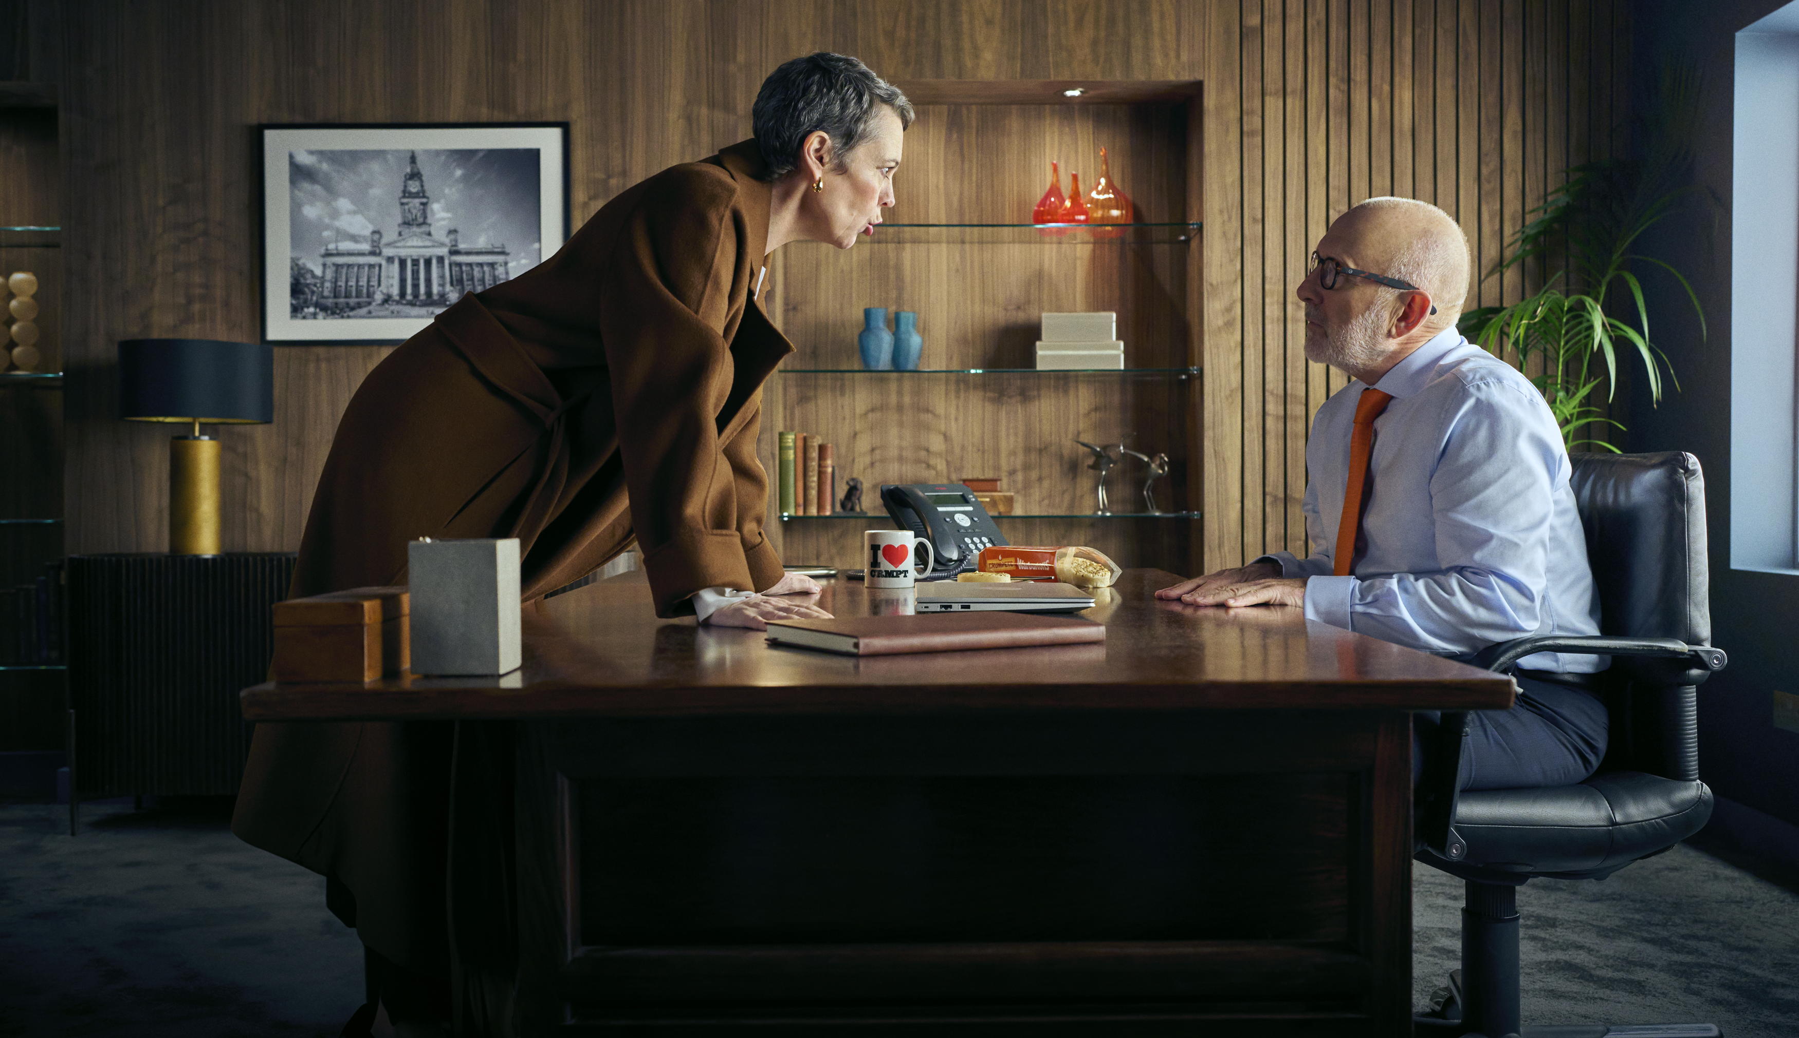
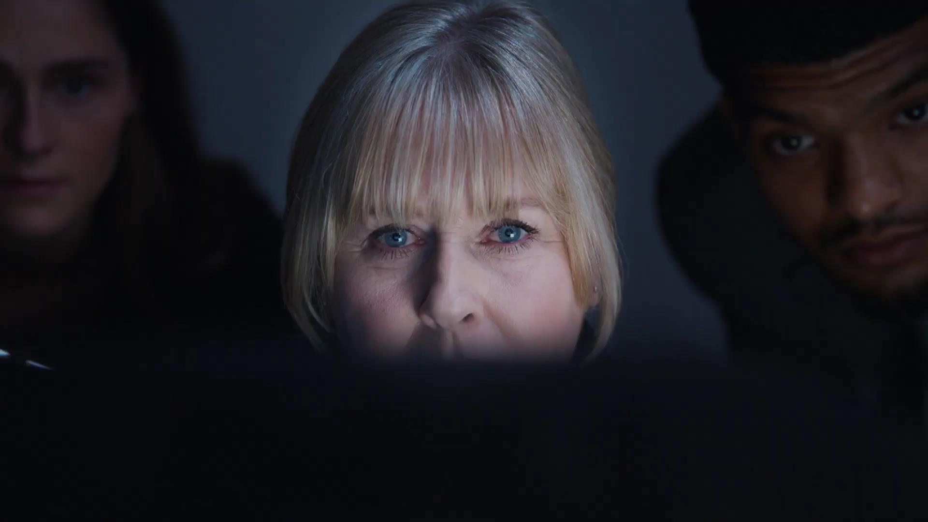
A missed opportunity to maximise reach & impact
RNID estimates that 1 in 3 adults in the UK are deaf, have hearing loss or tinnitus. That’s the equivalent of 18 million adults who can’t easily access or understand TV ads.
The easiest way to help make your ad more accessible (and impactful) to this audience is to add subtitles / closed captions.
Subtitles or ‘closed captions’ are where consumers can turn them on and off; they will only appear when the viewer opts into them. ‘Open captions’ are where they are permanently embedded for everyone, sometimes referred to as 'burnt in.
Notes:
Images:
1. Ribena – There’s No Taste Like Home
2. Warburtons – The Inspection
3. Yorkshire Tea – Investigations Done Proper

Slide 5


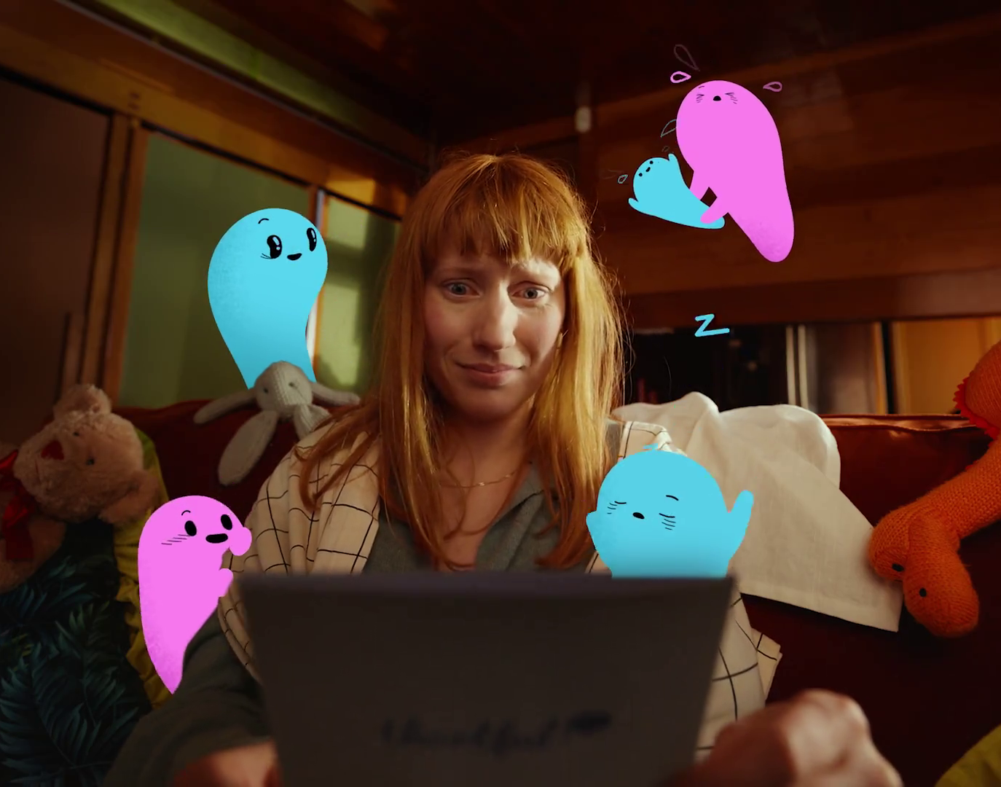
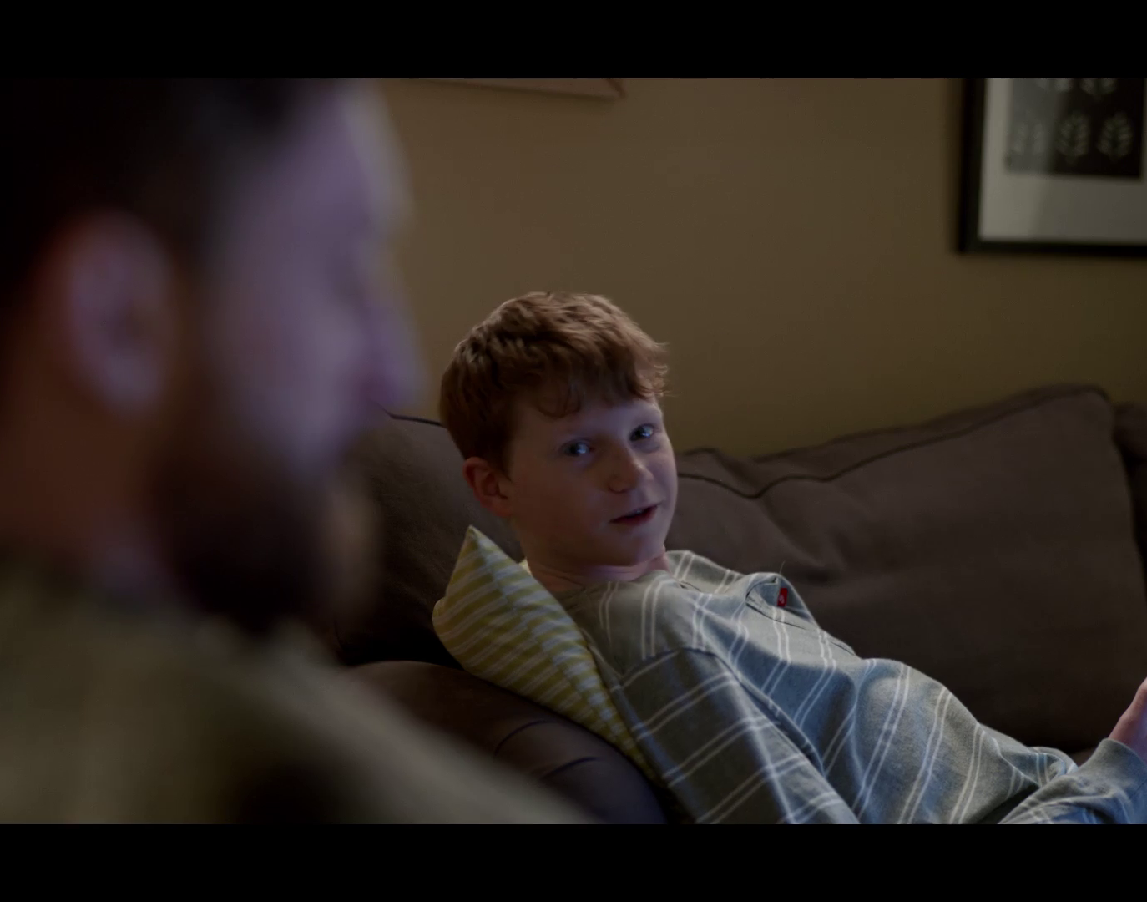
Adding subtitles to your ads
Subtitles are text captions displayed at the bottom of the screen that transcribe the on-screen dialogue.
Subtitles for ads are not generated automatically (as you find on some digital platforms) – they have to be created as a separate file and supplied with the ad (luckily, this is very easy and inexpensive to do!)
Subtitles not only transcribe the dialogue but also add in additional information such as tone of voice, music, or background noises.
They can be used to widen access for viewers who are deaf or have hearing loss but are also enjoyed regularly by 6 million people in the UK who don’t have an auditory disability.
Notes:
Visa – Security Hero
Fy! – Less Bland More You
Thortful – Creator
NatWest - Beads

Slide 6
Subtitle capability for ads on commercial TV
The UK TV companies already support ads with subtitles across most of their placements, both in linear and on-demand platforms, with development of further capability ongoing.
For more granular information on TV’s capability, we can break this up into the 3 main TV ad viewing approaches:
Linear
BVOD
OTT Linear
Viewing Approach |  | Example
LINEAR | Live | TV aerial / set top box / cable
 | Dynamic ad Insertion | Sky AdSmart
BVOD | IP delivered | Sky Go / Sky Glass / NOW / ITVX / Channel 4 streaming
 | Set top box delivered | Sky Q / Sky + HD / Virgin Media
OTT LINEAR | Live | Sky Go / ITVX / Channel 4 streaming
 | Dynamic ad insertion | DAI on Sky Go / ITVX / Channel 4 streaming

Slide 7
Linear TV accounts for the vast of majority of TV viewing in the UK, and live linear TV has 100% capability to carry subtitles in ads
Viewing approach | Channel 4 Sales |  | ITV Media |  | Sky Media
 | % of C4 Sales viewing (Barb) | Ad subtitle capability | % of ITV Media viewing (Barb) | Ad subtitle capability | % of Sky Media viewing (Barb) | Ad subtitle capability
Linear – Live | 85% | Yes | 85% | Yes | 87% | Yes
Linear – dynamic ad insertion |  | Yes |  | n/a |  | No
BVOD – IP delivered | 13% | Yes | 11% | Yes | 9% | In progress
BVOD – set top box delivered |  | Yes |  | Yes |  | In progress
OTT linear – live | 2% | In progress | 4% | Yes | 4% | Yes
OTT linear – dynamic ad insertion |  | Yes |  | In progress |  | In progress
Notes:
*Yes on iOS, tvOS, and Android; in progress elsewhere

Slide 8


























































































































Viewing info includes analysis from an array of channels
+

Slide 9
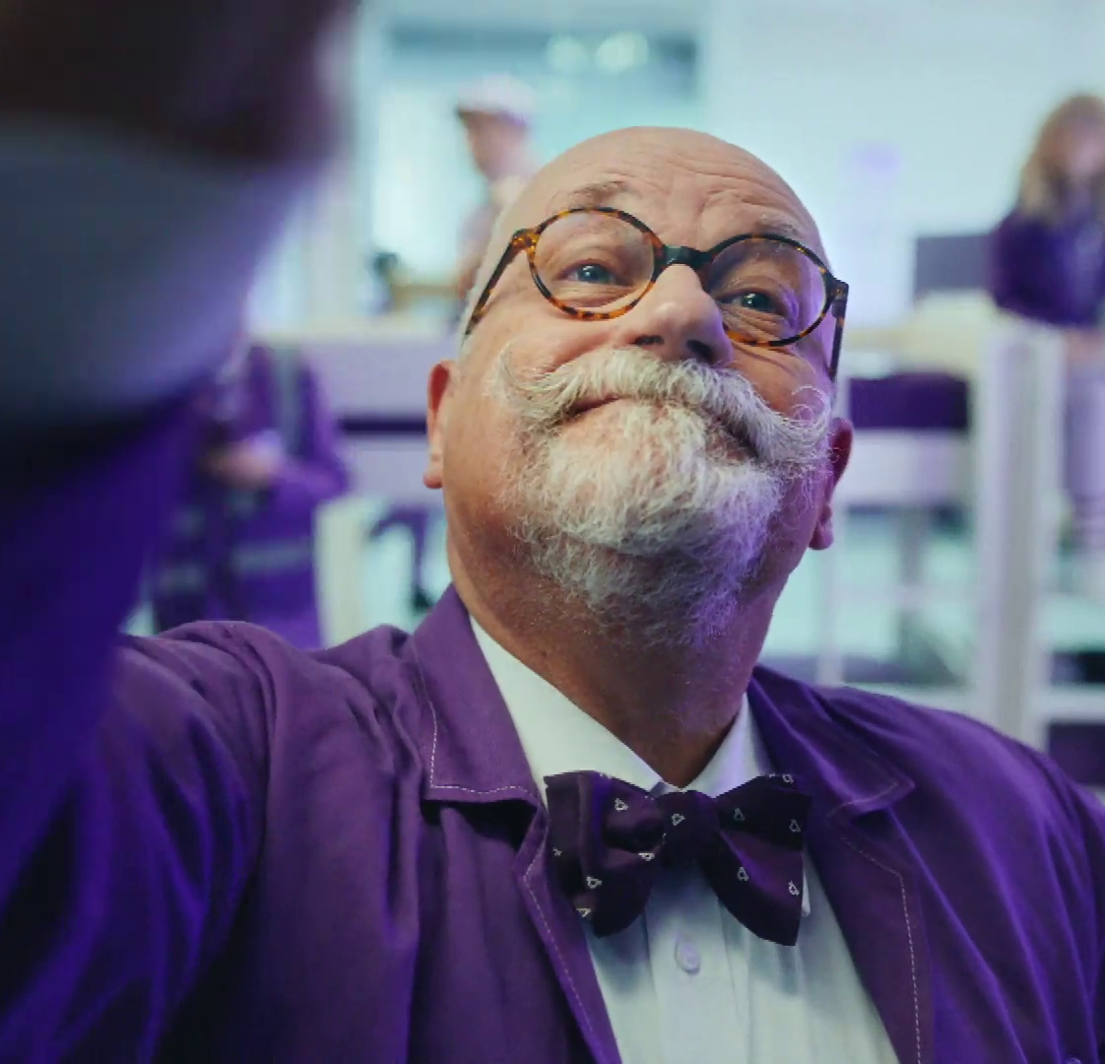
Subtitling best practice
Subtitles in ads should:
Be readable in size, font and colour
Accurately reflect what is being said and heard
Be synched with the audio
Be positioned to not cover any important information
Bensons for Beds - Obsessed

Slide 10



Subtitling services are easily accessible
Adding subtitles to an ad does not require separate pre-clearance
Providers such as Clearcast, Peach and XR help advertisers add subtitles in parallel with the clearance process
After the final ad is uploaded to the chosen provider’s platform, advertisers can select a subtitle provider to support accessibility, making it easier to comply with regulations
Clearcast have produced a Style Guide to ensure a consistent quality of subtitle output without detracting from your ad’s core messaging
Notes:
Away – Travel Changed Me
Grosvenor – Feel the Love
Virgin Atlantic – A Rainbow in the Clouds

Slide 11

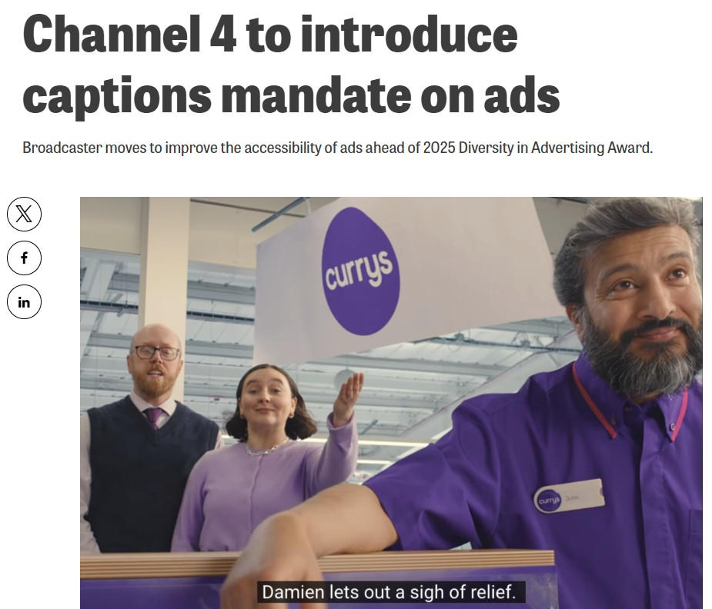
Demand for accessible ads is growing
Channel 4 has announced that from Spring 2026, subtitles will be required for all new ads on its channels (linear and on demand)
Whilst subtitles help make your ads more accessible for hearing-impaired viewers, to better serve sight-impaired viewers you should consider:
Audio description - voiceover narration played in parallel to the ad's main audio track, with narration in the gaps between dialogue
Audio-led storytelling - integrating descriptive elements directly into the script, doesn't require an additional audio description track to convey its meaning

Slide 12


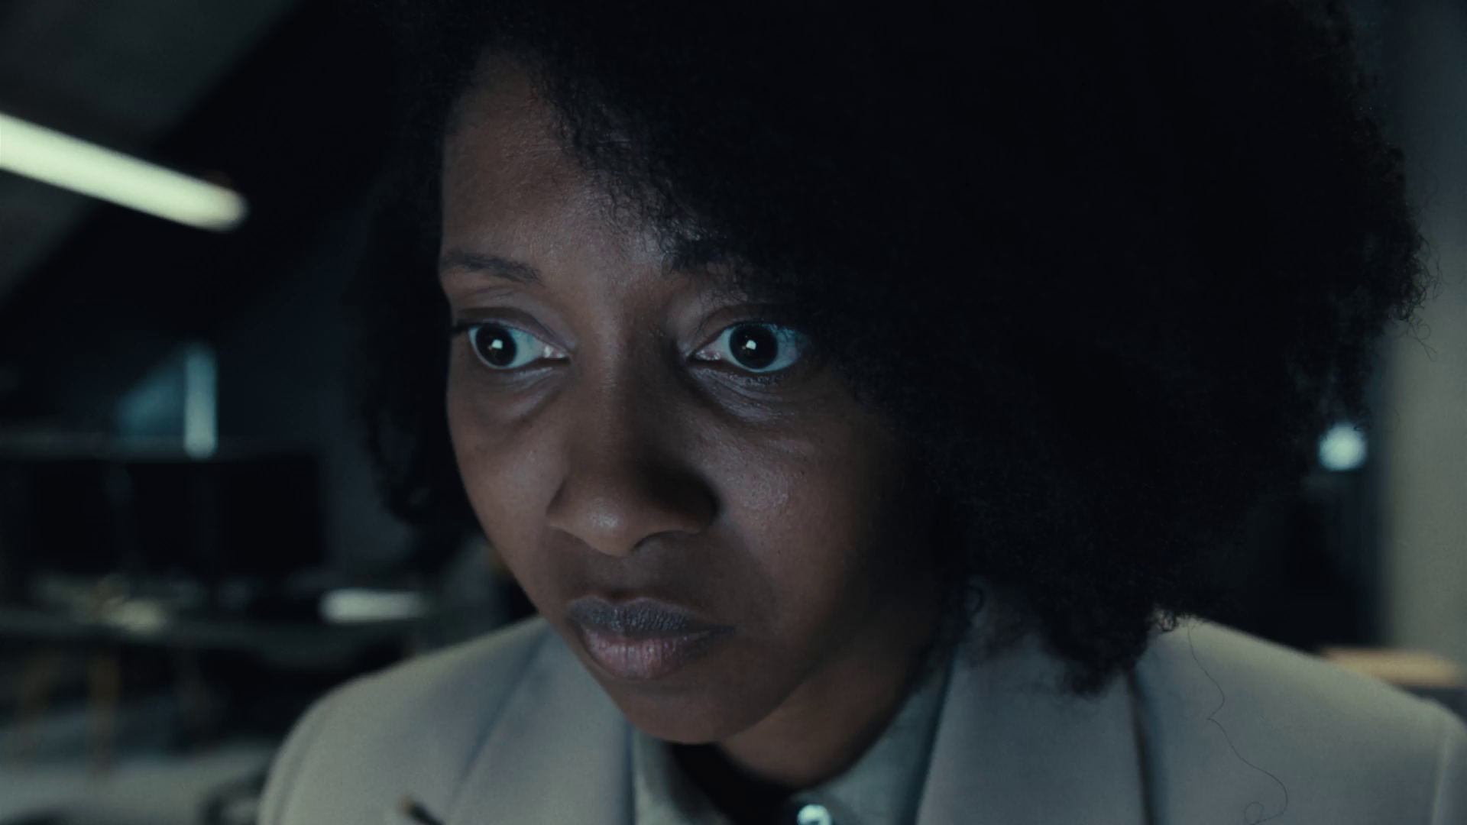
Audio description
AD describes the most important on-screen visuals, ensuring the meaning and narrative of the ad is delivered via sound to those who are sight impaired
Audio description is toggled on and off by viewers who want to use it
Adding audio description to an ad requires additional pre-clearance. You should start working on the audio description track early in the process to allow enough time for writing, recording and clearance
Notes:
Android - Wanderlust
Lightning Link Casino - Dragon
Hubspot – Spread Too Thin

Slide 13

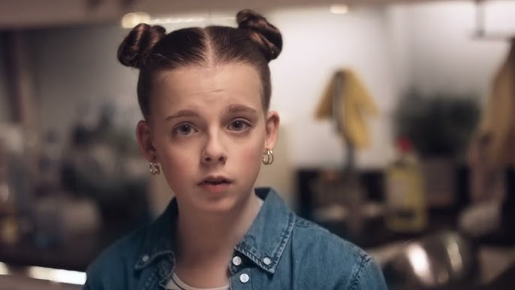
Audio description tips
Convey key information: ensure that the audio description conveys information about the product, brand, benefits and any special offers
Check volume levels: make sure the audio levels are correct to avoid the music, sounds and dialogue in the ad obscuring the audio description
Remember text: in the UK, audio descriptions must read out all on-screen text, including the terms and conditions
Integrate to reduce cost: consider the cost and integration of audio description early in the process to reduce costs and make delivery more efficient
Don’t assume its not needed: even the most audio-rich ads can miss some of the meaning; a well-placed audio description can be the difference between bewilderment and comprehension
Ctrl+Click above to watch the audio described ads

Slide 14
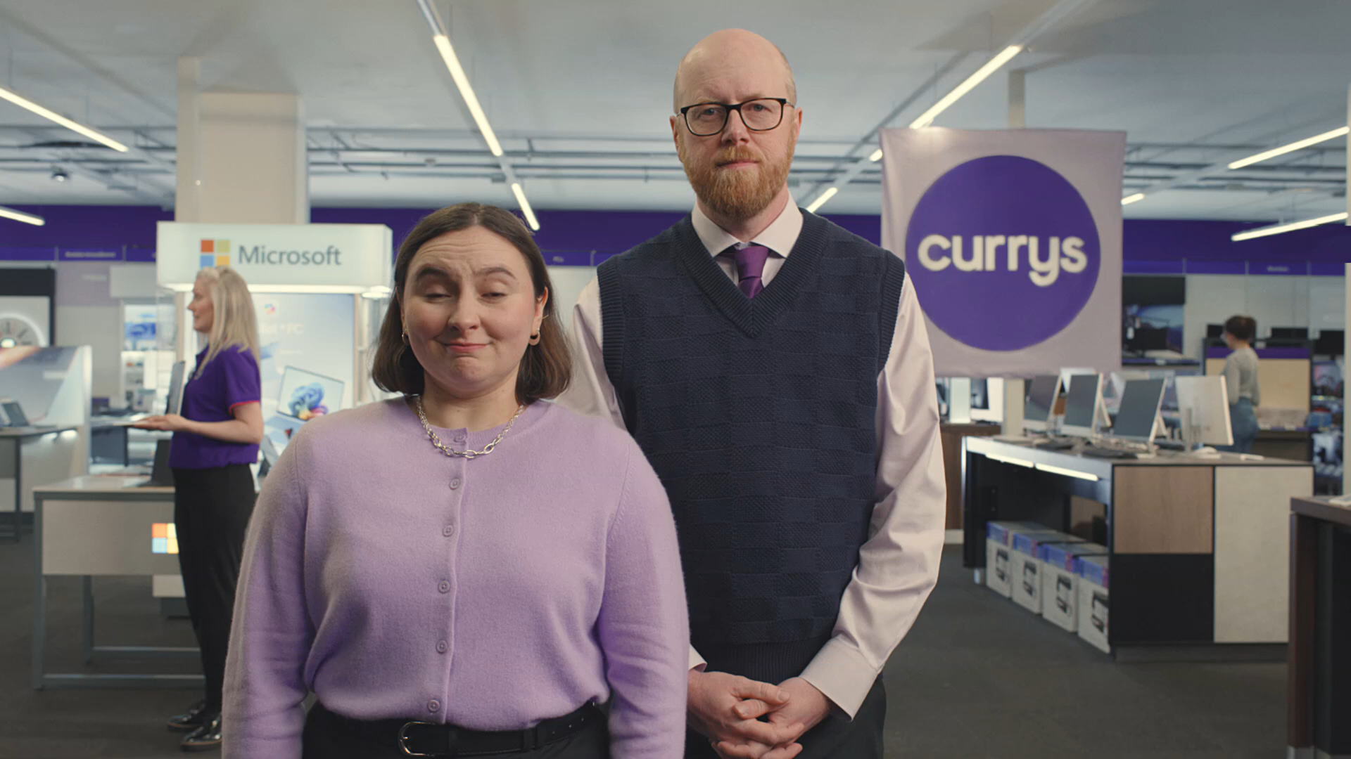
Audio-led storytelling
Consider accessibility from the beginning: integrate accessibility into your processes right from the start to enable delivery and higher quality.
Aim for an audio-led narrative: get your ad message delivered strongly through audio alone, so that people who are blind or have low vision can engage with it easily
Accessible by design: create a story that naturally conveys the necessary visual information, allowing all viewers to understand and enjoy the content equally – see this example from Currys, winner of Channel 4’s Diversity in Advertising Award

Slide 15
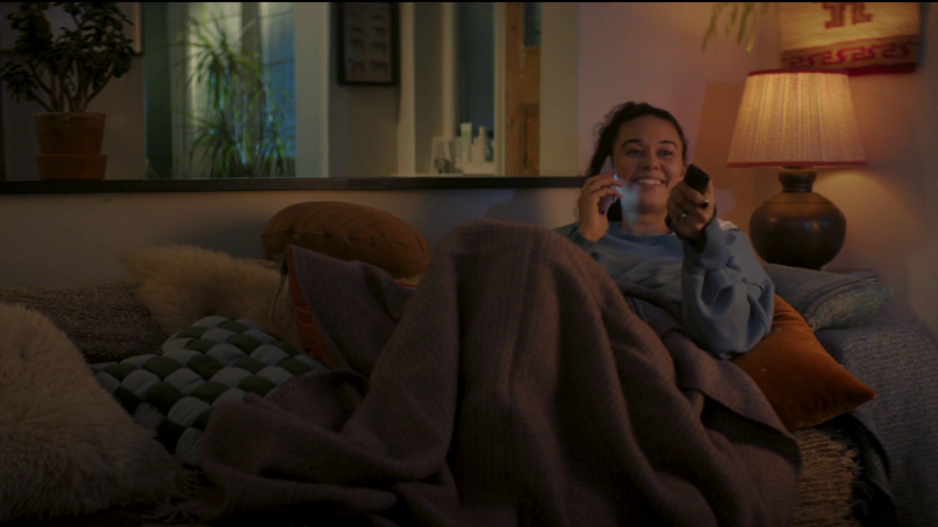
For more information on making your ads accessible for all, visit The Ad Accessibility Network Hub
Cadbury - Scrounger

Slide 16
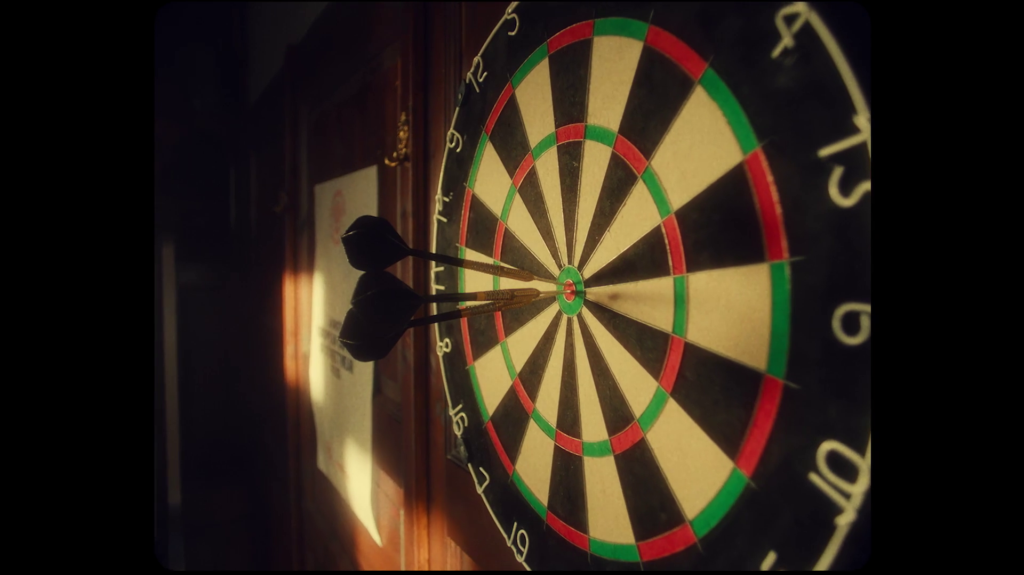
Making the case for accessible TV advertising
Jägermeister – Flowers for Society

Slide 17



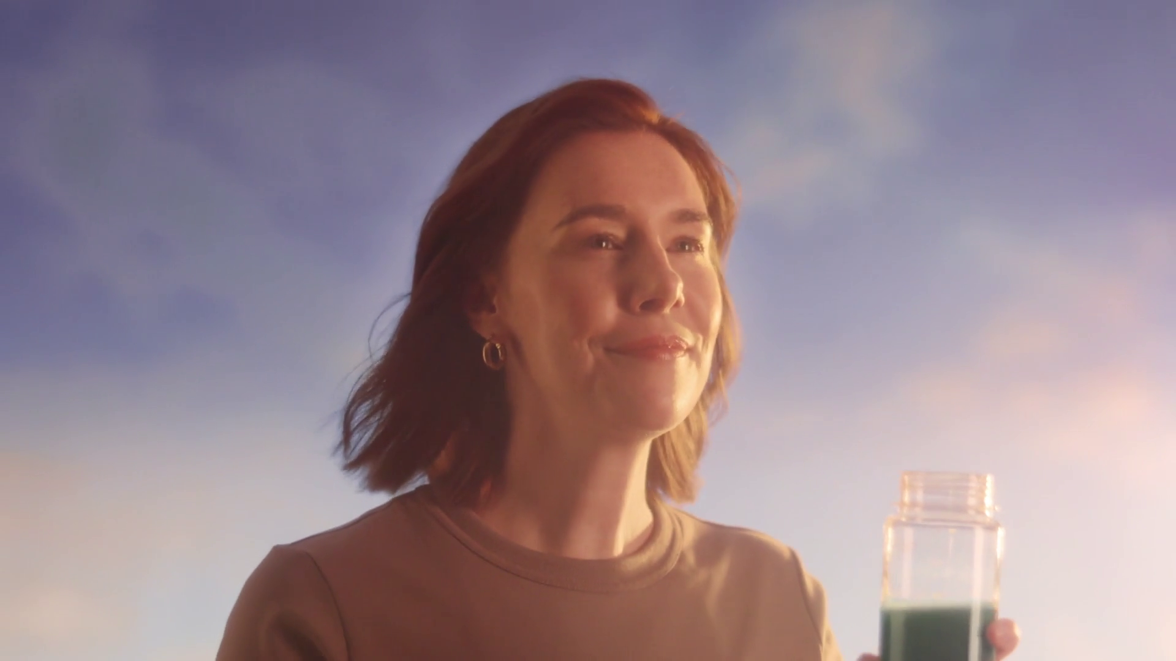
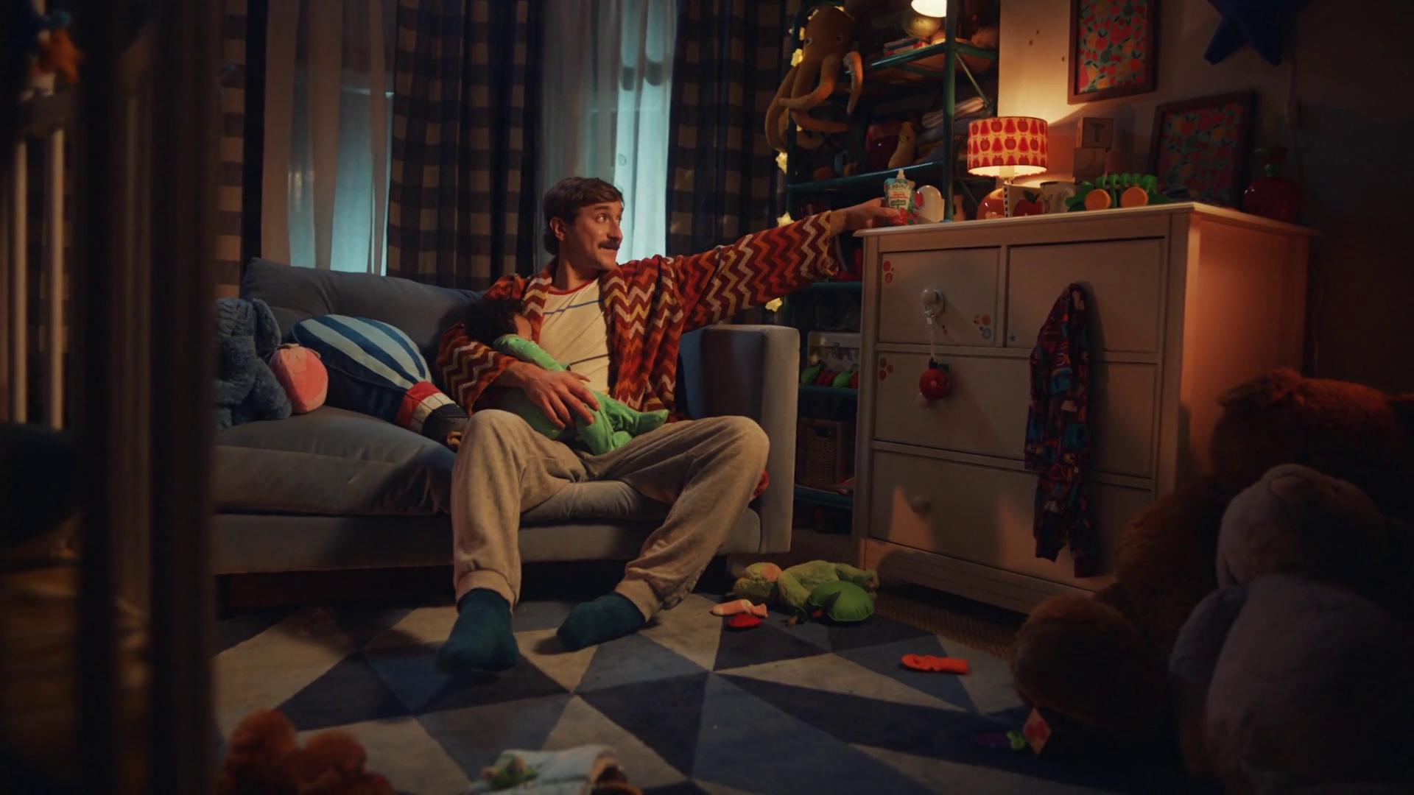
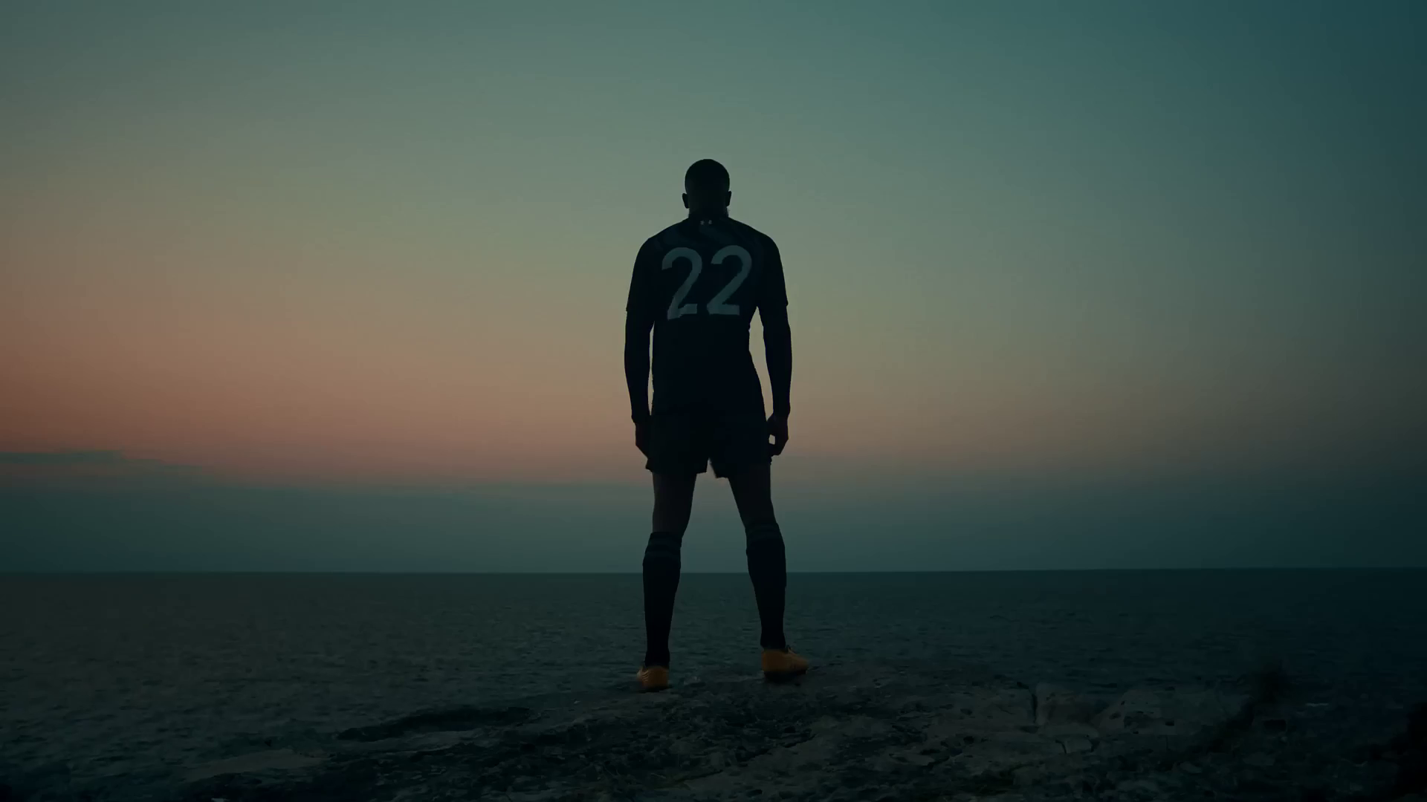
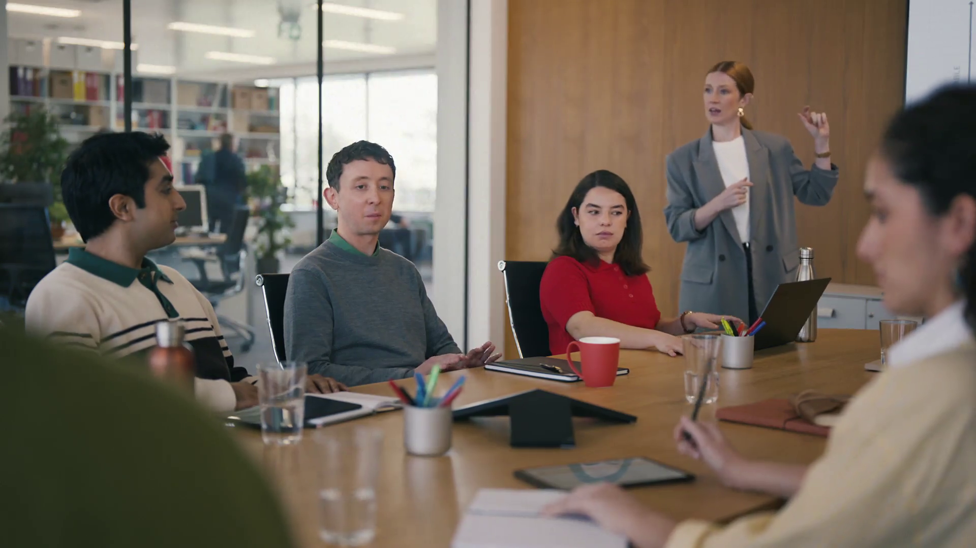
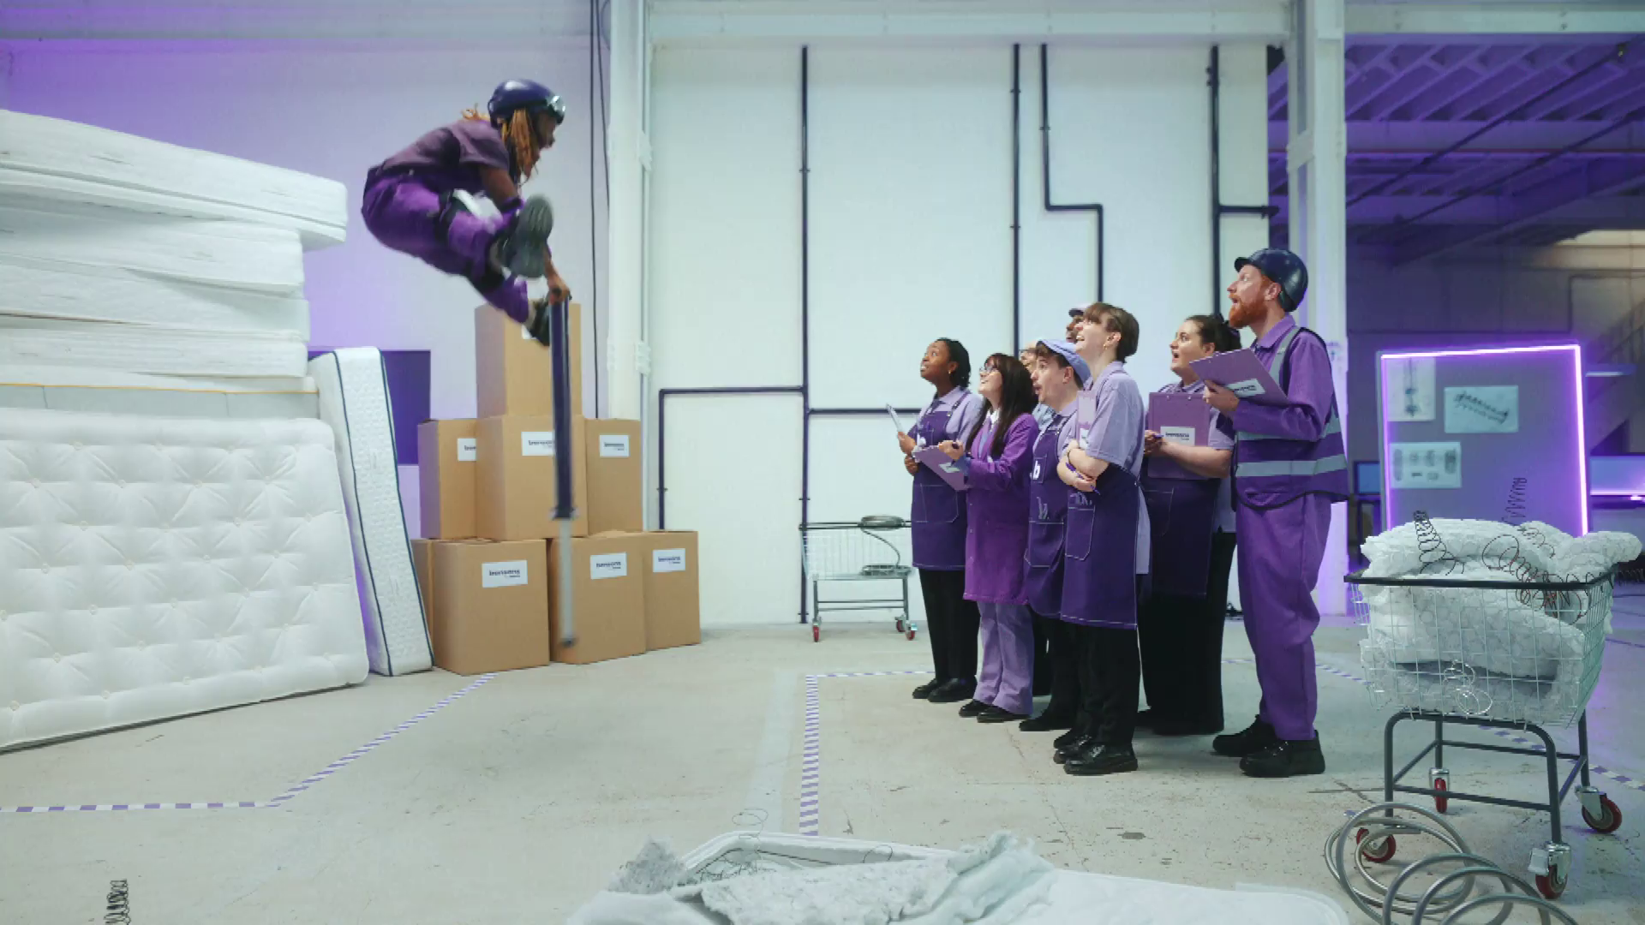
8 reasons to prioritise accessible TV advertising
1.
It's simply the right thing to do
2.
Greater accessibility means greater reach
3.
People with disabilities are a sizeable market
4.
Accessibility is viewed positively by the general population
5.
Access services are used by audiences without disabilities
6.
Major advertisers and industry bodies are committing to accessibility
7.
Ensuring greater media accessibility may soon be a requirement
8.
Delivering access services for advertising is easier than you think

Slide 18
1. It's simply the right thing to do
As a society, we have a responsibility to create a world in which everyone can access and benefit from the same services and experiences, regardless of having a disability.
For too long, people with disabilities have been excluded. Accessibility is about making sure everyone can participate equally, confidently and independently in everyday activities.
Salesforce – Dining Alfiasco

Slide 19
2. Greater accessibility means greater reach
The European Blind Union estimates that there are around 30 million people with blindness and low vision living in geographical Europe, with an average of 1 in 30 Europeans experiencing some form of low vision.
According to the World Health Organisation (WHO), almost 200 million people in the European region experience some degree of deafness or hearing loss.
Access services allow media companies and advertisers to expand their audiences and reach those who have traditionally been excluded.
Original Source – Nature Hits Different

Slide 20
3. People with disabilities are a sizeable market
Accessibility features allow people with disabilities to enjoy the advertising that informs their consumer choices.
According to the WHO, people with disabilities make up over 1 billion people globally– this figure is set to increase due to ageing populations and other demographic trends.
People with disabilities, therefore, represent a sizeable market. One study estimates that the total disability market influences over $13 trillion USD in annual disposable income – a market larger than China.
Smarty - ZigZag

Slide 21
4. Accessibility is viewed positively by the general population
Over 3.3 billion people globally have a friend or family member with a disability and almost everyone is likely to experience some form of disability – either temporary or permanent – at some point in life.
As disability affects almost all of us in one way or another, greater accessibility is positively viewed by the wider population.
In fact, one study found that purpose-driven companies, such as those with commitments to inclusion and accessibility, have a distinct advantage in the marketplace.
AG1 – One Step

Slide 22
5. Access services are used by audiences without disabilities
Ofcom found that 18% of the UK population (7.5 million people) use closed captions while only 1.5 million of those people are deaf or have hearing loss.
80% of those television viewers, therefore, are using closed captions for reasons other than an auditory disability – they could be non-native speakers or watching in noisy environments.
TV content is now available anywhere, anytime and on any device, and users are increasingly watching TV on the go, with subtitles activated.
In fact, young people today are almost four times more likely than older viewers to watch TV shows with subtitles, despite being less likely to have hearing loss.
Heinz – Loved by Babies, Craved by Parents

Slide 23
6. Major advertisers and industry bodies are committing to accessibility
Global advertisers are making commitments to ensure their campaign messaging across all channels is more accessible, with accessibility increasingly considered within the context of wider diversity and inclusion objectives.
P&G, for example, aim to make 100% of their advertising accessible by 2025, an important first move that is being supported by other advertisers such as Unilever, Mastercard, Diageo and others as well as the World Federation of Advertisers and the European Association of Communication Agencies.
In this guide, you will find some examples of accessible ads made by organisations who have made progress on their accessibility journey.
Under Armour – Antonio Rudiger

Slide 24
7. Ensuring greater media accessibility may soon be a requirement
Organisations such as the RNID & RNIB who champion audiences with disabilities have been campaigning for years on this topic and legislation is soon to be in place that will help to drive better accessibility.
The European Accessibility Act (2025) will be rolled out across all EU countries to make products and services more accessible.
Learn more about what this means for global organisations.
McDonald’s – Big Arch

Slide 25
8. Delivering access services for advertising is easier than you think
The technical infrastructure required to deliver access services on TV already exists and is already being used for TV programming, where subtitles and audio description is more readily available.
For broadcasters, extending this capability to commercial breaks on their live linear broadcast is not difficult.
On digital platforms, many access services are already supported, such as subtitles and alt text, and wider support is being developed.
Bensons for Beds - Obsessed
More at https://adaccessibility.org/business-case#Reasons

