Slide 1
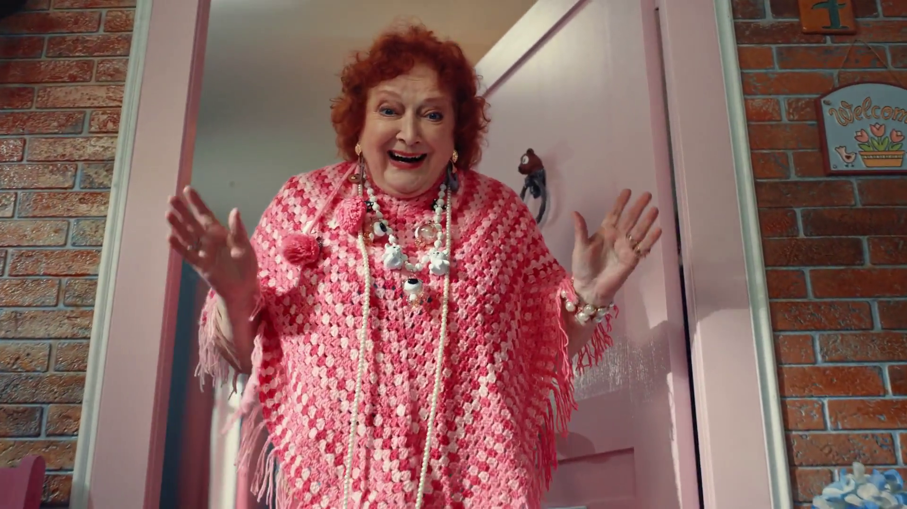
Ecommerce nickable charts
Moonpig - Biker

Slide 2
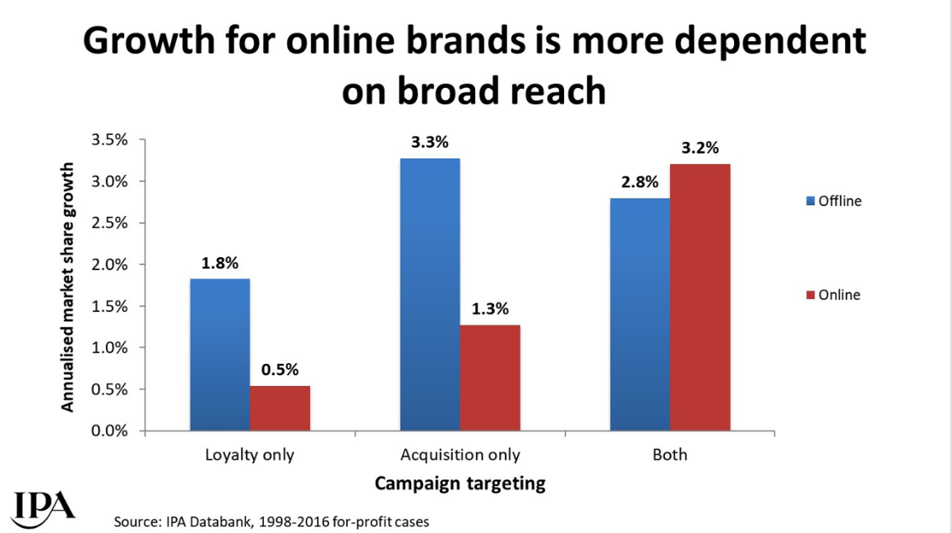
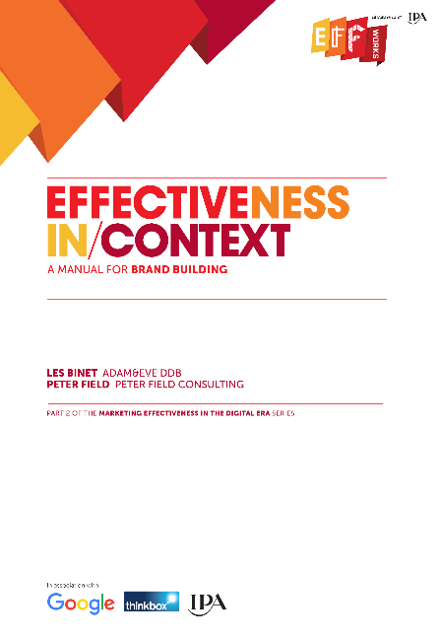
In the busy online world, reaching new customers is vital
Source: Effectiveness in Context, 2018, Binet / Field / IPA
Notes:
The IPA study ‘Effectiveness in Context’, authored by Les Binet & Peter Field, proved just how important reach is to online brands.
One of the potential advantages of online brands is their closer knowledge of their customers and contact with them. This is likely to make loyalty marketing easier and cheaper to undertake, but IPA Databank data suggests that it doesn’t make it any more worthwhile. In fact, compared to offline brands, growth for online brands is even more dependent on broad targeting beyond existing customers.
This chart shows how online brands who deployed an acquisition strategy to attract new customers alongside a customer loyalty strategy reaped the benefits by driving significantly higher market share growth.
In the crowded online world, reaching out to new customers is vital.
For more information on this study please see:
https://www.thinkbox.tv/research/thinkbox-research/effectiveness-in-context-free-download/

Slide 3
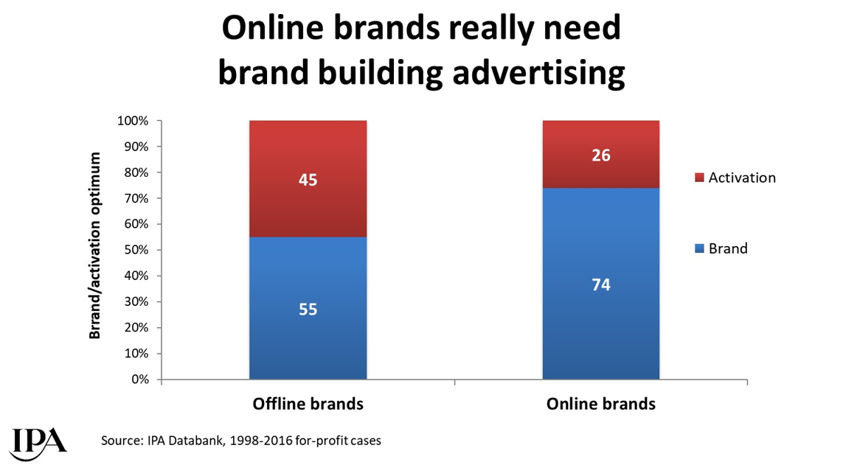
Online brands require more brand advertising to drive growth
Source: Effectiveness in Context, 2018, Binet / Field / IPA
Notes:
The IPA study ‘Effectiveness in Context’, authored by Les Binet & Peter Field, demonstrated how important brand advertising is to online advertisers.
The online world is a busy place for brands and the nature of consideration in online categories is more likely to be rational than emotional (whereas the reverse is true in offline categories), so brand building and long-term effectiveness are likely to be more difficult to achieve. This has implications for balancing budget between brand and activation for online brands: the optimum balance of brand building to sales activation for online brands is rather higher than for offline brands.
For more information on this study please see:
https://www.thinkbox.tv/research/thinkbox-research/effectiveness-in-context-free-download/

Slide 4
If you are in an online category, you desperately need to reach broadly. You need to reach everyone in the category, and you need to reach them early and prime them… Otherwise it’s just a bidding war at that last moment of decision. And if you don’t have a powerful brand it’s going to get expensive and it’s going to get ineffective. The online world is no place for weak brands
“
“
Peter Field, October 2018
Notes:
Peter Field, Thinkbox’s ‘Perfectiveness’ event, October 2018.
https://www.thinkbox.tv/news-and-opinion/events/perfectiveness/

Slide 5
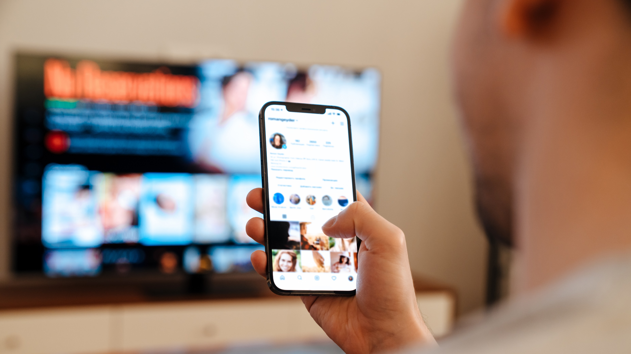
Multi-screening brings the high-street to the living room
31 mins
spent using internet while watching TV per day.
This is likely due to the ease and convenience of searching simultaneously via a mobile device.
Source: IPA TouchPoints 2023, Wave 1 (Fieldwork Dates: 17th January – 26th March 2023). Base: adults 15+.

Slide 6
Online born businesses are the biggest investors in TV
-6%
MILLIONS
-3%
+8%
-4%
+5%
+8%
-5%
+84%
-13%
-10%
+4%
Source: Nielsen Ad Intel, 2022, Thinkbox-created category of online-born businesses (YoY category % change).
Notes:
Analysis from Nielsen Ad Intel shows that Online Born businesses the biggest investors in linear TV.

Slide 7
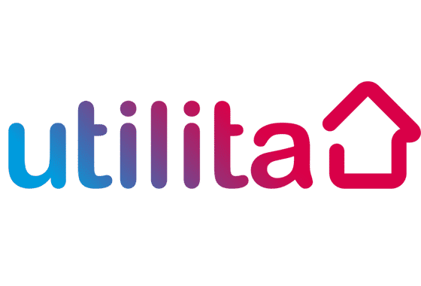
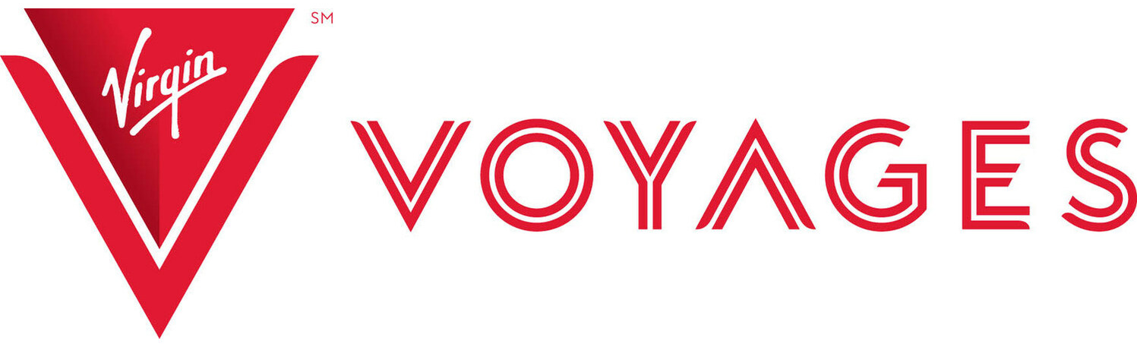
959 advertisers used TV for the first time in 2022
Source: Nielsen Ad Intel / Sky – New to TV advertisers classed as those not advertising on TV 5 years prior (2017—2021) on Linear TV and Sky AdSmart
Notes:
In 2022, there were 959 new to TV advertisers, many of whom were ecommerce business looking to supercharge their growth through TV.
Here’s a flavour of some of the businesses who’ve used TV for the first time.
BikeClub - bicycle rental service
WeAre8 – social media app
National Highways - government-owned company
Standard Life – insurance
Novo Nordisk - global healthcare company
Saga Personal Finance – financial services
Naked Wines – wine retailer
Tesco Bank – financial services
Chase Bank – financial services
EVRI – delivery service
Thames Water – water and wastewater services
North Cyprus Tourist Office – travel and tourism
Eset Software – cybersecurity
Simply Business – business insurance
Clim8 – sustainability fund
Utilita – electricity and gas supplier
Cunard Line – cruise line
Virgin Voyages – cruise line
Einhell – DIY tools
Flight Centre – travel agency
St Mungos – charity
Reddit – social news website
Tiger Group – sheds
Absolute Collagen – skincare
Tilney – financial planning and investments
Intercontinental Hotels & Resorts – hospitality chain
Exoticca – travel agency
Moda – furniture
The Trussell Trust – charity
Beauty Pie – cosmetics
Pizza Express – restaurant chain
Jo Malone – perfume
Fixter – car service
Animals Asia Foundation – charity
Pendragon – automotive retailer
Wish – online marketplace

Slide 8
TV is a driver for ecommerce businesses
Source: Media Mix Navigator– Online retailer, Brand size £200m, Budget £10m, Mass market. Very low risk
Campaign uplift = return during campaign + following 3 months. Base sales = sustained sales over three years.
Notes:
The Media Mix Navigator tool, developed by WPP for Thinkbox, proves just how powerful TV is for online retailer brand growth.
This chart shows the revenue effect from one year’s investment for a mid-sized online retailer brand with an annual media budget of £10m. Including TV on the media plan (linear & broadcaster on demand) drives a shorter-term campaign uplift of compared with the same budget excluding TV.
More about the Media Mix Navigator:
The Media Mix Navigator tool, powered by econometrics, helps you get the most out of your media investment.
It allows you to explore different scenarios to define the optimum media mix for your business, whether your objective is to drive increased profit or revenue. The results are modelled across the first year of investment and the resulting ‘base’ sales growth across the following two years.
This tool draws on data from 52 EssenceMediacom, Wavemaker, Mindshare and Gain Theory client brands, totalling £2.2 billion of media spend over 3 years (2018-mid 2021). These have been carefully chosen to represent as many business types as possible. Cost of media is based on 2021 prices.
For more information on the Media Mix Navigator please see:
https://www.thinkbox.tv/research/media-mix-navigator/media-mix-navigator/

Slide 9
What does TV advertising offer ecommerce businesses?
Scale & broad reach
Delivers good ROI performance
Low short-term risk
Highly trusted
Makes brand more famous
Boost effects of other advertising
Notes:
TV is a powerful tool for ecommerce businesses. It offers scale, powerful short-term sales effects, it’s a low risk advertising channel, highly trusted, makes brands more famous, and boosts the effect of all other advertising.

Slide 10
Commercial TV delivers scale
ADULTS REACHED PER WEEK
(MILLIONS)
Newsbrand / Mag
Social Media
Commercial TV
Commercial Radio
YouTube
TikTok
AVERAGE HOURS PER WEEK
Source: IPA TouchPoints 2023, Wave 1 (Fieldwork Dates: 17th January – 26th March 2023). Base: adults 15+. Newspaper/magazine/TV figures include online/app consumption.
Notes:
As well as reaching into every corner of the country, people also spend a lot of time with TV. It is the most popular medium.

Slide 11
Both linear TV and BVOD deliver good ROI performance
Total (short and long-term) ROI Index Channel Hierarchy
Source: Media Mix Navigator, Sept. 2022, EssenceMediacom / Wavemaker / Mindshare / Gain Theory
Notes:
Both Linear TV and BVOD deliver good ROI performance, as shown by findings from ‘BVOD Almighty: Reach and Return’ commissioned by Thinkbox.
This chart demonstrates the total (short and long term) ROI performance by channel. It’s worth noting that the data is shown as indices (and not absolute ROI delivery). Thus, it means that linear TV is 41% better than the average of all channels.
The data is shown as indices because the dataset behind the analysis includes a range of product categories. The absolute £££ return you would normally expect from advertising, of course, varies by category. Thus using indices helps understand overall normative performance of each channel relative to everything else.
The channels are ranked by total performance. But in the bars you can see the differing delivery of return by short term (up to 3-months) and long-term (3-months up to three years).
You can see that linear TV has the highest proportion of longer term delivery.
For more information on this study please see:
https://www.thinkbox.tv/research/thinkbox-research/bvod-almighty-reach-and-return/

Slide 12
The predictability of payback varies greatly by channel
The Variability of Returns by Channel
(Data 2018 – Mid 2021)
Increasing risk / reward of achieving return
0% = Median ROI
Source: Media Mix Navigator, Sep. 2022, EssenceMediacom / Wavemaker / Mindshare / Gain Theory
Notes:
Findings from ‘BVOD Almighty: Reach and Return’, shows that the predictability of payback varies greatly by channel. Using the Media Mix Navigator, it’s based on data from Gain Theory, EssenceMediacom, Wavemaker, and Mindshare which covers 52 brands and £2.2 billion of media spend over 3 years.
The charts shows how the variability of returns differs significantly across different forms of advertising. This essentially indicates the risk of investing in different channels based on the predictability of their returns.
The median brand ROI in the databank for each channel is represented by the zero across the middle. To assess the predictability of each channel, the analysis looks at how spread out the different brand ROIs are for each channel in comparison to that middle brand. Basically, the bigger the bar, the bigger variance there is between the best performer and the worst performer – so the greater degree of risk. Outliers have been removed.
As you can see, BVOD is the most predictable (therefore least risky) channel, delivering 20% of variance compared with the median return. This was closely followed by linear TV with a variability of 24%.
It’s worth noting that high variability works both ways: although it involves greater risk, there is the possibility of achieving a much higher than average ROI (as well as a much lower one).

Slide 13
TV advertising is the most trusted
Newspapers
Radio
Magazines
Search
Cinema
TV
Social Media
Outdoor
Direct Mail
YouTube
Websites
Source: Adnormal Behaviour, 2022, Ipsos / Thinkbox. Q.TN3: In which, if any, of the following places are you most likely to find advertising that...you trust
Base: ‘normal’ people (1,158)
Notes:
Thinkbox’s ‘Adnormal Behaviour’ work showed that TV ads were the most trusted form of advertising.
For more information on this study, see the full write up on the Thinkbox website:
https://www.thinkbox.tv/research/thinkbox-research/adnormal-behaviour/

Slide 14
TV advertising makes brands more famous
Social Media
Newspapers
Magazines
Outdoor
Cinema
TV
YouTube
Search
Radio
Websites
Direct Mail
Source: Adnormal Behaviour, 2022, Ipsos / Thinkbox. Q.TN3: In which, if any, of the following places are you most likely to find advertising that... Makes brands, products or services more recognisable/ famous
Base: ‘normal’ people (1,158)
Notes:
Thinkbox’s ‘Adnormal Behaviour’ work showed that TV ads make brands more famous
For more information on this study, see the full write up on the Thinkbox website:
https://www.thinkbox.tv/research/thinkbox-research/adnormal-behaviour/

Slide 15
TV boosts effects of other ad channels by up to 54%
 | Channel Benefiting from the Effect
Channel Generating the Effect | TV | Online Video + VOD | Social Media | Online Display | Out of Home | Radio | Print | Generic Search | Cinema | Direct Mail
TV |  | 20% | 31% | 31% | 22% | 31% | 31% | 8% | 54% | 20%
Online Video + VOD | 3% |  | 5% | 2% | 5% | 3% | 12% | 1% | 7% | 2%
Social Media | 2% | 2% |  | 2% | 3% | 2% | 3% | 1% | 3% | 1%
Online Display | 3% | 4% | 4% |  | 4% | 3% | 9% | 3% | 11% | 4%
Out of Home | 6% | 8% | 9% | 8% |  | 9% | 11% | 1% | 3% | 1%
Radio | 4% | 4% | 4% | 6% | 4% |  | 3% | 2% | 1% | 1%
Print | 5% | 6% | 7% | 5% | 6% | 4% |  | 4% | 13% | 7%
Generic Search | 3% | 2% | 4% | 2% | 2% | 3% | 7% |  | * | 6%
Key: | 0-2% | 3-4% | 5-8% | 9-20% | 20%+
Source: ‘Demand Generation’ Nov 2019, MediaCom/Wavemaker/Gain Theory/Thinkbox NB: Insufficient data to robustly report Cinema & Direct Mail’s effect on other channels. *insufficient data to report effect
Notes:
‘Demand Generation’, commissioned by Thinkbox and conducted WPP agencies Mediacom, Wavemaker and Gain Theory, looked at how one ad channel boosts the efficiency of another ad channel. Most channels boost the efficiency of others, but the scale and consistency of the effect differs significantly.
This chart outlines this multiplier effect between ad channels and the effects each channel can receive. The Y axis indicates the active channel generating the effect, with the X axis relating to the channel benefiting from that effect.
We can see that when TV is active, the effectiveness of Cinema is bolstered up by 54% - more than any other channel. This makes sense as Cinema has a relatively small reach but a high impact, and with TV copy tending to be a cutdown version of what Cinema shows, it is extending its reach.
TV stands out as having the biggest and most consistent effect on other channels. This isn’t a coincidence. On average brands are spending 45% of their advertising budgets on TV, so it is bound to have a bigger effect.
For more information on this study please see:
https://www.thinkbox.tv/research/thinkbox-research/demand-generation/

Slide 16
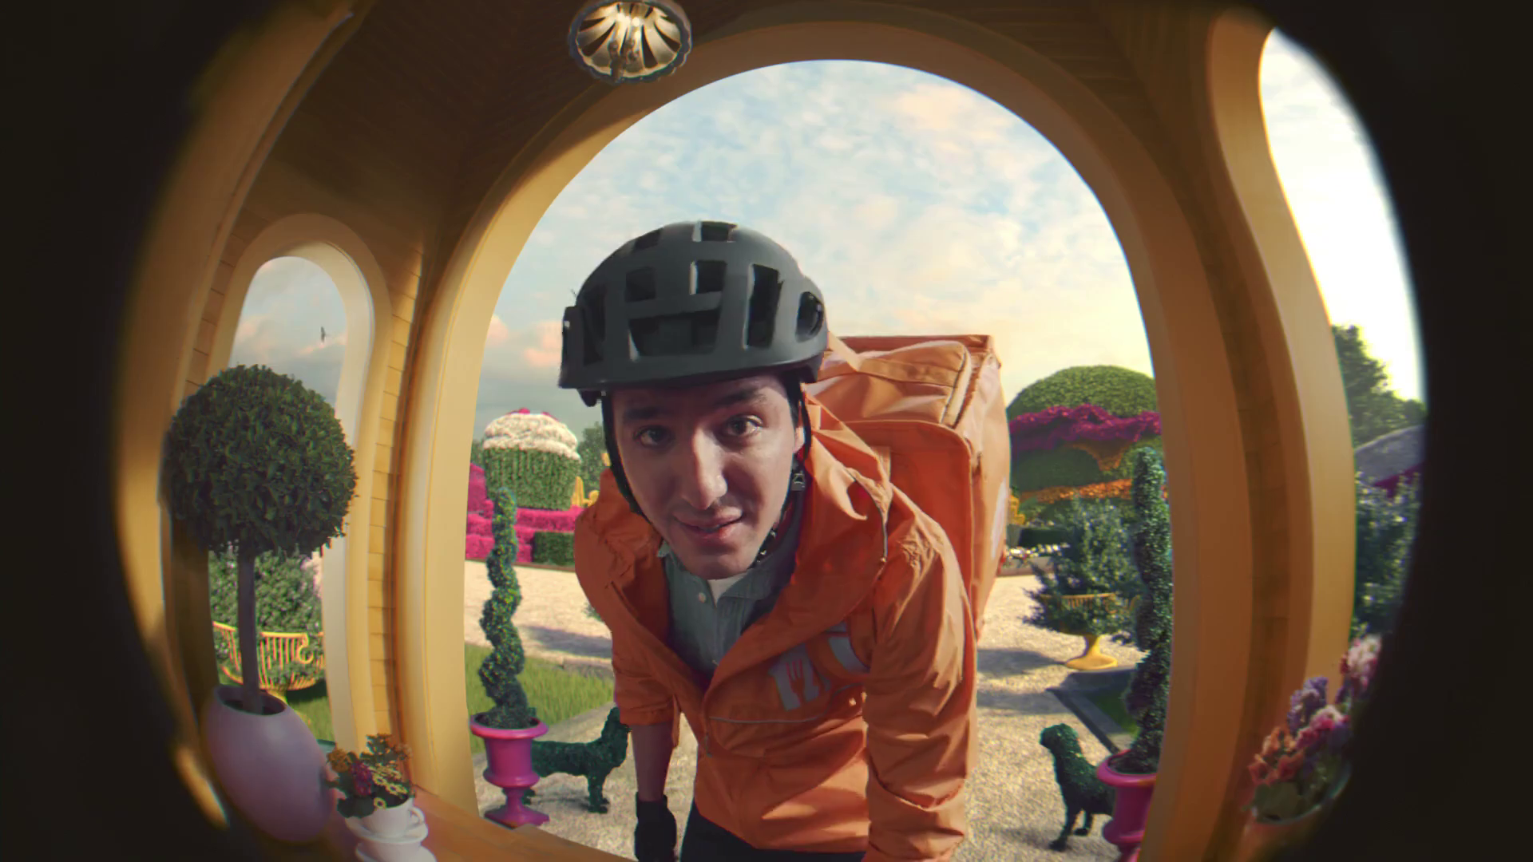
Case studies
JustEat – Katy Perry

Slide 17
How PrettyLittleThing became a PrettyBigThing
Challenge
PrettyLittleThing were operating in a fiercely competitive market, but with lower budgets than their competitors
The challenge was to drive 16-34 women to the website and grow the brand over several years
Solution
Their strategy evolved over the years from short-term response led campaigns to longer term brand building to sustain growth
Results
PrettyLittleThing’s share of Google search grew by 33 percentage points from 7% in 2014 to 40% in 2018
Notes:
The Challenge
PrettyLittleThing was launched in 2012 when brothers Umar and Adam Kamani spotted a gap in the market for a fashionable yet affordable online accessories brand (which quickly expanded into clothing).
PrettyLittleThing have always operated in a fiercely competitive market but with above-the-line budgets lower than their competitors. There wasn’t any VC funding – every pound came from the founders’ own pockets, so any media investment had to work hard and achieve immediate results.
In 2014, they tasked their media agency The Specialist Works with driving 16 to 34-year-old women to the website to grow the brand over the coming years.
The TV Solution
The Specialist Works had been planning and buying airtime for Boohoo since 2011 and had experienced great success for that brand. Therefore, they knew about TV’s unrivalled ability to cut through and deliver results and felt that TV should be the medium of choice for PrettyLittleThing.
The Plan – 2014 to 2018
2014
Their strategy in year one was to buy one spot at a time in programmes that really mattered to their target audience and converted well for 16 to 34-year-old women. They then used their proprietary TV attribution tool [mint]^{av} to determine whether the spot had driven traffic to the site. If it had, more spots would be booked the following week, and if it hadn’t, they wouldn’t reinvest.
2015
They identified that spots in TOWIE were performing particularly well, and PrettyLittleThing went on to develop a collaboration with TOWIE star Lucy Mecklenburgh, where she launched a range of clothing. Following the success of their 2014 TV campaign, they doubled their investment YoY in 2015, with a focus on TOWIE to support the Lucy partnership.
2016
TV’s role was evolving from generating demand to creating brand associations. Also, they had identified Made in Chelsea as a programme that performed well. But they were struggling to find enough spots to buy, due to the regulation that you can’t have competing brands in the same break and the high demand from their competitors. So, they were able to negotiate with Channel 4 who created an additional break, exclusive to them, in every episode of the programme.
2017
The key programme that they aligned with was Love Island – a perfect vehicle for their young fashion brand and with high levels of viewing by their target audience. They invested heavily, buying first in break slots on linear and on-demand and as a result drove fame for the brand. By the end of 2017, PrettyLittleThing was the fastest growing online fashion retailer in the world. (Source: Hitwise, Fast Fashion Report, based on website traffic)
2018
Over the years, activity had evolved from short-term response to longer-term brand building to sustain growth. They chose to invest in programmes that got the nation talking. For example, they bought a national peak spot in I’m A Celebrity Get Me Out Of Here and The X Factor. They used linear TV and added on-demand to amplify reach. They also continued collaborating with models and celebrities to create their own collections.
Results
PrettyLittleThing’s share of Google search grew by 33 percentage points from 7% in 2014 to 40% in 2018 (Source: Nielsen AdDynamix, Google Trends).
As of February 2019, PrettyLittleThing has 5m active customers. That’s 40 times the number they had before they started working with The Specialist Works.

Slide 18
Get Minted with Vinted
Challenge
Following successful campaigns in Europe, Vinted were looking to launch their app in the competitive UK market
Solution
Adopted a test and learn approach around audience-centric planning, value optimisation, integrated creative and bespoke scheduling
This led to a younger target audience, a Sunday to Thursday skew into more peak, high quality programming with their 30” creative
Results
63% increase in the baseline of new listers
Notes:
The Challenge
Fashion marketplace app Vinted was looking to launch in the UK following successful TV campaigns in France and Germany. VCCP Media, Vinted’a media agency, knew the challenge of launching Vinted in the UK would be twofold.
Firstly, Vinted was entering an extremely competitive market already populated with established brands such as Ebay, Shpock, Gumtree and Depop. They also knew, due to the social nature of the Vinted app, they were competing against well-loved online fashion marketplaces such as ASOS, Boohoo.com and PrettyLittleThing for audience share and attention.
Secondly, Vinted’s success with their European TV campaigns came from their broad buying parameters and focus on inexpensive short-form TV ads. This meant that VCCP had to mimic performance with their own activity in the UK, while also setting them up for long-term growth.
The TV Solution
Across Europe, they had adopted a low-cost, high frequency and broadly targeted campaign. However, VCCP believed that Vinted’s European TV buying strategy wouldn’t cut through and create long-term growth in the UK due to local nuances, competitor aggression and audience insights. A test and learn approach, that would prove the benefit of taking a longer-term view to TV buying, was recommended and would cover four key areas: audience-centric planning, value optimisation, integrated creative and bespoke scheduling.
Research showed that younger audiences were more open than ever to their clothing and fashion choices, which suggested that Vinted could be a tool in helping them create their own images. VCCP also addressed the balance between cost efficiency and awareness and tested creative variations to understand what landed with the audience. Finally, the daytime-only scheduling brief was amended with the need to upweight weekends (as many of the audience were employed) and was expanded further into post-peak to test programming environments which were perfect for the audience.
The Plan
The launch plan in January 2018 was a small 3-week test to gather learnings around the audience and creative. They ran 30”, 20” and 10” adverts with two different stories – 6 copies in total – and started with a broad audience target of Women 18-44s with a Sky stations focus at a low adult CPT. While the plan had a female skew, VCCP also analysed the effect of airtime skews towards other audiences (e.g. Young vs Old, Male vs Female, ABC1 vs C2DE) to understand which audiences were more likely to download the Vinted app. The results from the initial campaign were promising, with Vinted beating their CPA target by 9% and quickly seeing the potential for further growth and expansion.
After a few months of data, VCCP could see that 70% of Vinted customers were aged 16-25. However, this segment only accounted for 7% of the population. Data analysis also provided an insight into the target market: the more young and female the airtime was skewed, the more responsive it became. The next stage was making the copy resonate with this audience and so Vinted developed an advert to connect with younger viewers which featured them using the app itself, with the talent talking in ‘selfie mode’ on a mobile phone and the phrase “Get Minted with Vinted!”.
After establishing the most optimal audience planning, the first large campaign was planned across 5 weeks in February and March 2018. The campaign was scaled up to reach a much larger audience and awareness was growing. The other major change was time-length, with Vinted preferring the 10” copy as this time length had performed better in Europe compared to the longer time-lengths. So, for this burst, they rotated the time lengths in a 3:1:1 ratio of 10”:20”:30”. The results of this campaign were positive, although VCCP believed that the increase in 10” activity had reduced the potential effectiveness of the campaign. They used regression analysis alongside an attribution model that showed that the 30” copy outperformed the 10” due to its longer-term effect over immediate response.
VCCP also noticed that, when looking at dayparts, weekends had a lower response rate than weekdays. However, Sunday had a similar response rate to Tuesday with many more impacts, meaning Sunday was performing well to maintain this response rate. It was decided that the next campaign would have a Sunday to Thursday upweight, fitting with the younger audience as they are more likely to be out and about or thinking about other things on a Friday/Saturday night compared to a Monday or Tuesday. This was important as it took Vinted away from the traditional “retail” day of week strategy and stood them apart from the competition, making their voice louder on key days.
The final campaign of the year had the most highly refined audience strategy, designed to cut-through and make a rapid and meaningful impact with the audience. VCCP focused on more expensive but highly targeted airtime where the 16-24 audience had a deeper connection with the content. They carefully examined competitive weights within the most efficient channels, concentrating on buying spots to ensure Vinted had a disproportionate share of voice. They also started measuring the impact of the TV campaign over a longer time period. For the first, smaller burst, there was a shorter lag period and the installs returned to the base level 11 days after the campaign finished. However, the second, larger burst provided a much more pronounced time lag. In fact, the day before burst three, installs were 253% above base, proving that the larger campaign had produced a much longer lag period. Vinted and VCCP therefore started measuring applications until they returned to their base level, to monitor the full effect of a targeted TV campaign
Results
In 2018, Vinted was a huge success, resulting in downloads exceeding expectations and a lower cost per download than the targets set. With the move away from a cheaper, performance-led approach to the TV campaign, Vinted was able to become a bigger player in a shorter period of time and had spots in key programming for 18-24s such as Love Island and I’m A Celebrity Get Me Out of Here, by being able to demonstrate their effect in both the short and long-term.
The final October-November campaign was the biggest and saw a budget increase of 15 times the initial January test spend. Performance across the year lead to an increase in the baseline of new listers of 63% in the UK. Because of these achievements, Vinted is set to invest more into TV in 2019.
The campaign was a finalist in the 2019 TV Planning Awards ‘Best Newcomer to TV’ category.

Slide 19
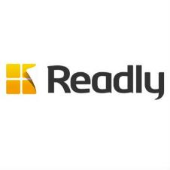
Readly leverages TV to reach digital magazine subscribers
Challenge
Readly wanted to grow their business, drive subscribers and usage and drive brand awareness
Solution
Achieved their goal of getting onto TV through an airtime-for-equity deal with Channel 4
TV campaign ran Jul-Dec, weighted towards weekends at breakfast time or mid-morning, with an ad that was shown 6,500 times in programming identified to drive the strongest engagement
Results
Tripled its subscriber base during the campaign, accounting for +210% year on year growth
Stimulated usage among existing customers with 40% of subscribers using the app daily
Notes:
Challenge:
Readly UK is a digital magazine newsstand that provides readers with unlimited, multi-device access to the digital editions of more than 700 magazines. Digital magazines are growing in popularity, particularly on mobile where consumers can have easy, immediate access.
Previously, Readly had spent the bulk of its marketing spend on online advertising and there was a feeling that TV would be too expensive. Not to mention that, in the publishing world, TV is considered an elitist medium. But Readly wanted to grow the business and they knew that TV had the ability to do this by reaching large numbers of people. Also, because many TV viewers multi-screen whilst watching TV, this provided the perfect environment for an online brand.
The challenge was how to get on TV with a small budget.
Solution:
Readly achieved their goal of getting on to TV through an airtime-for-equity deal with Channel 4. The airtime was funded by Channel 4’s Commercial Growth Fund – an initiative that offers high growth potential companies, who are not currently advertising on TV, the opportunity to build their business through advertising on Channel 4.
So from July to December 2016, Readly’s 30 second ads were shown 6,500 times. The airtime’s rate card cost was estimated at more than £1m.
Ranj Begley, Readly’s UK Managing Director said “The partnership with Channel 4 opened up the world of TV to us. For the first time, we had a mainstream presence and the opportunity to scale up our audience much more rapidly than we had originally forecast.”
Throughout the campaign, Readly worked closely with its agency Squadron Venture Media and also TVSquared’s ADvantage platform to measure and optimise spots. By accessing same-day analytics on TV performance, Readly could measure the immediate impact of TV and assess the precise ROI of each spot at every step of the acquisition process – from initial contact to free trial and on to paid subscription.
Working with TVSquared, Readly uncovered powerful, data-driven insights on campaign performance by day, daypart, genre, programme and ad creative. They were able to identify that the best days were weekends, the best times of day were breakfast and mid-morning and also which programmes drove the strongest engagement.
Results:
In the second half of 2016, when the TV campaign ran, readers opened more than 4m magazines – up 84% compared to the second half of 2015
Readly tripled its subscriber base during the TV campaign, accounting for +210% year on year growth
The subscribers that came that came through the Channel 4 activity proved to be highly engaged, using the service more quickly and intensely compared to subscribers from other sources
The TV campaign stimulated usage among existing customers, with 40% of subscribers using the app daily, averaging 22 minutes per reading session
Due to the success of the UK campaign, Readly Germany and also Readly Sweden have started their own TV initiatives. Readly UK is going to continue with the Channel 4 partnership and also launch into Ireland
For the full case study and to view the ad campaigns visit: https://www.thinkbox.tv/Case-studies/Readly-leverages-TV-to-reach-digital-magazine-subscribers

Slide 20
TV advertising drove uplifts in search for Serenata Flowers
R^{2=0.56}
Source: BARB/Google Trends, Jan 2020 – Jun 2022, please note, an improvement to Google Trend’s data collection system was applied from 01/01/22

Slide 21
TV advertising drove uplifts in search for Mindful Chef
R^{2=0.69}
Source: BARB/Google Trends, Jan 2020 – Jun 2022, please note, an improvement to Google Trend’s data collection system was applied from 01/01/22

Slide 22
Broadcaster case studies
ITV & Dashly
Channel 4 & Deliveroo
Sky Media & Hotter
ITV & Wattbike
Channel 4 & Gumtree
Sky Adsmart & Not on the High Street

