Slide 1
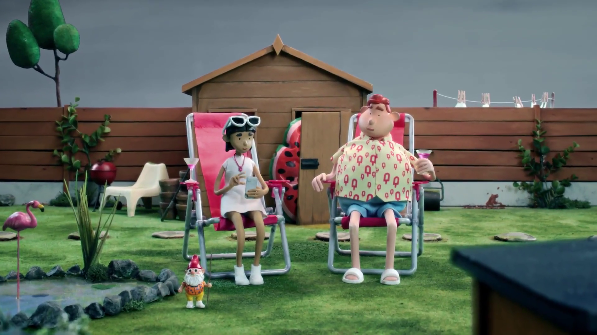
Ecommerce nickable charts
Icelolly.com - Vans

Slide 2
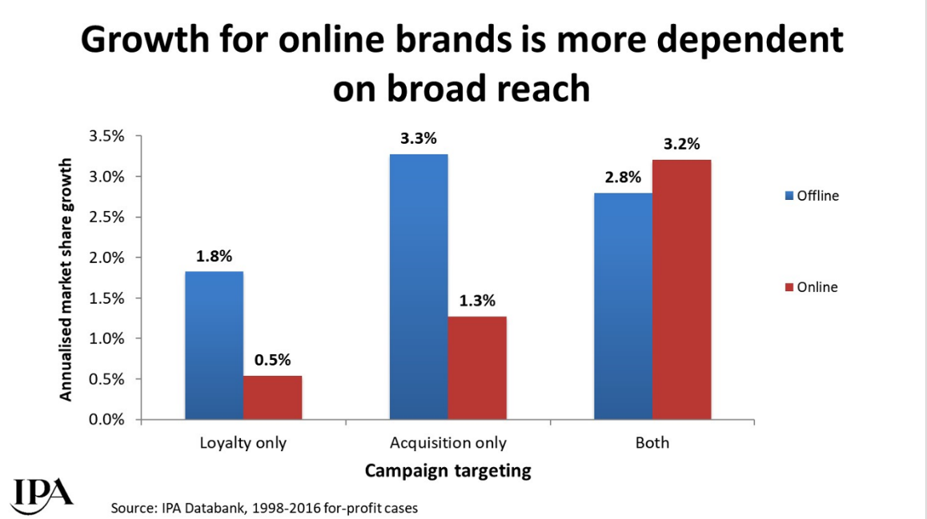
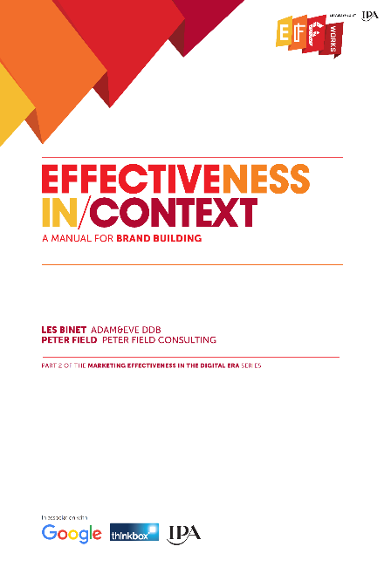
In the busy online world, reaching new customers is vital
Source: Effectiveness in Context, 2018, Binet / Field / IPA
Notes:
The IPA study ‘Effectiveness in Context’, authored by Les Binet & Peter Field, proved just how important reach is to online brands.
One of the potential advantages of online brands is their closer knowledge of their customers and contact with them. This is likely to make loyalty marketing easier and cheaper to undertake, but IPA Databank data suggests that it doesn’t make it any more worthwhile. In fact, compared to offline brands, growth for online brands is even more dependent on broad targeting beyond existing customers.
This chart shows how online brands who deployed an acquisition strategy to attract new customers alongside a customer loyalty strategy reaped the benefits by driving significantly higher market share growth.
In the crowded online world, reaching out to new customers is vital.
For more information on this study please see:
https://www.thinkbox.tv/research/thinkbox-research/effectiveness-in-context-free-download/

Slide 3
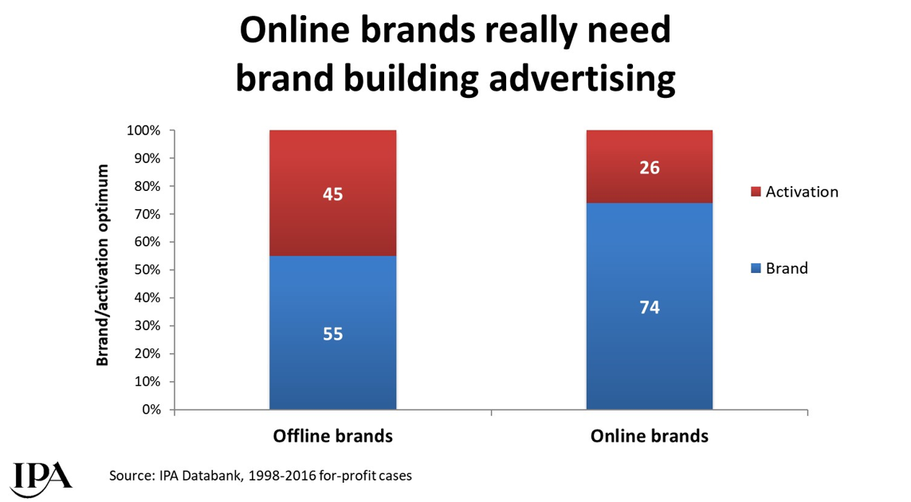

Online brands require more brand advertising to drive growth
Source: Effectiveness in Context, 2018, Binet / Field / IPA
Notes:
The IPA study ‘Effectiveness in Context’, authored by Les Binet & Peter Field, demonstrated how important brand advertising is to online advertisers.
The online world is a busy place for brands and the nature of consideration in online categories is more likely to be rational than emotional (whereas the reverse is true in offline categories), so brand building and long-term effectiveness are likely to be more difficult to achieve. This has implications for balancing budget between brand and activation for online brands: the optimum balance of brand building to sales activation for online brands is rather higher than for offline brands.
For more information on this study please see:
https://www.thinkbox.tv/research/thinkbox-research/effectiveness-in-context-free-download/

Slide 4

If you are in an online category, you desperately need to reach broadly. You need to reach everyone in the category, and you need to reach them early and prime them…
Otherwise it’s just a bidding war at that last moment of decision. And if you don’t have a powerful brand it’s going to get expensive and it’s going to get ineffective.
The online world is no place for weak brands
“
“
Peter Field, October 2018
Notes:
Peter Field, Thinkbox’s ‘Perfectiveness’ event, October 2018.
https://www.thinkbox.tv/news-and-opinion/events/perfectiveness/

Slide 5
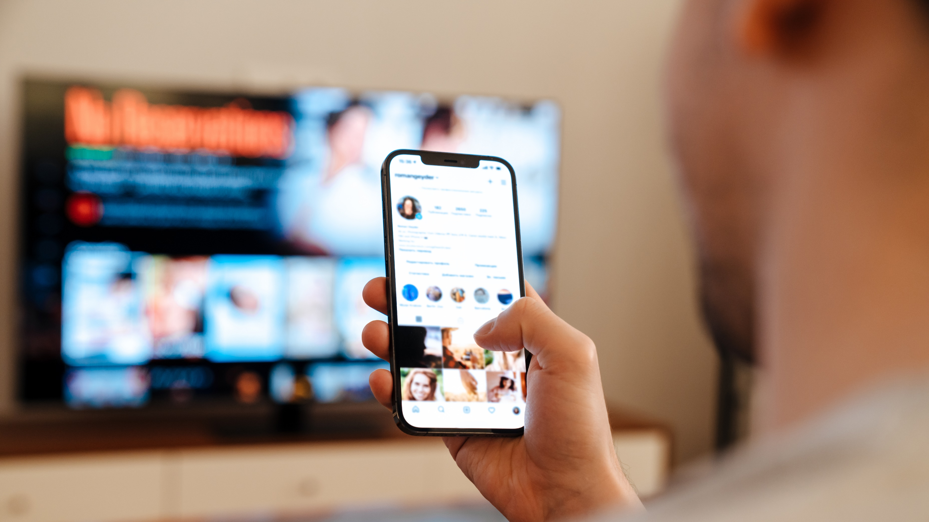

Multi-screening brings the high-street to the living room
31 mins
spent using internet while watching TV per day.
This is likely due to the ease and convenience of searching simultaneously via a mobile device.
Source: IPA TouchPoints 2024 SuperHub (W2 2023 + W1 2024), Fieldwork Dates: 20th Sep 2023 – 3rd Dec 2023, 16th Jan 2024 – 12th Apr 2024). Base: adults 15+.

Slide 6
Online born businesses are the biggest investors in TV
MILLIONS
Source: Nielsen Ad Intel, 2023, Thinkbox-created category of online-born businesses (YoY category % change).
Notes:
Despite a year-on-year decline, online born businesses persist as the biggest investors in TV. TV investment has experienced its most significant growth from the Household FMCG category.

Slide 7
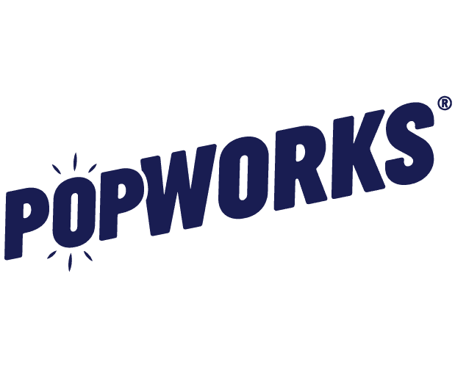


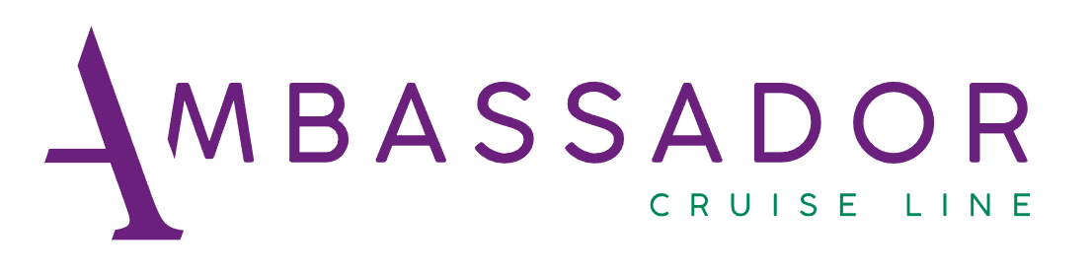

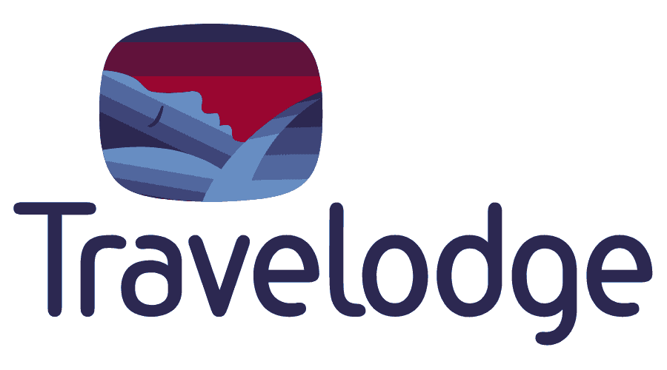
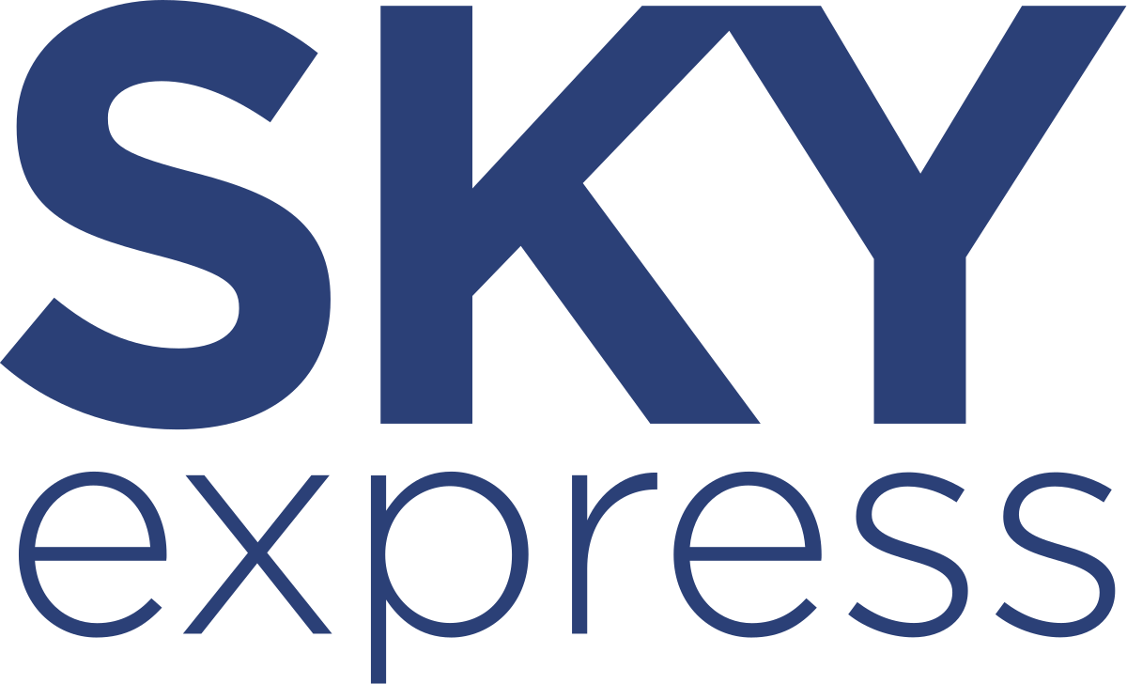

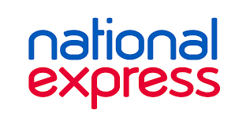
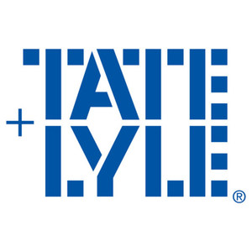






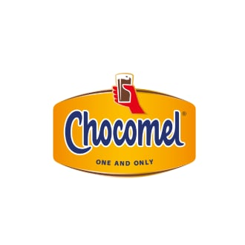
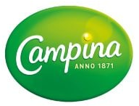
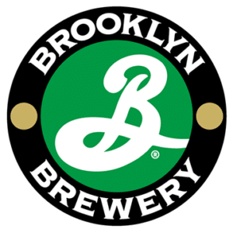


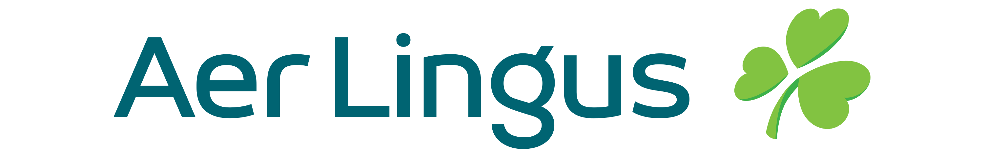




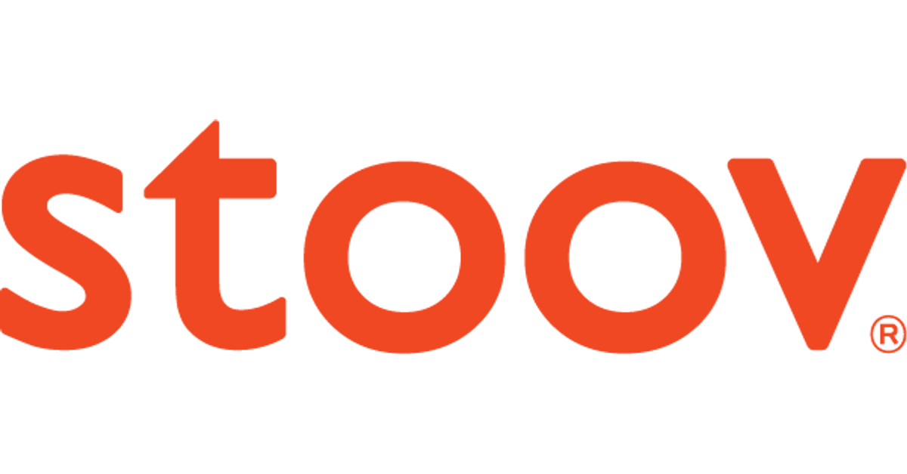

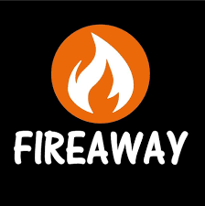
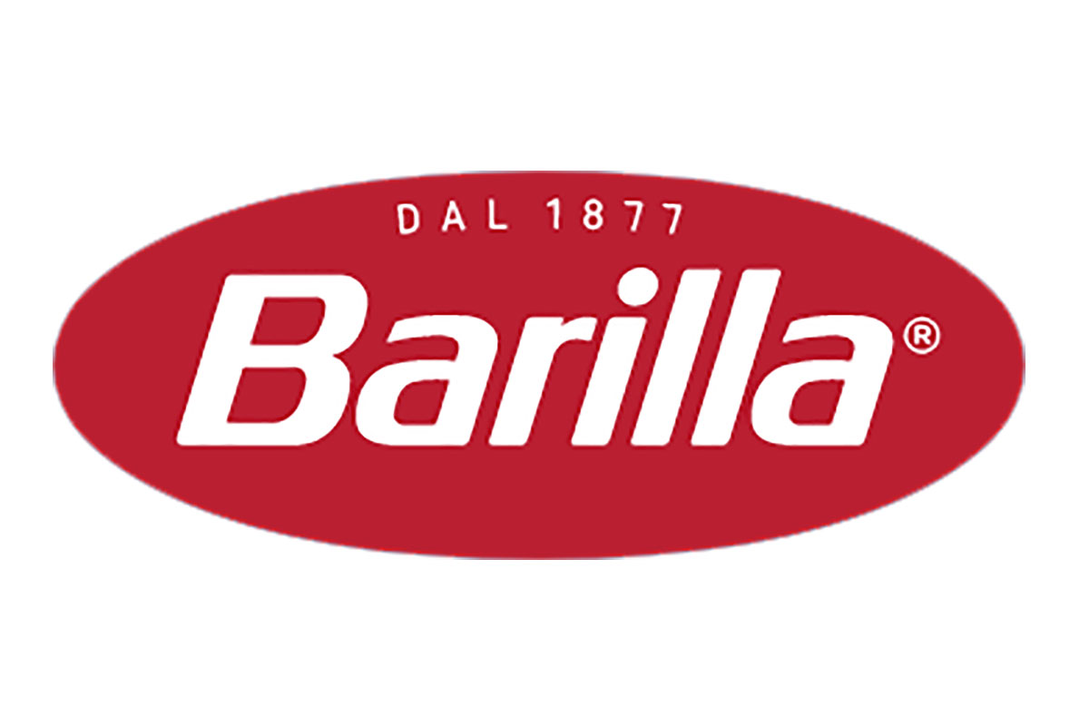
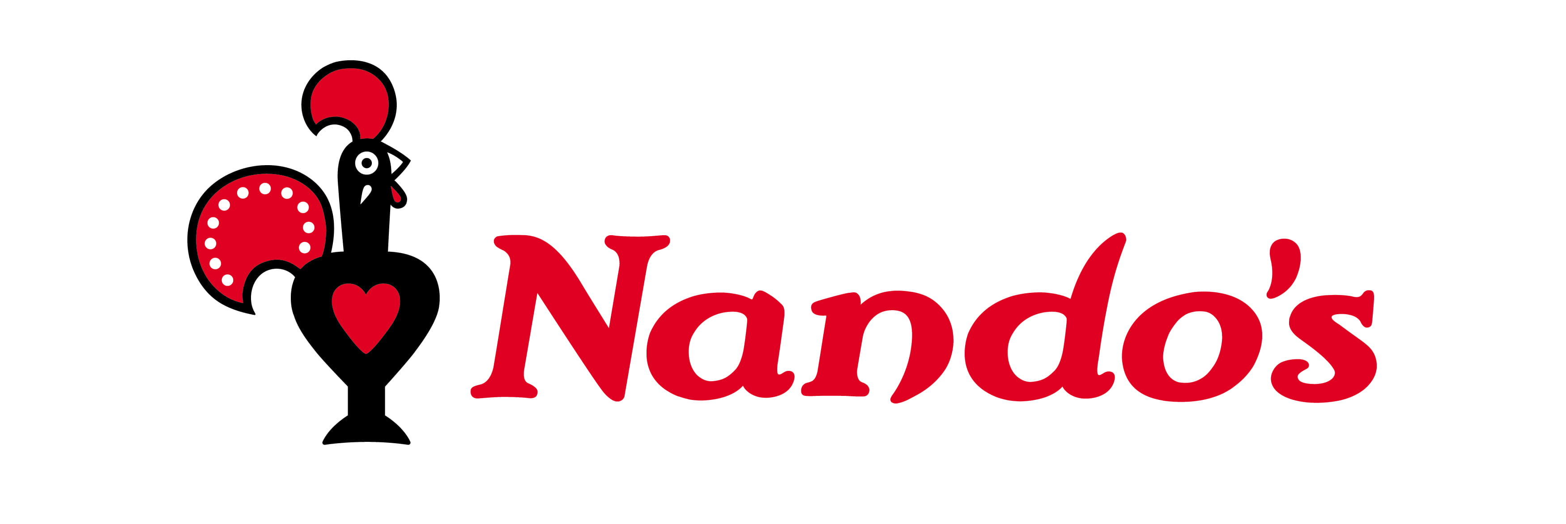


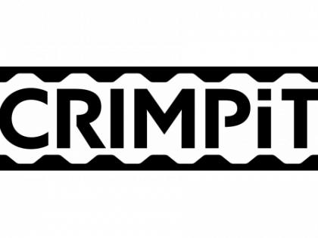
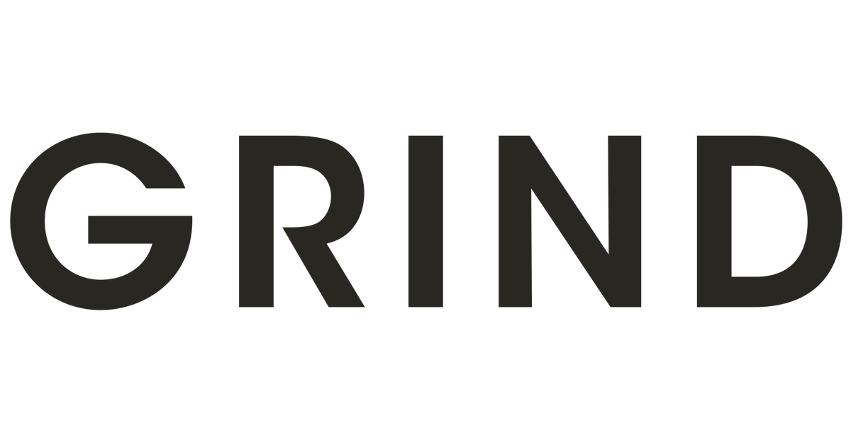







791 advertisers used TV for the first time in 2023
Source: Nielsen Ad Intel / Sky – New to TV advertisers classed as those not advertising on TV 5 years prior (2018—2022) on Linear TV and Sky AdSmart
Notes:
In 2023, there were 791 new to TV advertisers, many of whom were ecommerce business looking to supercharge their growth through TV.

Slide 8
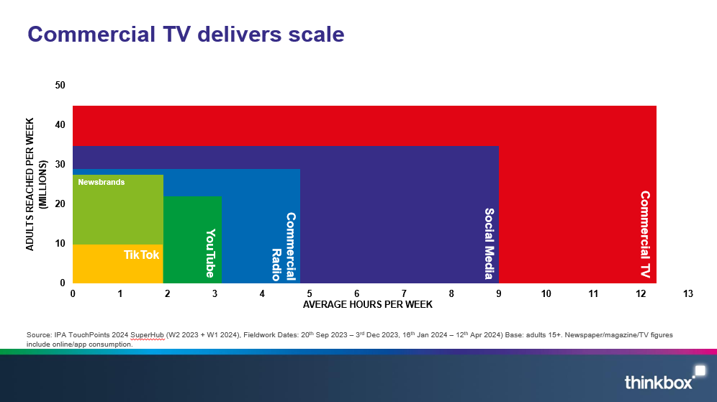
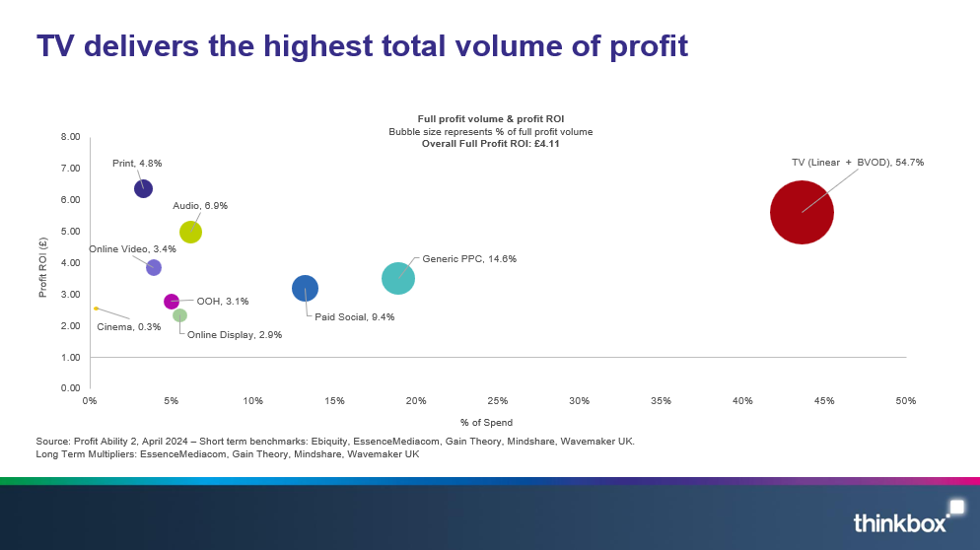
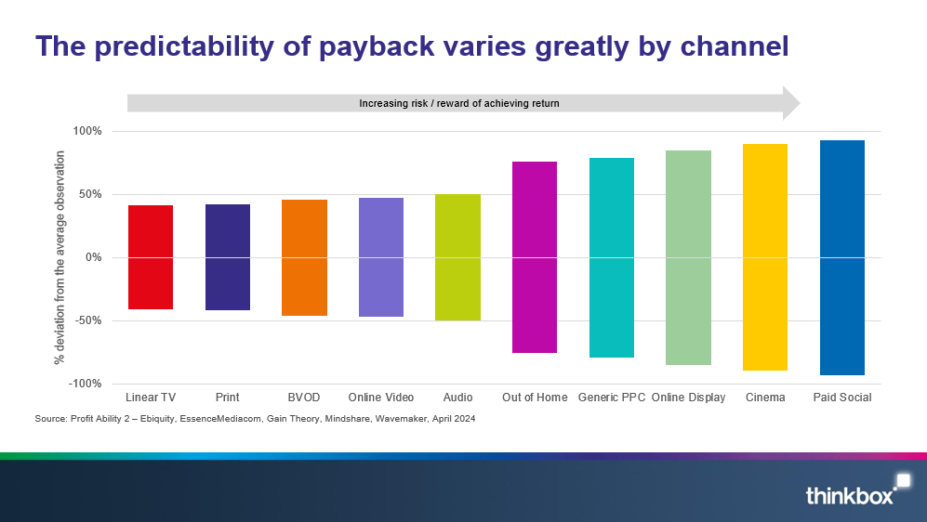
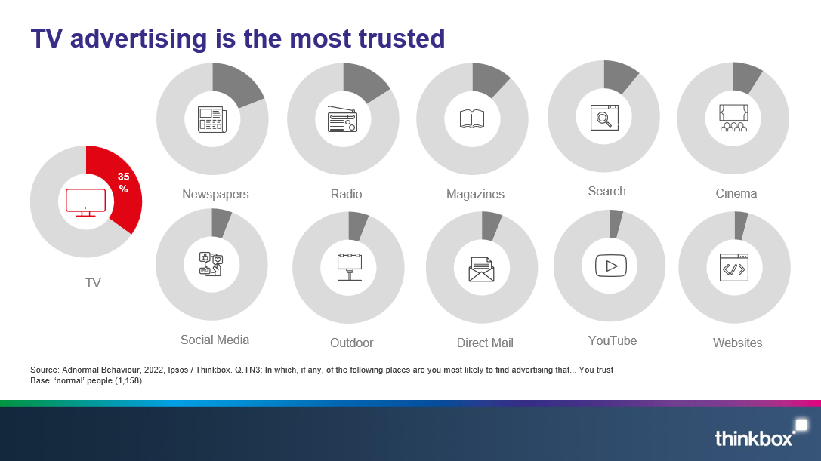
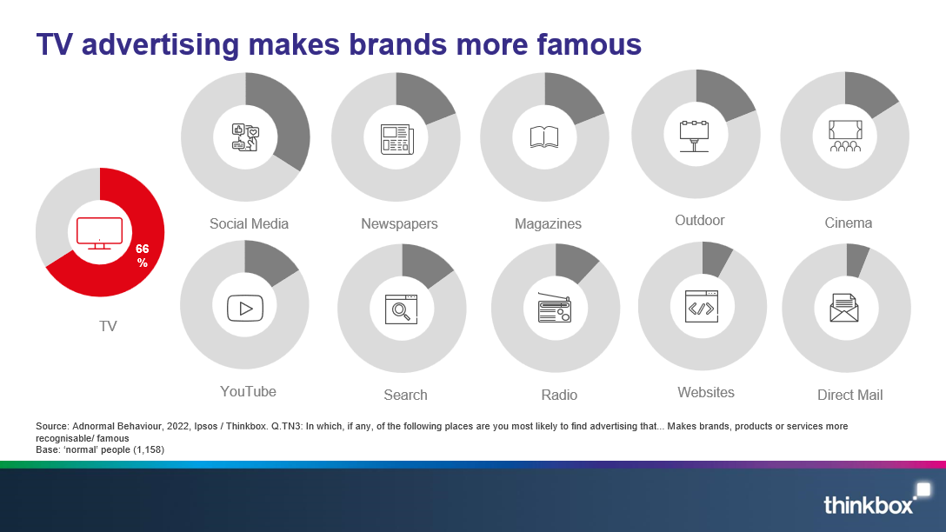
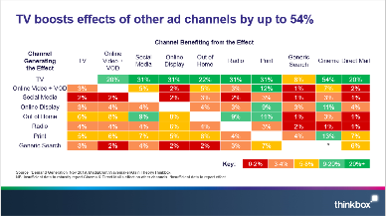
What does TV advertising offer ecommerce businesses?
Scale & broad reach
Delivers high total volume of profit
Low short-term risk
Highly trusted
Makes brand more famous
Boost effects of other advertising
Notes:
TV is a powerful tool for ecommerce businesses. It offers scale, powerful short-term sales effects, it’s a low risk advertising channel, highly trusted, makes brands more famous, and boosts the effect of all other advertising.

Slide 9
Commercial TV delivers scale
ADULTS REACHED PER WEEK
(MILLIONS)
Newsbrands
Social Media
Commercial TV
Commercial Radio
YouTube
TikTok
AVERAGE HOURS PER WEEK
Source: IPA TouchPoints 2024 SuperHub (W2 2023 + W1 2024), Fieldwork Dates: 20th Sep 2023 – 3rd Dec 2023, 16th Jan 2024 – 12th Apr 2024) Base: adults 15+. Newspaper/magazine/TV figures include online/app consumption.
Notes:
As well as reaching into every corner of the country, people also spend a lot of time with TV. It is the most popular medium.

Slide 10
TV delivers the highest total volume of profit
Full profit volume & profit ROI
Bubble size represents % of full profit volume
Overall Full Profit ROI: £4.11
Profit ROI (£)
% of Spend
Source: Profit Ability 2, April 2024 – Short term benchmarks: Ebiquity, EssenceMediacom, Gain Theory, Mindshare, Wavemaker UK.
Long Term Multipliers: EssenceMediacom, Gain Theory, Mindshare, Wavemaker UK
Notes:
TV delivers the highest total volume of profit
Findings from our most recent study, ‘Profit Ability 2: the new business case for advertising’, which shows that TV (Linear and BVOD) accounts for 54.7% of advertising-driven profit (within 0-24 months) but only accounts for 43.6% of total advertising investment.
The study brings together the vast econometric databases of client data from Ebiquity, EssenceMediacom, Gain Theory, Mindshare and Wavemaker UK, covering £1.8 billion of media investment in the UK across 10 media, 141 brands, and 14 product sectors. It is an update of Ebiquity and Gain Theory’s Profit Ability study from 2017 and offers the first post-Covid/Brexit view of advertising’s business performance.
Profit Ability 2 analysed the profit generated by advertising at different stages as its effects build over time. It examined four speeds of payback: immediate payback (within one week), short-term payback (up to 13 weeks), sustained payback (week 14 through to 24 months) and full payback (total payback over a 24-month period).
It found that, on average, a pound invested in advertising returns £4.11 in profit (when sustained effects are included). Crucially, all the sectors analysed in the study generated a positive payback from advertising when sustained effects are accounted for.
This chart shows how TV accounts for 54.7% of advertising’s full payback but only accounts for 43.6% of total advertising investment. Within this, Linear TV accounts for 46.6% of full payback and BVOD accounts for 8.2%.
For more advertising effectiveness insight, read: https://www.thinkbox.tv/research/thinkbox-research/profit-ability-2-the-new-business-case-for-advertising

Slide 11
The predictability of payback varies greatly by channel
Increasing risk / reward of achieving return
Source: Profit Ability 2 – Ebiquity, EssenceMediacom, Gain Theory, Mindshare, Wavemaker, April 2024​
Notes:
Findings from ‘Profit Ability 2: the new business case for advertising’, shows that the predictability of payback varies greatly by channel. Profit Ability 2 was conducted by Ebiquity, EssenceMediacom, Gain Theory, Mindshare, and Wavemaker UK. It’s a meta-analysis of econometric studies from 141 brands covering £1.8 billion of media spend across 10 media channels and 14 business sectors (where 7 are reported individually).
The charts presents the percentage standard deviation (the standard deviation divided by the mean, expressed as a percentage). The wider the bar, the more variable around the average ROI a channel is. Channels like Linear TV, Print and BVOD have low variation and therefore represent a lower risk investment.
It’s worth noting that high variability works both ways: although it involves greater risk, there is the possibility of achieving a much higher than average ROI (as well as a much lower one).

Slide 12



TV advertising is the most trusted
Newspapers
Radio
Magazines
Search
Cinema
TV
Social Media
Outdoor
Direct Mail
YouTube
Websites
Source: Adnormal Behaviour, 2022, Ipsos / Thinkbox. Q.TN3: In which, if any, of the following places are you most likely to find advertising that...you trust
Base: ‘normal’ people (1,158)
Notes:
Thinkbox’s ‘Adnormal Behaviour’ work showed that TV ads were the most trusted form of advertising.
For more information on this study, see the full write up on the Thinkbox website:
https://www.thinkbox.tv/research/thinkbox-research/adnormal-behaviour/

Slide 13
TV advertising makes brands more famous
Social Media
Newspapers
Magazines
Outdoor
Cinema
TV
YouTube
Search
Radio
Websites
Direct Mail
Source: Adnormal Behaviour, 2022, Ipsos / Thinkbox. Q.TN3: In which, if any, of the following places are you most likely to find advertising that... Makes brands, products or services more recognisable/ famous
Base: ‘normal’ people (1,158)
Notes:
Thinkbox’s ‘Adnormal Behaviour’ work showed that TV ads make brands more famous
For more information on this study, see the full write up on the Thinkbox website:
https://www.thinkbox.tv/research/thinkbox-research/adnormal-behaviour/

Slide 14
TV boosts effects of other ad channels by up to 54%
 | Channel Benefiting from the Effect
Channel Generating the Effect | TV | Online Video + VOD | Social Media | Online Display | Out of Home | Radio | Print | Generic Search | Cinema | Direct Mail
TV |  | 20% | 31% | 31% | 22% | 31% | 31% | 8% | 54% | 20%
Online Video + VOD | 3% |  | 5% | 2% | 5% | 3% | 12% | 1% | 7% | 2%
Social Media | 2% | 2% |  | 2% | 3% | 2% | 3% | 1% | 3% | 1%
Online Display | 3% | 4% | 4% |  | 4% | 3% | 9% | 3% | 11% | 4%
Out of Home | 6% | 8% | 9% | 8% |  | 9% | 11% | 1% | 3% | 1%
Radio | 4% | 4% | 4% | 6% | 4% |  | 3% | 2% | 1% | 1%
Print | 5% | 6% | 7% | 5% | 6% | 4% |  | 4% | 13% | 7%
Generic Search | 3% | 2% | 4% | 2% | 2% | 3% | 7% |  | * | 6%
Key: | 0-2% | 3-4% | 5-8% | 9-20% | 20%+
Source: ‘Demand Generation’ Nov 2019, MediaCom/Wavemaker/Gain Theory/Thinkbox
NB: Insufficient data to robustly report Cinema & Direct Mail’s effect on other channels. *insufficient data to report effect
Notes:
‘Demand Generation’, commissioned by Thinkbox and conducted WPP agencies Mediacom, Wavemaker and Gain Theory, looked at how one ad channel boosts the efficiency of another ad channel. Most channels boost the efficiency of others, but the scale and consistency of the effect differs significantly.
This chart outlines this multiplier effect between ad channels and the effects each channel can receive. The Y axis indicates the active channel generating the effect, with the X axis relating to the channel benefiting from that effect.
We can see that when TV is active, the effectiveness of Cinema is bolstered up by 54% - more than any other channel. This makes sense as Cinema has a relatively small reach but a high impact, and with TV copy tending to be a cutdown version of what Cinema shows, it is extending its reach.
TV stands out as having the biggest and most consistent effect on other channels. This isn’t a coincidence. On average brands are spending 45% of their advertising budgets on TV, so it is bound to have a bigger effect.
For more information on this study please see:
https://www.thinkbox.tv/research/thinkbox-research/demand-generation/

Slide 15
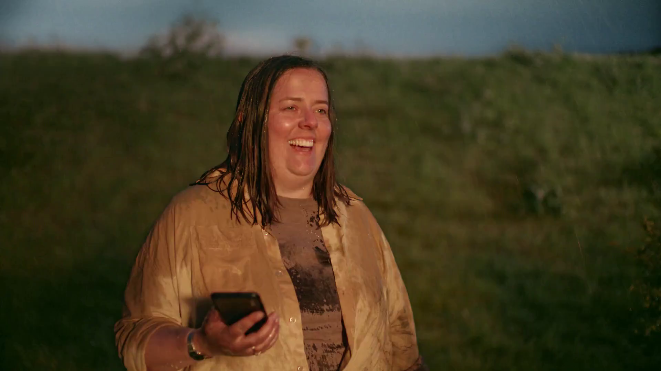
Case studies
Audible - Breakdwon

Slide 16

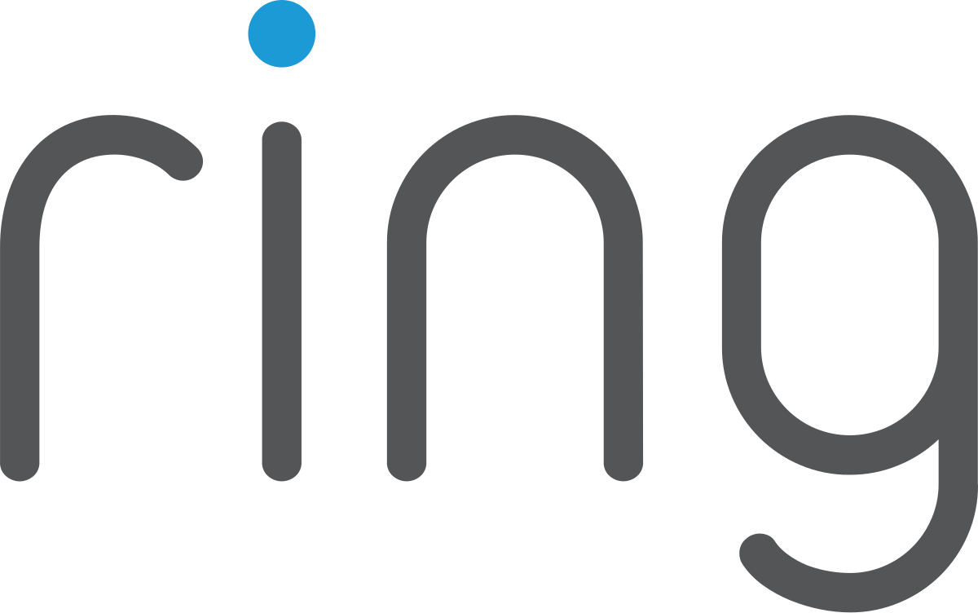
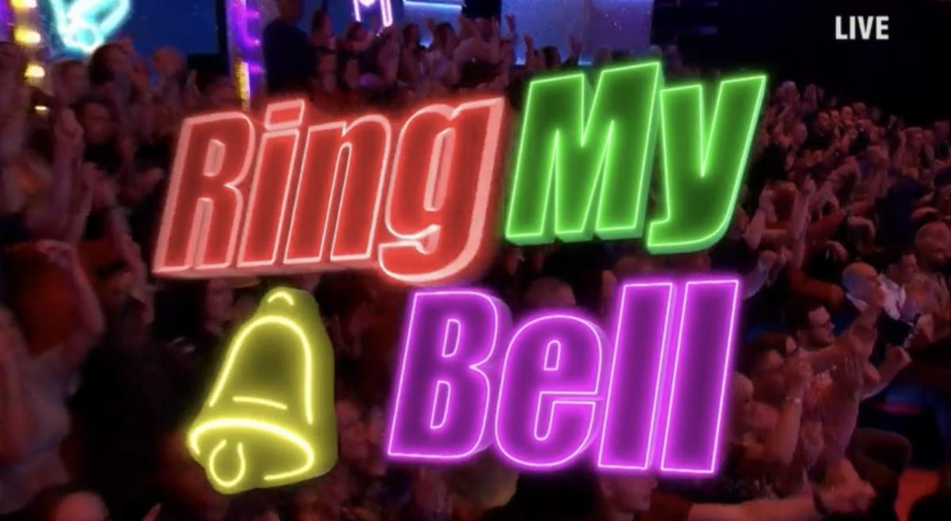
Ring.Com: Ringing the bell of mass awareness.
The Challenge:
Ring were being outspent 2:1 by competitors and were at risk of losing their position as number 1 in the home security sector. They needed to increase awareness against a budget reduction of 45% year on year.
The Solution:
Created a game show in Ant & Dec’s Saturday Night Takeaway called ‘Ring My Bell’ that used a real-life Ring doorbell feed.
The Results:
Activity reached 17 million viewers on linear, 23 million on social media with 78% positive sentiment. 50% increase in attention vs start of campaign, 150% increase in buzz and delivered an ROI of 10:1.
Notes:
The Challenge
Ring were being outspent 2:1 by competitors and were at risk of losing their position as number 1 in the home security sector. They needed to increase awareness against a budget reduction of 45% year on year.
The TV Solution
Created a game show in Ant & Dec’s Saturday Night Takeaway called ‘Ring My Bell’ that used a real-life Ring doorbell feed.
The Results
Activity reached 17 million viewers on linear, 23 million on social media with 78% positive sentiment. 50% increase in attention vs start of campaign, 150% increase in buzz and delivered an ROI of 10:1.
Read more here: https://www.thinkbox.tv/case-studies/ring-com-ringing-the-bell-of-mass-awareness

Slide 17


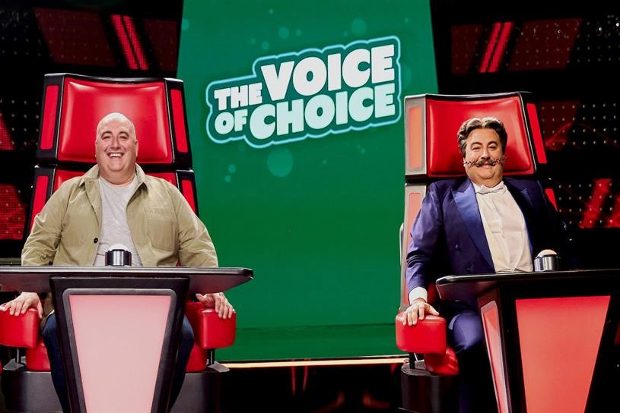
Go Compare and The Voice of Choice
Challenge
GoCompare were rebranding to Go.Compare and needed to communicate this subtle but important difference to a wide audience
Solution
They sponsored The Voice on ITV
The Voice of Choice was created – a parody of the show that told the story of finding Dot through sequential and entertaining idents
Results
12% increase in consideration for Go.Compare
Reached 16m people, driving awareness
Notes:
The Challenge
GoCompare were rebranding to Go.Compare and needed to communicate this subtle but important difference to a wide audience
The TV Solution
They sponsored The Voice on ITV
The Voice of Choice was created – a parody of the show that told the story of finding Dot through sequential and entertaining idents
Results
12% increase in consideration for Go.Compare
Reached 16m people, driving awareness
Read more here: https://www.thinkbox.tv/case-studies/go-compare

Slide 18


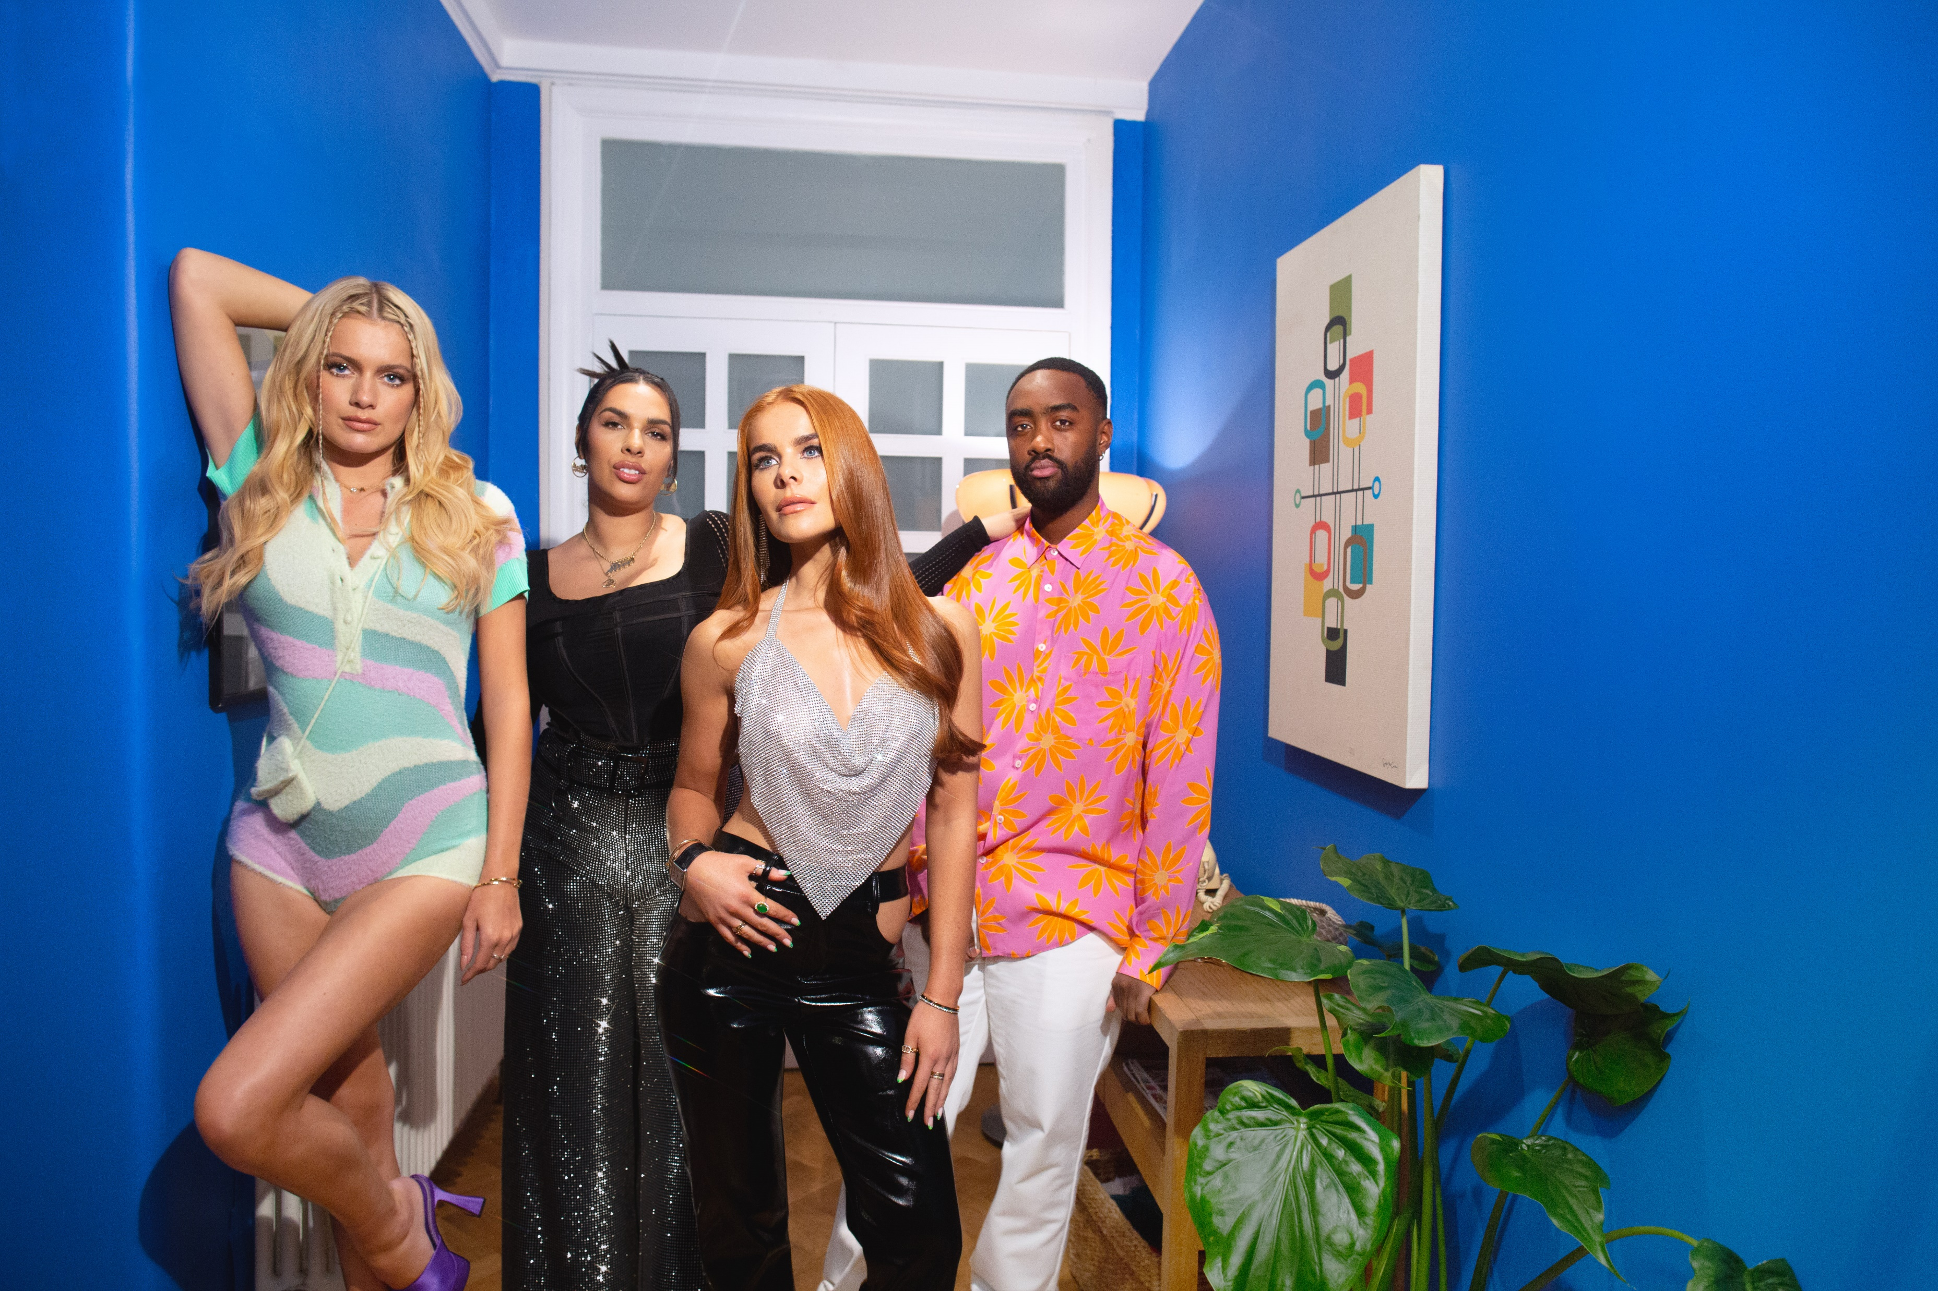
eBay: Making the pre-loved Loved with a TV Partnership
The Challenge:
eBay wanted to drive mass appeal for second-hand fashion with 16-34-year-olds against a backdrop where fast fashion was still king.
The Solution:
A partnership with Love Island that would reframe second-hand clothing as ‘pre-loved’.
The Results:
1,700 positive pieces of press coverage which resulted in over 14 billion impressions. A 935% increase in mentions of ‘pre-loved fashion’ recorded across all online platforms. 7,000% increase in ‘pre-loved fashion’ searches on eBay and 756% increase in searches on Google for ‘eBay pre-loved clothes’.
Notes:
The Challenge:
eBay wanted to drive mass appeal for second-hand fashion with 16-34-year-olds against a backdrop where fast fashion was still king.
The Solution:
A partnership with Love Island that would reframe second-hand clothing as ‘pre-loved’.
The Results:
1,700 positive pieces of press coverage which resulted in over 14 billion impressions. A 935% increase in mentions of ‘pre-loved fashion’ recorded across all online platforms. 7,000% increase in ‘pre-loved fashion’ searches on eBay and 756% increase in searches on Google for ‘eBay pre-loved clothes’.
Read more here: https://www.thinkbox.tv/case-studies/ebay-making-the-pre-loved-loved-with-a-tv-partnership

Slide 19

TV advertising drove uplifts in search for Stoov
R^{2=0.84}
Source: Barb/Google Trends, Jan 2023 – Dec 2023

Slide 20
TV advertising drove uplifts in search for Natures Menu
R^{2=0.78}
Source: Barb/Google Trends, Jan 2023 – Dec 2023

Slide 21
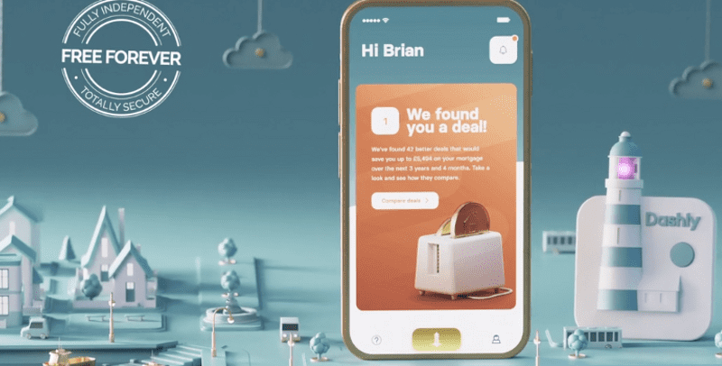
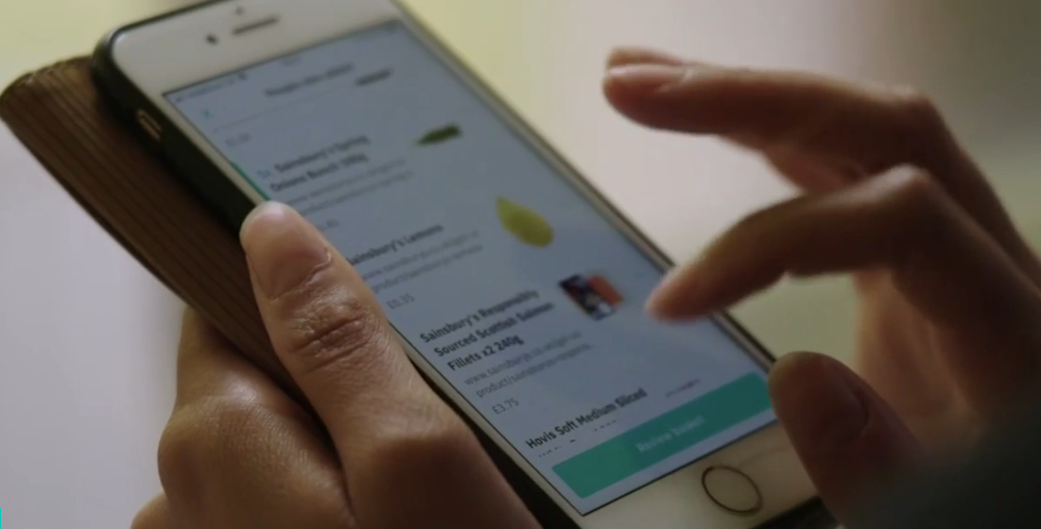

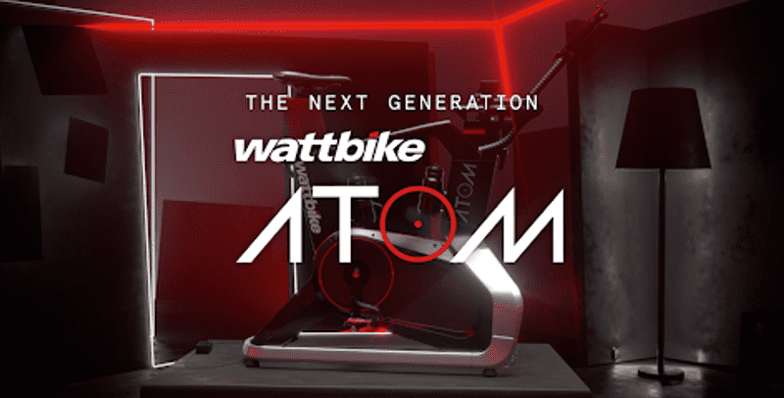
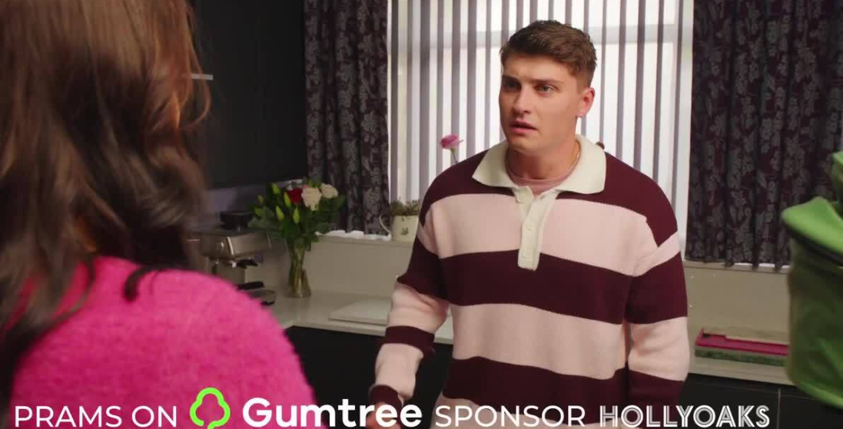

Broadcaster case studies
ITV & Dashly
Channel 4 & Deliveroo
Sky Media & Hotter
ITV & Wattbike
Channel 4 & Gumtree
Sky Adsmart & Not on the High Street

