Slide 1
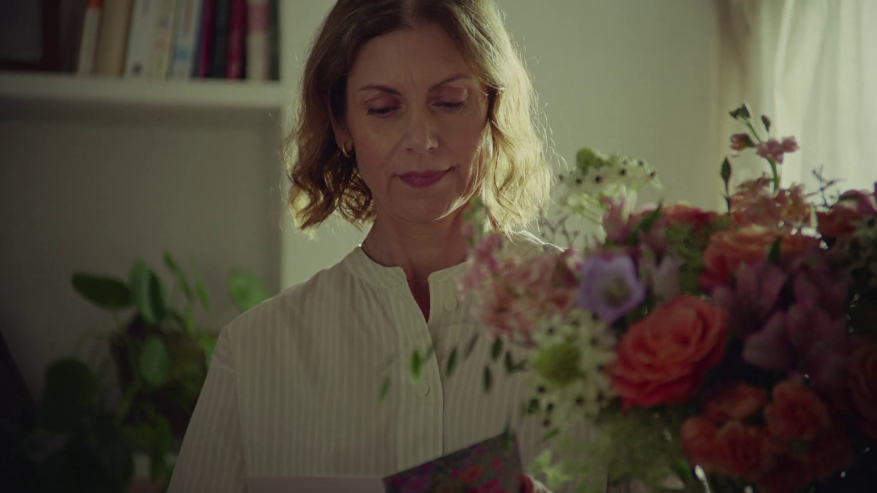

Ecommerce nickable charts
Bloom & Wild - It’s not an empty nest. It’s a new beginning

Slide 2
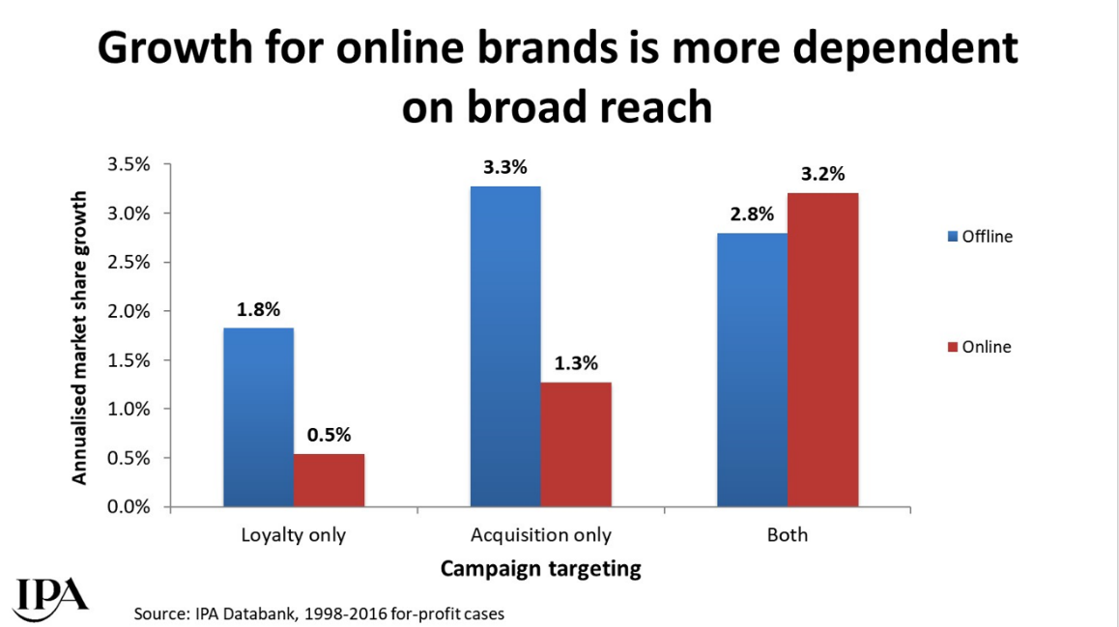
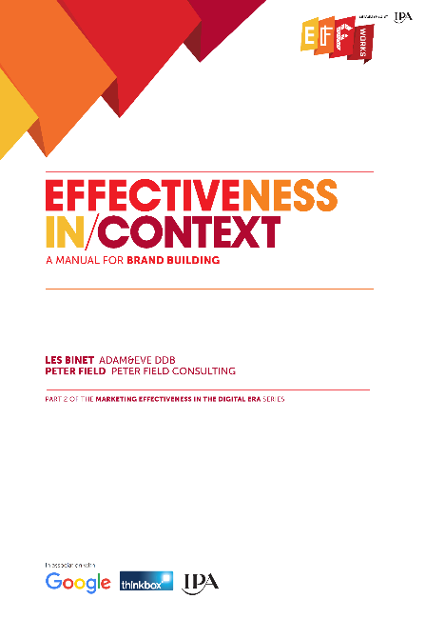
In the busy online world, reaching new customers is vital
Source: Effectiveness in Context, 2018, Binet / Field / IPA
Notes:
The IPA study ‘Effectiveness in Context’, authored by Les Binet & Peter Field, proved just how important reach is to online brands.
One of the potential advantages of online brands is their closer knowledge of their customers and contact with them. This is likely to make loyalty marketing easier and cheaper to undertake, but IPA Databank data suggests that it doesn’t make it any more worthwhile. In fact, compared to offline brands, growth for online brands is even more dependent on broad targeting beyond existing customers.
This chart shows how online brands who deployed an acquisition strategy to attract new customers alongside a customer loyalty strategy reaped the benefits by driving significantly higher market share growth.
In the crowded online world, reaching out to new customers is vital.
For more information on this study please see:
https://www.thinkbox.tv/research/thinkbox-research/effectiveness-in-context-free-download/

Slide 3
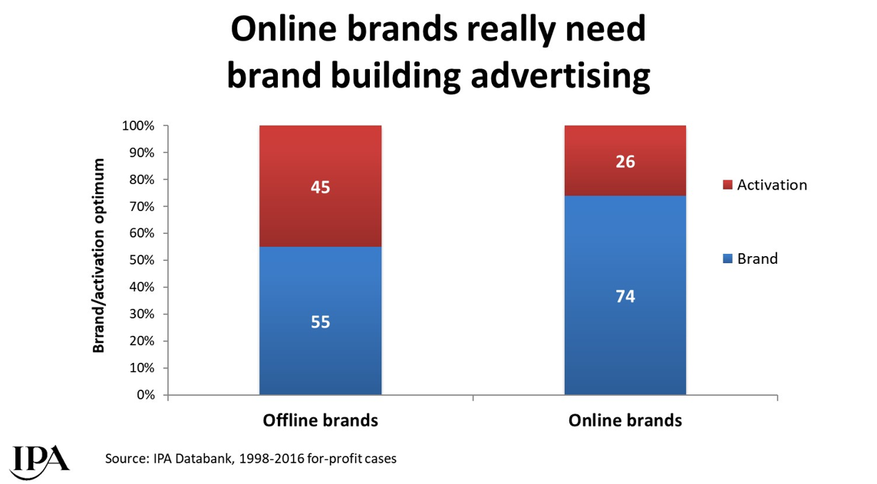

Online brands require more brand advertising to drive growth
Source: Effectiveness in Context, 2018, Binet / Field / IPA
Notes:
The IPA study ‘Effectiveness in Context’, authored by Les Binet & Peter Field, demonstrated how important brand advertising is to online advertisers.
The online world is a busy place for brands and the nature of consideration in online categories is more likely to be rational than emotional (whereas the reverse is true in offline categories), so brand building and long-term effectiveness are likely to be more difficult to achieve. This has implications for balancing budget between brand and activation for online brands: the optimum balance of brand building to sales activation for online brands is rather higher than for offline brands.
For more information on this study please see:
https://www.thinkbox.tv/research/thinkbox-research/effectiveness-in-context-free-download/

Slide 4

If you are in an online category, you desperately need to reach broadly. You need to reach everyone in the category, and you need to reach them early and prime them…
Otherwise it’s just a bidding war at that last moment of decision. And if you don’t have a powerful brand it’s going to get expensive and it’s going to get ineffective.
The online world is no place for weak brands
“
“
Peter Field, October 2018
Notes:
Peter Field, Thinkbox’s ‘Perfectiveness’ event, October 2018.
https://www.thinkbox.tv/news-and-opinion/events/perfectiveness/

Slide 5
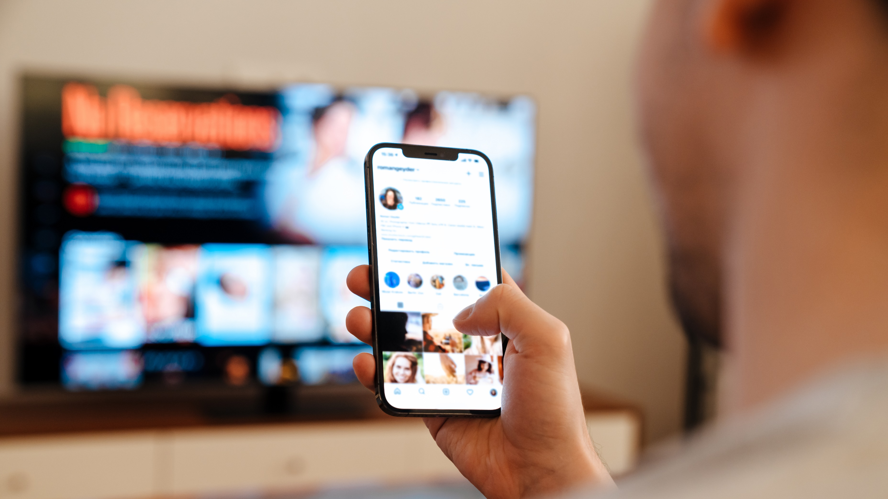
Multi-screening brings the high-street to the living room
32 mins
spent using internet while watching TV per day.
This is likely due to the ease and convenience of searching simultaneously via a mobile device.
Source: IPA TouchPoints 2025 SuperHub (W2 2024 + W1 2025), Fieldwork Dates: 3rd Sep 2024 – 15th Nov 2024, 14th Jan 2025 – 24th Mar 2025. Base: adults 15+.

Slide 6
Online born business sector is the largest investor in TV
Online brands spend = £774 million
Millions
Source: Nielsen Ad Intel, 2025, Thinkbox-created category of online-born businesses (YoY category % change).

Slide 7
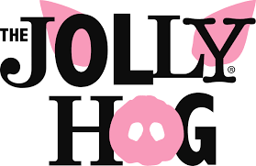
























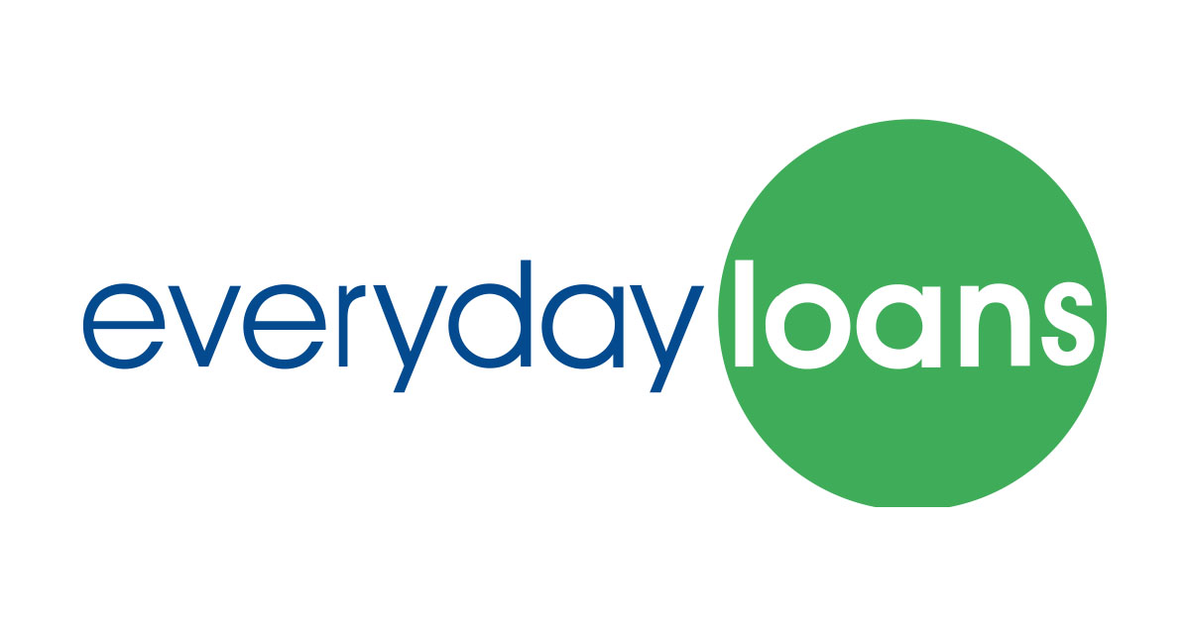


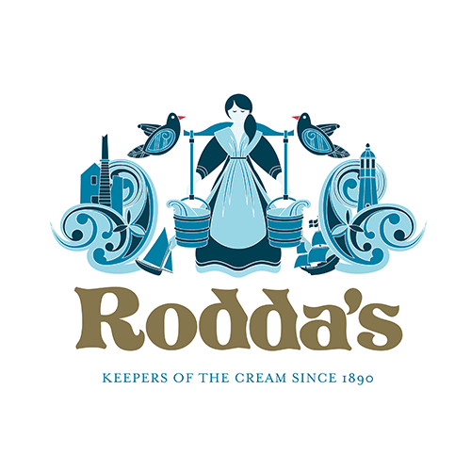






















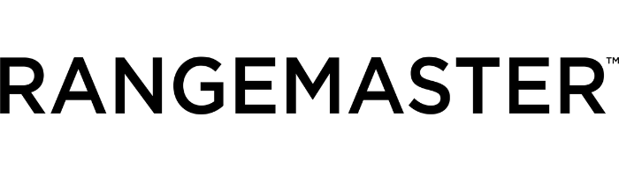







984 advertisers used TV for the first time in 2025
Source: Nielsen Ad Intel / Sky – New to TV advertisers classed as those not advertising on TV 5 years prior (2020-2024) on Linear TV and Sky AdSmart
Notes:
In 2025, there were 984 new to TV advertisers, many of whom were ecommerce business looking to supercharge their growth through TV.

Slide 8
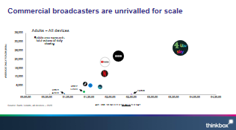
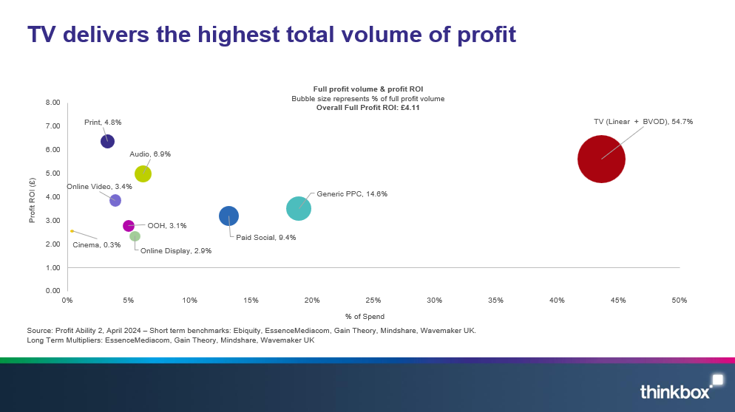
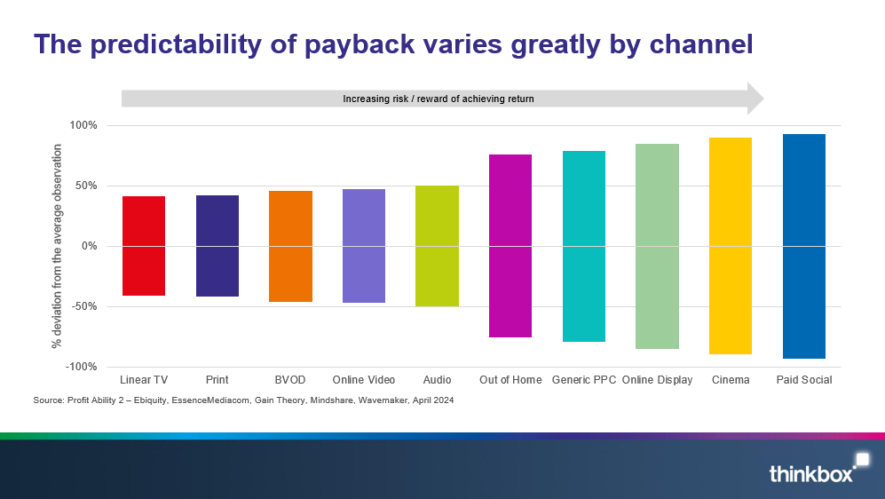
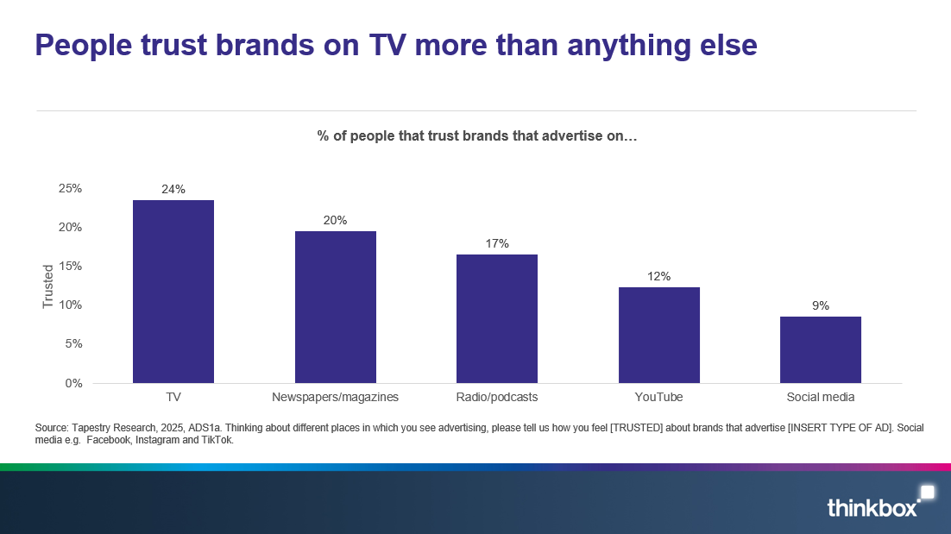
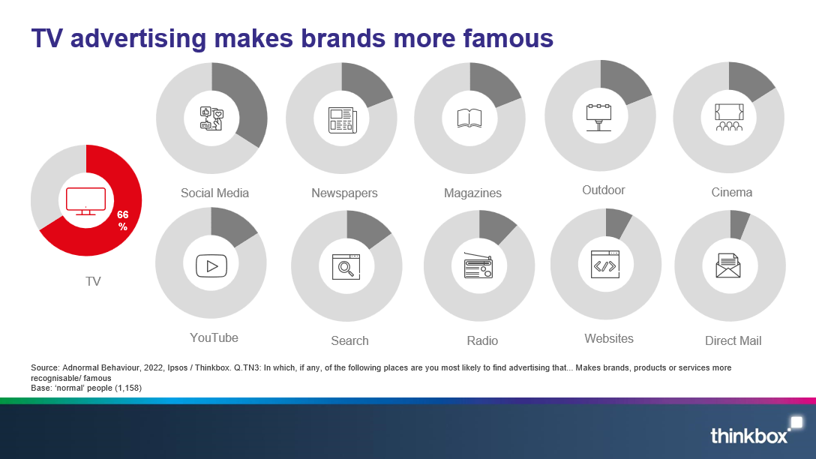
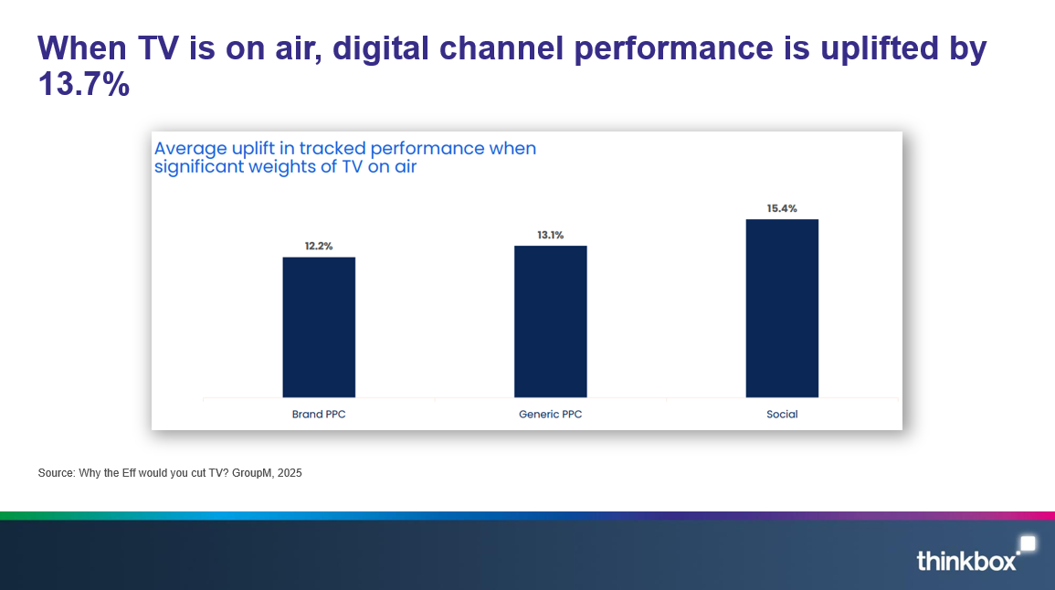
What does TV advertising offer ecommerce businesses?
Scale & broad reach
Delivers high total volume of profit
Low short-term risk
Highly trusted
Makes brand more famous
Boost effects of other advertising
Notes:
TV is a powerful tool for ecommerce businesses. It offers scale, powerful short-term sales effects, it’s a low risk advertising channel, highly trusted, makes brands more famous, and boosts the effect of all other advertising.

Slide 9
Commercial broadcasters are unrivalled for scale
Adults – All devices
Bubble area represents total volume of daily viewing
AVERAGE DAILY REACH (000s)
Other
SVOD
Other AVOD
Twitch
AVE TIME VIEWED PER VIEWER PER DAY
Source: Barb / Adults, all devices – 2025
Notes:
This chart breaks down viewing to the various platforms in terms of the average number of people watching per day (for at least 3 minutes) compared with the average time spent watching per viewer (i.e. only counting those who watched on that day).
Analysis across 2025 shows that the commercial broadcasters (linear and on demand) collectively reach over 26 million viewers every day, with each of those viewers watching for an average of 3hrs, 40 mins a day. The combined portfolio of BBC channels (linear and on demand) attracts the second largest volume of viewing, with 22 million daily reach and an average view time of 2 hours, 12 mins a day. YouTube is next, with a daily reach of 18 million and a view time of 1hr 53 mins (Barb only measure in-home viewing, we estimate that YouTube would be larger in viewing time if out of home viewing was included).
SVOD services such as Netflix has a daily reach of 12 million people and a view time of 1hr 52 mins.

Slide 10
TV delivers the highest total volume of profit
Full profit volume & profit ROI
Bubble size represents % of full profit volume
Overall Full Profit ROI: £4.11
Profit ROI (£)
% of Spend
Source: Profit Ability 2, April 2024 – Short term benchmarks: Ebiquity, EssenceMediacom, Gain Theory, Mindshare, Wavemaker UK.
Long Term Multipliers: EssenceMediacom, Gain Theory, Mindshare, Wavemaker UK
Notes:
TV delivers the highest total volume of profit
Findings from our most recent study, ‘Profit Ability 2: the new business case for advertising’, which shows that TV (Linear and BVOD) accounts for 54.7% of advertising-driven profit (within 0-24 months) but only accounts for 43.6% of total advertising investment.
The study brings together the vast econometric databases of client data from Ebiquity, EssenceMediacom, Gain Theory, Mindshare and Wavemaker UK, covering £1.8 billion of media investment in the UK across 10 media, 141 brands, and 14 product sectors. It is an update of Ebiquity and Gain Theory’s Profit Ability study from 2017 and offers the first post-Covid/Brexit view of advertising’s business performance.
Profit Ability 2 analysed the profit generated by advertising at different stages as its effects build over time. It examined four speeds of payback: immediate payback (within one week), short-term payback (up to 13 weeks), sustained payback (week 14 through to 24 months) and full payback (total payback over a 24-month period).
It found that, on average, a pound invested in advertising returns £4.11 in profit (when sustained effects are included). Crucially, all the sectors analysed in the study generated a positive payback from advertising when sustained effects are accounted for.
This chart shows how TV accounts for 54.7% of advertising’s full payback but only accounts for 43.6% of total advertising investment. Within this, Linear TV accounts for 46.6% of full payback and BVOD accounts for 8.2%.
For more advertising effectiveness insight, read: https://www.thinkbox.tv/research/thinkbox-research/profit-ability-2-the-new-business-case-for-advertising

Slide 11
The predictability of payback varies greatly by channel
Increasing risk / reward of achieving return
Source: Profit Ability 2 – Ebiquity, EssenceMediacom, Gain Theory, Mindshare, Wavemaker, April 2024​
Notes:
Findings from ‘Profit Ability 2: the new business case for advertising’, shows that the predictability of payback varies greatly by channel. Profit Ability 2 was conducted by Ebiquity, EssenceMediacom, Gain Theory, Mindshare, and Wavemaker UK. It’s a meta-analysis of econometric studies from 141 brands covering £1.8 billion of media spend across 10 media channels and 14 business sectors (where 7 are reported individually).
The charts presents the percentage standard deviation (the standard deviation divided by the mean, expressed as a percentage). The wider the bar, the more variable around the average ROI a channel is. Channels like Linear TV, Print and BVOD have low variation and therefore represent a lower risk investment.
It’s worth noting that high variability works both ways: although it involves greater risk, there is the possibility of achieving a much higher than average ROI (as well as a much lower one).

Slide 12
People trust brands on TV more than anything else
% of people that trust brands that advertise on…
Source: Tapestry Research, 2025, ADS1a. Thinking about different places in which you see advertising, please tell us how you feel [TRUSTED] about brands that advertise [INSERT TYPE OF AD]. Social media e.g. Facebook, Instagram and TikTok.
Notes:
Working with Tapestry Research, we asked respondents about the different places that they see advertising and how they felt about brands that advertised on these channels.
Analysis reveals that TV emerges as the strongest at 24%, with newspapers/magazines coming in second at 20%. Twice as many people trust brands advertised on TV than YouTube (12%).

Slide 13



TV advertising makes brands more famous
Social Media
Newspapers
Magazines
Outdoor
Cinema
TV
YouTube
Search
Radio
Websites
Direct Mail
Source: Adnormal Behaviour, 2022, Ipsos / Thinkbox. Q.TN3: In which, if any, of the following places are you most likely to find advertising that... Makes brands, products or services more recognisable/ famous
Base: ‘normal’ people (1,158)
Notes:
Thinkbox’s ‘Adnormal Behaviour’ work showed that TV ads make brands more famous
For more information on this study, see the full write up on the Thinkbox website:
https://www.thinkbox.tv/research/thinkbox-research/adnormal-behaviour/

Slide 14
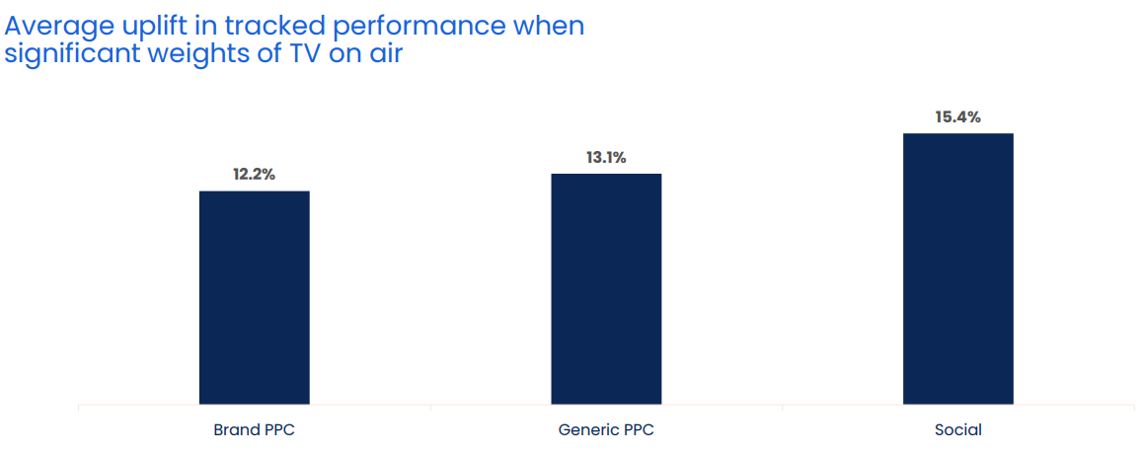
When TV is on air, digital channel performance is uplifted by 13.7%
Source: Why the Eff would you cut TV? GroupM, 2025
Notes:
When TV is on air, digital channel performance is uplifted by 13.7%
One of TV advertising’s most underestimated strengths is its halo effect — the way it boosts the performance of other media channels. While often misattributed, this cross-channel impact is both real and measurable.
According to GroupM analysis in ‘Why the Eff would you cut TV?’ presented at Thinkbox Trends in TV 2025, digital response channels see a clear uplift when TV is live. The study analysed the performance of TV, brand PPC, generic PPC and Social across 14 brands, which included 1,489 weeks, and £283m total performance media spend.
Analysis found that on average, the performance of lower-funnel response channels improves by 13.7% when TV is part of the media mix.
More specifically, brand PPC, generic PPC and social saw an average uplift of 12.2%, 13.1% and 15.4% respectively in tracked performance when significant weights of TV were on air. This shows how TV makes digital channels work harder.

Slide 15
TV is the battery that charges other media
% average reduction in Purchase Intent over 8 weeks if TV is NOT included alongside…
Other Online (search, display) | Audio (radio & streaming) | Social Media | Online Video | Print (physical) | OOH
Source: Staying Power: The longevity of advertising, Tapestry Research, 2025.
Purchase Intent (‘definitely consider’): All brands, among those exposed (nat rep, 18-75). Online Video is mostly YouTube.
Notes:
This chart from ‘Staying Power: the longevity of advertising’, explores how advertising continues to drive impact long after campaigns end.
Based on data from almost 20,000 UK adults aged 18–75, the research tracked post-campaign effects of advertising by measuring purchase intent over eight weeks from nine major brands — uncovering what really helps ads stay impactful over time.
Analysis revealed that campaigns using four or more media channels are twice as likely to make people definitely consider buying a product compared with single-channel campaigns (40% vs. 20%). And TV plays a crucial role in that mix as the battery that charges other media. When TV is included, it boosts the impact of other media on definite purchase intent by an average of 26%.
But when TV is excluded, the effect drops sharply across the board, with Print and OOH seeing the largest declines in definite purchase intent (-28%), whilst Other Online (mainly search and display) experienced the least (-9%).
For more insight on the longevity of advertising, watch Staying Power on demand: https://www.thinkbox.tv/news-and-opinion/events/staying-power-the-longevity-of-av-advertising
Source: A5 [Definitely consider]. How likely (if at all) would you be to consider [SELECTED BRAND] the next time you come to [CATEGORY OCCASION]?
Base: 19,251 respondents aged 18-75; 19,251 Wave 1, 5,569 Wave 2, 6,000 Wave 3, 3,595 Wave 4

Slide 16
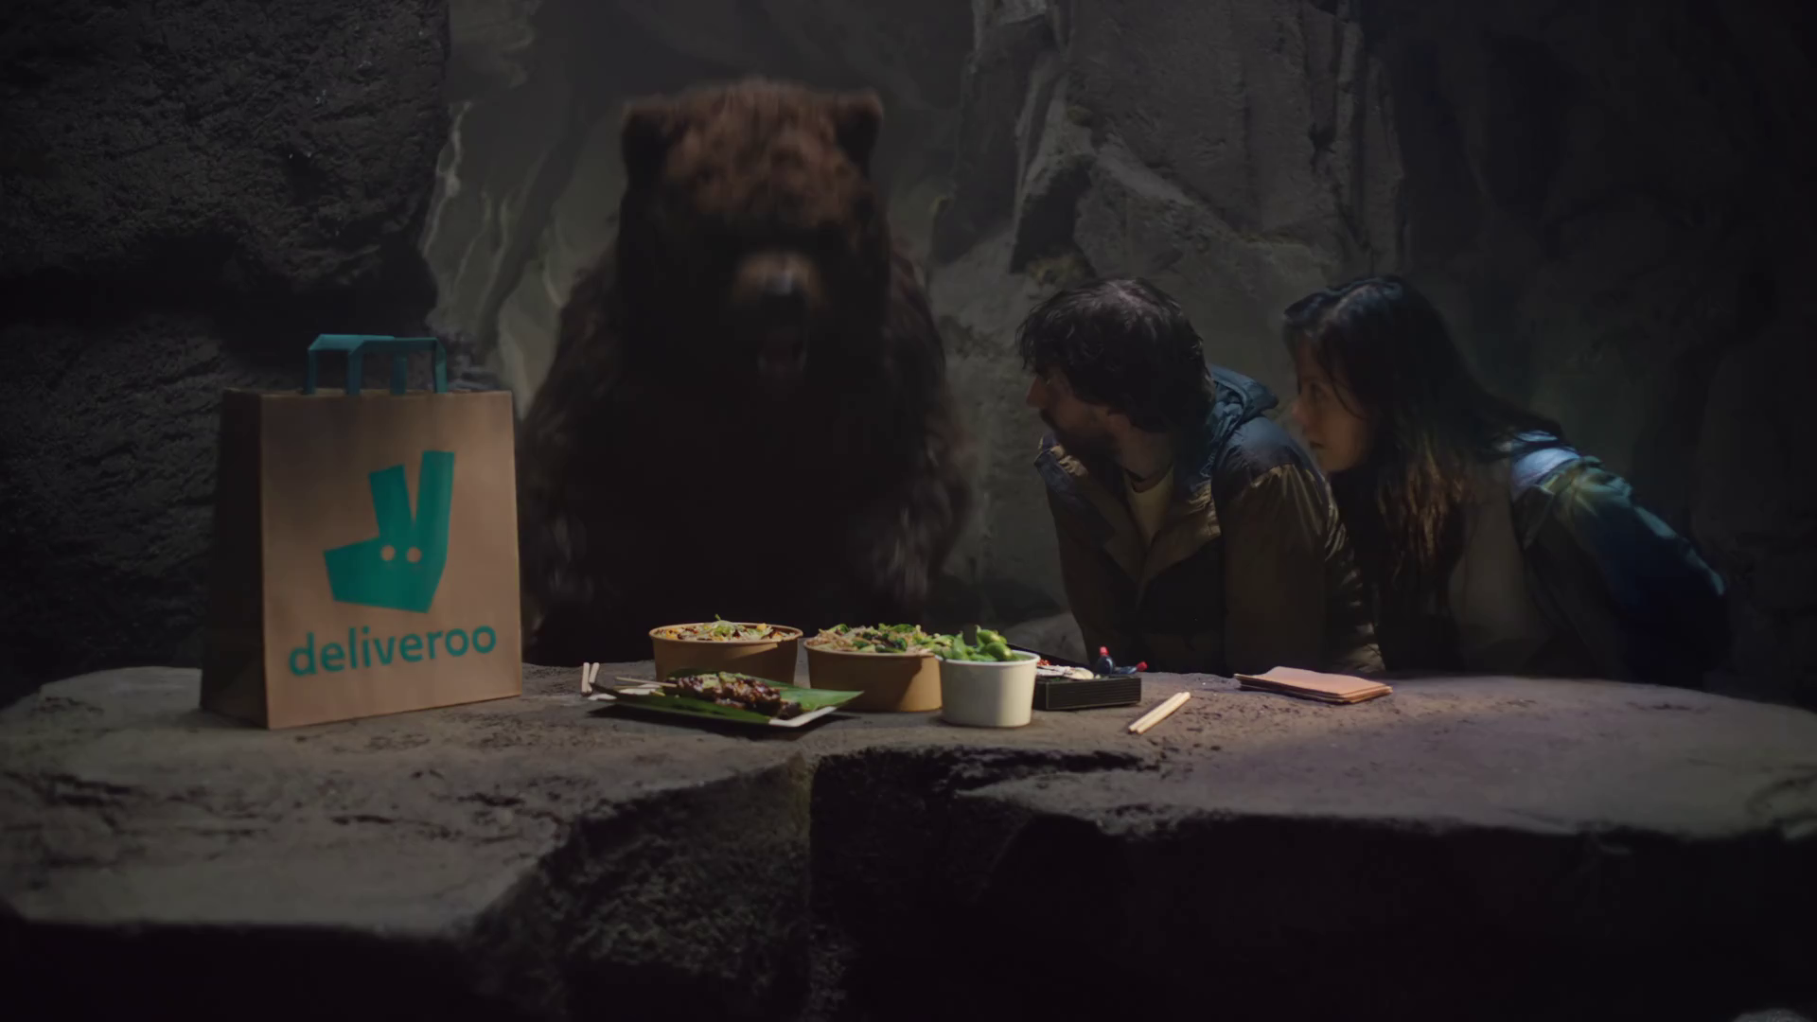
Case studies
Deliveroo - Unexpected Guests

Slide 17


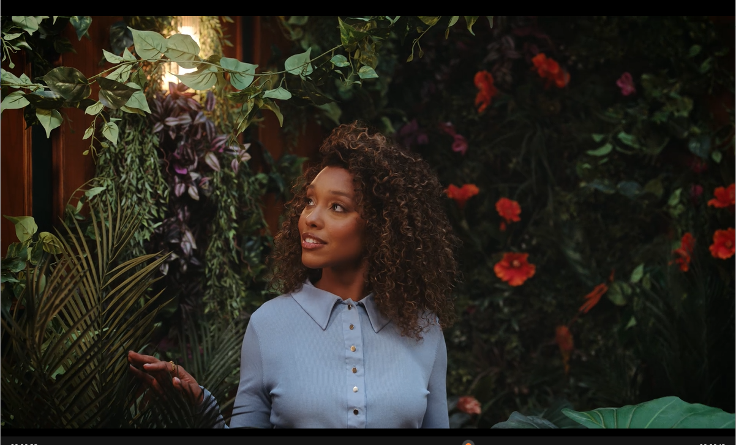
Flora & Curl: TV for the first time with Channel 4 & Lloyds’ ‘Black in Business’
The Challenge:
Launched in 2017, Flora & Curl provides plant-based hair care to those with textured hair. They were looking to grow brand awareness, increase site visits and ultimately sales in the long term.
The Solution:
Entered Channel 4 and Lloyds’ ‘Black in Business’ Initiative to launch on TV across the Channel 4 ecosystem.
The Results:
The campaign saw an increase in recognition with a core audience of 25–44-year-old women with textured hair and delivered improvements in key brand statements above those of Channel 4’s micro brand norms.
Notes:
The Challenge
Flora & Curl are a plant-based hair care brand with a focus on those with textured hair, either wavy, curly, or coily. Founded in 2017 by Rose Ovensehi, who herself was dealing with dry and brittle hair. After taking a break from chemical relaxers, Rose started mixing in her kitchen and Flora & Curl was born.
With a focus on sustainability, the brand had gone from strength to strength but were keen to grow beyond their loyal fan base. They wanted to introduce the brand to as many people as possible as fast as possible, while growing site visits and ultimately sales in the long run.
The TV Solution
With TV feeling like a distant dream, Flora & Curl had typically focused on social campaigns targeting those who were their exact demographic. However, to accelerate their brand, they discovered something that would become a silver bullet for their growth ambitions.
Being a Black-owned business, Flora & Curl had already seen the success that similar brands had had with Channel 4 and Lloyds’ Black in Business initiative.
The scheme, now in its second year, was designed to highlight the struggles that Black-owned businesses face when it comes to funding, with research highlighting that 56% of Black businesses only receive funding once the business is already successful. The research also highlighted that just 0.24% of venture capital goes to black businesses.
The initiative offers black entrepreneurs £150,000 of free airtime across Channel 4, alongside 6 months of business mentoring provided by Channel 4 and Lloyds.
After a process attracting over 200 applicants, Flora & Curl successfully pitched to win the opportunity to use TV to drive awareness, thanks to Channel 4’s ability to reach people en masse at the right time with the right messaging.
The Plan
With planning undertaken by Channel 4’s commercial team and armed with a creative led by Quiet Storm, Flora & Curl were ready to leverage the power of TV.
The campaign kicked off with a premier break alongside all other winning brands, with the spot playing out during Bake Off: The Professionals, reaching 1.4 million people. Following the launch, Channel 4 took Flora & Curl to new environments with a campaign planned across the Channel 4 ecosystem, featuring in top channel programming including The Handmaid’s Tale, Below Deck, The Couple Next Door and Sunday Brunch, hitting key dayparts and engaging an audience alongside the content they love the most. This programming presence continued across Channel 4 Streaming with the campaign featuring in the top programming for the audience and platform during the campaign period, such as 24 Hours in Police Custody, Taskmaster and Married at First Sight Australia.
Results
The campaign was a huge success for Flora & Curl. With the aim of lifting brand awareness for the brand, the campaign successfully delivered ad recognition in line with Channel 4’s Micro brand norms, while also seeing an uptick in recognition with the key audience of women aged 25-44 and those with textured hair.
Alongside this, there was a rise in spontaneous awareness among 25–44-year-old women with textured hair, above that of the micro brand norms and above those of competitors also included in Channel 4’s brand tracking study.
The creative for the campaign was also hugely impactful for Flora & Curl, delivering scores above the Black in Business norm for statements including ‘something I’d share with others’, ‘portraying the brand in a positive way’ and ‘telling me something new about the brand’. This culminated in seeing an improvement in overall opinion with both a general audience and the target audience of those with textured hair. Finally, brand awareness rose above those of key competitors throughout the course of the campaign.

Slide 18



JD Williams: Made for Midlife
The Challenge:
JD Williams wanted to support their new creative positioning, Made for Midlife and drive consideration amongst 45-65 women in their key trading period of September
The Solution:
They sponsored ITV1’s new dating show ‘My Mum Your Dad’ which ran in peak time in September 2023
Ten episodes over a two week period
The Results:
Brand consideration grew by 10%, significant increase in search
Notes:
The Challenge
JD Williams is a lifestyle brand with a long heritage of more than 150 years. But despite good prompted awareness and an established presence in British households, the brand was increasingly being overlooked by newer brands with deeper pockets in the world of fashion retail.
The key trading period is around September, when a change in the fashion season coincides with the early ramp up for Christmas. JD Williams needed to find a way to keep their brand top of mind, drive consideration and ensure stand out amongst their key target audience on women aged 45-65.
The TV Solution
Research conducted by the7stars found that this age group of women felt that the media didn’t reflect them accurately and that they were underrepresented in the clothing industry, leading them to feel undervalued and invisible within the world of fashion. The reality is that middle age is a vibrant, energetic and positive time of life and so JD Williams wanted to show the 8.5m middle age women in the UK that they understood this and celebrated them wholeheartedly.
JD Williams had a new creative positioning – ‘Made for Midlife’ with a comms strategy to make the invisible unmissable. They found the perfect property to tie in with this in the new ITV show ‘My Mum Your Dad’ – a dating show for older single parents.
Not only was this a great fit for the brand, but with the show going out in prime time on ITV1, they could expect large numbers of viewers, although as a brand new programme, it was an unknown entity.
The Plan
The series had ten episodes in late peak every weeknight for two weeks in September, providing JD Williams with a consistent presence at a key time and a high frequency of idents.
The idents, made in partnership with House 337, featured midlife women having candid conversations with Davina McCall about their dating experiences. They revealed the highs and lows of midlife dating with humour, warmth and positivity and were a good fit with the programme itself.
The sponsorship was extended into BVOD and by sponsoring the catch-up content on ITVX they were able to increase the reach and scale of the partnership. In addition, they extended the association into paid, owned and earned comms including a photoshoot with the show’s contestants, social support and a PR event to launch the partnership to journalists.
Results
Brand consideration grew by 10% - impressive for a slow-moving metric in a competitive category
Search increased significantly and there was a sharp spike in Google Trends data every weeknight when the programme was on air
Analysis showed that there was a positive and long-lasting effect on site traffic
The show was a great success and has been recommissioned for a second series
The campaign was shortlisted in Best Use of Sponsorship at the TV Planning Awards 2024

Slide 19


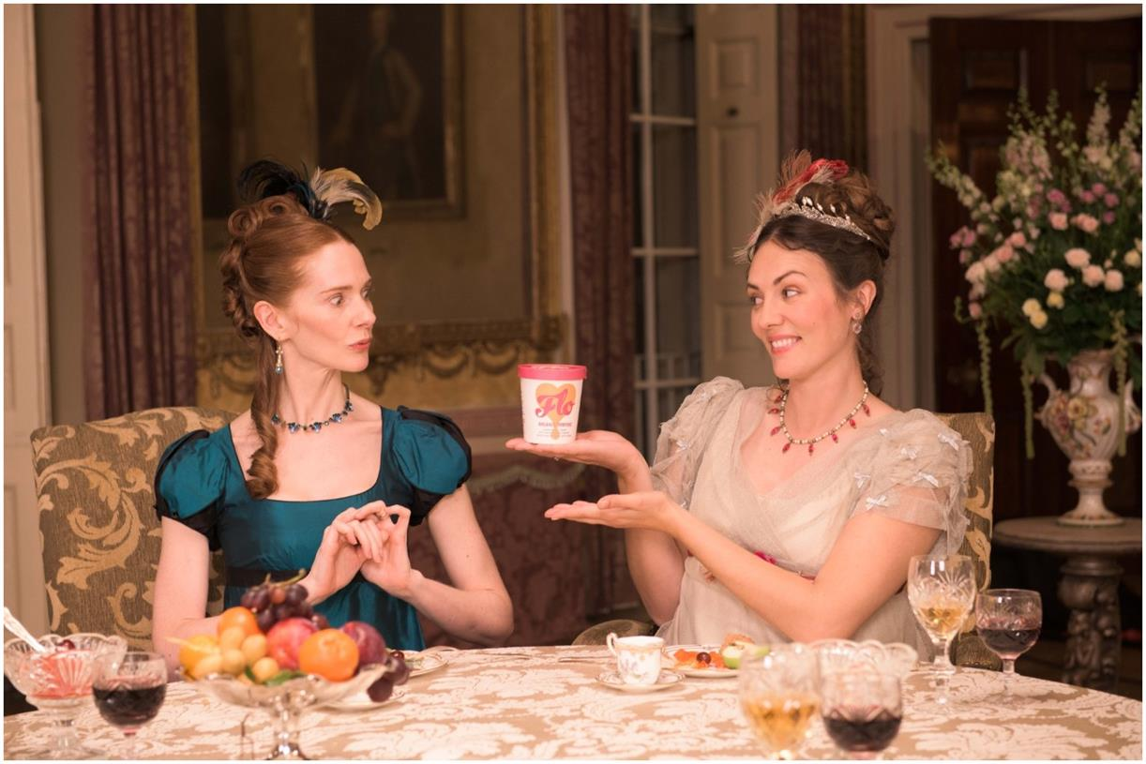
Here We Flo tries TV for the first time
The Challenge:
Here We Flo, an eco-friendly period care brand was launching into a market with very dominant brands.
They wanted to raise brand awareness, improve retail distribution and have a positive environmental effect.
The Solution:
They won Sky’s Footprint Fund Grand Prix prize which gave them access to £1m of airtime.
Hatch Collective created an impactful, humorous TV ad.
Campaign ran on Sky Linear, VOD & Sky AdSmart.
The Results:
50% increase in prompted brand awareness, 158% uplift in consideration, Highest ever website engagement – site visits up +1,000%
Notes:
The Challenge
Here We Flo, an eco-friendly period care brand, entered a market dominated by traditional feminine hygiene giants.
Conventional period care products are made of over 90% non-biodegradable plastic and synthetic materials – and women use over 11,000 pads or tampons throughout their lives, all of which end up in landfill.
Here We Flo offer a sustainable alternative to this as their products use biodegradable, plant-based materials and they are officially a Certified B Corporation. However, with minimal brand awareness and poor retail distribution, it was going to be a challenge convincing a wider audience to make the switch.
By empowering girls and women to talk freely and openly about “Life’s Messiest Moments”, they were confident that they could tackle the long-standing stigma surrounding menstruation, whilst at the same time making a positive impact on the environment.
The TV Solution
As a new to TV brand, Here We Flo needed support to bring their products to the masses. Sky’s Footprint Fund therefore provided an amazing opportunity for them to try to secure funding to enable them to get their brand on to TV and in to people’s homes, which in turn would support them in gaining greater retailer distribution.
Working closely with Hatch Collective, they created the idea for "No More Period Dramas", a campaign which would tap in to the zeitgeist of TV period dramas, parodying the likes of iconic series such as Downton Abbey and Bridgerton.
Set within a stately home, the formal dining room provided an opulent and somewhat ‘inappropriate’ dinner party setting for the ladies around the table (in all their finery), to discuss what happens “down there” – much to the shock and embarrassment of the accompanying gentlemen who very quickly head to the smoking room for brandy!
With a truly brilliant concept, incredible styling and a 100% female production crew, Hatch Collective and Here We Flo were able to carry through the importance of female empowerment from the screen to behind the scenes and resulted in them winning the Sky Footprint Fund’s Grand Prix prize, which was worth £1m in airtime.
This open, honest and humorous TV ad not only resonated with the audience but also the industry as it was voted Marketing Week’s “most effective TV ad” in April 2022.
The TV activity was supported by print and social and the campaign led to Here We Flo becoming the fastest-growing period care brand in the UK.
The Plan
The campaign launched with a spot in a special 170” Net Zero Carbon ad break, which was scheduled to coincide with the COP26. It featured all five winners of the Footprint initiative and ran on Sky News and Sky Nature for two weeks.
Following the launch, Here We Flo ran their first-ever targeted solus TV campaign in March 2022 and again in April 2023 across Sky Linear, VOD and Sky AdSmart channels.
In addition to the TV ad, Hatch Collective also created a suite of assets which allowed Here We Flo to activate the campaign across outdoor and on their social channels. Taking inspiration from their ‘FLO Babes’, they brought to life customers’ very own period dramas. These funny yet very relatable anecdotes were projected on moving billboards across London (in bright pink of course!), and via on-trend TikTok filters on social, allowing Here We Flo to empower women, normalise menstruation and promote conversation.
Results
Brand Awareness: The campaign led to a 50% increase in prompted brand awareness amongst those exposed to the TV campaign, with spontaneous awareness 6x amongst Sky customers
Brand Perception: Exposure to the campaign positively impacted brand perception with consumers noting the ad's humour and its ability to challenge the typical portrayal of periods in advertising
Purchase Consideration: Purchase consideration more than doubled for those looking for period care products (+158%) with Sky customers exposed 82% more likely to consider FLO.
Customer engagement: During the TV campaign, Here We Flo saw their highest-ever website engagement with site visits, +1,000% YoY
Retailer success: The TV campaign helped open the door to conversations with new retailers and, since winning the Footprint Fund, the brand has extended its distribution to include Superdrug, Holland & Barrett, Boots and most recently Tesco & Ocado.
Industry Recognition: Here We Flo achieved some incredible industry praise and acknowledgement, with Marketing Week labelling it “April’s most effective TV ad” in 2022.

Slide 20


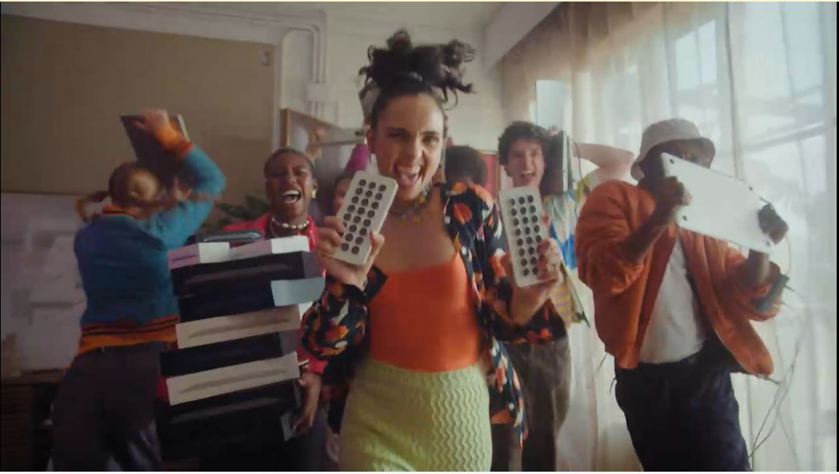
Back Market: TV’s trust building power
The Challenge:
6 million tonnes of e-waste (tech) finds its way into landfills each year. Back Market wanted to halt this and build trust and awareness in both the brand and refurbished tech.
The Solution:
Use TV to insert the brand into moments of family co-viewing to drive fame, awareness and trust in the brand among an audience of 12.3 million Chief Family Officers.
The Results:
Awareness lifts above target of 40%, 13% increase on target agreement with statement ‘Back Market is a brand I trust’ and increase site traffic of 46%.
Notes:
The Challenge
Every year in the UK, a huge 6 million tonnes of e-waste (tech) finds its way into landfill, with old phones, tablets and smart watches being binned off in favour of the shiny and new. Having launched in the UK in 2022, Back Market, were offering something new but also old to the market, refurbished tech. Back Market expertly refurbishes tech and offers it to the market at a more affordable price. Despite offering phones like new at a fraction of the cost and the obvious advantages of sustainability; there was an issue in the UK. Refurbished tech was unknown and untrusted; with 87% of the population saying they wouldn’t buy refurbished, 21% believing that refurbished meant stolen and 77% believing the product simply wouldn’t work. Refurbished tech had an image problem.
Back Market had been largely focused on digital marketing and was yet to really make an impact, stuck behind the likes of CEX and Music Magpie, brands that are both synonymous with refurbished tech in the UK. Back Market needed to drive awareness of their offering, build trust in the brand and drive web traffic.
The TV Solution
Armed with clear objectives of driving awareness, building trust and growing web traffic, Wavemaker UK got to work in understanding the problem at hand. Pre campaign research had indicated they needed to normalise refurbished tech by making it a purchase you can trust which would ultimately make Back Market the go to platform. With their current approach the campaign wouldn’t move the needle for Back Market, if they were going to hit their objectives, Wavemaker would need to get them acting like a category leader.
Leveraging Thinkbox research, it was clear to Wavemaker that only one channel would deliver the trust, fame and have an immediate impact on web traffic, TV. Wavemaker then used Cost of Living research to highlight that families were increasingly cash strapped but under pressure from Children for the latest tech and gadgets. This audience of 12.3 million were dubbed the Chief Family Officers- those in charge of the household buying and they could be captured in moments of co-viewing, putting Back Market right at the heart of the living room and the conversation.
The Plan
Using agency tools, Wavemaker allocated two thirds of the annual budget into TV. To maximise the impact of the campaign with the budget on hand, Wavemaker needed to normalise refurbished tech to as many people as possible as quickly as possible; all while balancing the line between effectiveness and efficiency. To achieve this, Back Market launched with a roadblock, cherry picking the biggest programming across linear to aid the goal of fast 1+ reach over the first three days of the campaign. This launch activity saw the campaign reach 28% of the population within the first 72 hours; making them the one of the top 3% most viewed advertisers across the 3-day period. The launch and wider campaign activity was selected to ensure that Back Market would have a foot hold in the market in the lead up to the key Black Friday and festive period. Launch activity was planned for October to negate the higher TV costs of September. This allowed the brand to remain on air for longer with higher weekly weights.
Leveraging Thinkbox research about the impact of longer ad lengths, the campaign kicked off with a 30” creative that was deployed to deliver impact and awareness from a standing start. After 2 weeks of sustained 30” messaging, reach curves started to plateau. This plateauing promoted a changed in second length to a 20” creative. This change ensured that the campaign delivered cost savings to the campaign with no impact on the brand messaging delivering maximum TVRs over a key period for the category.
Having launched the campaign with success, Wavemaker again turned to Thinkbox research that showed the environment for the brand was just as important as the channel it’s in. This promoted Wavemaker to focus on the biggest and best cultural moments over the period. This would see Back Market positioned alongside some of the UKs biggest known brands. This approach saw the campaign feature is some of the biggest shows across the campaign period like Bake Off, the Rugby World Cup and I’m a Celebrity. By using historical Barb data, Wavemaker were able to profile the core audience of Chief Family Officer. This created a hitlist of programming that would reach families in moments of shared viewing and help to shift perceptions of Back Market and refurbished tech with both the ‘wanters’ and the ‘buyers’. This approach meant Back Market featured in 8 out of the 10 top shows with the highest family co-viewing like The Voice, The Masker Singer and Great British Bake Off; all with a position in break to place them right next to the content to drive home the perception of quality.
Results
With the aim or rising brand awareness, Wavemaker’s meticulous approach to planning saw Back Market smash its targets and lift brand awareness over the campaign benchmark of 40%. Along side this, the campaign needed to foster trust in refurbished tech and Back Market being the place to get it. The campaign was again a raging success delivering 13% increase in target with audience’s agreeing that ‘Back market is a brand I trust’. Finally, Site traffic for the brand increased by 46% over the course of the TV campaign with it on average delivering 920,000 site visits a week.

Slide 21


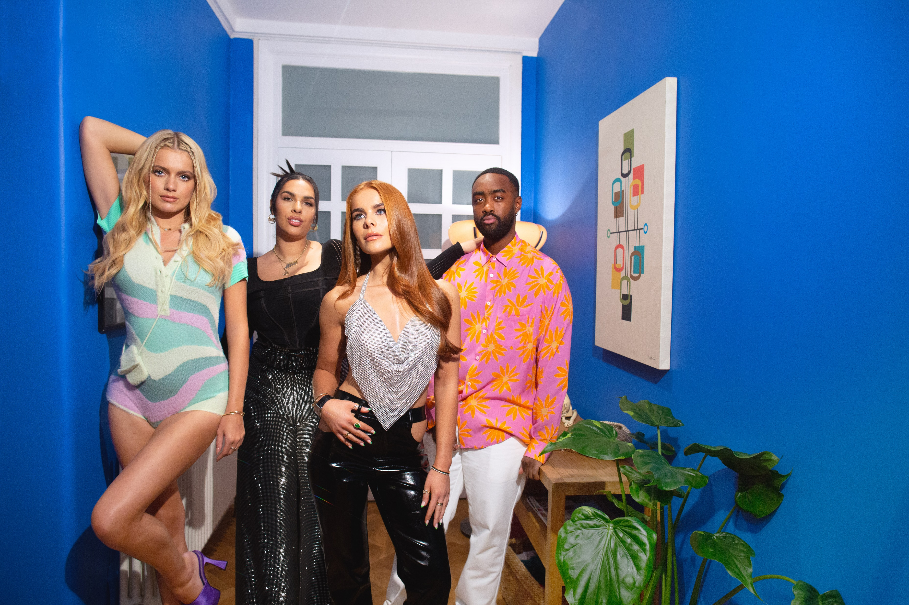
eBay: Making the pre-loved Loved with a TV Partnership
The Challenge:
eBay wanted to drive mass appeal for second-hand fashion with 16-34-year-olds against a backdrop where fast fashion was still king.
The Solution:
A partnership with Love Island that would reframe second-hand clothing as ‘pre-loved’.
The Results:
1,700 positive pieces of press coverage which resulted in over 14 billion impressions. A 935% increase in mentions of ‘pre-loved fashion’ recorded across all online platforms. 7,000% increase in ‘pre-loved fashion’ searches on eBay and 756% increase in searches on Google for ‘eBay pre-loved clothes’.
Notes:
The Challenge:
eBay wanted to drive mass appeal for second-hand fashion with 16-34-year-olds against a backdrop where fast fashion was still king.
The Solution:
A partnership with Love Island that would reframe second-hand clothing as ‘pre-loved’.
The Results:
1,700 positive pieces of press coverage which resulted in over 14 billion impressions. A 935% increase in mentions of ‘pre-loved fashion’ recorded across all online platforms. 7,000% increase in ‘pre-loved fashion’ searches on eBay and 756% increase in searches on Google for ‘eBay pre-loved clothes’.
Read more here: https://www.thinkbox.tv/case-studies/ebay-making-the-pre-loved-loved-with-a-tv-partnership

