Slide 1
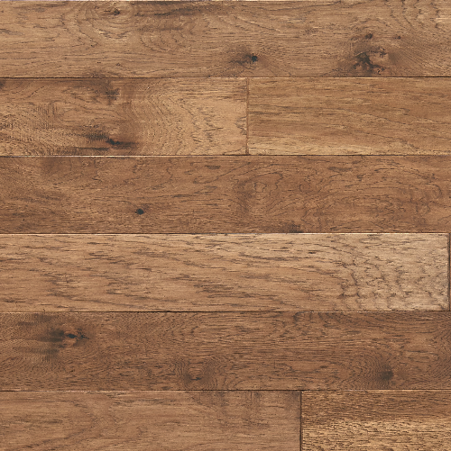
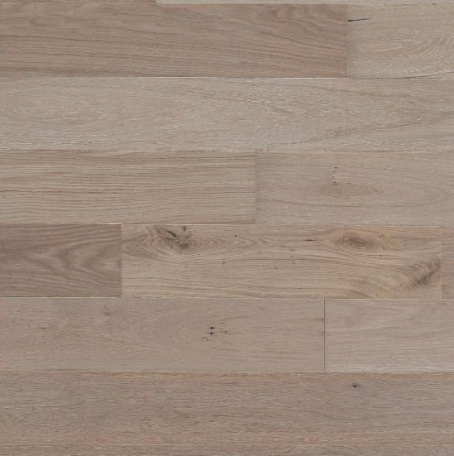
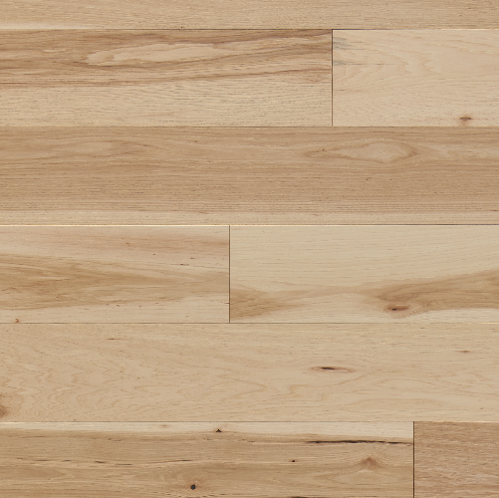
2021 Hardwood Introductions

Slide 2
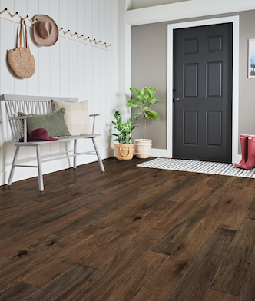
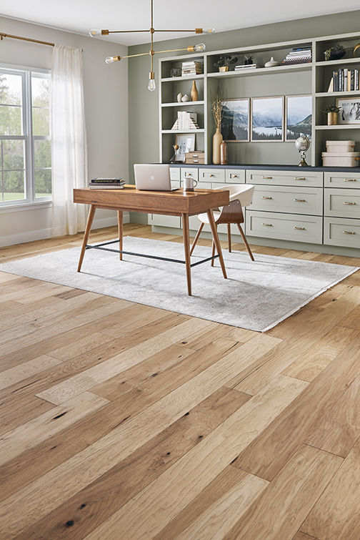
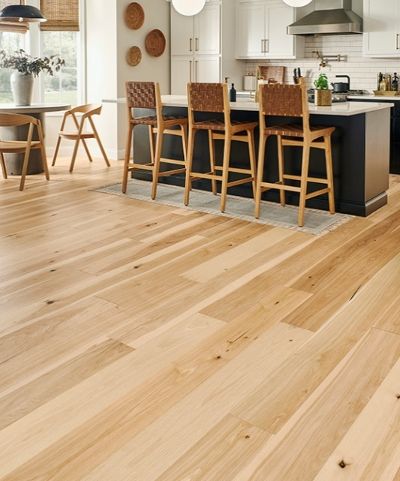
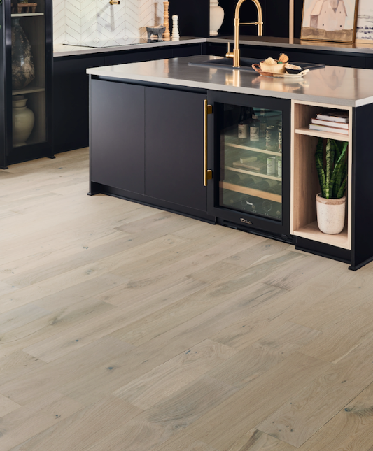

2021 Hardwood Introductions
Kodiak
Mountain View XL
Park City – new color!
Forest Park
Product launch video

Slide 3
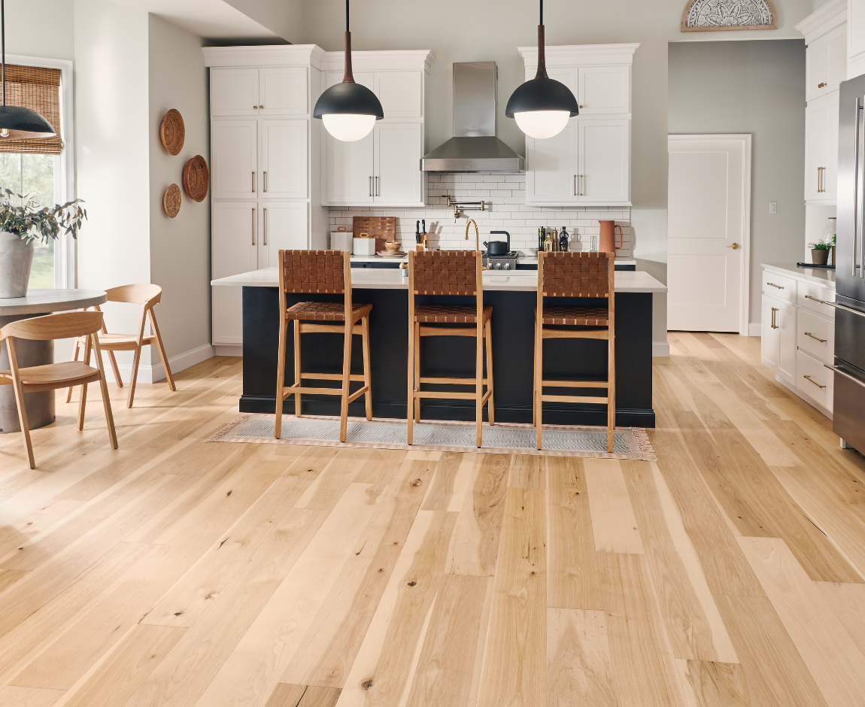
Why Mannington Hardwood is Different
Superior Performance
Premium Styling
Designed in-house
Responsible Sourcing
LACEY ACT
COMPLIANT

Slide 4
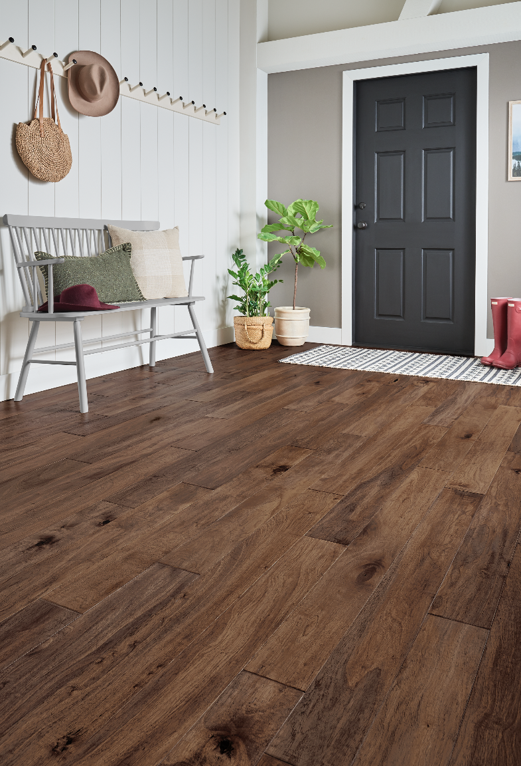
Kodiak

Slide 5
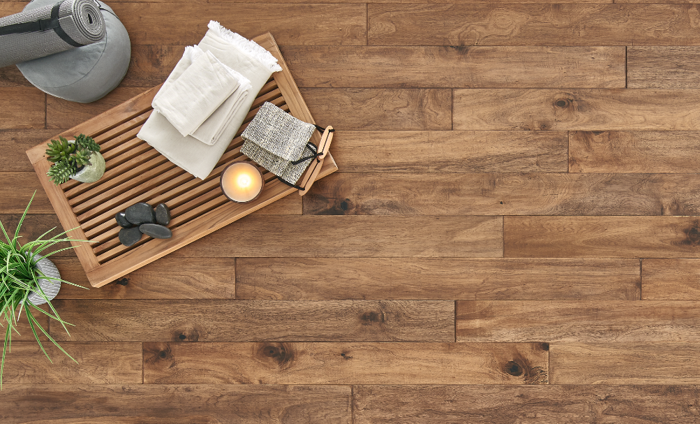



Kodiak
Style trend: Scandinavian Nordic/Eclectic Vintage
Hand scraped and hand stained
Sustainably harvested, plantation grown

Slide 6

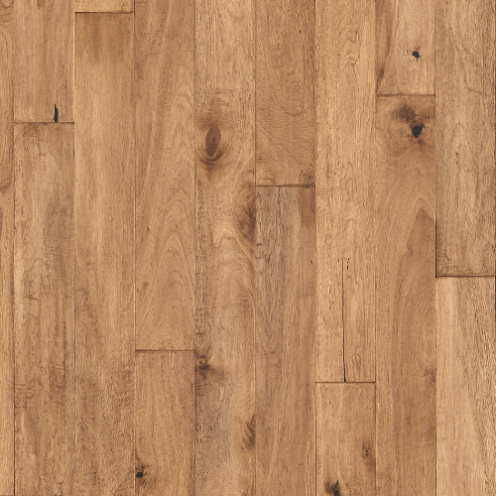
Kodiak
Autumn
KDK05AT1
Champagne
KDK05CHP1

Slide 7
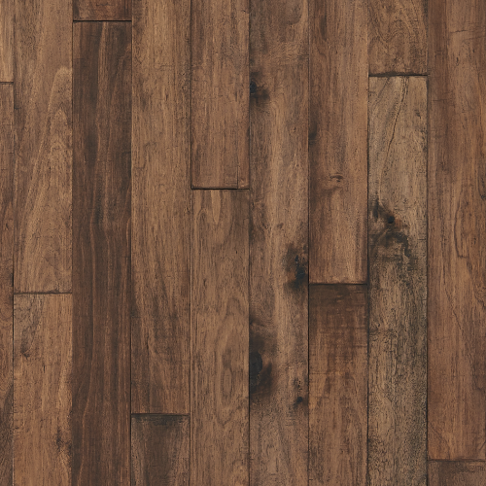

Kodiak
Fawn
KDK05FN1
Rye
KDK05RY1

Slide 8
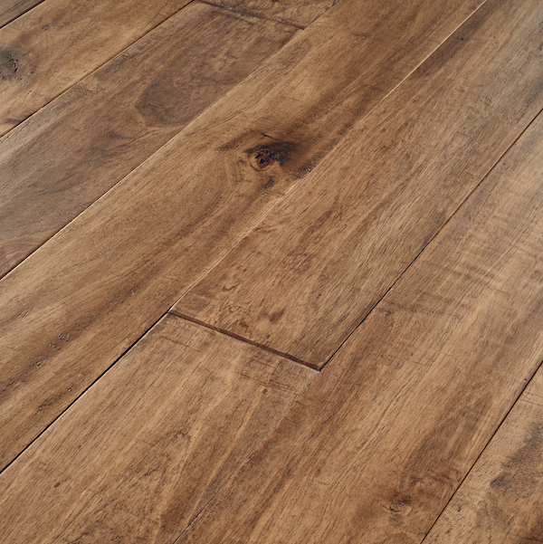
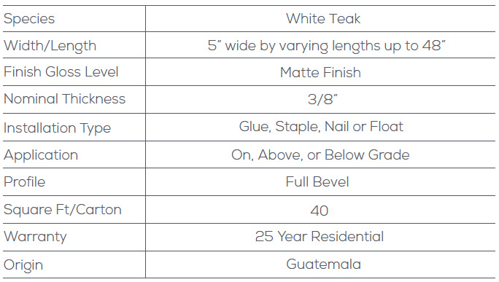
Kodiak Specs

Slide 9
Mountain View XL

Slide 10
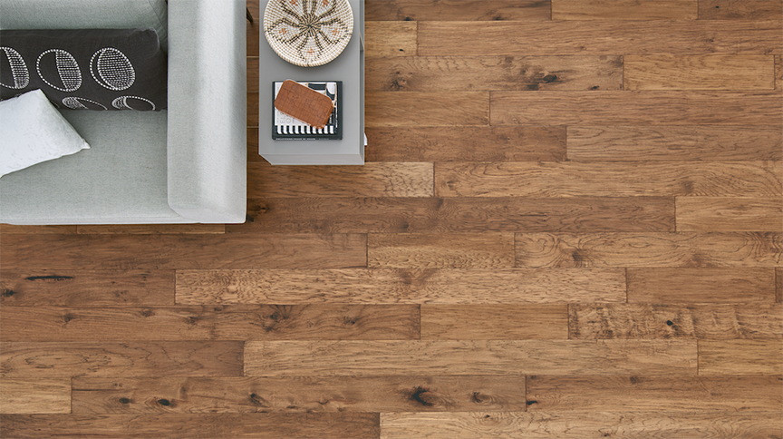

Mountain View XL
Style trend: Eclectic Vintage/Bohemian
Hand-scraped and double hand-stained
Longer, wider planks

Slide 11
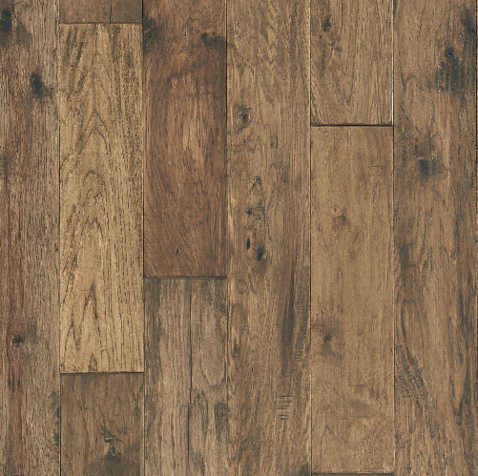
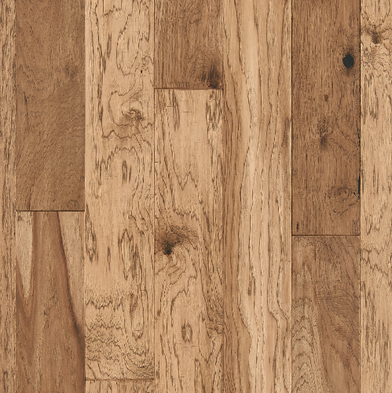
Mountain View XL
Autumn
MVXL06AT1
Bark
MVXL06BK1
Champagne
MVXL06CHP1

Slide 12
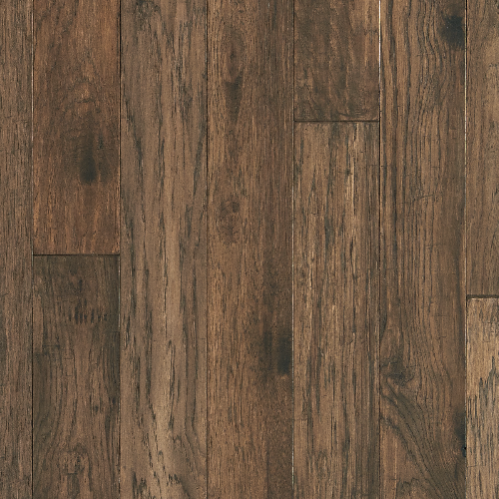
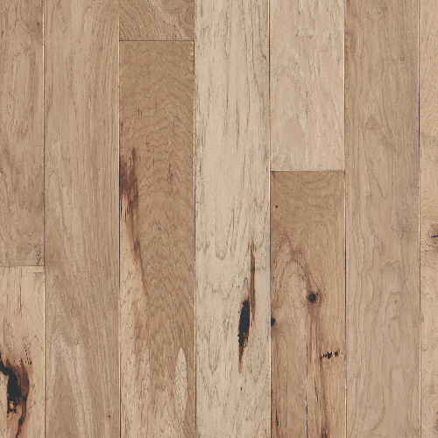
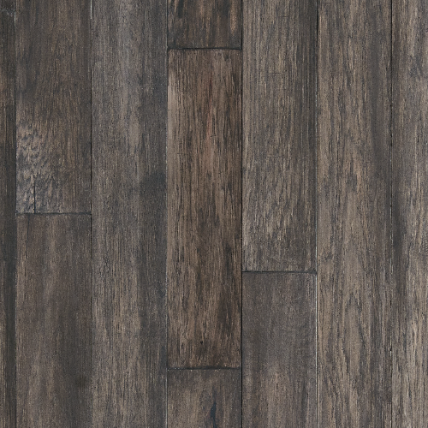
Mountain View XL
Fawn
MVXL06FN1
Platinum
MVXL06PT1
Smoke
MVXL06SM1

Slide 13
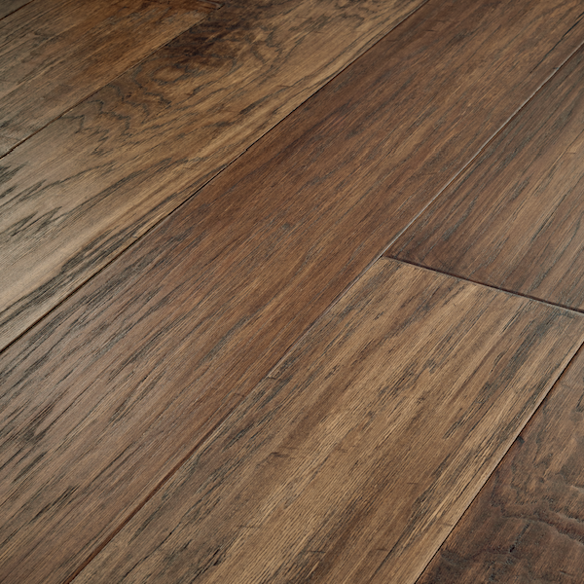
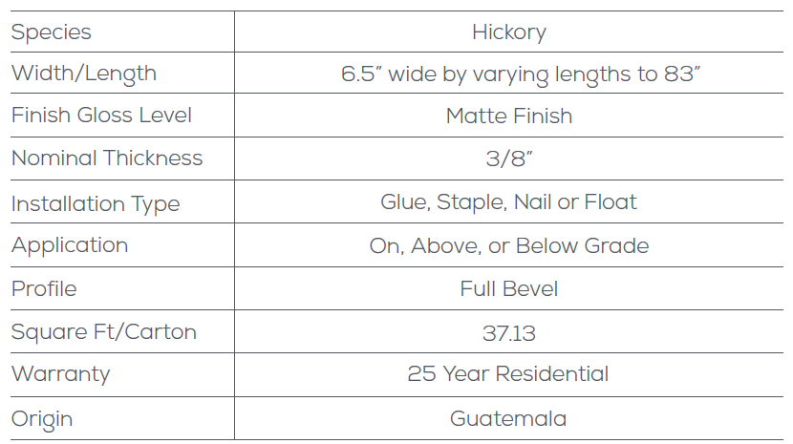
Mountain View XL

Slide 14
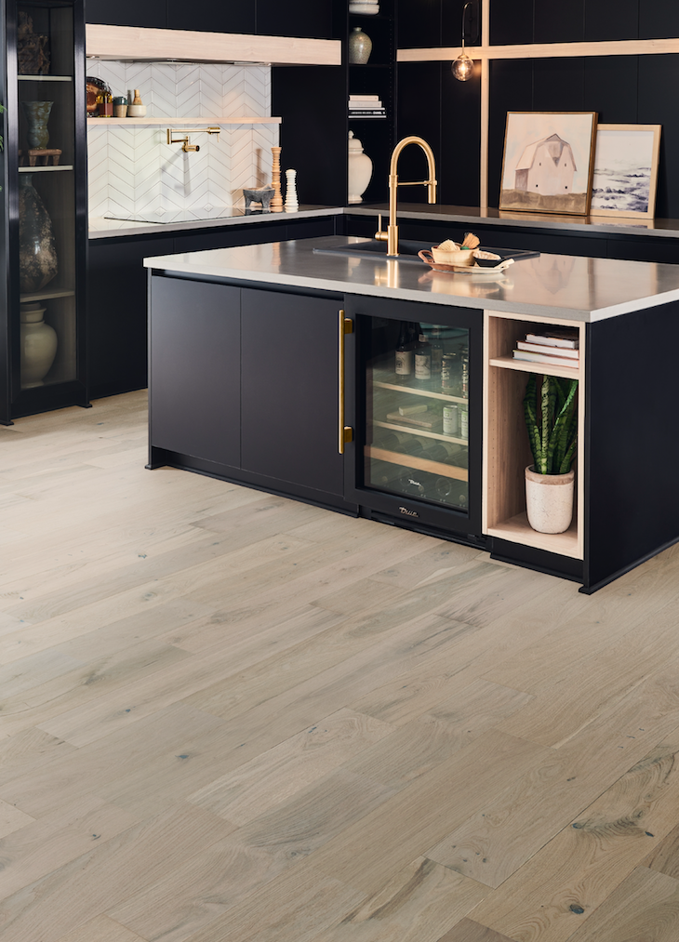
Park City
(Color Addition)

Slide 15
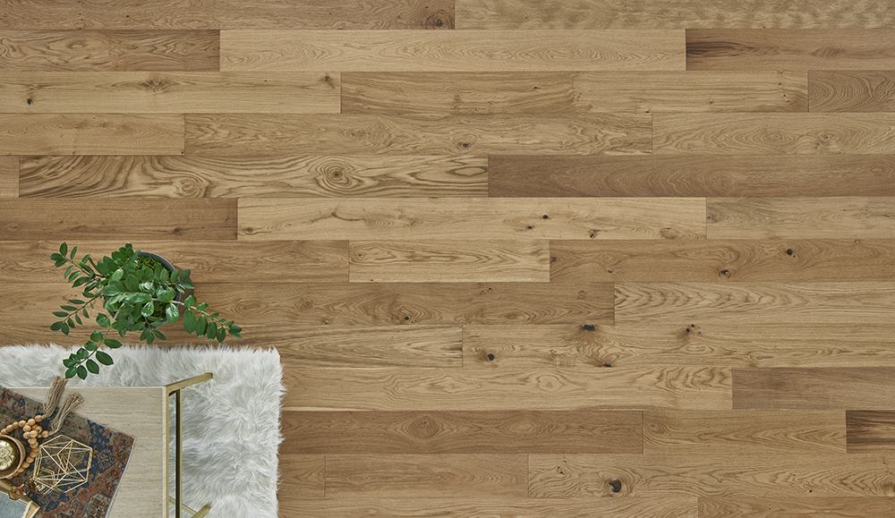

Park City
Style trend: Bohemian
Long and wide planks
True natural with ultra-matte finish to hit on trendy “raw” look

Slide 16
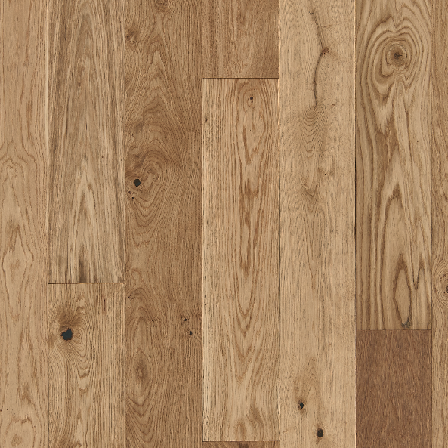
Park City
NEW color for 2021!
Natural
HPLV07NAT1

Slide 17
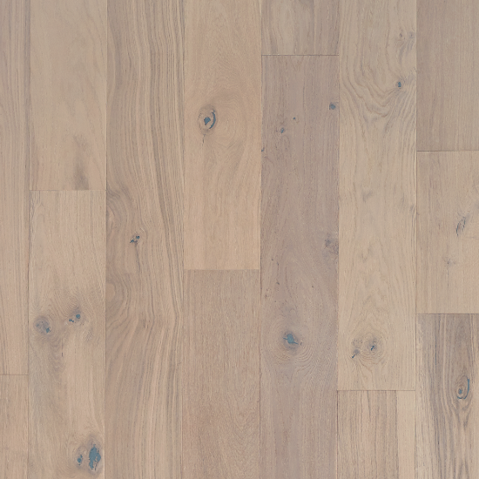
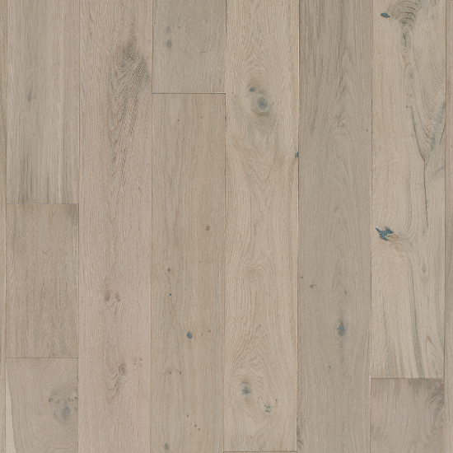
Park City
Existing Colors
Snowcap
HPLV07SNW1
Wintry
HPLV07WIN1
Alpine
HPLV07APN1

Slide 18
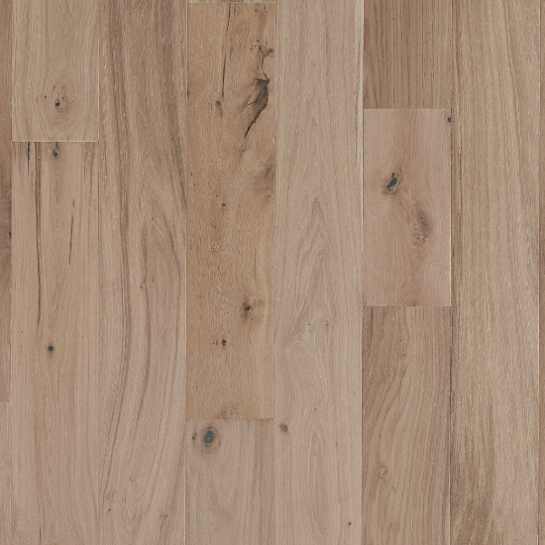
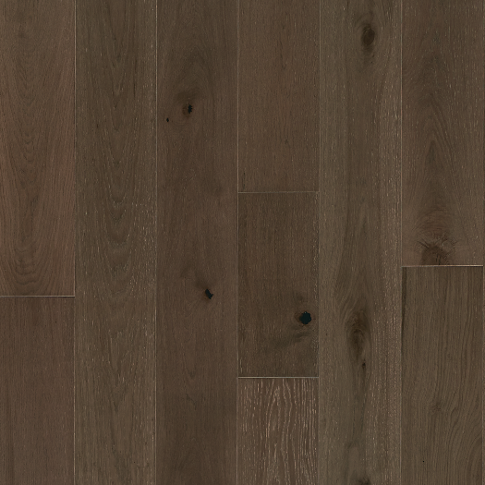
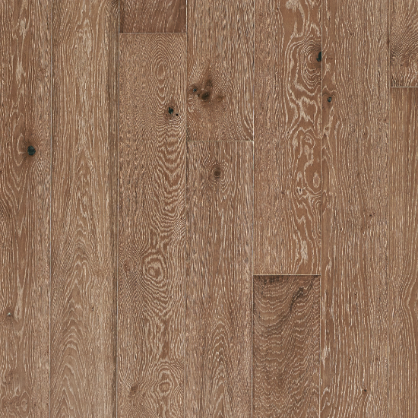
Park City
Existing Colors
Summit
HPLV07SUM1
Olympic
HPLV07OLY1
Sundance
HPLV07SUD1

Slide 19
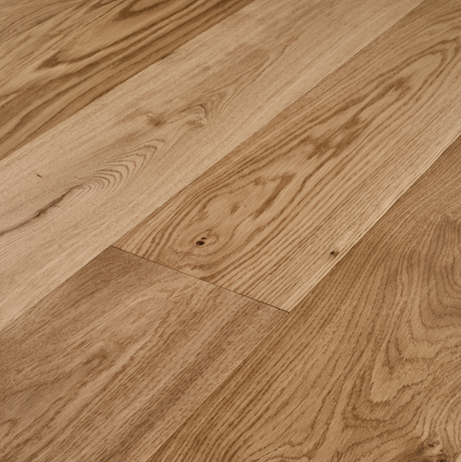
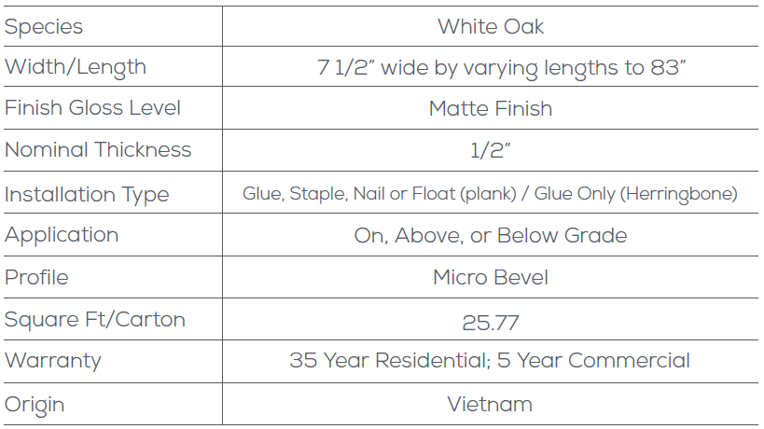
Park City

Slide 20
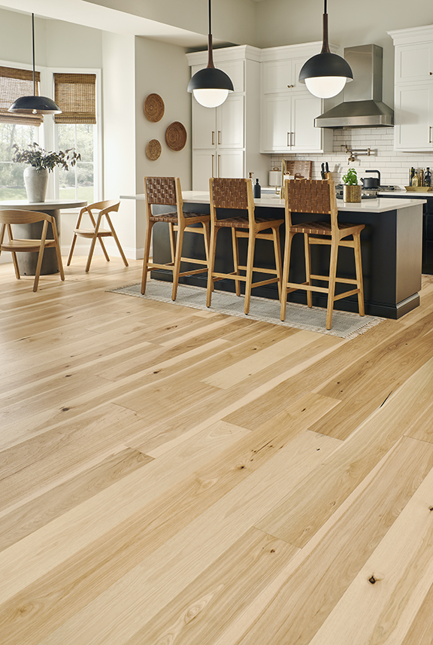
Forest Park

Slide 21
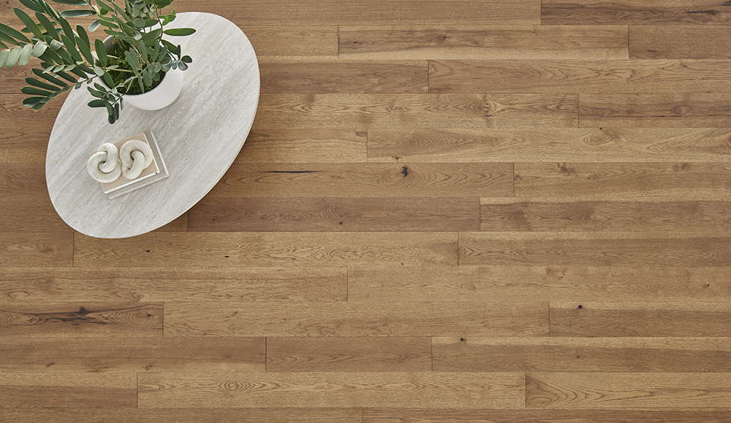
Forest Park
Style trend: Bohemian/Scandinavian/Nordic
Hand-stained and wire-brushed finish
Elegant, premium sliced face
Extra long planks

Slide 22
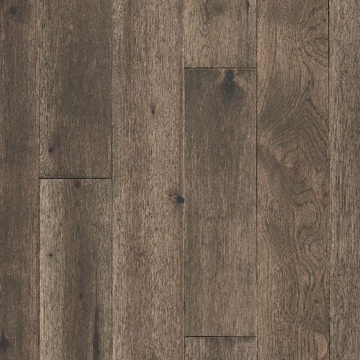
Forest Park
Natural
HPLY07NAT1
Twig
HPLY07TWG1

Slide 23
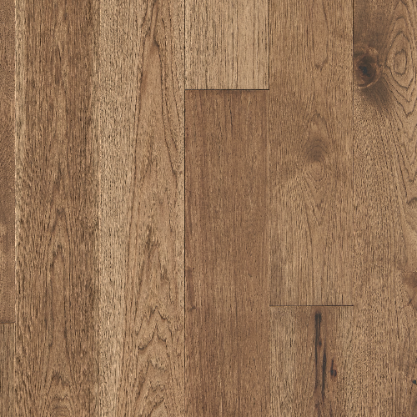
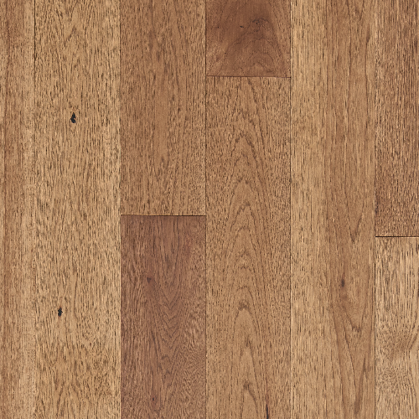
Forest Park
Trail
HPLY07RA1
Sunbeam
HPLY07SNB1

Slide 24
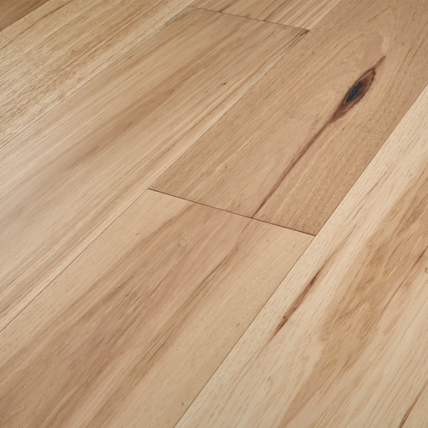
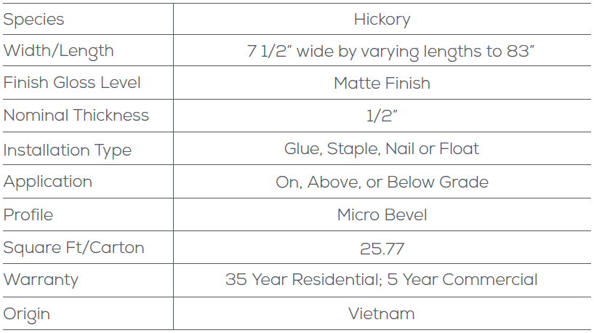
Forest Park

Slide 25



Digital Tools
The more the customer can see the floors, the more you can sell them.
When you go to measure the customer’s home, take pictures of their room so they can see what the new floor will look like in their home.
TIP

Slide 26
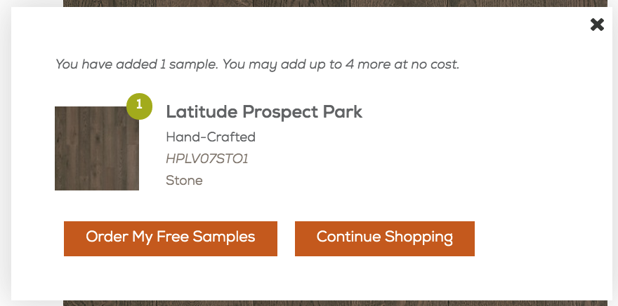
Free Consumer Samples
Order up to 5 different consumer samples at Mannington.com.
Samples are 12” long.

Slide 27
Thank You
For more information, visit:
www.Mannington.com/PK

