Slide 1
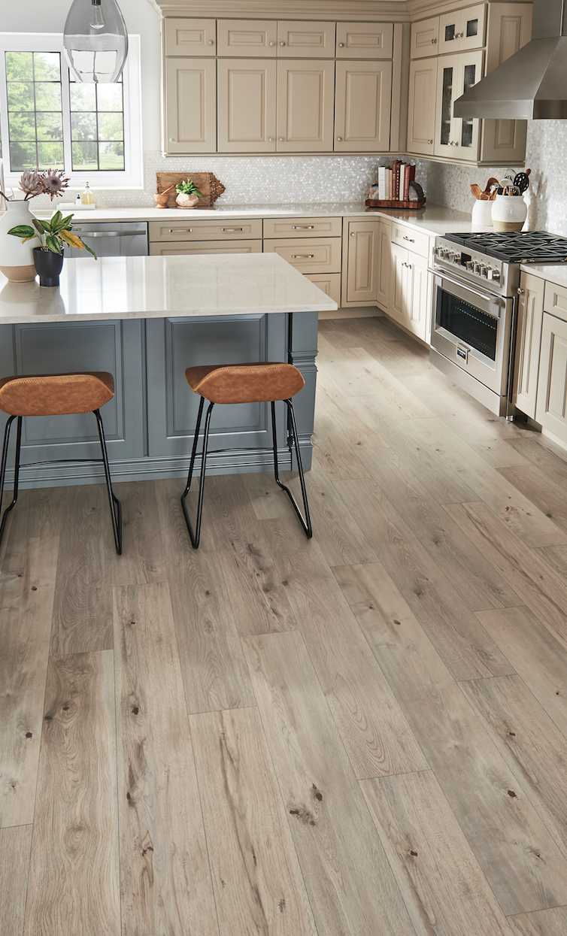
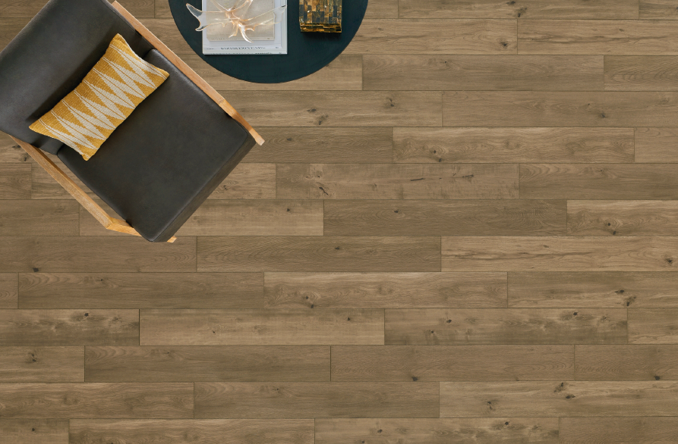


Restoration Collection
®

Slide 2

Why Mannington’s
Restoration Collection® is Different
NEW AND IMPROVED – SpillShield®Plus Waterproof Technology
Enhanced application renders the product waterproof.
Many competitors claim this but do not back it up with a warranty.

Slide 3
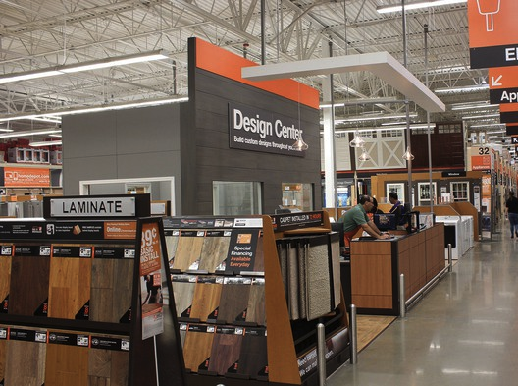
Why Mannington’s
Restoration Collection® is Different
Not in the Big Box Stores
Other premium brands can be found in the big box stores.
Restoration Collection® is only found at independent flooring retailers.

Slide 4
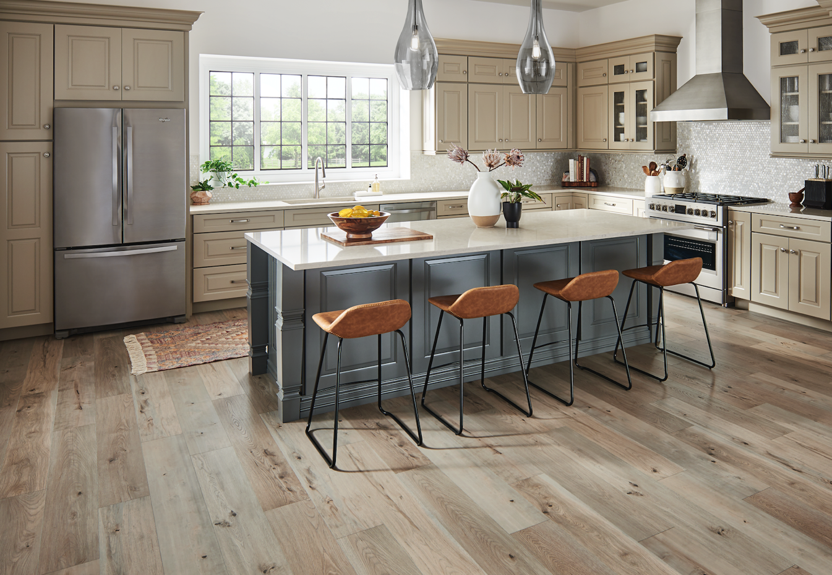
Why Mannington’s
Restoration Collection® is Different
Best-in-Class Style
The collection is filled with award-winning designs, hand-created by our in-house styling team.

Slide 5
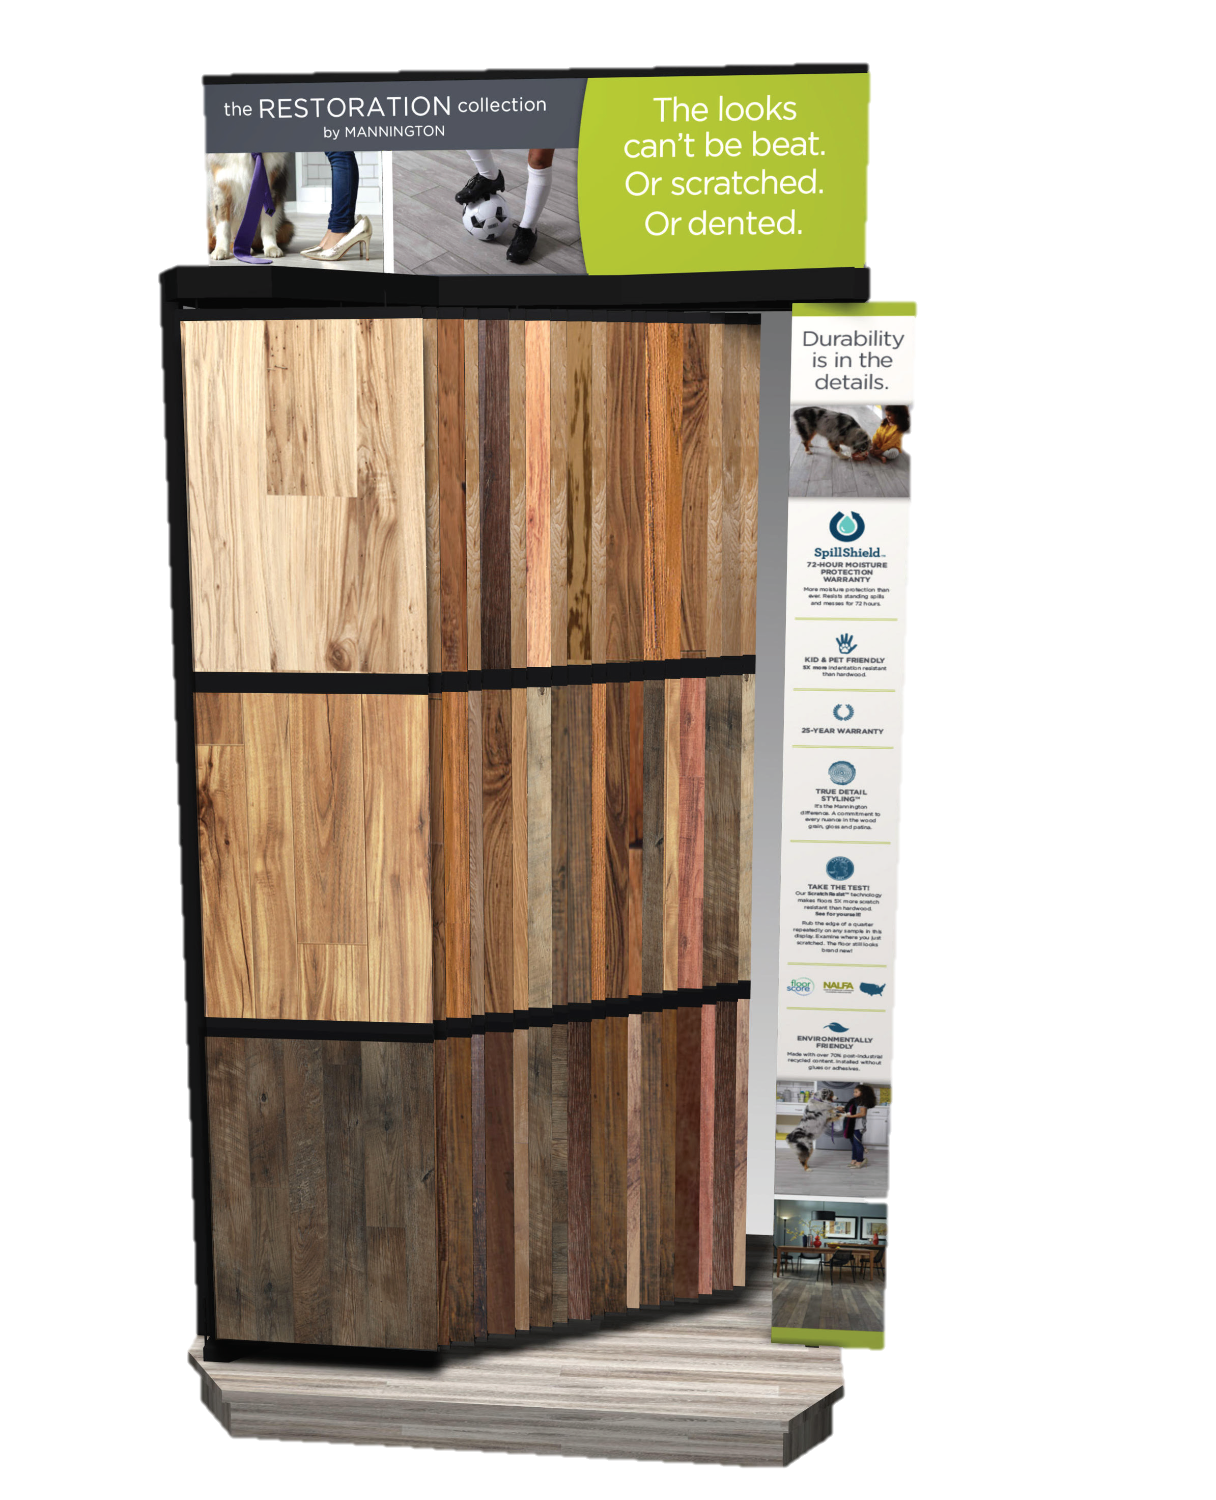
Why Mannington’s
Restoration Collection® is Different
All patterns and colors, just one price.

Slide 6





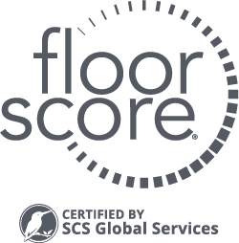

About the Restoration Collection®
All Restoration Collection® Floors Feature:
INDENTATION
RESISTANT
MADE IN
THE USA
25-YEAR
WARRANTY
KID & PET
FRIENDLY
CARB Phase 2 and
TSCA Title VI Compliant
ENVIRONMENTALLY
FRIENDLY
SCRATCH
RESISTANT

Slide 7
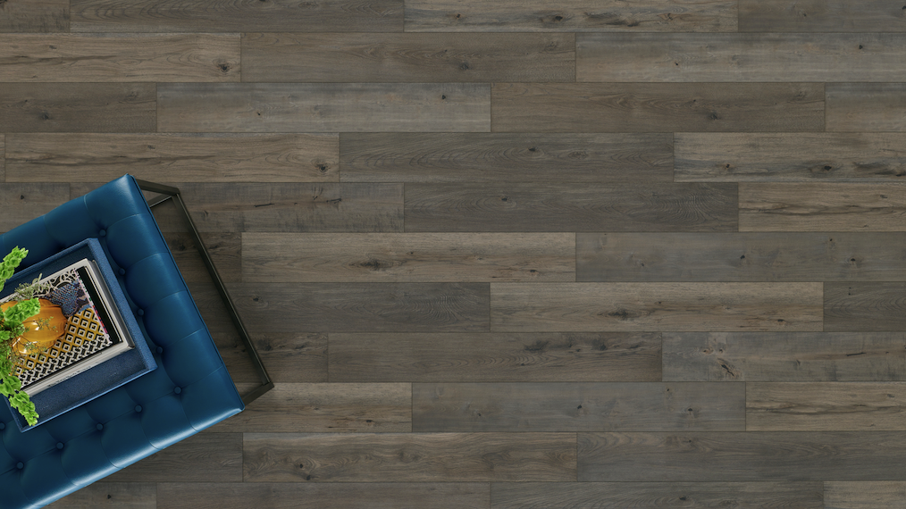
Anthology

Slide 8
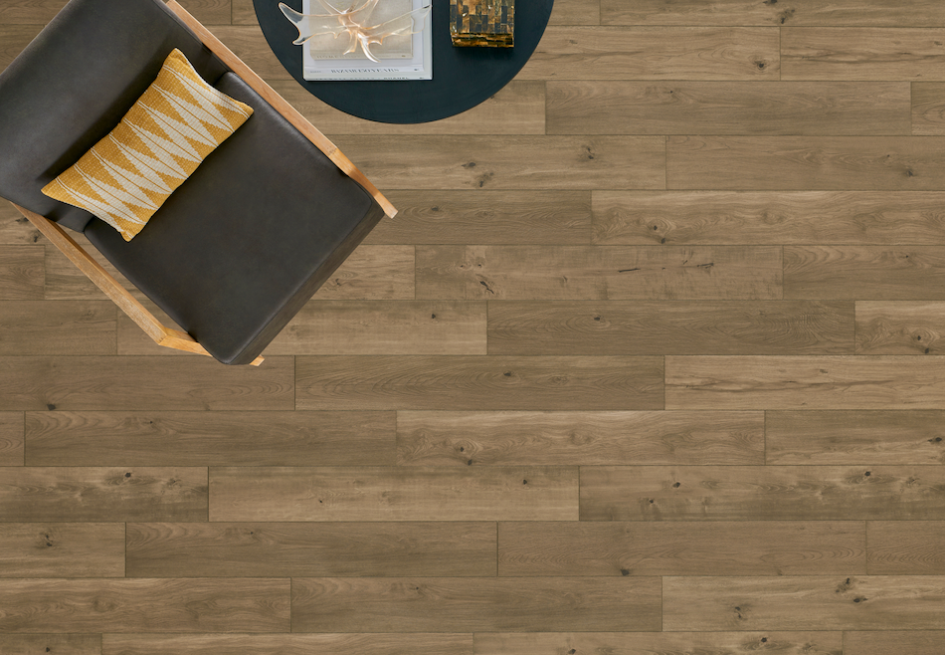


Anthology
Style Trend: Scandinavian/Nordic – Click here for video
The most realistic high- performance floor ever made!
More than double the planks of any competitor!
Uses digital printing technology for the most realistic visual.

Slide 9
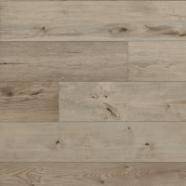
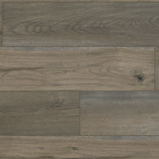
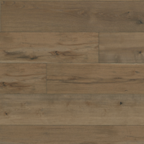
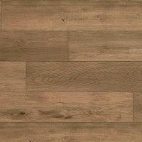
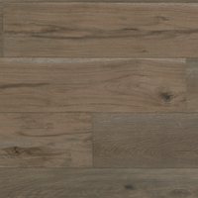
Anthology Colors
Parchment
28600
Ink
28601
Tannin
28602
Suede
28603
Quill
28604

Slide 10
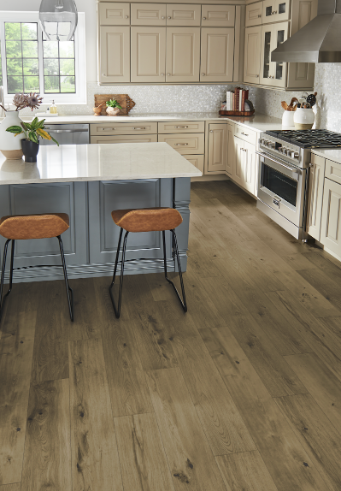
Anthology Specifications
Waterproof | Yes, SpillShield®Plus Waterproof Technology
Plank Size | 7 9/16” x 50 1/2”
Plank Thickness Nominal | 1/2” (12mm)
Edge Style | Micro Bevel
Sq. Ft. Per Carton | 21.22
Planks Per Carton | 8
Cartons Per Pallet | 45
Sq. Ft./Pallet | 954.9
Unique Planks | 20
Warranty | 25-Year Residential; 5-Year Light Commercial
Manufactured | High Point, NC

Slide 11
Restoration Collection® Sundries
ADHESIVES
NEW! Triple Stick™ Adhesive cartridge – great for installing on the walls!
INSTALLATION ACCESSORIES
Laminate Tapping Block
Universal Tapping Block
CLEANERS/FLOOR CARE
SpillShield® Applicator
UltraClean 32oz Bottle
UNDERLAYMENT
Whisper 3N1® Underlayment
Comfort Barrier® II Underlayment
Mannington Silent Solution Underlayment
Aqua Barrier II Underlayment

Slide 12







Restoration Collection® Moldings
FLUSH STEP NOSING
STEP NOSING
T-MOLDING
END CAP
REDUCER STRIP
WALL BASE
QUARTER ROUND

Slide 13
The More They See It,
The More You Can Sell It
Consumers have a hard time visualizing what their new floor will look like.
Use our free tools on a tablet or smart phone – no apps or downloads.
Floors.com/See
Take a virtual walk on our floors.
Floors.com/MyRoom
Try on our floors in any room.
Free Consumer Samples
Free large, individual samples available to help consumers see, touch, and feel the right construction in their homes. Just go to Mannington.com to order.

Slide 14
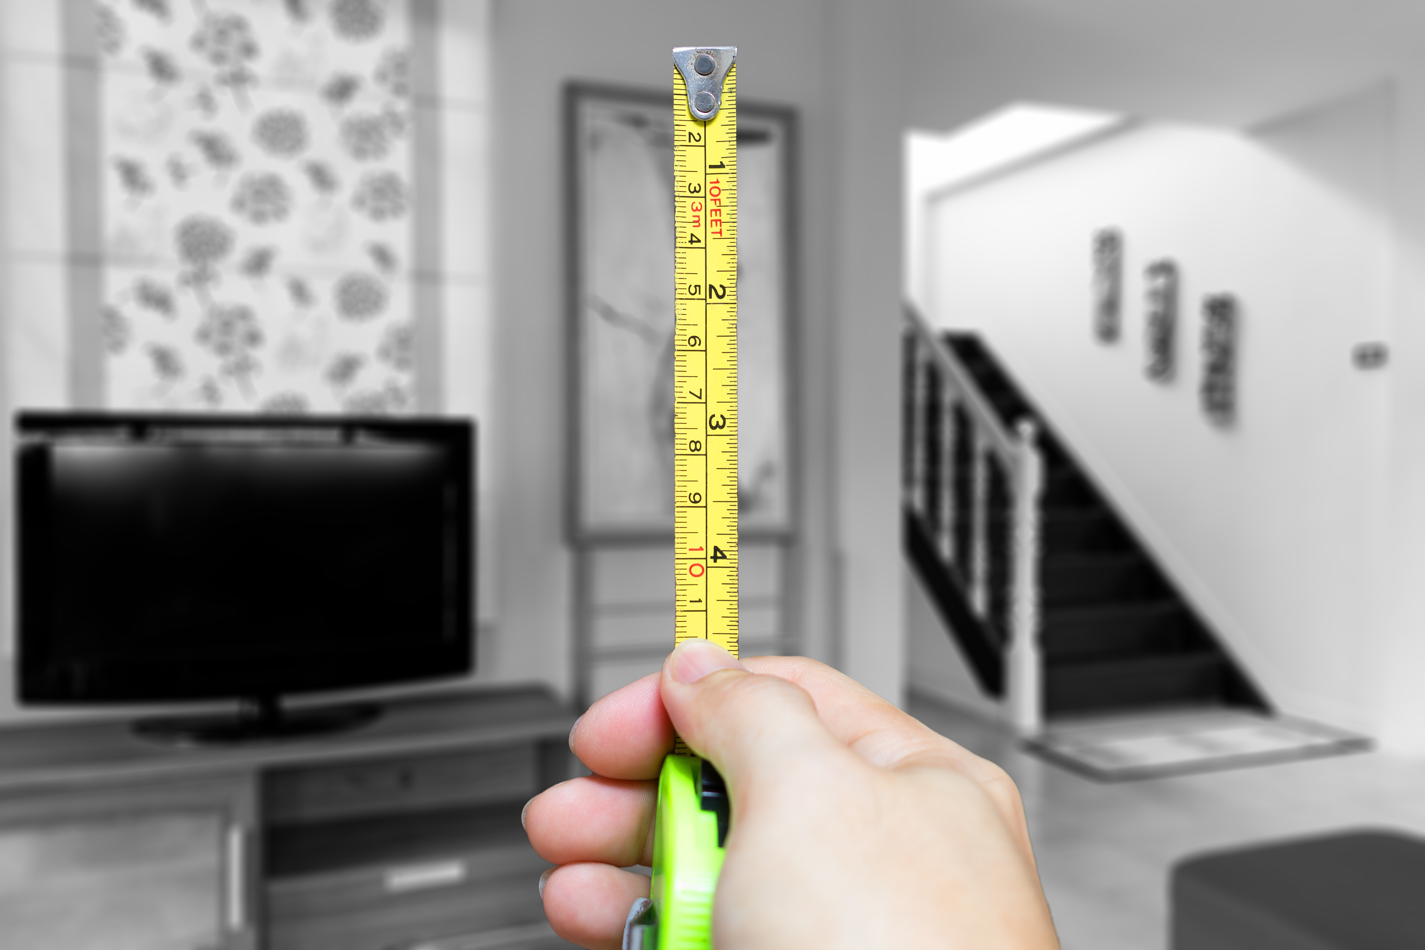
More on Floors.com/MyRoom
Tip: When you go to measure the consumer’s home, take pictures of their rooms to show them what their new floor will look like in their home.
Coming Soon: You'll able to add laminate to the walls to bring incredible style into the room!
New for 2020: Show them what the floor looks like at a 45° angle for an upgraded installation!

Slide 15
Thank You
For more information, visit:
www.Mannington.com/PK

