Slide 1
Board Presentation
Tuesday 6th May 2025
Clive Steed & Jo Davis

Slide 2
Agenda
Who are we?
How we engage with fans
What have we done so far?
What next – our strategic objectives?
The future….

Slide 3
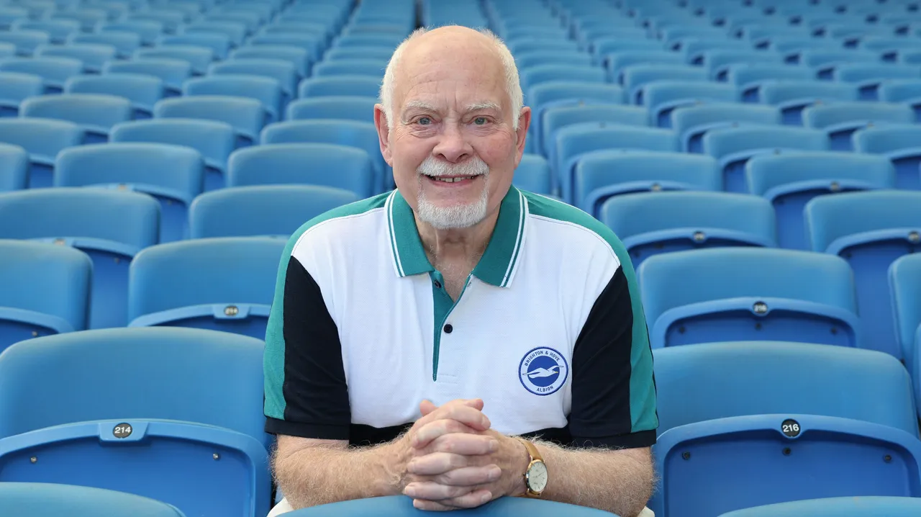
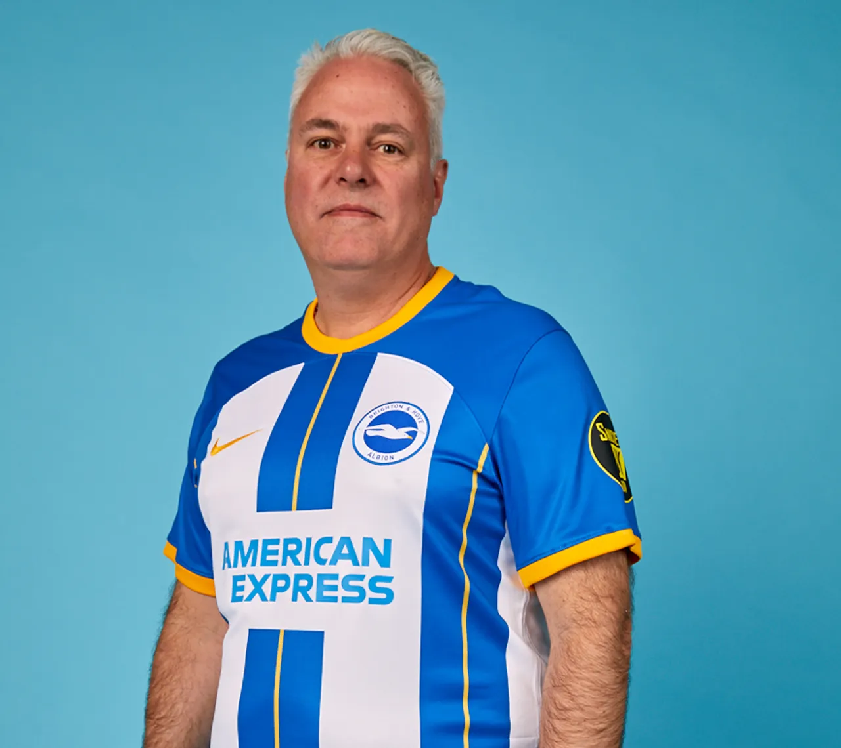
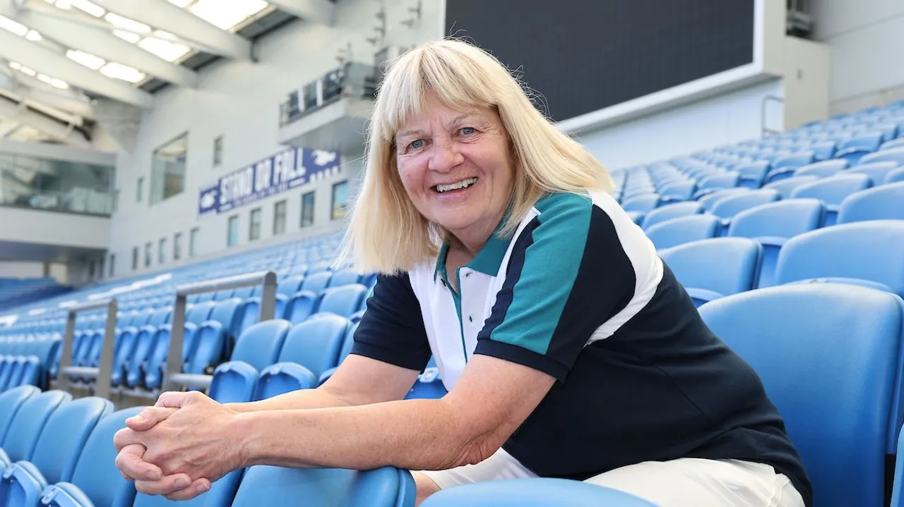
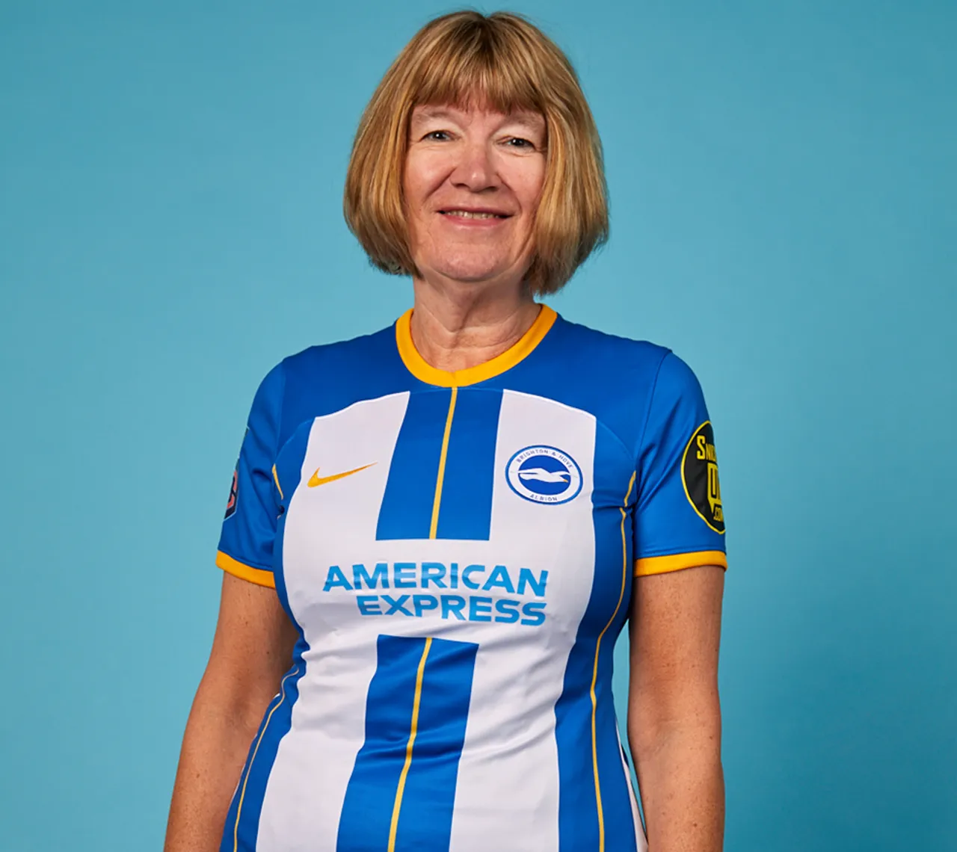
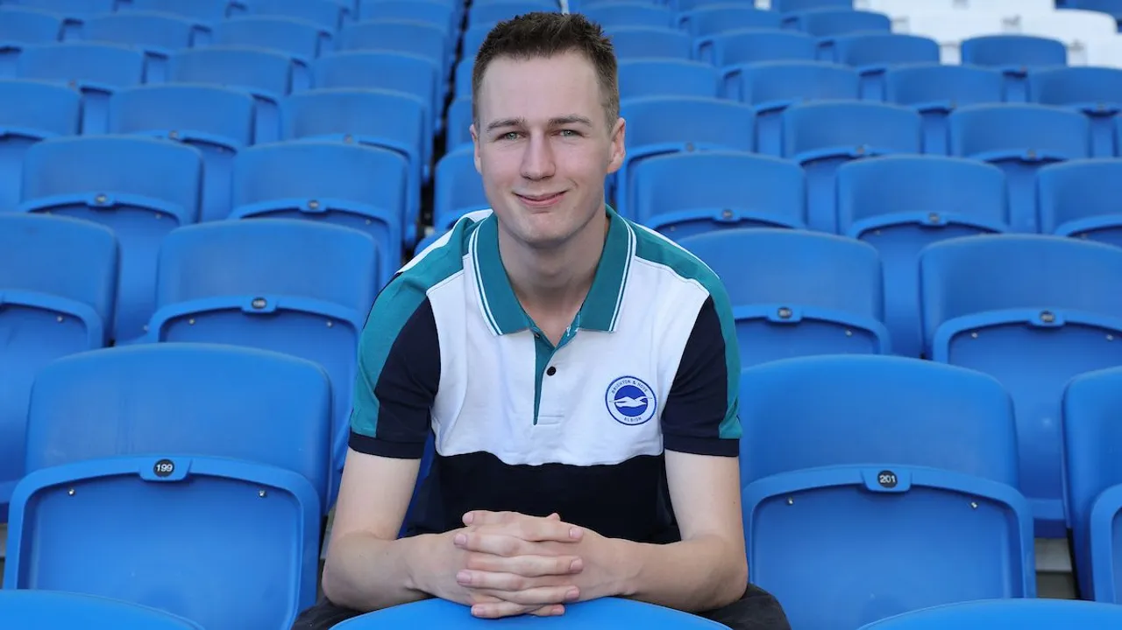
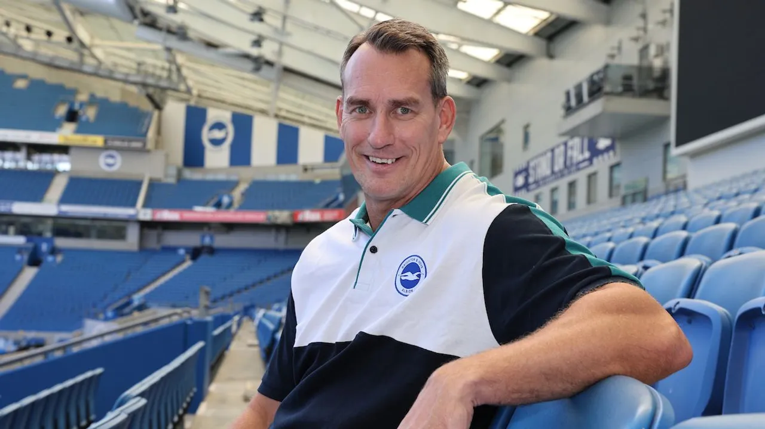
Family rep coming this year 25-26

Slide 4
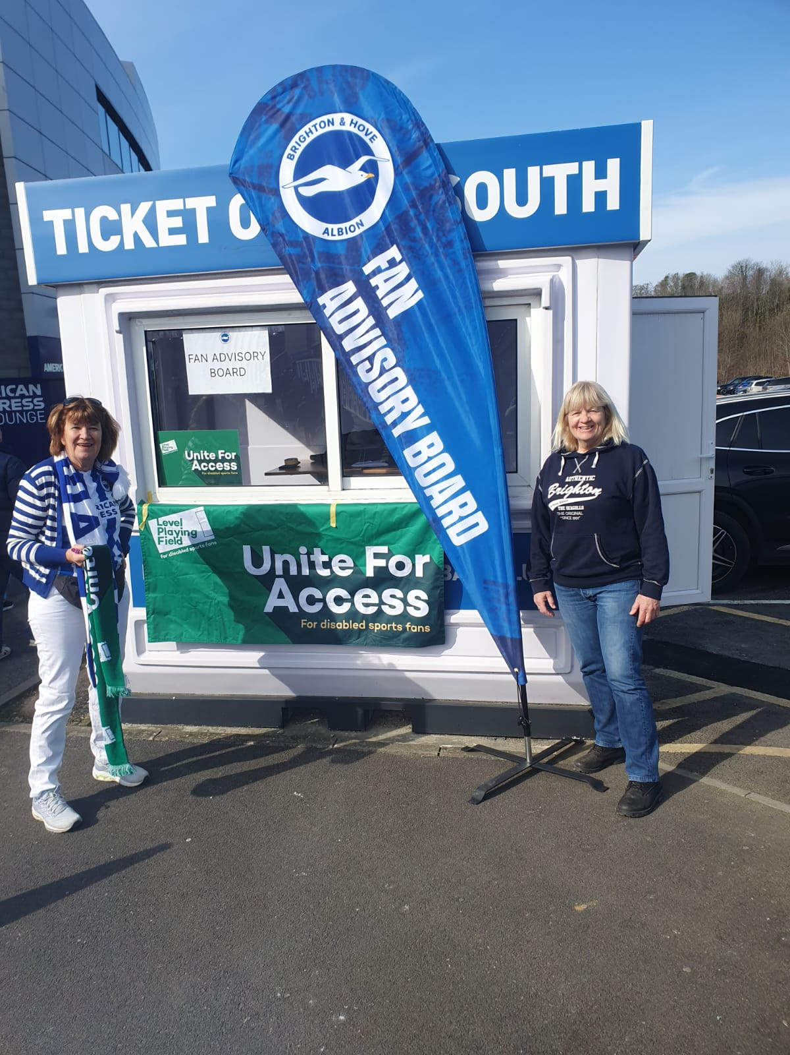
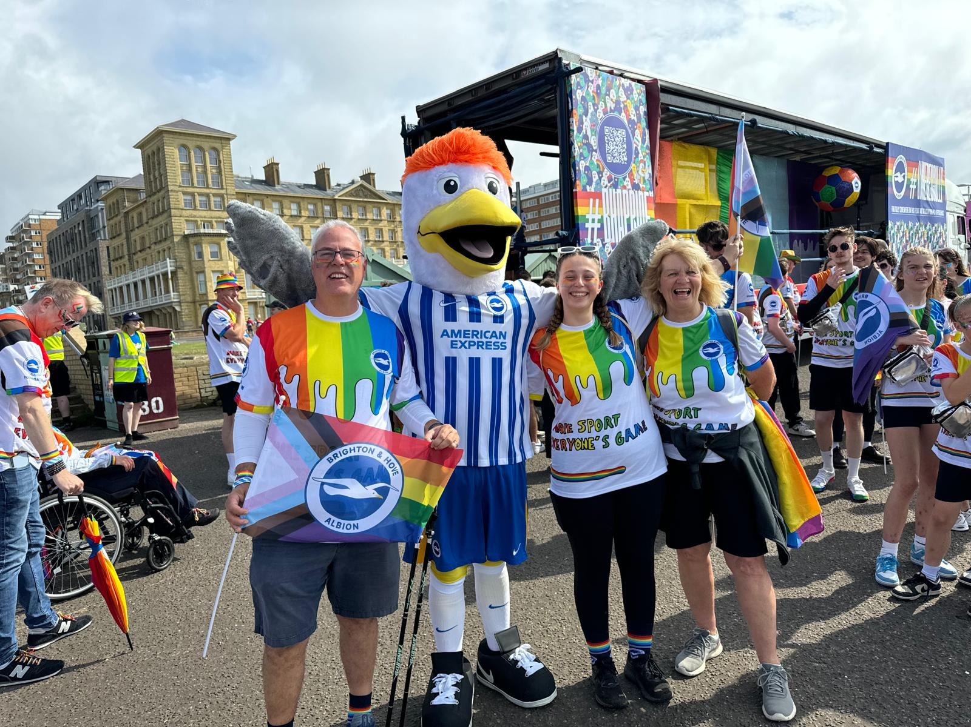
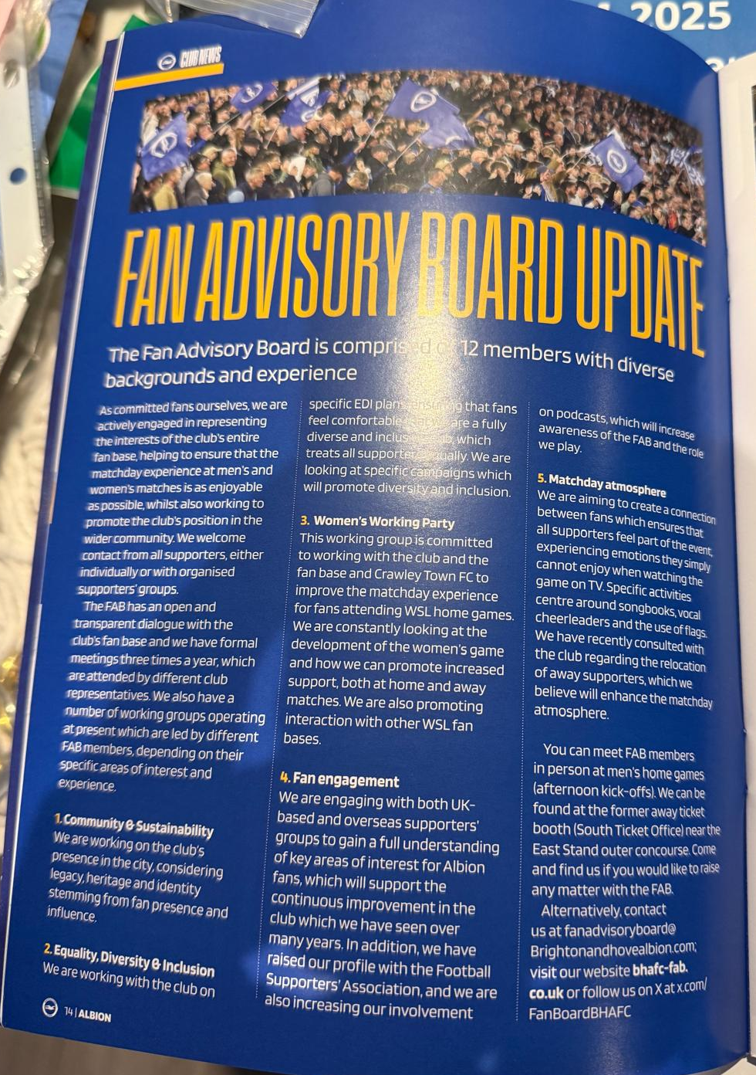
How we engage with Fans

Slide 5
How we engage with the club
Safe standing
Women’s season ticket and match ticket prices
Men’s season ticket prices
Men’s ticket policy changes – utilisation and concession age changes
Fan flag designs and distribution
Brighton museum exhibit
Albion allies' events
Guinness partnership

Slide 6
What we do
Fortnightly teams call with the FAB 1 hour
Fortnightly calls with Jenny Gower
Man the FAB stand for sensible kick off times
Liaising with marketing and ops on flag deployment match day activations
Premier league meetings
Working party groups
Attending committee meetings and fan group events

Slide 7
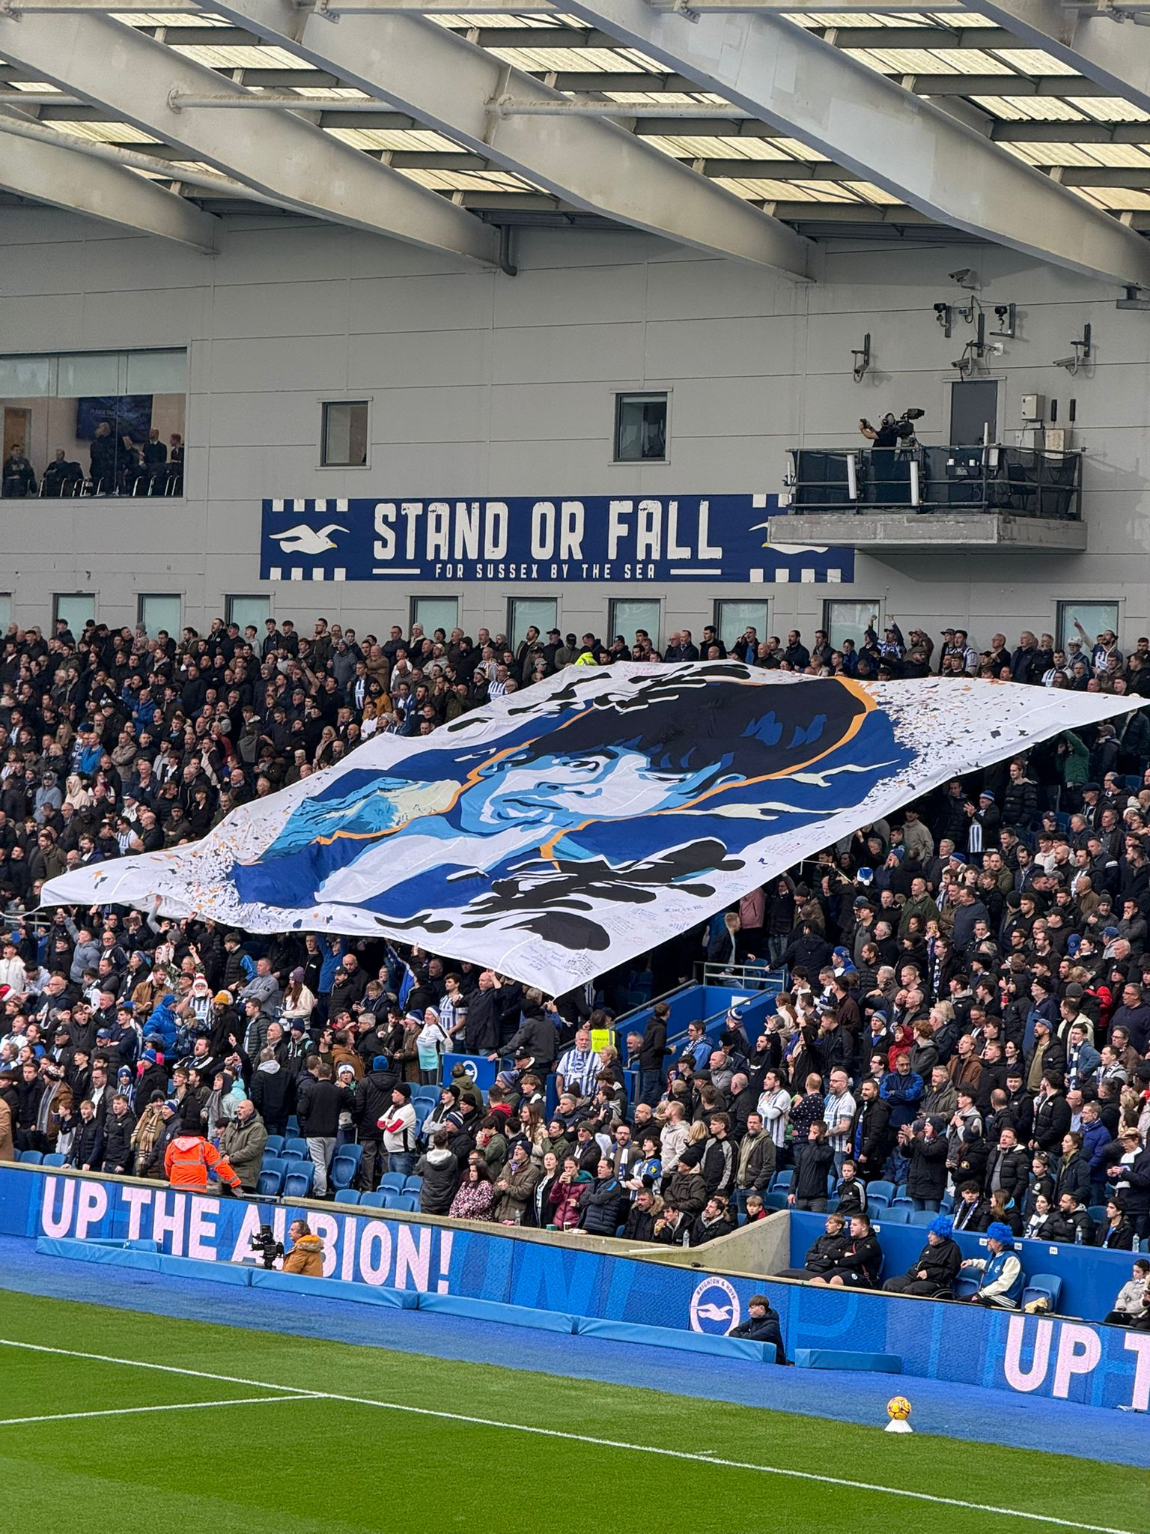
24-25
DSA Three C’s
Cost
Confidence
Companionship
WSL News
Singing Sections
“Her Game Too” - away travel guide for Arsenal away
Away travelling fans – fan led and Kissimmee coaches
New flags behind the South goal making Crawley more Brighton
Collaboration to grow the fan base
Fan interaction FAB swap shop, song sheets, stickers,
Match day atmosphere Surveys
Larger working group
Meetings opinion gathering
Hand help flags Plus kids !
Community & the City
Struggled to get momentum
ED&I support

