Slide 1

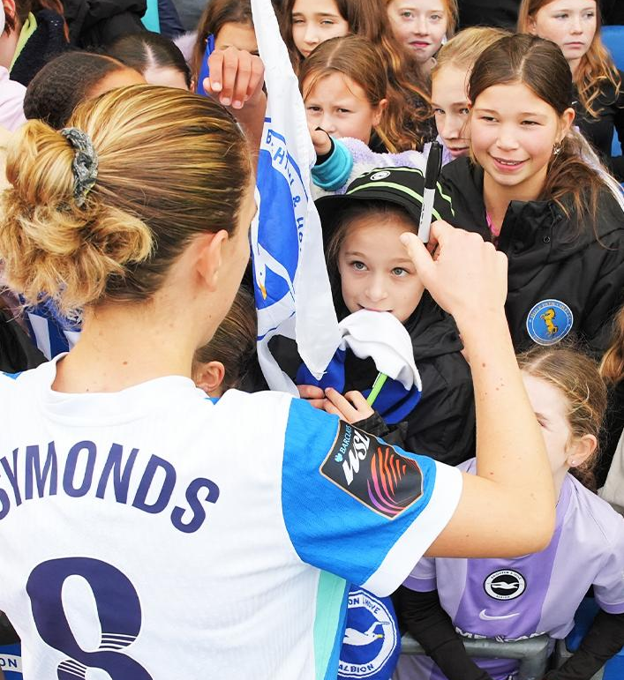

2025-26 Season Overview
• Current FAB
• Supporting Club Initiatives & Projects
• Fan Engagement & Activities
• Women's update

Slide 2

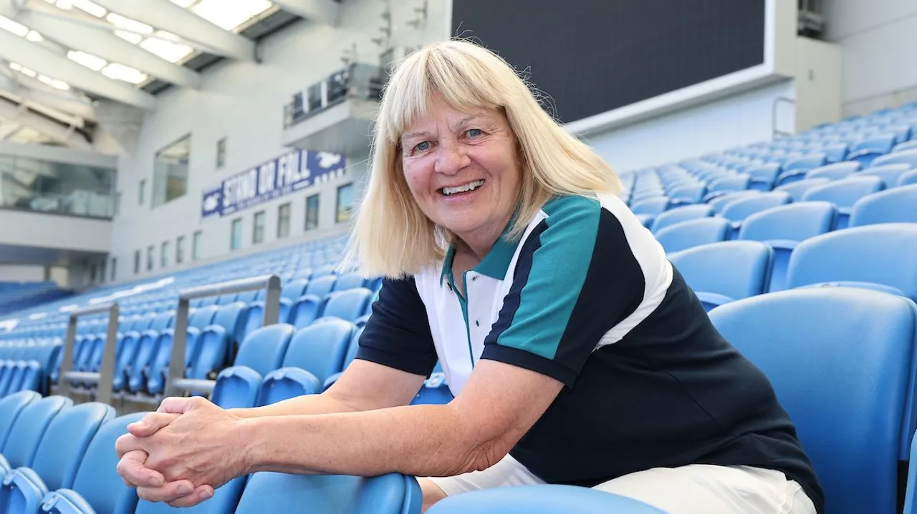
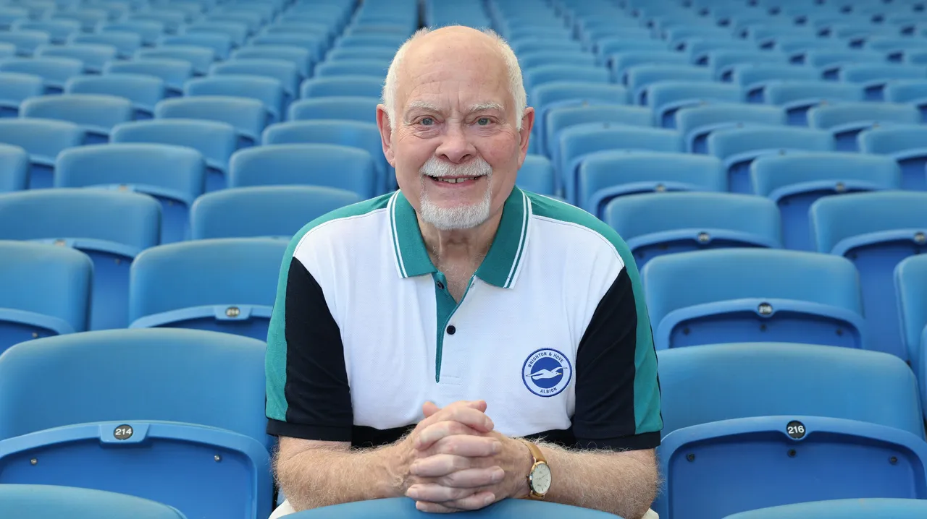
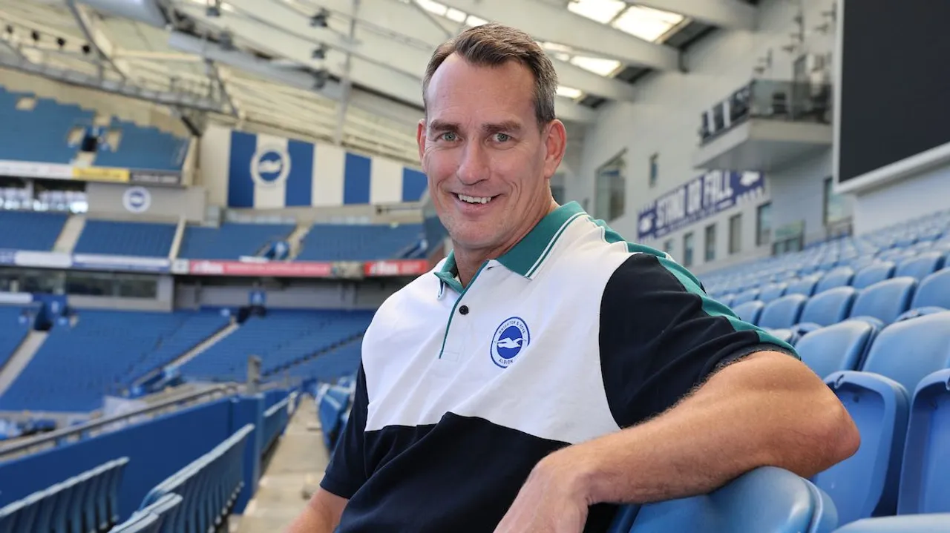
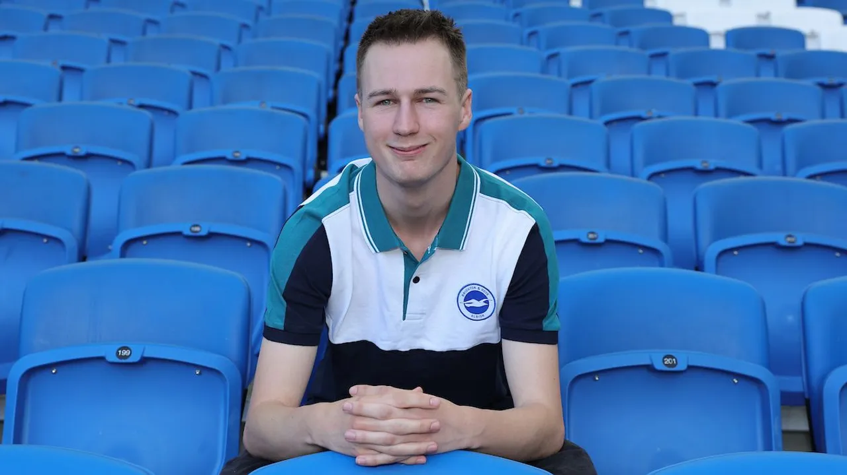
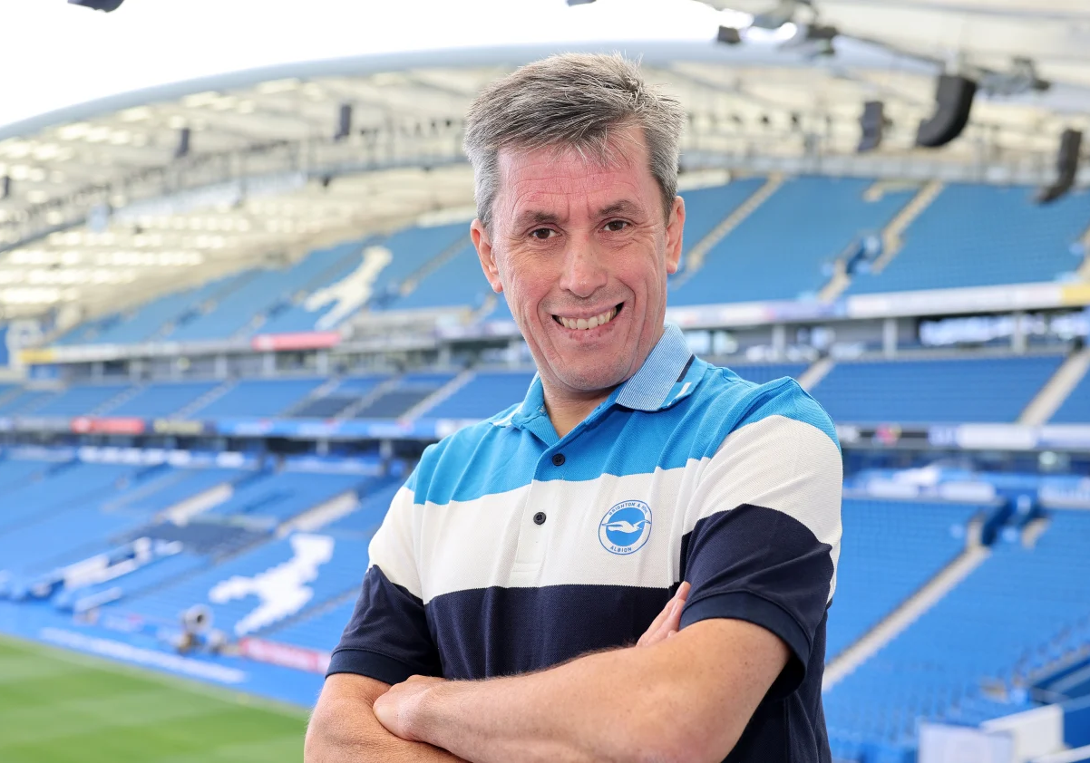
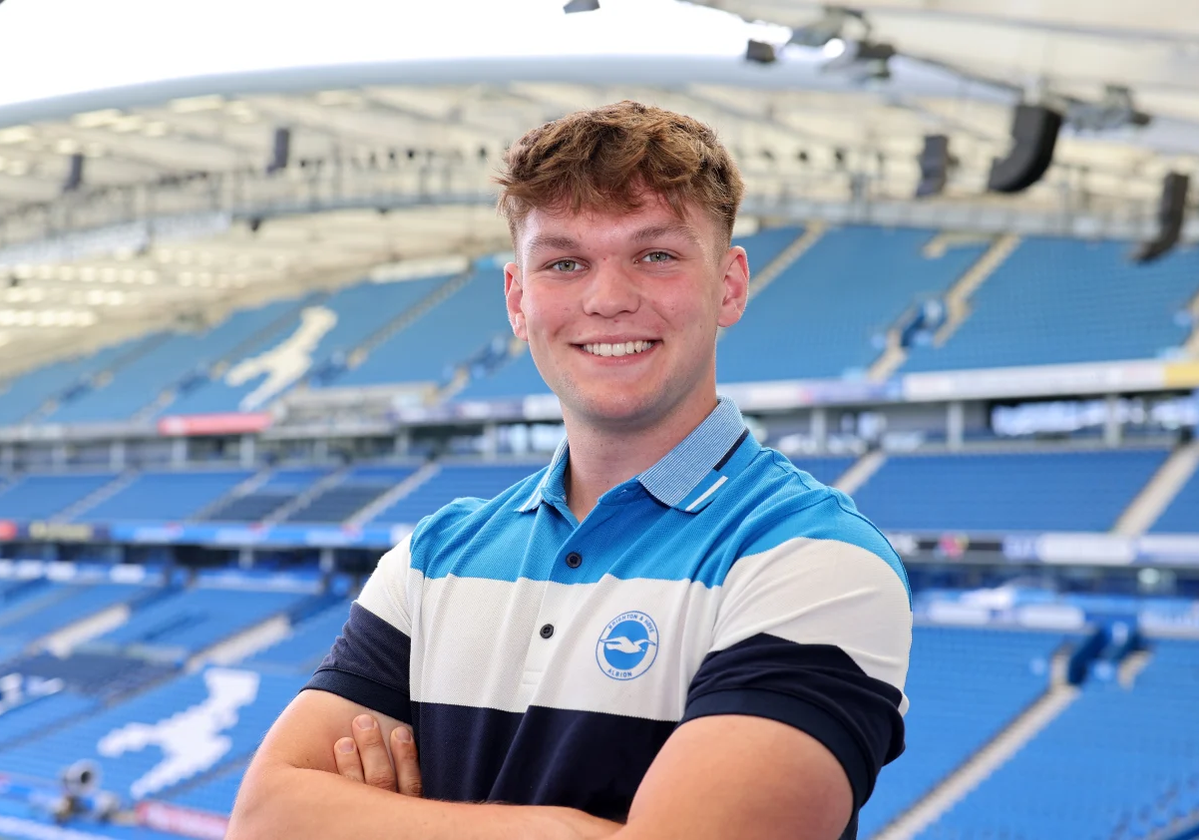
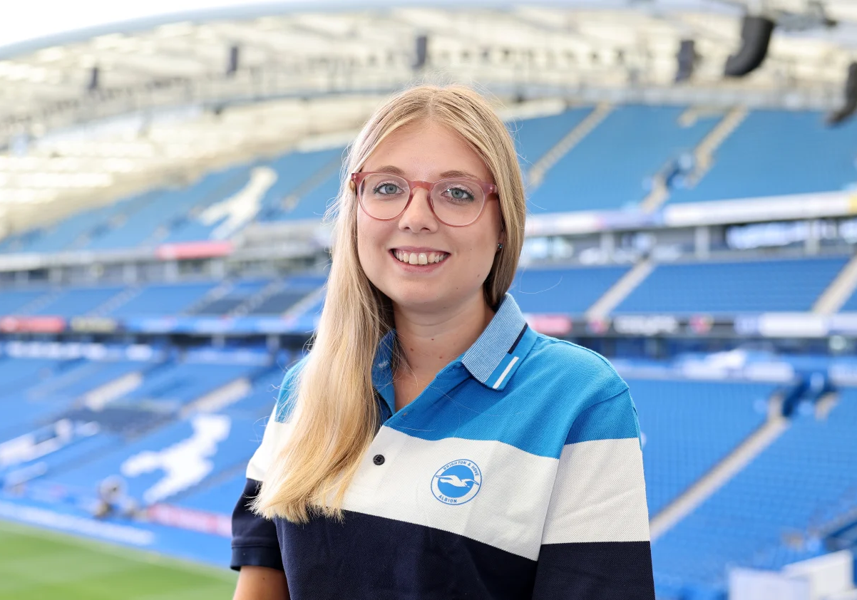
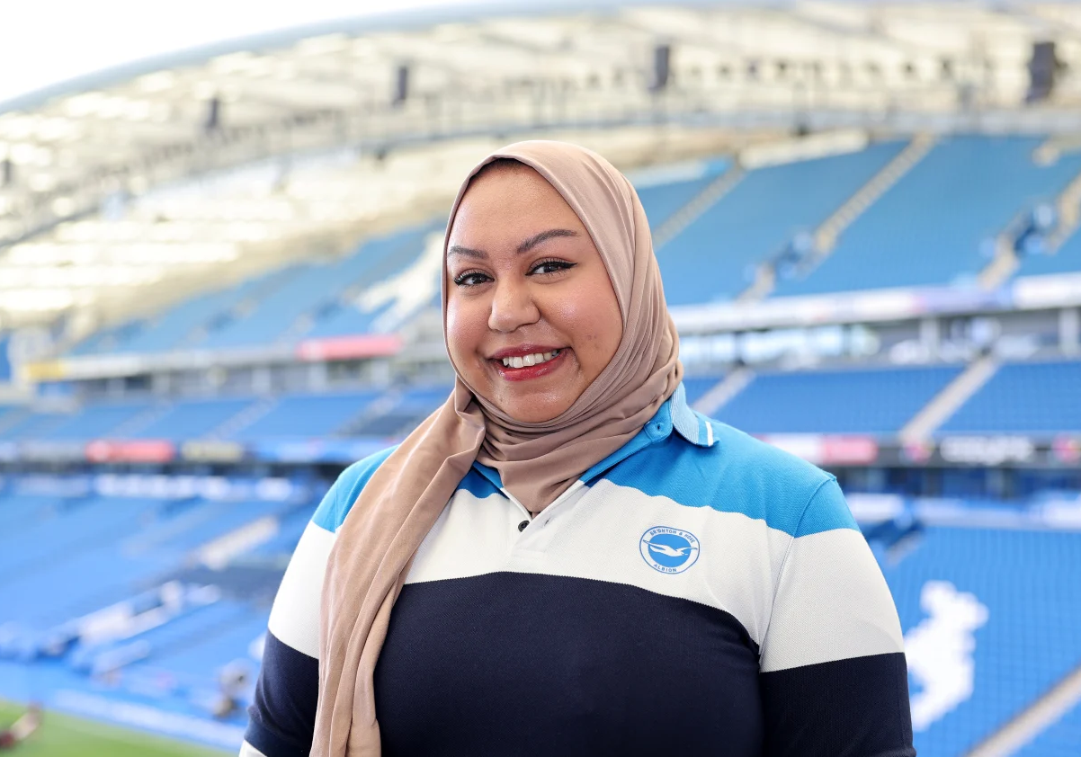
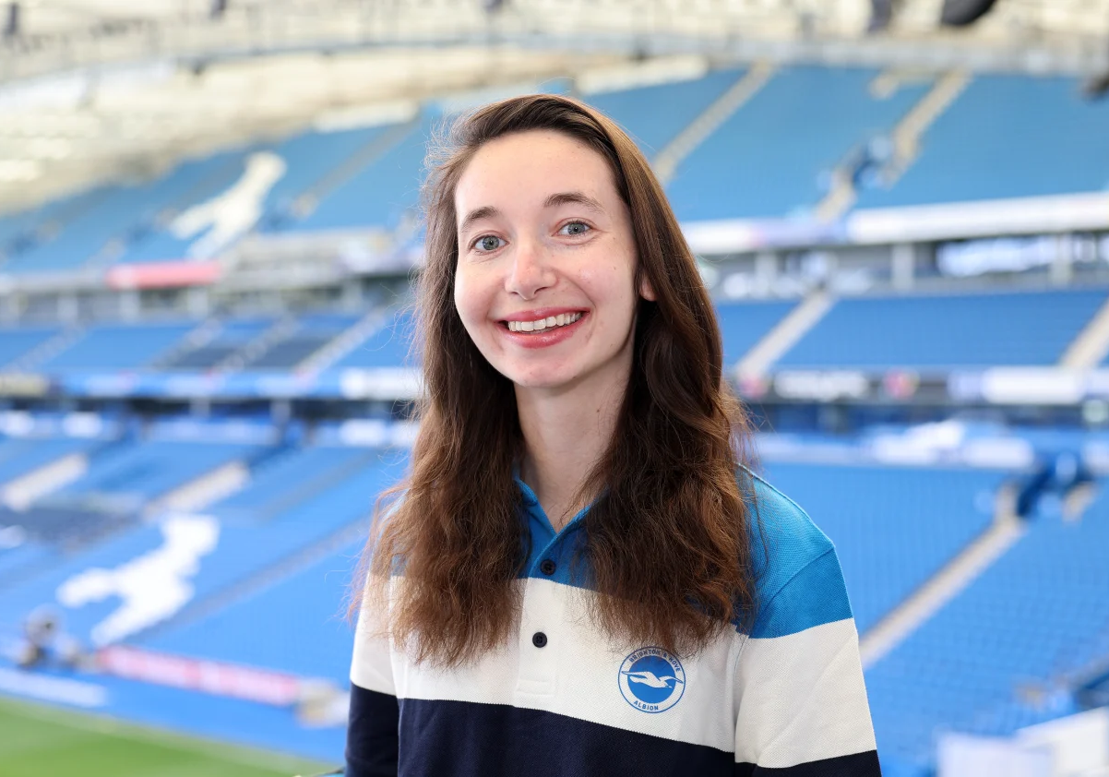
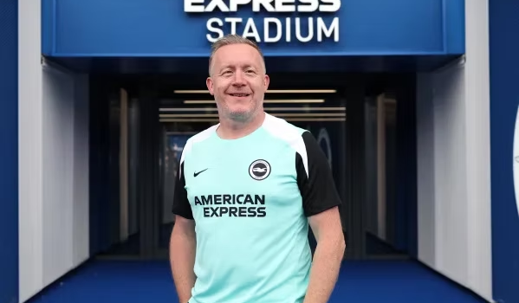
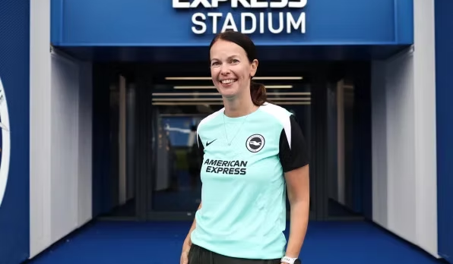
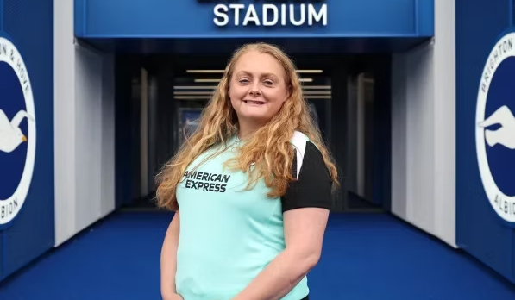
2025 – 2026 FAB TEAM
3RD YEAR
CHAIR
2ND YEAR
VICE CHAIR
1ST YEAR
Website designer
Journalist
Family Member

Slide 3
SUPPORTING CLUB INITIATIVES & PROJECTS
1901 Club
Pub team presentation and pricing discussion.
125 Celebrations
Anna Easthope presentation on milestone events.
PL Standards
Supporting the Premier League Fan Engagement Standard.
Ticket Sharing
Consultation on Season Ticket policy changes.
Fan Flag Designs
"Tribal, urban, and iconic" theme with North 9.
Match Pricing
Men's and Women's season ticket pricing strategy.
Safe Standing
Consultation process for safe standing areas.
Heritage Wall
Discussion on new design and sustainable materials.
BHA Heritage
Brighton Museum collaborations and heritage projects.
Albion Allies
Iftar events, Samaritans support, and Foundation work.
FAB Recruitment
New process devised with EDI lead.
Women's Travel
Increase in away travel coaches and fan uptake.

Slide 4

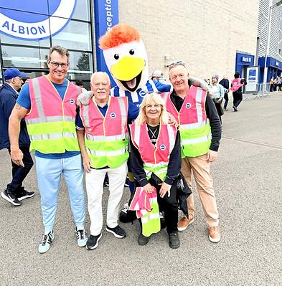
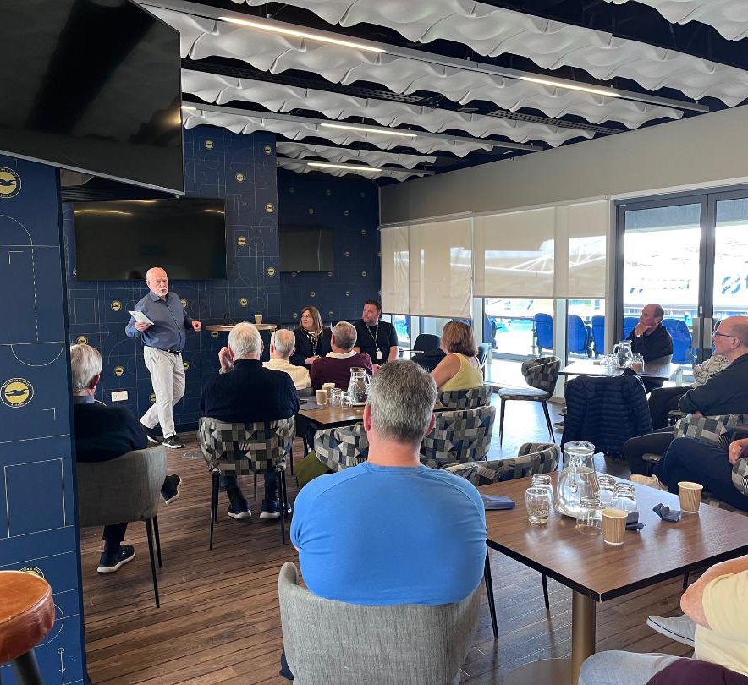
FAN ENGAGEMENT & ACTIVITIES
Core FAB Engagements
Fortnightly (Monday evening) call with the FAB team
Fortnightly Chair calls with Jenny Gower
Liaising with marketing (pie tasting, flag deployment) and operations to enhance the match day experience
Premier league meetings – men and women
Working party groups
Attendance at on site quarterly meetings with Jenny Gower
Attending fan group events
Monitoring FAB emails
New Digital Presence
Launch of the new FAB website: BHAFC Fan Advisory Board
Community Reach
• 13 UK based supporter groups
• BHA Heritage Society
• Brighton Museum
• BHA Foundation
Guest speakers: Jenny Gower, Anna Easthope, Russ Woods, Rose Reid & Joe Jenkins
Engagement Highlights
Iftar celebration
SAMARITANS: Together Against Suicide
Terrace 1st year celebrations
Supporting Foundation events
Commercial support: pie tasting!

Slide 5
WOMEN’S TEAM UPDATE
Supporter Groups & Media
2 new groups formed: Gulls Aloud & Seagulls over Sussex
SheGulls: Weekly podcasts and dedicated reporting
Fan of the Year Award presentation
Fan Travel & Growth
Doubled coach travel to away games from previous year
Global reach: Travelling fans from Kissimmee
Home & Away support: Club coaches & Seagull Travel
Match Day Experience
Fan interaction: Swap shop, song sheets, and drums
New stadium announcement driving excitement
Focus on growing the fan base through collaboration
Season Highlight
WFA Cup Final!
Major achievement for the women's side this season.

