Slide 1
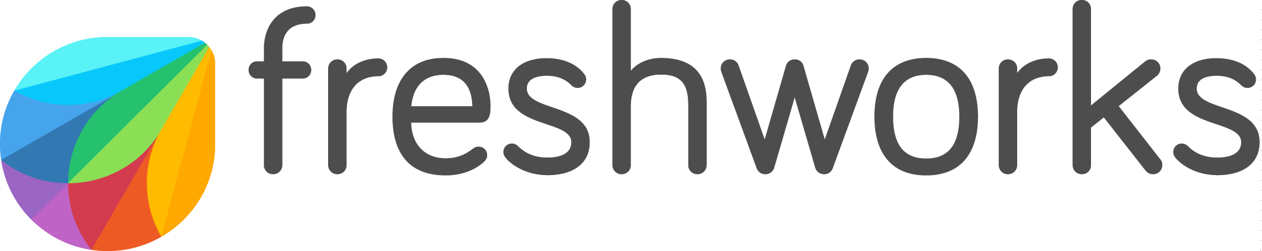

Delight Made Easy
We make it fast and easy for businesses to delight their customers and employees.
Notes:
All Live Features (March 2020)

Slide 2

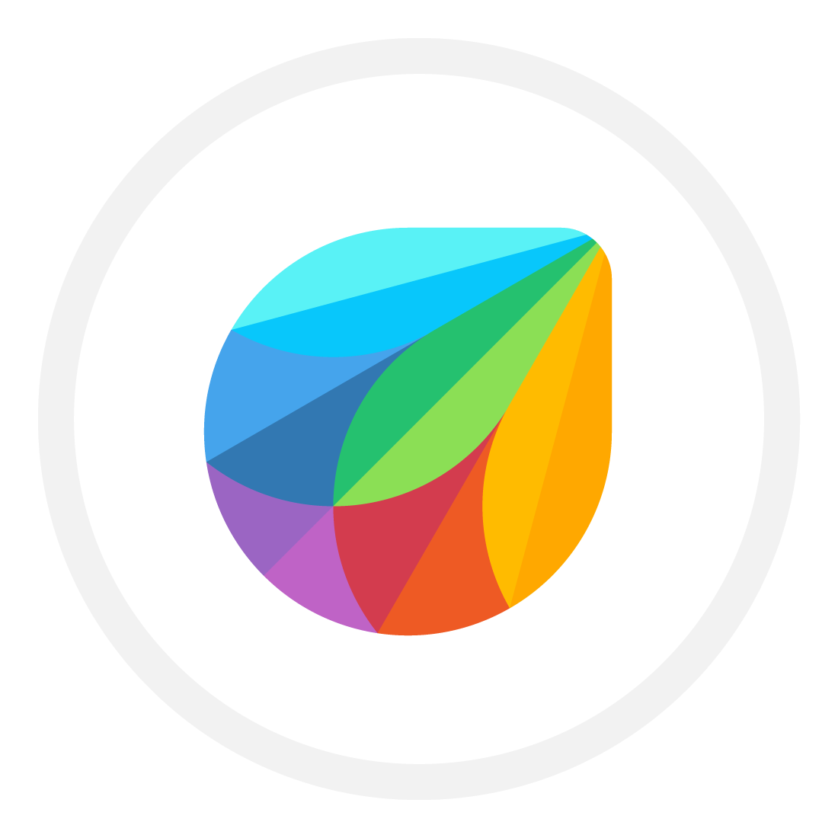










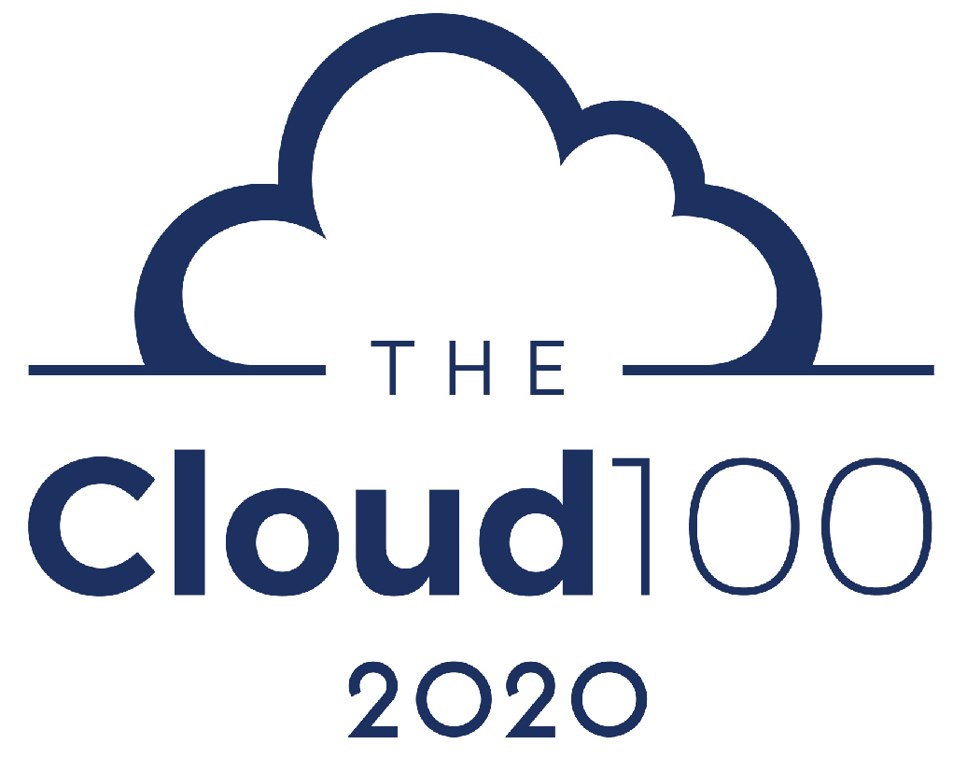





Freshworks at a Glance
NASDAQ
Listed
Founded in 2010
49% LTM Revenue Growth
Visionary in Gartner
52,500+ Paying Customers
4700+ Employees, 13 offices
350 Partners
Data Centres on 4 Continents
4.5 / 5 (5.5K+ ratings)
Notes:
With over 50,000 customers like you who trust us day in and day out, we have been growing at 40%+ YoY, crossing over $300M in LTM Revenue. What this means is that we’re at a size that we can serve customers regardless of scale, where ever they are are across the globe.
<Optional> And while we started in the SMB market, as our products have evolved we are increasingly serving the mid market and enterprise segments, which now makes up over 50% of our ongoing business.

Slide 3




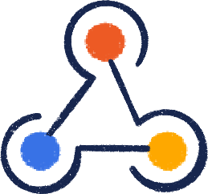
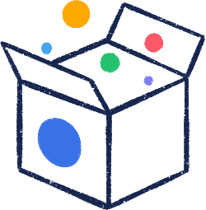




9 Segments where Freshworks is the
best!
Advanced Bots and AI
Better Agent Productivity
Advanced Automations
Easy Configurations
Truly
Omnichannel & Comprehensive
Self service
Wide Marketplace Integration Options
Secure Access to Sensitive data across teams
Effective Collaboration
Detailed Analysis

Slide 4



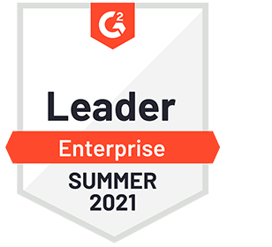




Industry Recognitions and Accolades
G2 Enterprise Leader Summer & TrustRadius Top Rated ITSM Tool
Only Challenger in 2021 Gartner MQ for ITSM Tools
Gartner Peer Insights Customers' Choice for ITSM Tools

Slide 5
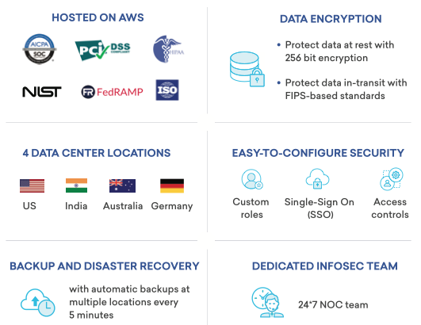
Top Security and Privacy Standards

Slide 6





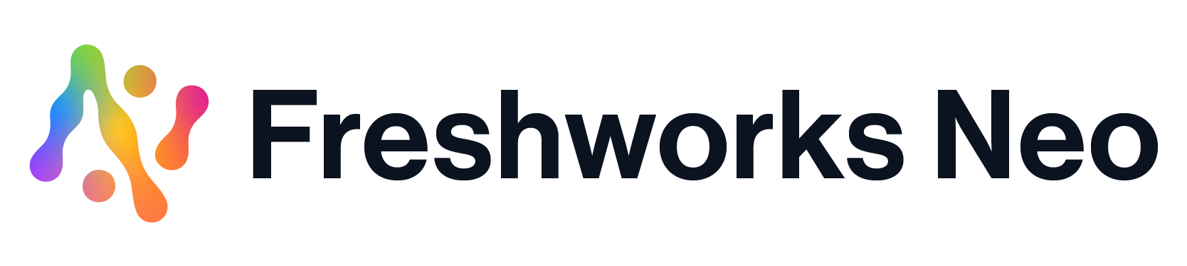
Freshworks’ Next-Gen SaaS Portfolio
Customer Solutions (CRM)
Employee Solutions
Customer Experience
Sales
Marketing
IT Service Management
HR Management
Platform
Customer’s Digital Workflows & Third-party SaaS Apps
© 2021 Freshworks Inc. – All Rights reserved. Confidential and Proprietary Information
Notes:
The Freshworks portfolio of apps represent a new generation of SaaS apps designed to deliver on that elusive SaaS promise. They are delightfully easy to set up, use, and scale. All of these solutions provide great user experience and a comprehensive set of out of the box capabilities. But we know that each of your companies has a unique set of requirements - based on the industry that you’re in, the location you operate in, and the types of business use cases you need. And these requirements may change over time. So you need the ability to customize and extend the capabilities of Freshworks products in ways that make sense for you and your users. You need a flexible platform.
The good news is that all FW products are built on a solid foundation of Freshworks Neo, a SaaS platform that addresses the challenges of legacy SaaS implementations.

Slide 7





Scalability Today Freshworks has..
3.4 Billion Daily ticket interactions
1 Billion API calls everyday
200 Million Serverless app executions per day
Serving
in
600 Million
contacts across all customers
150 Countries

Slide 8

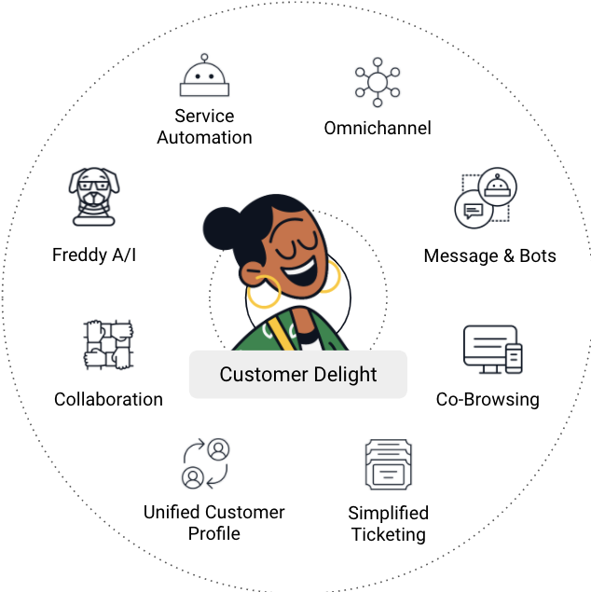



Delight Customers Effortlessly
with Freshdesk Omnichannel Experiences
Delight Customers Anywhere
Have more meaningful conversations across the entire customer journey.
Master Service Excellence
Solve inquiries faster and provide highly personalized service.
Effortlessly Grow Customer Value
Proactively anticipate customer needs and convert more business.
Notes:
By becoming customer centric, you’re then able to delight customers effortlessly. If we look at the right side of the screen, you can see that the omnichannel capabilities enable you to have more meaningful conversations across the entire customer journey.
Service automation, collaboration and simplified ticketing helps you to solve inquiries faster and provide highlight personalized service
While AI, Messaging and Bots, and ada Unified Customer Profile enables agents to proactively anticipate customer needs and convert more business.

Slide 9
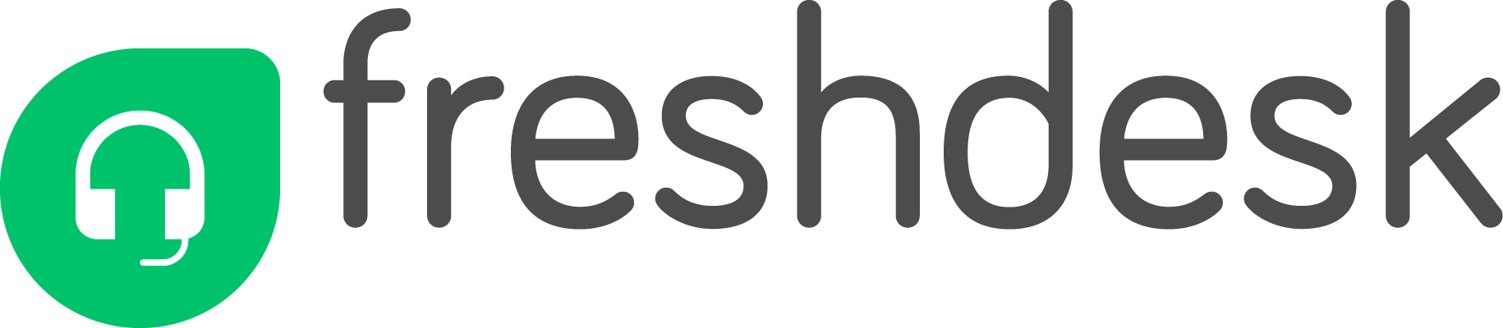





Breaking silos: resolving 94% of 4 million queries in the first interaction
Business Challenge
The Solution
About Customer
Fastest growing broadcasting companies in South Africa with 20M subscribers across Africa
Multiple tools for providing support over different channels and inability to measure KPIs.
Replaced 6 tools with Freshdesk Omnichannel for seamless, integrated, and consistent customer journey with FCR of 94%.
Incumbent Systems Replaced
© 2021 Freshworks Inc. – All Rights reserved. Confidential and Proprietary Information
Notes:
Once you can harness the power of digital-first customer engagement, the benefits are breathtaking. Multichoice is the fastest growing broadcasting company in South Africa with 20 Million subscribers. They consolidated multiple tools with Freshdesk Omnichannel. As a result, they assessed 4 million inquires anf found that 94% were resolved in the first interaction.
Key takeaway:-
Unifying tools has provided them a single view of the customer journey across touchpoints
Greater context has resulted in an extremely large percentage of queries being answered in the first contact
Reference:- https://docs.google.com/presentation/d/1h-aCmCSRFOEyJnwvW9rfXt1Gii1NHl4ByzxtL3auyLk/edit?ts=6047808e#slide=id.gc441b88861_0_380

Slide 10
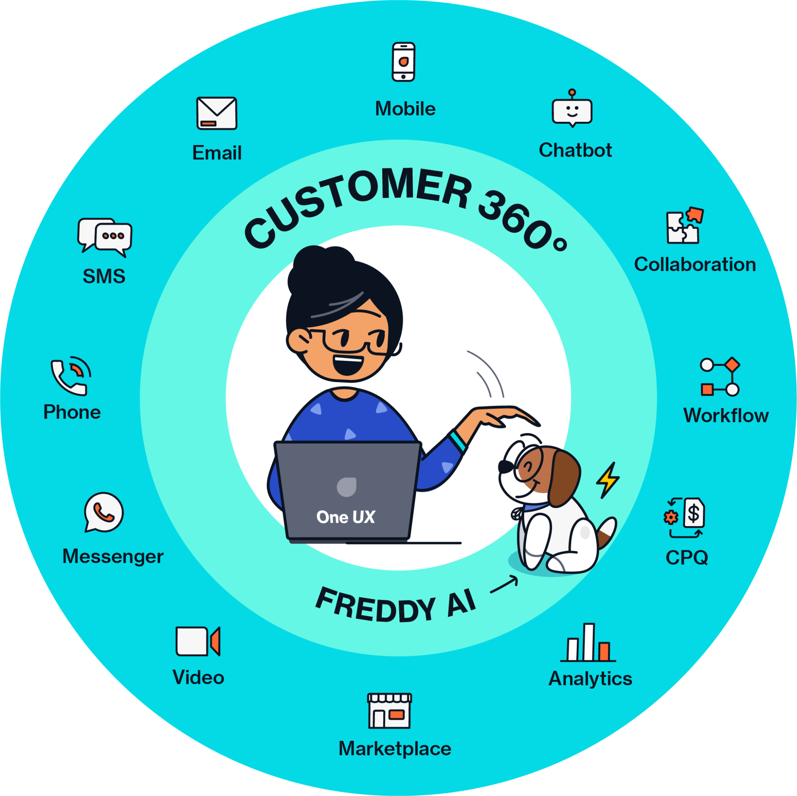
Unite sales & marketing around the customer
Freshsales Suite
Attract and engage the best leads, faster
Adopt a digital-first CRM fast and customize with ease
WIth powerful automation + AI based scoring to surface top leads and engage them easily
An all-in-one, ready to use sales & marketing suite avoids costly SIs/onboarding and complex integration
Grow relationships with single, built-in 360 view
Optimize campaigns, pipeline, and forecasts
With ready to use 360° intelligence that brings sales, marketing & support data into a single view
With unified pipeline analytics & forecasting for revenue predictability and fast course correction
Notes:
The Promised land with Freshworks: Here we showcase the breadth of our capabilities with an ‘all-in-one’ solution - all the features they need, ready-to-use together to know their customers best. Emphasize the value propositions that best align to your customer’s unique business drivers, and call out the ‘built-in’ features in the circle that address their goals.

Slide 11




Freshworks CRM Case study
Clopay empowers customer support and marketing teams to grow customer value with a single C360 view
About Customer
U.S. garage door manufacturer with distribution via dealers and larger commercial accounts.
Business Challenge
The Solution
Used <50% of legacy CRM functionality. Needed more integrated, cost effective alternative.
Replaced 5 separate systems with a single, simplified customer tech stack with a unified platform.
© 2021 Freshworks Inc. – All Rights reserved. Confidential and Proprietary Information
Notes:
Present Evidence: Now it’s time to convince the prospect that if they go with FW, we WILL help them achieve sustainable growth, but presenting relevant success stories. You will want to customize this use case by industry and your customer’s unique business profile.
This customer engaged us first for caller/chat to modernize their current Oracle tools that were being deprecated, the expanding the sale to include Freshdesk and CRM. Good MM use case in MFG, where they were not getting the value the wanted from an expensive, disconnected system like Oracle, and appreciated our simplified IT stack, and built in omni channel capabilities.

Slide 12




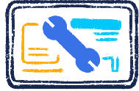



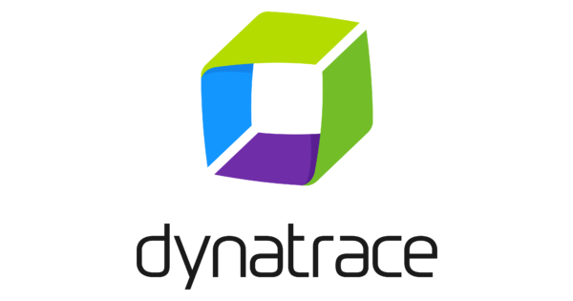

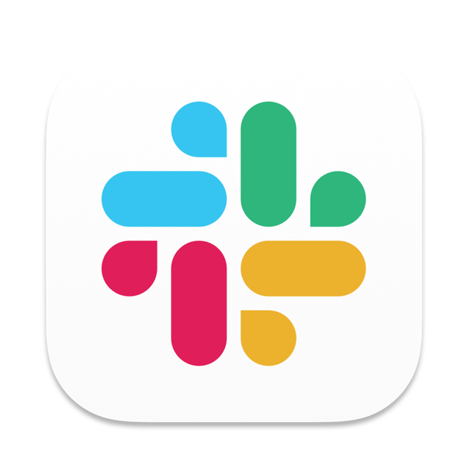

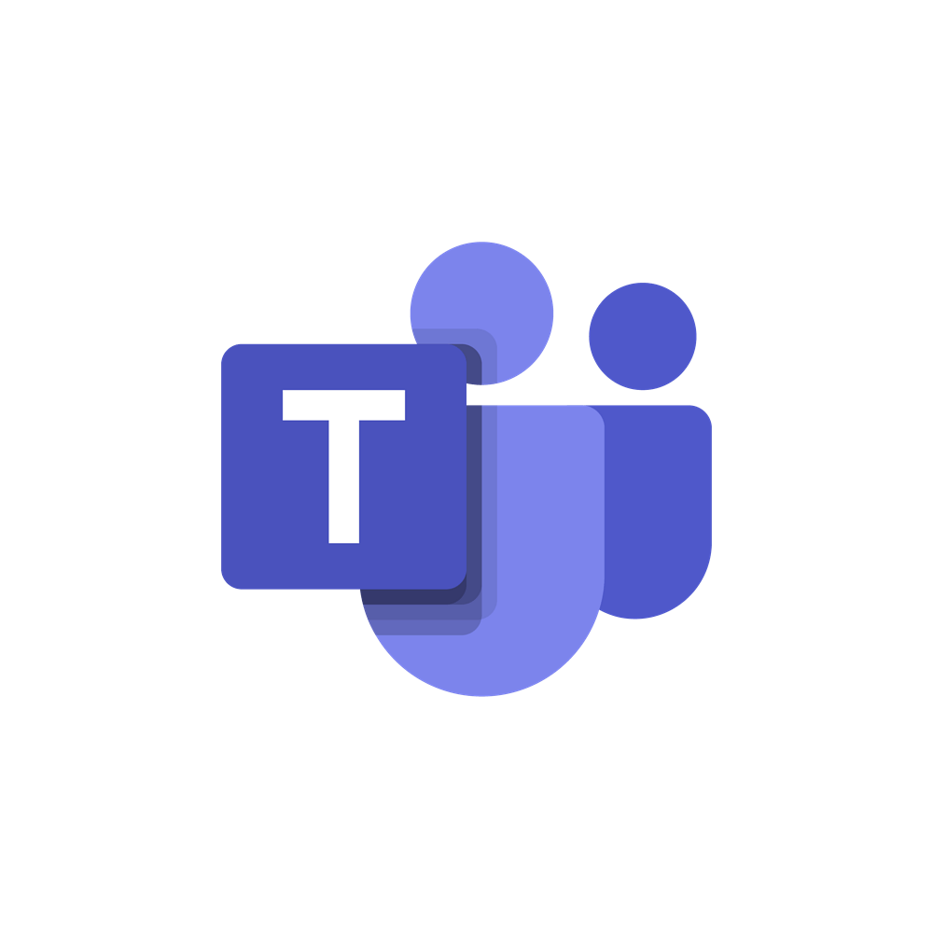
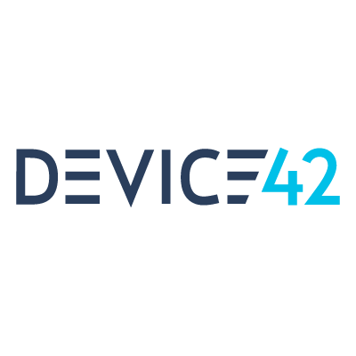


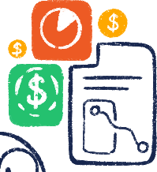



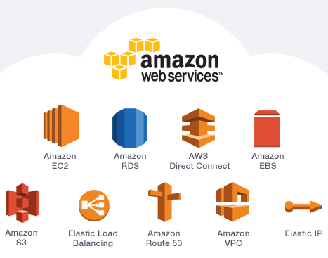



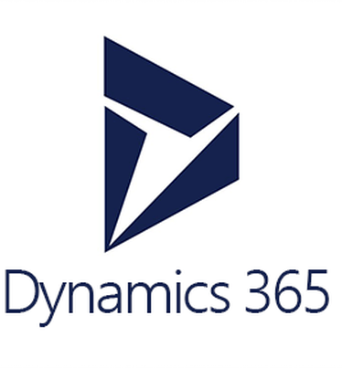





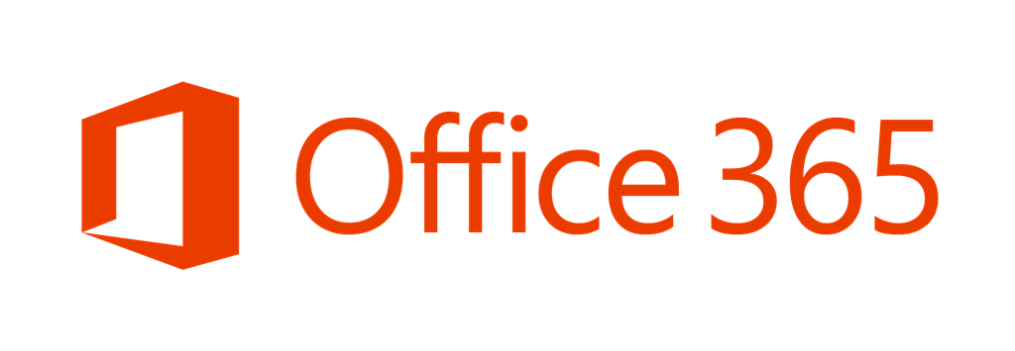


Freshservice - A platform Cross-section
Simplifying ITSM
APPS
Employee
Experience
Agent
Experience
ITSM
& ESM
PPM
& Analytics
ITAM
& ITOM
ITIL
Automation
CMDB
INC, SR, CR
PPM
On call
Orchestration
Workflows
Omni Channel
Platform
AI
Phone
Virtual Agent
Chat
Email
ML &
Insights
PLATFORM
Custom Apps
Customer Records
Analytics
Security
Collaboration
© 2021 Freshworks Inc. – All Rights reserved. Confidential and Proprietary Information

Slide 13






What you see is what you get
ITSM
ITOM
ITAM
PPM
ESM
Employee focused, modern service management
Cut through alert noise, manage critical incidents and minimize downtime
Future proof your CMDB and optimize process and spending
Plan, execute, and deliver projects on time with enhanced PPM
Unified service management across all business functions
Notes:
Key Takeaways:-
Product capabilities that go beyond the table stakes offered by pure play vendors with focus on automation and omnichannel
Capabilities catering to teams beyond the traditional customer service team - solutions for allied functions like support operations, customer success and field service management as part of our offering for the CX buyer
Intelligent Automation -
Automation across the support lifecycle
Deflecting queries raised by end-customers
Boosting agent productivity by
automating workflows like triaging tickets, remote onboarding through agent assist that take up agent time
Automating process executions on 3rd party systems through API integrations on agent assist bot and RPA connectors to reduce dependency on external teams and systems
Omnichannel engagement - to provide a single view of the support business for agents and admins
Ticket routing to the right agent available on the right channel with the right skillset
Customer timeline to get complete context of past interactions and journey across touchpoints
Bringing in additional members to help on tickets through collaboration capabilities
Key metrics across channels in a single view for admins to get a birds eye view of their support operations
Extending customer service - To offer a single integrated solution for the CCO org, across support services, support operations and customer success. Other vendors in the market rely on loosely coupled integrations with 3rd party vendors for these capabilities

Slide 14



AmexGBT implements Freshservice in 3 months and sees 70% ROI
“
Due to constraints produced by the pandemic, reducing costs by any means necessary became our #1 mandate. We needed a solution that we could operate with a reduced staff and a company willing to work within our price range. Freshworks came to the rescue!
Challenges
Solutions
Overcome outdated and often unnecessary service management tools and methodologies
Eliminate staff to manage minor upgrades
Reduce budget and maintain current core capabilities
Provide consistent experience
Modern no-code/ low-code platform simplified service management processes
In house, fully accountable onboarding and success team
Flexible long-term view of the partnership
Single digital entry point for all requests providing a consumer-like user and agent experience
David Levin
CISO at Amex GBT
About Customer
EFFICIENCY
PRODUCTIVITY
SATISFACTION
The world’s leading business partner for managed travel.
-
< 3 months
70%
SLA change despite staff reduction
Go-live, and to rip-and-replace ServiceNow with Freshservice instance
Reduction in cost/agent
Case study
Copyright Freshworks Inc. 2021 Freshworks Inc. Confidential and Proprietary Information
Notes:
Amex GBT distressed heavily because of COVID shutdown.
Coming up on SNOW renewal.
SNOW gave them over a 100 SKU from renewal. They wanted to partner with someone who can see through covid, but also work with the End-user folks.
Business challenge wasn’t a product challenge.
Relationship with SNOW was 10+ years.
Over-customization
12 month back-in-the-box project. Just to get back in the box.
Our value-prop:
MTTV : 16-week timeframe. Kicked-off just today.
Meet SNOW’s functionality on end-user experience.
Engage with them on all levels of leadership. Relationship/ Partnership was key to winning.
An in-house onboarding team can do a lot of heavy-lift.
Wanted a vendor that not only is able to deliver the product, but can onboard them within the realm of FS team.
Differentiating factor:
Marriage b/w FS and FChat was very attractive.
Our Messaging: This interaction will only get better as we get into 2021 because of the Virtual Agent and BOTS.
Being upfront and candid about what our product is and what our product can deliver.
Level of winning stakeholders’ trust and conviction

Slide 15






























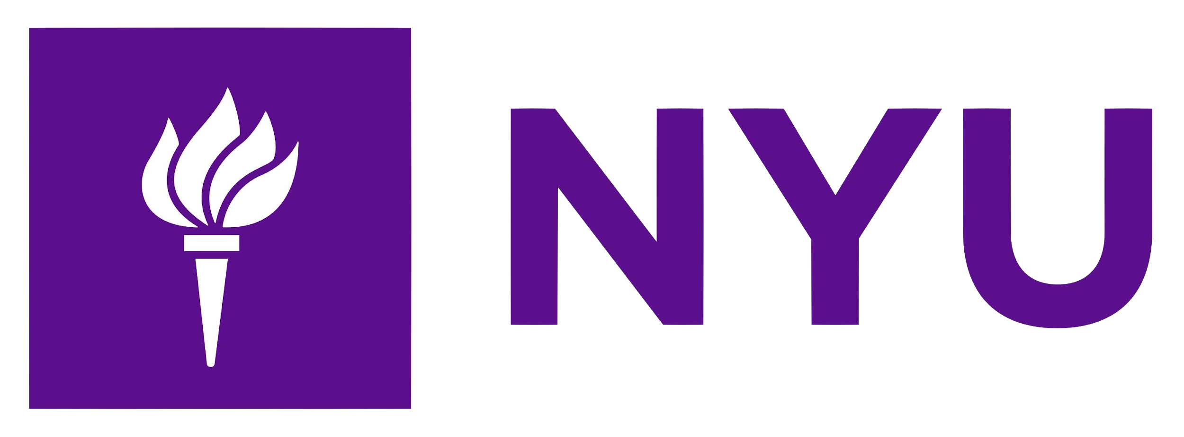




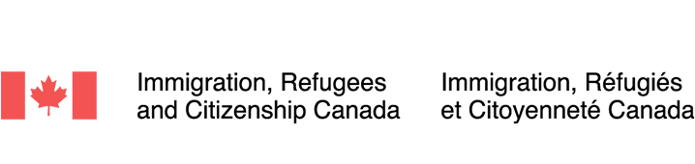

Trusted By Over 50K Growing Customers Across 120+ Countries
Technology, Media, Telecom
Automotive & Manufacturing
Financial services
Retail &
E-Commerce
Education
Government & Public sector

