Slide 1
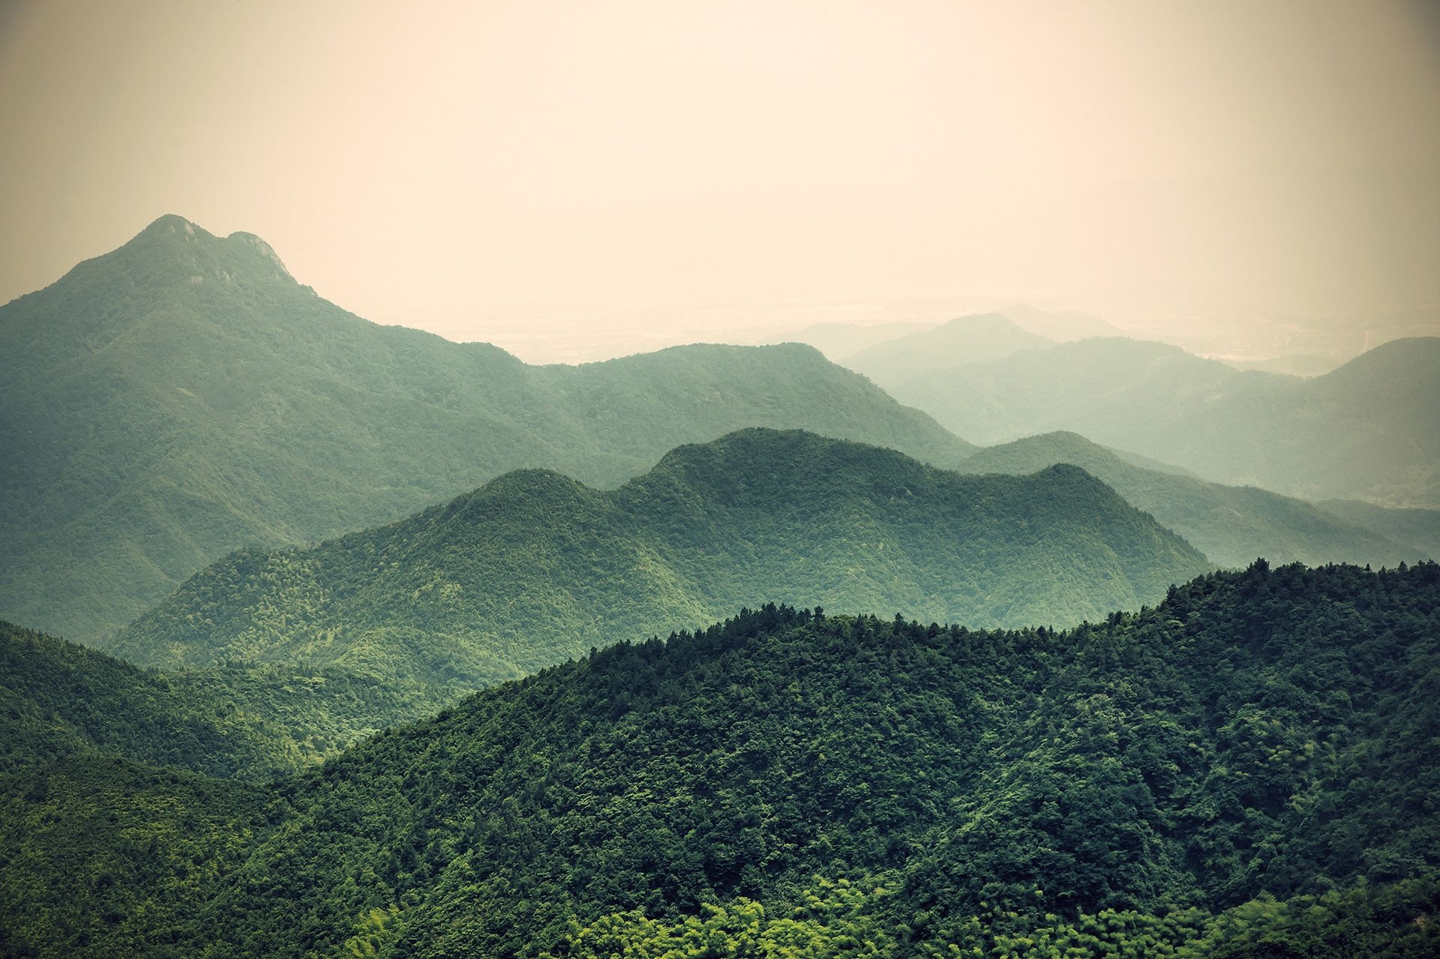
Bringing climate into your role as a Public Servant
(and busting myths about why you can’t!)
Peter Binfield-Smith
Senior Policy Advisor, Defra, UK Gov
Peter.Binfield-Smith@Defra.gov.uk
Notes:
[PETER]
Hello, welcome to our talk on lessons learned from building a cross-government climate and environment policy community, from the civil service climate + environment network
To introduce ourselves, (we can decide order later)
[Peter] - intro
[Charley] - hi I’m charley, one of the other three co-chairs. I lead on various sorts of content, including our website and all of its content (podcast, short educational videos, written articles), all of our communications, and our social media. I was also on the Fast Stream too, having finished in 2022, so it’s great to be able to come and talk to you all about this now.
Chris, our third and final co-chair, leads on all things development, including building training packages, running policy workshops, and forging connections across the civil service.

Slide 2

Bringing climate into your role as a Civil Servant
Learning objectives:
How to integrate climate literacy in daily tasks.
Ways that basic knowledge can drive impactful change
We’ll discuss:
Going beyond the basics
Three myths about your role and climate
How you can make a difference
Reasons to be hopeful

Slide 3
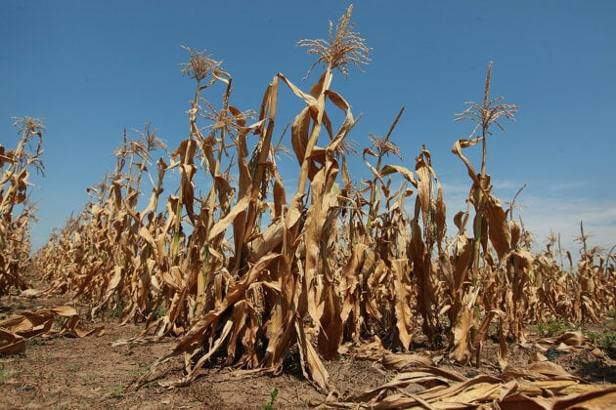
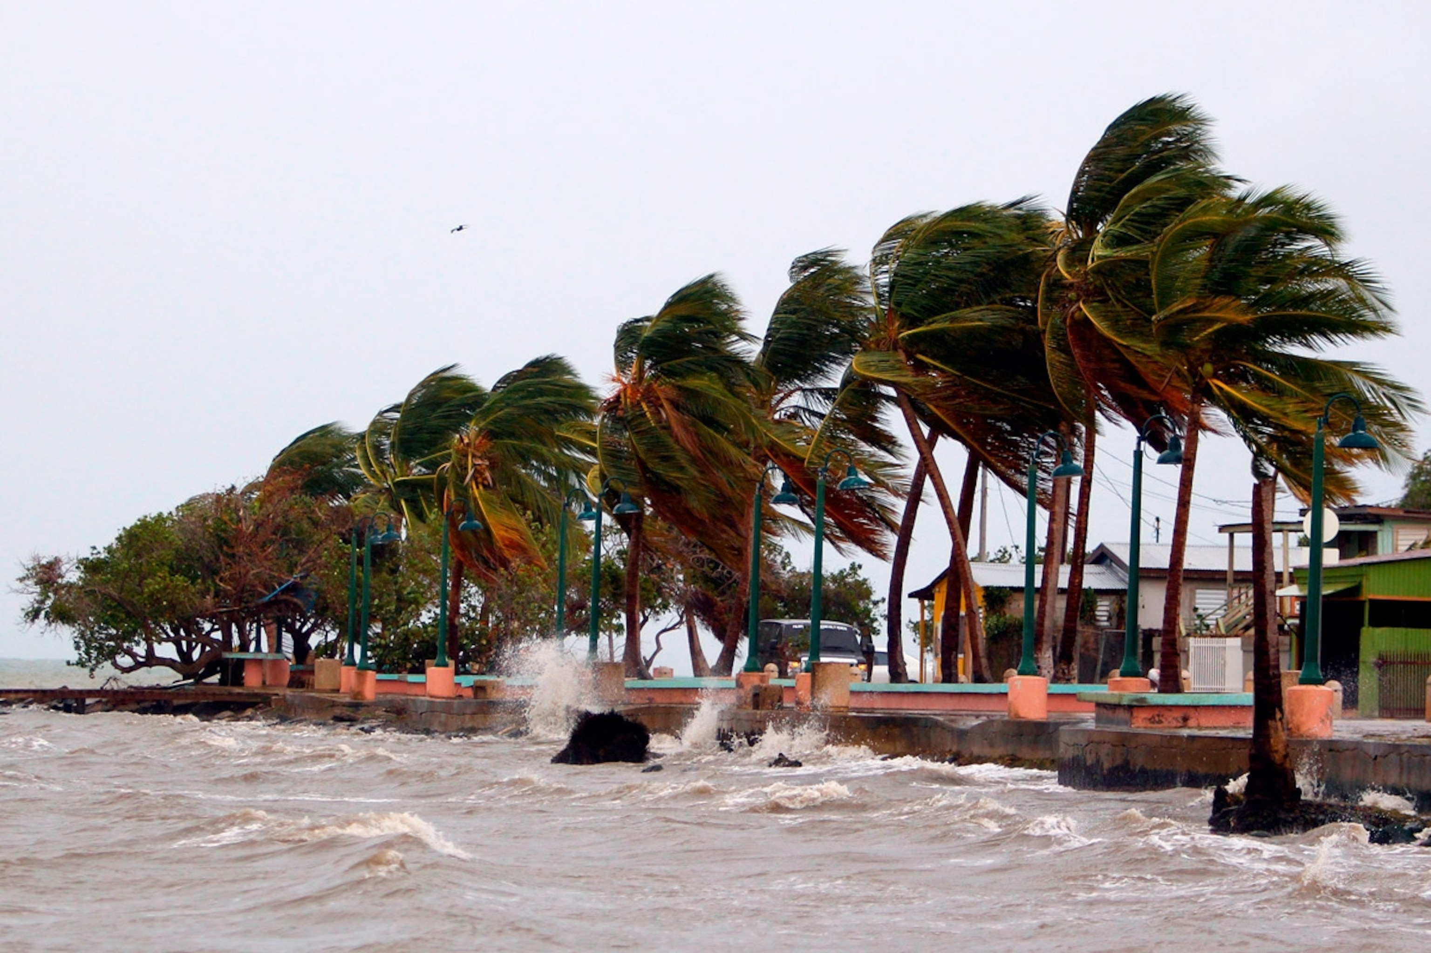
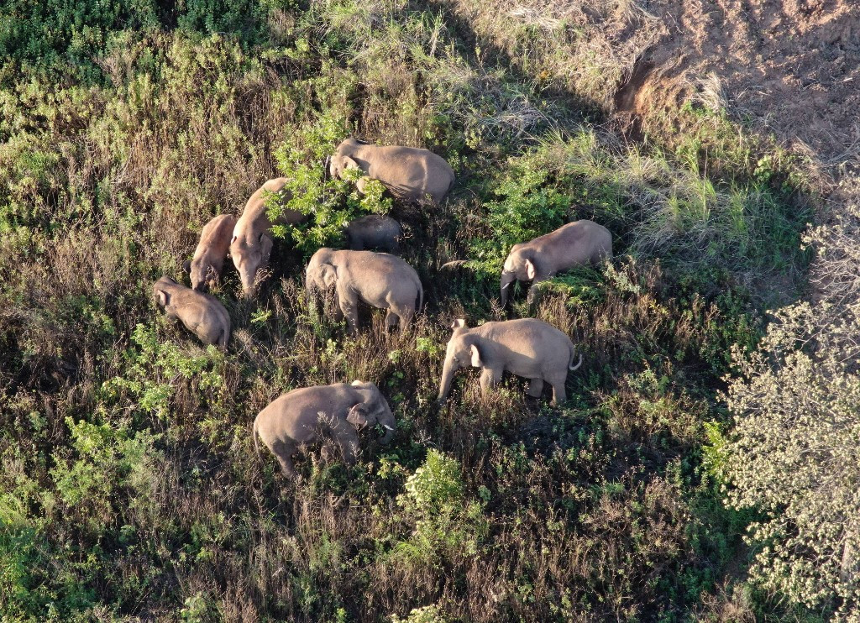
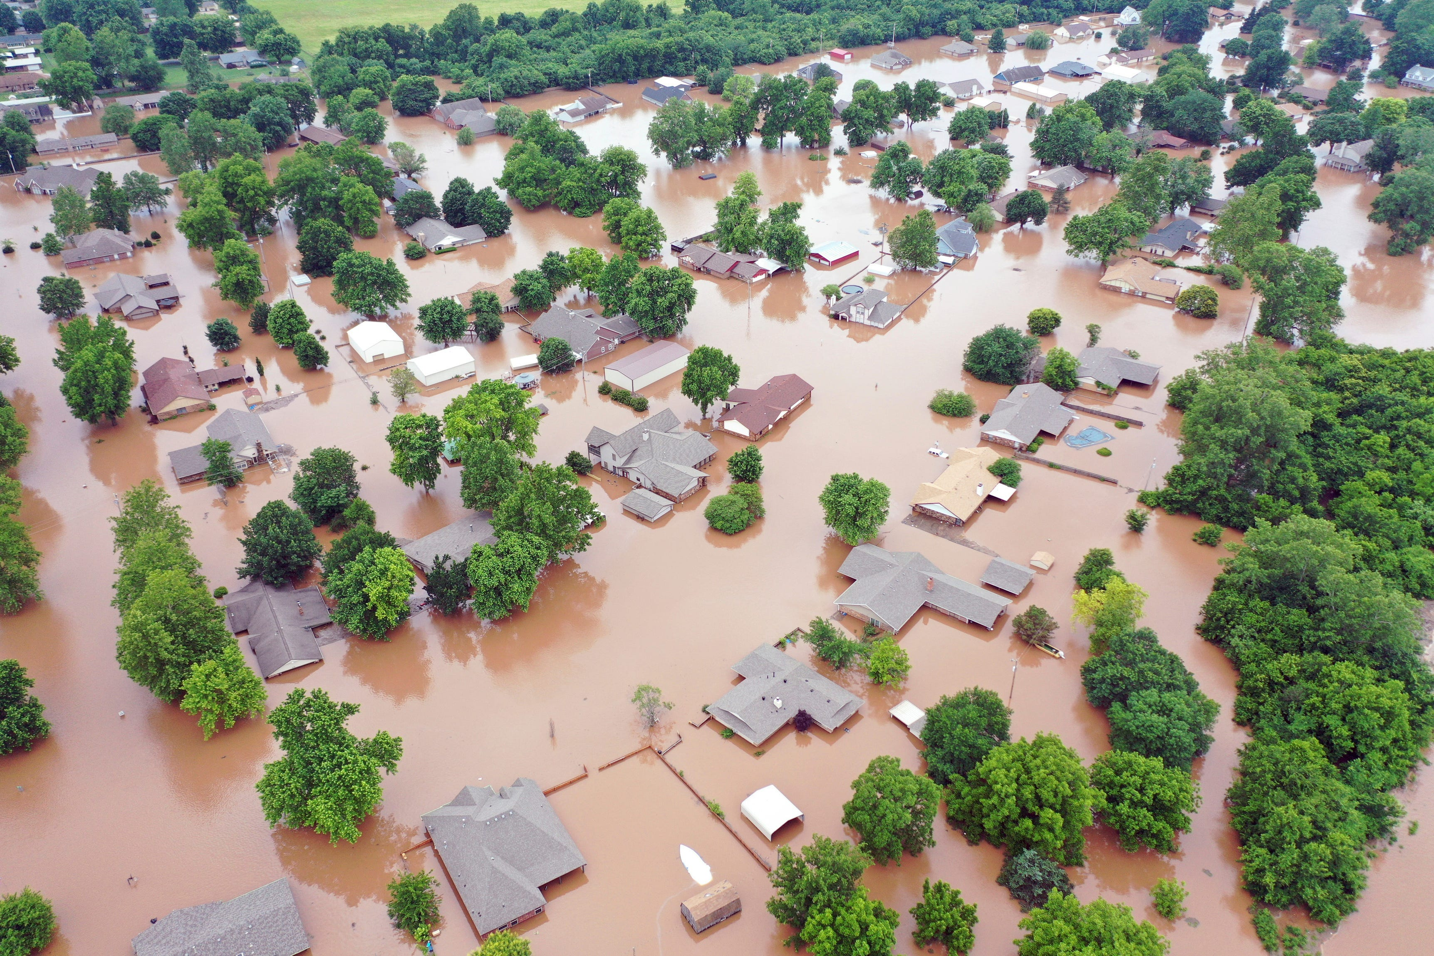
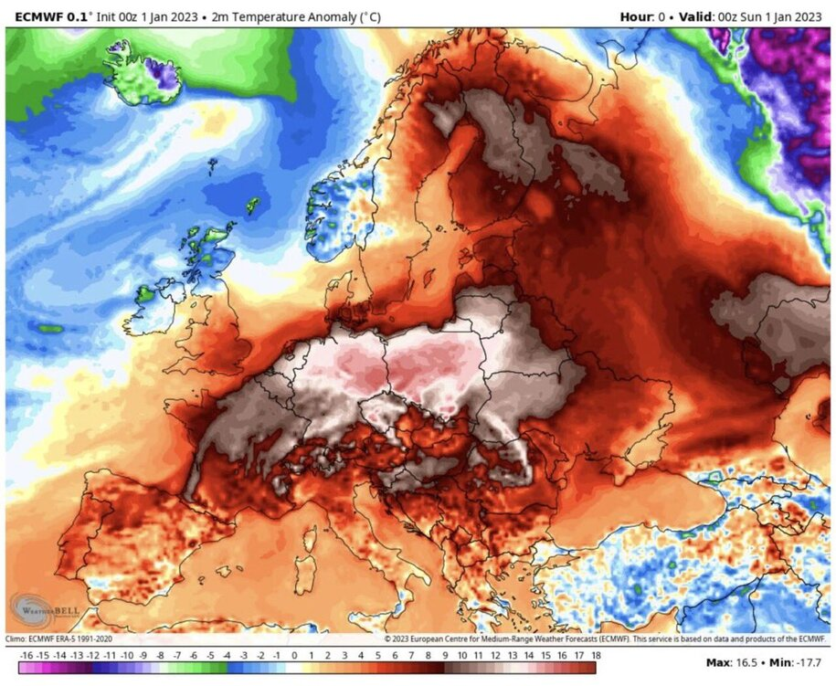
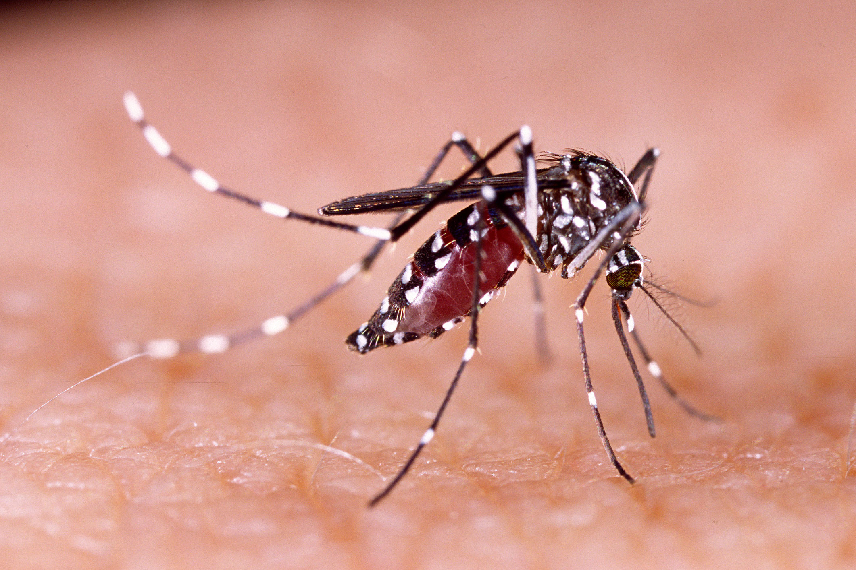

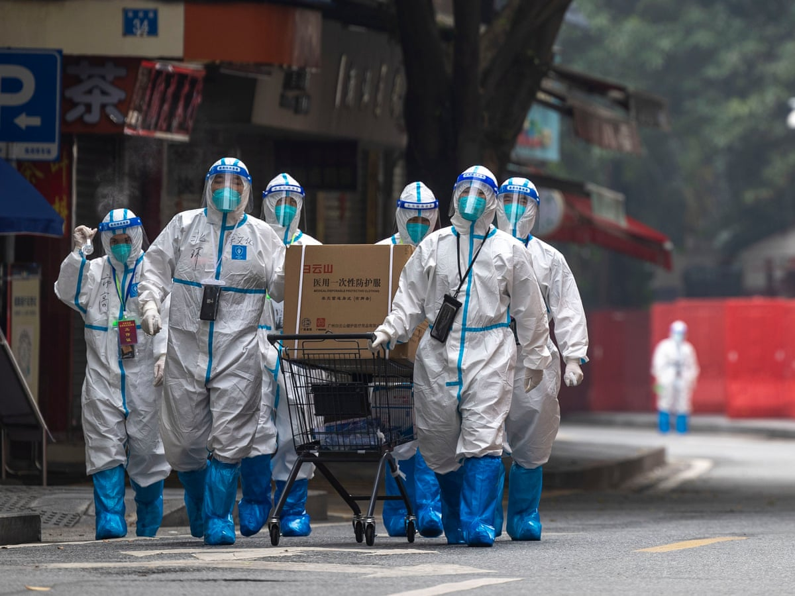

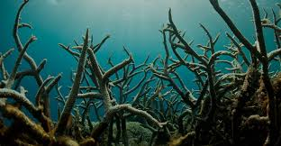

Slide 4
1) I don’t work in a climate facing role…
Recognise the diversity of sectors that impact, and are impacted by, climate and climate change
Find the connection to your area of work
Recognise yourself as potential agent of change
Start building your knowledge of climate impacts and solutions

Slide 5
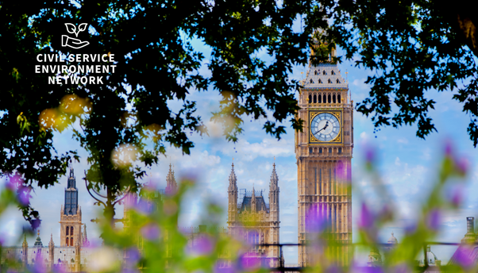
Recognise the impact you can have in your role
Champion climate in your team, division, or department
Seek out opportunities to make a difference
Be bold and get creative
2) But I’m not a decision maker…

Slide 6
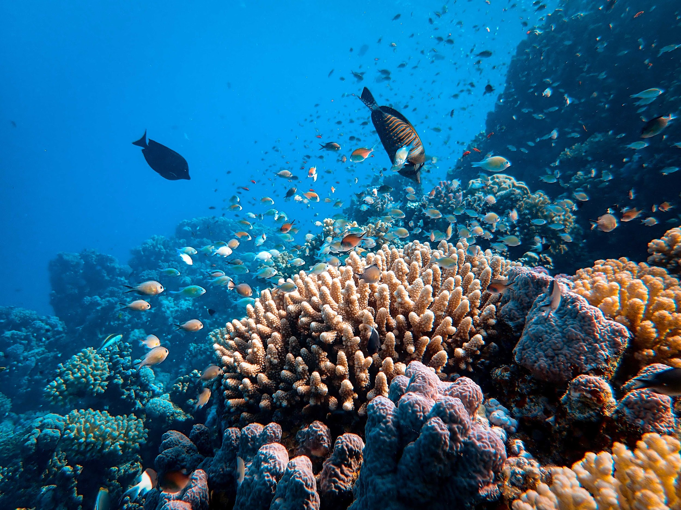
Seek out opportunities to learn more (or create your own)
You don’t have to BE an expert to KNOW an expert
Find others who want to learn
Build your network and connect
Speak up loudly and often
3) I don’t know enough about climate science…

Slide 7
