Slide 1
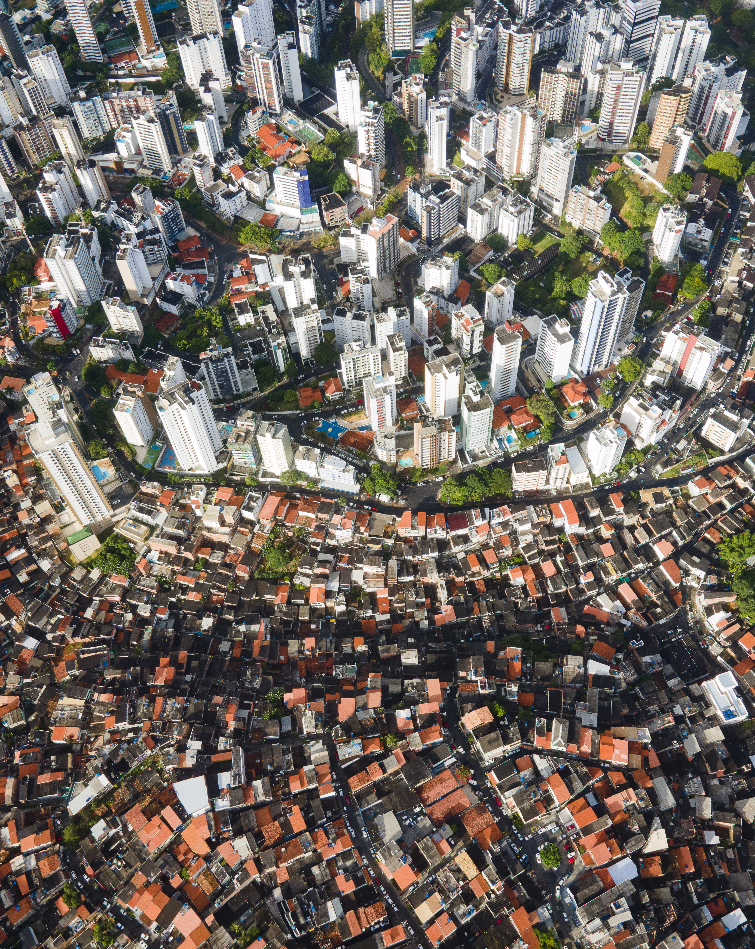

TOWARDS A MORE EQUAL CITY
Seven Transformations
for More Equitable and
Sustainable Cities
Apolitical webinar on Green Growth, Jan 2023 Dr. Robin King
www.citiesforall.org Robin dot King at wri dot org

Slide 2
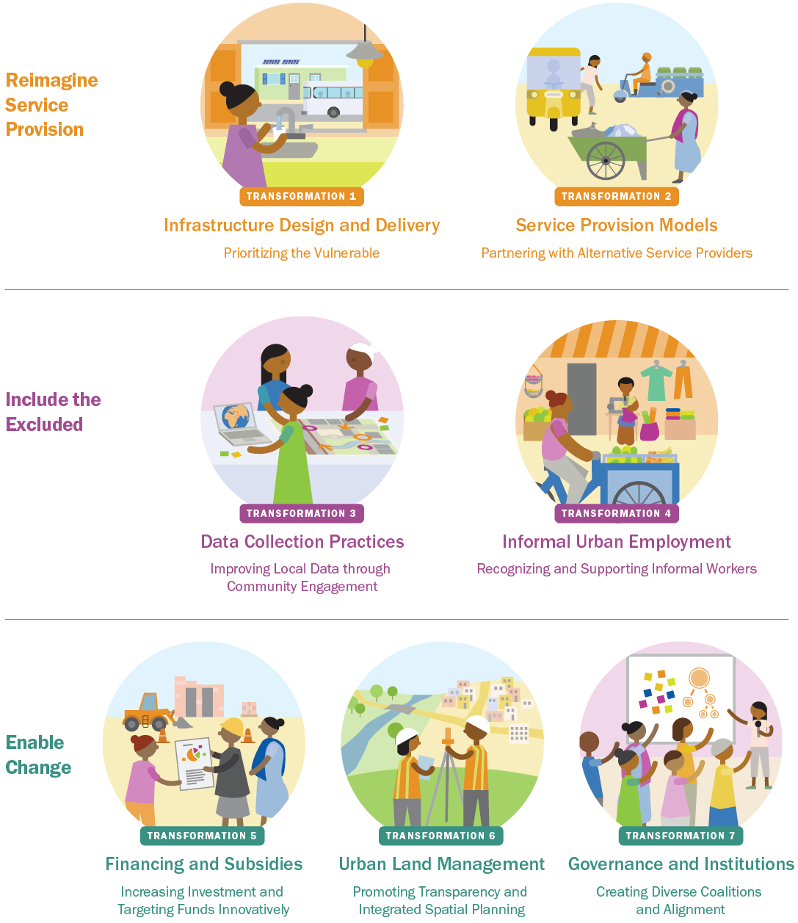
FINDINGS BASED ON 6 YEARS OF RESEARCH IN COLLABORATION WITH THOUGHT LEADERS: 7 Transformations for More Equitable & Sustainable Cities
Reimagine Service Provision
Include the Excluded
Enable Lasting Change
Source: World Resources Report (WRR) Synthesis, WRI, 2021, www.citiesforall.org
Notes:
These are the transformations, organized under the 3 buckets…..they are deliberately cross-sectoral to get the biggest return on investment. This gives cities a menu of options that can help close the urban services divide, improve equity, and trigger transformative change. They are clearly interconnected and that’s why acting on more of them will create synergies that lead to faster change.

Slide 3
FINDINGS BASED ON 6 YEARS OF RESEARCH IN COLLABORATION WITH THOUGHT LEADERS: 7 Transformations for More Equitable & Sustainable Cities
Enable Lasting Change
Source: World Resources Report (WRR) Synthesis, WRI, 2021, www.citiesforall.org
Notes:
These are the transformations, organized under the 3 buckets…..they are deliberately cross-sectoral to get the biggest return on investment. This gives cities a menu of options that can help close the urban services divide, improve equity, and trigger transformative change. They are clearly interconnected and that’s why acting on more of them will create synergies that lead to faster change.

Slide 4

Guidance for City government and urban sector specialists
Engage a diverse coalition of stakeholders
Commit to meaningful partnerships
Design processes for well-structured public participation in decision-making
Assess barriers to local planning and policymaking
Create demand for new legislation to ensure better policy coherence
www.citiesforall.org

Slide 5
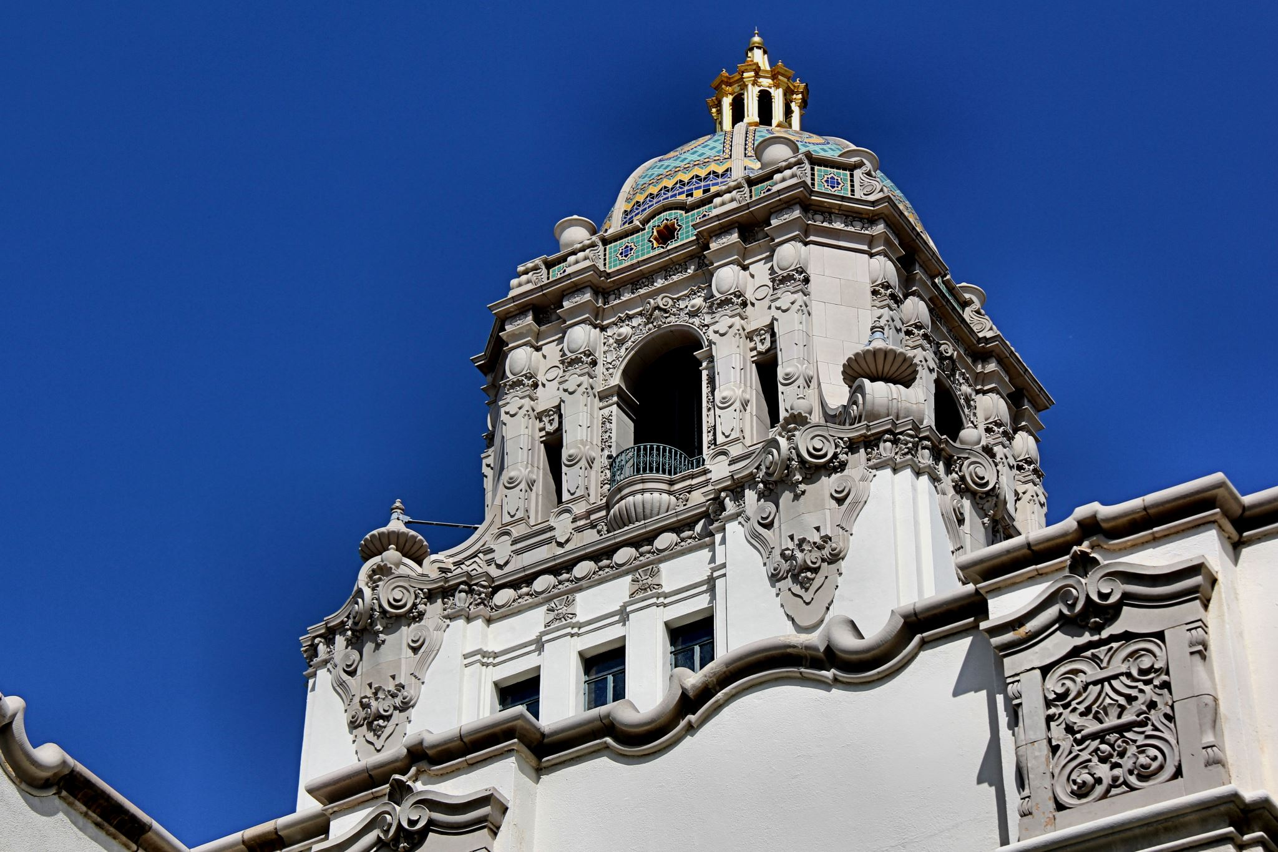
Guidance for National Government
Coordinate national initiatives with local priorities
Ensure public participation in decision-making
Provide a national shared vision and guidelines around resilience planning
Commit to knowledge coproduction and a common vision
Develop regulations and governance structures
Develop enabling national urbanization policies
Increase autonomy of urban governments
Develop financing mechanisms to incentivize inclusive service delivery
Build capacity to assess risks across multiple decision-making levels and establish corresponding institutional bodies
www.citiesforall.org

Slide 6
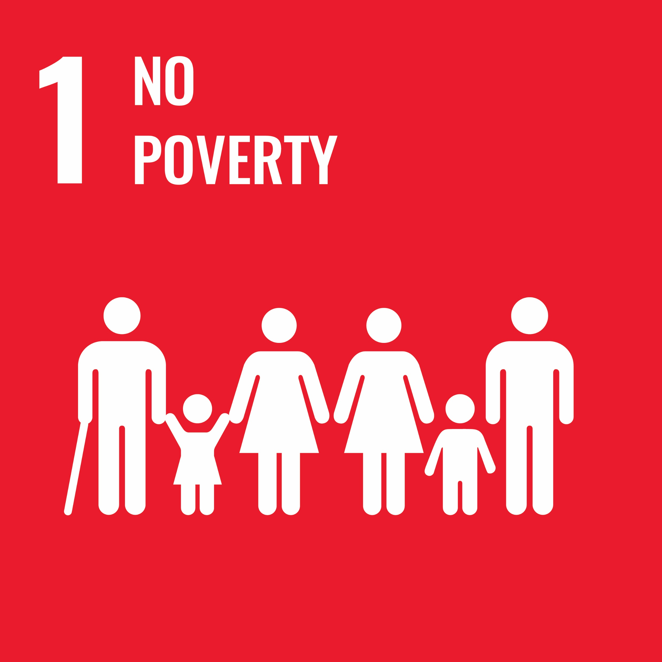


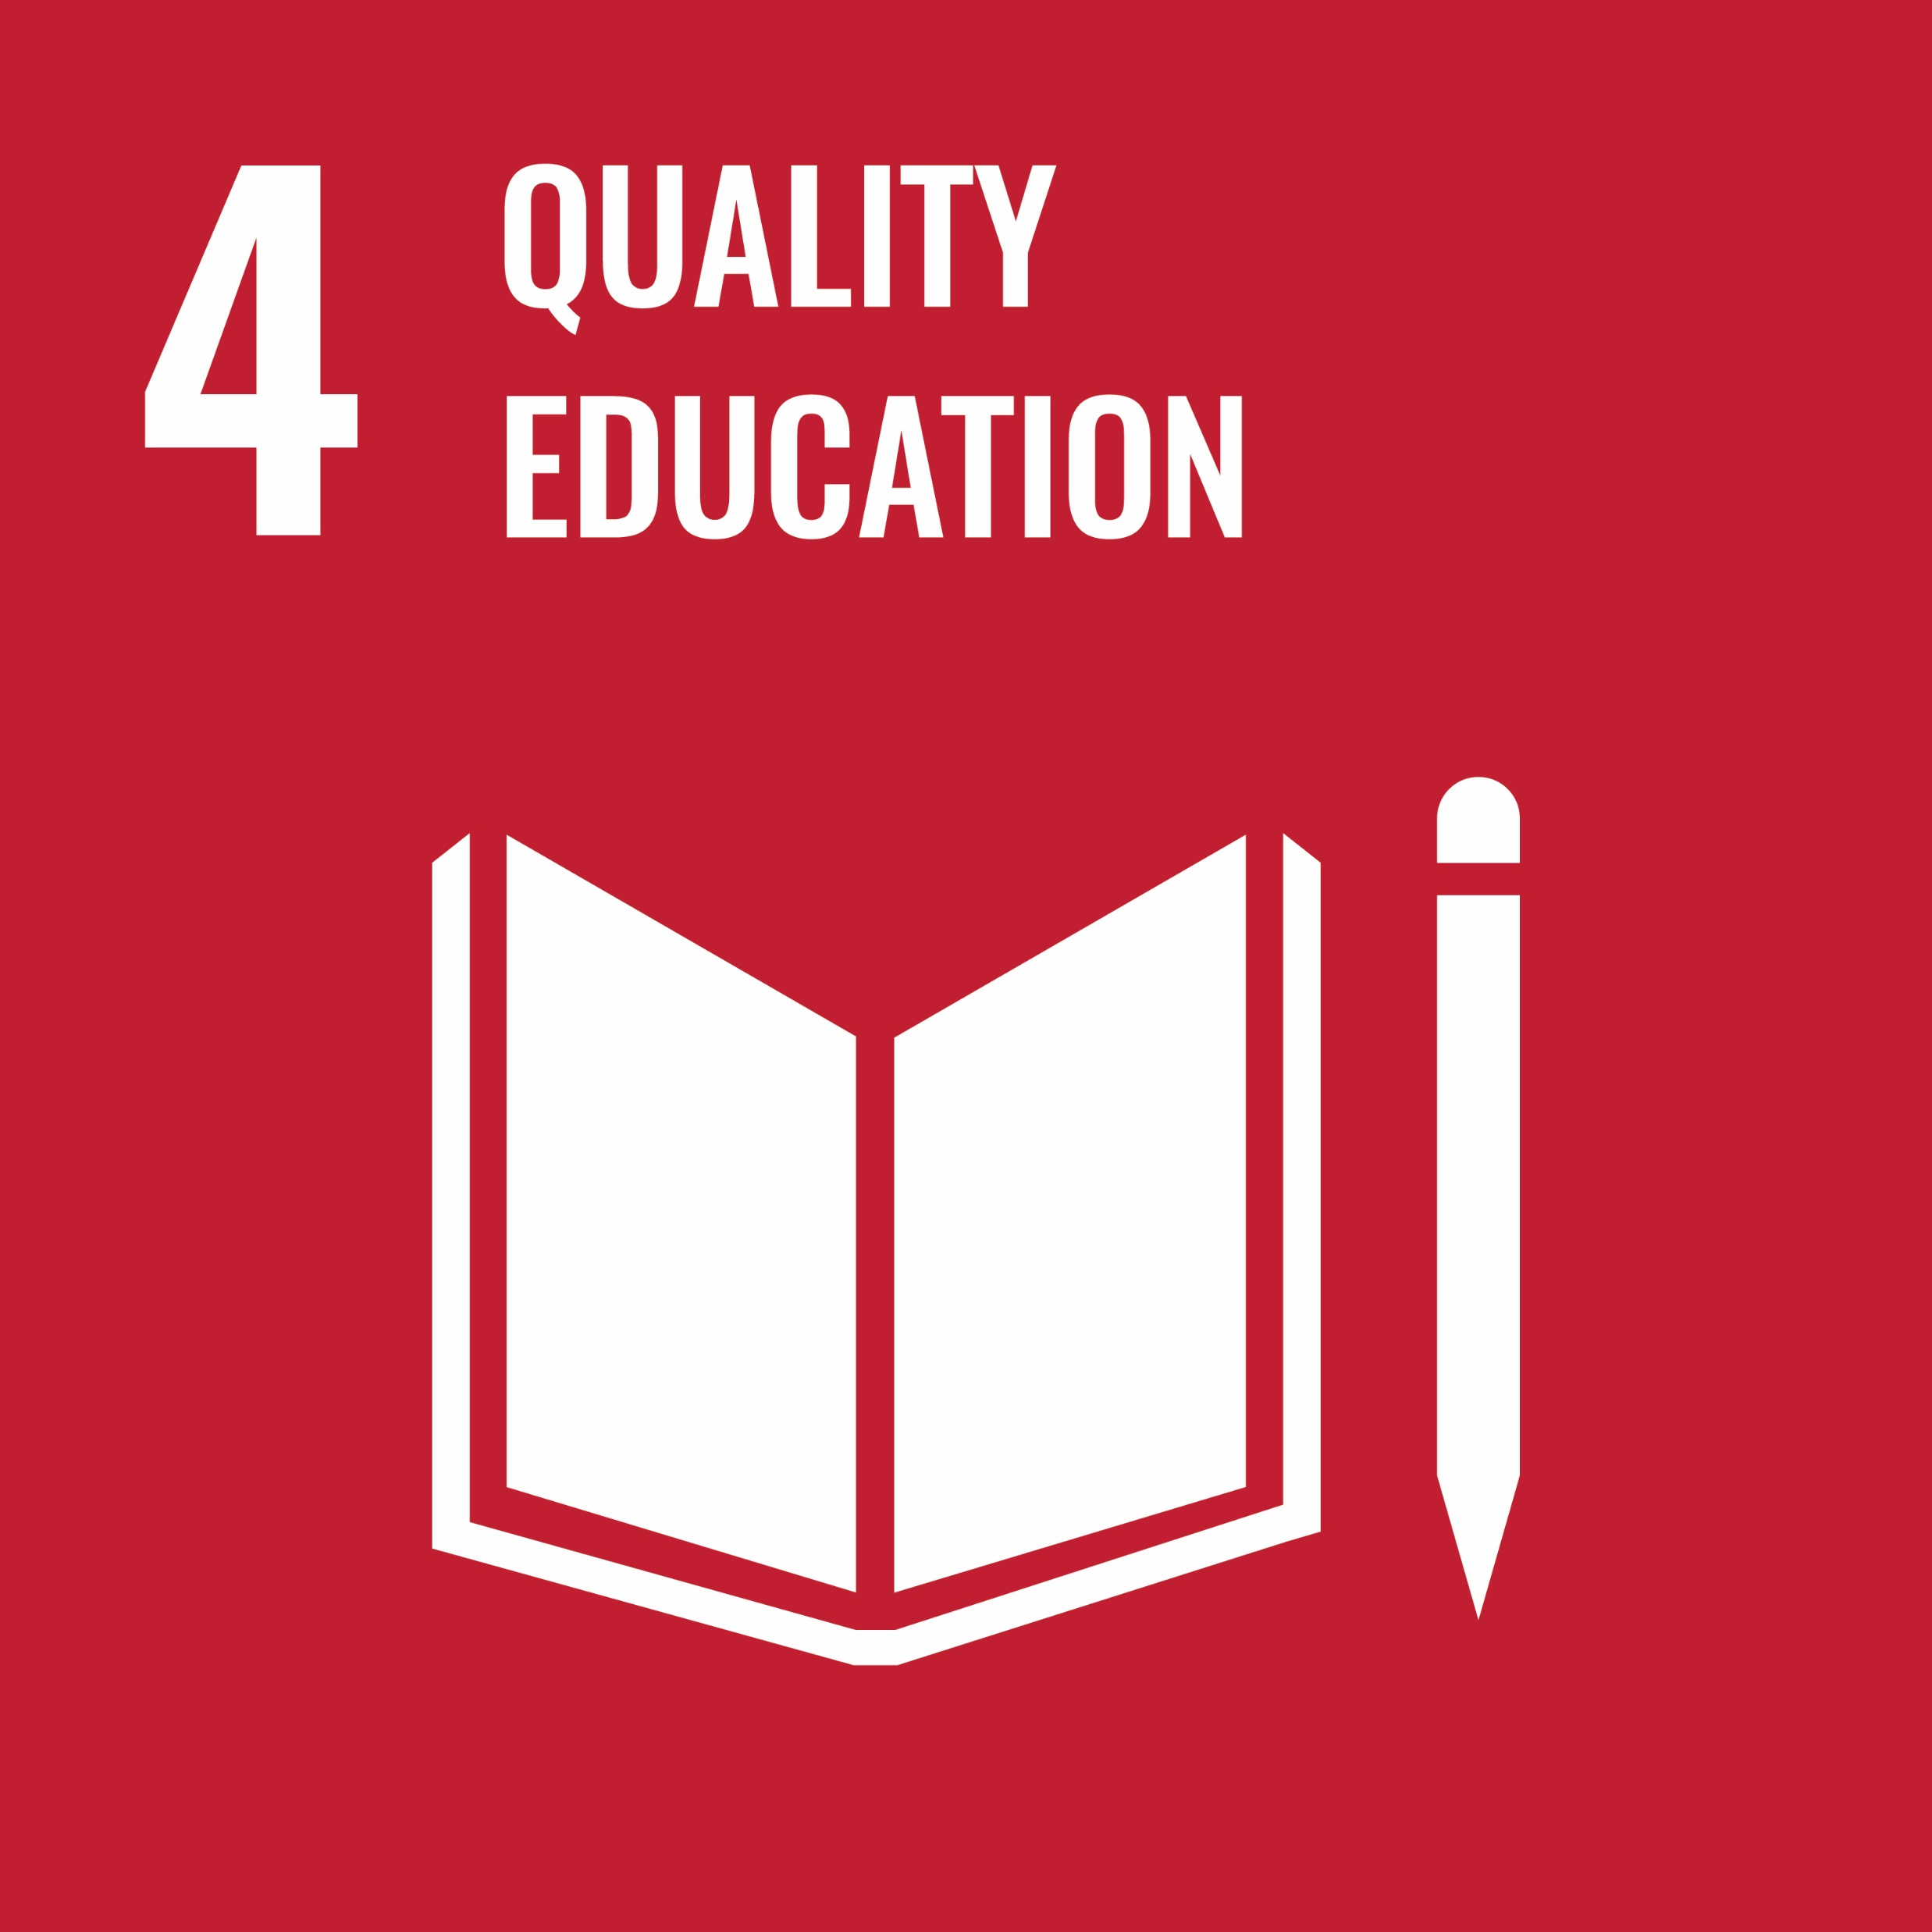
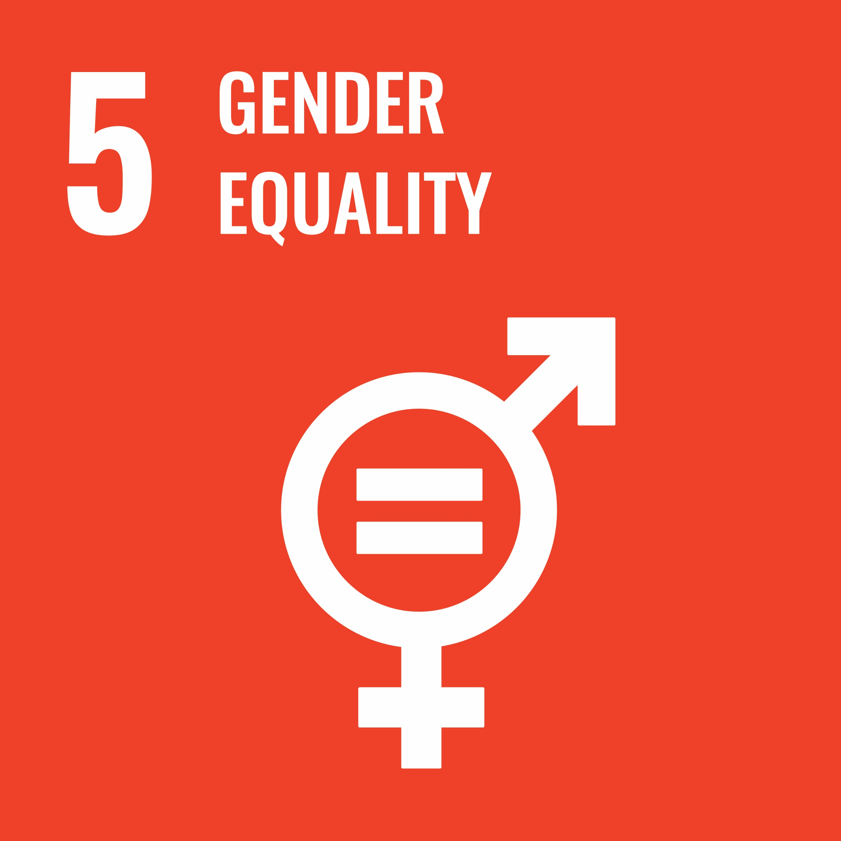
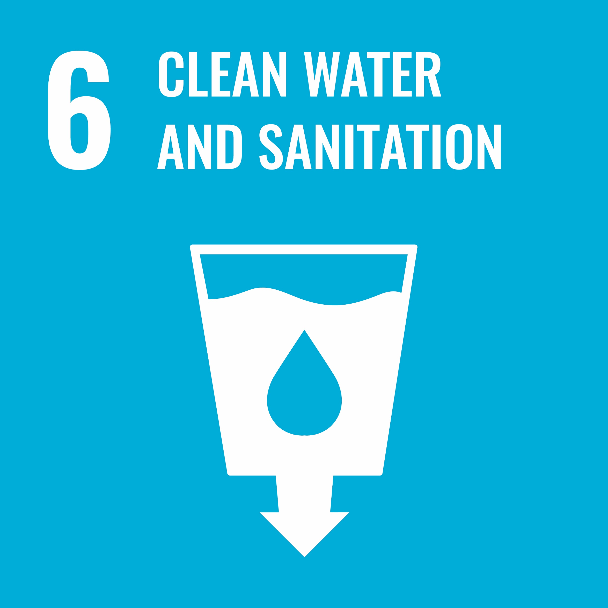

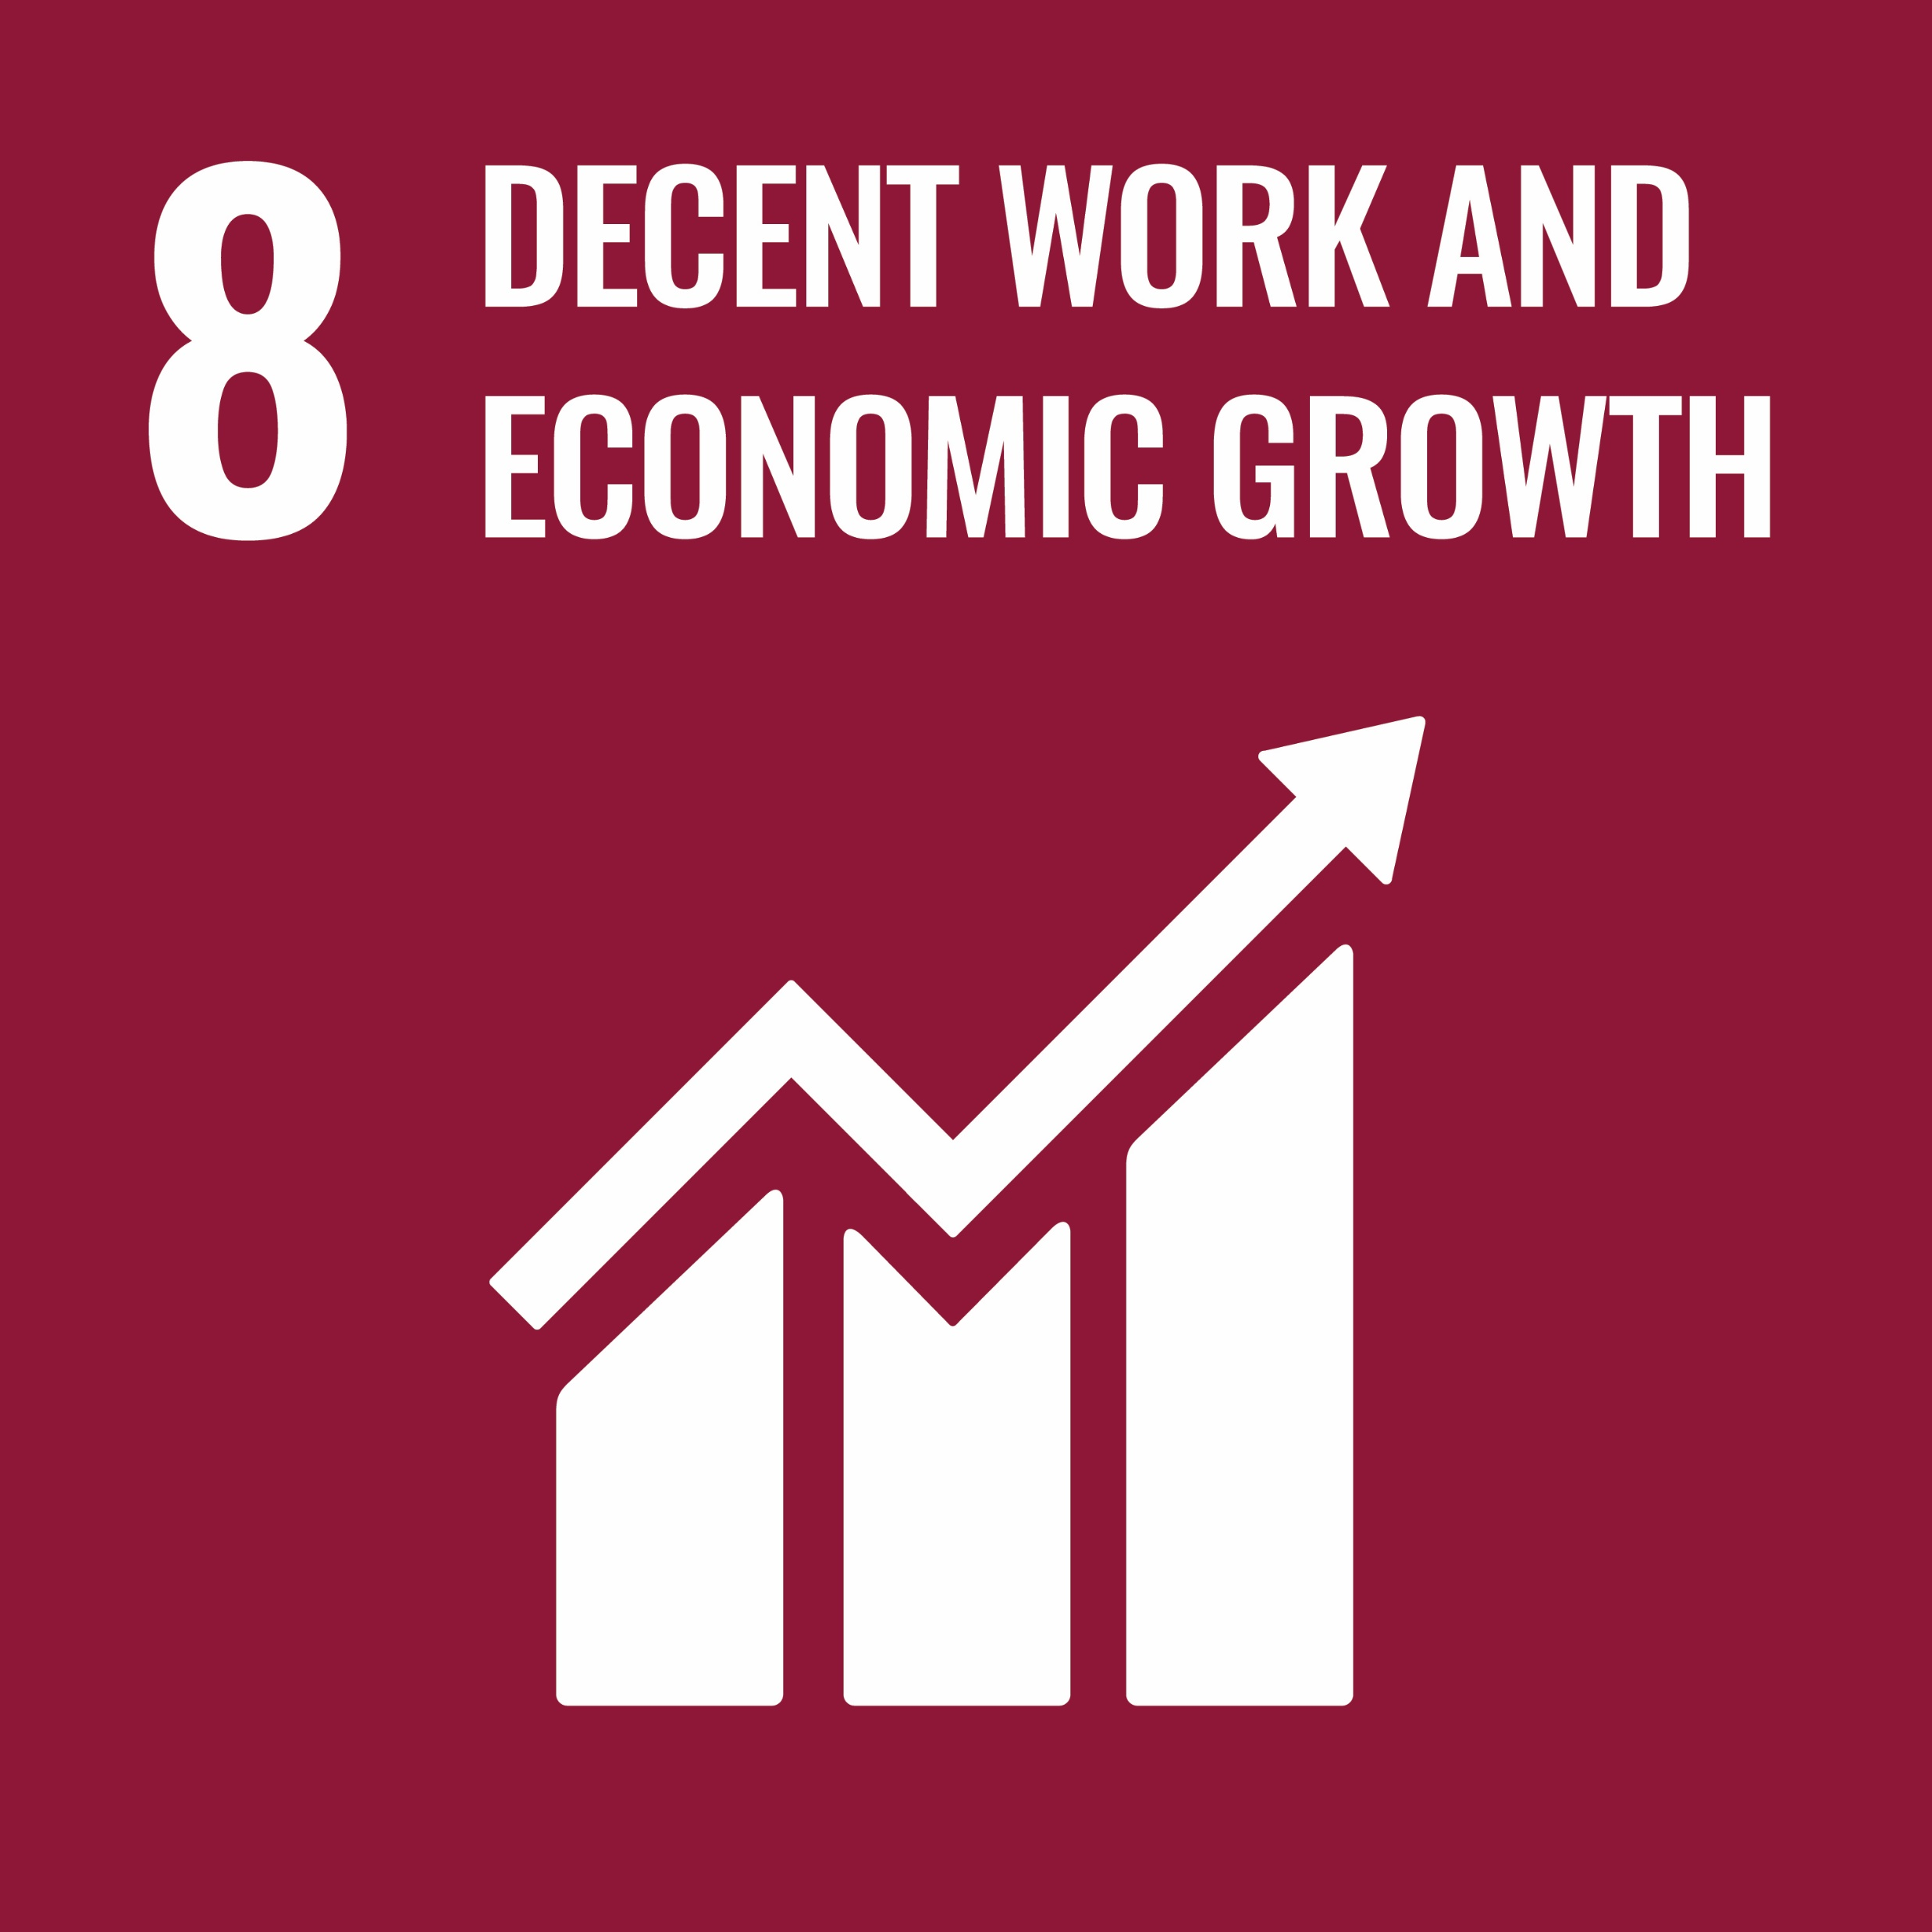

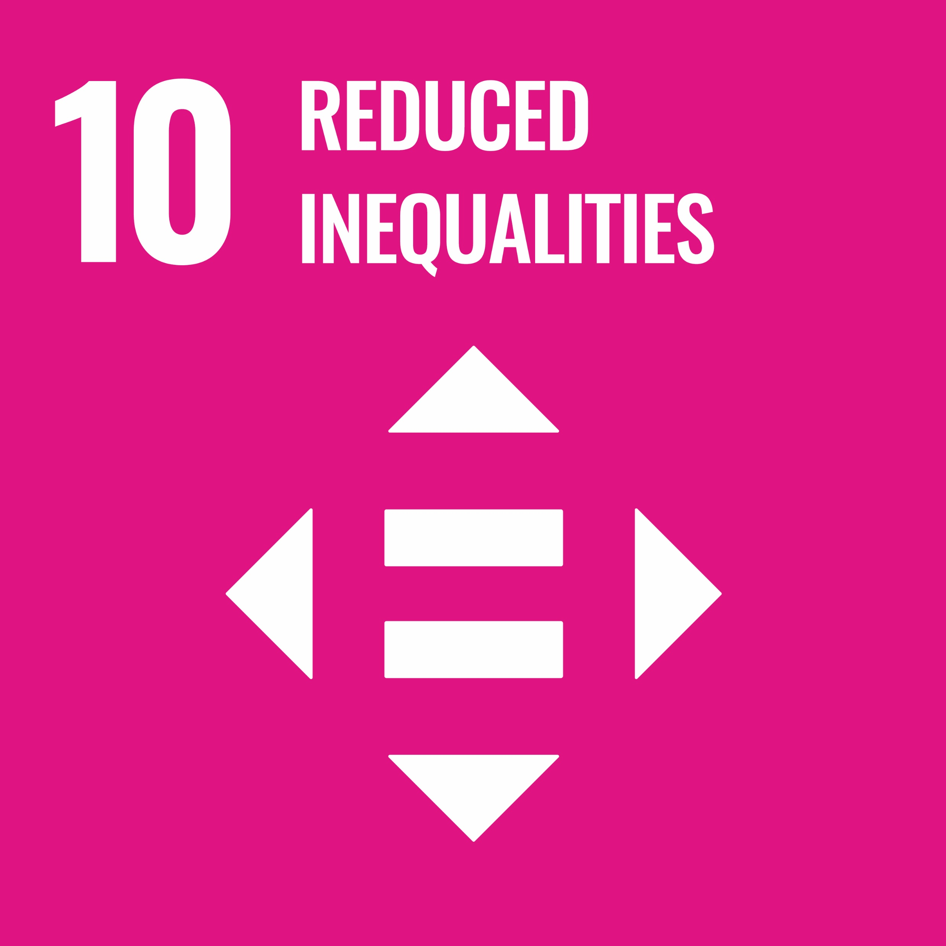
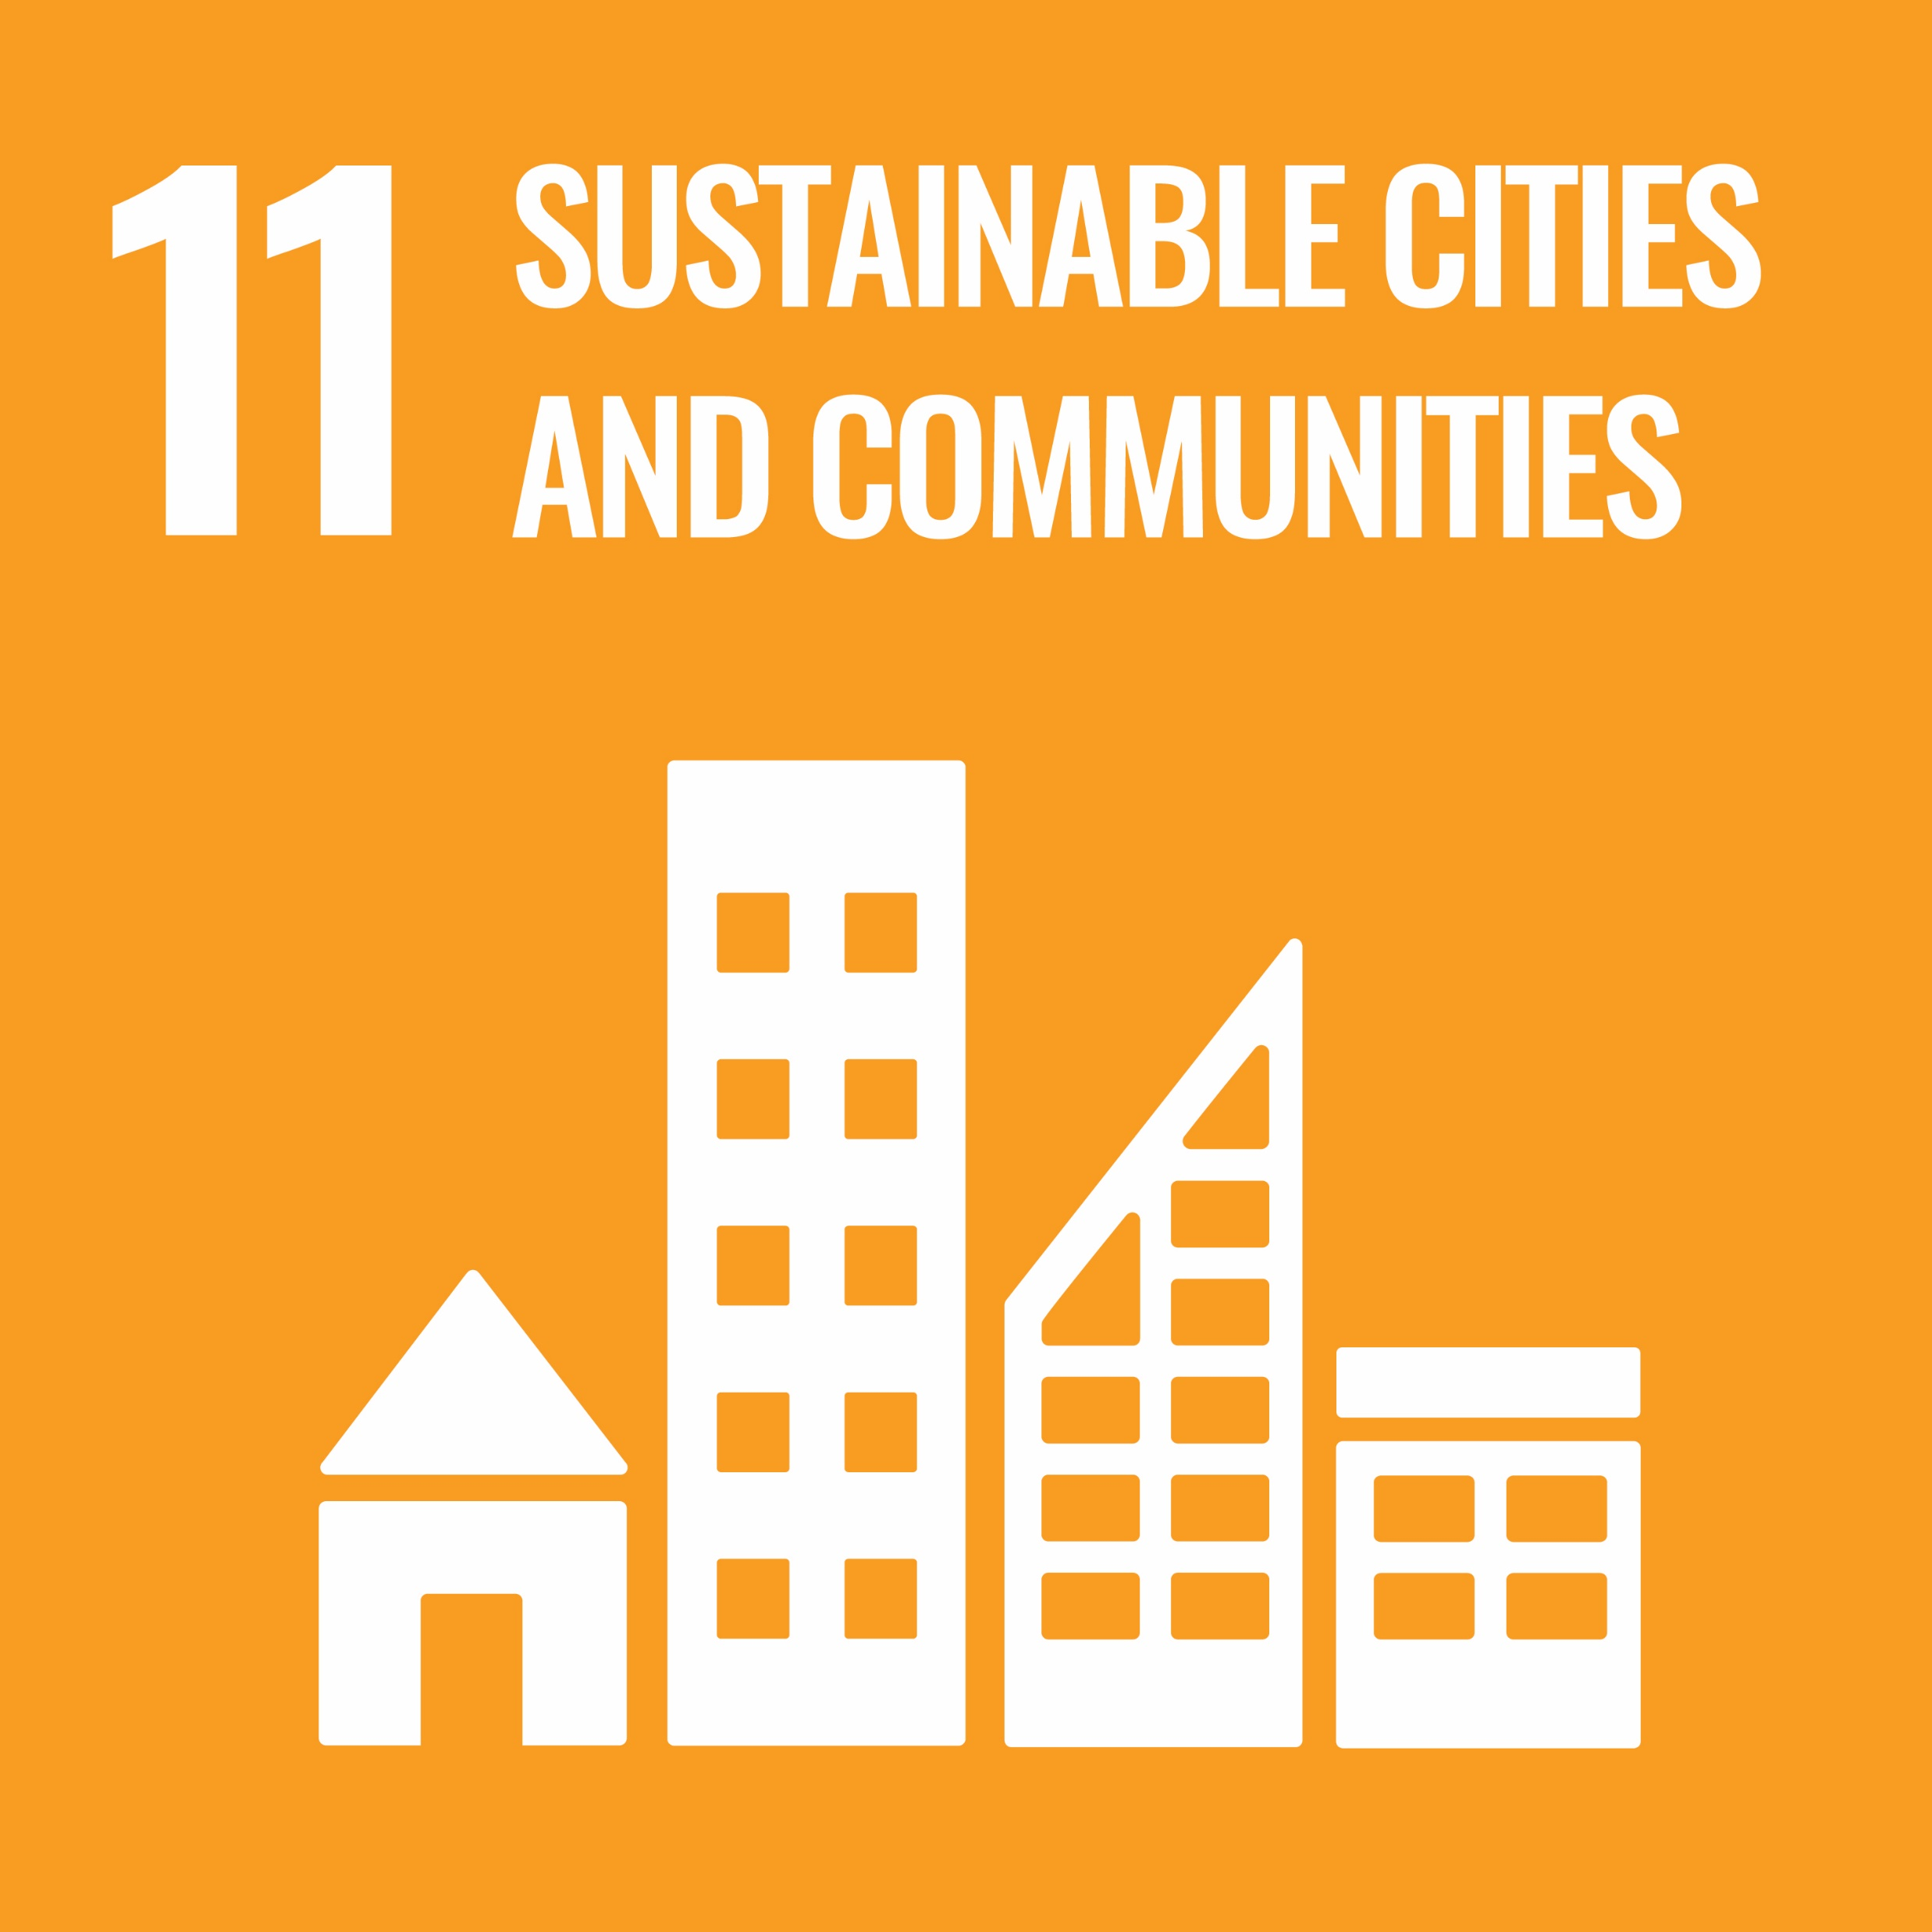


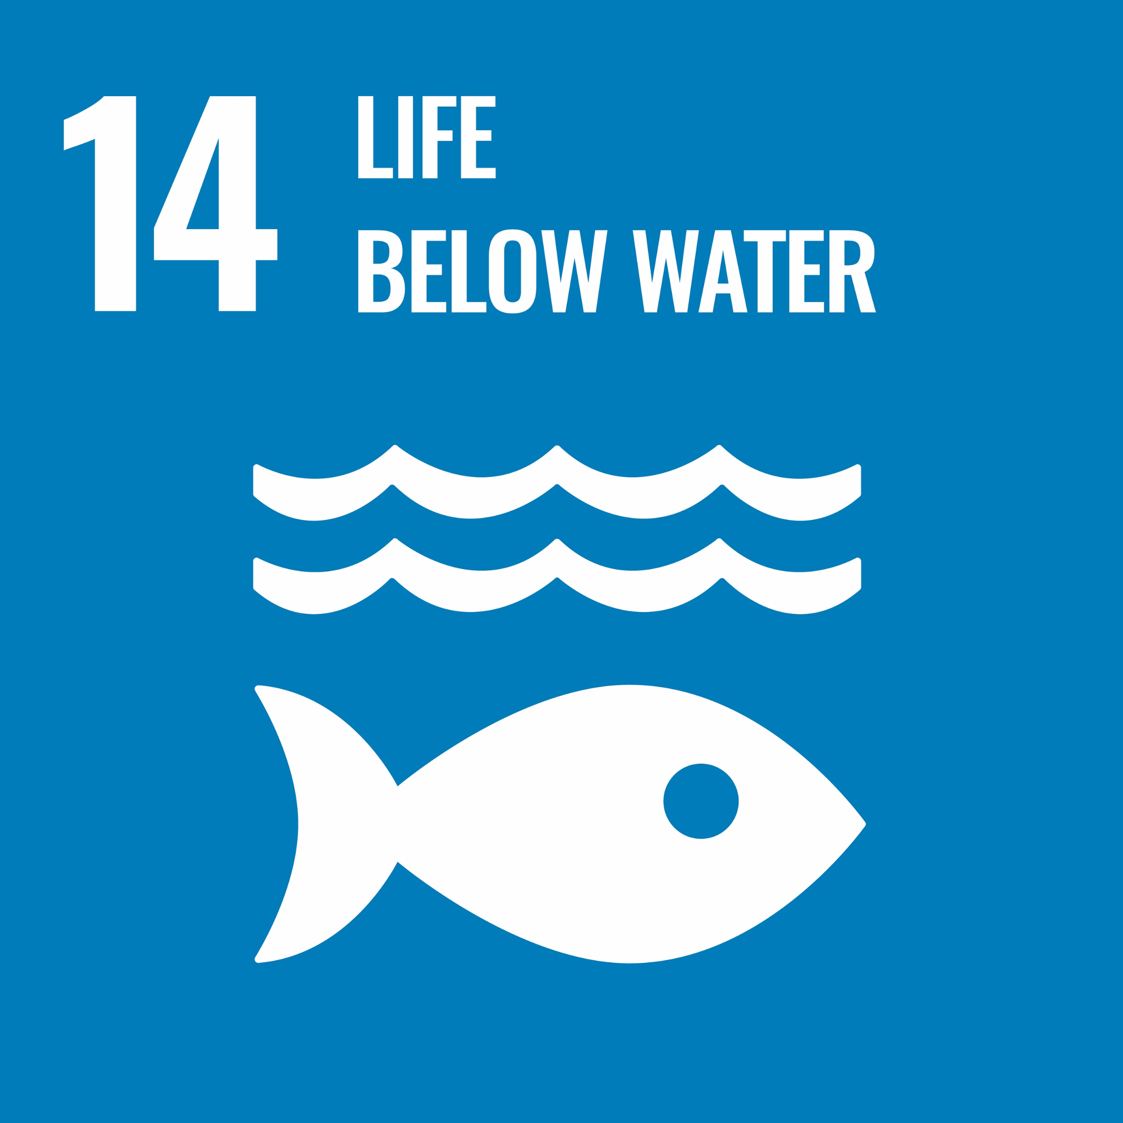
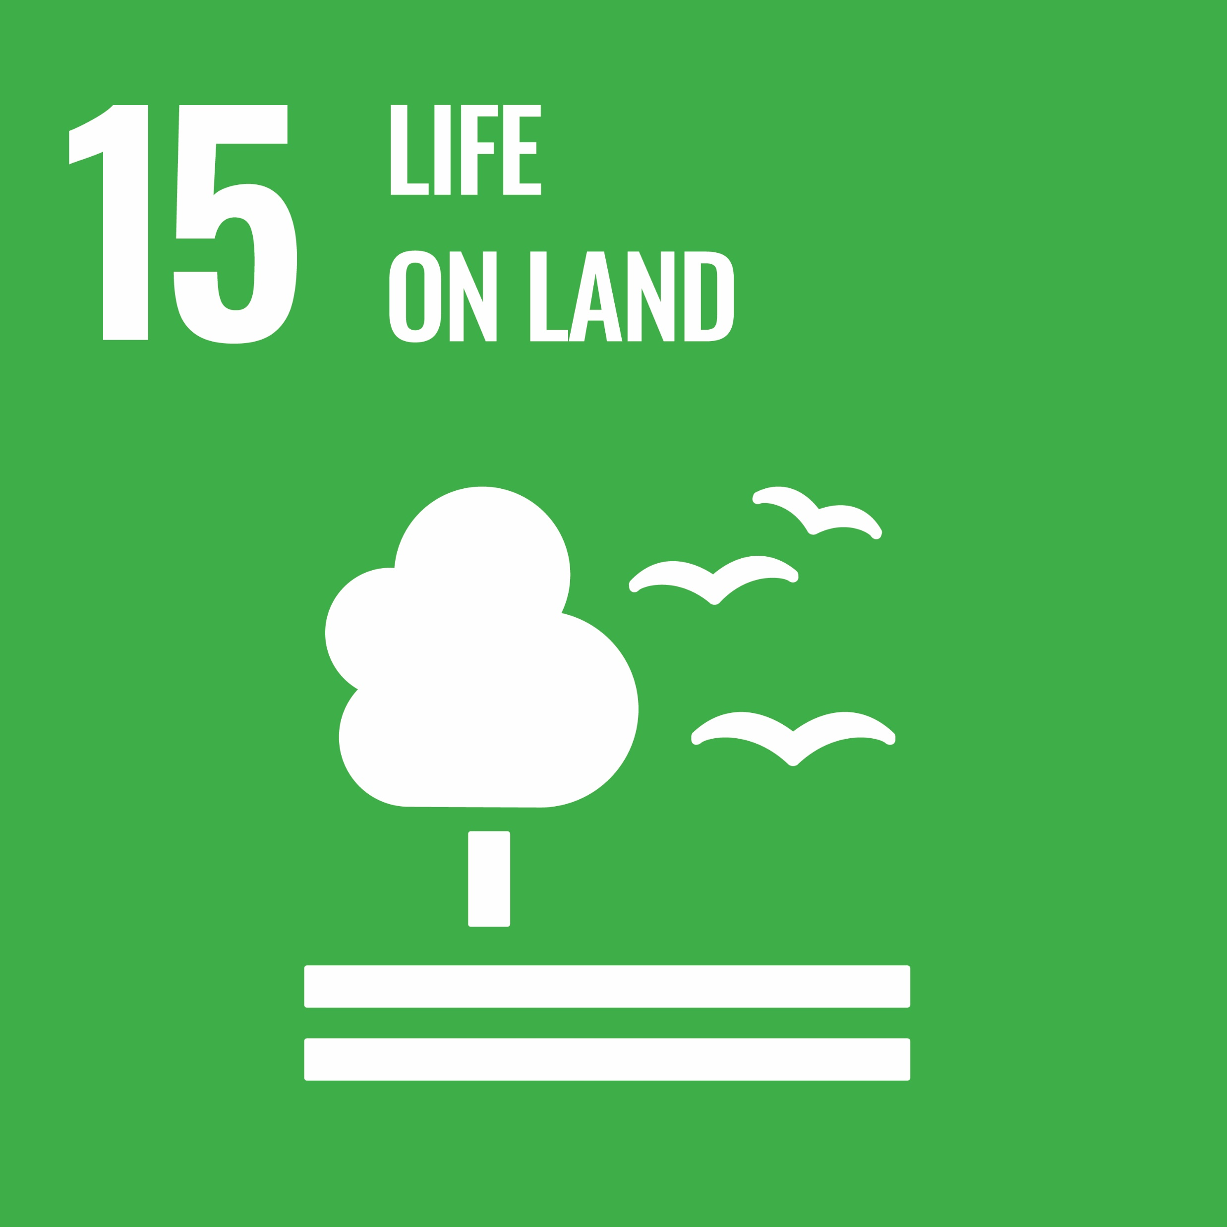

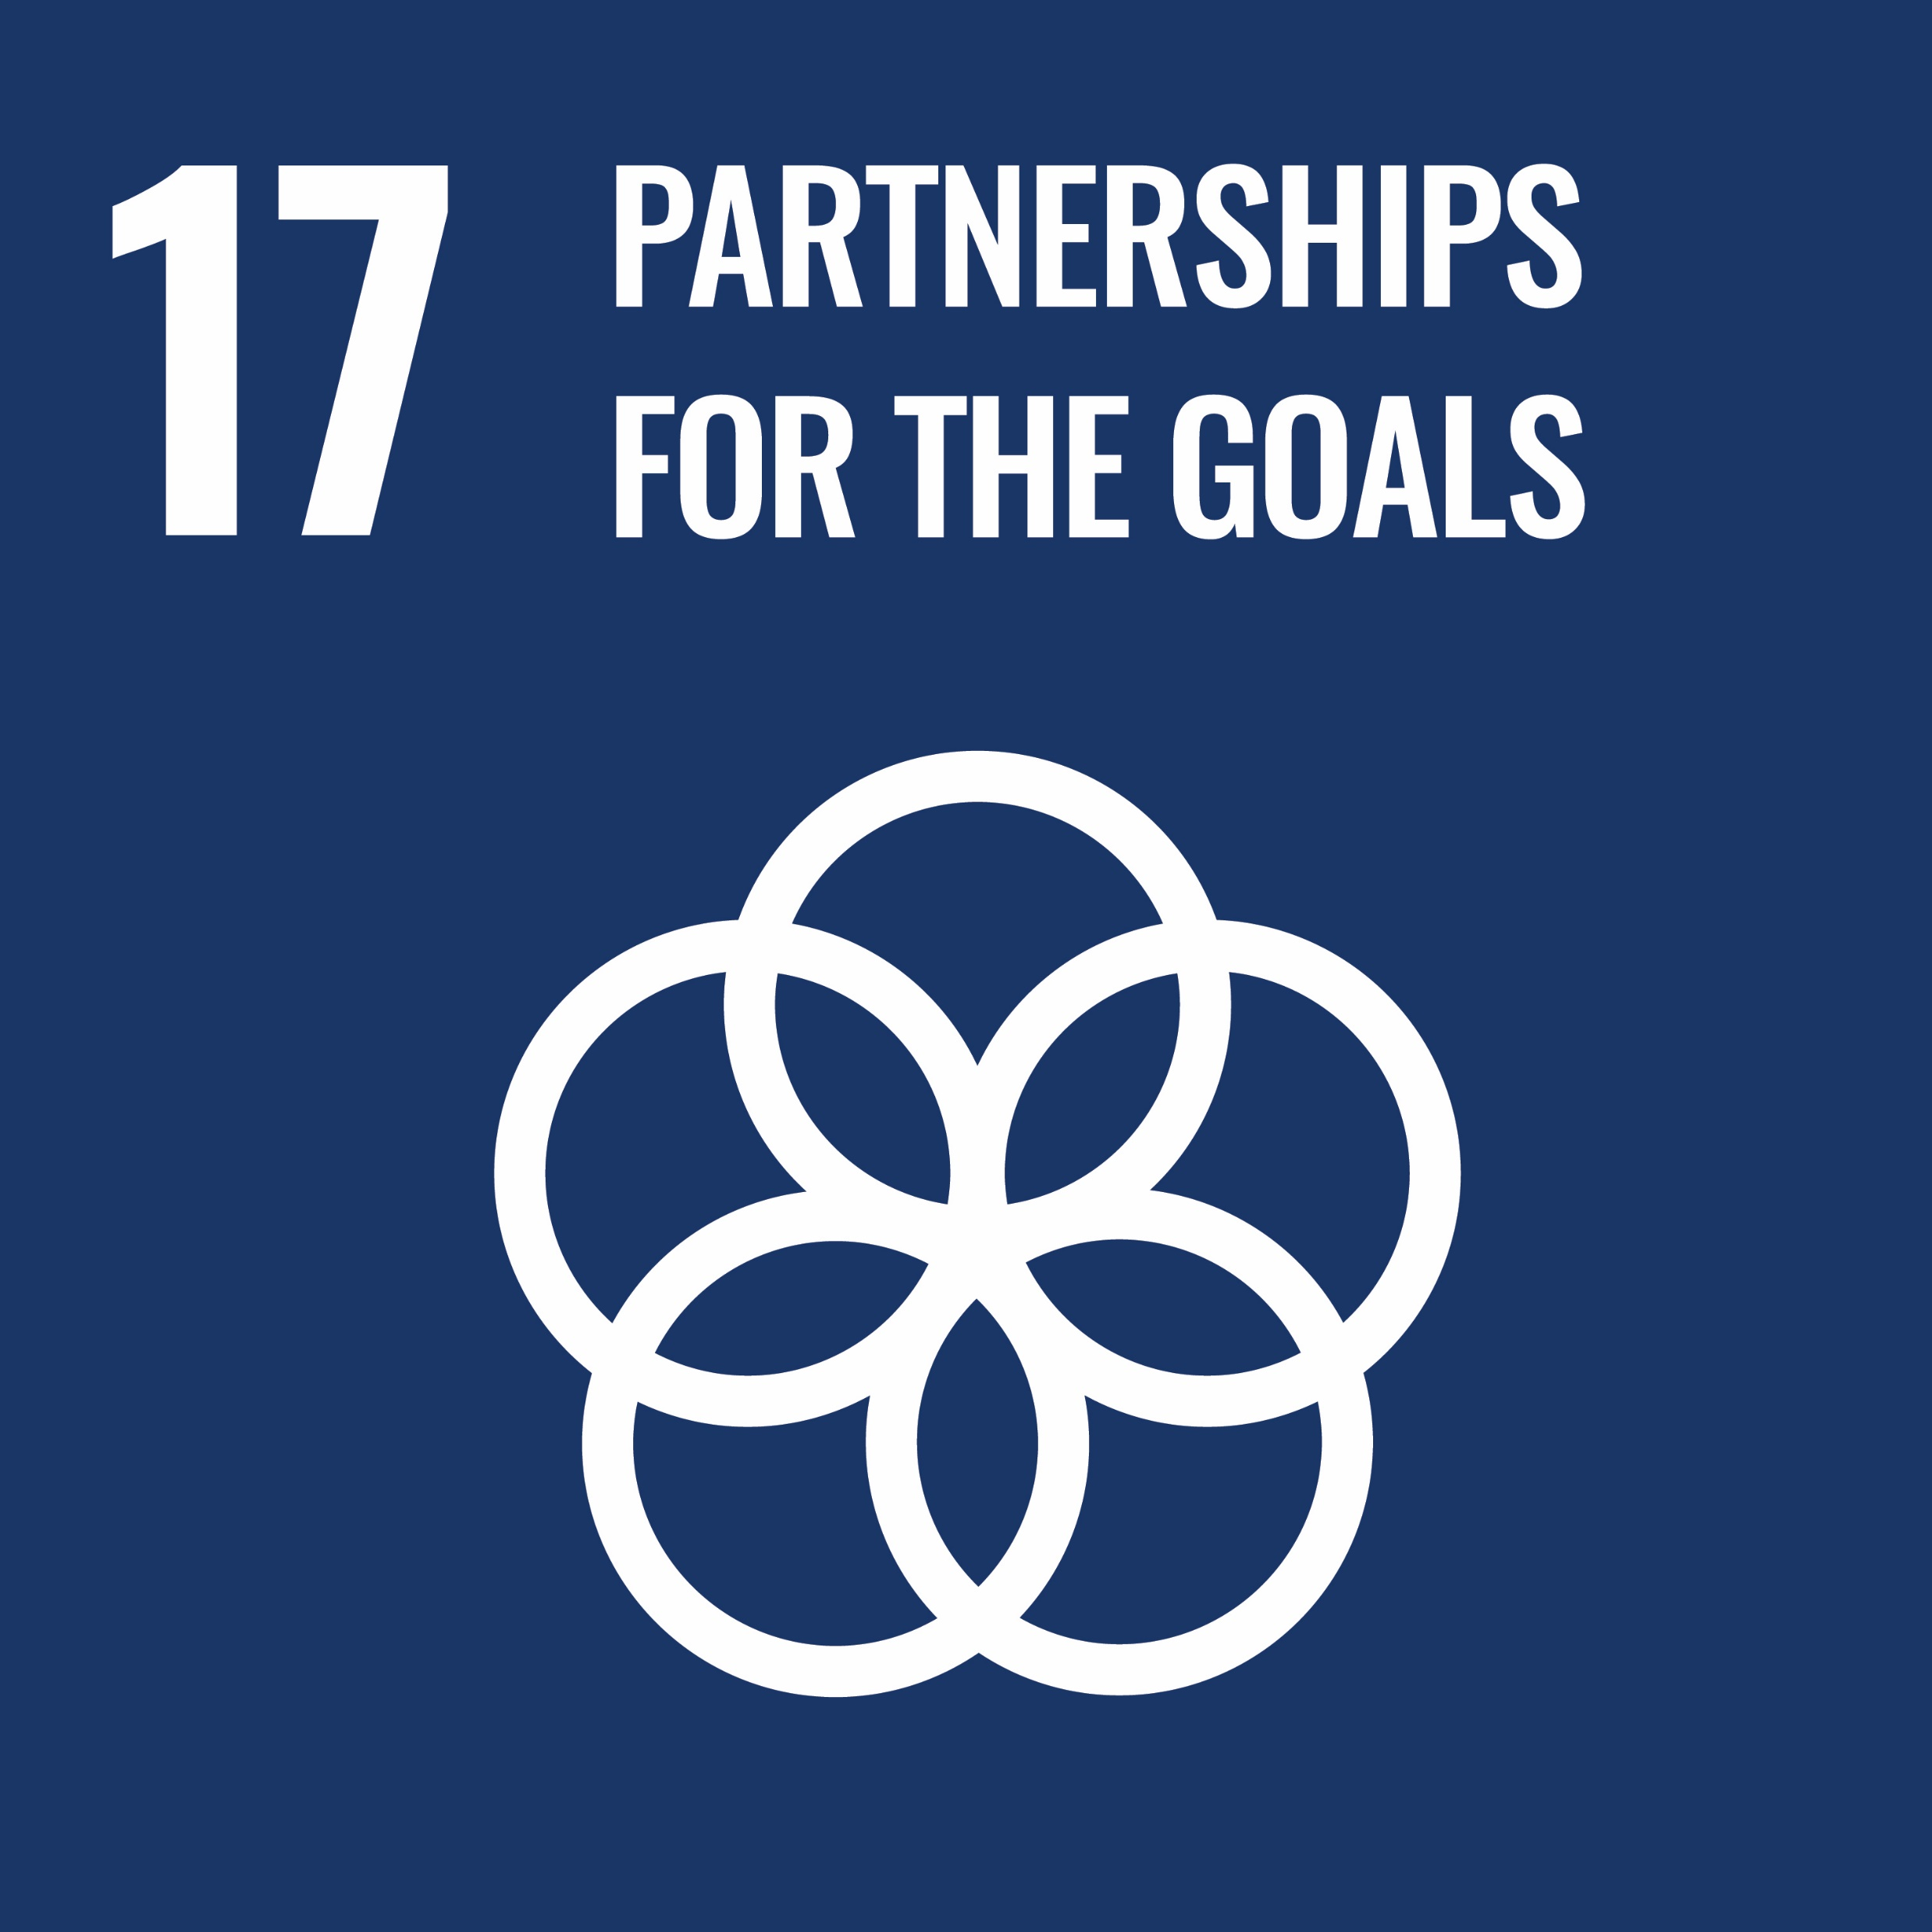
Seven Transformations linked to Sustainable Development Goals
Transformation
Sustainable Development Goal
1. Infrastructure Design and Delivery
2. Service Provision Models
3. Data Collection Practices
4. Informal Urban Employment
5. Financing and Subsidies
6. Urban Land Management
7. Governance and Institutions
Notes:
SDGs & Transformation Mapping.xlsx

Slide 7
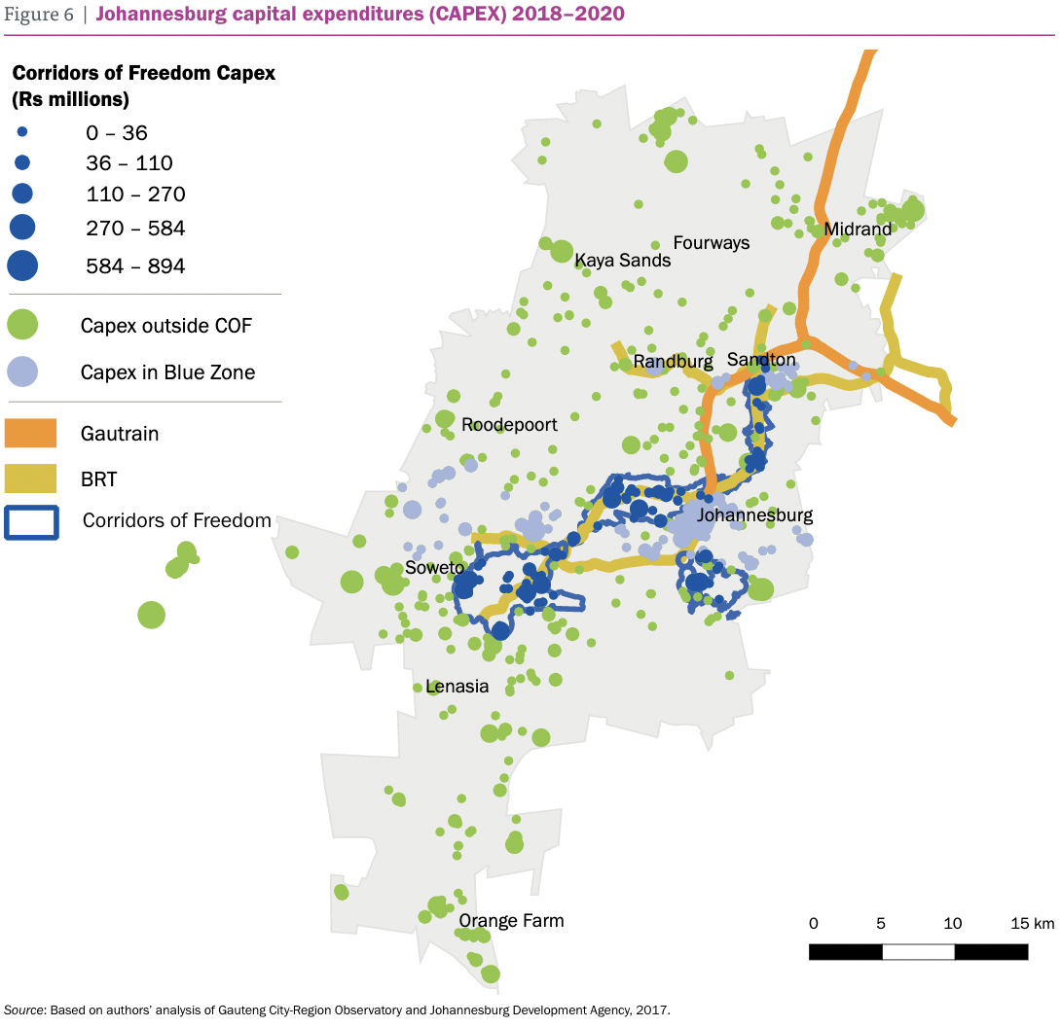
Case Study: Johannesburg Corridors of Freedom
The experience in Johannesburg with Corridors of Freedom, and its successor, the Transit-Oriented Development Corridors, constitute innovative policy experiments to create facilitating conditions along strategic mobility corridors. It demonstrates the importance of institutional coordination across scales and local government agencies to a city’s transformation. ​
​
Source: https://www.wri.org/initiatives/cities-all-towards-more-equal-city/case-studies
www.citiesforall.org
Notes:
The experience in Johannesburg with Corridors of Freedom, and its successor, the Transit-Oriented Development Corridors, constitute innovative policy experiments to create facilitating conditions along strategic mobility corridors. It demonstrates the importance of institutional coordination across scales and local government agencies to a city’s transformation. ​
The COF enjoyed strong leadership from the former mayor, who was able to marshal most of the senior metropolitan government managers and utilities behind the vision. Aligning budgets around the shared planning framework was a significant success.​
This is particularly impressive because the approach was novel, and the program had to be implemented with relatively modest human resources within the City of Johannesburg and implementing agencies such as the JDA​
Furthermore, despite new political leadership that did not demonstrate the same enthusiasm for the initiative, a network of administrators were able to persuade key policy thinkers in the new administration of the initiative’s fundamental rationale. ​

Slide 8
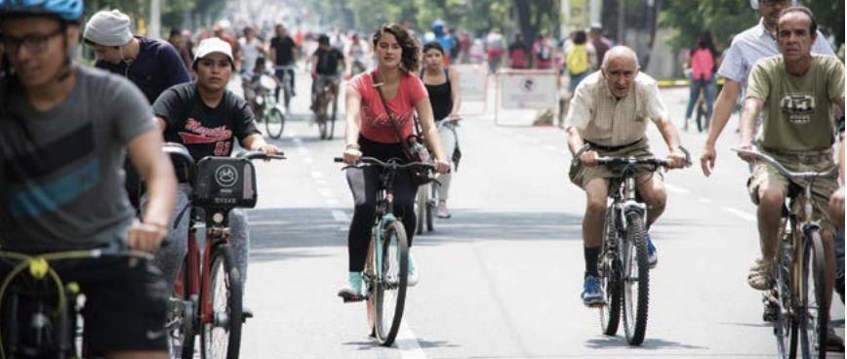
CASE STUDY: Guadalajara Via RecreActiva
The momentum created by civil society groups that advocated for the Via RecreActiva shifted demands for basic public infrastructure to progressive political commitments. This has increased transparency, created new roles for public space activists in municipal institutions, and institutionalized participatory processes. ​
​
In 2004 the municipality of Guadalajara in Jalisco, Mexico, established the Via RecreActiva, a ciclovía, or bike path, that operates every Sunday. Today, four out of the nine municipalities in the metropolitan area of Guadalajara close major streets and over 220,000 people use the path.
Source: https://www.wri.org/initiatives/cities-all-towards-more-equal-city/case-studies
www.citiesforall.org
Notes:
In 2004 the municipality of Guadalajara in Jalisco, Mexico, established the Via RecreActiva, a ciclovía, or bike path, that operates every Sunday. Today, four out of the nine municipalities in the metropolitan area of Guadalajara close major streets and over 220,000 people use the path.
The Via RecreActiva is currently held every Sunday from 8 AM to 2 PM. Ciclovías close roads to motorized vehicles for several hours to allow citizens from all classes of society to enjoy the space by riding bicycles, walking, or exercising.
The momentum created by civil society groups that advocated for the Via RecreActiva shifted demands for basic public infrastructure to progressive political commitments. This has increased transparency, created new roles for public space activists in municipal institutions, and institutionalized participatory processes. ​
​
Investing in public spaces can unite competing interests and encourage them to move towards progressive politics. To sustain transformation, this case suggests implementing social measures to address the uneven distribution of investment and potential displacement and inequality. ​
​

