Slide 1


Green Growth by Design
apolitical webinar on green growth
18th January 2023
Jagan Shah

Slide 2
How do we know it’s green growth – are there ‘telltale signs’?
‘The quality without a name’- Christopher Alexander, The Timeless Way of Building, 1979
        Holistic; integrated; spatially just; materiality, tactility, rooted
  Disrupts business as usual: approaches problems obliquely (socialising urban planning)
  (Dare we say) A new economics; eschewing the trickle down, secures stake
  Evidence of just transitions (FairTrade; portraits of construction workers at a construction site)
  Mindful of outcomes and long-term impact – Bruntland Commission
  Achieving the ‘butterfly effect’
  Feedback loops and continual innovation

Slide 3

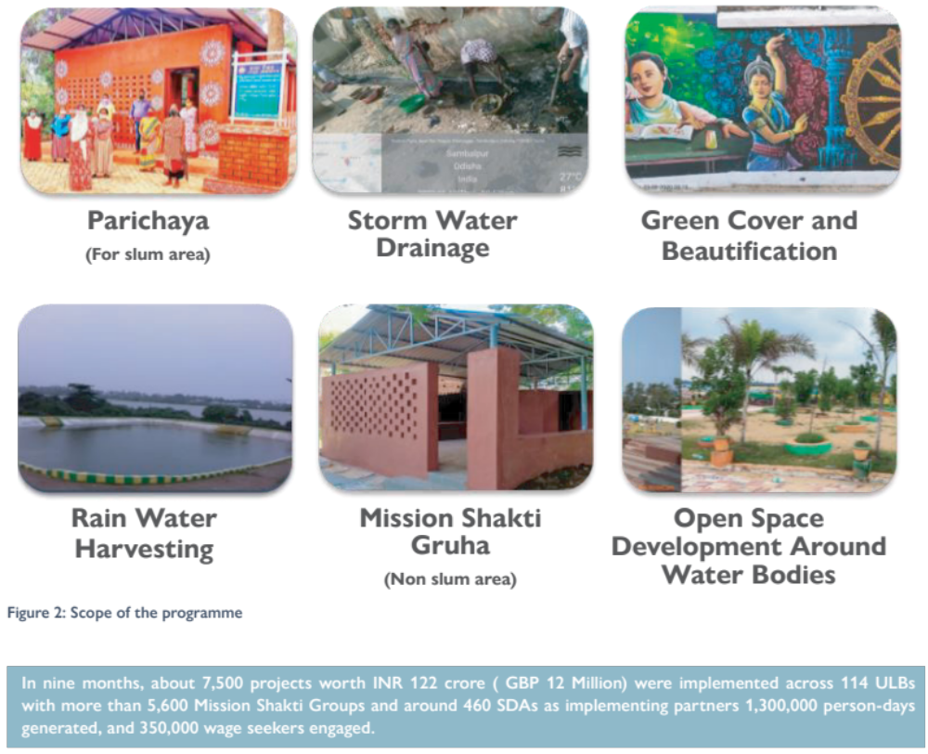






Combining the principles of green growth: Odisha, India
Land Rights
Upgrade Infrastructure
25% City Budget
Slum Dwellers Association: the 4th Tier
Implementing partner in infrastructure upgradation
Devolution of funds - ULBs to SDA
Custodian of Community Assets & Responsibility of Maintenance
Revenue collection for ULBs

Slide 4
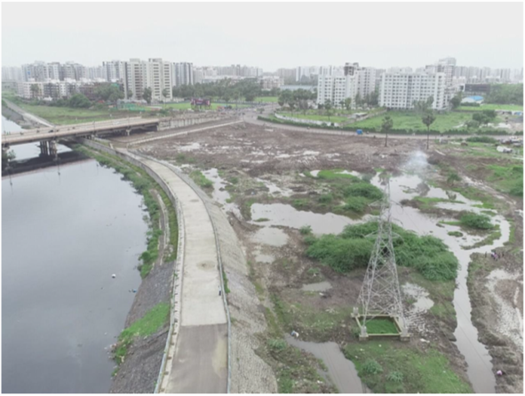
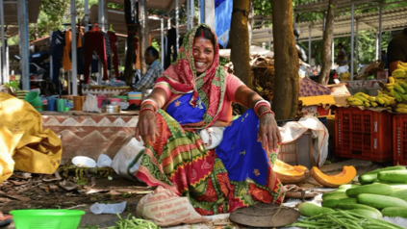
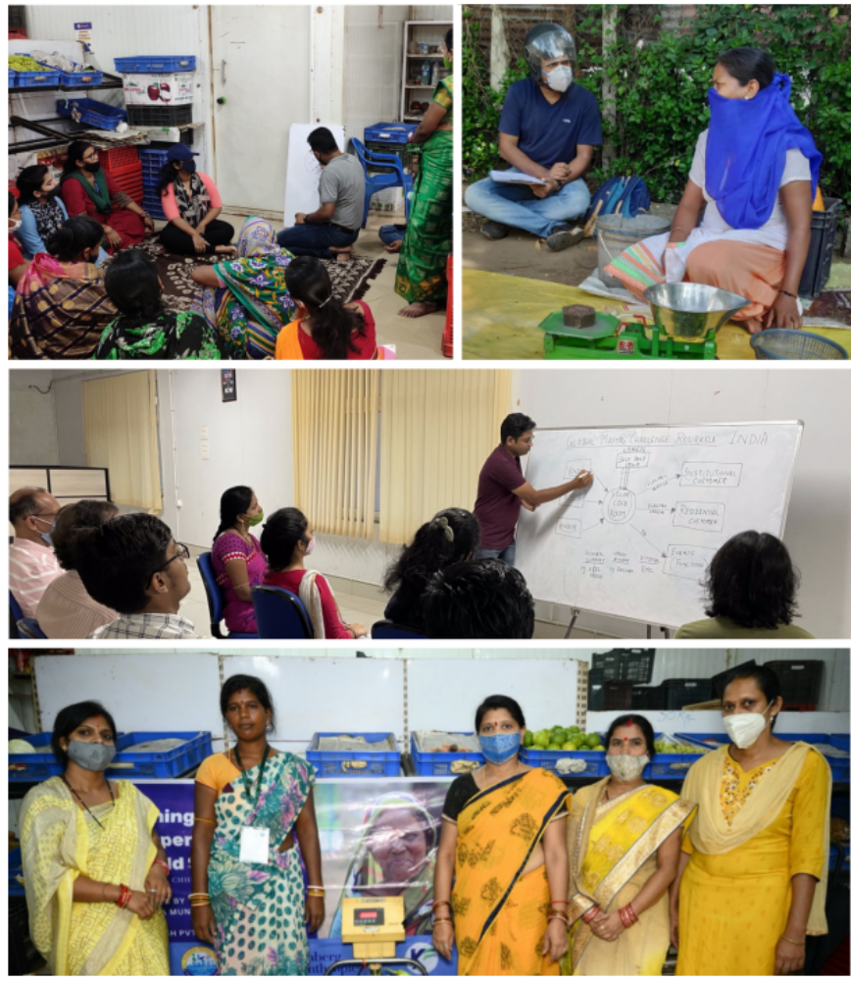
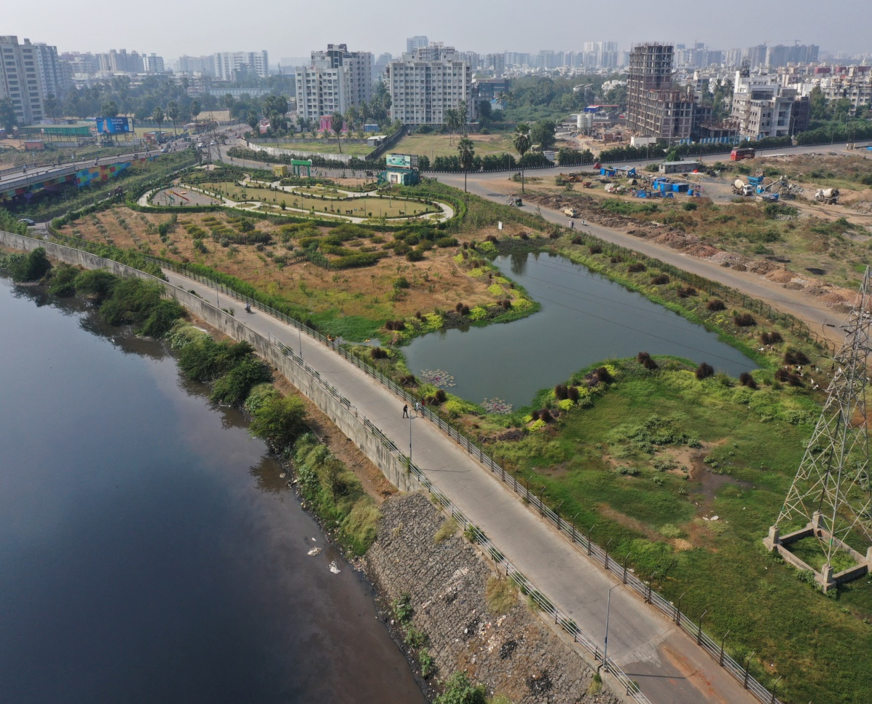
Myriad forms
Photo: Sucharita Dash
Before
After
A new green lung on reclaimed wasteland in Surat, Gujarat
Women-owned business federation + Greentech +
e-commerce in Rourkela, Odisha

Slide 5
Thank you!

