Slide 1
Climate change 101: causes, consequences, and the latest science
Dr. Sarah Burch
University of Waterloo
Notes:
My sincere thanks to PlentyCanada for welcoming me into this space to share a little of what I’ve been working on and to listen.
My role here today is to share how Western science is coming to know and grapple with climate change. This is only one way of knowing, and certainly comes laden with a set of assumptions about what’s causing climate change (ie technology, rather that a disconnect between many humans and nature), and the solutions (ie technology, rather than a more fundamental re-thinking of the purpose and function of our societies).
I’m living and working on the traditional territory of ‎ the Attawandaron (also known as Neutral), Anishinaabe, and Haudenosaunee peoples. The University of Waterloo is situated on the Haldimand Tract, the land promised to the Six Nations that includes six miles on each side of the Grand River. Listen to and learn from Indigenous groups who have cared for this land since time immemorial and continue to do so today.

Slide 2
What we’ll cover
4 fundamentals:
  What is the greenhouse effect?
  What impacts are unfolding from climate change?
  What can we do about it?
  Are we making progress?

Slide 3
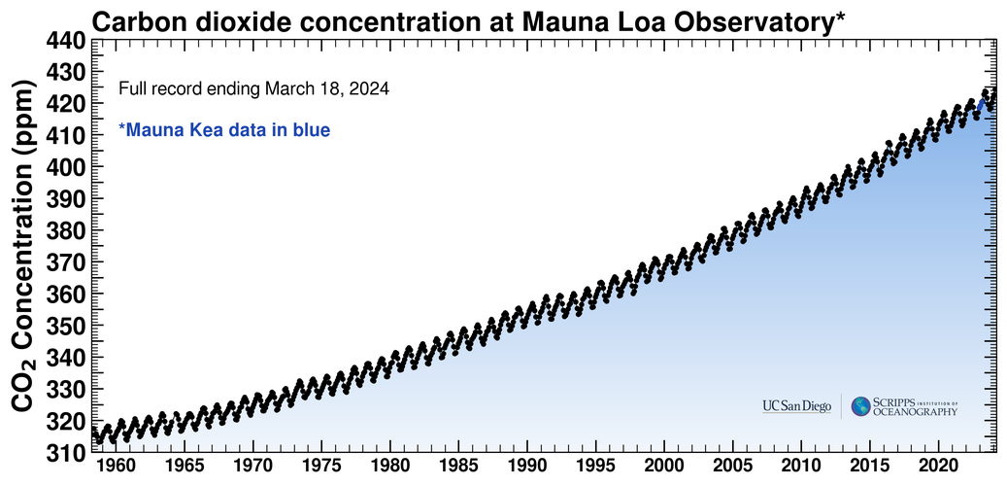
Preamble: Just how much are we changing things?

Slide 4
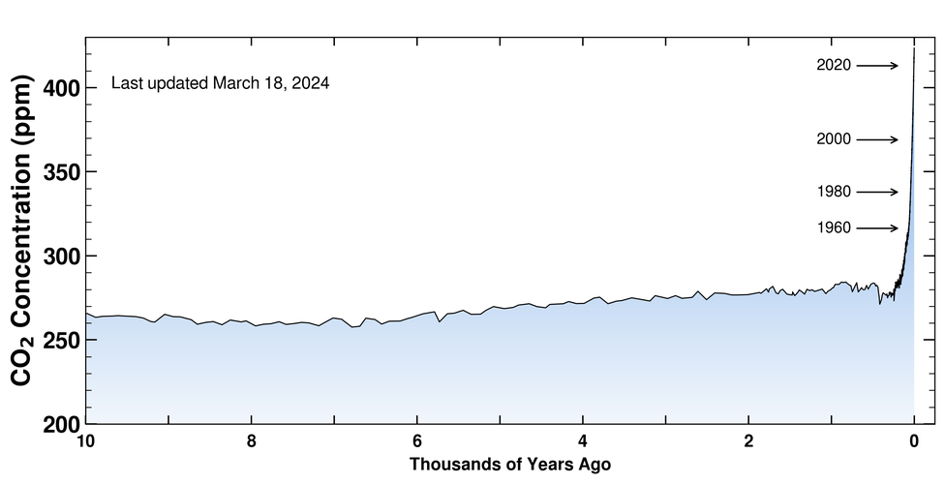
Preamble: Just how much are we changing things?

Slide 5
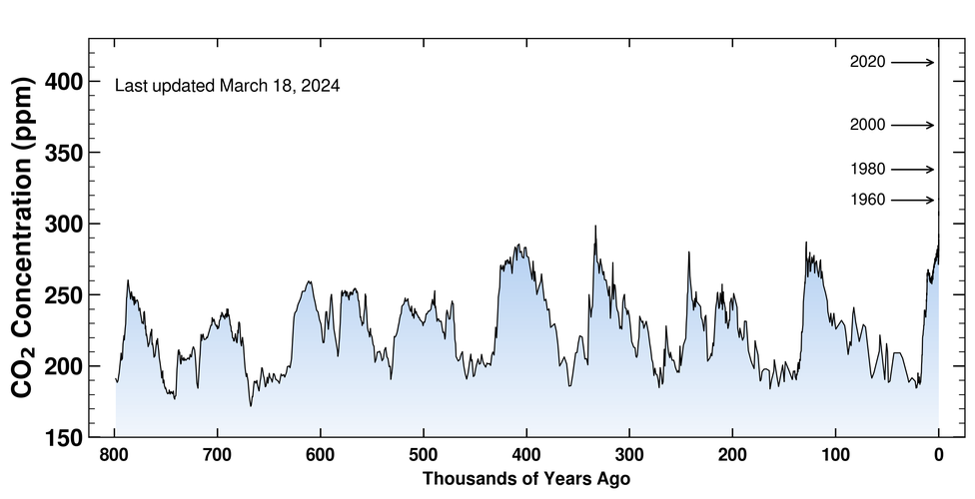
Preamble: Just how much are we changing things?
426 ppm

Slide 6
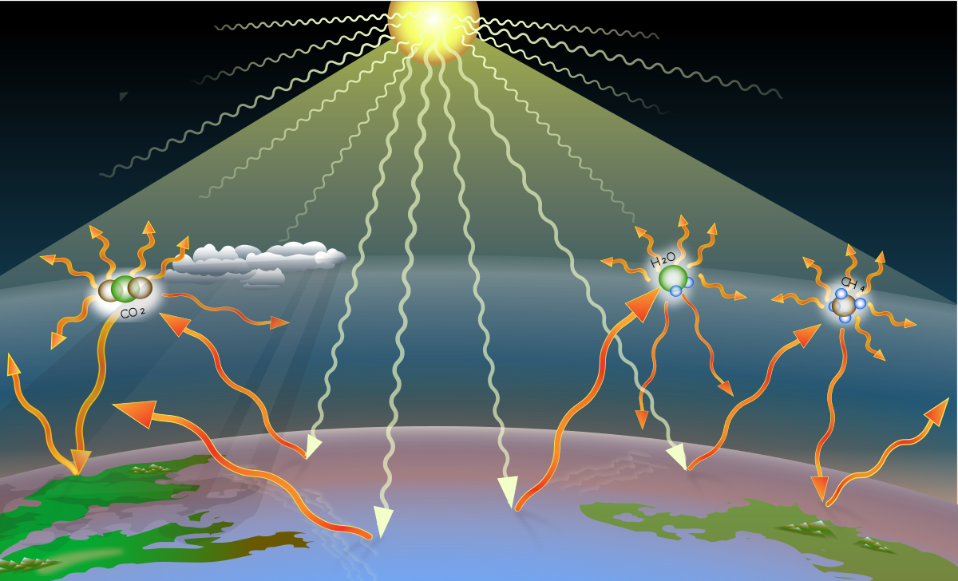
1. What is the greenhouse effect?

Slide 7
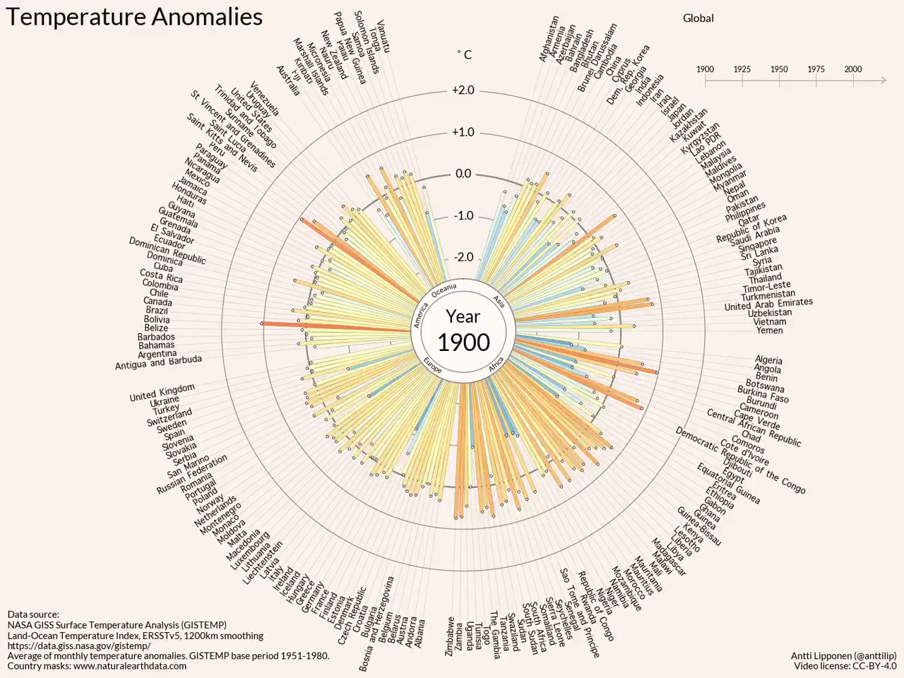
2. What impacts are unfolding?
Source: US Global Change Research Program, 2014
Notes:
Heat waves; Floods in non-coastal areas due to extreme rainfall and glacial melt
Missing from this figure:
Injustice and exploitation
Conflict over resources
Extreme events – floods and storms
Heat waves, especially in cities
Climate refugees

Slide 8
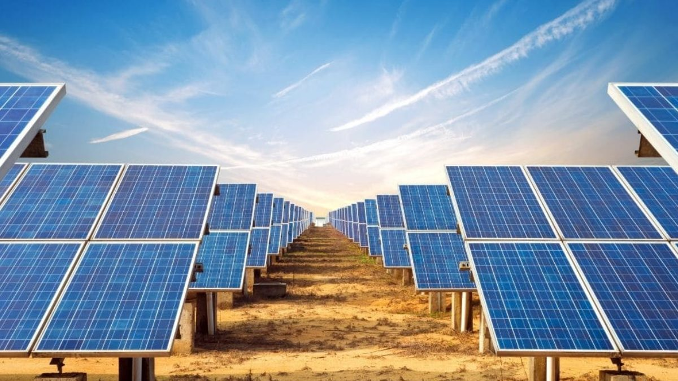
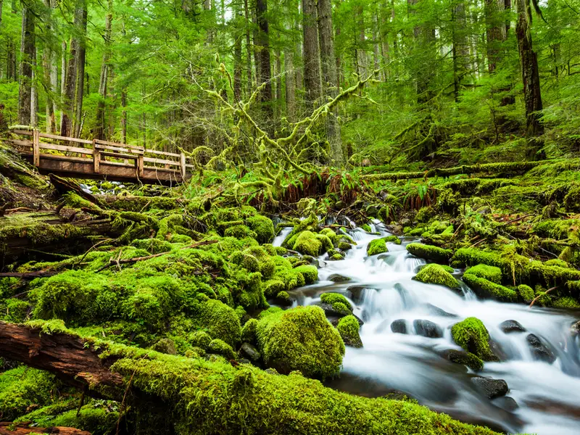
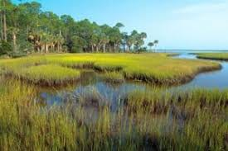
3. What can we do about it?
Mitigation
  Dealing with the causes
  Reducing greenhouse gas emissions or enhancing carbon sinks
Adaptation
  Dealing with the consequences
  Protecting and regenerating communities and ecosystems from impacts

Slide 9
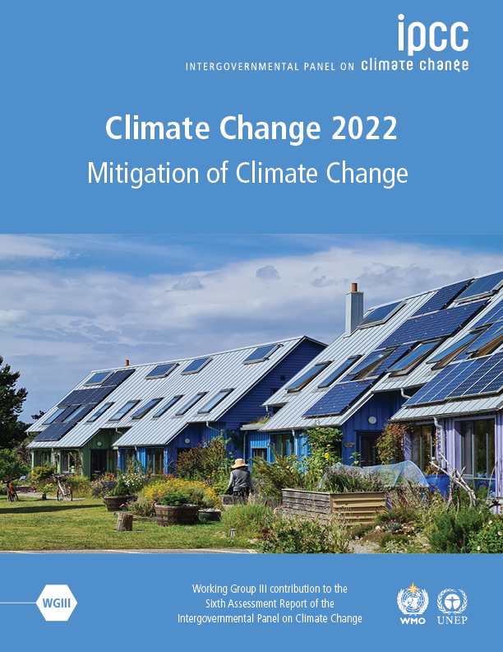
4. Are we making progress?
Highest emissions in human history
We are not on track to limit warming to 1.5 degrees C
There is real evidence of sustained GHG reductions in some countries
The cost of renewables has plummeted
We have the solutions in every sector that can halve our emissions by 2030
Notes:
Take a minute to describe the IPCC.
Without immediate and deep ghg emissions reductions across all sectors, 1.5 degrees is beyond reach.
There are examples of zero energy or zero carbon buildings in almost all climates.
There is significant potential to reduce emissions in the transport sector BUT this means we need to scale UP our production of electricity and that electricity has to be low carbon.

Slide 10
4. Are we making progress?
Lifestyle change (food, transportation, buildings) can provide up to 70% of emissions reductions
BUT
Individuals are locked into high-carbon pathways
We can’t achieve Sustainable Development Goals without dealing with climate change
A just transition is crucial
Notes:
Individual choice ALONE makes only a modest contribution to reducing greenhouse gases. This is INSUFFICIENT unless it’s linked to structural and cultural changes.
Significant changes across transport, industry, buildings, and land-use will make it easier for people to lead low carbon lifestyles, and at the same time improve well-being. GLOBAL SCIENCE SUPPORTS THIS CLAIM. By 2050 a combination of effective policies, improved infrastructure and technologies leading to behaviour change has the potential to enable those individual reductions. What are they? Plant-based diets, right-sized homes and compact urban areas, efficient housing and appliances, walking and cycling. We know the list.
For example – access to public transit, active transport infrastructure, affordable housing near work/play.
So how do we talk about whether this is an individual or collective problem?
Cities: responsible for more than 2/3 of global GHGs. Electrification (with low emissions energy), improving C uptake and storage (green roofs, permeable surfaces, green spaces, nature-based solutions); retrofit buildings fast, co-locate jobs and housing; support active transport and cycling – why? Transition to next slide

Slide 11
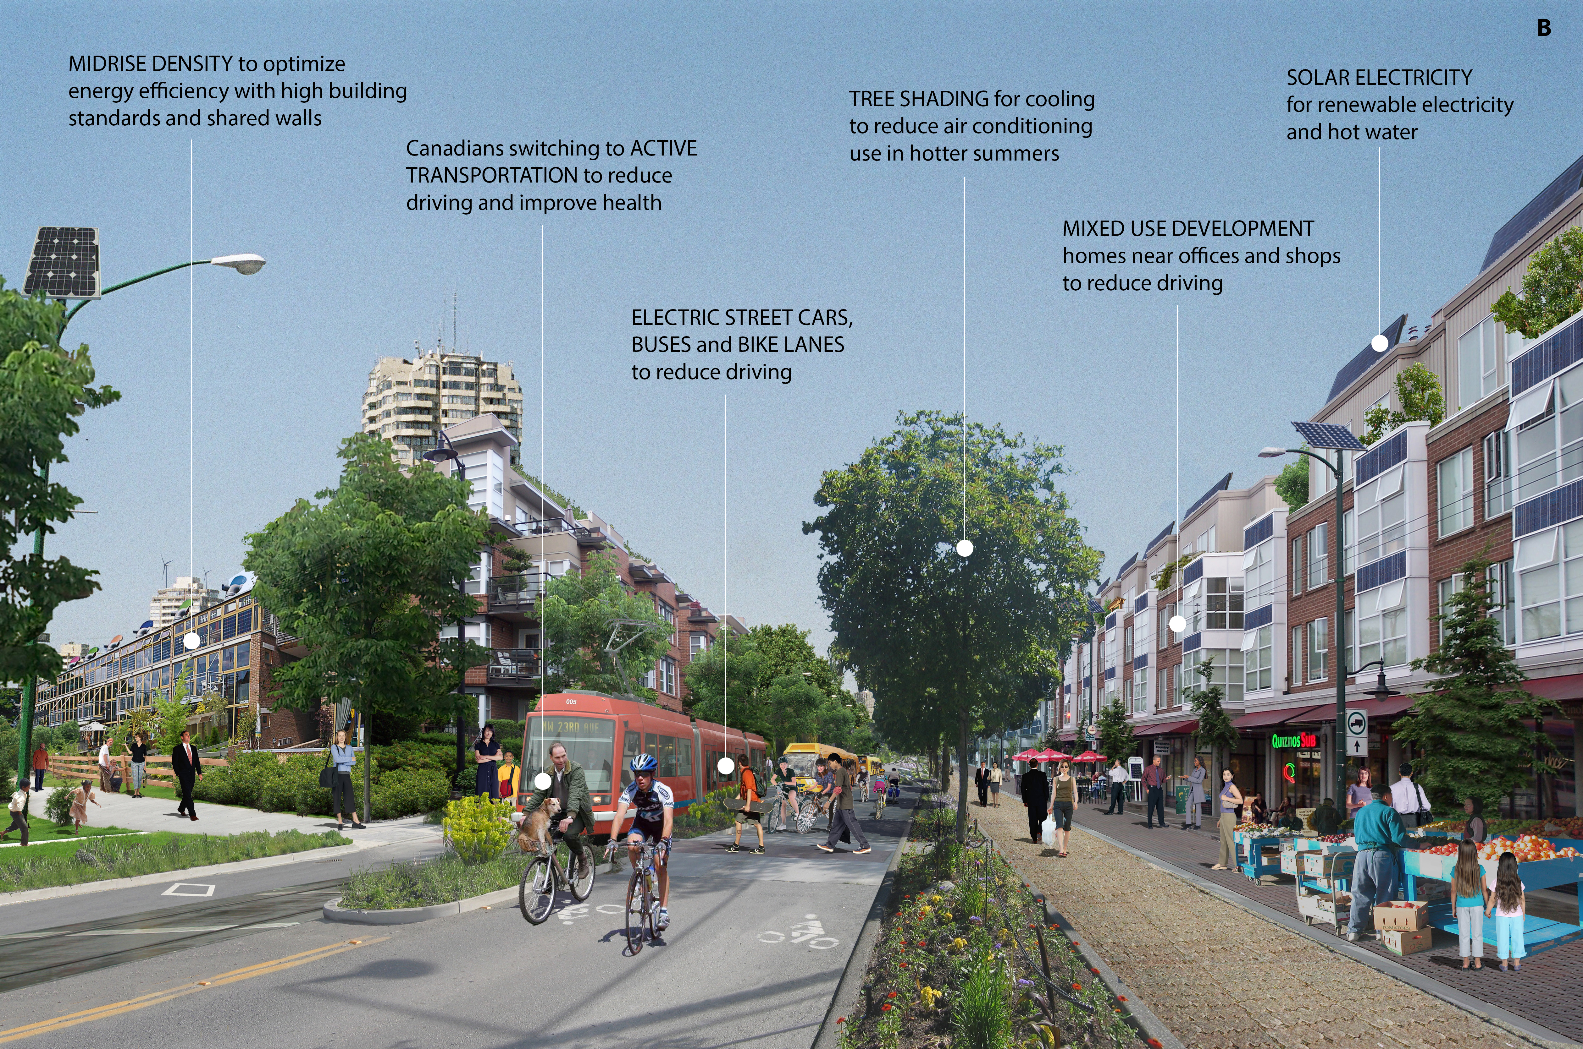
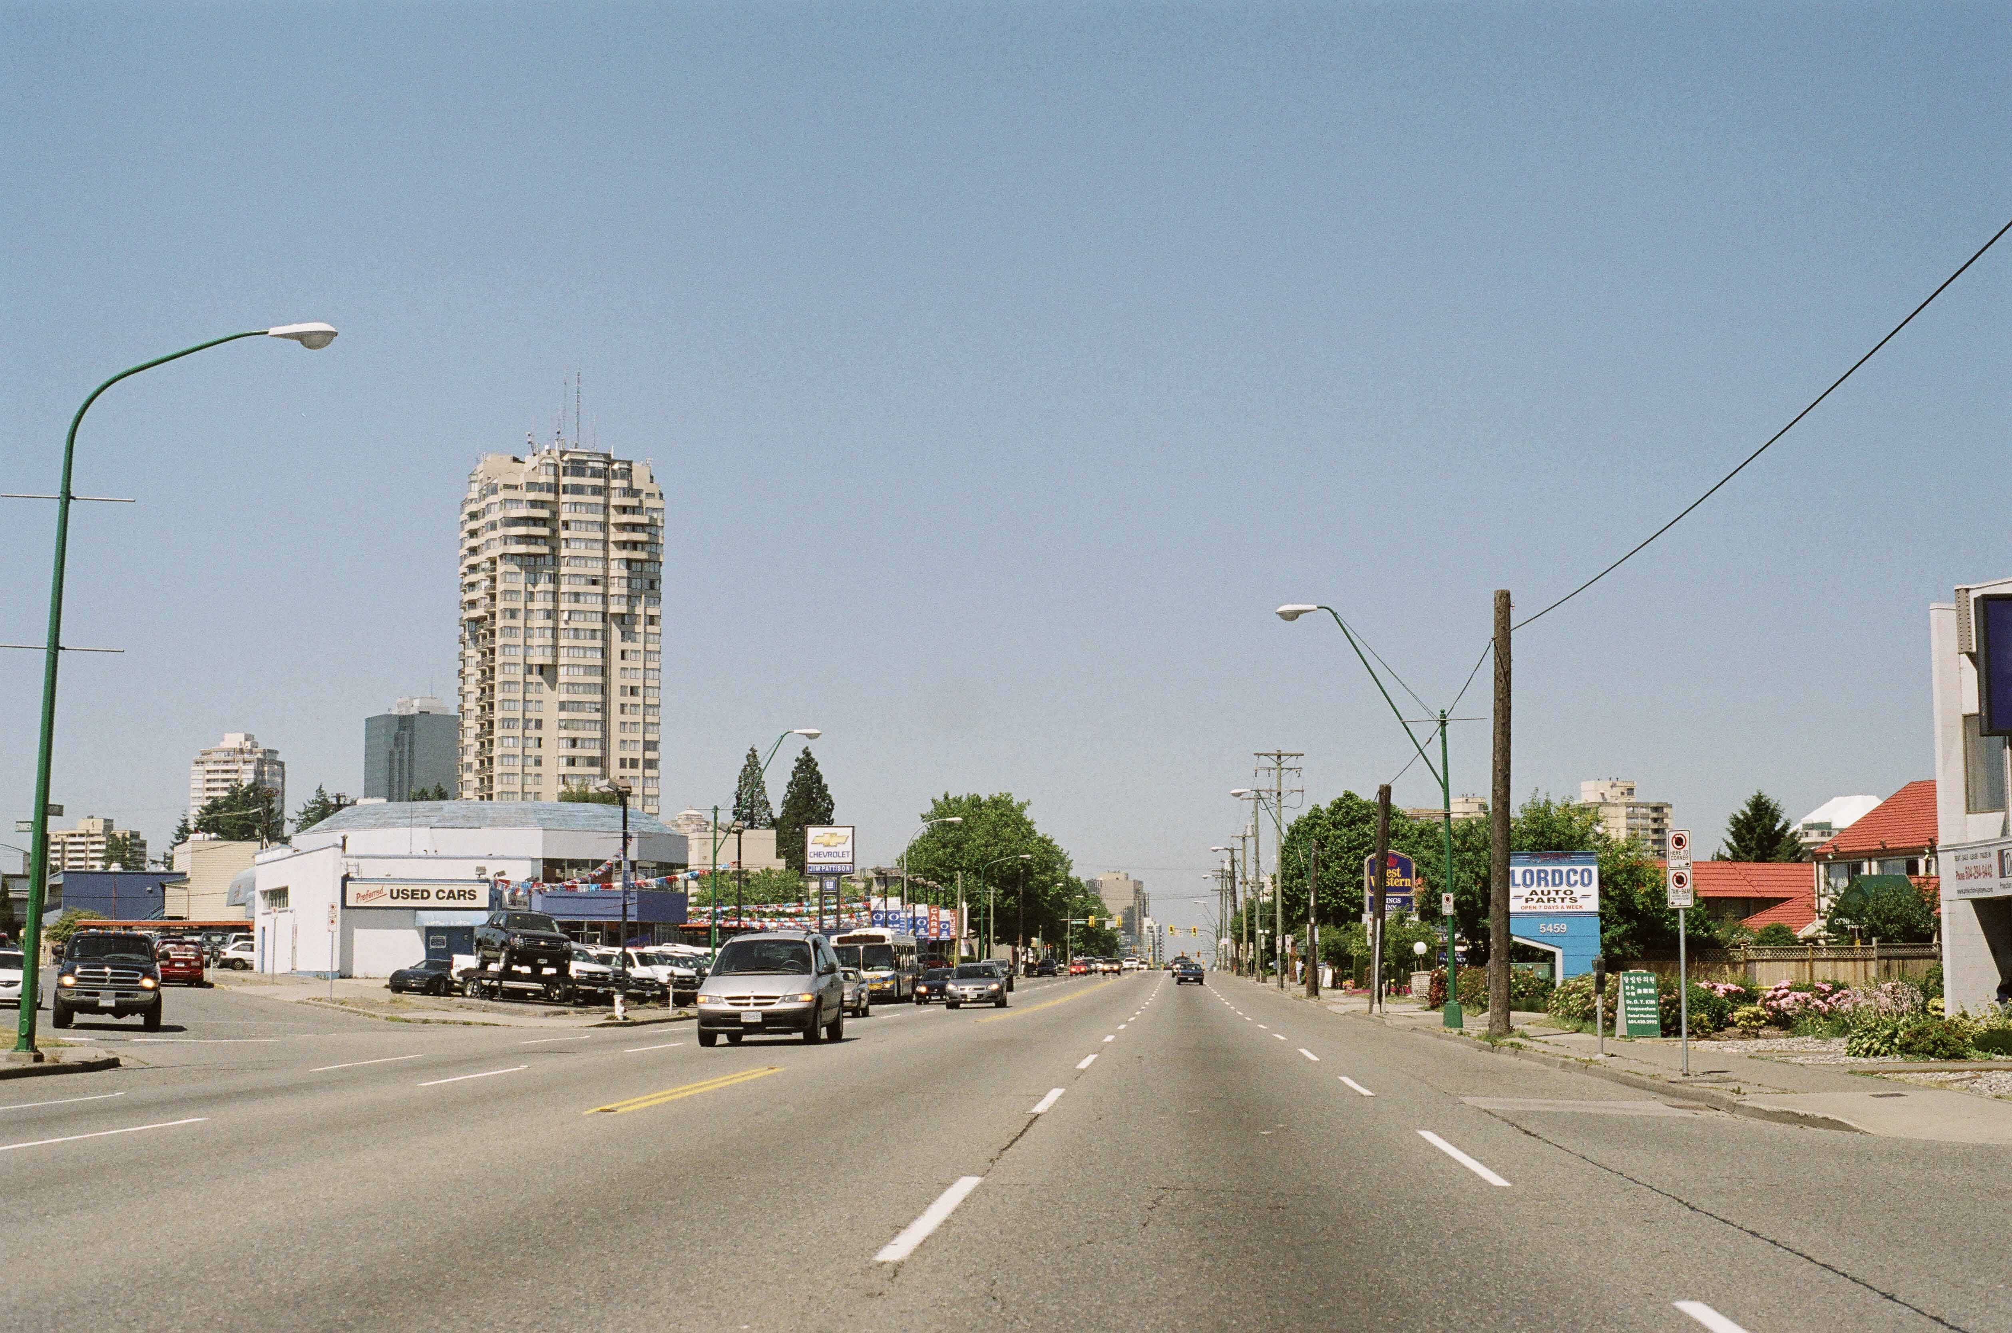
Created by David Flanders, CALP (UBC)
Notes:
We have incredible potential, but this is all too often the place we’re starting.
There are layers of information in this image. About what we value. About what we think the future will hold. About what kind of lives most of us lead. This picture is really an homage to the car. If you have roads like this, you might assume that nearly everyone has one. You might assume that we can, and will always be able to, fill it up with gas. We can’t see around the image, but if this is a low lying area near a coastline or a river, then we assume that flooding won’t be a major problem (there are no flood defenses). We assume that the past is a pretty good indicator of the future.
It’s been said that the way we plan our cities and make decisions in our businesses is like driving at a 100km/hour using only our rearview mirrors as a guide. Obviously this creates some challenges, when we have mountains of evidence to suggest that the road ahead is in fact twisting and turning very rapidly indeed.
Move to next image.
But sustainability is a conversation about what kind of future we want. It casts a big net. It’s not simply greenhouse gas emissions, or greenspace. It’s the shape and function of our cities. How close can we live to where we play? Can we live our values through the work we do?
Sustainability is also about reconciling our economy with the environment that sustains us, and about creating a new definition of prosperity. Are we prosperous if many are left behind? Are we prosperous if our children will be less well off than we are? Are we prosperous if we feel disconnected and alone?
So how do we support, deepen, cultivate transformations that ARE desirable?
What is needed? vision (ambitious, creative, holistic, equitable, long term); learn from examples; tackle deeper levers of change; and evaluate/monitor/demonstrate effectiveness

Slide 12
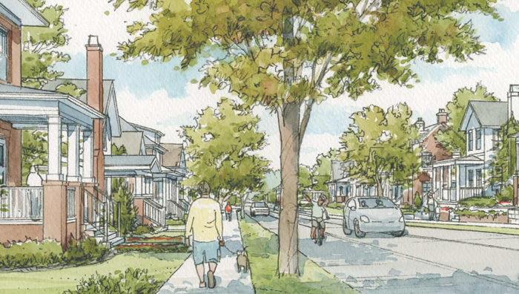

Thank you!
Please get in touch:
https://uwaterloo.ca/climate-institute/
sburch@uwaterloo.ca
www.transformcities.ca
@sarahlynnburch.bsky.social
Smartgrowthamerica.org

