Slide 1
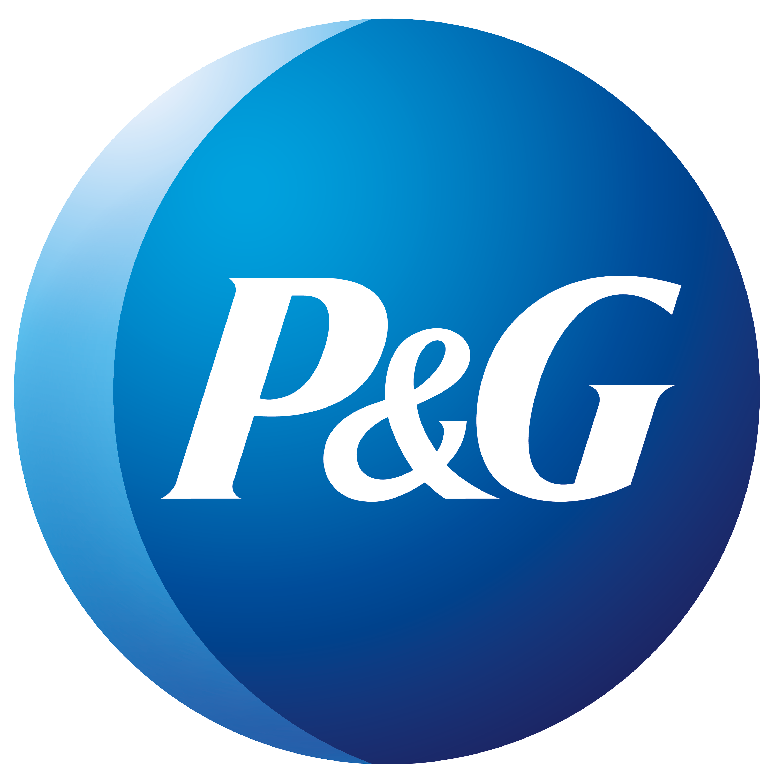
WHAT TYPES OF TOOTH WHITENING OPTIONS EXIST?

Slide 2
WHITENING OPTIONS
SURFACE STAIN REMOVAL AND CHEMICAL INHIBITION VIA ABRASIVE OR CHELANTS
IN-OFFICE OXIDATIVE WHITENING
AT HOME OXIDATIVE WHITENING
OVER THE COUNTER
OXIDATIVE WHITENING

Slide 3
WHITENING OPTIONS
IN-OFFICE OXIDATIVE WHITENING
Notes:
Consultation to determine the desired teeth colour​
Covering of lips and gums leaving the teeth exposed​
Application of the H₂O₂ whitening gel​
The light activation to commence the whitening procedure ​ to work in conjunction with the applied gel for 1-3 15-minute session(s)​
Repeating the same procedure for further sessions up to a total of 45 to 60 minutes depending on the patient’s needs​
Sensitivity reducing gel application

Slide 4
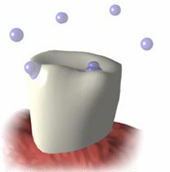
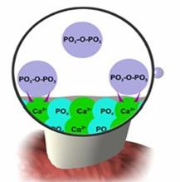
WHITENING OPTIONS
SURFACE STAIN REMOVAL AND CHEMICAL INHIBITION
VIA ABRASIVE OR CHELANTS
This option is ideal for post whitening maintenance
Abrasives: Physical removal of plaque biofilm
Examples: Silica, calcium carbonate
Chemical inhibition: Slow the rate of mineralization
Pyrophosphate as 1st generation
Polyphosphates as 2nd generation
Longer, more resistant to inactivation

Slide 5
WHITENING OPTIONS
IN-OFFICE OXIDATIVE WHITENING
Advantages
Good for busy patients or unable to follow at-home regimen
No take home trays or gel
One hour vs. weeks for results
Good jump start for darker stained teeth
Viewed as high profit margin
Disadvantages
Possible color regression
Tooth Dehydration
May require more than 1 visit to meet expectations
Possible thermal sensitivity or chemical tissue burn
Expensive for patients
Monopolizes treatment operatory and staff for 90 minutes

Slide 6
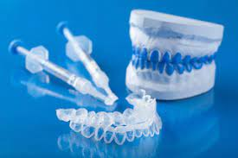
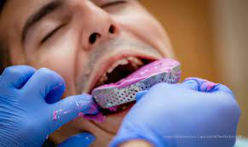
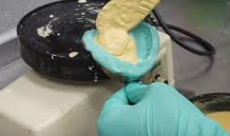
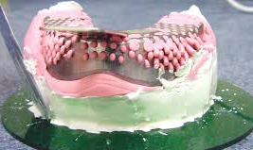
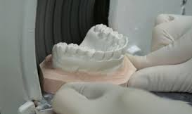
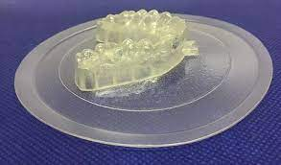
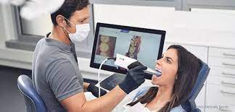
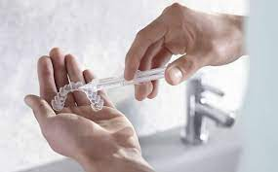
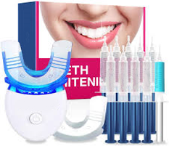
WHITENING OPTIONS
PROFESSIONAL AT-HOME OXIDATIVE WHITENING
Physical Impression
Pour the Model
Mount
Trim the Model
Suction (vacuum form) the tray
OR
Digital Impression

Slide 7
WHITENING OPTIONS
PROFESSIONAL AT-HOME OXIDATIVE WHITENING
Advantages
Good for patients with misaligned teeth
Provides whitening for full arch
Ability to touch up inexpensively
Viewed as a high profit margin
History of safety and efficacy
Disadvantages
Misuse could cause gingival irritation
Gag reflex problem for some patients
Too expensive for many patients
Time/Cost associated with tray fabrication
Chair time, repeat visits by patient to monitor progress

Slide 8
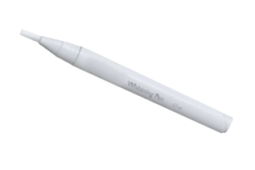
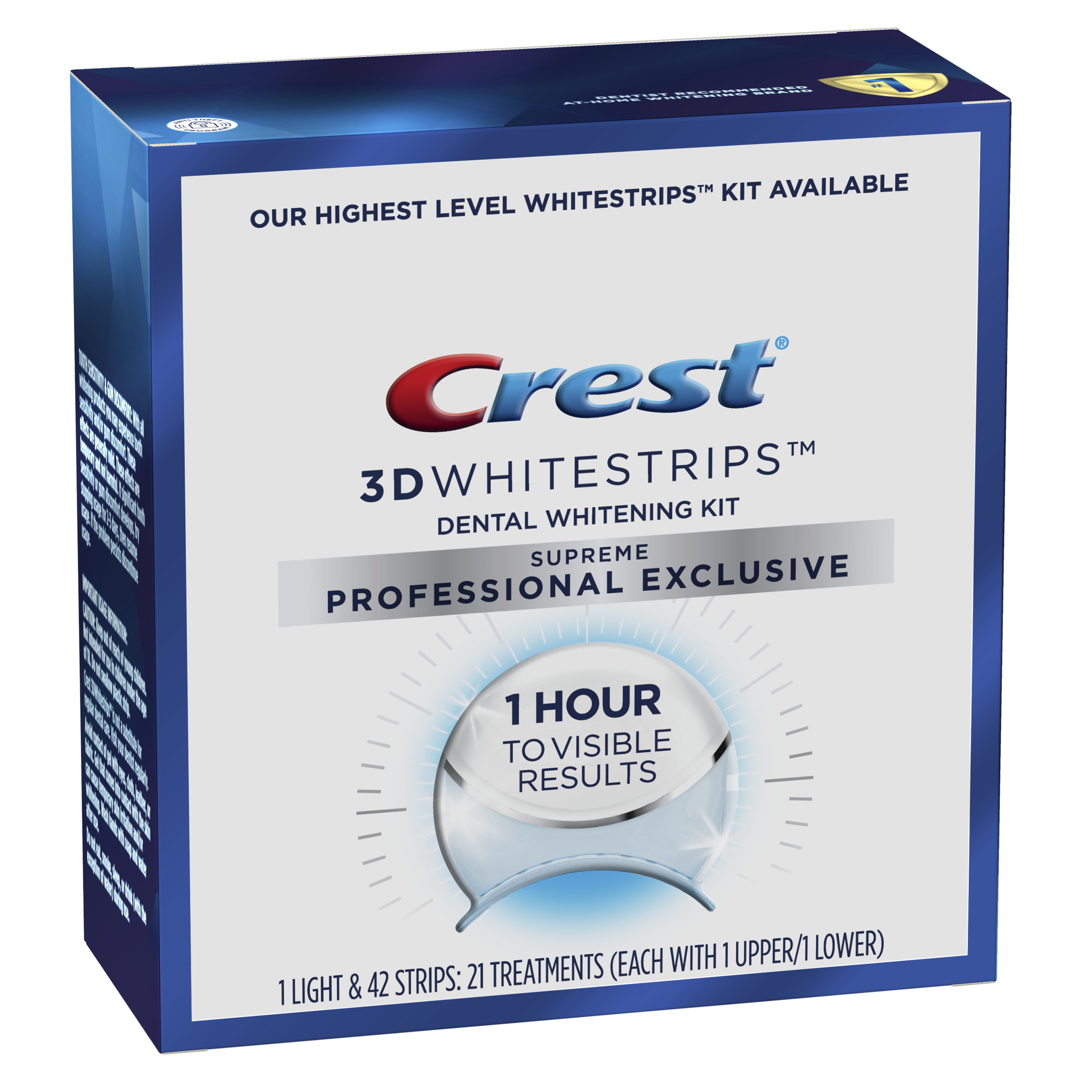
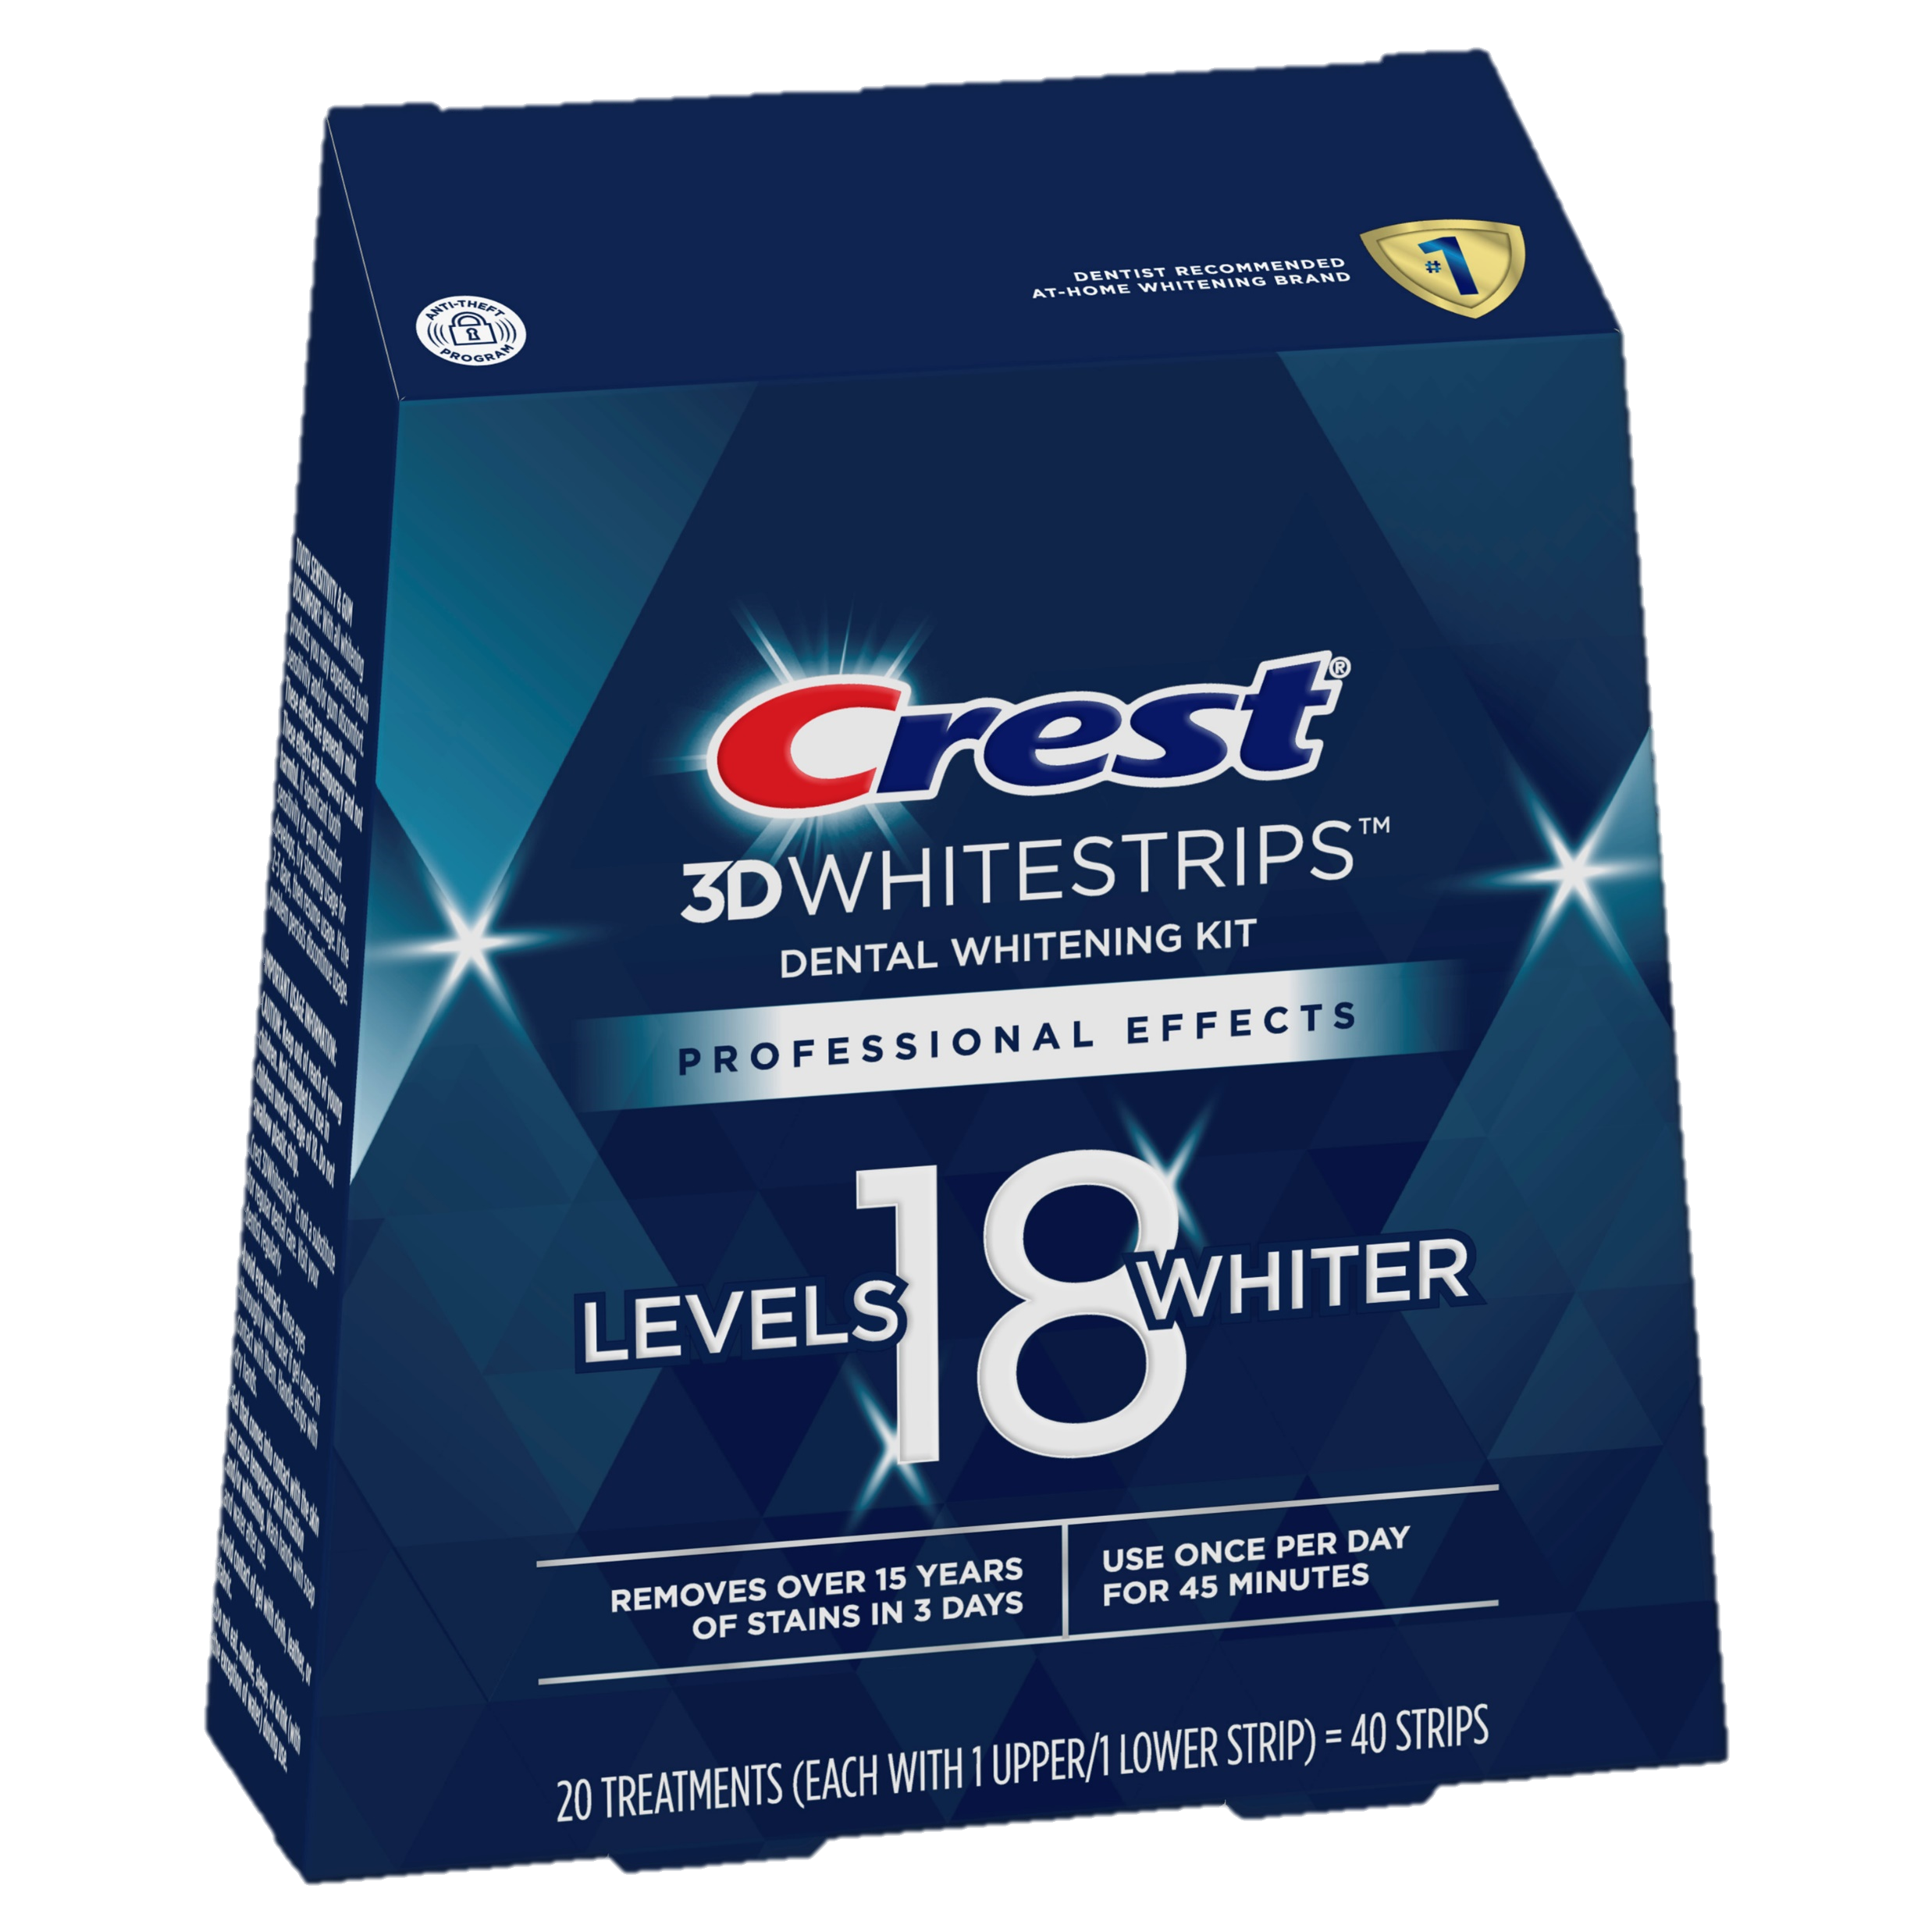
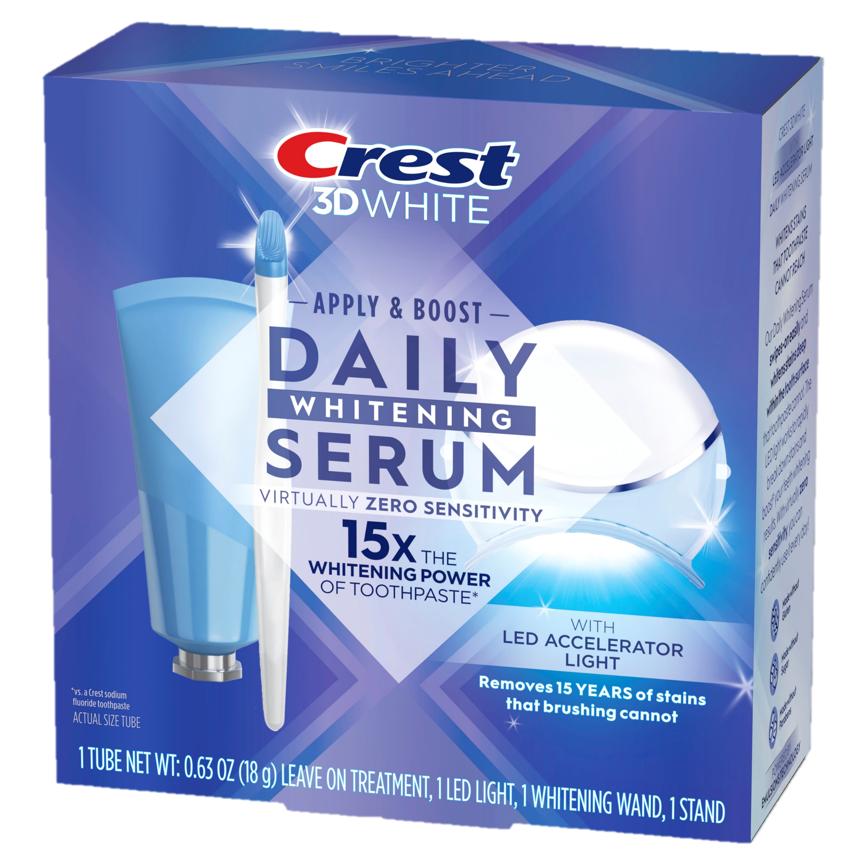
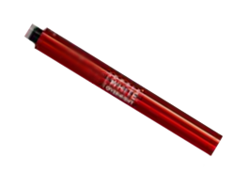
WHITENING OPTIONS
OVER THE COUNTER OXIDATIVE WHITENING

Slide 9
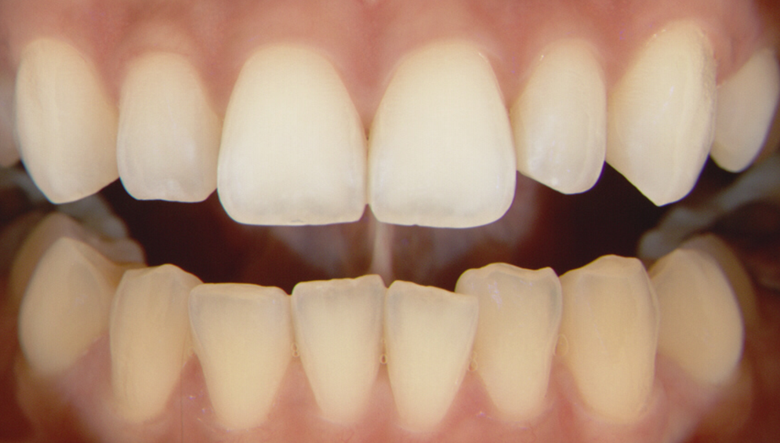
HOW DOES OXIDATIVE TOOTH WHITENING WORK?
For ALL forms of whitening
Concentration + Contact Time = Results
All forms continue to work until your teeth reach saturation point where they will not whiten further

