Slide 1
Emulsion Technology

Slide 2
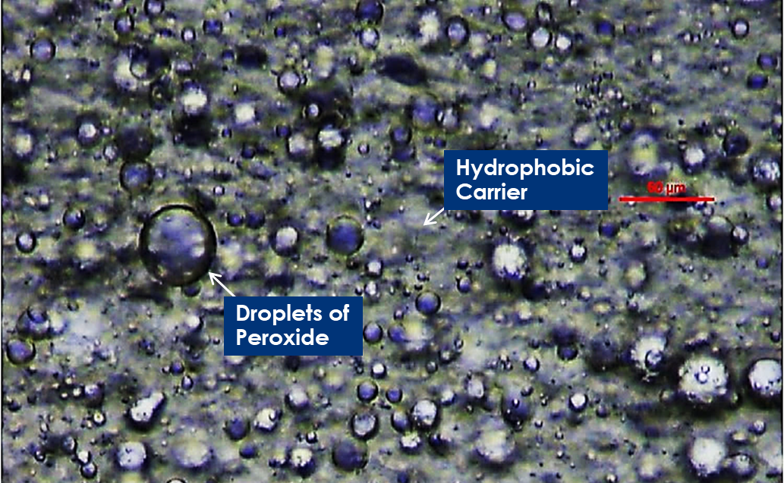
A RECENT ADVANCEMENT IN TOOTH WHITENING
EMULSION TECHNOLOGY
T O O T H S U R F A C E (Hydrophilic)
_{DEFINE}
HYDROPHOBIC: tending to repel water
HYDROPHILIC: tending to mix with or dissolve in water

Slide 3
A RECENT ADVANCEMENT IN TOOTH WHITENING
EMULSION TECHNOLOGY
HYDROPHOBIC CARRIER
T O O T H S U R F A C E (Hydrophilic)
_{DEFINE}
HYDROPHOBIC: tending to repel water
HYDROPHILIC: tending to mix with or dissolve in water

Slide 4
A RECENT ADVANCEMENT IN TOOTH WHITENING
EMULSION TECHNOLOGY
HYDROPHOBIC CARRIER
H₂O₂ HYDROPHILIC MICRODROPLETS
3% H₂O_{2 OVERALL}
T O O T H S U R F A C E (Hydrophilic)
_{DEFINE}
HYDROPHOBIC: tending to repel water
HYDROPHILIC: tending to mix with or dissolve in water

Slide 5
A RECENT ADVANCEMENT IN TOOTH WHITENING
EMULSION TECHNOLOGY
HYDROPHOBIC CARRIER
H₂O₂ HYDROPHILIC MICRODROPLETS
3% H₂O_{2 OVERALL}
T O O T H S U R F A C E (Hydrophilic)
Concentration inside the microdroplets is 5x higher than the OVERALL 3% concentration

Slide 6
A RECENT ADVANCEMENT IN TOOTH WHITENING
EMULSION TECHNOLOGY
HYDROPHOBIC CARRIER
H₂O₂ HYDROPHILIC MICRODROPLETS
3% H₂O_{2 OVERALL}
T O O T H S U R F A C E (Hydrophilic)
Concentration inside the microdroplets is 5x higher than the OVERALL 3% concentration
INTRINSIC WHITENING

Slide 7
Notes:
Here is a video of the mechanism of action of emulsions.
We have the emulsion layer that is comprised of the hydrophilic highly active H₂O₂ microdroplets encased in the hydrophobic carrier petrolatum.
Because the enamel is hydrophilic, a diffusion gradient is formed and the hydrophilic microdroplets are attracted to it. The H₂O₂ travels through the enamel to the dentin enamel junction next to the stain. It is there that the H₂O₂ droplets react with the porphyrin stain and render it colorless. This diffusion takes time.
Just as in other forms of whitening, a barrier is needed to drive infusion. However, in contrast to other forms of whitening, the Emulsions barrier is not held by gels or adhesives, but by the hydrophobic carrier petrolatum.

Slide 8
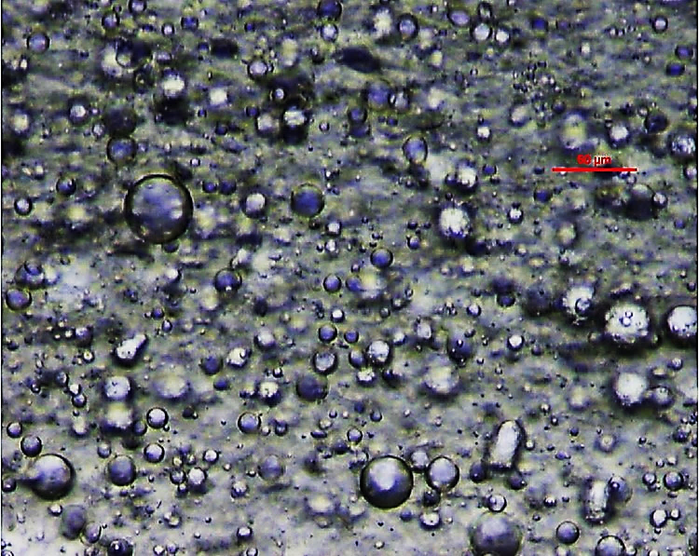
Highly active and highly bioavailable H₂O₂ droplets
Delivers a continuous, metered dose of peroxide throughout application
Stays on teeth without strip – hydrophobic carrier protects peroxide from rinsing off
No polymers that dehydrate
Hydrophobic Carrier
Droplets of Peroxide

Slide 9
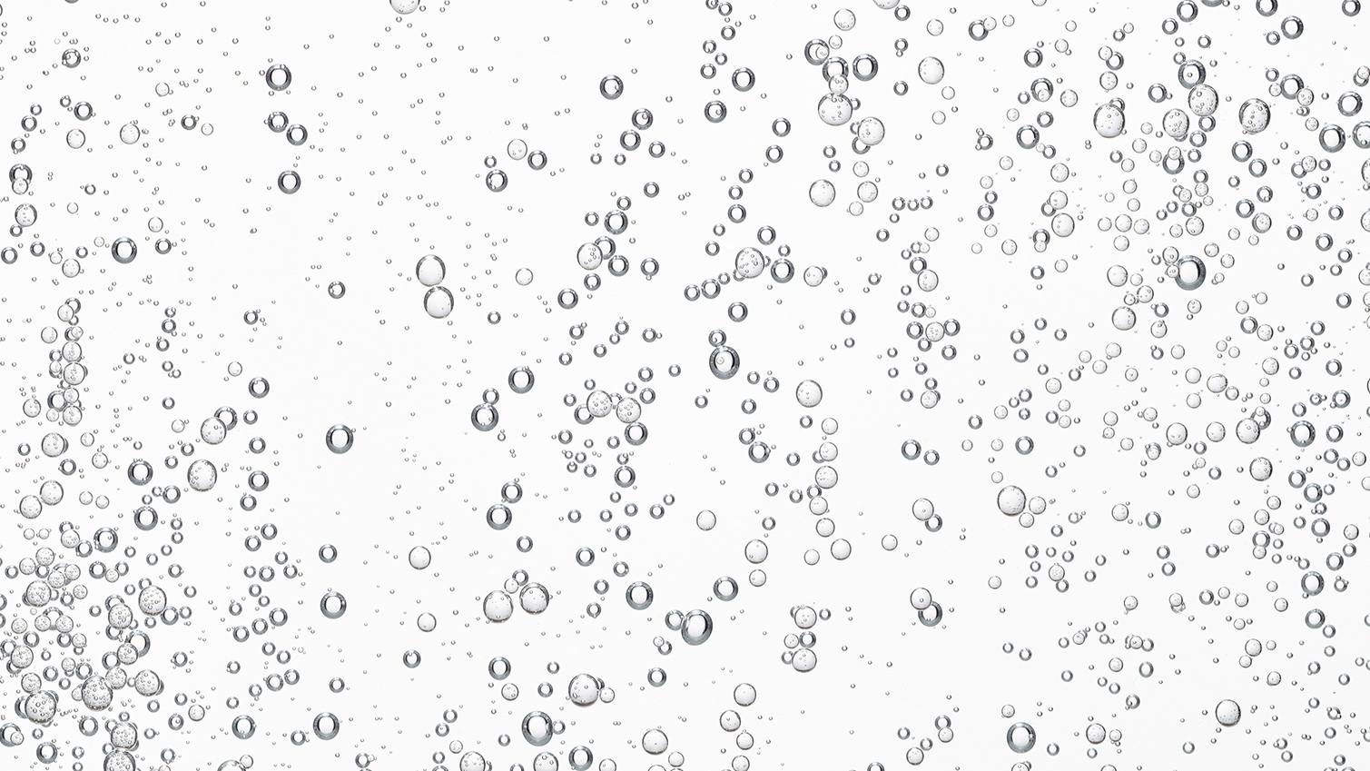
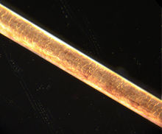
25μm
COMPARISON: HUMAN HAIR = 50-70 μm
T O O T H S U R F A C E (Hydrophilic)
Notes:
Again, when we discuss emulsions, we talk about the AMOUNT of microdroplets AVAILABLE to migrate to the stain. LIKE ATTRACTS LIKE.
Micrometre, also called micron, metric unit of measure for length equal to 0.001 mm, or about 0.000039 inch

Slide 10
A RECENT ADVANCEMENT IN TOOTH WHITENING
EMULSION TECHNOLOGY
Efficacy & Tolerability
Unprecedented
Efficacy
Tooth Sensitivity
WHITENING PERFORMANCE
NEW & EXISTING FORMS
WITH & WITHOUT LIGHT
Efficacy: Increase Concentration or Contact Time

Slide 11
A RECENT ADVANCEMENT IN TOOTH WHITENING
EMULSION TECHNOLOGY
Efficacy & Tolerability
Unprecedented
Efficacy
Tooth Sensitivity
WHITENING PERFORMANCE
NEW & EXISTING FORMS
WITH & WITHOUT LIGHT
21 Clinical Trials
<5%
Sensitivity
& Irritation
SENSITIVITY FREE WHITENING!!
Efficacy: Increase Concentration or Contact Time

Slide 12
A RECENT ADVANCEMENT IN TOOTH WHITENING
EMULSION TECHNOLOGY
Hydrophobic Carrier
Provides the Contact Time
VS
Unprotected Carrier
BASELINE
EMULSION
30 MINUTES
POST-APPLICATION
BASELINE
LEADING WHITENING PEN
30 MINUTES
POST-APPLICATION

