Slide 1
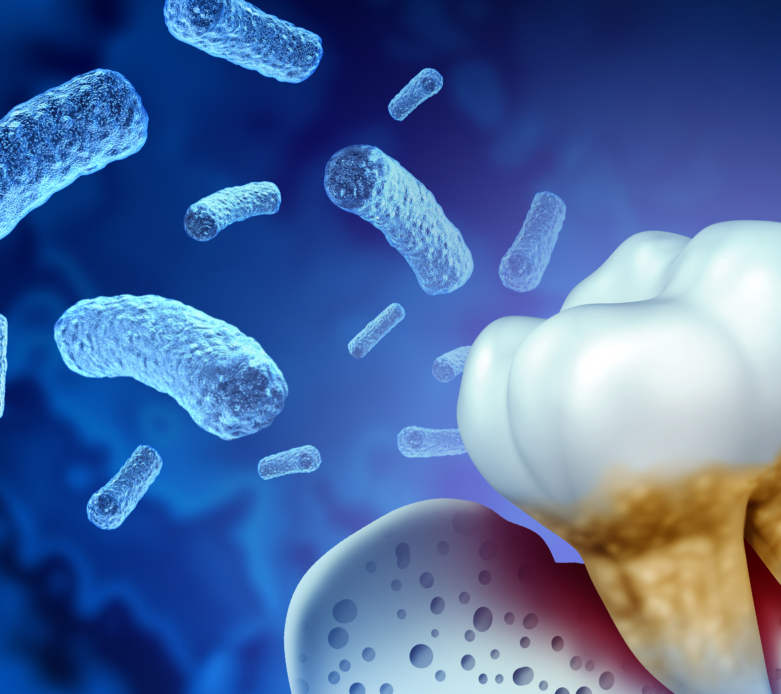
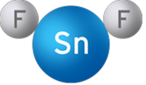
STANNOUS FLUORIDE & THE ORAL MICROBIOME:
Increase in oral health associated bacteria
Decrease in gingivitis-associated bacteria
Stabilizing Effect in Natural Teeth ​
Stabilizing Effect Peri-Implant
Short-Term Response¹ (2 Weeks)
Long-Term Response² (3 Years)
SnF₂ treatment favorably shifted oral microbiomes in peri-implant mucositis subjects toward the no-mucositis state
A 4-week SnF₂ toothpaste treatment reduced the relative abundance of Fusobacterium, Porphyromonas, Treponema, Prevotella, etc and increased the relative abundance of Rothia, Actinomyces. This change to the dental plaque microbiome composition is consistent with a return to a healthy no-mucositis microbiome and improved clinical signs and symptoms
Baseline
Control (NaF)
Vs.
Vs.
¹ He et al. (2021) Am J Dent 34: 222-227
² Kruse et al. (2021) Antibiotics 10, 481
Ramji et al. J Dent Res (Spec Iss A) 2024; 103: Abstract 2509.
Courtesy of Procter & Gamble

Slide 2
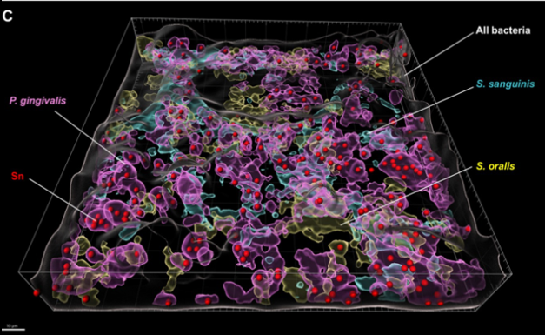
Representative FISH-CLSM and 3D reconstructed images using probes targeting specific bacterial strains and metal ions. Simultaneous hybridization for the SN treated biofilm with species-specific probes targeted for: (C) Combined 3D reconstructed image for SN-treated in situ biofilm with probes targeting for Sn²⁺ (red), S. oralis (yellow), S. sanguinis (cyan), P. gingivalis (purple) and non-specific white (non-specific). Bar: 10 μm.
Sn²⁺ specific intracellular imaging reflected the colocalization of Sn²⁺ ions with P. gingivalis but not with other species.
Courtesy of Procter & Gamble
Chen, D et al. Front. Microbiol., 14 February 2024 Volume 15 - 2024 | https://doi.org/10.3389/fmicb.2024.1327913

Slide 3
S. Mutans vs Rest Bacteria
‘Red Complex’ Pathogen vs General Bacteria P. gingivalis, T. forsythia, and T. denticola commensal: S. oralis,
Before
After
primary causative agent S. mutans, the pivotal “bridging species” F. nucleatum, and two beneficial commensals, S. oralis and A. naeslundii.
Courtesy of Procter & Gamble
Chen, D et al. Front. Microbiol., 14 February 2024 Volume 15 - 2024 | https://doi.org/10.3389/fmicb.2024.1327913

Slide 4
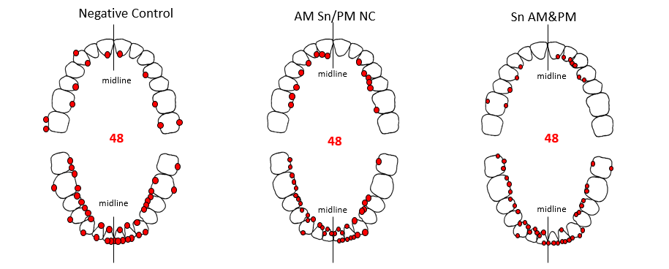
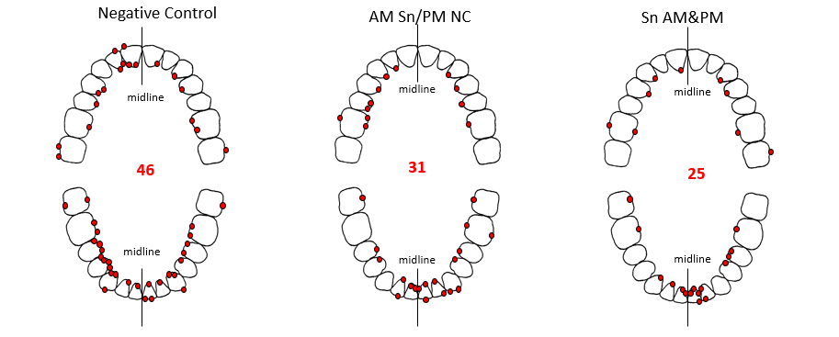
Overall Average Bleeding
Dose Dependent Response Sodium Vs Stannous
Design | 3 treatment Parallel group study Randomized Controlled Trial | 3 treatment Parallel group study Randomized Controlled Trial
Duration | 1 month (BL, Week 4) 90 Subjects Subjects Brushed for 1 minute | 12 weeks (BL, week 4, week 12) 90 subjects Subjects Brushed for 1 minute
Clinical Indices | LSGI, # of bleeding sites | LSGI, # of bleeding sites
Test Products | 3 Treatments (30/trt) Colgate Cavity Protection (NC, am/pm) CPH Sensitive and Enamel Shield (PC, am/pm) CPH Sensitive and Enamel Shield am & Colgate Cavity Protection pm (Experimental)
Week 4
3X
One Time vs. None
Likelihood of transitioning to health:
3.2X
Two times vs. One
Courtesy of Procter & Gamble
Study No. 2020112

Slide 5
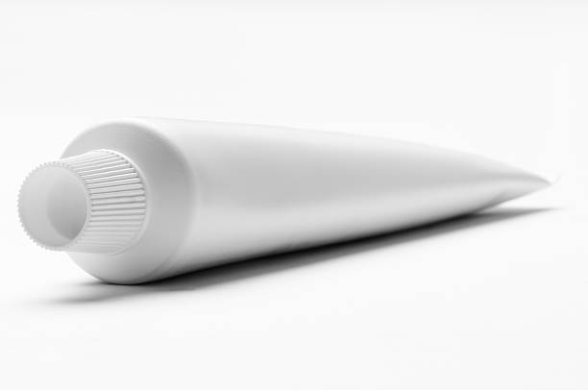
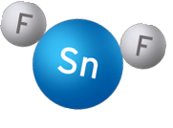
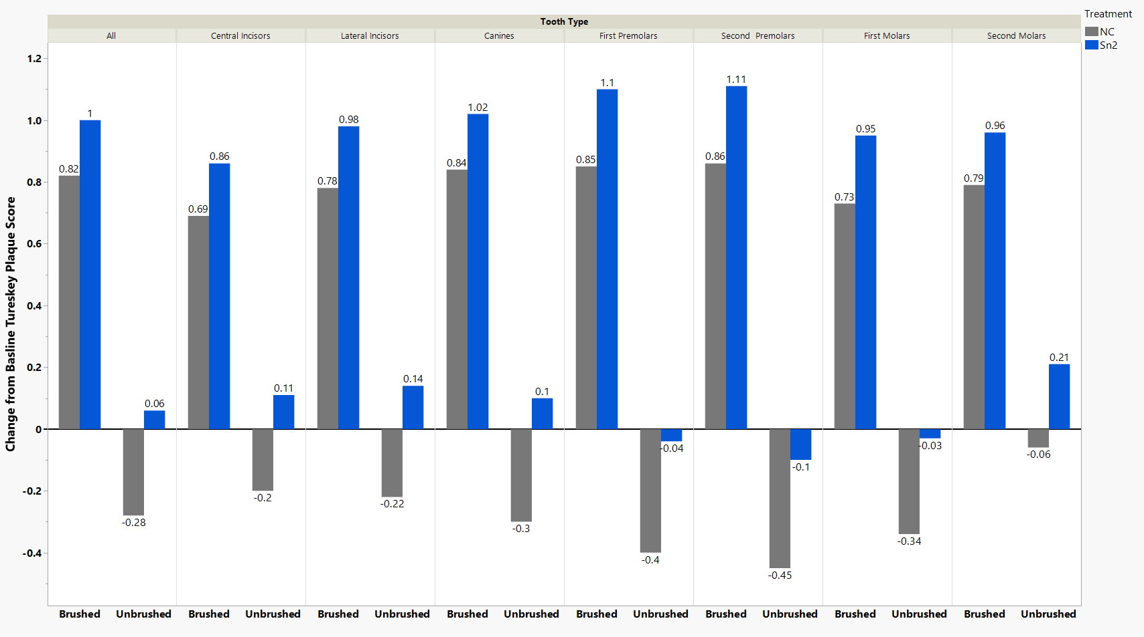
CHEMISTRY BEYOND THE BRUSH
Brushed vs Unbrushed Surfaces
Plaque Score Change
Getting Worse Getting Better
Brushed = lingual surfaces; Unbrushed = buccal surfaces
Highly Restricted

Slide 6
Formulation Matters
Stannous must be in the correct oxidation state
Stannous in the Sn2+ is the only form shown to have gingivitis efficacy
Stannous must be soluble
Stannous cannot exist in nature without being bound to a negative ion (a.k.a. chelant) to make a salt
The ideal formula has a Sn2+ salt that keeps the Sn2+ from adsorbing to the silica in toothpaste.
Stannous must be delivered to the mouth
The ideal formula releases all of its Sn2+ salt during the average consumer’s brushing time
Sn2+ that is bound too tightly in formulation will not reduce biological materials nor bind to LPS
Sn2+ that is not bound tightly enough in formulation will easily bind to other negative ions
Stannous must have reductive potential in the mouth
Stannous must release to the bacteria and the bacteria must be able to “uptake” Sn2+ in order to have the desired physiological benefits

Slide 7
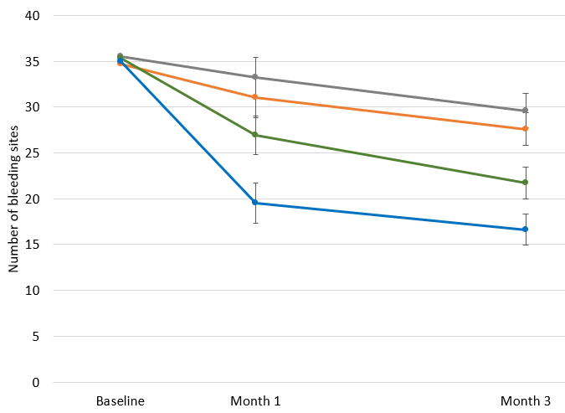
A 3-Month Randomized Trial Evaluating Effects of Stannous Fluoride Bioavailability on Gingivitis
Objective: To assess the impact of formulation chemistry on gingivitis effects of two experimental 0.454% stannous fluoride (SnF2) dentifrices with low tin bioavailability versus positive and negative controls.
Conclusion: SnF₂ dentifrice formulation chemistry influences the level of antigingivitis efficacy, which was also reflected in tin bioavailability, tin uptake into biofilm, and bacterial glycolysis inhibition.
Study Design | RCT (double blind; parallel)
Study | 120 Participants Measurements taken Baseline, month 1 & month 3 Brush 1 min 2x daily Manual toothbrush
Clinical Assessments | Löe Silness Gingival Index (in-vivo) Tin Uptake and Biofilm Glycolysis (In –vitro)
Legs | Neg Ctrl : 0.76% sodium monofluorophosphate, soluble tin = 0 ppm Experimental A: 0.454% SnF2, pH 4.7, soluble tin = 592 ppm Experimental B: 0.454% SnF2, pH 5.8, soluble tin = 102 ppm Positive Control: 0.454% SnF2 commercial dentifrice, soluble tin = 2037 ppm
At Months 1 and 3, the Positive Control showed significantly fewer bleeding sites versus all treatments (p≤0.04) and Experimental dentifrice A had significantly less bleeding versus the Negative Control (p≤0.041). Experimental dentifrice B was not significantly different from the Negative Control (p≥0.438) at either timepoint. Tin biofilm uptake and in vitro PGRM exhibited a similar trend.

Slide 8
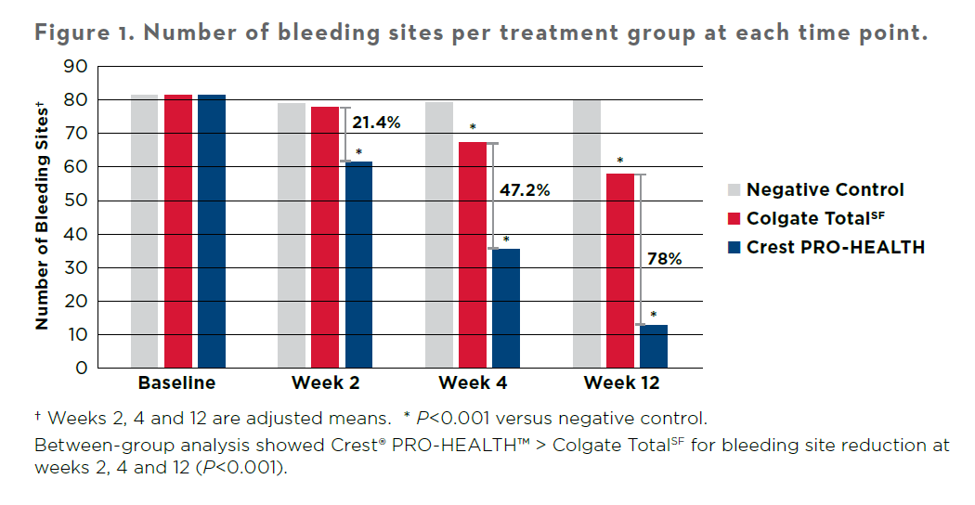
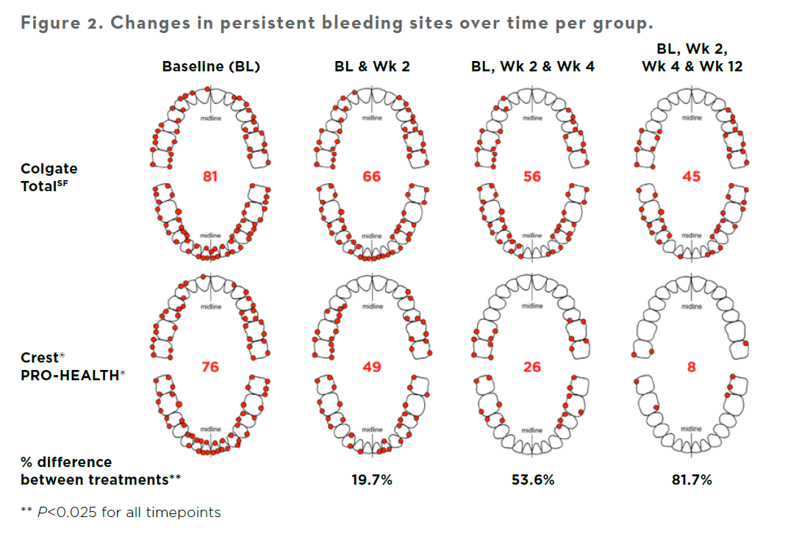
Week 2
Week 4
Week 12
In market Formula
In market Formula
In market Formula
3 out of 4 subjects using Crest Stannous fluoride dentifrice moved from being classified as having generalized or localized gingivitis to generally Healthy in just 3 months vs no subject using the in-market formula
He T, Nachnani S, Lee S, Zou Y, Grender J, Farrell S, Sagel P, Biesbrock AR. The relative clinical efficacy of three 0.454% stannous fluoride dentifrices for the treatment of gingivitis over 3 months. Am J Dent. 2020 Aug;33(4):218-224. PMID: 32794398.

Slide 9
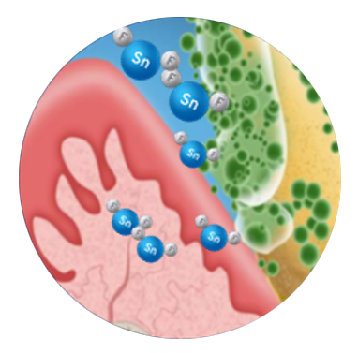
Gingivitis protection: Biofilm Penetration Up to 4mm Below the Gumline (Sub-gingival) Penetration
In vivo, Stannous (tin) was detectable up to 4mm below the gumline at 12 hours after use of a P&G stabilized stannous fluoride formulated dentifrice
Median Tin (ng/strip/ul)
*
25
20
15
10
*
*
5
0
Baseline
Day 1 (30 min)
Day 1 (12 HR Post-Brushing
Day 14 (12 HR Post-Brushing
* Significantly different vs. Baseline at P<0.0001
Klukowska MA et al. Am J Dent (2018) 31: 184–188
Notes:
Voiceover: Additionally, its important to ensure stannous is getting to where it needs to be to leverage these mechanisms, namely, sub gingivally. To demonstrate stannous’ sub-gingival penetration, participants gingival crevicular fluid (GCF) was analyzed at baseline, and then 30 mins and 12 hours post brushing with P&G stannous fluoride dentifrice. Then participants were asked to brush again 14 days later and had GCF analyzed 12 hours post brushing. Tin levels were significantly higher below the gumline 12 hours after brushing on days 1 and 14. This demonstrates the ability of stannous fluoride to penetrate below the gumline over an extended period of time to act upon gram negative microbes beneath the gum line. This shows how and why chemistry is such an important contribution to gingival health.

