Slide 1
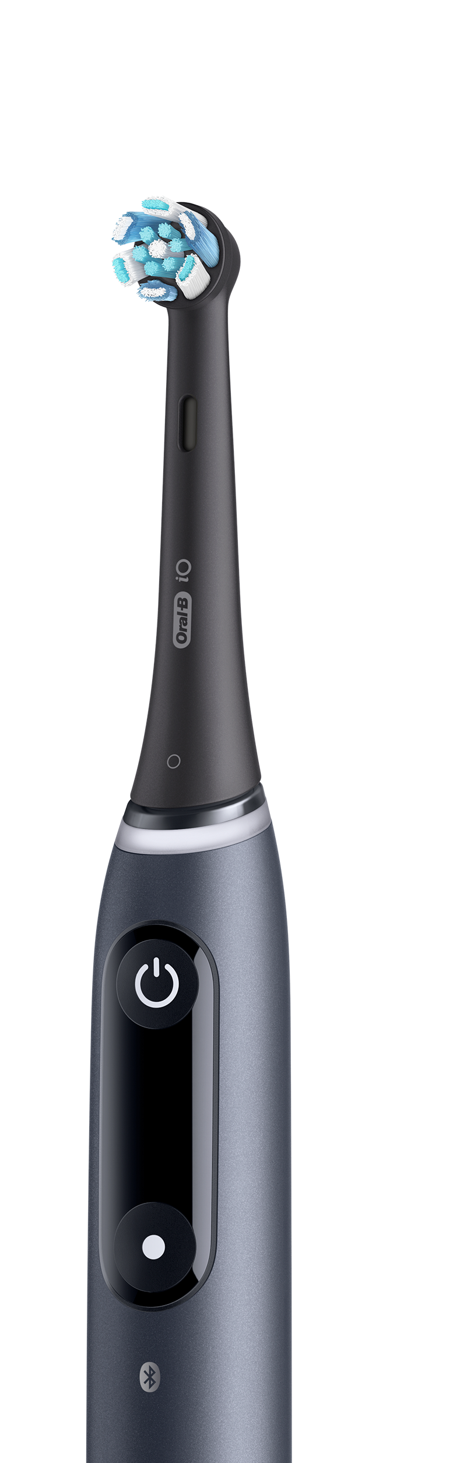
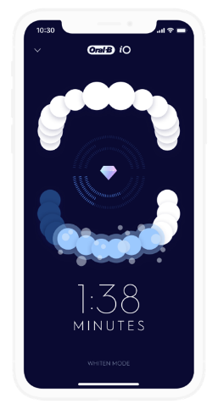
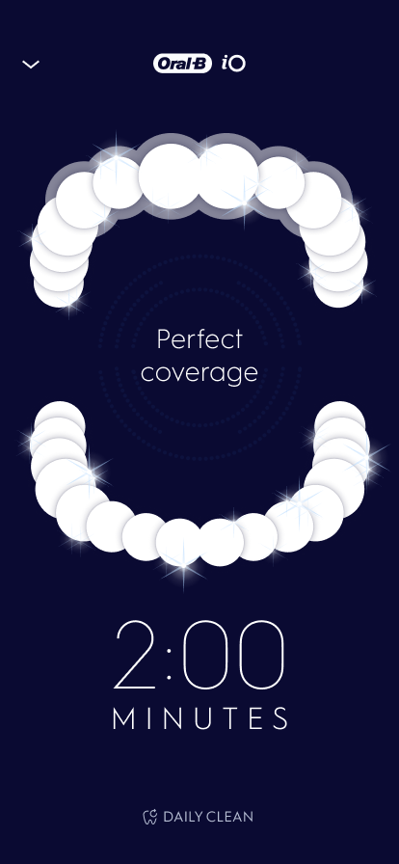

EMPOWERING
PATIENTS
IN SELF-CARE
Better oral care routines with interactive brush technologies
Real-world Data Analysis

Slide 2
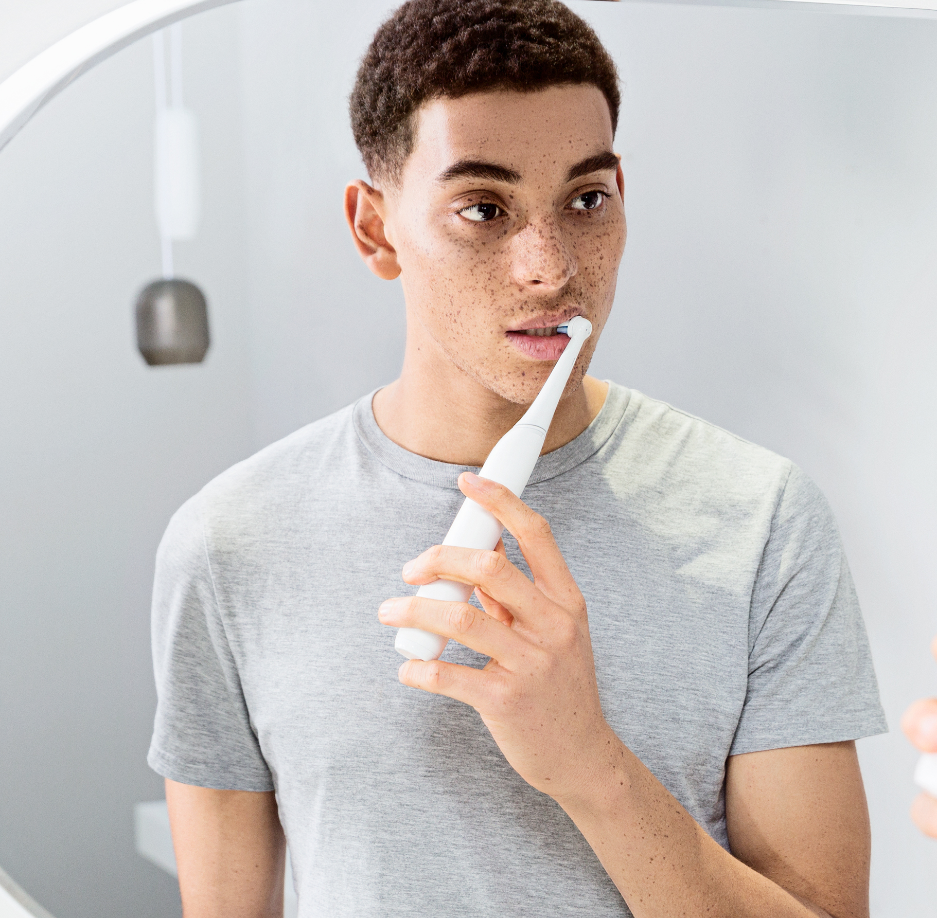
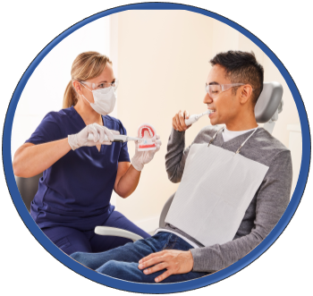


GUIDANCE is essential for establishing good oral hygiene behaviors,
yet evidence to support conventional interventions is limited
Guidelines for
Clinical Practice
Up to 50% of the global
adult population suffers from periodontal disease¹
Maintenance of periodontal health is critically dependent upon the behavior of the patient²
Dental Professionals must provide Oral Hygiene Advice to their patients³
Conventional
interventions have limited outcomes⁴
¹ https://fdiworlddental.org/gphp
² Newton, JT, Asimakopoulou, K. Behavioral models for periodontal health and disease. Periodontol 2000. 2018; 78: 201– 211. https://doi.org/10.1111/prd.12236
³ Sanz M, J Clin Periodontol. 2020 Jul;47 Suppl 22(Suppl 22):4-60. doi: 10.1111/jcpe.13290. Erratum in: J Clin Periodontol. 2021 Jan;48(1):163. PMID: 32383274; PMCID: PMC7891343.
⁴ Soldani FA et al Cochrane Database Syst Rev. 2018 Oct 31;10(10):CD007447. doi: 10.1002/14651858.CD007447.pub2. PMID: 30380139; PMCID: PMC6516798.
“There was insufficient high‐quality evidence to recommend any specific one‐to‐one OHA method as being effective in improving oral health or being more effective than any other method” ⁴
IT’S HARD TO CHANGE BEHAVIOR
Systematic Review & Meta Analysis

Slide 3
GUIDANCE is essential for establishing good oral hygiene behaviors,
yet evidence to support conventional interventions is limited
Guidelines for
Clinical Practice
Up to 50% of the global
adult population suffers from periodontal disease¹
Maintenance of periodontal health is critically dependent upon the behavior of the patient²
Dental Professionals must provide Oral Hygiene Advice to their patients³
Conventional
interventions have limited outcomes⁴
“There was insufficient high‐quality evidence to recommend any specific one‐to‐one OHA method as being effective in improving oral health or being more effective than any other method” ⁴
¹ https://fdiworlddental.org/gphp
² Newton, JT, Asimakopoulou, K. Behavioral models for periodontal health and disease. Periodontol 2000. 2018; 78: 201– 211. https://doi.org/10.1111/prd.12236
³ Sanz M, J Clin Periodontol. 2020 Jul;47 Suppl 22(Suppl 22):4-60. doi: 10.1111/jcpe.13290. Erratum in: J Clin Periodontol. 2021 Jan;48(1):163. PMID: 32383274; PMCID: PMC7891343.
⁴ Soldani FA et al Cochrane Database Syst Rev. 2018 Oct 31;10(10):CD007447. doi: 10.1002/14651858.CD007447.pub2. PMID: 30380139; PMCID: PMC6516798.
Systematic Review & Meta Analysis
IT’S HARD TO CHANGE BEHAVIOR¹

Slide 4
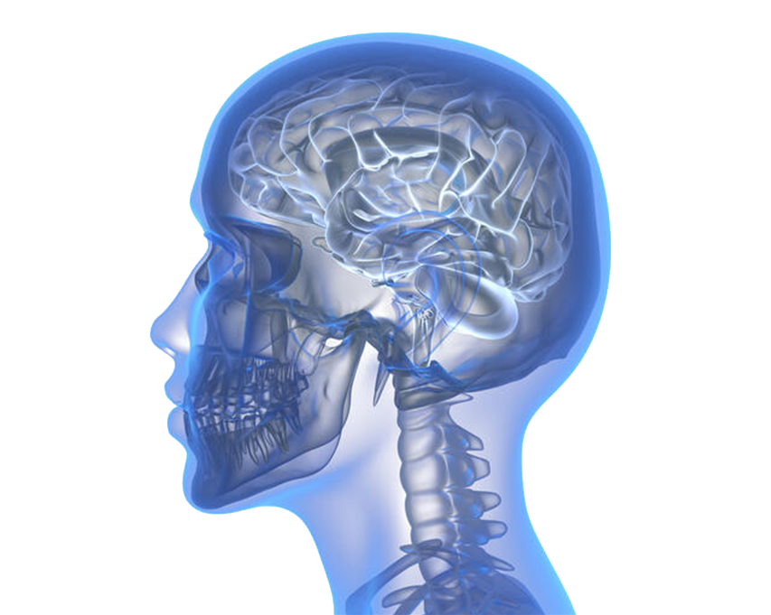
IT’S HARD TO CHANGE BEHAVIOR¹
SOURCE: OUELLETTE & WOOD (1998)
  We value
  shortcuts and repetition - 50%
  of what you did today you will do again tomorrow
95% of behavior
is processed unconsciously
  Intentions and attitudes are poor predictors of future behavior
Notes:
Existing habits take less energy than new habits
Example of habit: eg exercising

Slide 5
IT’S HARD TO CHANGE BEHAVIOR¹
Neocortex
Existing Behaviors
New Behaviors
Information processed automatically in the background.
Used for everyday events
Require a high level of processing
Reserved for novel and important events
Basal ganglia interacting with Neocortex
Habit Strength
High
Intentions/Attitudes
High
  We value
  shortcuts and repetition - 50%
  of what you did today you will do again tomorrow
Intentions/Attitudes
Low
Habit Strength
Low
95% of behavior
is processed unconsciously
“The Autopilot is ON”
“The Pilot is in Control”
  Intentions and attitudes are poor predictors of future behavior
¹Ouellette, Judith & Wood, Wendy. (1998).Psychological Bulletin - PSYCHOL BULL. 124. 54-74. 10.1037/0033-2909.124.1.54.
Notes:
Existing habits take less emotional energy than new habits
Example of habit: eg exercising

Slide 6
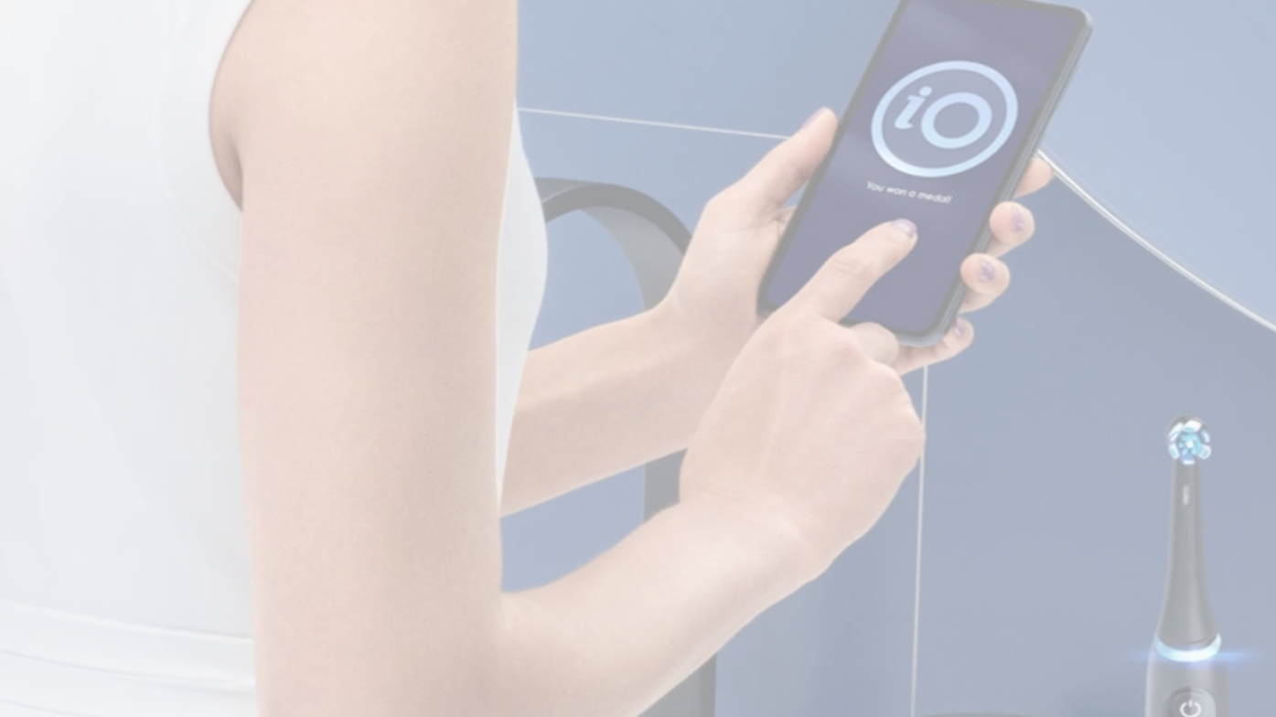
IT’S HARD TO CHANGE BEHAVIOR¹
SELF-MONITORING & FEEDBACK
are integral to establishing effective oral care routines¹
Self-Monitoring
& Feedback
Goal
Setting
Planning
Behavioral Intervention Model for Periodontal Health¹
¹ Newton, JT, Asimakopoulou, K. Behavioral models for periodontal health and disease. Periodontol 2000. 2018; 78: 201– 211
  We value
  shortcuts and repetition - 50%
  of what you did today you will do again tomorrow
95% of behavior
is processed unconsciously
  Intentions and attitudes are poor predictors of future behavior

Slide 7
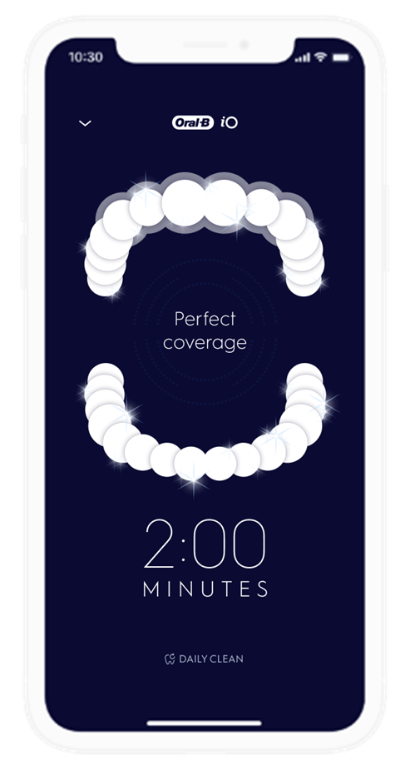
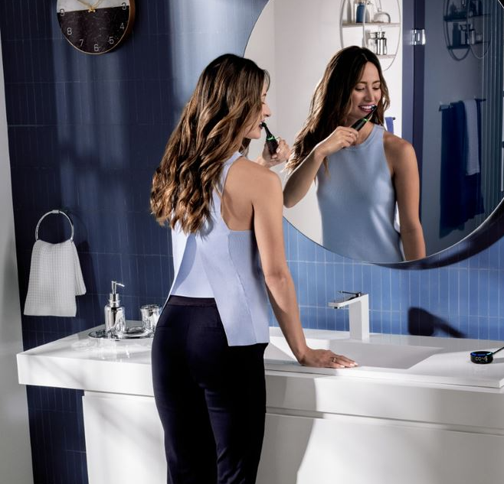
Feedback with NUDGING & COACHING
designed to facilitate behavior change
Can App technology bridge the
HOME VS DENTAL OFFICE GAP
to improve oral care compliance¹?
+
=
Self-Monitoring
& Feedback
Goal
Setting
Planning
Behavioral Intervention Model for Periodontal Health¹
Oral Health Intervention
App
Technology
Effective
Self-Care
¹Rui-Araujo M. Inside Dentistry;2017.Vol.3.Issue 9

Slide 8
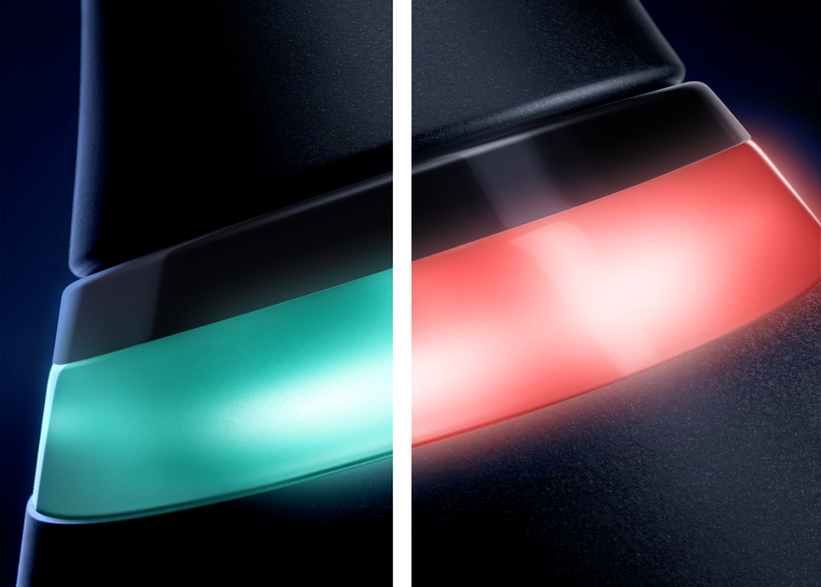
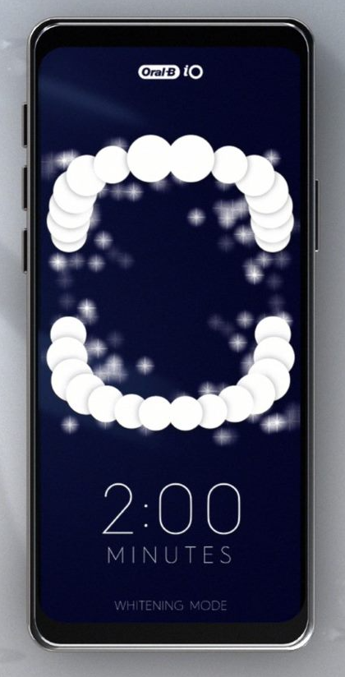
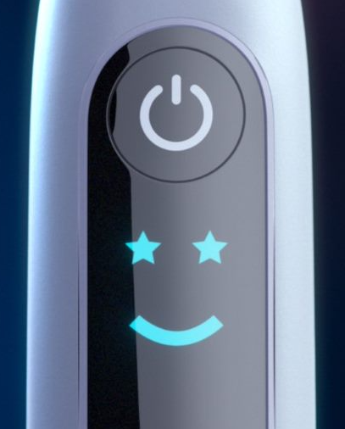

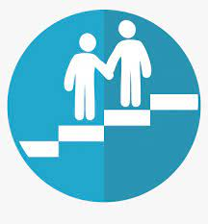
Feedback with NUDGING & COACHING
designed to facilitate behavior change
App Technology:
Brush coaching
Oral Care Journeys
Self-reporting of oral hygiene habits
Pressure Sensor Technology
Interactive Display:
Timer
Smileys
NUDGING
COACHING
Subtle or invisible cues to enable
a desired, but infrequently exhibited, behavior associated with a goal
Explicit guidance to
encourage or mandate a behavior
or behavior change
Notes:
Nudges use subtle or invisible cues to enable a desired, but infrequently exhibited, behavior associated with a goal. iO is beautiful and counter worthy. Its prominent place in the bathroom results in high physical and psychological availability. Smiley faces are intuitively positive, they provide a universal, low cognitive load, message that reinforces longer brushing behaviors
Coaching provides explicit guidance to encourage or mandate a behavior or behavior change. The iO app requires the consumer to consciously engage and process information to reinforce or change a behavior associated with the goal of comprehensive cleaning

Slide 9
A Global, In-Market, Evaluation of Toothbrushing Behavior and Self-Assessed Gingival Bleeding
with Use of App Data from an Interactive Electric Toothbrush¹
To determine if an interactive electric toothbrush and smartphone application (app) can reduce self-reported gingival bleeding and promote better brushing behavior based on global, in-market usage data.
OBJECTIVE
Anonymized data from the Oral-B app collected between July 2020- January 2021
ANALYSIS
Genius, Genius X and iO users
Self-reported gingival bleeding and brushing behavior data analyzed via Google Firebase & Google Big Query
¹ Thurnay S, Adam R, Meyners M. Oral Health Prev Dent. 2022 Jan 20;20(1):1-10. doi: 10.3290/j.ohpd.b2572911. PMID: 35049247.
Notes:
Users can opt in to share the usage data with us. Data collected over 6 month period post-iO launch. Data taken only from people who have opted in and who have NOT registered handle in order to keep it anonymous. This means we cannot do any breakouts by age/gender etc. What we have is brushing behaviors and rough geographical distribution- ie there is no way that the user can be identified.
We looked only at the people who started using the app in this period to ensure the behavior change could be observed from baseline to end of evaluation

Slide 10
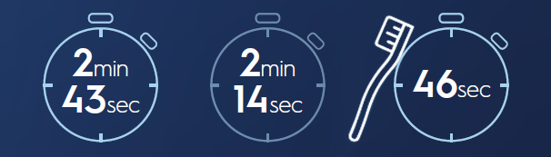
REAL-TIME FEEDBACK
resulted in the biggest improvements in brushing behavior¹
Mean Brushing Durations
21.6 % longer brushing time with Position Detection
v No App
Position Detection
No App
Average brushing
time reported for
Manual Brush²
16,681,216
Total Brushing Sessions
.
² Beals et al. Am J Dent 2000; Mar;13(Spec No):5A-14A. ¹ Thurnay S, Adam R, Meyners M. Oral Health Prev Dent. 2022 Jan 20;20(1):1-10. doi: 10.3290/j.ohpd.b2572911. PMID: 35049247

Slide 11
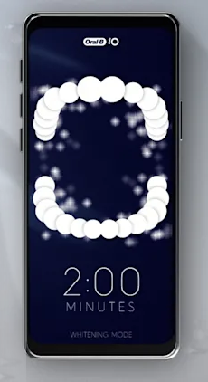
REAL-TIME FEEDBACK
resulted in the biggest improvements in brushing behavior¹
 |  | ADJUSTED MEANS§
BRUSHING MEASURE | NUMBER OF BRUSHING SESSIONS | Position Detection | Timer only | Offline Session (app not used)
Coverage [%] | 7,568,598† | 94.4
Sessions with complete coverage [%] | 7,568,598† | 79.6
Duration [s] § | 16,681,216‡ | 162.6 | 122.7 | 133.8
Overpressure [s] § | 16,681,213‡ | 1.55 | 1.64 | 2.35
Overpressure [% of total duration] § | 16,681,213‡ | 1.06 | 1.35 | 2.04
Brushing sessions with Position Detection lasted longer
and with less overpressure¹
¹ Thurnay S, Adam R, Meyners M. Oral Health Prev Dent. 2022 Jan 20;20(1):1-10. doi: 10.3290/j.ohpd.b2572911. PMID: 35049247.
² Beals et al. Am J Dent 2000; Mar;13(Spec No):5A-14A.
Notes:
† total sum of sessions with position detection
‡ total sum of sessions with non-missing data: guided + timer-only + offline
Factors used in the statistical model as covariates included we brushing session type (PD, timer, offline), handle series (D701, D706, Sonos) as fixed effect and subject as random effect (User.ID, derived from handle ID) -might have multiple real subjects behind one ID as discussed in the paper.

Slide 12
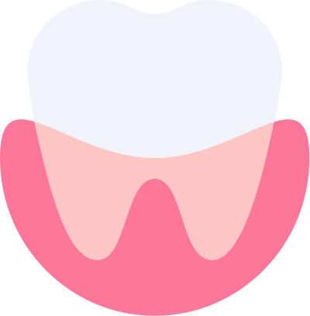
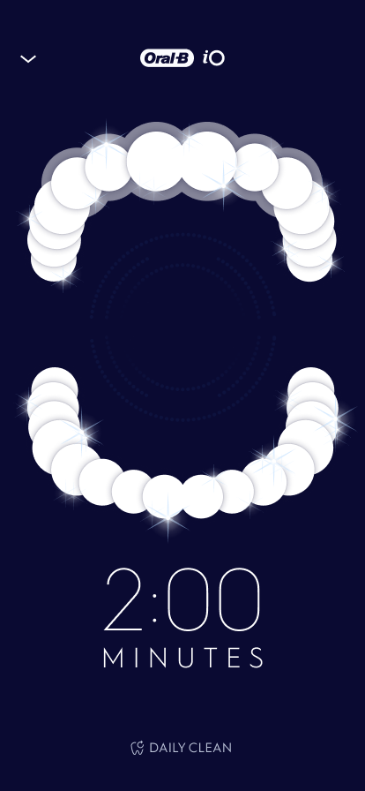
POSITION DETECTION
facilitates thorough brushing coverage¹
94.4%
79.6%
Mean coverage during brushing sessions
Brushing sessions with complete coverage
7,568,598
Total Brushing Sessions
with Position Detection
¹ Thurnay S, Adam R, Meyners M. Oral Health Prev Dent. 2022 Jan 20;20(1):1-10. doi: 10.3290/j.ohpd.b2572911. PMID: 35049247.

Slide 13
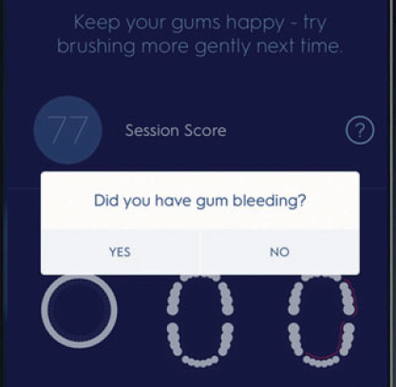
Self-reported gingival bleeding was less frequent the longer GUM GUARD was used ¹
Self-Reporting of gingival bleeding over time via Gum Guard
28.1 %*
55%
reduction
18.7 %*
% of users reporting gum bleeding at least once
12.7 %*
¹ Thurnay S, Adam R, Meyners M. Oral Health Prev Dent. 2022 Jan 20;20(1):1-10. doi: 10.3290/j.ohpd.b2572911. PMID: 35049247

Slide 14
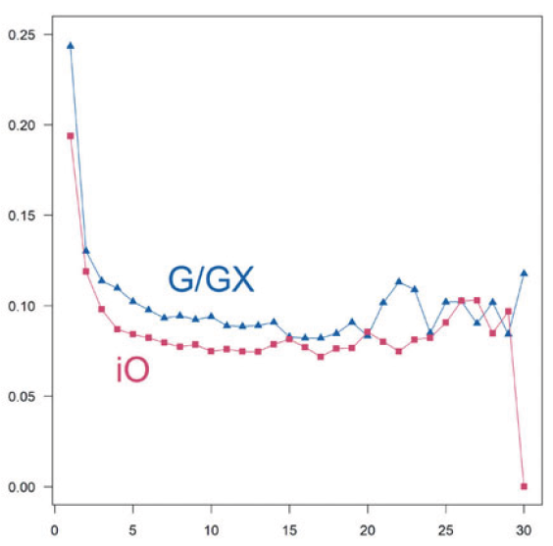
Self-reported gingival bleeding was less frequent the longer GUM GUARD was used,
with statistically significant reductions as early as week 2¹
Proportion of self-reported gingival bleeding over time by brush*
Oral-B iO users had consistently lower rates
of self-reported gingival bleeding versus
Genius/Genius X users
Brush Model
Oral-B Genius & Oral-B Genius X
Proportion of gingival bleeding
Oral-B iO
Week
* p<0.001 for first 10 weeks, p<0.05 through week 13
¹ Thurnay S, Adam R, Meyners M. Oral Health Prev Dent. 2022 Jan 20;20(1):1-10. doi: 10.3290/j.ohpd.b2572911. PMID: 35049247
Notes:
Data based on the starting week of the period. Only the people who started in the first week of the iO launch had the ability to cover the full 30 weeks.

Slide 15
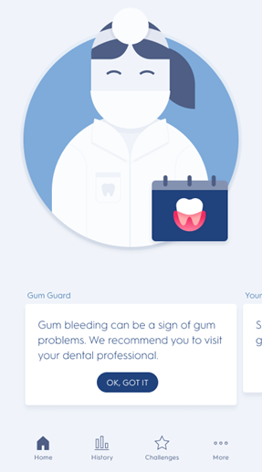
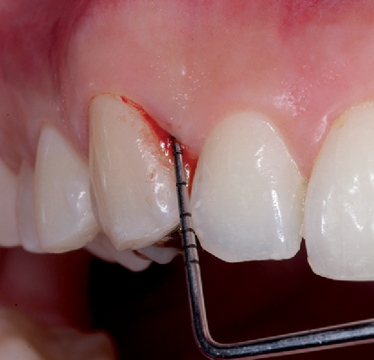
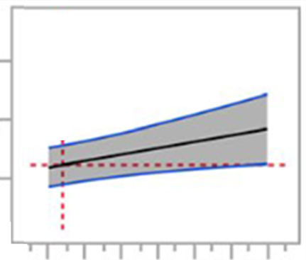
Earlier analysis shows self-assessment of gingival BLEEDING-ON-BRUSHING is a clear predictor of BLEEDING-ON-PROBING¹
Prediction Profiler of
Self-Reported Bleeding-on-Brushing
v Clinical Bleeding-on-Probing*
16 %
10 %
Full Mouth Bleeding Scores
Predictor of
Bleeding on probing
4 %
95 % confidence interval of prediction
0
1
2
3
4
5
6
# of Self-Reported Bleeding-on-Brushing episodes recorded in app over 2 weeks
¹ Tonetti, MS, Deng, K, Christiansen, A, et al. Self-reported bleeding on brushing as a predictor of bleeding on probing: Early observations from the deployment of an internet of things network of intelligent power-driven toothbrushes in a supportive periodontal care population. J Clin Periodontol. 2020; 47: 1219– 1226. https://doi.org/10.1111/jcpe.13351
Notes:
Prediction profiler based on multiple linear mixed model analysis with bleeding on probing at a SPC session as dependent variable. Prediction plots of the significant factors in the model after stepwise backwards elimination of non-significant factors (p> .15). In each plot, the grey-shaded area represents the 95% confidence interval of the prediction. The red dotted lines represent the reference point for the prediction and the confidence intervals; they are set at the population average for these plots. FMBS is the percentage of sites with bleeding on probing at appointment, with oral hygiene level (FMPS) at a SPC session as dependent variable.

Slide 16
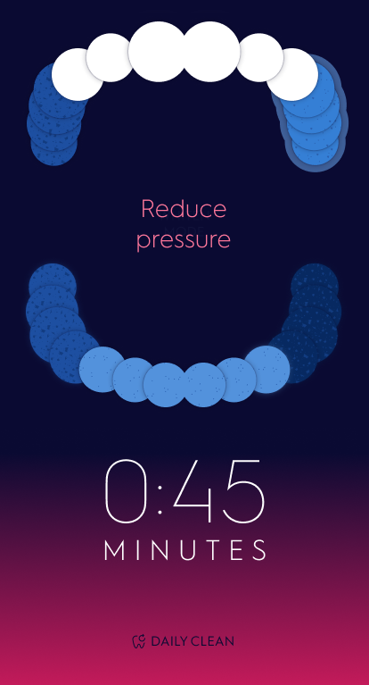
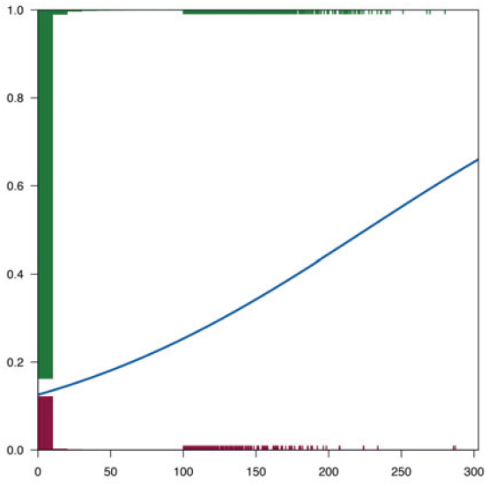
Oral-B app Users were MORE LIKELY to self-report gingival bleeding with increased overpressure ¹
Probability of Self-Reported
Gingival Bleeding vs Overpressure*
Proportion of gingival bleeding
Overpressure [sec]
Responses without
gingival bleeding
Responses with
gingival bleeding
Probability of self-reported gingival bleeding
¹ Thurnay S, Adam R, Meyners M. Oral Health Prev Dent. 2022 Jan 20;20(1):1-10. doi: 10.3290/j.ohpd.b2572911. PMID: 35049247
§ Adjusted means
Notes:
Data based on the starting week of the period. Only the people who started in the first week of the iO launch had the ability to cover the full 30 weeks.

Slide 17
Oral-B app Users were MORE LIKELY to self-report gingival bleeding with increased overpressure ¹
Probability of Self-Reported
Gingival Bleeding vs Overpressure*
Brushing sessions using
the Oral-B app had less overpressure*
* vs sessions without app
Proportion of gingival bleeding
BRUSHING MEASURE | NUMBER OF BRUSHING SESSIONS | Position Detection | Timer only | Offline Session (app not used)
Overpressure [s] § | 16,681,213 | 1.55 | 1.64 | 2.35
Overpressure [% of total duration] § | 16,681,213 | 1.06 | 1.35 | 2.04
Overpressure [sec]
Responses without
gingival bleeding
Responses with
gingival bleeding
Probability of self-reported gingival bleeding
¹ Thurnay S, Adam R, Meyners M. Oral Health Prev Dent. 2022 Jan 20;20(1):1-10. doi: 10.3290/j.ohpd.b2572911. PMID: 35049247
§ Adjusted means
Notes:
Assessed period of time that overpressure is used
Every handle registers duration of overpressure and sense data to the app
For every overpressure session the consumer was asked if they had gum bleeding
The more overpressure the higher chances of reporting gum bleeding (emphasis on increased reporting)-proves what we see before that overpressure duration reduces the more the app is used
Hypothesis-with existing gum issues its possible to see gum bleeding- we have data that our products are safe

Slide 18
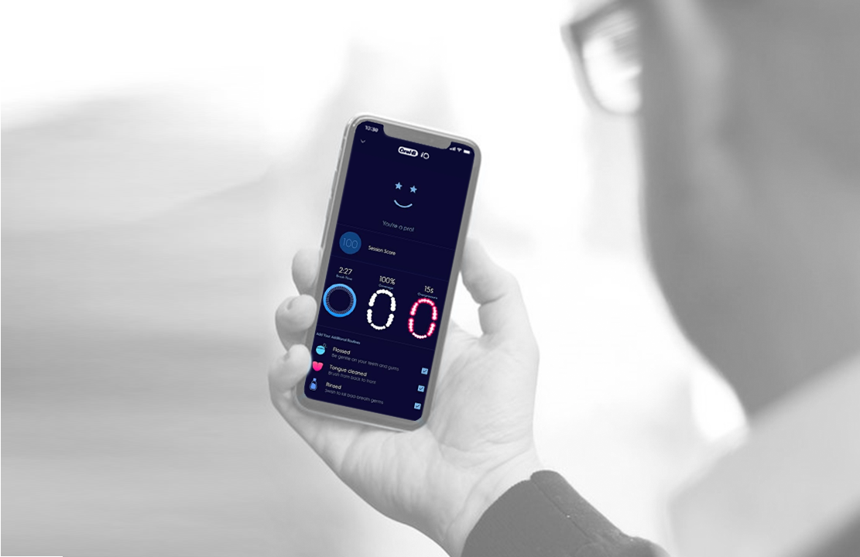
SUPPLEMENTARY
ANALYSIS
beyond the publication

Slide 19
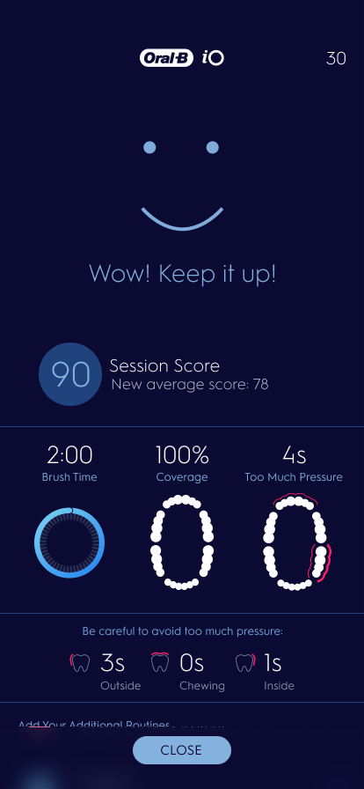
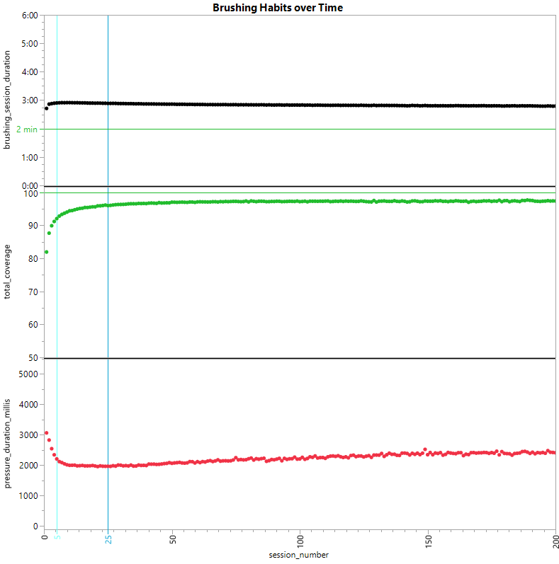
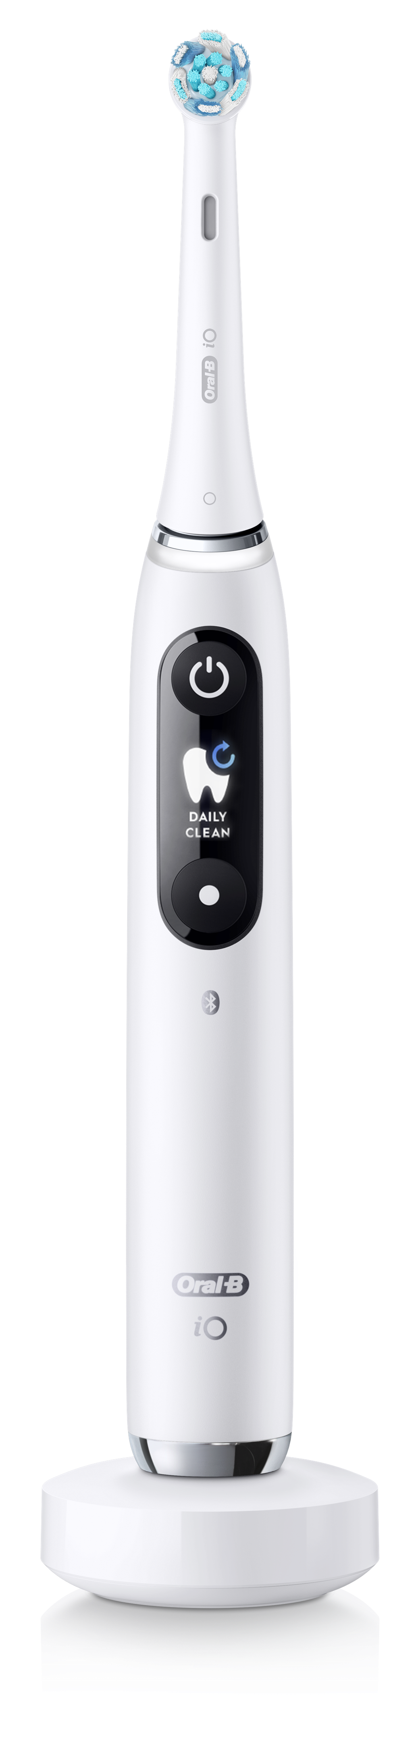
iO + Oral-B app usage shown to improve & sustain key brushing behaviors WITHIN 5 SESSIONS¹
Brushing Habits over Time
Within the first 5 sessions, brushing habits are seen to improve and are then maintained
Coverage and in-app brushing duration increase
Overpressure duration decreases
Brushing
Duration
Total
Coverage
Pressure
Duration
Mean (brushing_session_duration)
Mean (total_coverage)
Mean (pressure_duration_millis)
¹ Oral-B app data on File

Slide 21
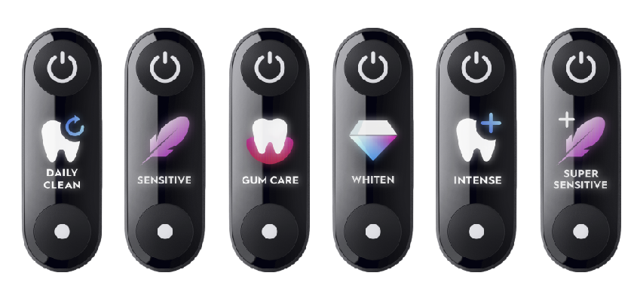
DAILY CLEAN
is the mode most often used
among iO brushers*
% of sessions
per mode
71 %
13 %
6%
11 %
4 %
3 %
* 8,626,019 total sessions with reliable data July 2020-June 2021

Slide 22
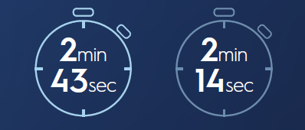
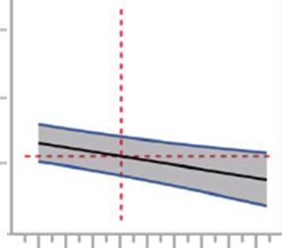
Real-world data suggests that using Oral-B interactive oscillating-rotating electric toothbrushes with the Oral-B app can support Dental Professional oral hygiene guidance and empower patients in Self-Care¹
DAILY CLEAN
is the mode most often used
among iO brushers*
Real-time feedback
resulted in the strongest brushing behavior improvements¹
Mean Brushing Durations
Position Detection
No App
Self-reported gingival bleeding was less frequent the longer Gum Guard was used ¹
28.1 %
55 % reduction
% of users reporting
gingival bleeding at least once
12.7 %
Week 1
Week 5
Findings support previous analysis showing usage of
Oral-B app correlates positively with improved oral hygiene²
40 %
Correlation between Oral-B App Usage & Full Mouth Plaque Scores
FMPS
25 %
10 %
* p>0.15
0
10
20
30
40
App usage sessions
1 Thurnay S, Adam R, Meyners M. Oral Health Prev Dent. 2022 Jan 20;20(1):1-10. doi: 10.3290/j.ohpd.b2572911. PMID: 35049247
2 Tonetti, MS, Deng, K, Christiansen, A, et al.. J Clin Periodontol. 2020; 47: 1219– 1226. https://doi.org/10.1111/jcpe.13351

