Slide 1

EMPOWERING PATIENTS IN SELF-CARE
This slide deck is non-promotional in nature and intended for scientific peer-to-peer exchange to further your learning.
ELEVATING CHILDHOOD ORAL HEALTH WITH OSCILLATING ROTATING TECHNOLOGY
Scientific Exchange Educational Program Toolkit

Slide 2
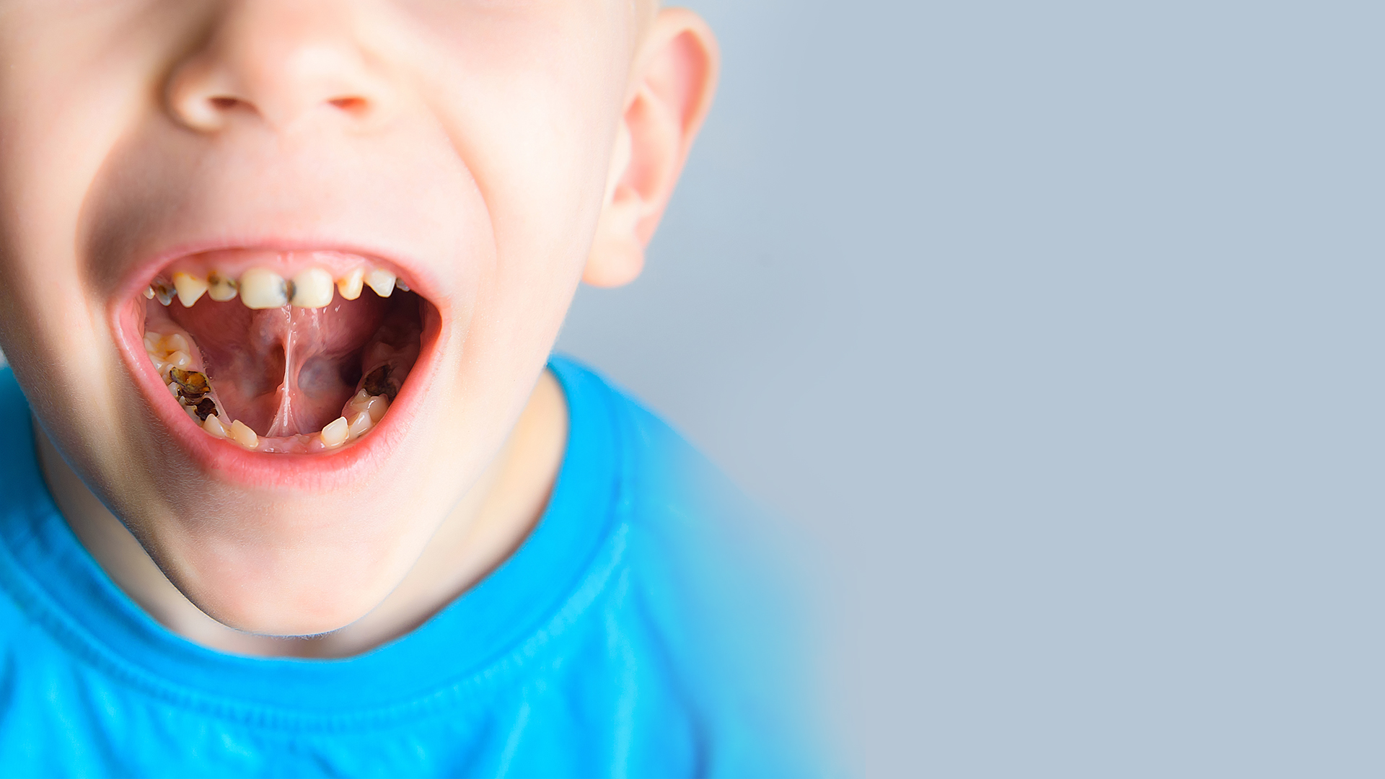
CHILDHOOD CARIES
A GLOBAL PANDEMIC ¹⁻²
#1
most common preventable infectious disease in children
573
million
children worldwide have untreated dental caries in primary teeth
60-90%
of schoolchildren globally have experienced caries
#1
cause of hospital admissions in children aged 5-9
¹ https://www.fdiworlddental.org/oral-health/ask-the-dentist/facts-figures-and-stats
² https://www.who.int/news-room/fact-sheets/detail/oral-health

Slide 3
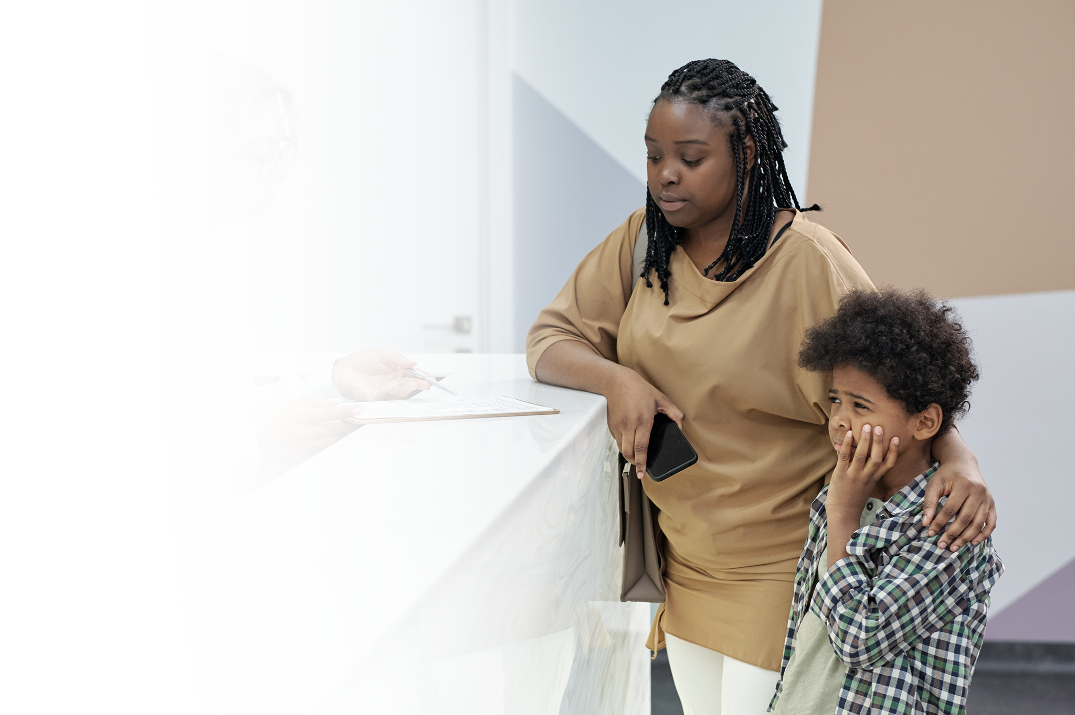
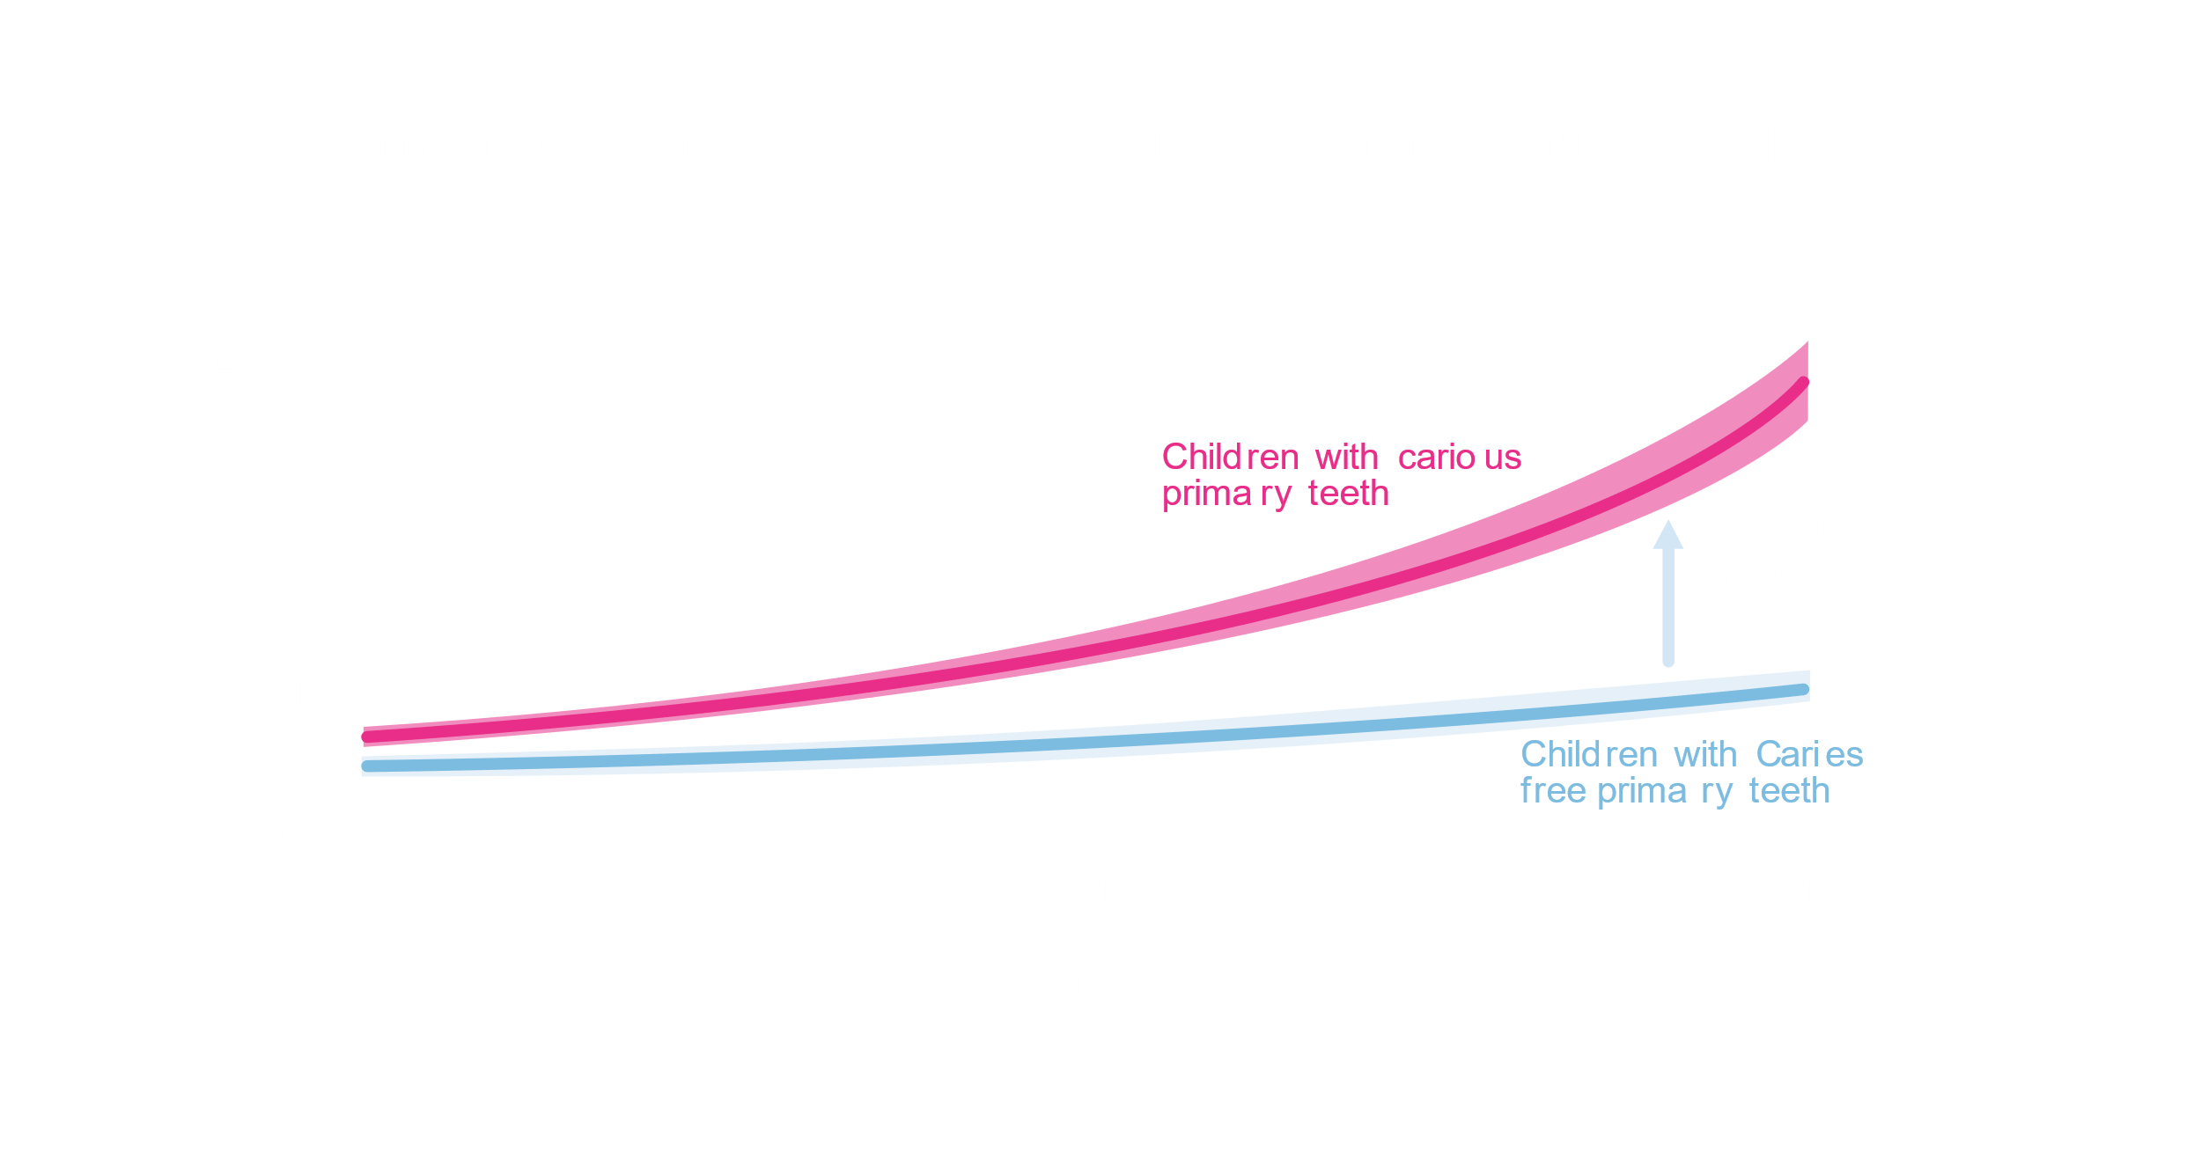
CAVITIES IN THE PRIMARY DENTITION
IS A PREDICTOR OF CAVITIES IN THE PERMANENT DENTITION
56% OF CHILDREN WITH CAVITIES in primary teeth develop cavities in permanent teeth.¹*
¹ Hall-Scullin et al. Journal of Dental Research 2017, Vol. 96(7) 762–767
* Versus 22% of children with caries-free primary teeth
Notes:
Pattern of caries development from childhood into adolescents
Almost 5x higher
People with caries in their primary teeth had a very different caries trajectory in their permanent dentition
Caries in primary dentition are a predictor of caries in permanent dentition
-6651 kids
Why caries in the primary dentition matters
While there is a need to develop effective prevention strategies requires an understanding of how this condition develops and progresses over time, there are few longitudinal studies of caries onset and progression in children. The aim of the study was to establish the pattern of caries development from childhood into adolescence and to explore the role of potential risk factors (age, sex, ethnicity, and social deprivation). Of particular interest was the disease trajectory of dentinal caries in the permanent teeth in groups defined by the presence or absence of dentinal caries in the primary teeth. Intraoral examinations to assess oral health were performed at 4 time points by trained and calibrated dentist examiners using a standardized, national diagnostic protocol. Clinical data were available from 6,651 children.
A population-averaged model (generalized estimating equations) was used to model the longitudinal data
Estimated mean values indicated a rising D₃MFT count as pupils aged (consistent with new teeth emerging), which was significantly higher (4.49 times; 95% confidence interval, 3.90-5.16) in those pupils with caries in their primary dentition than in those without
This study is one of the few large longitudinal studies to report the development of dental caries from childhood into adolescence. Children who developed caries in their primary dentition had a very different caries trajectory in their permanent dentition compared to their caries-free contemporaries

Slide 4
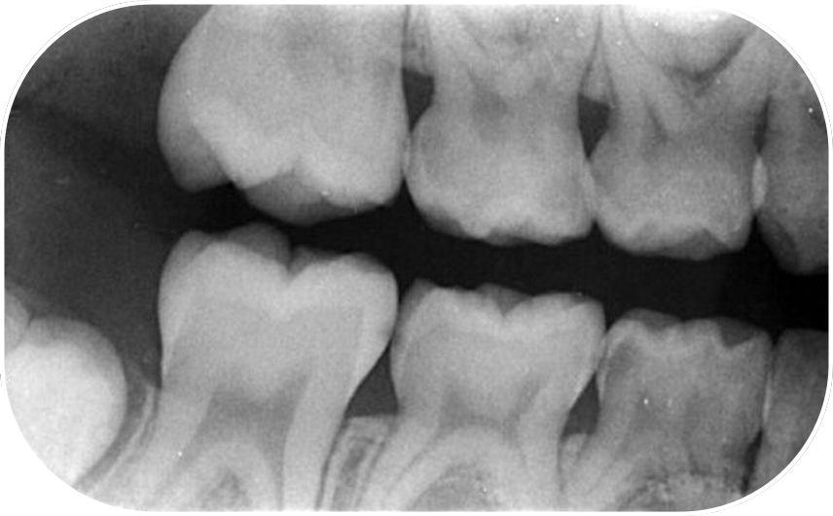

INTERPROXIMAL CARIES IN PRIMARY MOLARS LEADS TO A 15x HIGHER CARIES RATE IN PERMANENT MOLARS ¹
Influence of caries in primary molars on caries rate of first permanent molars among children aged 6-12 years *
Image courtesy of Dr Clarissa Bonifacio, Faculty of Dentistry, ACTA
Status of distal surface of second primary molars
¹ Mejàre I, Caries Res. 2001 May-Jun;35(3):178-85. doi: 10.1159/000047453. PMID: 11385197.​
* 95% Confidence interval​
Notes:
Interproximal caries in primary molars leads to a 15x higher rate of caries in permanent molars
Looks at mesial of of permanent 1st molar and distal
Influence of approximal caries in primary molars on caries rate for the mesial surface of the first permanent molar in swedish children from 6 to 12 years of age
The study design was retrospective and included 374 children with an average of 5 sets of bite-wing radiographs. The mean age of the children was 6.7 years when the first bite-wing radiographs were taken and 11.5 years at the time of the latest radiographs included in the study. The approximal surfaces were classified according to a scoring system: 0 = no visible radiolucency, 1= radiolucency in the outer half of the enamel, 2 = radiolucency in the inner half up to the enamel-dentin border, 3 = radiolucency with a broken enamel-dentin border but with no obvious involvement of the dentin, 4 = radiolucency with obvious spread in the outer half of the dentin, and score 5 = radiolucency in the inner half of the dentin
The influence of the status of 05d on the caries rate for 6m (state > or =2) was assessed by using a model for dependence between the two neighbouring surfaces. Presence or absence of approximal caries in the distal surface of the first primary molars (04d) and/or the mesial surface of the second primary molars (05m) at the time of eruption of 6m was also related to the caries rate for 6m. The caries rate for 6m was 15 times higher if 05d had developed enamel/enamel-dentin border caries (state 2 or 3) compared to a radiographically sound 05d (state 0 or 1). No significant increase in the caries rate for 6m was found when 05d had deeper unrestored dentin caries than when 05d had superficial caries (state 2 or 3)

Slide 5

PREVENTIVE HABITS REINFORCED BY PARENTS FROM EARLY CHILDHOOD ARE A DOMINANT INFLUENCE ON ORAL HEALTH ¹
“You learn it from a young age don’t you, like your parents tell you to brush your teeth before you go to bed and when you wake up, and you just stick to the routine”
Qualitative study of the views of English adolescents on their caries risk and prevention behaviors
¹ Hall-Scullin, E., Goldthorpe, J., Milsom, K. et al. BMC Oral Health 15, 141 (2015). https://doi.org/10.1186/s12903-015-0128-1
Notes:
-strongly influenced by what their parents do
-oral health educators and promoters should engage with parents to start the right habits
Never to early to start establishing brushing habits
-brushing the right way with the right products
The Hall Scullin qualitative study was a companion to the longitudinal study on slide 13 and was designed to explore the attitudes and beliefs of adolescents towards dental caries and their use or non-use of caries prevention regimens.
The study concluded that parents primarily influence the habitual behaviours of adolescents. With age, the external environment (availability of sugar and peers) has an increasing influence on behaviour. This suggests that to improve adolescent health, oral health promoters should engage with parents from early childhood and create supportive environments including public policy on sugar availability to encourage uptake of risk-minimising behaviours.

Slide 6
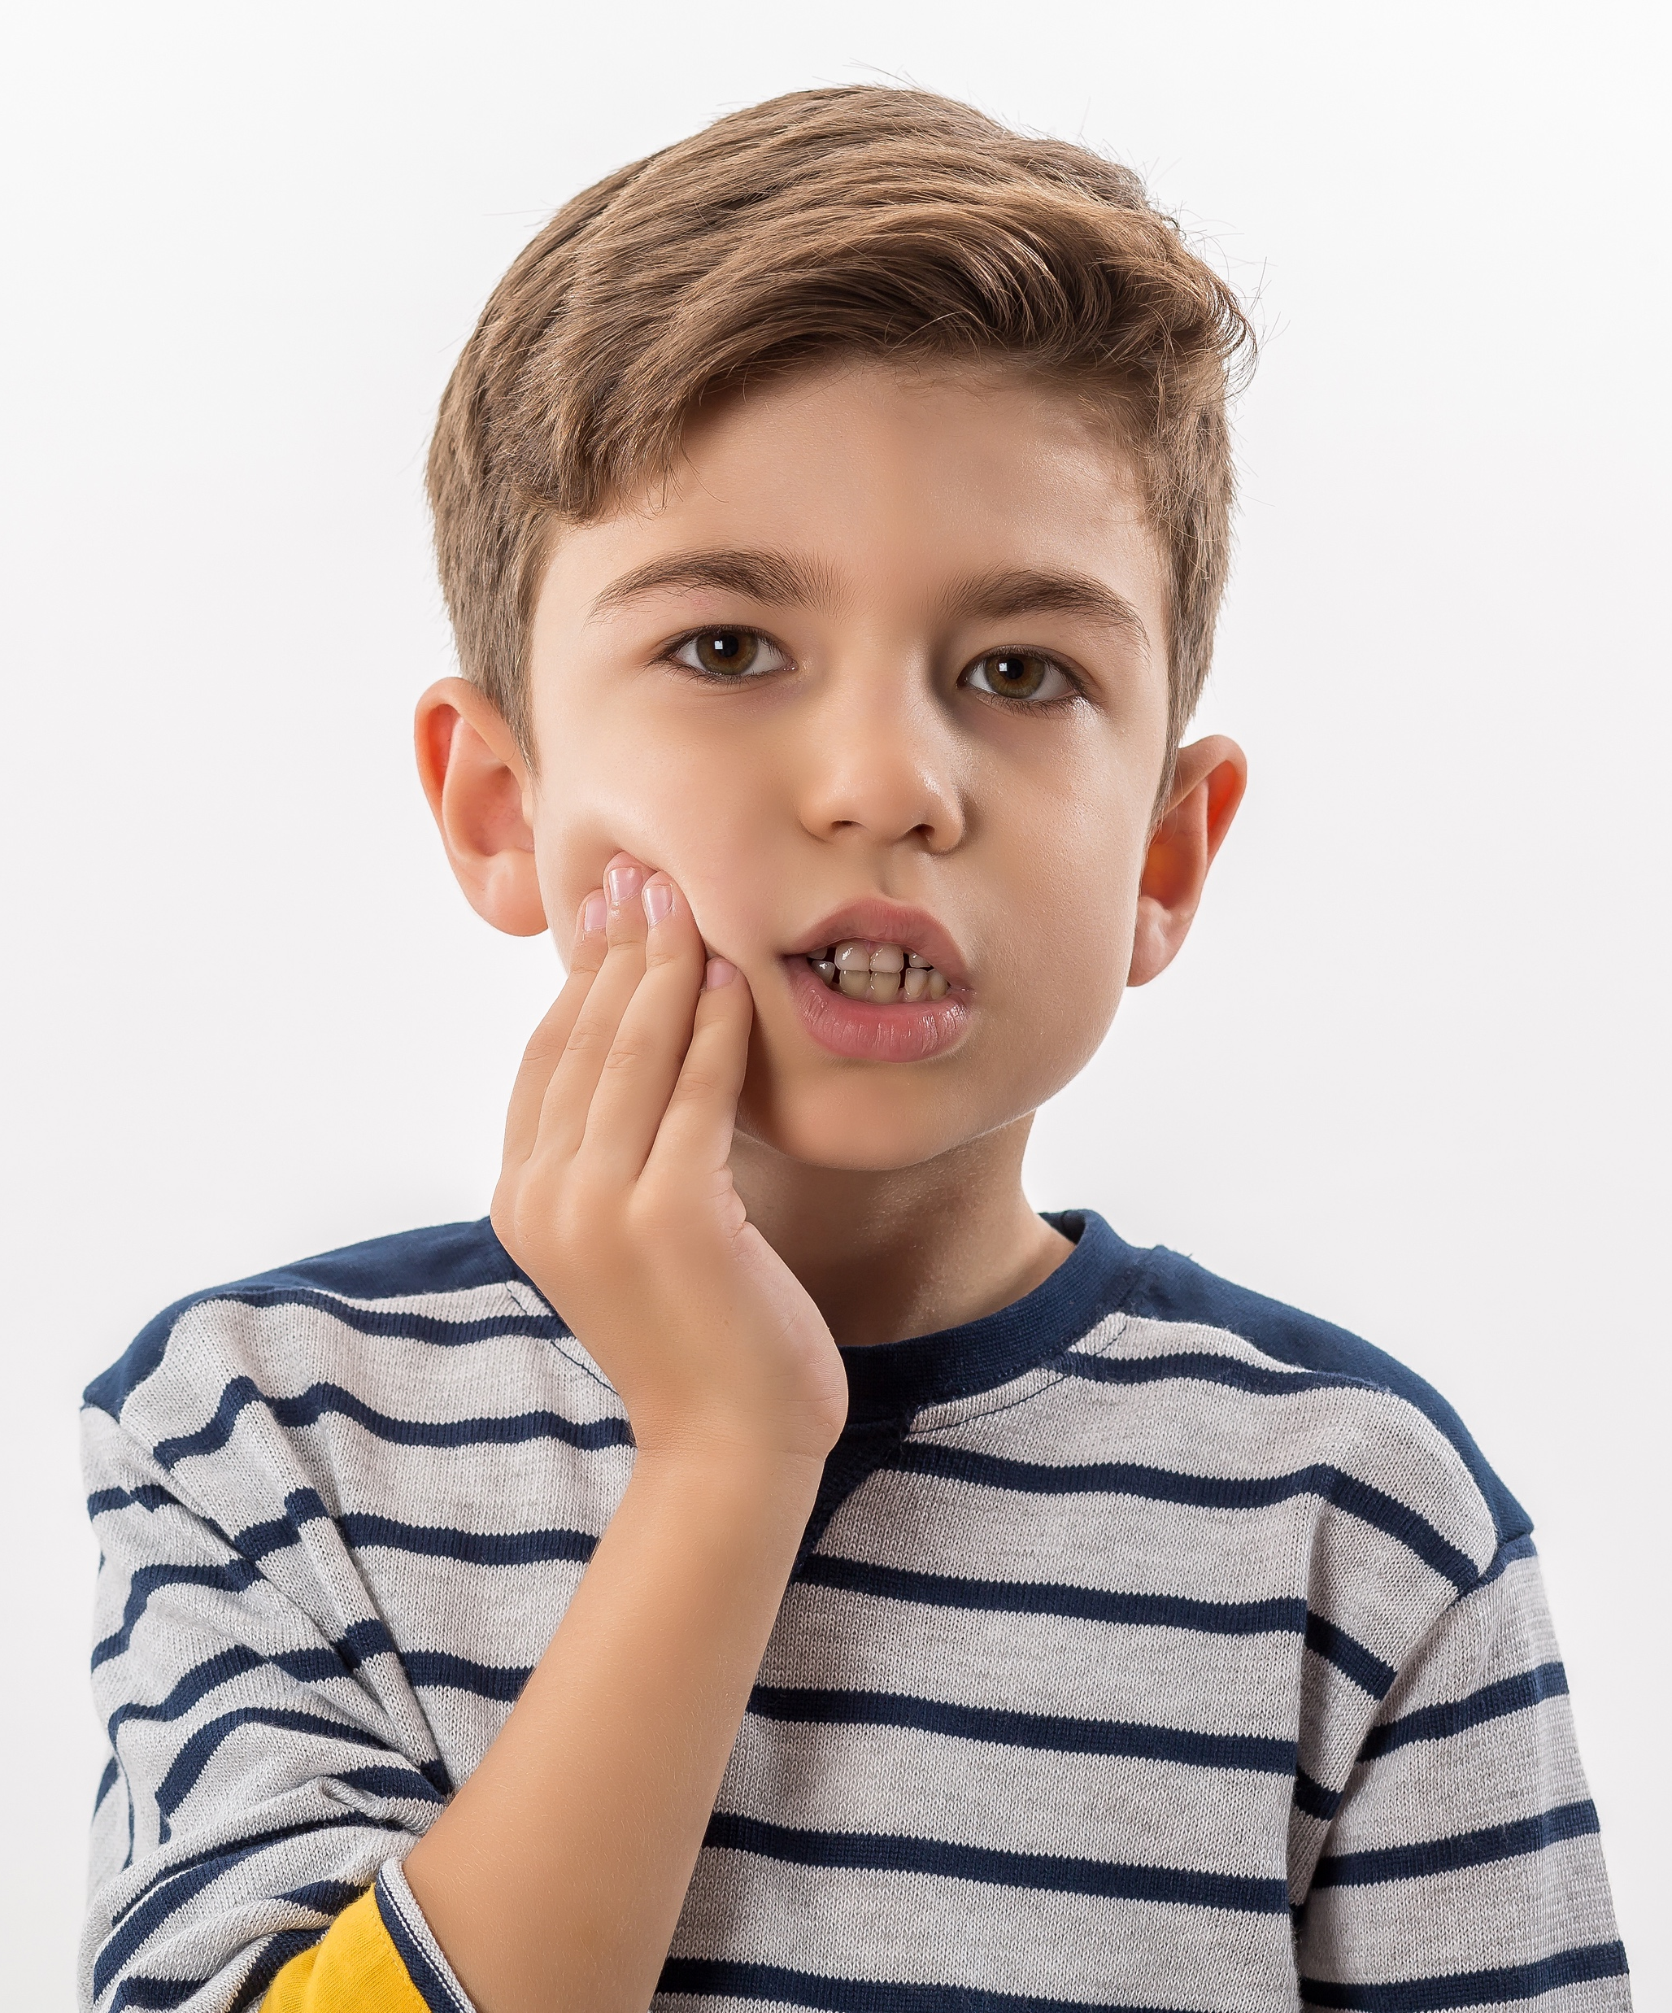
POOR ORAL HEALTH HINDERS THE PHYSICAL
AND MENTAL WELLBEING OF CHILDREN
PAIN
ANXIETY
3 out of 10
45% MORE LIKELY
children or adolescents may have experienced dental pain in the past¹
to experience emotional distress³
DISRUPTED
DEVELOPMENT
LOW SELF-CONFIDENCE
3x MORE LIKELY
35%
to miss school & perform poorly²
of children aged 12 are too embarrassed
to smile or laugh due to the condition of their teeth^{4*}
¹ Pentapati KC et al Eur Arch Paediatr Dent. 2021 Feb;22(1):1-12. doi: 10.1007/s40368-020-00545-7. Epub 2020 Jun 16. PMID: 32557184; PMCID: PMC7943429.;
² Jackson et al Am J Public Health. 2011;101: 1900–1906. doi:10.2105/AJPH.2010.200915;
³ Alsumait et al. Health and Quality of Life Outcomes (2015) 13:98 DOI 10.1186/s12955-015-0283-8;
⁴ National Health Service Child Dental Health Survey 2013
Notes:
Beyond the oral cavity poor oral health has been shown to have significant overall physical and mental health impacts on the child, which can ultimately disrupt their development

Slide 7
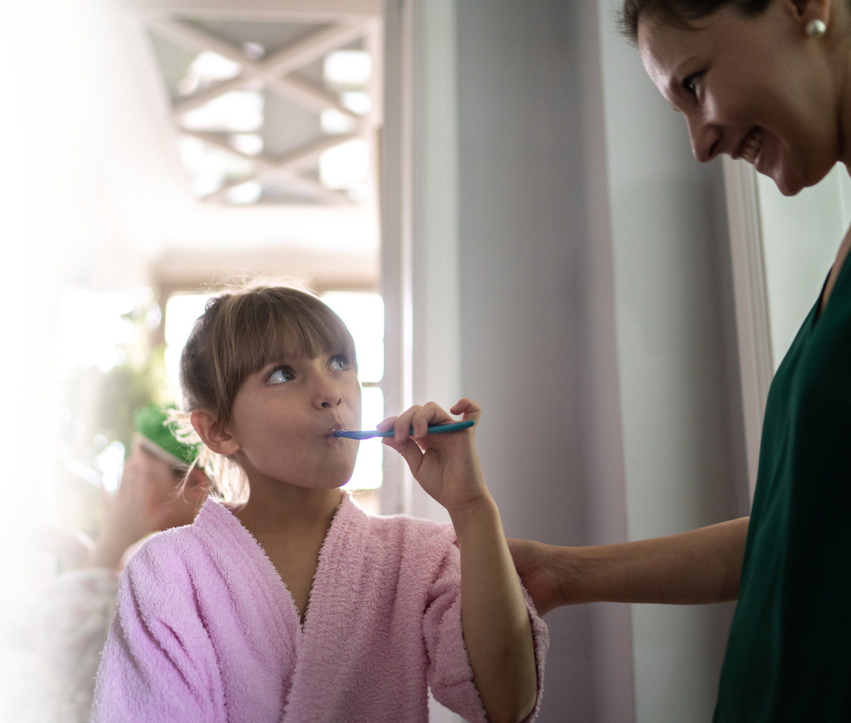
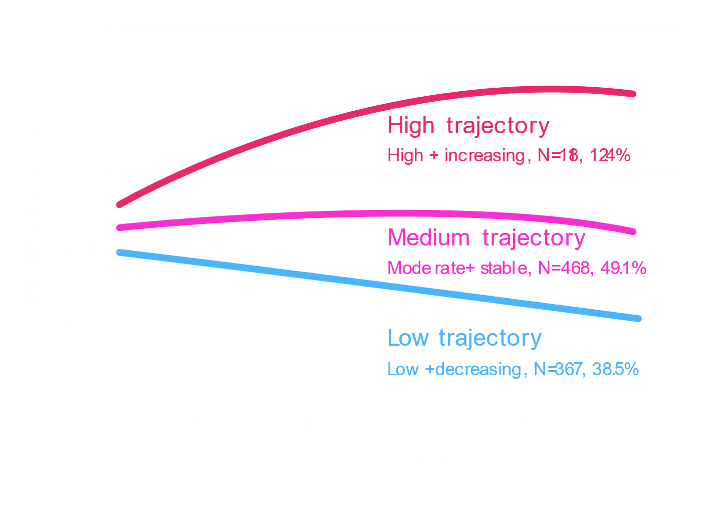
EPIDEMIOLOGICAL FINDINGS CONFIRM IMPORTANCE
OF ESTABLISHING EFFECTIVE BRUSHING HABITS EARLY IN LIFE¹
Plaque trajectory group plots. Simplified Oral Hygiene Index
(OHI-S) plaque scores, according to age.
A LONGITUDINAL STUDY OF 1,015 SUBJECTS
found that patients followed identifiable trajectories of oral hygiene over the course of their lives.
¹ Broadbent JM et al. J Am Dent Assoc. 2011 Apr;142(4):415-26. doi: 10.14219/jada.archive.2011.0197. PMID: 21454848
Notes:
32 year study
Age 5-32 with 4 assessments in between
Key takeways – three differentl plaque trajectory (low, medium, high)
Substantial and significant differentces in both caries and periodontal disease experience in these groups
Once the author controls for sex, SES and dental visits Controlled for sex, SES,
People in the high trajectory lost 5x more teeth due to caries
Once you get into that trajectory it’s hard to get out of it
Mean # of teeth lost – significant increased , between low and high there is a 4x difference in teeth lost
Studies investigating the role of dental plaque in oral disease have focused primarily on the quantity and quality of plaque at a given point in time. No large-scale epidemiologic research has been conducted regarding the continuity and change in plaque levels across the long term and the association of plaque levels with oral health. This research by Broadbent et al analysed data from the Dunedin Multidisciplinary Health and Development Study in the UK. Collection of dental plaque data occurred at ages 5, 9, 15, 18, 26 and 32 years by means of the Simplified Oral Hygiene Index. The authors assessed oral health outcomes when participants were aged 32 years.
The authors identified three plaque trajectory groups (high, medium and low) and found substantial, statistically significant differences in both caries and periodontal disease experience among those groups. For example, after the authors controlled for sex, socioeconomic status and dental visiting pattern, they found that participants in the high-plaque-trajectory group lost nearly five times more teeth owing to caries than did those in the low-plaque-trajectory group.

Slide 8

EPIDEMIOLOGICAL FINDINGS CONFIRM IMPORTANCE
OF ESTABLISHING EFFECTIVE BRUSHING HABITS EARLY IN LIFE¹
Mean number of teeth lost due to caries at age 32 by plaque trajectory group
¹ Broadbent JM et al. J Am Dent Assoc. 2011 Apr;142(4):415-26. doi: 10.14219/jada.archive.2011.0197. PMID: 21454848
Notes:
Want effective plaque removal as young as possible
For example, after the authors controlled for sex, socioeconomic status and dental visiting pattern, they found that participants in the high-plaque-trajectory group lost nearly five times more teeth owing to caries than did those in the low-plaque-trajectory group
Low to High: IR = 1.0 (ref), IR = 1.8, IR = 4.0
Subjects with high plaque scores ​at a young age were more likely to suffer from and experience greater severity in:​ Caries, periodontal disease, loss of 4x more teeth, 4.8x more likely to have lost a tooth due to caries.
Ultimately the key to long term children’s oral health is dependent on the ability to perform effective mechanical plaque removal as early as possible- quite simply, its never to early to establish the right brushing habits

Slide 9

SCIENTIFIC EVIDENCE ON SUPERIORITY
OF ELECTRIC TOOTHBRUSHES FOR CHILDREN
SYSTEMATIC REVIEWS AND META-ANALYSES:
EFFICACY
CROSS-SECTIONAL STUDY:
IMPACT
COCHRANE
Collaboration
“PEDIATRIC DENTISTRY” Journal
Children brushing with OR electric toothbrushes had:
5 clinical trials
“Powered toothbrushes provide a statistically significant benefit
compared with manual toothbrushes.” ¹
9 clinical trials
“Superior plaque removal with the powered rather than the manual toothbrush, support similar findings in the adult population” ²
6x higher odds of less plaque
5.1x higher odds of less gingivitis
1.4x higher odds
of being caries-free
versus manual toothbrushes ³
¹ https://www.cochrane.org/CD004971/ORAL_different-types-powered-toothbrushes-plaque-control-and-healthy-gums
² https://pubmed.ncbi.nlm.nih.gov/32847667/
³ https://www.mdpi.com/1660-4601/17/22/8595
Notes:
In their most recent systematic review there were 5 clinical trials in the pediatric population
In 2020 Esti and Zini published a meta analysis looking at 9 clinical trials
Cross Sectional: done with esti and P&G
Cross sectional was a pediatric chart review looking at 1000 healthy children. Looking at electric vs. manual
Kids using OR were more likely to brush better and have better outcomes
Brushing 2x daily and brushing starting at an earlier age
Kids with anterior bite abnormalities have higher change of accumulating more plaque
And when it comes to evidence based choices for which technology should be used for effective plaque removal in the paediatric population, research has consistently shown the superior efficacy of electric v manual toothbrushes. The Cochrane collaboration of 2014 performed a systematic review and meta-analysis of power v manual toothbrushes and food that the latter provide a statistically significant benefit versus manual toothbrushes. More recently, a systematic review and meta-analysis published in 2020 in the Paediatric Dentistry Journal, showed that, across 9 clinical trials included in the analysis powered toothbrushes were more effective than manual toothbrushes for plaque removal in children.
Meanwhile a 2021 cross-sectional study, which assessed Factors Associated with Dental Plaque, Gingivitis, and Caries in a Pediatric Population, evaluated dental records of 1000 healthy children and found that children using OR toothbrushes were more likely to brush better and achieve better outcomes, including a greater likelihood of being caries-free versus children who used manual toothbrushes
Similarly, brushing twice daily and starting brushing at an earlier age were associated with better oral health outcomes. Children with anterior bite abnormalities had increased odds of developing moderate/severe plaque and gingivitis than children with normal anterior bites. Ultimately the study demonstrated that Children’s oral health is influenced by toothbrush type (with the OR toothbrush performing best), starting age of brushing, compliance with twice-daily brushing, and bite abnormalities

Slide 10

SUPERIORITY AND SAFETY OF OR ELECTRIC TOOTHBRUSHES VERSUS MANUAL TOOTHBRUSHES FOR CHILDREN
EFFICACY
Superior plaque removal by the OR electric toothbrush versus a manual toothbrush
PLAQUE REDUCTION AT SINGLE USE¹
PLAQUE REDUCTION AT 4 WEEKS²
RECENT FINDINGS
FROM P&G SPONSORED CLINICAL TRIALS
1.3x greater
in the primary dentition
1.6x greater
in the primary dentition
1.5x greater
in the mixed dentition
1.9x greater
in the mixed dentition
The OR electric brush was well tolerated in both studies with no adverse hard or soft tissue events ¹⁻²
SAFETY
¹ Davidovich E, Int J Paediatr Dent. 2020 Nov 22. doi: 10.1111/ipd.127535
² Data on file, publication in 2022
Notes:
P&G sponsored clinical trials – single use plaque reduction
Increased benefit over time – plaque reduction increases at 4 weeks
Findings from recent P&G sponsored clinical trials comparing OR v manual toothbrushes showed consistent superiority and safety compared to the manual toothbrush with the plaque reduction benefit actually increasing over time

Slide 11


CROSS-SECTIONAL STUDY SHOWS CHILDREN ARE MORE LIKELY TO BE CARIES-FREE WITH OR TECHNOLOGY ^{1*}
Probability of caries by toothbrush type and age (months)
Children brushing with OR electric toothbrushes had 1.4x higher odds of being caries-free​
​
Manual toothbrush
Probability of caries
Oscillating-Rotating
Toothbrush
Study findings also showed that children’s oral health is mainly influenced by:¹
Toothbrush type
Starting age for brushing
Twice daily brushing
Age of child (months)
¹ Davidovich.et al, Int. J. Environ. Res. Public Health 2020, 17(22), 8595
*.Versus manual toothbrushes
Notes:
Comment on Study – 17% less DMFS progression
Chart reviews offer advantages over clinical studies in that they are easier to manage logistically, require fewer resources, and offer a real-world perspective with no study influence or concern of novelty effects. In addition, patient compliance, of particular concern in studies of young children, is not a factor in chart review studies. There are, however, some limitations to this research. While retrospective chart reviews provide important complementary information, they lack the robustness of randomized clinical studies. The findings described here indicate associations, and its not possible to make statements about causation. The results are also based on records from a single dental clinic and therefore may not be representative of the pediatric population at-large. It was not possible to assess how long children were using the type of brush noted, which could affect our results. Possible biases also should be taken into consideration, such as the issue of self-reported data regarding health behaviors. This is most likely a factor for the brushing frequency variable, as parents may not report accurately brushing behaviors that are inconsistent with the child’s dentist’s recommendation. Finally, the effect of toothbrush type was most substantial for plaque and gingivitis, while daily brushing frequency was more impactful for caries.
Nevertheless the findings in this study do correlate a recent 11-year cohort study assessing electric versus manual brush use in adults found that electric toothbrush users had 17.7% lower DMFS progression throughout the study period

Slide 12
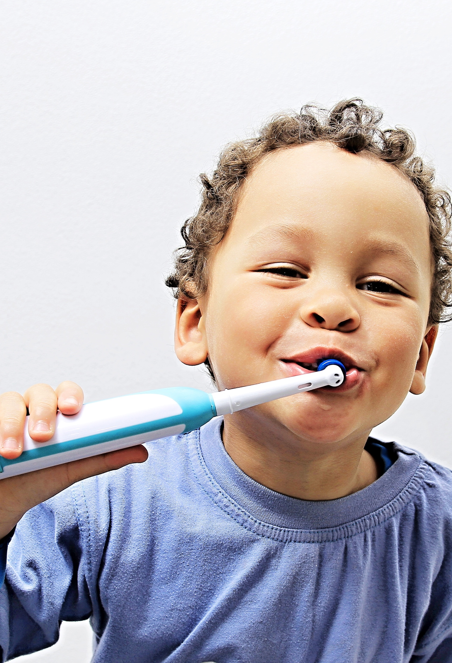
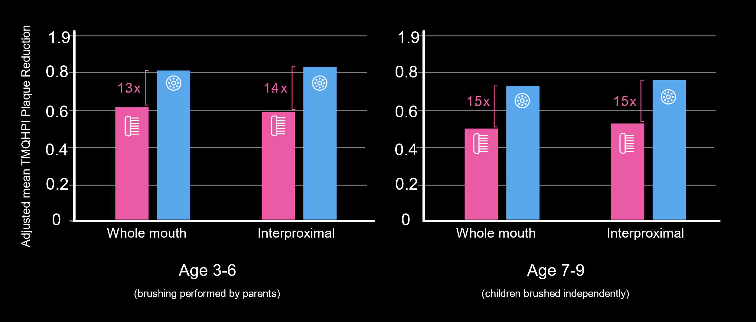
THE OR ELECTRIC TOOTHBRUSH REDUCED SIGNIFICANTLY
MORE PLAQUE AT FIRST USE IN THE PRIMARY AND MIXED DENTITIONS ¹ ⁺
Single-use analysis of plaque removal by an OR v manual toothbrush in 3- to 9-year old children¹
OR electric toothbrush
Manual toothbrush
p<0.009
p<0.009
p<0.015
p<0.015
¹ Davidovich E, Int J Paediatr Dent. 2020 Nov 22. doi: 10.1111/ipd.127535
+ Versus manual toothbrushes
Notes:
CLINICAL RELEVANCE
Children often lack the manual dexterity, responsibility, and cooperation required to achieve optimal oral hygiene. This study….demonstrates the superior plaque removal efficacy of an oscillating-rotating electric brush relative to a manual brush”
6 and under were brushed by parents
7+ kids brushed their own teeth

Slide 13
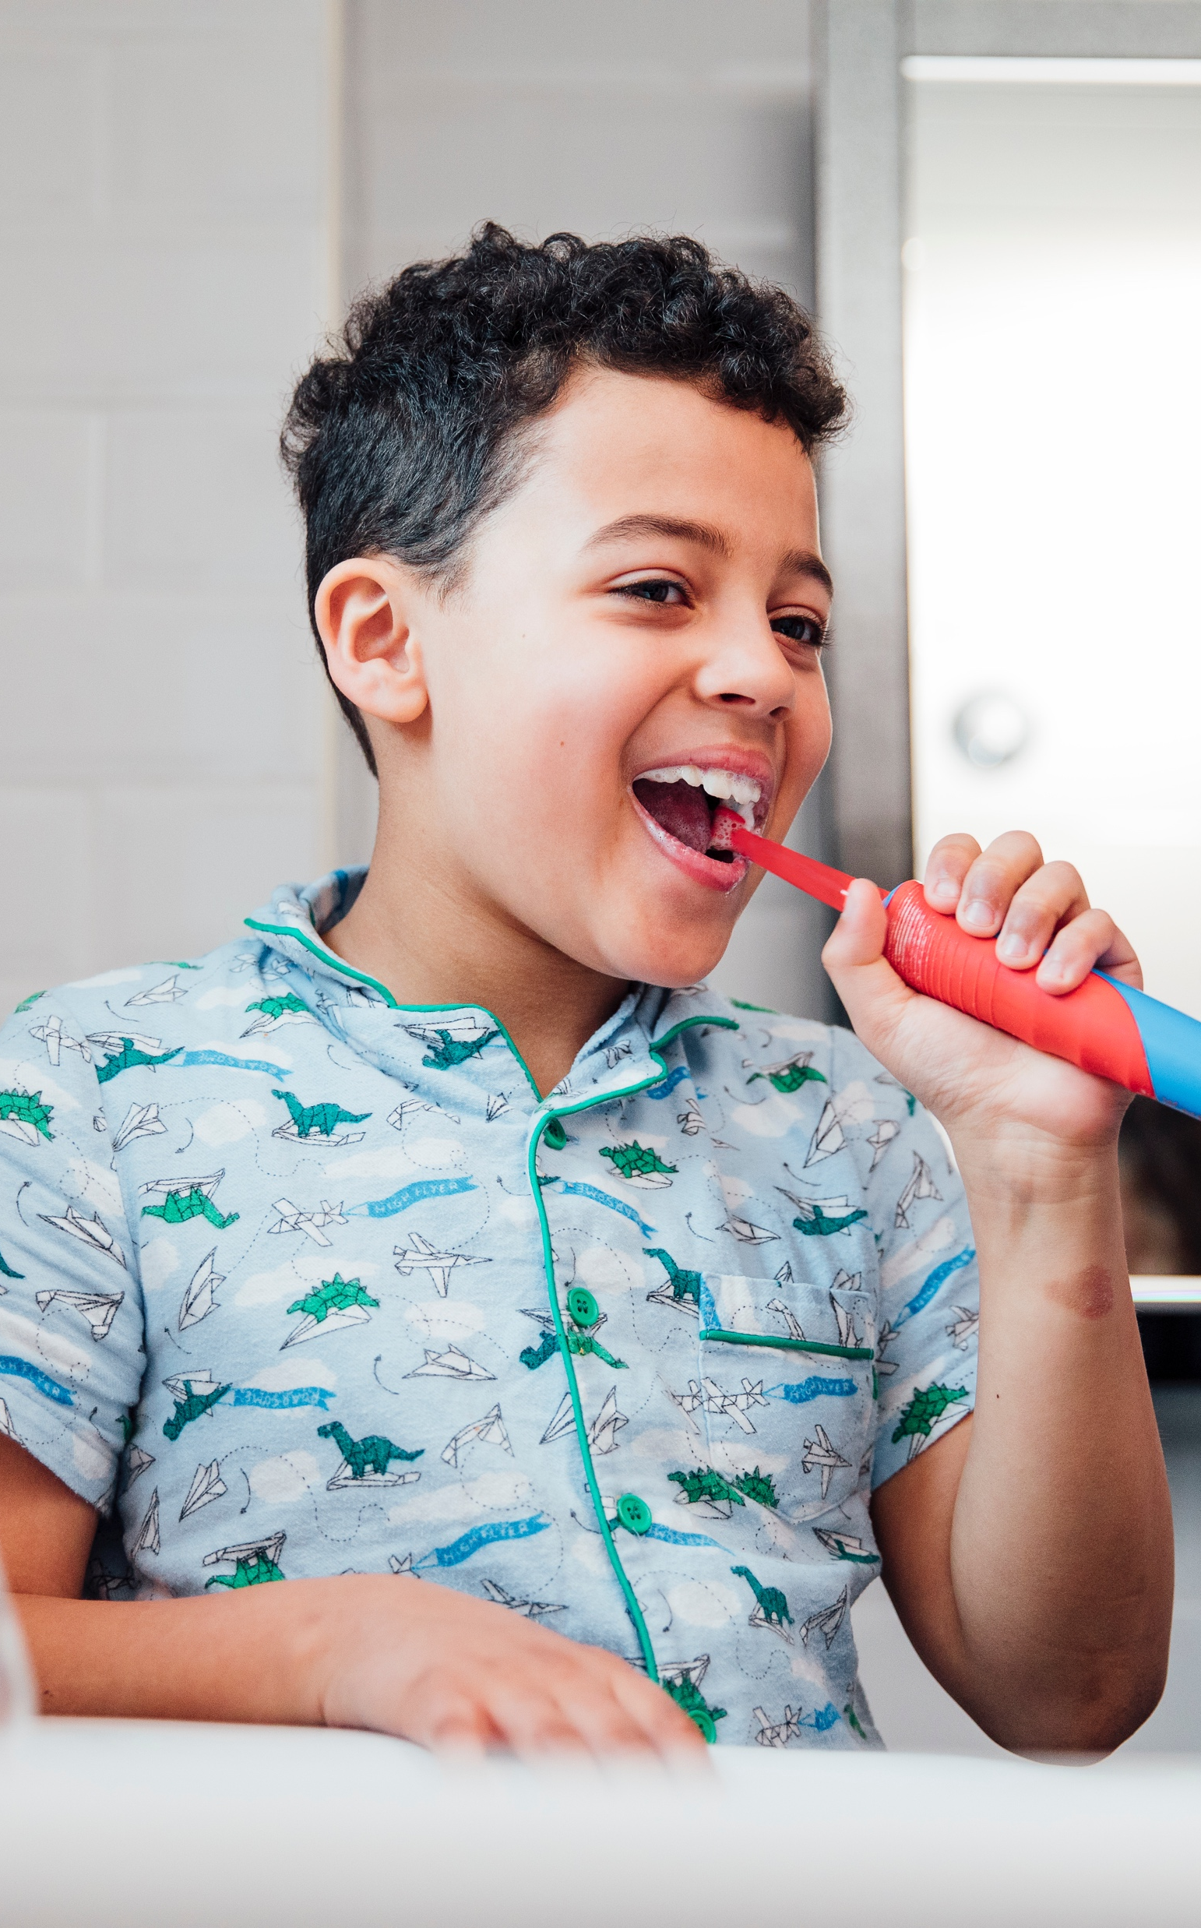
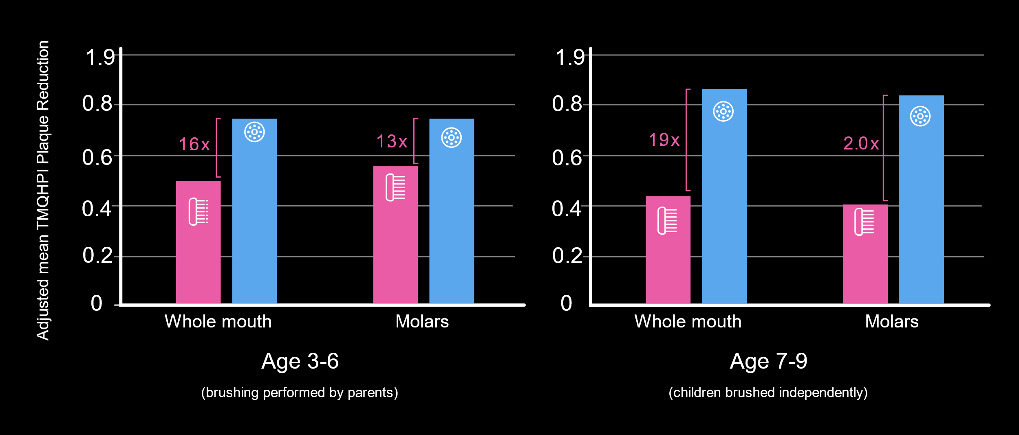
THE OR ELECTRIC TOOTHBRUSH REDUCED SIGNIFICANTLY​
MORE PLAQUE OVER 4 WEEKS IN THE PRIMARY AND MIXED DENTITIONS ⁺
4 week evaluation of plaque removal by an OR v manual toothbrush in 3- to 9-year old children¹​
OR electric toothbrush
manual toothbrush
p=0.016
p=0.032
p<0.001
p<0.001
¹ Data on file. Publication in 2023
+ Versus manual toothbrushes
Notes:
CLINICAL RELEVANCE
The plaque reduction superiority of the oscillating rotating electric toothbrush was most pronounced at the molars of the 7-9 age group (who brushed independently), where caries incidence is most prevalent
This study has been submitted for publication and is expected to be published in 2023. Few studies in the paediatric population extend to a period of 4 weeks

Slide 14

CURRENT PRACTICES & RECOMMENDATIONS ¹⁻⁴
Preventive care
via a team approach
PEDIATRIC
ORAL
HEALTH
Professional
oral health education
Brushing guidance
Fluoride toothpaste
Dietary advice
Parent-supervised plaque control + fluoride toothpaste
From first tooth to
at least age 9
¹ https://www.scottishdental.org/wp-content/uploads/2014/04/SIGN138.pdf
² http://mouthmonsters.mychildrensteeth.org/wpcontent/uploads/2019/02/StateofLittleTeeth.2ndEdition.pdf
³ https://www.eapd.eu/index.php/post/prevention-is-effective-when-it-starts-early
⁴ https://www.eapd.eu/uploads/files/EAPD_Fluoride_Guidelines_2019.pdf
Notes:
Clinical guidelines for children’s oral health indicate a multifactorial approach which includes professional oral health education that includes brushing guidance, use of fluoride toothpaste and dietary advice, parent supervised brushing and a holistic team approach to preventive care
Parent supervised means the parent held the brush during the brushing experience. Supervision is supposed to go up to age 9

Slide 15
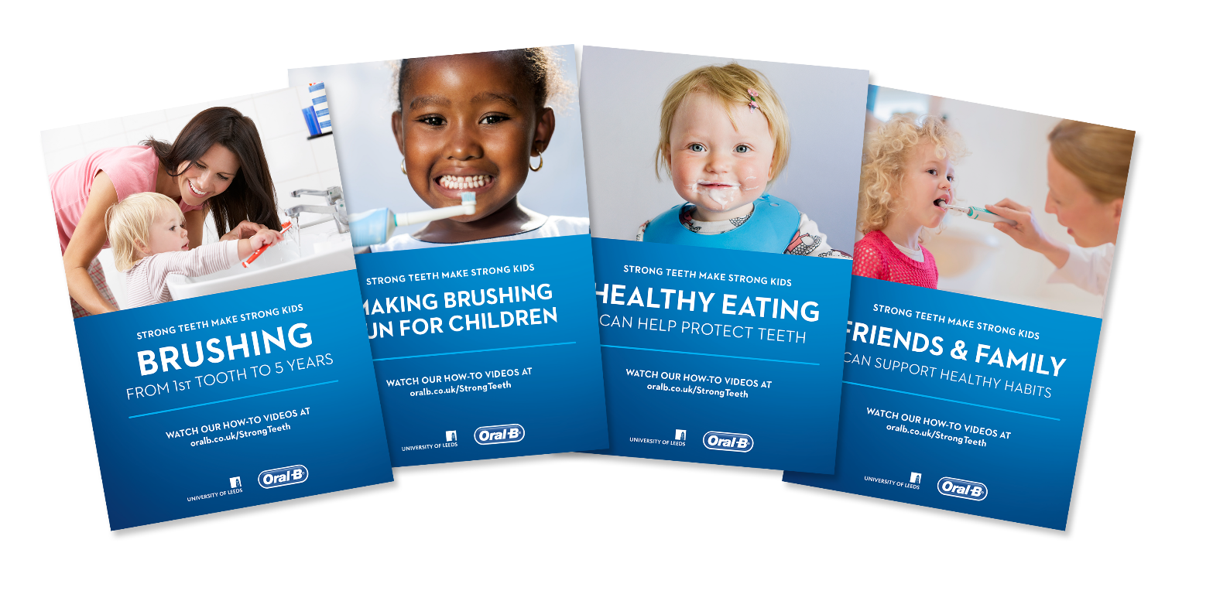
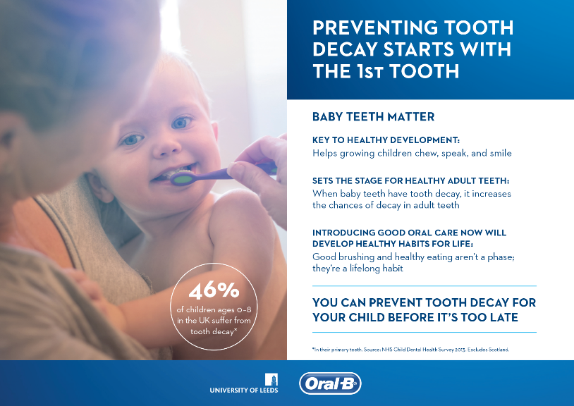
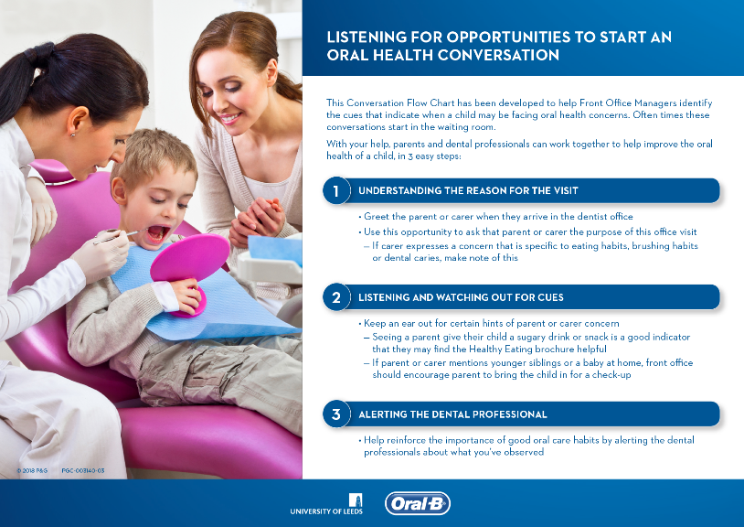
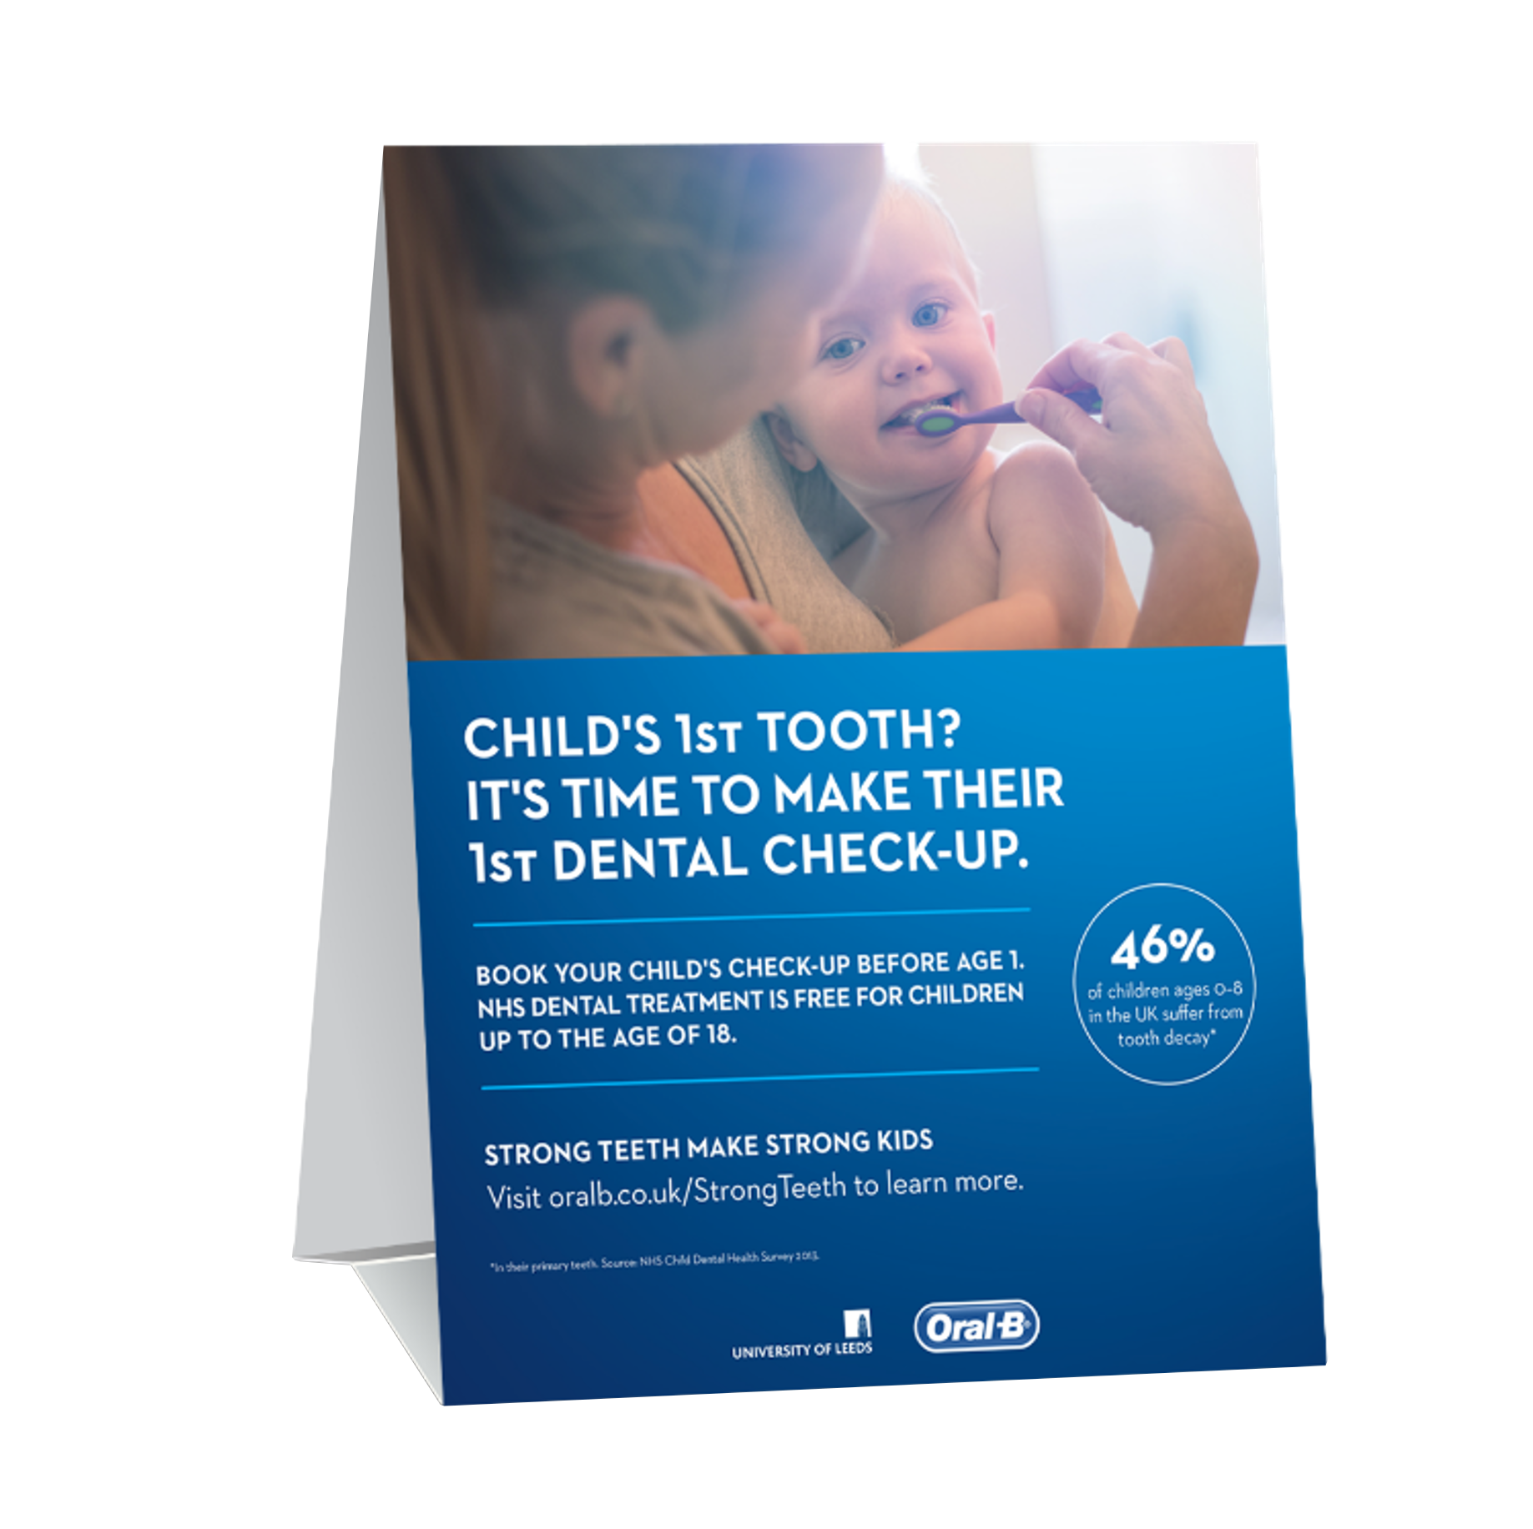
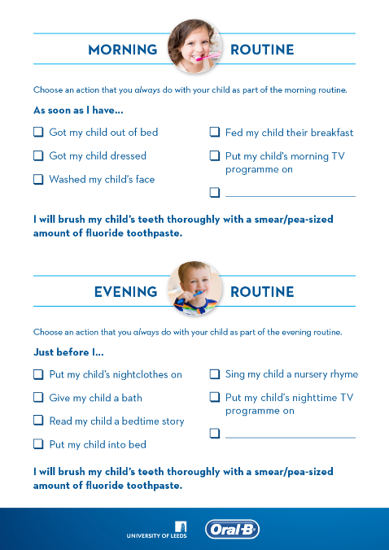
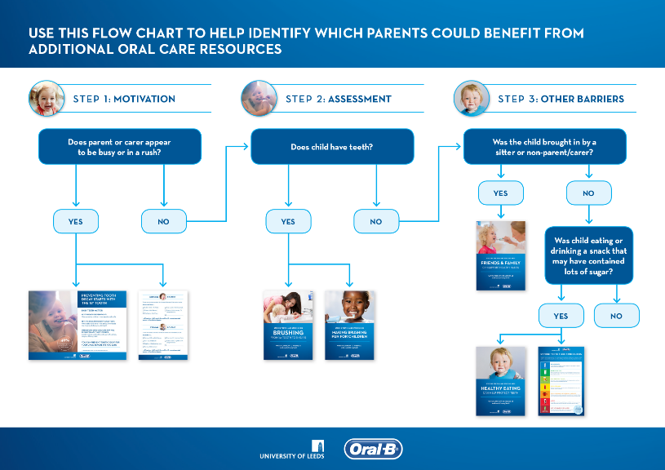
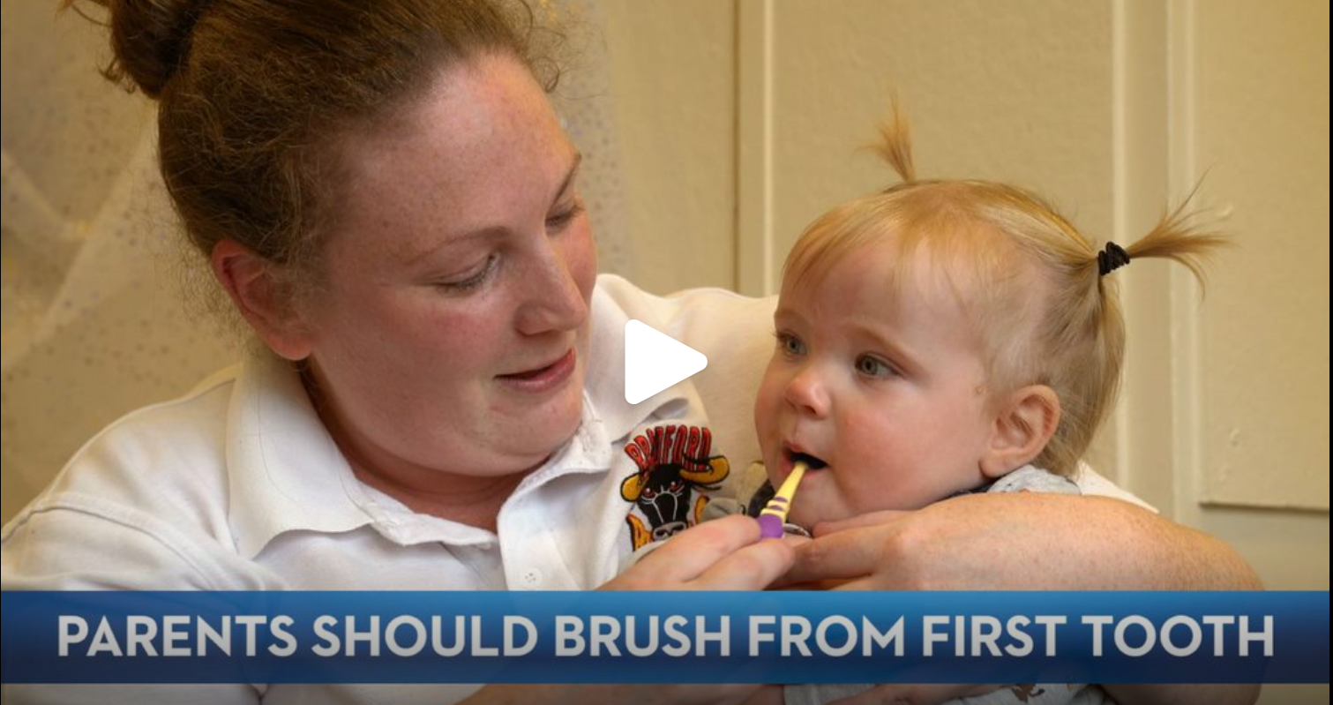
STRONG TEETH MAKE STRONG KIDS:
RESOURCES DESIGNED TO SUPPORT ORAL HEALTH CONVERSATIONS
RESOURCES TO GUIDE & SUPPORT PARENTS, carers and children on good oral health habits at home
RESOURCES FOR DENTAL PROFESSIONALS
to enhance oral health conversations
Educational pamphlets & laminates
Waiting room tent cards
Worksheets to facilitate at-home care
Action Plans
Communication and behavior change training
Patient conversation flow-charts
Patient education videos
Implementation guides
Notes:
Resources are designed to supplement and NOT replace oral health conversations and recognize key guidance points
Readily available on dc.com
The Strong Teeth resources were iteratively developed for the dental team and patients & their parents with input from Public Health England to ensure alignment to local clinical guidelines eg /DBOH- delivering better oral health (UK)
It’s important to emphasise that the resources are designed to support NOT replace the oral health conversations, allow the parents to reflect on the conversations and reinforce key guidance points oral health behaviors at home. Its critical the dental team invests time with the patient and parent on having the conversation, personalizing the guidance and THEN sharing the support resources.
Key Features among the resources are they are underpinned by behavior change theory, involve the whole dental team and include interactive/multiformat resources (eg print media/videos/laminates/ worksheets
Resources are available on dentalcare.com, www.oralprofessional.co.uk to role model sustainable approaches to patient education (ie paper-free resources)

Slide 16
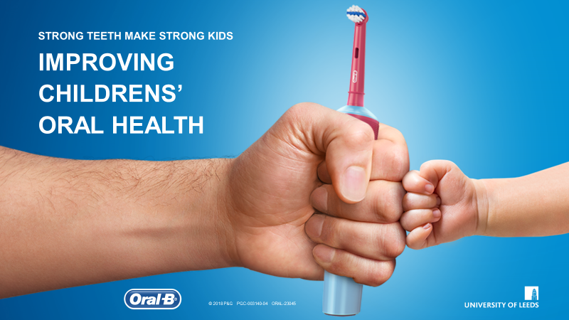
STRONG TEETH MAKE STRONG KIDS:
P&G- FUNDED FEASIBILITY STUDY TO SUPPORT DENTAL TEAMS
Complex oral health intervention underpinned by behavior change theory
Training with a focus on the conversation between dental professional and parent
Evaluation of the acceptability of the "Strong Teeth" oral health conversation
Quantitative Study¹
Qualitative Study²
¹ Giles E et al. "Strong Teeth": BMC Oral Health 21, 267 (2021). https://doi.org/10.1186/s12903-021-01608-x;
² Bhatti et al. BMC Oral Health (2021) 21:138 https://doi.org/10.1186/s12903-021-01444-z;
³ Bhatti et al. BMC Oral Health (2021) 21:210 https://doi.org/10.1186/s12903-021-01560-w
Notes:
A summary of the Strong Teeth Make Strong Kids feasibility study to support dental teams, which included the qualitative, quantitative studies and a supplementary qual analysis
Underpinned by behavior change theory
Feasibility study – not RCT

Slide 17
FEASIBILITY STUDY TO EXPLORE ACCEPTABILITY, FEASIBILITY AND IMPACT OF
STRONG TEETH ORAL HEALTH CONVERSATION TO SUPPORT DENTAL TEAMS ¹⁻³
RECRUITMENT
BASELINE
STRONG TEETH INTERVENTION
2 WEEK
FOLLOW-UP
2 MONTH
FOLLOW-UP
Dental Teams | 5 dental practices in North of England
Participants at Baseline | 36 dyads (parents & children aged 0-5)
Data Collection
Questionnaire
Dental Examination
Filming of parent-child toothbrushing interaction
Questionnaire
Dental Examination
Filming of parent-child toothbrushing interaction
Questionnaire
Dental Examination
Filming of parent-child toothbrushing interaction
Qualitative interview with parents and dental team members
¹ Giles E et al. "Strong Teeth": BMC Oral Health 21, 267 (2021). https://doi.org/10.1186/s12903-021-01608-x
² Bhatti et al. BMC Oral Health (2021) 21:138 https://doi.org/10.1186/s12903-021-01444-z
³ P&G Funded
Notes:
feasibility study to explore acceptability, feasibility and impact of Strong Teeth oral health conversation -

Slide 18
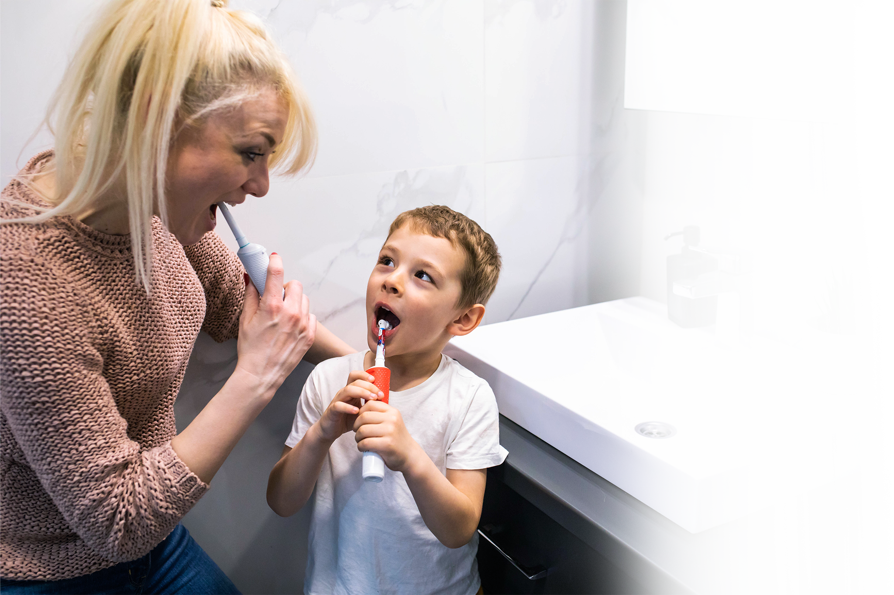
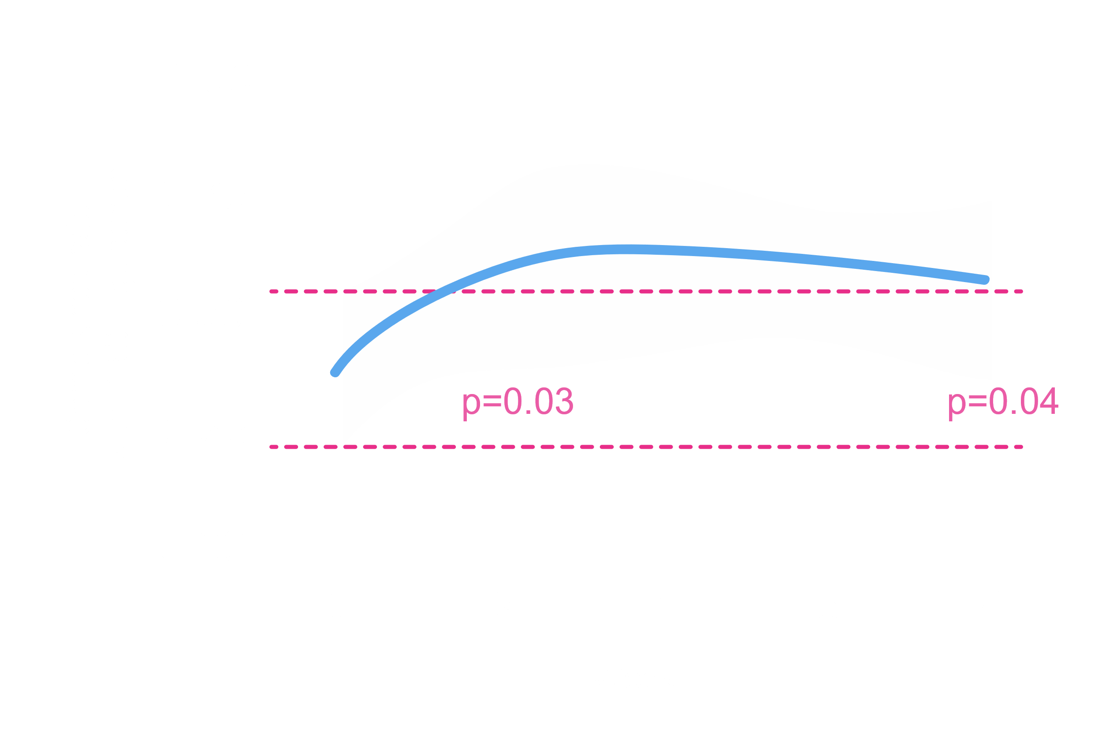
STRONG TEETH MAKE STRONG KIDS: INTERVENTION SHOWS TREND TOWARDS COMPLIANCE WITH GUIDELINES AND IMPROVED PLAQUE CONTROL WITH OR ¹
QUANTITATIVE STUDY RESULTS
Compliance to Delivering Better Oral Health guidance
at 2 weeks and 2 months post "Strong Teeth" intervention
24% MORE PATIENTS showed total compliance with all DBOH Guidelines at the 2 month follow up.
¹ Giles E et al. "Strong Teeth": BMC Oral Health 21, 267 (2021). https://doi.org/10.1186/s12903-021-01608-x
Notes:
Dietary habits remained largely unchanged
Results
Strong Teeth was feasible to deliver in a General Dental Practice setting in 94% of cases. Feasibility of recruitment (37%) exceeded progression criterion, however retention of participants (75%) was below the progression criterion for the 0–2 age group. More than half of children recruited aged 3–5-years had caries experience (52%). Total compliance to toothbrushing guidance at baseline was low (28%) and increased after the intervention (52%), an improvement that was statistically significant. Dietary habits remained largely unchanged. Plaque scores significantly decreased in the 3–5-year-olds and toothbrushing duration increased in all age groups.
Blue line represents compliance rate

Slide 19
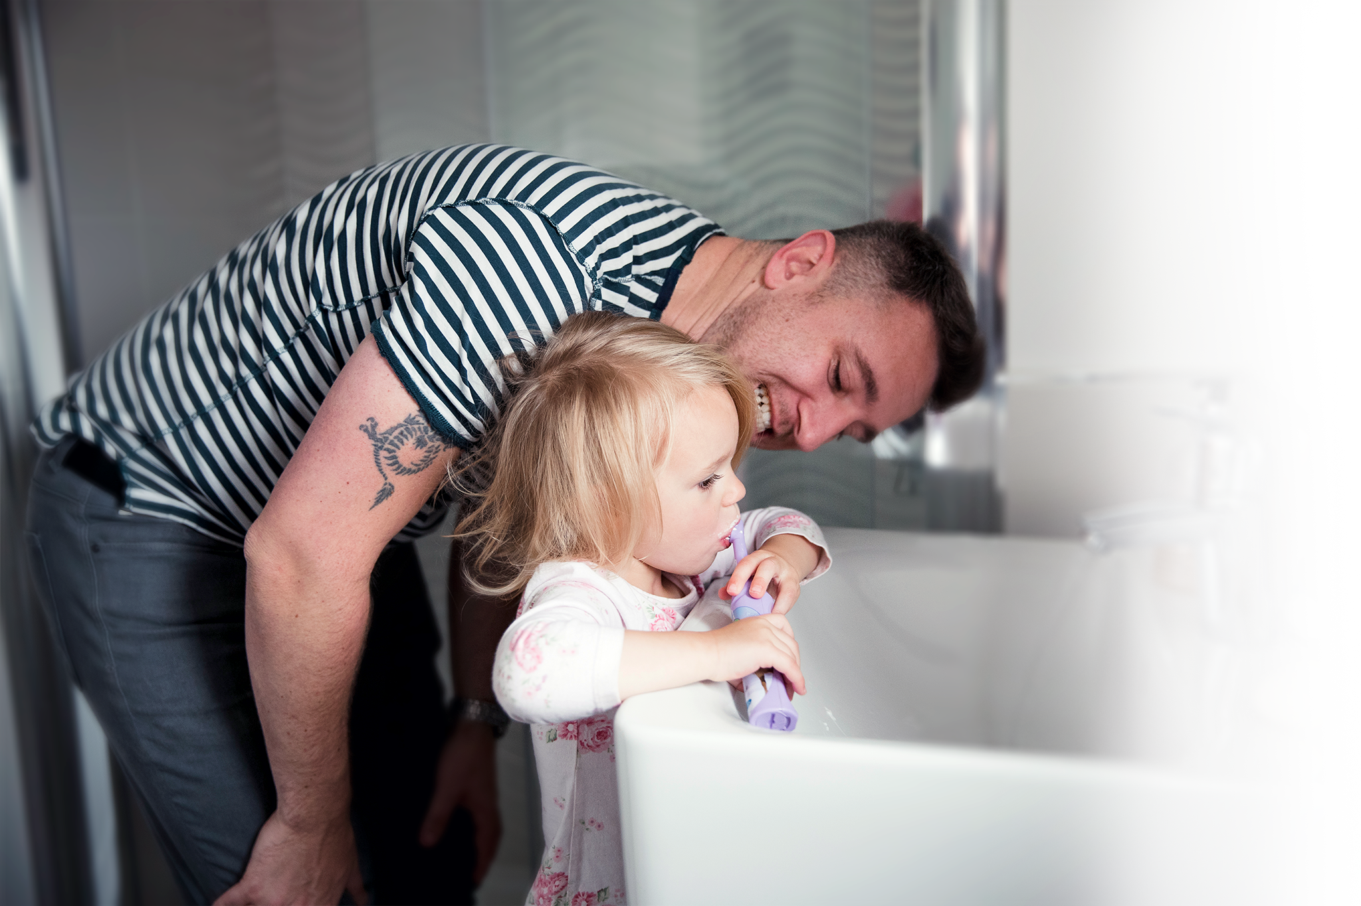

STRONG TEETH MAKE STRONG KIDS: INTERVENTION SHOWS TREND TOWARDS COMPLIANCE WITH GUIDELINES AND IMPROVED PLAQUE SCORES WITH OR ¹
QUANTITATIVE STUDY RESULTS
Improving plaque scores for children aged 3-5 years old using an OR electric toothbrush
Box plot for plaque scores within the 3-5 age group
Average brushing duration increased by 18 seconds
¹ Giles E et al. "Strong Teeth": BMC Oral Health 21, 267 (2021). https://doi.org/10.1186/s12903-021-01608-x
Notes:
Plaque scores significantly decreased in the 3–5-year-olds and toothbrushing duration increased in all age groups.
Improvement in plaque scores and kids brushed longer

Slide 20

EFFICACY, IMPACT, SAFETY AND ACCEPTANCE
OF OSCILLATION ROTATION TECHNOLOGY FOR PEDIATRIC PATIENTS
EFFICACY
IMPACT
SAFETY
ACCEPTANCE
Superior whole mouth plaque control over 4 weeks ^{1*}:
1.6x greater plaque reduction in children ages 3-6
1.9x greater plaque reduction in children ages 7-9
Cross-sectional study findings show children using OR electric toothbrushes are more likely to have ^{2*}
Less Plaque: 6x higher odds
Caries-free teeth: 1.4x higher odds
3 separate studies on safety for pediatric patients ^{3-5*}
256 subjects
No adverse effects on hard
or soft tissues
81% of parents thought the OR brush was more effective ³
74% of children agreed the OR brush was more fun to use ³
80% of dental professionals felt strongly that they would recommend the OR brush for children³
¹ Data on File, Publication in 2023;
² Davidovich.et al, Int. J. Environ. Res. Public Health 2020, 17(22), 8595;
³ Nowak et al. Compendium 23(3): Suppl2:25-32, 2002;
⁴ https://www.dentalcare.com/-/media/dentalcareus/research/pdf/ca_power/garciagodoy.pdf?la=en&v=1-201604250926;
⁵ https://www.dentalcare.com/-/media/dentalcareus/research/pdf/vitality/grossman1997.pdf?la=en&v=1-201604251004
* Versus manual toothbrush
** Practice-based study involving 13 dental offices and a total of 154 children aged 4 to 9 years
Notes:
Summary of the evidence

