Slide 1
WHAT ABOUT SENSITIVITY?

Slide 2
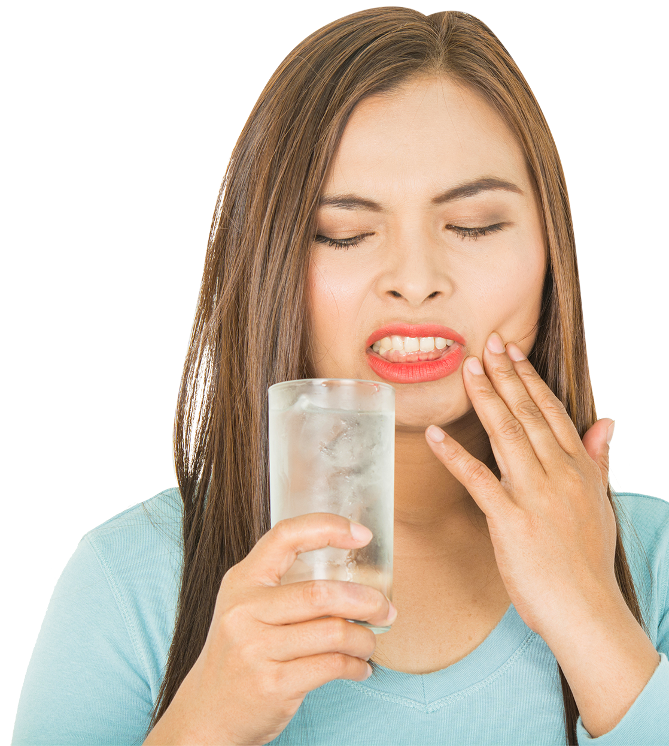
TOOTH WHITENING RELATED SENSITIVITY ¹⁻⁹
A common side effect
Transient - it goes away
It’s not harmful – smear layers are not etched -not the result of development of exposed tubuli
In toxicological data no evidence for risk
Current belief
Directly related to rate of whitening and solely related to peroxide
Reality
The gelling and adhesive agents also contribute to sensitivity through dehydration.
This is true for ALL current effective whitening products.
Notes:
1. Sato C, et al. Tooth bleaching increases dentinal protease activity. J Dent Res. 2013 Feb;92(2):187-92.
2. Vaz MM, et al. Inflammatory response of human dental pulp to at-home and in-office tooth bleaching. J Appl Oral Sci. 2016 Sep-Oct;24(5):509-517.
3. Benetti F, et al The presence of osteocalcin, osteopontin and reactive oxygen species-positive cells in pulp tissue after dental bleaching. Int Endod J. 2019 May;52(5):665-675.
4. Epple M, et al. A critical Review of Modern Concepts for Teeth Whitening. Dent J (Basel). 2019 Aug 1;7(3):79.
5. Bersezio C, et al. Teeth whitening with 6% H₂O₂ and its impact on quality of life: 2 years of follow-up. Odontology. 2019 Jan;107(1):118-125. doi: 10.1007/s10266-018-0372-3.
6. Estay J, et al. The change of teeth color, whiteness variations and its psychosocial and self-perception effects when using low vs. high concentration bleaching gels: a one-year follow-up. BMC Oral Health. 2020 Sep 11;20(1):255.
7. Auschill TM, et al Randomized clinical trial of the efficacy, tolerability, and long-term color stability of two bleaching techniques: 18-month follow-up. Quintessence Int. 2012 Sep;43(8):683-94.
8. Moghadam FV, et al. The degree of color change, rebound effect and sensitivity of bleached teeth associated with at-home and power bleaching techniques: A randomized clinical trial. Eur J Dent. 2013 Oct;7(4):405-411.
9. Haywood VB, et al. Effectiveness, side effects and long-term status of nightguard vital bleaching. J Am Dent Assoc. 1994 Sep;125(9):1219-26. doi: 10.14219/jada.archive.1994.0154. PMID: 7930184.
77. Karaarslan ES, Özmen ZC, Aytac F, Bicakci AA, Buldur M, Aydogan L, Hologlu F, Özkocak B. Evaluation of biochemical changes in dental tissues after different office bleaching methods. Hum Exp Toxicol. 2019 Apr;38(4):389-397.
78. Sato C, Rodrigues FA, Garcia DM, Vidal CM, Pashley DH, Tjäderhane L, Carrilho MR, Nascimento FD, Tersariol IL. Tooth bleaching increases dentinal protease activity. J Dent Res. 2013 Feb;92(2):187-92.
79. Vaz MM, Lopes LG, Cardoso PC, Souza JB, Batista AC, Costa NL, Torres ÉM, Estrela C. Inflammatory response of human dental pulp to at-home and in-office tooth bleaching. J Appl Oral Sci. 2016 Sep-Oct;24(5):509-517.
80. Benetti F, Briso ALF, Carminatti M, de Araújo Lopes JM, Barbosa JG, Ervolino E, Gomes-Filho JE, Cintra LTA. The presence of osteocalcin, osteopontin and reactive oxygen species-positive cells in pulp tissue after dental bleaching. Int Endod J. 2019 May;52(5):665-675.
82. Epple M, Meyer F, Enax J. A Critical Review of Modern Concepts for Teeth Whitening. Dent J (Basel). 2019 Aug 1;7(3):79.
83. Bersezio C, Martín J, Angel P, Bottner J, Godoy I, Avalos F, Fernández E. Teeth whitening with 6% H₂O₂ and its impact on quality of life: 2 years of follow-up. Odontology. 2019 Jan;107(1):118-125. doi: 10.1007/s10266-018-0372-3.
84. Pinto MM, Gonçalves ML, Mota AC, Deana AM, Olivan SR, Bortoletto C, Godoy CH, Vergilio KL, Altavista OM, Motta LJ, Bussadori SK. Controlled clinical trial addressing teeth whitening with H₂O₂ in adolescents: a 12-month follow-up. Clinics (Sao Paulo). 2017 Mar;72(3):161-170.
85. Estay J, Angel P, Bersezio C, Tonetto M, Jorquera G, Peña M, Fernández E. The change of teeth color, whiteness variations and its psychosocial and self-perception effects when using low vs. high concentration bleaching gels: a one-year follow-up. BMC Oral Health. 2020 Sep 11;20(1):255.
86. Auschill TM, Schneider-Del Savio T, Hellwig E, Arweiler NB. Randomized clinical trial of the efficacy, tolerability, and long-term color stability of two bleaching techniques: 18-month follow-up. Quintessence Int. 2012 Sep;43(8):683-94.
87. Moghadam FV, Majidinia S, Chasteen J, Ghavamnasiri M. The degree of color change, rebound effect and sensitivity of bleached teeth associated with at-home and power bleaching techniques: A randomized clinical trial. Eur J Dent. 2013 Oct;7(4):405-411.
88. Haywood VB, Leonard RH, Nelson CF, Brunson WD. Effectiveness, side effects and long-term status of nightguard vital bleaching. J Am Dent Assoc. 1994 Sep;125(9):1219-26. doi: 10.14219/jada.archive.1994.0154. PMID: 7930184.

Slide 3
TOOTH WHITENING RELATED SENSITIVITY ¹⁻⁹
Natural processes mitigate effects even during bleaching. There are no lasting known pulp effects of properly applied peroxide bleaching.
The source of the increased hypersensitivity is minor inflammation of the pulp.
Hypersensitivity is commonly observed in patients without exposed dentin; hence the bleaching does not have to expose dentinal tubules to produce the effects. ¹⁻⁴
Long term studies have now followed up on patients following bleaching and has established that transient hypersensitivity which occurs during oxidative whitening recedes with time.⁵⁻¹¹, long term follow up studies reveal that bleached patients exhibit no long-term increased hypersensitivity following their bleaching procedure. ⁵⁻¹¹
Notes:
1. Karaarslan ES, et al. Evaluation of biochemical changes in dental tissues after different office bleaching methods. Hum Exp Toxicol. 2019 Apr;38(4):389-397.
2. Sato C, et al. Tooth bleaching increases dentinal protease activity. J Dent Res. 2013 Feb;92(2):187-92.
3. Vaz MM, et al. Inflammatory response of human dental pulp to at-home and in-office tooth bleaching. J Appl Oral Sci. 2016 Sep-Oct;24(5):509-517.
4. Benetti F, et al The presence of osteocalcin, osteopontin and reactive oxygen species-positive cells in pulp tissue after dental bleaching. Int Endod J. 2019 May;52(5):665-675.
5. Epple M, et al. A critical Review of Modern Concepts for Teeth Whitening. Dent J (Basel). 2019 Aug 1;7(3):79.
6. Bersezio C, et al. Teeth whitening with 6% H₂O₂ and its impact on quality of life: 2 years of follow-up. Odontology. 2019 Jan;107(1):118-125. doi: 10.1007/s10266-018-0372-3.
7. Pinto MM, et al. Controlled clinical trial addressing teeth whitening with H₂O₂ in adolescents: a 12-month follow-up. Clinics (Sao Paulo). 2017 Mar;72(3):161-170.
8. Estay J, et al. The change of teeth color, whiteness variations and its psychosocial and self-perception effects when using low vs. high concentration bleaching gels: a one-year follow-up. BMC Oral Health. 2020 Sep 11;20(1):255.
9. Auschill TM, et al Randomized clinical trial of the efficacy, tolerability, and long-term color stability of two bleaching techniques: 18-month follow-up. Quintessence Int. 2012 Sep;43(8):683-94.
10. Moghadam FV, et al. The degree of color change, rebound effect and sensitivity of bleached teeth associated with at-home and power bleaching techniques: A randomized clinical trial. Eur J Dent. 2013 Oct;7(4):405-411.
11. Haywood VB, et al. Effectiveness, side effects and long-term status of nightguard vital bleaching. J Am Dent Assoc. 1994 Sep;125(9):1219-26. doi: 10.14219/jada.archive.1994.0154. PMID: 7930184.

Slide 4
TOOTH WHITENING RELATED SENSITIVITY
Combined data suggest mild inflammatory response in some pulps is likely correlated to transient and reversible hypersensitivity side effects
A Model for Peroxide Effects Pulp and Hypersensitivity Response¹⁻⁸
Peroxide treatment of teeth
Peroxide diffusion into tooth and
into dentin and some pulp penetration
Mild inflammatory reactions
seen in pulp
Transient hypersensitivity begins
Upregulation of catalase in pulp
Continued bleaching
Hypersensitivity response modulates during treatment
– and resolves post treatment
Notes:
1. Karaarslan ES, et al. Evaluation of biochemical changes in dental tissues after different office bleaching methods. Hum Exp Toxicol. 2019 Apr;38(4):389-397.
2. Sato C, et al. Tooth bleaching increases dentinal protease activity. J Dent Res. 2013 Feb;92(2):187-92.
3. Vaz MM, et al. Inflammatory response of human dental pulp to at-home and in-office tooth bleaching. J Appl Oral Sci. 2016 Sep-Oct;24(5):509-517.
4. 5. Epple M, et al. A critical Review of Modern Concepts for Teeth Whitening. Dent J (Basel). 2019 Aug 1;7(3):79.
5. Bersezio C, et al. Teeth whitening with 6% H₂O₂ and its impact on quality of life: 2 years of follow-up. Odontology. 2019 Jan;107(1):118-125. doi: 10.1007/s10266-018-0372-3.
6. Pinto MM, et al. Controlled clinical trial addressing teeth whitening with H₂O₂ in adolescents: a 12-month follow-up. Clinics (Sao Paulo). 2017 Mar;72(3):161-170.
7. Auschill TM, et al Randomized clinical trial of the efficacy, tolerability, and long-term color stability of two bleaching techniques: 18-month follow-up. Quintessence Int. 2012 Sep;43(8):683-94.
8. Haywood VB, et al. Effectiveness, side effects and long-term status of nightguard vital bleaching. J Am Dent Assoc. 1994 Sep;125(9):1219-26. doi: 10.14219/jada.archive.1994.0154. PMID: 7930184.

Slide 5
EFFICACY AND TOLERABILITY OF CURRENT PEROXIDE WHITENING
In-office, 15-35% H₂O₂
Tooth Sensitivity
WHITENING PERFORMANCE
Efficacy: Increase Concentration or Contact Time

Slide 6
EFFICACY AND TOLERABILITY OF CURRENT PEROXIDE WHITENING
In-office, 15-35% H₂O₂
Tooth Sensitivity
TOOTH SENSITIVITY & GUM IRRITATION
WHITENING PERFORMANCE
5-10 minute, any concentration
(Pens, paint-ons, trays, Snow, Luster)
Efficacy: Increase Concentration or Contact Time

Slide 7
EFFICACY AND TOLERABILITY OF CURRENT PEROXIDE WHITENING
Pain is too much
In-office, 15-35% H₂O₂
Tooth Sensitivity
TOOTH SENSITIVITY & GUM IRRITATION
WHITENING PERFORMANCE
Benefit not big enough
5-10 minute, any concentration
(Pens, paint-ons, trays, Snow, Luster)
Efficacy: Increase Concentration or Contact Time

Slide 8
EFFICACY AND TOLERABILITY OF CURRENT PEROXIDE WHITENING
Good performance
30% Tooth Sensitivity
Pain is too much
In-office, 15-35% H₂O₂
Tooth Sensitivity
TOOTH SENSITIVITY & GUM IRRITATION
WHITENING PERFORMANCE
30-minute to one hour contact time,
5-10% concentration H₂O₂
(OTC trays & strips, Professional products)
Benefit not big enough
5-10 minute, any concentration
(Pens, paint-ons, trays, Snow, Luster)
Efficacy: Increase Concentration or Contact Time

Slide 9
WITH CURRENT WHITENING OPTIONS…
”YOU CAN ONLY PICK TWO” ATTRIBUTES
SPEED
NO
SENS
EFFICACY
Introducing a new delivery form Emulsions….NO tradeoffs.

