Slide 1

Avoiding Scams and Fraud for Older Adults
June 27, 2024

Slide 2
Presented by:
Westerra Credit Union Fraud Prevention Department
Denver Police Department
City Attorney’s Office
Notes:
Tricia Intro from the beginning

Slide 3
Introducing our Presenters:
  Cynnomon Gordon, Director Fraud Operations
  Julie Lopez, Senior Fraud Analyst
  Crystal Salazar, Fraud Analyst
  Maria Mendoza, Fraud Analyst
  Detective Jeremy McConnell, Denver Police Department - Special Victims Unit (SVU)
  Lynn Lowe, Denver City Attorney's Office - Senior Resource Advocate Navigator
Notes:
Tricia Intro from the beginning

Slide 4

Purpose Of This Training
To Bring Awareness and Education
Provide Tips and Resources
How to Report Elder Abuse
Notes:
Cynn-Present thank you for joining us

Slide 5

AGENDA
              Elder Abuse & At-Risk Adult Defined
              Types of Elder Abuse
              When and Who To Call
              Legal Reporting Requirements
              Individual Exploitation
              Situations and Examples
              Red Flags
              AI Video
              Law Enforcement and City Attorney
              Resources
              Q&A
Notes:
Cynn present

Slide 6
Definition of Elder Abuse
Defined as: Unauthorized Use of the Senior’s Assets for Someone Else’s Personal Gain
Any Person Who is 70 Years of Age or older
No Additional Risk Factors or Disability Required
Notes:
Cynn present

Slide 7
Definition of an At-Risk Adult
An at-risk adult with Intellectual and development disability (IDD) is a person who is eighteen years of age or older who has an intellectual and developmental disability resulting in an impairment of intellectual function or adaptive behavior
The onset of IDD occurs before the person is 22 years old
Notes:
Cynn present

Slide 8
Financial exploitation and financial abuse
Offenders steal about $28.3 billion yearly from seniors 60 and older.
About 72% of losses ($20.3 billion) are due to someone the senior knows, such as caregivers, friends, or relatives.
87.5% of these cases go unreported. However, in cases where the senior does not know the perpetrator, 67% of these cases get reported.
Only about $7.8 billion of stolen funds overall get reported
Sources cited:
https://www.seniorliving.org/research/elder-abuse-statistics/
Notes:
Stats page how many cases have been reported through FI’s data from 3 years, increasing fraud and the money lost

Slide 9
Types of Elder Abuse
Exploitation/Financial Exploitation
  Majority of our cases
Caretaker Neglect
Physical Abuse-Call Law Enforcement Immediately
Sexual Abuse
Notes:
Crystal present

Slide 10
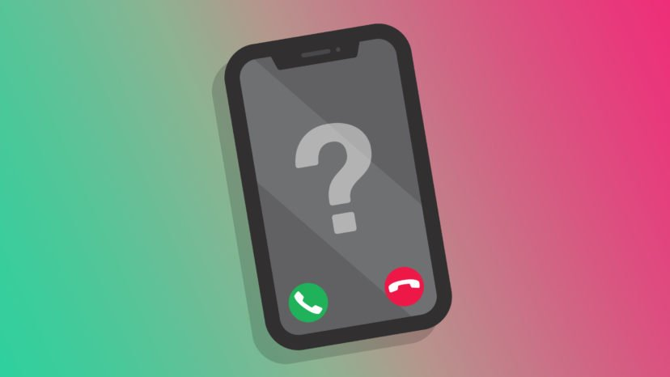
When and Who To Call
When to call
When you witness an elderly person is being physically abused (call law enforcement immediately)
When you witness an elderly person is being verbally abused
When the elderly person appears to be fearful
When you know an elderly person is taking a financial loss
When someone has taken advantage of an elderly person
Who to call
When in doubt call
Call the County that the loved one lives in.
  Or where the abuse took place
Notes:
Crystal

Slide 11
Financial Institutions Failure To Report
Colorado Mandatory Elder Abuse reporting went into effect July 1, 2014
Financial Institutions are required to follow the mandatory reporting laws
If a Financial Institution willfully fails to file a report of a mistreatment it is a class 3 Misdemeanor
If charged and convicted, you could receive a fine of up to $750.00 or 6 months in jail or both
**A report must be filed within 24 hours of the incident taking place.**
Notes:
Crystal

Slide 12

Sweetheart/Romance Scams
How it works
  Social media or dating apps
  Long distance-Often in a different Country
Why are sweetheart romance scams hard to stop
  Emotions are involved
  Months or years are invested
  Lonely
Risk
  Loss of trust
  Isolation from family and friends
  Loss of money
  Identity theft
How to protect yourself
  Use extreme caution
  Don’t send money or gift cards

Slide 13
Individual Exploitation
Power of Attorney, Representative Payees, Conservators, & Legal Guardians | Example of Exploitation | Example of Exploitation
These reps are to act in the best interest of the individual. Funds are to be used for their care and benefit. Using funds for personal benefit is financial exploitation. | An individual uses your loved one's funds for personal use. Your loved one then does not have funds to pay their own living expenses. | Individual has a medical situation, and a family member moves in with them. Then begins using their funds for personal use. And when confronted threatens to put them in a nursing home.
Notes:
Jl present
An individual uses their your loved ones funds for personal use such as travel, getting their nails done, or paying their rent.
Example: Member called in to order a new debit card. During Covid the member called in to order a new D/C card the son got out of jail and moved in with him and then took his debit card and was using it for his own expenses
Example: Our members wife passed away and our member wanted to make sure his daughter would inherit the house so he filed a Quit Claim Deed making her the sole owner of the home. Once she moved in he was expected to pay rent for living in his own house and when they got into an argument, she kicked him out of the house and he was not able to afford to rent his own place. WCU and LE couldn’t do anything about this since she legally owned the home.

Slide 14
Situations and Examples
Individual wants to wire funds | Individual wants to withdrawal a large amount of cash | Individual has a “friend” come into the branch
Email Lottery Scam Must pay winning collection taxes Large international wire | Large cash withdrawal Unusual request Nervously insisting to withdrawal funds immediately Willing to travel to multiple locations to fulfill the request | Individual comes to the branch with “friend” to withdrawal large cash amount Informed about the special order “Friend” then requests available cash and cashier check in their name
Notes:
The loved one came in to withdrawal a large amount of cash. Then your loved one was nervous and said they needs the funds immediately. When the loved one was told it would be a special order they wanted to know how much they could withdrawal immediately and asked if they could go to different branches for the additional funds. your loved one has never withdrawn large sums of cash before.
The loved one comes in with a “friend” to withdrawal cash. Then the loved one was told they cannot withdrawal this much money in one day and it would be a special order. The “friend” then asked the your loved one to get cash and a cashier check payable to them for the remaining dollar amount. your loved one has never done this in the past.
JL present

Slide 15

Vacation/Rental Property Scam
Questions to ask yourself:
Where did you receive the information for this property rental?
  Craigslist
  Social Media-Facebook, Instagram etc.
How do you know the property owner?
Is this a reputable company?
Have you seen the property in person and toured the property?
Does the price sound to good to be true?
Does the agreed upon rental price keep increasing? (ie-deposits etc.)
Are you sending the deposit or funds to an unknown 3rd party?
Notes:
Share example
JL present

Slide 16

Financial Institution Fraud Impersonators
How it works
  Impersonators call, text or email
  Impersonators asks about fraudulent transactions
  Impersonator informs you that fraud has taken place
  Impersonator phishes for information
    Email address
    Online banking username
    Debit card number
Impersonator will say they are sending a verification text code
  They are changing your online banking password
  At times this may be legitimate verification
How to protect yourself
  Hang up and call the number that you know is legitimate
  Never provide full card numbers or CVV codes to callers
Notes:
JL present
This tactic also works for Computer pop ups.

Slide 17

Red Flags
Increased spending and account is negative
Your loved one states they do not have money to pay their bills
Suspicious transactions on the account that your loved one doesn’t recognize
Transactions not in line with your loved one's age (Online Play station transactions)
Your loved one appears fearful when questioned about suspicious transaction or states they don’t want to get anyone in trouble
Recent Online Bill Pay activity when your loved one has never used Online Bill Pay
Your loved one wants to get a notary to transfer a Deed of Trust for their home
Your loved one wants to add a POA to the account, or add a joint account owner. (Especially when beneficiaries are listed)
Your loved one attempts to do transactions that they have never done in the past.(ie-wires) and doesn’t want to disclose the reason for the transactions
Notes:
JL present

Slide 18
What is My Responsibility
Trust your Instincts
See Something Say Something
Ask Questions (Does this make sense, are they asking for money, wires, gift cards or Bitcoin/Crypto currency)
Use your Resources
You are Empowered
Notes:
Wrap up
JL present

Slide 19
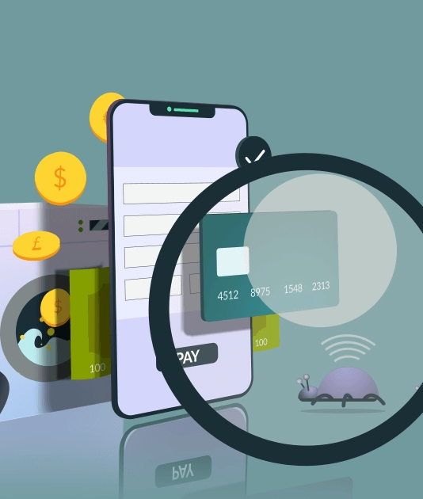
Artificial Intelligence
Artificial intelligence is the science of making machines that can think like humans. It can do things that are considered "smart.“
Impact of AI on Financial Institutions and your loved ones
AI can impersonate your voice
AI can impersonate your loved one voices
AI can correct grammar on emails and text
AI Video-AI scam victim tells Senate story in which his son's voice was spoofed by artificial intelligence (youtube.com)
Notes:
Presented by Maria
https://youtu.be/3x7ghdE1UIs?si=5HiKYbnnCaoYMuSe

Slide 20
Artificial Intelligence
As you can see AI is getting more prevalent, please make sure to contact your family before acting these types of scams are not limited to the elderly
How to protect yourself
  Create a code word/ safe word
  Keep your personal information off the internet
  Authenticate the source
  Stay informed on AI scams
Notes:
Presented by Maria
https://youtu.be/3x7ghdE1UIs?si=5HiKYbnnCaoYMuSe

Slide 21
Law Enforcement - Next Steps
Presented By Det. McConnell
Next steps by law enforcement once an Elder Abuse Report is completed
  DPD elder abuse unit employees
  How many cases are worked in a year
  Recovery of funds
Introduction of Lynn Lowe with Denver City Attorney Office (Denver City Police Department Navigator)
Notes:
Cynn – Please welcome Det. McConnell with DPD he has been in law enforcement for 24 years and a detective in fraud/svu for 7 years.
How they partner with Lynn
Either we will discuss LE next steps and then introduce Lynn if LE is not present.

Slide 22
Why Are Scams Successful?
We are accessible; the internet, cell phones.
The story they provide seems plausible.
Scams are sophisticated.
Scams evolve.
We may already be dealing with a loss, stress, or a significant change in our life.
Scammers gain trust and build relationships.

Slide 23
Scammer Techniques
Trigger the emotional center of our brain rendering our critical thought process paused.
Promises of joy/elation inducing the serotonin and dopamine.
Communication regarding a problem that creates stress which results in a chemical dump of cortisol and adrenaline.

Slide 24

1st RED FLAG
EMOTIONAL CENTER TRIGGER
If any business, government agency, or stranger communicates that there is a problem and they can help you fix it, stop communicating with that person or agency immediately.
If any business, government agency, or stranger promises something that sounds too good to be true, stop communicating with that person immediately.
  There is a release of adrenaline and cortisol inducing a “flight or fight” response. Stop, take some deep breaths and ask yourself, what is a safe source that I can contact right now.
STOP COMMUNICATING AND CONTACT A SAFE, VALID SOURCE.

Slide 25
2nd RED FLAG
SENSE OF URGENCY
Are there threats of worse consequences if you don’t pay now or give information now?
No legitimate business or government agency is going to rush you into giving money or private information.
Do not make a rushed or rash decision out of fear or exhaustion.
STOP COMMUNICATING AND CONTACT A SAFE, VALID SOURCE.

Slide 26
3RD RED FLAG- ISOLATION AND COACHING
Did they tell you not to call someone, i.e. police, your bank, partner, family member?
Did they give you a script for the bank teller or cashier?
No legitimate business or government agency is going to ask you to lie.
STOP COMMUNICATING AND CONTACT A SAFE, VALID SOURCE.

Slide 27

SAFETY FIRST
SLOW DOWN. Nothing is an emergency unless it’s your health or your house is on fire.
BREATHE. Take 5-10 deep breaths, exhaling longer than you inhale. Reset your critical thinking brain.
TRUST YOUR GUT. If something doesn’t feel right, stop, ask questions, seek help from trusted sources.
DO YOUR RESEARCH. Double check phone numbers, contact a family member, drive to the bank, etc.

Slide 28
PLEASE REMEMBER:
Never call the phone numbers back from the scammer calls from, do your own research to contact the company and ask questions.
Never take part in free trial offers without doing your research to include understanding the Terms and Conditions.
NEVER deposit a check and wire or cash app money back.
DO NOT ASK for verification of who they are or the prize, they can generate fake letters that look real, i.e., make it look like it comes from Bank of America.

Slide 29
TECHNOLOGY TRICKS
SPOOFING PHONE CALLS- faking the caller ID.
VOIP PHONE CALLS-Voice-Over Internet Protocol. It works like a virtual number and facilitates phone calls using an Internet connection. The number itself isn’t tied to a device or a geographical location.
FAKE ACCOUNTS- Anyone can steal other people’s photos on social media and create a fake account.
DEEP FAKE- Technology allows the ability to create a video with a single photo.
VOICE CLONING- theft of a sound byte of someone’s video allows to duplicate that voice.

Slide 30
TECHNOLOGY TRICKS
Don’t believe your caller ID.
DO NOT pay for anything you didn't order.
NEVER prepay for a service.
Don't respond to offers to "opt out" of future calls: That alerts callers to a working number.

Slide 31
TECHNOLOGY TRICKS
DISREGARD URGENT EMAILS, i.e., PayPal, Amazon, McAfee, Norton, etc.
Pay attention to the email address
JOHNWAYNE9@GMAIL.COM
VS
JOHNWAYNE9@YAHOO.COM
.

Slide 32
TECHNOLOGY TRICKS
DO NOT CLICK ON ANY LINKS!
DO NOT call Customer Service Numbers provided in emails or texts.
Double check numbers you are calling and if something doesn’t feel right, hang up!

Slide 33
I.T. SUPPORT SCAM
TURN OFF YOUR COMPUTER AND UNPLUG YOUR WIFI IMMEDIATELY.
DO NOT LOG BACK ON UNTIL YOU HAVE HAD YOUR COMPUTER “SCRUBBED” BY A PROFESSIONAL COMPUTER REPAIR COMPANY.

Slide 34

Resources
The Fraud Dept. is here to support you
The Denver Police Dept. is here to support you
www.IC3.gov Scam Reporting and Tips
Federal Trade Commission-Federal Trade Commission | Protecting America's Consumers (ftc.gov)
IAFCI - The Protectors Podcast
(International Association of Financial Crimes Investigators)

Slide 35

Questions and
Takeaways
Notes:
Team work this one together

Slide 36
Contacts
Tricia DeFord | VP of Payment Operations and Fraud Prevention
Cynnomon Gordon | Director of Fraud Prevention
Julie Lopez | Senior Fraud Analyst
Crystal Salazar | Fraud Analyst I
Maria Mendoza | Fraud Analyst I
Fraud – Ext. 2229
Det. Jeremy McConnell | Denver Police Department Special Victim’s Unit
Lynn Lowe | City Attorney’s Office Senior Resource Advocate Navigator
Notes:
Does LE want to add any contacts
Cynn present

Slide 37

Thank You!
Thank You!
Notes:
Team Thank you!

