Slide 1

Relay For Life
PowerPoint
Template

Slide 2
Relay For Life
PowerPoint
Template

Slide 3
Colour
Palette
Magenta
Cyan
Navy
These are our brand colours. We use the Relay purple, along with all the other colours that make up the CRUK brand. ​
R: 255
G: 0
B: 135
R: 0
G: 156
B: 238
R: 0
G: 0
B: 126
Relay Purple
Black
White
Grey
R: 89
G: 0
B: 117
R: 0
G: 0
B: 0
R: 255
G: 255
B: 255
R: 187
G: 199
B: 217

Slide 4
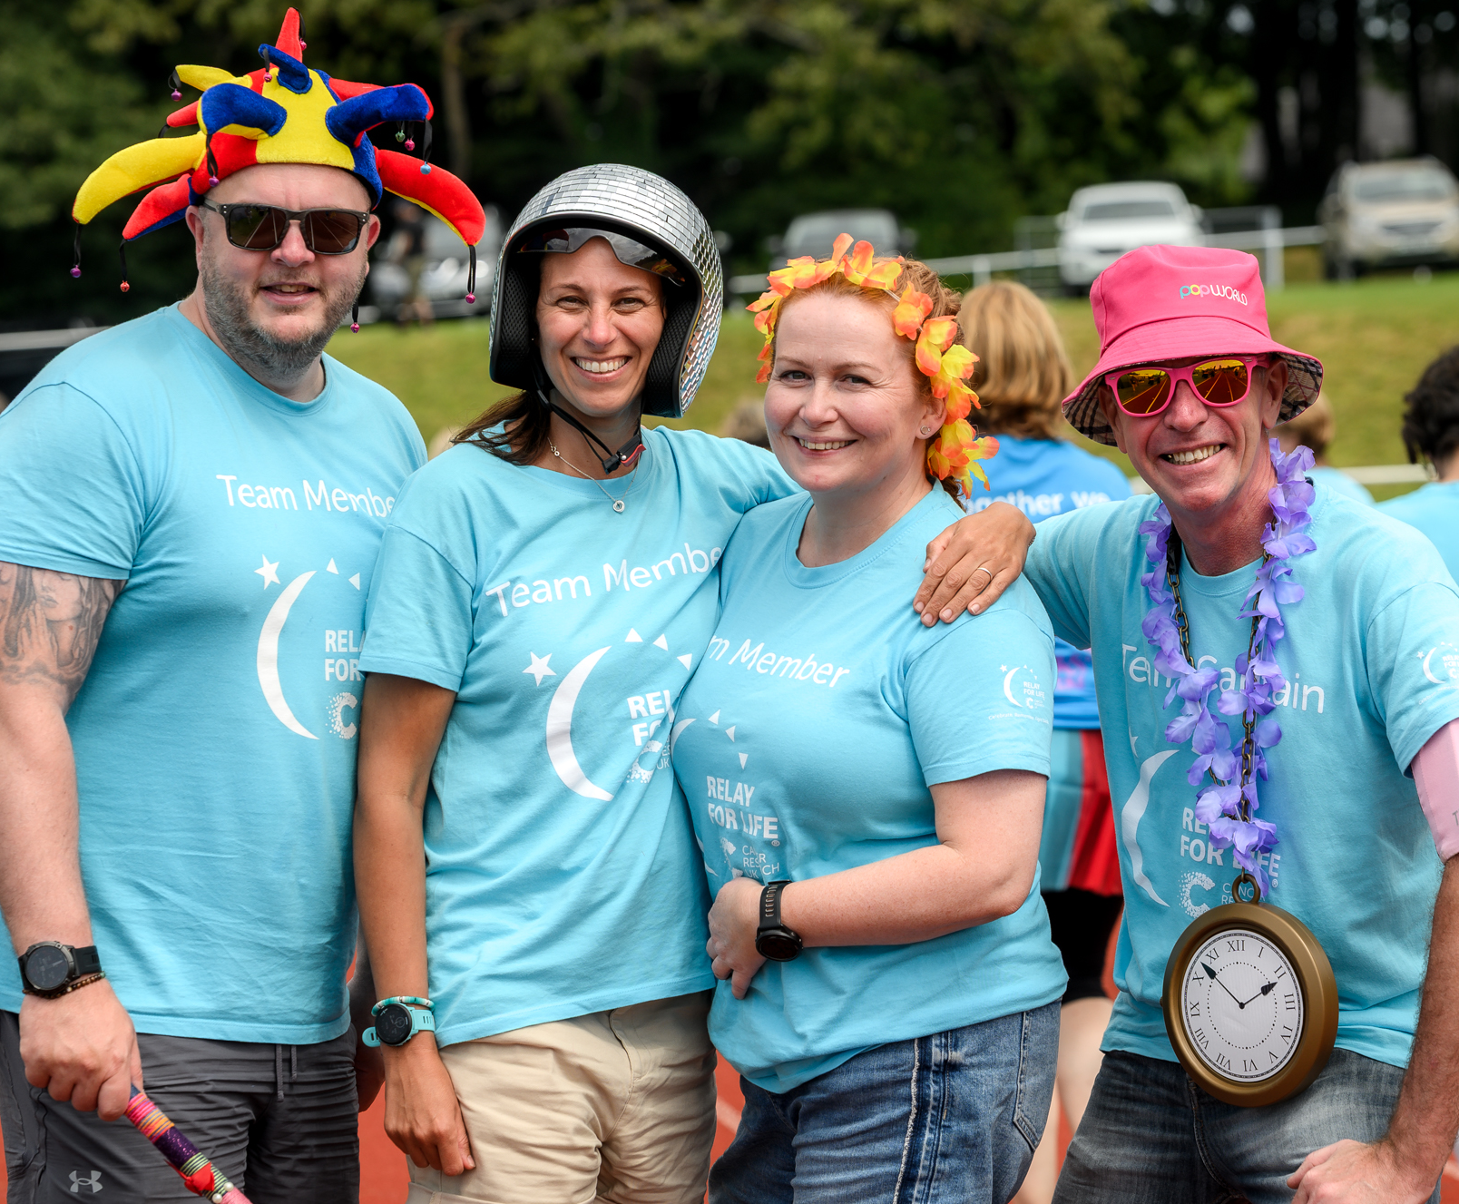
Title goes here
Subtitle goes here

Slide 5
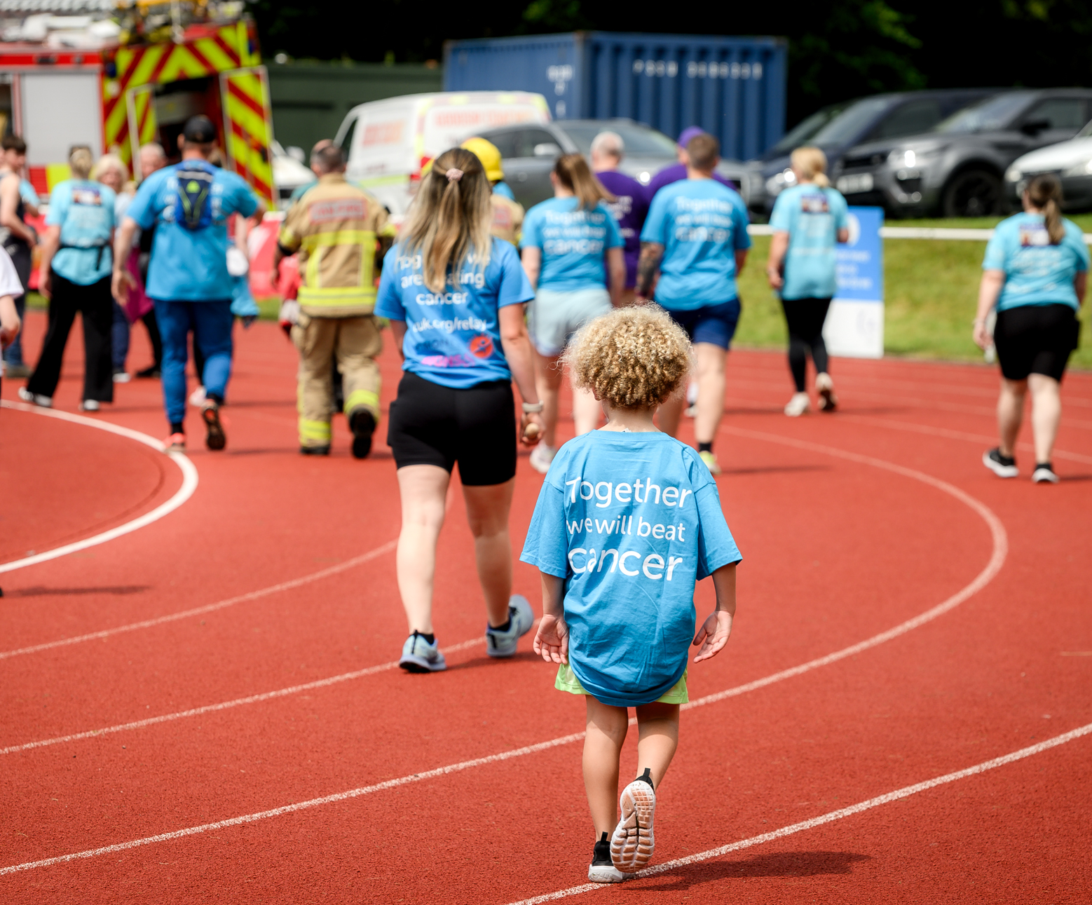
Title goes here
Subtitle goes here

Slide 6

Title goes here
Subtitle goes here

Slide 7
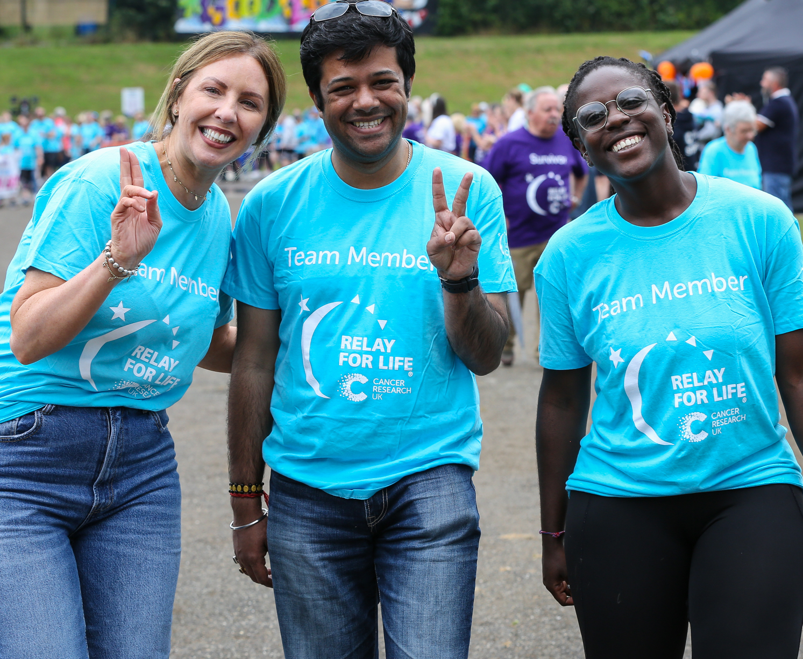
Title goes here
Subtitle goes here

Slide 8

Title goes here
Subtitle goes here

Slide 9
Title goes here
Subtitle goes here

Slide 10
Using our circles
We use our circles to represent significant moments in time. ​
​
Individually, these circles tell the stories of our supporters, researchers and people affected by cancer. They also highlight the key discoveries, markers and achievements that we have made along the way. These moments are naturally rooted in time and the more specific we can be with names, dates, locations and times, the more impactful the moments in our circles will be.​
​
For further guidance on using our circles,
please see our brand guidelines.

Slide 11
Do
“Well, we got to the beach after a long drive in the car. I lost it right there and then in that moment.”
Nicky Brown,​
born after her​
mother Louise​
survived bowel​
cancer
Make the message impactful by: ​
using language that is specific, human, relatable and inspiring​
including a date or time stamp and/or attribution to the person or team​
making it a moment of action (eg a call to action)​
linking two or more circles together to indicate a timeline of linear progression and forward momentum​
Feel free to place copy outside the circle​
Keep it short and snappy
Amy Shields, ​
Liverpool,​
2003
1991
Discovering the first bowel cancer drug for 35 years
2023
Lives still being changed daily

Slide 12
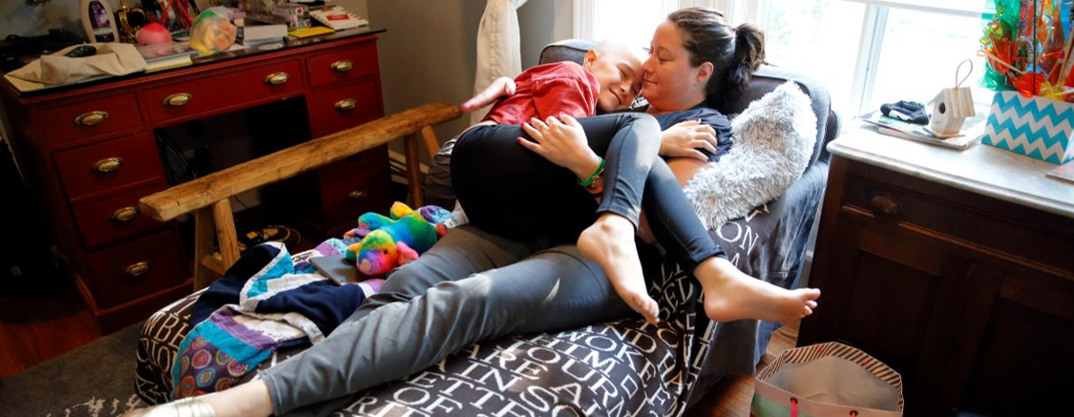


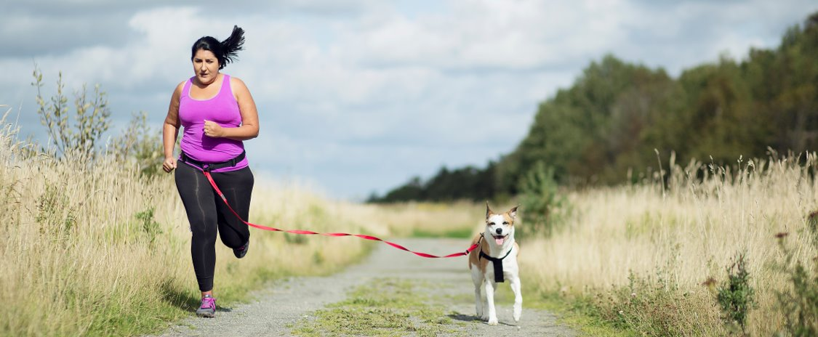

Don’t
Use a circle if there is no
"moment', such as:
on its own without text
• for a generic heading or
purely informational copy
• our endline in a circle
Put an image within
a circle or crop
Together we are beating cancer

