Slide 1
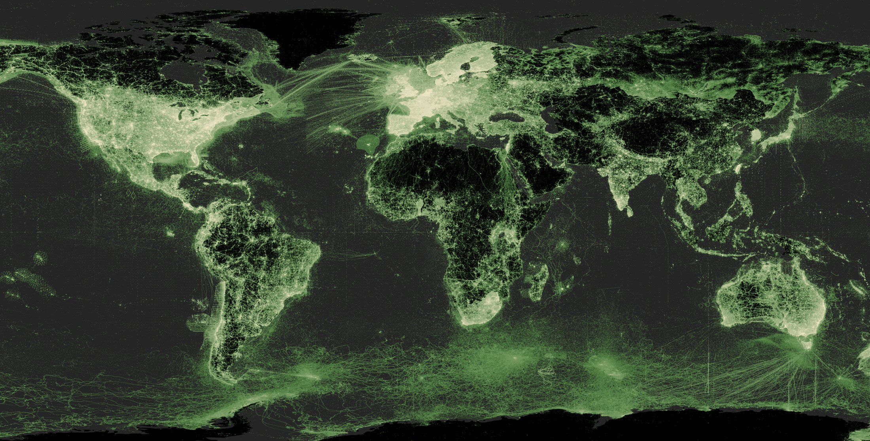
Overview slides
April 2026

Slide 2


Datasets
Hosted portals
121,395
69
Country Participants
Peer-review papers
using data (1 Oct 2025)
69
14,415
Organizational Participants
Average records
downloaded per month (2025)
42
297 billion
Publishers
Species
occurrence records
2,669
3,660,126,436
By the numbers | 1 April 2026
www.gbif.org

Slide 3
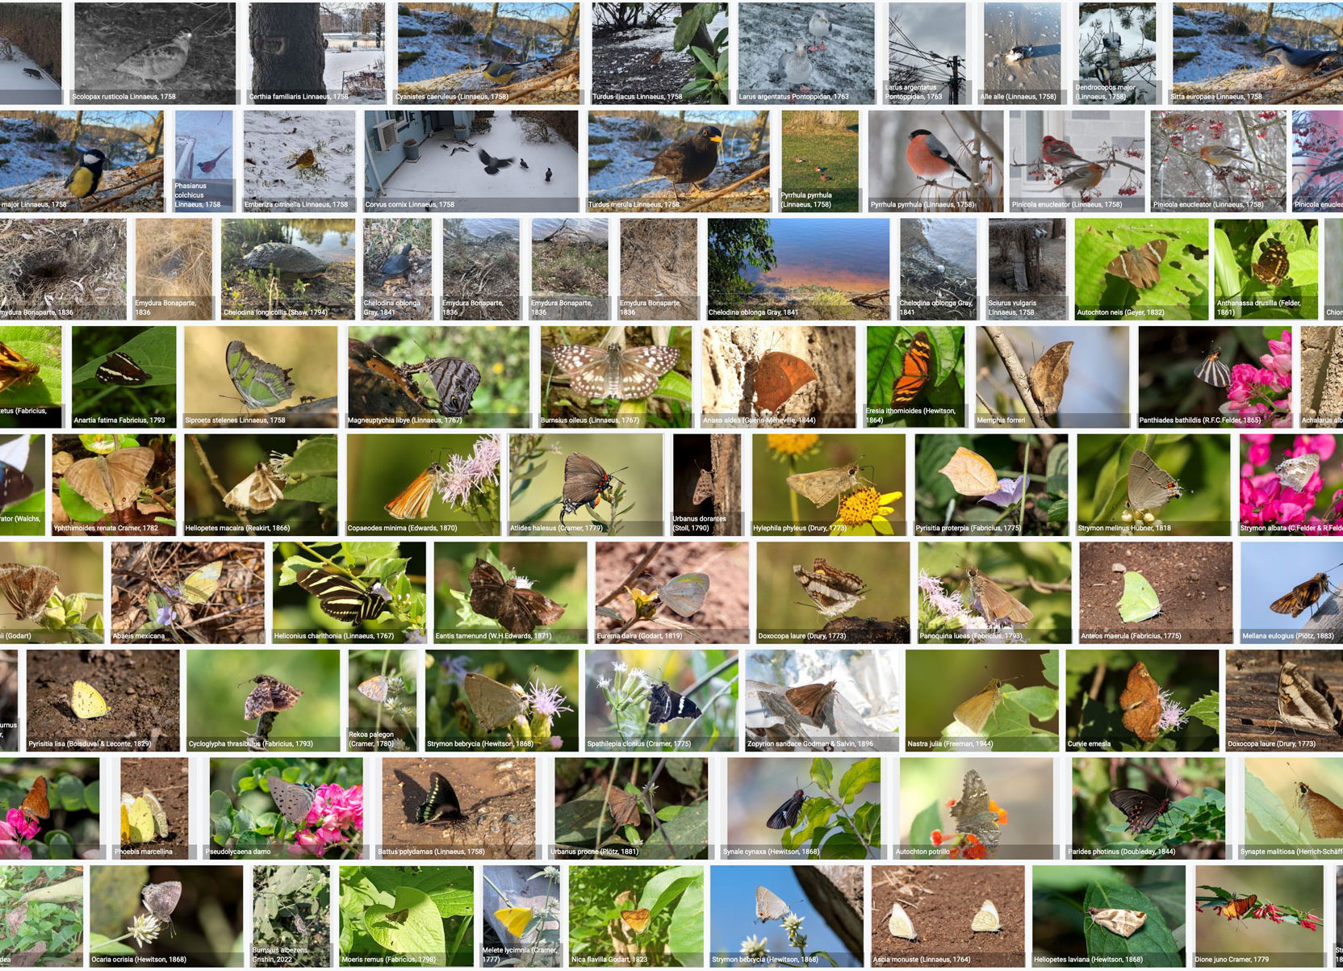
Species occurrence records with multimedia evidence
8 April 2026
272.8
million records
with taxonomically
identified images
1,980,192
audio files
6,250
videos
https://www.gbif.org/occurrence/gallery

Slide 4
GBIF Participant countries
1 April 2026
Voting Participants
Associate Participants

Slide 5
GBIF network of data publishing institutions
1 April 2026
148
countries/areas with institutions
sharing data through GBIF
Number of active publishers by country or area

Slide 6
GBIF.org traffic by country: 2025
14 April 2026
Rank | Country/Territory | Visitors | Visits | Effective visits* | % Effective visits | 2025 rank | Views / visit
1 | United States | 609,750 | 735,409 | 117,665 | 16 % | 1 | 2.46
2 | China | 313,153 | 658,326 | 157,998 | 24 % | 4 | 2.37
3 | Russian Federation | 188,313 | 221,239 | 26,549 | 12 % | 10 | 2.5
4 | France | 102,980 | 123,635 | 61,818 | 50 % | 9 | 6.19
5 | United Kingdom | 72,723 | 95,179 | 34,264 | 36 % | 22 | 5.49
6 | Germany | 68,413 | 82,941 | 44,788 | 54 % | 17 | 8.78
7 | Colombia | 66,470 | 81,212 | 43,854 | 54 % | 11 | 6.37
8 | Vietnam | 62,883 | 64,236 | 3,854 | 6 % | 12 | 1.59
9 | Spain | 61,423 | 76,784 | 44,535 | 58 % | 13 | 7.94
10 | Brazil | 61,353 | 72,191 | 36,096 | 50 % | 2 | 6.28
 | TOTAL | 1,607,458 | 3,108,830 | 1,025,914 | 33 % |  | 4.39

Slide 7
Occurrences published by country: 2026
14 April 2026
Rank | Country/Territory | 2026 | 2025 total | 2025 rank
1 | Australia | 52,256,917 | 53,466,496 | 2
2 | United States | 8,694,274 | 203,021,107 | 1
3 | Netherlands | 4,996,292 | 21,639,084 | 8
4 | Canada | 4,920,733 | 32,338,096 | 5
5 | South Africa | 4,183,639 | 3,205,585 | 24
6 | United Kingdom | 3,766,760 | 41,629,288 | 3
7 | Czechia | 2,496,906 | 862,103 | 43
8 | Sweden | 1,474,542 | 15,314,346 | 10
9 | French Guiana | 1,368,501 | 47,406 | 116
10 | Finland | 1,218,436 | 4,211,838 | 20
OTHER COUNTRIES + AREAS | OTHER COUNTRIES + AREAS | -12,817,312 | 237,985,556
TOTAL |  | 72,559,688 | 613,827,594

Slide 8
Data download requests by country: 2025
1 April 2026
Rank | Country |  | 2026 | 2025 total | 2025 rank
1 | China | 16,966 |  | 68,869 | 1
2 | United States | 15,876 |  | 46,554 | 2
3 | Mexico | 6,182 |  | 27,758 | 3
4 | United Kingdom | 5,983 |  | 15,124 | 6
5 | Brazil | 5,179 |  | 19,629 | 5
6 | France | 5,039 |  | 10,125 | 8
7 | Spain | 4,412 |  | 15,030 | 7
8 | Germany | 4,294 |  | 9,628 | 10
9 | Colombia | 4,293 |  | 22,565 | 4
10 | Canada | 3,258 |  | 9,678 | 9
OTHER COUNTRIES + AREAS | ALL OTHERS | 35,778 |  | 131,765
TOTAL |  | 107,260 |  | 376,725
174
countries, islands & territories where users have ≥5 requested downloads in 2026
Notes:
DOWNLOAD ADJUSTMENTS FOR USERS ≥500 DOWNLOADS FOR JAN-SEPT 2025: AT (1) 2084; AU (1): 961; BE (2): 1440; BR (7): 14717; CA (2): 1358; CH (2): 2474; CN (18): 33554; CZ (2): 2308; DE (4): 2552 ; DK (2): 5583; ES (3): 4034; FR (2): 1597; GB (15): 171162; HR (1): 1977; IL (2) 4302; IN (1): 667; IT (3): 3047; JP (2) 4676; KR (2): 8477; MO (1): 2163; MX (3): 7919; NL (3): 7755; PT (2): 1508; RO (1): 559; TH (1): 1583; TW (1) 2947; US (18): 42321; ZA (2): 31504

Slide 9
Peer-reviewed publications using GBIF-mediated data
1 November 2025

Slide 10
Data use in peer-reviewed journals: 2025
1 November 2025
Peer-reviewed uses by country
Peer-reviewed uses by region
End of Year |  |  | 2025 total | 2024 total | 2024 rank
1 | China |  | 656 | 529 | 1
2 | United States |  | 446 | 486 | 2
3 | Brazil |  | 226 | 238 | 3
4 | United Kingdom |  | 206 | 186 | 5
5 | Germany |  | 181 | 186 | 6
6 | Spain |  | 141 | 171 | 7
7 | Australia |  | 121 | 104 | 10
8 | Mexico |  | 115 | 186 | 4
9 | Canada |  | 106 | 100 | 11
10 | India |  | 93 | 78 | 12

Slide 11


1 April 2026
Suggestions reviewed
Institutions
8,998
3,236
vv
Countries
Collections
130
10,805
Country editors
Digitized specimens
71
269,447,293
GRSciColl by the numbers | 14 April 2026
scientific-collections.gbif.org
Notes:
Our community of editors is doing a huge work to update GRSciColl. In 2024 alone, more than 1600 entries were added to GRSciColl. At the core of the GRSciColl work are our Nodes and the GBIF Regional support teams which have been working on reaching out to institutions in GRSciColl as an entry point to sharing GBIF data.

Slide 12




Hosted portals update
1 April 2026
15
GBIF national Participants and regions
10
Institutional
71
Hosted portals in production
12
34
Networks/thematic networks
Scientific journal

Slide 13
Metabarcoding data programme
1 April 2026
63
109,822,958
22
Datasets
Records
Installations
gbif.org/metabarcoding
Notes:
Notes

Slide 14
Social media
1 April 2026
FOLLOWERS
18,889
14,760
1,947
3,049
POSTS
66
3,947
63
2,377
87
401
97
619
ENGAGEMENTS

Slide 15
Providing biodiversity evidence for research and policy

Slide 16
Sources of biodiversity evidence
Create
Combine sources
of evidence

Slide 17
Access to biodiversity evidence
Share
FAIR and open access

Slide 18
Uses of biodiversity evidence
Transform
Apply and use data

