Slide 1
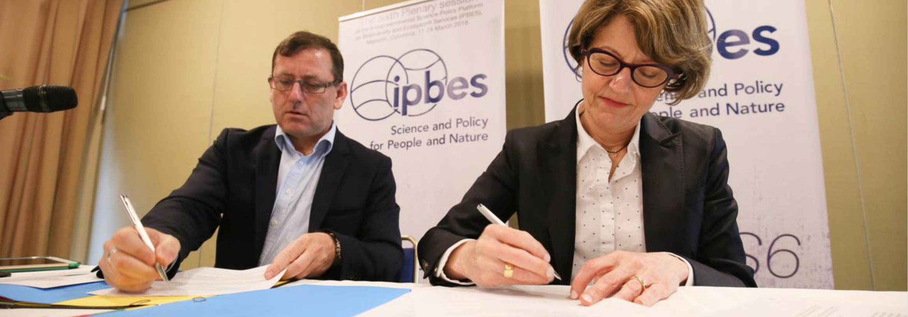
GBIF nodes and IPBES
Tim Hirsch, Deputy Director
Gbif community webinar, 5th april 2018

Slide 2
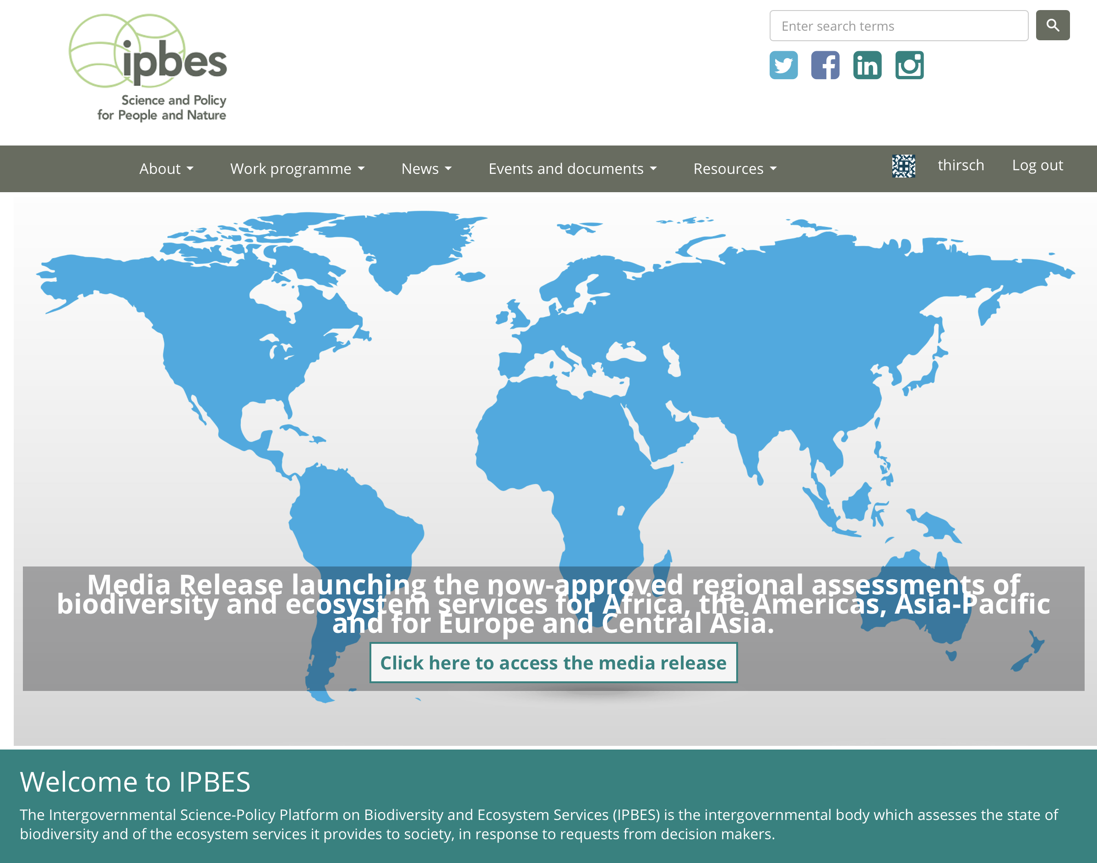
Ipbes goal
“strengthen the science-policy interface for biodiversity and ecosystem services for the conservation and sustainable use of biodiversity, long-term human well-being and sustainable development”
https://www.ipbes.net

Slide 3
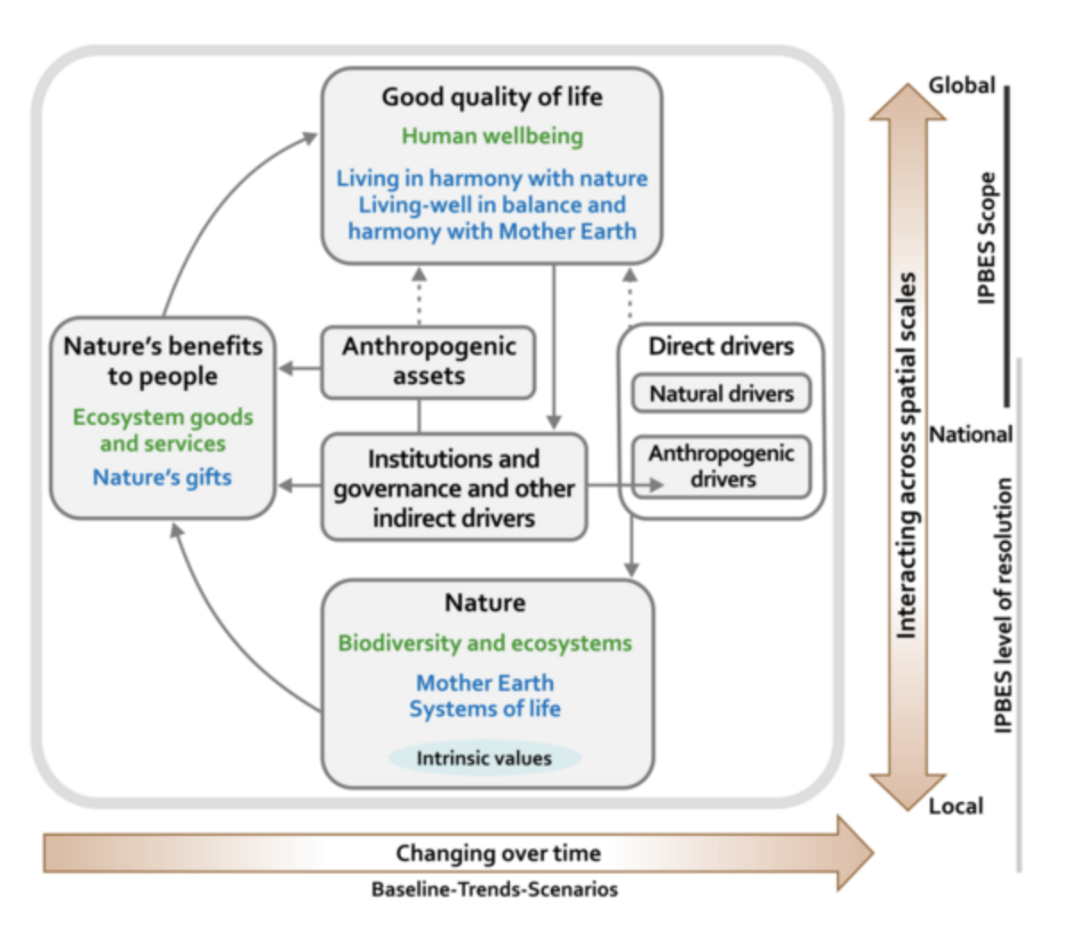
Ipbes functions
Produce assessments of existing knowledge
Catalyse generation of new knowledge/fill gaps
Support policy formulation, implementation
Build capacities relevant to achieving its goals
https://www.ipbes.net/work-programme
Notes:
The Platform identifies and prioritizes key scientific information needed for policymakers at appropriate scales and catalyses efforts to generate new knowledge by engaging in dialogue with key scientific organizations, policymakers and funding organizations, but should not directly undertake new research;
(c) ThePlatformperformsregularandtimelyassessmentsofknowledgeonbiodiversityand ecosystem services and their interlinkages, which should include comprehensive global, regional and, as necessary, subregional assessments and thematic issues at appropriate scales and new topics identified by science and as decided upon by the Plenary. These assessments must be scientifically credible, independent and peer-reviewed, and must identify uncertainties. There should be a clear and transparent process for sharing and incorporating relevant data. The Platform maintains a catalogue of relevant assessments, identifies the need for regional and subregional assessments and helps to catalyse support for subregional and national assessments, as appropriate;
(d) ThePlatformsupportspolicyformulationandimplementationbyidentifyingpolicy- relevant tools and methodologies, such as those arising from assessments, to enable decision makers to gain access to those tools and methodologies and, where necessary, to promote and catalyse their further development;
(e) The Platform prioritizes key capacity-building needs to improve the science-policy interface at appropriate levels and then provides and calls for financial and other support for the highest-priority needs related directly to its activities, as decided by the Plenary, and catalyses financing for such capacity-building activities by providing a forum with conventional and potential sources of funding.

Slide 4
Ipbes milestoneS
2012: Establishment of platform
2014: Launch of first work programme (2014-18)
2016: Publication of ‘fast track’ assessment on pollinators
March 2018 (Medellín): Publication of four regional assessments, land degradation assessment
April 2019 (Paris): Publication of global assessment, launch of second work programme

Slide 5
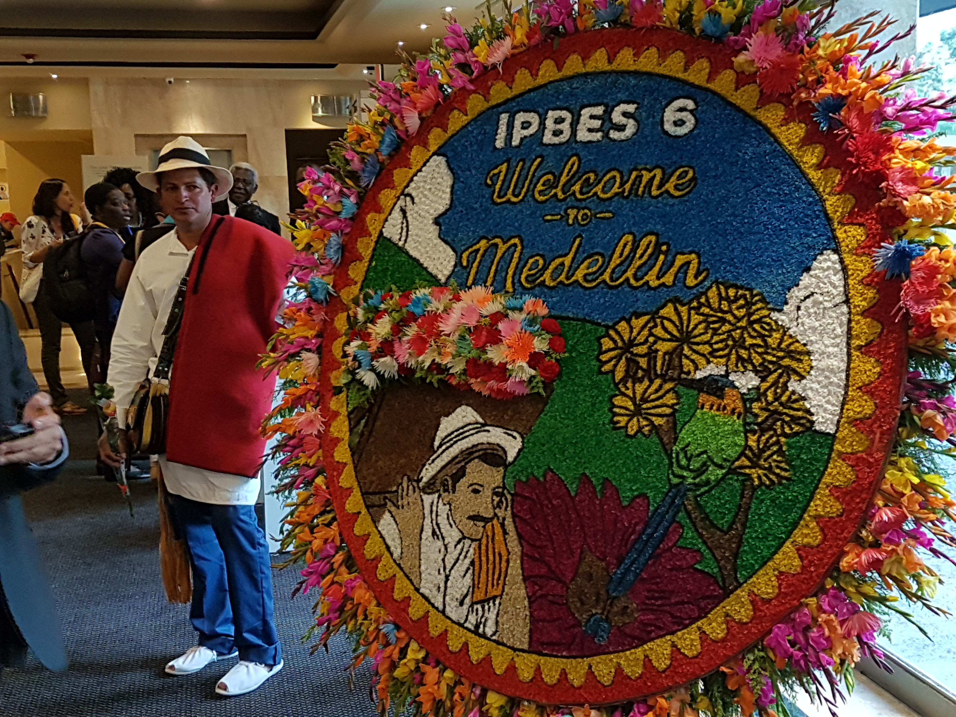
Ipbes-6 PLENARY MEETING, MEDELLÍn, colombia 17-24 march 2018
Approval of 5 assessments on:
Africa; Asia-Pacific: Americas; Europe/Central Asia
Land degradation and restoration
Scheduling of 3 new assessments on:
Sustainable use of wild species; methods for valuing biodiversity/nature’s benefits to people (starting now)
Invasive alien species (starting 2019)
PLUS:
Review of work programme, draft strategic framework to 2030
Election of new Multidisciplinary Expert Panel (MEP)
MoU with GBIF!
https://www.ipbes.net/event/ipbes-6-plenary

Slide 6
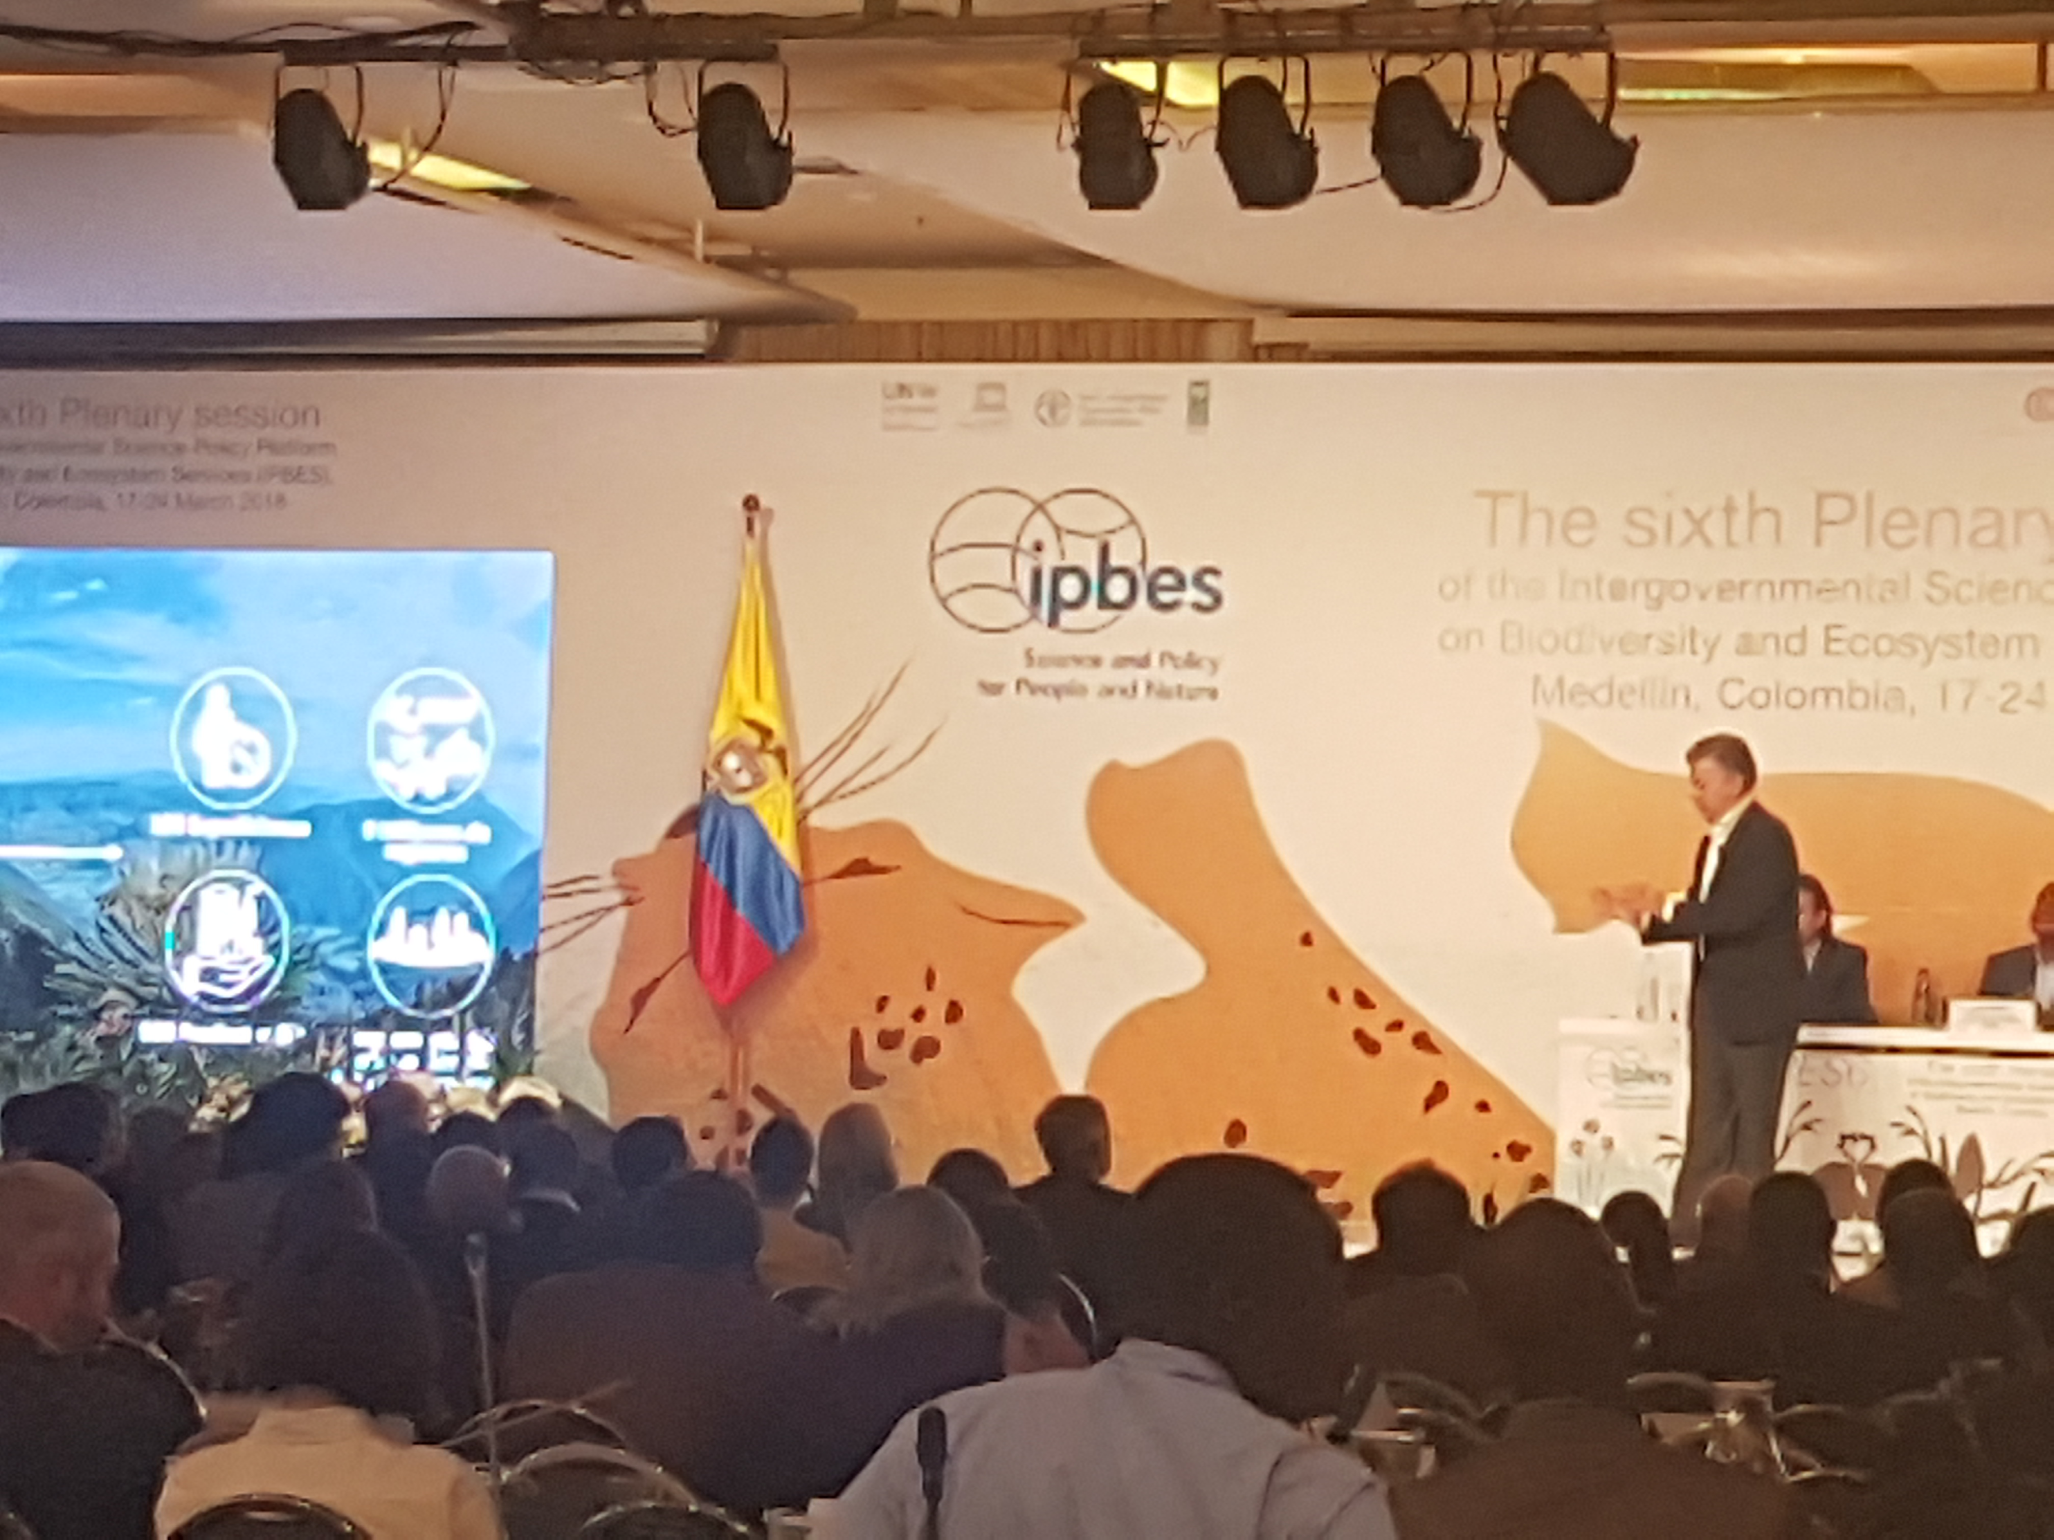
Ipbes-6 PLENARY MEETING, MEDELLÍn, colombia 17-24 march 2018
Official opening by Colombian President Juan Manuel Santos highlighted ‘Colombia Bio’ programme involving GBIF node SiB-Colombia and dept of science, technology and innovation (Colciencias)
https://www.sibcolombia.net/proyectos/colombiabio/

Slide 7
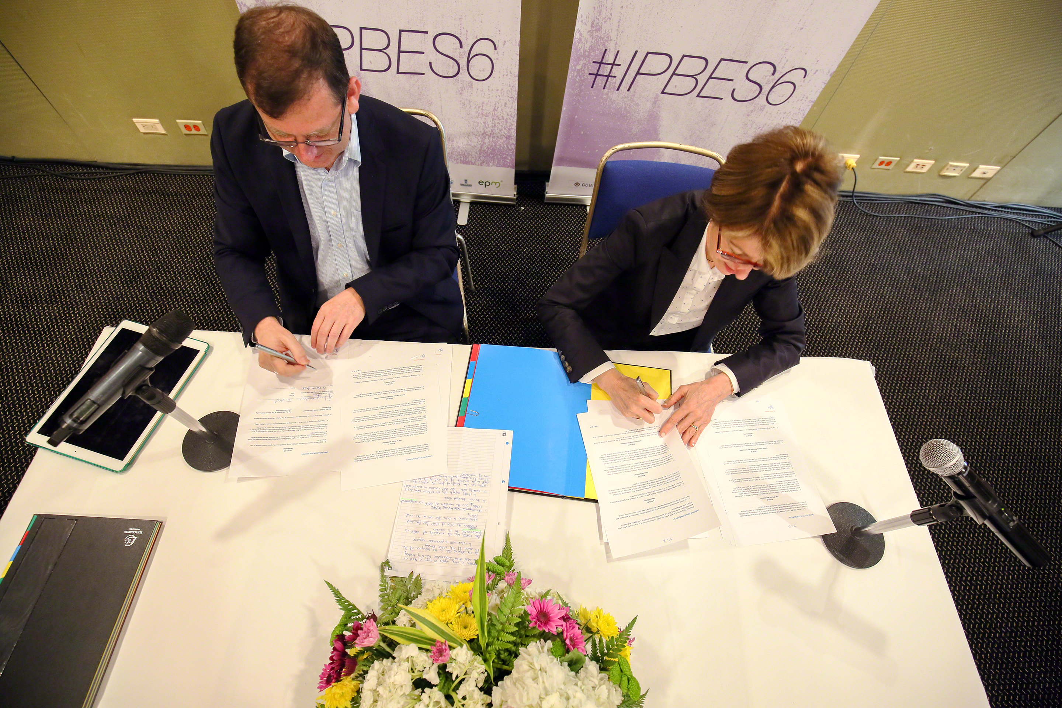
IPBES-GBIF Mou
Helping IPBES to identify and access datasets relevant to assessments, indicators
Using knowledge gaps identified through IPBES to prioritise data mobilization through GBIF nodes and publishers
Coordinating capacity building to support data mobilization & access relevant to IPBES
Encouraging collaboration between GBIF nodes and IPBES national focal points
https://www.gbif.org/news/2ggIFqrxre4im4oSMeMmA2/gbif-formalizes-collaboration-with-biodiversity-assessment-platform https://youtu.be/eUFbO6slHv4

Slide 8
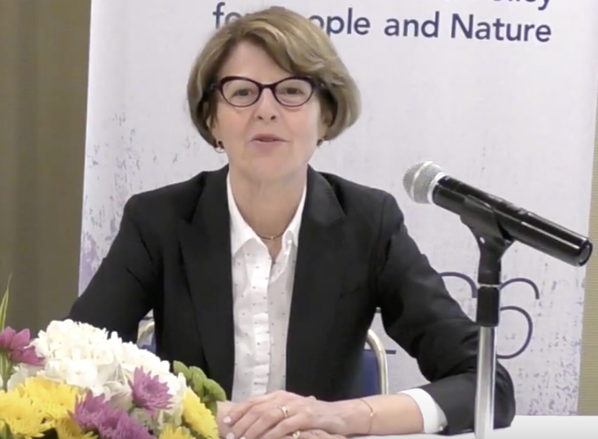
Ipbes-GBIF mou
“IPBES shares the vision of GBIF for free and open access to biodiversity data for use in research and policy, and IPBES also sees the mandate of GBIF as very complementary to its own. IPBES relies on analysis of published literature which itself relies on robust datasets – and this is where GBIF kicks in.”
– Anne Larigauderie, Executive Secretary, IPBES
https://www.gbif.org/news/2ggIFqrxre4im4oSMeMmA2/gbif-formalizes-collaboration-with-biodiversity-assessment-platform

Slide 9
Ipbes-GBIF mou
Use knowledge gaps identified by IPBES to prioritise data mobilization, e.g. :
Data gaps on insect pollinators especially Africa
Significant geographic data gaps in E. Europe, Central Asia
Process of identifying and communicating priority gaps through IPBES knowledge and data task force – can inform digitization priorities and funding programmes
https://www.gbif.org/news/2ggIFqrxre4im4oSMeMmA2/gbif-formalizes-collaboration-with-biodiversity-assessment-platform

Slide 10
Ipbes-GBIF mou
Coordinate capacity building efforts, e.g.
Contribute GBIF guidance on node-building to IPBES capacity ‘rolling plan’ for improving science-policy interface (open call, deadline 3 June)
Collaborate with UNEP-WCMC project on supporting national ecosystem assessments (starting in Cameroon, Vietnam, Ethiopia, Colombia)
Structure future GBIF calls on supporting data needs of IPBES
https://www.ipbes.net/capacity-building-project/supporting-decision-making-building-capacity-through-national-ecosystem http://www.ecosystemassessments.net/support/training-events/developing-capacity-for-undertaking-national-ecosystem-assessments-in-ipbes

Slide 11
Ipbes-GBIF mou
Encourage collaboration between GBIF nodes and IPBES national focal points:
Do you know who your IPBES focal point is? https://www.ipbes.net/national-focal-points
Establish/renew contact, using MoU as catalyst
Discuss areas of joint working, e.g. in national assessments
Guiding examples of collaboration to inform updated nodes guide

Slide 12
And finally…
External review of second-order draft of IPBES global assessment chapters, first draft of Summary for Policy Makers – opens 30 April, runs until 29 June
http://www.ipbes.net/user/login?destination=registration_global_fod
(must first register as IPBES website user)

Slide 13
GBIF Capacity Self-Assessments
Mélianie Raymond
Senior Programme Officer for Node Development
5 Apr 2018
Notes:
We developed the GBIF capacity self-assessment tools in 2015 and so many of you should now be fairly familiar with them. I’d like to use this opportunity to remind you all what these tools can be used for, and what they were not designed to be used for. ‘We will also be reviewing these tools this year – and so this presentation should serve as an invitation for feedback.

Slide 14
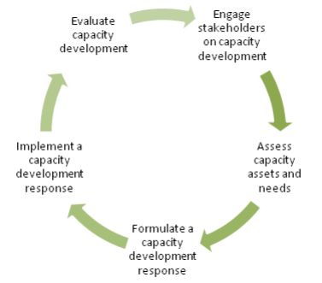
Role of capacity self-assessment
Capacity self-assessment is an integral part of a capacity development approach
UNDP capacity enhancement cycle; GBIF Capacity Enhancement Framework https://www.gbif.org/document/80954/gbif-capacity-enhancement-framework
Notes:
When we were putting together the CE framework for GBIF, we included the UNDP capacity enhancement cycle shown on this slide – which outlines a logical way to address capacity enhancement, starting by engaging with key stakeholders, the assessing the capacity assets and needs, before formulating and implementing a capacity development response, which should finally be evaluated to see whether the desired progress has been made before starting the cycle again.
The important part of this for the way our network is approaching capacity enhancement is that GBIF should aim to support capacity development actions that are demand-driven and based on solid assessments of the baseline capacity assets and needs.
From this, we then went on to consider how GBIF could develop a tool that would assist our Participants in carrying out these kinds of capacity assessment.

Slide 15
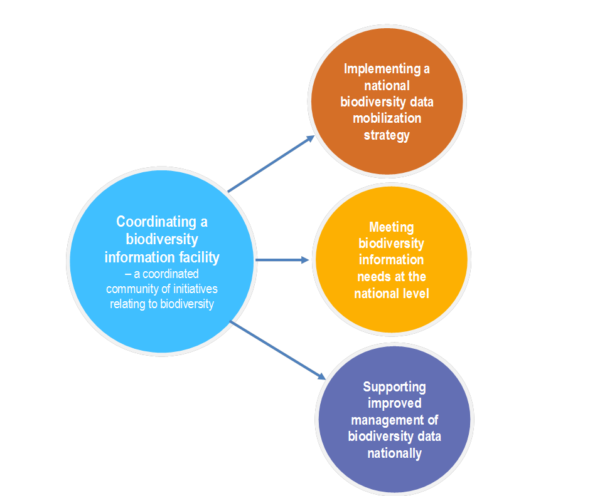
Capacity self-assessment guidelines for national biodiversity information facilities
Capacity self-assessment guidelines for national biodiversity information facilities: http://www.gbif.org/resource/82277
Notes:
We started by developing a tool for capacity self assessment for national biodiversity information facilities – or GBIF-related activities carried out in a country.
Firstly, It is important to note that this is about self-assessment – we also wanted to move away from too many reporting requirements for our Participants or nodes.
This self-assessment was built on a framework that is used in our guide to establishing an effective GBIF Participant node, and covers capacity in the four key areas of node activity that are described in the guide.
So in addition to serving as a self-assessment tool, this tool is intended to provide further details to Participants on what capacity nodes may need to consider to meet their goals in the four key areas of node activity.

Slide 16
Coordinating a National biodiversity information facility
Notes:
For each of the key areas of node activity, we have tried to sketch out paths for progress in capacity development for national biodiversity information facilities.
These should be seen as a sort of generic model – these are not instructions! Many Participants and nodes will not follow these steps in order, but for those Participants that are just getting started, this should help to give some idea of how to approach these issues.
The self-assessment tool then leads you through a series of questions to assess capacity in for each of these areas.
SO for this first key area of coordinating a national biodiversity information facility, the capacity areas are about designating a national node, ensuring that the institution that hosts the node has assumed the responsibilities for the nodes work, identifying the major stakeholders,…

Slide 17
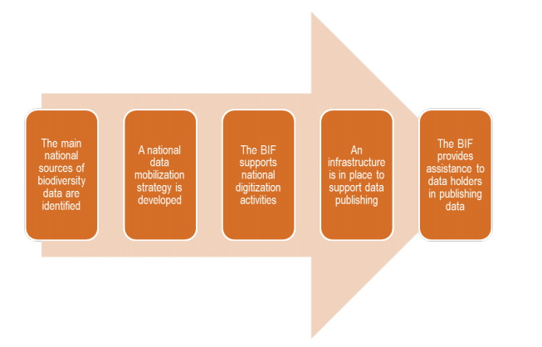
Implementing a national biodiversity data mobilization plan
Notes:
The second area is about capacity required to implement a national biodiversity data mobilization plan.

Slide 18
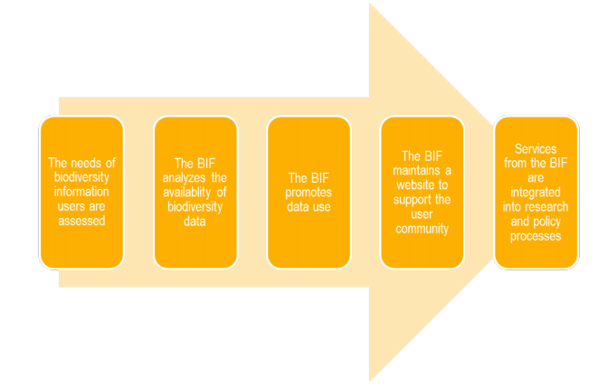
Meeting biodiversity information needs at the national level
Notes:
The third is on meeting biodiversity information needs on the national level. This is an area that we have recognized as very important – but in which we have been lacking training materials and resources.
This year – starting with a workshop in Cape Town next week – we will be developing many new training resources for nodes in this area that we will be sharing with you this year.

Slide 19
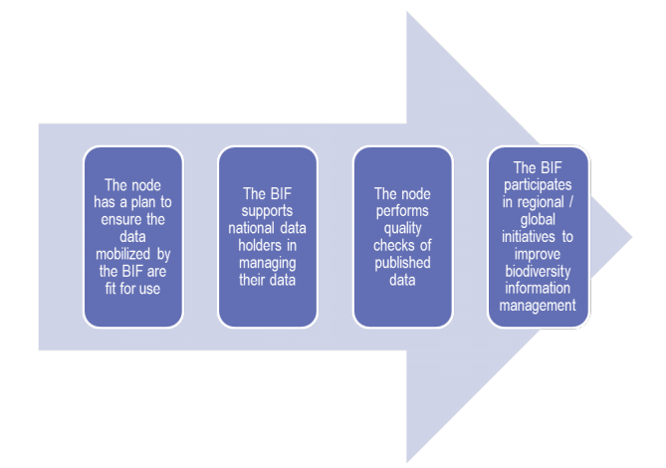
Supporting improved management of biodiversity data nationally
Notes:
The final section is about supporting improved management of biodiversity data nationally. This area includes the work at the national level to ensure data quality – and is also an area that is changing rapidly – for example with new tools available such as the GBIF data validator.

Slide 20
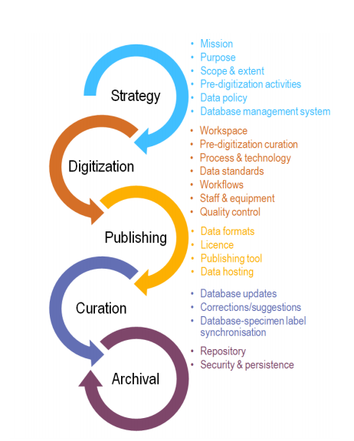
Self-assessment guidelines for data holding institutions
Self-assessment guidelines for data holding institutions: http://www.gbif.org/resource/82785
Notes:
Strategy: Planning how to execute the data mobilization. Key considerations include the purpose for mobilization; prioritization of what materials to digitize; labour/expertise; equipment; data standards; choice of database system; and intellectual property rights and licensing issues.
Digitization: Conversion and capture of data associated with physical specimens and artefacts into electronic formats and databases. This process may involve imaging.
Publishing: Making digital data (including associated images and multimedia) publicly available online, whether through dedicated institutional and community websites or major Internet repositories.
Curation and Maintenance: Ongoing performance of tasks including cleaning, correcting and updating data, in part based on feedback.
Preservation and Archiving: Long-term conservation of digital content and databases to ensure its integrity and persistence.

Slide 21
What Capacity self-assessment Is not
Not another reporting requirement for all nodes
Not designed for comparisons between nodes or institutions

Slide 22
Capacity self-assessment uses
Tool for planning with links to further material
Questionnaire based approach with scoring to make it easier
Useful in project design and monitoring and evaluation

Slide 23
Capacity self-Assessment Recommendations
Use a participatory approach – include the team’s views
Results can be shared with partners, region, GBIF Secretariat…
Notes:
Engage stakeholders in the needs assessment and action planning

Slide 24
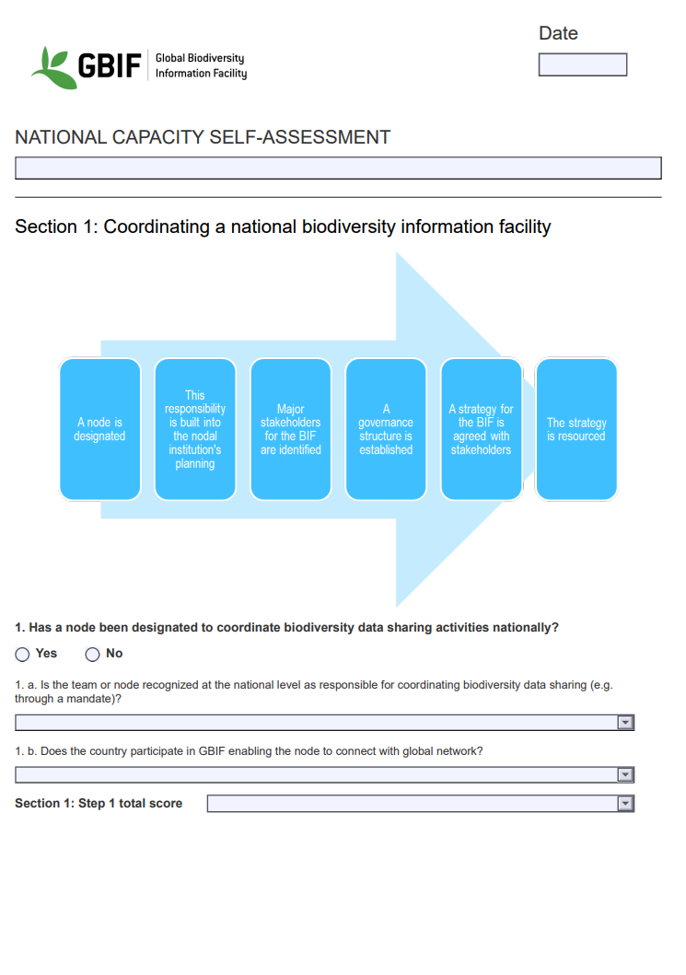
2018 review of GBIF self-assessments
Feedback please!
How have you used the self-assessments?
How can we improve the format?
Any areas missing?
Help with translations
- French and English versions currently…
Feedback to mraymond@gbif.org

Slide 25
GBIF Capacity Self-Assessments
Mélianie Raymond
Senior Programme Officer for Node Development
5 Apr 2018

Slide 26
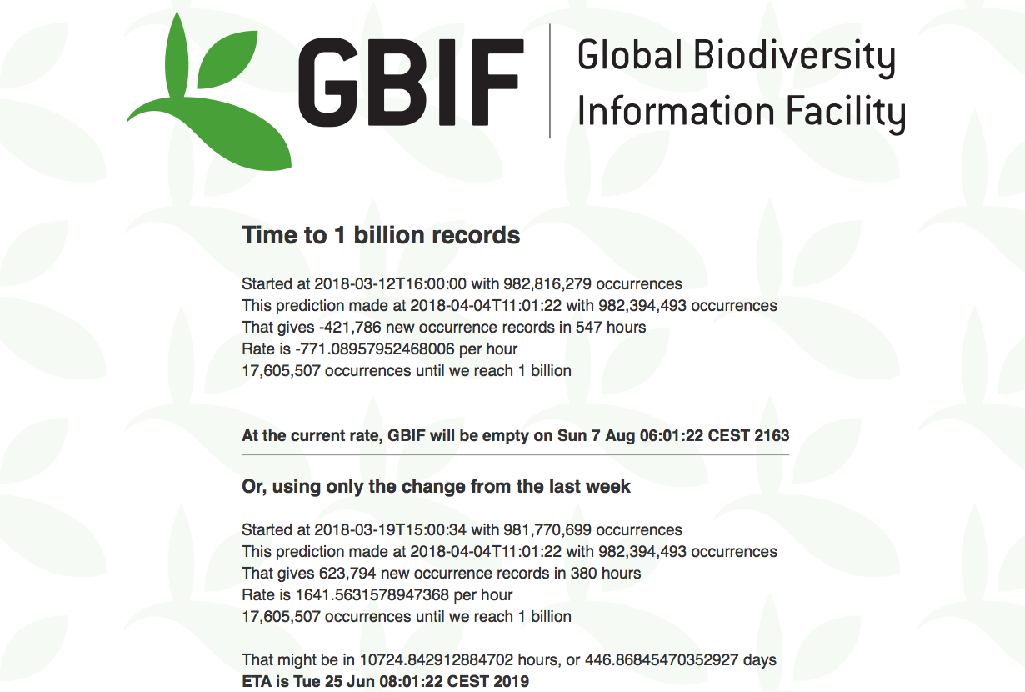
#GBIF1billion update
Santo Domingo curlytail lizard (Leiocephalus lunatus subsp. lunatus), Distrito Nacional, Dominican Republic, 31 Jan 2018. Photo BY-NC-SA 3.0 by Justin. From Museum of Comparative Zoology, Harvard University https://www.gbif.org/occurrence/1807806467
March 2018

Slide 27
BY THE NUMBERS 4 Apr 2018
Species occurrence records
Datasets
982,398,010
38,737
Country Participants
Organizational Participants
Publishers
54
36
1,163
Average records downloaded per month (2018)
Avg monthly user sessions (2018)
127.6 billion
168,401
Notes:
Useful to see GBIF in its different modalities:
A window on biodiversity
An informatics infrastructure focuseD on tools and standards in service to science and society
A global network on bioinformatics

Slide 28
#GBIF1billion Toolkit for network communications a work-in-progress
5 April 2018

Slide 29
Photo gallery
bit.ly/gbif1billion-photos
Collection of 44 photos across a wide range of taxa
All photos licensed for reuse and drawn from occurrences on GBIF.org
Accompanying Excel sheet contains ready-to-use attribution lines in both plain text and HTML

Slide 30
Social media calendar
bit.ly/gbif1billion-social
Set of ready-made messages for Twitter and Facebook
Add ‘the day of’, schedule ahead or just share @GBIF feeds
Additions and suggestions welcome!

Slide 31
Draft news article
1-2 more cycles of revision
Ready for translations in six UN languages + Portuguese by 16 April
Volunteer translators contact communication@gbif.org to receive final version
Target date for translations: 1 week after distribution
Talking points to follow after

Slide 32
Infographics
Working with Copenhagen-based designers, Units.io
Initial design concepts presented in next meeting— tomorrow, 6 April
Narrative content focuses on GBIF as the sum of all its parts—the network, people, data inputs and processing, research outputs and contributions
Five global infographics planned, along with streamlined country reports
Target dates: 23 April

Slide 33
Support stories Matrix
Story | Scale | Status
Living Atlases community | Global | In progress
Crediting data use: DOI-based citation tracking | Global | In progress
GBIC2: Global-scale planning for biodiversity informatics | Global | In progress
BID mentors | Africa | In progress
Southern Africa Bird Atlas | Africa | Not started
Post-Fukushima wildlife monitoring | Asia | Not started
TBD | Asia | Not started
‘Dark taxa’ fungi: combining Linnaean taxonomy with DNA barcodes | Europe | In progress
Filling data gaps in Russia | Europe | In progress
Biodiversity for reconciliation: Proyecto Colombia BIO | LAC | In progress
Tracking lionfish invasion in Barbados | LAC | Tentative
BioMob: Digitization of Canadian collections | North America | In progress
TBD | North America | Not started
Alien & invasive species data mobilization in the Pacific | Oceania | In progress
Opening EIA data from the mining industry in Western Australia | Oceania | Tentative

Slide 34
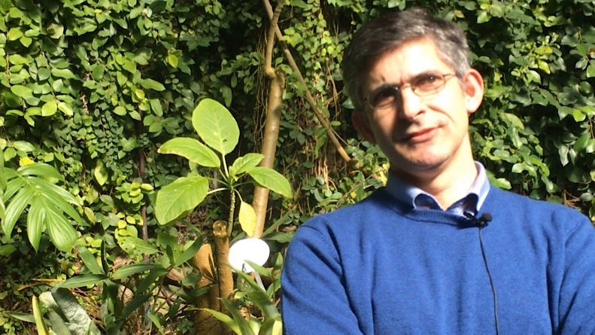
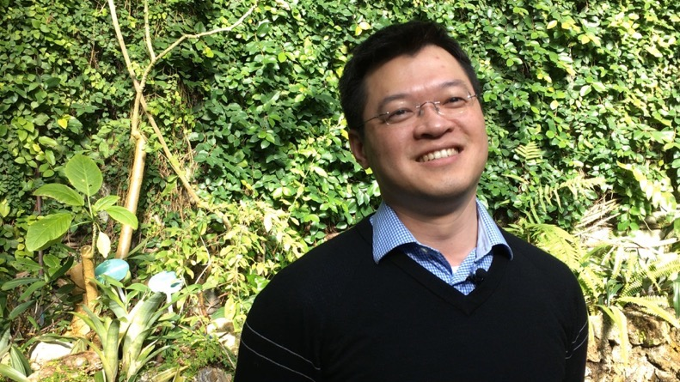
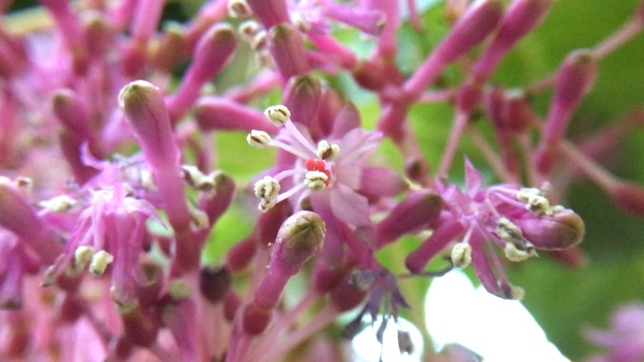
Support stories Video
Shot footage for two videos to vary the content for the campaign
Living Atlases workshop in Madrid

Slide 35
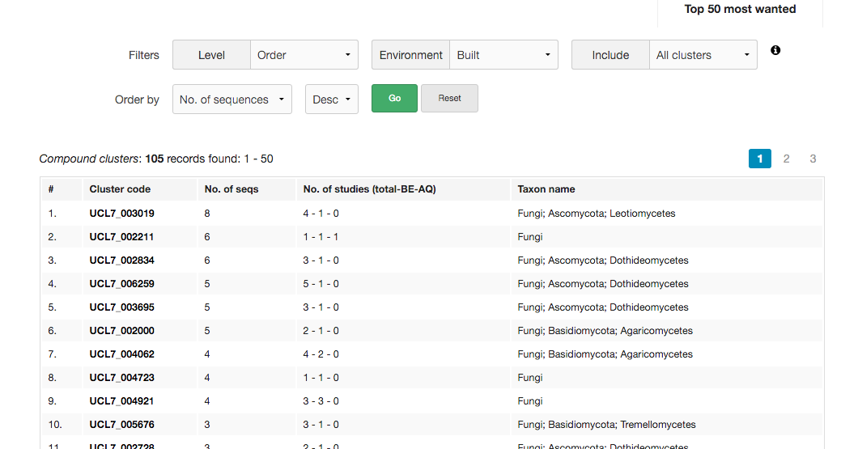
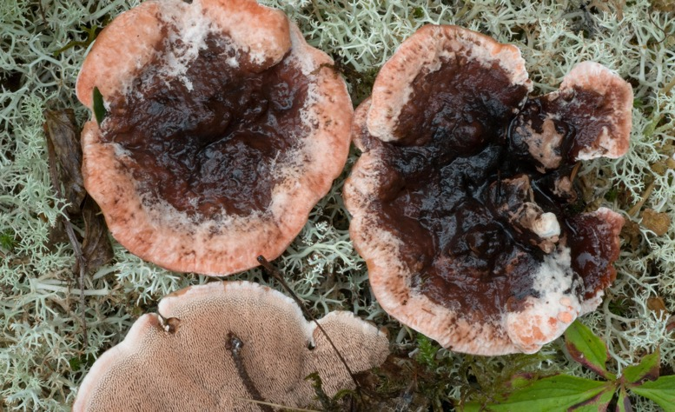
Support stories Video
Shot footage for two videos to vary the content for the campaign
Living Atlases workshop in Madrid
‘Dark taxa’ fungi: combining Linnaean taxonomy with DNA barcode ‘species hypotheses’

Slide 36
#GBIF1billion Schedule
Pace of data mobilization in 2017
Records added: 261 million
eBird update: 85 million
Monthly average without eBird: 14 million
Pace of data mobilization in 2018
Records added (Jan-Mar): 17 million
Current estimate date: mid-May?
Target dates
16 April All support stories underway
20 April Final press release, in translation
23 April Infographics complete
26 April Videos complete
4 May 1st seven support stories complete
31 May All support stories complete

Slide 37
#GBIF1billion What you can do
Volunteer to translate press release
Suggest / assist with pitching journalists
Contribute to social media calendar
Coordinate / schedule outreach with your local communications staff
Monitor progress at GBIF homepage and labs.gbif.org/~mblissett/billion.html
Email communication@gbif.org

Slide 38
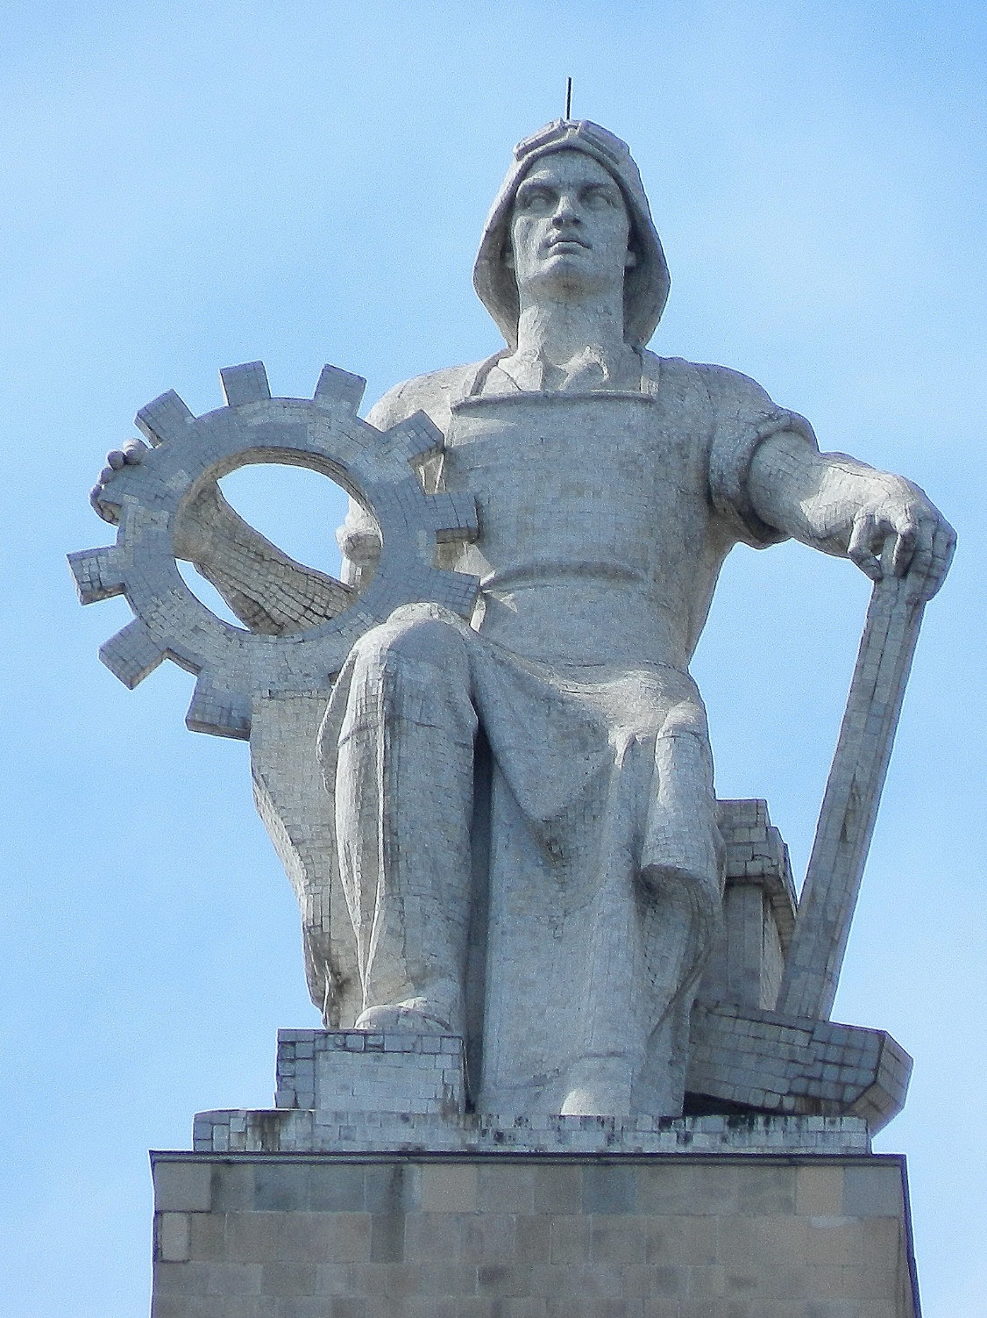
Dmitry Schigel GBIF Scientific Officer
Outreach in the former Soviet Union
GBIF webinar 6 April 2018
Moscow State University, sculpture Photo by C K Leung https://www.flickr.com/photos/leungck/29561866670

Slide 39
Outline
Data activities in Russia: history and data growth
GBIF.ru: the nucleus of regional coordination
Additional contribution from Finland: two GBIF grants in the European part of Russia
Digitization and publication in Moscow, May 2018
Moscow University: the Depositarium project
Saint Petersburg: the giant collections
Data conference in Siberia, Sep 2018
SIU grant to ForBio / GBIF Norway, 2018-2021: Tajikistan, Belarus, Ukraine and Armenia
Map of GBIF activity in former USSR, participation needs

Slide 40
Data activities in Russia History and data growth
16 publishers, 35 datasets: 1,345,888 of 2,731,156 = 49%
Yearly events since 2014: Moscow, St.Petersburg, Apatity
Steady growth of interest, N publishers, and data
IPT and documents in Russian
Low and patchy funding
Slowly towards participation
Skills and benefits
https://www.gbif.org/country/RU/publishing

Slide 41
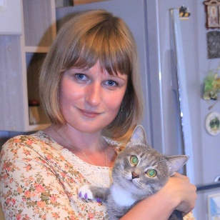
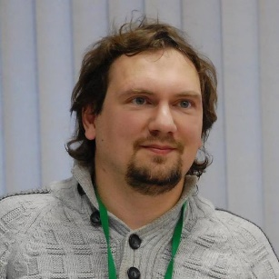
GBIF.RU The nucleus of regional coordination
Natalya Ivanova Maxim Shashkov
Information, coordination, training, data hosting, IPT accounts and helpdesk, network growth, mailing list
All you need to know about GBIF—in Russian

Slide 42
Additional contribution from Finland Two GBIF grants in the European part of Russia
Governing Board 24, Helsinki, 2017
Finland announced additional contribution of €30K to stimulate data mobilization west of Ural mountains
Two grants coordinated by GBIF Secretariat
GBIF.ru – training workshop, content growth, expansion of network: +20 publishers in 2018
Depositarium – bird and mammal data from Moscow University
Deliverables by 1 October 2018 -> report at GB25
Cross-border data interests -> cross-border funding
New Finnish-Russian project on alien & invasive species

Slide 43
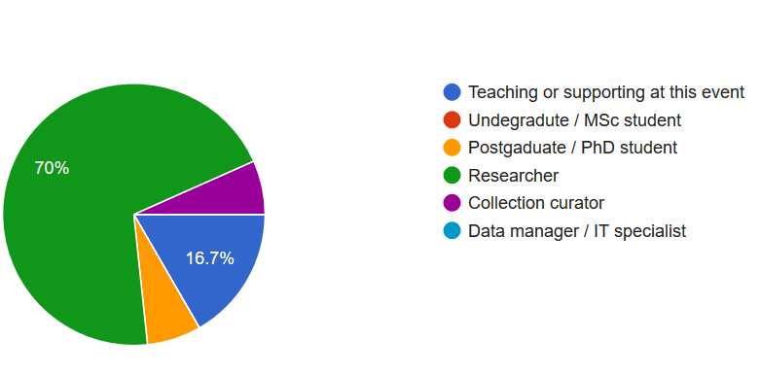
Digitization & publication Moscow, May 2018
15-17 May, Moscow
Data capture, wet collections, and IPT
Sophie Pamerlon
Larissa Smirnova
Susan Matland
Natalya Ivanova
Maxim Shashkov
Nina Filippova
N=31

Slide 44
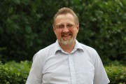
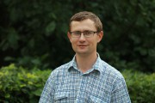
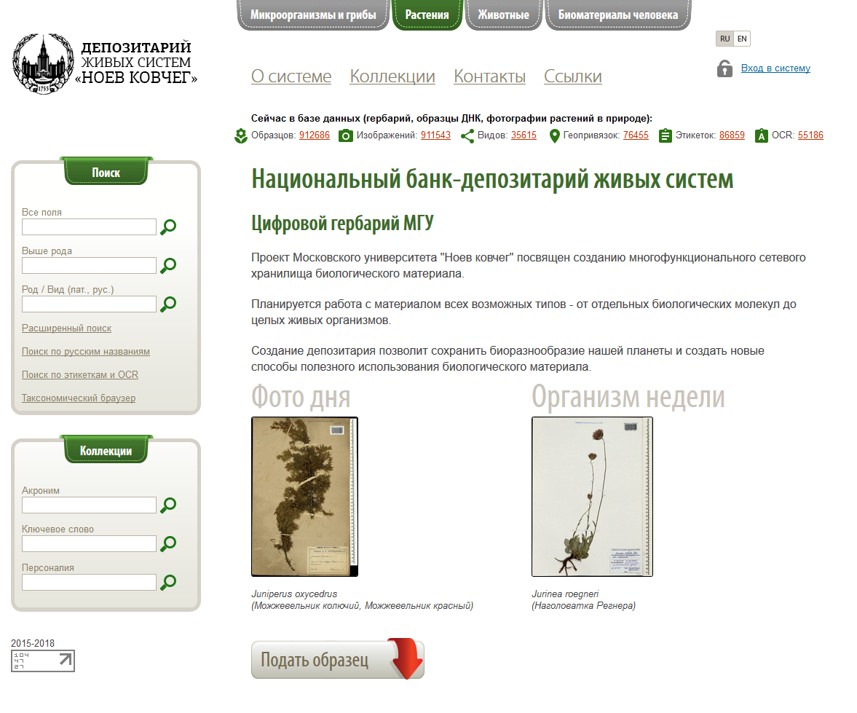
Moscow University The Depositarium Project
Mikhail Kalyakin Alexey Seregin
Moscow University: the II oldest GBIF publisher in Russia
”Speed” approach, coverage -> DQ improvement
4 datasets with over 1M records, mainly plants
Birds and mammals coming, co-€ by GBIF Finland

Slide 45
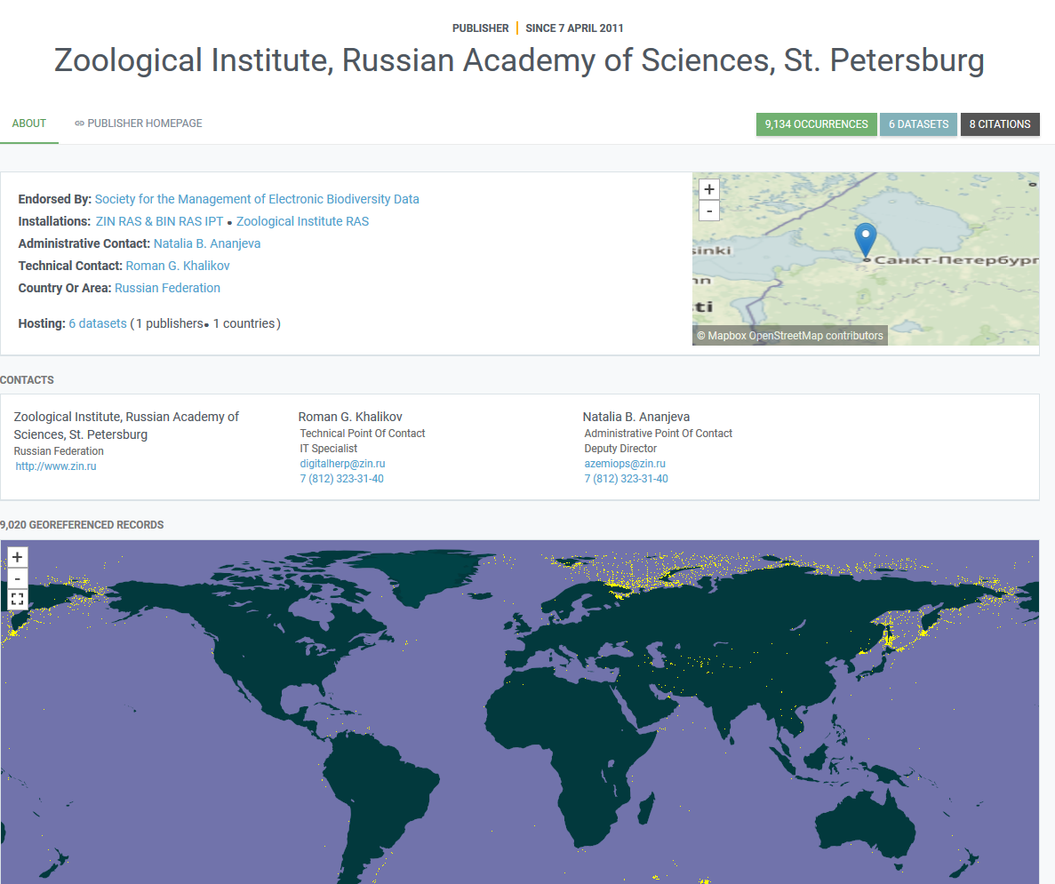
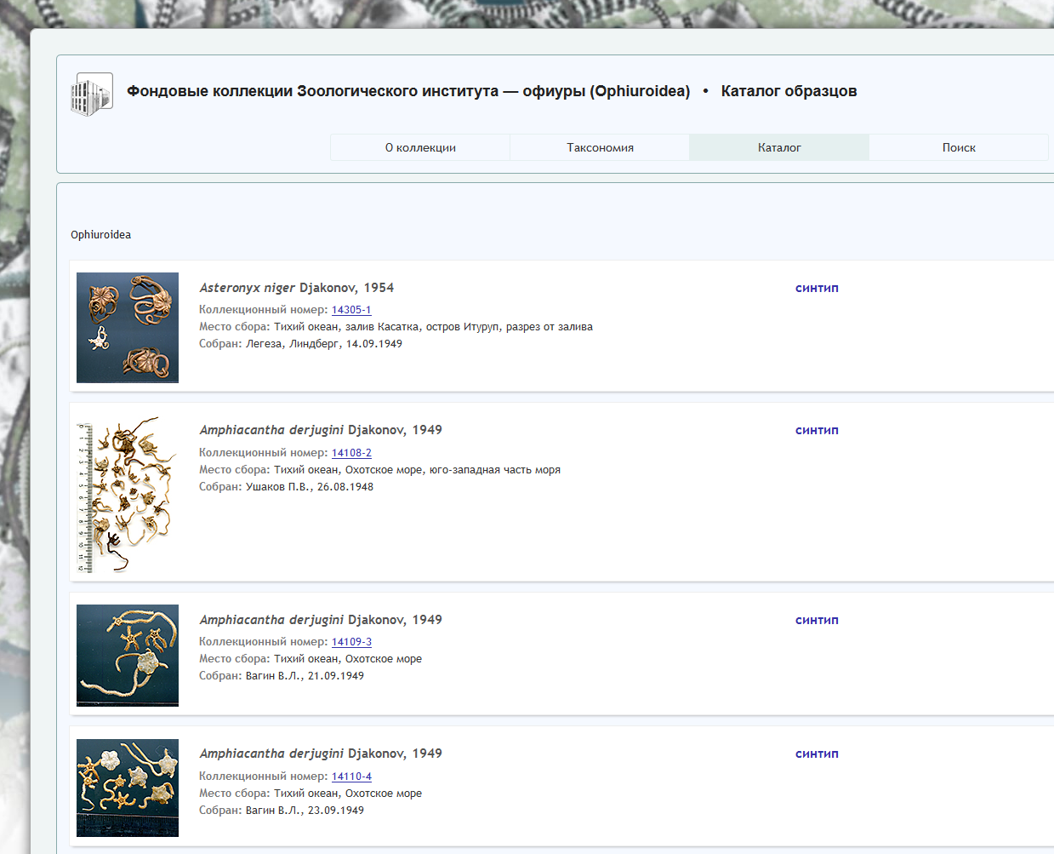
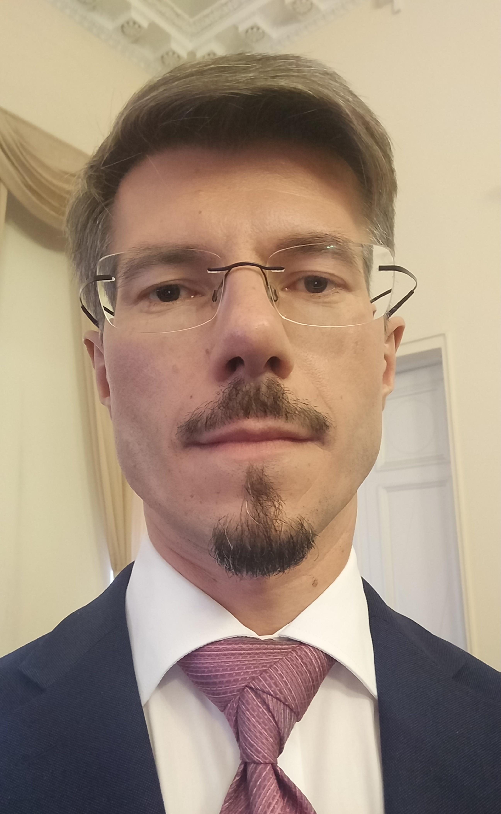
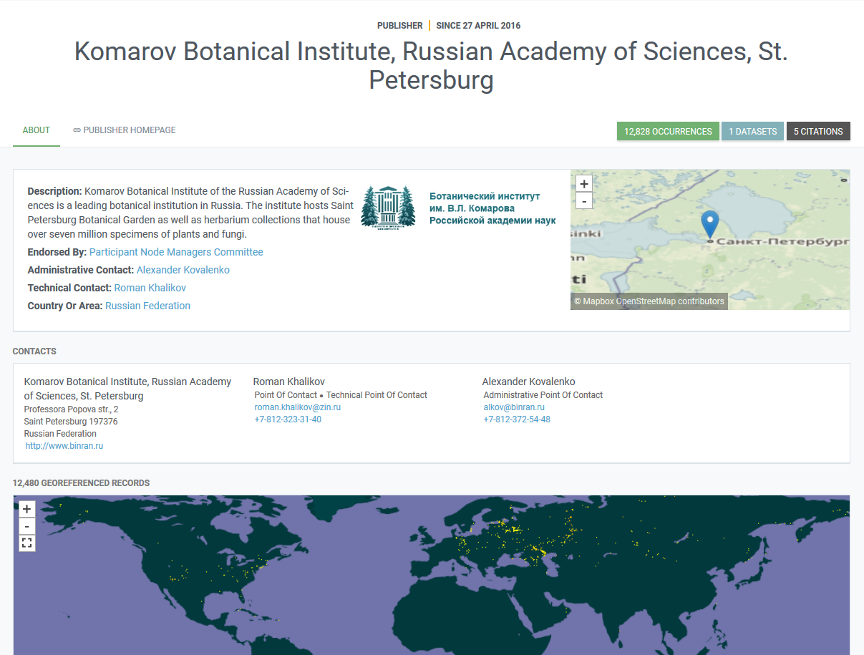
Saint Petersburg The Giant Collections
Roman Khalikov
ZIN RAS – the oldest GBIF publisher in Russia
”Perfectionist” approach: 6 datasets, 9,134 records, excellent metadata, images
BIN RAS – new to GBIF, 12,828 myxomycetes, via GBIF Germany
Data consortium, two institutions
68M zoological, botanical and mycological specimens
https://www.binran.ru/files/seminar/BIN_Seminar_21_03_2018_Khalikov_Presentation.pdf (in Russian)

Slide 46
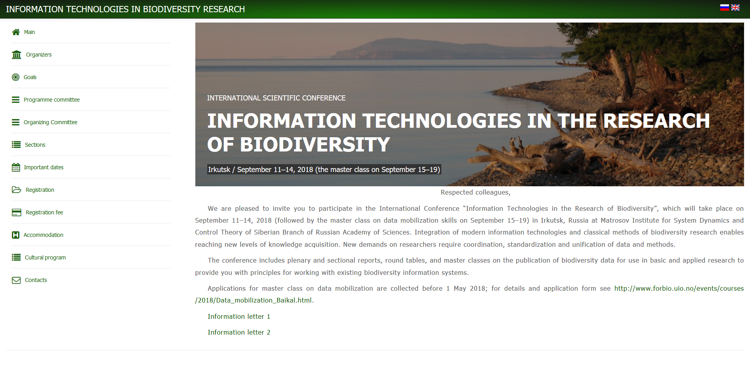
Data conference in Siberia 11–14 Sep 2018
Major data event in Siberia in Russian and English
200 expected, international attendance encouraged
Registration by 1 May 2018
Data publishing and barcoding workshop, 15–19 Sep, by Lake Baikal

Slide 47
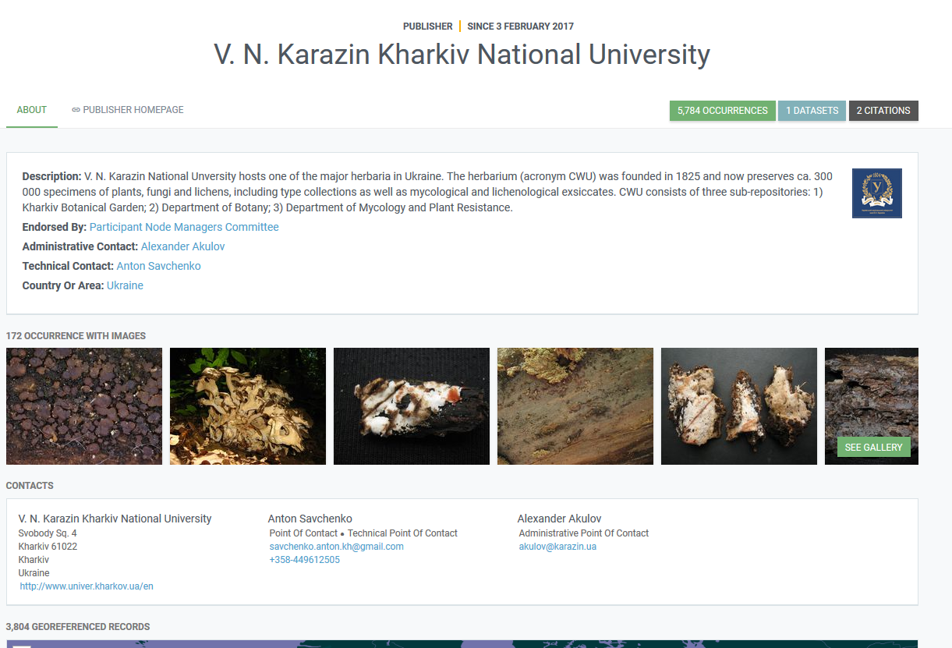
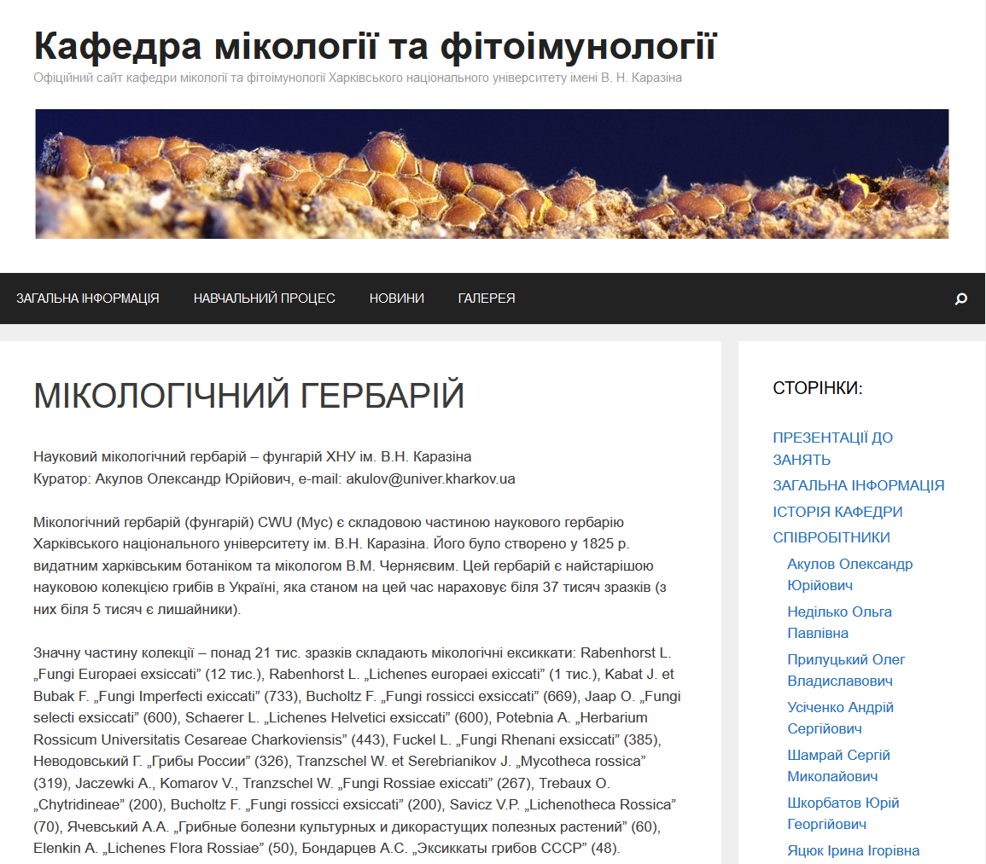
Data publishing in Ukraine
Anton Savchenko
3 publishers
11 datasets
52,836 of 319,509 records
Support from GBIF Estonia: IPT PlutoF Biodiversity
https://www.gbif.org/country/UA/publishing

Slide 48
SIU grant 2018–2021, ForBio / GBIF Norway Tajikistan, Belarus, Ukraine, Armenia
A major project funded by SIU and coordinated by Norway
Links between data work, research and higher education
6 events over three years start in 2018: Minsk, Dushanbe, Yerevan and Oslo are waiting
Data capture and data publishing
Three regional data hubs: slavic republics, Central Asia, and Caucasus
West – East (North – South?) transfer of skills and tools
Data mobilization: major data gaps, areas of high endemism
GBIF participation hopes + IPBES + CBD delegations

Slide 49
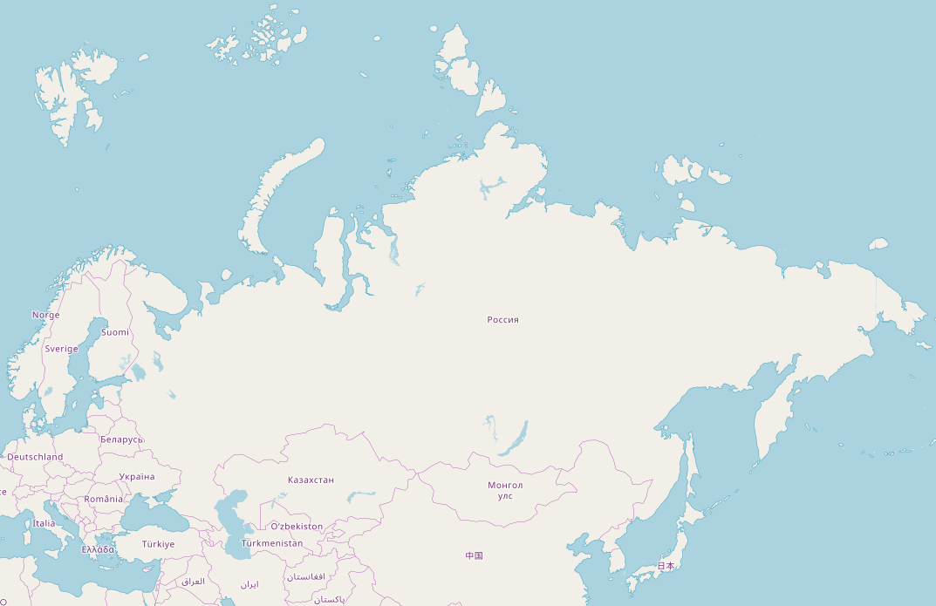
GBIF activity in the former USSR Participation, collaboration, data publishers / datasets
See you in Siberia, by the lake Baikal?
16/35**
GBIF.no*
GBIF.fi**
0/0
5/13
0/0
0/0*
!
3/11*
0/0
0/0
0/0
0/0
1/2
0/0*
0/0*
0/0
0/0
www.openstreetmap.org

Slide 50
Wrap-up
Tim Hirsch, Deputy Director
Gbif community webinar, 5th april 2018

