Slide 1
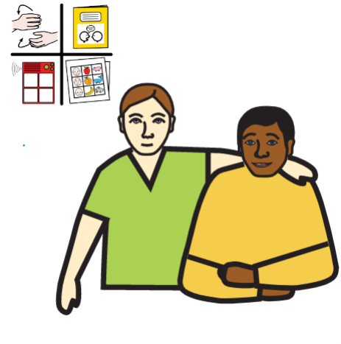
Communication using Symbols – A Carer’s Training Pack
Global Symbols CIC
https://globalsymbols.com/

Slide 2

Overview
This 5 step guide is about using images and symbols to help with communication when speaking and understanding may be difficult.
It is a short introduction to visual aids and their use in caring situations, designed for those supporting adults when conversations are hard, due to challenging settings, physical, sensory and/or cognitive difficulties.
Study Times
The training is divided into topics. Each topic will take around 30 minutes to complete, with discussion times highlighted by the symbol of a tutor and student.
Objectives
Gain a basic understanding about communication and active listening to build conversations
Make use of free images and symbols with labels, phrases and sentences to support communication in different settings
Encourage conversations to support well being.

Slide 3
Contents
The five topics can be dipped into at any stage and need no prior knowledge.
They include:
How we communicate
Managing conversations
Finding the right words and images
Adapting images and symbols for each individual
Creating opportunities to encourage conversations.
There are some activities, case studies and examples of communication boards and information charts with most steps.

Slide 4
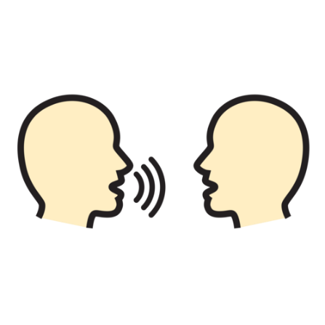
1. How we communicate…
Sender wants to share information
Sender chooses a way to send the message – the channel used
Sender converts thoughts into a message
Receiver wants to send feedback
Receiver converts thoughts into a message
Message is interpreted
Receiver chooses a way to send the message – the channel used
Message is interpreted

Slide 5

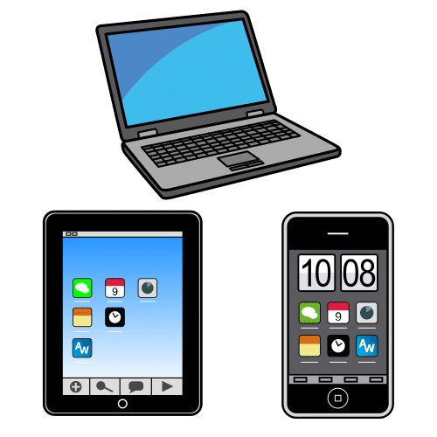

Explanation about Communication
Communication happens when we send and receive messages using different channels.
The channels may be face to face, writing or involve the use of technology.
We need to be able to create and understand messages and find the best way to tell or express our thoughts, needs and emotions.

Slide 6
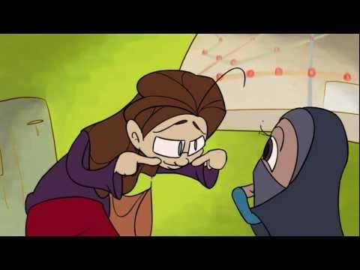
Message breakdown
There are several reasons communication or the messages we send and receive fail. Have a look at this video and think about the ways the conversation failed at times. https://youtu.be/8Ox5LhIJSBE

Slide 7
Barriers to Communication
Barriers to communication
Situation due to noise, distance and the way a message is sent or when you cannot understand what is being said e.g. messages are muffled - everyone is wearing personal protective equipment or masks or the technology used is not available or breaks down so the message is lost.
Physical because of a functional difficulty such as moving the mouth, palate, tongue, vocal chords or breathing in a coordinated way or ability to show facial expressions. Even a lack of gestures can make communication harder at times.
Sensory due to deafness, a hearing impairment or lack of feeling around the face or other parts of the body that are needed for communication.
Cognitive due to intellectual ability, brain damage, psychological, emotional or memory difficulties or limited knowledge or understanding of the language spoken or written
Notes:
Situation due to noise, distance and the way a message is sent or when you cannot understand what is being said e.g. messages are muffled - everyone is wearing personal protective equipment or masks or the technology used is not available or breaks down so the message is lost.
Physical because of a functional difficulty such as moving the mouth, palate, tongue, vocal chords or breathing in a coordinated way or ability to show facial expressions. Even a lack of gestures can make communication harder at times.
Sensory due to deafness, a hearing impairment or lack of feeling around the face or other parts of the body that are needed for communication.
Cognitive due to intellectual ability, brain damage, psychological, emotional or memory difficulties or limited knowledge or understanding of the language spoken or written

Slide 8

Other ways we can communicate…
Can you think of more ways we might communicate with people to overcome these difficulties?
Make a short list of some examples

Slide 9
Sending messages in several ways
Let’s discuss more ways we can send a message that might be better understood.
gestures
signing
eye contact
facial expression
touch
body movement
posture
sounds
space
drawing
writing
symbols
pictures
photographs
emojis
objects
technology

Slide 10
Is it possible to communicate these messages without speaking?
Find someone to chat with and use a different form of communication for each of these messages…
  Gesture - I fell off my bicycle and hurt my knee.
  Drawing - I need to walk home now.
  Facial Expression - I am tired and want to go to sleep.
  Emojis on a phone - I do not like being cold.

Slide 11
How did it go?
Did you find you might have given clues by mixing different ways of communicating?
Were you more comfortable using certain types of communication to get your message across?
Did the person who was your ‘communication partner’ have to ask for any help to understand the sentences?

Slide 12

2. Managing Conversations
When you are talking to someone, how do you find out the things you want to know?
Do you know how to really listen carefully?
Do you think they felt that you had understood them?
How did you know they had really understood you?
Have you thought how culture, language and any personal issues might affect the conversation?
Notes:
THE CARE CERTIFICATE WORKBOOK Standard 6
https://www.skillsforcare.org.uk/Documents/Learning-and-development/Care-Certificate/Standard-6.pdf

Slide 13
Communication in difficult times…
Conversations may be:
short, because of an instant need such as an emergency (pain, hygiene, discomfort, anxiety or other emotions) and can also be confusing.
linked to functional requirements, such as the toilet, but may need more supporting to understand real need.
about something that has to be explained in more detail. Need more time and pauses to find out more.
about instructions that can be helped with visual aids using images, written words or phrases alongside all the other interactions we have discussed.
Notes:
Ten Hoorn, S., Elbers, P.W., Girbes, A.R. and Tuinman, P.R., 2016. Communicating with conscious and mechanically ventilated critically ill patients: a systematic review. Critical Care, 20(1), pp.1-14.
https://ccforum.biomedcentral.com/articles/10.1186/s13054-016-1483-2

Slide 14
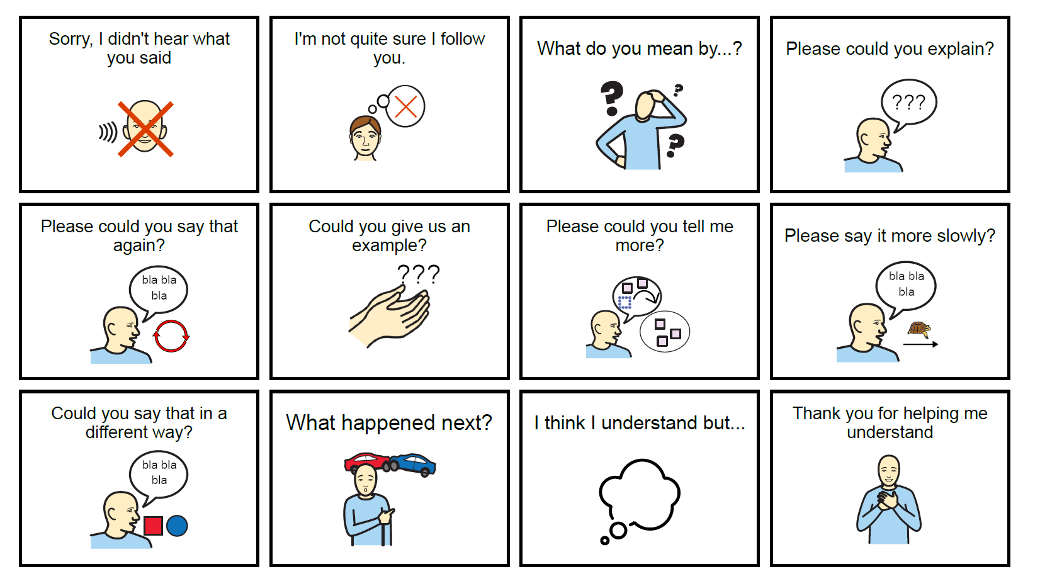
Clarifying Communication with images

Slide 15
Guide to Clarification
It is better to say if you are unsure about what has been said.
You may need to ask the speaker to repeat a part of what they have said, so start to say their message and pause to see if they clarify.
Ask if you really heard what was said correctly if you cannot prompt them.
Can they give you an example of the situation or item required etc?
Try to use an open question that means the speaker has to say more than a Yes/No answer

Slide 16


Impact of not being listened to…
Think of an occasion when you told someone something important, but felt that you were not listened to…
What made you think you were not being understood?
How did it make you feel?
Notes:
https://www.nursingtimes.net/clinical-archive/assessment-skills/communication-5-effective-listening-and-observation-skills-12-03-2018/

Slide 17
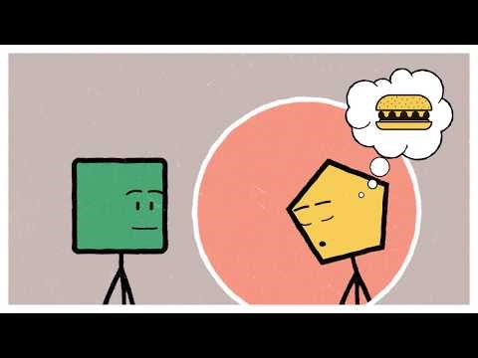
Confirm your thoughts
Watch this short video to see what else you can do to be an active listener.
https://youtu.be/0nmJW_zExk0

Slide 18
3. Finding the right words and images
There are many words that you will know you need to use every day when working with clients.
These words and ones that are complex may be the most important words that need images to help understanding.
The images can be drawings, symbols, icons, signs or photos.
They may represent a phrase or a single word, such as an action, object, person, expression or feeling.
Not every word has to be linked to a symbol in an information sheet. It is the main concept or idea that is important.

Slide 19
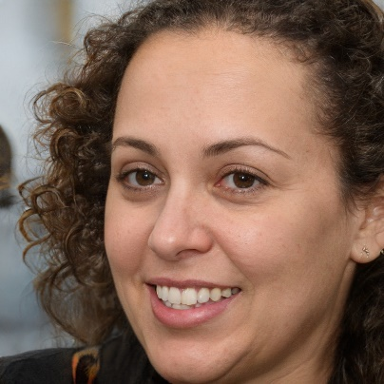
How could you help Amara?
Background
Amara works long hours in A&E and has taken on more duties during the pandemic. She loves dancing Zumba and Salsa with a wide circle of friends if she has time off. Family breaks are also important, cooking and sharing dishes from her homeland, as well as getting out into the countryside. She is a chatty person, full of fun and keen to make the most of life.
Despite PPE and taking care, one day she tested positive for COVID-19. She became anxious, could not sleep with respiratory difficulties worsening over four days. She was admitted to ICU on becoming delirious and had mechanical ventilation. Her involuntary movements caused concern and she appeared to be unable to understand or speak. After 3 weeks medication and management of breathlessness, she began to respond to treatment with good eye contact and improving voluntary movements, but speech remained difficult.
Amara
Nurse
Personal Data
AGE: 30
ADDRESS: University Hospital, Hampton Cross, Birmingham
JOB: Accident and Emergency Nurse
HOBBIES: Dancing, socialising, cooking with friends and family.
Notes:
Imagined by a GAN (generative adversarial network)
StyleGAN2 (Dec 2019) - Karras et al. and Nvidia
Don't panic. Learn how it works [1] [2] [3]
Code for training your own [original] [simple] [light]
Art • Cats • Horses • Chemicals • Contact me
Another

Slide 20
Communication Strategy for Amara
Use of gestures in particular thumbs up or down, nodding etc.
Initially use larger pictures or symbols to help understanding.
Make sure instructions and requests are simple, repeated if necessary. Pause to check for understanding.
Progress to communication boards with choices, if Amara still cannot write. Allow for pointing and indicate yourself what you mean when you want Amara to make choices.
Gather more symbol topic boards, rather than an alphabet board, in the early days. Encourage conversation, but be aware that Amara may tire quickly
Try pauses. Allow time for spoken replies as speech returns
Offer clear explanations for complex subjects, even asking questions in a different way, remembering Amara is a nurse.

Slide 21
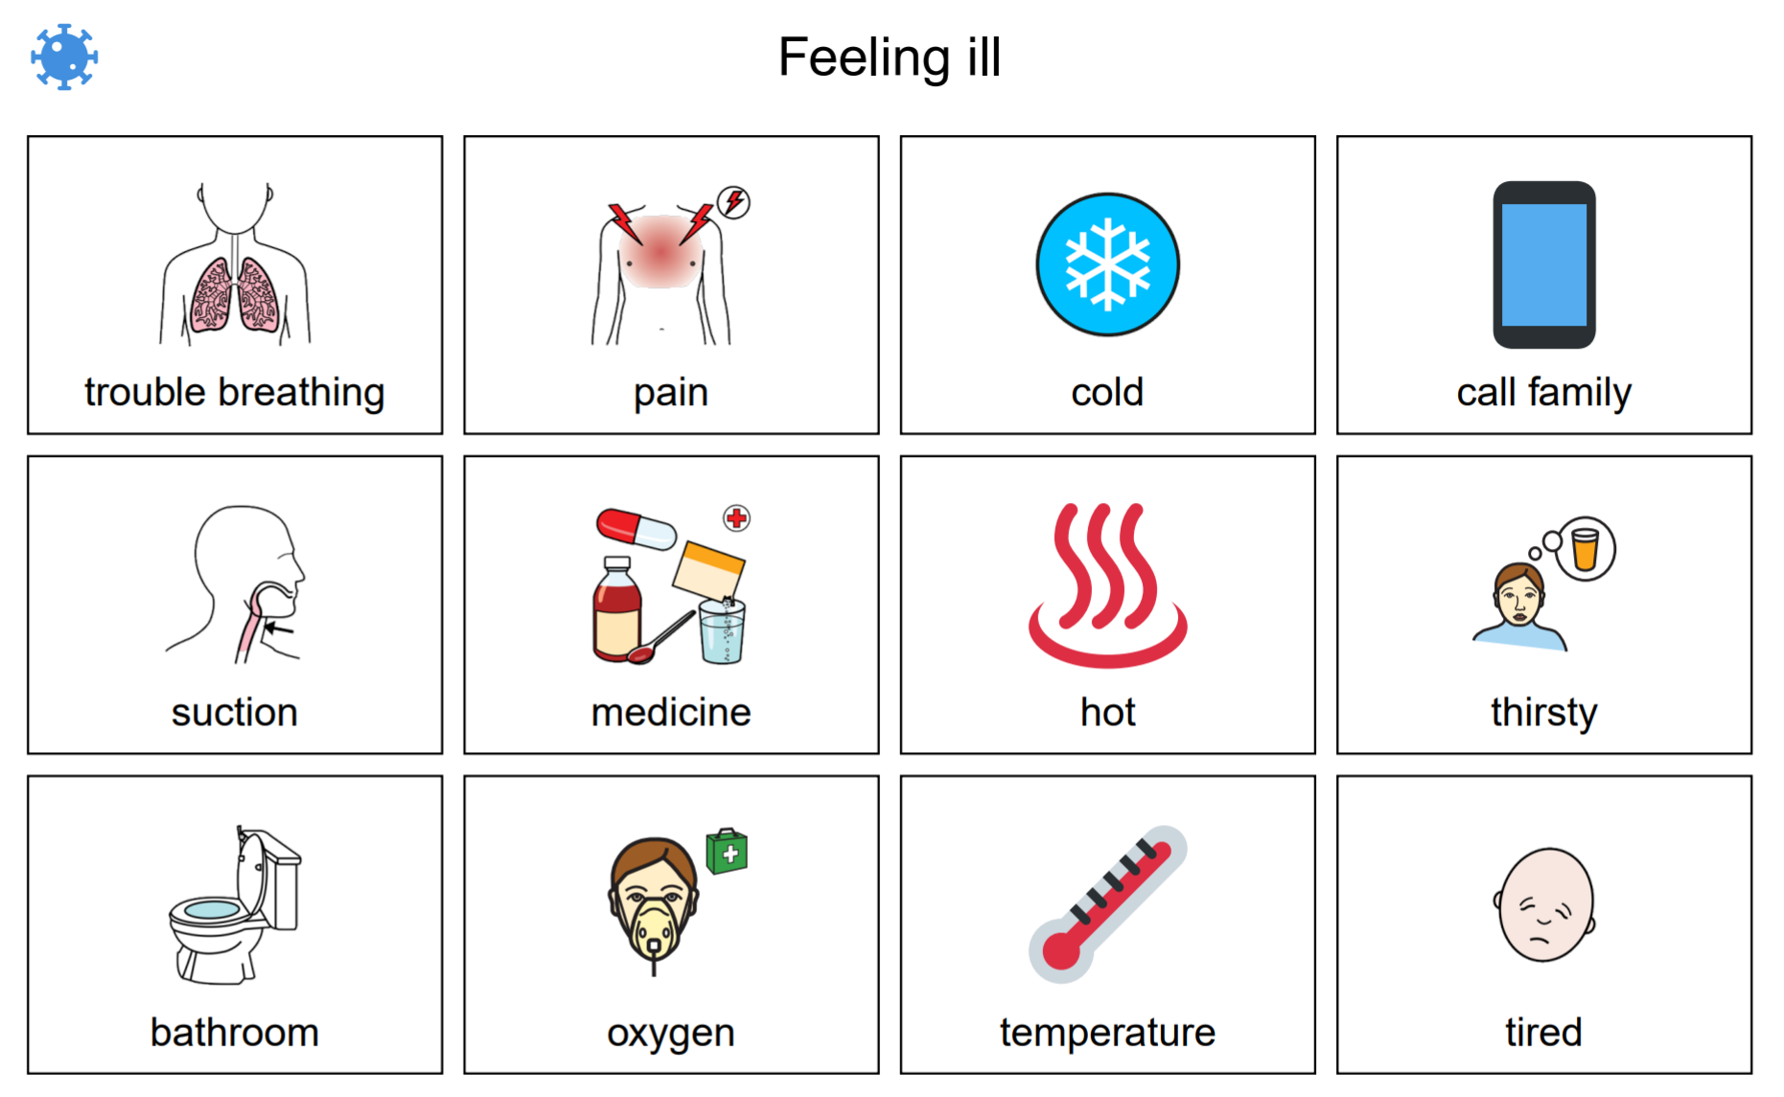
Examples of images that might go with questions about health

Slide 22
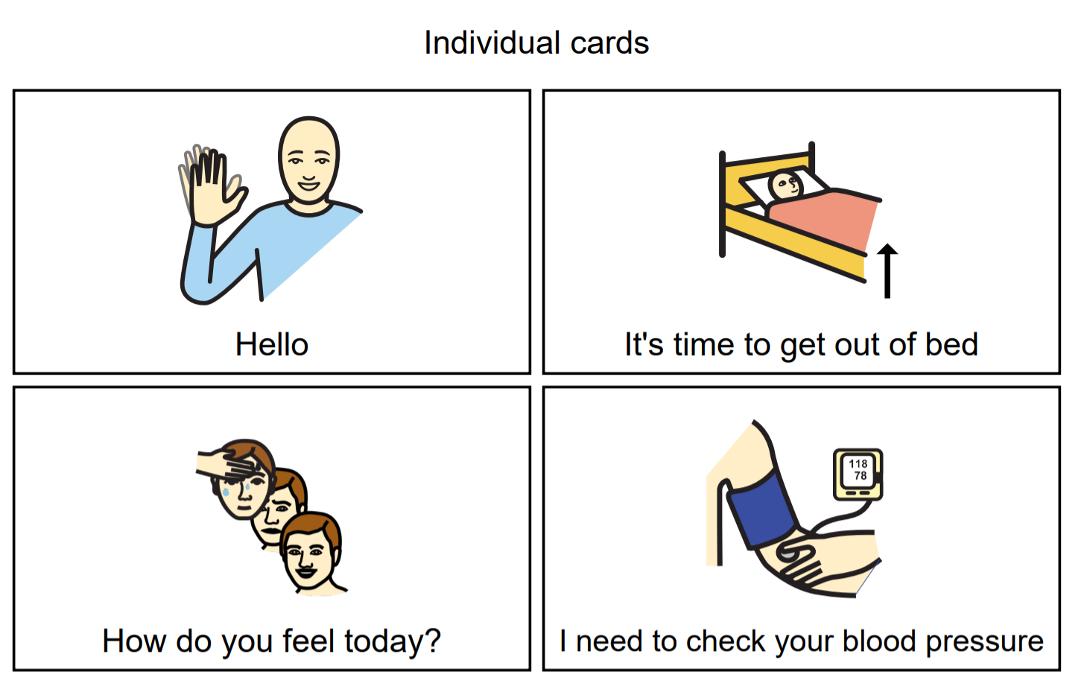
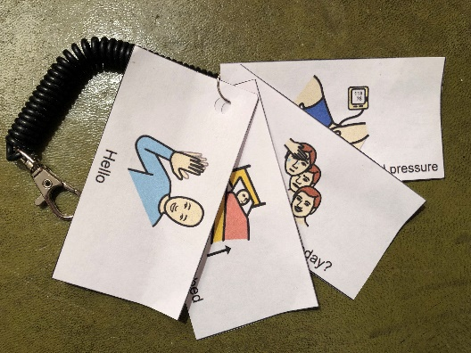
Individual cards
Sometimes simple flash cards with phrases that can be cut up and put on a key ring can help.
Key Ring with symbols
Notes:
Vidatak EZ Board
EZ Board Vidatak Patient Communication Board, Picture Board £50
https://www.ninelife.uk/products/ez-board-vidatak-patient-communication-board-picture-board?gclid=CjwKCAjw-sqKBhBjEiwAVaQ9a4eqr6p-ZOWsP39l1N7zY7lDP_SKe-kM0tXrTdLYvJxsLICJRbK8fhoC5foQAvD_BwE

Slide 23
Topic based words and phrases
Sample topic words you may find useful when providing care that can be used on cards, communication boards etc
Food | Drink | Clothes | Medical | Body | Actions
bread | alcohol | belt | blood pressure | abdomen | choking
butter | chocolate | coat | dizzy | arm | comb hair
cereal | coca cola | gloves | fit | back | drowsy
chips | coffee | hat | gagging | body | go home
cold meal | cold drink | jacket | headache | face | go to sleep
dessert | horlicks | jumper | injection | feet | lights off
eggs | hot drink | pyjamas | light headed | fingers | lights on
fish | ice | scarf | medication | hair | make a call
fruit | juice | shirt | mouth wash | hands | massage
hot meal | milk | shoes | nauseous | head | quiet
meat | tea | slippers | pain | legs | read
snack | water | socks | respiratory | neck | rest
sugar | bottle | trousers | short of breath | nose | sit up
toast | can | T-shirt | sick | stomach | tired
vegetables | glass | underwear | suction | teeth | turned

Slide 24
Words and Phrases
More words…
Feelings | Daily Life/Time | Things | People/chat | Personal Hygiene | Places/ Transport
afraid | bed changing | blanket | carer | bath | cinema
angry | bedtime | cigarette | chaplain | bathroom | countryside
anxious | breakfast | comb | children | bed pan | home
better | change clothes | glasses | doctor | clean | hospital
cold | cut toenails | hairbrush | family | shampoo | library
comfortable | exercise | handkerchief | friends | shower | park
disappointed | get dressed | lighter | nurse | tissue | pub
frustrated | get out of bed | lotion | social worker | toilet | restaurant
happy | listen to music | mobile phone | therapist | tooth brush | shops
hot | lunch | money | don’t know | urinal | theatre
hungry | prayer | newspaper | don't want | wash body | town
lonely | supper | paper | good bye | wash face | ambulance
sad | teatime | pen | hello | wash hair | bus
thirsty | now | pillow | please | wash hands | car
unsure | later | tablet | thank you | wet | taxi

Slide 25

How could you help John?
Background
John lived in London and at an early age was involved with the family joinery business. The small firm was like a family and John often enjoyed time out with colleagues. He also spent weekends doing DIY on the family home and always felt that he had kept himself fit, so it was a shock to them all when he woke up one morning with a blinding headache and was unable to speak coherently. The ambulance was called and he spent time undergoing tests that indicated he had suffered a stroke and had Aphasia. His mobility initially affected, improved over time and John clearly understood what was happening around him. He indicated a considerable degree of frustration and felt trapped by his disability. He still has word finding difficulties, often repeats himself and cannot cope in busy social settings. He has begun to become isolated and depressed. Writing remains difficult and he finds communication tiring. Using the tools of his trade is impossible, even after months of rehabilitation.
John
Joiner
Personal Data
AGE: 55
ADDRESS: Upper Street, London
JOB: Joiner / Carpenter
HOBBIES: Making things, DIY, meeting friends in the pub, films.
Notes:
Imagined by a GAN (generative adversarial network)
StyleGAN2 (Dec 2019) - Karras et al. and Nvidia
Don't panic. Learn how it works [1] [2] [3]
Code for training your own [original] [simple] [light]
Art • Cats • Horses • Chemicals • Contact me
Another

Slide 26
Communication Strategy for John
Start asking questions that need more than a ‘yes’ or ‘no’ answer when John is not too tired, in order to encourage word finding.
Provide images / symbols and objects to help when naming something is difficult and start a phrase that gives John a prompt for words e.g. You said you like fruit… is that an apple or …….. Pause and wait to see if John can offer another fruit. If not, show an image of several pieces of fruit or the actual items.
Try repeating the type of question that results in an answer you have already requested, so John practices words he knows. For example people and pet names – have photographs of family, well known places etc. to use with gesturing and encouraging. Use music with lyrics you John likes.
Help develop short sentences by showing a topic board with key words in place – this can be done using technology such as a tablet or paper based boards.
Encourage reading with matching words and phrases to images and try other letter and word games. Relaxed repetition is key.

Slide 27
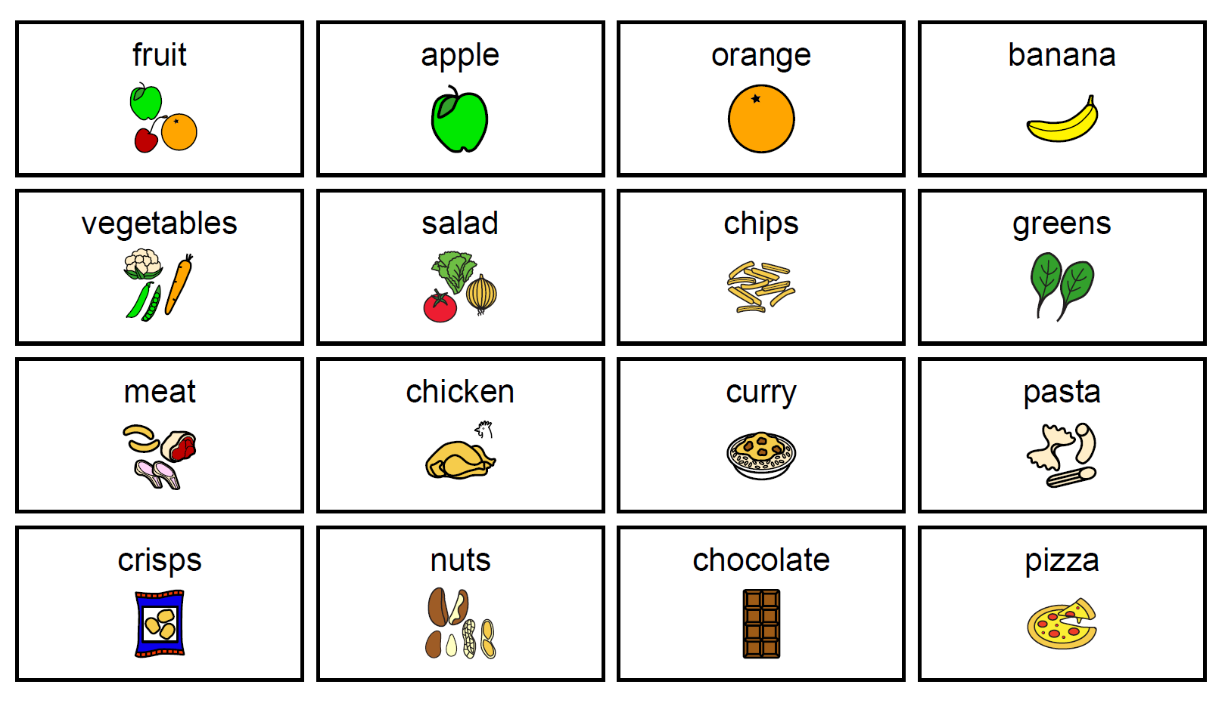
Food Topic Board

Slide 28
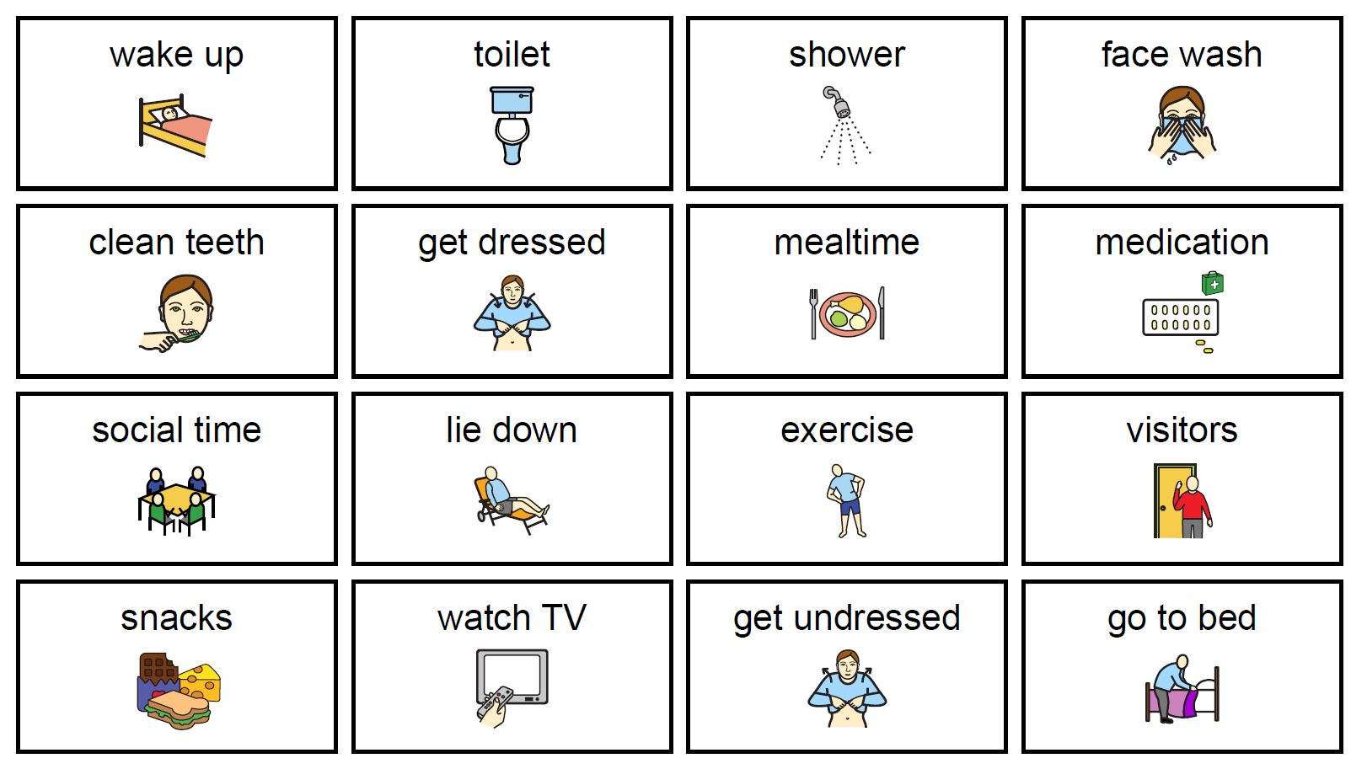
Daily Topic Board

Slide 29
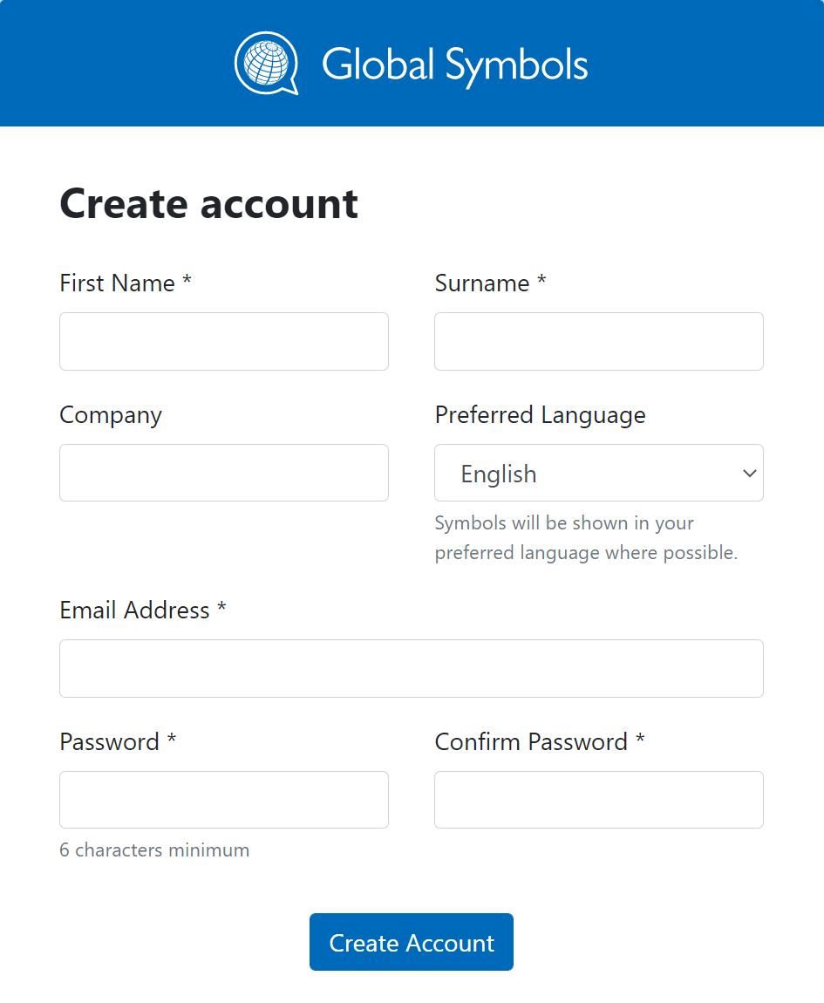
Find some images to match your words
Find images online that can be shared with others.
Make sure they are copyright free (you have permission) to use them.
You can search and download symbols for free using Global Symbols https://globalsymbols.com/ (You will need to create an account and use a password word)
Hello | How do you feel?
hot | cold

Slide 30
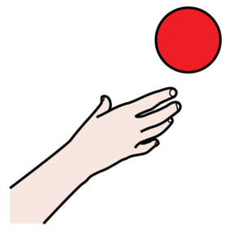
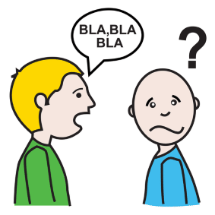
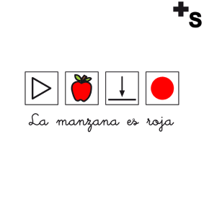

4. Adapting symbols and images
Choose symbols and images that make the meaning easy to guess
Avoid clutter – keep symbols and images simple with clear backgrounds
Try to use a single style on a board or information sheet so symbols have a similar look and feel.
Use good colour contrast - black and white may be easier for some users.
Large clear text is needed, especially where labels are being used alongside the symbols.

Slide 31

How could you help Karl?
Background
Karl has Cerebral Palsy and lives independently in a flat provided by Social Services. He uses a wheelchair for mobility over any distance, although he can stand to transfer and take a few steps. As he ages his communication has deteriorated, he has suffered several chest infections that affected his wellbeing, his speech has been impacted by having several teeth removed and his cognitive ability including memory has become less accurate. As a result, when he fell ill, he found it difficult to both remember all the words and phrases he needed, and his articulation made the production of multi-syllabic words unclear and many of his carers found it hard to discuss his medication, treatment and social needs with him.
Karl can comfortably use an iPad to type, but can be slow when he is tired, he gets frustrated when people do not understand what he is trying to say
Karl
Unemployed
Personal Data
AGE: 50
ADDRESS: St Stephens Close, Ipswich
JOB: Unemployed
HOBBIES: Reading, watching TV collecting films .
Notes:
Imagined by a GAN (generative adversarial network)
StyleGAN2 (Dec 2019) - Karras et al. and Nvidia
Don't panic. Learn how it works [1] [2] [3]
Code for training your own [original] [simple] [light]
Art • Cats • Horses • Chemicals • Contact me
Another

Slide 32
Communication strategy for Karl
Use symbols to communicate complex terms and phrases to carers and support understanding.
Integrate speech, gesture and images so Karl can use the most suitable channel according to his needs and current status.
Choose topic boards or flash cards that are specific to his current social setting, interest and topic of conversation.
Make sure instructions and requests are repeated or said in a slightly different or more accurate way to encourage Karl and ensure understanding.
Allow time for Karl to try to respond and initiate using different channels.
Expand vocabulary to support Karl’s needs.
Try to make the most of the technology Karl wants to use with interesting images and topics.

Slide 33
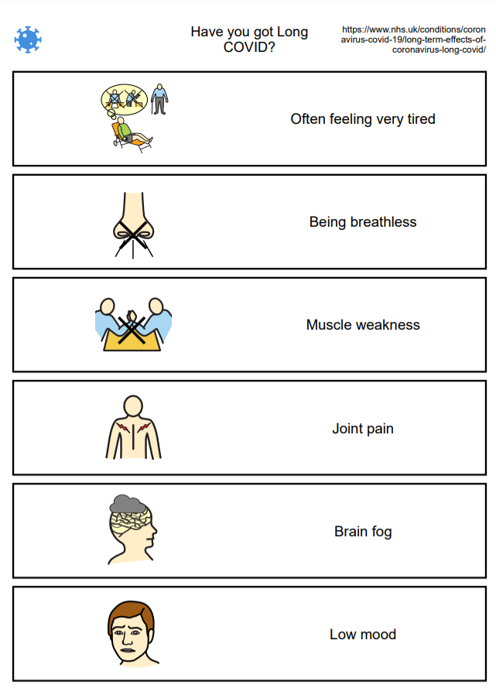
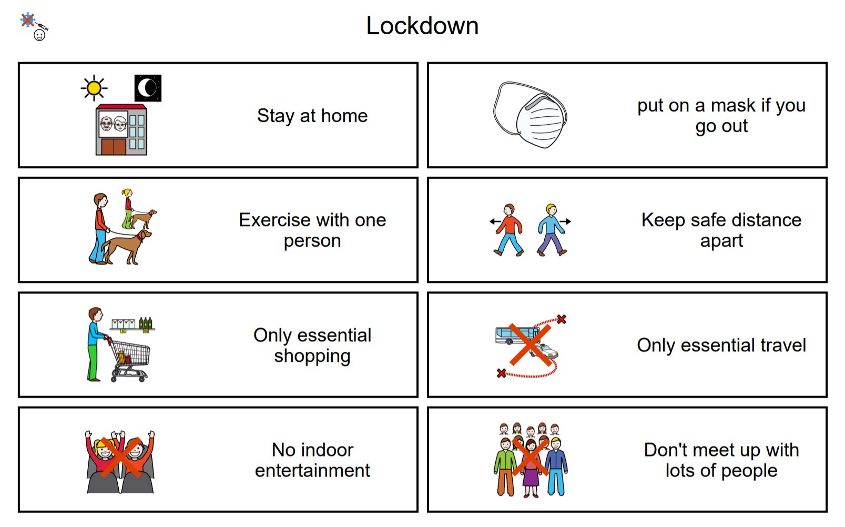
Information sheets to help understanding
You can use a word processor to make a table or columns with images, words and phrases or use an app.

Slide 34

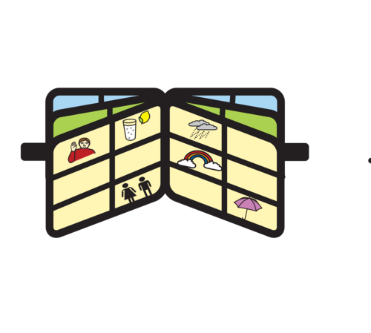


Talking whilst using images
As you talk, point to the images or symbols that represent important words in your sentence
Pause to check your client is following your finger and is near enough to the board to point or indicate with their eyes, facial expression or gesture they have understood.
You don’t have to point at everything on the board – not all the words are included as images or symbols.

Slide 35
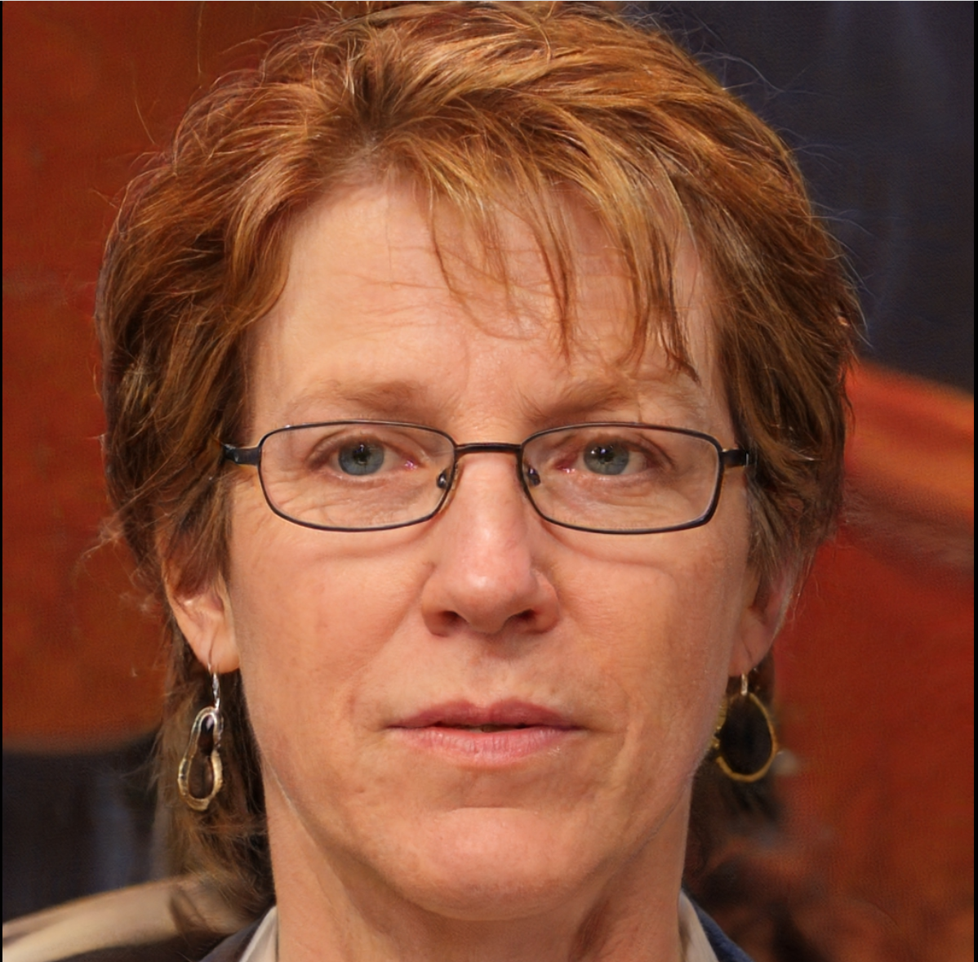
How could you help Sarah?
Background
Sarah was born in England, but spent most of her life farming in South Africa and loved her horses. She returned to England and life became much harder, eventually spiraling down into alcoholism. Although relatively independent, the family felt she was safer living in sheltered accommodation where she could receive regular medication and control her drinking and epilepsy. Sarah now has severe fits and during these episodes becomes confused and incoherent. Carers find they cannot always get through to her with speech alone and she does not appear to listen to instructions that can result in her failing to understand she must ring a bell when she feels she is going to fall. There are times when she does not realise that she needs to schedule in mealtimes, showers and other daily living requirements.
Sarah
Unemployed
Personal Data
AGE: 60
ADDRESS: St Benedict’s Home, Itchen Rd, Southampton
JOB: Was a Farmer
HOBBIES: Reading, horses, TV.
Notes:
Imagined by a GAN (generative adversarial network)
StyleGAN2 (Dec 2019) - Karras et al. and Nvidia
Don't panic. Learn how it works [1] [2] [3]
Code for training your own [original] [simple] [light]
Art • Cats • Horses • Chemicals • Contact me
Another

Slide 36
Communication strategy for Sarah
Use of gestures and body language to reinforce verbal instructions – allow space and time when struggling to be coherent.
Target flash cards with symbols or images to go with instructions needed at the time – possibly use a key ring. Take photos of familiar objects.
Have daily schedules ready with meal times etc and options available when necessary.
Update topic boards and settings as situations change.
Possibly use a tablet, so cards and boards can be swiped through quickly.

Slide 37
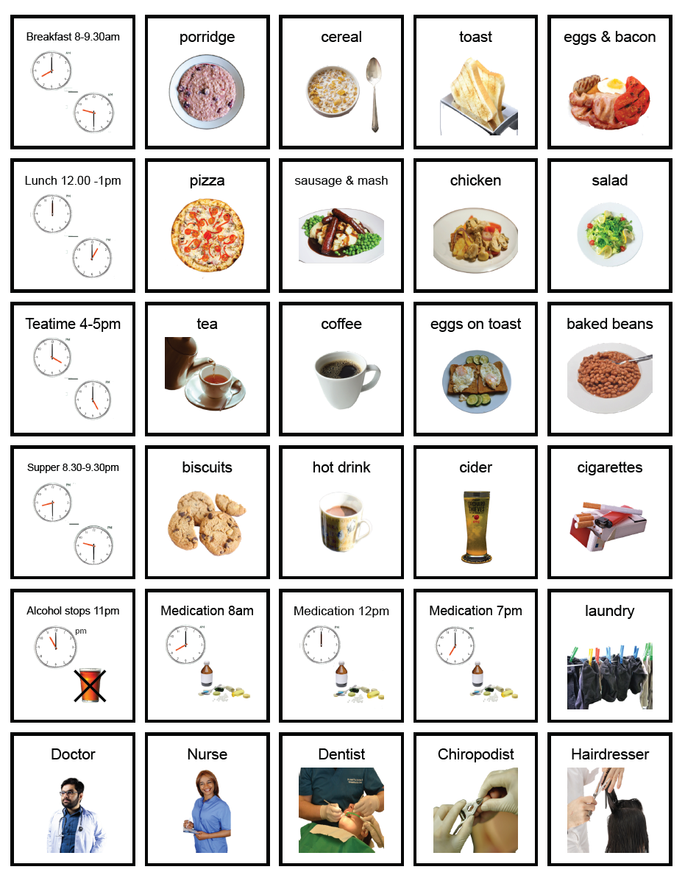
Sarah’s personal chart
This board provides some of the important reminders for Sarah’s daily schedule to help her when feeling unwell.

Slide 38
A Sentence or Phrase Practice board
If English is not a first language or someone is learning the language, cells can be coloured by the type of word (part of speech) to help to say them in the right order, so they are more easily understood.
People choose different colours, but here are some examples
  yellow for pronouns e.g. I, you, she, he, we, they
  green for actions e.g. go, walk, talk, help, come
  blue for descriptions e.g. hot, cold, little, large
  soft orange for objects or people e.g. table, chair, friends
  purple for questions e.g. who? what? when? where? why? how?
Check how easy it is to make phrases or sentences using a test board in English – the order may change in other languages.

Slide 39
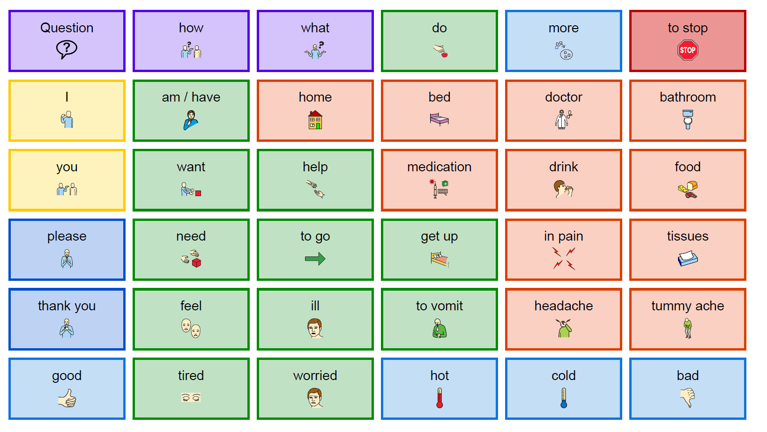
Can you make some phrases or sentences by pointing at the symbols or words?

Slide 40
5. Creating opportunities to encourage conversations.
Finding topics that can lead to conversations and discovering ways of communicating …
What do they like to do?
  How do they show that they like or are enjoying something?
What do they dislike/not like to do?
  How do they show that they dislike or are not enjoying something?
Who are the important people in their life?
In a typical week/month where do they spend their time – list all that apply.

Slide 41
Considering different types of boards
Some boards may have too many symbols or words and be hard to read at a distance.
Larger text with less cells containing images on one page may be necessary,
Too many choices can cause confusion if a client has ‘brain fog’, dementia or a cognitive impairments
Think about using half a page (A5) with images on both sides that may be easier to handle if dexterity is a problem, or you only have one free hand.

Slide 42
Ideas for creating Conversations
Good conversations can mean that there is a chance to use what are known as ‘open questions and comments’. Not just ones that need a ‘yes / no’ answer.
Think how to add new topics…
  that reminds me of…
  that makes me think of …
  Have images, music, other objects at the ready.
who? what? when? where? why? how?

Slide 43

Remembering to listen and pay attention as well as question
Listen carefully, pausing and clarifying by asking questions such as ….
  “Can I just check that I’ve understood this correctly? You have said that…”;
  “Let me check that I’m clear about your difficulty. You tell me that…”;
  “I want to be sure I understand what you mean…”;
  “What you seem to be saying is…”;
  “Could you tell me more about…”
Notes:
https://www.nursingtimes.net/clinical-archive/assessment-skills/communication-5-effective-listening-and-observation-skills-12-03-2018/

Slide 44
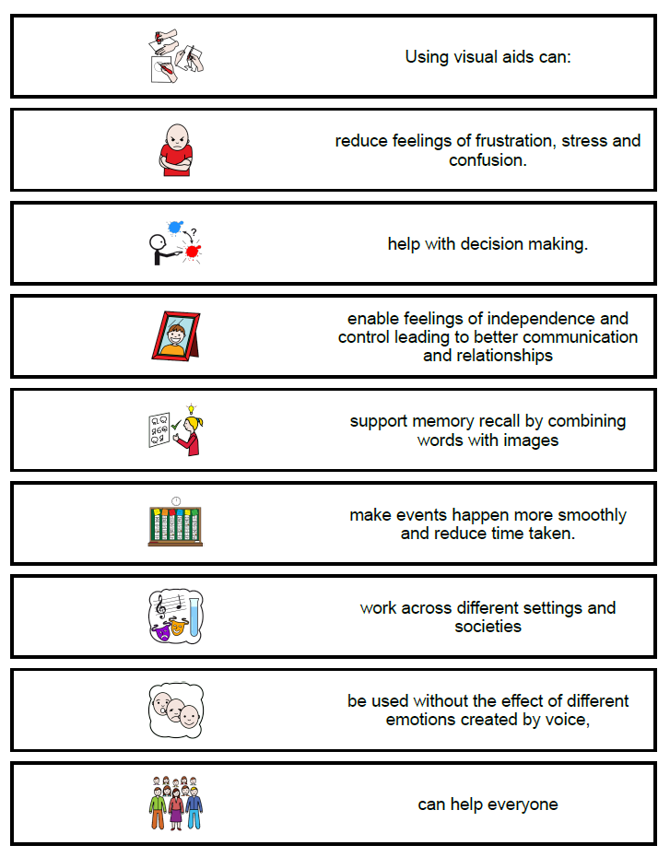
Supporting Spoken Communication
Notes:
Happ, M.B., 2001. Communicating with mechanically ventilated patients: state of the science. AACN Advanced Critical Care, 12(2), pp.247-258.
https://aacnjournals.org/aacnacconline/article-abstract/12/2/247/13823/Communicating-With-Mechanically-Ventilated
Patak, L., Gawlinski, A., Fung, N.I., Doering, L., Berg, J. and Henneman, E.A., 2006. Communication boards in critical care: patients' views. Applied Nursing Research, 19(4), pp.182-190.
https://www.sciencedirect.com/science/article/pii/S0897189706000826?casa_token=IdwYtxMimeMAAAAA:5cG61PDhbmylzpXBsAzpDgVwlVvHRM509sKkCyTF6f4Kxx_z_TjORHhRSw5qL9JJQxw-oUbKqQ
Patak L, Gawlinski A, Fung NI, Doering L, Berg J. (2004). Patient's reports of health care practitioner interventions related to communication during mechanical ventilation. Heart & Lung - The of Acute and Critical Care, 33(5), 308320.

Slide 45
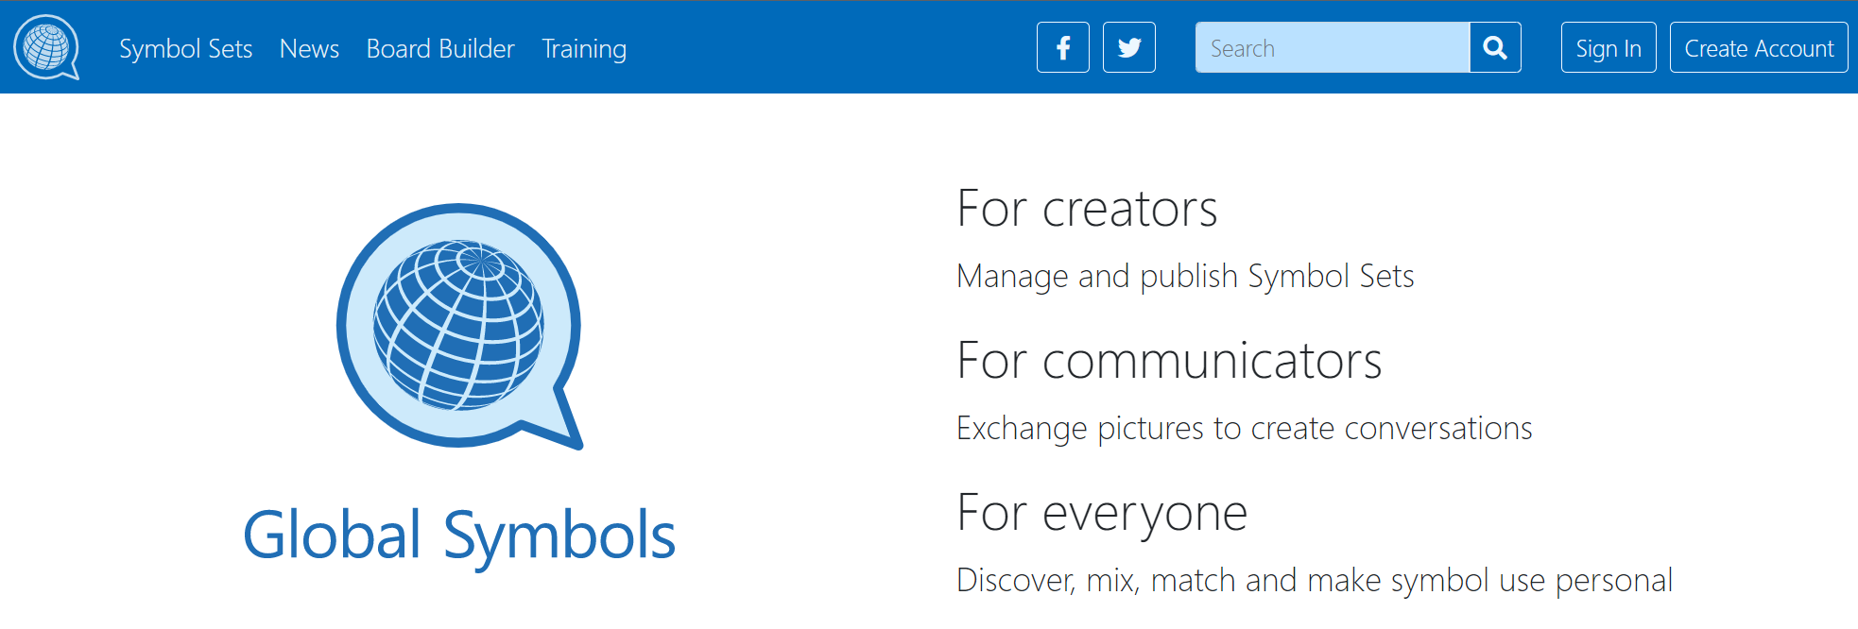
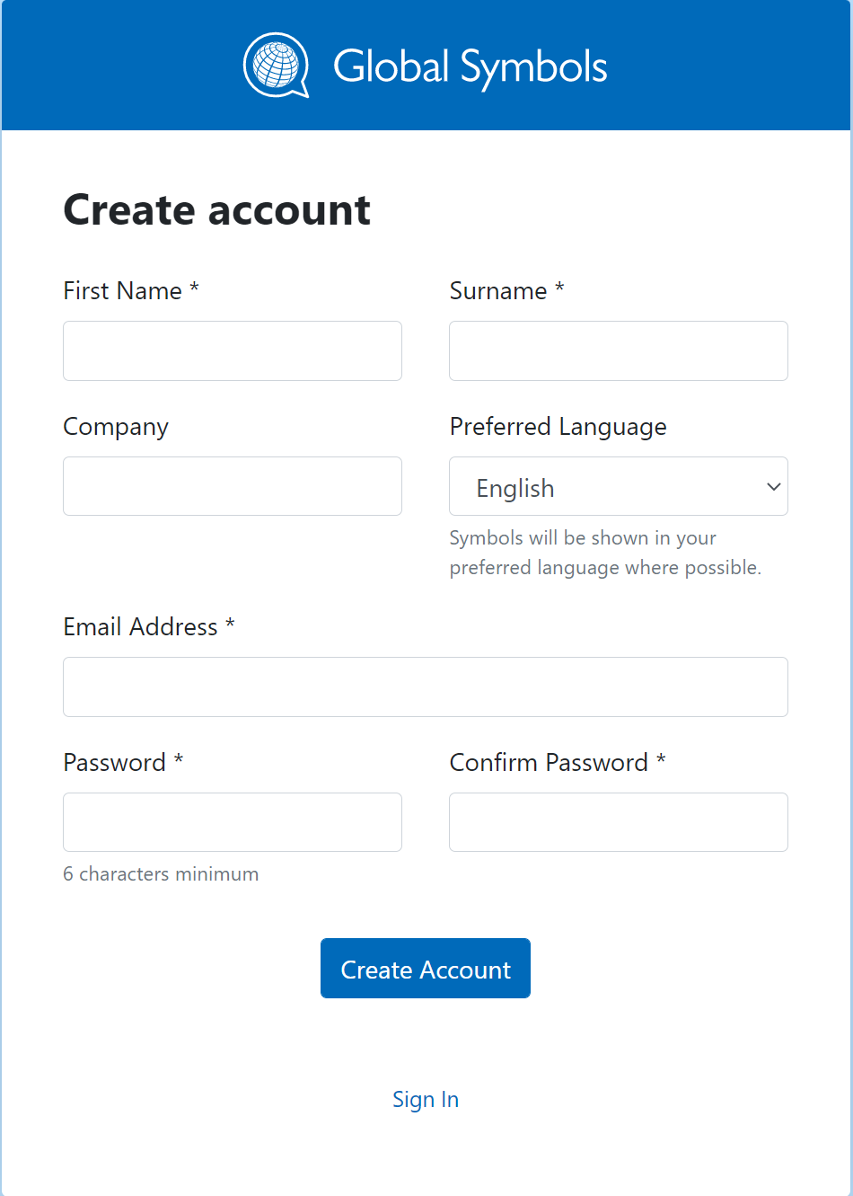
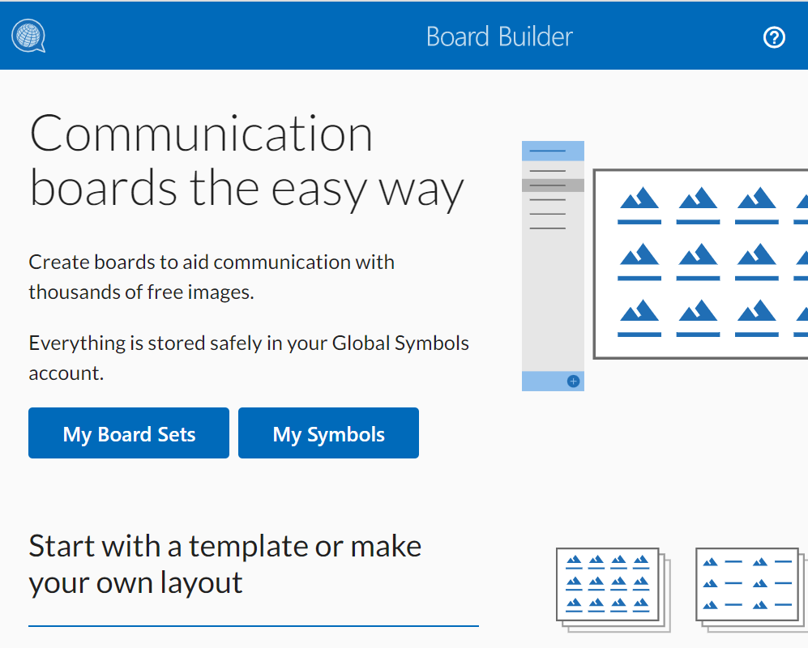
Using Board Builder and Symbol Creator https://globalsymbols.com/
Once you have an account on Global Symbols you can use “Board Builder” (select from the top menu) to make a communication board. Use ‘My Board Sets’ button to start making a board.
1
2
3

Slide 46
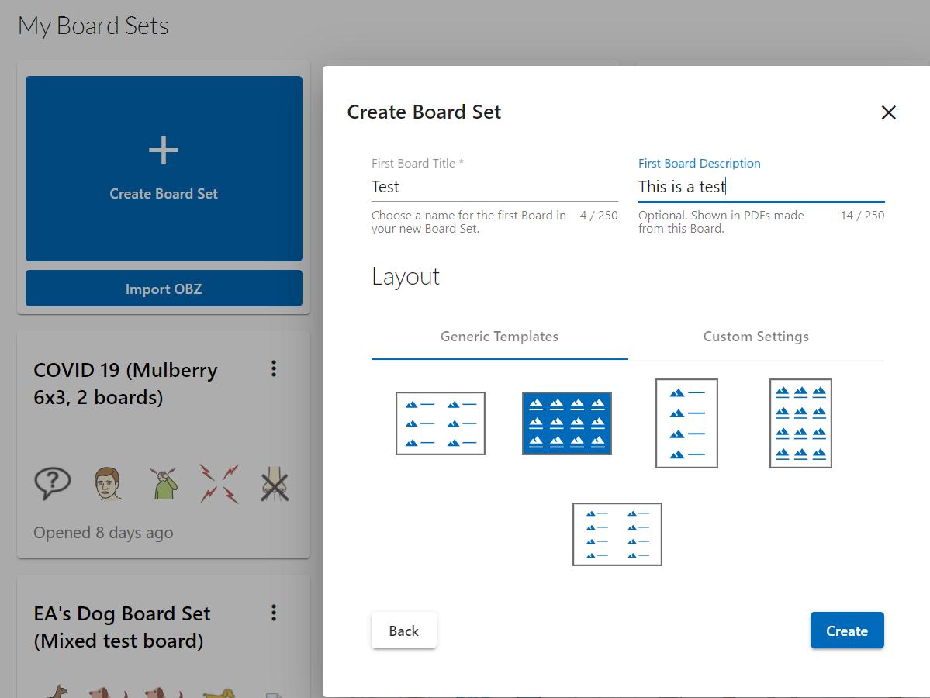
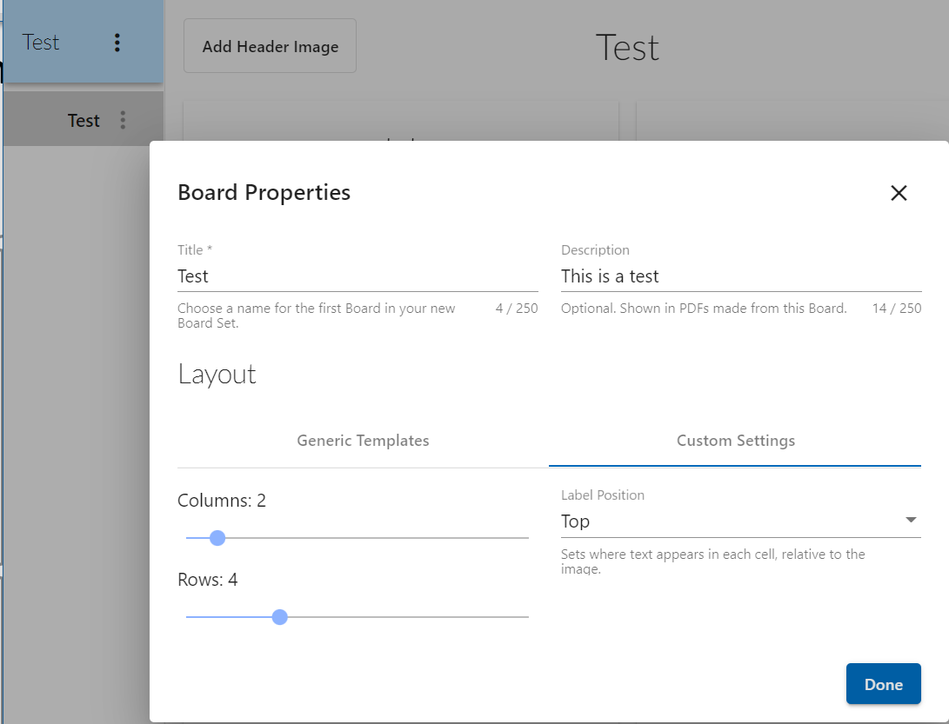
Board Builder
Select ‘Create Board Set’, choose a template and set up a board set, then start your first board and set up the boards properties, number of columns and rows required, plus the position of the label. Use the ‘done’ button to go to the board properties
1
2
3

Slide 47
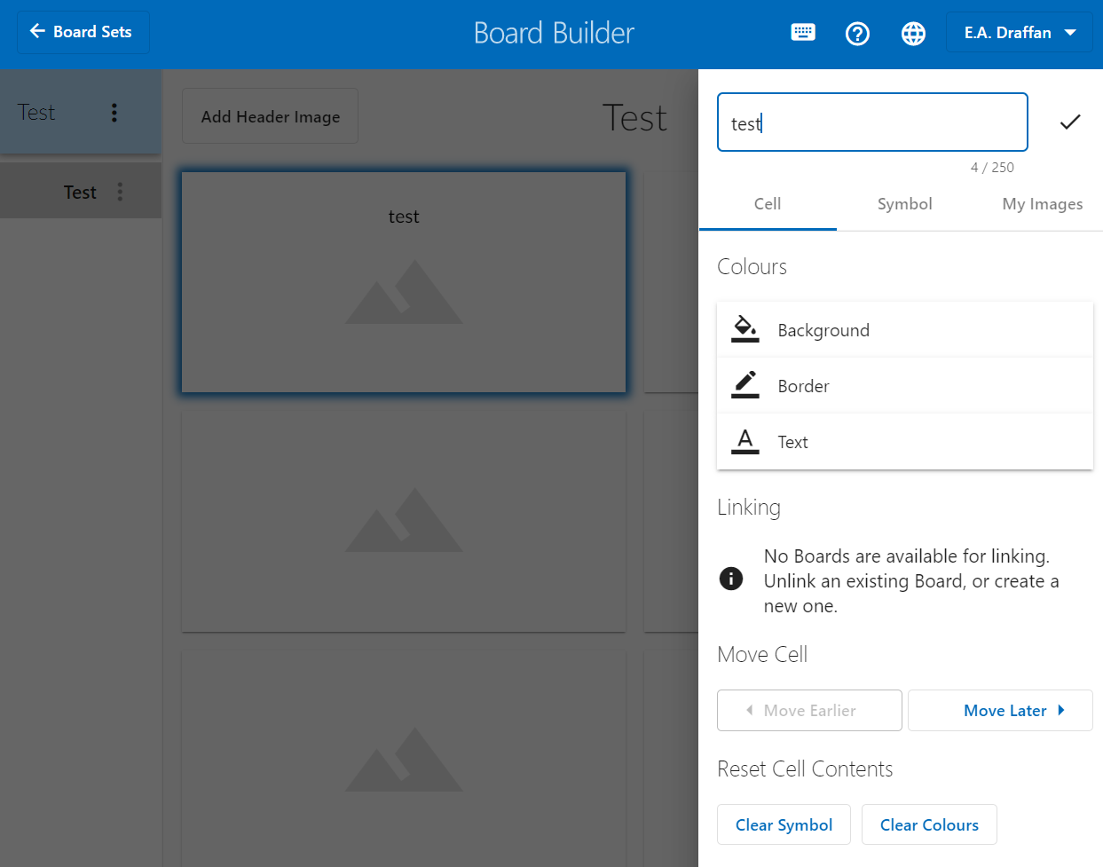
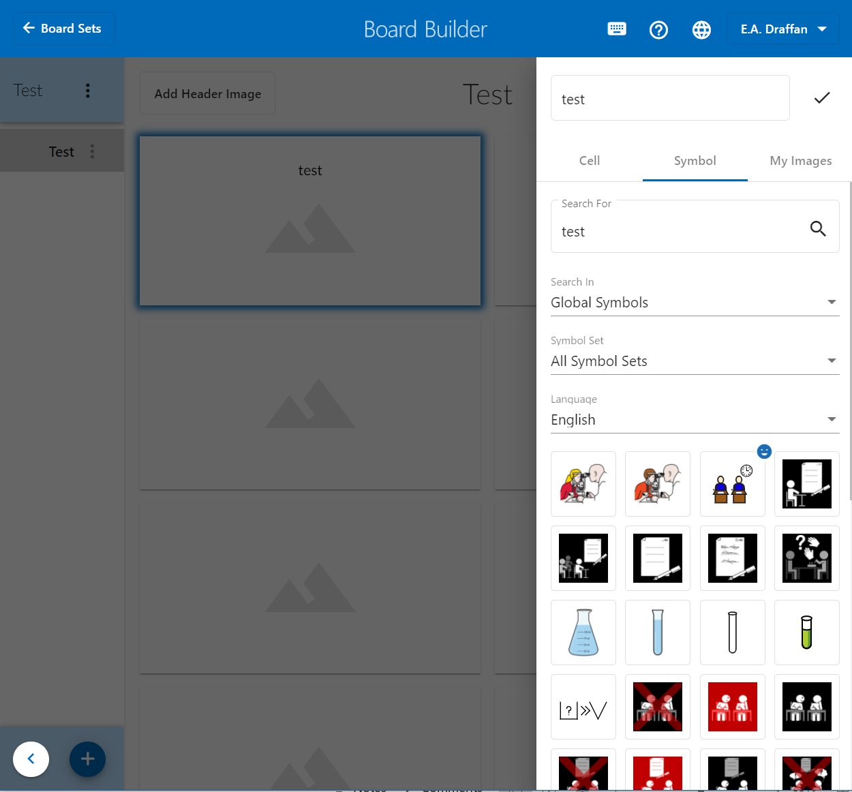
Add a Label and Symbol
Select a cell, add a word where it says label on the right, the cell will be greyed out while you type in the word. Then search for a symbol
1
2

Slide 48
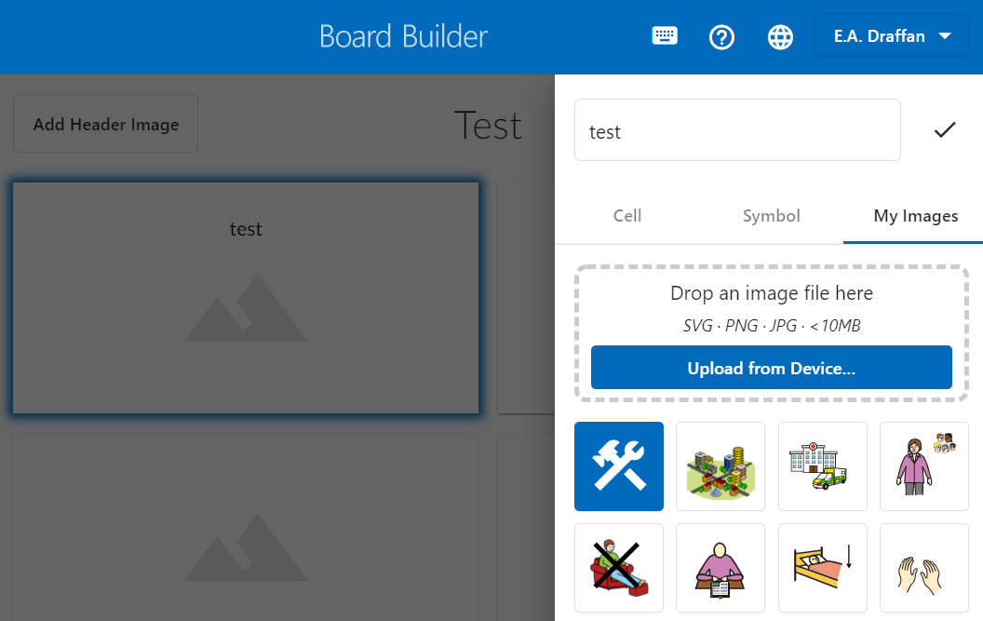
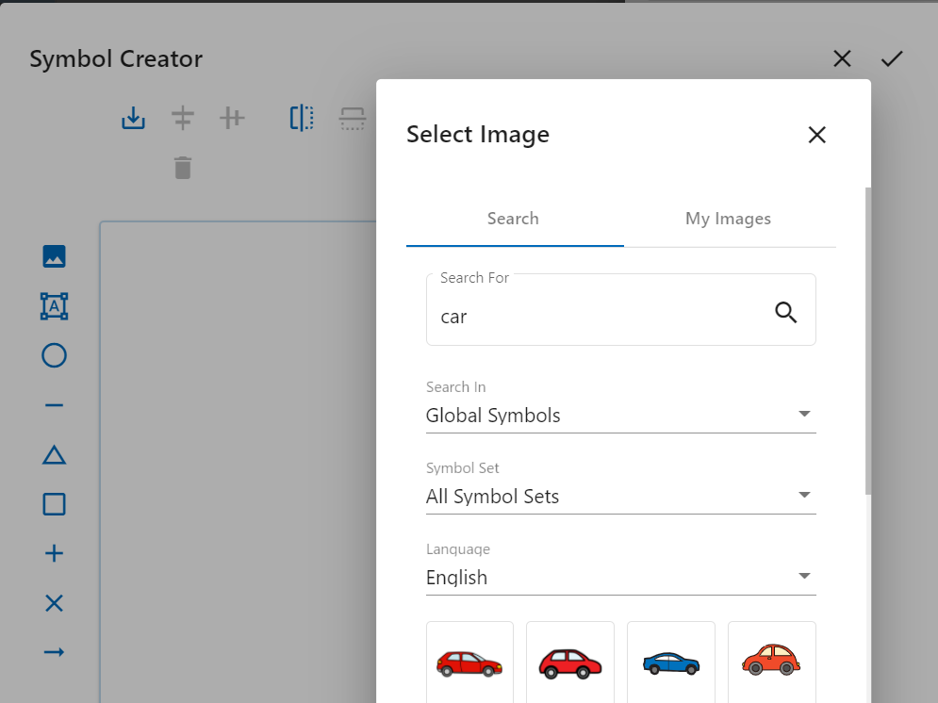
Symbol Creator
You can make your own image or symbol by going to ‘My Images’ and choosing the blue button (hammer/spanner).
Upload your image or search for a symbol and add shapes etc. Select the ‘tick’ to add it to the board
3
2
1

Slide 49
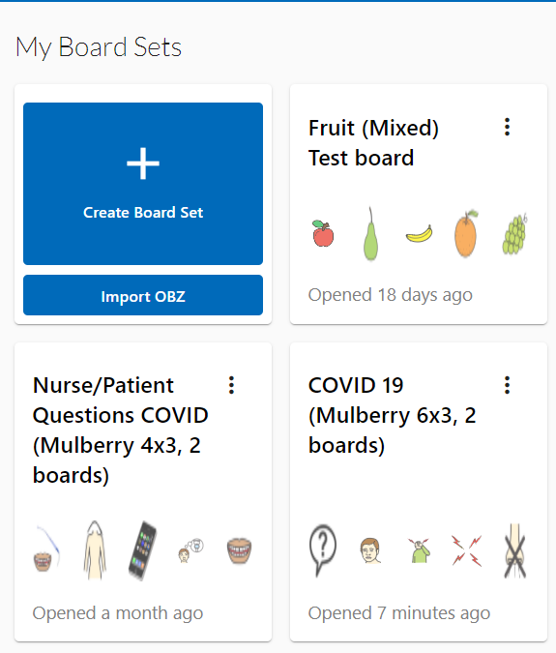
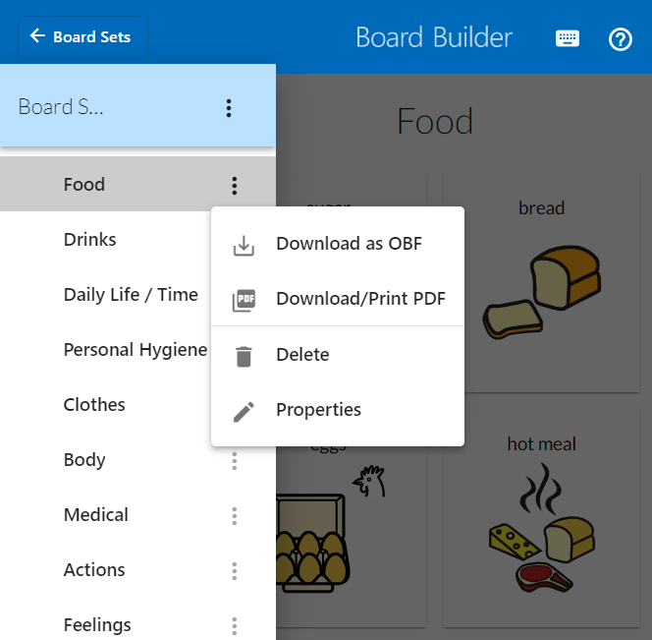
Finishing the Board and Printing.
The board you are making will always be automatically saved to the ‘My board sets area. You can go back and edit at any time.
Make it public if you want to share it with others by going back to the board properties
Save it as a ‘obf’ file if you want to upload it to Cboard or CoughDrop communication apps or print it out as a PDF for laminating.

Slide 50

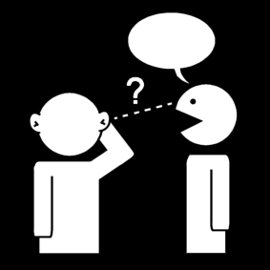

Final Tips
Keep it simple – a piece of paper with a few pictures may be all that is needed when speech does not come easily.
It may be simpler just to use key words
Pause – wait – try not to cut in when someone is trying to express themselves – help with gentle prompts around the subject if word finding is difficult.
Help by talking about the concepts/ ideas behind complex words rather than using them or expecting answers about them

Slide 51

More Instructions and Training
Keyboard access, more instructions and language changes for Board Builder and Symbol Creator can be found on the Board Builder menu bar.
Global Symbols courses have more information about making boards and other visual aids. https://training.globalsymbols.com/course/view.php?id=57
Ace Centre course for communication partners. https://acecentre.org.uk/learning/communication-partners-i
CALL Scotland about communication and AAC. https://www.aacscotland.org.uk/modules/

Slide 52
Useful images and cards online
Finding free photos to print out as cards if these are not available from family https://pixabay.com/
More black and white icons https://thenounproject.com/
Working with children – more ideas on Lesson https://lessonpix.com/
Communication support for stroke patients https://www.stroke.org.uk/what-is-aphasia/communication-tools

Slide 53
Glossary
channel | The way a message might be sent such as via speaking in a language which may or may not be understood by the receiver, email, SMS, phone etc
cognitive | Related to the ability to learn, reason, think, remember, have language skills and appropriate social skills.
convert | To change, adapt or translate a message into another form such as text or images from spoken language or just an idea in the head.
degenerative | An illness that gets worse with loss of function (physical and/or cognitive).
interpret | To understand or work out the meaning of a message
Motor Neurone Disease (MND) | Affects the brain and nerves causing muscle weakness, difficulty with mobility, swallowing and speech
physical | These difficulties are to do with the body’s mobility, dexterity and function of the organs
rehabilitate | restore (someone) to health or normal life by training and therapy after imprisonment, addiction, or illness.
sensory | The five senses humans have: touch, sight, hearing, smell and taste.
visual aids | Use of images, symbols, emojis, icons to help make the spoken word or text easier to understand.

Slide 54

From the Global Symbols Team
To use this free course online, download boards and other resources, please create accounts on Global Symbols and the training site
https://globalsymbols.com/users/sign_up?locale=en
https://training.globalsymbols.com/course/index.php?categoryid=12
Symbols thanks to ARASAAC, Mulberry and Sclera
This course was funded by the Churchill Fellowship COVID-19 Action Fund

