Slide 1
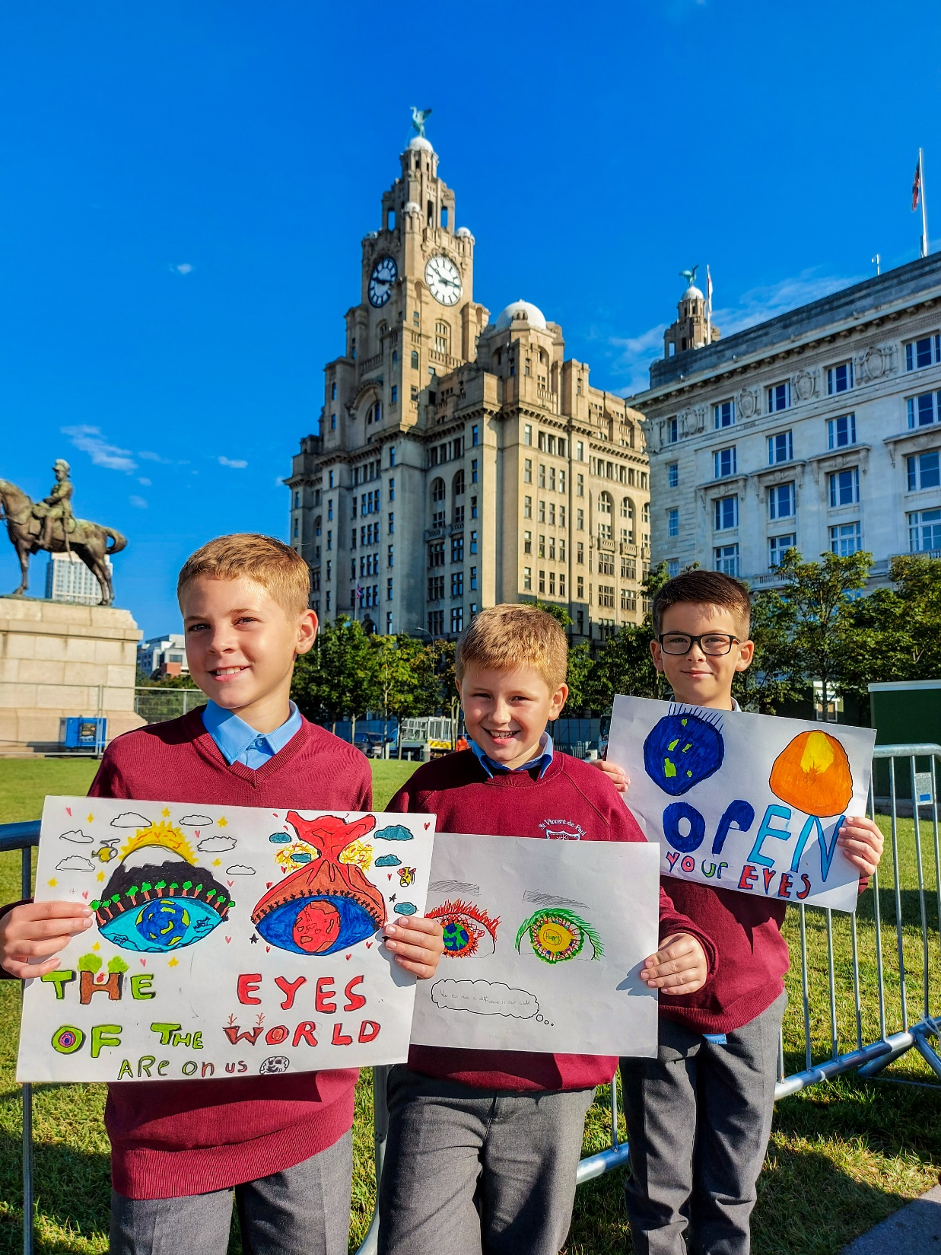
How can I get ready for Jesus?
Gather
Notes:
Photo credit: Pupils from St Vincent de Paul Catholic Primary School, Liverpool Tamala Ceasar

Slide 2
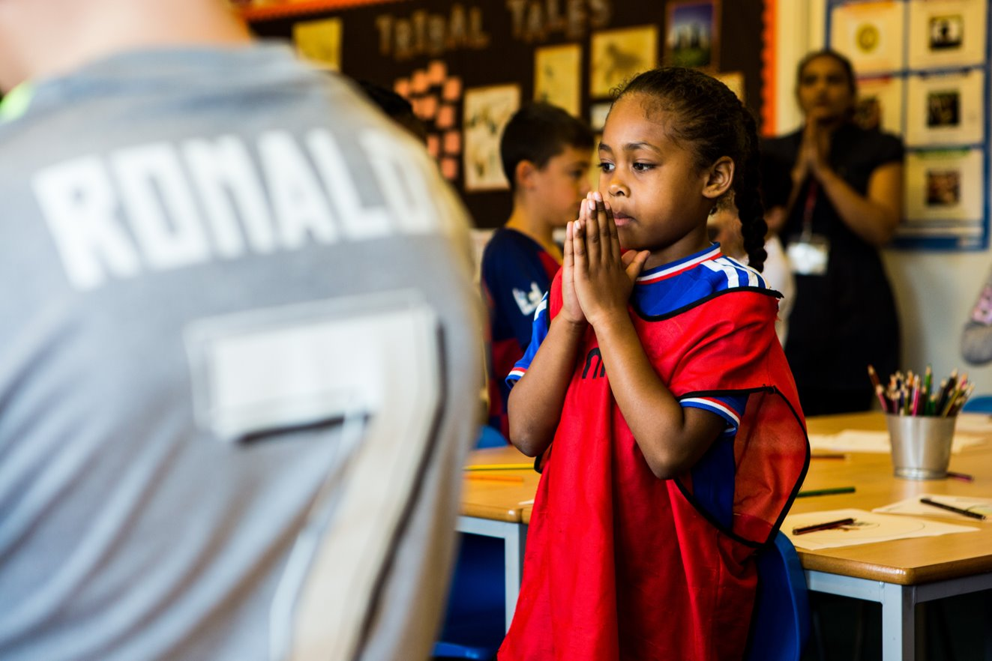
Christ Jesus, we know that one day you will come again.
Help us to be ready when the time comes.
Amen.
Notes:
Photo credit: Children at Our Lady Queen of Heaven Primary School, Crawley
Thom Flint

Slide 3
Mark 13: 24-32
“In the days after that time of trouble, the sun will grow dark, the moon will no longer shine, the stars will fall from heaven, and the powers in space will be driven from their courses. Then the Son of Man will appear, coming in the clouds with great power and glory. He will send the angels out to the four corners of the earth to gather God's chosen people from one end of the world to the other.
“Let the fig tree teach you a lesson. When its branches become green and tender and it starts putting out leaves, you know that summer is near. In the same way, when you see these things happening, you will know that the time is near, ready to begin. Remember that all these things will happen before the people now living have all died. Heaven and earth will pass away, but my words will never pass away.
“No one knows, however, when that day or hour will come - neither the angels in heaven, nor the Son; only the Father knows.”
Word

Slide 4
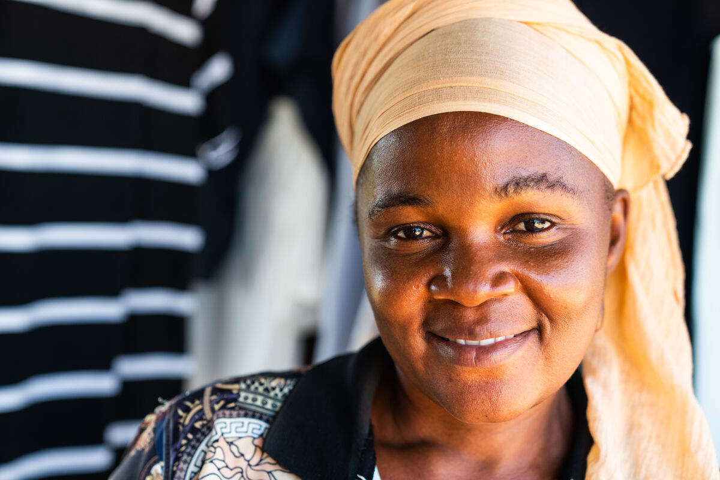
What do you remember from the Gospel reading?
We often prepare for special events. Can you think of some events that we get ready for?
We get ready to welcome visitors.
We prepare when there is going to be a new baby in the family.
We prepare for a party or a meal.
We get ready for the school play.
Respond
Notes:
Photo credit: Ramatulai Musa, Sierra Leone
Michael Duff

Slide 5
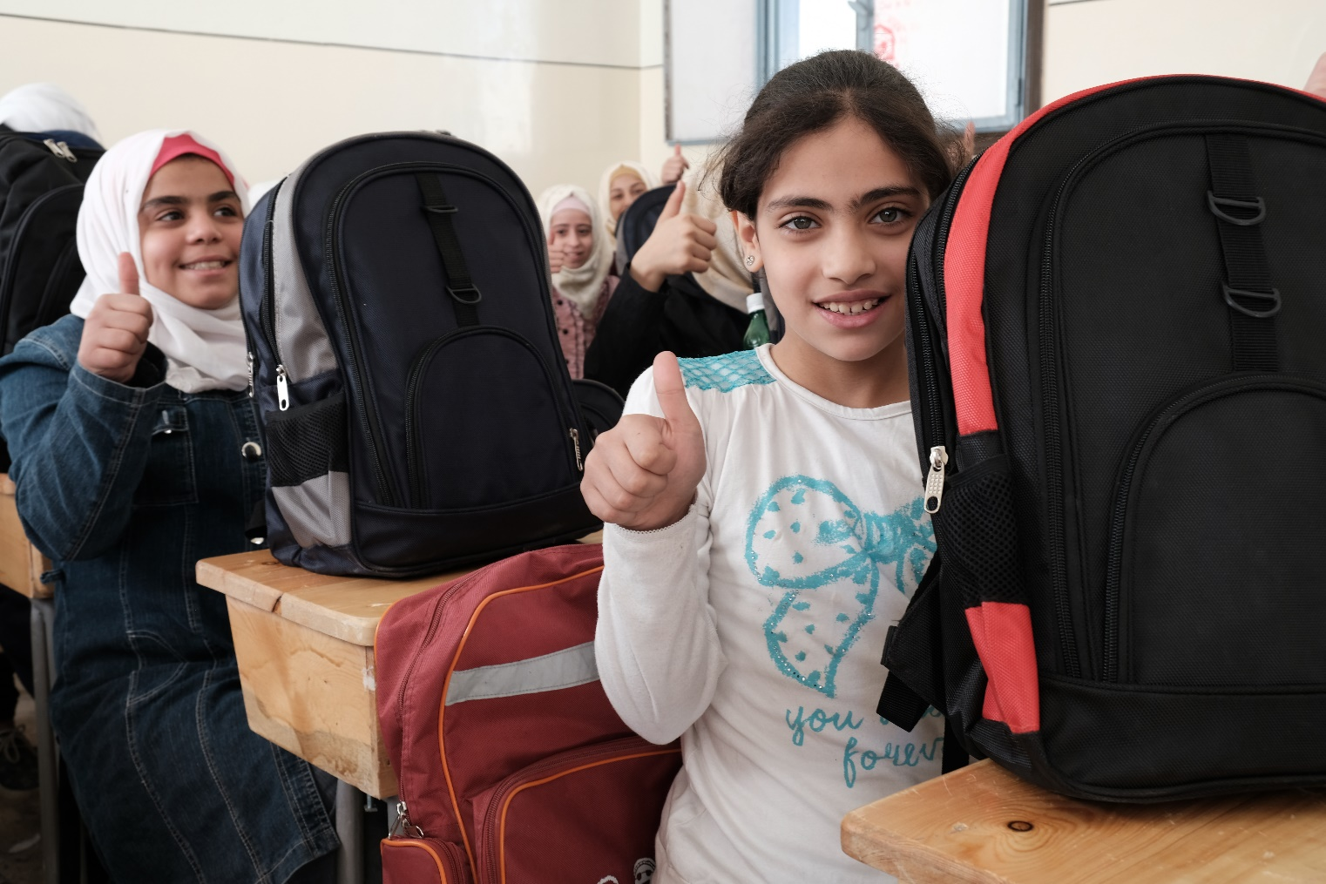
All around the world, children get ready to go to school in the morning. They get up, get washed and dressed, have breakfast and make their way to school ready to learn.
By doing their homework each night, children everywhere are also learning and preparing for their future.
Notes:
Photo credit: School children in Aleppo receiving school bags containing books and stationery from Caritas International
Patrick Nicholson/Caritas International

Slide 6
When they get home from school, many children will help their parents prepare to get the dinner ready, so that the family can have something to eat.
Notes:
Photo credit: Marie-Claire Nsimire-Rutale and her family, Democratic Republic of Congo
Thom Flint

Slide 7
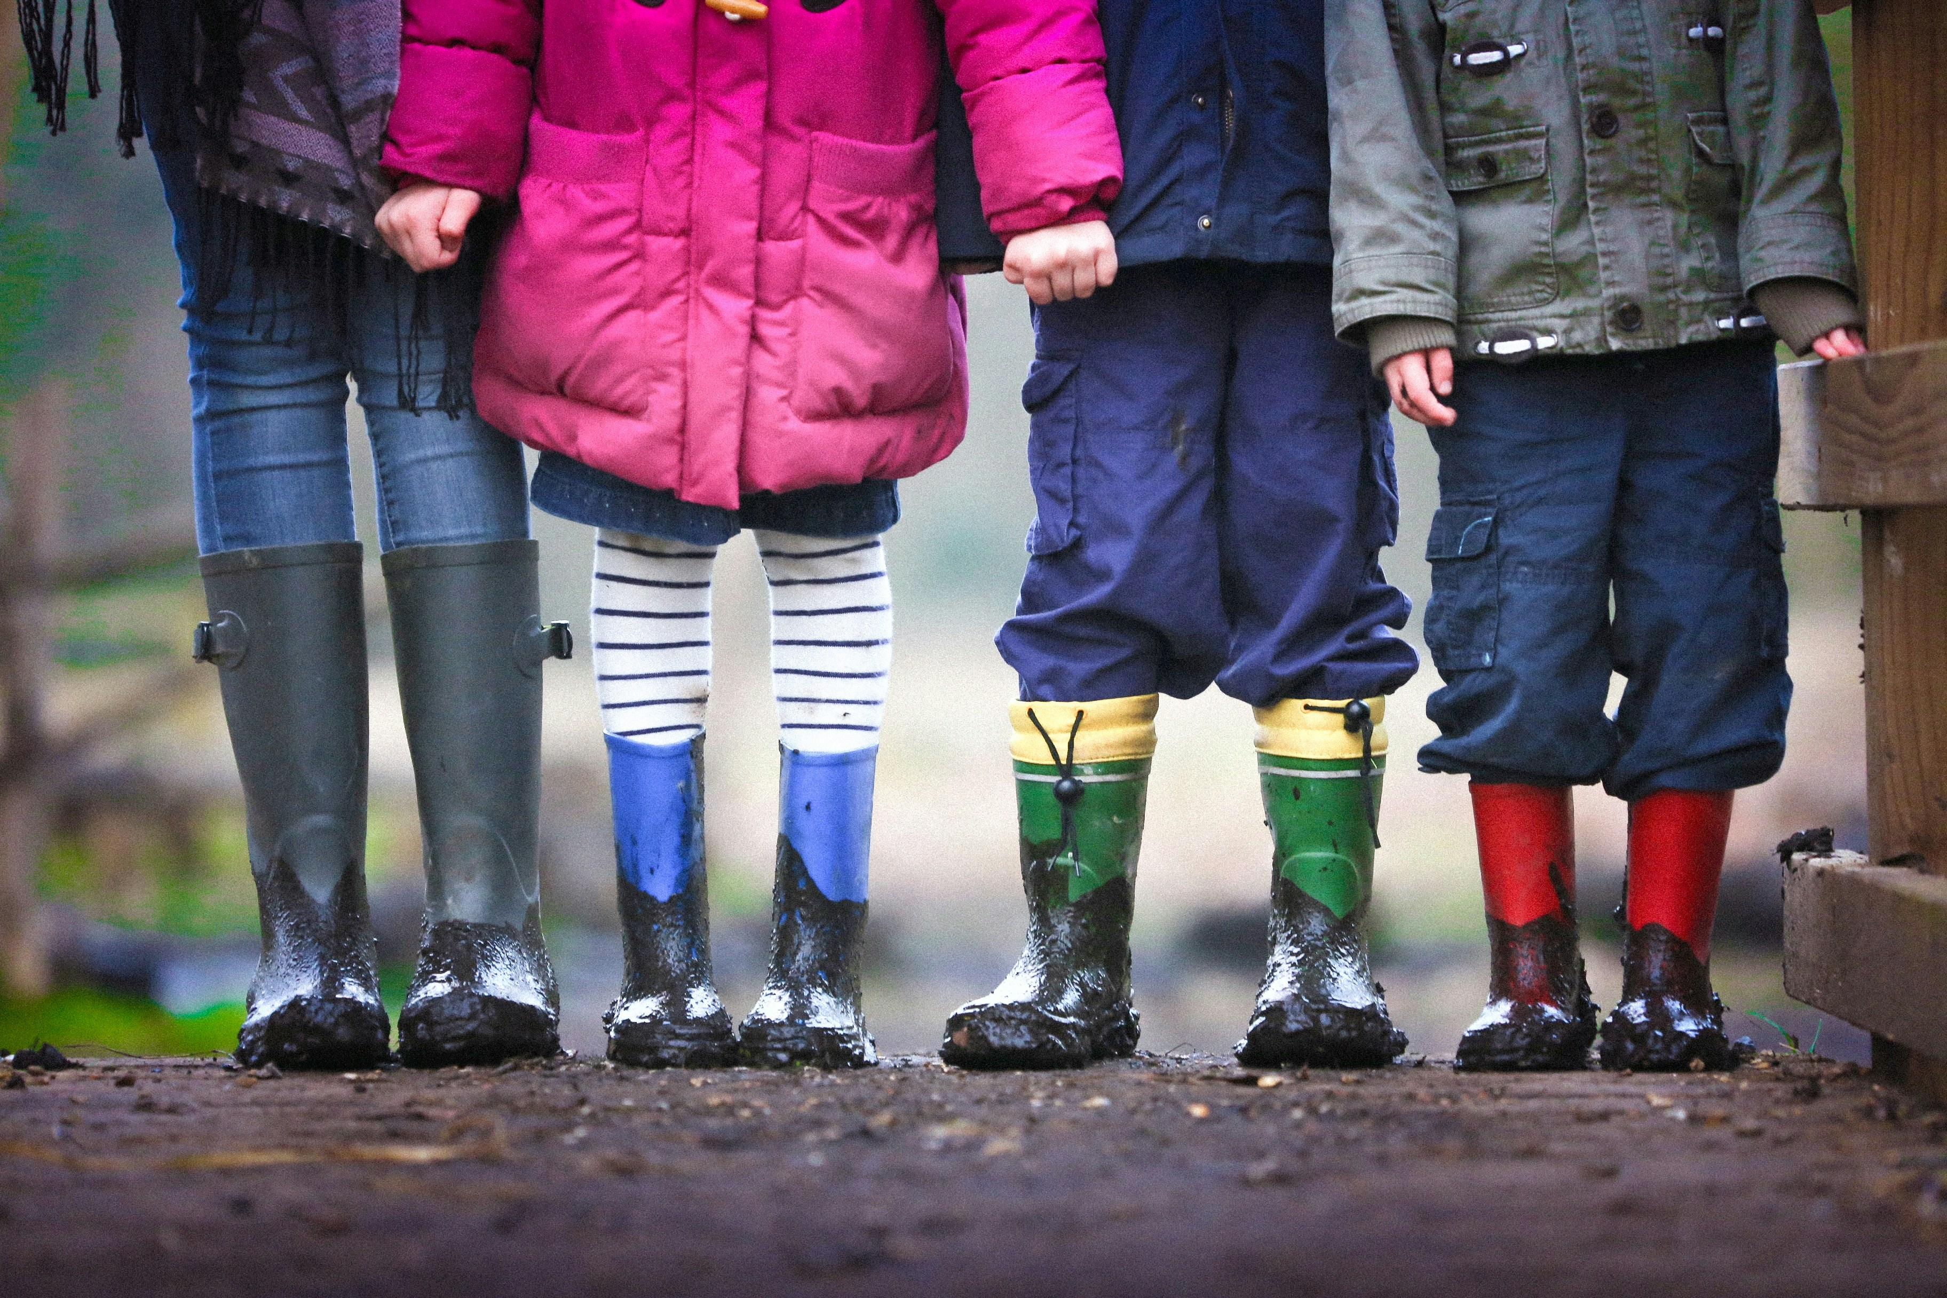
Do you get ready in any of these ways during your day? Can you think of any other ways you get ready or prepare for things?
In today’s gospel, Jesus talks about the time when he will come again. Do you remember what he says about when that will be?
Jesus says nobody except God knows when Jesus will come again. But as his followers we should still try to be ready to greet him when he comes.
How do you think we can be ready for Jesus? What kind of people should we be so that we are ready for Jesus?
Notes:
Photo credit: Ben Wicks on Unsplash

Slide 8
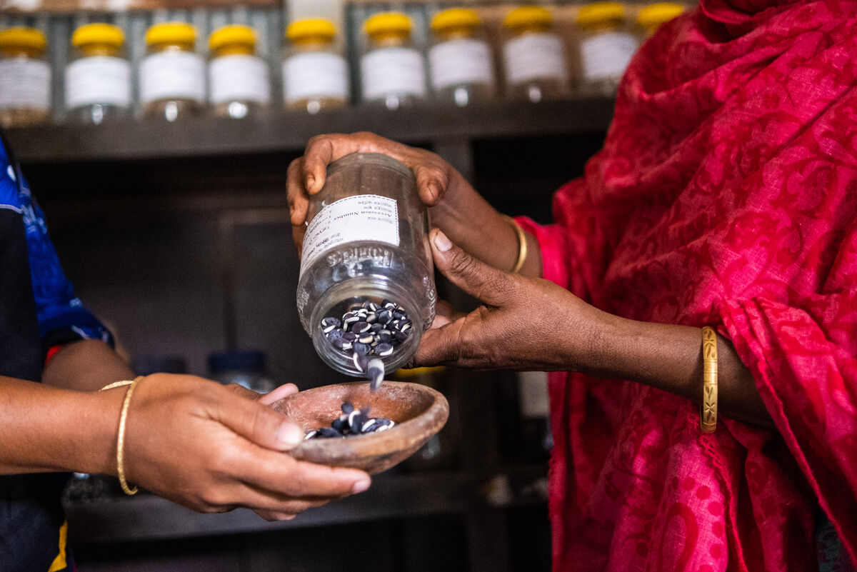
We can try to be ready by doing all that Jesus asks of us: by loving God and one another and by helping other people; by living in peace with each other and by sharing what we have so that all people have enough.
What will you do so that you can try to be ready when Jesus comes again in glory?
Notes:
Photo credit: Sharmin Akthem and Anowera Begum, Bangladesh
Amit Rudro

Slide 9
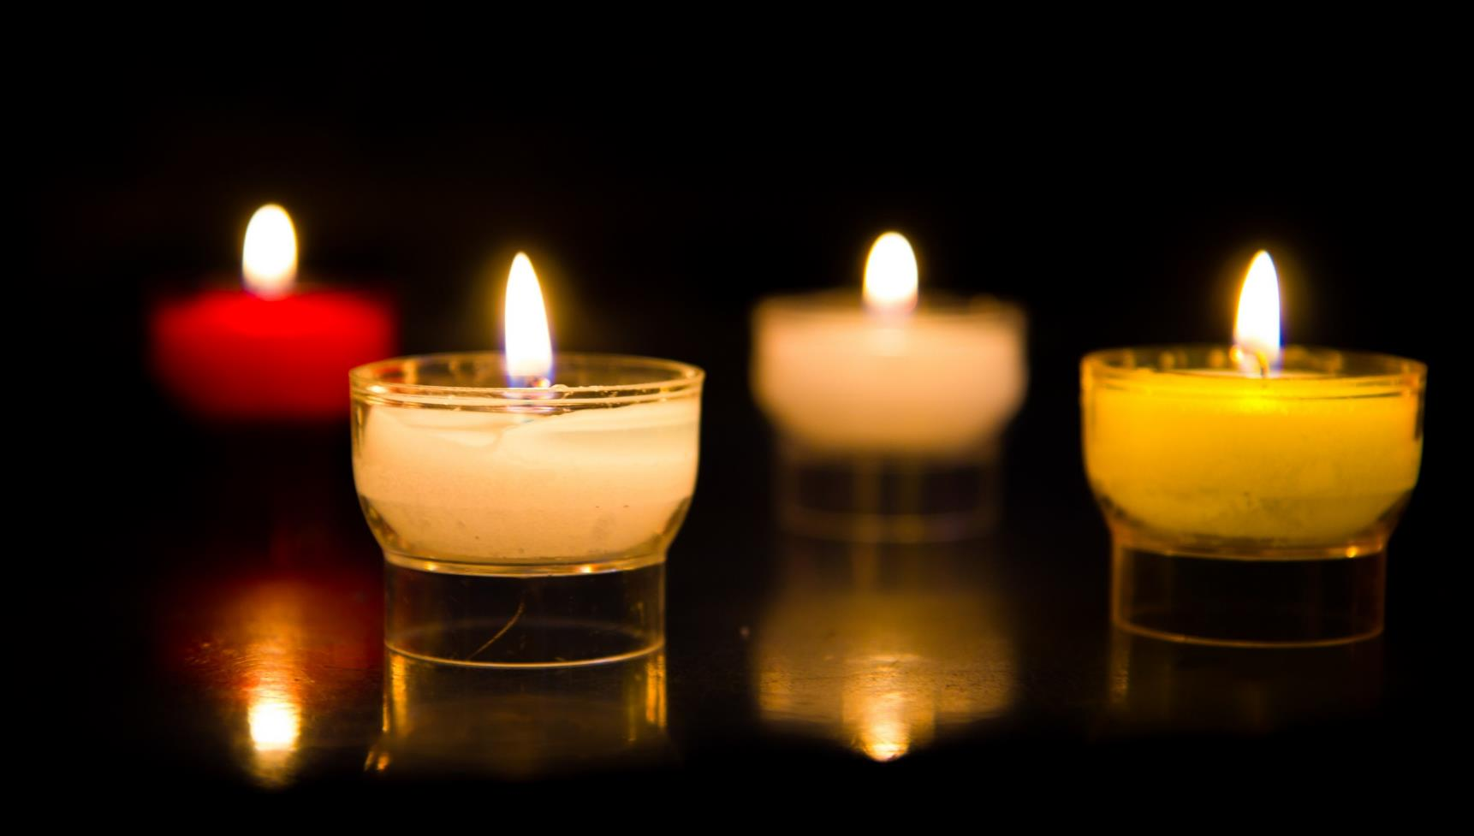
Let us pray…

Slide 10
We pray for the Church throughout the world: that it may be an example of generous, welcoming love for all people, leading the way for when Jesus comes again. Lord, in your mercy…
We pray for all children around the world: that they may have the chance to go to school, to learn and prepare for the future.
Lord, in your mercy…

Slide 11
We pray for our parish, family and friends: that we may always try to be kind, loving and generous to others, so that we may be ready when Jesus comes again.
Lord, in your mercy…
God of power, show us how to live in peace and harmony with each other, so that we may be ready to welcome your Son Jesus when he comes again in glory. Amen.

Slide 12
What will you do so that you can try to be ready when Jesus comes again in glory?
Send
Notes:
Photo credit: Yulia Gadalina on Unsplash

Slide 13
Activity suggestions
Invite the children to colour in the accompanying illustration of a family preparing for a meal and to draw or write on the back what they will do to prepare for the coming of Jesus.
Remind the children to share all that they have heard and thought about today with the people at home and to do their best to try and live so that they will be ready for Jesus when he comes again.
Encourage the children to think about how they can show kindness and generosity to their brothers and sisters around the world as Jesus taught. Putting CST into practice (cafod.org.uk)
Ask the children to think about all the children around the world who do similar things to them every time they prepare for something this week – getting ready for school, or bed, or dinner, or a party, etc.

Slide 14
Advent save the date!
Join our next national assembly! Come together with schools across England and Wales to mark the start of Advent.
Watch live on Tuesday 28 November at 9.30am or at any time during Advent.
CAFOD's Advent calendar will help us prepare together to be the best people we can be to celebrate the birth of Jesus – reflections, activities, prayers and actions for each day of Advent. Download it here
This Advent, we are asking schools across England and Wales to consider fundraising for a £100 CAFOD Christmas stocking, full of life-changing gifts. Find out more about the stocking and a poster to support your fundraising. Explore World Gifts
Why not use CAFOD Advent prayers cards as part of your Advent preparation? Order them for free here

Slide 15
Notes:
Illustration: Emma Metcalfe

