Slide 1
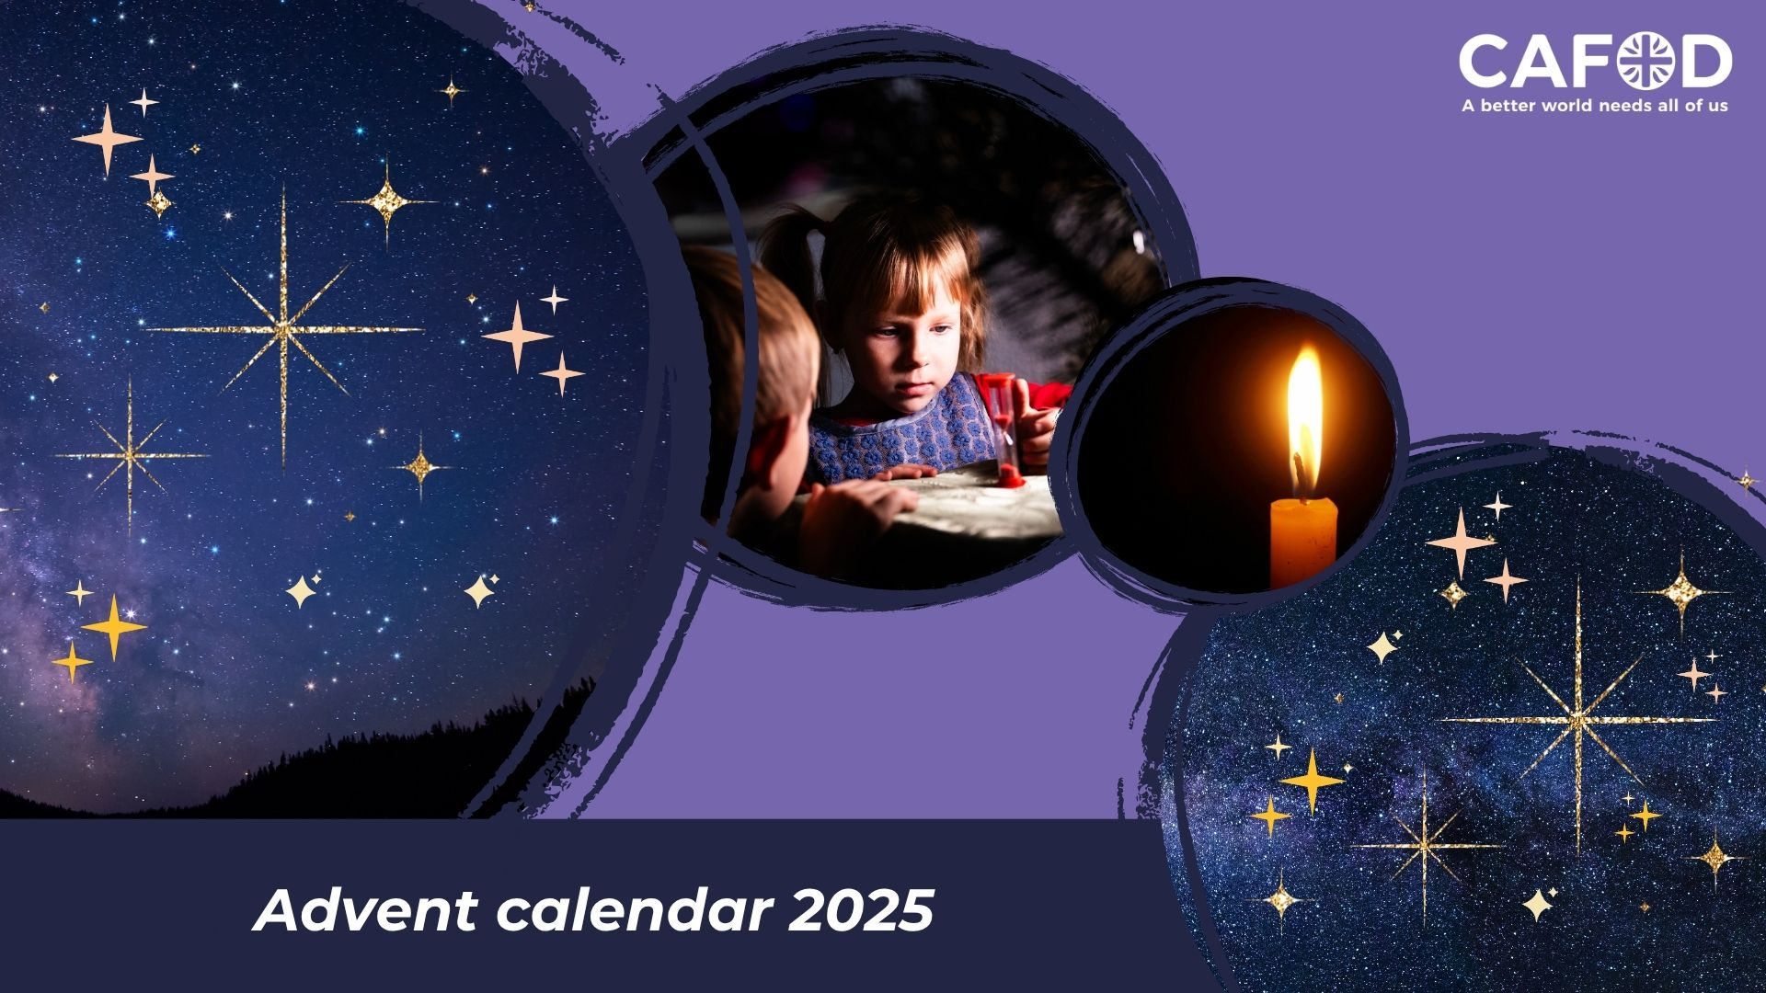

Slide 2

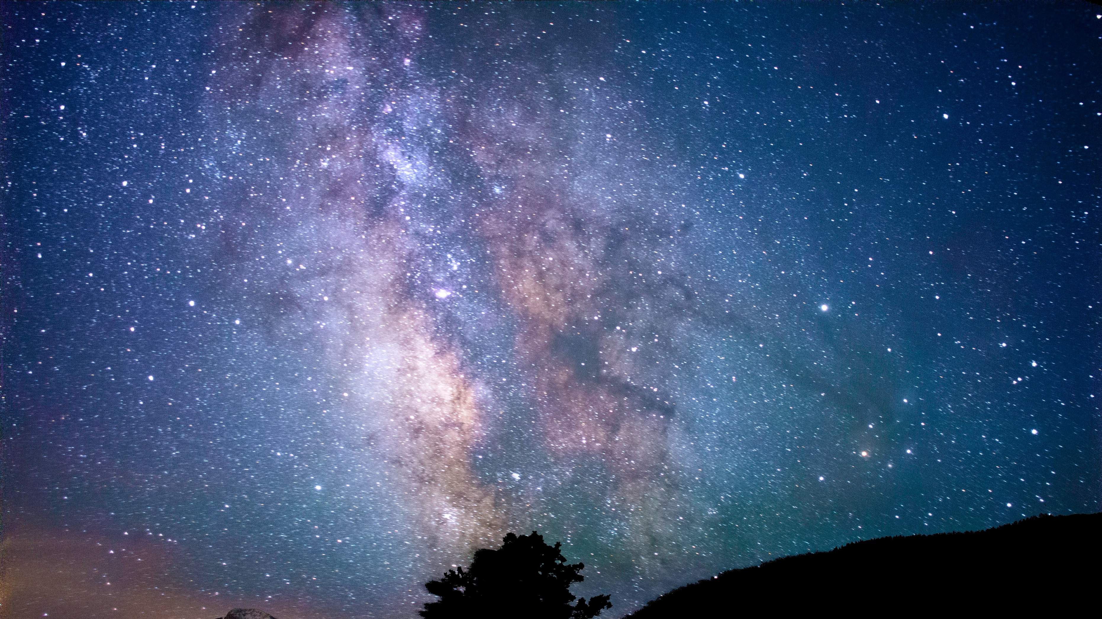
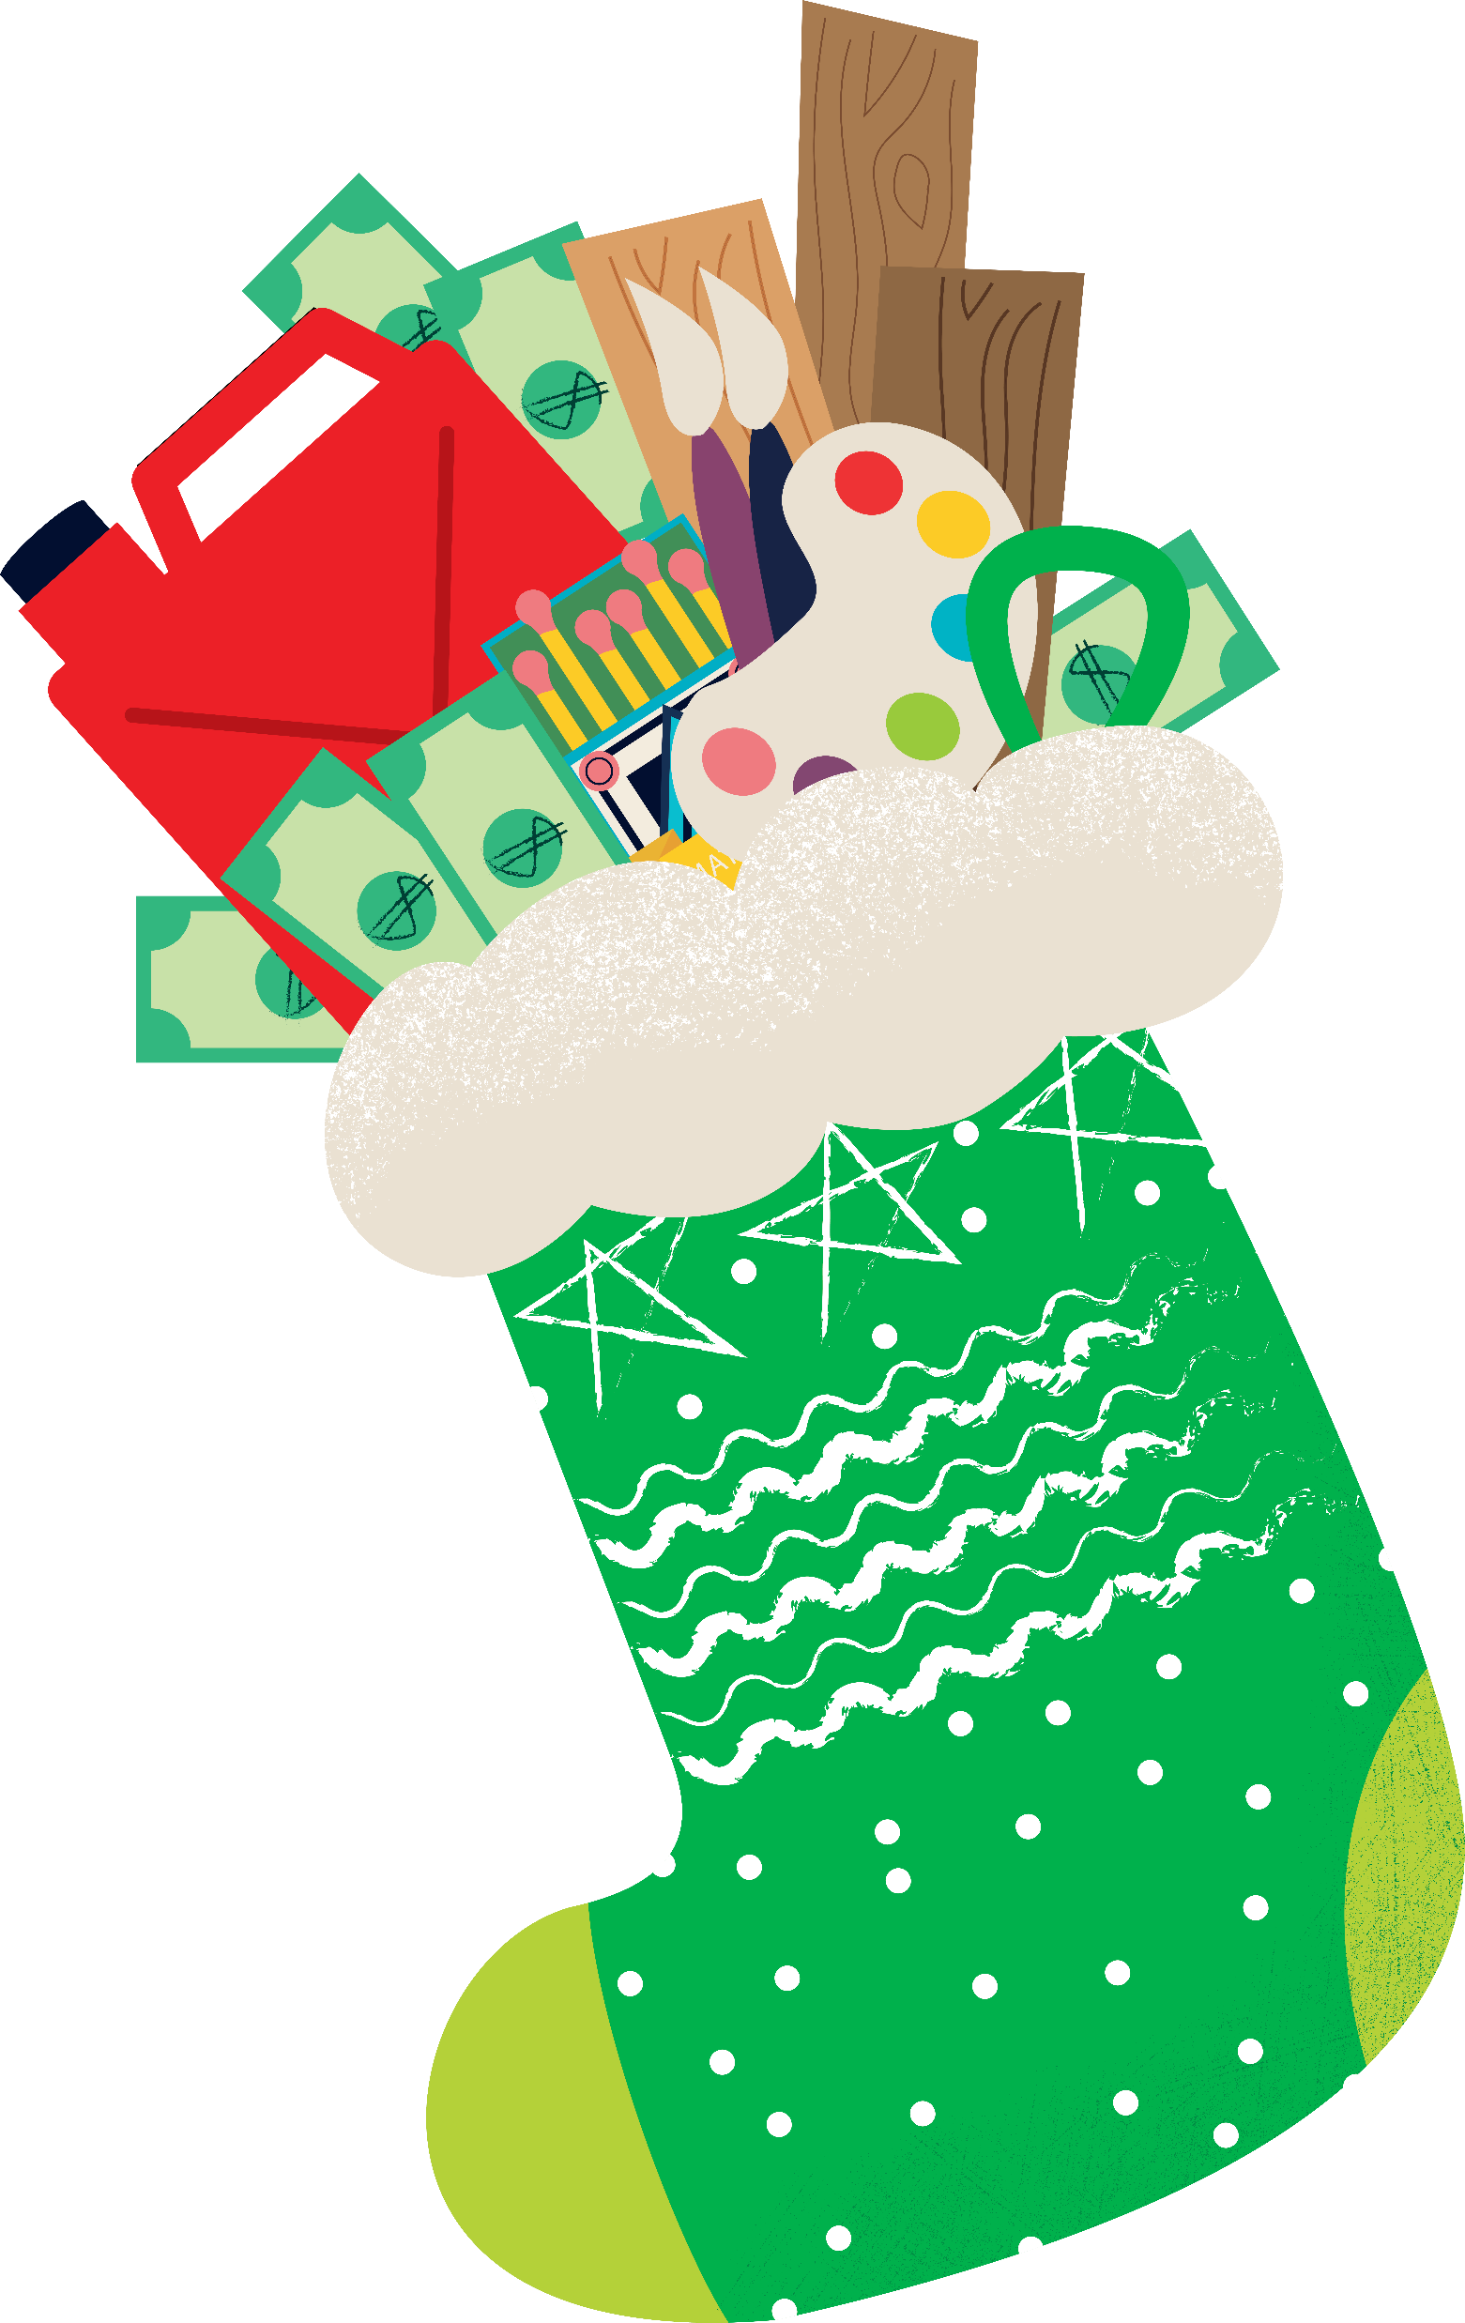


Welcome to the CAFOD Advent calendar
Advent is a time to prepare and reflect: to look up to God, to look in at ourselves, and then to look out to the world around us. Each day of the calendar includes two pages of reflection and prayer.
As we reflect on what it means to wait for Jesus’ arrival this Advent, we’re reminded of our brothers and sisters around the world who are also praying for hope, love, joy and peace.
Throughout our Advent calendar, we'll be looking at projects that are supported by World Gifts, CAFOD's range of virtual charity gifts that will help transform the lives of families and communities living in poverty.
Our special World Gifts Christmas stocking is £100 and includes the gifts of:
Promoting peace
Firewood for winter
Therapy through play
Winter survival kit
Super soup kitchen
As we look forward to welcoming Jesus at Christmas time, let's start our Advent journey.

Slide 3

15
20
24
7
12
21
1
19
4
23
16
14
6
18
2
8
3
25
22
9
13
10
17
5
11

Slide 4

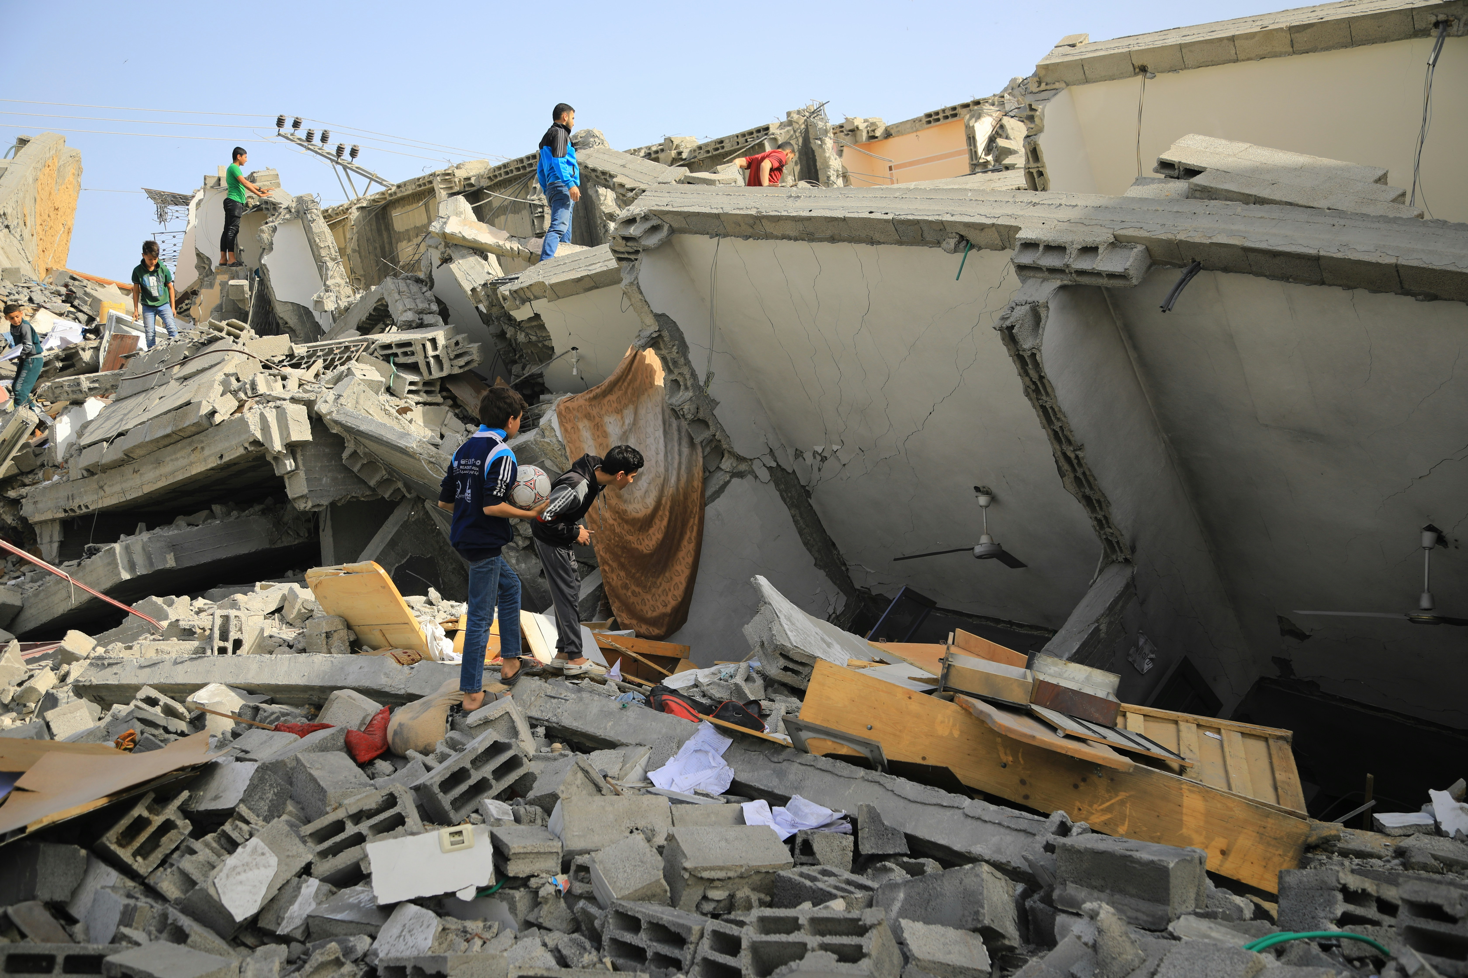
1 December
"Peace be within your walls and security in your towers!" Psalm 122:7
Peace, perfect peace
Home is the place we can return to at the end of the day. It's the place where we can put our feet up, eat something, be surrounded by our loved ones and rest, ready to face a new day tomorrow.
At least that’s the theory. Sadly, for so many people around the world, it is a dream rather than a reality.
Notes:
Destroyed building
Photo credit: Mohammed al Bardawil

Slide 5
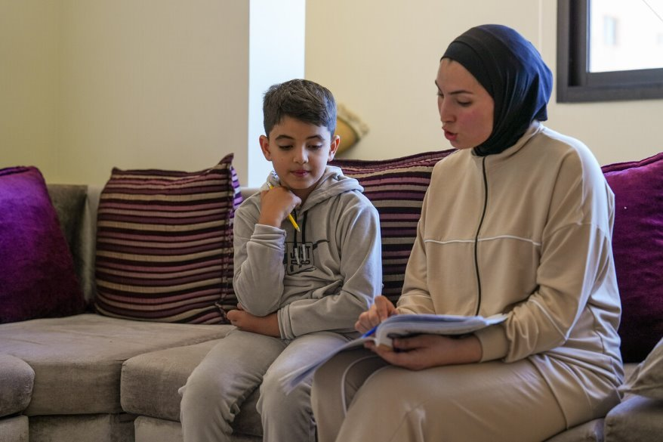
1 December
Zein is eight years old and had to leave his home in southern Lebanon because of war. He is staying at a camp for displaced people in northern Lebanon. With CAFOD's help, the families here receive food parcels and bedding.
"What I want most is to go back home," says Zein. "No one understands the value of home until they leave it."
Find out about this little boy who just wants to live in peace. Zein's story
Let us pray today for peace in every home throughout the world and work for peace among our family, friends, local community and throughout the world.
Amen.
Zein studies with his sister Jinane
Promoting peace World Gift
Notes:
Zein with his sister, Jinane
Photo credit: Elisa Oddone/Arete/DEC

Slide 6
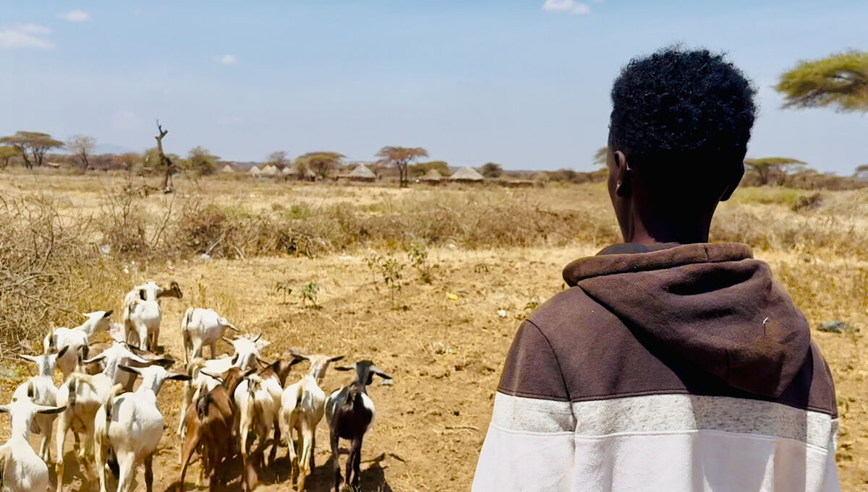
2 December
"I thank you Father, Lord of heaven and earth, that you have hidden these things from the wise and understanding and revealed them to little children." Luke 10:21
We are young
Sometimes children and young people find it difficult to know how to help with the problems in the world. At times, we may feel quite helpless and think that nothing we do can change things.
In this reading, Jesus emphasises how important children and young people are and the difference they can make.
So what are the things we can do to make a difference in our world today?
Abadhalee takes care of goats
Notes:
Abadhalee, Southern Ethiopia
Photo credit: Louise Norton

Slide 7
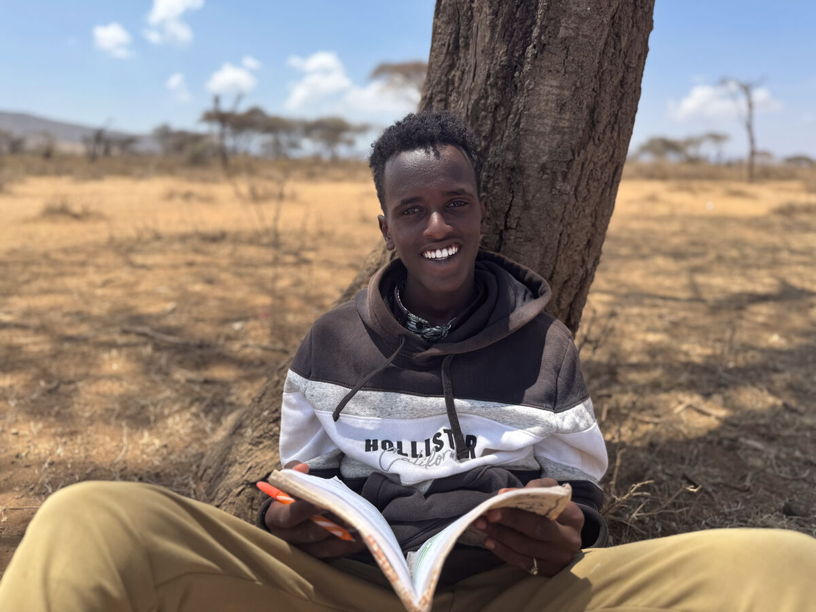
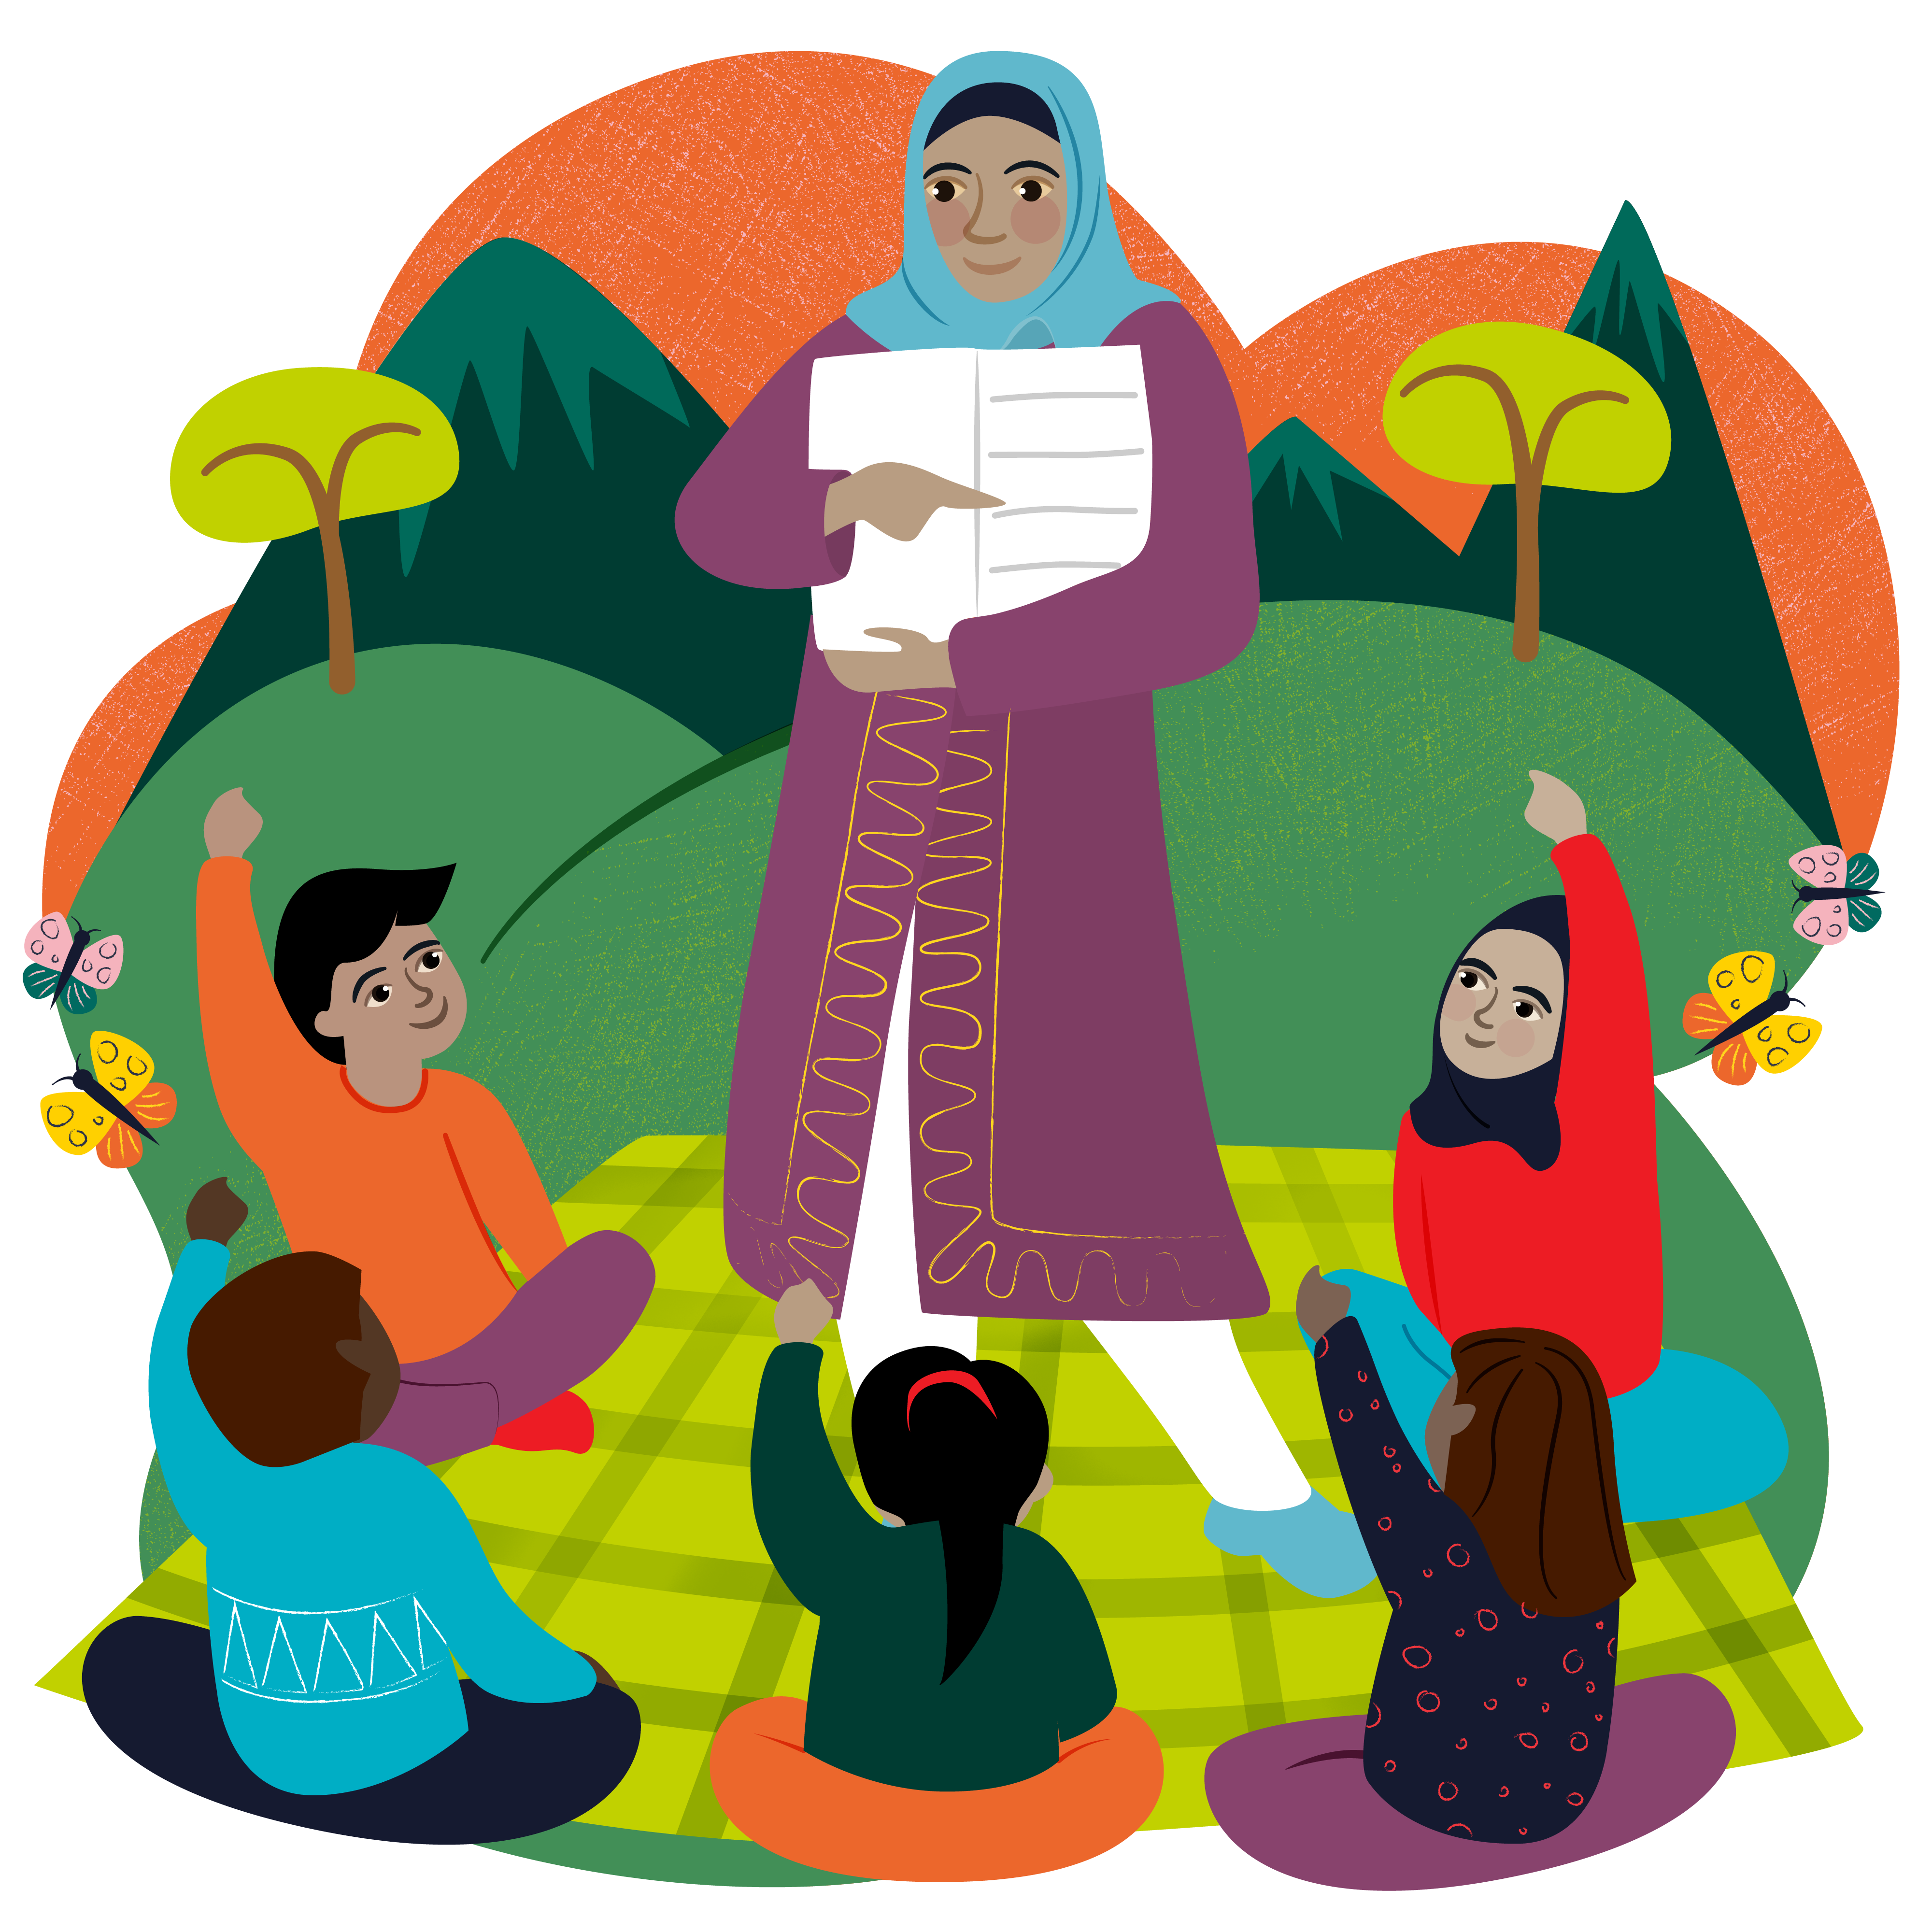
2 December
“I want to tackle poverty – that's why I want to study economics,” says Abadhalee.
Drought in Southern Ethiopia means water is scarce. Abadhalee's mum, Adi, often walked five hours to fetch water for her family. With CAFOD's help, a water tank was installed by their village and it's now a much shorter walk.
Abadhalee knows a better world needs all of us. “I'd like to create an organisation supporting my community to move out of poverty,” he explains.
Watch CAFOD's A better world needs all of us
Abadhalee and his books
Lord, in this year of Jubilee, help us remember that young people can be Pilgrims of Hope by being kind to those around us, praying for our global family and raising money for CAFOD. Amen.
    Teach someone to read World Gift
Notes:
Abadhalee, Southern Ethiopia
Photo credit: Louise Norton

Slide 8
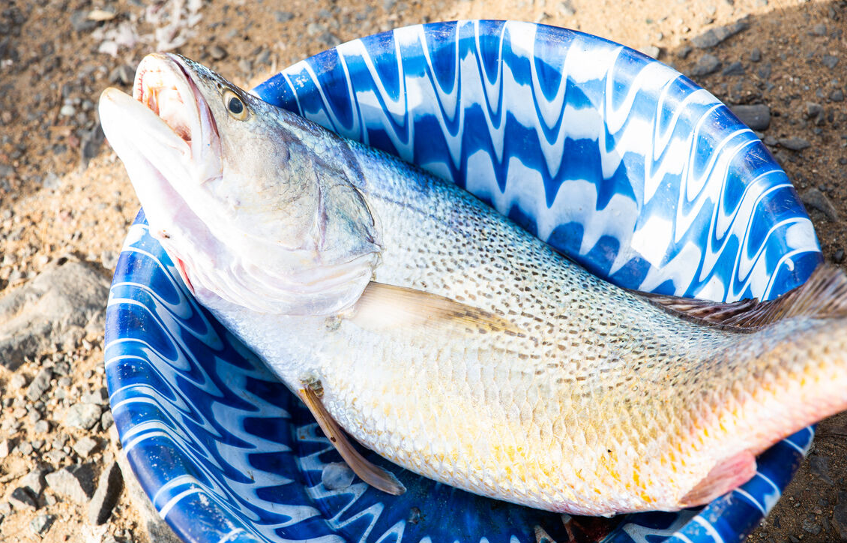
3 December
Jesus called his disciples to him and said, "I have compassion on the crowd because they have been with me now three days and have nothing to eat. And I am unwilling to send them away hungry, lest they faint on the way." Matthew 15:32
Feeding the 5,000
Jesus takes pity on the crowd and shares out seven loaves and a few small fish to feed them all. It is a story of welcome, of compassion and of practical help from Jesus.
The rest of the reading is the well-known story of how a young boy brings five loaves and two fishes to Jesus which he shares out among 5,000 people.
How can we best share what we have with others?
Notes:
Catch in Liberia
Photo credit: Thom Flint

Slide 9
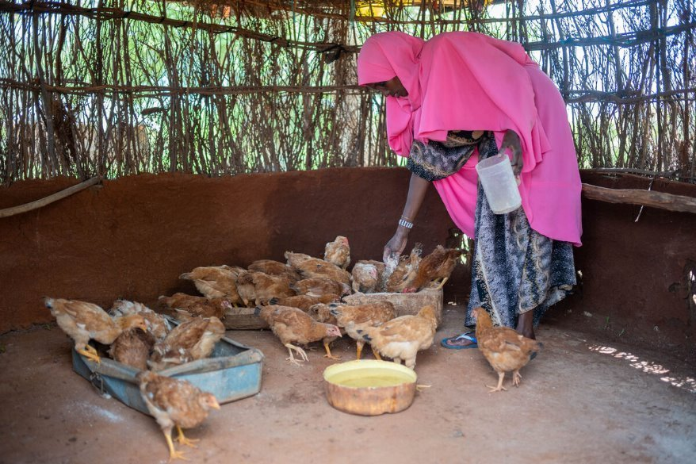
3 December
Severe drought meant Chirri's family struggled to make a living. "There was no rain for years,” she says. “We had to get water far away. We started our journey at seven and came back at ten. I got tired and thirsty. The sun was way too hot.”
With CAFOD's help, the community were given chickens to raise. They eat the eggs the chickens lay and sell what's left over to buy food, clothes and soap.
Chirri enjoys helping with the chickens. “My mum taught me how to take care of the chickens. I like eating the eggs too – fried for breakfast!”
We pray for those around the world who do not have enough to eat. Just as the young boy helped Jesus with loaves and fishes, let us do what we can to help those who are hungry. Amen.
Chirri's mum Kerra
Chirpy chickens World Gift
Notes:
Kerra and her chickens, Kenya
Photo credit: Joe Newman

Slide 10
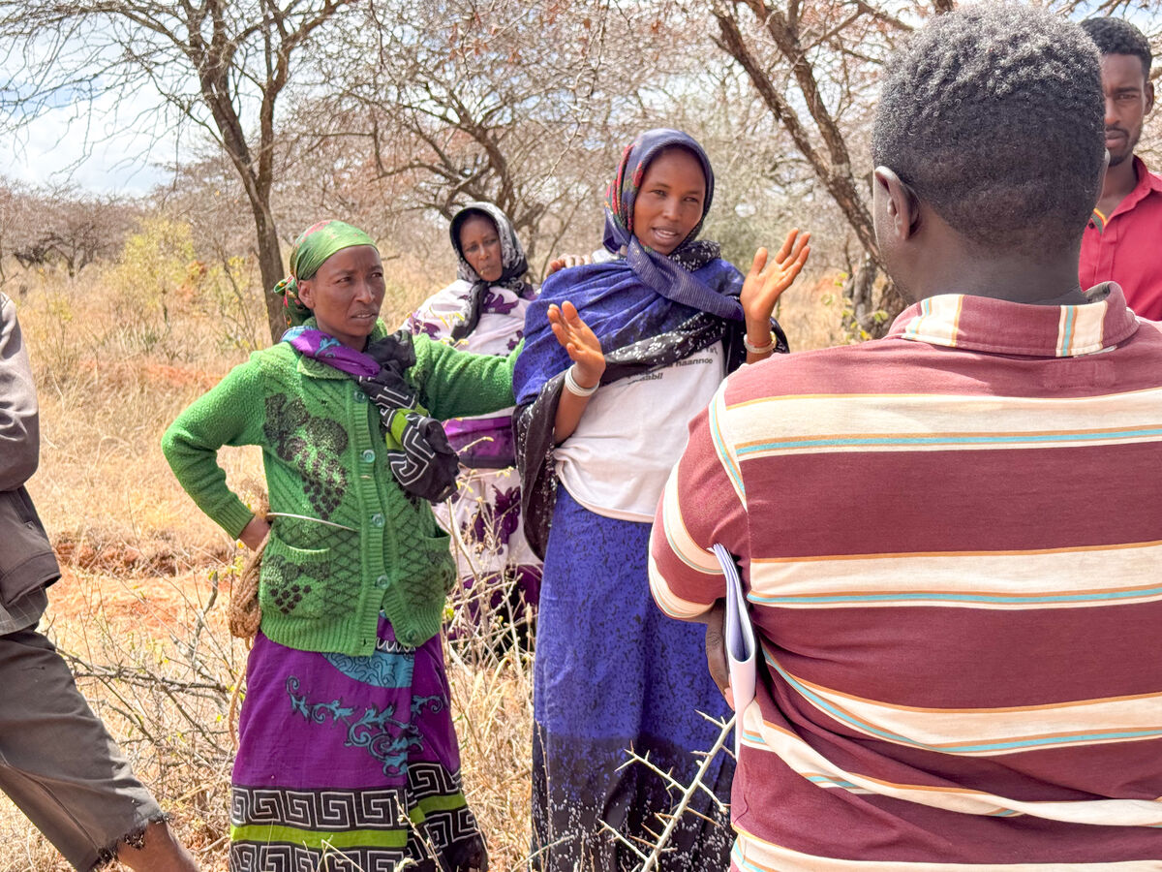
4 December
"Not everyone who says to me, ‘Lord, Lord’, will enter the kingdom of heaven, but the one who does the will of my Father who is in heaven." Matthew 7:21
Actions speak louder than words
The phrase 'actions speak louder than words' means what we actually do is more important than just saying we are going to do something. And this is what this reading highlights.
There are many times when we have good intentions, but life sometimes gets in the way, it seems.
In this year of Jubilee, how can we be Pilgrims of Hope in our world, particularly during Advent as we prepare for the birth of Jesus?
Abbiott discusses the water project
Notes:
Abbiott with his community, Southern Ethiopia
Photo credit: Louise Norton

Slide 11
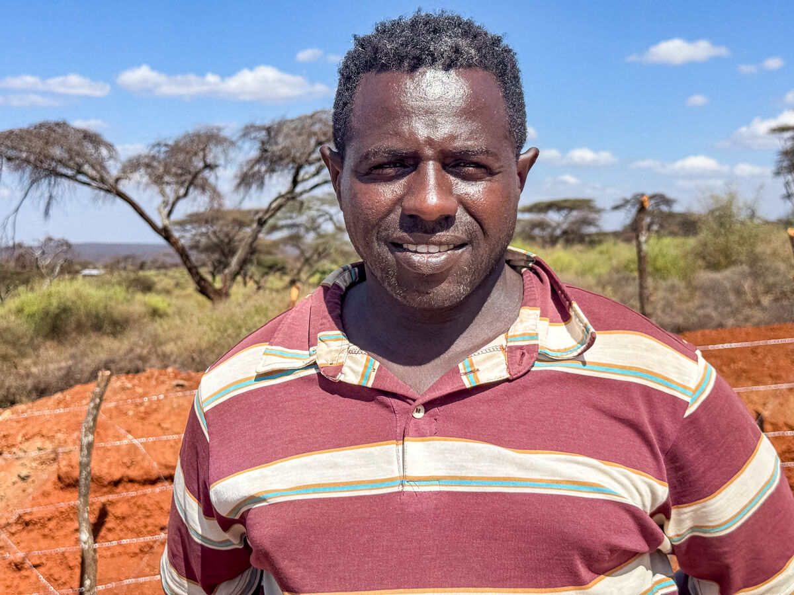
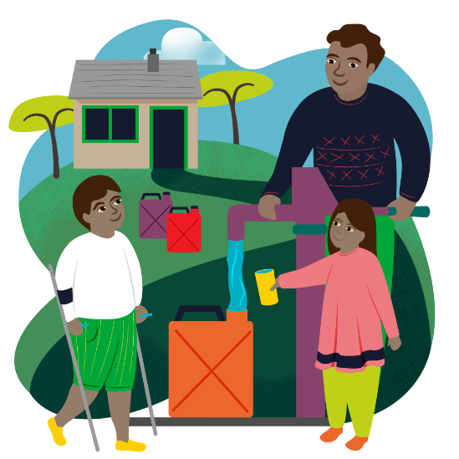
4 December
    Abbiott is a climate change officer where he grew up in Southern Ethiopia. Changing weather has affected his people. “When I was a child, this Borana land was not affected by climate change. We had milk and cheese and no water problem.”
    Drought meant drinking water was scarce and crops and cattle died. Abbiott wanted to do something, studying climate change to help his community and working to build a better world.
    Pope Francis asked us to care for our common home, like Abbiott. Watch Laudato Si'
    As we prepare for the birth of Jesus, we pray to be kind, helpful and that our actions speak louder than words, showing others that a better world needs all of us.
    Amen.
Abbiott
Water for a family World Gift
Notes:
Abbiott, Southern Ethiopia
Photo credit: Louise Norton

Slide 12

5 December
"Wait for the Lord; be strong and let your heart take courage; wait for the Lord!" Psalm 27:14
Hope encouraging hope
'Courage' and 'Hope' are important words in this year of Jubilee, where we have been called to be Pilgrims of Hope; leading by example in the things we say and do – seeking a better world, one where all people and creation can flourish.
We are coming towards the end of the Jubilee Year, which officially finishes on 6 January 2026.
How can we continue to be signs of hope in this world? Write a message of hope to someone using CAFOD's Postcards of Hope set. What might your special message be? How can we encourage others to be hopeful?

Slide 13
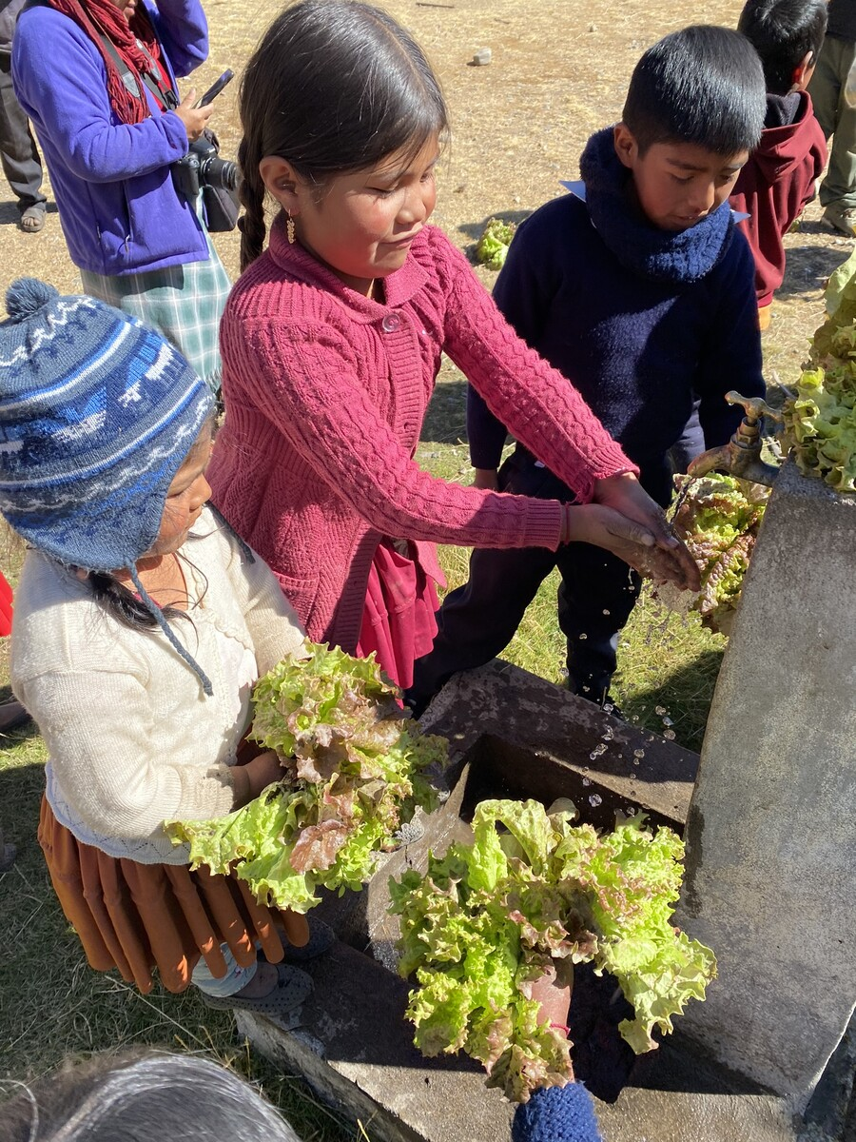
5 December
With CAFOD's help, communities in Cochabamba in Bolivia are learning about environmentally-friendly farming and understanding how to grow nutritious food to feed their families. In spite of changing weather patterns that have affected crops in recent years, they will have enough to eat and extra produce to sell to make a living.
Children and young people like Rosa are finding out about protecting the environment, connecting with the natural world and building on, and celebrating, their indigenous knowledge and culture.
All this brings hope for the future.
As we prepare for Advent during this Jubilee Year, help us to be Pilgrims of Hope, Lord, by being kind and thoughtful, always remembering that a better world needs all of us.
Amen.
Rosa and friends
Christmas stocking World Gift
Notes:
Rosa and her friends, Bolivia
Photo credit: Nikki Evans

Slide 14
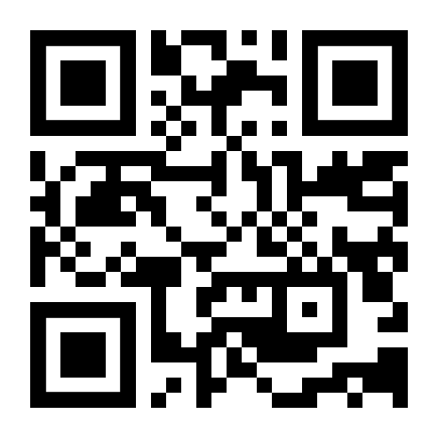
6 and 7 December
It’s the weekend!
Here are a few exciting things we’ve got coming up:
Look out for new Volunteer workshops coming in January 2026!
Look out for our Lent resources on floating gardens in Bangladesh
Sign up to the Big Lent Walk for 2026!

Slide 15
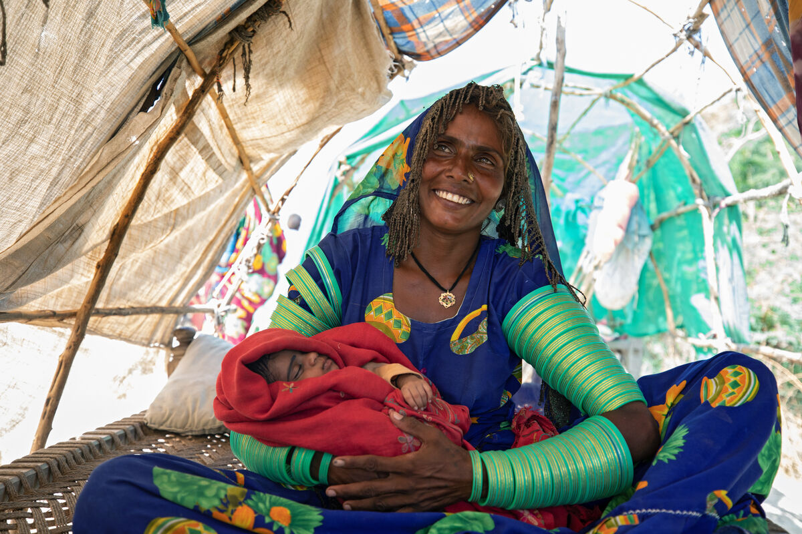
8 December
And Mary said, "Behold, I am the servant of the Lord; let it be to me according to your word." And the angel departed from her. Luke 1:38
A frightened young mum
Today we are celebrating the Feast of the Immaculate Conception.
Let's imagine what it must have been like for Mary when the angel Gabriel appeared to her and asked her to be the mother of Jesus.
Wouldn't she have felt frightened, confused, overwhelmed? Mary knew it would be difficult, yet she said ‘yes’. She trusted in God.
There'll be times when we feel like Mary. How can trusting in God help us with challenges?
Meera and her baby, Marwi
Notes:
Meera and her baby, Marwi, Pakistan
Photo credit: Community World Service Asia (CWSA)

Slide 16
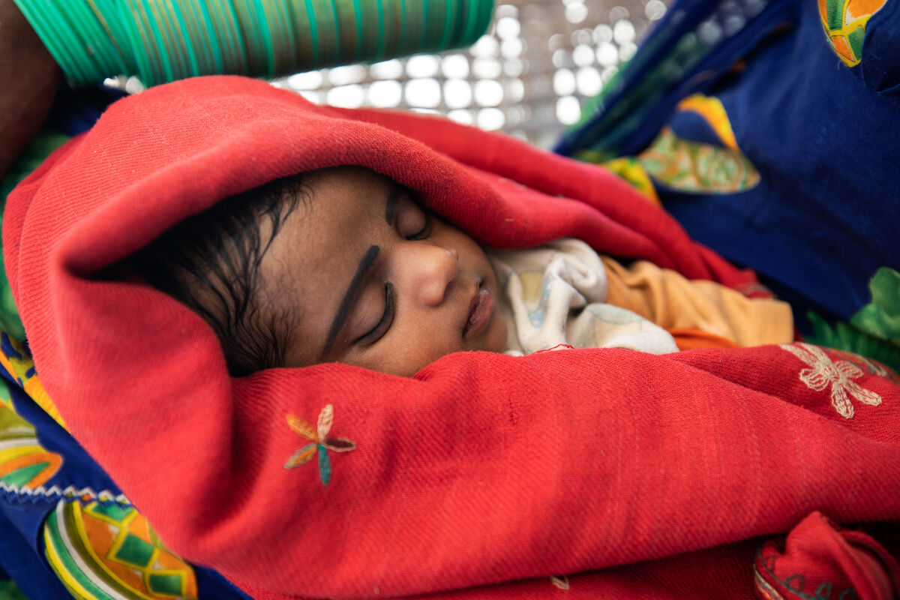
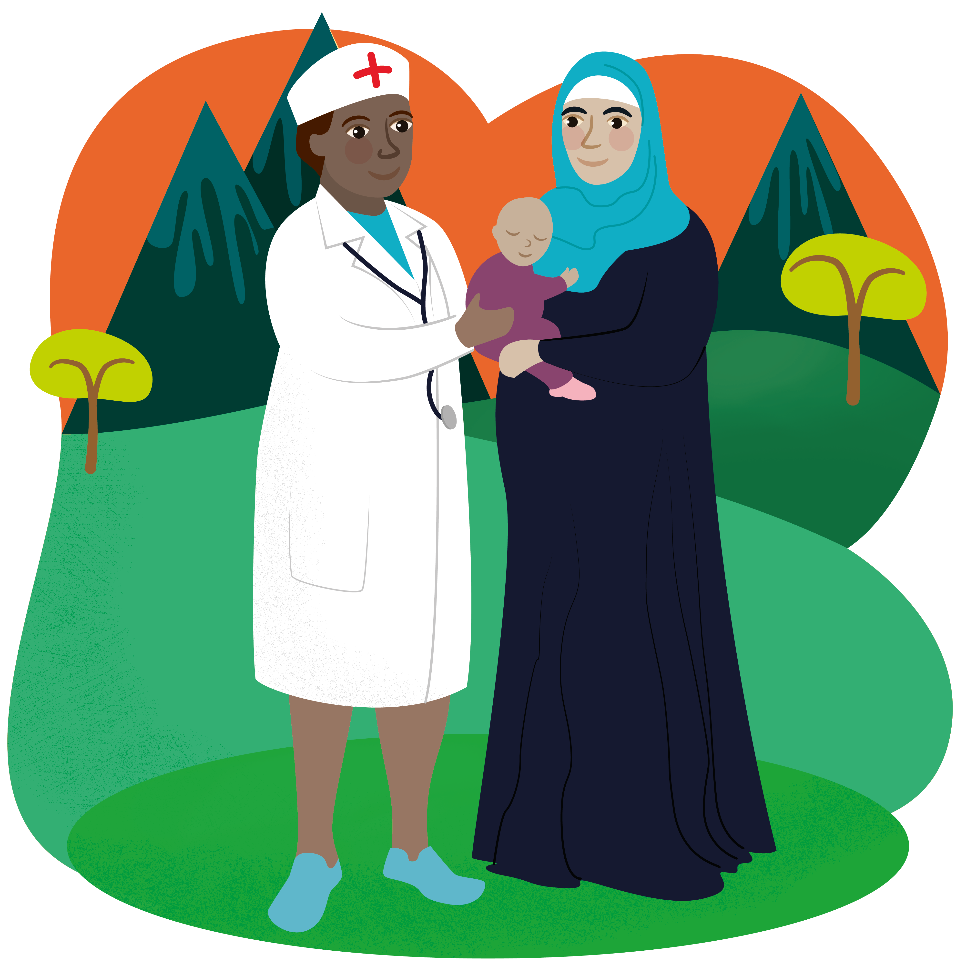
8 December
Meera gave birth to Marwi during floods in Pakistan. "My house was full of water. Just reaching the road to get out to go to the hospital was very difficult," explains Marwi.
"My husband rode me on a bicycle and took
me to the hospital where I delivered the baby," she says.
Marwi, her baby, was very sick. A medical camp funded by CAFOD gave her much-needed medicine to make her better.
As we prepare for the coming of Jesus at Christmas, we pray for all women around the world preparing to give birth, that they will deliver their babies safely.
Amen.
Marwi
Mother and baby World Gift
Notes:
Marwi, Pakistan
Photo credit: Community World Service Asia (CWSA)

Slide 17
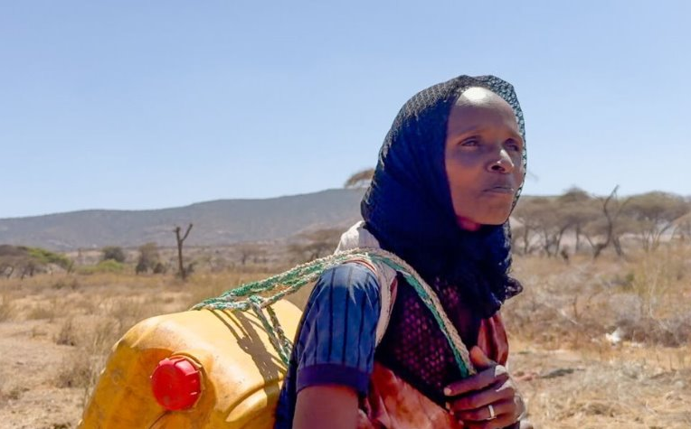
9 December
"Comfort, comfort my people, says your God." Isaiah 40:1
Reaching out
This reading tells us that God wants us to comfort one another when we are feeling sad.
We could be upset for all kinds of reasons – an argument with a friend, struggling with school work, someone sick at home.
Don't be afraid to reach out to someone who needs a friend. What are the ways we can comfort someone if they are feeling anxious or overwhelmed?
Adi fetching water
Notes:
Adi, Southern Ethiopia
Photo credit: Louise Norton

Slide 18
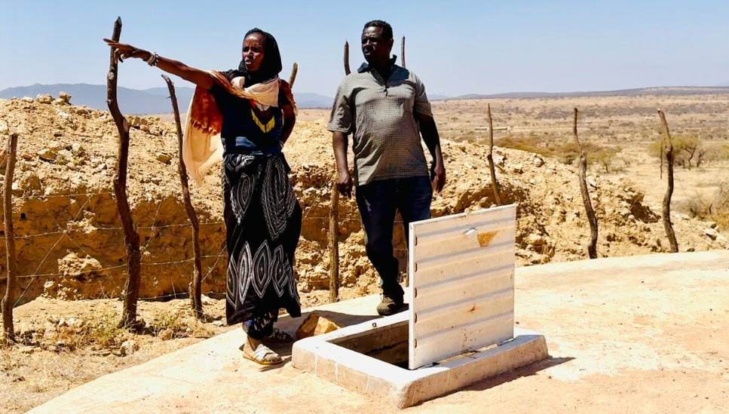
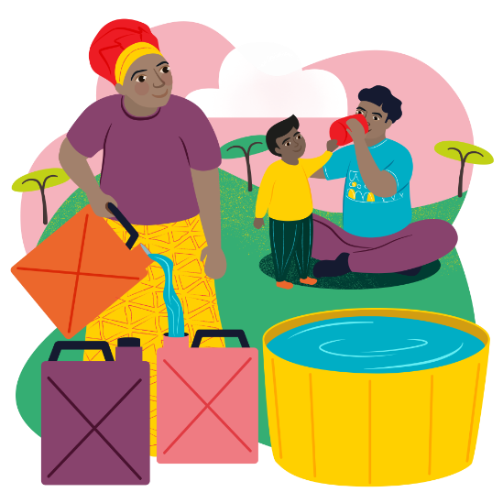
9 December
Adi often had to leave her children alone to fetch water – a round trip of five hours.
With CAFOD's help, a water tank has been installed in the community. It brings great comfort to Adi. She knows a better world needs all of us and helped with the project.
"The community worked with Abbiott to select the best site for the water tank, also helping to carry sand and stone," she says.
"This tank is a blessing," says Adi. "We can now spend time with our children."
We pray that people struggling in their daily lives will find comfort in knowing that God is always with them.
Amen.
Abbiott and Adi at the water tank
Water for a community World Gift
Notes:
Abbiott and Adi at the water tank, Southern Ethiopia
Photo credit: Louise Norton

Slide 19
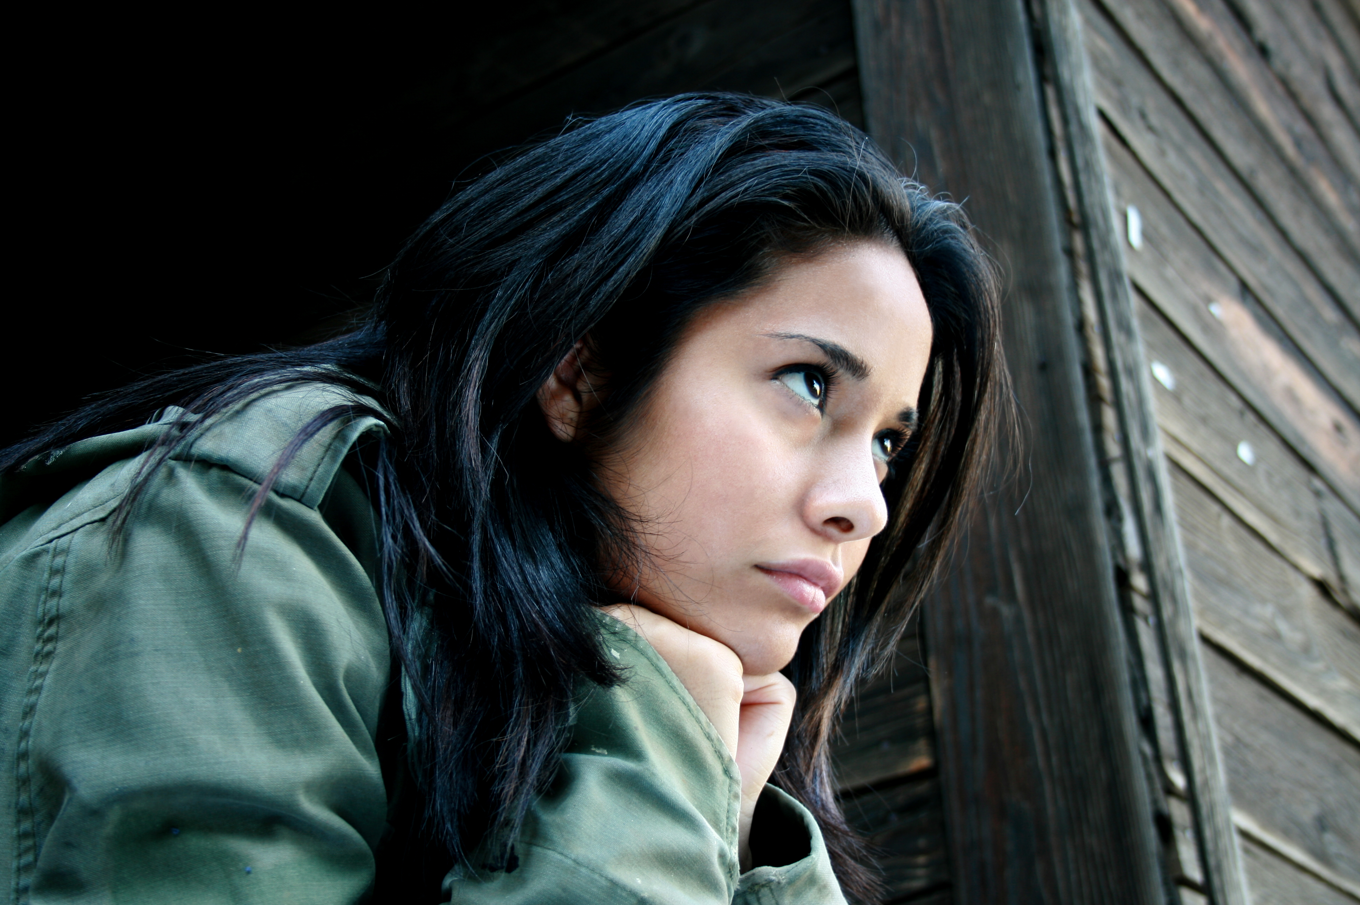
10 December
"Come to me all who labour and are heavy laden, and I will give you rest." Matthew 11:28
All too much...
We all have days when everything just feels too much. We can feel weary at the never ending to do lists in our own lives or at the bigger problems facing our world.
Let's think too about all those people who are working hard to look after their families, but conflict, drought and not enough food makes this difficult.
Today is Human Rights Day, reminding us that everyone in the world, whoever they are and wherever they are, is important.
Notes:
It feels too much
Photo credit: Stock image

Slide 20
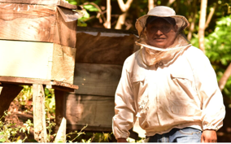
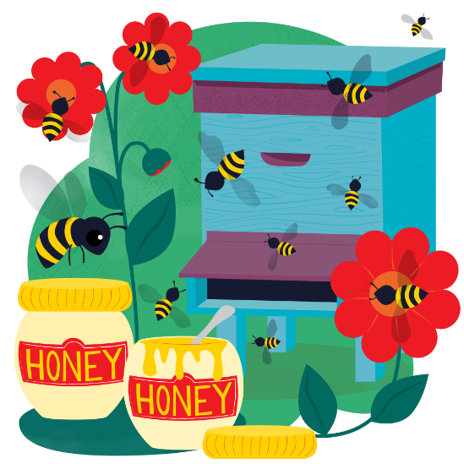
10 December
With CAFOD’s help, Manuel in El Salvador has learned how to keep bees. His hard work is paying off.
“We benefit from bees in many ways: their pollination, the food they provide, the health benefits" says Manuel. "With all this, your love for bees grows even greater!” The money Manuel makes from selling honey helps support his family and their small farm, where they also grow maize and fruit trees (pollinated by their hardworking bees!)
We pray that we can lighten the loads of others, whether they are someone close to us, or someone whose story we hear from around the world.
Amen.
Manuel and his bees
Happy Queen bee World Gift
Notes:
Manuel the bee keeper, El Salvador
Photo credit: Guillermo Aleman

Slide 21
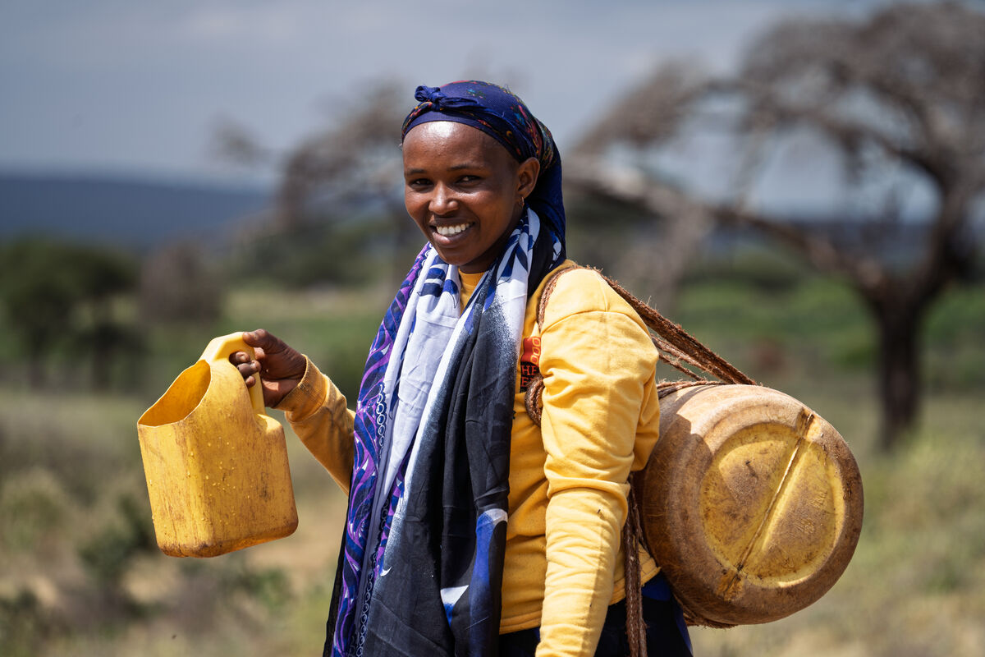
11 December
"When the poor and needy seek water, and there is none, and their tongue is parched with thirst, I the LORD will answer them. I the God of Israel will not forsake them." Isaiah 41:17
Water, water everywhere...?
There are so many places in our world today where people struggle to get the safe, clean water they need to drink, wash and keep crops and animals alive. And yet we are used to water flowing freely from the taps in our homes.
How do you think we would feel if we couldn't have a glass of clean, cold water when we felt thirsty? Or have a bath or shower when we wanted one?
Ware fetching water
Notes:
Ware, Southern Ethiopia
Photo credit: James Cave/ SCIAF

Slide 22
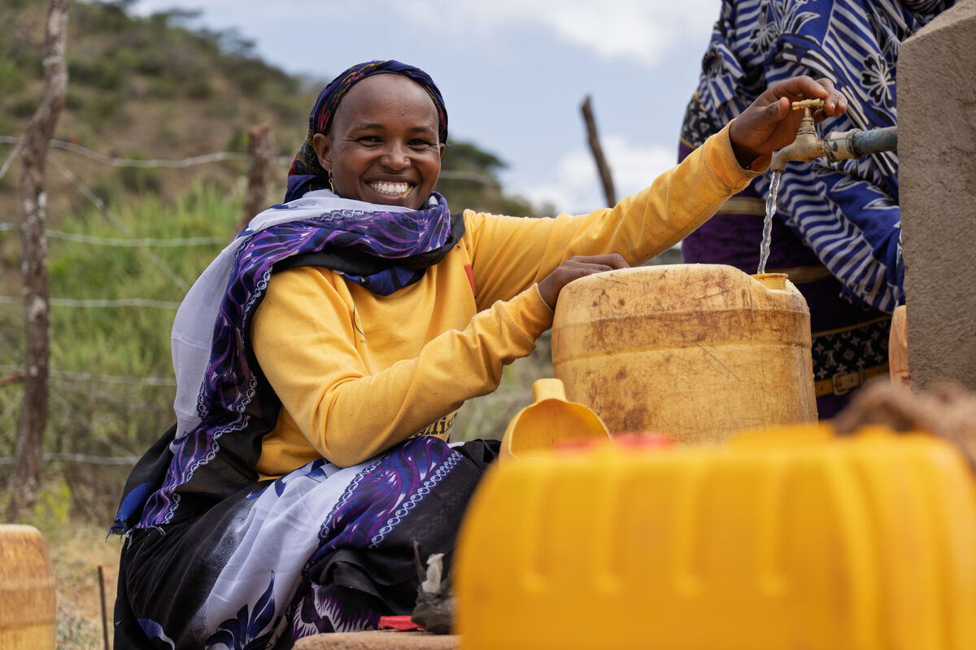
11 December
Ware lives in Southern Ethiopia. Severe drought meant all her livestock died and the family lost everything.
"I was pregnant with my child," explains Ware. "Even pregnant, I had to fetch water in the mountains. Sometimes, I felt so weak, I worried about my child. But God helped me. There were no complications and I gave birth safely."
The new water tank means Ware and her community now have clean water for all their needs and a much shorter walk to fetch it.
Lord, we are thankful for our supply of water to drink, to cook and to wash and we pray for all those around the world who struggle to find clean water.
Amen.
Ware at the water tank
Water for a family World Gift
Notes:
Ware, Southern Ethiopia
Photo credit: James Cave/ SCIAF

Slide 23
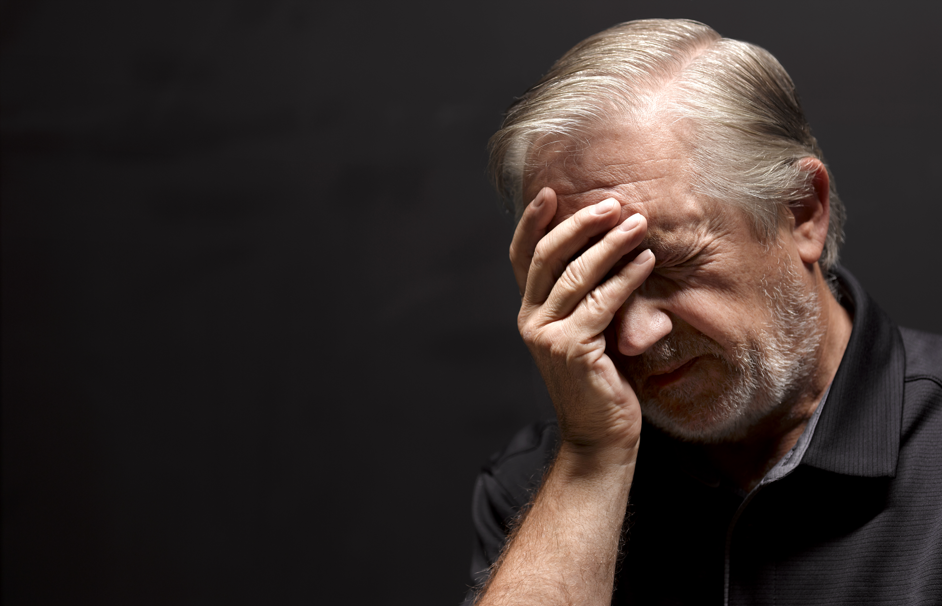
12 December
"The Son of Man came eating and drinking, and they say, ‘Look at him! A glutton and a drunkard, a friend of tax collectors and sinners!’ Yet wisdom is justified by her deeds." Matthew 11:19
Friend to the outcast
Jesus wonders why people are struggling to believe his message of hope because he ate, drank and spent time with ordinary people. He did not go looking for the company of the powerful in society. In fact, he often spent time with those people others were wary of.
What would the world think if Jesus came back in person today and befriended refugees and the homeless, instead of prime ministers and presidents?
Notes:
Worried
Photo credit: Stock image

Slide 24
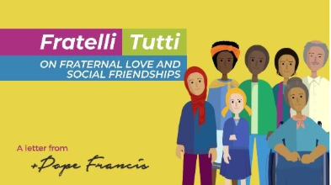
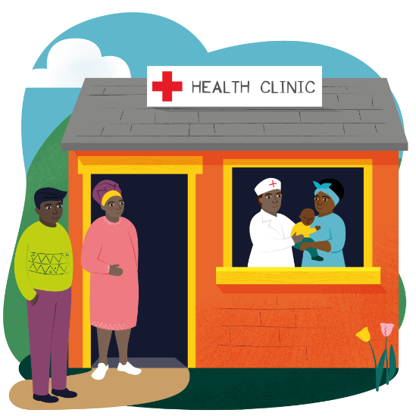
12 December
Pope Francis wrote a letter to everyone in the world, asking us to reach out to our sisters and brothers in need, whoever they are, wherever they may come from. We are all challenged to think of ourselves as a single global family living in one common home, and neighbours to all.
Watch CAFOD's Fratelli Tutti film to see how we can be good global neighbours.
Fratelli Tutti: being a good global neigbour
We pray for people on the margins of our communities. Let us be signs of hope in this Jubilee Year, doing our best to help those that society does not always welcome. Amen.
Health clinic World Gift

Slide 25
13 and 14 December
It’s the weekend!
Here are a few exciting things we’ve got coming up:
Look out for new Volunteer workshops coming in January 2026!
Look out for our Lent resources on floating gardens in Bangladesh
Sign up to the Big Lent Walk for 2026!

Slide 26
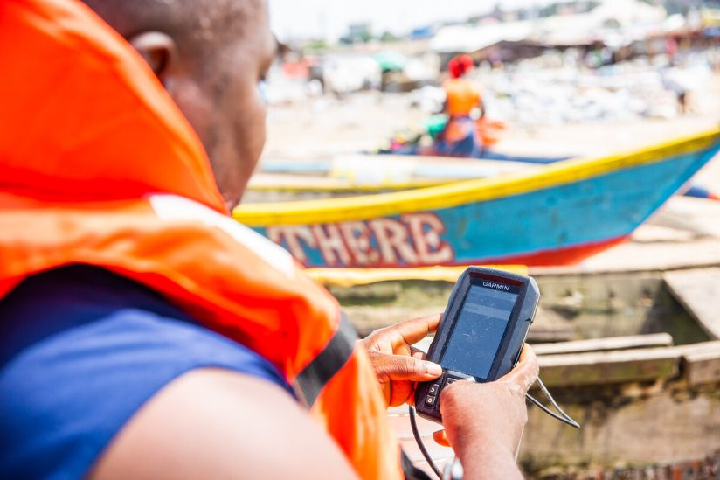
15 December
"Make me know your ways, O Lord; teach me your paths." Psalm 25:4
Which way?
We all have times when we need some guidance, to know which way to go. It could be anything – having trouble with homework, not knowing how to get somewhere, having a sick pet, worrying about a quarrel with a friend.
Isn't it reassuring to know we can always turn to God for guidance?
And because a better world needs all of us, how can we be a good guide for others when they might need help?
Tekon and his fishfinder
Notes:
Fisherman Tekon, Liberia
Photo credit: Thom Flint

Slide 27
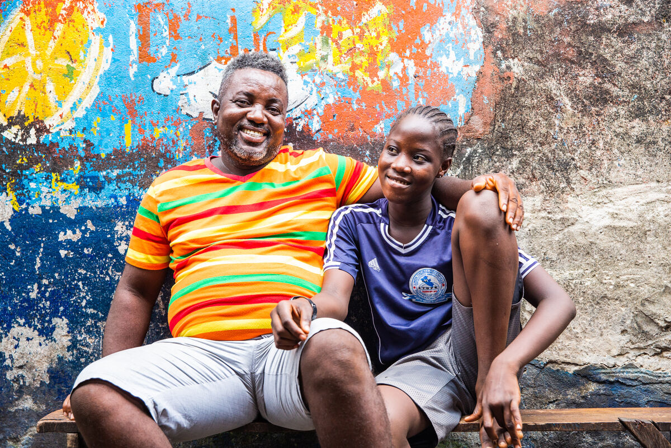
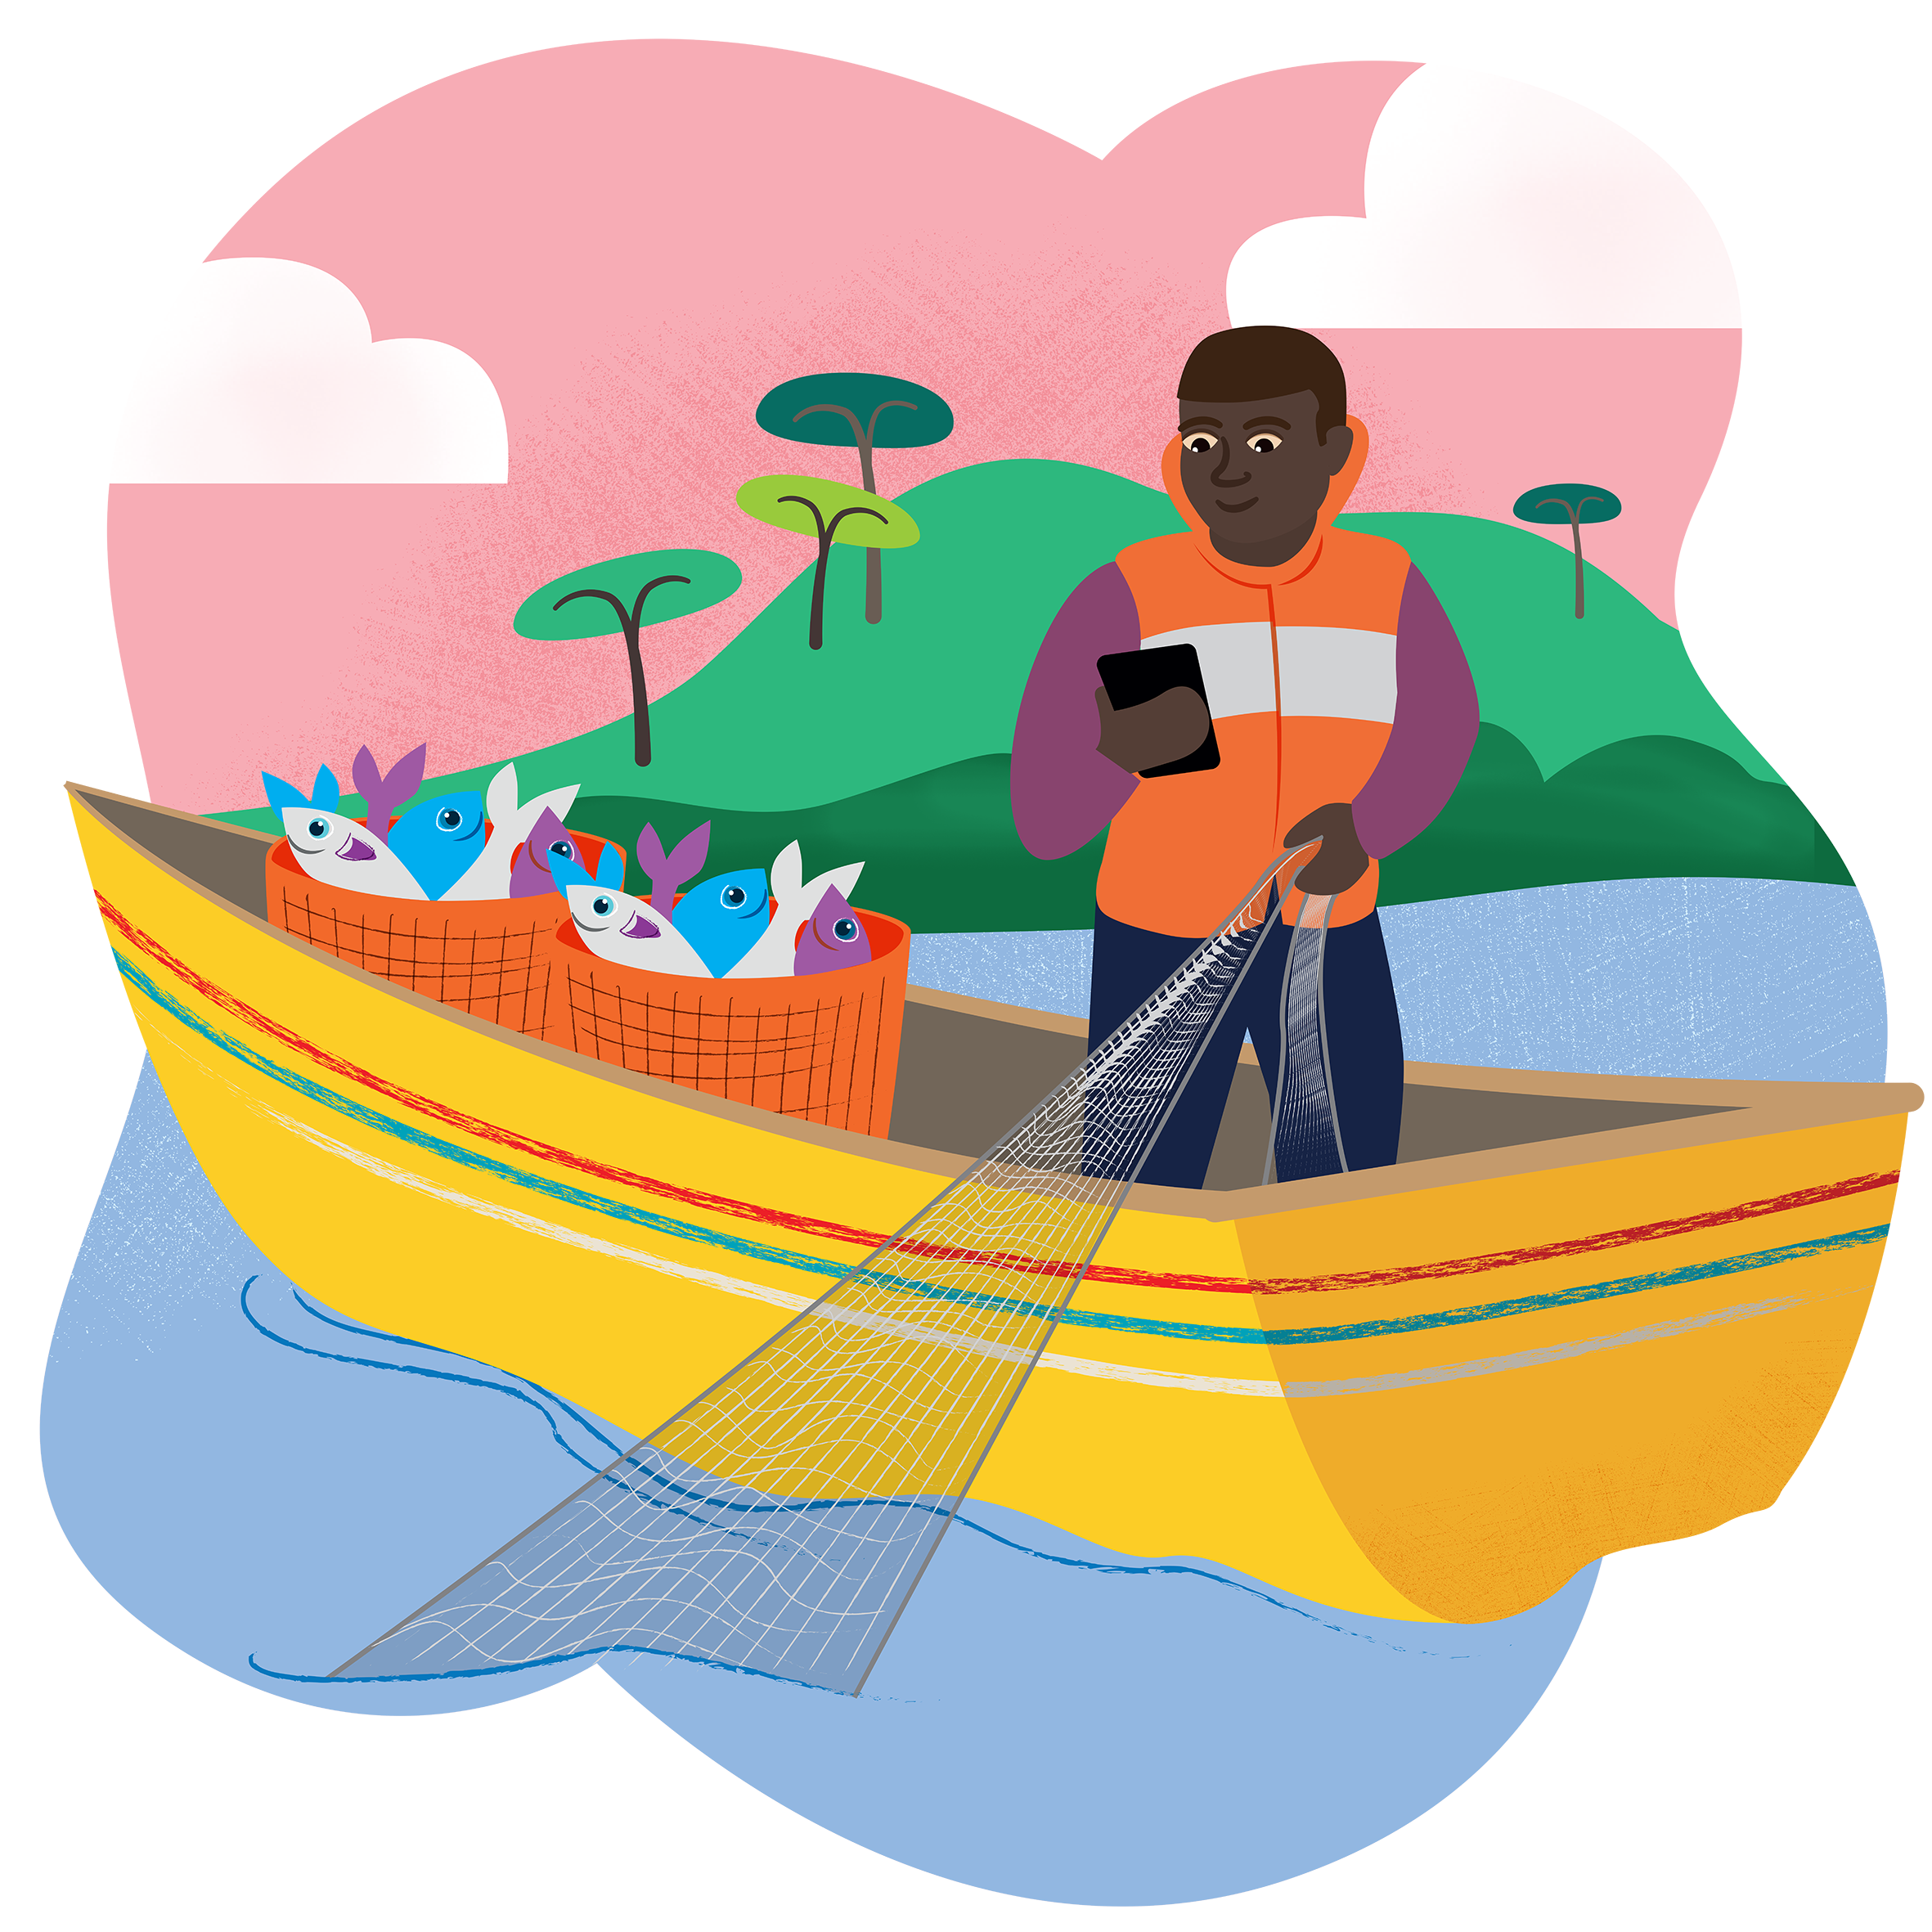
15 December
Lue lives in Liberia by the sea. Her dad, Tekon, is a fisherman. Although these communities have worked at sea for generations, the fish are more difficult to find these days.
Fishermen now use technology which show where to safely catch fish to eat and sell. "Our fishfinders and safety at sea training have helped us save lives," says Tekon.
Lue's mum, Vivian, is also involved in CAFOD’s fisheries project. They now have money for food, school equipment and are able to help others.
We pray for those people around the world who do dangerous jobs just to put food on the table for their families. Please guide them, Lord, and keep them safe.
Amen.
Tekon and Lue
Safe at sea World Gift
Notes:
Lue and her dad, Tekon, Liberia
Photo credit: Thom Flint

Slide 28
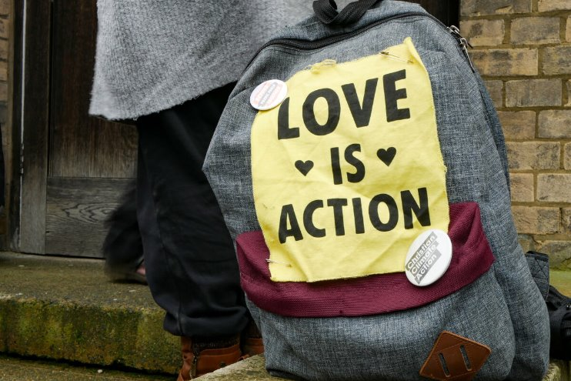
16 December
"Which of the two did the will of his father? "
Matthew 21:31
Empty words?
Two sons are asked to help their father. One says yes, the other no, but they both change their minds. This reading shows how important it is not just to say things that we know sound good. Words are empty if they are not backed up by action.
Like the sons in the gospel, we can also choose. Will we simply say we believe, but carry on doing just what we want? Or will we listen to God in our lives, and try to do our best to do what he asks us every day?
Notes:
Climate vigil
Photo credit: Sophia White

Slide 29
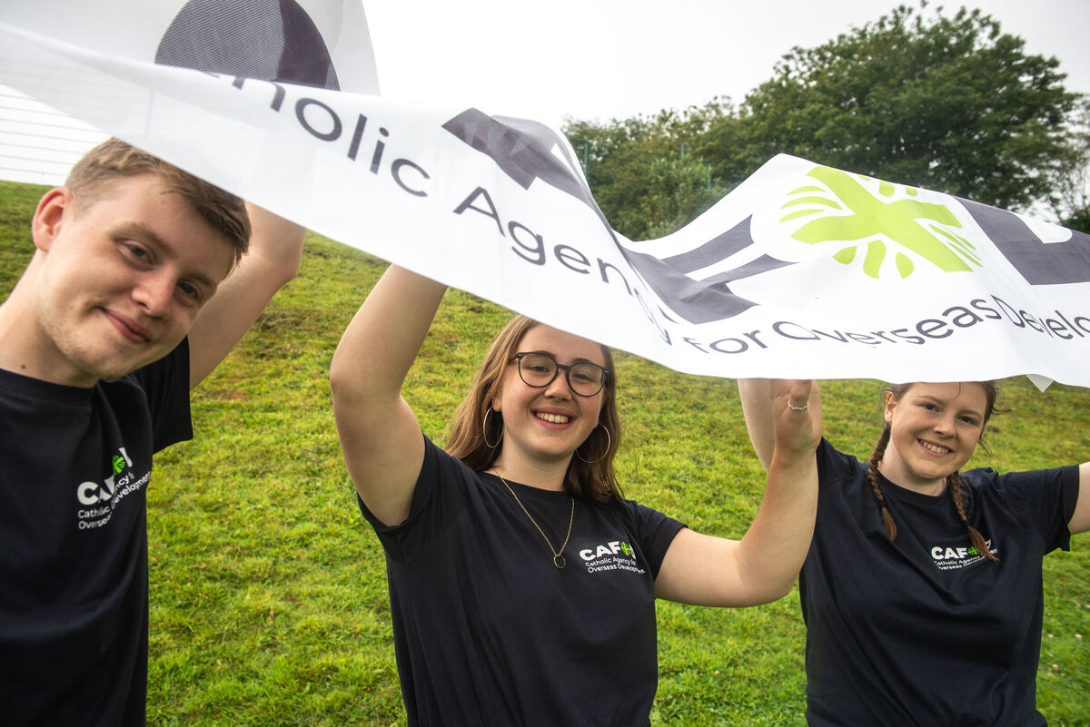
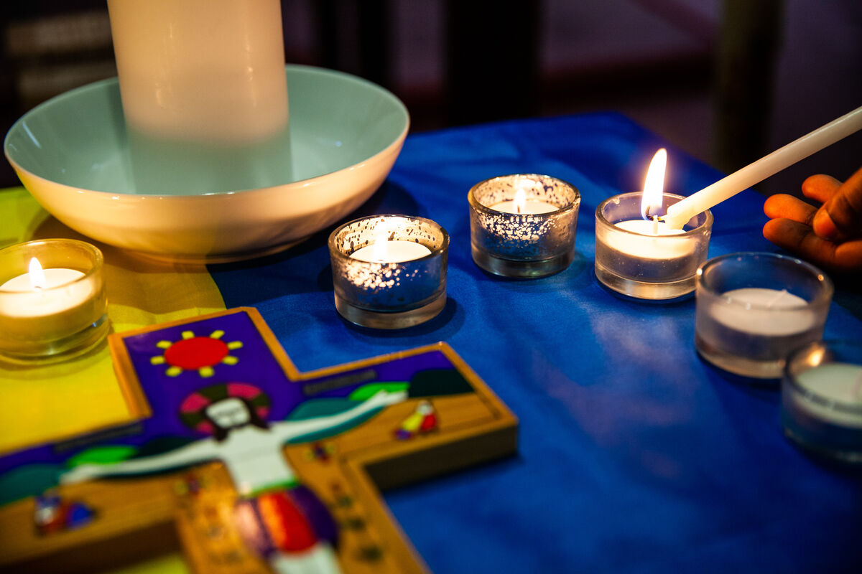
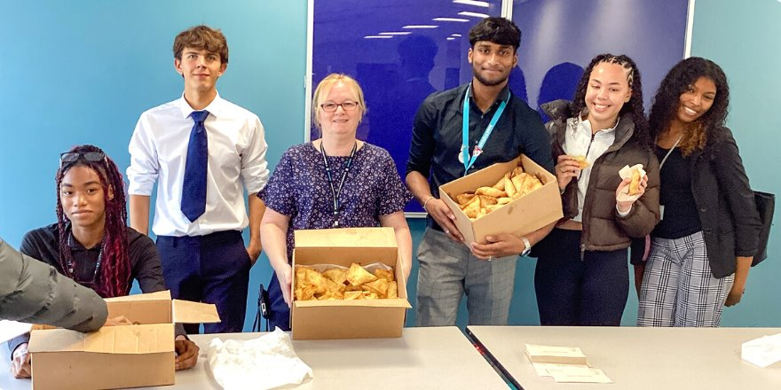
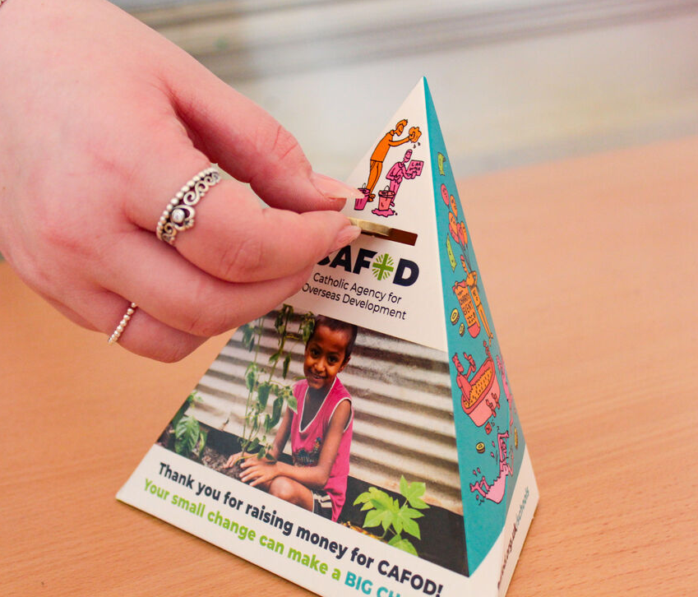
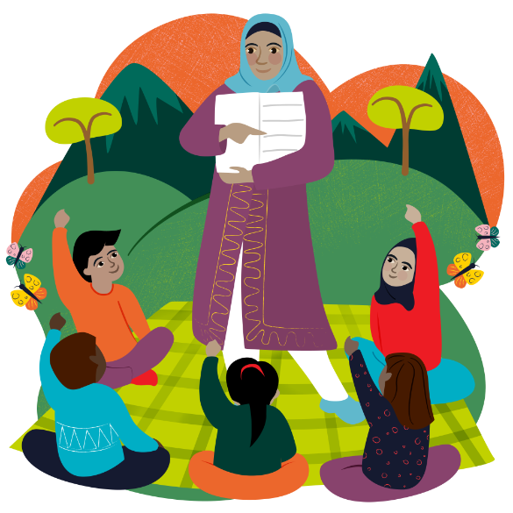
16 December
Schools and communities across England and Wales regularly ensure that actions speak louder than words as students pray, act and give with CAFOD!
What could you do to make a difference to your sisters and brothers living in poverty around
the world?
Lord, give us the enthusiasm and energy to do things that make your love known to everyone, so we can be signs of hope during Advent and in this Jubilee Year. Amen.
Teach a class to read World Gift
Notes:
All Saints school, Sheffield
Photo credit: Thom Flint
Young campaigners, Cornwall
Photo credit: Annie Bungeroth
St Mary's School, Herefordshire
Photo credit: Victoria Ahmed
'Samosa Friday', St Edmund's, Wolverhampton
Photo credit: St Edmund’s Catholic Academy

Slide 30
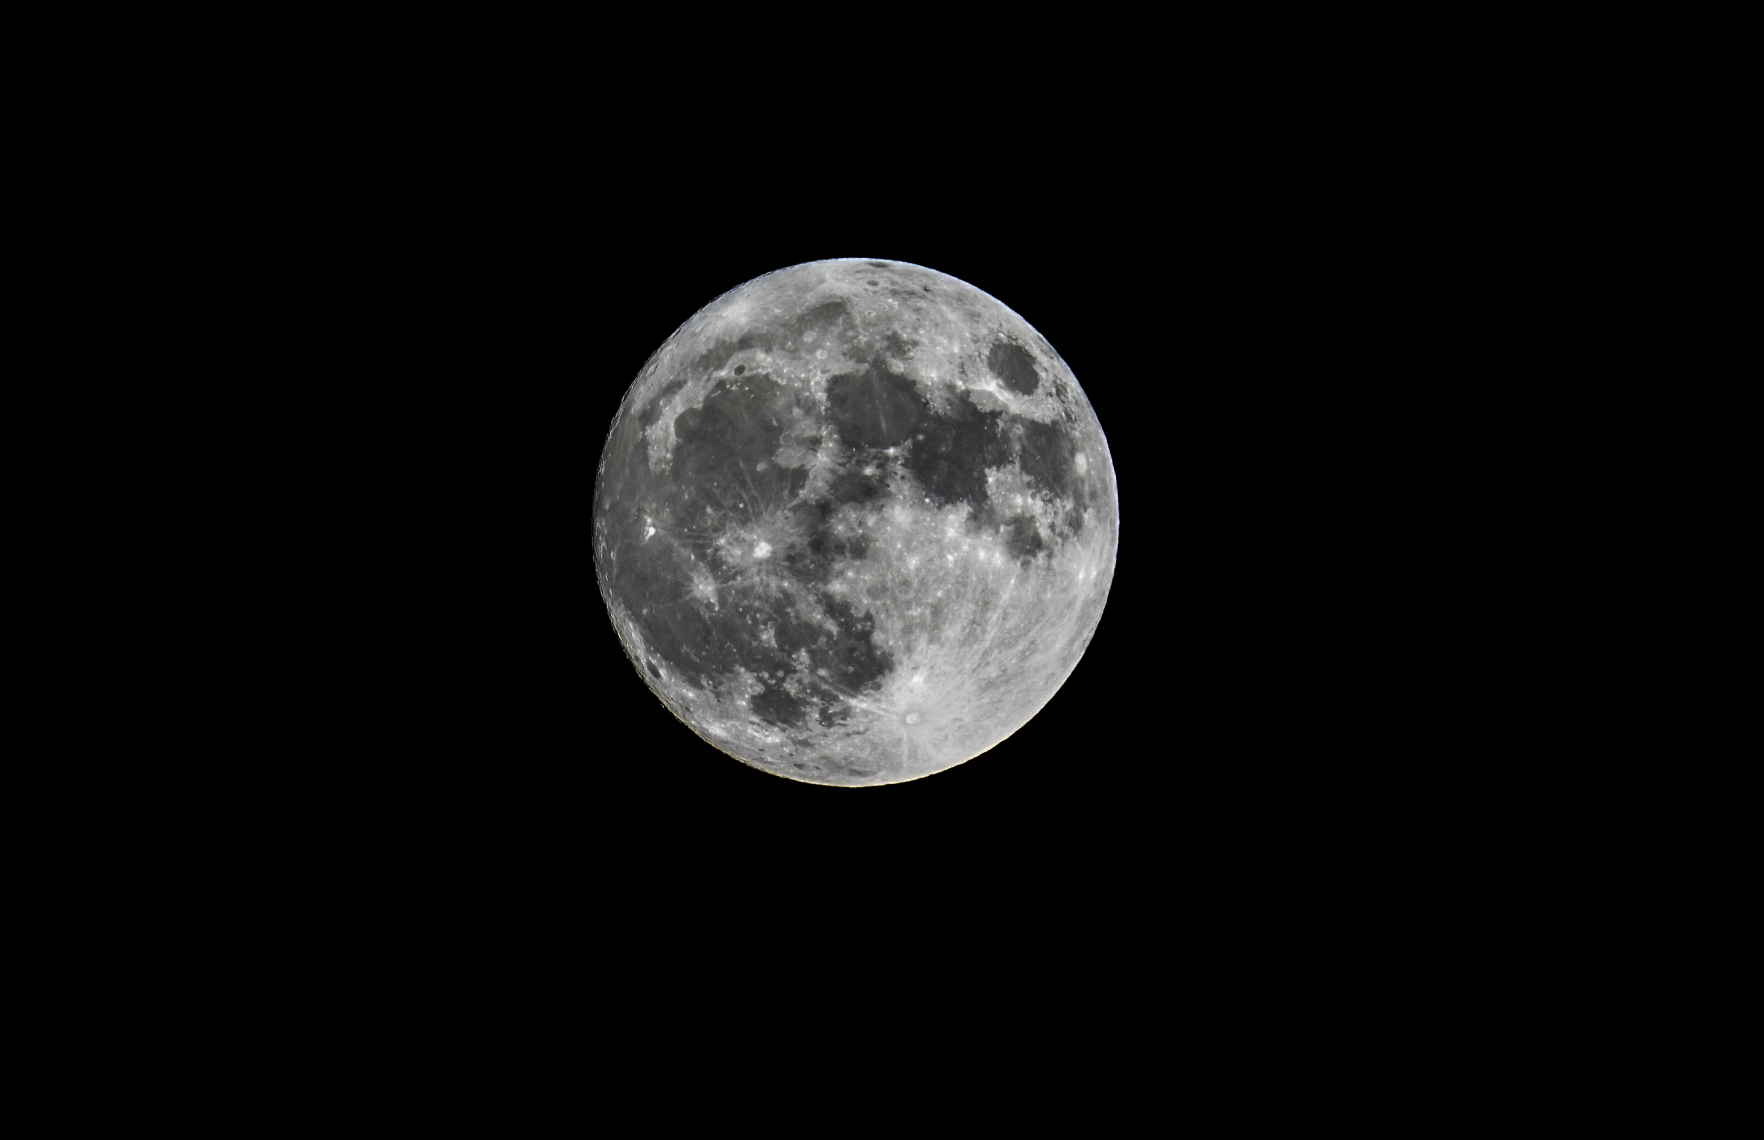
17
December
" In his days may the righteous flourish, and peace abound, till the moon be no more!" Psalm 72:7
Peace be with you
This reading tells us that in a world where we live as Jesus teaches us, peace and justice will flourish. But we know that many of our global family are living lives without justice and peace, daily.
Yet, this reading gives us hope; that justice and peace can prevail.
Let us try to be Pilgrims of Hope in this Jubilee Year. How can we best live lives that promote justice and peace? How can we bring hope to others?
Notes:
The moon
Photo credit: Stock image

Slide 31
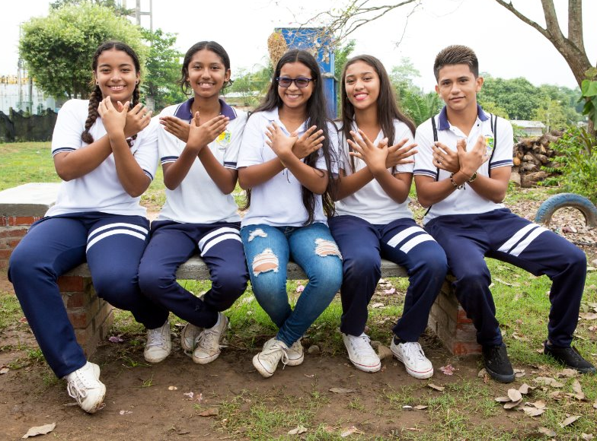
17 December
Rosana lives in Colombia where there's been fighting for 50 years. She and her schoolfriends are part of a peace-building project.
"My classmates and I had to share our dreams, aims and goals," says Rosana. "We are not interested in continuing with war, we have much greater aspirations,” she says.
With CAFOD's help, these peace workshops teach young people how to avoid violence, sharing what they've learnt with family and neighbours so everyone can live in peace.
“It's time to leave violence behind," says Rosana.
As we prepare for the birth of Jesus, Lord, we ask you to bring comfort and hope to our global brothers and sisters who long to live in peace. Amen.
Rosana and friends
Promoting peace World Gift
Notes:
Rosana and friends, Colombia
Photo credit: Jessica Michelmore

Slide 32
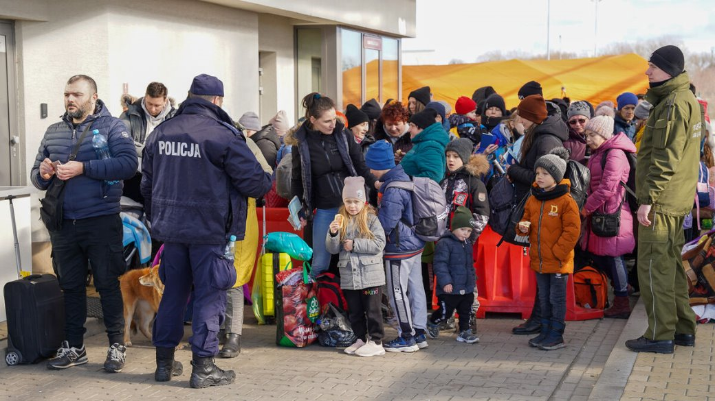
18 December
But as he considered these things, an angel of the Lord appeared to him in a dream, saying, "Joseph, son of David, do not fear to take Mary as your wife, for that conceived in her is from the Holy Spirit."
Matthew 1:20
A long way from home
Mary and Joseph travelled a long way to Bethlehem. Today, people journey around the world for many reasons – work, holidays, to see family. But some are forced to travel because of poverty or war. Migrants do not always receive a warm welcome. Too often they are sent on their way.
On Migrants Day, how do we show we have compassion for others and welcome them into our communities?
Families fleeing Ukraine
Notes:
Families fleeing Ukraine
Photo credit: Caritas Poland

Slide 33
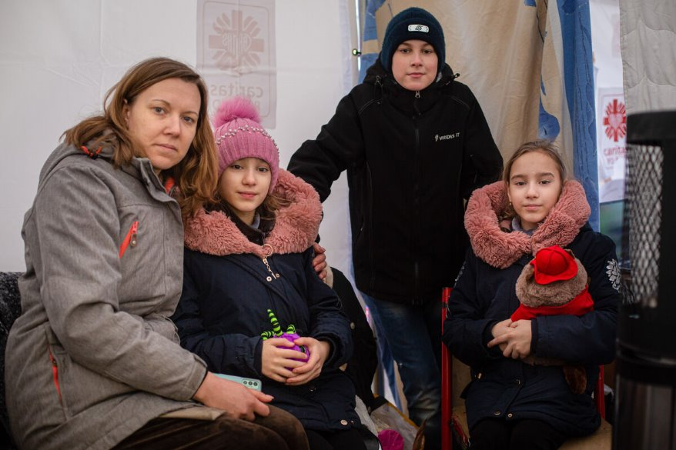
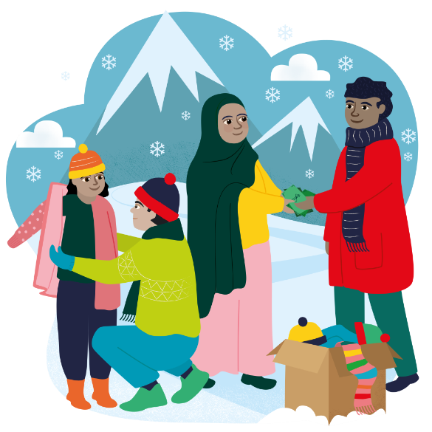
18 December
Maria and her three children are refugees from the war in Ukraine. When fighting started, they became very frightened and fled their home to Poland.
"When I heard bombs going off and helicopters flying over our house, I didn't want to believe it," Maria says.
After a 30-hour journey by train and coach, with very little to eat or drink, they arrived tired and scared in Poland. Here, Caritas volunteers welcomed them with a hot meal and shelter.
Lord, may we act compassionately so that all our brothers and sisters receive a warm welcome and have enough to eat.
Amen.
Maria and her family
Christmas stocking World Gift
Notes:
Maria and her family fleeing Ukraine
Photo credit: Philipp Spalek / Caritas Germany

Slide 34
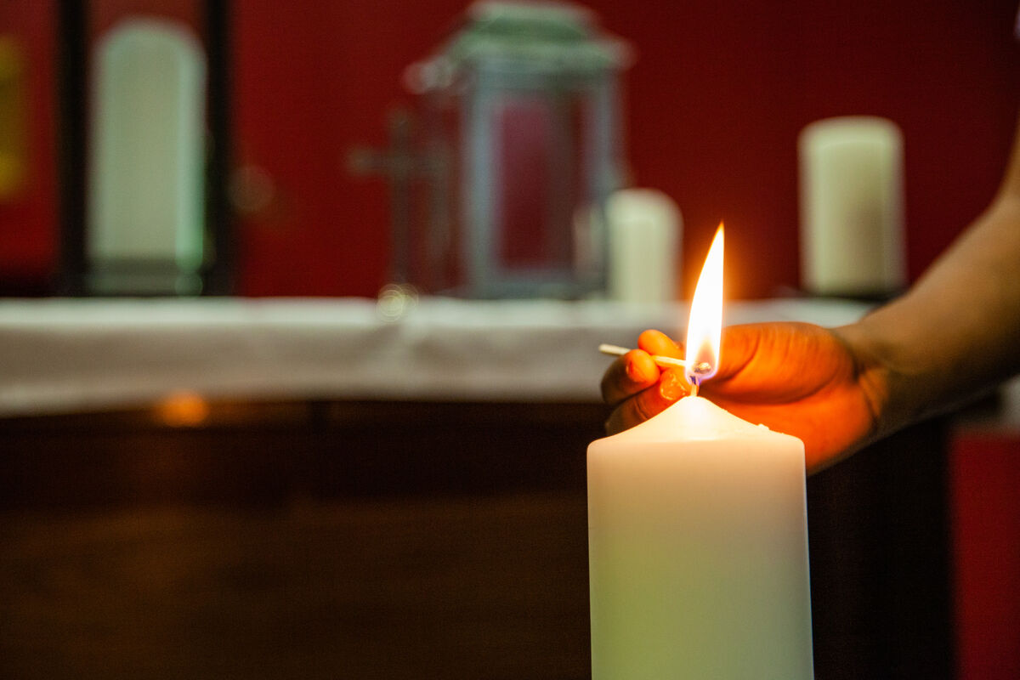
19 December
"For he will be great before the Lord. And he must not drink wine or strong drink, and he will be filled with the Holy Spirit, even from his mother's womb." Luke 1:15
Filled with the spirit
We are all filled with the Holy Spirit - we are all special.
The spirit guides us in our lives, showing us the way and helping us to achieve great things.
Who are the special people in our lives? Because a better world needs all of us, how can we make sure we don’t take special people for granted? How do we make them feel special? How do we let the Holy Spirit guide us to do special things?
Notes:
All Saints School, Sheffield
Photo credit: Thom Flint

Slide 35
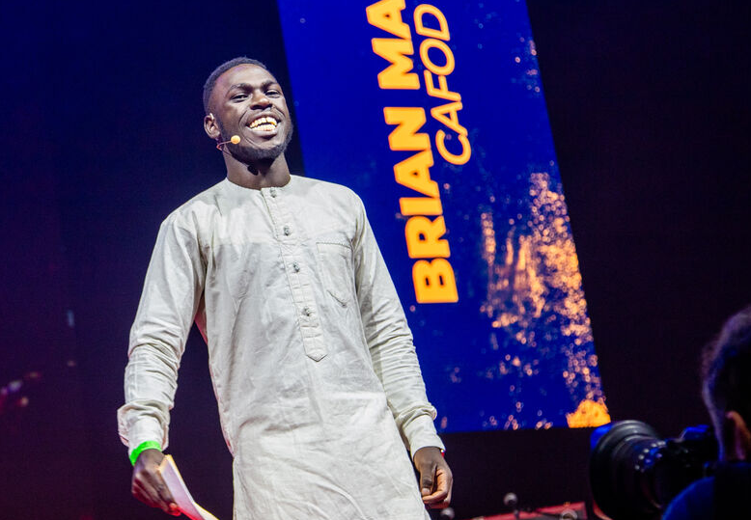
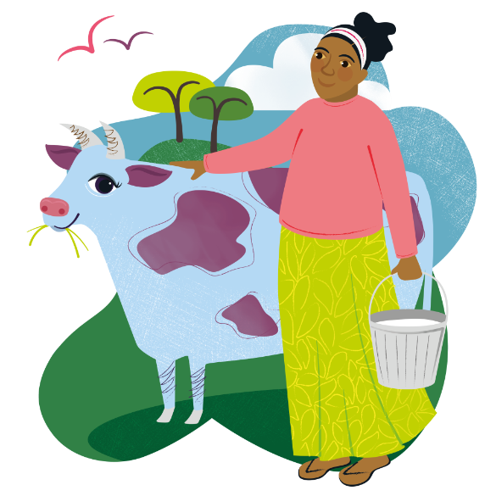
19 December
With CAFOD's help, Kenya's Brian Maeba trains young people to make a living in sustainable farming.
At Flame, an event attended by thousands of young Catholics earlier this year, he said: “God has not given us a spirit of fear, but of power and love. With his guidance, we achieve great things.”
Flame was a spark, says Brian. "Since then, I’ve been more active in my parish, more intentional in my prayer and more committed to speaking up on issues.”
He also saves a little from his salary through the year to share with street children in Nairobi on Christmas Day.
Guide us, Holy Spirit, to speak up for what matters, to share love with our neighbours and to care for our common home.
Amen.
Brian at Flame
Marvellous moo cow World Gift
Notes:
Brian Maeba
Photo credit: Mazur/catholicnews.org.uk

Slide 36
20 and 21 December
It’s the weekend!
Here are a few exciting things we’ve got coming up:
Look out for new Volunteer workshops coming in January 2026!
Look out for our Lent resources on floating gardens in Bangladesh
Sign up to the Big Lent Walk for 2026!
Notes:
Rosa and her friends, Bolivia
Photo credit: Nikki Evans

Slide 37
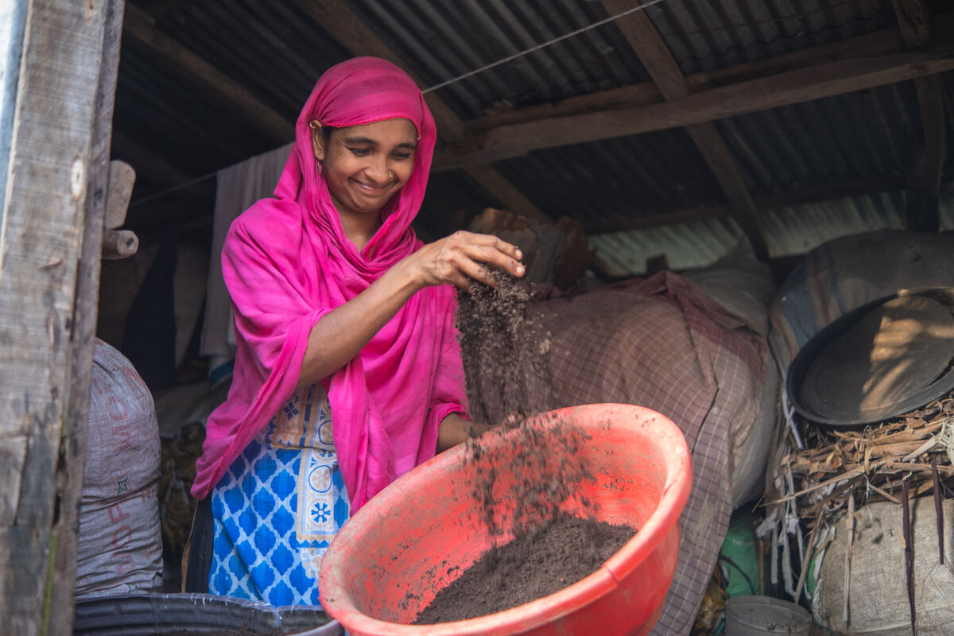
22 December
"He has filled the hungry with good things, and the rich he has sent away empty." Luke 1:53
Sharing what we have
Mary has gone to visit her sister Elizabeth
to tell her about the news from the angel Gabriel.
Mary praises God and describes a world where God's kingdom reigns, where the hungry have enough food to eat and where the poor are raised up.
In this year of Jubilee, how can we be signs of hope and make sure we do our best to share what we have and look after people experiencing poverty? What can we do?
Hawa
Notes:
Hawa, Bangladesh
Photo credit: Amit Rudro

Slide 38
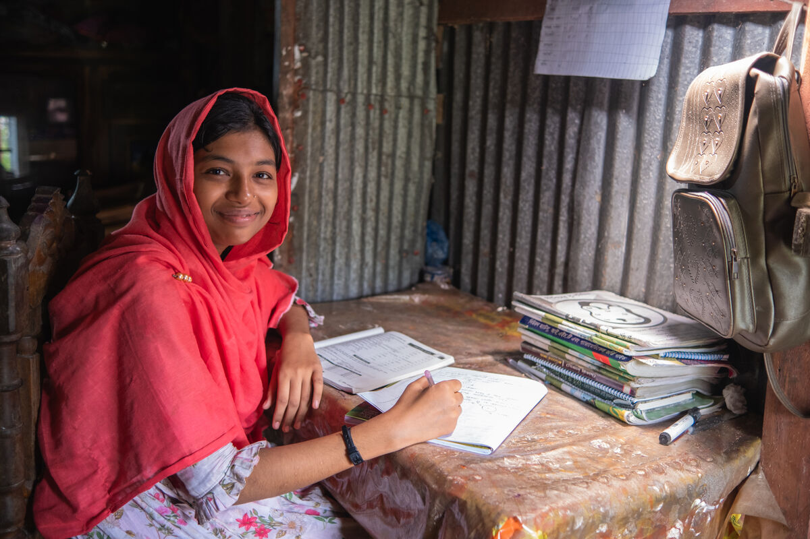
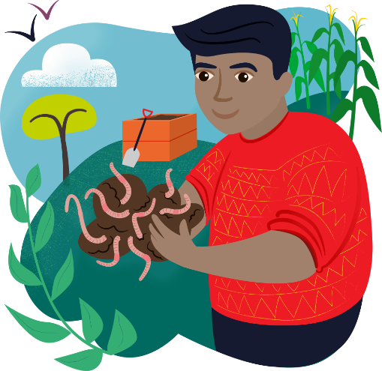
22
December
Talisma's parents struggled to put food on the table in Bangladesh – until CAFOD gave them earthworms!
"Of all things, why earthworms? What good would they do?" asked Talisma's mum, Hawa.
With the creatures, Hawa learned how to produce enough compost to grow her own vegetables and to sell to other growers. With the money she made, she started to raise ducks and chickens too.
The income means she can buy food, pay medical bills and support her children's education. "I can now prepare for university," says Talisma.
For all those around the world who struggle with hunger, we pray that they too may be filled with the good things you promise, Lord.
Amen.
Talisma
Wriggly worms World Gift
Notes:
Talisma, Bangladesh
Photo credit: Amit Rudro

Slide 39
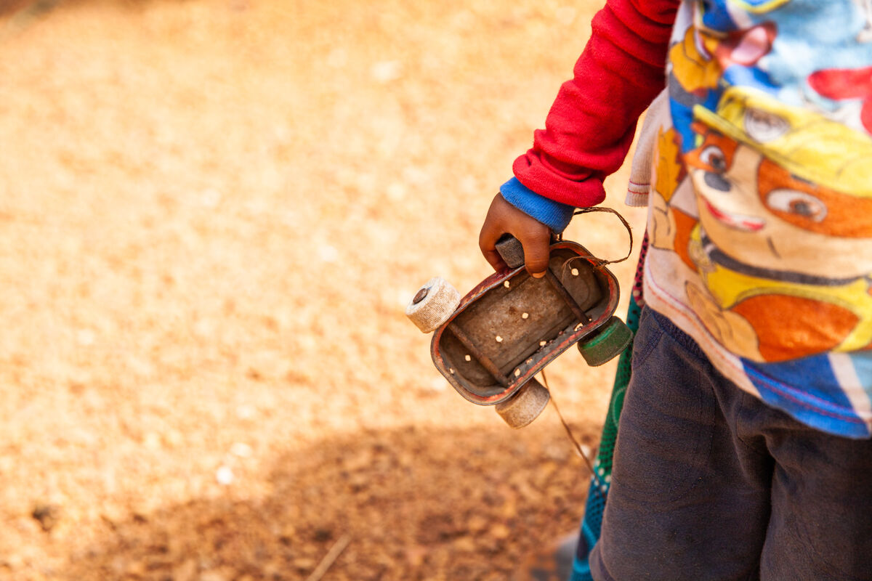
23 December
All who heard them laid them up in their hearts, saying, "What then will this child be?" For the hand of the Lord was with him.
Luke 1:66
When I grow up, I want to be...
This reading is not about Jesus, but about John the Baptist who prepared the way for the birth of the Lord. It is a question families often ask.
What will this baby grow up to be? A builder? A judge? A teacher? An artist? Will they follow in the footsteps of other family or do something different? Every child has the ability to surprise us, to grow and to flourish. Yet, as we know, not all children have the same life chances.
With God's help, what might we be when we 'grow up' and finish school?
Notes:
Playing cars in Sierra Leone
Photo credit: Thom Flint

Slide 40

23 December
Long's family have farmed in fields in a village in Cambodia for generations.
They knew the best time to plant, what to grow and when to harvest their crops, but climate change makes farming difficult for them now.
With CAFOD's help, Long is learning to grow crops even in bad weather, to eat and sell. She also works in the village café, which is supported by CAFOD.
"In the future, I wish to start a small café to support my family and train others to do the same," says Long.
We pray for young people all over the world, that they grow up knowing they have the potential to be who and what they want to be. Amen.
Long watering her crops
Water for a family World Gift
Notes:
Long, Cambodia
Photo credit:

Slide 41

24th
December
"Because of the tender mercy of our God, whereby the sunrise shall visit us from on high..." Luke 1:78-19
Here comes the sun...
This reading's words - 'tender', 'mercy', 'sunrise' are full of hope.
As we look forward to Christmas day tomorrow, let's look at what those words mean to us.
How can we show 'mercy', be 'tender' and bring a bright dawn or 'sunrise' to our family and friends around us and to our brothers and sisters around the world? How can we continue to work at being Pilgrims of Hope?
Notes:
Sunrise
Photo credit: Stock image

Slide 42



24 December
There'll be lots of excitement in houses everywhere today! It's Christmas day tomorrow!
With just one day to go, you might be busy wrapping presents, making mince pies, seeing friends, but In amongst all that, let's just take a few moments to remember why we're celebrating.
Here are some prayers you can say together as a family. Maybe say one around the Christmas tree or in front of your crib? Christmas family prayer ideas
And it's not too late to order a World Gift for a Christmas present! It's a special gift that reflects the true meaning of Christmas. Buying one makes a huge difference to our brothers and sisters living in poverty around the world.
So, who's for a marvellous moo cow or some wriggly worms? CAFOD World Gifts
CAFOD World Gifts
Notes:
Brian Maeba
Photo credit: Mazur/catholicnews.org.uk

Slide 43

Happy Christmas!
"And the angel said to them, 'Fear not, for behold, I bring you good news of great joy that will be for all the people. For unto you is born this day in the city of David a Saviour, who is Christ the Lord'."
Luke 2:10-11
Notes:
Nativity
Phill Brown on Unsplash

