Slide 1

Notes:
This Jubilee animation can be found here: Jubilee for schools 2025 – Pilgrims of Hope
Hope does not disappoint,

Slide 2

Notes:
because God’s love

Slide 3

Notes:
has been poured into our hearts

Slide 4

Notes:
through the Holy Spirit

Slide 5

Notes:
that has been given to us” (Rom 5:1-2.5).

Slide 6
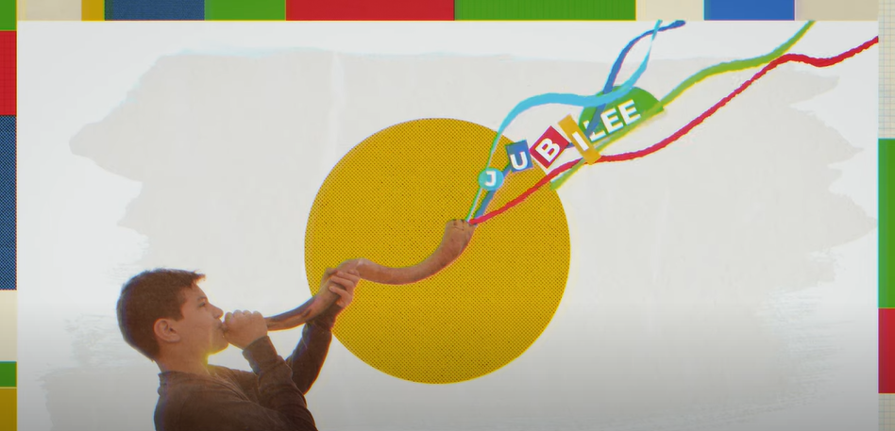
Notes:
2025 is a Year of Jubilee!

Slide 7
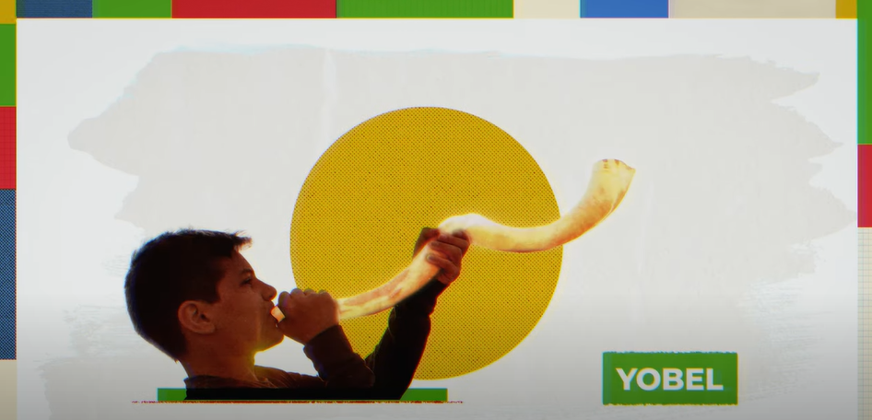
Notes:
The word ‘Jubilee’ comes from the Hebrew word for a ram’s horn, which was blown to announce the start of a Jubilee year in the Bible.

Slide 8

Notes:
In the Old Testament, the Jubilee Year was a time of renewal and celebration, every fifty years.

Slide 9

Notes:
Debts were cancelled, people could rest, and because crops weren’t planted, even the land was able to rest.

Slide 10
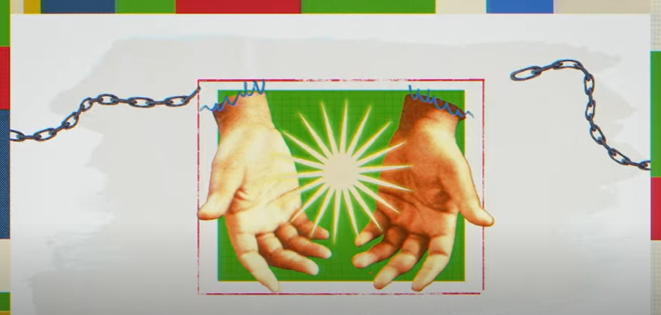
Notes:
It was also a time of freedom: prisoners and slaves were freed, and land was given to those who didn’t have any.

Slide 11
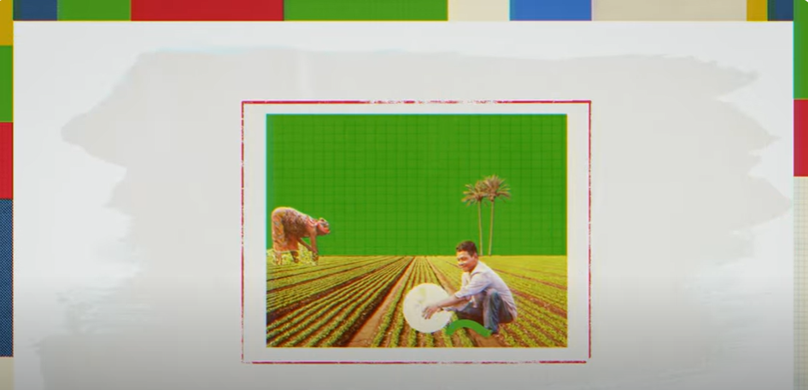
Notes:
It was known as the year of the Lord’s favour.

Slide 12

Notes:
Jesus makes it clear that his mission is to bring the justice and freedom of the Jubilee.

Slide 13
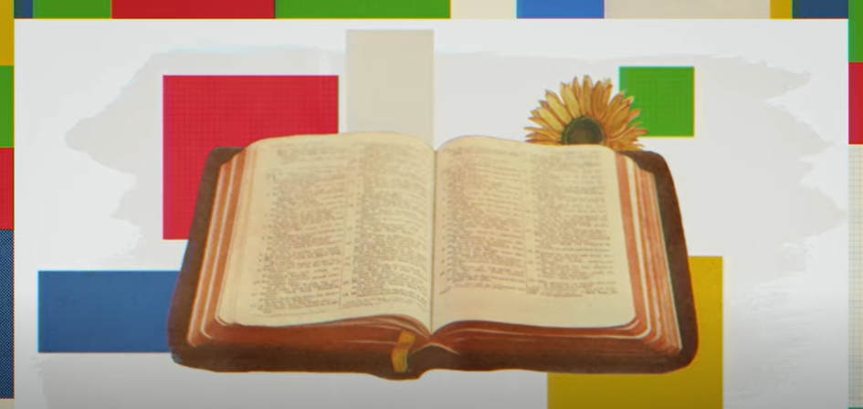
Notes:
In the Gospel of Luke, Jesus read from the prophet Isaiah,

Slide 14
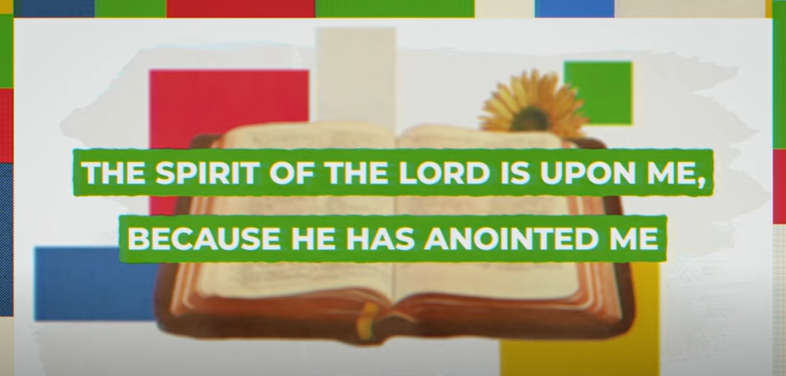
Notes:
“The Spirit of the Lord is upon me, because he has anointed me

Slide 15

Notes:
to proclaim good news to the poor.

Slide 16
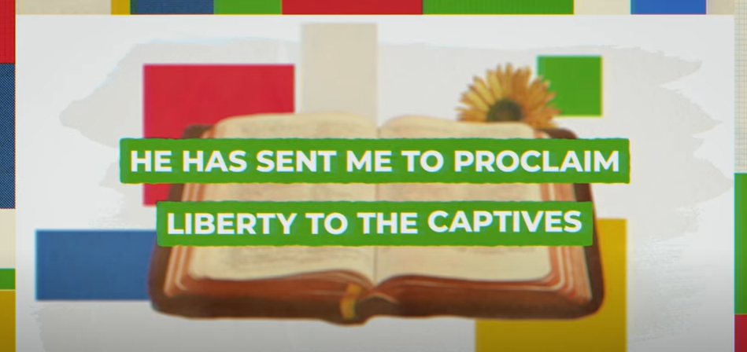
Notes:
He has sent me to proclaim liberty to the captives

Slide 17

Notes:
and recovering of sight to the blind,

Slide 18
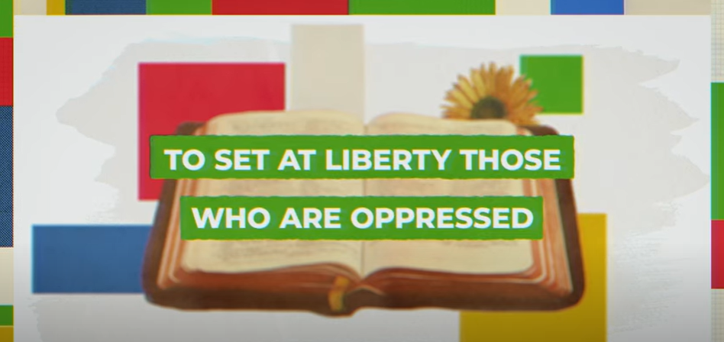
Notes:
to set at liberty those who are oppressed,

Slide 19
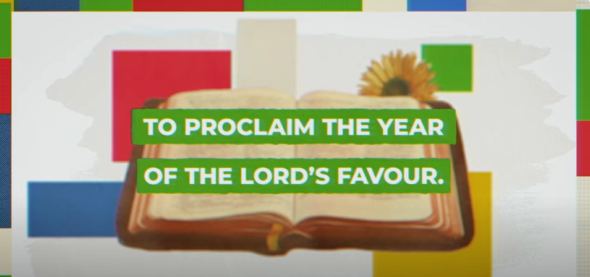
Notes:
to proclaim the year of the Lord's favour.” Luke 4: 18-19 (ESV)

Slide 20

Notes:
Jesus makes it clear that his mission is to bring the justice and freedom of the Jubilee. Inspired by his example, we can share in his mission to create a world of justice, peace and love.

Slide 21
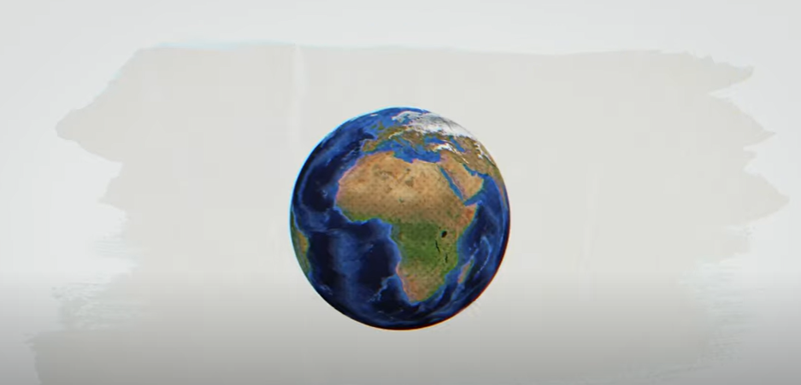
Notes:
Now, we celebrate a Jubilee every twenty-five years. It’s still a very special, holy, year of forgiveness and mercy, a time to reset, and to renew our relationship with God, with one another, and with all of creation.

Slide 22
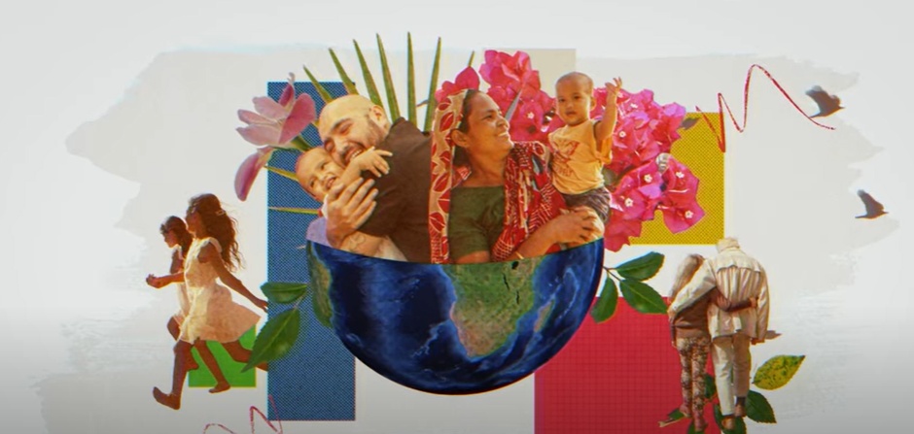
Notes:
Pope Francis has called this Jubilee Year ‘Pilgrims of Hope’. It’s an invitation to renew our hope, a hope which comes from knowing that God loves each one of us, whoever we are.

Slide 23

Notes:
Pilgrims are people who travel to holy places on a journey that helps them grow closer to God.

Slide 24

Notes:
Even if we can’t travel far away, the Jubilee Year will still be a journey for all of us - a journey of hope.
Even if we can’t travel far away, the Jubilee Year will still be a journey for all of us - a journey of hope.

Slide 25

Notes:
Pope Francis asks us to be signs of hope for others,

Slide 26

Notes:
by putting Catholic Social Teaching into action through caring for our common home and supporting our sisters and brothers who are experiencing war, hunger or poverty.
but you are one of millions of people who are joining together in the Jubilee year, to bring the light of hope and the message of God’s love to every part of the world!

Slide 27

Notes:
We know that the world is facing many of these challenges…

Slide 28
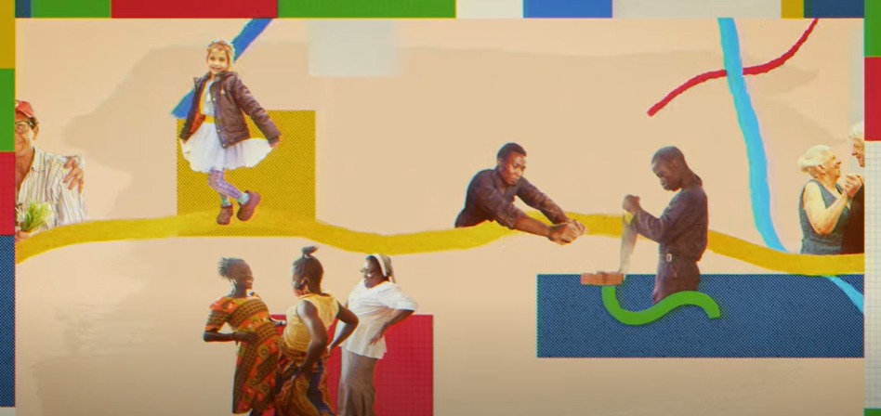
Notes:
but you are one of millions of people who are joining together in the Jubilee year, to bring the light of hope and the message of God’s love to every part of the world!

Slide 29

Notes:
We can all be Pilgrims of Hope (in 2025), so let’s start our journey right now!

Slide 30
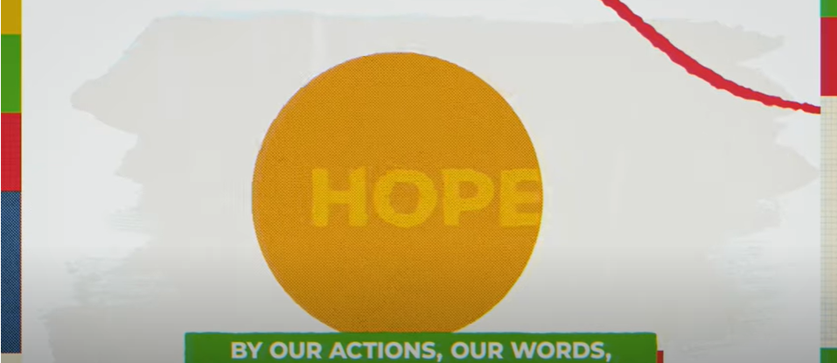
Notes:
Pope Francis says: “By our actions, our words..

Slide 31
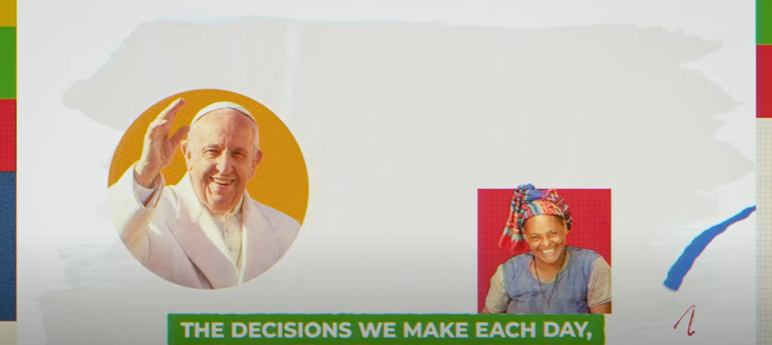
Notes:
the decisions we make each day…

Slide 32
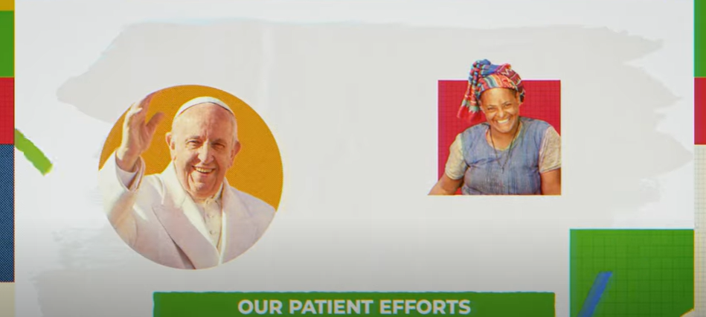
Notes:
our patient efforts

Slide 33
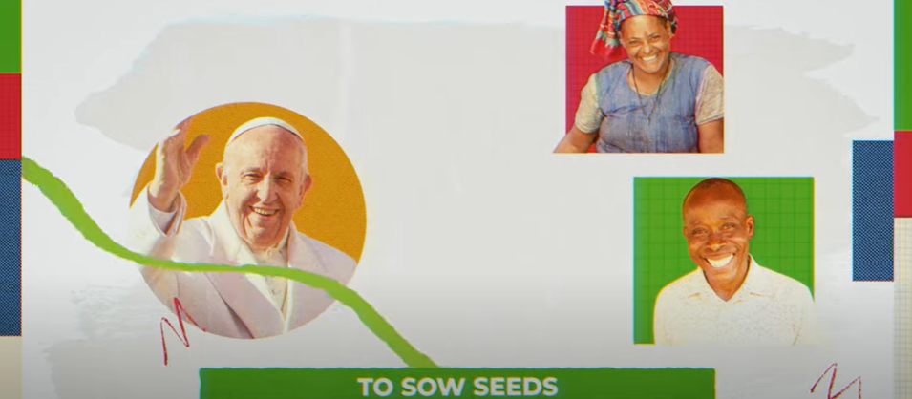
Notes:
to sow seeds

Slide 34

Notes:
of beauty and kindness

Slide 35
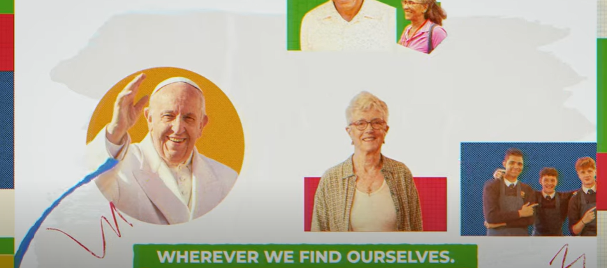
Notes:
wherever we find ourselves,

Slide 36
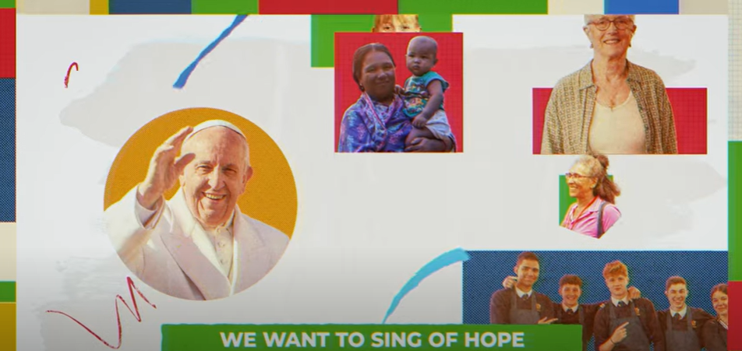
Notes:
we want to sing of hope…

Slide 37
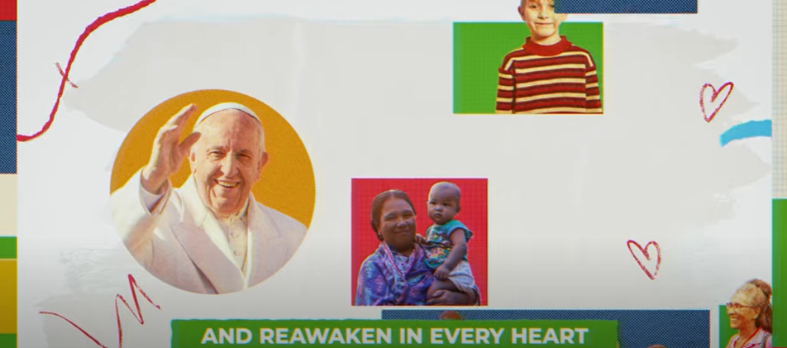
Notes:
and reawaken in every heart

Slide 38
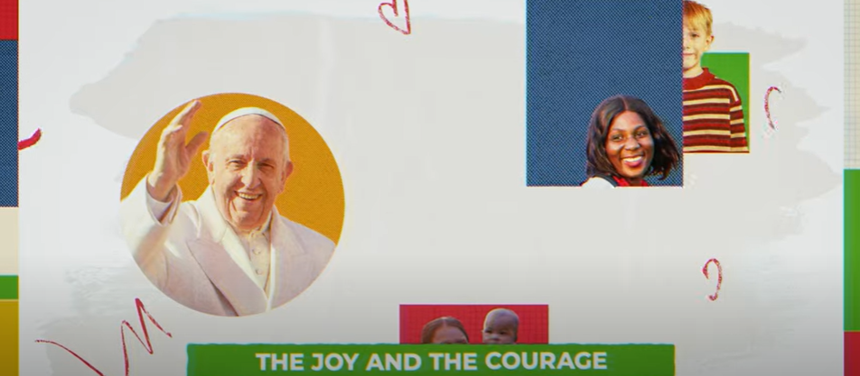
Notes:
the joy and the courage

Slide 39
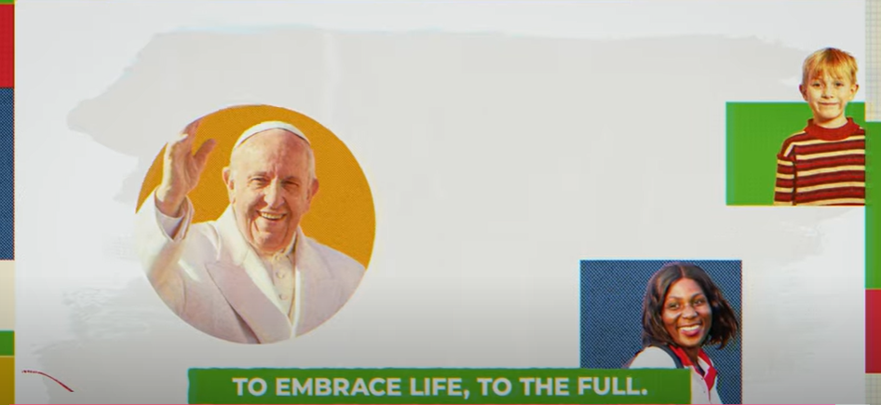
Notes:
to embrace life to the full.”

Slide 40

Notes:
Find out more – visit Jubilee-schools.org.uk

