Slide 1
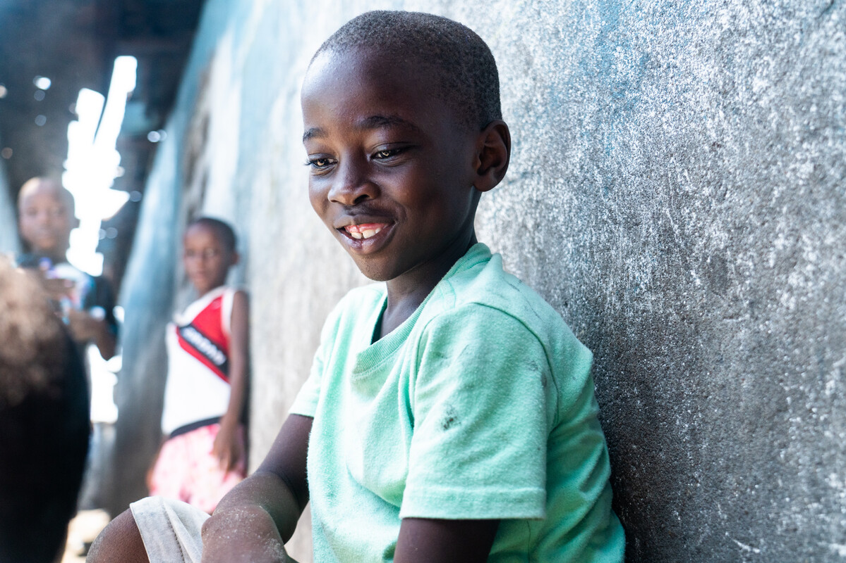
Human Dignity
Exploring CST principles in CAFOD’s work
Notes:
Aaron in Liberia.
Photo credit: Carielle Doe

Slide 2
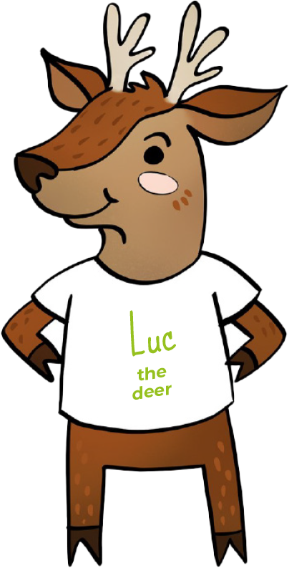
Human Dignity means we believe that
everyone is special.

Slide 3
"God said, 'Let us make humankind in our image, according to our likeness.'”
Genesis 1:26

Slide 4
Human Dignity
We are are all beautifully made in the image and likeness of God. We are all special.
Notes:
Photo credit: Tabitha Turner, Unsplash

Slide 5
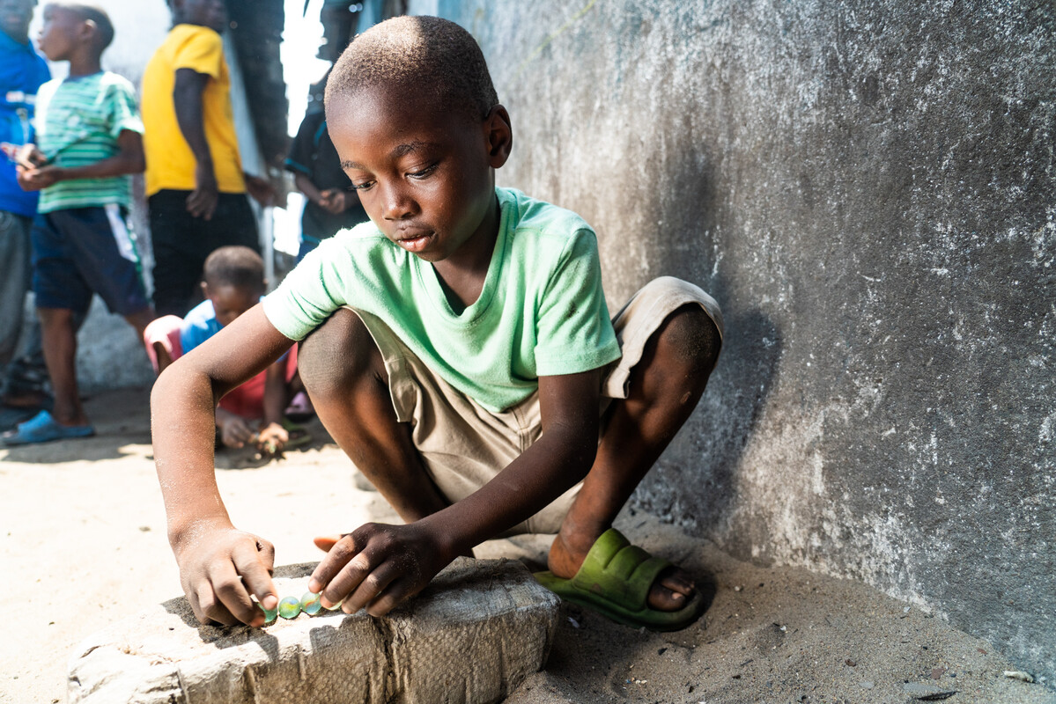
This is Aaron.
He lives in Liberia with his grandparents.
Aaron's grandfather is a fisherman. "I help wash and dry the fish he catches ready for my grandmother to sell," says Aaron.
Notes:
Photo credit: Carielle Doe

Slide 6
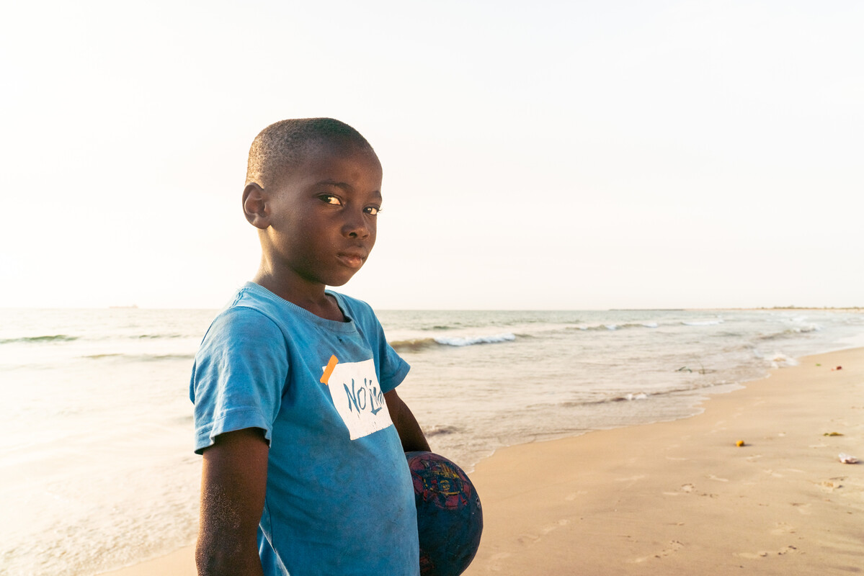
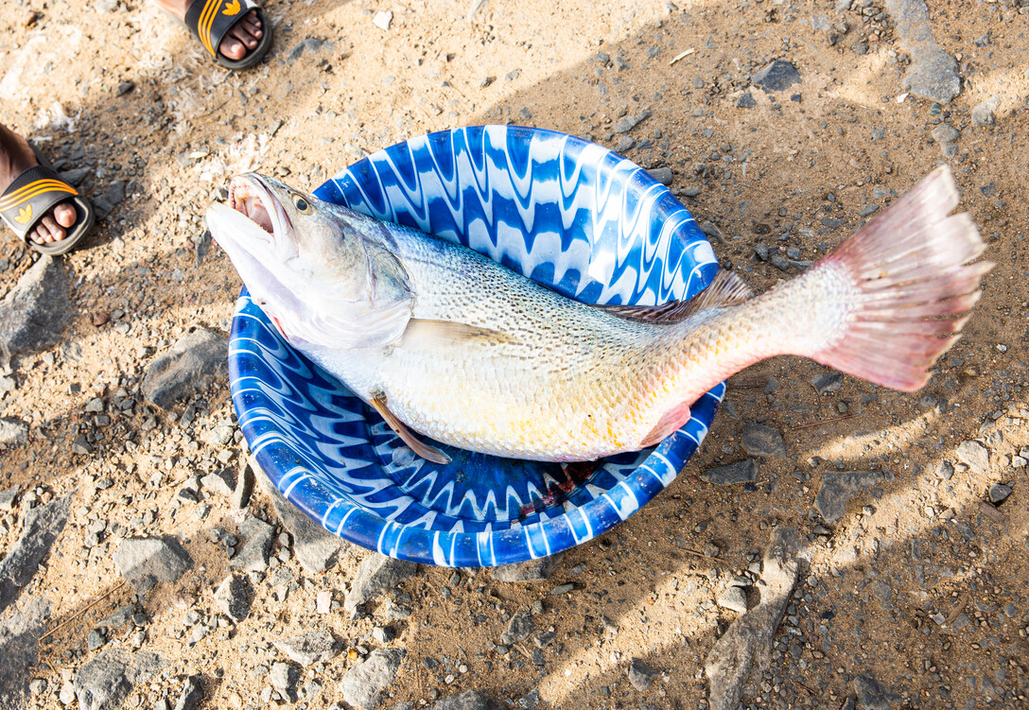
"I would like to be a fisherman," says Aaron, but being a fisherman is hard and dangerous work. The fish are becoming more and more difficult to find.
Notes:
Photo credit: Carielle Doe
Photo credit: Thom Flint

Slide 7
With CAFOD's help, local fisherman use fishfinders on their boats so they can safely catch fish to eat and sell.
Aaron's grandparents can give Aaron food, clean water and the things he needs to be happy. Everyone deserves this because we are all special.
Notes:
Photo credit: Carielle Doe

Slide 8
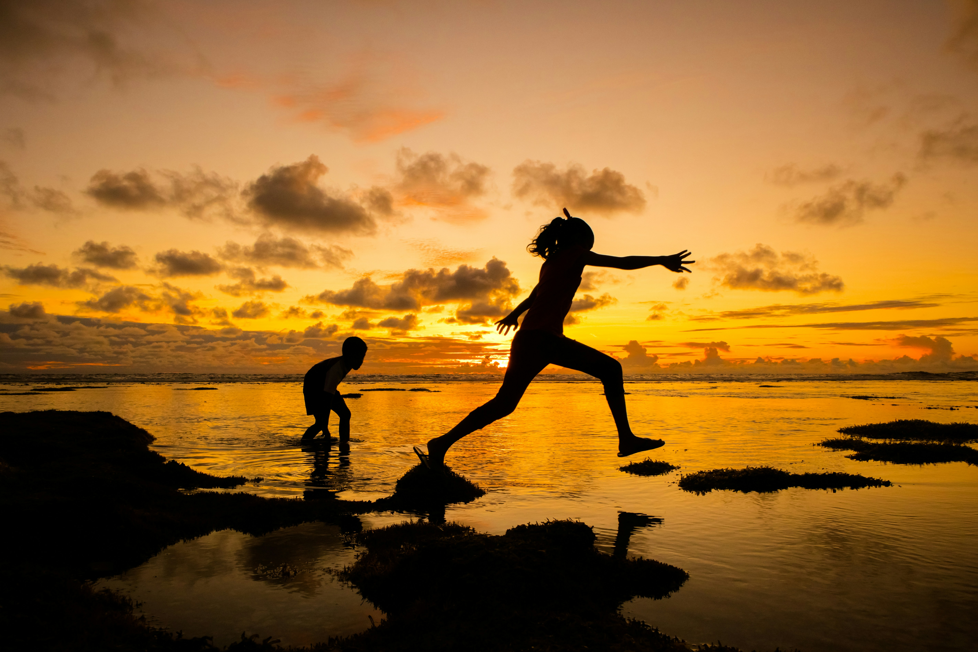
“Every person is worthy of our giving...they are God’s handiwork, his creation. God created that person in his image, and he or she reflects something of God’s glory.”
Pope Francis,
Evangelii Gaudium, 274
Notes:
Photo credit: Nattu Adnan on Unsplash

Slide 9
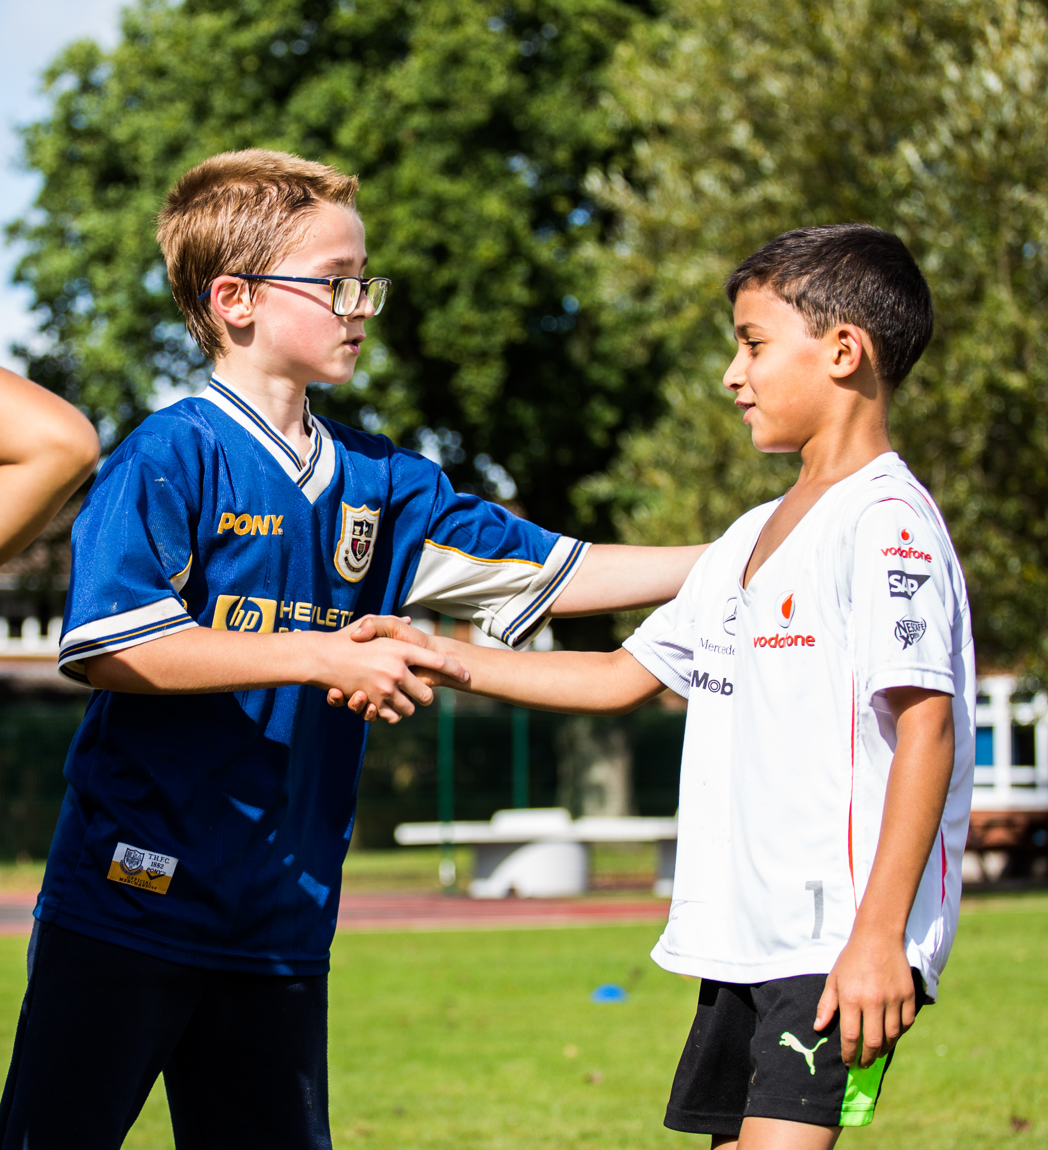
Everyone is special
We are all made in the image of God.
This means that everyone is special. We should treat every person the same way we want to be treated.
For example:
At home: Taking care of elderly family members.
At school: No bullying or name calling.
Notes:
Photo credit: Thom Flint

Slide 10
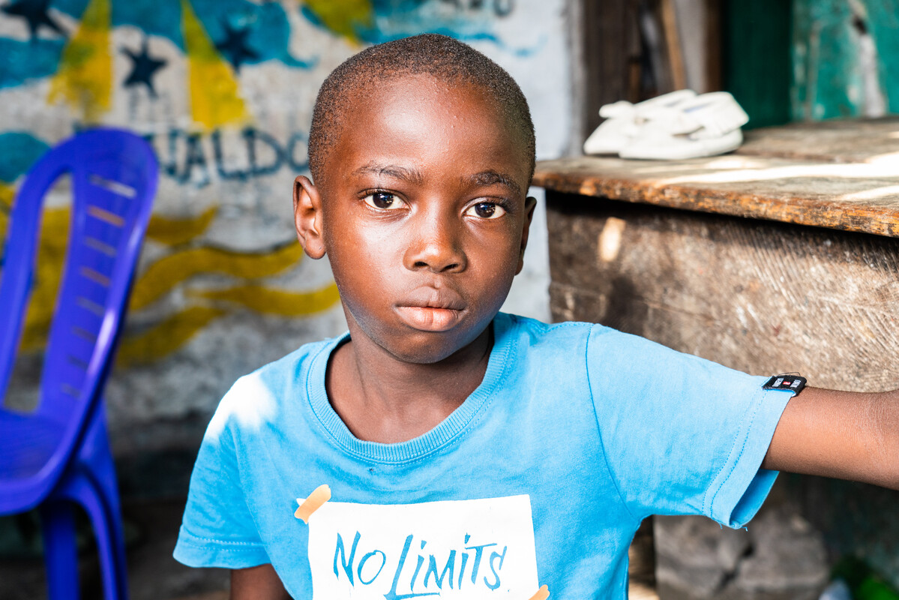
Let us pray
Loving God,
We believe that each person is special because God made us all.
Help us try to make sure all people are treated with respect and have what they need because God made them too.
Lord in your mercy
Hear our prayer
Everyone is special
Human Dignity
Notes:
Photo credit: Carielle Doe

Slide 11
Everyone is special
Luc the deer reminds us that we are all special and made in the image of God.
How can we make sure other people feel special?

