Slide 1
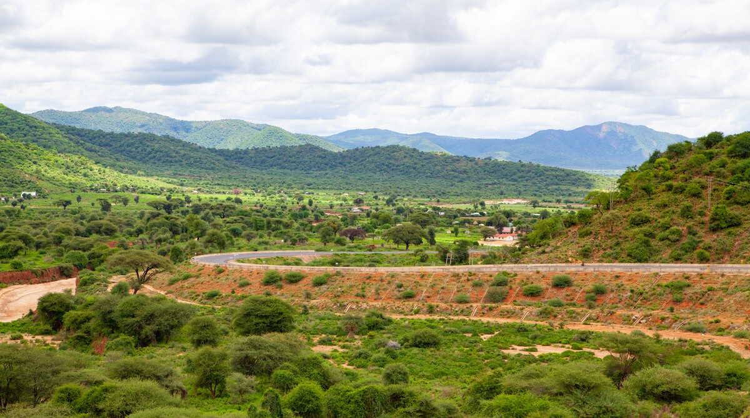
Lent Calendar 2025
Marsabit, Kenya
Notes:
Marsabit village, Kenya
Photo credit: Louise Norton

Slide 2
Note for teachers… Welcome to our Lent Calendar.
We would really value your feedback! Please email schools@cafod.org.uk. This Lent calendar can be used in conjunction with our Lent 2025 Assembly or on its own.
Student pages start on Page 4. We have created optional activities so teachers/chaplains can be flexible depending on how much time you have. Each week has
- a verse from the Sunday readings
- a Lectio Divina (optional)
- a Biblical reflection (audio and written)
- a story from a community in Marsabit, Kenya.
- and additional follow-up activities for 5, 10 and 15 minutes.
We know form time can be busy! You could use each section daily if you only have 5 minutes. Or you could do a few slides if you have a longer form time.
We have left it undated so you can use any slide on any day.

Slide 3
Notes on Lectio Divina…
Lectio Divina may be a new practice for your school and as such it is option.
It might support schools who are implementing the new Prayer and Liturgy Directory. We have included it in case it is a helpful introduction to this form of prayer.
Step 1: Make the sign of the cross. We listen to God’s word for the first time. As you do so listen out for a word or phase that stands out for you (Students could write it down)
Step 2: We listen to God's word for the second time. (At this point people usually share more widely - how the passage speaks to their life and if they feel it invites them to do something. This could work for a partner task or small group for some classes. If your class are quieter they could draw or write images, questions or thoughts that come to mind.)
Step 3: We thank God in prayer. (The teacher could lead in this instance and suggested phrases are in the notes).
Notes:
Faith into action
Lord Jesus,
help us to follow your call
and to put faith into action.
Let reflection on your word
lead to action in our world.
Amen.
OR
We are inspired by your Word,
challenged by your example,
empowered by your Spirit.
Give us the strength to be people who
inspire others with your Word,
challenge others with your example
and empower others with your Spirit.
Amen.
OR
In all we do
In our waiting, in our praying, in our being,
by our actions and our words,
by our choices and decisions
may we make your love known.
In our tears and our anger,
by our sharing and our sheltering,
through our joy and thanksgiving,
may we make your love known.

Slide 4
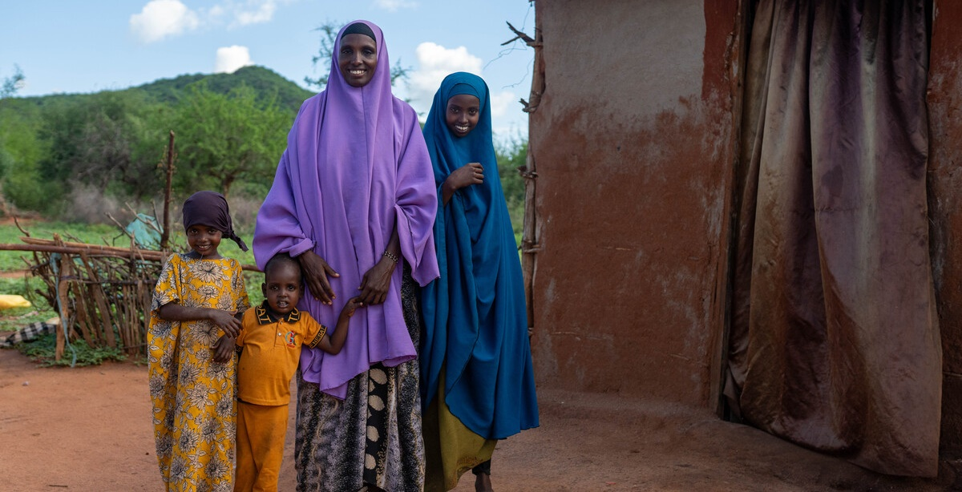
This year we'll be sharing the story of Khera who lives with her family in Marsabit, Kenya.
Severe drought has turned their lives upside down, but with CAFOD's help, the community is working together to raise chickens so they can make a living.
Notes:
Khera and her family, Marsabit, Kenya
Photo credit: Joe Newman

Slide 5
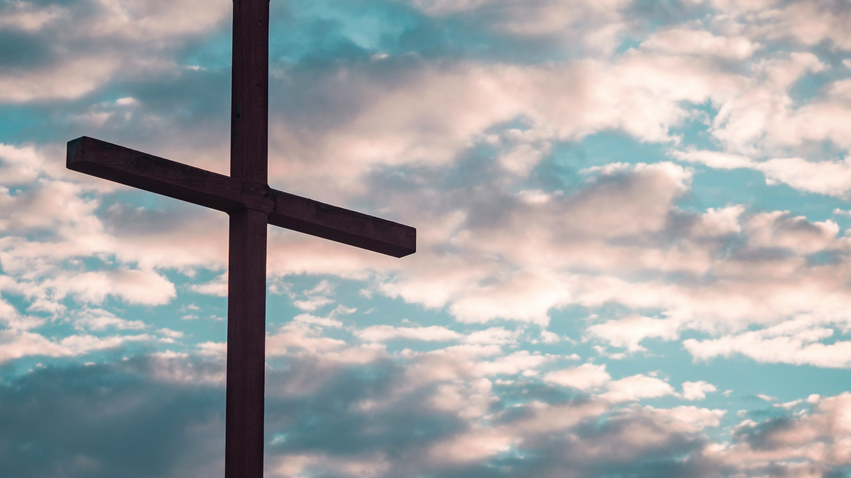
Start our journey towards Easter with Khera's family and CAFOD's Lent liturgy.
Lent 2025 resources for young people
Notes:
Cross in silhouette
Photo credit: Aaron Burden, Unsplash
Khera and her family
Photo credit: Joe Newman

Slide 6
We’d love for you to get involved with the Big Lent Walk and help us raise money for chickens!

Slide 7
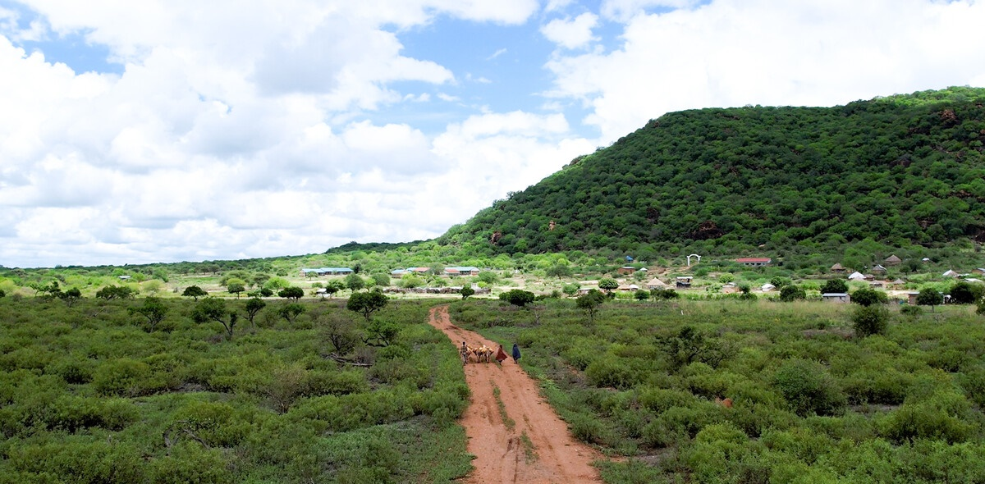
Week One
Week Two
Week Three
Week Four
Week Five
Holy Week
Notes:
Photo credit: Louise Norton

Slide 8
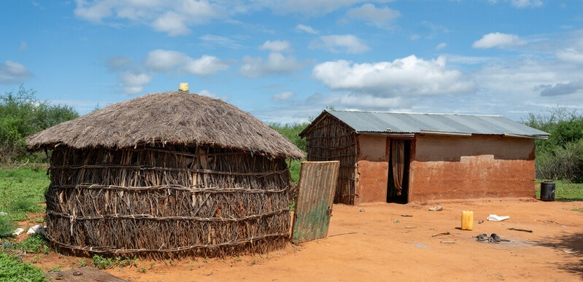
Week One
Notes:
Photo credit: Louise Norton

Slide 9
Genesis 9:12-13
"Return to the Lord your God, for he is gracious and merciful, slow to anger, and abounding in steadfast love.”
Joel 2:13
ThePhoto by PhotoAuthor is licensed under CCYYSA.

Slide 10
Reflection
Let’s listen to the reflection.
Notes:
Picture credit: Chris Nguyen, Unsplash

Slide 11
Reflection
Lent is a time for us to turn back to God. A time to reflect on the choices we make and the way we live our lives, to seek forgiveness for where we have gone wrong and to draw closer to God, knowing he loves us very much. It is a time to pray, to fast, and to share what we have with others.
In this special Jubilee year, Pope Francis invites us all to be Pilgrims of Hope to build a better world; to feel the joy of joining together with other young people to take action for our brothers and sisters in need around the world.
The Glitter Group and the whole community struggled because of the drought, but they pulled together. "This community has the spirit of sharing the little we have with each other,” says Khera. Just as God's love for us is "steadfast", let us show our love and commitment to our global family this Lent by praying, acting and giving.
ever.

Slide 12
The year 2025 is a special Jubilee year.
Pope Francis invites us all to be Pilgrims of Hope, with deep faith, lively hope and active charity – lets learn what that's all about!
Jubilee for Schools Animation | CAFOD

Slide 13
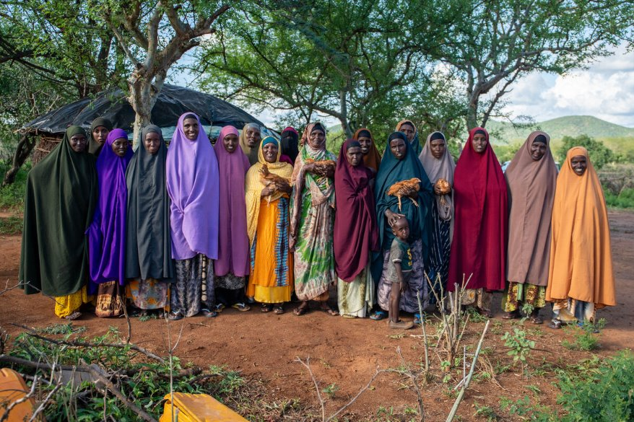
Khera, belongs to the Glitter Group, a club of woman from the local community. They help each other with lots of things, but particularly when times are tough – and times have been very tough for this community in Kenya.
Notes:
The Glitter Group, Marsabit, Kenya
Photo credit: Joe Newman

Slide 14
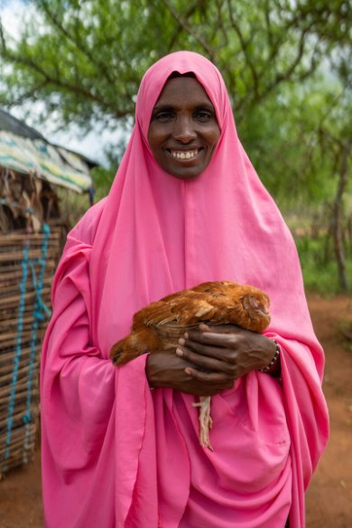
Severe drought meant water was scarce, with not enough for people to drink or for crops to grow. Animals died and there was no way for the community to make a living.
“Before the drought, we had camels, cows and goats that we used for food. Anything left over I sold for money for other things we needed,” says Khera. “We had no worries.”
With the drought, everything changed. Khera struggled to feed her family. “Most of the time, our children went to school on an empty stomach,” remembers Khera.
Say the Jubilee prayer, remembering communities
like Khera's Education_Jubilee_Prayercard.pdf
Notes:
Khera, Marsabit, Kenya
Picture credit: Joe Newman

Slide 15
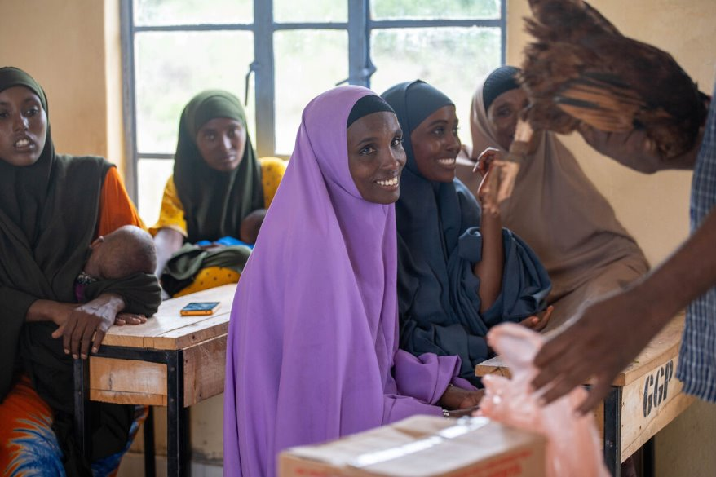
With CAFOD's help, Khera and the Glitter Group were given some chickens, which need less water to survive, and together, they learned how to look after them.
“Everyone has a duty - cleaning, feeding, letting them free to catch worms or driving them in at night. We are now good farmers!"
Keeping chickens means Khera can sell eggs, or a chicken, for money to buy food, clothes, soap and school equipment.
Stand in solidarity and help communities like the Glitter Group make a living!
Why not raise money by doing
the Big Lent Walk?
“We have a slogan: Unity is strength. Let’s pull together to inspire; let’s pull together to be strong."
Khera, the Glitter Group
Notes:
Khera and the Glitter Group, Marsabit, Kenya
Picture credit: Joe Newman

Slide 16
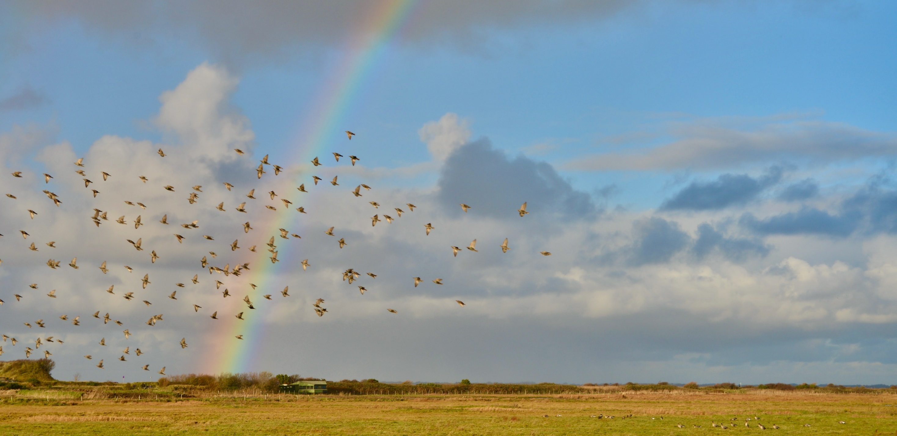
Lectio Divina (Optional)
Lectio Divina is about reading scripture prayerfully, slowly and with imagination.
Read, meditate, pray and focus on God.
"Return to the Lord your God, for he is gracious and merciful, slow to anger, and abounding in steadfast love.” Joel 2:13
Notes:
Photo credit: Gavin Allanwood, Unsplash
Step 1: Make the sign of the cross. We listen to God’s word for the first time. As you do so listen out for a word or phase that stands out for you (Students could write it down)
Step 2: We listen to God's word for the second time. (At this point people usually share more widely - how the passage speaks to their life and if they feel it invites them to do something. This could work for a partner task or small group for some classes. If your class are quieter they could draw or write images, questions or thoughts that come to mind.)
Step 3: We thank God in prayer. (The teacher could lead in this instance and suggested phrases are in the notes).
Faith into action
Lord Jesus,
help us to follow your call
and to put faith into action.
Let reflection on your word
lead to action in our world.
Amen.
OR
We are inspired by your Word,
challenged by your example,
empowered by your Spirit.
Give us the strength to be people who
inspire others with your Word,
challenge others with your example
and empower others with your Spirit.
Amen.
OR
In all we do
In our waiting, in our praying, in our being,
by our actions and our words,
by our choices and decisions
may we make your love known.
In our tears and our anger,
by our sharing and our sheltering,
through our joy and thanksgiving,
may we make your love known.

Slide 17
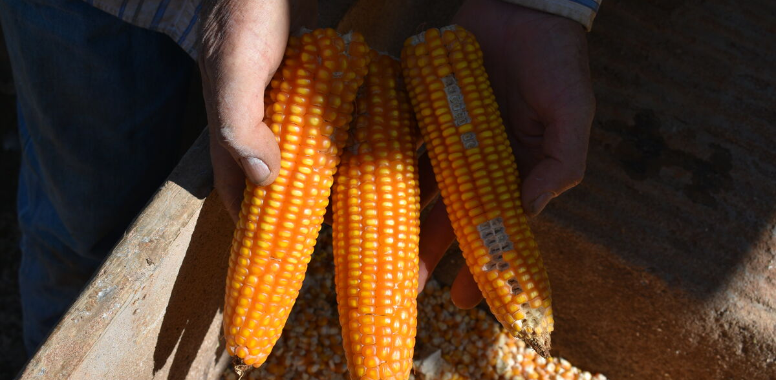
It's Family Fast Day this week. What will you do to stand with our brothers and sisters who don't have enough food to eat?
Perhaps you could support CAFOD's Family Fast Day by eating more simply and donate any savings to our Lent appeal?
Notes:
Dristy, Bangladesh
Photo credit: Amit Rudro
Farmer in Sao Paolo, Brazil
Photo credit: Kezia Lavan
Lokho, Masarbit, Kenya
Photo credit: Louise Norton

Slide 18
Activity
5 minutes
Watch our CST solidarity animation.
10 minutes
Research the spiritual practice of Lectio Divina.
15 minutes
Watch the Kenya video and have a class discussion on some of the issues raised.
Notes:
Watch this interview with Sister Mary Magdalen explaining Lectio-Divina.
(8mins onwards)

Slide 19
Sign up for the Big Lent Walk today and raise money to help our global family.

Slide 20
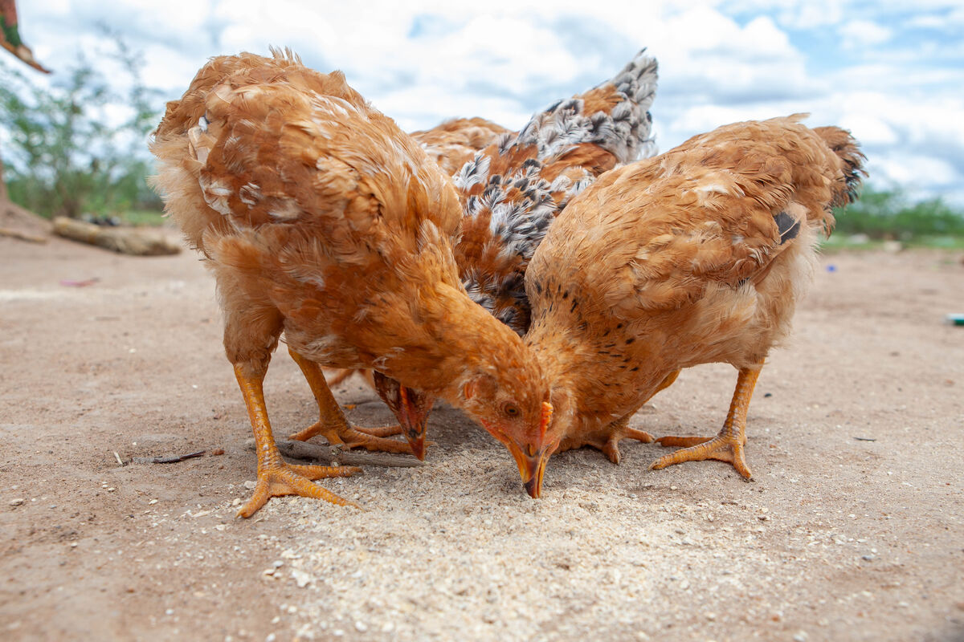
Week Two
Notes:
Hens, Marsabit, Kenya
Photo credit: Joe Newman

Slide 21
‘‘He ate nothing during those days. And when they were over, he was hungry.’’
Luke 4:2
Notes:
Photo credit: Stock image

Slide 22
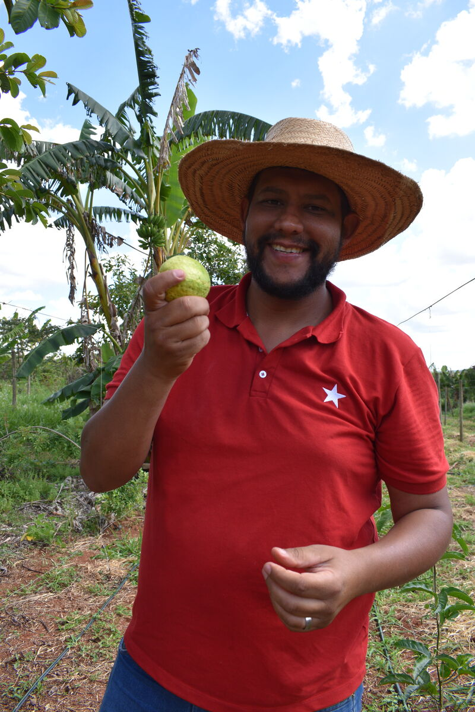
Reflection
Let’s listen to the reflection.
Notes:
Vagnar, Sao Paolo, Brazil
Picture credit: Kezia Lavan

Slide 23
Reflection
Jesus spends forty days in the desert with nothing to eat. Like Khera and her community in northern Kenya, Jesus experiences harsh conditions. We are not surprised to learn he is hungry. During this difficult time however, Jesus is never alone. He is filled with the Holy Spirit, who strengthens him.
When we face challenges, we can feel isolated and lonely, but our faith teaches us that God is always with us, helping us to overcome difficulties. It can also lead us to stand with others facing challenges. Striving together with others can make a real difference, whether in our local community, or in our wider global family.
It can mean working towards everyone having enough food to eat, clean water to drink and the things everyone needs to live a life a happy and healthy life.

Slide 24
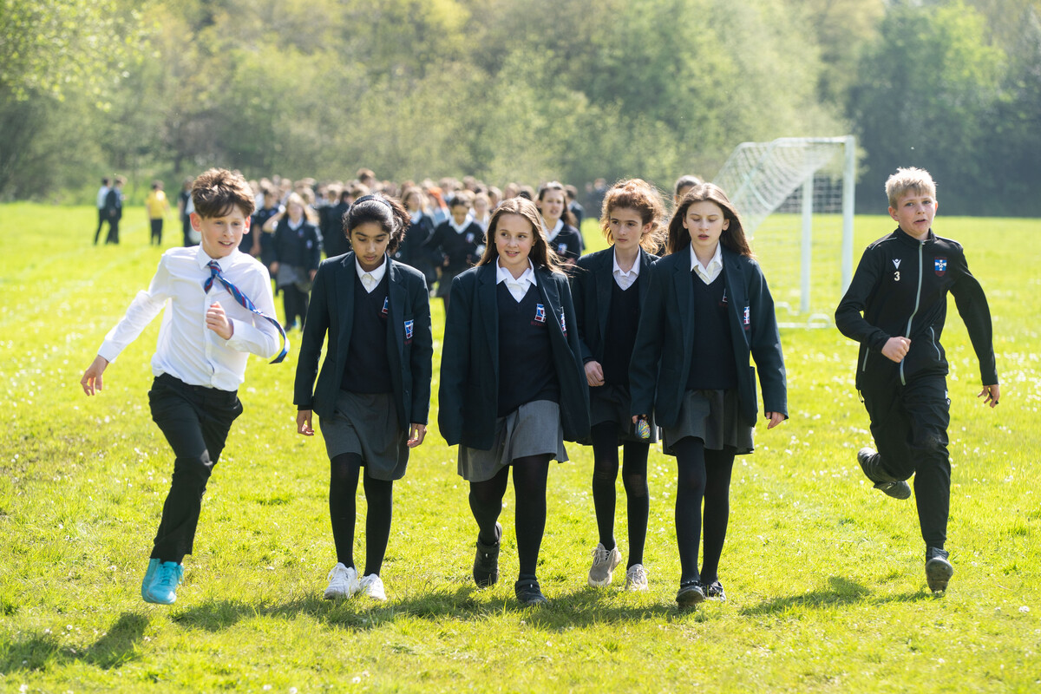
How can we be a neighbour to those who are hungry and thirsty so far away? Sometimes it may seem difficult.
Standing in solidarity with our global family and raising money for CAFOD gives us that opportunity. And there are so many easy ways to do it! How about a cake sale, a sponsored silence or the Big Lent Walk?
Notes:
CAFOD cake sale
Photo credit: Joe Newman
Fingers on lips
Photo credit: Stock image
Big Lent Walk at St Gregory's Catholic School, Tunbridge Wells
Photo credit: Joe Newman

Slide 25
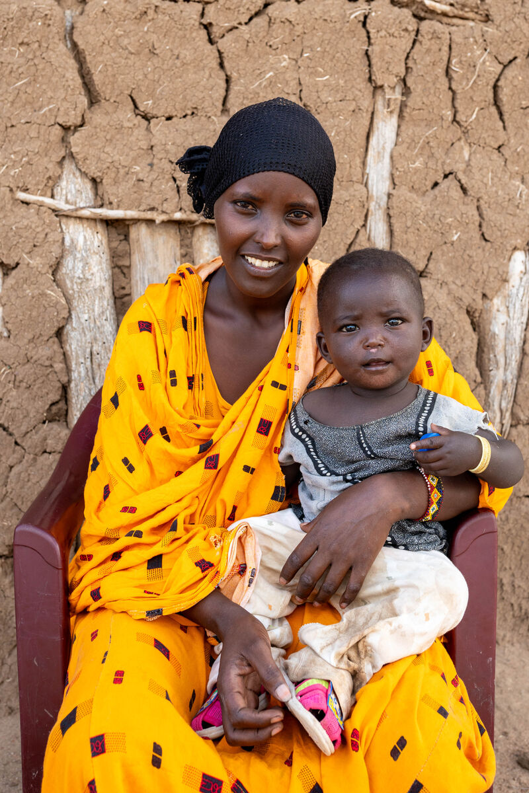
Lokho lost all her animals in the the drought too. She had no other way to feed her family, including her baby, Gurati, who was born during the drought.
In spite of these very real challenges, her faith in God remained.
“I turn to God through prayer. I pray for a better life in which to raise my children. I pray for good health and peace of mind… Since we believe the provider is God, I rely on God.”
As you journey towards making your special Jubilee pledge this summer, think about what it means to be agent of change, standing in solidarity with your global family?
Notes:
Lokho and her baby, Marsabit, Kenya
Picture credit: Joe Newman

Slide 26
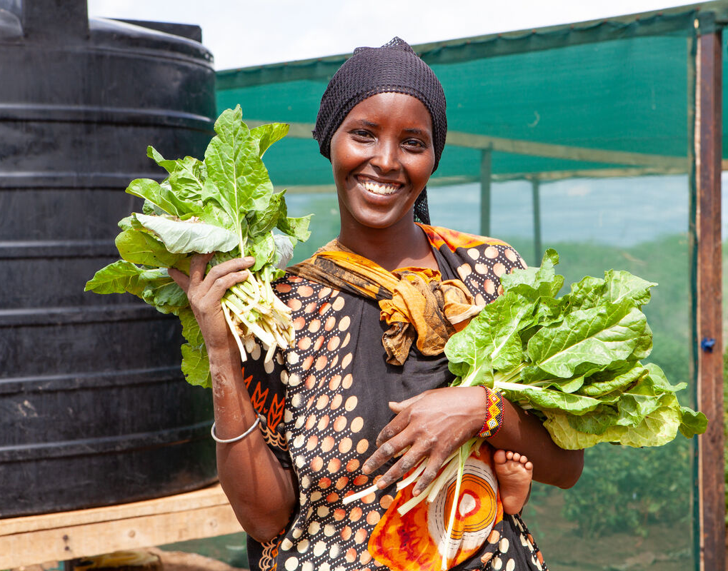
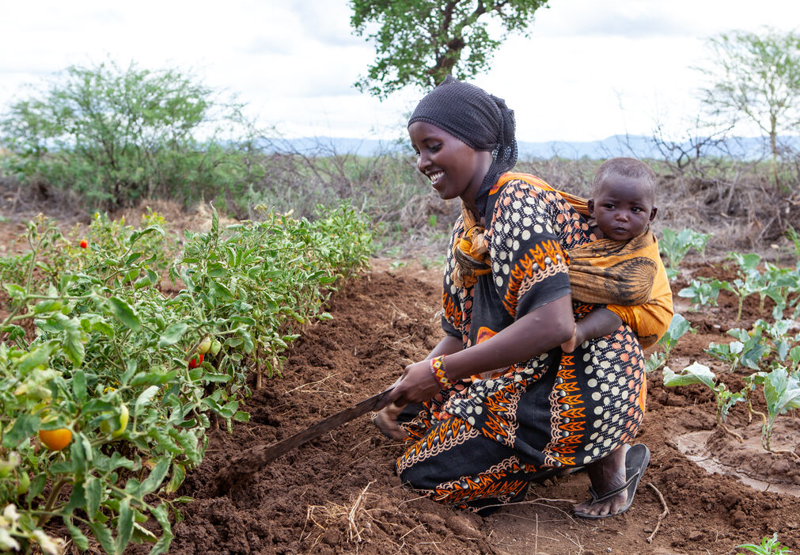
With CAFOD's help, woman in the village were given seeds and tools, learning how to grow food in hot and harsh climates.
The woman now have food to feed their families. By selling some of their produce, they make money to buy the other things they need.
Lokho, who dreams of being a shopkeeper, sells the group’s extra produce. This means the women can save up in case things are difficult again.
“I feel like I’m safe and secure,” says Lokho.
Notes:
Lokho and her baby, Marsabit, Kenya
Picture credit: Louise Norton

Slide 27
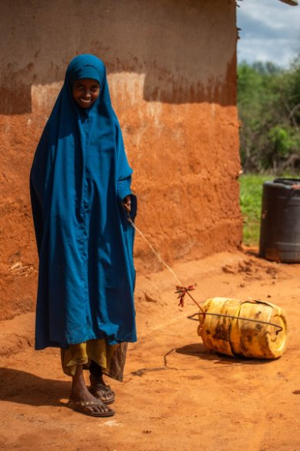
World Water Day is on Saturday 22 March
Severe drought in Kenya has meant water is scarce, with not enough for people, crops or animals.
"There was no rain for years,” says Chirri. “We had to get water far away. I walked with my neighbour. We started out at seven and came back at ten. I got tired and thirsty. The sun was way too hot.”
How many different ways do you use water in a day? How would you feel if drinking a glass of water or having a shower wasn't as easy as just turning on the tap?
God who walks with us, and knows what it is to be hungry and thirsty, teach us to walk alongside one another and to work together to overcome the challeges in our world. Amen.
Notes:
Chirri, Marsabit, Kenya
Photo credit: Joe Newman

Slide 28
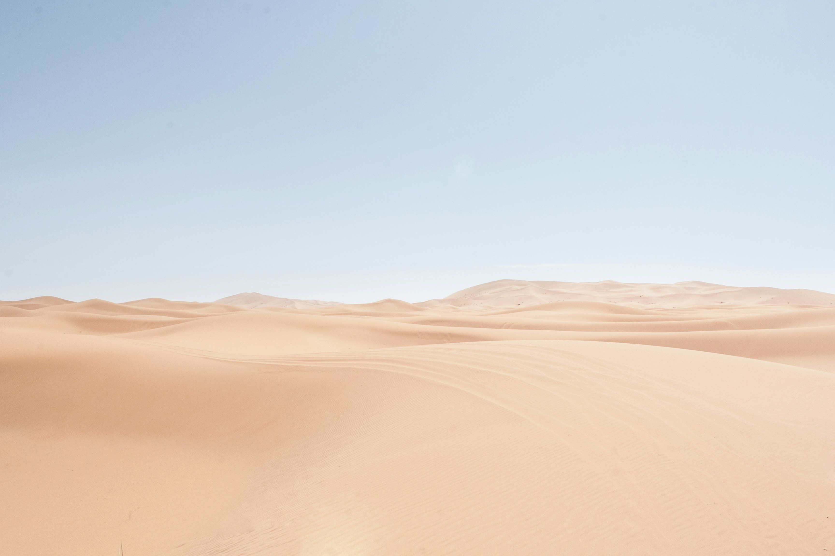
Lectio Divina (Optional)
Lectio Divina is about reading scripture prayerfully, slowly and with imagination.
Read, meditate, pray and focus on God
“He ate nothing during those days. And when they were over, he was hungry.”
Luke 4:2
Notes:
Photo credit: Mark Eder, Unsplash
Step 1: Make the sign of the cross. We listen to God’s word for the first time. As you do so listen out for a word or phase that stands out for you (Students could write it down)
Step 2: We listen to God's word for the second time. (At this point people usually share more widely - how the passage speaks to their life and if they feel it invites them to do something. This could work for a partner task or small group for some classes. If your class are quieter they could draw or write images, questions or thoughts that come to mind.)
Step 3: We thank God in prayer. (The teacher could lead in this instance and suggested phrases are in the notes).
Faith into action
Lord Jesus,
help us to follow your call
and to put faith into action.
Let reflection on your word
lead to action in our world.
Amen.
OR
We are inspired by your Word,
challenged by your example,
empowered by your Spirit.
Give us the strength to be people who
inspire others with your Word,
challenge others with your example
and empower others with your Spirit.
Amen.
OR
In all we do
In our waiting, in our praying, in our being,
by our actions and our words,
by our choices and decisions
may we make your love known.
In our tears and our anger,
by our sharing and our sheltering,
through our joy and thanksgiving,
may we make your love known.

Slide 29
How can we show solidarity with our brothers and sisters in need? You can sign up for the Big Lent Walk today…!

Slide 30
Activity
5 minutes
Say the Jubilee prayer
Jubilee prayer
10 minutes
Do you have a Pilgrims of Hope map in your classroom?
Use this map to help you on your way, as you travel to become agents of change!
Pilgrims of Hope Map
15 minutes
Discussion:
How can your school community show solidarity with Khera's community?
Notes:
Send a prayer in to schools@cafod.org.uk

Slide 31
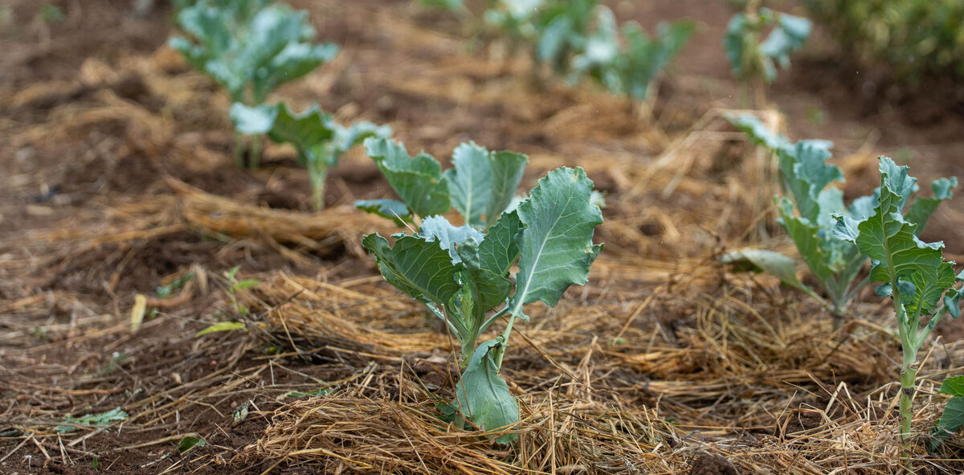
Week Three
Notes:
Crops in Marsabit, Kenya
Photo credit: Louise Norton

Slide 32
Hello...! Did you know you can order resources like stickers and posters for your Big Lent Walk?!

Slide 33
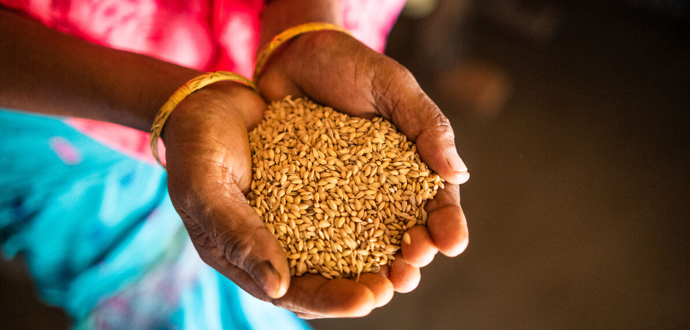
"The rain and the snow came down from heaven... giving seed to the sower and bread to the eater.“
Isaiah 55:10
Notes:
Anowera Begum with seeds, Bangladesh
Photo credit: Amit Rudro

Slide 34
In this Jubilee year, think about what hope means to you; all the things that bring you hope; your hopes for the future.
Use this worksheet to be as creative as you can!

Slide 35
In this Jubilee year, think about what hope means to you; all the things that bring you hope; your hopes for the future.
Use the Hope worksheet and be as creative as you can!
Hope Reflection Sheet
Notes:
Hope Reflection Sheet

Slide 36
Reflection
Let’s listen to the reflection.
Notes:
Picture credit: Unknown

Slide 37
Reflection
The reading uses the image of rain and snow nourishing the ground and causing life to spring forth, to talk about the word of God. As the rain softens the earth, allows the seed to grow and transforms it into something new, the word of God softens our hearts, causes us to grow and transforms our lives.
The Bishop of Marsabit in Kenya reflects on the wonderful difference that rain has made in the dry and arid landscape: “We always say the rain is a blessing. I hope also in your country, you say the same… Those seeds of the grass were alive all those years. And it became so green and beautiful. They covered all our stones and sand. Wow, how beautiful it is!”
The rain brings hope to those people who have suffered because of the drought. It helps plants grow and ensures water for people and animals. It suggests that better days lie ahead.
What seed of hope, love, joy or peace is sprouting in your heart as we listen to God's word? How will this seed transform your life and lead you to think and act differently?

Slide 38
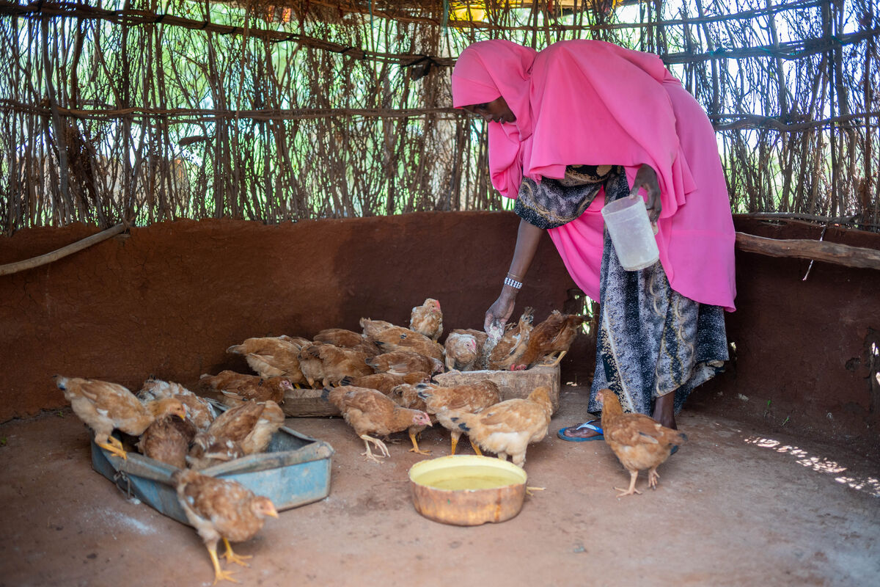
Khera says the Glitter Group and the community has hope for the future. "The rain has given us hope for a better life, but if another drought comes, the chickens are hardy," she says.
Because the women have hope, they want to plan for the future. The money raised from the chickens means the community can pay to build a permanent shelter for the chickens.
Notes:
Khera and the Glitter Group chickens, Marsabit, Kenya
Photo credit: Joe Newman

Slide 39
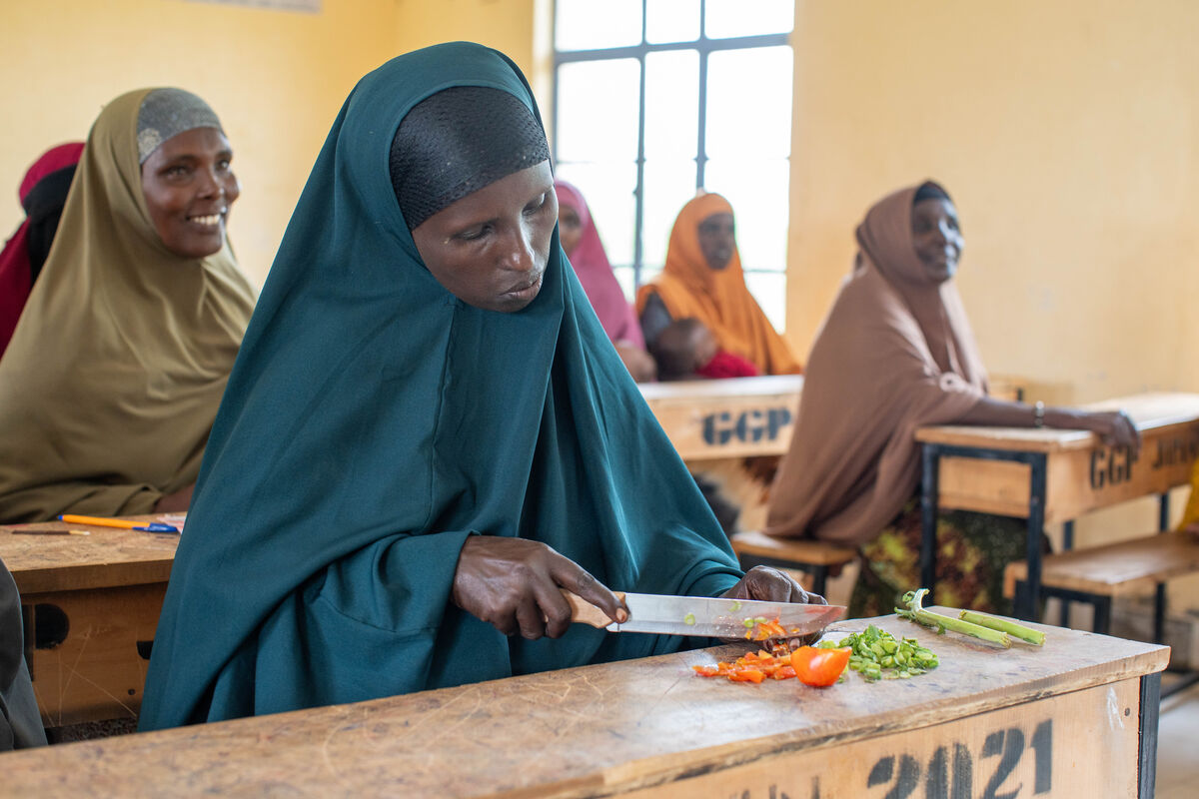
The Glitter Club is also looking at other businesses for the group to make money and help their families support themselves.
“I love this group so much,” says Khera. "There is so much benefit to being in the group," she explains. "We are so close to one another. We are people who are living the same dreams.”
How could you help bring hope to communities
like the Glitter Group? Think about this when making your Jubilee pledge...
Notes:
The Glitter Group, Marsabit, Kenya
Photo credit: Joe Newman

Slide 40
Jar of hope
Rain brings hope to those in places affected by drought. In this Jubilee year, Pope Francis asks us to be Pilgrims of Hope. How can we do that? Share your hopes!
​
Jar of Hope

Slide 41
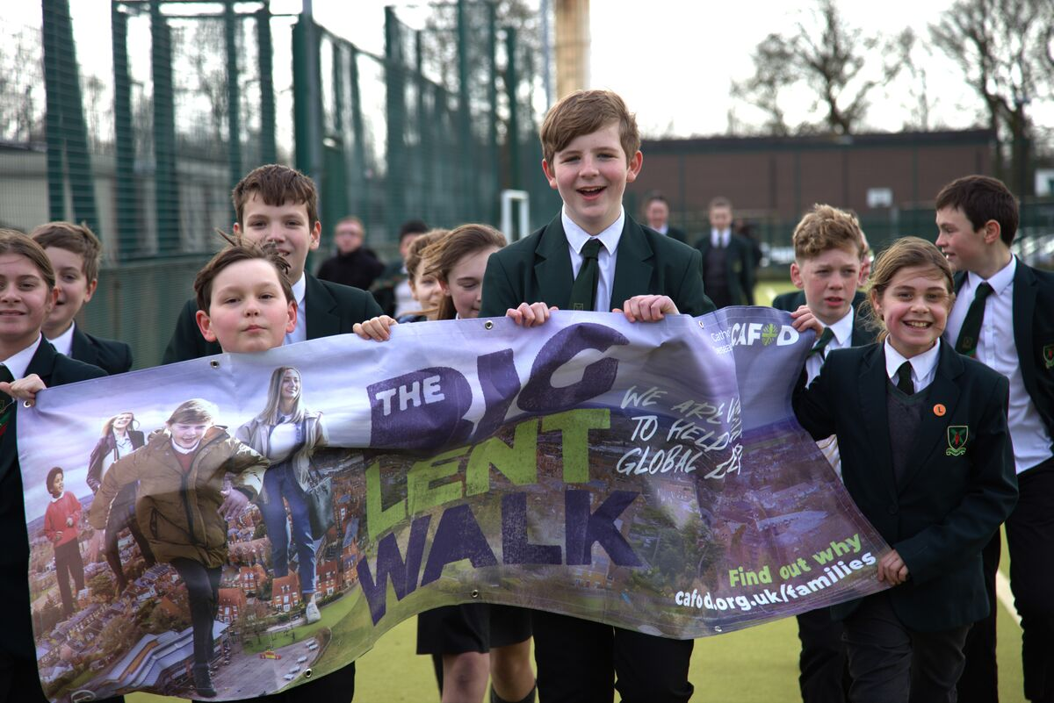
Could you make the Big Lent Walk your school Jubilee pledge?
Sign up today to walk (or run, or dance, or shimmy) around the playground, park or school hall.
It's that simple!
Sign up here!
Notes:
Pupils from St Edmund Arrowsmith Catholic High School
Photo credit: HOPE Friendship for Development Organization

Slide 42
Lectio Divina (Optional)
Lectio Divina is about reading scripture prayerfully, slowly and with imagination.
Read, meditate, pray and focus on God
"The rain and the snow came down from heaven... giving seed to the sower and bread to the eater." Isaiah 55:10
Notes:
Photo credit: Chuttersnap, Unsplash
Step 1: Make the sign of the cross. We listen to God’s word for the first time. As you do so listen out for a word or phase that stands out for you (Students could write it down)
Step 2: We listen to God's word for the second time. (At this point people usually share more widely - how the passage speaks to their life and if they feel it invites them to do something. This could work for a partner task or small group for some classes. If your class are quieter they could draw or write images, questions or thoughts that come to mind.)
Step 3: We thank God in prayer. (The teacher could lead in this instance and suggested phrases are in the notes).
Faith into action
Lord Jesus,
help us to follow your call
and to put faith into action.
Let reflection on your word
lead to action in our world.
Amen.
OR
We are inspired by your Word,
challenged by your example,
empowered by your Spirit.
Give us the strength to be people who
inspire others with your Word,
challenge others with your example
and empower others with your Spirit.
Amen.
OR
In all we do
In our waiting, in our praying, in our being,
by our actions and our words,
by our choices and decisions
may we make your love known.
In our tears and our anger,
by our sharing and our sheltering,
through our joy and thanksgiving,
may we make your love known.

Slide 43
Activity
5 minutes
Get ready for pledge day. Give a few minutes to thinking about what it might be.
10 minutes
Write a prayer thanking God for a gift he has given us and send it to our CAFOD Schools team for us to feature in another resource soon.
15 minutes
As a class list your hopes for the future. How might our hopes be the same or differ from those of our global family?
Notes:
Send a prayer in to schools@cafod.org.uk

Slide 44
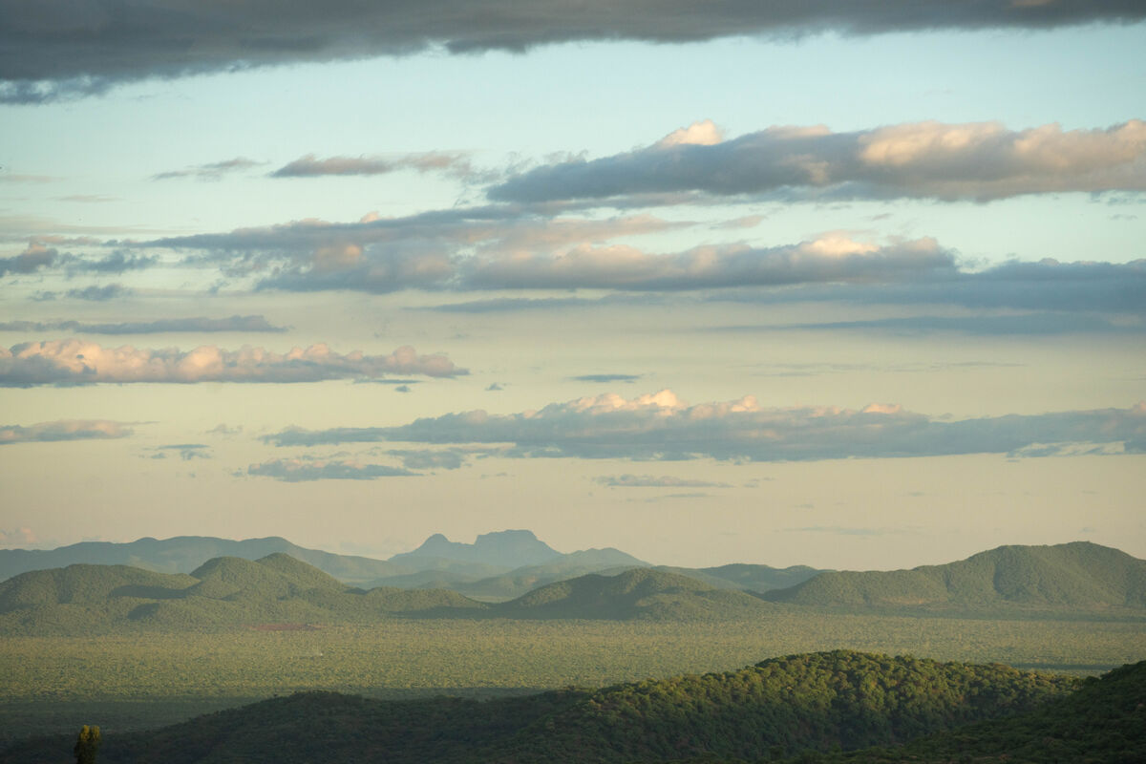
Week Four
Notes:
Marsabit, Kenya
Photo credit: Joe Newman

Slide 45
“Do not think that I have come to abolish the Law or the Prophets;
I have not come to abolish them but to fulfil them.”
Matthew 5:17
Notes:
Photo credit: Stock image

Slide 46
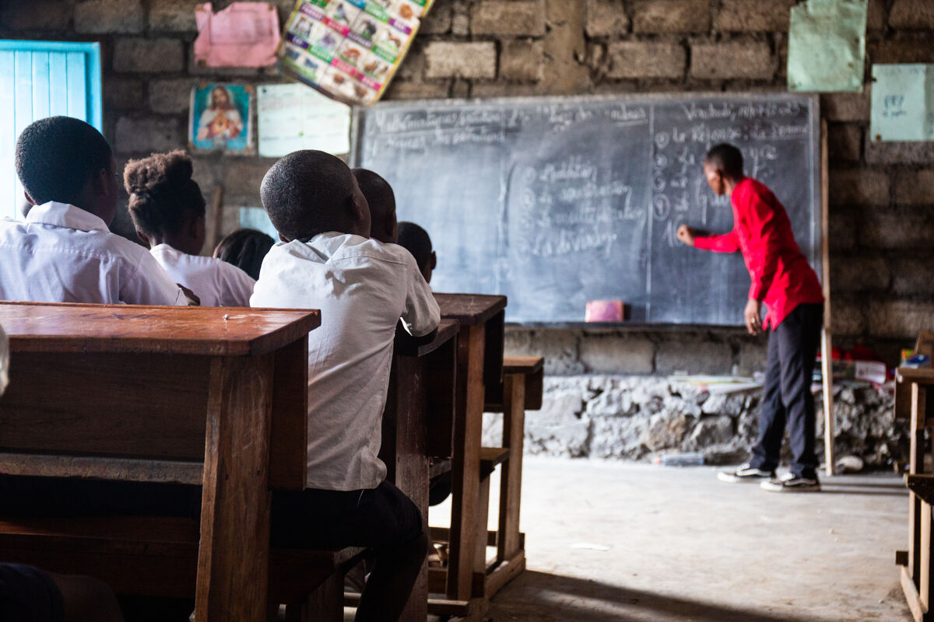
Can you remember a teacher who's had a big impact on your life?
How did they inspire you?
Notes:
Children at school in Goma, DRC
Photo credit: Thom Flint

Slide 47
Reflection
Let’s listen to the reflection.
Notes:
Picture credit: Stock image

Slide 48
Reflection
Today’s readings focus on the Law. We’re reminded that God’s Law is not just a set of rules we must not break for fear of punishment, but rather a valuable gift to teach us how we can be in better relationship with God and neighbour.
We all remember those who have been good teachers for us, and the influence they have had on our lives. Schoolteacher Ibrahim lives in northern Kenya and is passionate about the value of education. As there was no school in his village, he set one up himself. As he tells us, “Even when I worked as a teacher in the school for five years, I didn’t earn anything for myself or from the government. I don’t have anything; I just volunteer myself and I just pray to God and I never have any problems. I believe in God.”
In the season of Lent, as we continue to reflect on what it means to live faithfully together, let’s open our hearts to God’s law of love and seek, like Ibrahim, to respond to the Lord with trust and generosity.
Notes:
Picture credit: Unknown

Slide 49
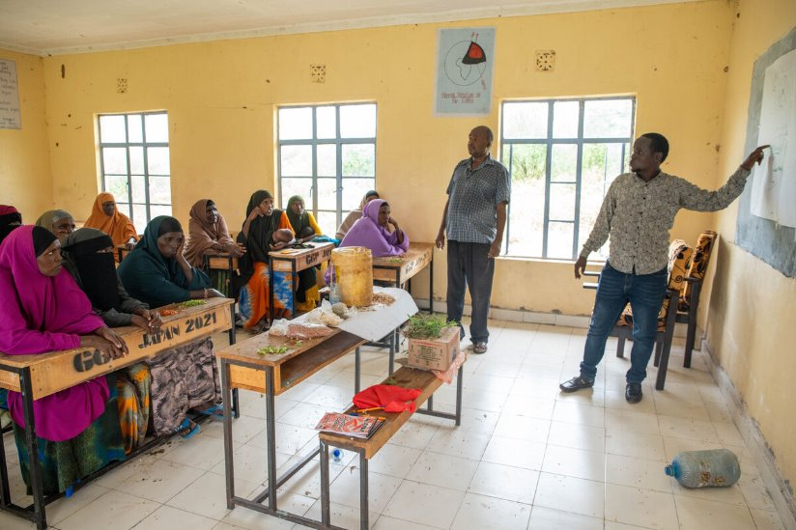
Khera and the Glitter Group went 'back to school' and learned how to keep chickens. With a livelihood that brings them food to eat and sell, the women have money to buy food, clothes and soap.
It can also buy things for school. Khera is proud her children are going to school and enjoying learning.
“Every dream is realised through education,” says Khera. “There is no situation not improved by education.”
Want to stand in solidarity with other young people around the world who want to go to school and can't? Do the Big Lent Walk and raise money for CAFOD.
Notes:
The Glitter Group learning to look after chickens, Marsabit, Kenya
Photo credit: Joe Newman

Slide 50
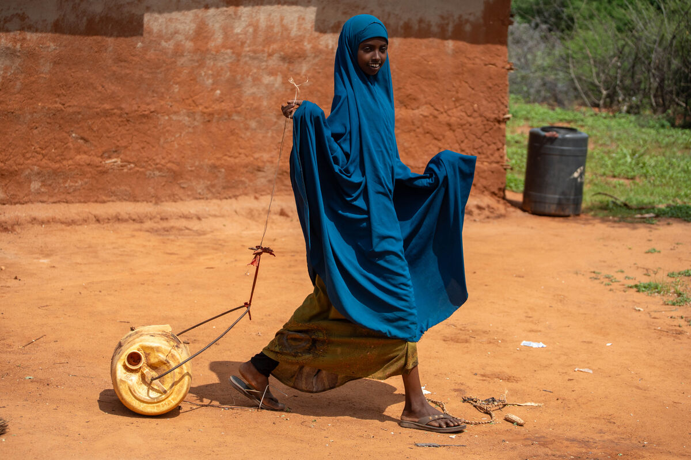
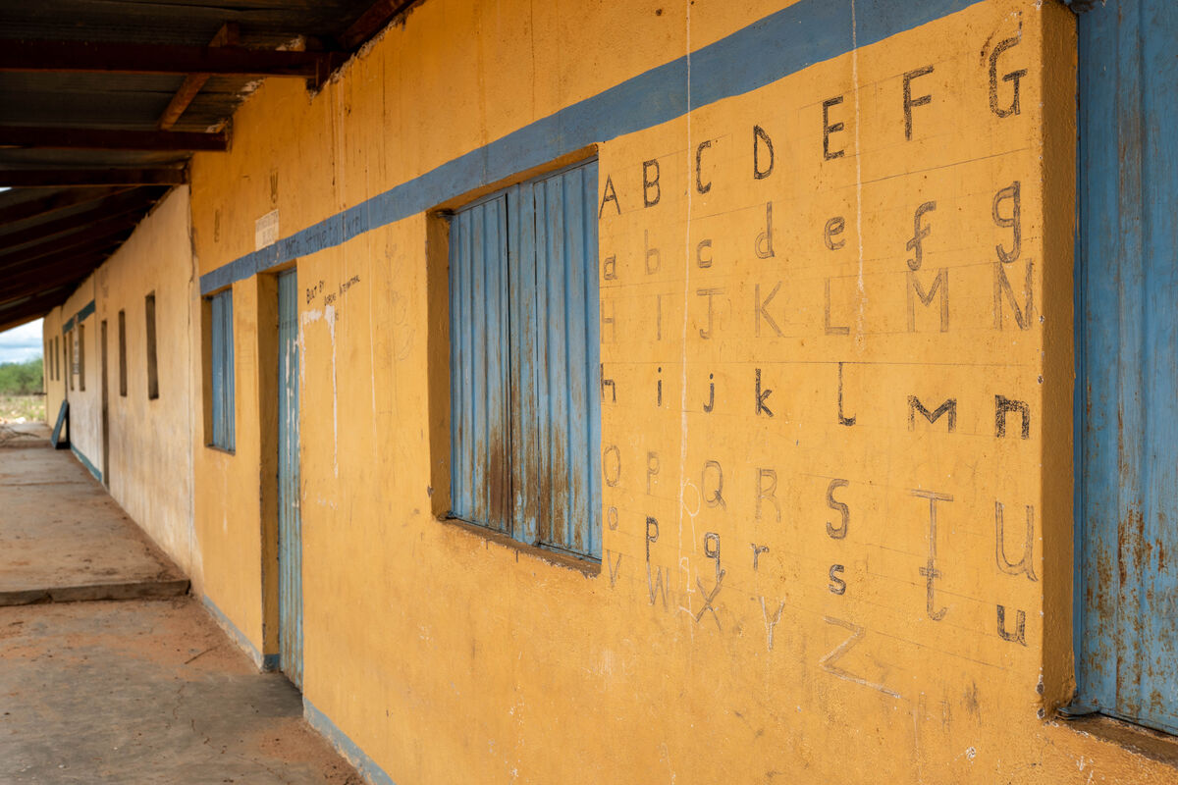
Khera taught Chirri to look after the chickens. "I enjoy helping and I feed them when my mother is away," explains Khera.
"I like it when the chickens jump about and seeing them lay eggs. I like eating the eggs too – fried for breakfast!
"In the future, I want to help my parents and my family. I want to be a teacher when I grow up. I want to teach children in my area. It’s good to help children."
Notes:
Marsabit school and Chirri
Photo credit: Joe Newman

Slide 51
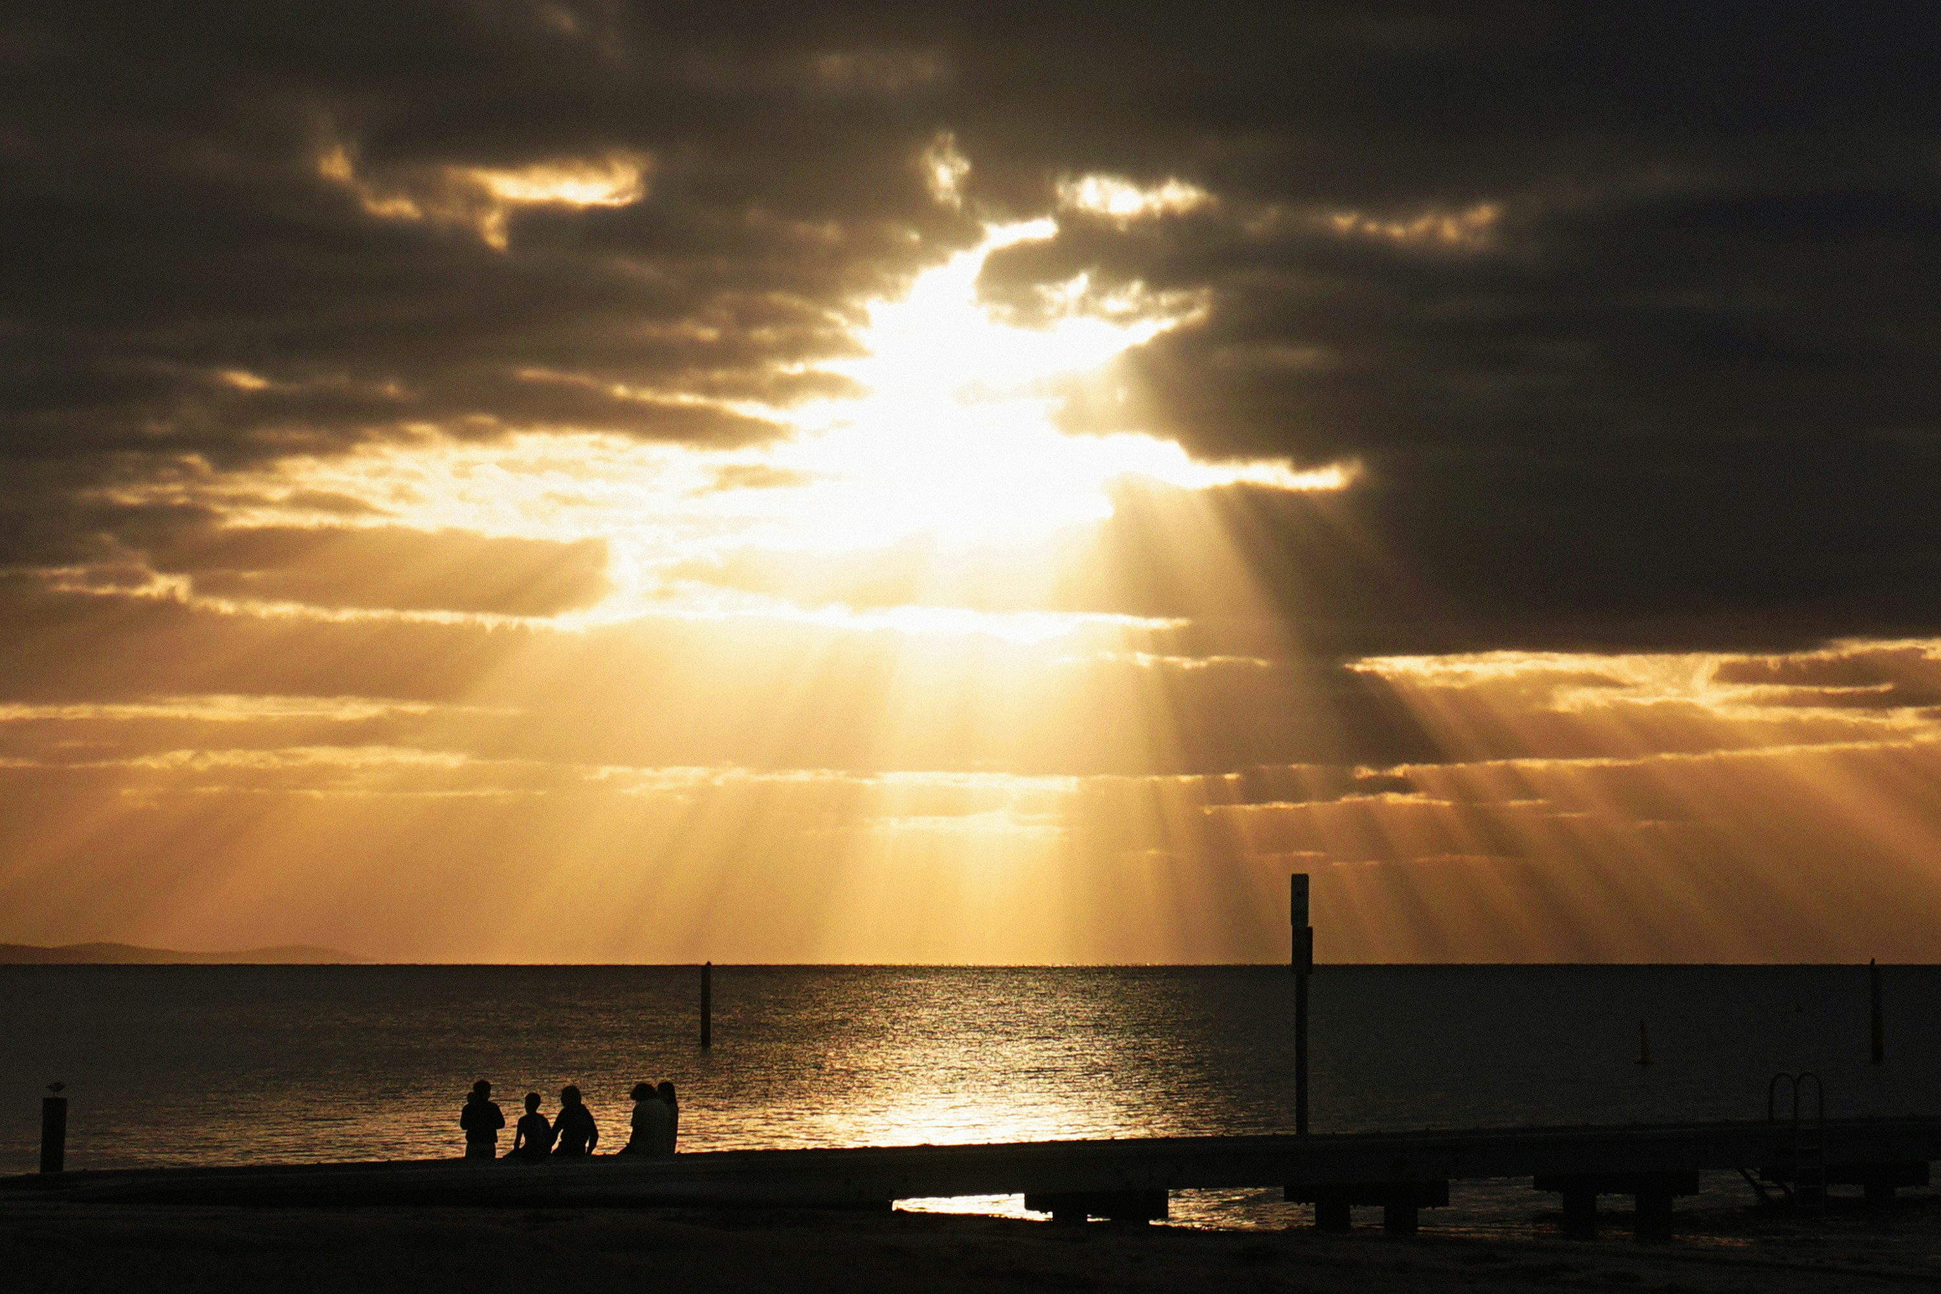
Lectio Divina (Optional)
Lectio Divina is about reading scripture prayerfully, slowly and with imagination.
Read, meditate, pray and focus on God
“Do not think that I have come to abolish the Law or the Prophets; I have not come to abolish them but
to fulfil them.” Matthew 5:17
Notes:
You may like to read the full passage for the Lectio Divina (John 3)
Step 1: Make the sign of the cross. We listen to God’s word for the first time. As you do so listen out for a word or phase that stands out for you (Students could write it down)
Step 2: We listen to God's word for the second time. (At this point people usually share more widely - how the passage speaks to their life and if they feel it invites them to do something. This could work for a partner task or small group for some classes. If your class are quieter they could draw or write images, questions or thoughts that come to mind.)
Step 3: We thank God in prayer. (The teacher could lead in this instance and suggested phrases are in the notes).
Photo credit: Serjan Midili, Unsplash
Faith into action
Lord Jesus,
help us to follow your call
and to put faith into action.
Let reflection on your word
lead to action in our world.
Amen.
OR
We are inspired by your Word,
challenged by your example,
empowered by your Spirit.
Give us the strength to be people who
inspire others with your Word,
challenge others with your example
and empower others with your Spirit.
Amen.
OR
In all we do
In our waiting, in our praying, in our being,
by our actions and our words,
by our choices and decisions
may we make your love known.
In our tears and our anger,
by our sharing and our sheltering,
through our joy and thanksgiving,
may we make your love known.

Slide 52
Activity
5 minutes
Say the Jubilee prayer
Education_Jubilee_Prayercard.pdf
10 minutes
Research an organisation that you think could do more to tackle the injustices within their corporation. It might be an ecological or a humanitarian injustice. Research brings the truth into the light.
15 minutes
Reflect on the special CAFOD-commissioned icon of Jesus teaching a crowd. What does it tell us?
Icon reflection
Notes:
Send a prayer in to schools@cafod.org.uk

Slide 53
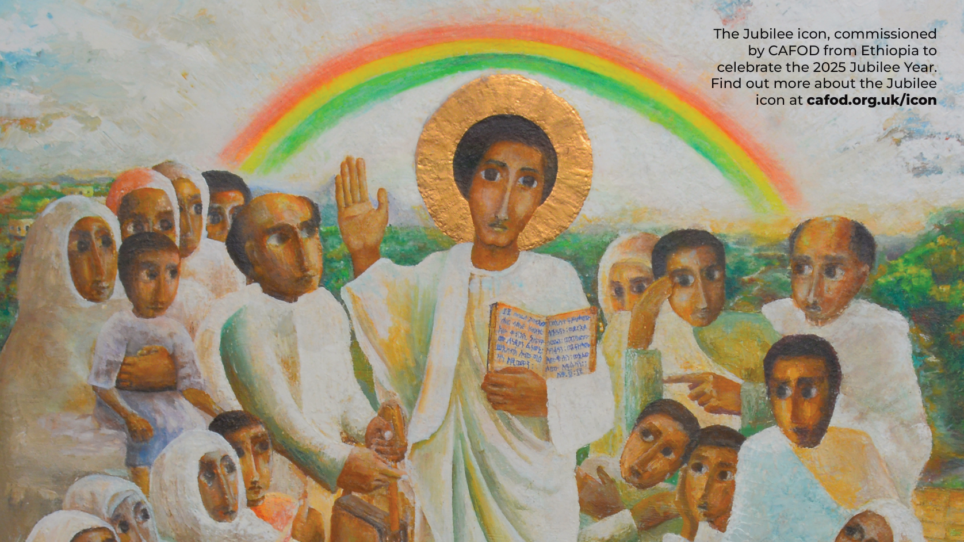
Notes:
Jubilee icon
Illustration: Mulugeta Araya

Slide 54
We’d love for you to get involved with the Big Lent Walk and help us raise money for chickens!

Slide 55
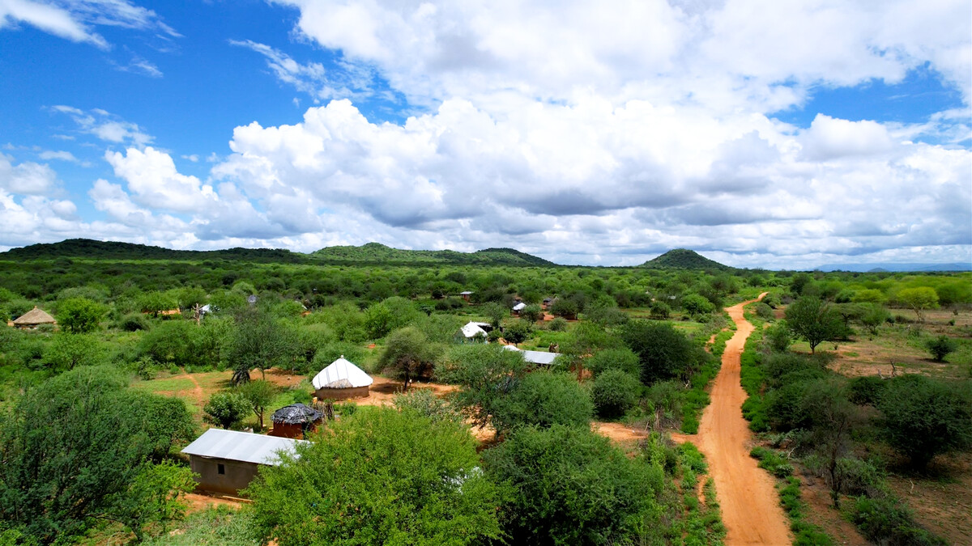
Week Five
Notes:
Marsabit village, Kenya
Photo credit: Alex Kamweru

Slide 56
"Again, Jesus spoke to them, saying, ‘I am the light of the world.’”
John 8:12
Notes:
Photo credit: Tyler Nix, Unsplash

Slide 57
We’d love for you to get involved with the Big Lent Walk and help us raise money for chickens!

Slide 58
Reflection
Let’s listen to the reflection.
Notes:
Picture credit: Unknown

Slide 59
Reflection
We can feel overwhelmed by the climate crisis, environmental devastation, conflict. Yet, in the face of such challenges, we have been given this wonderful task – to be "the light of the world".
How can we begin to do this? Our Jubilee challenge is to be “tangible signs of hope for those of our brothers and sisters who experience hardships of any kind.” (Spes non confundit, #10) Of course, we do not have to do this alone. We are part of a global community, acting in solidarity with one another to bring about change, to spread goodness. As Pope Francis explains, we should keep in mind Jesus’ promise to us, “He will not cast you into the abyss, or leave you to your own devices. He will always be there to encourage and accompany you.” (Dilexit Nos, #215)
This special Jubilee year gives us a great opportunity to be Pilgrims of Hope, to spread goodness, to be good neighbours, to stand up for what is right, to challenge unfair systems, to stand in solidarity with our global family in need – to be "the light of the world".
Notes:
Picture credit: Unknown

Slide 60
The Glitter Group is a club of woman from Marsabit who help each other with lots of things, but particularly when times are tough – and times have been very tough for this community.
“We call it the Glitter Group because glitter is something visible, easily seen,” says Khera, referring not only to its sparkle, but also the group standing out as a support to women.
Notes:
The Glitter Group, Marsabit, Kenya
Photo credit: Joe Newman

Slide 61
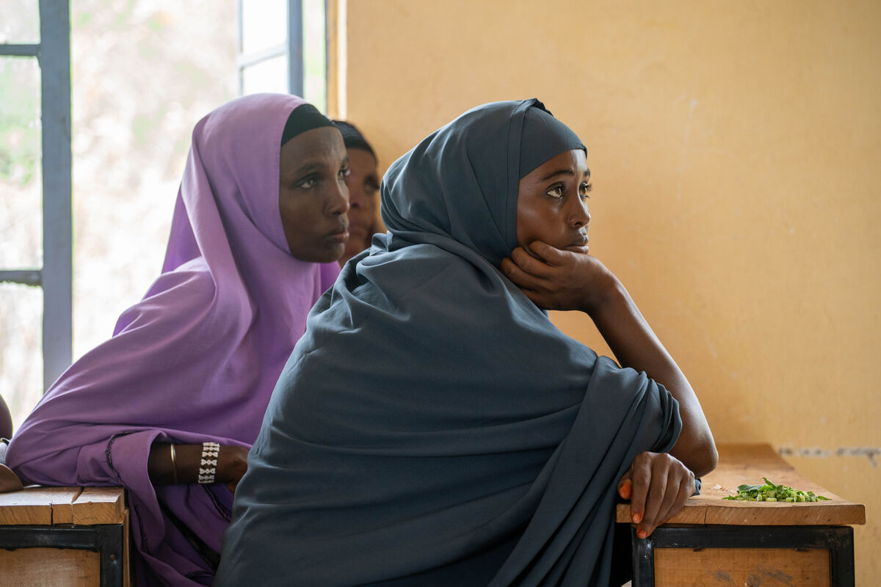
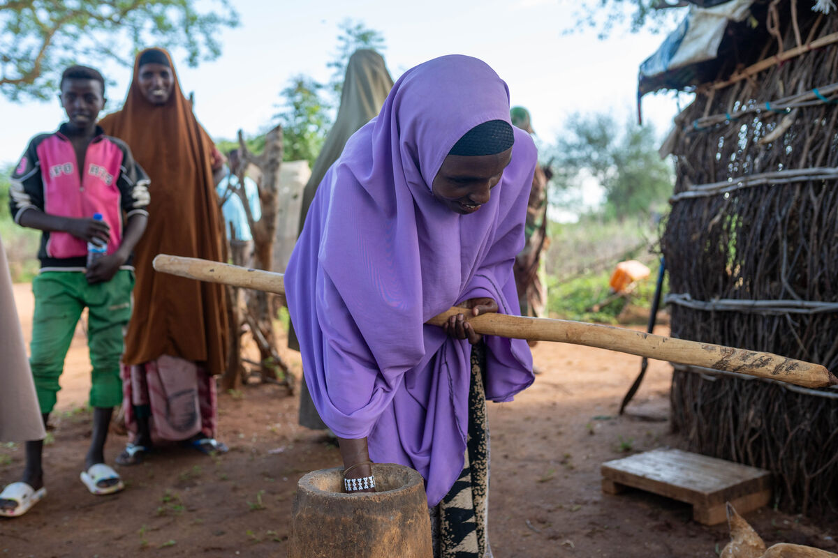
This group has been the glittering light in a dark time for the women. Severe drought meant water was scarce, with not enough for people to drink or for crops to grow. Animals died.
“This caused so much frustration,” remembers Khera. “Most of the time, our children went to school on an empty stomach.”
The Glitter Group pulled together. "This community has the spirit of sharing the little we have,” says Khera. “We have a slogan: Unity is strength. Let’s pull together to inspire; let’s pull together to be strong.”
Could you be the Pilgrim of Hope or the 'light of the world' that Pope Francis
calls us to be in this Jubilee Year?
Notes:
The Glitter Group, Marsabit, Kenya
Photo credit: Joe Newman

Slide 62
Activity
5 minutes
Send in your fundraising money for Big Lent Walk.
10 minutes
Look at the diagram on the next slide. Can you explain in words the impact chickens have had on the Glitter Group community ?
15 minutes
Let’s talk about eggs! As a class try and work out the average egg consumption every year.
Distributive justice means giving every equal access to food. Do you think this is happening?
Notes:
Send a prayer in to schools@cafod.org.uk

Slide 63
Lectio Divina (Optional)
Lectio Divina is about reading scripture prayerfully, slowly and with imagination.
Read, meditate, pray and focus on God
"Again, Jesus spoke to them, saying,
‘I am the light of the world.’”
John 8:12
Notes:
Photo credit: Rajiv Bajaj, Unsplash
Step 1: Make the sign of the cross. We listen to God’s word for the first time. As you do so listen out for a word or phase that stands out for you (Students could write it down)
Step 2: We listen to God's word for the second time. (At this point people usually share more widely - how the passage speaks to their life and if they feel it invites them to do something. This could work for a partner task or small group for some classes. If your class are quieter they could draw or write images, questions or thoughts that come to mind.)
Step 3: We thank God in prayer. (The teacher could lead in this instance and suggested phrases are in the notes).
Faith into action
Lord Jesus,
help us to follow your call
and to put faith into action.
Let reflection on your word
lead to action in our world.
Amen.
OR
We are inspired by your Word,
challenged by your example,
empowered by your Spirit.
Give us the strength to be people who
inspire others with your Word,
challenge others with your example
and empower others with your Spirit.
Amen.
OR
In all we do
In our waiting, in our praying, in our being,
by our actions and our words,
by our choices and decisions
may we make your love known.
In our tears and our anger,
by our sharing and our sheltering,
through our joy and thanksgiving,
may we make your love known.

Slide 64
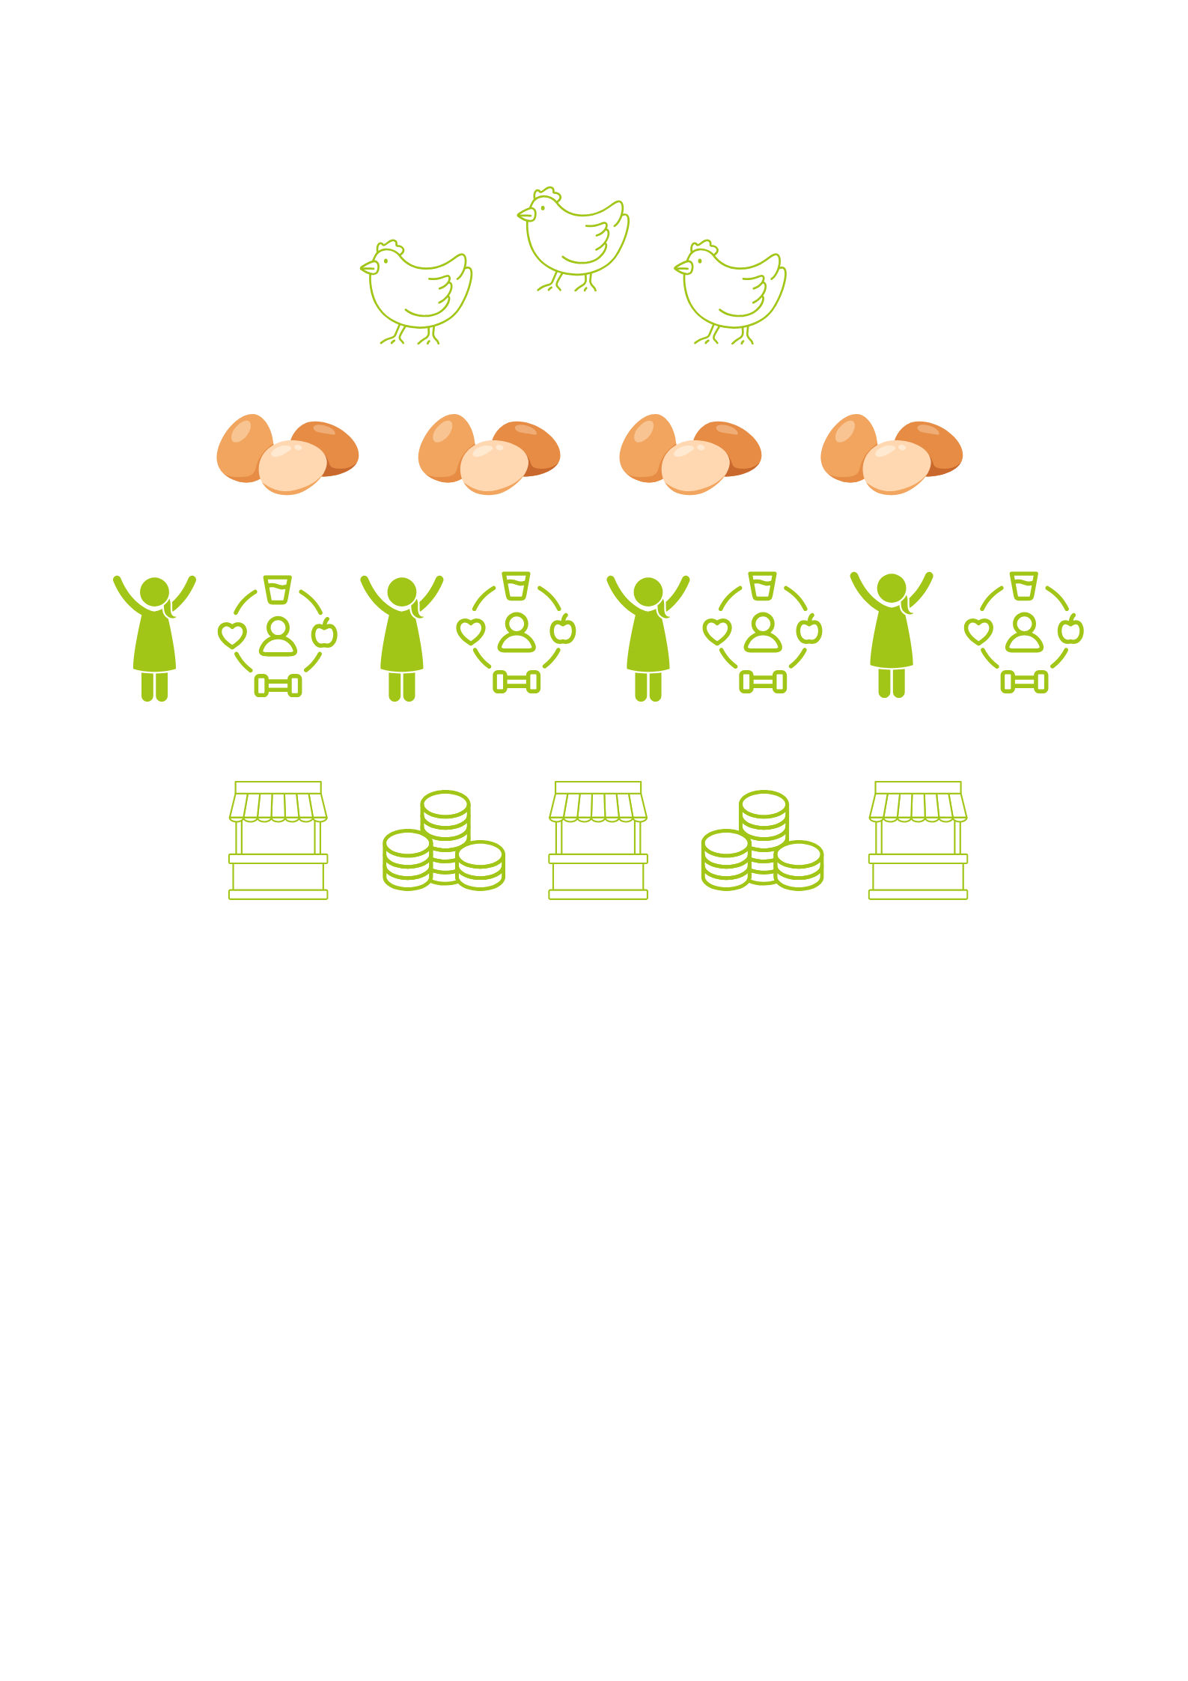

Slide 65
Send us pictures of your Big Lent Walk!
@cafodschools

Slide 66
Holy Week
Notes:
Photo credit: Thom Flint

Slide 67
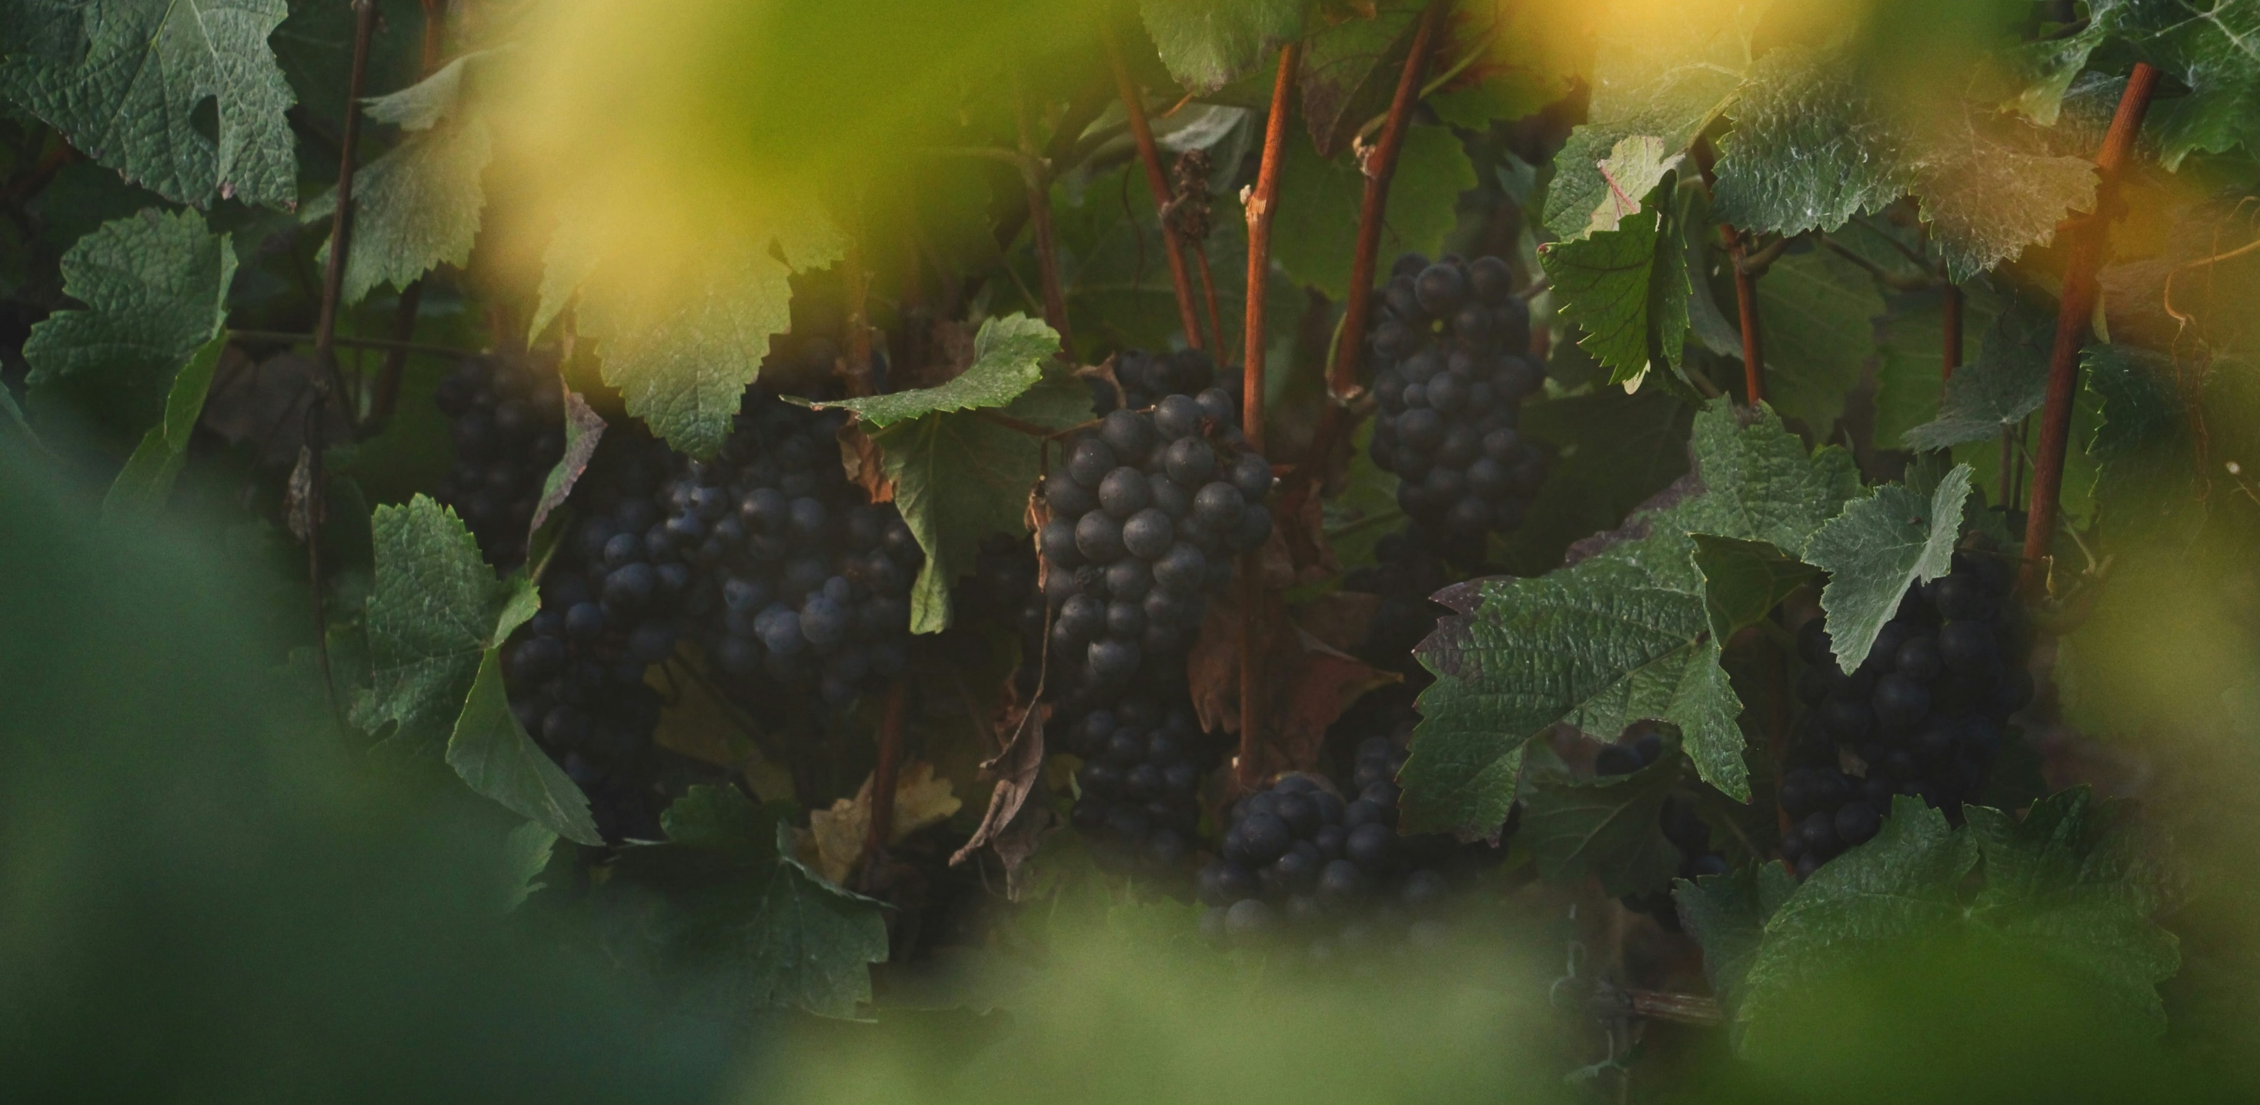
After this, Jesus knew that everything had now been completed and, so that the scripture should be completely fulfilled, he said: I am thirsty. A jar full of sour wine stood there; so, putting a sponge soaked in the wine on a hyssop stick, they held it up to his mouth. After Jesus had taken the wine he said, 'It is fulfilled'; and bowing his head he gave up his spirit.
John 19: 28-30

Slide 68
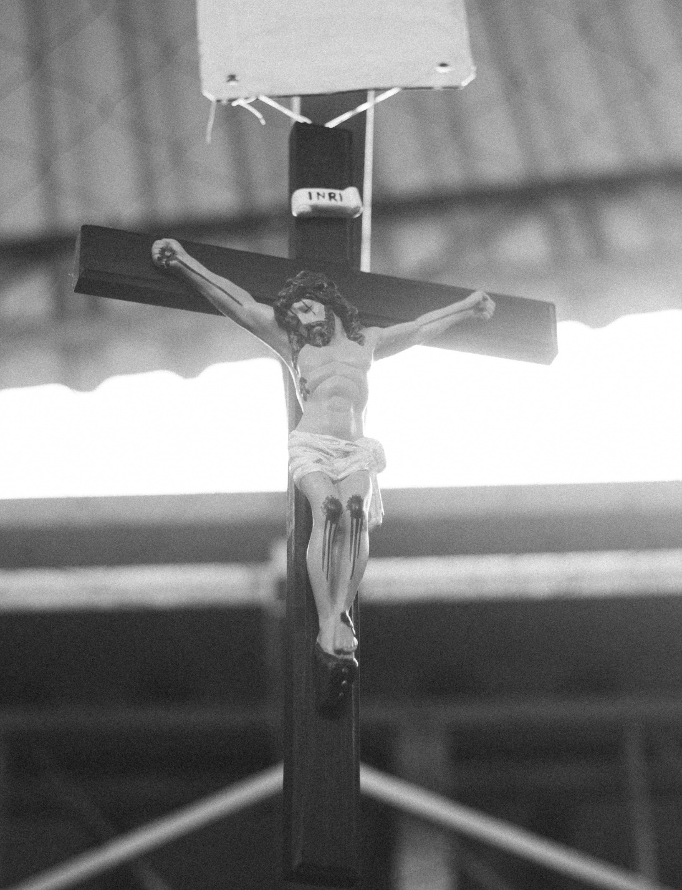
Reflection
Let’s listen to the reflection.
Notes:
Picture credit: Thays Orrico, Unsplash

Slide 69
Reflection
As we come into Holy Week we know that many schools will start their annual Easter holidays. Perhaps you have made plans for what you’ll be doing on Maundy Thursday, Good Friday, Easter Saturday and finally Easter Sunday. Perhaps you could factor some time in to think about Khera and the people living in Marsabit, Kenya and to pray for them during Holy Week.
It might be nice to listen to a piece of music today as we reflect on those words, ‘It is fulfilled’.
Thankyou for taking the time to journey with us this Lent and to learn about our project in Kenya and to fundraise with us through the Big Lent Walk. We are so grateful that you have chosen to stand in solidarity with us.
Happy Easter!
Notes:
Picture credit: Unknown

Slide 70
Activity
5 minutes
Send in your fundraising money for Big Lent Walk.
10 minutes
Download our stations of the cross resources.
15 minutes
Write to your local MP and ask them to make sure aid is given to countries experiencing drought.
Notes:
Send a prayer in to schools@cafod.org.uk

Slide 71
This Lent, schools in England and Wales are taking part in the Big Lent Walk, raising money to help communities like Marsabit in Kenya.
Find out more
Notes:
St Gregory's Catholic School pupils taking part in the Big Lent Walk
Photo credit: Joe Newman

Slide 72
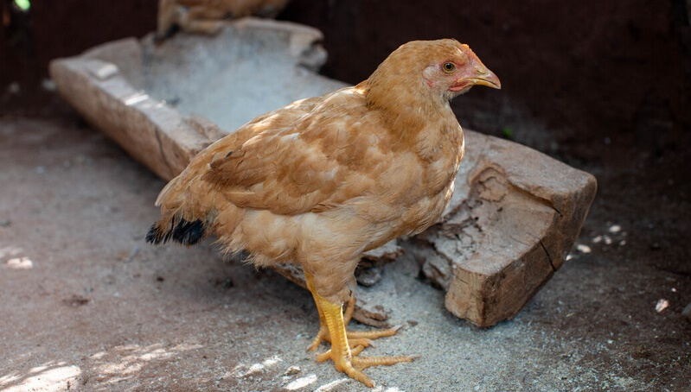
Happy Easter from everyone at CAFOD and this chicken!
Notes:
Photo credit: Carielle Doe

