Slide 1
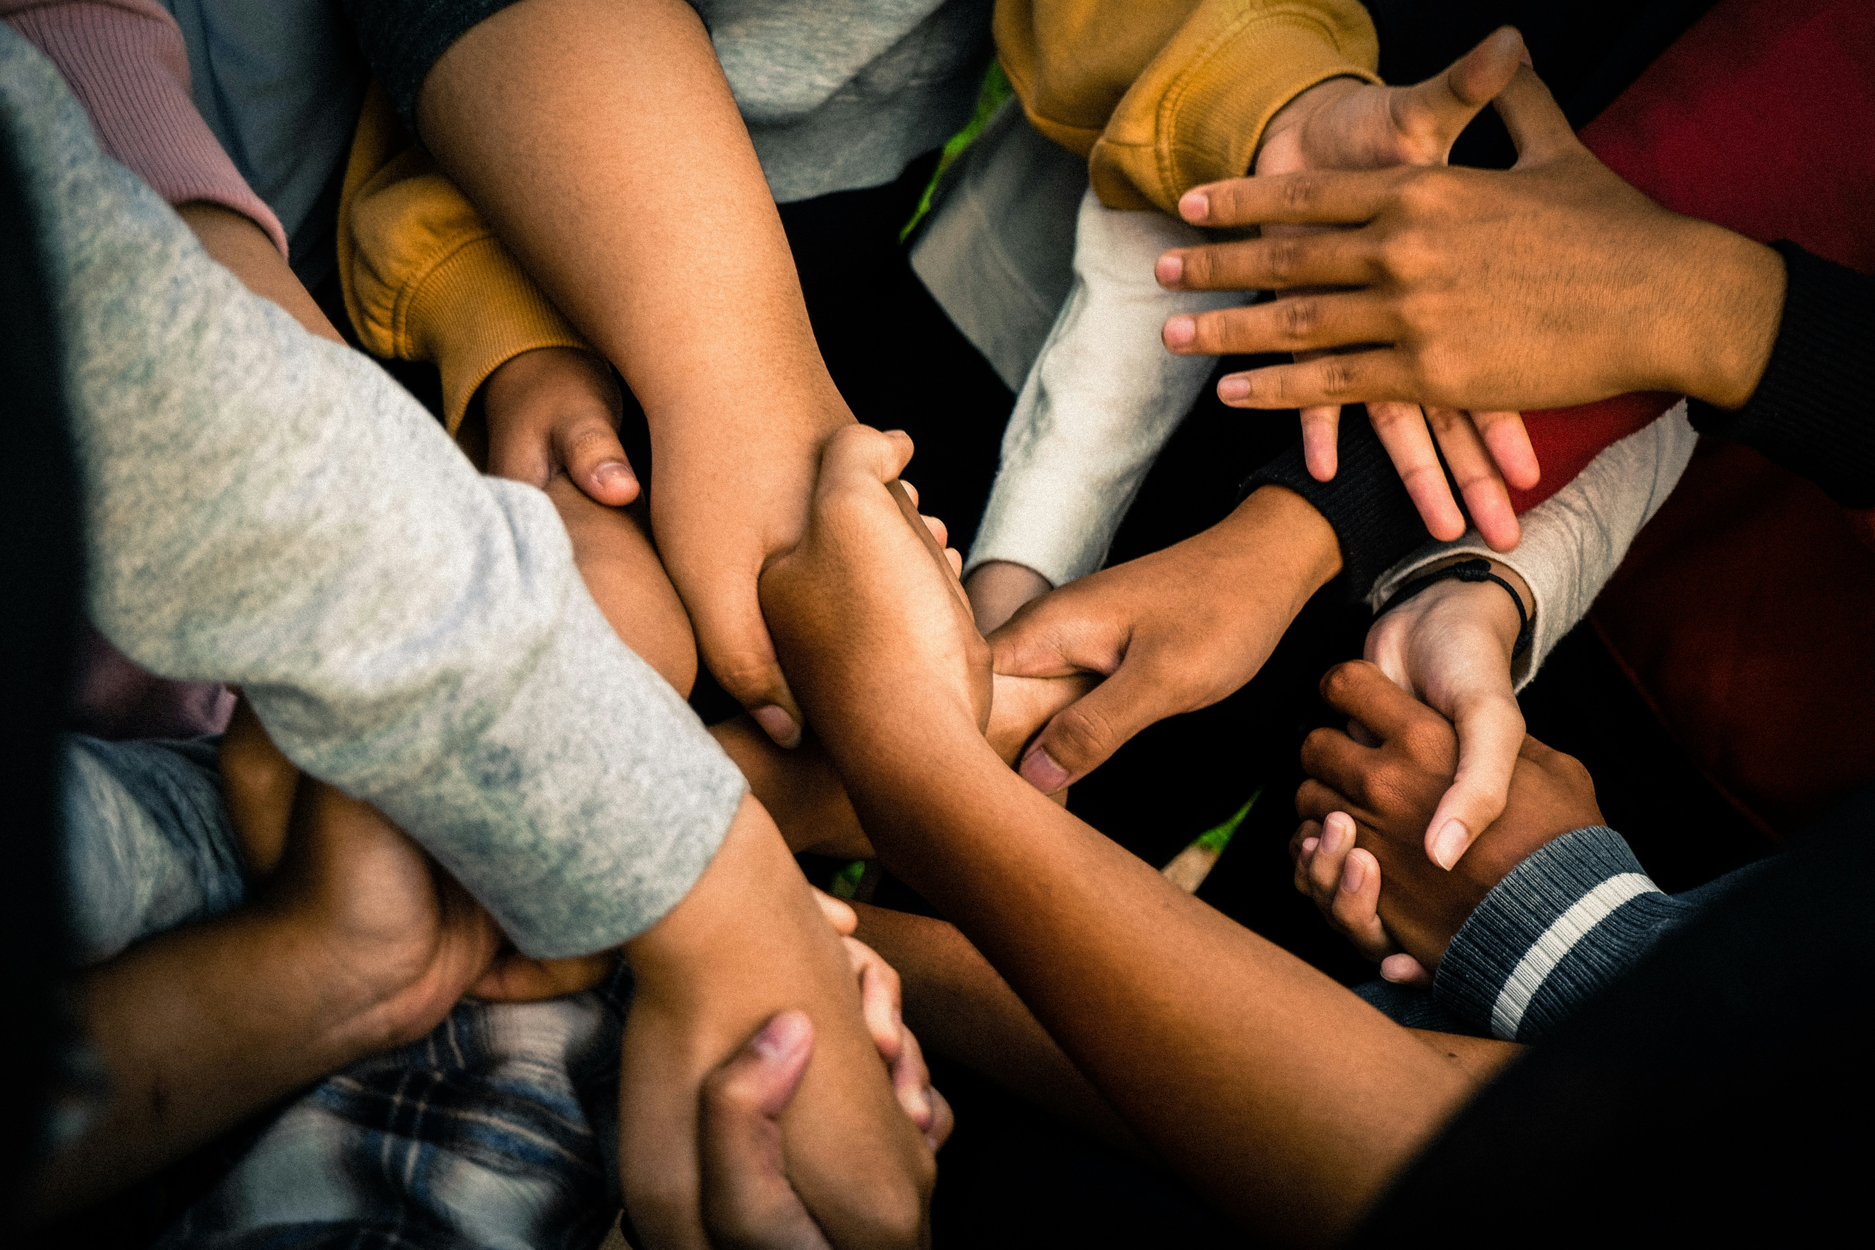
How will you share the gift of peace in your community? And around the world?
Gather
Notes:
Children’s liturgy: Sixth Sunday of Easter (Year C)
Preparation of the worship space
Colour: white
Props: coloured paper or card, pens and pencils
Song suggestions
Peace is flowing like a river (902, Laudate) Peace, perfect peace (597, Celebration Hymnal for Everyone) Make me a channel of your peace (898, Laudate)
Welcome
In today’s gospel, Jesus gives the disciples a very special gift – the gift of peace. Let’s think some more about peace today.
Hands
Photo credit: Marlis Trio Akbar on Unsplash

Slide 2
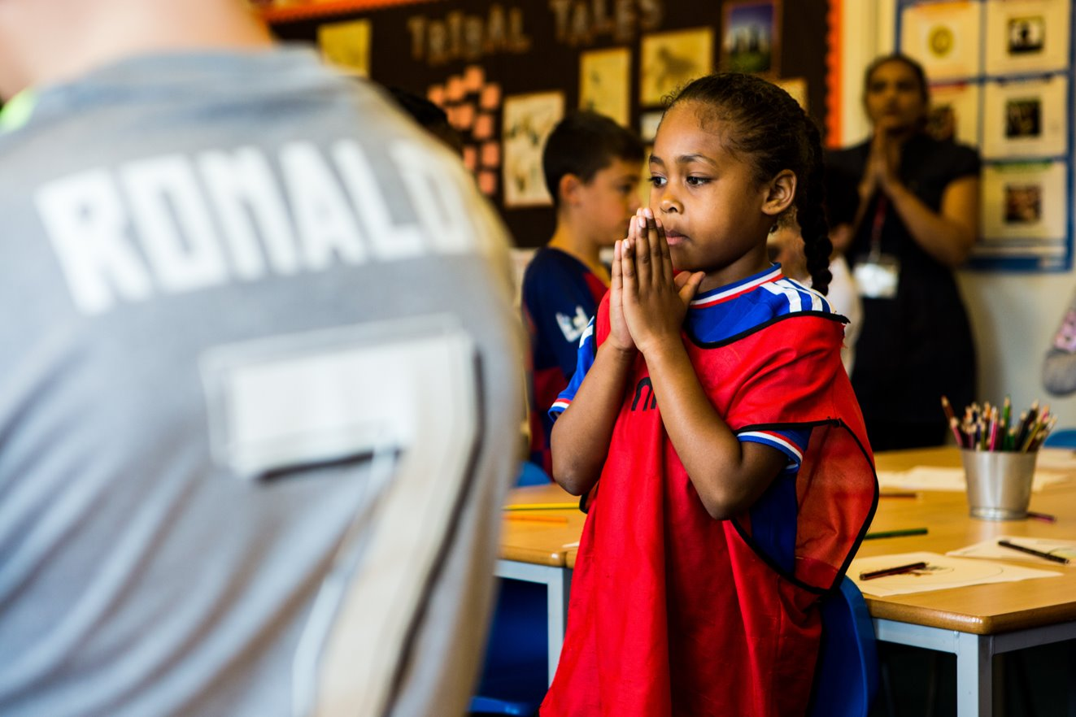
Dear God,
Help us to make our world a peaceful place so that all people may live free from the fear of fighting and war. We ask this through Christ our Lord, Prince of Peace.
Amen.
Notes:
Children at Our Lady Queen of Heaven Primary School
Photo credit: Thom Flint

Slide 3
Gospel: John 14: 23-29
Jesus said to his disciples:
“Whoever loves me will obey my teaching. My Father will love him, and my Father and I will come to him and live with him. Whoever does not love me does not obey my teaching. And the teaching you have heard is not mine, but comes from the Father, who sent me.
“I have told you this while I am still with you. The Helper, the Holy Spirit, whom the Father will send in my name, will teach you everything and make you remember all that I have told you.
“Peace is what I leave with you; it is my own peace that I give you. I do not give it as the world does. Do not be worried and upset; do not be afraid. You heard me say to you, ‘I am leaving, but I will come back to you.’ If you loved me, you would be glad that I am going to the Father; for he is greater than I. I have told you this now before it all happens, so that when it does happen, you will believe.”
Word

Slide 4
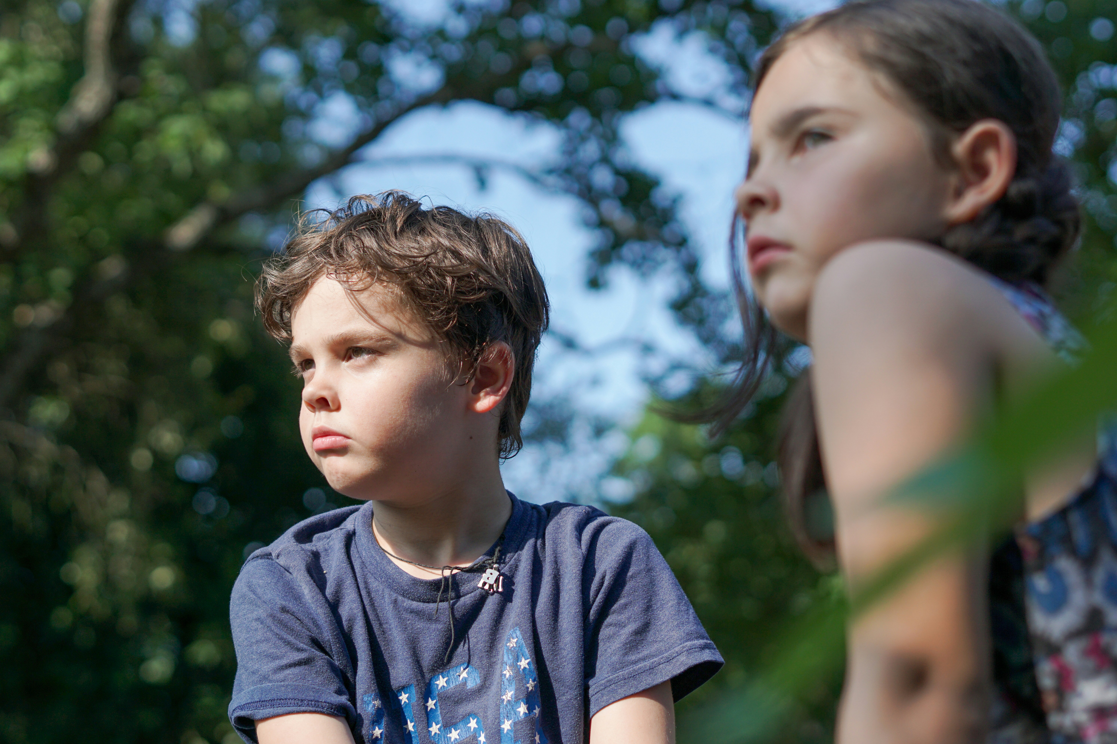
What do you remember from the Gospel reading?
Today Jesus gives his disciples a very special gift. Can you remember what that gift is?
Jesus gives his disciples peace. And he tells his disciples not to be afraid. Can you think of a time when you were fighting or arguing with someone? How did you feel?
Can you remember a time when other people were arguing near you? How did you feel then?
Respond
Notes:
Children
Photo credit: Izzy Park on Unsplash

Slide 5
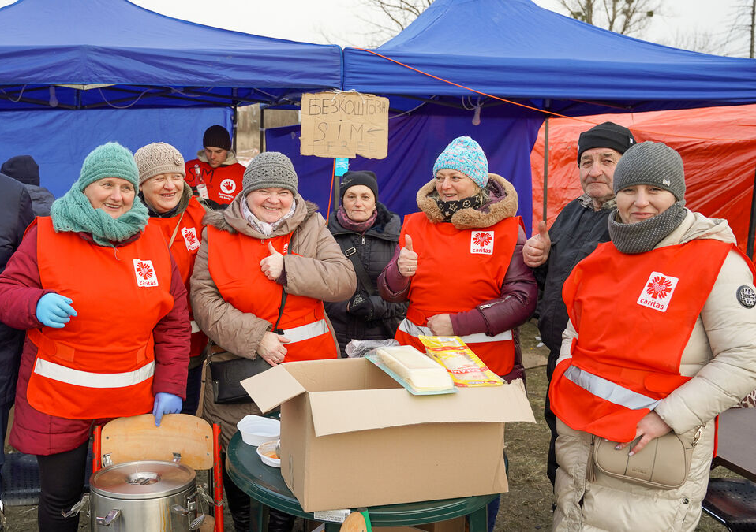
Can you remember a time when you stopped fighting with someone and made friends with them again?
Or when the argument near you ended and the people forgave each other? How did that feel?
CAFOD is a part of a family of Catholic charities around the world called Caritas.
CAFOD is supporting their Caritas sisters and brothers to reach communities in need in Ukraine and neighbouring countries because of the war.
Notes:
Caritas Ukraine volunteers
Photo credit: Caritas Ukraine

Slide 6
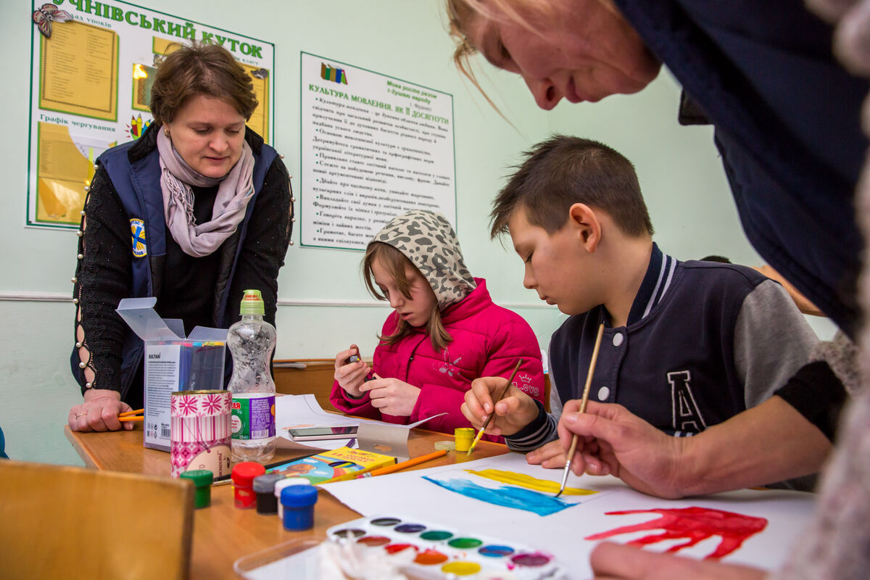
Caritas workers have set up places where children living in Ukraine can go to feel safe despite the war.
Maria runs art activities for the children to help them cope with what is going on around them.
She says of the children, “We try to play with them, paint together, just create a safe space and make contact.”
Notes:
Maria and children who are refugees from Ukraine
Photo credit: Caritas Ukraine

Slide 7
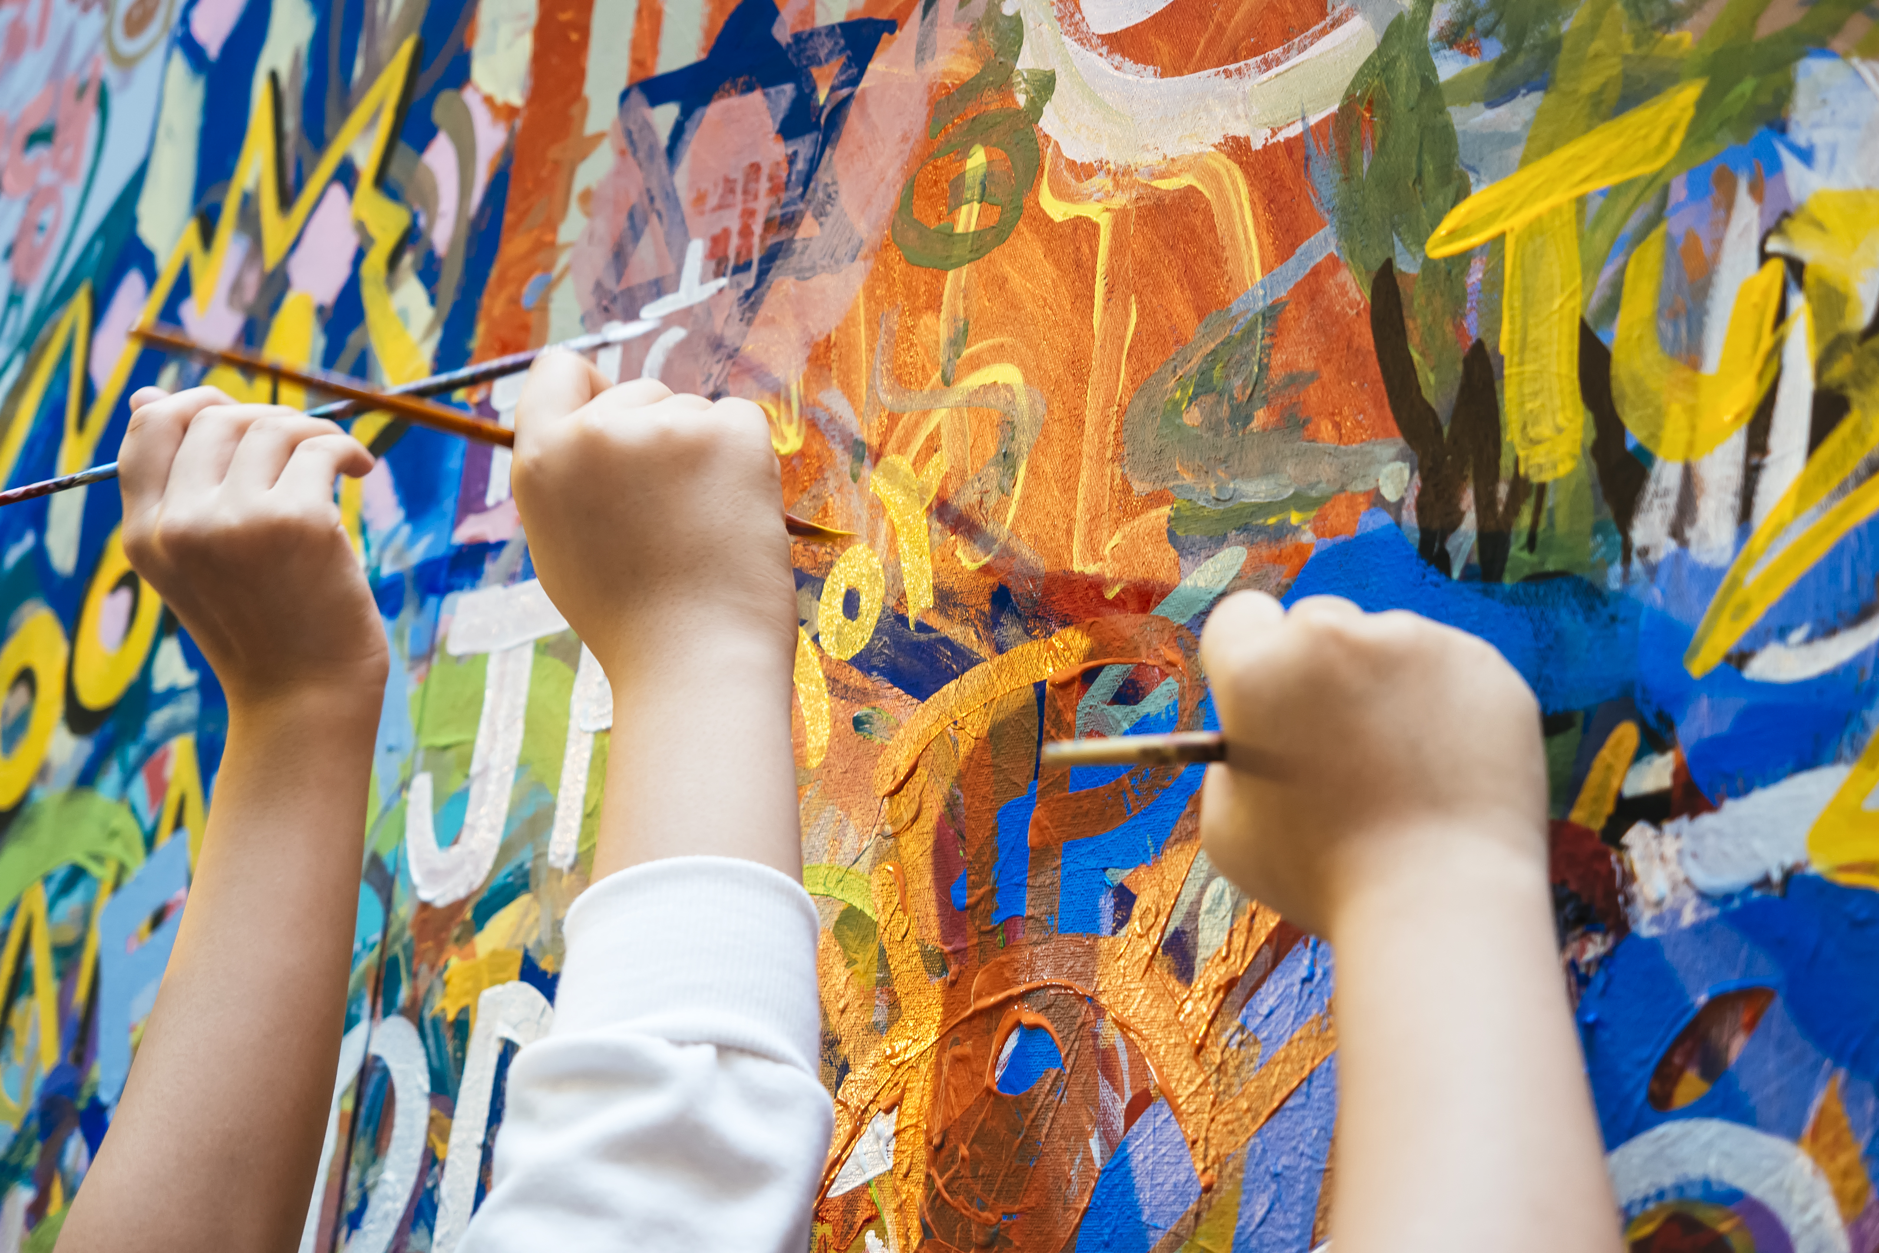
Some children in other countries around the world where there is lots of fighting or violence go to peace clubs.
These clubs focus on art, sport, music or dancing to bring different children together somewhere safe. The clubs help them learn to live peacefully together.
This helps the children to build peace in their community.
Notes:
Children painting
Photo credit: Stock image

Slide 8
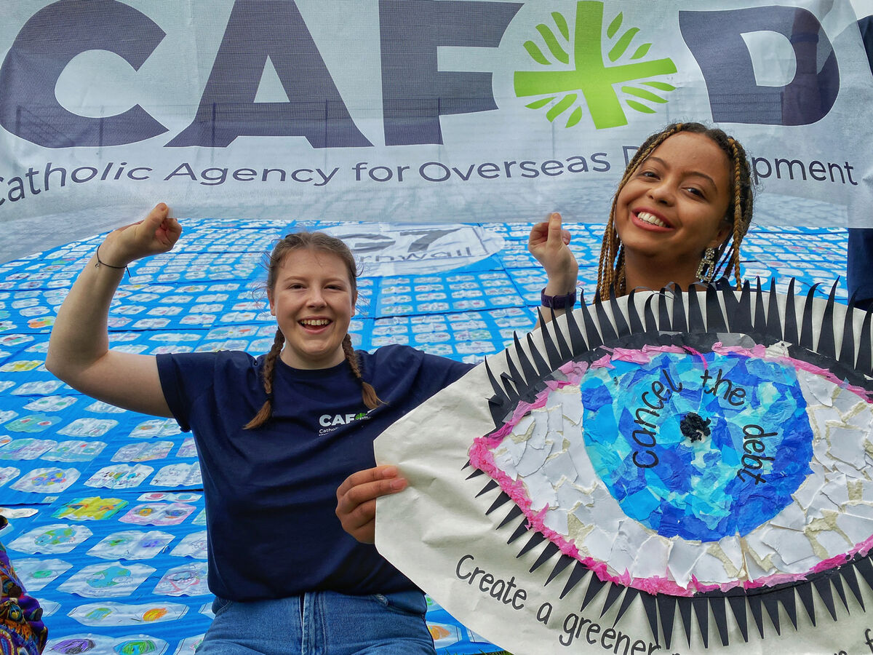
How do you think you can build peace? Think about how you speak to and treat others you disagree with, or how you could be friendly to someone who doesn’t have many friends?
What could you do to stop someone else from being unkind to others?
Or how could you let people in power know that you would like to live in a peaceful world?
Notes:
Taking a hand
Photo credit: Remi Walle on Unsplash
Young CAFOD campaigners
Photo credit: Annie Bungeroth

Slide 9
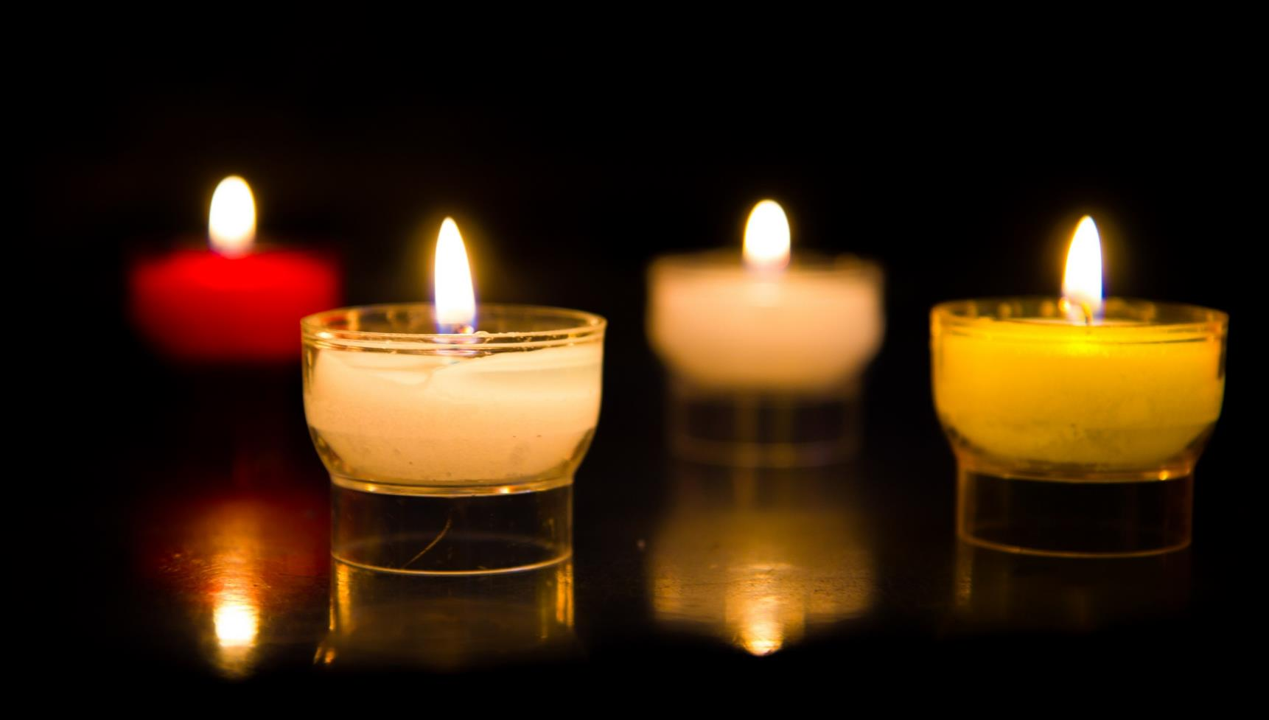
Let us pray…

Slide 10
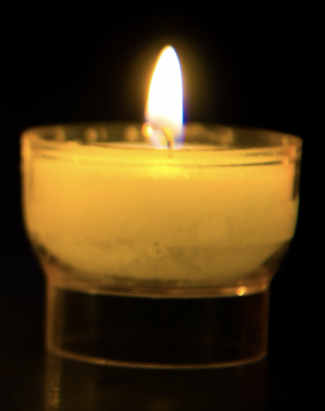
We pray for world leaders: that they may do all that they can to make the world a peaceful place for everyone to live in.
Lord in your mercy…
We pray for all people around the world who live where there is fighting or war: that they may know peace. Lord, in your mercy…

Slide 11
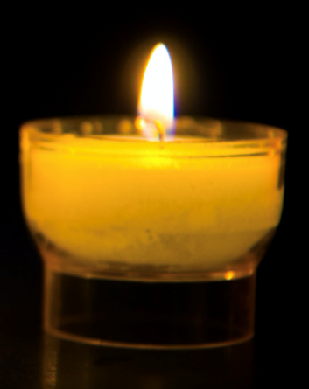
We pray for our parish, family and friends: that we may do all we can to share the gift of peace with others; and that in this Jubilee Year, we may be signs of hope in our world through all we do and how we treat one another. Lord, in your mercy…
Living God, may we bring the light of your peace to those we meet. Help us to find a peaceful way to solve our problems, so that the world may be a safer place for everyone to live. Amen.

Slide 12
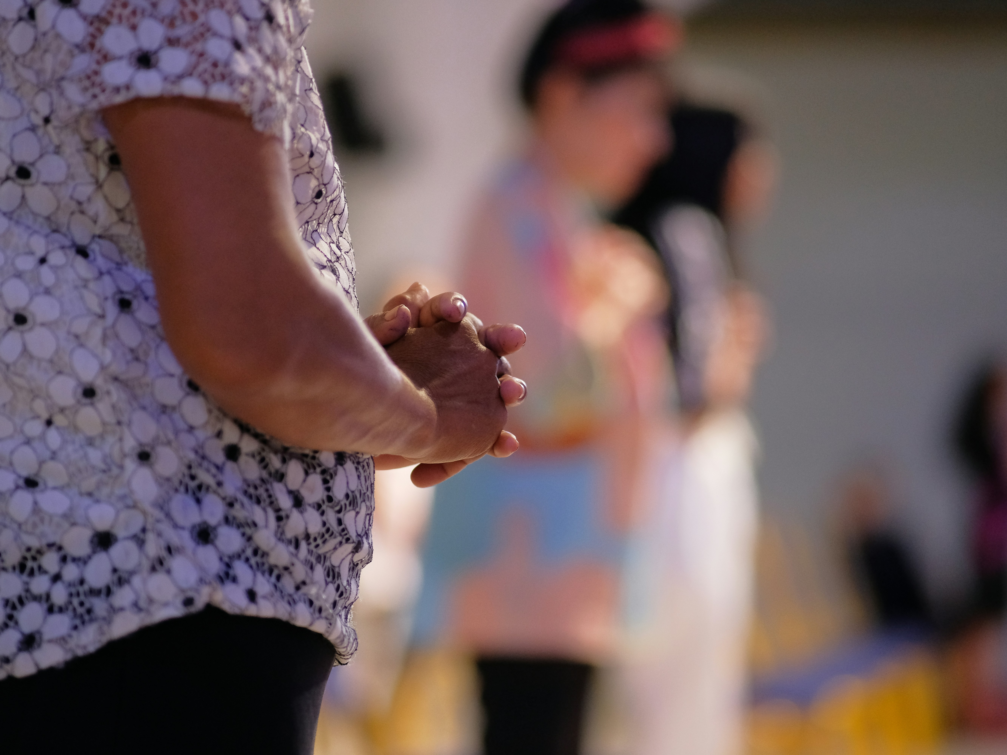
This week, how will you share the gift of peace in your community? And around the world?
Send
Notes:
Hands
Photo credit: Set SJ on Unspash

Slide 13
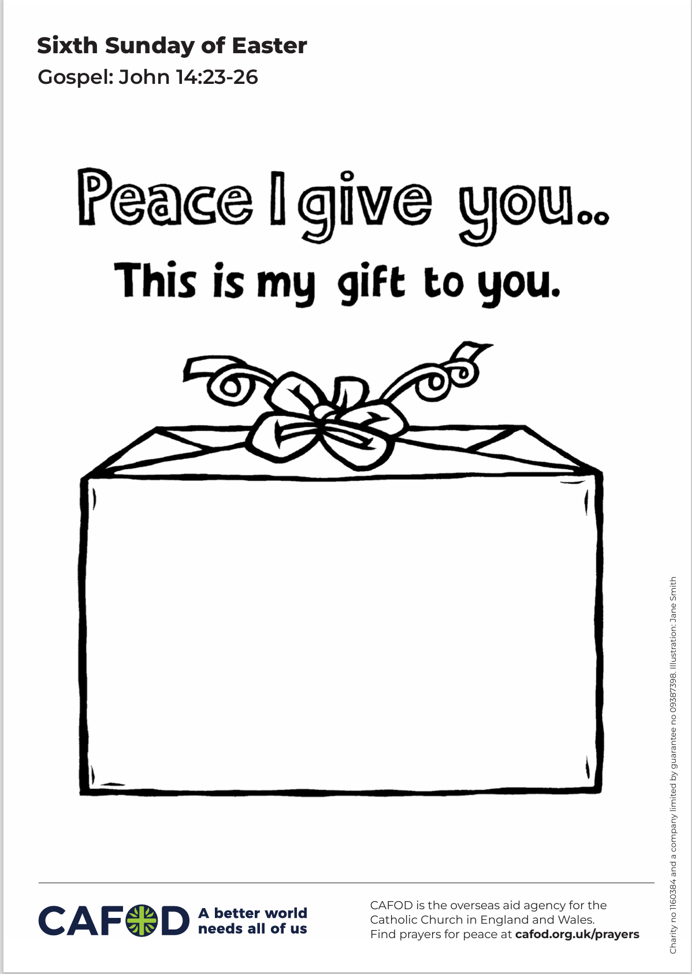
Activity suggestions
Invite the children to colour in the accompanying illustration of a gift – the gift of peace – and to write or draw in it one or all of the following things:
What peace looks like or means to them
How they will share the gift of peace over the coming week
Who they will share the gift of peace with over the coming week
Give the children a gift-shaped piece of paper with the word ‘peace’ written on it. Encourage them to write on it who they will share peace with over the coming week and what other things peace might bring with it, for example: hope, happiness, togetherness, etc, so that they can see just what an amazing gift peace is.
Encourage the children when they go back to their seats and make the sign of peace in Mass to think about children around the world who live in a place where there is fighting and who hope to build peace in their communities.
Remind the children to tell the people that they live with all that they have heard and thought about in the liturgy today and to share their message of peace with others during the week.
Notes:
Illustration: Jane Smith

Slide 14
Notes:
Illustration: Jane Smith

Slide 15
Planning your Jubilee Pledge?
It will soon be time to make your Jubilee Pledge!
In June or July, all Catholic schools are invited to make a Jubilee Pledge to live out Catholic Social Teaching.
A better world needs all of us, and the Pledge will be a whole school, long-term commitment to building a fairer world.
Watch our film and download our resources to help you write your Pledge and plan your Pledge Day:
Jubilee pledge for schools
The Jubilee Year is a landmark moment in the life of the global church. School communities are invited to join together as pilgrims of hope, pledging to work together for God’s kingdom of justice, peace and love. Find resources at:
Jubilee for schools 2025 – Pilgrims of Hope

