Slide 1
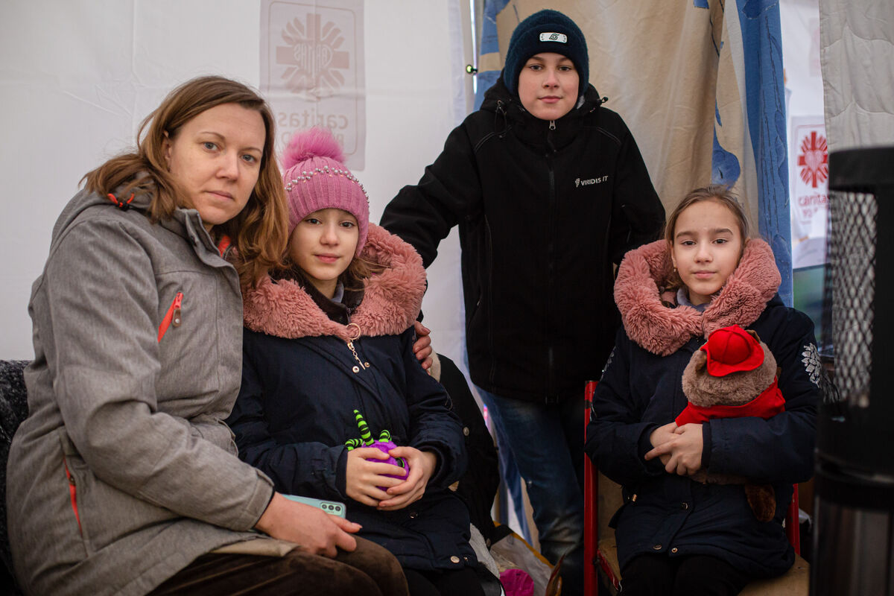
The
Common
Good
Exploring CST principles
in CAFOD’s work
Notes:
Photo credit: Philipp Spalek / Caritas Germany

Slide 2
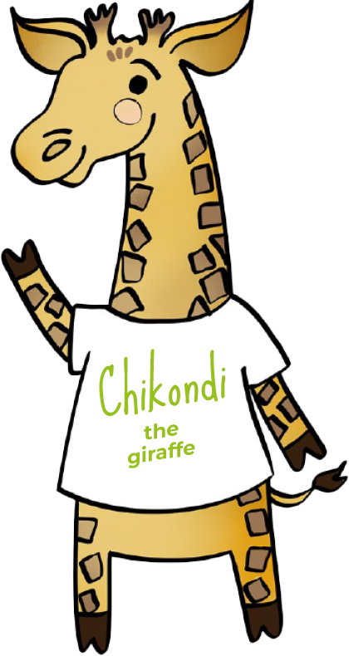
The Common Good means we believe in
thinking of everyone.

Slide 3
“All who believed were together and had all things in common; they would... distribute the proceeds to all, as any had need.”
Acts 2:44-45

Slide 4
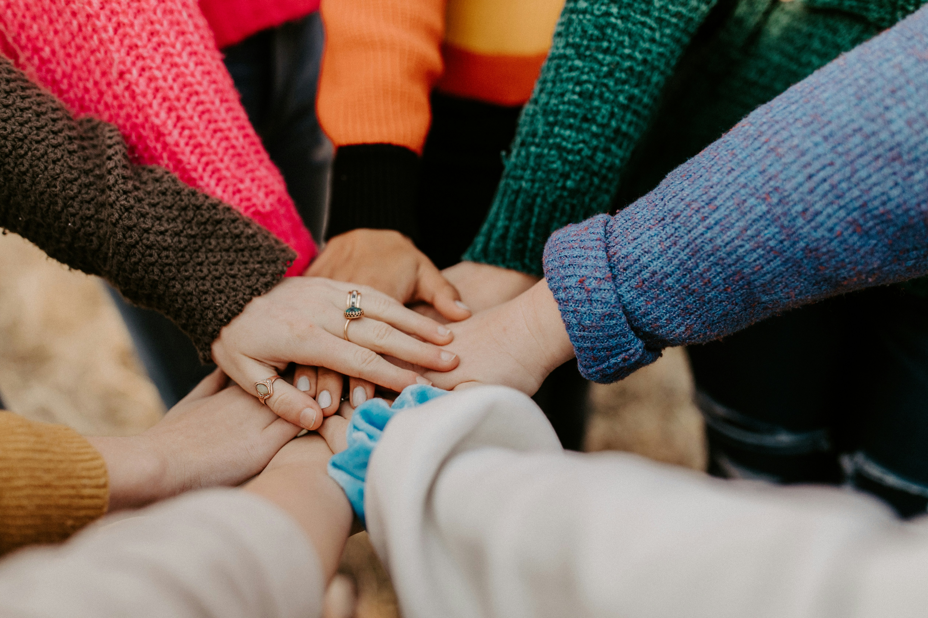
The Common Good
Our actions can affect all of those around us. When
we make decisions, we should be thinking of everyone.
Notes:
Photo credit: Hannah Busing on Unsplash

Slide 5
This is Maria with her three children. They are refugees from the war in Ukraine. When fighting started, she became very frightened for her family, so they fled to Poland.
"When I heard bombs going off and helicopters flying over our house, I didn't want to believe it, " Maria says.
Notes:
Photo credit: Philipp Spalek / Caritas Germany

Slide 6
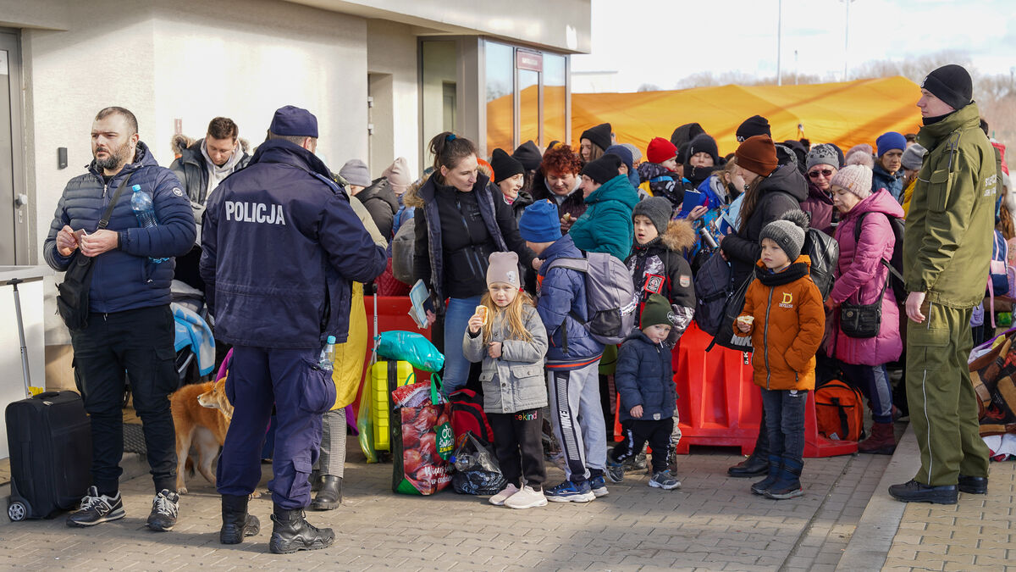
The journey to Poland took 30 hours. Maria and her children were lucky to find space on a very crowded train.
"There was hardly any water and nothing to eat," says Maria. After hours on the train, they boarded a bus.
When they arrived at the Polish border, the family waited for many hours in the cold before they could enter Poland.
Notes:
Photo credit: Caritas Poland

Slide 7
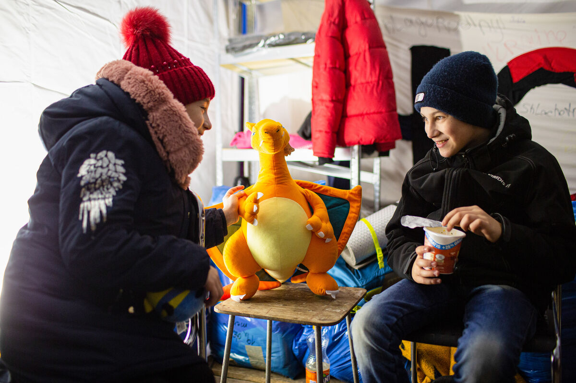
CAFOD is part of Caritas, a charity that helps people in times of crisis. A Polish Caritas worker took Maria's family to a tent where refugees get a hot meal, warm clothing, soap – and even a cuddly toy.
These are called "tents of hope" by Caritas staff.
"I'm hopeful the war ends and we'll go back home," says Maria.
Notes:
Photo credit: Philipp Spalek / Caritas Germany

Slide 8
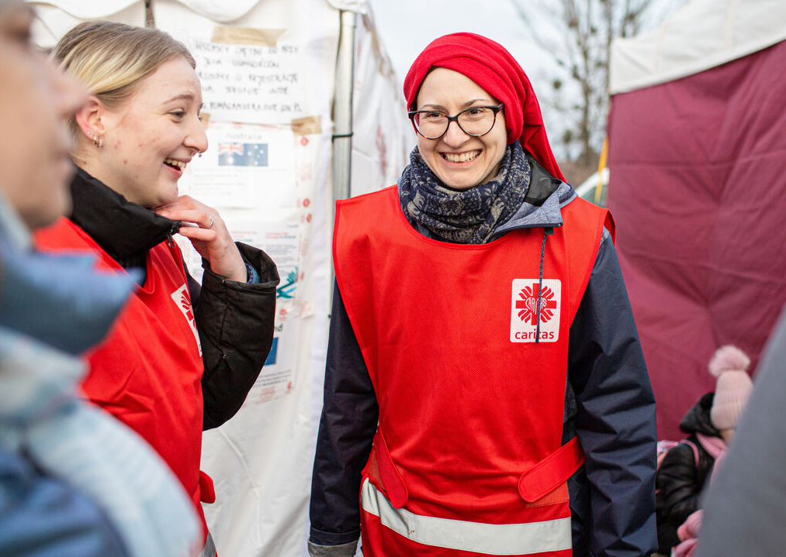
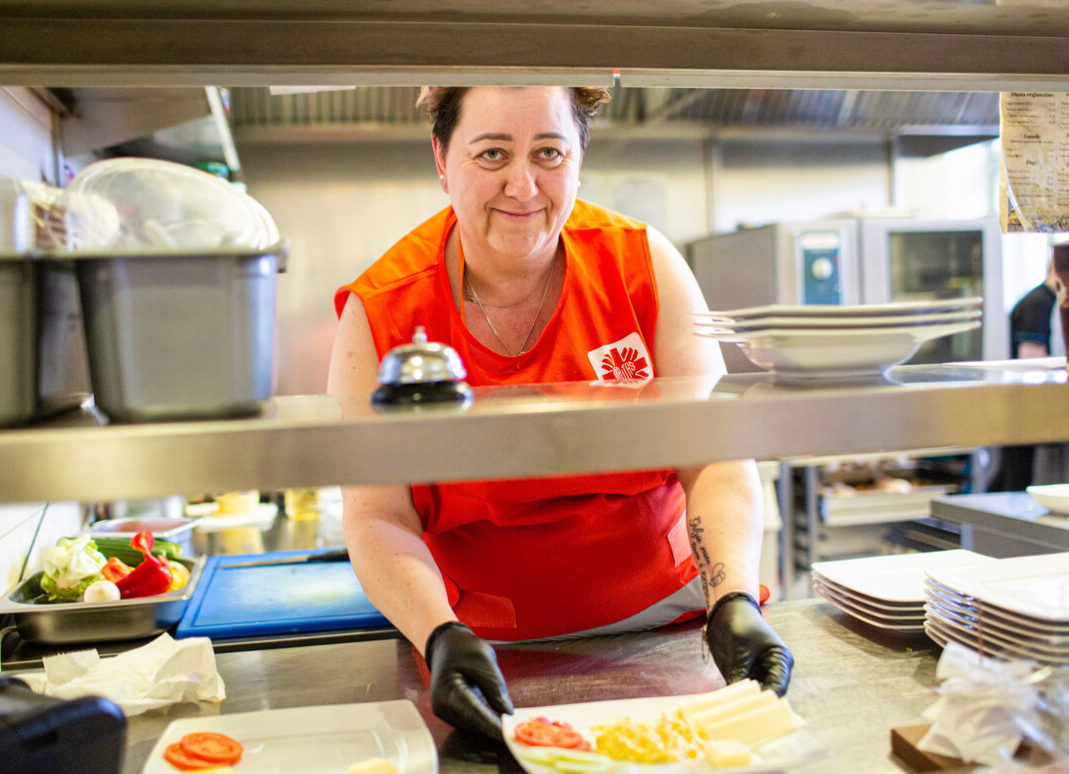
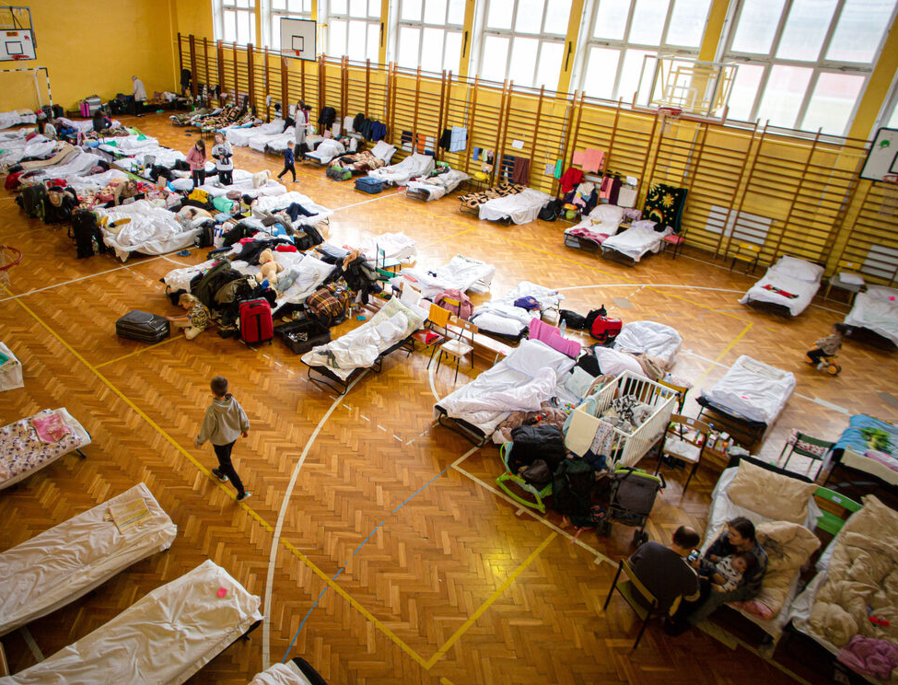
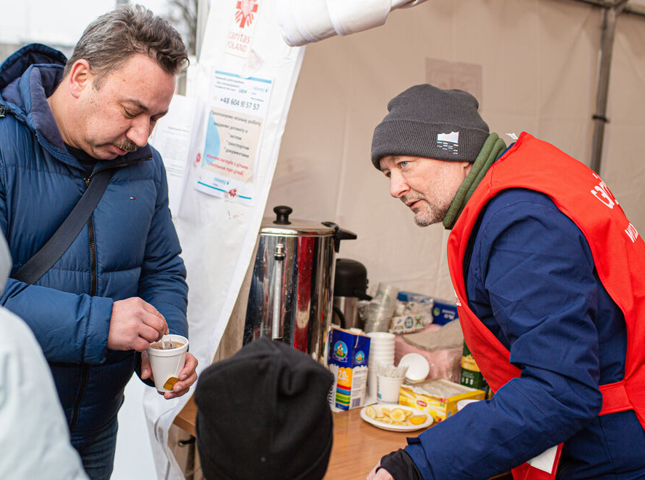
People fleeing their homes because of war or disaster may feel scared, hungry, exhausted and confused.
With CAFOD's help, Caritas provides a welcome, food, clothing and comfort for refugees in times of trouble.
CAFOD also campaigns to ensure politicians make decisions for the good of all – including people who are forced to leave their homes.
Notes:
Photo credit: Philipp Spalek / Caritas Germany

Slide 9
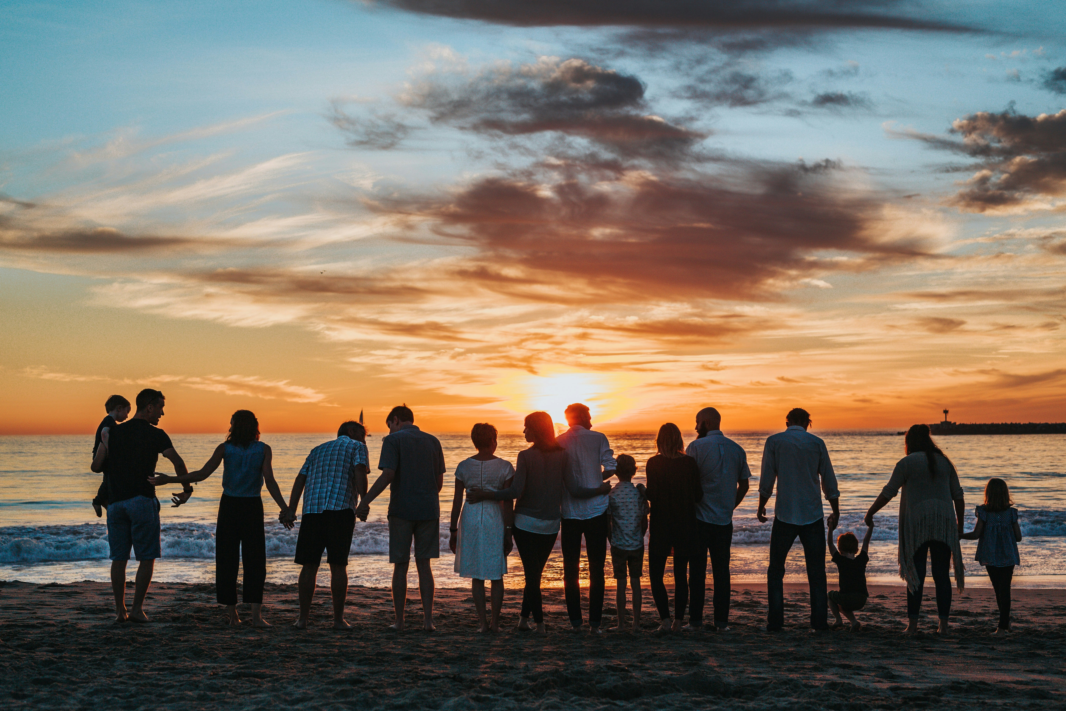
“Beside the good of the individual, there is a good linked to living in society: the common good, the good of ‘all of us’...To desire the common good is a requirement of justice and charity.”
Pope Benedict XVI, Caritas in Veritate, 7
Notes:
Photo credit: Tyler Nix on Unsplash

Slide 10
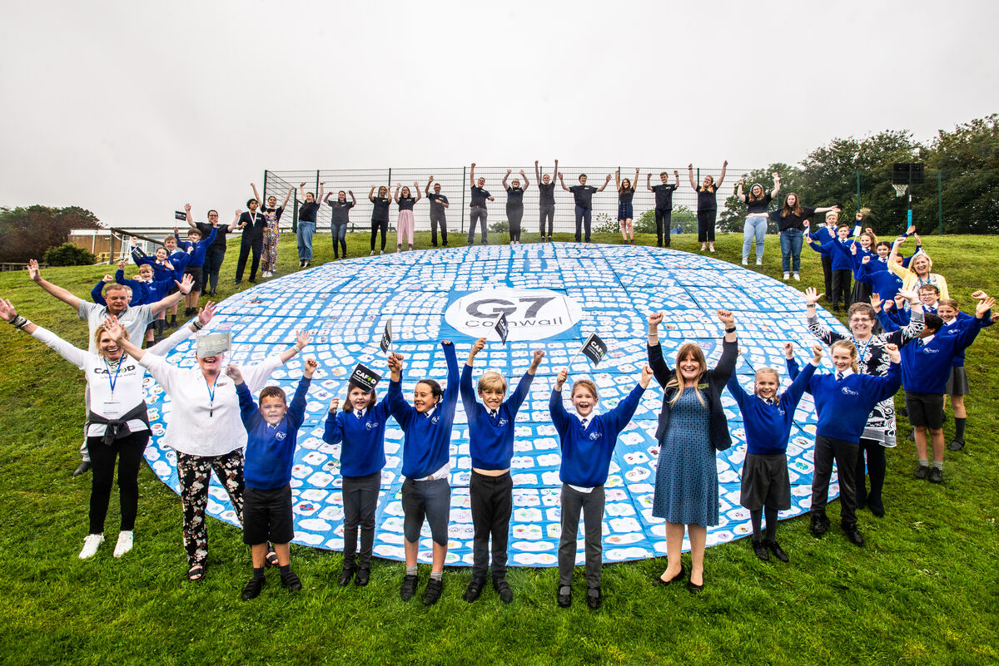
Thinking of everyone
The Common Good is making sure we think of everyone in all decisions we make.
Incredible 'eyes' artwork from St Mary's Primary School sent a message to world leaders meeting to discuss global issues, including the plight of refugees.
St Mary's pupil May said: "The eyes of the world are watching them, and all young people, to make sure they make the right decisions.”
Notes:
Photo credit: Annie Bungeroth

Slide 11
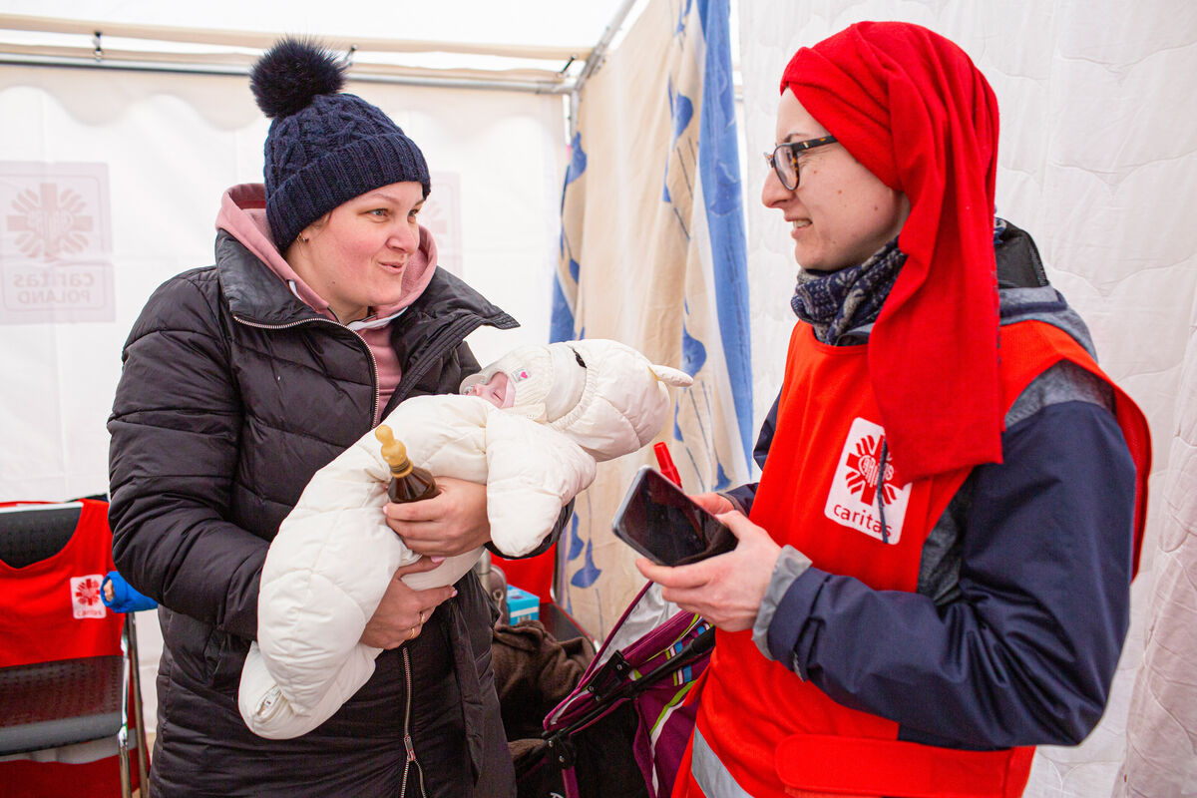
Let us pray
Loving God,
We believe that we are all brothers and sisters.
Help us to think about what is good for everyone, not just ourselves.
Lord in your mercy
Hear our prayer
Thinking of everyone
The Common Good
Notes:
Photo credit: Philipp Spalek / Caritas Germany

Slide 12
Thinking of everyone
Chikondi the giraffe reminds us that The Common Good is thinking of everyone.
How can we make sure we are thinking of everyone when we make our decisions?

