Slide 1
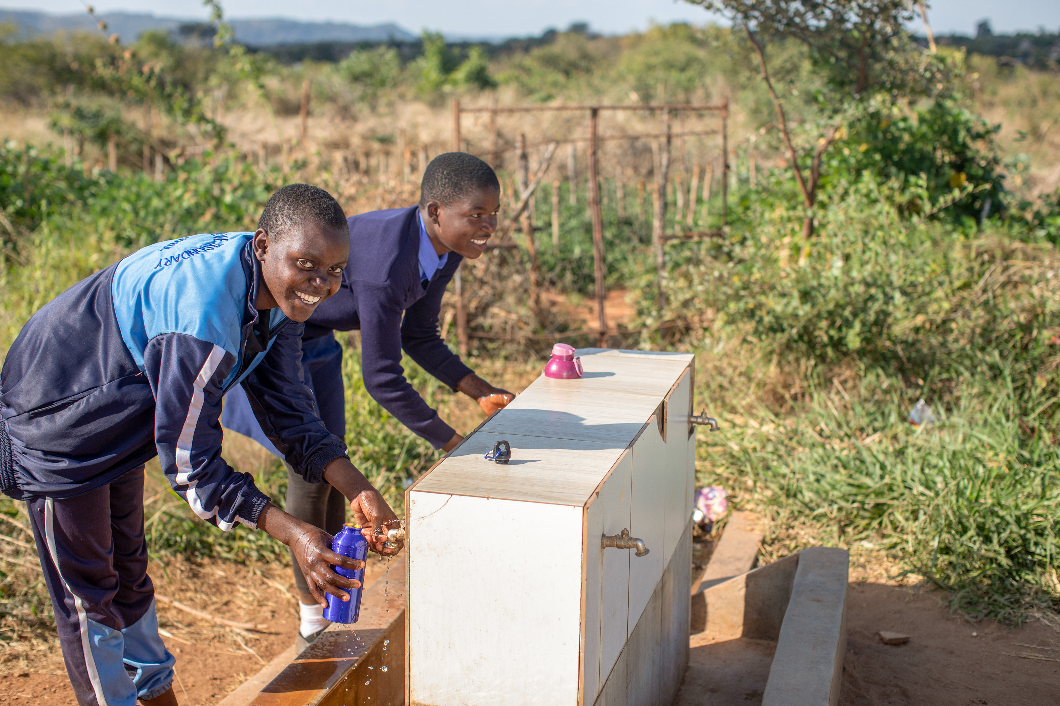
Zimbabwe photopack
For secondary schools

Slide 2

How to use this photopack
This photopack accompanies the Zimbabwe film and is designed to help young people learn about how access to water is keeping children at school.
Learn more about how water projects are helping communities in Zimbabwe like Maggie's: Film for young people | CAFOD
Each card includes photos, quotes and prompt questions.
Order a fundraising pack and think about ways your school could raise money to help more communities have access to water.

Slide 3
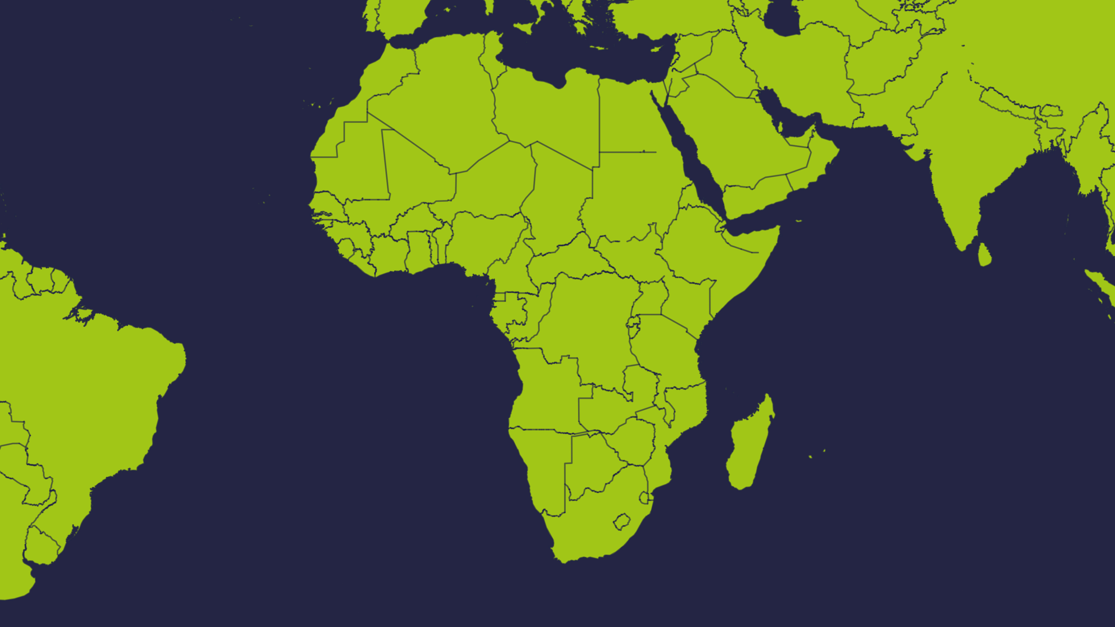
Zimbabwe is a country on the continent of Africa

Slide 4
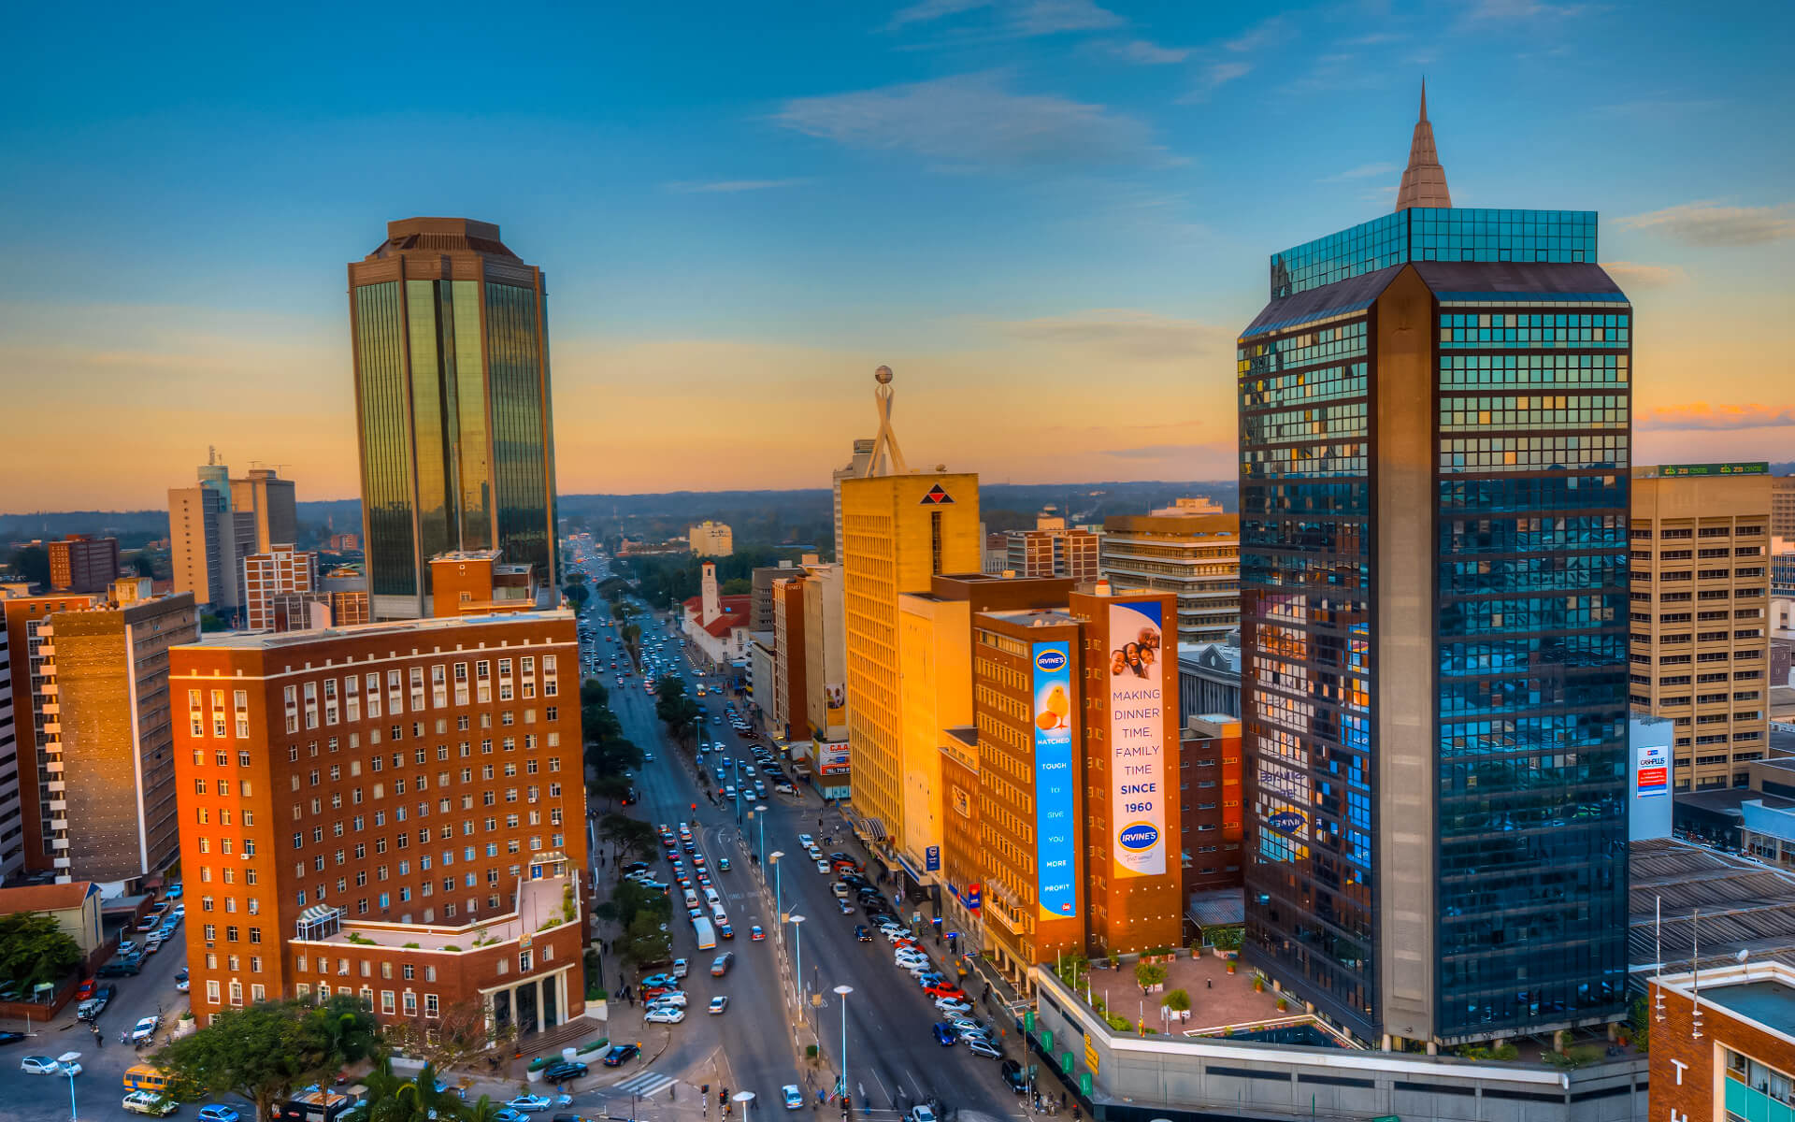
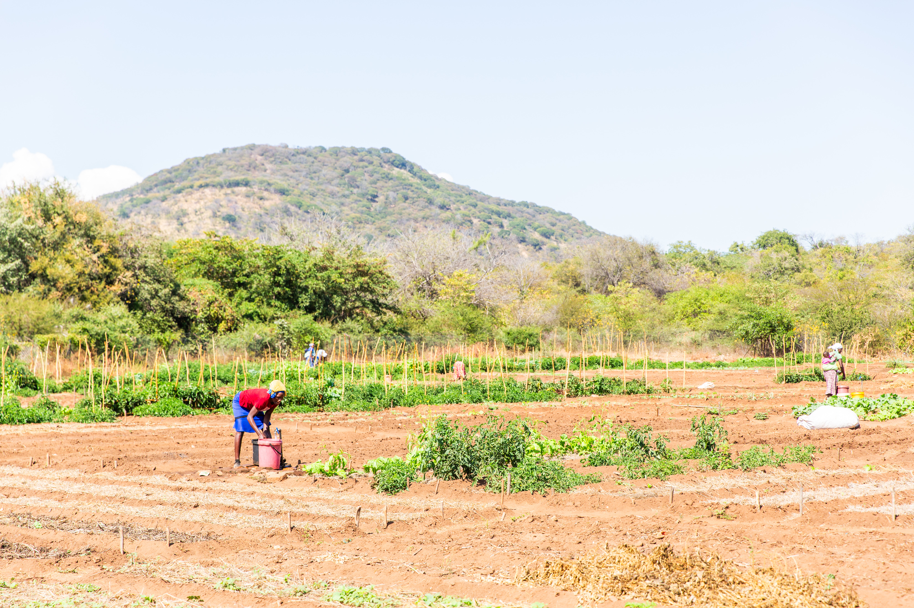
Zimbabwe fact file
Zimbabwe is a country in the south of Africa. Its capital city is Harare.
Zimbabwe is a country with amazing animals and beautiful natural wonders.
Climate change has made Zimbabwe's weather hard to predict for many years.
Capital city: Harare
Poor rainfall leads to drought. This can mean it’s hard to grow crops.
In places with too little water, some children miss school because they need to collect water.
Rushinga, in northern Zimbabwe

Slide 5
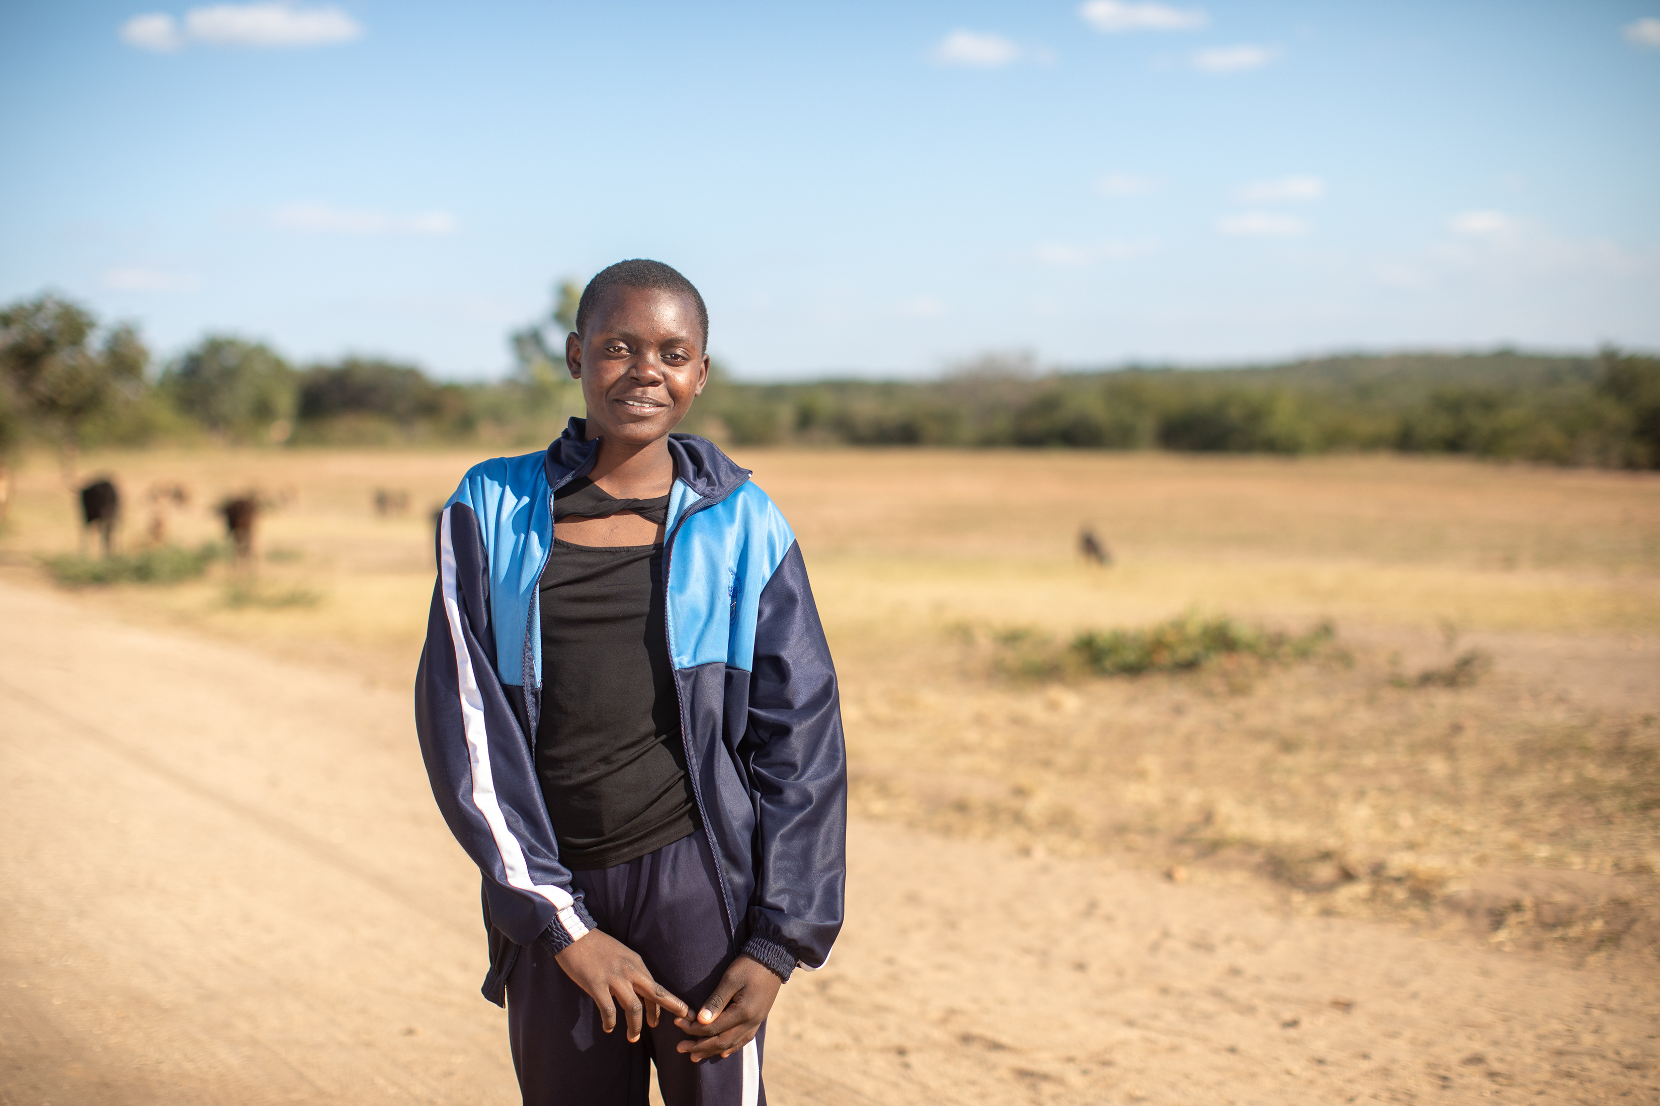
Photo 1

Slide 6
Photo
1
“We would wake up very early in the morning, and my mother would get a bucket, and I would get my five litre tin, and then we'd go. We’d fetch water and then come back home.
But usually the water was not clean, because there were people with livestock, especially pigs - they would play in the water. So sometimes the water would not be very clean.”
Maggie
Due to the effects of climate change, the weather in Zimbabwe is very hard to predict. Lack of rain has brought drought in many areas. Because of this, many people, including schoolgirls like Maggie, walk long distances to collect water. Climate change is not only an environmental issue - it is a justice issue, communities like Maggie's are experiencing some of its greatest impacts, despite contributing least to the causes of the climate crisis. Maggie said that carrying water was difficult because it was heavy. She would carry five litres of water - that’s about the weight of ten water bottles and often the water wasn't even clean. What tasks or jobs do you need to do in the morning before going to school? How do these compare with Maggie’s responsibilities? How might long journeys for water affect young people's education, dignity, health or safety?
Photo credit: Cynthia Matonhodze, CAFOD

Slide 7
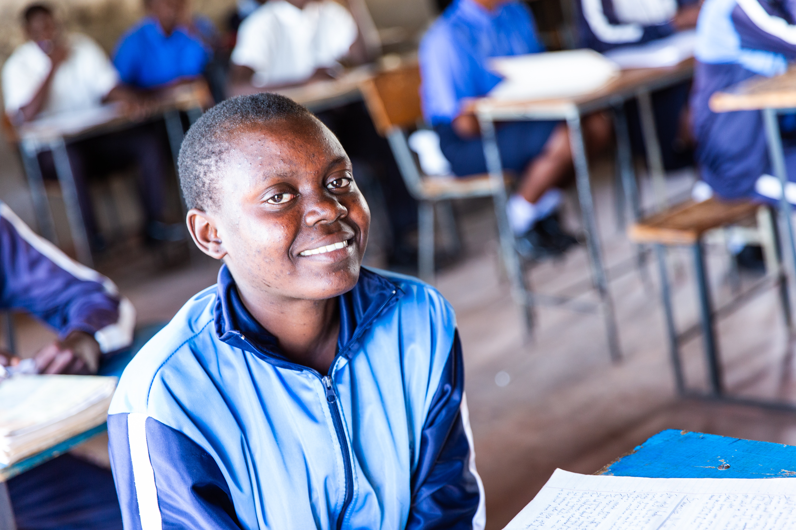
Photo 2
Notes:
Photo Credit: Thom Flint

Slide 8
Photo
2
“Spending time at the water point affects your studying time. Most of your day you spend time at the water, so don't have time to read. Usually during the weekends, we’re given homework by the teacher, so if you spend most of the time fetching water, what happens is that you cannot study.”
Maggie
Many girls at Maggie's school, such as Mary - Maggie's friend, would need to collect water before school. Maggie said that she noticed her friend Mary would miss lessons and began to fail in subjects. It made Maggie really sad to see her friend not able to achieve her full potential in school and she really missed spending time with her best friend in lessons and at break time. Think of all the different ways you have used water today. Can you imagine not being able to attend your favourite lesson in school, or seeing your best friend at break time, because of access to water? How might limited time for study and building friendships affect Mary’s, and other young people’s, confidence at school?
Photo credit: Thom Flint, CAFOD

Slide 9
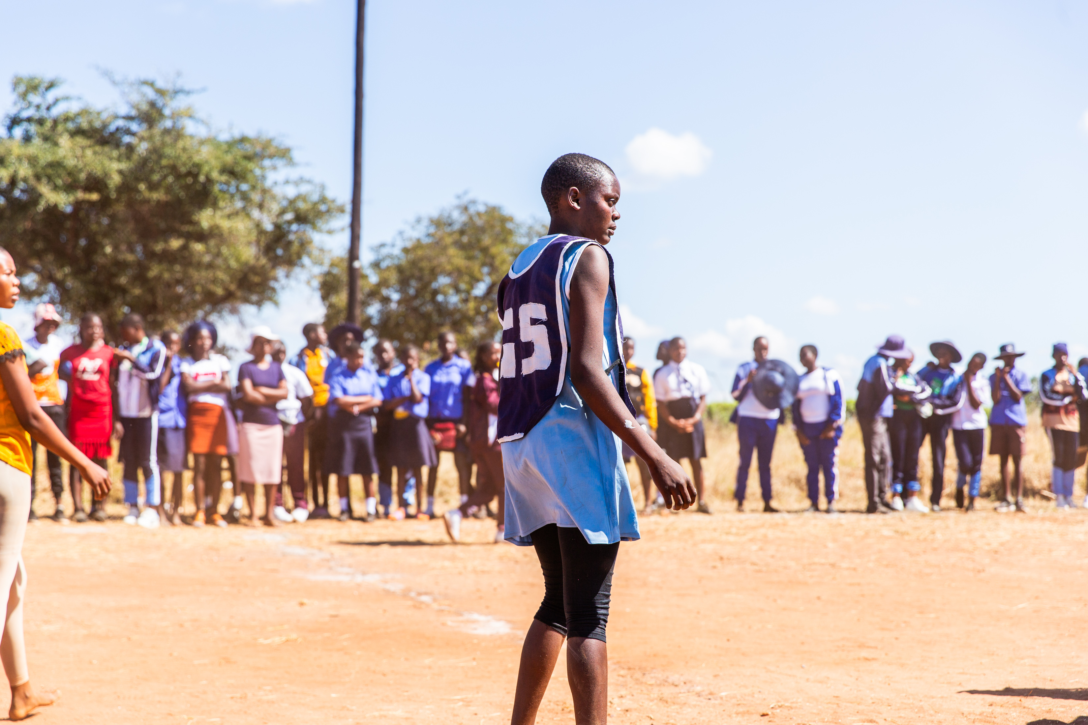
Photo 3
Notes:
Photo Credit: Thom Flint

Slide 10
Photo
3
“When my friend first told me that now the showers are working, I actually ran to my gym teacher and asked for soap and went to shower because I really wanted to make sure that it's true that they were actually working. I just felt good to have water, just having water. After I finished showering, I just stood in the shower and just let water flow on my body. And it was just a good feeling.”
Maggie
Maggie loves playing netball - it gives her the chance to make new friends, learn new skills, have fun and stay active. Maggie said "It's important to have fun because you stop thinking about other issues that have happened before, you’re just in your zone of being happy." Before the showers were installed, girls often struggled to manage their periods safely and hygienically at school. Some missed lessons, felt embarrassed, or avoided sport altogether. With CAFOD’s help, taps and showers were installed at Maggie’s school, powered by solar panels. Now, with clean water and private washing facilities, girls can take part in netball confidently, manage their periods with dignity and arrive to lessons feeling clean and refreshed. What hobby supports your wellbeing and helps you feel “in your zone of being happy”? How does access to showers help girls participate fully in sport, lessons and school life?
Photo credit: Thom Flint, CAFOD

Slide 11
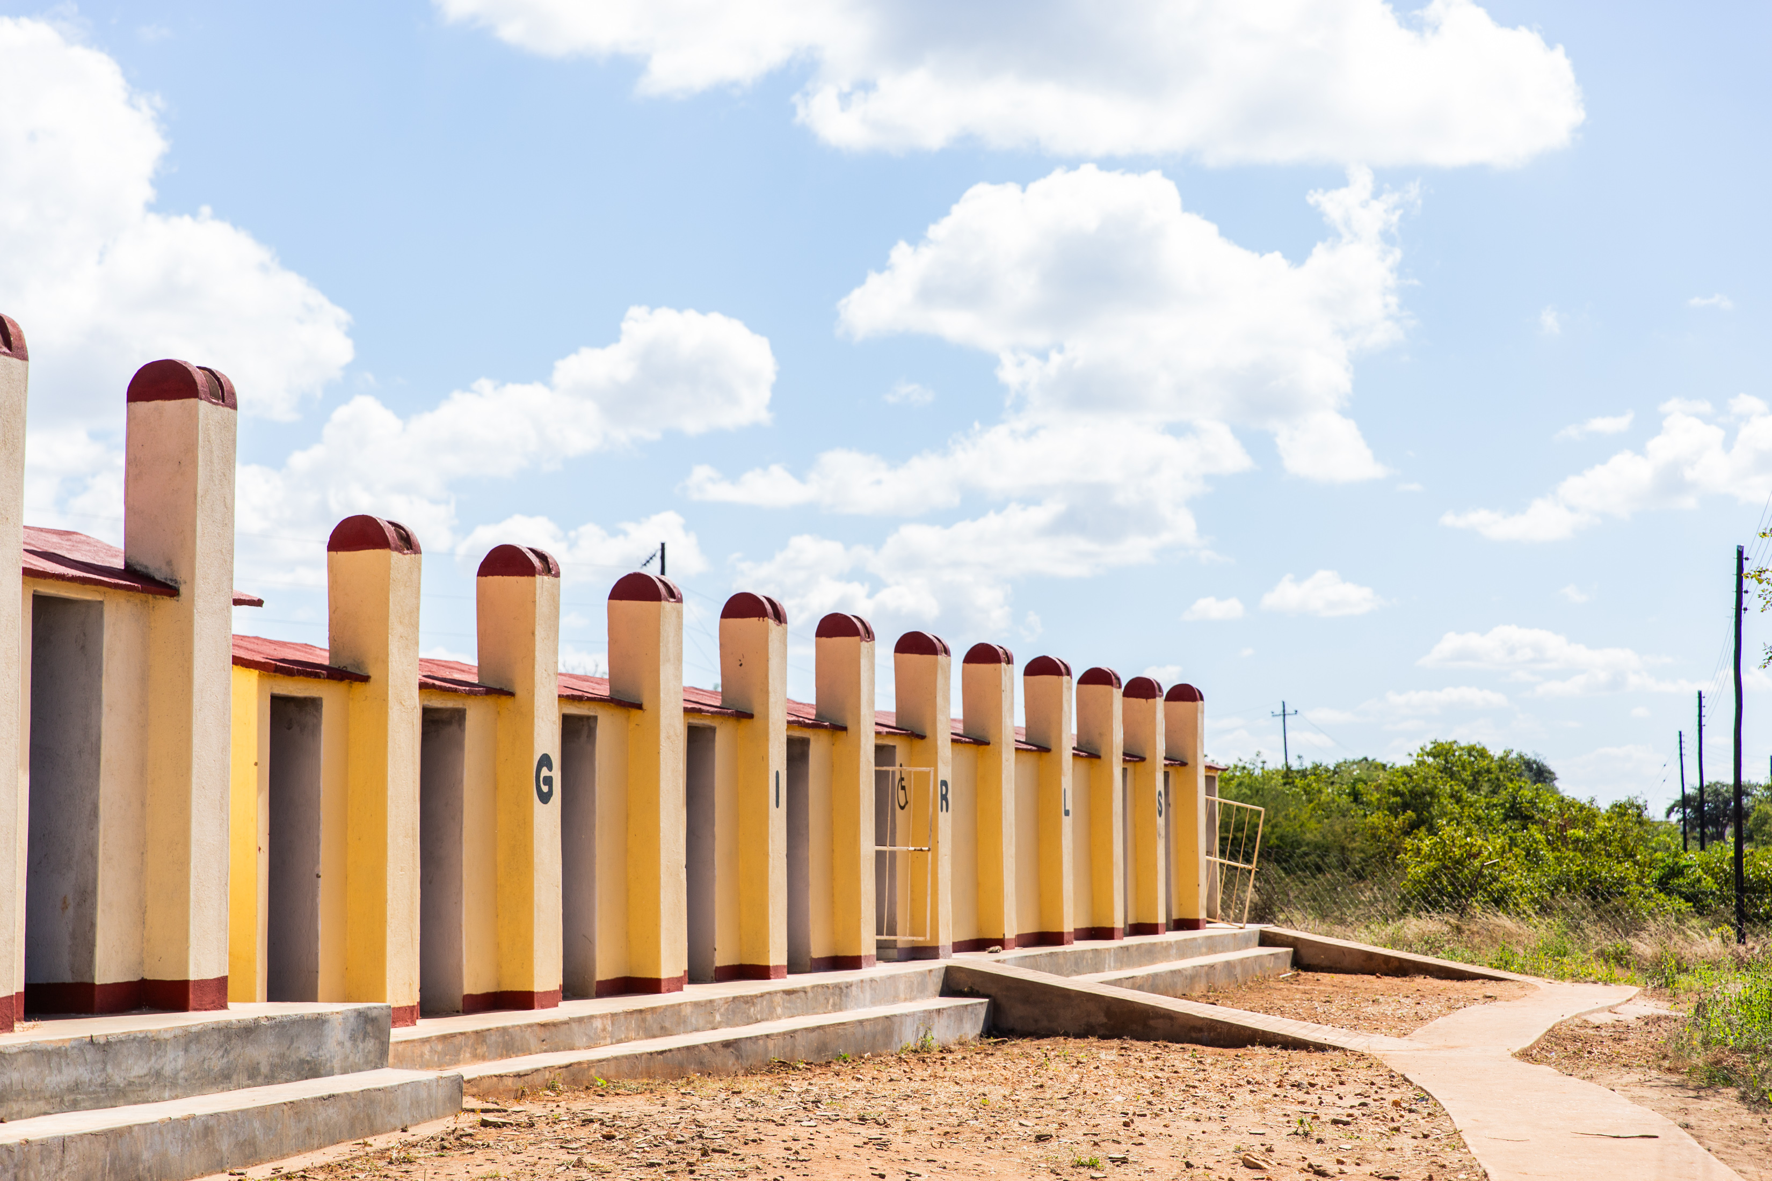
Photo 4
Notes:
Photo Credit: Thom Flint

Slide 12
Photo
4
“Girls missed lessons because of their periods...And then they’d spend two or three days, or even six days, not coming to school because of that.
Some of the girls start failing lessons... It really, really bothered me, because we always thought that you are the same as the boys, you can excel just as much as the boys. Even my mother always tells me that. So, it really bothered me… because of the issue of periods, that you cannot excel in school. The showers have helped us…I can now play netball when I'm on my period.”
Maggie
Before the new toilets and showers were installed, many girls at Maggie’s school struggled to manage their periods safely and privately. Some had to go home to wash or change, meaning they missed lessons, while others were unable to come to school at all during their period. When people do not have access to the products, water or facilities they need to manage their periods safely and with dignity, this is sometimes called period poverty. Maggie explained that having showers and mirrors at school has made a huge difference. Girls can now wash, check their clothes and manage their periods privately and with dignity, helping them to participate more fully in school life. Why should having a period never be a barrier to someone’s education or opportunities? How does Maggie’s story show the Catholic Social Teaching principle of human dignity?
Photo credit: Thom Flint, CAFOD

Slide 13
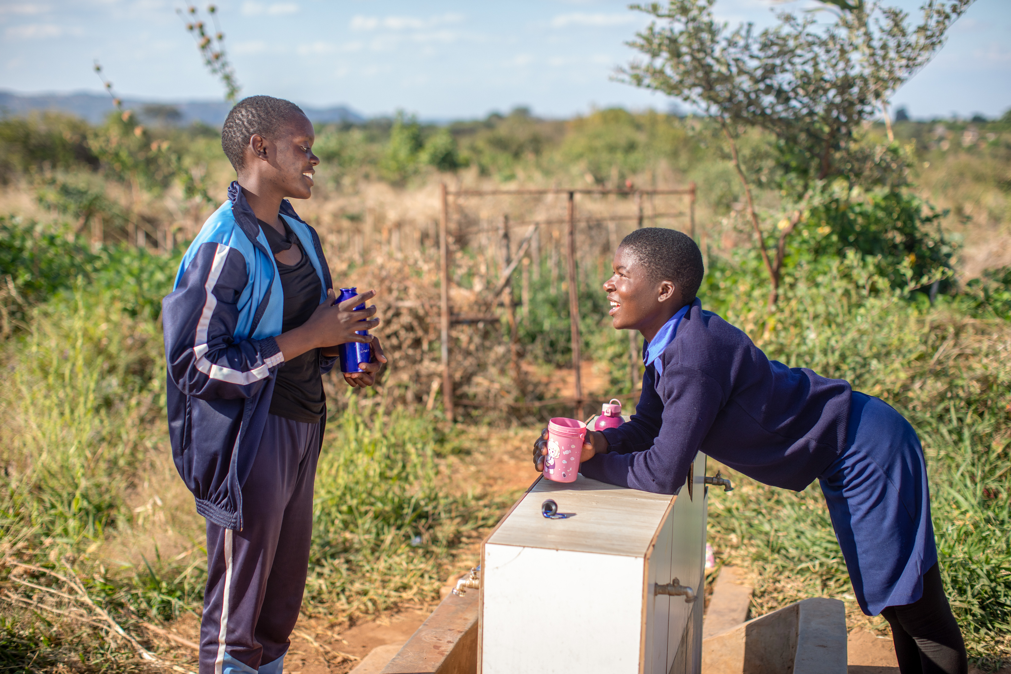
Photo 5
Notes:
Photo Credit: Thom Flint

Slide 14
Photo
5
“Someone from the community comes and talks to girls in the clubs...
The club has made me confident. If you want to say anything, you stand in front and address the group. So, at first I was shy, but now I've gained confidence, and that actually made me become a prefect.”
Maggie
CAFOD has helped set up Gender Clubs at Maggie’s school, where girls can learn about hygiene, their rights, gender-based violence and how to report concerns. The clubs provide a safe space for students to learn, speak up and support one another. Taking part has given Maggie opportunities to use her voice and build her confidence and leadership skills. She explained that this newfound confidence helped her to become a prefect. What helps you feel confident enough to speak up and share your ideas? How could you use your voice and skills to make a positive difference in your school or community?
Photo credit: Cynthia Matonhodze, CAFOD

