Slide 1
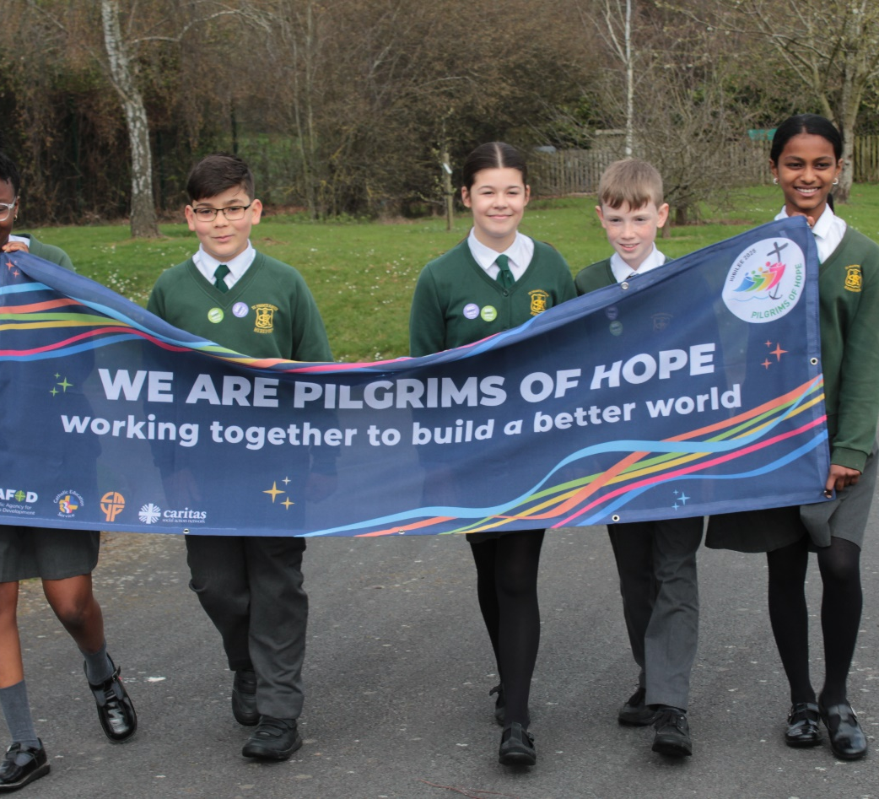
How do you think you can help to make the world a fairer place?
Gospel Celebration of the Word
Notes:
Children’s liturgy: Twenty-ninth Sunday in Ordinary Time (Year C)
Preparation of the worship space
Colour: green
Props: coloured pens and pencils, weighing scales, small plain cards, pebbles
Song suggestions
O Lord, hear my prayer (929, Laudate)
Welcome
Today we hear about a bad judge and a widow who would not give up. Jesus teaches us the importance of justice, of praying and of never giving up hope. Let’s find out more...
Abadhalee, Southern Ethiopia
Photo credit: Louise Norton

Slide 2
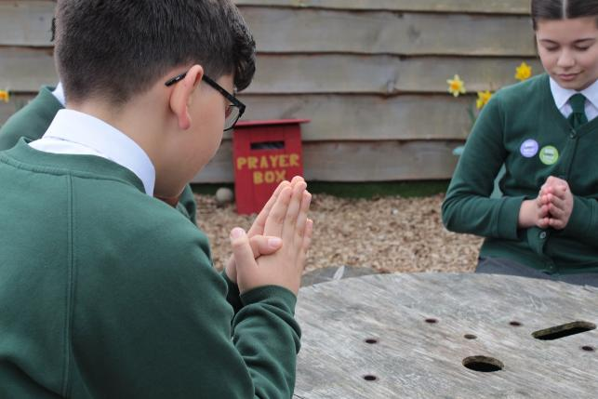

God of justice and wisdom, Help us to keep on praying and never to doubt that you will be with us always. Amen.
Gather
Notes:
St Francis Xavier's RC Primary School, Herefordshire
Photo credit: Vicky Ahmed

Slide 3

Gospel: Luke 18: 1-8
Jesus told his disciples a parable to teach them they should always pray and never be discouraged.
“In a certain town there was a judge who neither feared God nor respected people. And there was a widow in that same town who kept coming to him and pleading for her rights, saying, ‘Help me against my opponent!’
For a long time, the judge refused to act, but at last he said to himself, ‘Even though I don’t fear God or respect people, yet because of all the trouble this widow is giving me, I will see that she gets her rights. If I don’t, she will keep on coming and finally wear me out!’”
Word

Slide 4
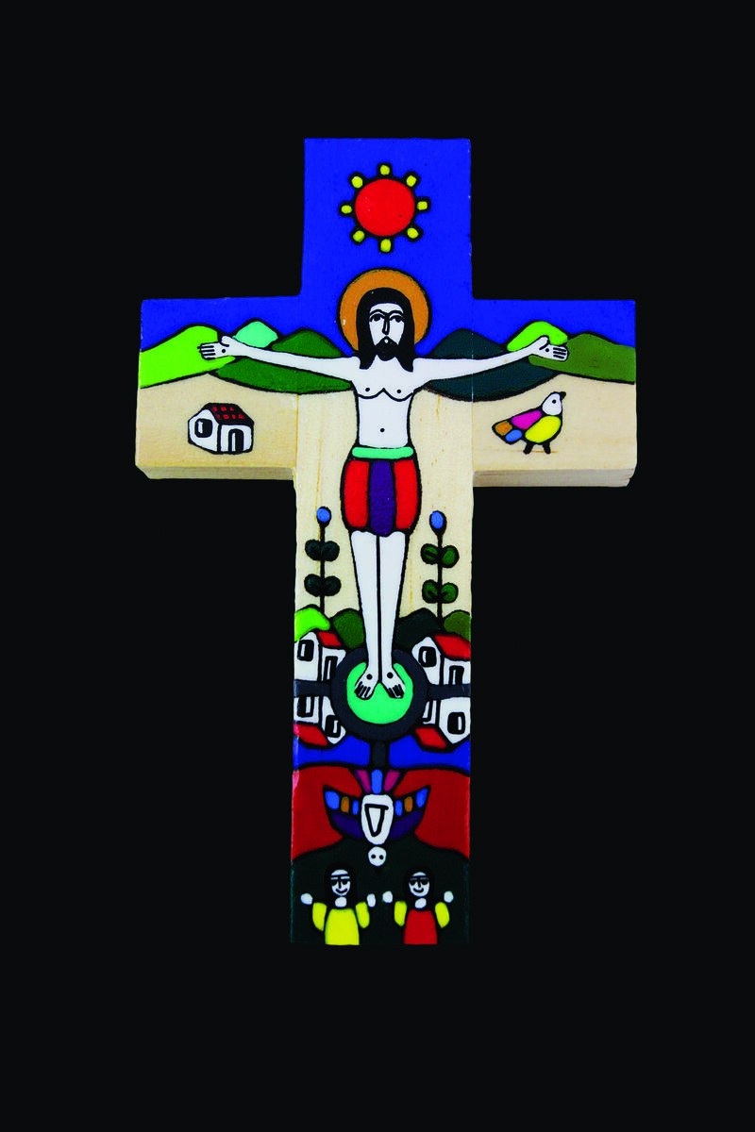
And the Lord continued, “Listen to what the corrupt judge said. Now, will God not judge in favour of his own people who cry to him night and day for help? Will he be slow to help them? I tell you, he will judge in their favour and do it quickly. But will the Son of Man find faith in the earth when he comes?”
Notes:
Romero cross
Photo credit: CAFOD

Slide 5
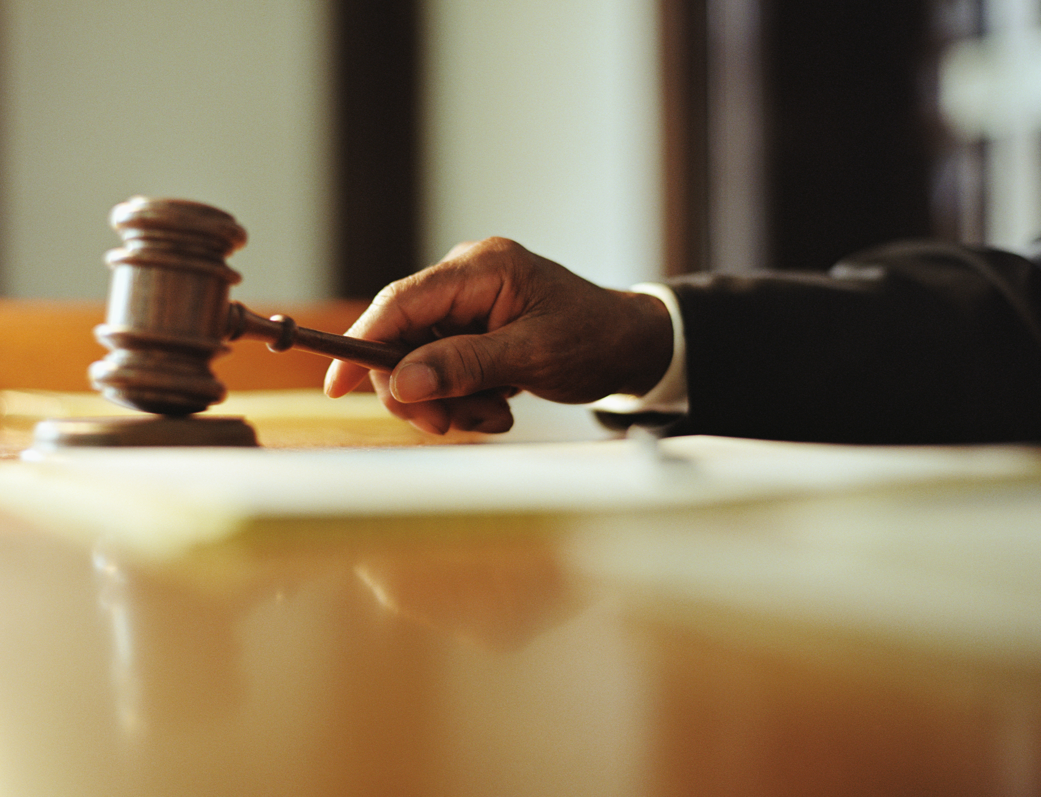

What do you remember from the Gospel reading?
Jesus tells us a story about a bad judge and a woman who wants justice – she wants what is right and fair.
Judges are supposed to be fair and honest, but this isn’t always the case.
The prophets in the Bible were always getting angry with bad judges who thought more about themselves than about the people who needed their help. And if the judges didn’t sort out the problems fairly,
then people would suffer again and again.
Respond
Notes:
Judge's gavel
Photo credit: Stock image

Slide 6
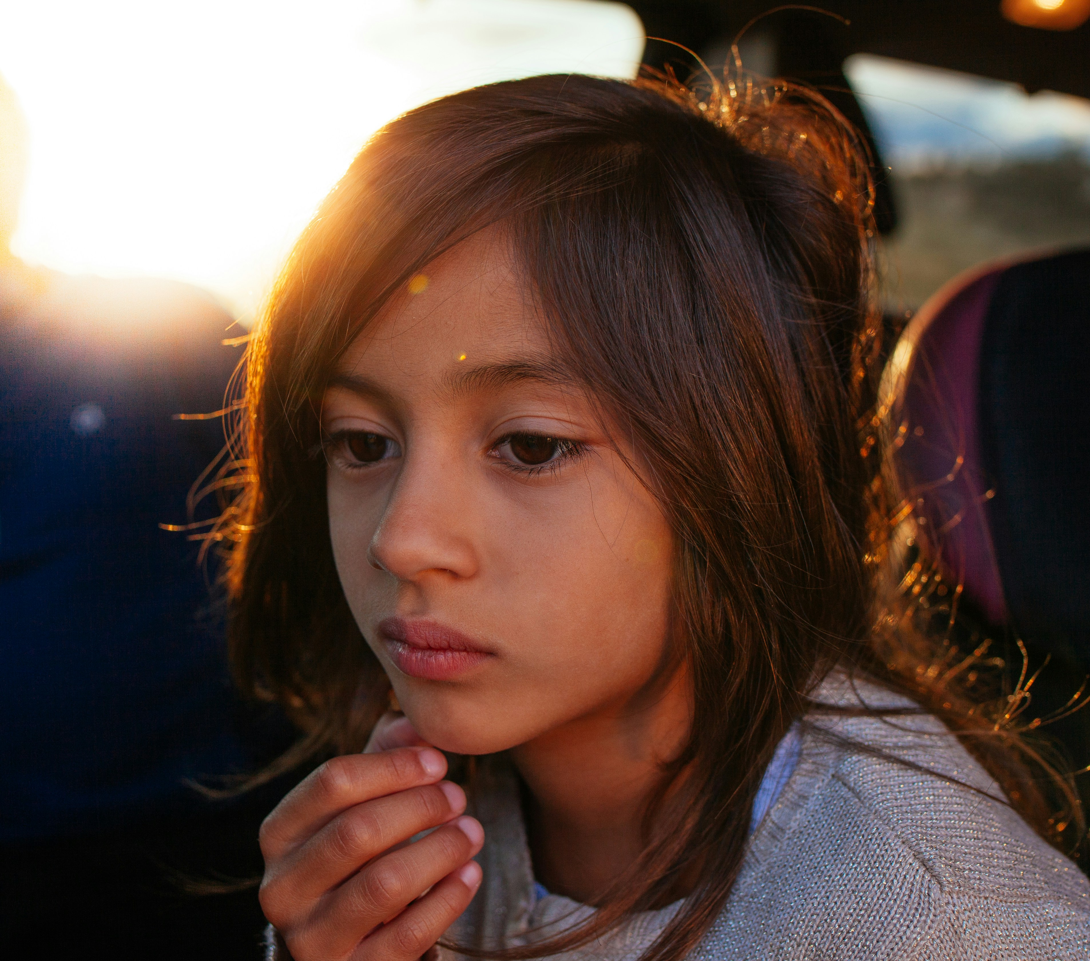
Can you think of things that seem unfair to you?
How do you feel when someone has treated you unfairly?
The woman was ignored by the judge, but she didn’t give up. She just kept asking the judge to make things right. Eventually, just to get rid of her, he gave her what she wanted. Her prayers were finally answered.
Why do you think Jesus told us this story? What does he want us to understand?
Notes:
Thoughtful
Photo credit:Joseph Gonzalez on Unsplash

Slide 7
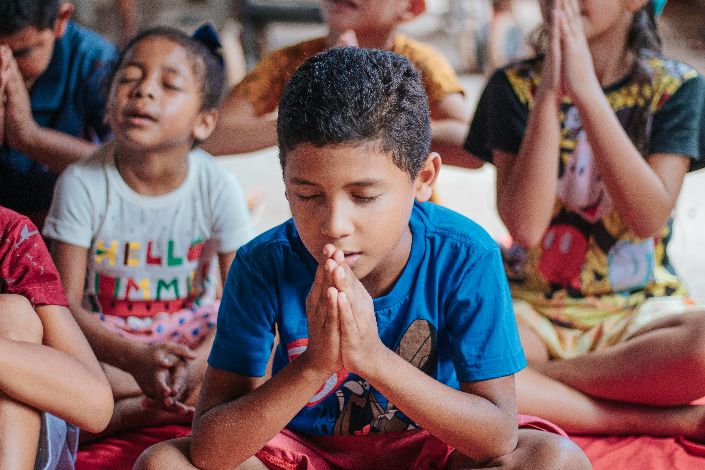
The woman is like us. Just like she asked the judge, we call to God in our prayers to give us what we need and want.
If even the bad judge eventually did the right thing, how much more will God, who is all-powerful and good, do what is right?
So, if we don’t get what we pray for the first time, should we just give up?
Notes:
Children praying
Photo credit: Carlos Magno

Slide 8
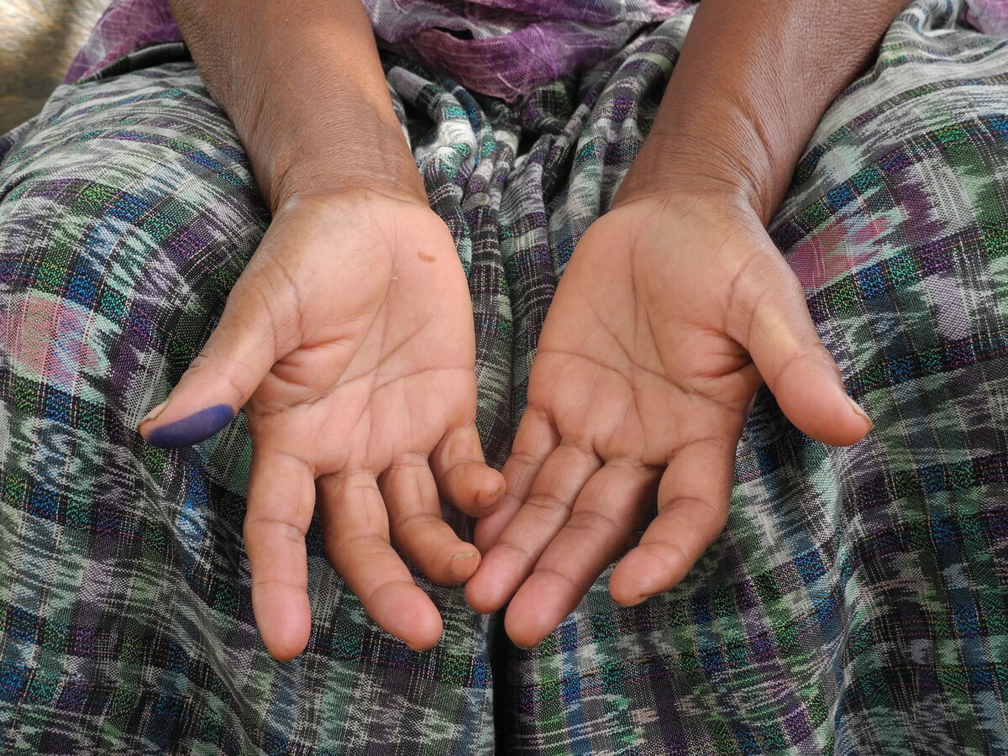
Jesus says that God hears the cries of all who call out to him day and night. And God will certainly answer our prayers, even if it’s not in the way that we expect.
How does it make you feel to know that God always hears you when you pray?
There are many things that are unfair in our world. And there are many people like the woman in the story who struggle to make their voices heard.
Notes:
Lucia, Guatemala
Photo credit: Montserrat Fernandez

Slide 9
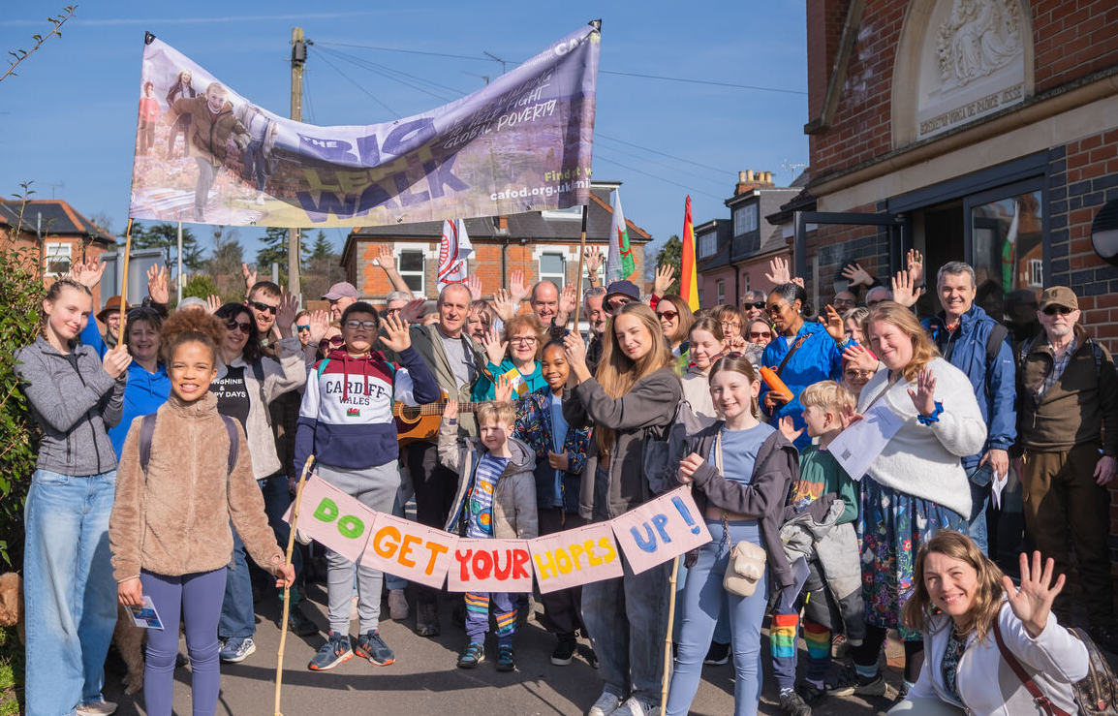
We can pray for these people, but we also have to do what we can to make sure that all people are treated fairly. Who knows, we might even be the answer to someone’s prayers!
This year is a Jubilee Year, a special year when we try to make the world a fairer place for all people to live in.
We are called to join together as pilgrims of hope, working together for God’s kingdom of justice, peace and love.
Notes:
Community Big Lent Walk, Reading
Photo credit: Amit Rudro

Slide 10
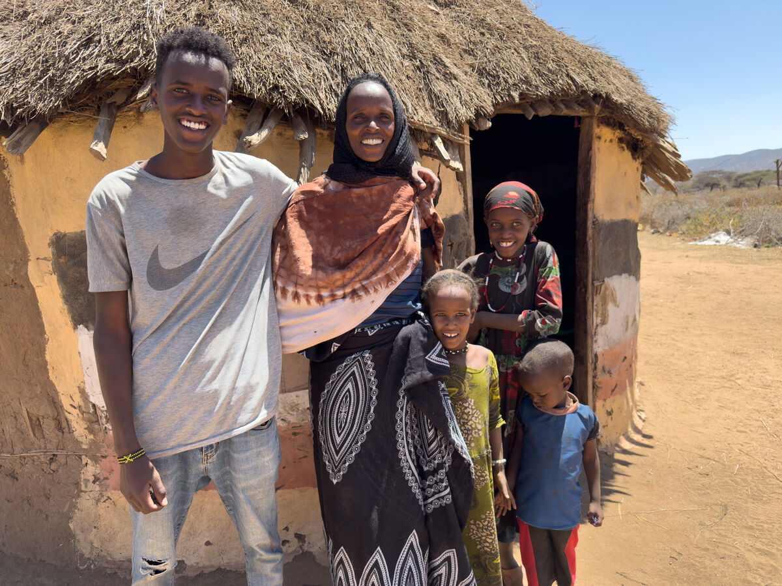
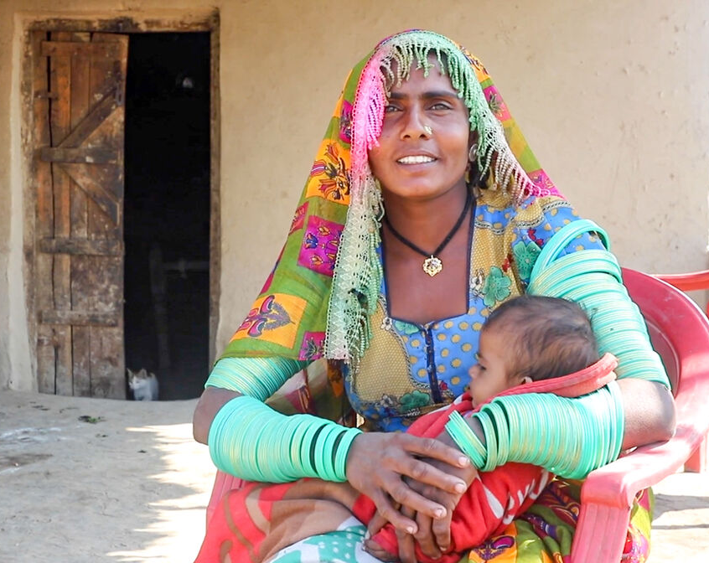
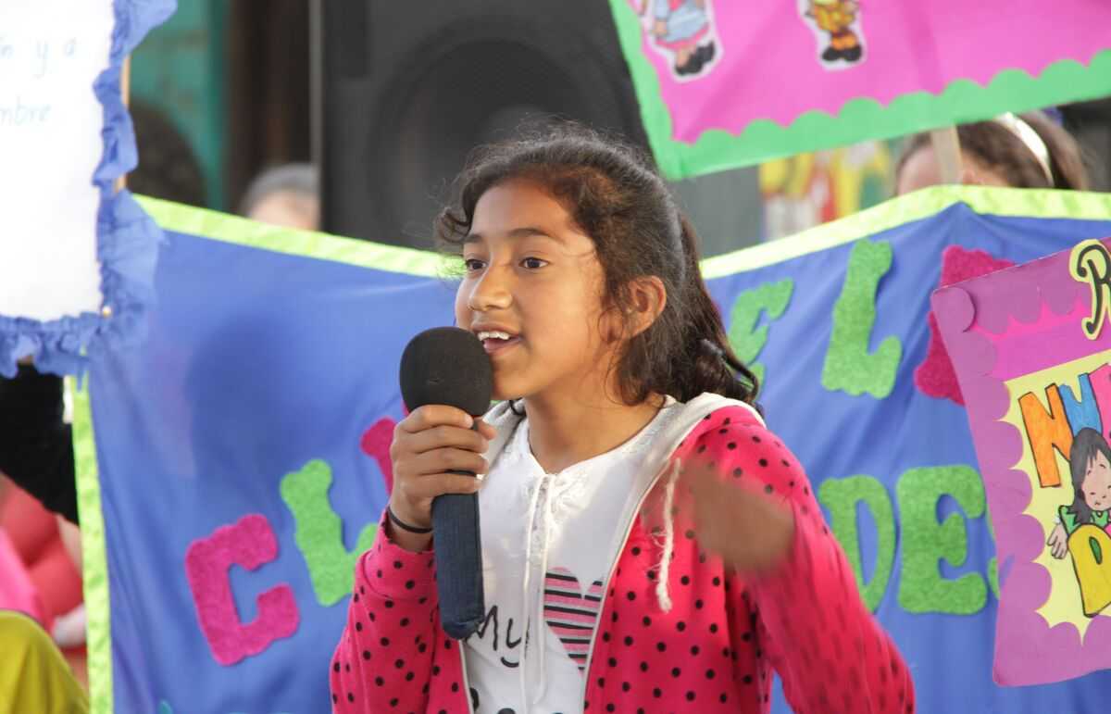
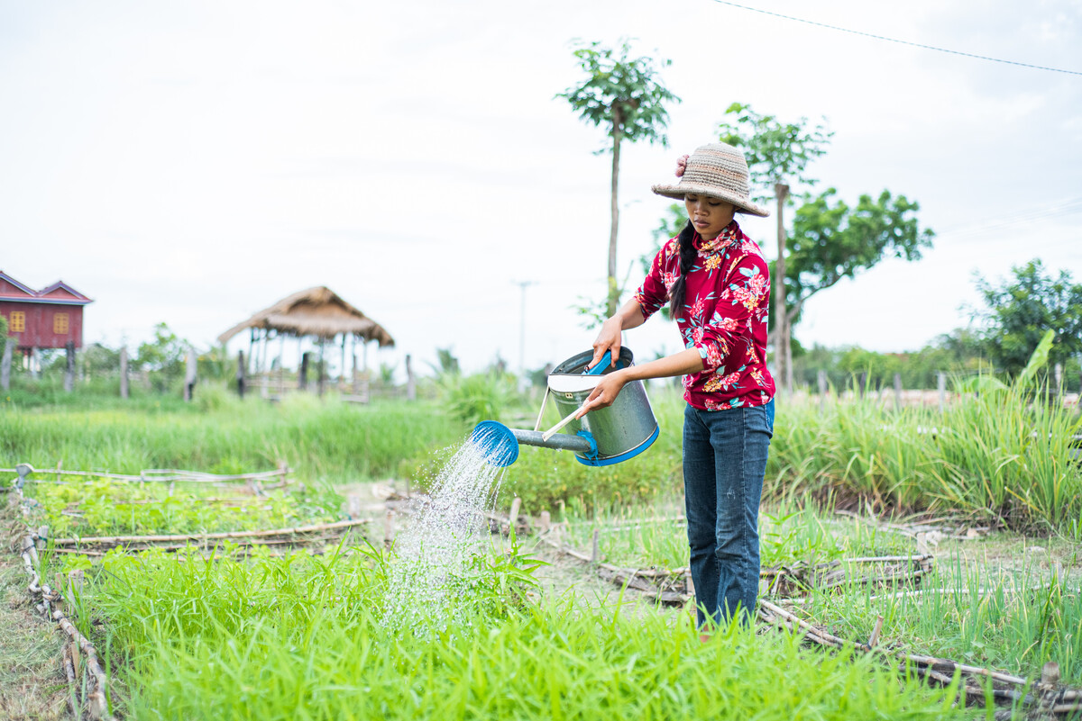
CAFOD works with our global brothers and sisters living in poverty, because a better world needs all of us. With your prayers and fundraising, we all work together to try and make the world a fairer place. Watch our film to find out more:
A better world needs all of us - CAFOD
Notes:
Adi and her children, Southern Ethiopia
Photo credit: Louise Norton
Meera and her daughter, Pakistan
Photo credit: Community World Service Asia (CWSA)
Esmerelda, Peru
Photo credit: Gemma Salter
Long Sreyneang, Cambodia
Photo credit: Tom Chheat

Slide 11
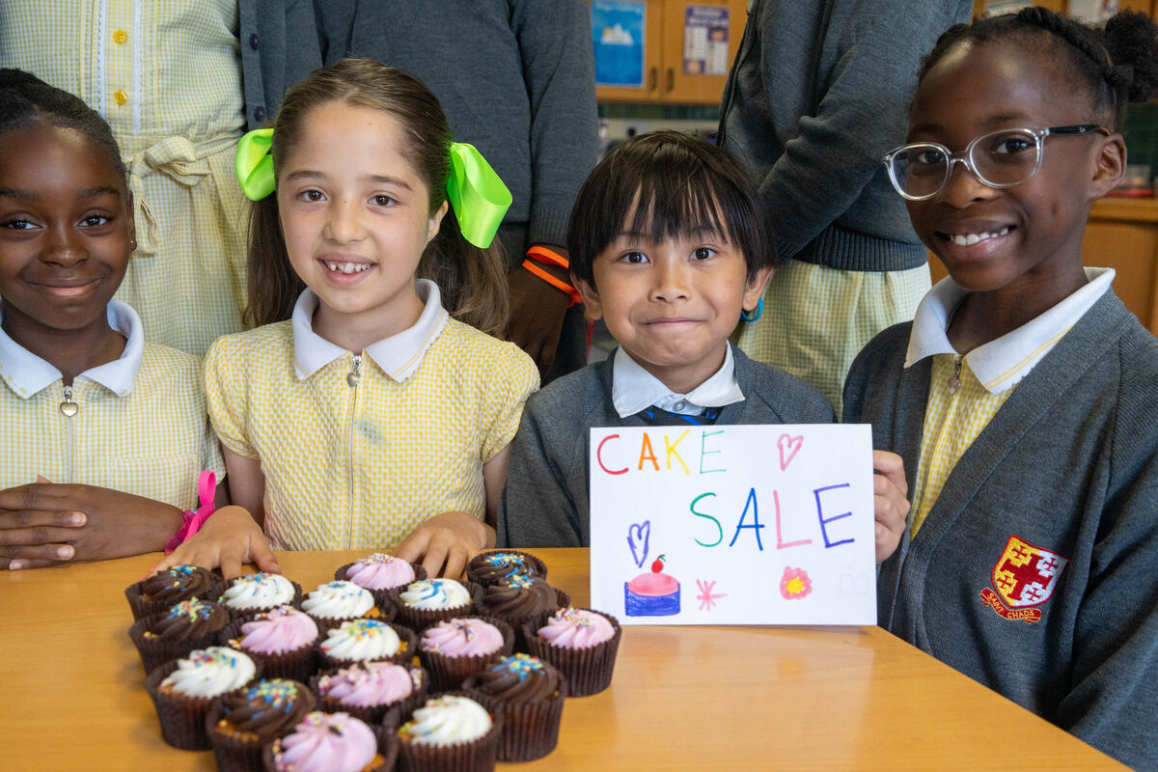
Children at St Chad's Primary School wanted to do something to help make the world a fairer place.
They organised a cake sale, with all the money raised going to CAFOD.
The cakes look delicious, don't they?!
Notes:
Children at St Chad's Primary School
Photo credit: Joe Newman

Slide 12
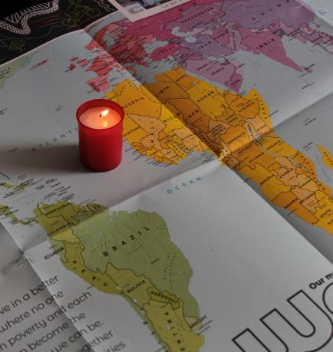
Let us pray
We pray for the church:
that it may stand up for what is right and never stay silent when people are treated unfairly.
Lord in your mercy…
We pray for our community and those around the world who are struggling to make their voices heard, who are left out or treated unfairly: may God give us all strength to work together for a fairer world.
Lord in your mercy…

Slide 13
Let us pray
We pray for our parish, family and friends:
that they may be show kindness, fairness and justice to one another in our hearts and in our homes.
Lord in your mercy…
God who always hears us,
Help us to make a change when we see something that is not right in our world. May we find strength to keep going, even if at first we are not heard. Amen.

Slide 14
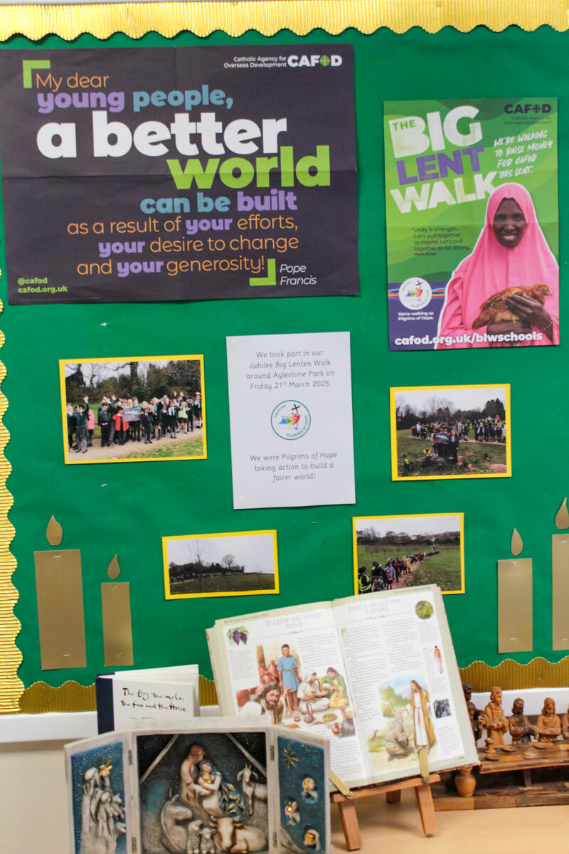

How do you think you can help to make the world a fairer place this week?
Send
Notes:
St Francis Xavier's RC Primary School, Herefordshire
Photo credit: Victoria Ahmed

Slide 15
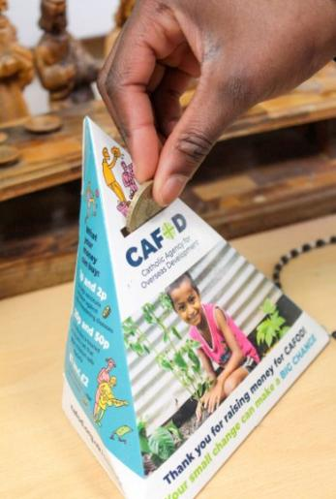
CAFOD Family Fast Day
Hundreds of schools and parishes across England and Wales raised money for CAFOD's recent Family Fast Day.
Explore our fundraising resources and find out how your school can support people like Abadhalee and his family.
Notes:
St Francis Xavier's RC Primary School, Herefordshire
Photo credit: Vicky Ahmed

Slide 16
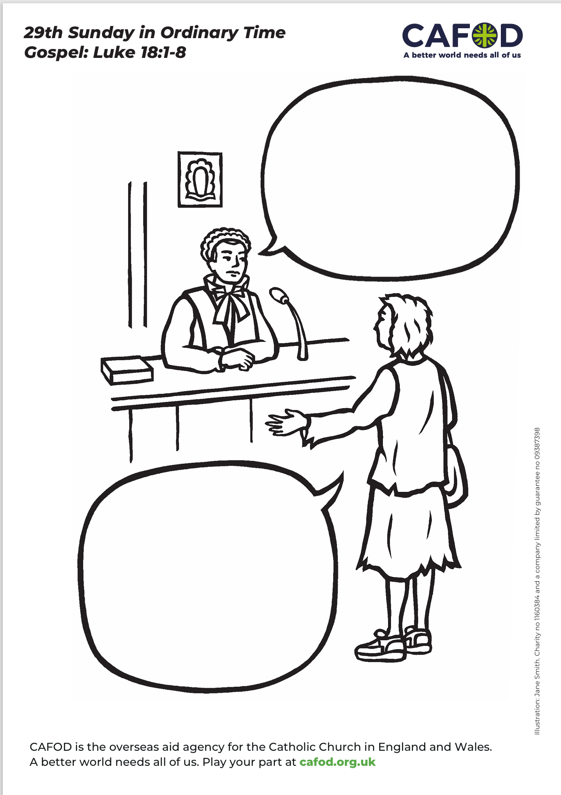
Activity suggestions
Download the illustration
Invite the children to colour in the accompanying illustration. They could add what they think the judge and the woman are saying to each other in the speech bubbles. On the back they could write or draw how they will stand up for what is right in the coming week.
Encourage the children to make some simple cards with the words justice, fairness, mercy, prayer, faith and hope on them. Then invite them to add them to the weighing scales and to keep adding cards with the same words to make the scales equally balanced. Then they can see fairness. (You might need to add some little pebbles if it takes too long!)
Invite the children to write a prayer to God for a fairer world for all people to live in.
Encourage the children to get involved with our Jubilee debt campaign. Find out more at https://cafod.org.uk/education/campaign-in-your-school
Remind the children to share all that they have heard and thought about in the liturgy today with the people at home. If they have written a prayer, encourage them to say it together in the coming week. Remind them to do all that they can to stand up for what is right and fair in the coming week.
Notes:
Illustration: Jane Smith

Slide 17
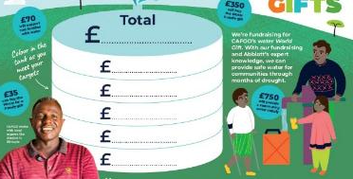

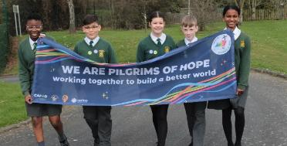
Get involved with CAFOD this term
Season of Creation
Fundraise this term
Jubilee activities
Watch our national assembly
Order an Autumn fundraising pack
Watch our new animation on water
Pray for long-lasting peace in the Middle East and think about fundraising
Make the Jubilee Pledge
Tell us about your Jubilee Debt action!

Slide 18
