Slide 1
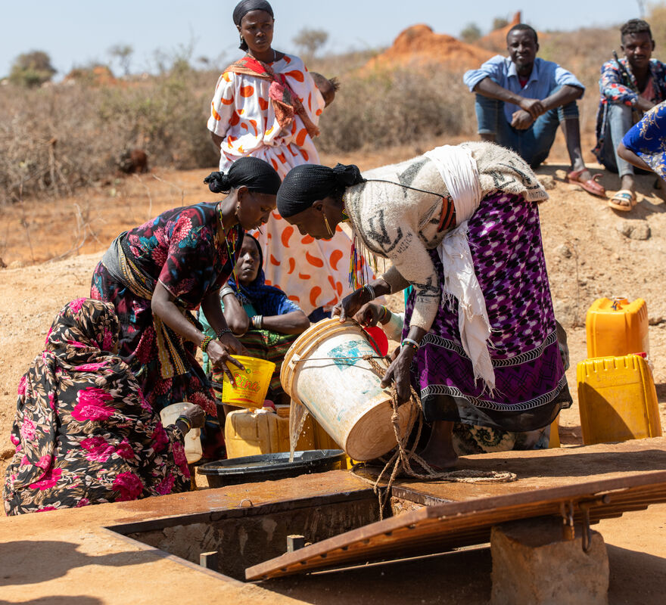
What can you do to help more people get the water they need?
Gospel Celebration of the Word
Notes:
Children’s liturgy: Baptism of the Lord (Year A)
Preparation of the worship space
Colour: white
Props: pictures of water and its uses, blue paper or card shaped like drops of water
Song suggestions
Come to the water (408, Laudate) O wash me (513, Laudate)
Welcome
Today we hear about how Jesus is baptised by John in the waters of the River Jordan. Water is a very important part of baptism. Water is also really important in our lives for other reasons. We all need water to live.

Slide 2
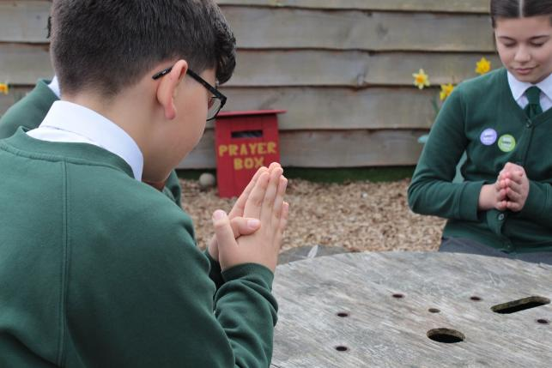

Living God,
We give thanks for water which gives us life. We pray that all your children around the world may have safe water to drink. Amen.
  Gather
Notes:
St Francis Xavier's RC Primary School, Herefordshire
Photo credit: Vicky Ahmed

Slide 3

Gospel: Matthew 3: 13-17
At that time Jesus arrived from Galilee and came to John at the Jordan to be baptised by him.
But John tried to make him change his mind. “I ought to be baptised by you,” John said, “and yet you have come to me!”
But Jesus answered him, “Let it be so for now. For in this way we shall do all that God requires.” So John agreed.
As soon as Jesus was baptised, he came up out of the water. Then heaven was opened to him, and he saw the Spirit of God coming down like a dove and alighting on him. Then a voice came from heaven, “This is my own dear Son, with whom I am pleased.”
Word

Slide 4
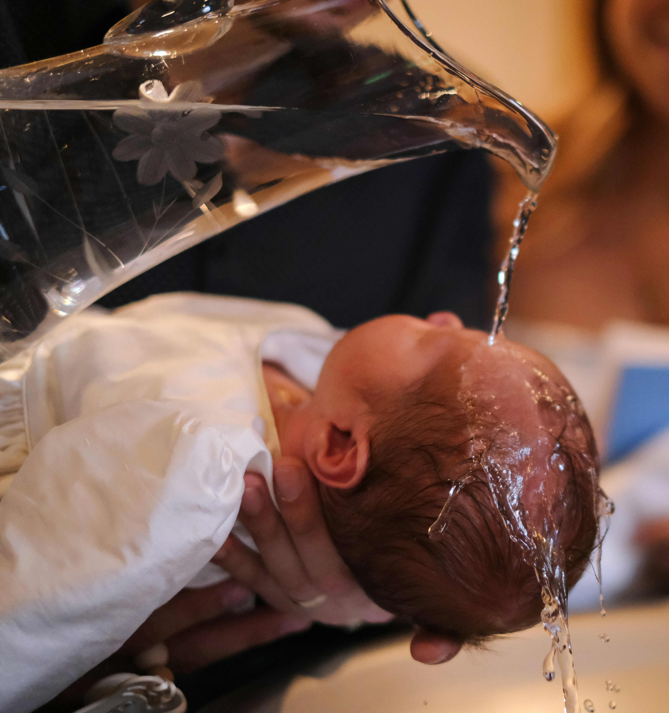

What do you remember from the Gospel reading?
John baptises Jesus in the river, and a voice from heaven says something important. Whose voice do you think it is? What does God say?
God reminds everyone that Jesus is his son, and that Jesus is doing God’s work on earth.
Water is very important in baptism. It is used to show we are starting a new life with God. When you were baptised, the priest put holy water on your head and welcomed you into God’s family.
Respond
Notes:
Baptism
Photo credit: Julia Michelle on Unsplash

Slide 5
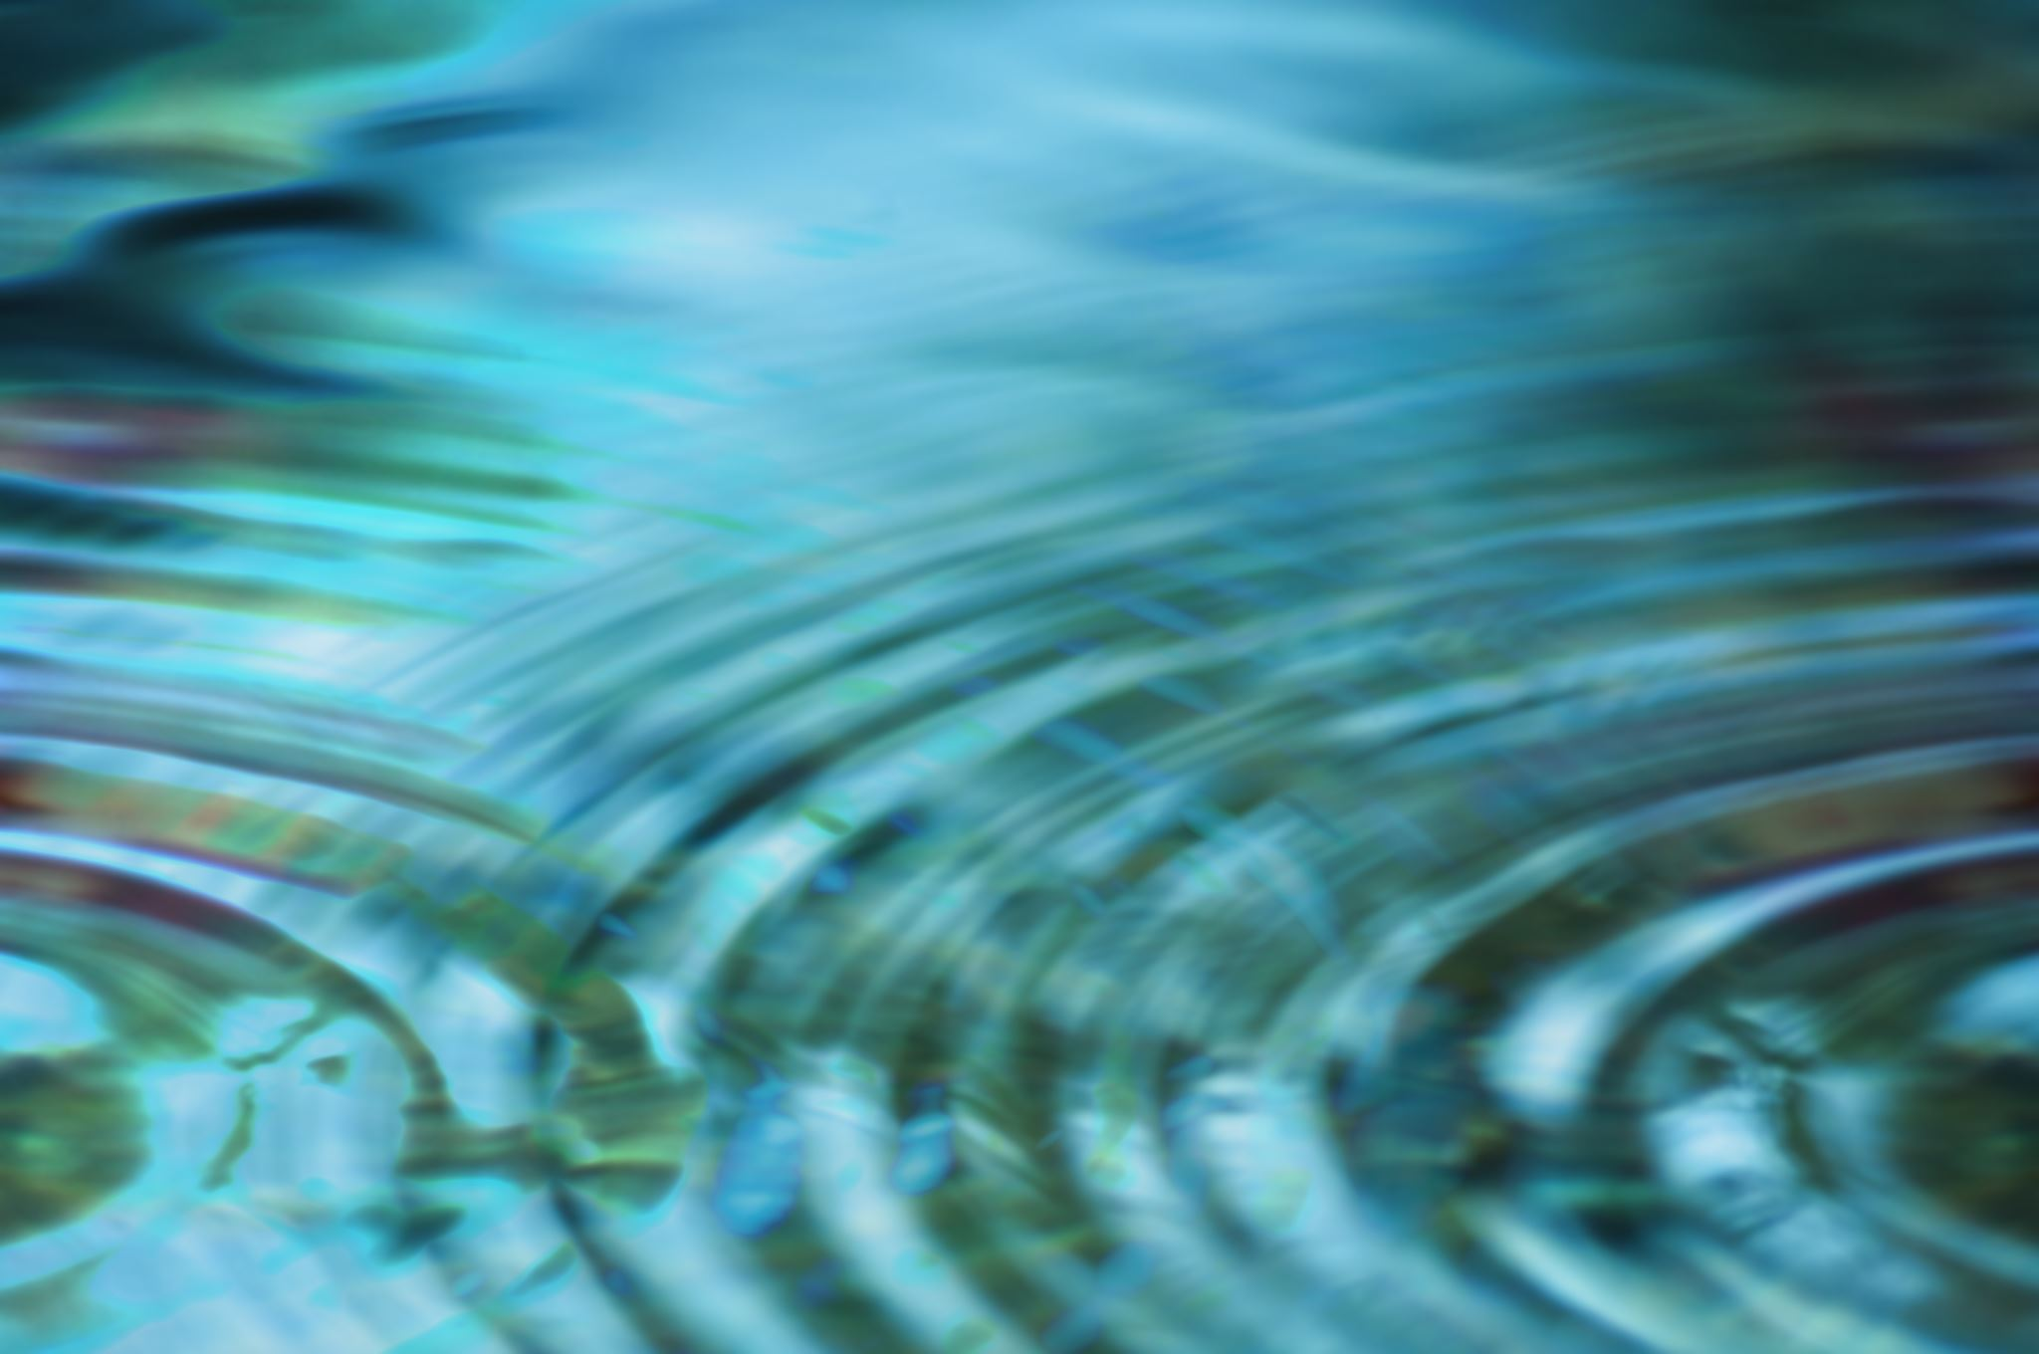
Water is also important for other reasons. There are many ways that we use water every day. How many can we think of?
That’s a lot of water! Are there any ways that we could save water so that we do not waste it?
We could turn the tap off when cleaning our teeth, use rainwater to water the garden. Do you have any other ideas?
Notes:
Water
Photo credit: Stock image

Slide 6
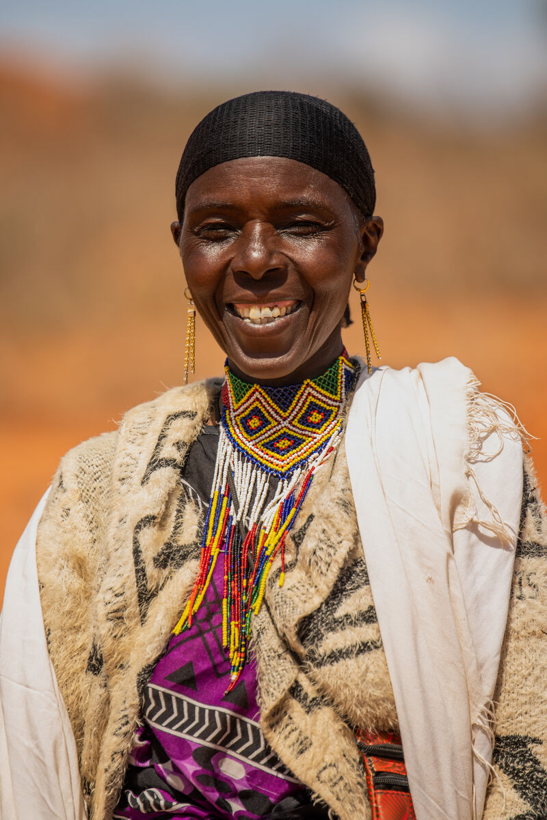
Mortikana lives in southern Ethiopia. Her village did not have access to a water source and Mortikana and the other women had to walk for six hours every day to collect water.
With CAFOD’s help, a local organisation built a cement water tank that can store enough water for all of Mortikana’s village. It’s much closer as well, so the women no longer have to walk for hours for water.
Notes:
Mortikana, Southern Ethiopia
Photo credit: Barnaby Jaco Skinner/ Trocaire

Slide 7
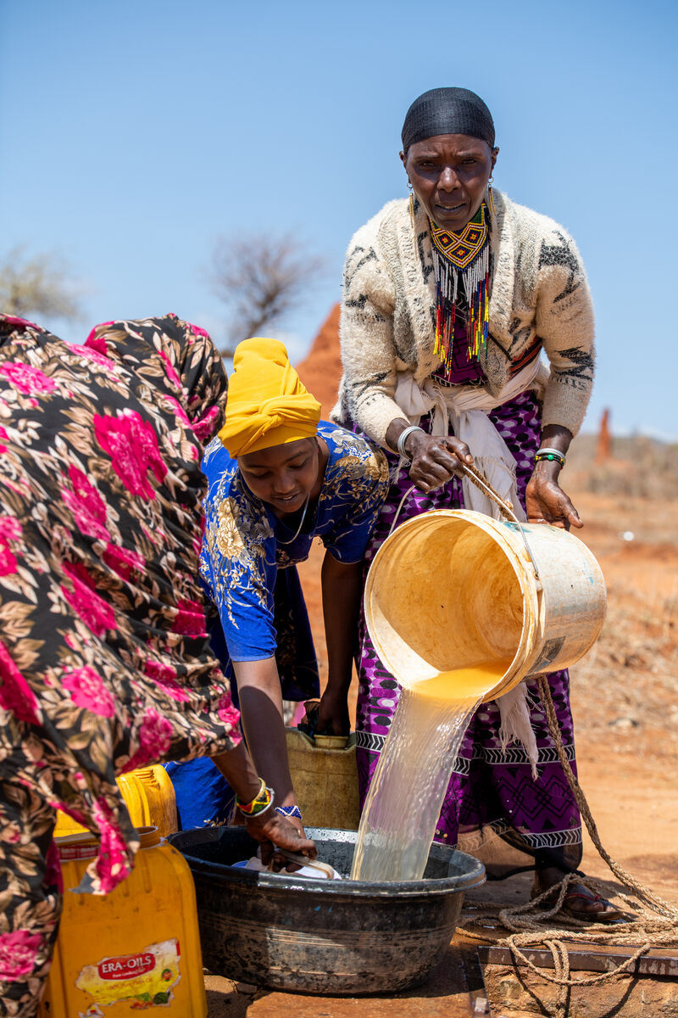
The water tank has made a huge difference to the lives of the people in the village.
“I can look after my children at home and send them to school with water to keep them hydrated and focused," Mortikana explains.
"Now, my children’s life will be better than mine, more stable and happier,” she says.
Notes:
Mortikana and some of her neighbours, Southern Ethiopia
Photo credit: Barnaby Jaco Skinner/ Trocaire

Slide 8
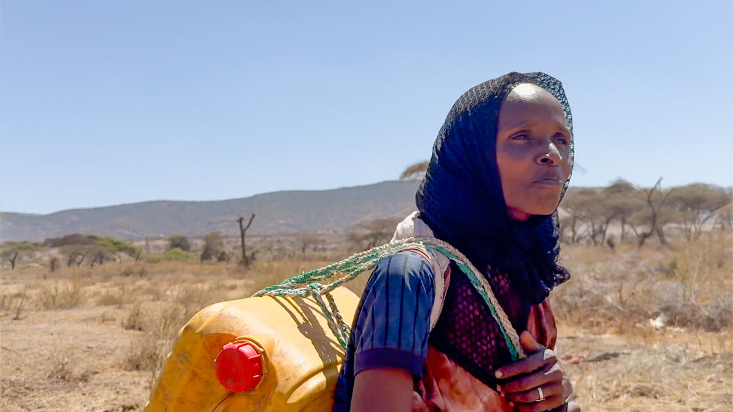
We all need water to live, but so many people around the world don’t have access to clean and safe water.
Or they have to travel a very long way to get any water at all.
Can you imagine what it would be like if you had to travel a long way to find water. What would it be like?
Before a water tank was installed near her village in Southern Ethiopia, Adi had to walk for hours to fetch water for her family
Notes:
Adi fetches water, Southern Ethiopia
Photo credit: CAFOD Clifton

Slide 9
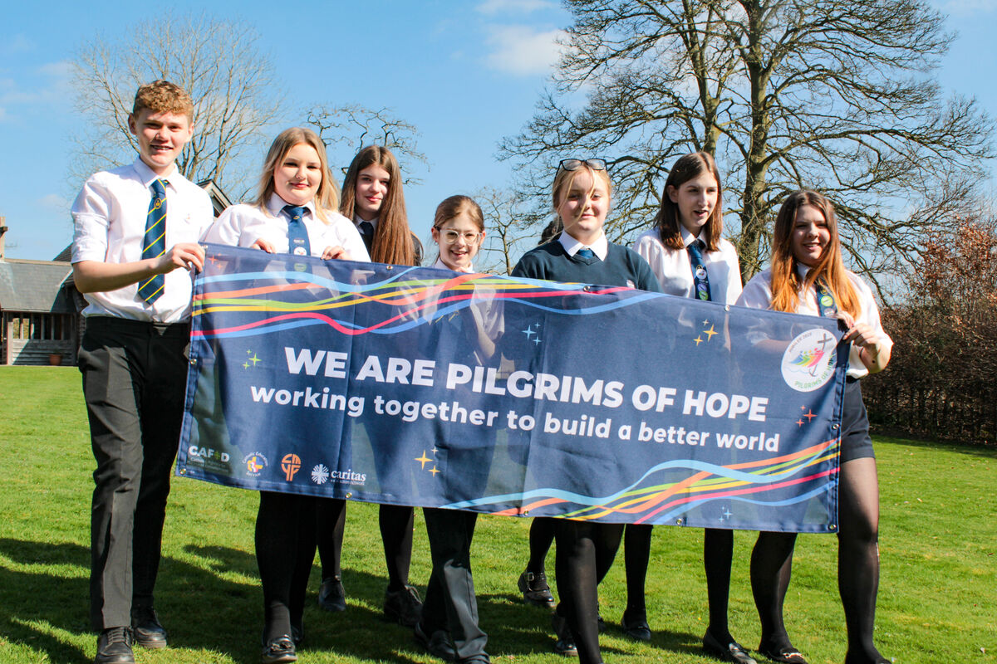
Because children like you have been praying, walking, fundraising and campaigning to build a better world, CAFOD can support people like Mortikana and Adi.
All these different things you do, help our brothers and sisters in need around the world to change their lives for the better.
Notes:
Pilgrims of Hope - St Mary's RC High School, Herefordshire
Photo credit: Victoria Ahmed

Slide 10
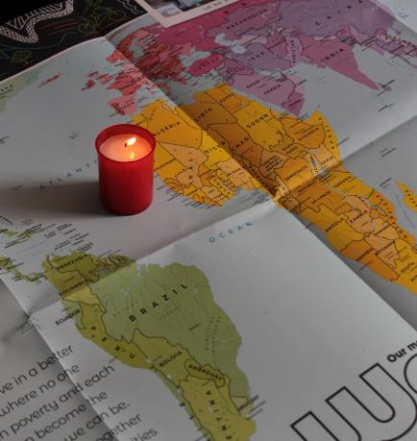
Let us pray
We pray for our brothers and sisters around the world :
that they may have safe water to drink and not have to travel long distances to collect it.
Lord in your mercy…
We pray for our parish, family and friends:
that the Holy Spirit will move us to do what we can to build a better world for everyone.
Lord in your mercy…

Slide 11
Let us pray
We pray for world leaders:
that they may make wise decisions so that all people have the water they need to live.
Lord in your mercy…
God of life, help us to act so that no-one goes thirsty:
help us ensure that all people around the world have enough water for their needs.
Amen.

Slide 12
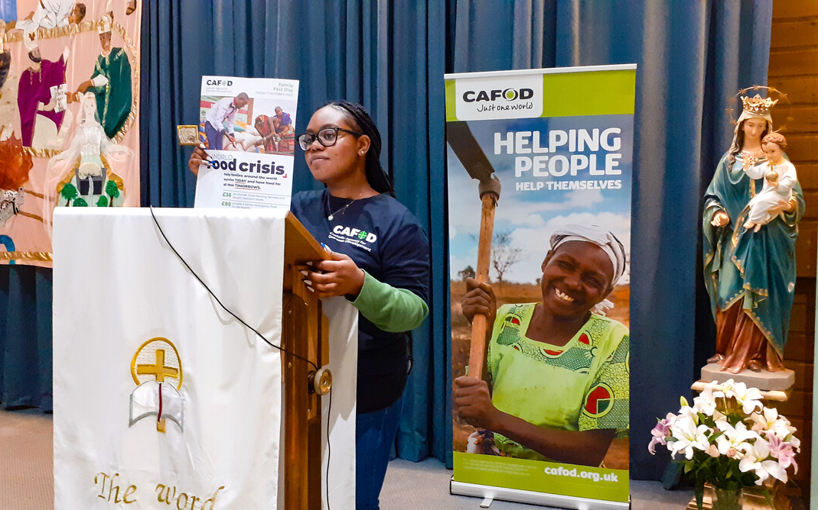

What can you do this week to help more people get the water they need?
Roxinne volunteers in the Diocese of Northampton
Send
Notes:
Roxinne volunteers in the Diocese of Northampton
Photo credit: CAFOD Northampton

Slide 13
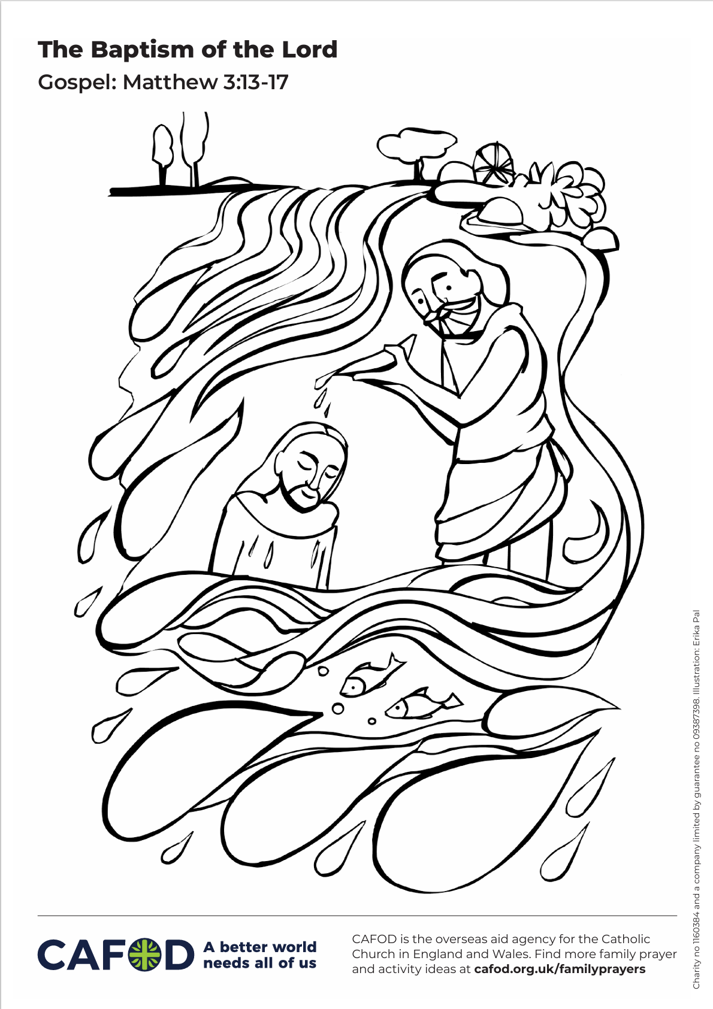
Activity suggestions
Download the illustration
Invite the children to colour in the accompanying picture. They could write some of the ways they use water in the big drops around the outside of the picture.
Make big drops of water out of blue card or paper and encourage the children to write or draw one way that they use water on their droplet. Stick them onto a timeline showing how the group uses water throughout the day. How many buckets of water do they think it would take to do all these things that they normally do? How would they feel about carrying all this water back from the next village or town?
Explore some of our family prayer activity ideas on the theme of water with the children. These are available at Family prayer ideas
Notes:
Illustration: Erika Pal

Slide 14
Remind the children to share all that they have heard and thought about today with the people at home. Encourage the children to try to save water during the next week. Maybe they could turn off dripping taps, avoid drinking bottled water or they could save rainwater
to help water the garden.
Encourage the children to spend time looking at photos of their own baptism, or the baptism of friends or family members and to remember what a special day this was. While they are looking at the photo, they can remember that they are part of God’s family and we are all brothers and sisters.

Slide 15
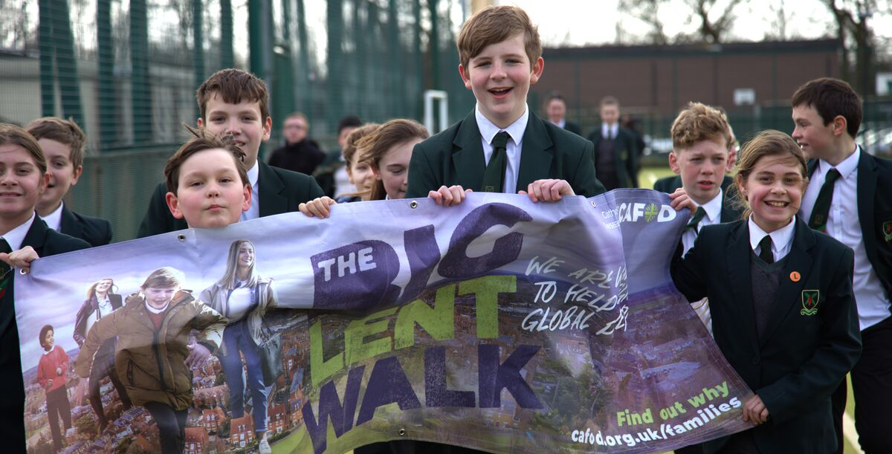
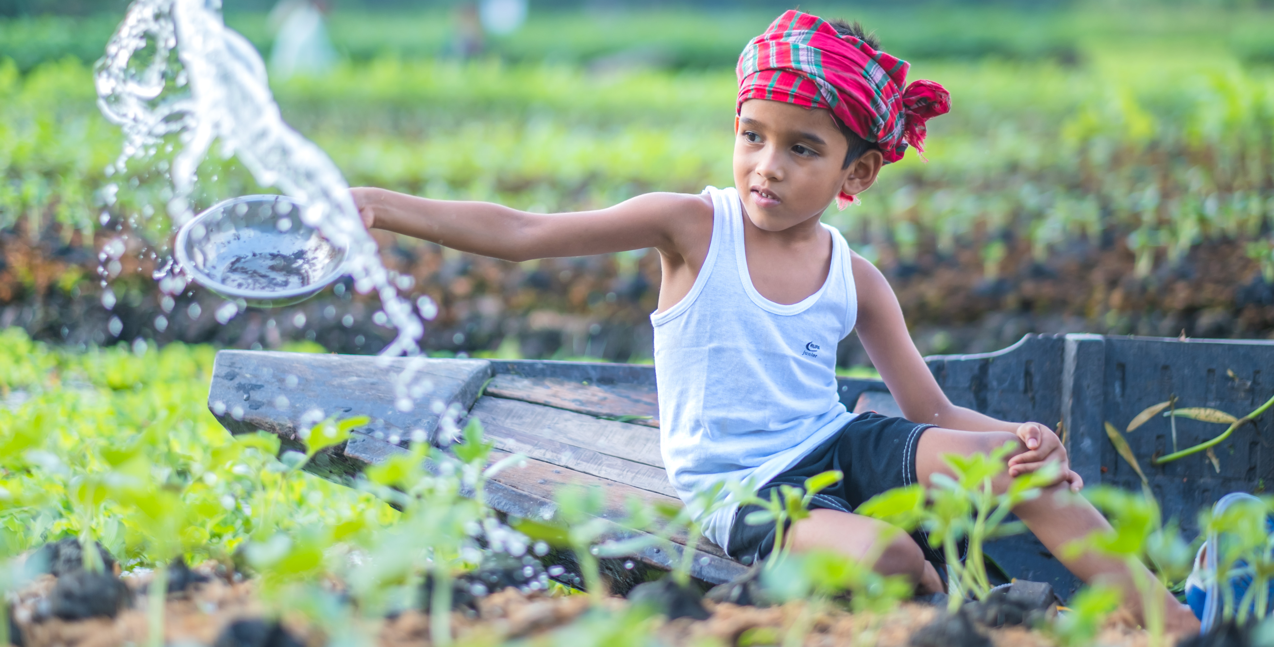
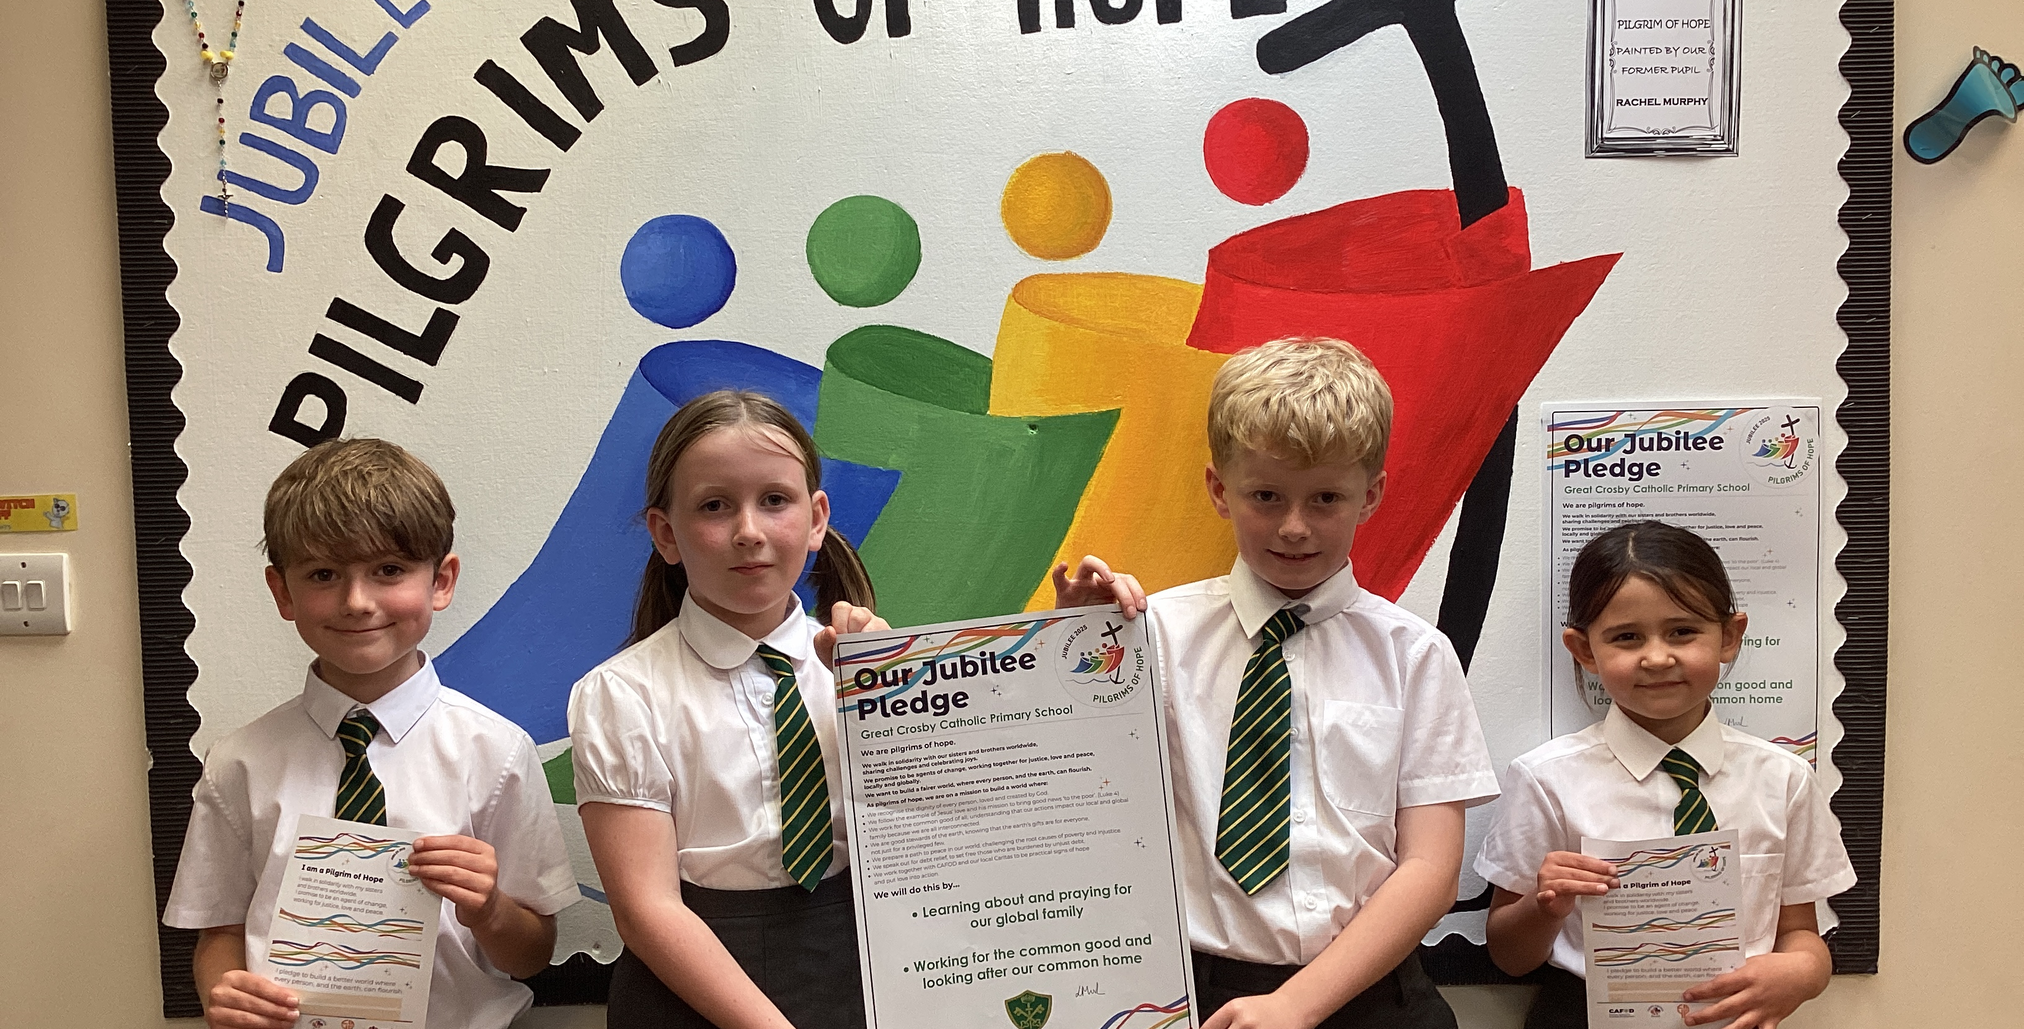
Get involved with CAFOD this term
Big Lent Walk resources
Save the date!
Jubilee Pledge resources
Join us on the Big Lent Walk!
Join our national assembly
It's not too late to make a Jubilee Pledge!

Slide 16


