Slide 1
Advent Calendar 2024

Slide 2
Welcome to the CAFOD Advent calendar.
Advent is a time to reflect: to look up to God, to look in at ourselves, and then to look out to the world around us.
As we reflect on what it means to wait for Jesus’ arrival this Advent, we’re reminded of our brothers and sisters around the world who are currently waiting for hope, love joy and peace. We want to focus our prayers on certain situations.
We’ll be looking at projects that are supported by World Gifts.
Firewood and therapy through play (Ukraine)
Winter survival kit (Afghanistan)
Super soup kitchens (Poland)
Training workshops (Democratic Republic of Congo).

Slide 3
We hope you might consider donating your Christmas card or present money to support World Gifts with your school.
£100 Stocking

Slide 4
1 | 2 | 3 | 4 | 5 | 6 | 7
8 | 9 | 10 | 11 | 12 | 13 | 14
15 | 16 | 17 | 18 | 19 | 20 | 21
22 | 23 | 24 | 25

Slide 5
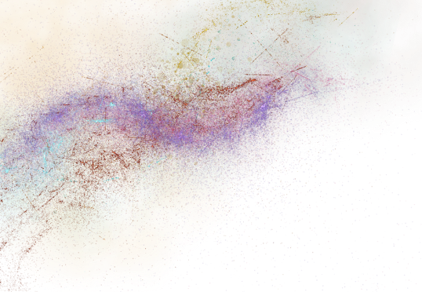
Sunday
1 December
And then they will see the Son of Man coming in a cloud with power and great glory.
Luke 21:27
Waiting well
We start our Advent journey with the assurance that Jesus will come again and redeem all things. It’s a bit odd to start our Advent journey at the end of the gospel but this gives us hope whilst we are waiting.
When we’re in the middle of our story we don’t always know how it will end. The gospel reading today gives us hope that with Jesus, all things end well.
Daniel and his family in Goma, in the DRC.
Notes:
Photo credit: Thom Flint, CAFOD

Slide 6
Daniel waited patiently for three days to join the CAJED woodwork project but he was proactive while waiting. This determination was noticed by his teacher. Daniel didn’t always know how his story would end and the ongoing conflict in the DRC means our partners still live with uncertainty.
We asked DRC CAFOD staff member Katy Katonda what hope means to her. She said, "the belief in a better tomorrow". Like Daniel we are to be both patient and proactive in waiting for that day.
Lord, help us to wait well, with patience and determination, till you return. Amen.
Daniel in the workshop. Support other training projects with the Back to school World Gift.

Slide 7
Monday
2 December
That he may teach us his ways
and that we may walk in his paths.
Isaiah 2:3
Teach us your ways
Isaiah was a prophet who lived in Jerusalem. He prophesied a message of warning and of hope. In Isaiah 2 he shared a vision for a much more hopeful time that was coming.
In this particular verse he says there will be a new day when all the nations will come to learn from God. As a result there will be no more fighting between the nations.
Daniel’s school friends and their teacher Suleiman in Goma, in the DRC.

Slide 8
The DRC has been experiencing civil war for decades. Children as young as seven are recruited to fight. CAFOD are working with young people to run peacebuilding projects.
We learn from our teachers; they model behaviour and skills and we take that on board. In today's reading we are reminded that when we look to God as our teacher and follow his lead, this is the way to peace.
Lord, we look to you the source of all hope and peace. Teach us your ways. Amen.
A school in Goma, DRC.

Slide 9
Tuesday
3 December
You have hidden these things from the wise and understanding and revealed them to little children.
Luke 10:21
Got it!
In this passage Jesus is celebrating that the Kingdom message has been understood, not necessarily by the people you would think – the really clever people – but by humble ‘childlike’ people.
If you’ve ever misunderstood something, you know how good it feels when it finally clicks! Jesus was celebrating that moment as he watched the disciples starting to understand what he was saying.
Adeline at school in Goma, DRC.

Slide 10
CAFOD supports children around the world – in their joys and in their sorrows.
This is Yuliia. She lives in Ukraine. Yuliia wants to be a baker when she’s older and enjoys making pastries with her Mum and Grandmother.
Yuliia was evacuated two years ago with her family along a Red Cross route. The family left their beloved home and made a traumatic journey to where they live today in a village in another part of the country. “My dream,” she says, “is to have peace over our heads.”
Lord, we pray for children around the world. Let us not forget all the things young children can teach us. Amen.
Yuliia in Ukraine. You can support children around the world through our Therapy through play World Gift.

Slide 11
Wednesday
4 December
I have compassion on the crowd because they have been with me now three days and have nothing to eat.
Matthew 15:32
The basics
This passage shows how Jesus cares about our basic needs – food and water. He cares about the whole self; our mind, body and spirit.
CAFOD reflects this by attending to the needs of the whole person – that’s an expression of dignity, a key principle in Catholic Social Teaching.
Maria cooking on their firewood stove in Ukraine.

Slide 12
Maria and Steve live with their children in a small village in Ukraine. They had been displaced from their original home in Luhansk province in 2014 but had to move again in 2022.
They left on a Red Cross evacuation route but the process was very distressing with over 23 checkpoints, often being held at gunpoint.
It gets very cold in Ukraine and Maria and Steve didn’t have enough money for the basics like firewood to heat their stove. Caritas Khmelnytskyi – CAFOD’s partner organisation in Ukraine – helped the family to get enough fuel to heat the home so they can stay warm during the extreme cold.
Lord, following your example help us share all our resources. Amen.
Maria and Steve in Ukraine. You can support families in Ukraine through the Firewood World Gifts.

Slide 13
Thursday
5 December
Everyone then who hears these words of mine and does them will be like a wise man who built his house on the rock.
Matthew 7:24
Secure foundations
When Daniel builds a piece of furniture he needs to make sure it is secure!
Jesus says how true wisdom comes from hearing his words and acting on them – you will be like a house that can withstand all the storms.
We’re used to hearing about the Wise men at Christmas but now we know what true wisdom looks like!
Daniel in the workshop in Goma, DRC.

Slide 14
We are are going to hear from Katy Katonda, our country representative in the Democratic Republic of Congo, who explains why CAFOD help create opportunities to help people build secure foundations.
Lord, we thankyou for modelling what a secure way of life looks like through your teaching. Help us to make wise choices that build secure foundations, just like Daniel. Amen.

Slide 15
Friday
6 December
Then he touched their eyes, saying, “According to your faith be it done to you.” And their eyes were opened.
Matthew 9:29-30
Their eyes were opened
At the start of this week we spoke about not always being able to see how our story ends whilst we’re in the middle of it.
Sometimes, we don’t see things as God sees them. We see things on a surface level, but Jesus sees our hearts. This passage is a reminder to keep checking if our ‘eyes are open’ to God’s work in the world around us.
Dodo at the seamstress project in Goma, DRC.
Notes:
Photo credit: Arlette Bashizi

Slide 16
This is Dodo and her ten month old baby. Dodo dropped out of school in fifth grade and left home at the age of 13. She became pregnant while she was living on the streets. The father of her child is a bandit and is currently in jail.
Staff from CAJED, CAFOD’s partner, found Dodo when she was living on the street and persuaded her to take part in the seamstress training. She is now reconciled with her parents and trying to make up for some of the mistakes she made in the past – and to help build a better future for herself and her child.
Lord, help us see things as you see them; where we see the end, may you show us new beginnings. Amen.
Young people like Dodo can do additional training with the Back to School World Gifts.
Maria and Steve in Ukraine. You can support families in Ukraine through the Firewood World Gifts.
Notes:
Photo credit: Arlette Bashizi

Slide 17
Saturday
7 December
Like sheep without a shepherd.
Matthew 9:36
Lost and found
Have you ever felt a bit lost? What used to be cool isn’t as popular now? Or maybe things are changing quite rapidly. Maybe you’ve actually got lost before…
Jesus said in this passage he had compassion on those who had become like lost sheep. Life can be really disorientating sometimes!
Bernadette making charcoal stoves in Goma, DRC.

Slide 18
For refugees life is very disorientating. They have to leave their homes immediately, leaving family and possessions. CAFOD’s partners try to bring some kind of stability to these situations by providing income projects.
Bernadette was forced to flee from her home when rebels burned down the houses in her village and killed many people. Bernadette escaped on foot with her four sons and fled across the country while she was pregnant with her fifth child. Sadly, she lost her baby, but she has been able to find a new place to live in Goma and is starting to rebuild her life through the mushroom farming project.
Lord, thank you for the promise that you will shepherd us when we feel lost. Amen.
You can go Back to School at any age.
Notes:
Photo credit: Arlette Bashizi

Slide 19
Sunday
8 December
And the crooked shall become straight,
and the rough places shall become level ways.
Luke 3:5
Sanding down
This year CAFOD filmed students at St Bede’s school for the World Gifts video.
The students were working on their GCSE projects, sanding and levelling things off. There was a great deal of concentration.
Can you imagine how they would have reacted if one of the CAFOD film crew went over and put a chip in the woodblock?!
St Bede’s students in the DT workshop

Slide 20
In this passage Luke connects the prophecy in Isaiah to John the Baptist who was preparing the way for Jesus. John told people that someone was coming who would make it all right – and they needed to get ready. He would fill valleys, level mountains, set crooked roads straight – all metaphors to describe how God would restore his relationship with those who have turned away. All we need to do is ask. Imagine a determined craftsman who would smooth out the chip in the wood if we let him.
Daniel’s story from the DRC is inspiring because it’s full of hope. And this is what Isaiah was also trying to show in today's passage.
Lord God, thank you for being the master craftsman who restores all things. Amen.
Notes:
Photo credit: Arlette Bashizi

Slide 21
Monday
9 December
The Feast of the Immaculate Conception
Blessed art thou
Today we specifically remember Mary, and her faithful ‘yes’ to God’s plan.
Women around the world show incredible strength when providing for their friends, family and communities in difficult circumstances. This is Agnjetschka Padzlowska. When the war in Ukraine began, the Caritas station kitchen in Przemyśl switched to feeding refugees. CAFOD is part of Caritas Internationalis.
Agnjetschka Padzlowska at the Caritas train station restaurant in Przemyśl train station.

Slide 22
50,000 units of soup were distributed at the beginning of the war. 1,800 litres of soup are cooked daily.
Agnjetschka and the volunteers cook from 6am to midnight. On her day off she asked friends and acquaintances if they could drive her into work but no one had time. She hadn’t driven a car by herself even though she had a licence but she was determined to get to the kitchen to check on things. “Caritas is there for everyone,” says Agnjetschka. “It needs everyone's commitment.” She spent her day off in the kitchen, cooking with her daughter.
Lord, we thank you for women who show great courage and actively participate in God’s plan. Amen.
Super Soup Kitchens World Gifts is available here Super soup kitchen
Notes:
Photo credit: Arlette Bashizi

Slide 23
Tuesday
10 December
If a man has a hundred sheep, and one of them has gone astray, does he not leave the ninety-nine on the mountains and go in search of the one that went astray?
Matthew 18:12
A shepherd King
Jesus uses the metaphor of being a shepherd a lot! Today’s passage explains that he will not tire from searching for any who are lost - each life is precious to him.
Humanitarian workers deeply care about the lives of civilians in the regions they are working in. At the moment Gaza is one of the most dangerous places for humanitarian workers – they are in constant danger as they try to continue their work.
In Gaza, CAFOD's partners provide safe activities for children. The children are painting pictures which reflect their desire for peace.

Slide 24
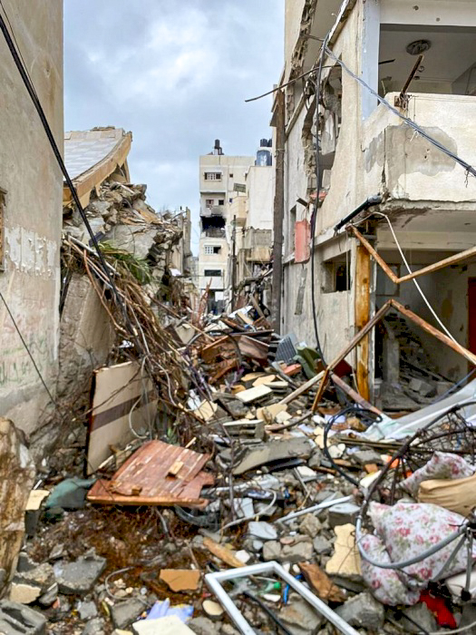
This year we have a School Christmas stocking and included in this bundle is the ‘promoting peace’ World Gift. It allows CAFOD partners to support those facing extreme conditions by providing safe spaces to engage in conversations and improve relationships.
Today we’d like to remember the families of the humanitarian workers who have been killed in the conflict in the Middle East. We pray for peace to come to the Middle East.
Lord, we pray for humanitarian workers whose job it is to search for those who are missing and protect your people. Keep them safe this Christmas time. Amen.
The Schools Stocking includes Therapy through Play, Super Soup Kitchens, Winter Survival Kit, Firewood for Winter and Promoting Peace.
Notes:
Photo credit: Arlette Bashizi

Slide 25
Wednesday
11 December
Come to me, all who labour and are heavy laden,
and I will give you rest.
Matthew 18:28
Heavily laden
Here’s a heavily laden truck full of wood for our partners in Ukraine. Look at the crane and everyone working to move it around. It’s tiring work.
Life can be quite tiring! In this verse Jesus reminds us that all the physical and emotional worries that weigh us down can be given to him through prayer.
Caritas Khmelnytskyi – the Church partner organisation CAFOD works with in Ukraine - unloading firewood.

Slide 26
In the next part of the passage Jesus says he has a gentle and lowly heart – another word we might use is humble.
Something wonderful happens when we pray – it’s hard to explain in words but Jesus relieves us of the things that cause anxiety. And we can pray for our brothers and sisters around the world to experience the same thing.
Lord, we pray for our brothers and sisters in Ukraine. Whatever their physical or emotional needs might be at this moment – we pray they find rest in you. Amen.
Firewood being unloaded in Ukraine.
Notes:
Photo credit: Arlette Bashizi

Slide 27
Thursday
12 December
Truly, I say to you, among those born of women there has arisen no one greater than John the Baptist.
Matthew 11:11
Listen up!
John the Baptist was really important! Jesus is so keen people understand this that he says later, “he who has ears to hear, let him hear”.
John the Baptist marks a change from the Old Testament to the New Testament. He was saying something new – and (spoiler alert) he was killed as a result. John was preparing people for an upside down Kingdom where the least will be first. It was a really bold thing to say at the time!
Messages of peace are projected onto the House of Commons by Save the Children with support from CAFOD, Action against Hunger and Oxfam

Slide 28
A key aspect of Catholic Social Teaching is the preferential option for the poor – in everything we do we should think about the least.
Sally was an Architecture student in Damascus. When the conflict broke out in Syria, she was forced to flee to Lebanon. Sally was inspired to take action and started visiting a nearby refugee camp to see how she could help. Sally now works with communities, organising activities promoting peace. The communities come together for workshops and plan local initiatives to build relationships and improve refugees’ and local communities’ quality of life.
Lord, we pray for all those who campaign for peace. We thank you for the example we see in John the Baptist to be brave and bold. Amen.
Sally, who works in peacebuilding initiatives in Lebanon.
Notes:
Photo credit: Arlette Bashizi

Slide 29
Friday
13 December
I am the Lord your God, who teaches you to profit,
who leads you in the way you should go.
Isaiah 48:17
Just like this…
Learning is not always straightforward. It can be fiddly and hard and sometimes tiring. We’re back in the book of Isaiah today, and you’ll remember earlier on in the Advent calendar we learnt Isaiah was a prophet sharing a message of hope and warning.
In Chapter 48 Isaiah now is repeating a message directly from God (because they weren’t quite getting it!) – God teaches us for our profit.
Raissa (20) in the sewing workshop in Goma, DRC.

Slide 30
Think about a textiles lesson. Have you ever had to use a sewing machine? If you thread it incorrectly the machine will break – so you watch your teacher very carefully. It’s because the teacher wants you to be able to use that machine again – for your profit!
Raissa was given a sewing machine as part of the DRC sewing project run by CAFOD’s partner CAJED. Raissa would now like to be the teacher. She said. “My biggest dream is to open my own workshop. That’s why I’m saving up to buy other sewing machines so that I can open a large workshop in the future.”
Lord, we thank you that you’re guiding us for our good. We’re sorry that we’ve not always followed your ways. Amen.
Raissa in the CAJED sewing group. CAJED is CAFOD’s partner organisation in the DRC.
Notes:
Photo credit: Arlette Bashizi

Slide 31
Saturday
14 December
Elijah does come, and he will restore all things. But I tell you that Elijah has already come, and they did not recognize him.
Matthew 17:11-12
Voices of change
Next year CAFOD will welcome two very special guests to Flame 2025. Brian and Ashley work at the Jesuit Hakimani Centre in Kenya.
Ashley helps mentor young care leavers and is passionate about gender justice. Brian helps young people learn new agricultural methods including financial skills.
Ashley who works at the Jesuit Hakimani Centre
Notes:
“Care leavers” – young people who have lived experience of alternative care, such as growing up in charitable children’s institutions (such as orphanages).

Slide 32
Brian and Ashley are two people who are voices of change within their community.
In this passage today Jesus was explaining to the disciples (who were a bit confused!) that John the Baptist had been like an Old Testament prophet, Elijah. Both John the Baptist and Elijah had been voices calling for change but very few recognised them.
What injustices do we need to raise our voice about? Remember, Pope Francis said “Young people demand change”. Maybe you could discuss this as a form today.
Lord, we thank you for those who inspire us to be voices of change in our community; calling out the injustices in society and bringing freedom to the oppressed. Amen.
Brian in Kenya doing his work at the Jesuit Hakimani Centre.
Notes:
Photo credit: Arlette Bashizi

Slide 33
Gaudete Sunday
I baptise you with water, but he who is mightier than I is coming, the strap of whose sandals I am not worthy to untie. He will baptise you
with the Holy Spirit and fire.
Luke 3:17
Sunday
15 December
Just you wait and see…
Today we are going to specifically pray for joy.
God of good news of great joy for all people,
give us warm and generous hearts,
inspire us to share what we have
and work for peace,
so we may share your joy. Amen.
Notes:
Photo credit: Emerson Peters, Unsplash

Slide 34
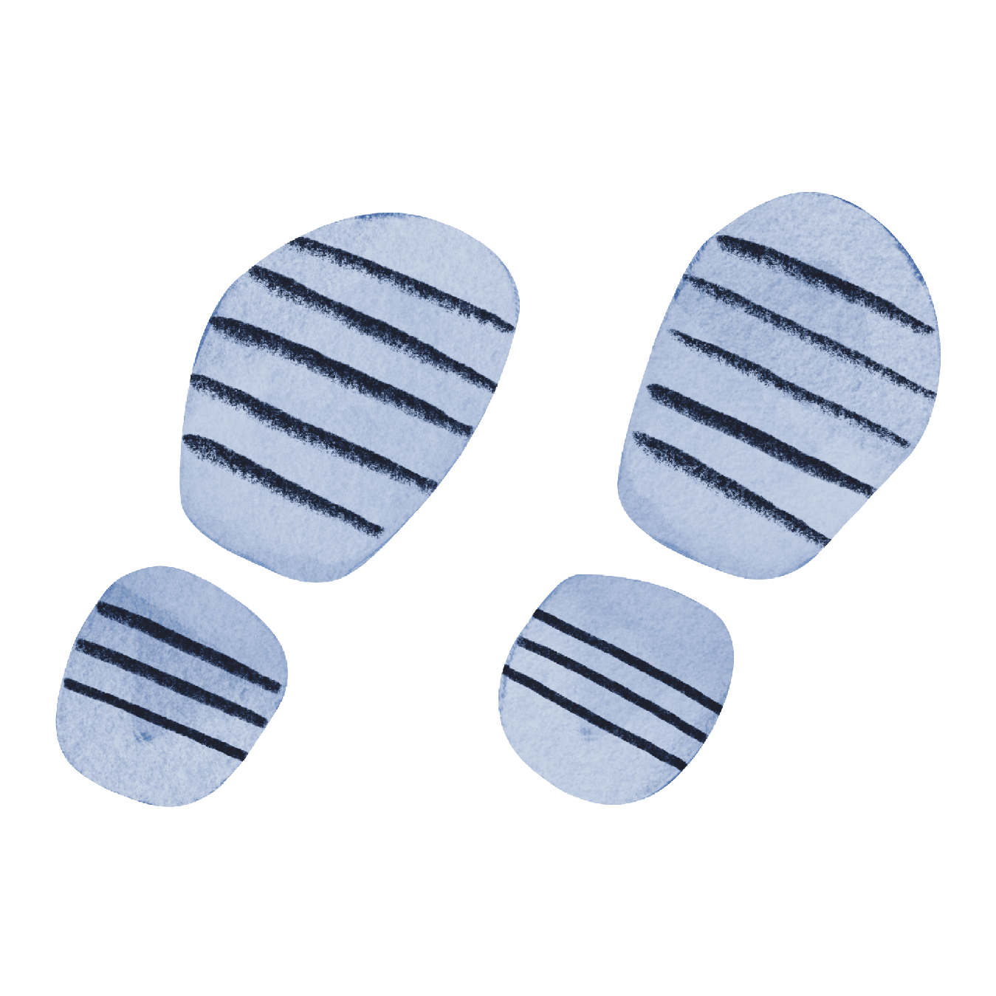
Excitement is building at CAFOD as we prepare for Jubilee 2025 “Pilgrims of Hope”. Every time one of our Jubilee for Schools resources gets completed the anticipation builds.
In the passage today, the excitement was building, so much so the people thought John the Baptist might be the Messiah. Today you can see he’s telling the people something far greater is coming…
Everything we’ll be doing in the Jubilee will come back to Jesus’ wonderful vision of hope and joy for all people.
Let’s get ready for Jubilee 2025!!!
jubilee-schools.org.uk has everything you’ll need to celebrate with HOPE and JOY!
Notes:
Photo credit: Arlette Bashizi

Slide 35
Monday
16 December
By what authority are you doing these things,
and who gave you this authority?
Matthew 21:23
Think quick…
Have you ever been put on the spot? Jesus was asked a tricky question in Matthew 21 but he was very careful in how he responded. He actually throws the question back to the people that asked him.
Jesus demonstrates an amazing ability to be very wise in his interactions with people, even in challenging circumstances.
Art therapy classes taking place in Ukraine

Slide 36
Therapists are also very discerning with their words. In Ukraine, the Therapy through Play programme has been an important way for children to express how they are feeling. Therapists prompt questions which help children process some of the trauma they have witnessed. They can then draw their feelings on the paper.
We would love to provide more opportunities for children and young people to be given spaces like this through World Gifts.
Lord, we thank you for all the therapists who are helping children and young people process the traumas of war. Give them wisdom in their interactions. Amen.
Therapy through Play is part of the World Gifts Schools stocking bundle.
Notes:
Photo credit: Arlette Bashizi

Slide 37
Tuesday
17 December
And from the deportation [exile] to Babylon
to the Christ fourteen generations.
Matthew 1:17
3 x 14 / 6 x 7
The beginning of Matthew comes with a very long list of names, showing the genealogy of Jesus (a bit like his family tree). This is important and the Jewish people reading this list would have been very impressed that Jesus’ ancestry linked back to Abraham and David.
There are three sets of 14 generations or six sets of seven. Numbers are very important in the Bible, particularly the number seven. Matthew has laid out the genealogy very deliberately to establish Jesus’ identity as the Messiah. You could think of it as a drum roll…
Daniel and his family sharing dinner in Goma, DRC.
Notes:
Photo credit: Thom Flint, CAFOD

Slide 38
Families and people at home shape our identity. We are influenced by the values of the people around us; we see each other at the best and the worst times; we are asked to care for one another.
Since Daniel became involved in the CAJED carpentry project, he has learned new skills and is now able to earn money to help his family and to make sure they have food to eat. The project helped Daniel, but he was then able to help all the different generations within his family.
Lord, thank you for families that span many generations. As we prepare for Christmas we pray for all who are separated or estranged from their family groups. May you bring restoration and healing. Amen.
Daniel’s family having dinner in Goma, DRC
Notes:
Photo credit: Thom Flint, CAFOD

Slide 39
Wednesday
18 December
She will bear a son, and you shall call his name Jesus, for he will save his people from their sins.
Matthew 1:21
This is Anna (four). She lives in Ukraine with her Mum, two brothers and sister. The name Anna means ‘favour’ or ‘grace’.
Anna and her family moved when a missile strike narrowly missed their flat. When they moved to a safe place they were cold. Anna talks about the winter: “When I’m cold, I go like this – I blow on my hands.”
Names
Anna playing a game at her new home in Ukraine.

Slide 40
Did you know at confirmation you can pick a confirmation name? The bishop says that name followed by “be sealed with the gift of the Holy Spirit”.
Names have important meanings; in Biblical times names were used to describe characters. Therefore, it’s no surprise that Mary was told to give Jesus a very specific name with the specific meaning, ‘God saves’ or ‘God’s salvation’. Elizabeth was told to name her child John, meaning ‘God is gracious’.
Lord, we thank you that you know each of us by name. You call each of us forward to participate in a much bigger vision. Amen.
Anna and her brother Orest checking on their dinner in Ukraine. This is part of the firewood world gifts.
Notes:
Photo credit: Thom Flint, CAFOD

Slide 41
Thursday
19 December
For you are my hope, O Lord.
Psalm 70:5
Pilgrims of Hope
The theme for the Jubilee 2025 is “Pilgrims of Hope”.
Hope is a gritty word! Bishop Stephen Wright spoke to CAFOD recently and said ‘‘Hope is a source for strength and action. Hope expands our vision, inspires us to persevere in demanding times, and enables us to make visible God's reign in our midst by living lives of solidarity, compassion and love.”
Firewood being processed and loaded before distribution to local families.
Notes:
Photo credit: Svitlana Dmytrenko

Slide 42
The temperature in some parts of Ukraine can drop to as low as -20 degrees. (For reference, the coldest it gets in the UK is between 0-7 degrees).
Caritas Ukraine are demonstrating that gritty hope. Whereas some might like to stay home in the warm, they are inspired to take action. They make visible God’s reign. They are empowered by the radical vision of Christian hope.
Lord, we thank you for pilgrims of hope who help us to see solidarity, compassion and love through their actions. Amen.
CAFOD partner, Caritas Ukraine, distributes firewood.
Notes:
Photo credit: Thom Flint, CAFOD

Slide 43
Friday
20 December
And of his kingdom there will be no end.
Luke 1: 33
Bigger picture
If you’ve ever seen the Lion King you’ll know that Simba is shown his kingdom by his father.
Whereas earthly kingdoms (and even Disney kingdoms) have imperfect and time bound rulers, Jesus’ Kingdom will have no end. The much larger plan for Jesus’ life is revealed to Mary.
Daniel walking to the CAJED workshop in Goma, DRC

Slide 44
When we face worries or trials due to the failures of earthly kingdoms, we can hold onto the promise that Jesus’ kingdom will have no end.
Earlier in the Advent calendar we spoke about how we don’t always see that bigger picture but we believe in a better tomorrow.
Let’s hear directly from Daniel who describes the impact of living in a war-torn country.
Lord, we cry out in prayer for the leaders of governments around the world. May they rule with wisdom. Amen.
Notes:
Photo credit: Arlette Bashizi

Slide 45
Saturday
21 December
The Lord your God is in your midst; a mighty one who will save;
he will rejoice over you with gladness; he will quiet you by his love;
he will exult over you with loud singing.
Zephaniah 3:17
Liberia update
Do you remember Mary and James from our Lent 2024 video?
We are pleased to be able to give you an update that they are hoping to expand the fish finders project to more coastal towns. James has been able to add a second boat to his fleet and is doing well.
Mary helps her Mum do the washing up in West Point, Monrovia which is in Liberia.

Slide 46
Today we want you to hear some of partners in Liberia sing over us. This was recorded by the CAFOD team at a church in New Kru, near to where Mary lives. The words are;
Because He lives
I can face tomorrow
Because He lives
All fear is gone
Because I know…
He holds my future
And life is worth a living just because He lives
Lord, we thank you that you rejoice over us all. Amen.
Mary in her school uniform. Mary was able to go to school because her family income was more stable after the fish finders’ project.
Notes:
Photo credit: Thom Flint, CAFOD

Slide 47
Sunday
22 December
And blessed is she who believed that there would be a fulfillment of what was spoken to her from the Lord.
Luke 1:45
Blessed is she
We were introduced to Yuliia’s Mum a bit earlier on in the Advent calendar.
Maria had to leave her home and travel on a Red Cross evacuation route. They had nowhere to go and chose another village by chance – by sticking their finger in the air, according to Maria. Their new community really helped the young family:
“We just came to the village office, there were some kind people. They called around and said, ‘There’s a house.’”
Yuliia and her Mum playing with playdough at their new home
Notes:
Photo credit: Svitlana Dmytrenko

Slide 48
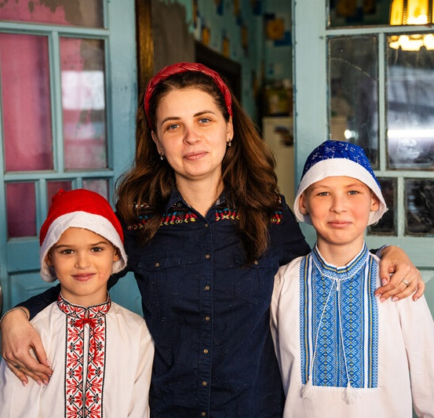
One of the first things Mary did after hearing the news that she would bear a son was to visit her cousin Elizabeth. Elizabeth would be able to empathise with a miraculous pregnancy.
The villagers who helped Maria and her young family also empathised with their situation. Maria said her neighbours have been amazing and have helped the family so much – during planting season, older community members joined with the family to help plant potatoes.
Lord, we thank you for friends and members of our community that demonstrate empathy towards us in our time of need. Amen.
Maria and her two sons
Notes:
Photo credit: Svitlana Dmytrenko

Slide 49
Monday
23 December
And her neighbours and relatives heard that the Lord had shown great mercy to her, and they rejoiced with her.
Luke 1:58
Rejoicing together
Sagesse is Bernadette’s daughter. We were introduced to Bernadette on 7 December.
Sagesse wants to be a doctor. At the moment, as well as going to school, she helps her mother to make and sell charcoal stoves, as well as helping to cultivate and sell the mushrooms that are part of the CAJED project in Goma, DRC.
Sagesse, 15, at home.
Notes:
Photo credit: Thom Flint, CAFOD

Slide 50
Sagesse said, ‘‘I would love to be a doctor, so that I am able to protect myself and also so that I am able to cater for my own needs.”
With the income Bernadette is able to earn, she can pay for Sagesse and her other daughter Adeline to go to school, including Sagesse. It’s impossible not to rejoice when we hear good news like this!
Lord, we rejoice with our brothers and sisters around the world when they experience joy. We praise you for all good things, especially the gift of education. Amen.
Sagesse with her classmate at school in the DRC, Goma. The Back to school World Gift can benefit many people within one family.
Notes:
Photo credit: Thom Flint, CAFOD

Slide 51
Tuesday
24 December
I have been with you wherever you went.
2 Samuel 7:9
Our global family
Over the last few weeks we have been introduced to many of our brothers and sisters around the world. They have shown such resilience, wisdom and compassion throughout very challenging situations.
We stand in solidarity with our global family by practically reaching out to all those experiencing poverty. We pray that our World Gifts will help transform many lives.
Daniel, Dodo, Maria and Steve, Raissa, Bernadette, Yuliia, Sally, Agnjetschka and Anna and Orest.
Notes:
Photo credits: Svitlana Dmytrenko, Thom Flint, CAFOD partners

Slide 52
We are are going to hear from Katy Katonda, our country representative in the Democratic Republic of Congo, who explains why she is grateful for the Back to school World Gift.
Lord, we thank you for each of our brothers and sisters around the world whom we have encountered through this Advent calendar. Bless them all this Christmas time. Amen.

Slide 53
Happy Christmas from everyone at CAFOD!
Thankyou for supporting World Gifts this Christmas time.

