Slide 1
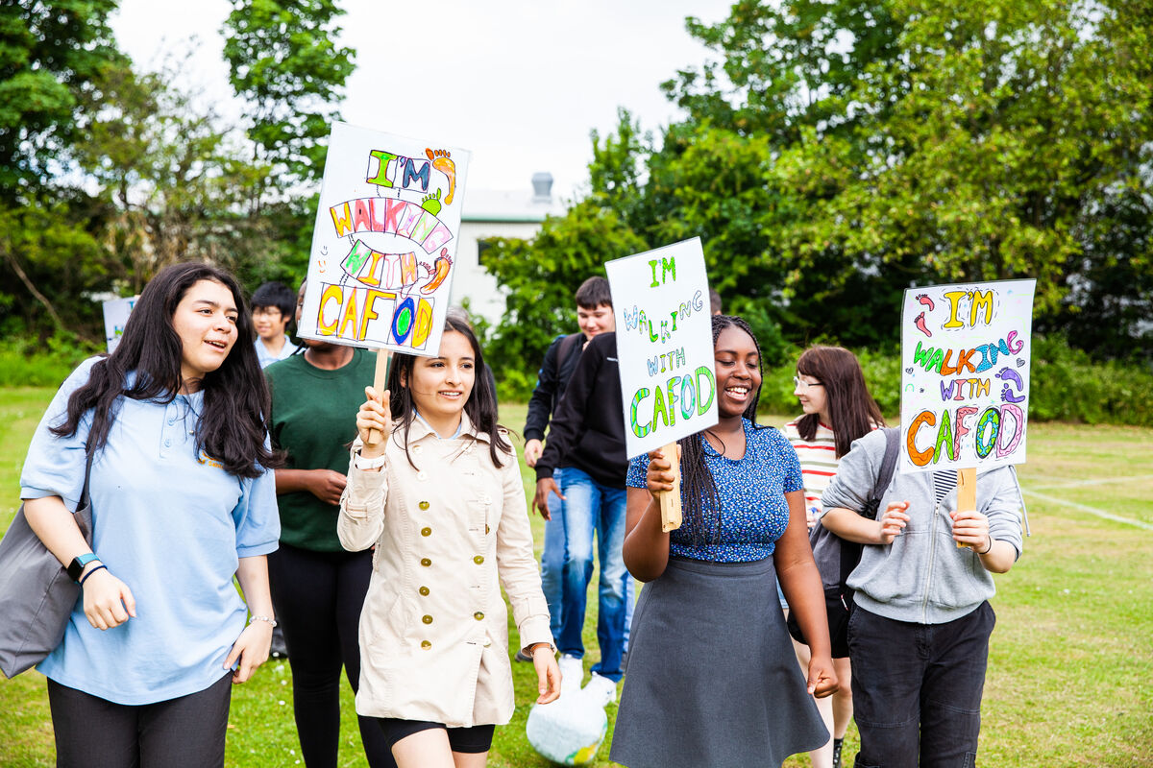
How can I share Jesus’ word through my actions this week?
We gather
Notes:
Children’s liturgy – the Most Holy Trinity (Year B)
Colour: white
Song suggestions: I will be with you (289, Celebration Hymnal for Everyone)

Slide 2
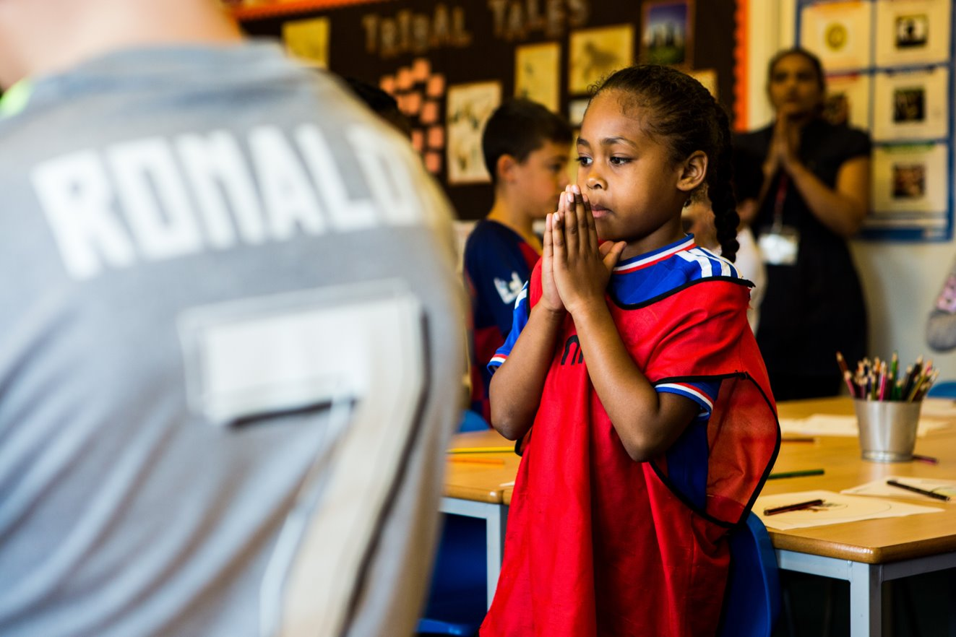
God of all, fill us with your Spirit of love and peace and help us to spread your word and to show our faith by how we treat each other. We ask this through Christ, your Son, who is with us always. Amen.
Notes:
Welcome: Today we hear how Jesus sent out his disciples to spread his word. And Jesus tells us that he will always be with us. Let’s think a bit more about this now.

Slide 3
Gospel: Matthew 28:16-20
The eleven disciples went to the hill in Galilee where Jesus had told them to go. When they saw him, they worshiped him, even though some of them doubted.
Jesus drew near and said to them, “I have been given all authority in heaven and on earth. Go, then, to all peoples everywhere and make them my disciples: baptise them in the name of the Father, the Son, and the Holy Spirit, and teach them to obey everything I have commanded you. And I will be with you always, to the end of the age.”
We listen

Slide 4
What do you remember from the Gospel reading?
Sometime after his death and resurrection Jesus appears to the disciples. He has a very special task for them. What does he ask them to do?
Jesus asks them to spread his word – to teach people to follow his commandments. Can you remember what these commandments are?
Jesus asks us to love God and to love our neighbour as ourselves. Can you think of a time when you have shown love for a neighbour? Tell me a bit about it.
Jesus’s words today weren’t just for his disciples – they were for all of us. St Francis of Assisi said, “Preach the gospel at all times, and when necessary use words.” What do you think this means?
We respond

Slide 5
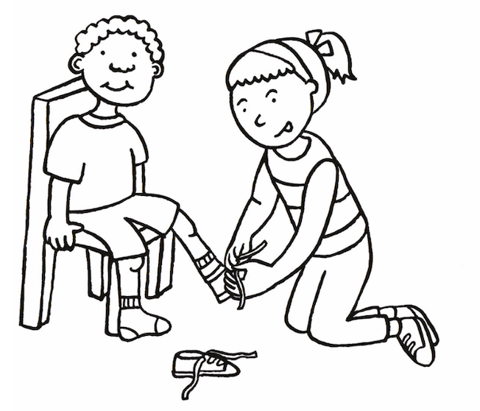
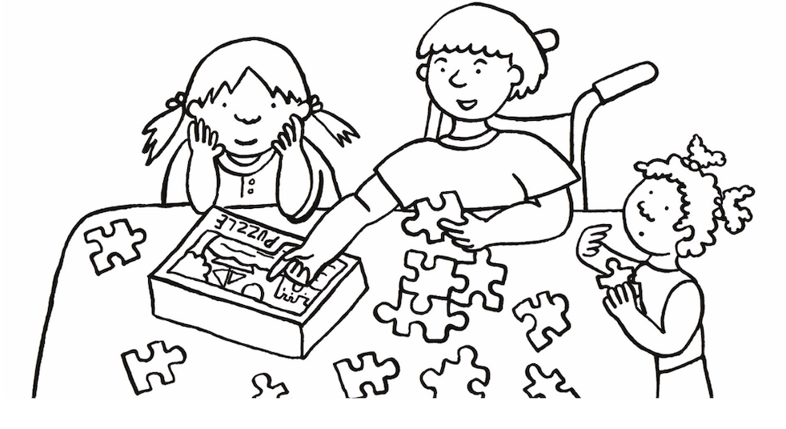
So what do you think is the best way of sharing Jesus’s word with other people is? Is it telling them about Jesus? Or might it be better to show people through our actions?
What do you think we might do? We could be kind and generous and share with others – the same way we would like them to treat us. We could try to make sure that the world is a fairer place for all people to live in.

Slide 6
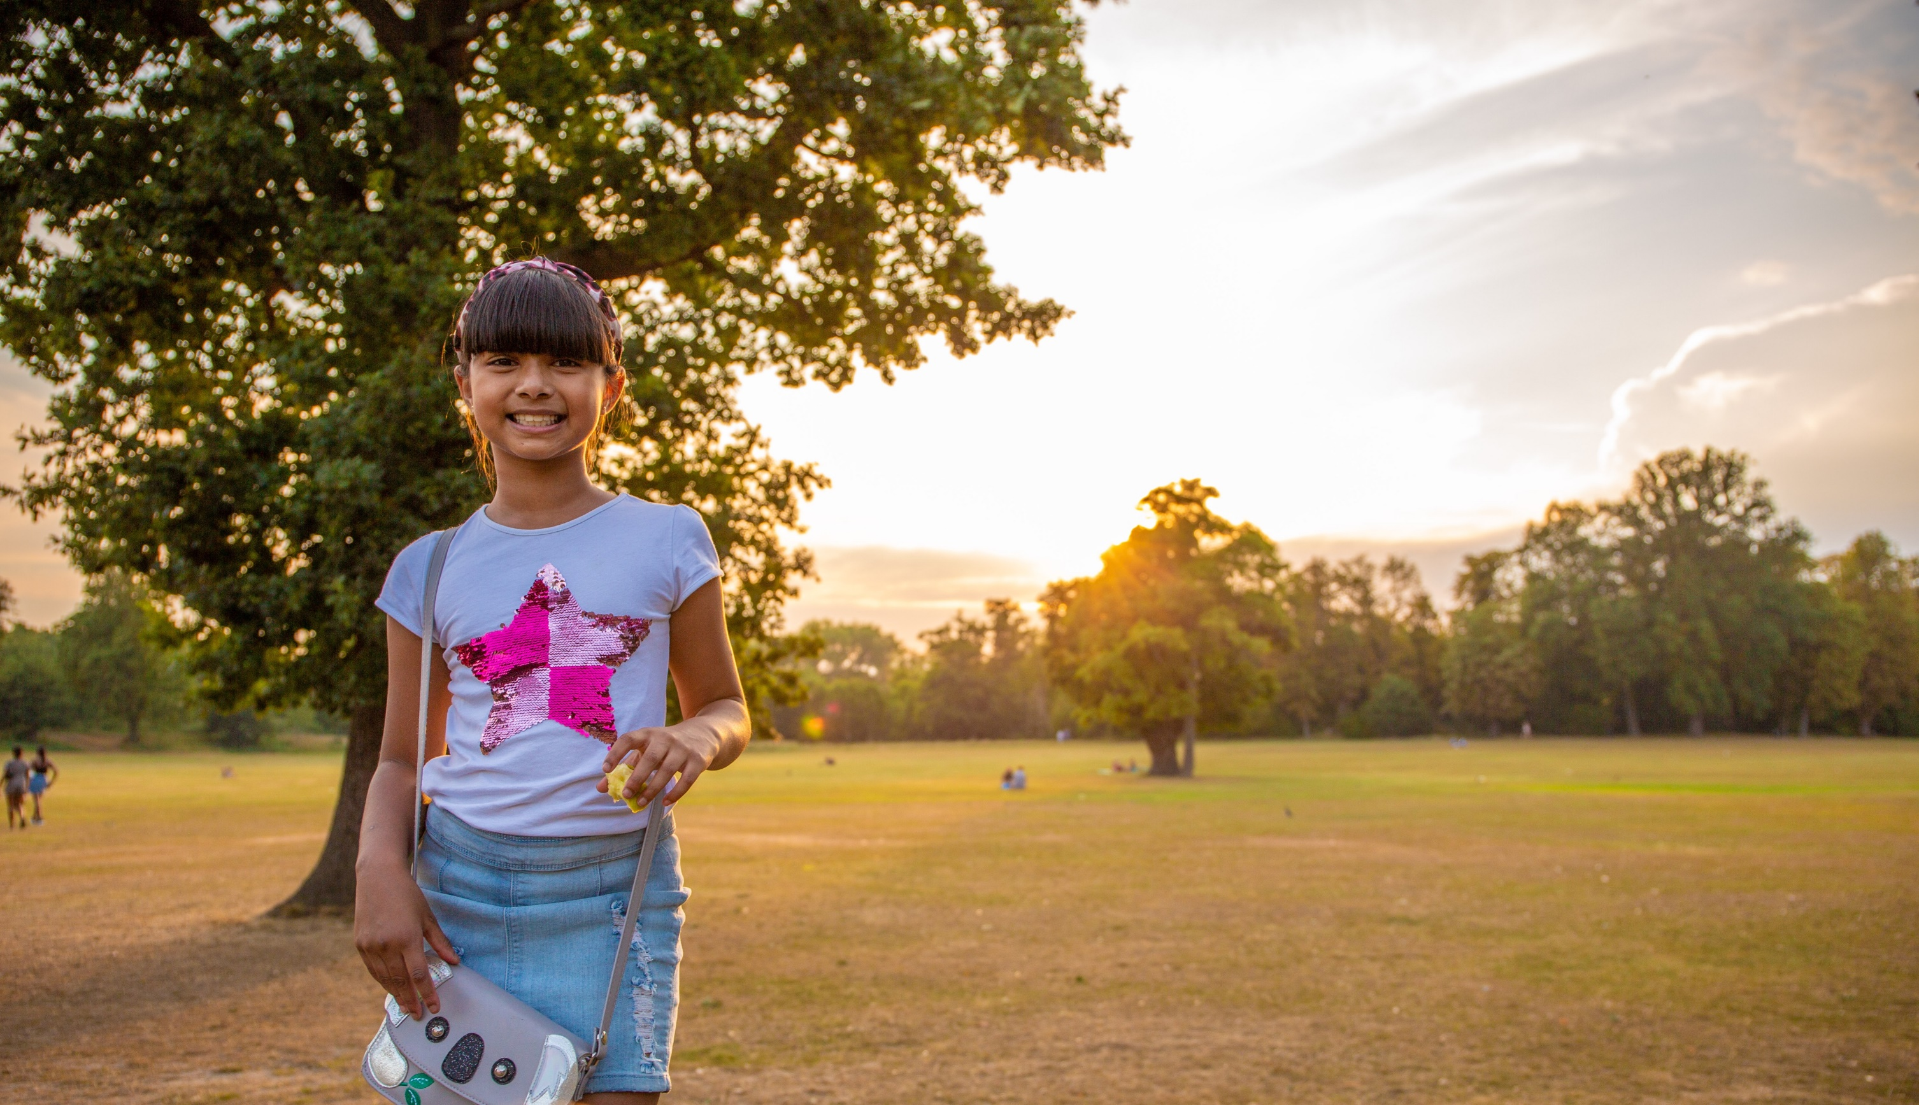
At the end of the reading, Jesus says, “I am with you always, yes to the end of time.”
How does it make you feel to know that Jesus is always with us? How do you know that
Jesus is still with us today?

Slide 7
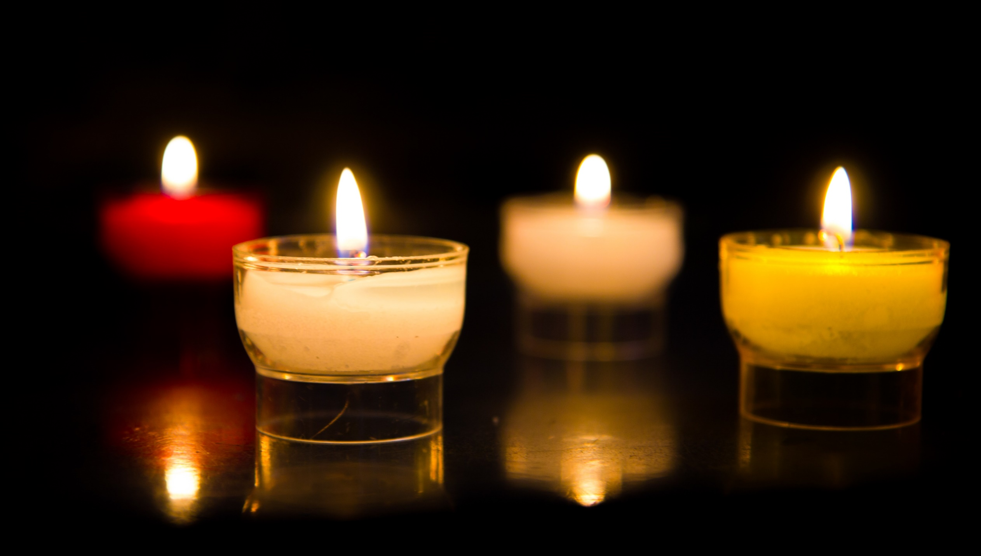
Let us pray…

Slide 8
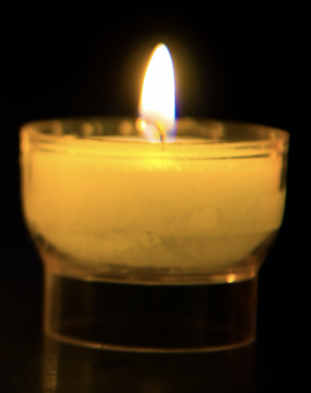
We pray for world leaders: that they may treat their people fairly and do all that they can to bring an end to poverty. Lord, in your mercy…
We pray for our neighbours, both local and around the world: that they may see by our actions that we care for and respect them, and that they too may reach out to their neighbours, in an unending circle of love. Lord, in your mercy…

Slide 9
We pray for our parish, family and friends: that we may be inspired to show our love for God and our neighbours throughout the world in all that we do. Lord, in your mercy…
Christ Jesus, you are always with us. May we show love for our neighbour, treating all people as we would wish to be treated. And through what we do, may others see that we believe in you. Amen.

Slide 10
Glory be to the Father, and to the Son, and to the Holy Spirit, as it was in the beginning is now and ever shall be.
Amen

Slide 11
What will you do this week to share Jesus’ word with others through your actions?
Send

Slide 12
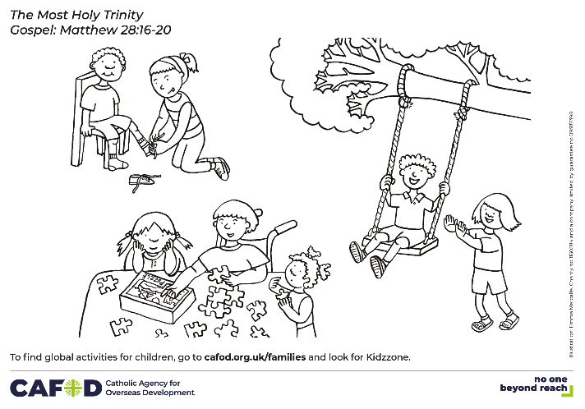
Activity suggestions
Invite the children to colour in the accompanying illustration and on the back to draw how they will spread Jesus’s message in their actions this coming week.
Invite the children to go home and tell their family all that they have heard and thought about today and to do all that they can in the coming week to show their faith in Jesus through their actions.
​
Learn more about how we can care for our global family. Why not think about setting up a CAFOD club at your school? https://cafod.org.uk/Education/For-teachers/CAFOD-clubs ​

Slide 13
Notes:
Illustration: Emma Metcalfe

