Slide 1
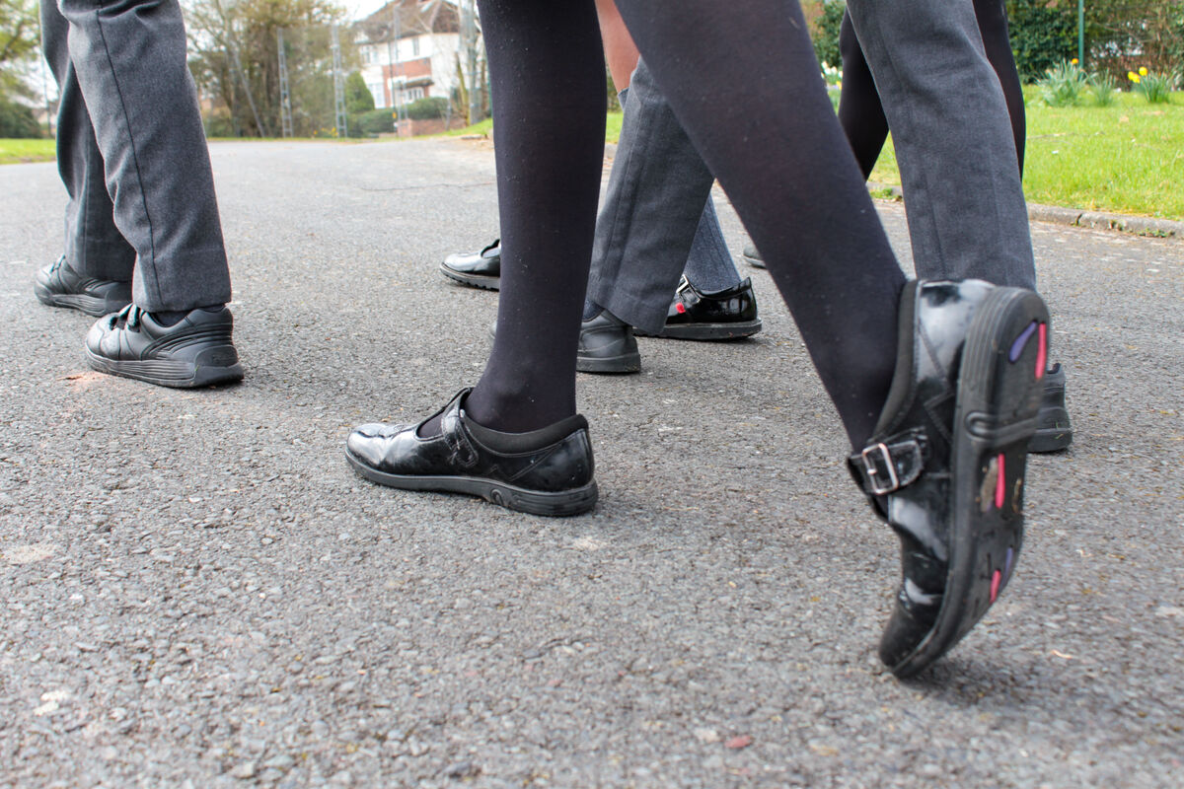
How will you go out and follow Jesus, sharing his good news with others?
Gather
Notes:
Children’s liturgy: Fourteenth Sunday in Ordinary Time (Year C)
Preparation of the worship space
Colour: green
Props: coloured pens and pencils, name badges, paper cups and plates. ‘Welcome mats’ made out of paper or card
Song suggestions
Follow me, follow me (863, Laudate)
Welcome
Today we hear how Jesus calls 72 people to follow him and how he prepares them for the journey. Let’s find out what happens.
St Francis Xavier's pupils on a walk
Photo credit: Vicky Ahmed

Slide 2
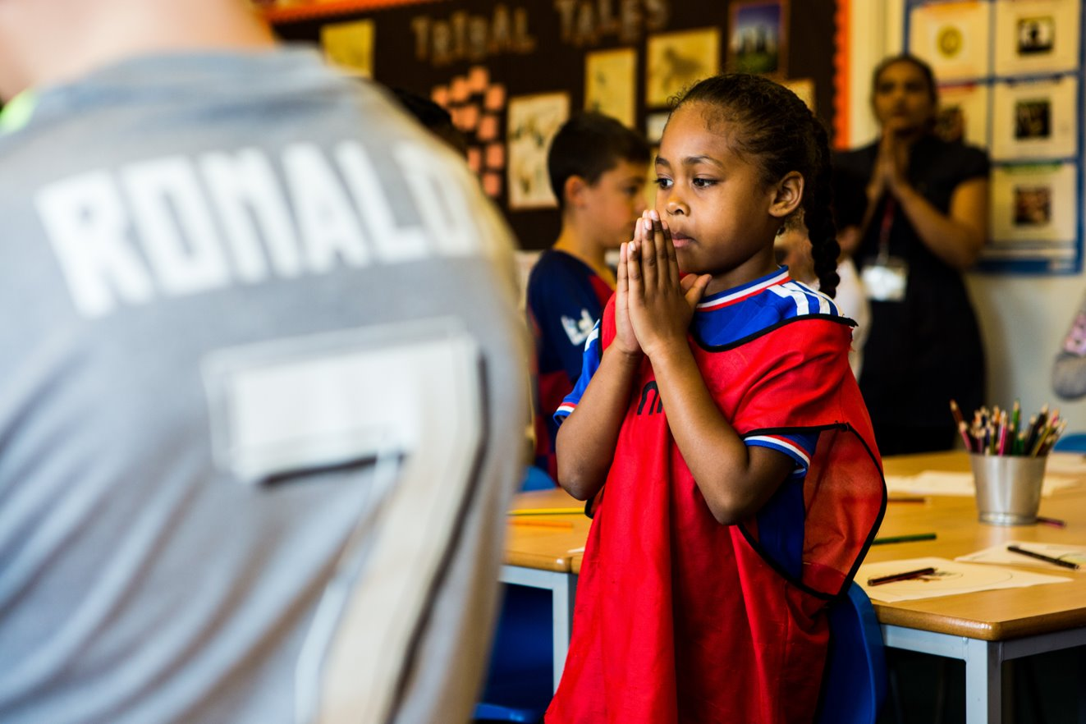
Welcoming God,
You call us to you with open arms and yet so often we find it difficult to answer you. Help us to hear you more clearly and to follow you always. Amen.
Notes:
Children at Our Lady Queen of Heaven Primary School
Photo credit: Thom Flint

Slide 3
Gospel: Luke 10: 1-12, 17-20
After this the Lord chose another 72 men and sent them out two by two, to go ahead of him to every town and place where he himself was about to go.
He said to them, “There is a large harvest, but few workers to gather it in. Pray to the owner of the harvest that he will send out workers to gather in his harvest. Go! I am sending you like lambs among wolves. Don’t take a purse or a beggar’s bag or shoes; don’t stop to greet anyone on the road.
"Whenever you go into a house, first say, ‘Peace be with this house.’ If a peace-loving person lives there, let your greeting of peace remain on him; if not, take back your greeting of peace. Stay in that same house, eating and drinking whatever they offer you, for workers should be given their pay. Don’t move round from one house to another.
Word

Slide 4
"Whenever you go into a town and are made welcome, eat what is set before you, heal the sick in that town, and say to the people there, ‘The Kingdom of God has come near you.’ But whenever you go into a town and are not welcomed, go out in the streets and say, ‘Even the dust from your town that sticks to our feet we wipe off against you. But remember that the Kingdom of God has come near you!’ I assure you that on Judgment Day God will show more mercy to Sodom than to that town!”
The 72 men came back with great joy. “Lord,” they said, “even the demons obeyed us when we gave them a command in your name!”
Jesus answered them, “I saw Satan fall like lightning from heaven. Listen! I have given you authority, so that you can walk on snakes and scorpions and overcome all the power of the Enemy, and nothing will hurt you. But don’t be glad because the evil spirits obey you; rather be glad because your names are written in heaven.”
Word

Slide 5
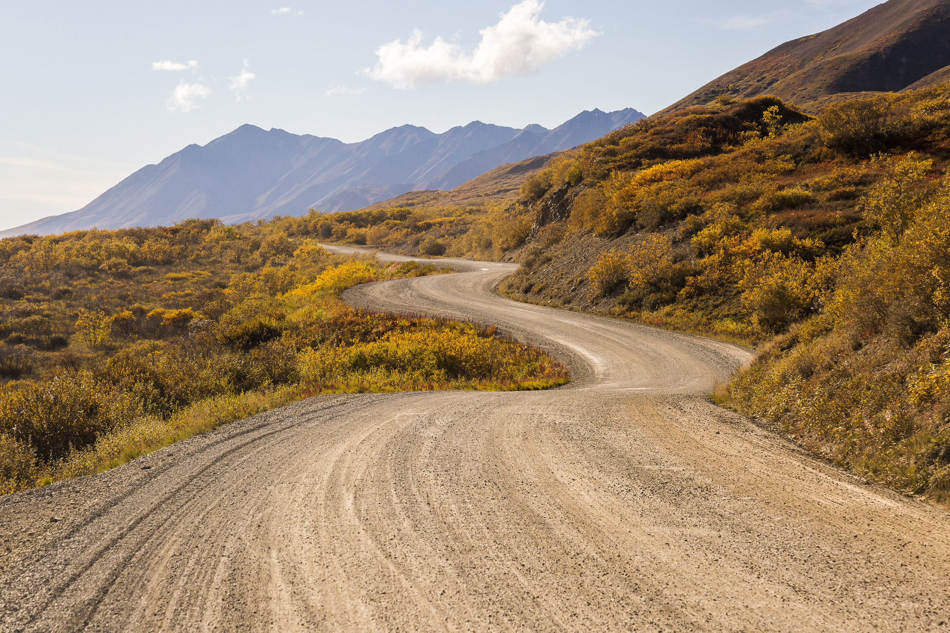
What do you remember from the Gospel reading?
A group of 72 people are sent out on a mission by Jesus to towns and villages all over the place. They are sent on ahead to prepare the way for Jesus and his disciples.
Jesus tells these people that there is much work to do, but not enough people to do it. “There is a large harvest, but few workers to gather it in.” He is asking for their help.
Jesus tells them to travel light without a purse, bag or sandals and not to greet anyone they meet on the road as they are in a hurry. There is no time to waste.
Respond
Notes:
Winding road
Photo credit: Stock image

Slide 6
Imagine you are one of those people – how do you feel about this mission?
How do you think the 72 people felt when they heard Jesus’ words and warnings?
The 72 followers are told that they might not be welcome in every town. Not everyone will want to hear their message. Why do you think this might be?
Notes:
Through the fence
Photo credit: Martin Olsen on Unsplash

Slide 7
Making a change can be hard. People often like to stick with what they know.
The disciples are asking people they visit to change their lives and to follow Jesus now. But the people might be too busy to listen, or just not ready to change their ways.
They might be more concerned about having the latest things, getting more money, rather than listening to Jesus’ message.
Notes:
Listen more
Photo credit: Brett Jordan on Unsplash

Slide 8
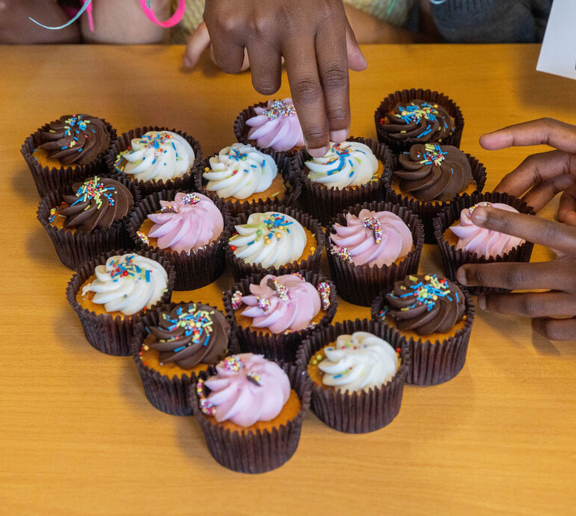
The 72 people hoped they would be welcomed, but Jesus warned them it might not always be that way. Do you always welcome others?
Or can you sometimes be like those who turned the 72 away?
Think about how you welcome visitors at home and school. Do you offer them a drink or something nice to eat?
Do you give them a special chair to sit in? What do you do?
Notes:
Cakes at St Chads primary school
Photo credit: Joe Newman

Slide 9
Some people around the world are forced to leave their homes because of fighting, floods or because there is no food or work where they live.
They travel to other countries in search of a safe home and a better life.
Is it easy to be welcoming to people who come to our country in search of a safe home? What could we do to be welcoming to them?
Notes:
Lending a hand
Photo credit: Remi Walle on Unsplash

Slide 10
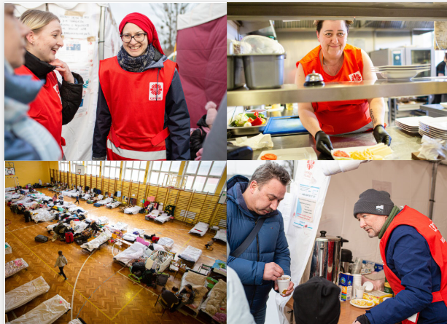
People fleeing their homes because of war or disaster may feel scared, hungry, exhausted and confused.
With CAFOD's help, the charity Caritas provides a welcome, food, clothing and comfort for refugees in times of trouble.
Notes:
Caritas Poland volunteers helping refugees from Ukraine in Poland
Photo credit: Caritas Poland

Slide 11
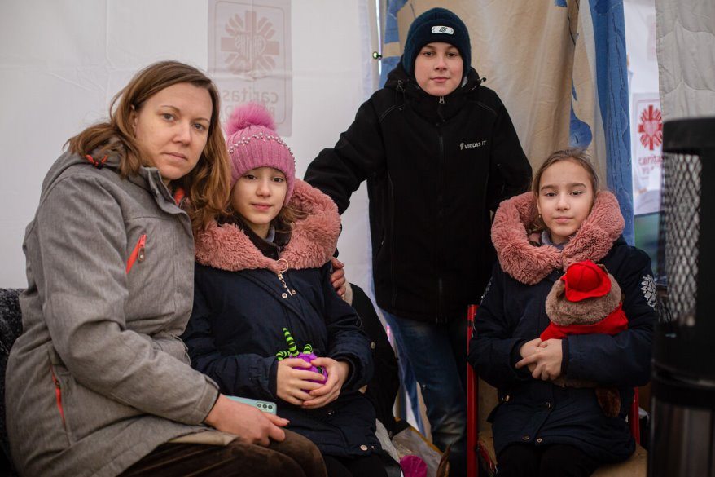
Maria and her three children are refugees from the war
in Ukraine.
"When I heard bombs going off and helicopters flying over our house, I didn't want to believe it, " Maria says.
When fighting started, they fled to Poland on a very crowded train and a bus. The journey took 30 hours.
Notes:
Maria and her family from Ukraine in Poland
Photo credit: Caritas Poland

Slide 12
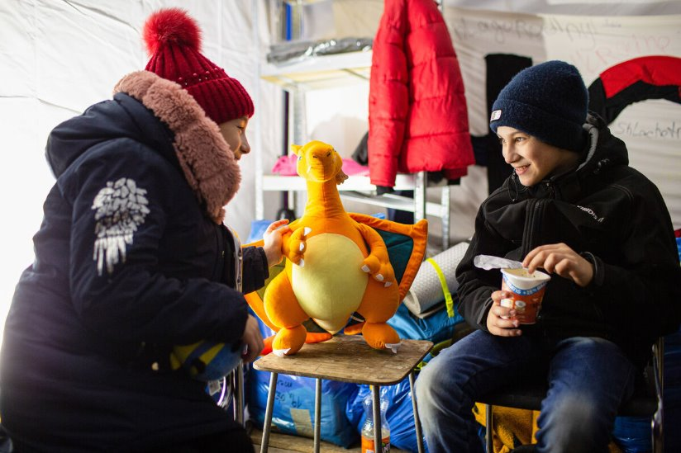
A Polish Caritas worker took Maria's family to a tent where refugees get a hot meal, warm clothing, soap – and even a cuddly toy.
These are called "tents of hope" by Caritas staff.
"I'm hopeful the war ends and we'll go back home," says Maria.
Notes:
Maria's children
Photo credit: Caritas Poland

Slide 13
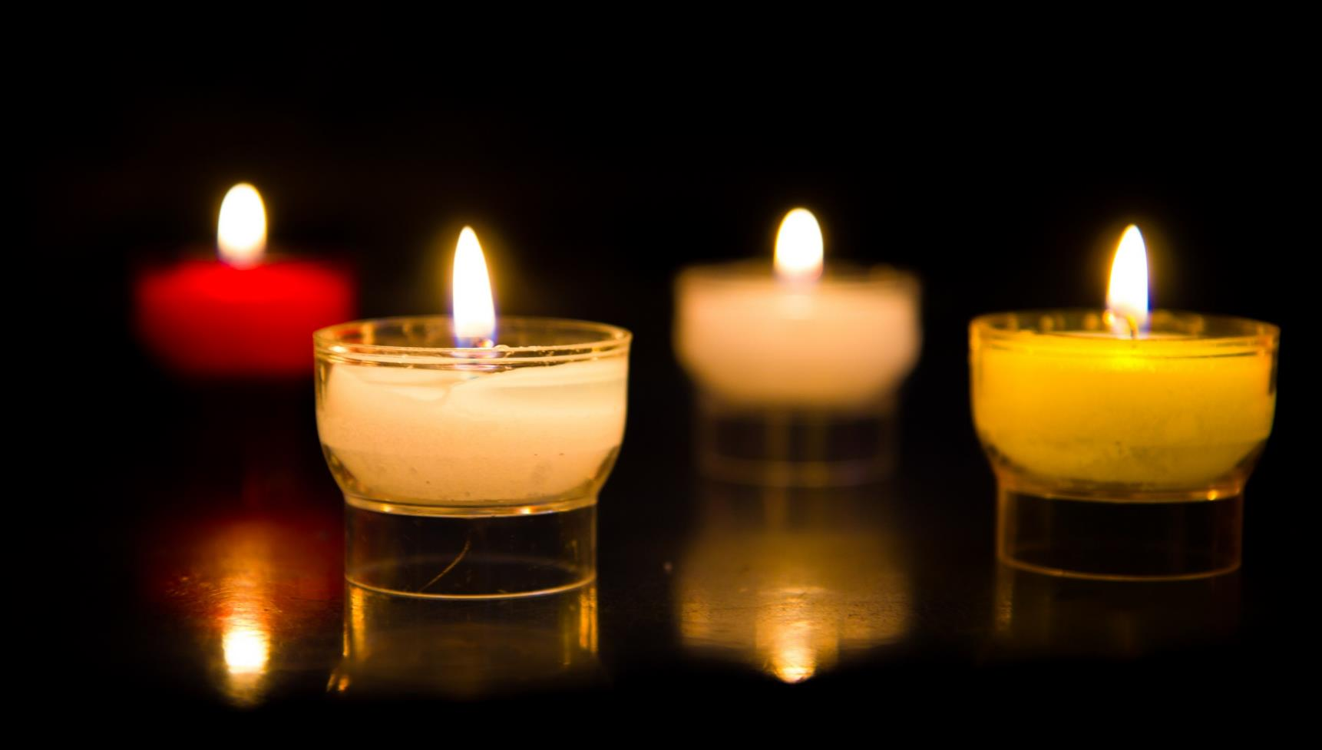
Let us pray…

Slide 14
We pray for the Church: that it may follow Jesus’ example and share his good news while welcoming all people. Lord in your mercy…
We pray for world leaders: that they may work more closely together to meet the needs of all their people. Lord in your mercy…
We pray for our parish, family and friends: that we may look for God in all people that we meet and treat them as we would wish to be treated. Lord in your mercy…

Slide 15
In this Jubilee Year, we pray that we may be signs of hope in our world through all that we do and how we treat one another.
Lord, in your mercy…
Christ our Messiah,
You call us to follow you. Help us to be welcoming to others and to spend time listening to and following your word. Amen.

Slide 16
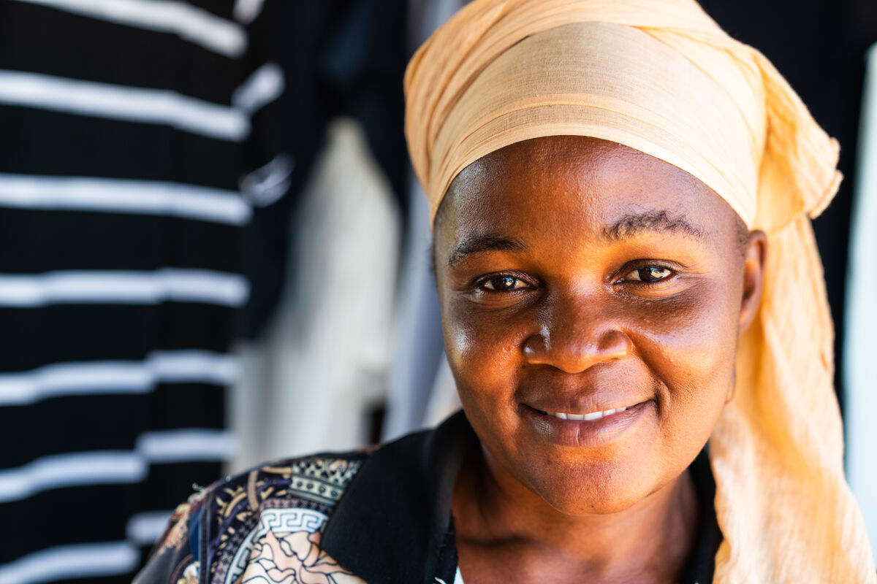
What will you do to be welcoming to others this week? How will you go out and follow Jesus, sharing his good news with others?
Send
Notes:
Ramatulai Musa, Sierra Leone
Photo credit: Michael Duff

Slide 17
Activity suggestions
Invite the children to colour in the illustration of the gospel story and write or draw on the back how they will welcome others in the coming week.
Encourage the children into groups of three/four and give them all name badges. Write either ‘disciple’ on the badge if they are in a pair to travel about, or their first name if they are the homeowner(s). Enact the scene of two people knocking on a door, being greeted happily by the homeowner(s) and invited in. Use the ‘welcome mat’ to walk on as they enter the house, the plates and cups for pretending they are given something to eat and drink.
Invite the children to write a prayer of welcome for people of different countries which can be said out loud or used later in the week at home.
Encourage the children to think about how they can follow Jesus more closely and the things that stop them from spending time with him and listening to his word. Can they spend a bit less time doing something this week e.g. watching TV and a bit more time with God in prayer or in helping someone else?
Remind the children to tell the people they live with all that they have heard and thought about in the liturgy today. Encourage them to try to follow Jesus closely in the coming week and to be welcoming to others in all that they do.
Notes:
Illustration: Jane Smith

Slide 18
Notes:
Illustration: Jane Smith

Slide 19
Have you made your Jubilee Pledge?
There's still time to make your Jubilee Pledge!
In June or July, all Catholic schools are invited to make a Jubilee Pledge to live out Catholic Social Teaching.
A better world needs all of us, and the Pledge will be a whole school, long-term commitment to building a fairer world.
Watch our films and download our resources to help you write your Pledge and plan your Pledge Day:
Jubilee pledge for schools
The Jubilee Year is a landmark moment in the life of the global church. School communities are invited to join together as pilgrims of hope, pledging to work together for God’s kingdom of justice, peace and love. Find resources at:
Jubilee for schools 2025 – Pilgrims of Hope

