Slide 1
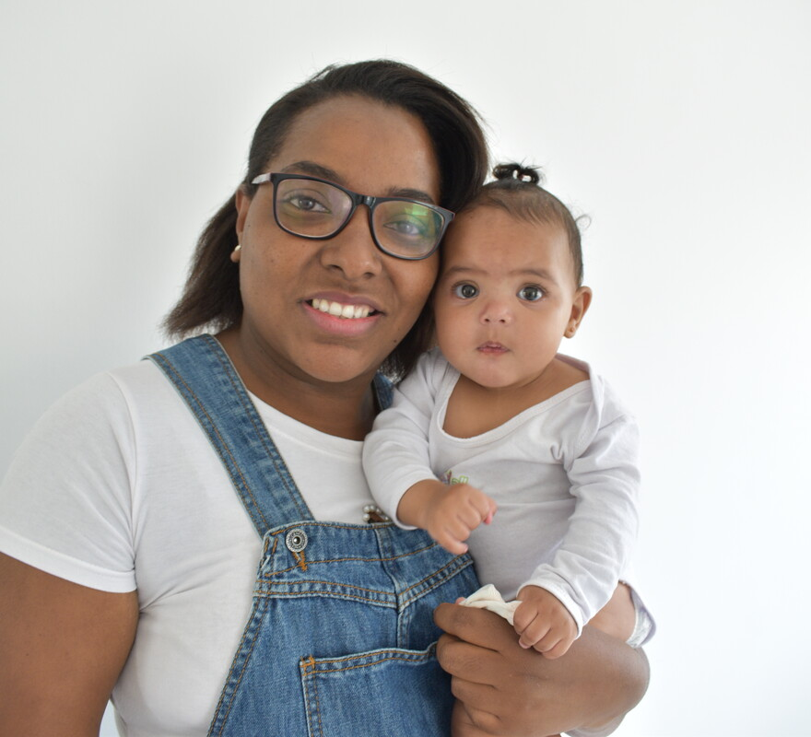
How can we be more loving, more forgiving and more generous to others?
Gospel Celebration of the Word
Notes:
Children’s liturgy: Saint Peter and Saint Paul (Year A)
Preparation of the worship space
Colour: red
Props: key shapes cut out of card
Song suggestions
City of God (824, Laudate) Seek ye first the Kingdom of God (820, Laudate)
Welcome
Today we hear how Jesus gave Peter the keys to the kingdom of heaven. Let’s find out why and what it means for us...
Monica and her baby, São Paulo, Brazil
Photo credit: Kezia Lavan

Slide 2
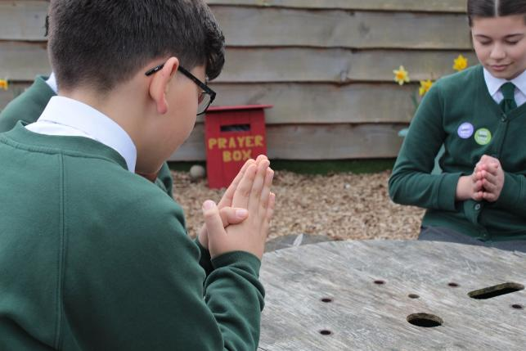
Christ Jesus,
Help us to be faithful to you, like Saint Peter and Saint Paul. Inspire us to show our faith in everything we do.
Amen.
  Gather
Notes:
St Francis Xavier's RC Primary School, Herefordshire
Photo credit: Vicky Ahmed

Slide 3
Gospel: Matthew 16:13-19
Jesus went to the territory near the town of Caesarea Philippi, where he asked his disciples, “Who do people say the Son of Man is?”
“Some say John the Baptist,” they answered. “Others say Elijah, while others say Jeremiah or some other prophet.”
“What about you?” he asked them. “Who do you say I am?” Simon Peter answered, “You are the Messiah, the Son of the living God.”
“Good for you, Simon son of John!” answered Jesus. “For this truth did not come to you from any human being, but given to you directly by my Father in heaven.
"I tell you, Peter; you are a rock, and on this rock foundation I will build my church, and not even death will be able to overcome it. I will give you the keys of the Kingdom of heaven; what you prohibit on earth will be prohibited in heaven, and what you permit on earth will be permitted in heaven.”
Word

Slide 4
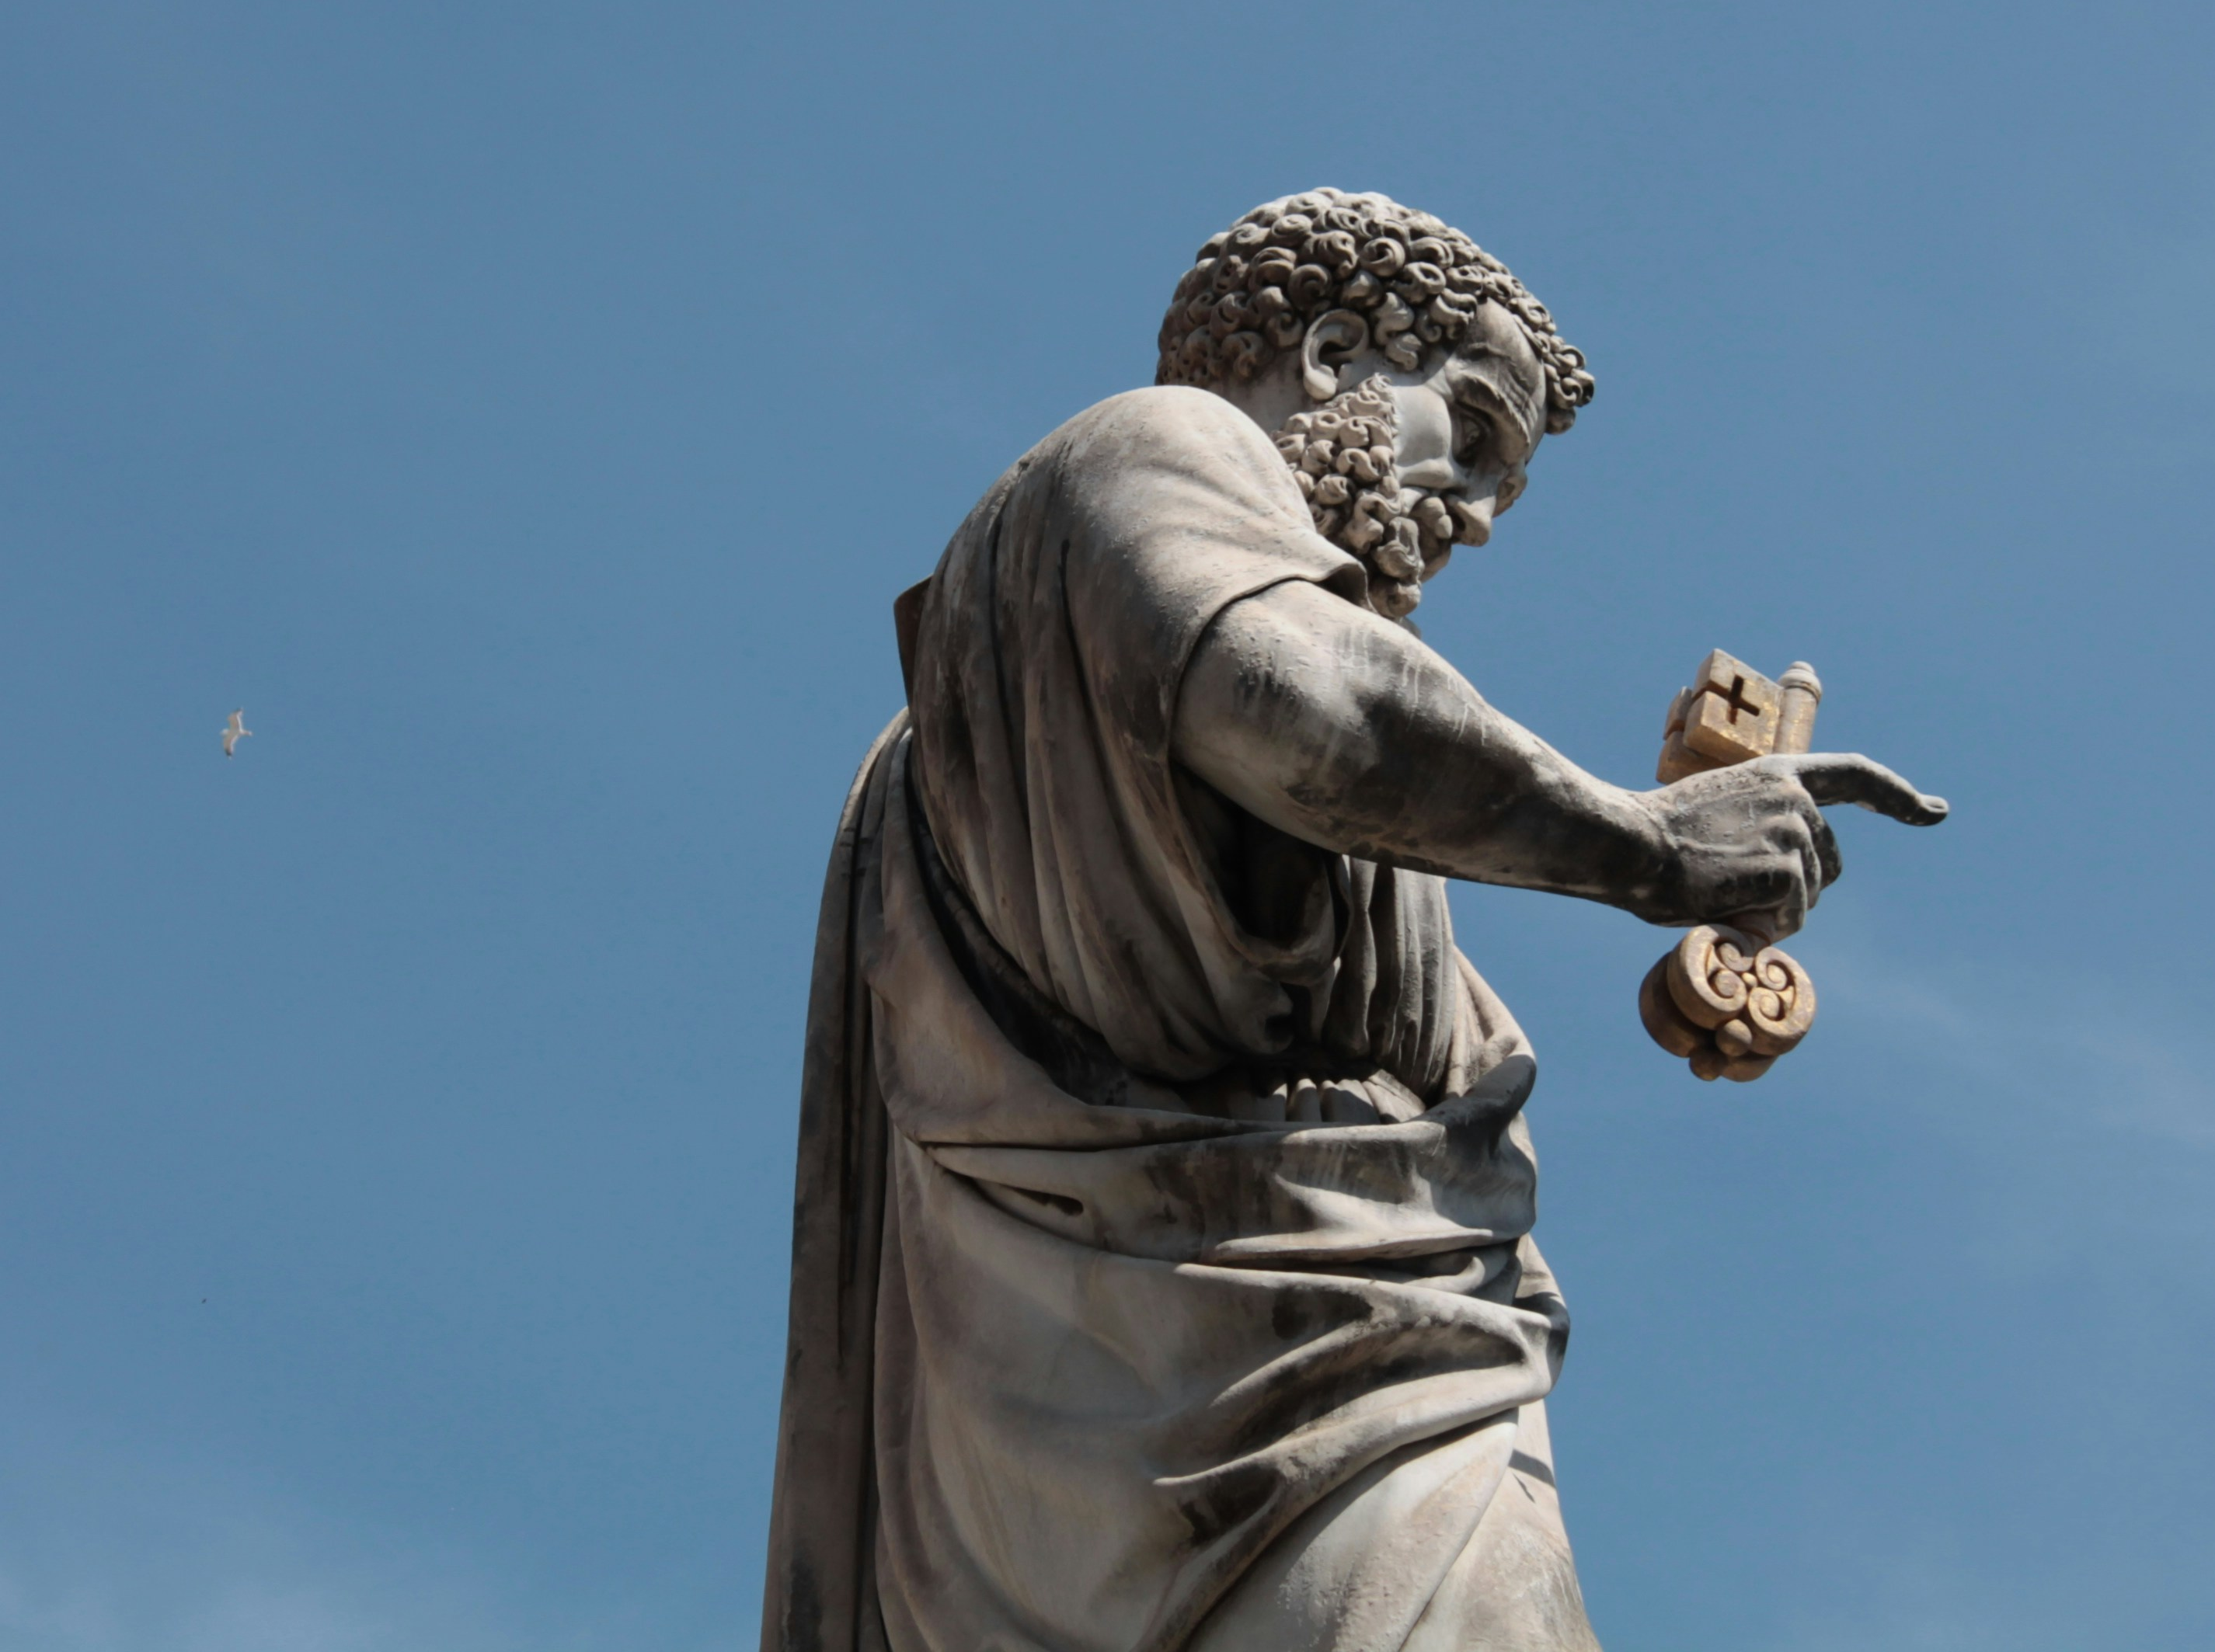
What do you remember from the Gospel reading?
Today we hear how Jesus was so impressed with Simon, that he gave him a new name.
Can you remember what that new name was?
Jesus said that he would build his church upon Simon Peter. Jesus also gave him the keys to the kingdom of heaven.
Why did Jesus give Simon Peter a new name and the keys to the kingdom?
Respond
Notes:
Photo credit: Nicolas Sorrenti on Unsplash

Slide 5
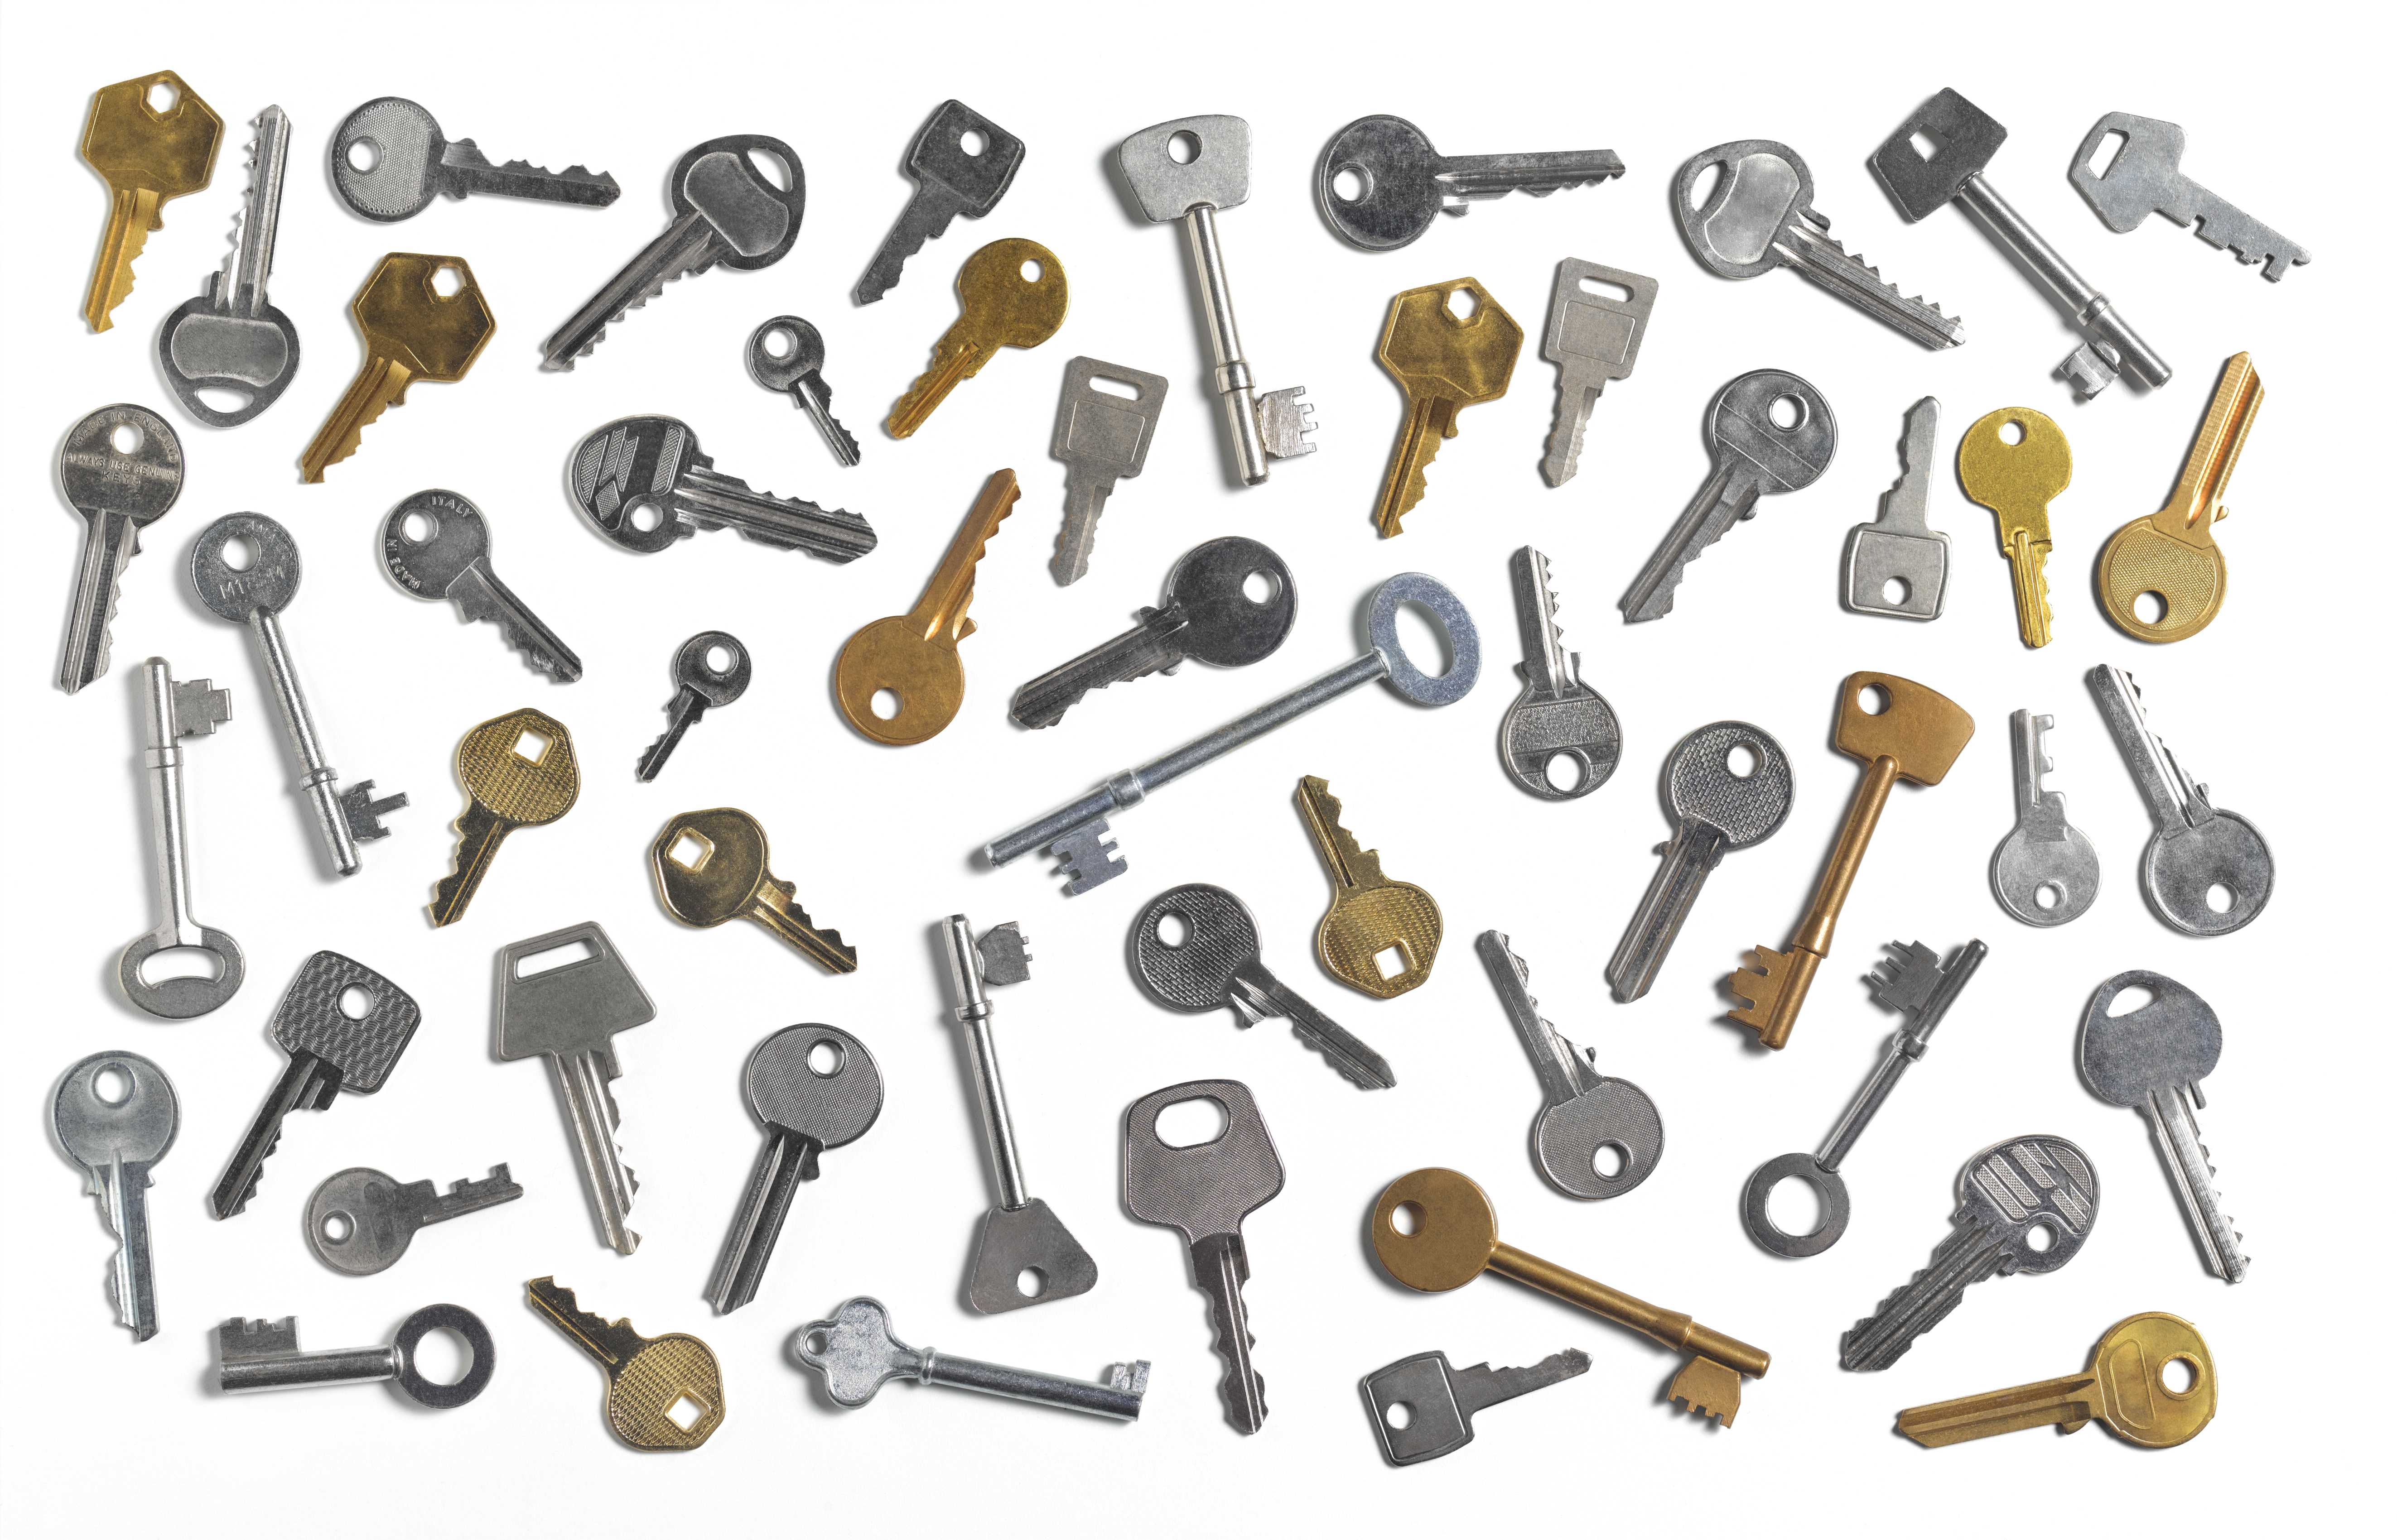
Simon Peter recognised and believed that Jesus was the Son of God.
He had great faith and was willing to put that faith into words but also into actions.
Because of Peter’s great faith, Jesus gave him the keys to the kingdom of heaven.
What are keys usually used for?
Notes:
Keys
Photo credit: Stock image

Slide 6
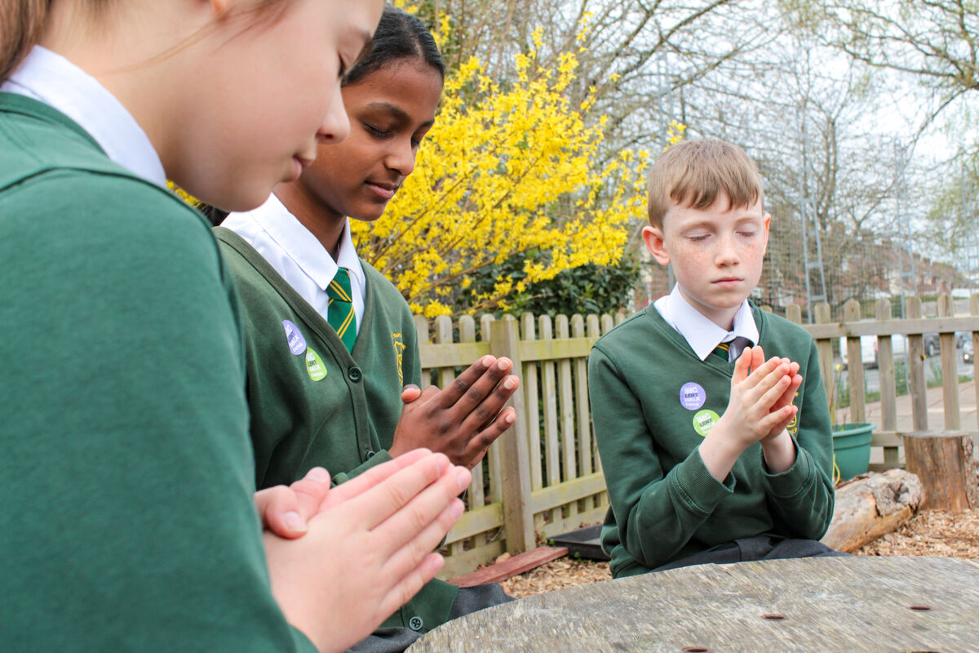
Keys lock doors, but they also open them.
As a disciple, Peter spent his time sharing Jesus’ message with other people. He opened their hearts to God’s love, just like a key opens a door.
We can open our hearts by taking some time to stop and listen, to pray and to try to hear what Jesus is asking us to do.
Notes:
St Francis Xavier's RC Primary School, Herefordshire
Photo credit: Vicky Ahmed

Slide 7
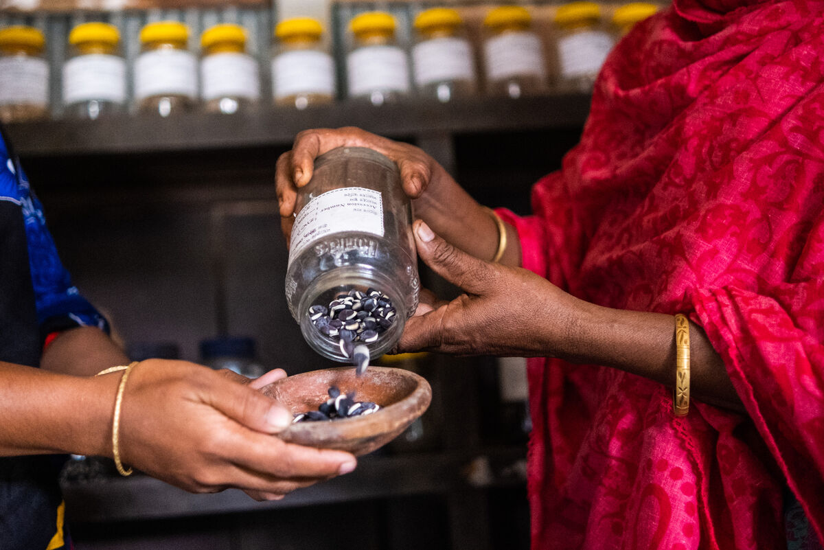
We can show our faith in our prayers and in our actions.
We can try to follow Jesus’ commandments to love God and to love our neighbour.
We can be kind and generous to others and we can try to make the world a fairer place where all people get what they need.
Anowera Begum sharing seeds with her neighbour Sharmin Akthem, Bangladesh
Notes:
Sharmin Akthem and Anowera Begum, Bangladesh
Photo credit: Amit Rudro

Slide 8
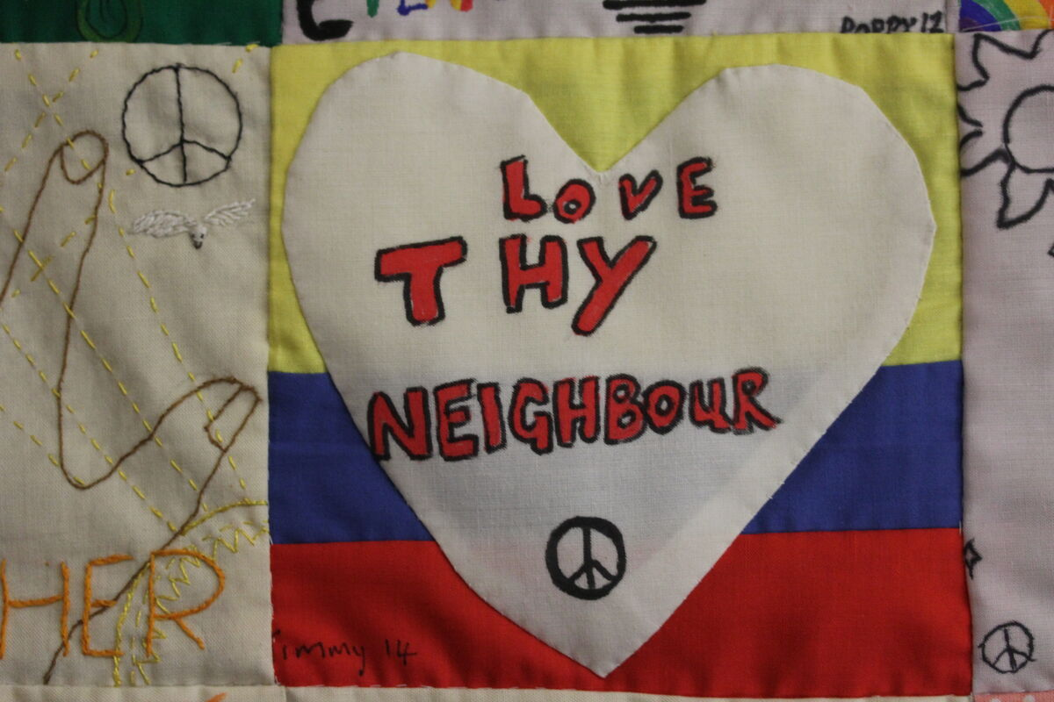
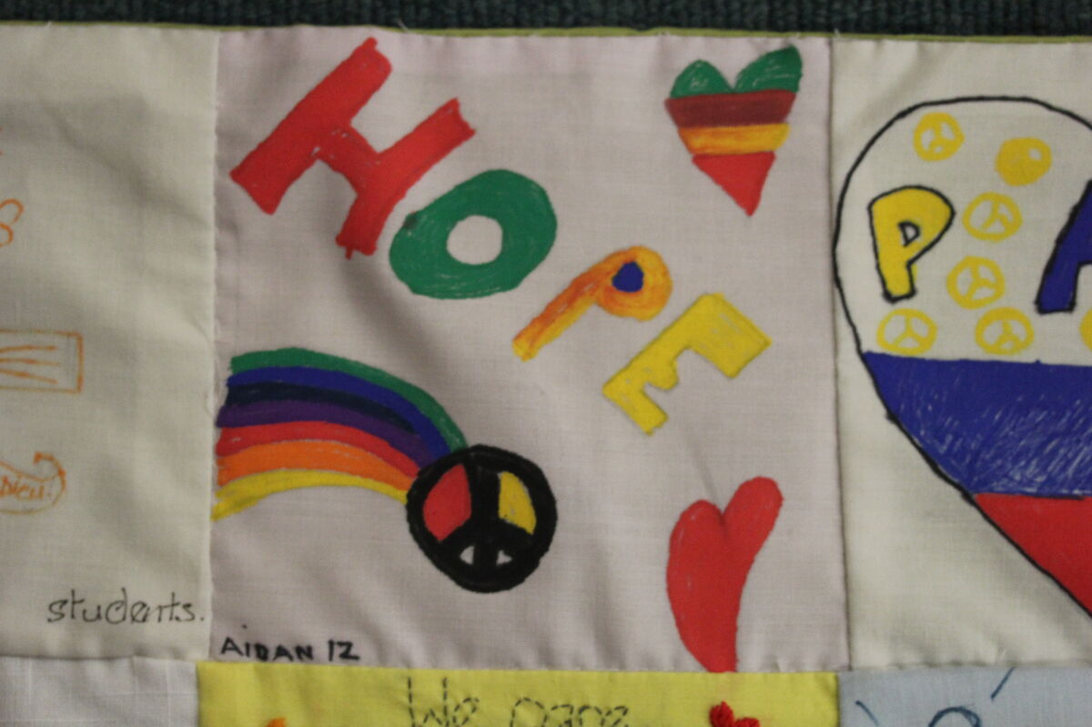
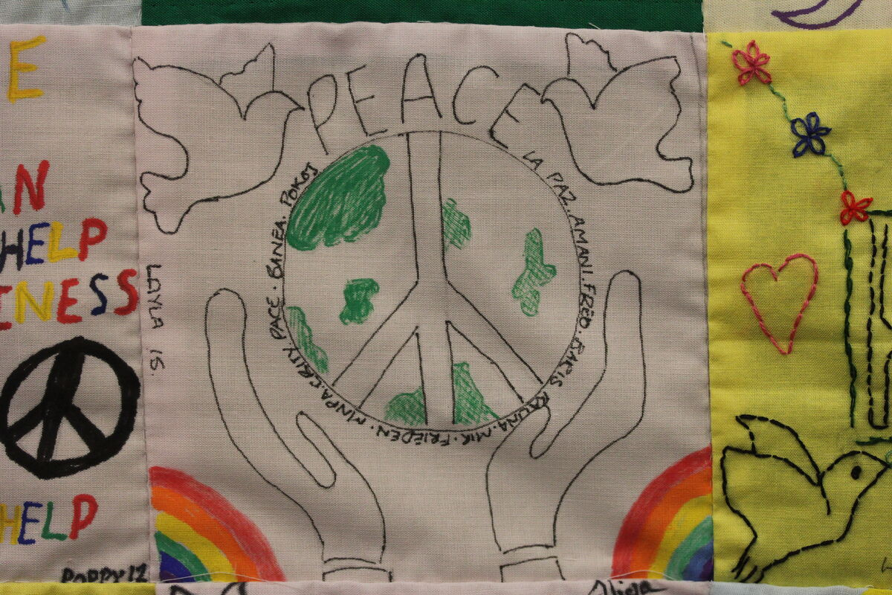
Can you think of some key words that show us what Jesus asks us to do?
These are just like the keys to God’s kingdom – opening us up to God’s love.
This week let’s try to be more loving, more forgiving and more generous to others. Let us try to share hope with others.
And let’s try to open our hearts to welcome Jesus in.
Notes:
Can you think of some key words that show us what Jesus asks us to do? (e.g. love, believe, forgive, give, share, hope, etc.)
Hands On Magdalena Medio Norwich wall hanging, UK
Photo credit: Joe Savage

Slide 9
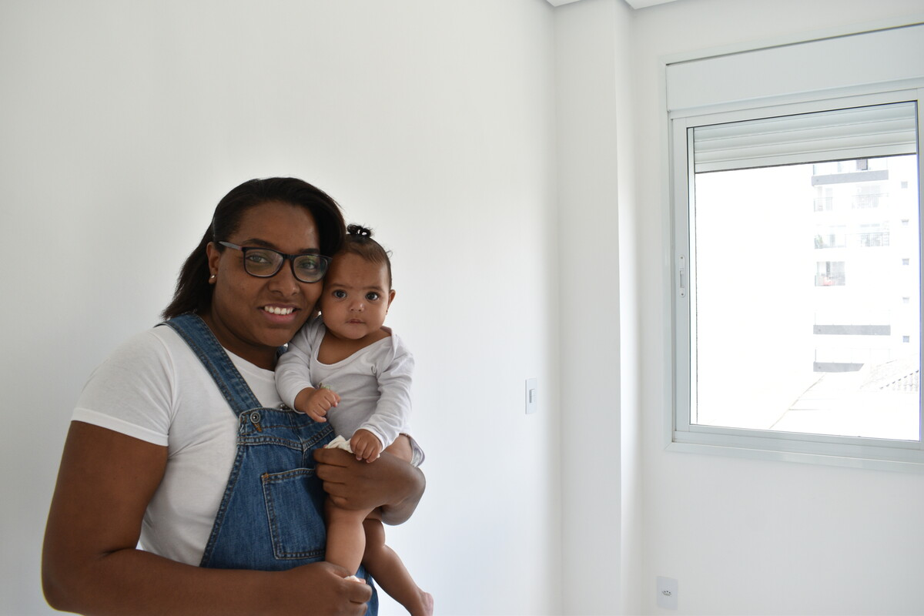
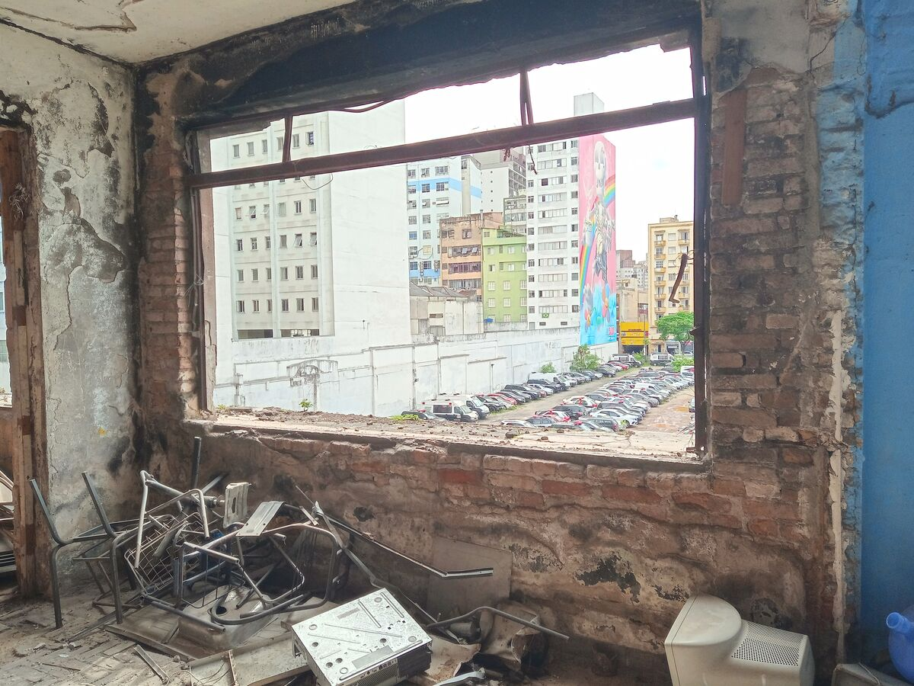
This is Monica and her daughter who received a very special key.
Monica grew up in slums called favelas near to São Paulo in Brazil. She moved to the city to find a job and somewhere to live.
Monica moved into an abandoned hotel because the family couldn't find anywhere else. But the government tried to force them out.
Notes:
Monica and her baby in their new home, São Paulo, Brazil
Abandoned building, São Paulo, Brazil
Photo credit: Kezia Lavan

Slide 10
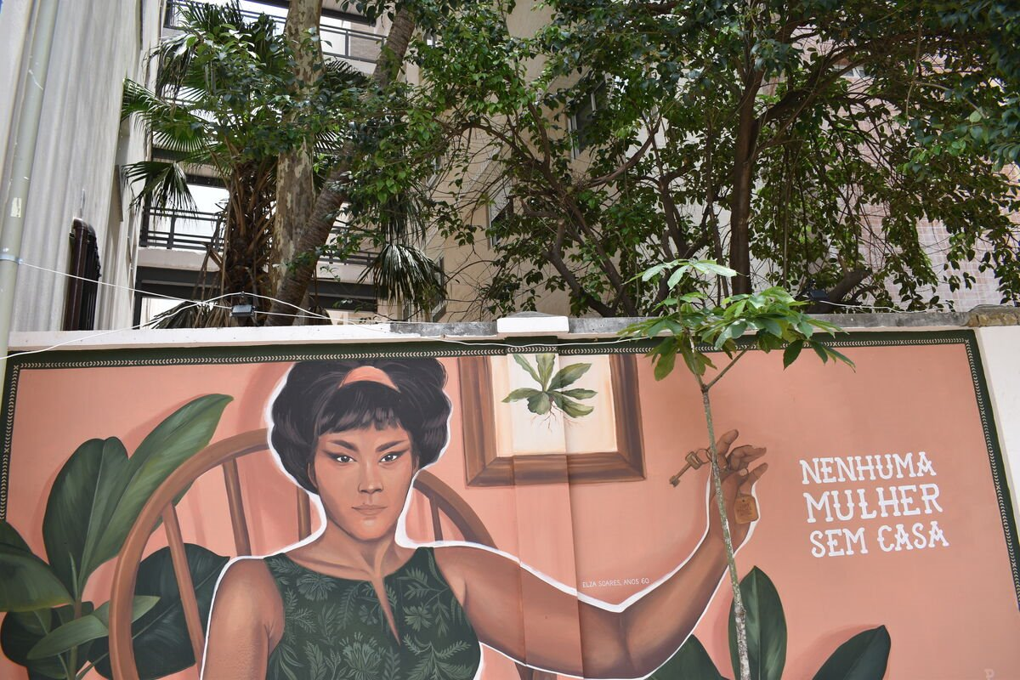
With CAFOD' s help, Monica learned about her rights to a safe home and how to speak out against injustice.
It was a challenge, but Monica and CAFOD's partners eventually got the money to convert the hotel into a place where 176 families can live!
Artwork by Elza Soares – The words mean 'No woman should be without a home.'
Notes:
Artwork by Elza Soares - 'No woman should be without a home.' São Paulo, Brazil

Slide 11
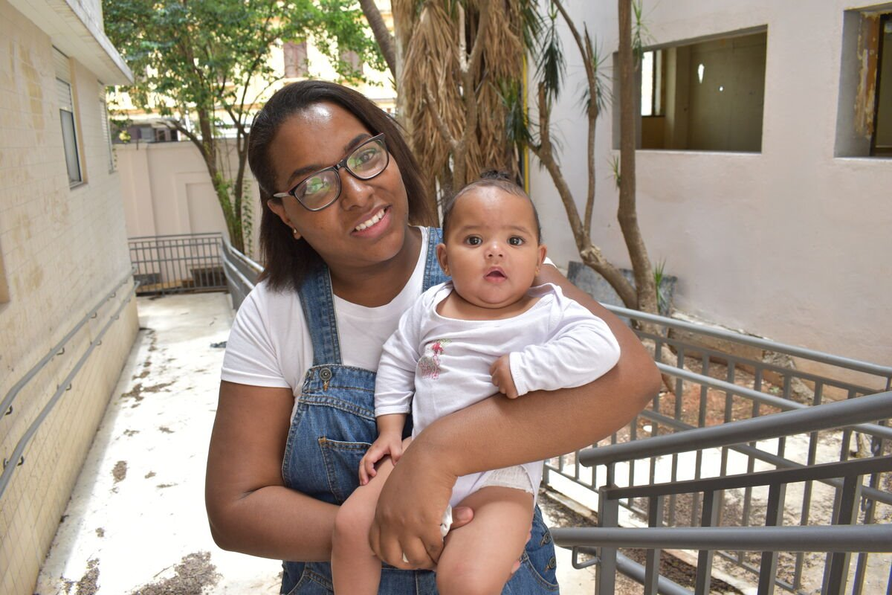
It includes green spaces and it's now an environmentally friendly place to call home, where families feel safe.
"When I got the key to the apartment, I wanted to shout in the street!" explains Monica. "I was overjoyed!"
Notes:
Monica and her baby in their new home, São Paulo, Brazil
Photo credit: Kezia Lavan

Slide 12
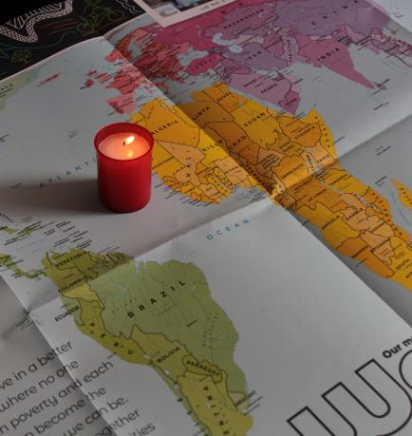
Let us pray
We pray for all our brothers and sisters around the world especially those who are poor:
that they may be able to change their lives for the better.
Lord in your mercy…
We pray for our parish, families and friends:
that we may open our hearts to Jesus and love our neighbour, wherever in the world they are.
Lord in your mercy...

Slide 13
Let us pray
We pray for the Church throughout the world:
that it may be a place of welcome and safety for all people.
Lord in your mercy…
Living God: help us to live with love, faith, generosity, fairness and hope so that our hearts may be open to you and to all people in need.
Amen.

Slide 14
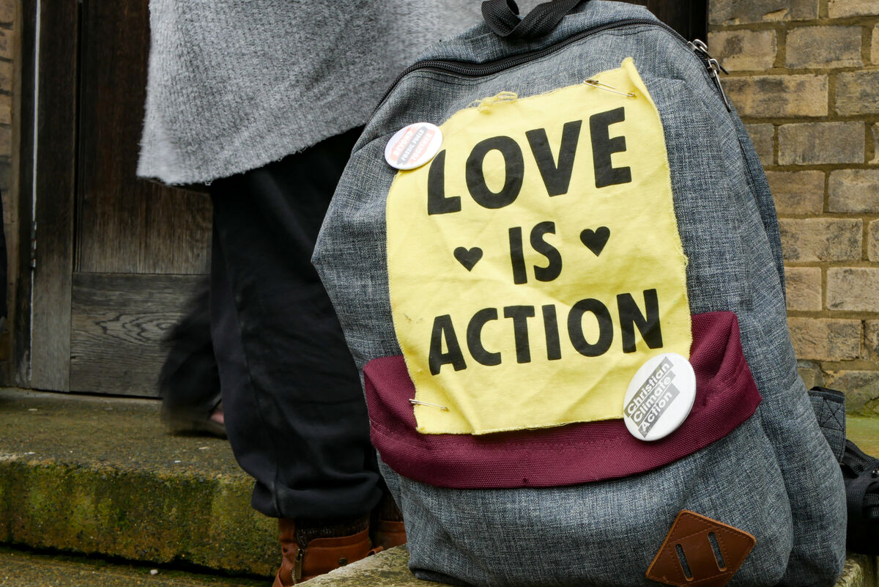
How will you be more loving, more forgiving and more generous to others this week?
Send
Notes:
CAFOD campaigning
Photo credit: Sophia White

Slide 15
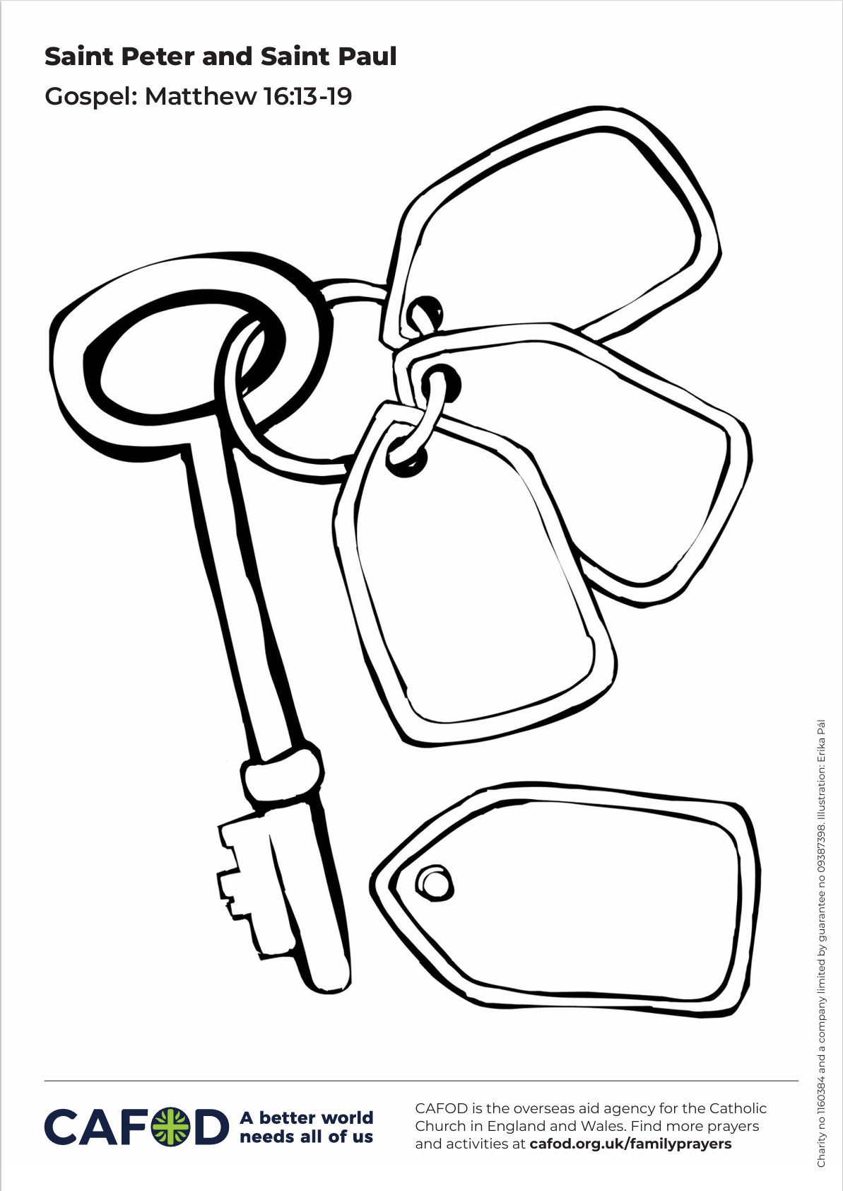
Activity suggestions
Download the illustration
Invite the children to colour in the accompanying illustration and to write in the key ring some of the “key words” that sum up what Jesus asks us to do, or what they will do to open their hearts to Jesus in the coming week.
Give the children key shapes cut out of card or paper and encourage them to write or draw on them what they will do to open their hearts to Jesus in the coming week, or the “key words” that sum up what Jesus asks us to do.
Remind the children to share all that they have heard and thought about today with the people at home. Encourage them to think during the week about how they can open their hearts to Jesus and live according to some of the “key words”.
For more CAFOD ideas and activities, please go to Primary teaching resources
Notes:
Illustration: Erika Pal

Slide 16
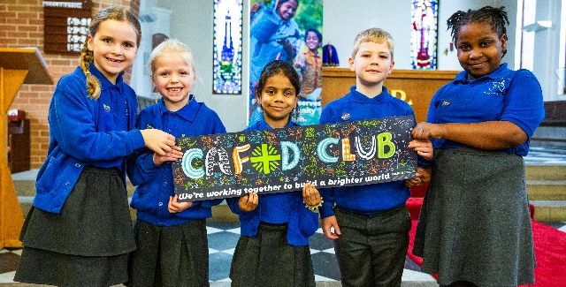
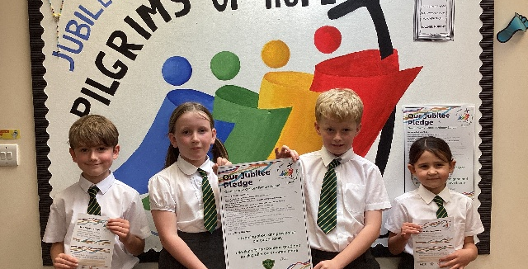

Get involved with CAFOD this term
Explore our summer term resources
Ways to live out your Jubilee Pledge
Fundraise for a World Gift

Slide 17
