Slide 1
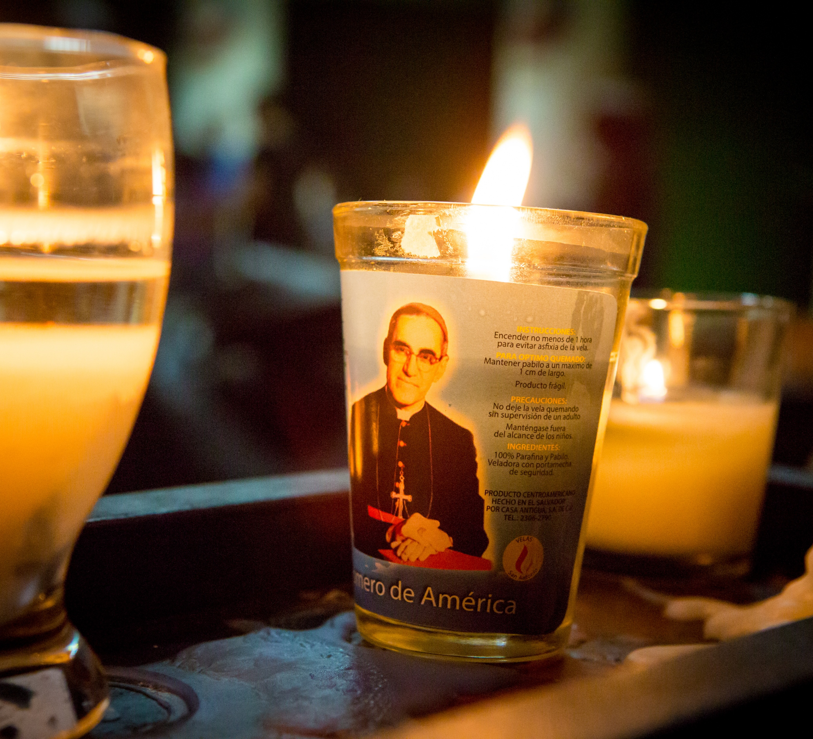
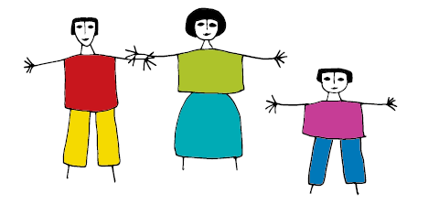
St Oscar Romero
Celebration of the word
Gather
For Primary Schools
Notes:
Photo credit: Louise Norton

Slide 2
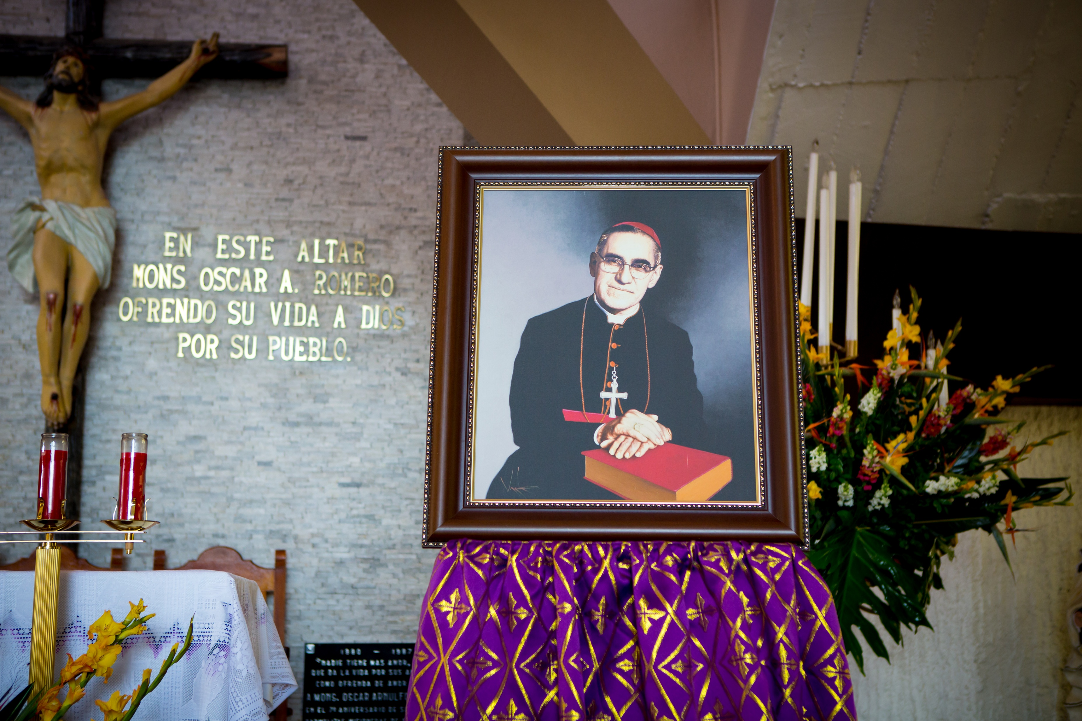
Welcome to our time of prayer.
Notes:
Reader: In the name of the +Father, and of the +Son, and of the +Holy Spirit Amen.
Today we celebrate the life of St Oscar Romero. Romero was a special man who stood up for the poor in his country of El Salvador. He spoke out against inequality and injustice and showed love in action, for God and for others.

Slide 3
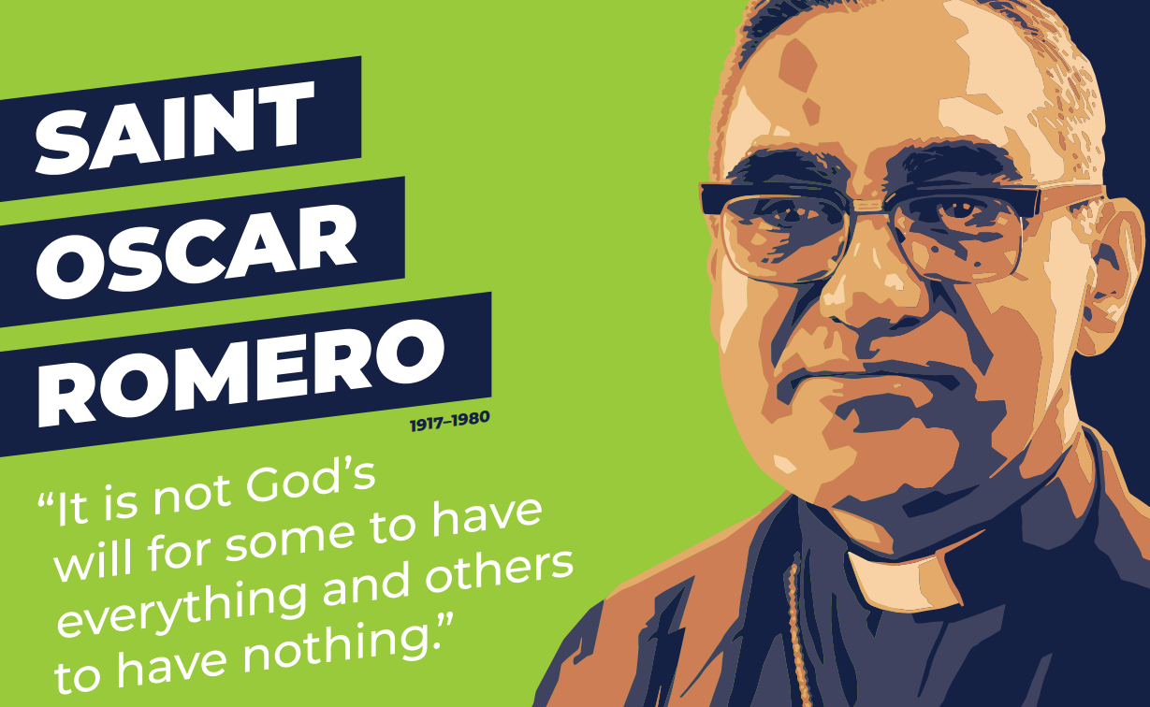
Gather
Notes:
Reader: But what is a saint?
Reader: We are all called to be saints – examples of God’s love in the world. When he visited Britain, Pope Benedict said to children: “I invite you to become saints”.
But when someone is declared a saint by the Church, they are being held up as an example for us . Let’s listen to God’s word and understand what it means to love like a Saint.

Slide 4
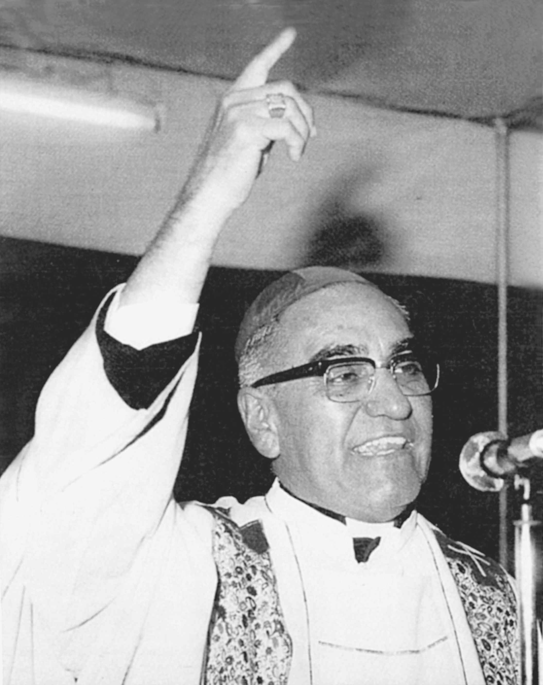
A reading from the
first letter of St John
Word
Notes:
Sing Alleluia
Reader: In John’s first letter, we hear him telling us to show our love in action.
Reader: A reading from the first letter of John
(1 John 3: 16-18)
“This is how we know what love is: Christ gave his life for us.
We too, then, ought to give our lives for others.
If we are rich and see others in need, yet close our hearts against them, how can we claim that we love God?
My children, our love should not be just words and talk: it must be true love, which shows itself in action.”
The Word of the Lord
All: Thanks be to God.

Slide 5

SACRED SILENCE…
What is God saying to us?
Love shows itself in action, not words.
Notes:
Reader: Our reading tells us to show our love in actions, not just words and talk.
Reader: Let us have a moment of silence to think about God’s words.

Slide 6

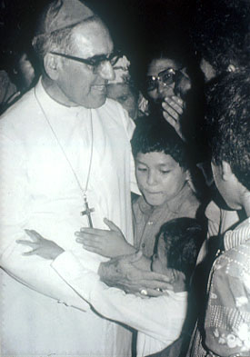
Who was Oscar Romero?
A special man.
Archbishop of San Salvador.
Stood up for poor communities in El Salvador.
Spoke out against inequality and injustice.
Respond
Notes:
Reader: Oscar Romero showed his love in action by standing up for others.
He was born in El Salvador and became archbishop of San Salvador in 1977.
Reader: In El Salvador there was a lot of inequality - a few families were very rich and owned lots of land but most people were poor and earned very little. People became angry at this unfairness. Many people, like Romero, spoke out against what was happening. But the rich were powerful – if people complained they were put in prison or even killed.

Slide 7
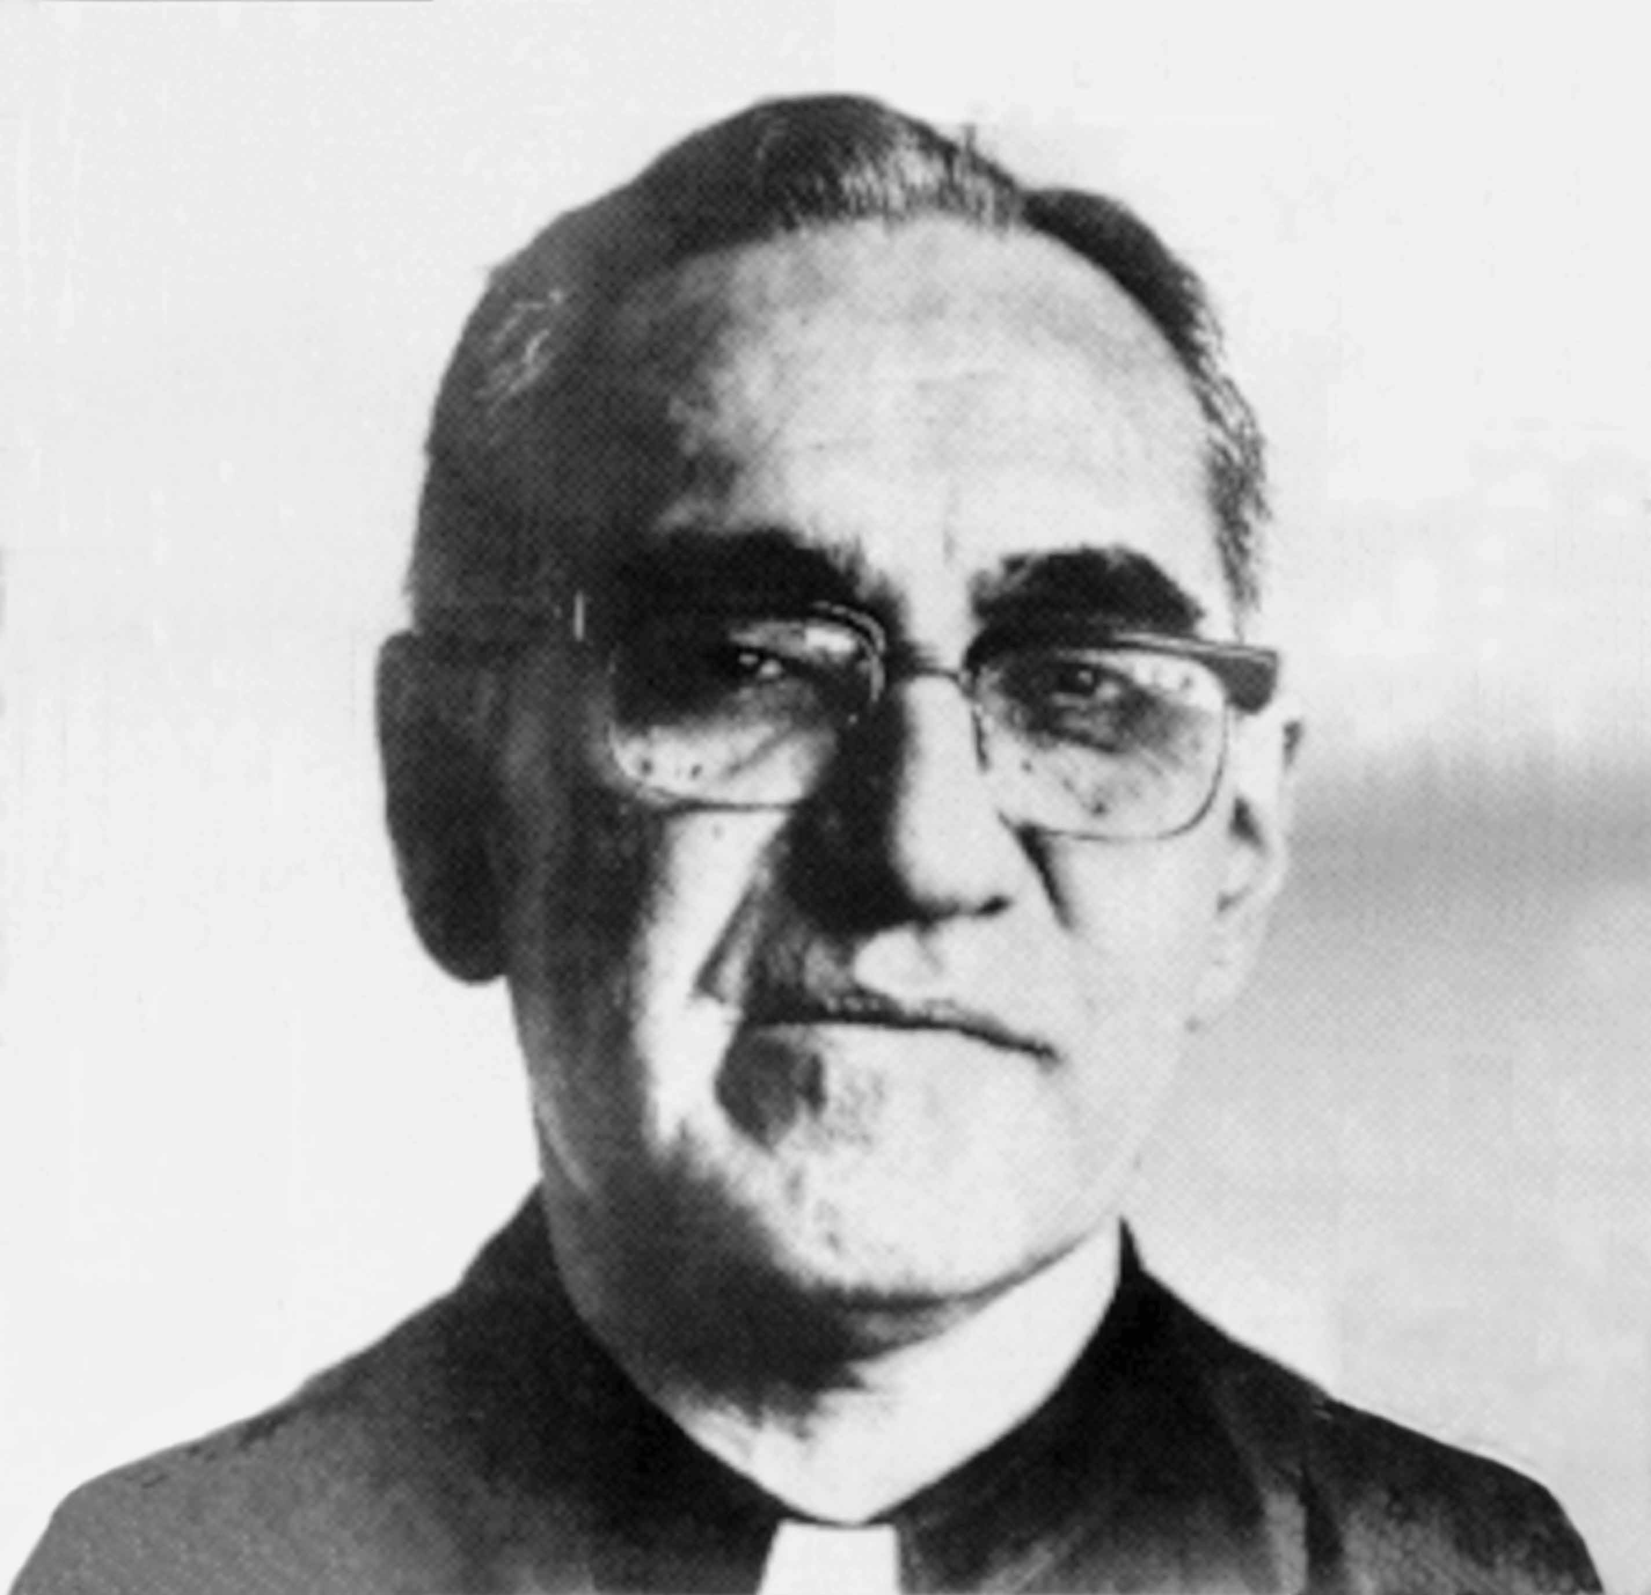
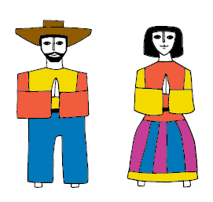
In 1980, Romero was killed while saying Mass.
Romero was canonised in 2018. He is now Saint Oscar Romero.
Notes:
Reader: Despite the dangers, Romero stood alongside his people and spoke out against injustice. In 1980, Romero was killed while saying Mass.
Reader: Oscar Romero knew that he was risking his life. And yet, like Jesus, he continued to speak out against the things he knew were wrong. Romero is remembered for his courage, his faith and his great love for the poor.
Reader: In 2016, the Church said that Romero was a martyr, that he died for his faith. So, Romero was ‘beatified’ - declared ‘Blessed’. Romero was ‘canonised’ – recognised as a saint - on 14 October 2018. He is now known as ‘Saint Oscar Romero’.

Slide 8

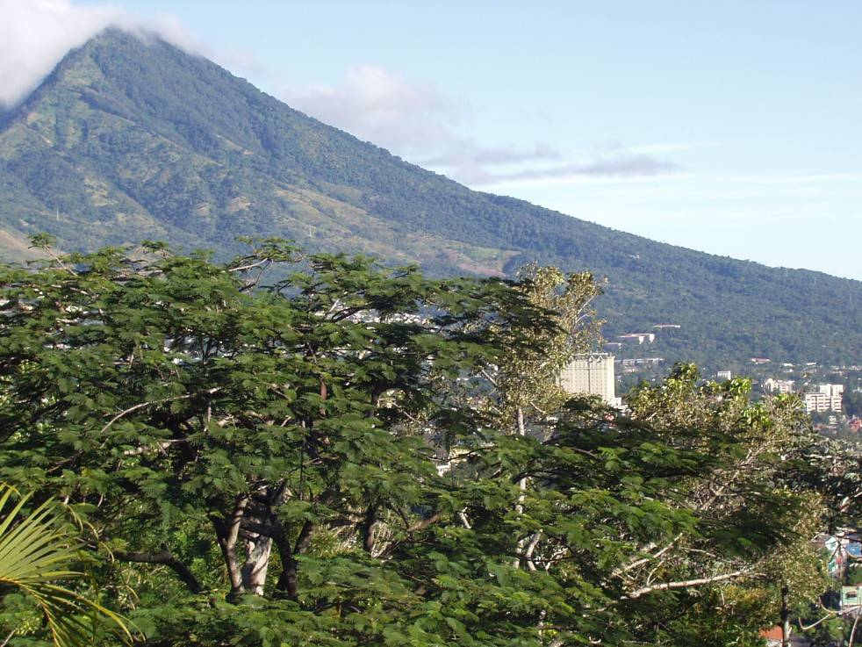
El Salvador today
In 1992, the civil war ended.
The people of El Salvador are working hard to rebuild communities and make a better future.
Notes:
Reader: After Romero’s death, there was a civil war in El Salvador. Many people were killed.
Reader: In 1992, the civil war ended. The people of El Salvador are working hard to rebuild communities and make a better future.
Reader: CAFOD supports projects in El Salvador. The people there are brave and dedicated, like Romero. We can learn from them.

Slide 9
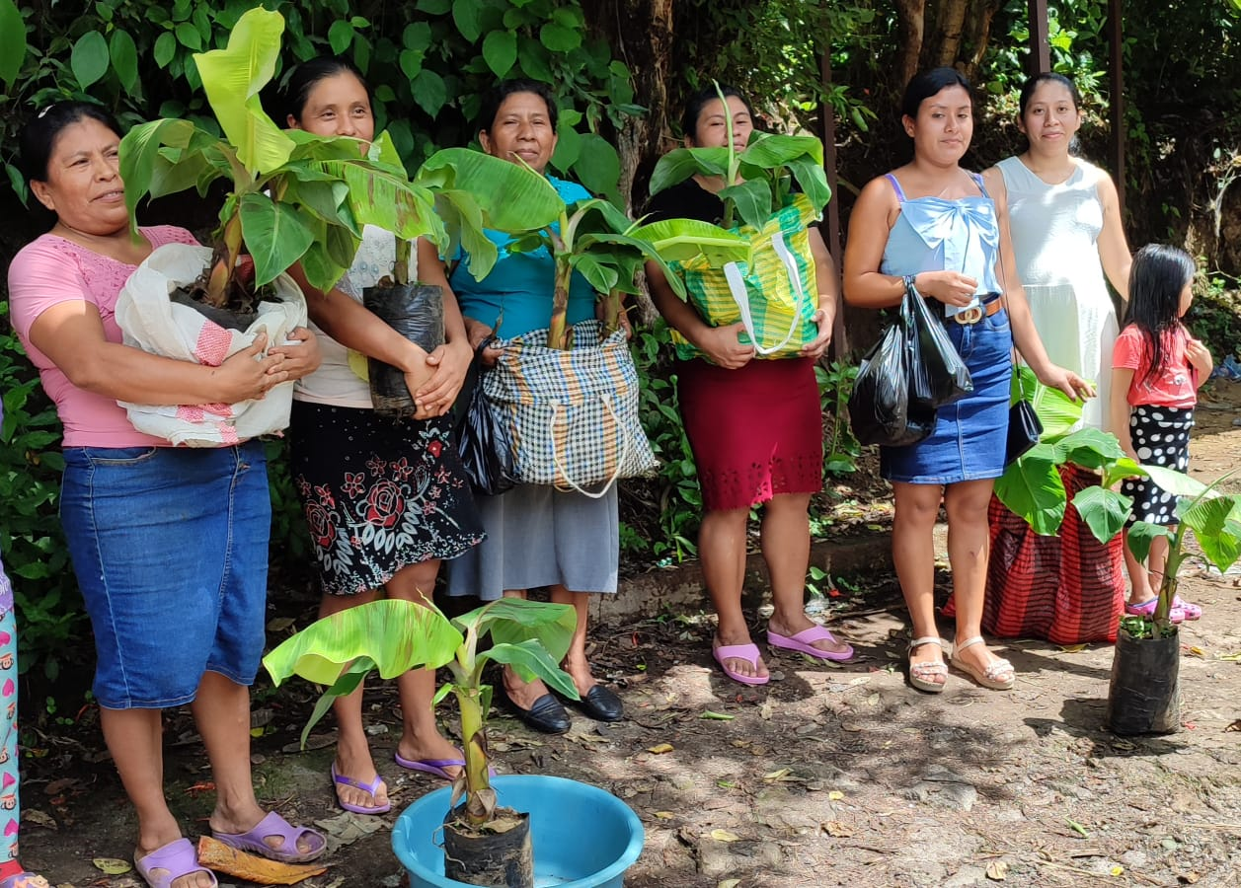
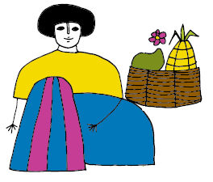
CAFOD’s work in El Salvador
Notes:
Photo credit: Solidaridad CVX
Reader: CAFOD works with local experts in El Salvador. In western El Salvador, CAFOD’s partner Solidaridad CVX are supporting women to learn more about their human rights, how to take forward their small businesses and how to care for the natural environment.
Reader: These women are planting trees so that they can grow and sell bananas.

Slide 10

Respond
Response: Lord in your mercy, hear our prayer
Notes:
Reader: Let us pray together, and with St Oscar Romero, for ourselves and our global family.
Reader:
Loving God,
We pray for the poorest people across the world. May the example of love in action shown by St Oscar Romero inspire us and others to help those in need.
Lord, in your mercy… Hear our prayer.
Reader:
Loving God,
We pray for the people of Central America, especially El Salvador. Bless CAFOD’s work supporting them, and give them courage like St Oscar Romero to continue to stand up to injustice and inequality.
Lord, in your mercy… Hear our prayer.
Reader:
Loving God,
We pray for ourselves and our global family. May we be inspired by the message of St Oscar Romero to show our love in action, aspiring not just to have more but to be more.
Lord, in your mercy… Hear our prayer.

Slide 11
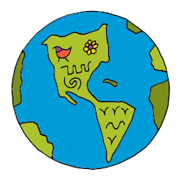

Let us pray
Loving God,
We thank you for the brave example of St Oscar Romero.
Give us the courage to speak out when something isn’t right and help us to grow in love so that we too may become saints.
May we work together for a fair and just world, bringing your love to everyone.
Amen
Notes:
Reader: Let us pray together…
All:
Loving God,
We thank you for the brave example of St Oscar Romero.
Give us the courage to speak out when something isn’t right and help us to grow in love so that we too may become saints.
May we work together for a fair and just world, bringing your love to everyone.
Amen

Slide 12

How can you put love into action?
Send
Notes:
Reader: What can we all do to put love into action and support to our sisters and brothers throughout the world?

