Slide 1
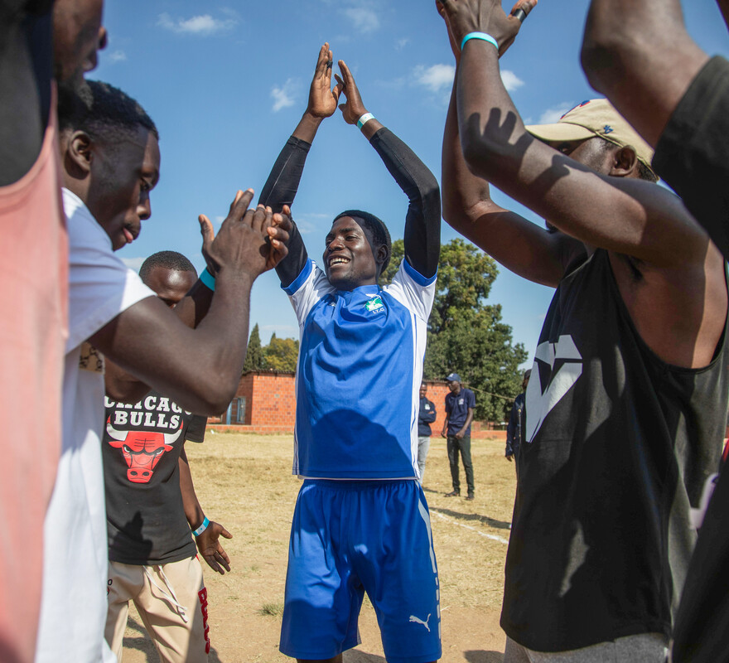
How will you join with others to spread the message of peace in our world?
Gospel Celebration of the Word
Notes:
Children’s liturgy: Twenty-third Sunday in Ordinary Time (Year A)
Preparation of the worship space
Colour: green
Song suggestions
Be still, for the presence of the Lord (720, Laudate)
Welcome
In today’s gospel, Jesus encourages us to meet together in his name and says he will be with us. When do we meet together in his name? How about here and now today? Let’s think a bit more about this together...
Harare Youth Sports Day, Zimbabwe
Photo credit: Cynthia Matonhodze

Slide 2
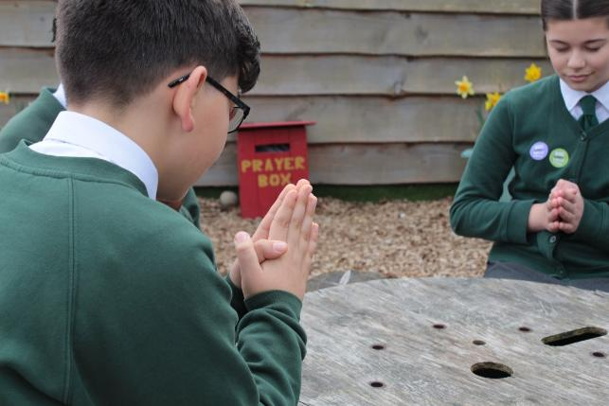
Christ Jesus,
Be with us now as we gather together in your name. Guide us in all that we say and all that we do, as we try to follow you. Amen.
  Gather
Notes:
St Francis Xavier's RC Primary School, Herefordshire
Photo credit: Vicky Ahmed

Slide 3
Gospel: Matthew 18:15-20
Jesus said to his disciples: “If your brother sins against you, go to him and show him his fault. But do it privately, just between yourselves. If he listens to you, you have won your brother back.
"But if he will not listen to you, take one or two other persons with you, so that ‘every accusation may be upheld by the testimony of two or more witnesses,’ as the scripture says. And if he will not listen to them, then tell the whole thing to the church.
"Finally, if he will not listen to the church, treat him as though he were a pagan or a tax collector.
Word

Slide 4
Gospel: Matthew 18:15-20
“And so I tell all of you: what you prohibit on earth will be prohibited in heaven, and what you permit on earth will be permitted in heaven.
“And I tell you more: whenever two of you on earth agree about anything you pray for, it will be done for you by my Father in heaven. For where two or three come together in my name, I am there with them.”
Word

Slide 5
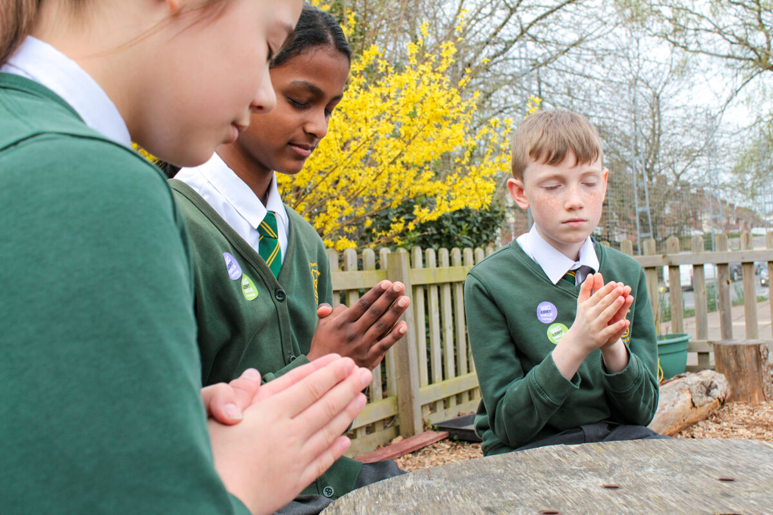
What do you remember from the Gospel reading?
Can you remember what Jesus says in today’s reading about prayer?
Jesus says that God listens to and answers our prayers.
What does Jesus say about when two or three people meet together in his name?
Respond
Notes:
St Francis Xavier's RC Primary School, Herefordshire
Photo credit: Vicky Ahmed

Slide 6

Jesus says that he is there with them. What do you think it means to meet together in Jesus’ name?
However we meet people, whether it’s to pray, to learn, to sing, or to talk, or to do something else together, if we invite Jesus in, then he will be with us, listening to us and guiding us.
Notes:
Together
Photo credit: Vitaly Kariev on Unsplash

Slide 7
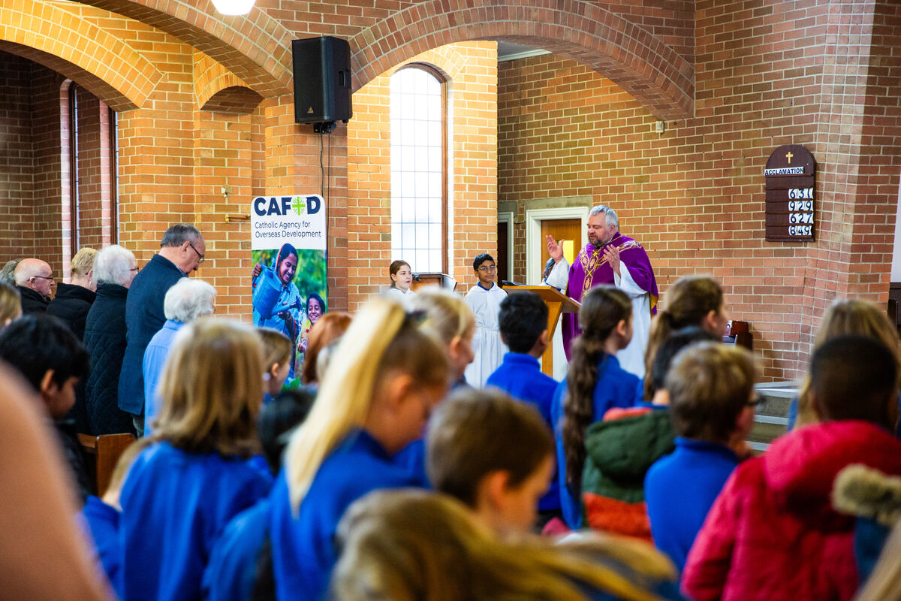
Can you think of a time when you meet together with others in Jesus’ name? Can you tell us a bit about it?
We can meet together in Jesus’ name at church, at home and at school.
Can you think of any other places where this happens?
Notes:
CAFOD Lent Family Fast Day Mass at Immaculate Conception, Rotherham
Photo credit: Thom Flint

Slide 8
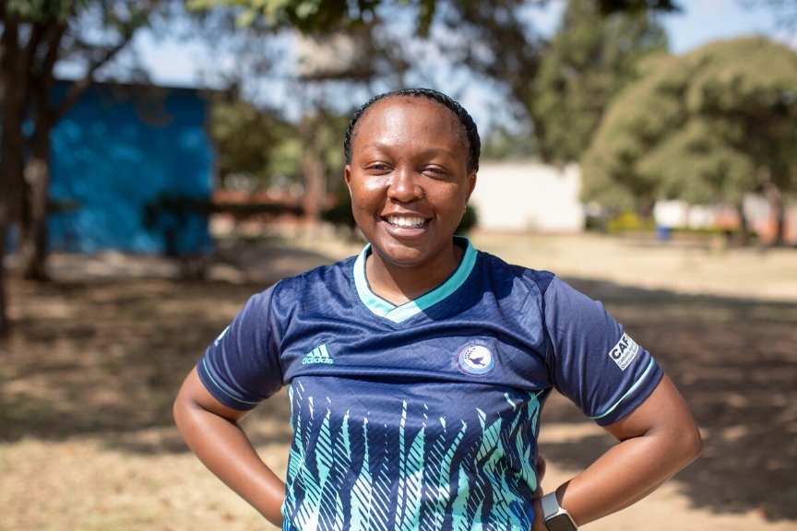
Vimbai works to build peace in Zimbabwe.
In her community, lots of people struggle to find work and many young people aren't able to go to school.
With not much to do, people can get drawn into violence and crime, making it difficult for them to live happy and peaceful lives.
Notes:
Vimbainashe 'Vimbai' Chiweshe, Catholic Commission for Justice and Peace, Zimbabwe
Photo credit: Cynthia Matonhodze

Slide 9
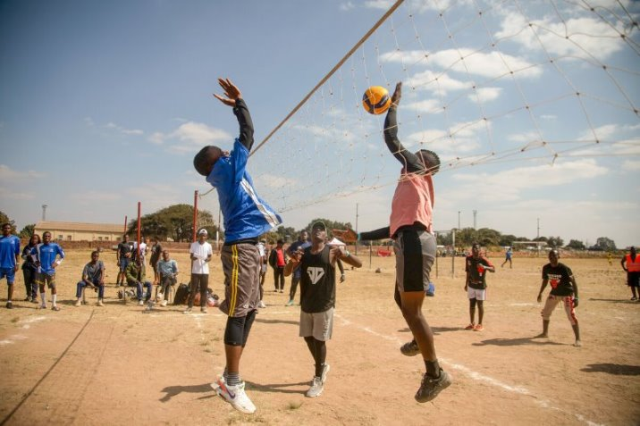
But Vimbai has a powerful way to bring people together: sport. She runs tournaments for young people.
As Vimbai explains: “We build peace through having them come to a place where they play together, they fight for a common cause, and we appreciate that we win together and we lose together."
Notes:
Harare Youth Sports Day, Zimbabwe
Photo credit: Cynthia Matonhodze

Slide 10
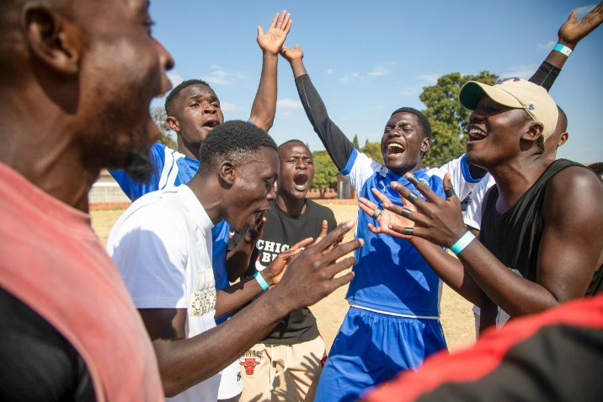
“Sport is a tool that’s been tried and tested in peace building, especially for young people,” says Vimbai.
It looks like this team had a good time!
If Jesus is with us, when we gather together, how can we make sure we listen to him and do what he asks of us?
Notes:
Harare Youth Sports Day, Zimbabwe
Photo credit: Cynthia Matonhodze

Slide 11
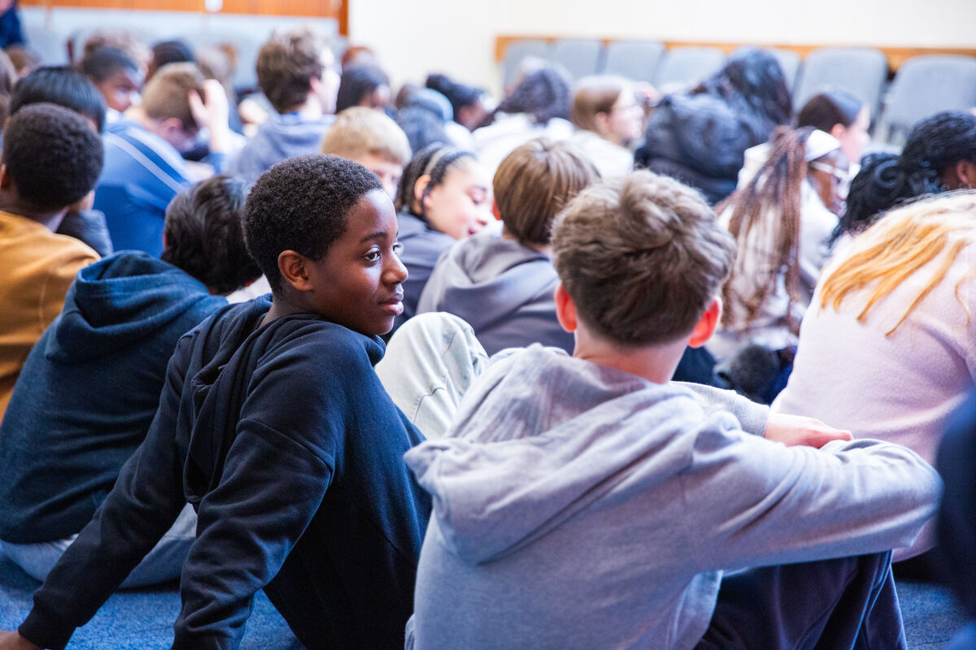
In the coming week, when you join together in Jesus’ name with other people to pray, to sing, or to play sport, remember that all around the world other children are also joining together in Jesus’ name.
Say a prayer for them: that all children around the world may live happy and healthy lives, in peace and free from poverty.
Notes:
Young people take part in CAFOD peacebuilding game, Nottingham
Photo credit: Thom Flint

Slide 12
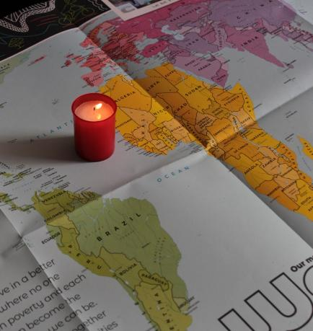
Let us pray
We pray for the church throughout the world: that everyone may know that she works in Jesus' name, who came to bring good news to the poor.
Lord in your mercy…
We pray for our parish, families and friends:
that we may invite Jesus to be with us in all we do, and that we may treat all people as they would wish to be treated.
Lord in your mercy...

Slide 13
Let us pray
We pray for our brothers and sisters around the world:
that they may all have the chance to lead healthy and happy lives in peace and safety and free from poverty.
Lord in your mercy…
Christ Jesus, we thank you for being with all of us: watch over us and all our sisters and brothers around the world. Help us to work together in peace and unity. Amen.

Slide 14
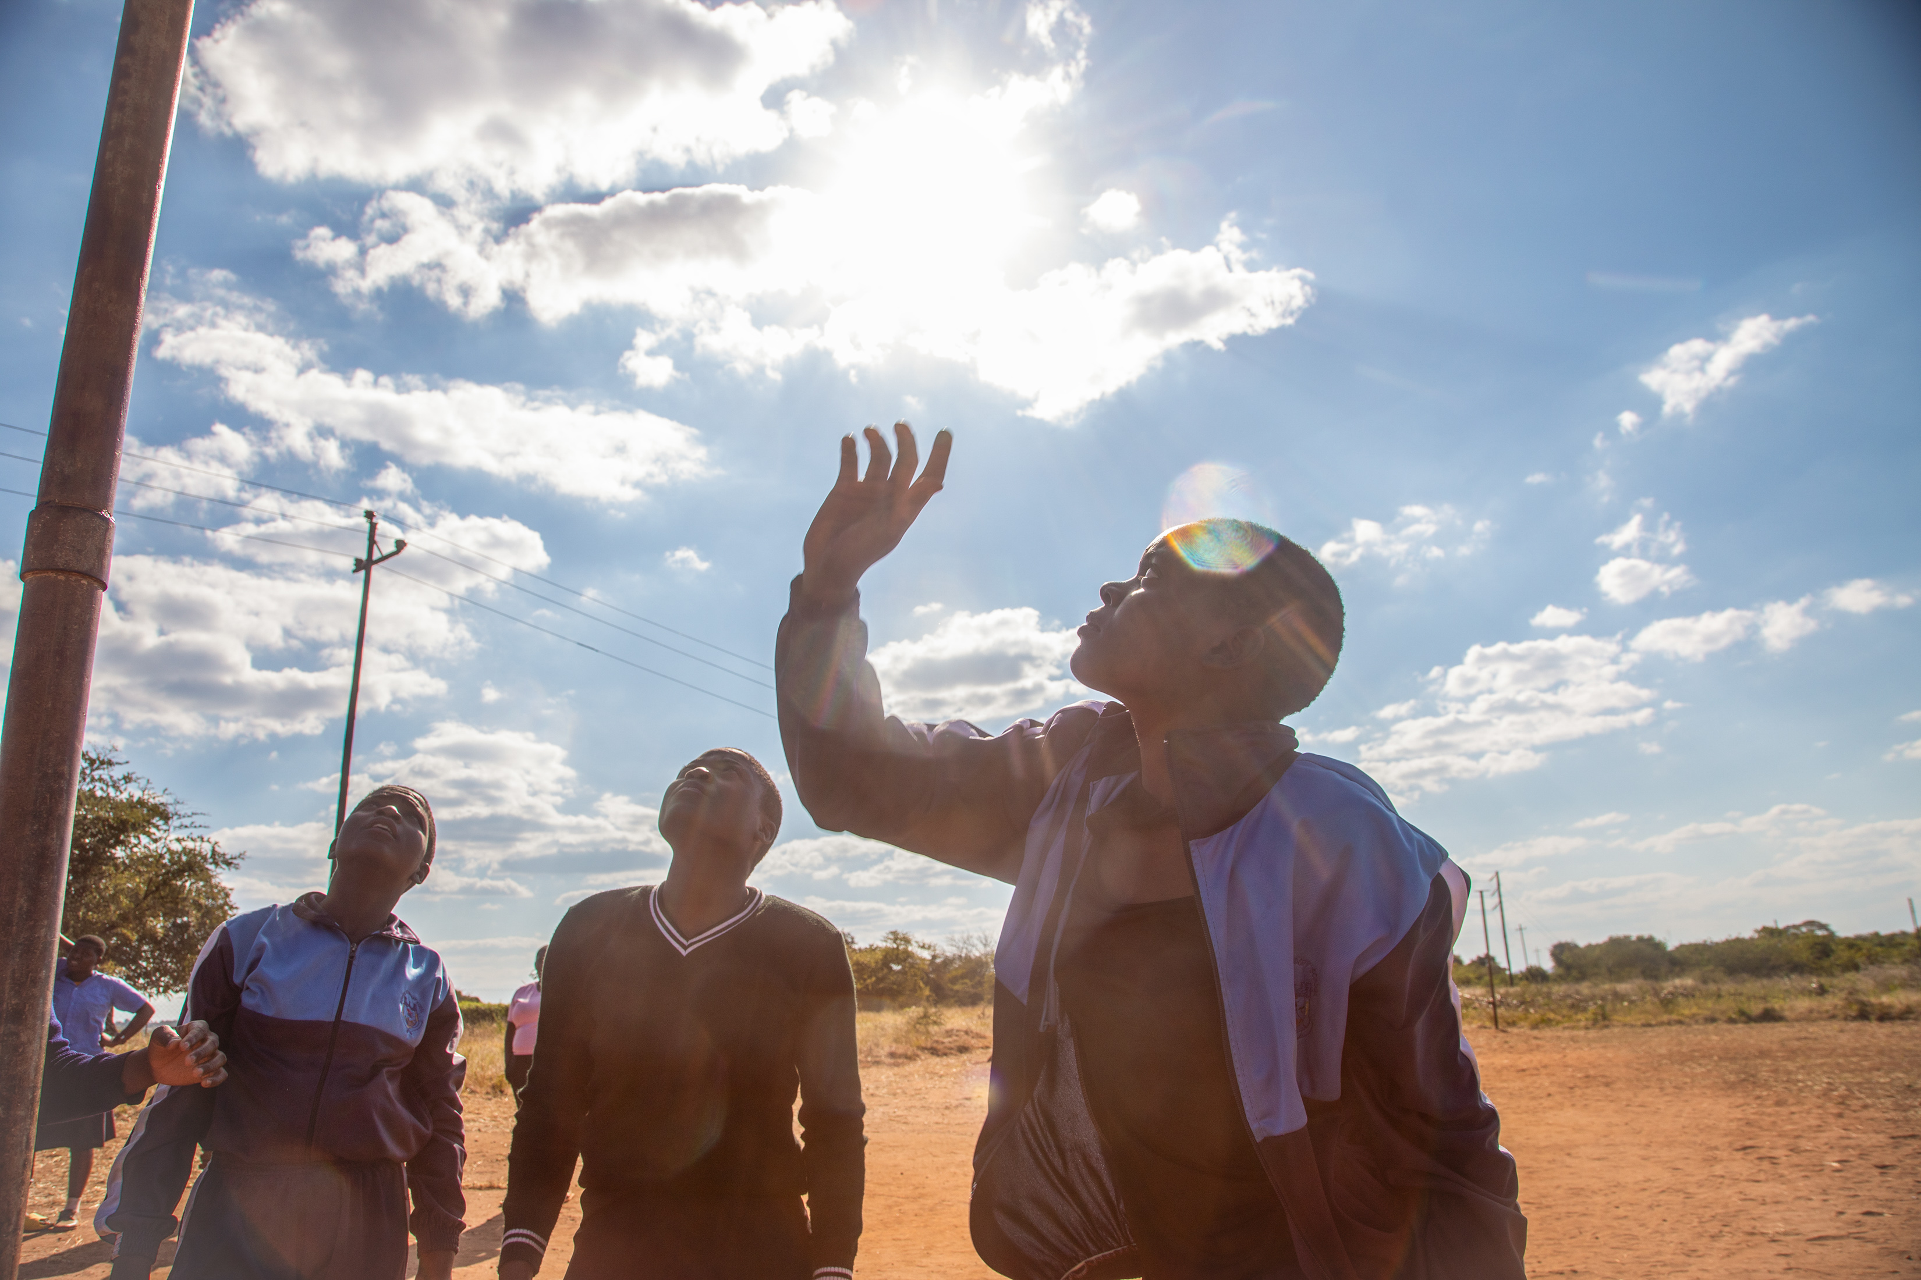
How will you join with others to spread the message of peace in our world this week?
Send
Notes:
Harare Youth Sports Day, Zimbabwe
Photo credit: Cynthia Matonhodze

Slide 15
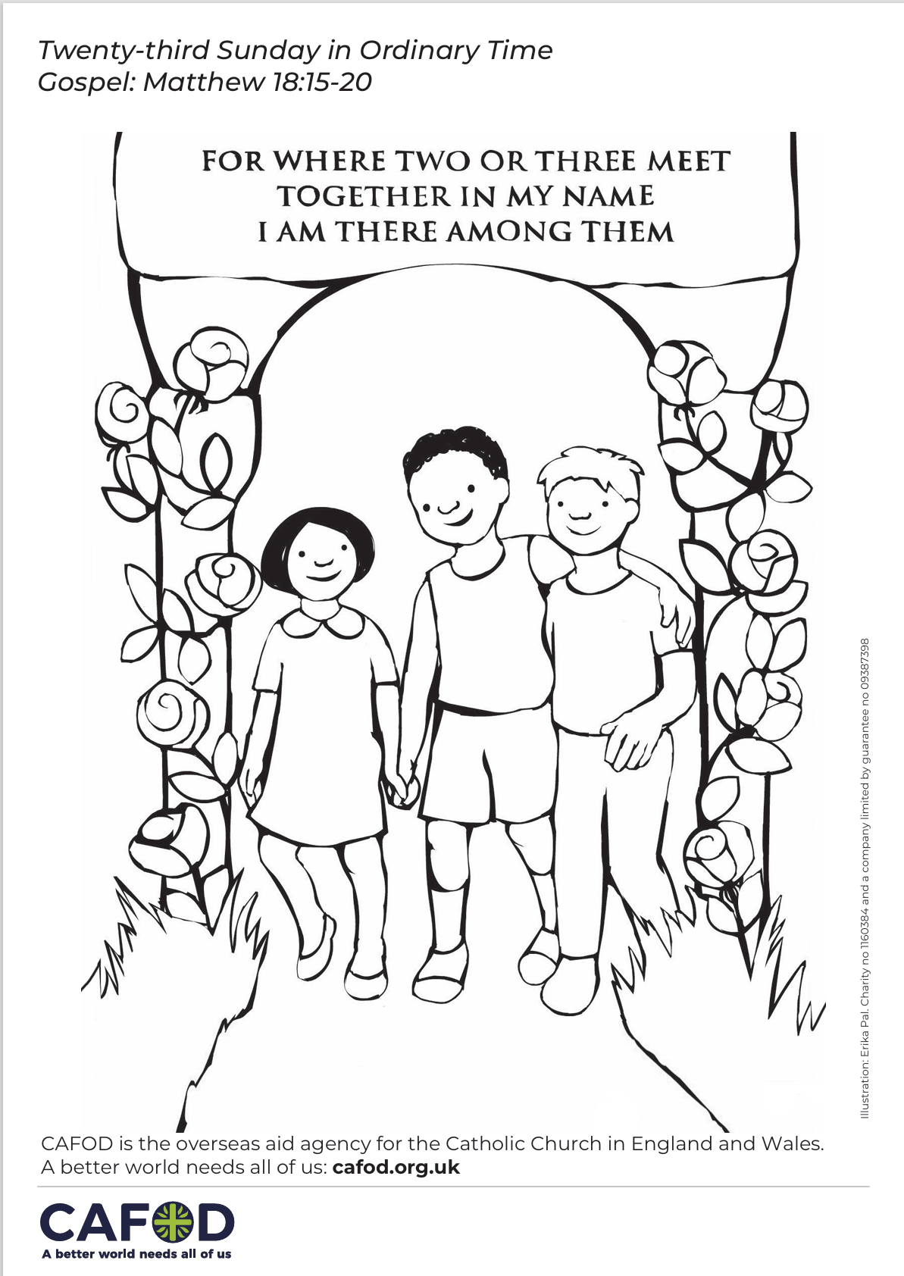
Activity suggestions
Download the illustration
Invite the children to colour in the accompanying illustration and on the back to write their prayer for their sisters and brothers around the world, especially those who are poor.
Encourage the children to hold hands with two or three other people. Ask them to spend a minute together in silence with Jesus and to listen to what he is saying to them.
Invite the children to discuss all they have heard and thought about today with their grown-ups at home. Encourage them to count the times they think they meet with others in Jesus’ name during the week, and each time to remember all our brothers and sisters around the world, especially those working for peace.
See Family prayer ideas for more child-friendly activities.
Notes:
Illustration: Erika Pal

Slide 16
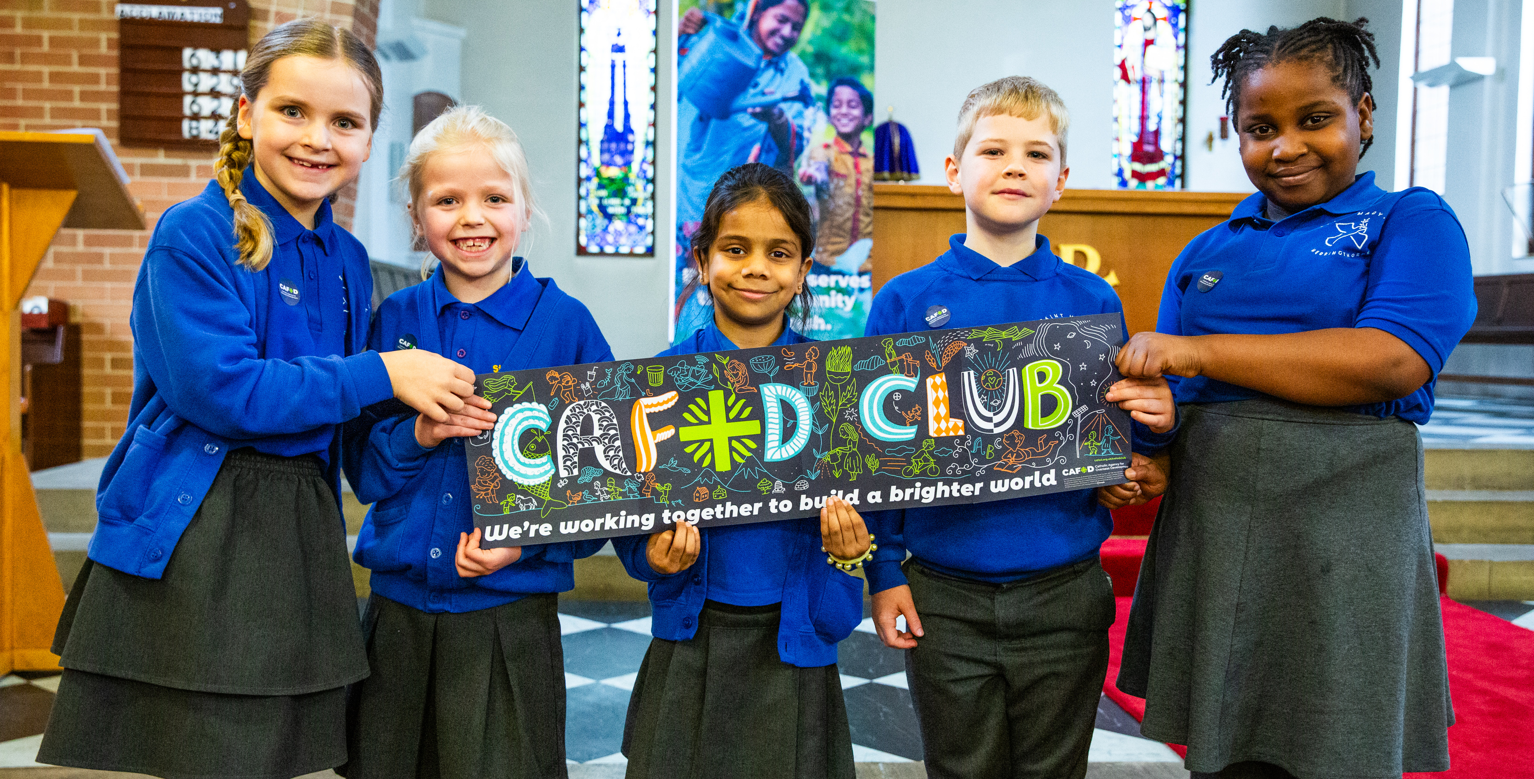
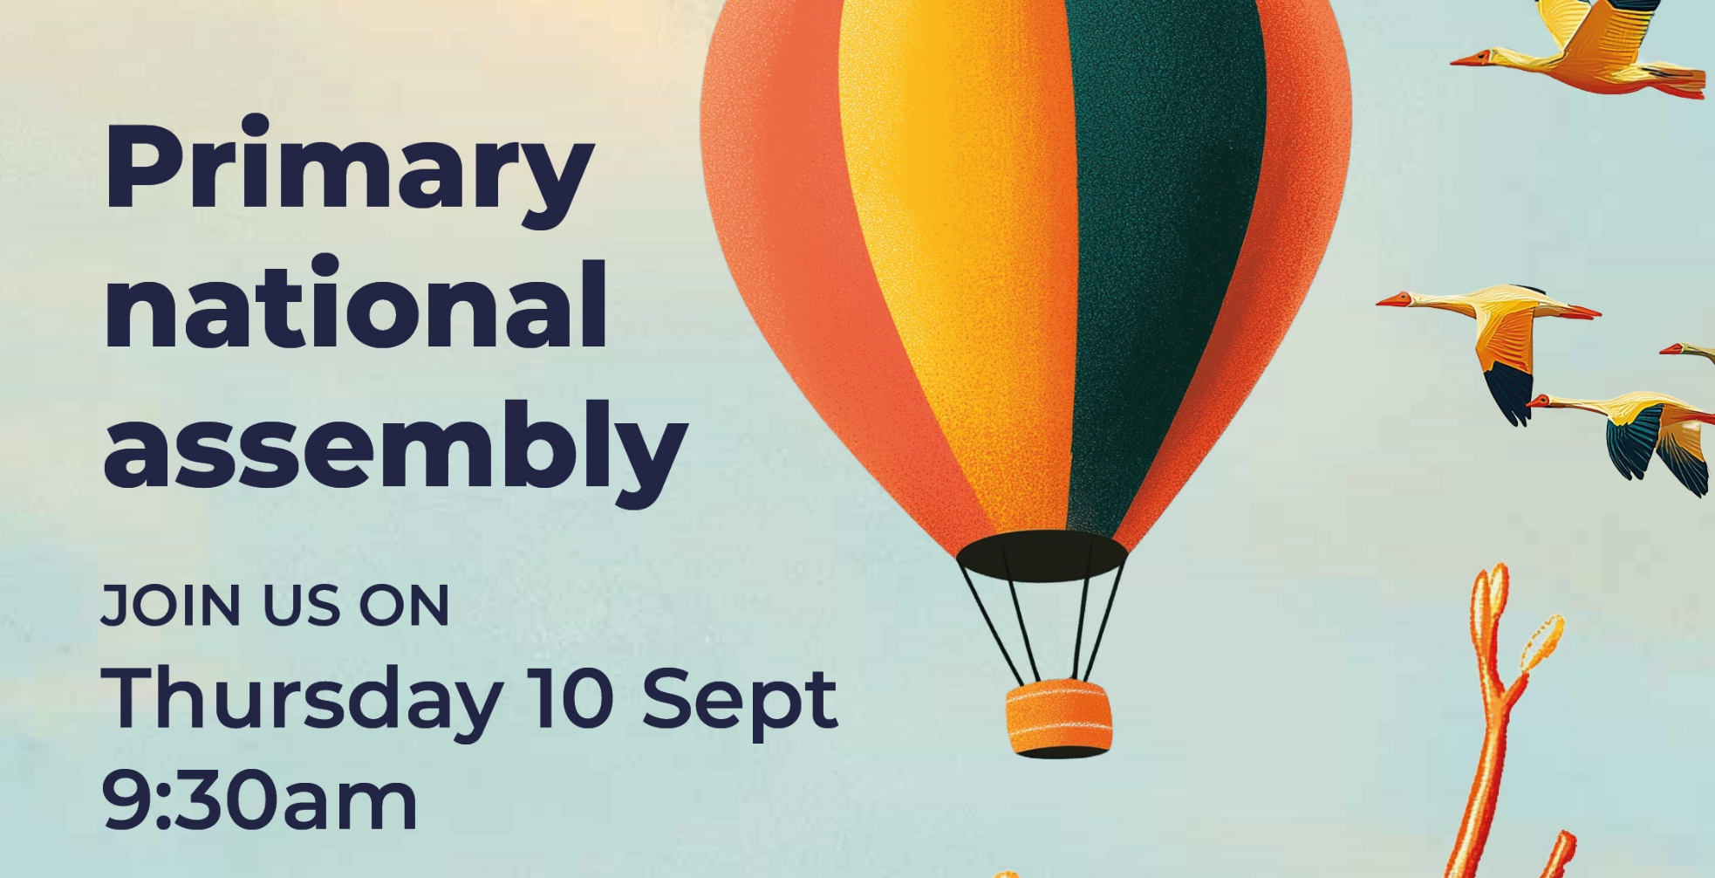
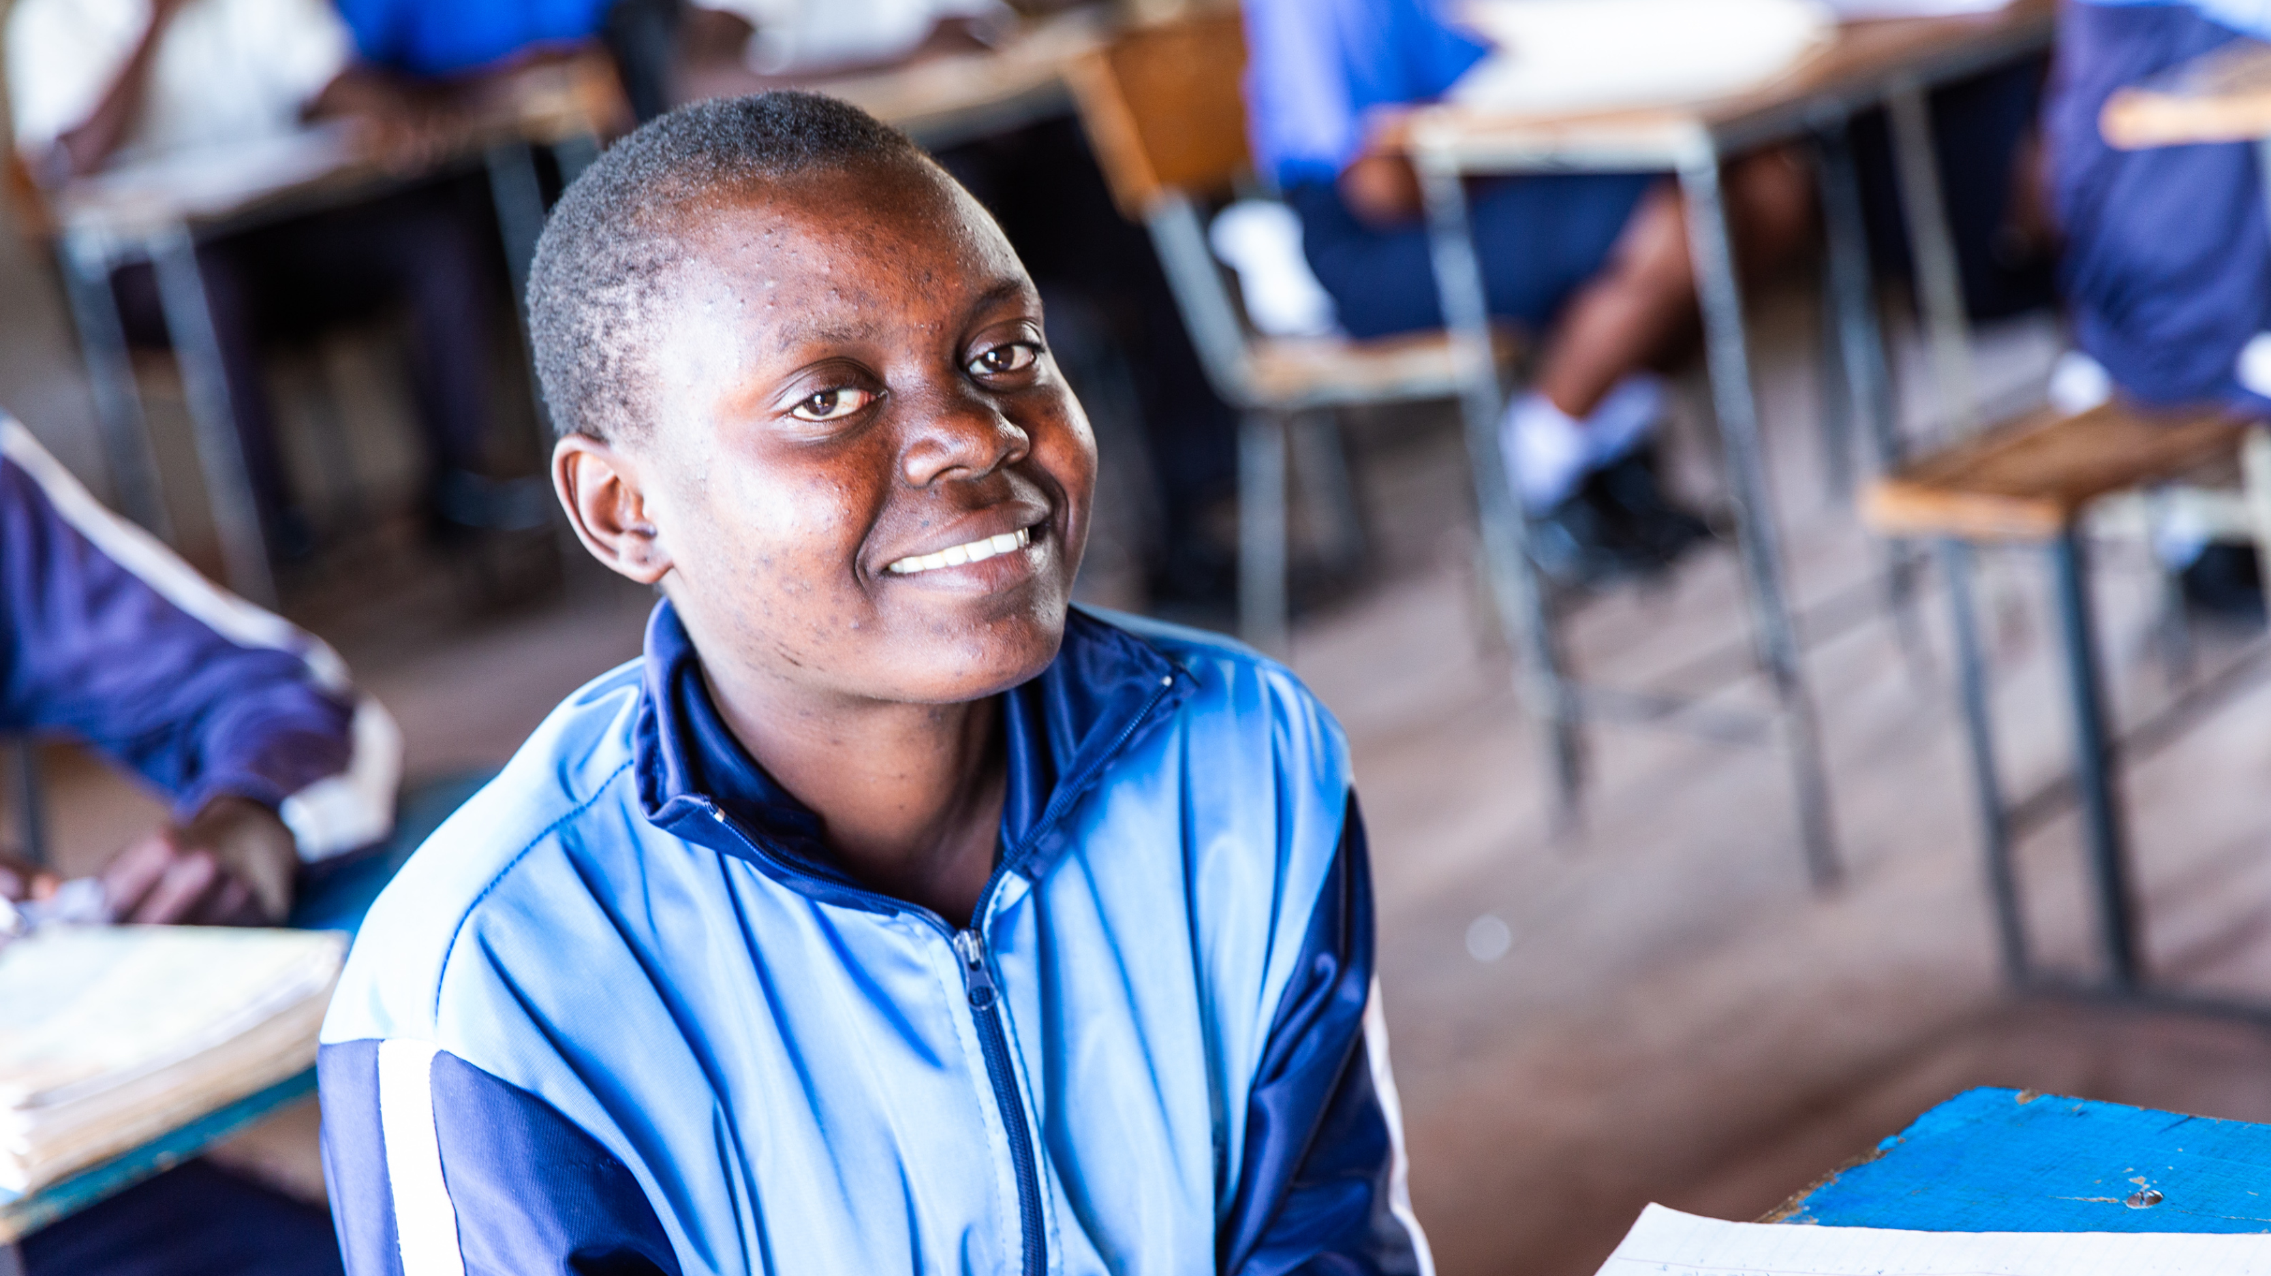
Get involved with CAFOD this term
Explore our resources for the new school term
Join our national assembly
Autumn fundraising resources

Slide 17


