Slide 1
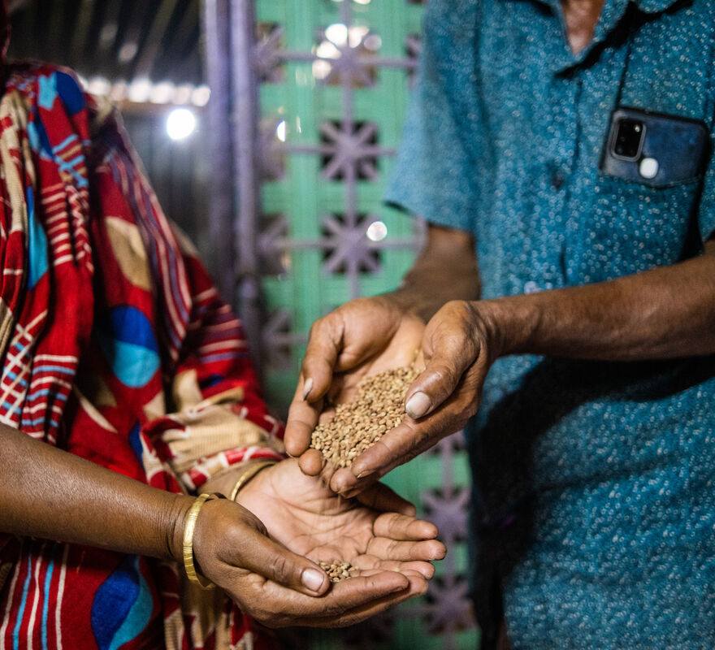
What will you do to help Jesus’ words come alive in our world?
Gospel Celebration of the Word
Notes:
Preparation of the worship space
Colour: green
Song suggestions:
Make me a channel of your peace (898, Laudate)
Welcome
Today we hear about how Jesus went onto a mountain and taught his disciples. Jesus told them about the kind of person who makes him happy and who is blessed. Some of what he said might be surprising, so let’s think about it together.
Salina and Mogibor, Bangladesh
Photo credit: Amit Rudro

Slide 2
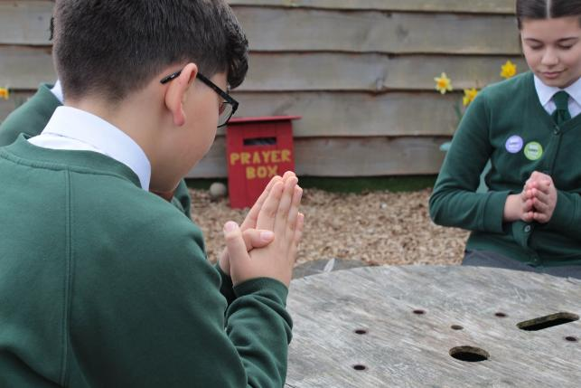

God of love,
You bless those people who are poor, who are sad, who are hungry and thirsty and who are hurt because they stand up for what they believe in. Help us to follow in your way. Amen.
  Gather
Notes:
St Francis Xavier's RC Primary School, Herefordshire
Photo credit: Vicky Ahmed

Slide 3

Gospel: Matthew 5:1-12a
Jesus saw the crowds and went up a hill, where he sat down. His disciples gathered around him, and he began to teach them:
“Happy are those who know they are spiritually poor; the Kingdom of heaven belongs to them!
Happy are those who mourn; God will comfort them!
Happy are those who hunger and thirst for what is right; God will satisfy them fully!
Happy are those who are merciful to others; God will be merciful to them!
Happy are the pure in heart; they will see God!
Happy are those who work for peace; God will call them his children!
Happy are those who are persecuted because they do what God requires; the Kingdom of heaven belongs to them!"
Word

Slide 4
“Happy are you when people insult you and persecute you and tell all kinds of evil lies against you because you are my followers. Be happy and glad, for a great reward is kept for you in heaven. This is how the prophets who lived before you were persecuted.”

Slide 5
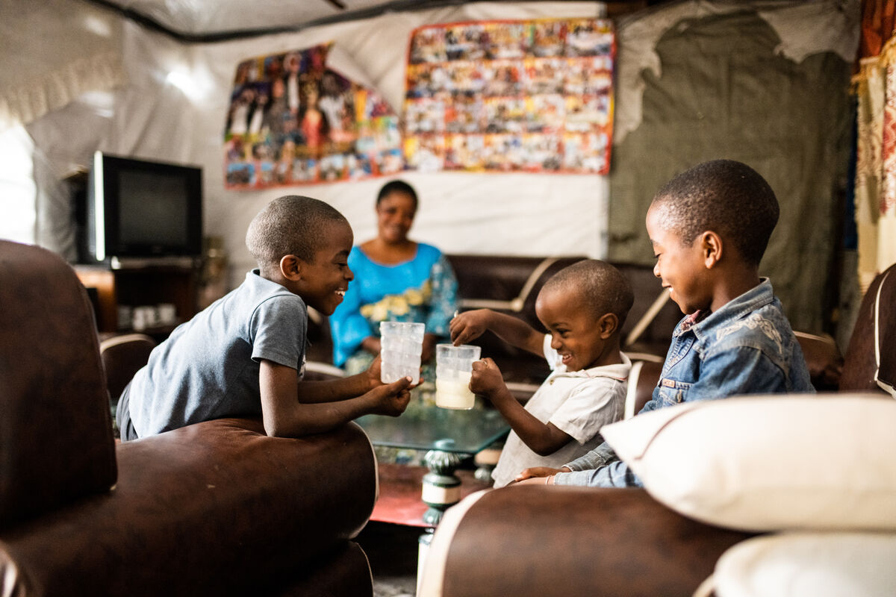

What do you remember from the Gospel reading?
Jesus teaches his disciples about the way he would like people to be treated.
He sees some types of people as extra special. He says that they will be happy or blessed.
Sharing with my brother – the Kahindo children, DRC
Respond
Notes:
Anuarite Kahindo sharing milk with her children, DRC
Photo credit: Arlette Bashizi

Slide 6
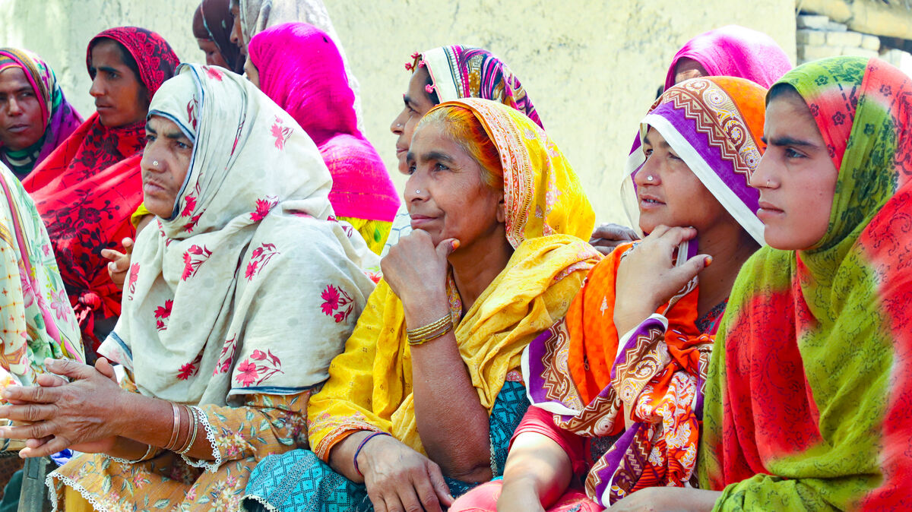
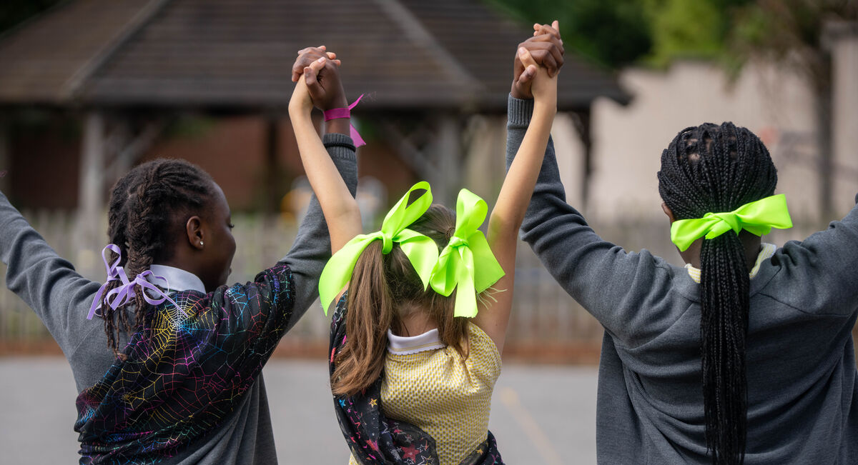
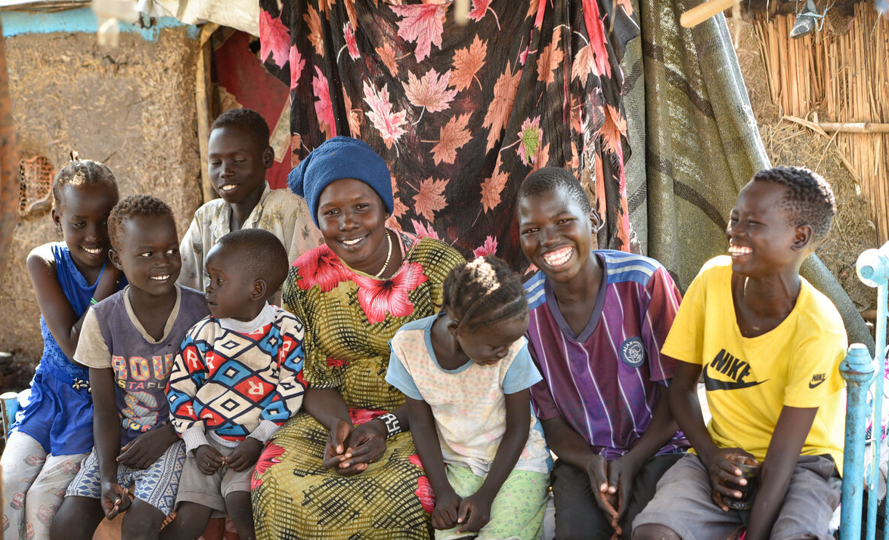
What kinds of people did Jesus say would be happy? And what will happen to them?
When will this happen?
Will this only happen in heaven?
Could it happen here on earth as well?
Women in Sindh province, Pakistan; St Chad's primary school, UK; Yani and family, Sudan
Notes:
What kinds of people did Jesus say would be happy? And what will happen to them? (E.g. those who mourn will be comforted. Those who are hungry will be satisfied.)
Helping communities rebuild lives affected by the Pakistan floods
Photo credit: Community World Service Asia (CWSA
St Chad's Primary School students
Photo credit: Joe Newman
Yani with her family, South Sudan
Photo credit: Amed Seed

Slide 7
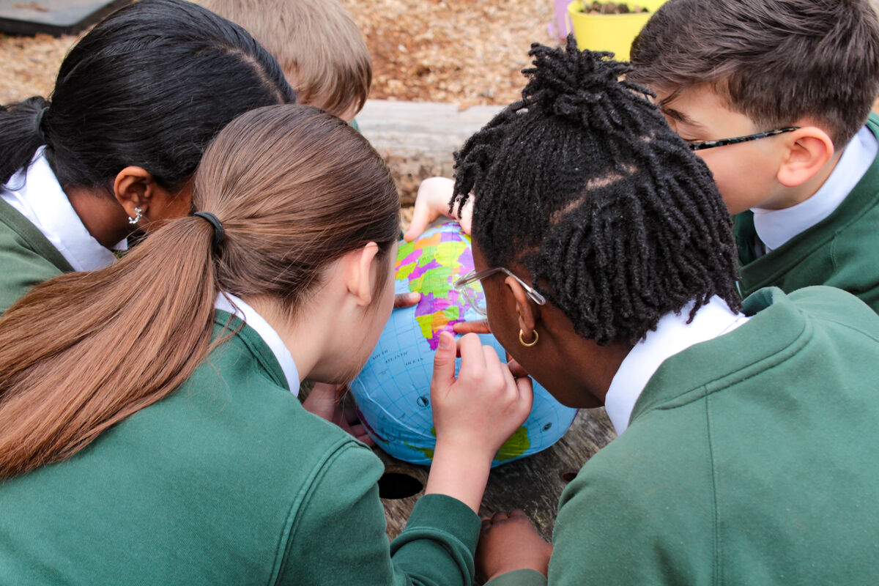
We are all part of one global family and we are called by God to care for the other members of that family, wherever they are in the world.
We can try to help Jesus’ words come alive today. Let’s think about how.
St Francis Xavier's pupils exploring the globe
Notes:
Pupils in Herefordshire
Photo credit: Victoria Ahmed

Slide 8

What could you do to help someone who is sad?
What could you do to help someone who is hungry or thirsty?
What could you do to help someone who is poor?
What could you do to help someone who is being laughed at or picked on for standing up for what they believe in?
Notes:
Ask the children to answer these questions and encourage some discussion.
Reaching out
Photo credit: Stock image

Slide 9
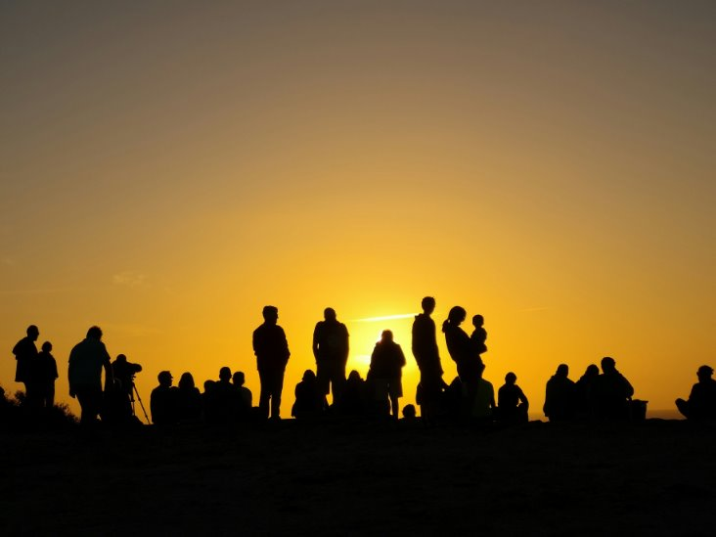
By doing these things we can help to build a better world. A world where all people have what they need to live happy, healthy lives.
By doing these things we will also be following Jesus. We can help to make the words he spoke to his disciples a reality. God can work through us to bring comfort, mercy and happiness to others.
Notes:
Happy
Photo credit: Fernando Marques on Unsplash

Slide 10
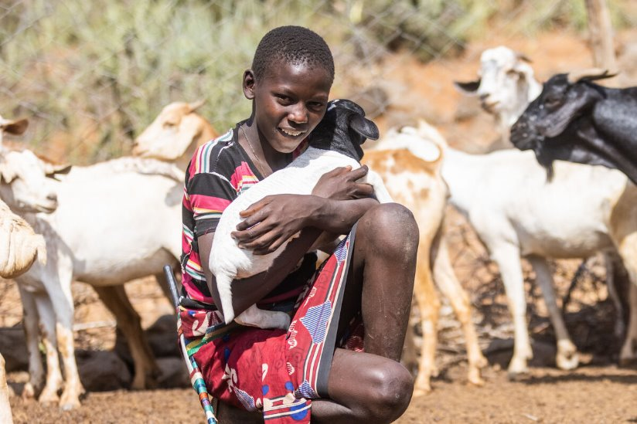
One way you can help others in the way God asks is by raising money for CAFOD.
Your fundraising helps our global family in need have enough food to eat and clean water to drink.
It supports them if they need shelter or they need to stand up to unfair treatment. It helps them to help themselves have a happy life.
With CAFOD's help, Saidimu's family in Kenya grows crops to eat and sell to make a living
Notes:
Saidimu, Kenya
Photo credit: Mwangi Kirubi

Slide 11
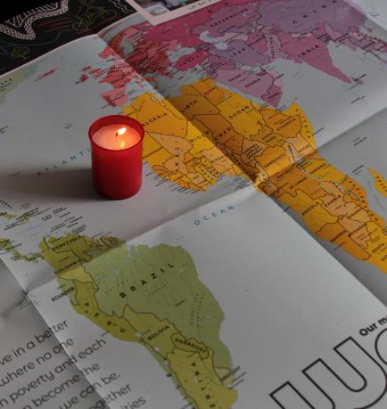
Let us pray
We pray for all people who are poor, sad, hungry or in danger:
that we may stand alongside them and support them, as together we work for a better future for all people.
Lord in your mercy…
We pray for our parish, families and friends:
that we may work together with others to follow Jesus' word, bringing comfort to those who are sad and helping make sure all people have enough to eat.
Lord in your mercy...

Slide 12
Let us pray
We pray for world leaders:
that they may work to bring about a world that is like Jesus' teachings – a fairer more peaceful world where everyone has enough.
Lord in your mercy…
God of mercy, open our hearts to listen to what Jesus tells us: move us to do what we can to bring those words to life through our actions.
Amen.

Slide 13
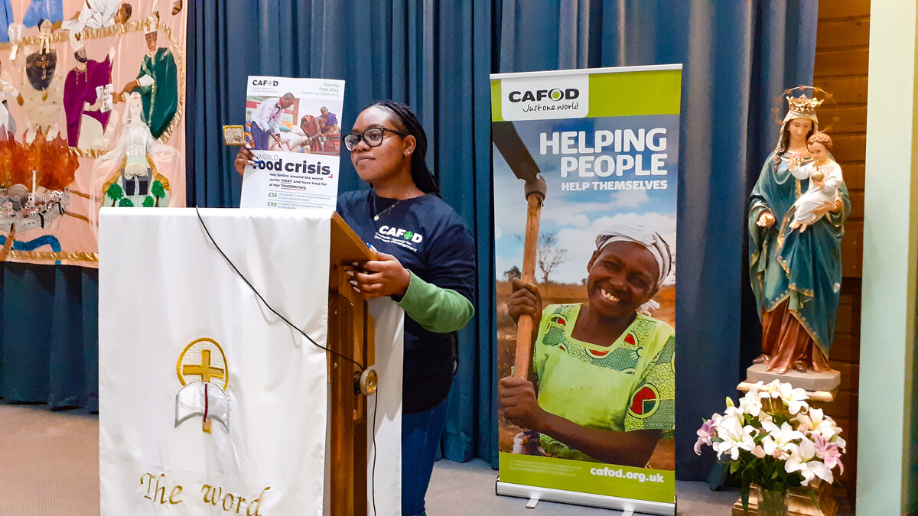

What will you do this week to help Jesus’ words come alive in our world?
Send
Notes:
Roxinne volunteers in the Diocese of Northampton
Photo credit: CAFOD Northampton

Slide 14
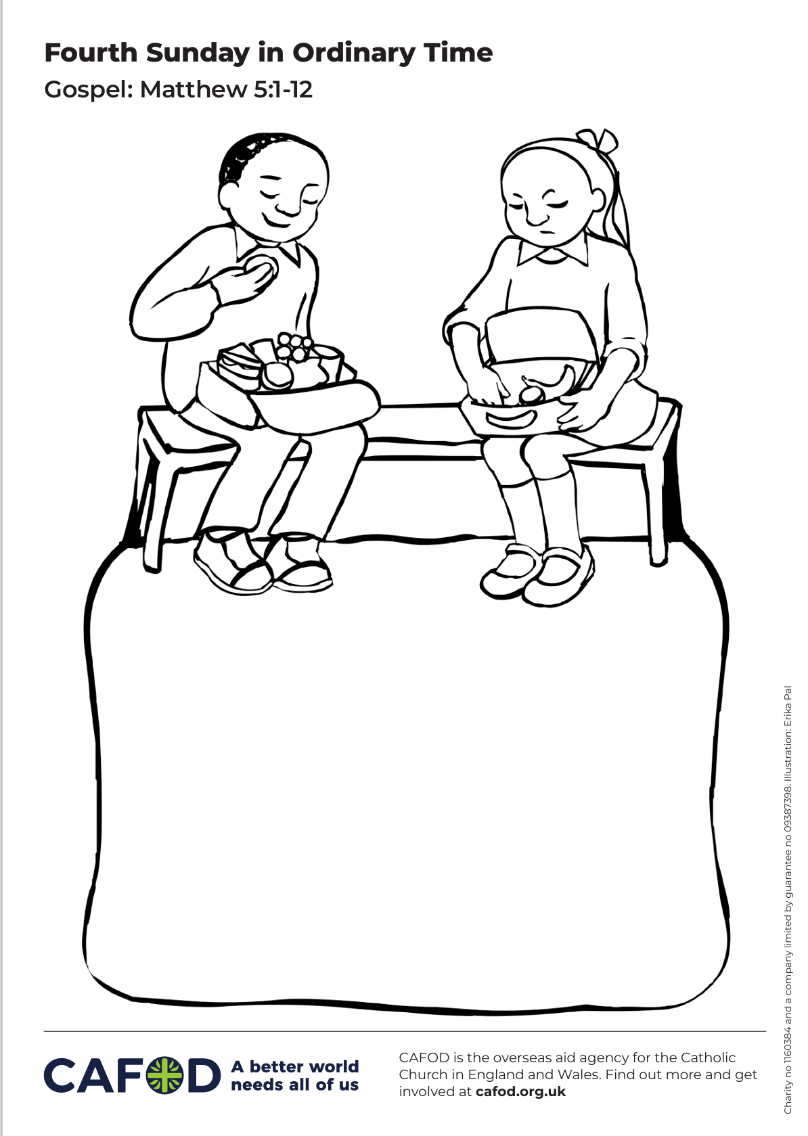
Activity suggestions
Download the illustration
Invite the children to look at the accompanying illustration. One of the children has a full lunchbox and looks very happy. One of the children has not got very much at all in their lunchbox and looks sad and hungry. Encourage the children to think about what they have heard today, to colour in the picture, and underneath to draw what they could do if they were the child with the full lunchbox.
Remind the children to share all that they have heard and thought about today with the people at home. Encourage them to do what they can to help someone who is sad, hungry, thirsty, poor or afraid, so that Jesus’ words may become a reality.
If they have written a prayer, encourage the children to say it together at home during the week.
Remind them to love their neighbours during the week, to care for others and by doing so, to share the light of God’s love for us all with one another.
Notes:
Illustration: Erika Pal

Slide 15
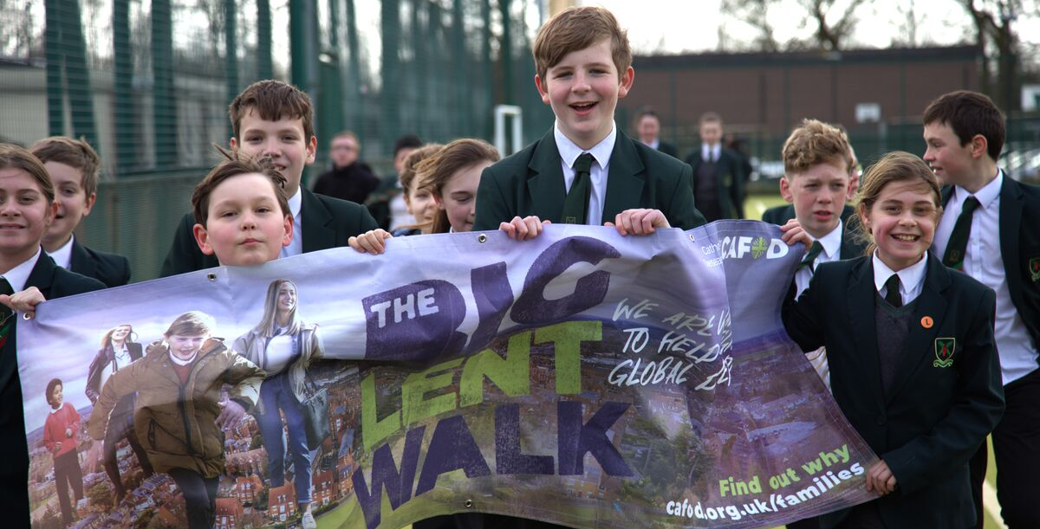
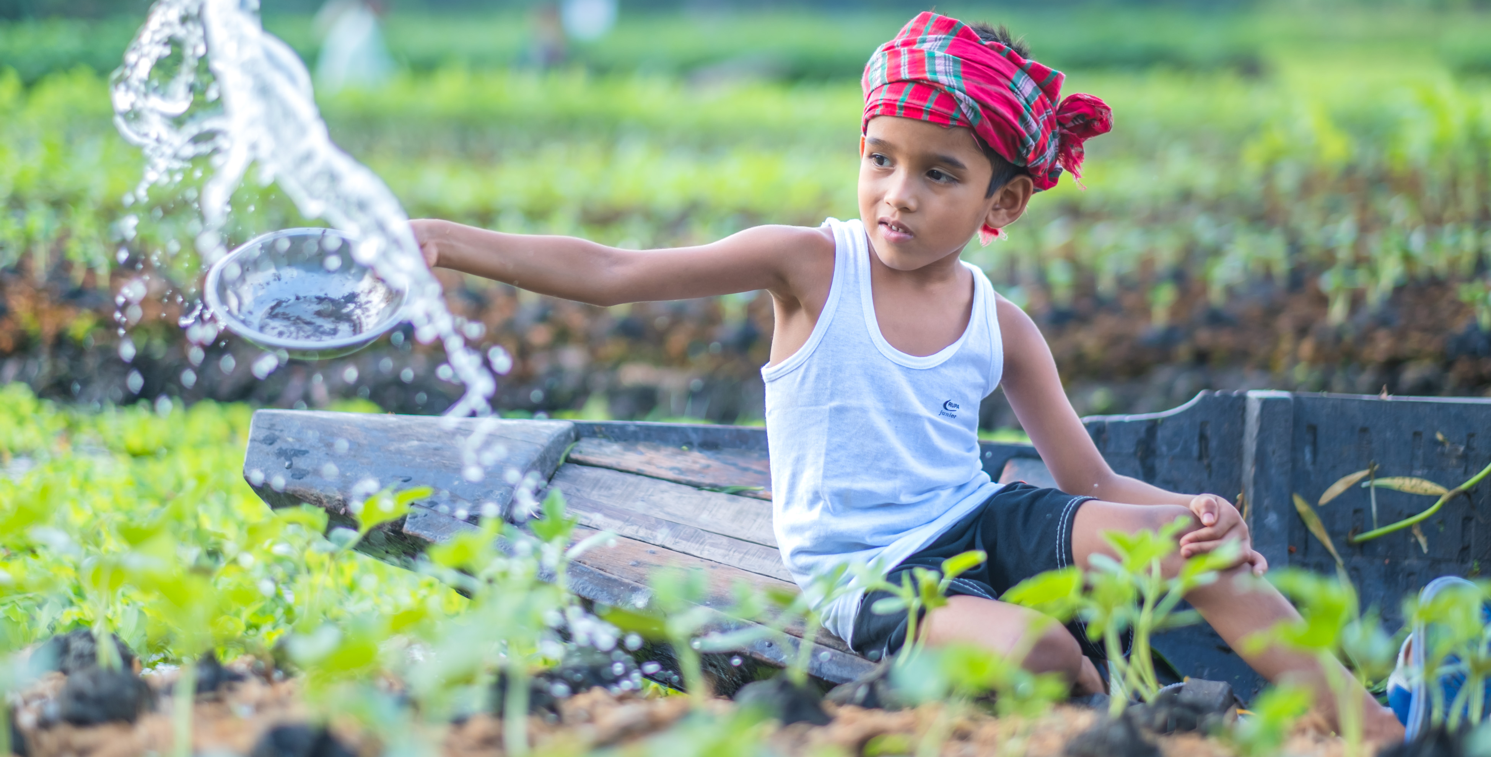
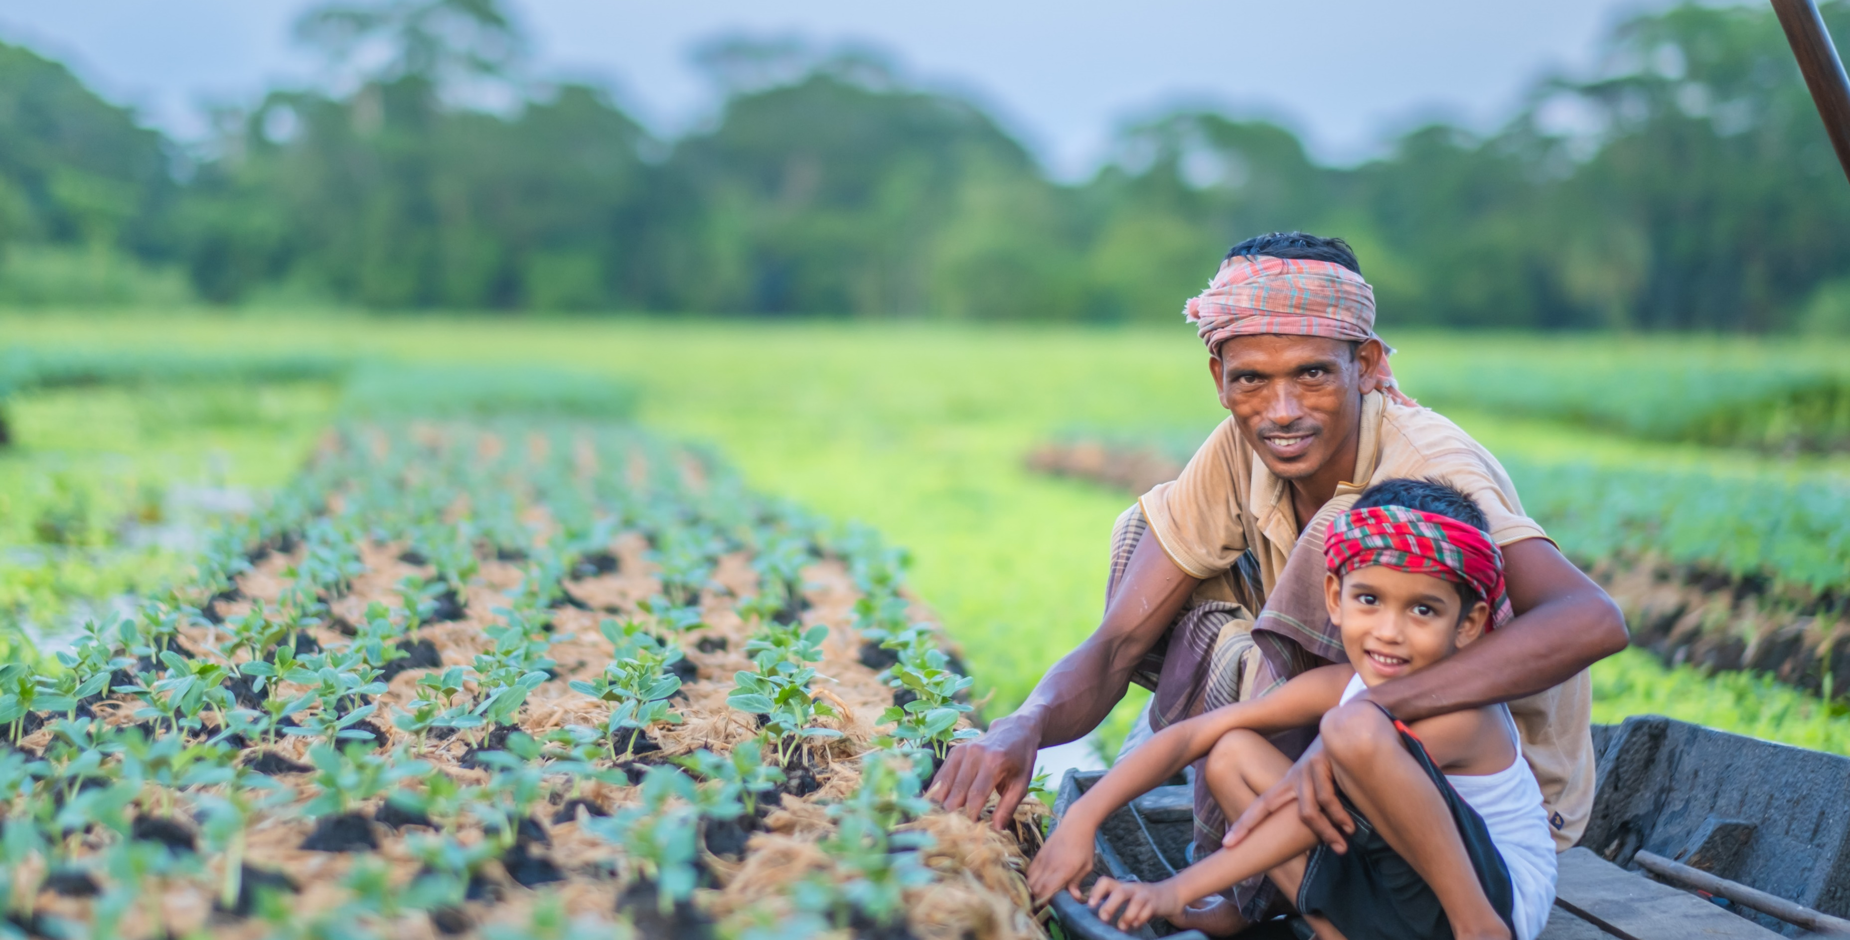
Get involved with CAFOD this term
Big Lent Walk resources
Save the date!
Lent resources
Join us on the Big Lent Walk!
Join our national assembly
Explore our Lent resources

Slide 16


