Slide 1
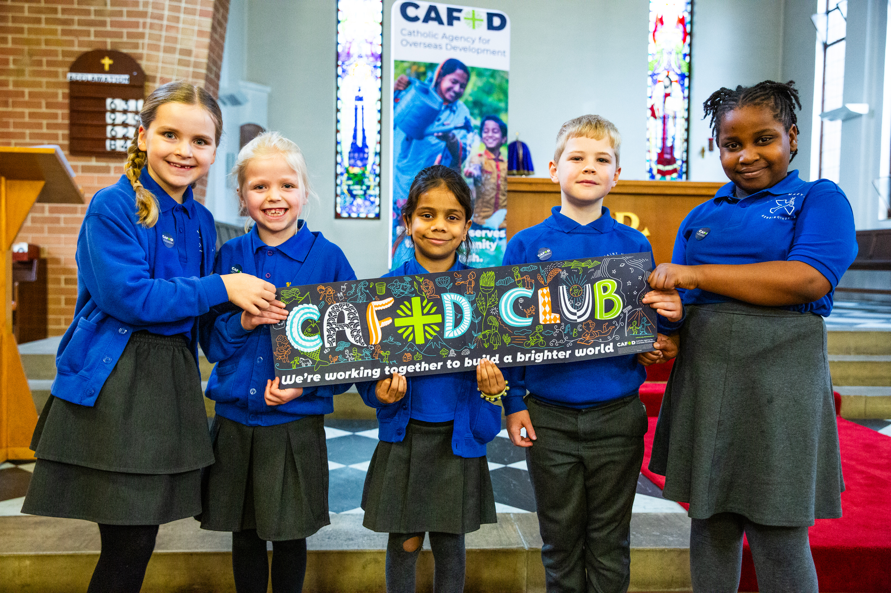
A better world needs all of us, so what can we do to help change it?
Gospel Celebration of the Word
Notes:
Children’s liturgy: Fourth Sunday of Lent (Year A)
Preparation of the worship space
Colour: purple (or rose)
Props: blindfold; covered box containing objects for the children to identify by touch, smell and sound.
Song suggestions
Look around you (936, Laudate)
Welcome
Today we hear how Jesus helped a blind man to see again. We can see many wonderful things that God has made in our world. But we also need to open our eyes to where things have gone wrong and try to do what we can to change them. Let’s think some more about this today.
Pupils at Our Lady of Perpetual Help primary, Doncaster
Photo credit: Thom Flint

Slide 2
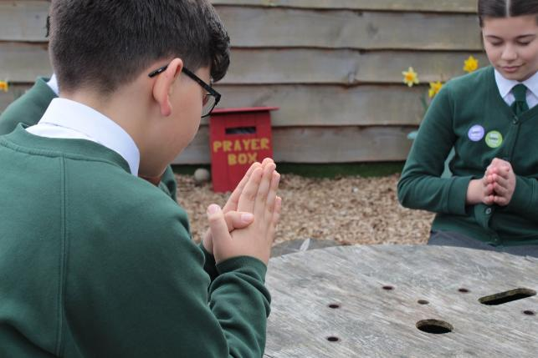

God of power and glory, We give you thanks for the gift of sight. Open our eyes to the good things in this world. Help us also to see when things are wrong and what we can do to change them. Amen.
Gather
Notes:
St Francis Xavier's RC Primary School, Herefordshire
Photo credit: Vicky Ahmed

Slide 3

Gospel: John 9:1-41 or John 9:1, 6-9, 13-17, 34-38
As Jesus was walking along, he saw a man who had been born blind.
Jesus spat on the ground and made some mud with the spittle; he rubbed the mud on the man’s eyes and said, “Go and wash your face in the Pool of Siloam.” (This name means “Sent.”) So, the man went, washed his face, and came back seeing.
His neighbours, then, and the people who had seen him begging before this, asked, “Isn’t this the man who used to sit and beg?” Some said, “He is the one,” but others said, “No he isn’t; he just looks like him.”
So the man himself said, “I am the man.”
Word
Notes:
Gospel: John 9:1-41 or John 9:1, 6-9, 13-17, 34-38. On the slide is the shortened version.

Slide 4
They took to the Pharisees the man who had been blind. The day Jesus made mud and cured him of his blindness was a Sabbath. The Pharisees, then, asked the man again how he had received his sight. He told them, “He put some mud on my eyes; I washed my face, and now I can see.”
Some of the Pharisees said, “The man who did this cannot be from God, for he does not obey the Sabbath law.”
Others, however, said, “How could a man who is a sinner perform such miracles as these?” And there was division among them.
So, the Pharisees asked the man once more, “You say he cured you of your blindness – well, what do you say about him?”

Slide 5
“He is a prophet,” the man answered.
They answered, “You were born and brought up in sin – and you are trying to teach us?” And they expelled him from the synagogue.
When Jesus heard what had happened, he found the man and asked him, “Do you believe in the Son of Man?”
The man answered, “Tell me who he is, sir, so that I can believe in him!”
Jesus said to him, “You have already seen him, and he is the one who is talking with you now.”
“I believe, Lord!” the man said, and knelt down before Jesus.

Slide 6

What do you remember from the Gospel reading?
Jesus makes a paste, puts it on the blind man’s eyes and tells him to wash in a pool.
When the blind man does this, he can see.
How do you think the man felt at being able to see for the first time?
Respond
Notes:
Happy man
Photo credit: Stock image

Slide 7
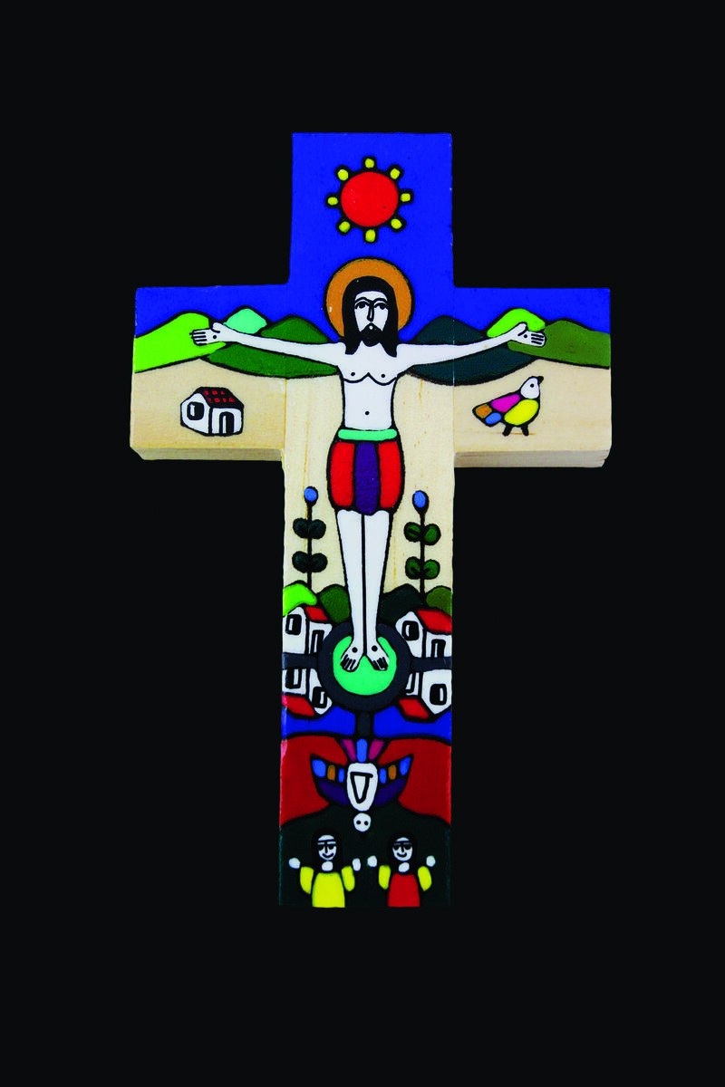
The Pharisees (some of the religious leaders of the time) question the man and his parents to find out how Jesus gave him his sight.
The man tells them, but they do not believe it and grow angry.
Jesus tells the Pharisees that they are blind because they cannot see that he is the Son of God.
Notes:
Romero cross from El Salvador
Photo credit: CAFOD

Slide 8
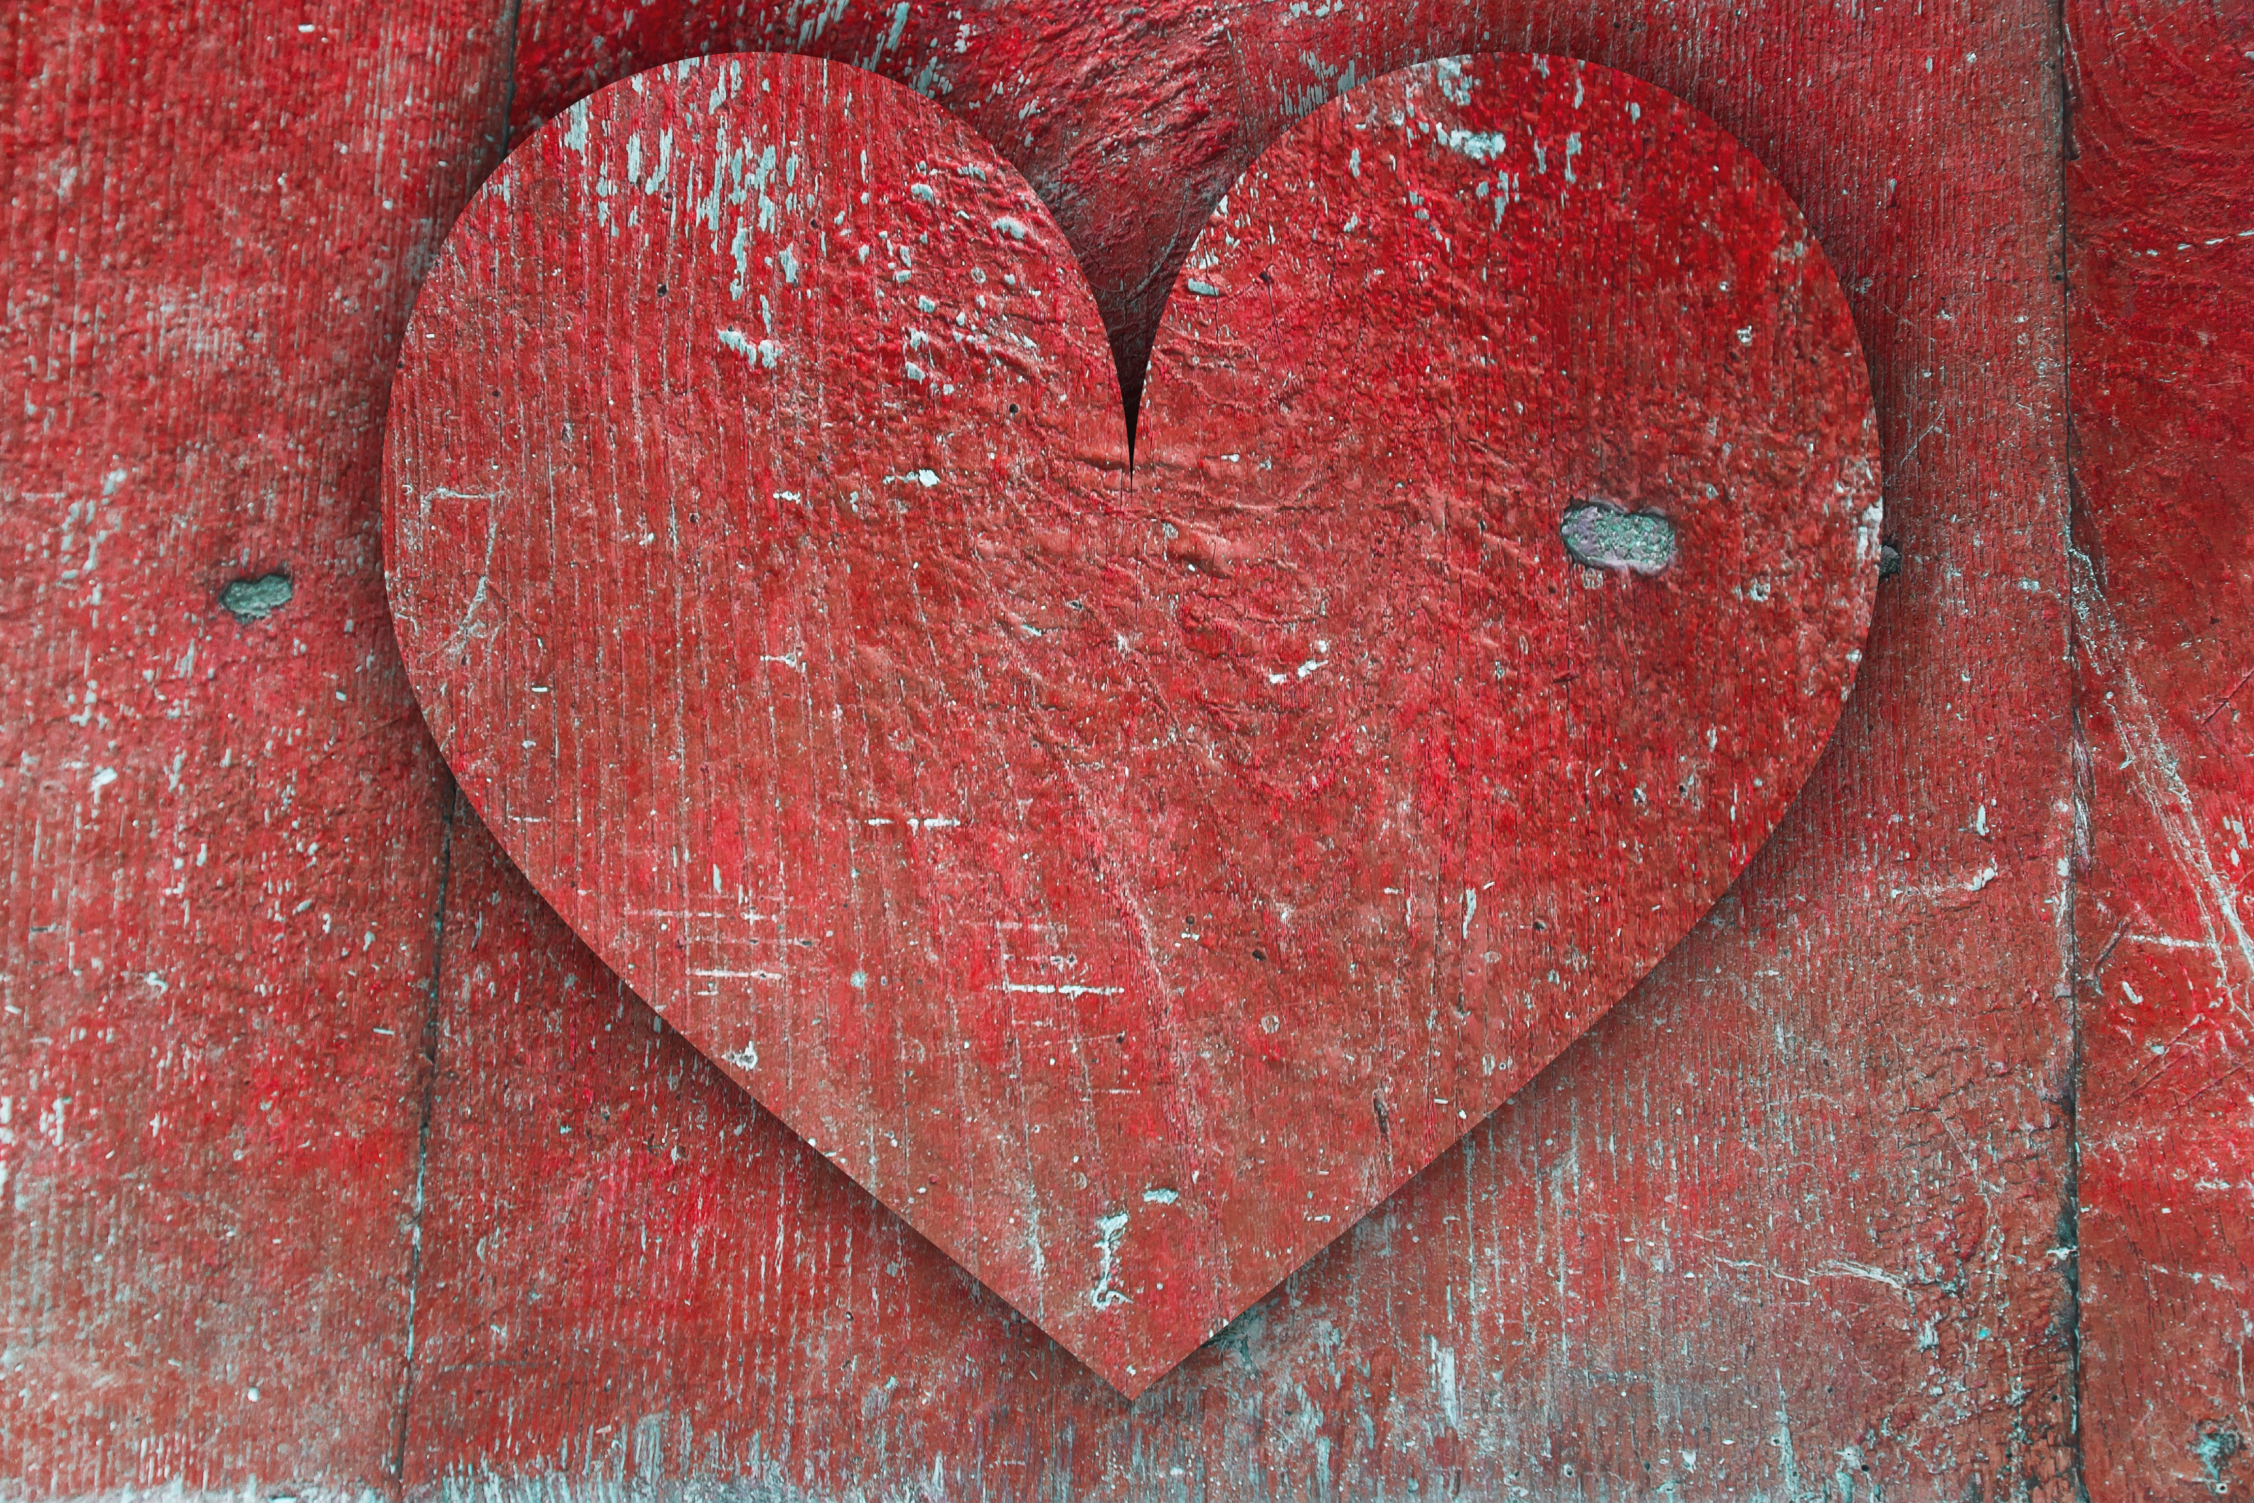
While there is nothing wrong with their eyes, the Pharisees do not open their hearts to see the truth of who Jesus is.
It is the blind man who is able to see and to believe that Jesus is the Christ, the Son of God.
God has given us five senses to learn about the world around us. Do you know what those five senses are?
Notes:
Heart
Photo credit: Stock image

Slide 9
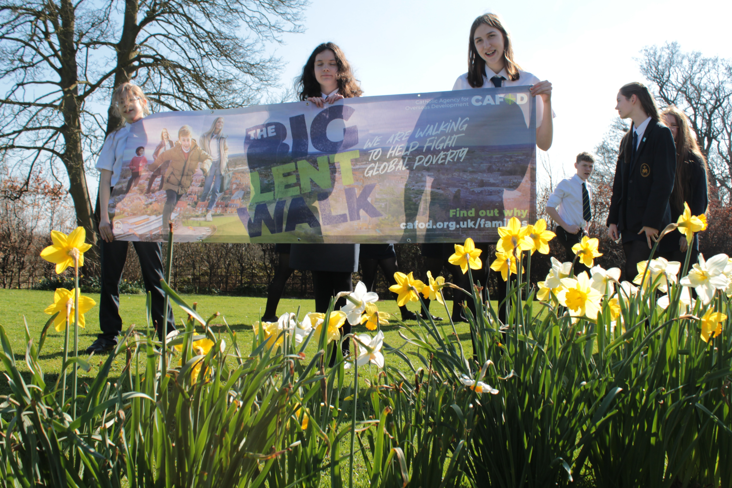
We can see all the beautiful and wonderful things that God has created like birds, trees, flowers, fish, family and friends.
We can hear lovely music and birds singing.
We can smell flowers, the sea, and grass when it has just been cut.
We can taste yummy food and drink.
We can feel the sun warm on our skin, the soft fur of a pet when we stroke it, and the hands of our friends when we do a high five.
Notes:
Students at St Mary’s High School
Photo credit: Victoria Ahmed

Slide 10
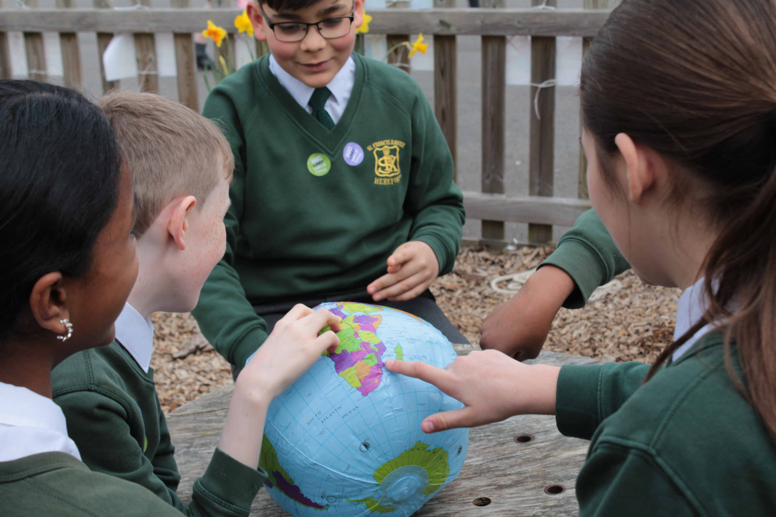
Can you tell me some of the wonderful things in our world that you have seen, heard, smelled, tasted or felt today?
As well as our five senses, we also need to open our hearts, so that we can feel God’s love for us and see the truth about the world around us.
Sometimes there are problems or things that are not right in this world. We can take notice of these problems and try to make them better.
Notes:
Pupils at St Francis Xavier Primary school
Photo credit: Victoria Ahmed

Slide 11
We can see that it is not fair for some people in the world to have lots of money, power and things. Meanwhile, others are poor, or hungry, or do not have a safe place to live.
We can see we are damaging our planet and the climate is changing. Floods, droughts and natural disasters are happening more often, affecting more people around the world.
Notes:
Pupils at St Mary’s Primary School
Photo credit: Thom Flint

Slide 12
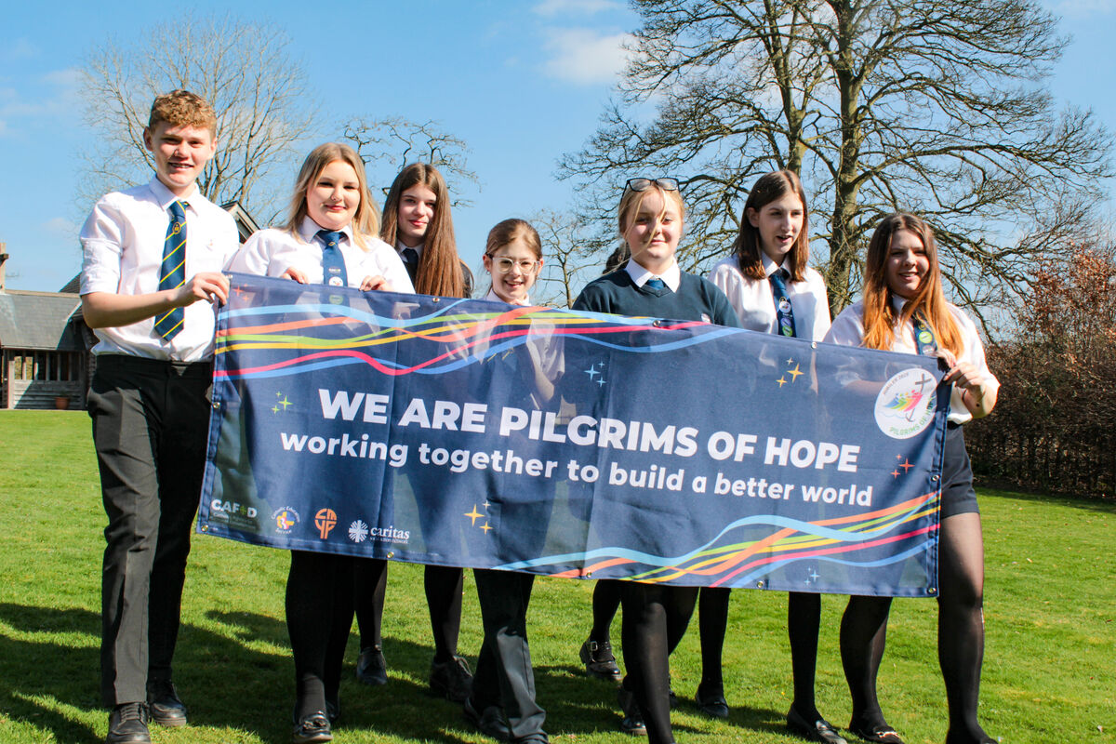
But we can also see what is possible when people work together to solve problems.
For example, thanks to support from you and your grown ups, CAFOD helps people who are poor around the world. It supports them to rebuild their homes after war or natural disaster, to grow their own food, to get clean water, to find new ways to earn money and to care for the earth at the same time.
Notes:
St Mary's RC High School, Herefordshire
Photo credit: Victoria Ahmed

Slide 13
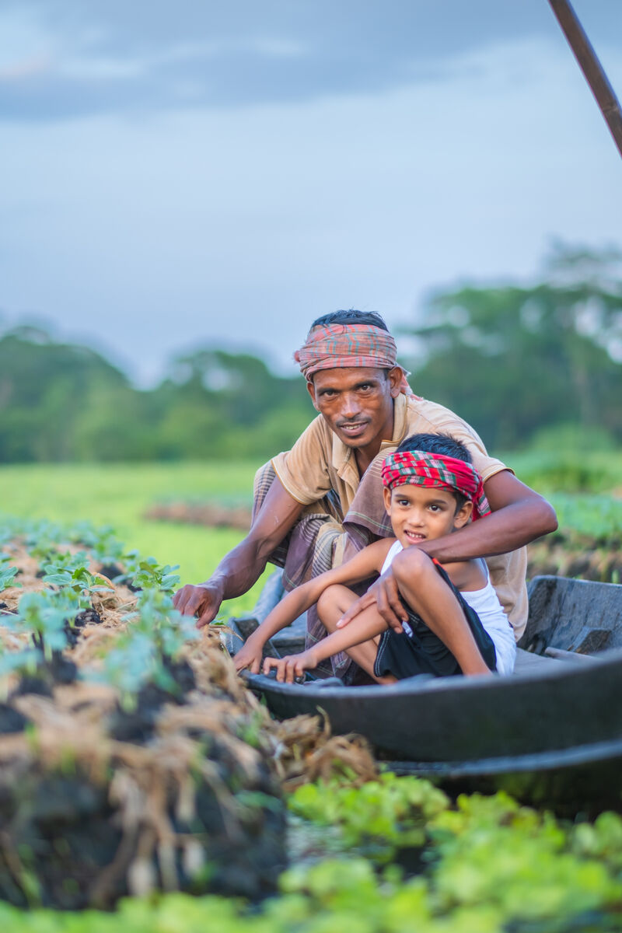
We can help our global brothers and sisters this Lent – people like the community that lives in Choto Bashail in Bangladesh.
Zunayed likes visiting the floating gardens his family now cultivates. Before, too much rain damaged their crops and they had to find another way to grow food.
Zunayed's father, Zahidul, saw neighbours plant floating beds. Curious, he went to training sessions, learning how to build them.
Notes:
Zunayed and his father, Zahidul, Bangladesh
Photo credit: Amit Rudro

Slide 14
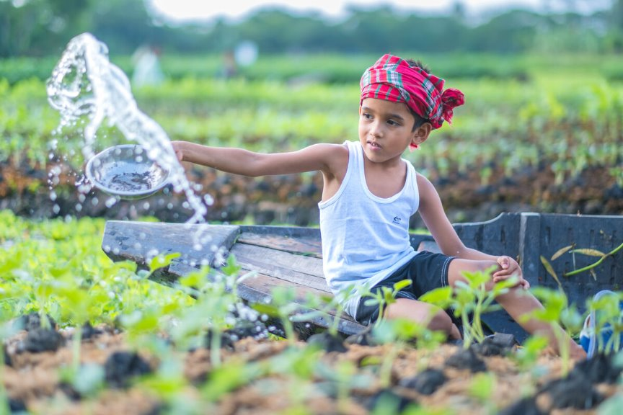
Zahidul is happy that he can provide enough food for his family. He can also sell what is left over to buy the other things they need like clothes and soap.
Zunayed is keen to keep an eye on things – checking that the plants on the floating beds are growing well.
Notes:
Zunayed in the floating garden, Bangladesh
Photo credit: Amit Rudro

Slide 15

During Lent, we can pray for those living in poverty, asking God to be with them as they work hard to put food on the table for their families.
We can also do the Big Lent Walk to walk in solidarity with our brothers and sisters in need and get sponsored.
With the money you raise, CAFOD's local experts can help our global family to help themselves.

Slide 16
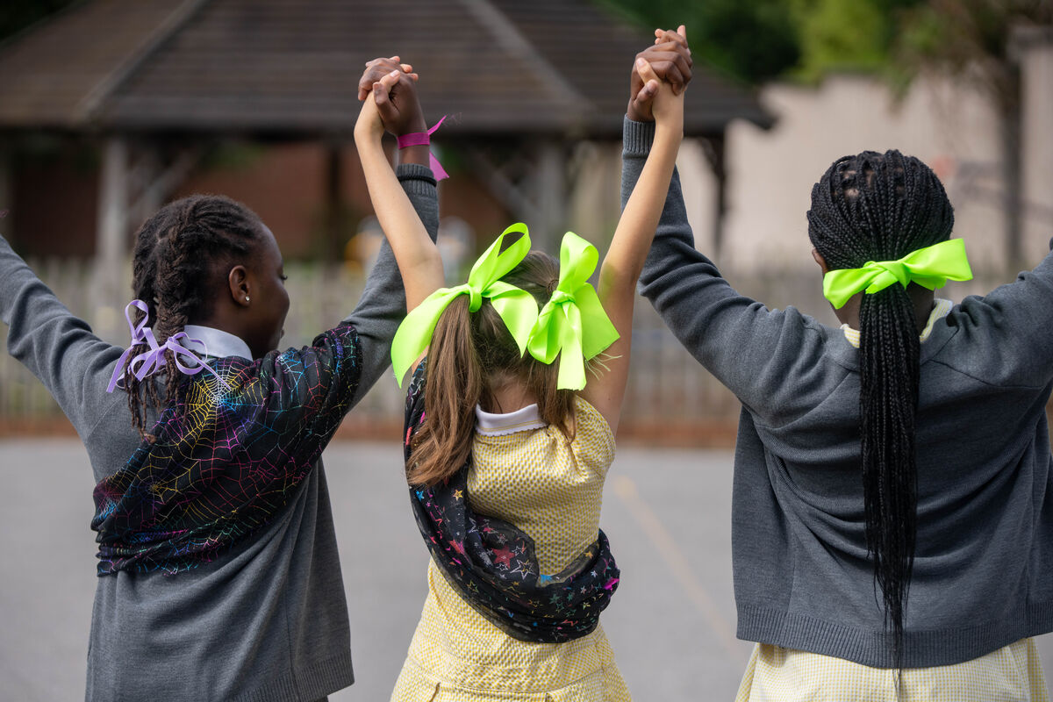
God calls us to use our gifts and not to ignore the problems that we see.
We can try our best instead to make a difference, to care for our earth and to work together with our global brothers and sisters to build a better world.
But a better world needs every one of us to play our part. So, this week, look out for all the good things that you can see. If you see anything that is wrong or unfair, think about what you could do to help change it.
Notes:
Pupils at St Chad's school,
Photo credit: Joe Newman

Slide 17
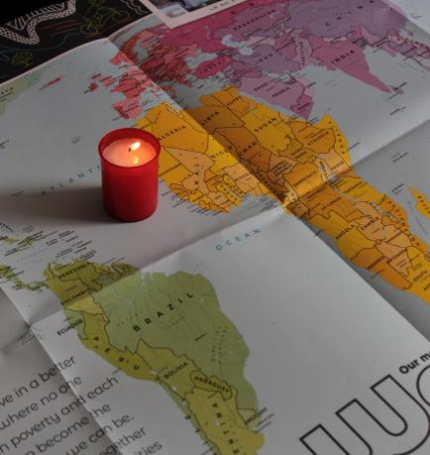
Let us pray
We pray for world leaders:
that the Holy Spirit will open their eyes to see the problems that their people face and find solutions that create a better world for all people to live in.
Lord in your mercy…
We pray for our parish, families and friends:
that the Lord may guide us to notice the problems of others and that together we may do all we can to make a difference.
Lord in your mercy...

Slide 18
Let us pray
We pray for people that are poor, hungry, sick or homeless:
that with God's help, we may work together with them to build a better future.
Lord in your mercy…
God of hope: inspire us to look out into the world, praising and thanking you for all that is good and seeking your help when we try to change what is not fair or right. Amen.

Slide 19
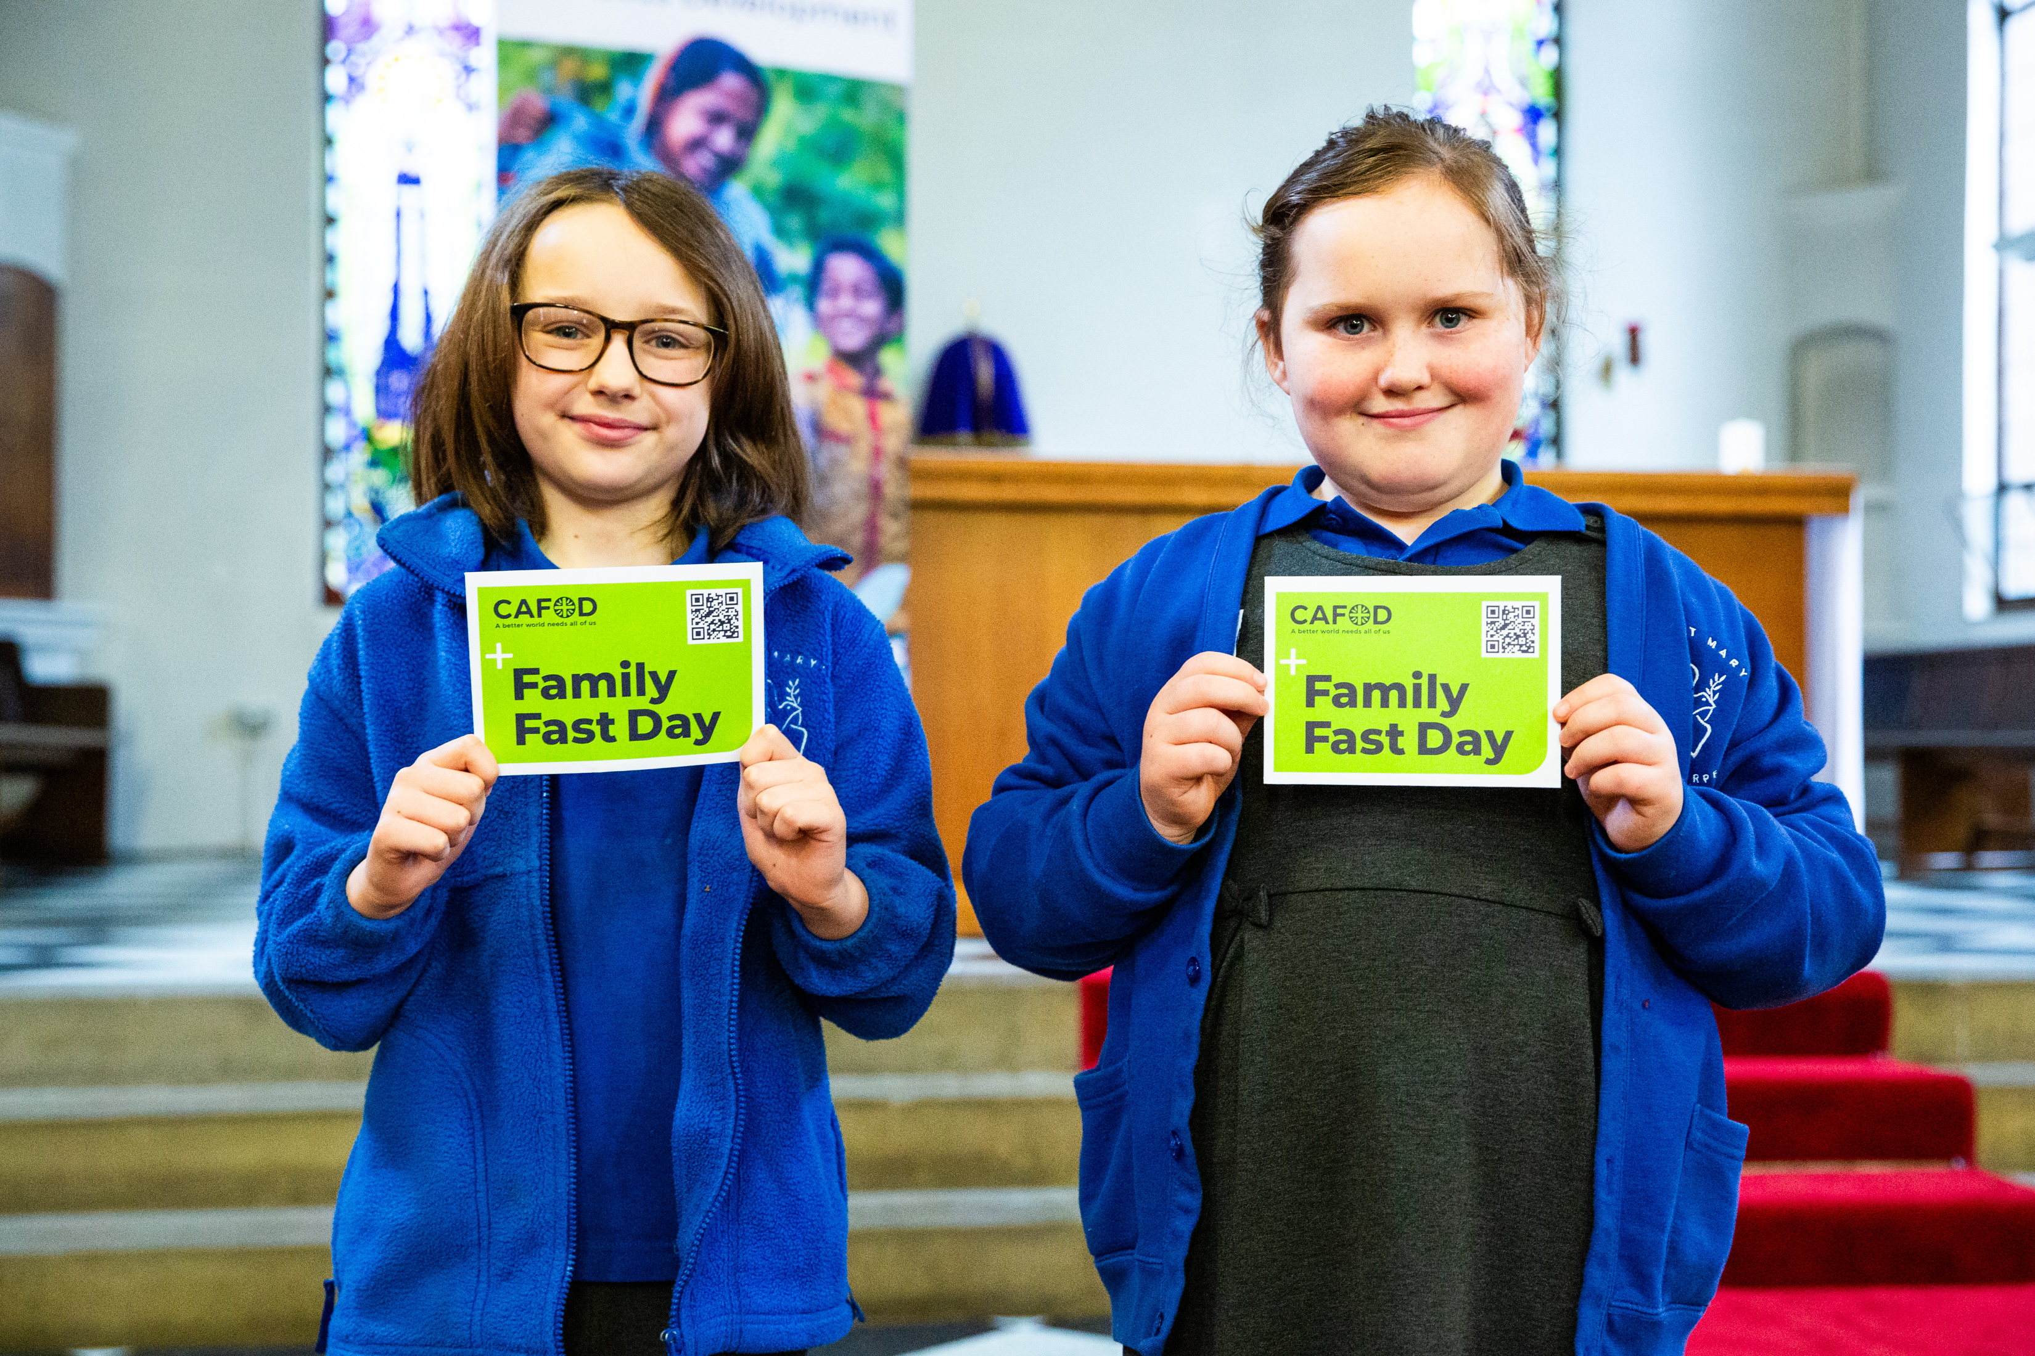

A better world needs all of us, so what can we do to help change it this week?
Send
Notes:
Pupils at St Mary’s Primary School
Photo credit: Thom Flint

Slide 20
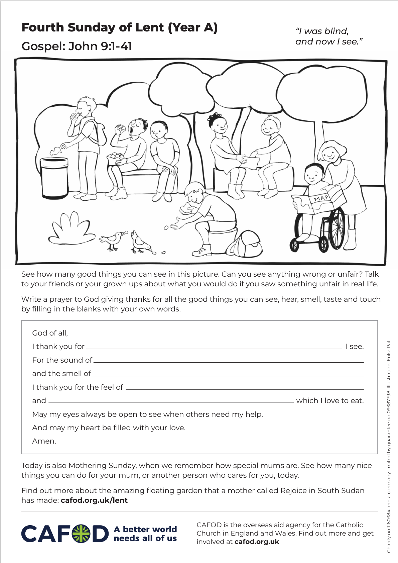
Activity suggestions
Download the illustration
Share the accompanying activity sheet with the children and encourage them to complete it, either in the liturgy or at home. Invite them to colour in the illustration and see how many good things they can spot in it.
Play a blindfold game with the children so that they can think about what life might have been like for the blind man in the reading. Invite the children to take turns to wear a blindfold.
While blindfolded invite them to identify one or two objects from a covered box by feel or by smell where appropriate. The box could include objects such as a banana, apple, wooden spoon, hairbrush, keys etc. You could also play/make a sound and see if the children can guess what object is making the noise.
Notes:
Illustration: Erika Pal

Slide 21
Remind the children to share all that they have heard and thought about today with the people at home. Encourage them to look out for at least one thing to be thankful to God for and one thing that they would like to change during the week, and to make that change even if it is small.
See Lent 2026 resources for primary schools for more child-friendly fundraising and other activities this Lent.

Slide 22
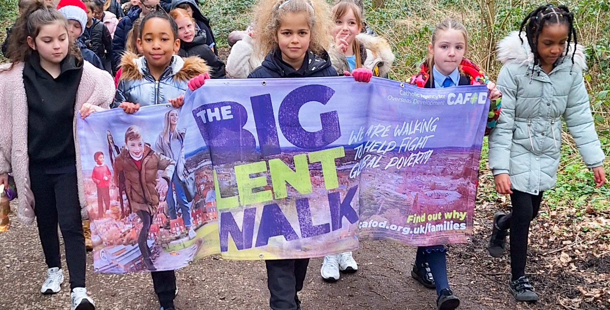

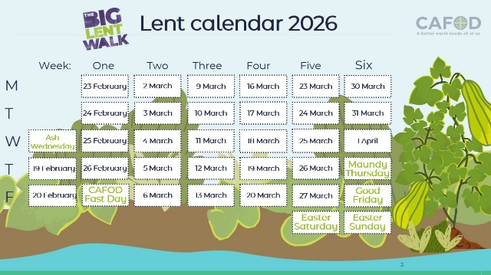
Get involved with CAFOD this term
Big Lent Walk resources
Lent national assembly
Lent resources
Join us on the Big Lent Walk!
Join our national assembly
Explore our Lent 2026 resources

Slide 23
