Slide 1
Gather
How can I make a change, doing what is right and forgiving others?
Notes:
Children’s liturgy – Fifth Sunday in Lent
Preparation of the worship space
Colour: purple
Song suggestions: Make me a channel of your peace (898, Laudate)
Welcome: When people have done something wrong to us, we often feel angry and want them to be punished, don’t we? But in today’s gospel Jesus teaches us that this isn’t always the right way. After all, we’re not perfect either are we?
Children together
Photo credit: Annie Spratt on Unsplash

Slide 2
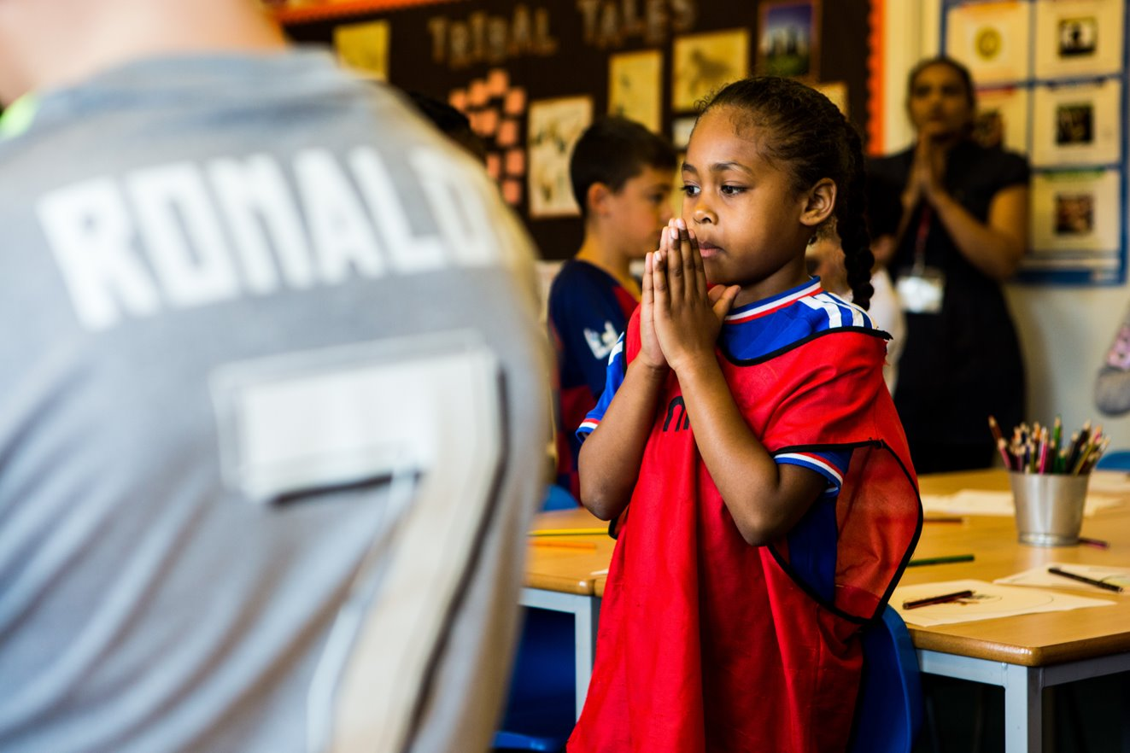
God of mercy,
we ask you to help us to do what is right.
Help us to see that we all get things wrong sometimes and to say sorry when we do.
Amen.
Notes:
Children at Our Lady Queen of Heaven Primary School
Photo credit: Thom Flint

Slide 3
Gospel: John 8:1-11
Jesus went to the Mount of Olives. Early the next morning he went back to the Temple. All the people gathered round him, and he sat down and began to teach them.
The teachers of the Law and the Pharisees brought in a woman who had been caught committing adultery, and they made her stand before them all. “Teacher,” they said to Jesus, “this woman was caught in the very act of committing adultery. In our Law Moses commanded that such a woman must be stoned to death. Now, what do you say?”
They said this to trap Jesus, so that they could accuse him. But he bent over and wrote on the ground with his finger. As they stood there asking him questions, he straightened himself up and said to them, “Whichever one of you has committed no sin may throw the first stone at her.” Then he bent over again and wrote on the ground. When they heard this, they all left, one by one, the older ones first. Jesus was left alone, with the woman still standing there. He straightened himself up and said to her, “Where are they? Is there no one left to condemn you?”
“No one, sir,” she answered. “Well, then,” Jesus said, “I do not condemn you either. Go, but do not sin again.”
Word

Slide 4
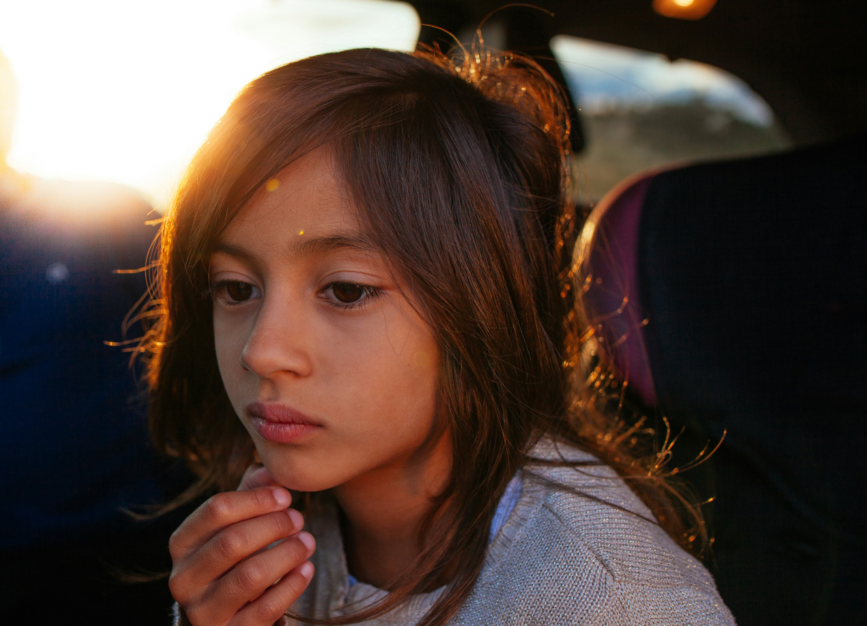
What do you remember from the Gospel reading?
Why would Jesus invite the person without sin to throw the first stone?
How do you think the woman felt when Jesus forgave her?
We have all done things wrong. Quietly think of a time when you did something wrong.
How did it feel? How did it feel when you had said sorry, and been forgiven? Will you try not to do whatever it was again?
Respond
Notes:
Child thinking
Photo credit: Joseph Gonzalez on Unsplash

Slide 5
The scribes and Pharisees bring a woman to Jesus who has done something wrong. The law says she should be punished, but the Pharisees ask Jesus what he'd do.
Jesus says that the person who has done nothing wrong themselves should be the person who throws the first stone at the woman.
Slowly, all the scribes and Pharisees leave, until just the woman and Jesus are left.
Jesus says he will not punish her either, but she should go away and try to do the right thing from now on. How did the woman feel when she heard this? Is it easy to change?
Notes:
Illustration: Jane Smith

Slide 6
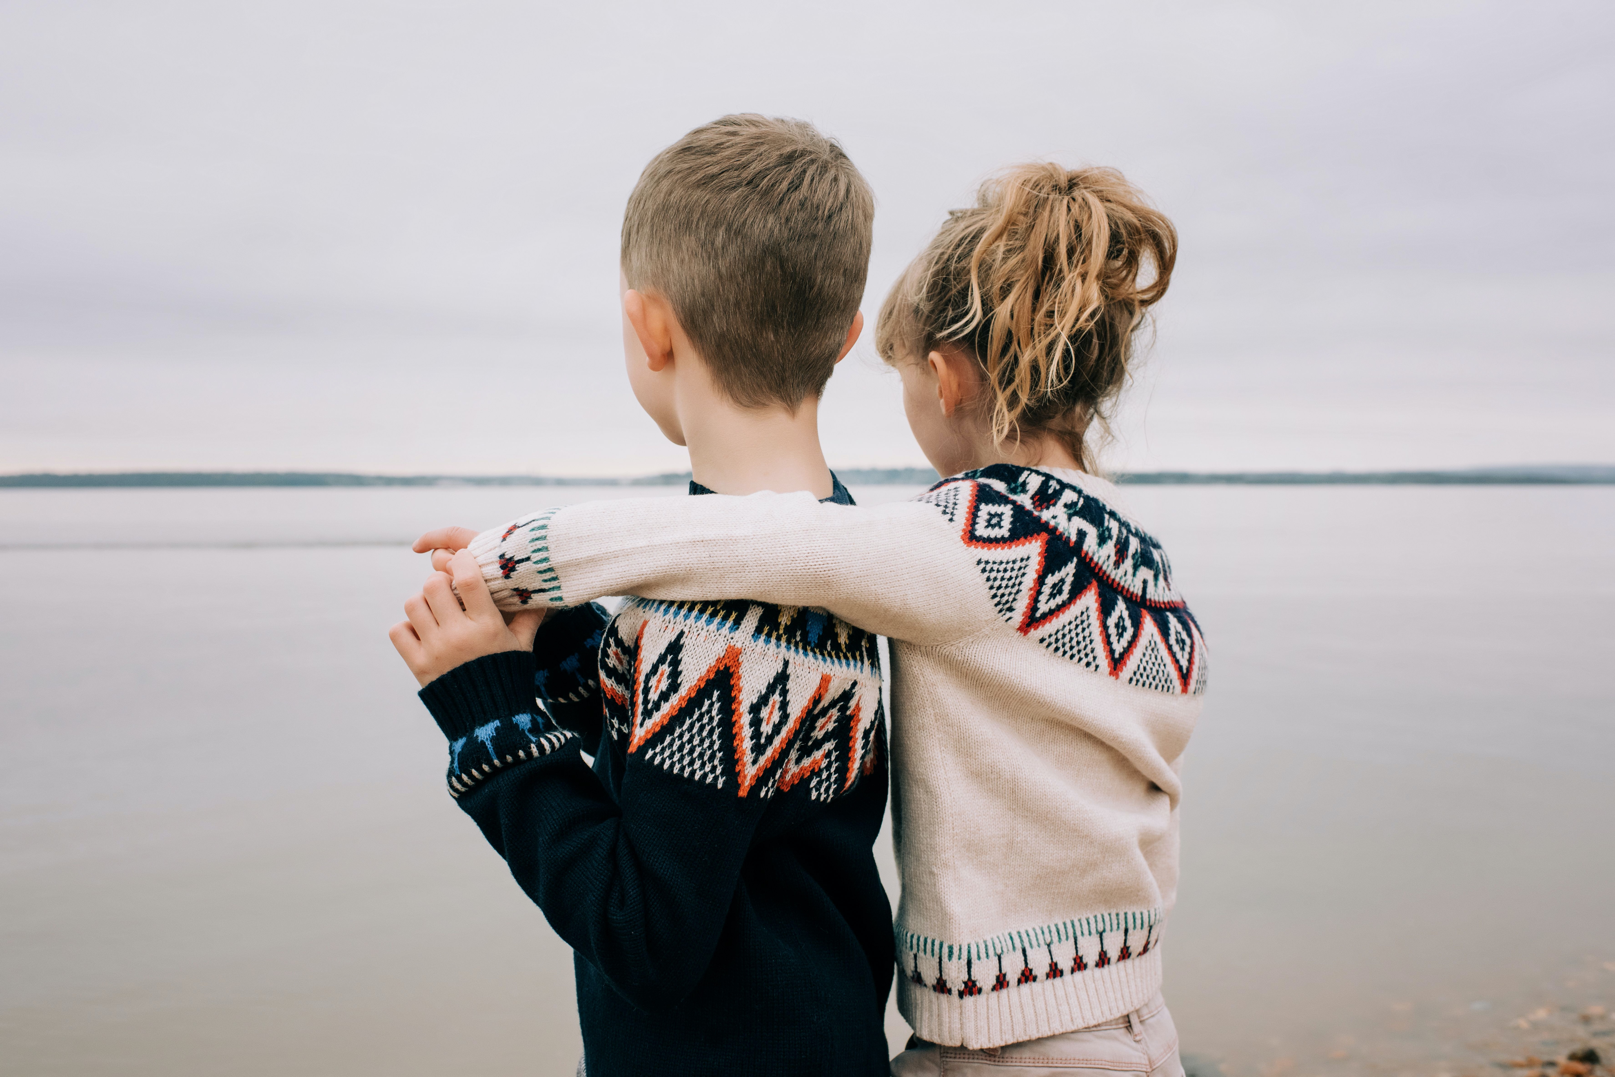
Can you think of a time when you did something wrong?
Don’t say it out loud, but keep it in your head.
How did it feel when you knew you had done something wrong?
What happened next? Did you get told off?
How did it feel when you had said sorry, and been forgiven?
Will you try not to do whatever it was again?
Notes:
Boy and girl
Photo credit: Stock image

Slide 7
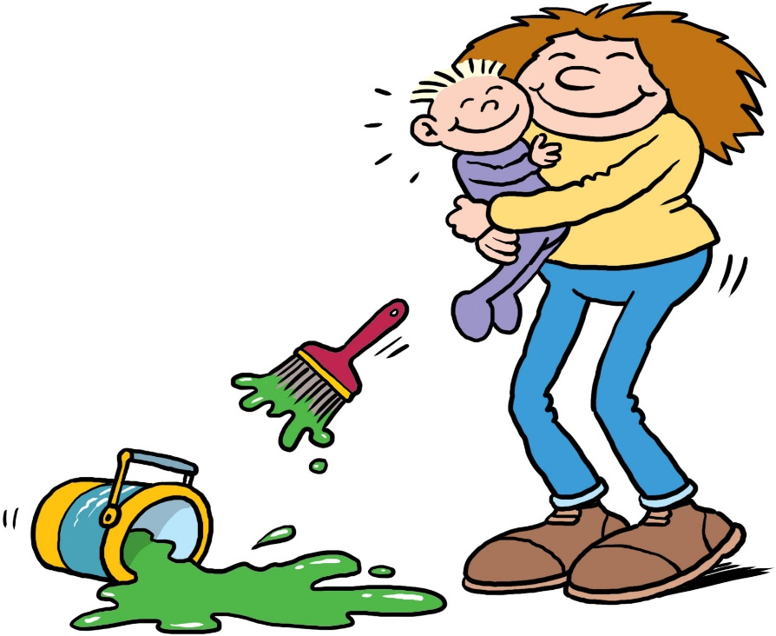
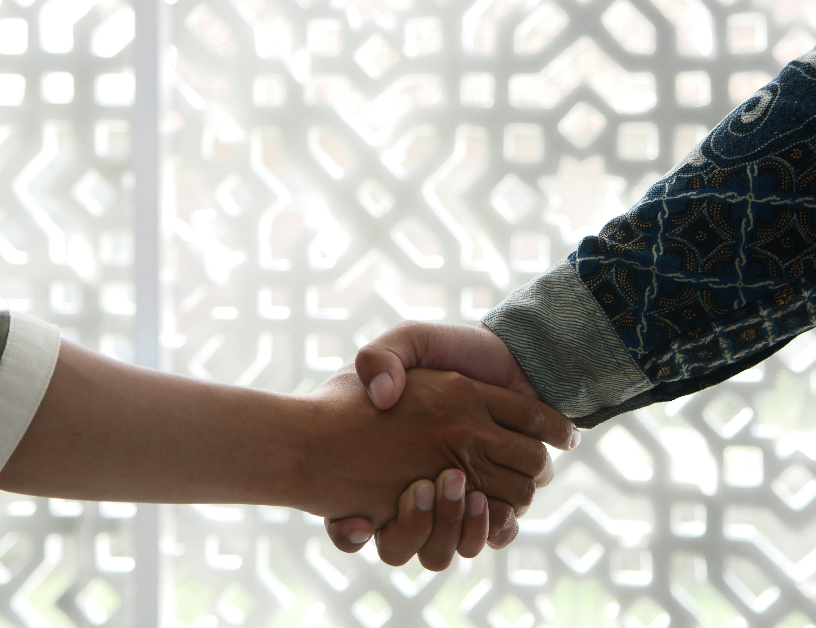
Jesus knows none of us are perfect. He forgives us for the things we have done wrong and no matter what, he always loves us.
But he also asks us to change, to try our hardest not to do the wrong thing again.
Jesus asks us not to judge people who have done something wrong, because we all do wrong things sometimes. Instead, we should try to forgive them, as God forgives us.
But we should also try to help them see that they need to change, so that they no longer do what is wrong, or hurt others.
Notes:
Shaking hands
Photo credit: Masjid Maba on Unsplash

Slide 8
We all have times when we are treated unfairly, and it hurts. We also all have times when we are not quite a nice as we should be.
Let's try and forgive those who treat us unfairly and to follow Jesus' example of love for all people. But let's also try to make a change – to do what is right, to help others to feel God's love in the way that we treat them.
Notes:
Hands in a heart
Photo credit: Stock image

Slide 9
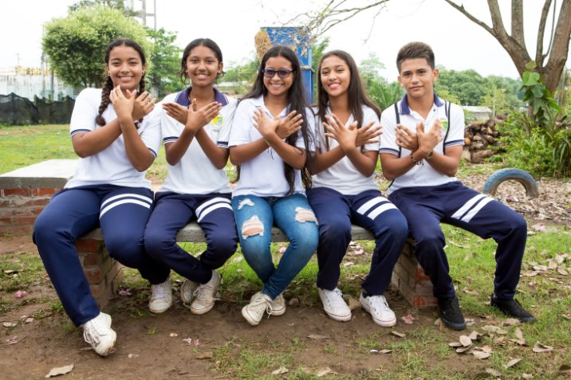
Rosana and her friends live in Colombia where there has been fighting for many years.
Rosana and her school friends are part of a peace-building project, where they learn about forgiveness.
"My classmates and I had to share our dreams, aims and goals," says Rosana.
"We are not interested in continuing with war, we have much greater aspirations,” she says.
Notes:
Rosana and friends, Colombia
Photo credit: Jessica Michelmore

Slide 10
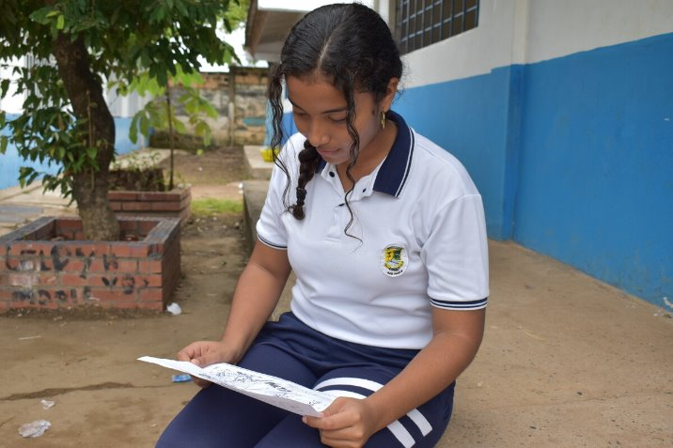
With CAFOD's help, workshops teach young people about forgiveness and how to build peace.
They are taught to share what they have learnt with their families and neighbours so that everyone can learn about forgiveness and try to live peaceful lives.
Notes:
Rosana, Colombia
Photo credit: Jessica Michelmore

Slide 11
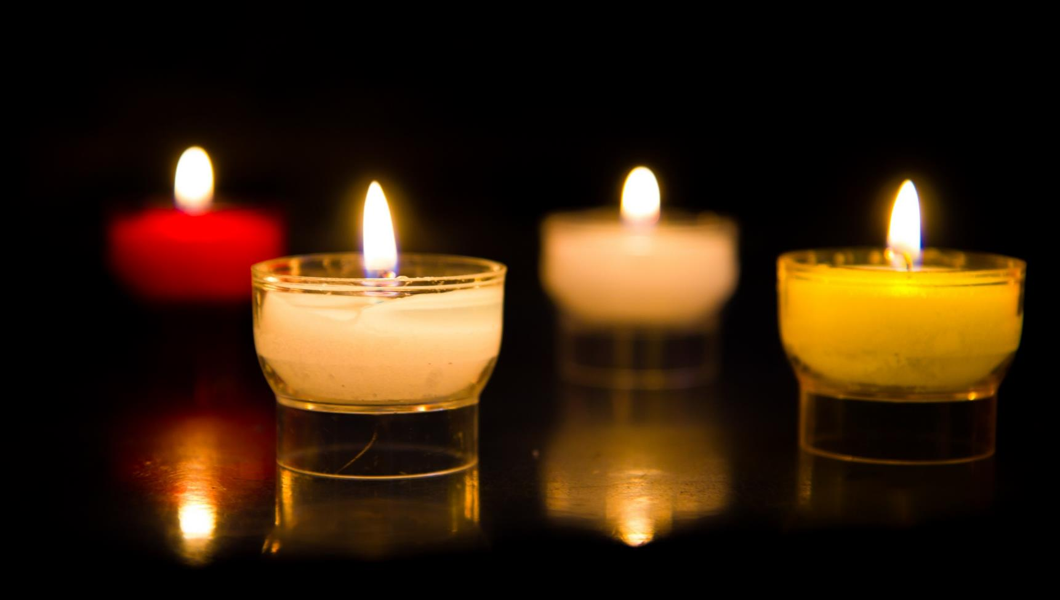
Let us pray…

Slide 12
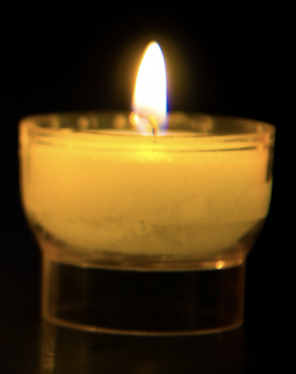
We pray for the Church throughout the world: that she may follow Jesus’ example and show understanding and forgiveness to all people. Lord, in your mercy…
In this Jubilee Year, we pray that we may be signs of hope in our world through all that we do and how we treat one another. Lord, in your mercy…

Slide 13
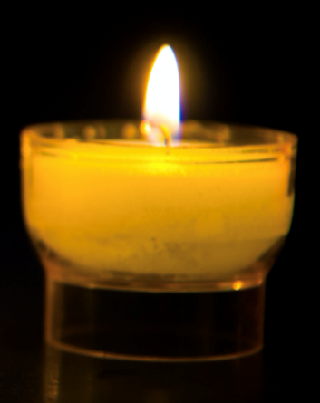
We pray for our parish, family and friends: that we may always try our best to do what is right, so that the world becomes a fairer place for all to live.
Lord, in your mercy…
God of love,
you forgive us when we go wrong and encourage us to try again to be better. Guide us to do what is right and to make this world a fairer place for all who live in it. Amen.

Slide 14
How can I make a change, doing what is right and forgiving others?
Send
Notes:
Boys playing football
Photo credit: CAFOD

Slide 15
Activity suggestions
Share the activity sheet with the children and invite them to colour in the illustration. Encourage them to try the other activities on the sheet at home during the week.
Remind the children to tell their grown-ups all that they have heard and thought about in the liturgy today. Can they try throughout the week to make a change, do what is right and forgive others? Can they try to stand up against unfairness and make the world a fairer place for everyone?
For more activities and resources for children this Lent visit
cafod.org.uk/primary
A CAFOD club could strongly support the Catholic life of your school. Find out more: https://cafod.org.uk/Education/For-teachers/CAFOD-clubs
Notes:
Illustration: Jane Smith

Slide 16
Jubilee activities!
The Jubilee Year is a landmark moment in the life of the global church. School communities are invited to join together as pilgrims of hope, pledging to work together for God’s kingdom of justice, peace and love. Find resources at:
Jubilee for schools 2025 – Pilgrims of Hope
Why not make the Big Lent Walk part of your Jubilee pledge?
For sign up and more information go here:
BLW25 Schools Sign up – Formstack
Find resources to learn about and fundraise for the Myanmar Earthquake: https://cafod.org.uk/education/education-resources/emergency-resources-schools
A CAFOD club could strongly support the Catholic life of your school, particularly in this Jubilee year. Find out more:
https://cafod.org.uk/Education/For-teachers/CAFOD-clubs

Slide 17
Notes:
Illustration: Jane Smith

