Slide 1
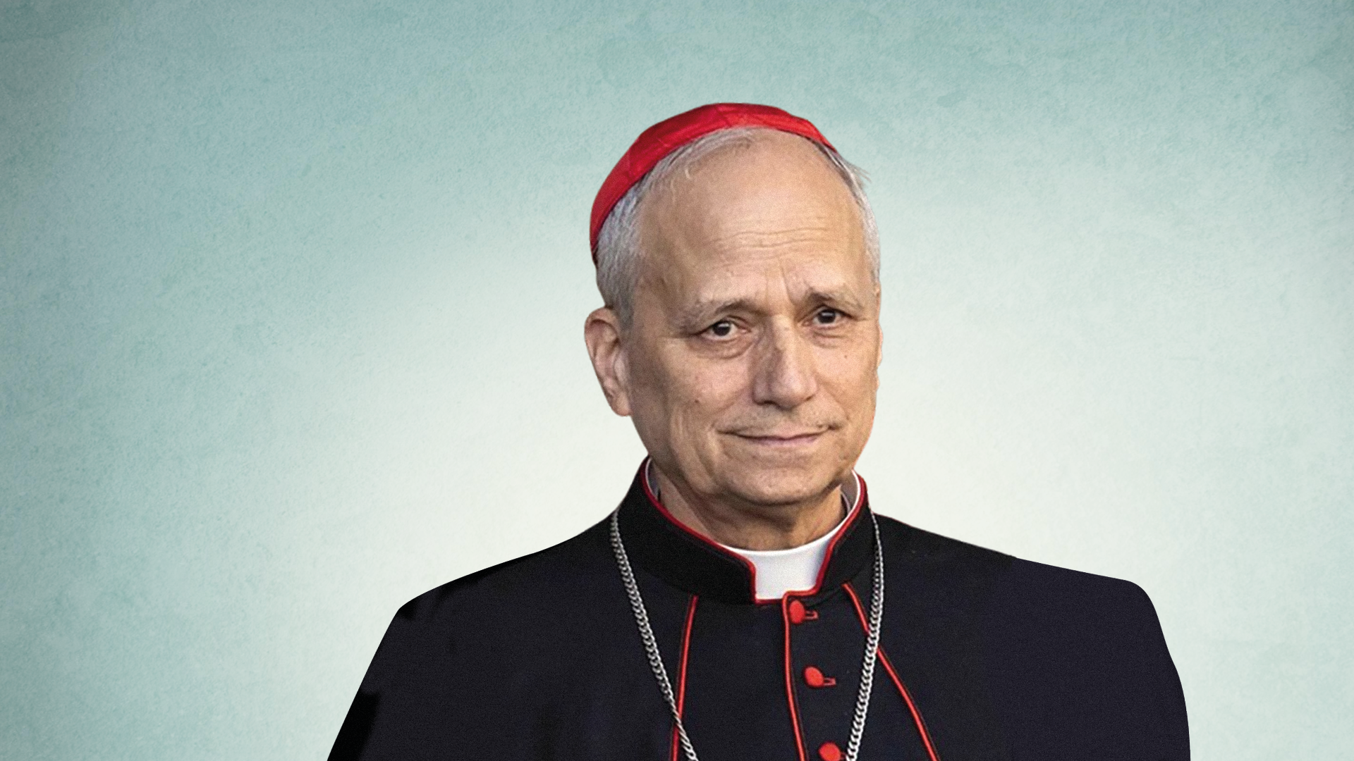
Pope Leo XIV
An assembly for secondary schools

Slide 2
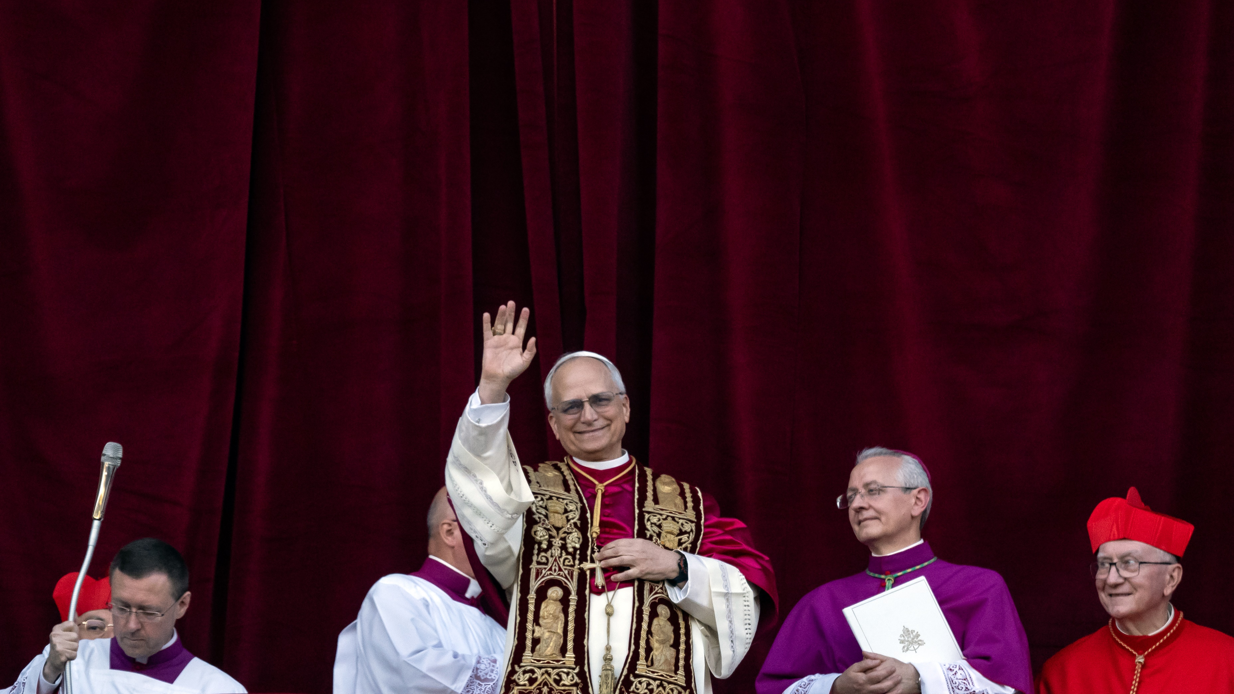
“Peace be with you all.”
Pope Leo XIV
Notes:
© Mazur/cbcew.org.uk

Slide 3
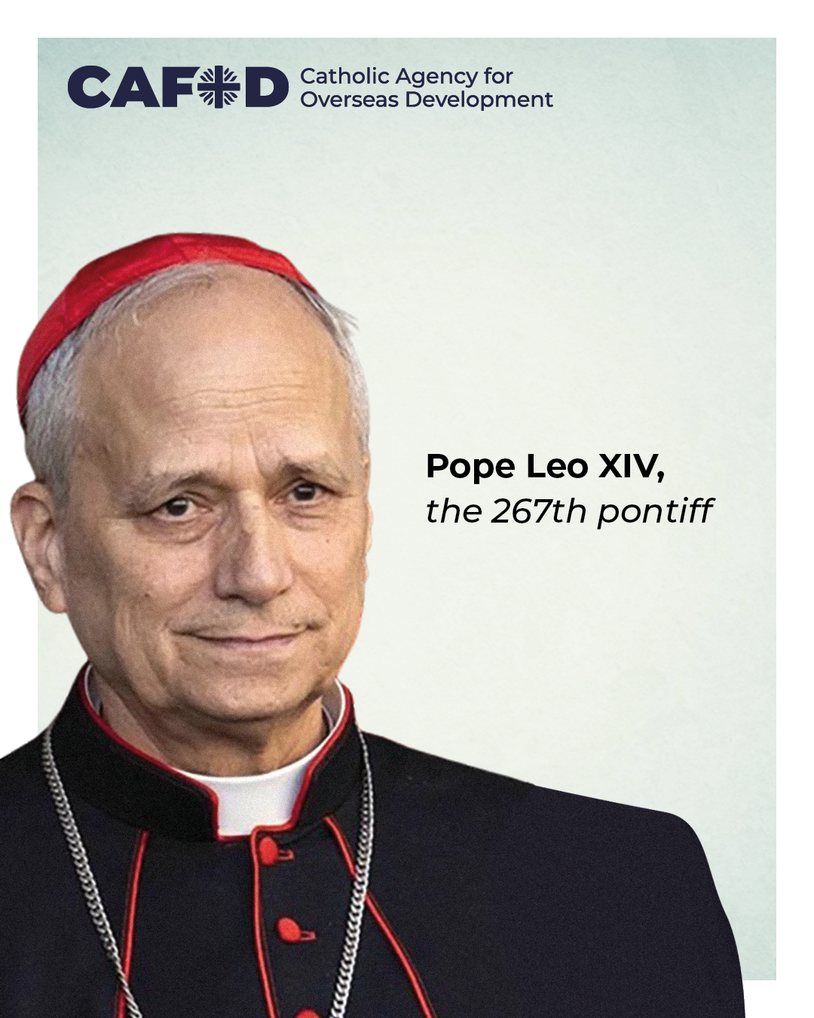
The Pope is the spiritual leader of 1.4 billion Catholics.
He will provide spiritual and moral guidance and can bridge political divides and bring world leaders together for the common good.

Slide 4
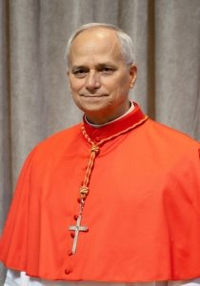
Pope Leo XIV was born Robert Francis Prevost. He was born in America but has lived all over the world.
Pope Leo XIV lived and worked with the people of Peru, in South America, for decades.
He gave a warm greeting in Spanish to people from Peru on the balcony.

Slide 5
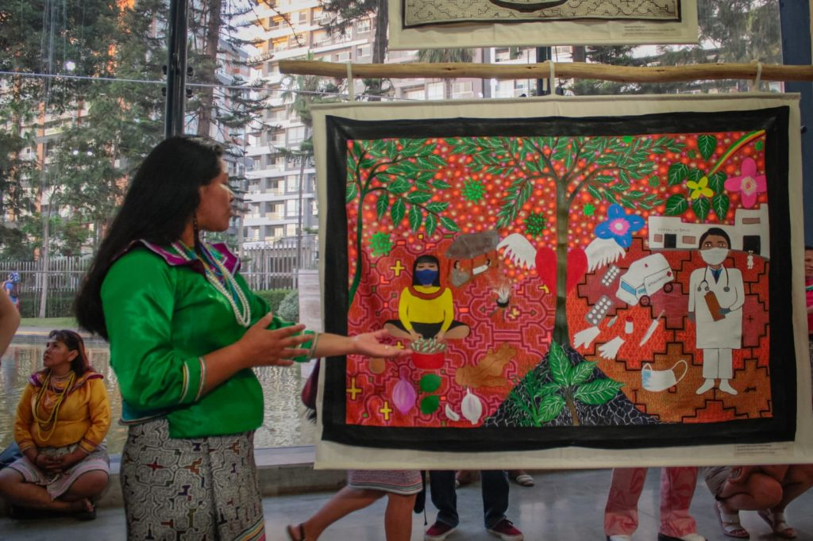
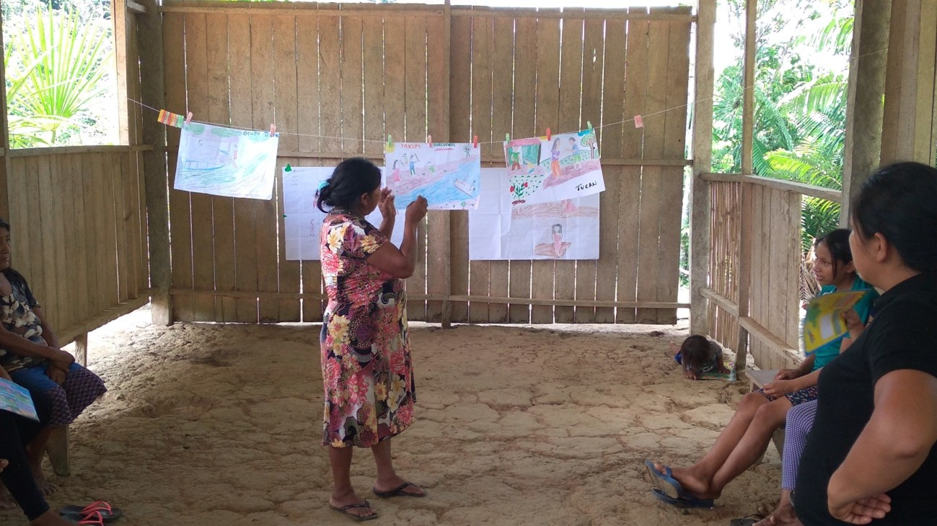
CAFOD’s work in Peru
CAFOD has been supporting projects in Peru through our partners and local experts.
We work alongside indigenous women in Peru, supporting them in standing up for their individual rights and indigenous people’s rights through artwork.

Slide 6
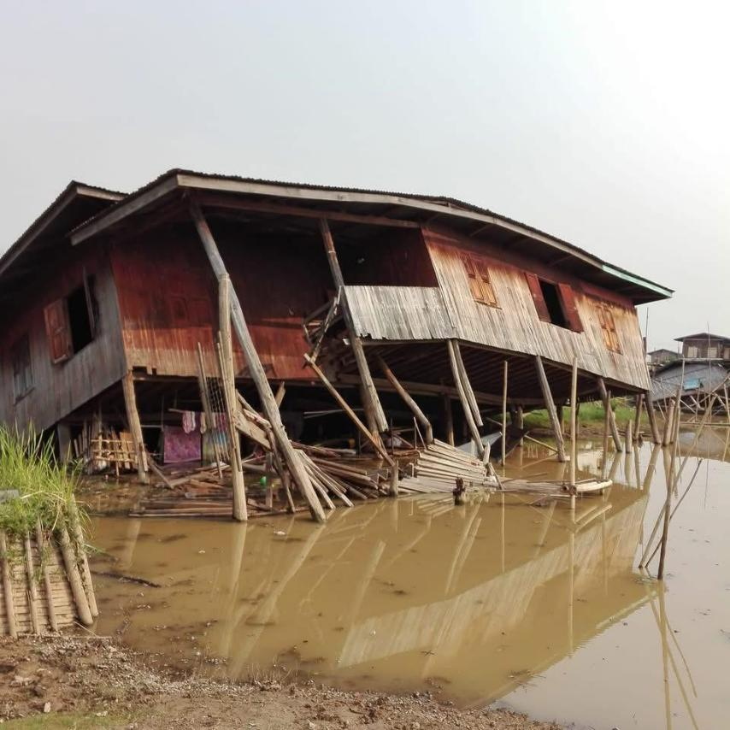
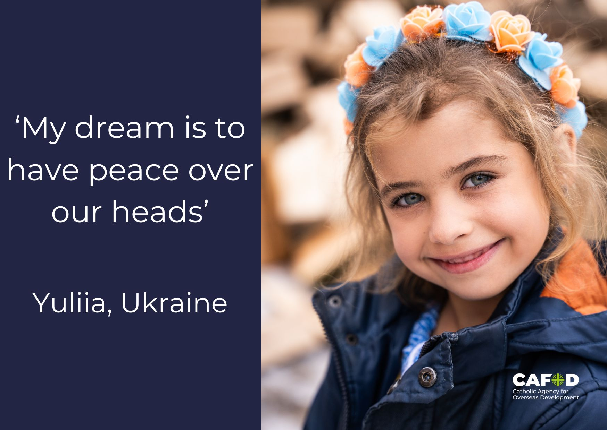
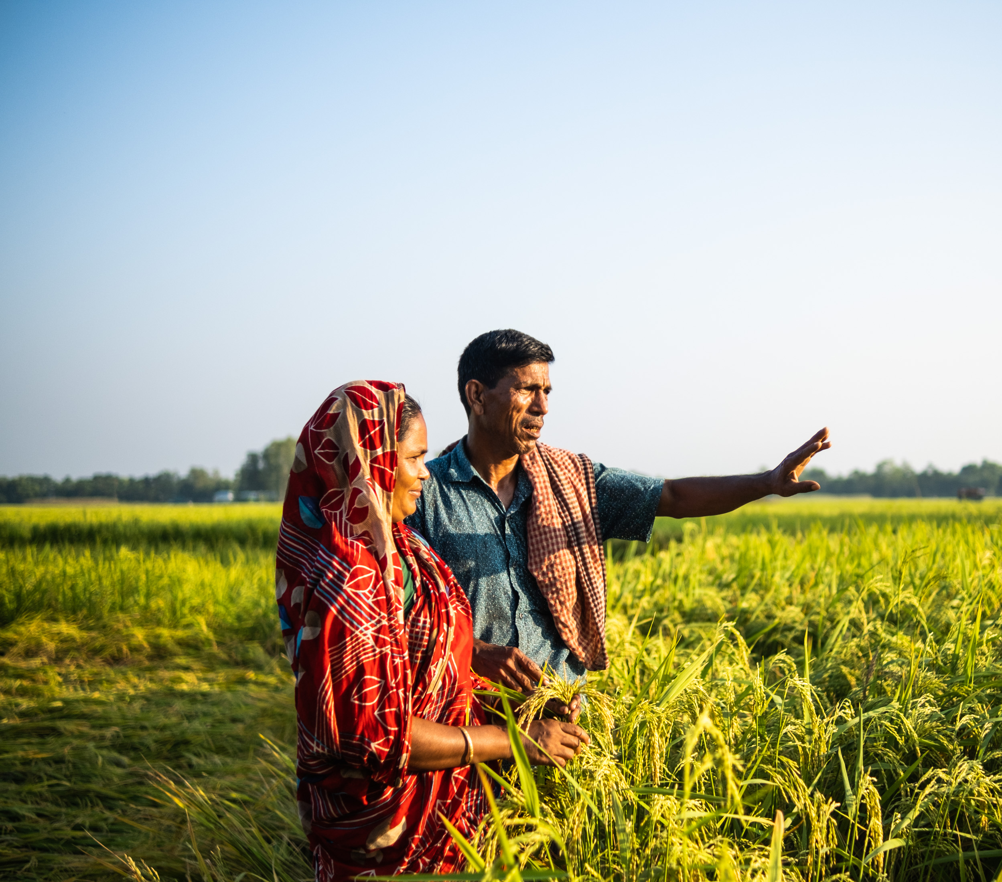
Pope Leo XIV has a unique perspective of the Global South which is important in addressing global issues that affect our world today.
Myanmar Earthquake
War and Conflict
Yuliia, Ukraine
Food security
Selima in Bangladesh

Slide 7
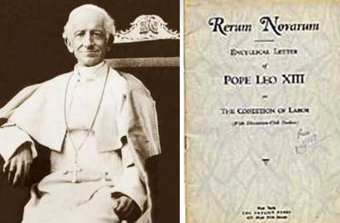
Pope Leo XIV chose his name ‘Leo’ which means ‘Lion’.
It was Pope Leo XIII who wrote about Catholic Social Teaching in 1891 in an encyclical called Rerum Novarum.
Pope Leo XIV will continue to build on Catholic Social Teaching by offering his reading of issues present in our world today and inviting Catholics to respond in the light of faith.

Slide 8
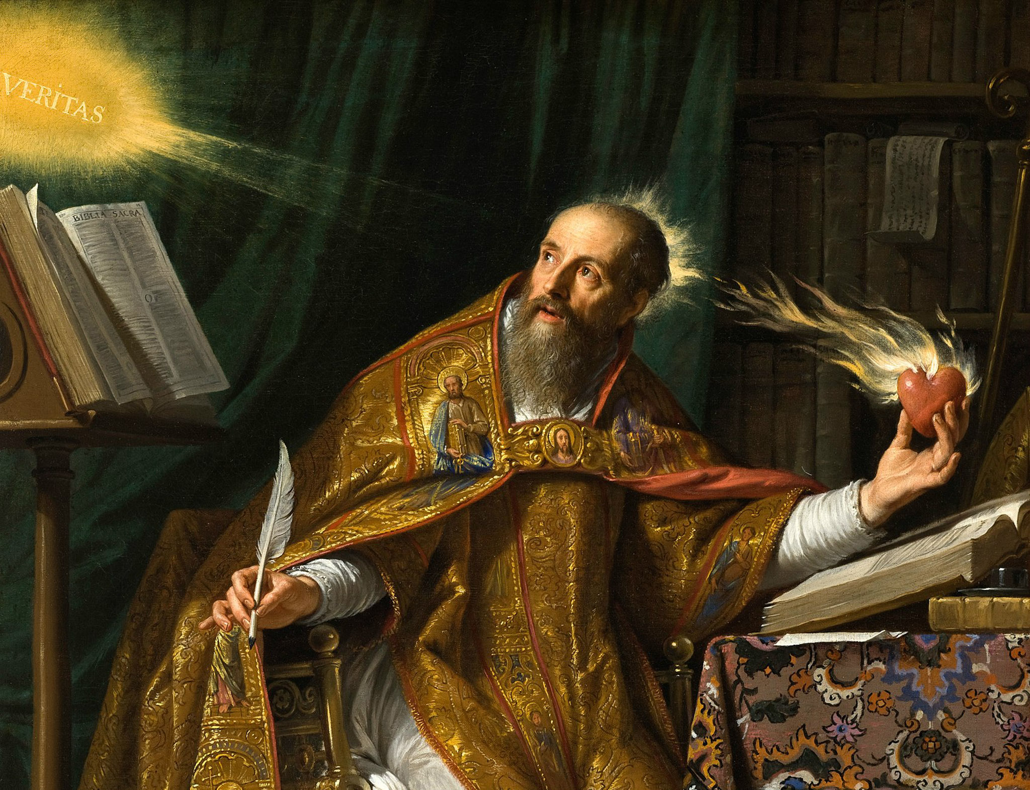
Pope Leo XIV is the first Pope from the Order of St Augustine. This means they follow the Rule of Augustine of Hippo which focuses on truth, love and community.

Slide 9
Pope Leo XIV will be a voice of wisdom as he continues the important work of leading the church in the world.
Pope Leo said on the balcony of the Vatican;
‘We must build bridges with dialogue, coming together, uniting, becoming people in one single people in peace.’

Slide 10
CAFOD will work with the Vatican and Pope Leo, to continue important work on global issues, especially around the issues of climate change and international debt which have been a key focus of the Jubilee Year.

Slide 11
A prayer for the new pope
God in Heaven
Hear our prayers for our new Pope, Leo XIV.
May he be a messenger of hope and peace to the Church and the world in this Jubilee year and for many years to come. Give him wisdom and courage to lead your people and help us listen to him carefully.
Amen

