Slide 1
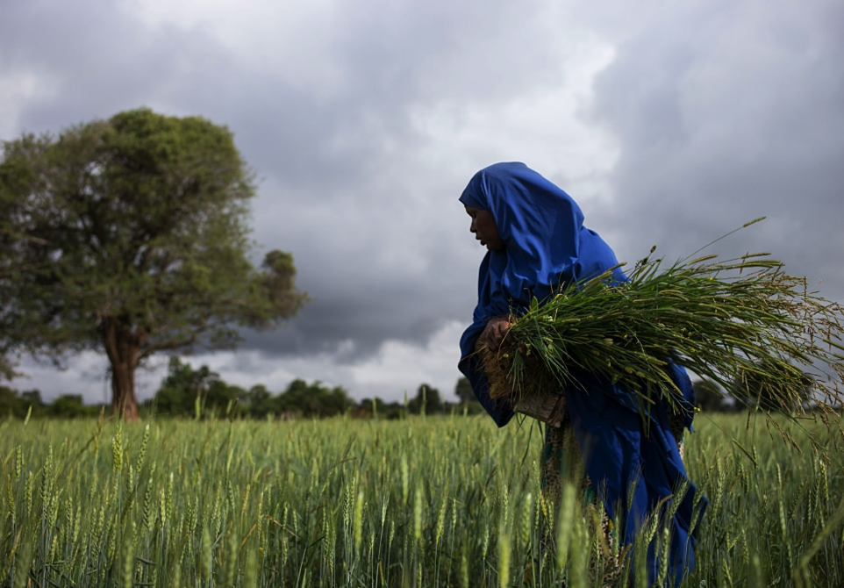
Queen of all creation
A meditation in praise of Mary
From Laudato Sí,
by Pope Francis
Notes:
Rukiya Hassen, a farmer participating in a Caritas Switzerland agricultural project in Ethiopia.
Photo: Joshua Smith / Caritas Switzerland

Slide 2
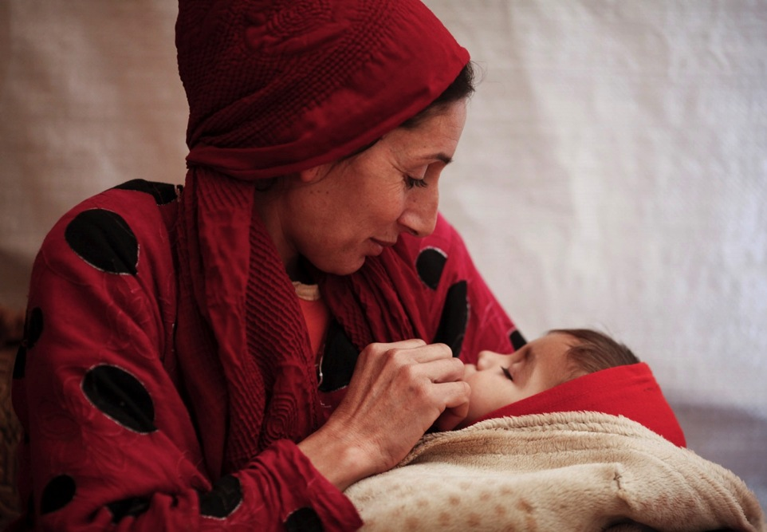
Mary, the Mother who cared for Jesus,

Slide 3
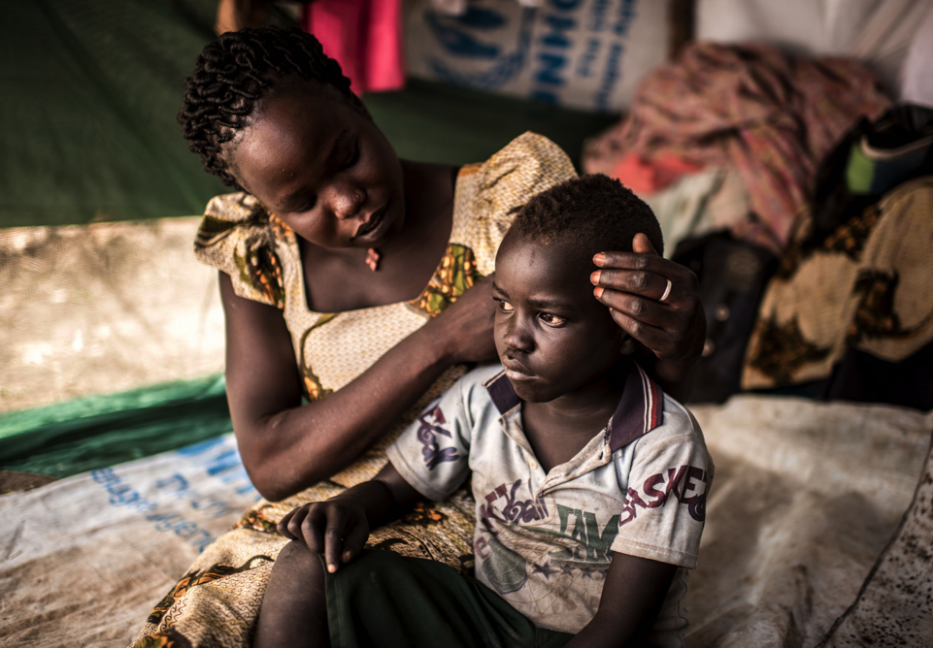
now cares with maternal affection and pain
Notes:
Viola Tabo and son Charles fled to Bidibidi refugee camp, Uganda, when many of their family were killed in South Sudan.
Photo: Tommy Trenchard/Caritas

Slide 4
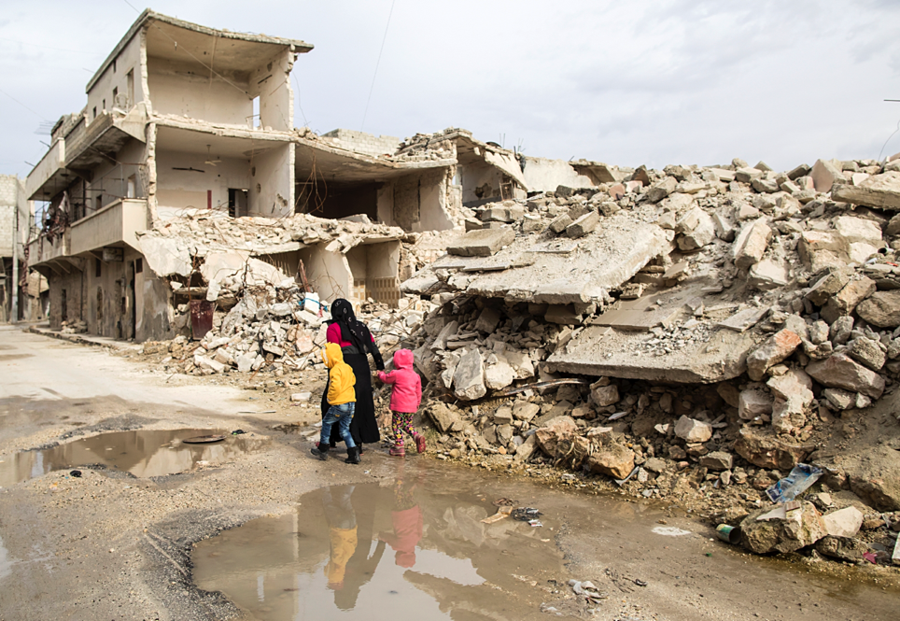
for this wounded world.
Notes:
Witwe, 43, is bringing up three daughters and a son in Syria’s civil war.
Photo: Alexandra Wey/Caritas

Slide 5
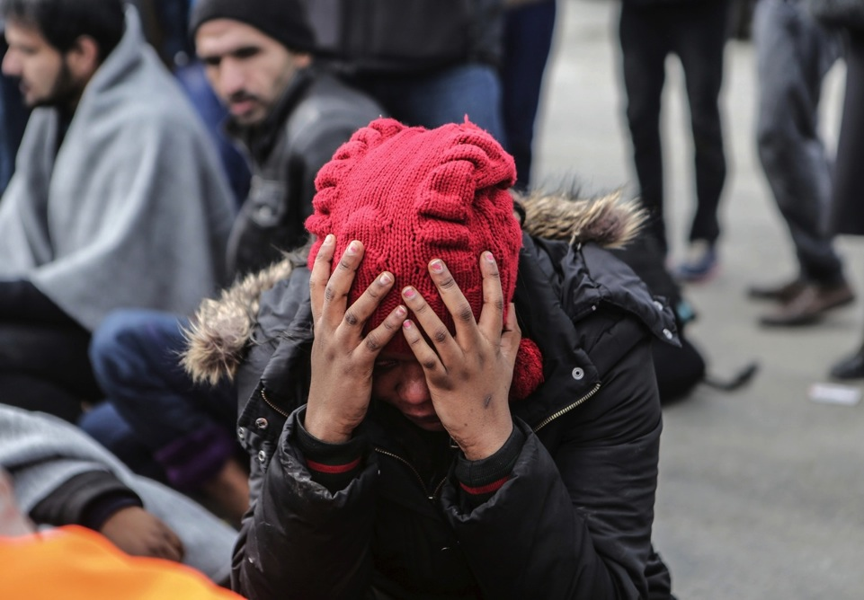
Just as her pierced heart mourned the death of Jesus,
Notes:
Refugee in transit through Greece.
Photo: Leftheris Partsalis/Caritas

Slide 6
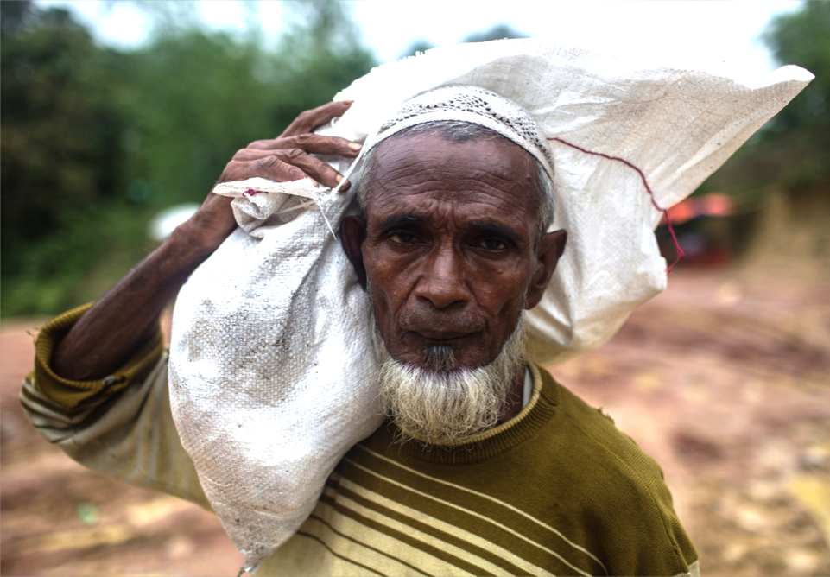
so now she grieves for the sufferings of the crucified poor
Notes:
Rohingya refugees who have fled from Myanmar receive rice and household goods at a camp in Bangladesh.
Lauren deCicca/Caritas

Slide 7
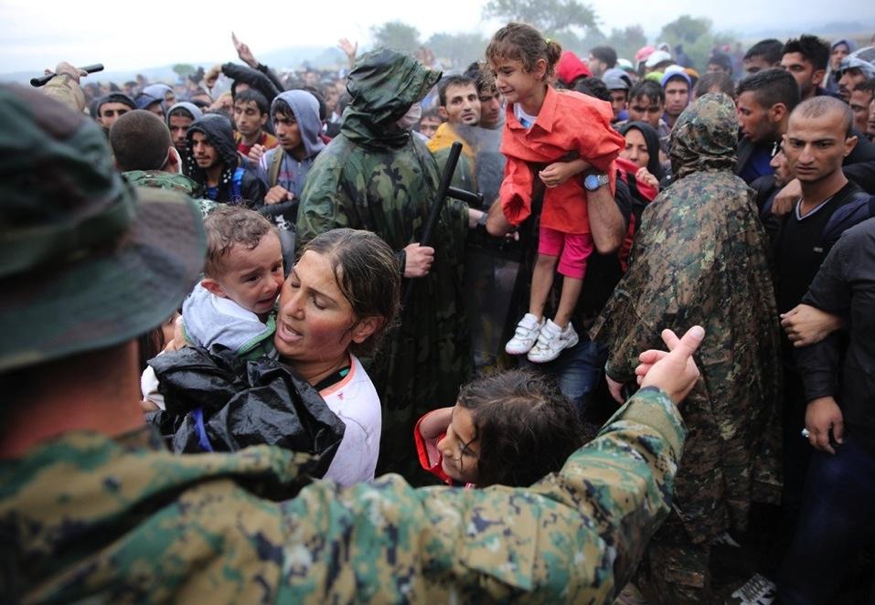
and for the creatures of this world laid waste by human power.

Slide 8
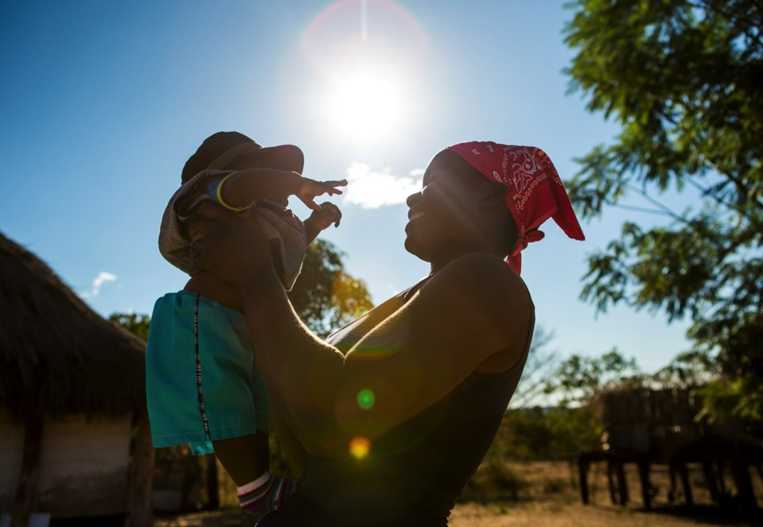
Completely transfigured, she now lives with Jesus,
Notes:
Unity and baby Twalumba, nutrition project, Zimbabwe.
Photo: Thom Flint / CAFOD

Slide 9
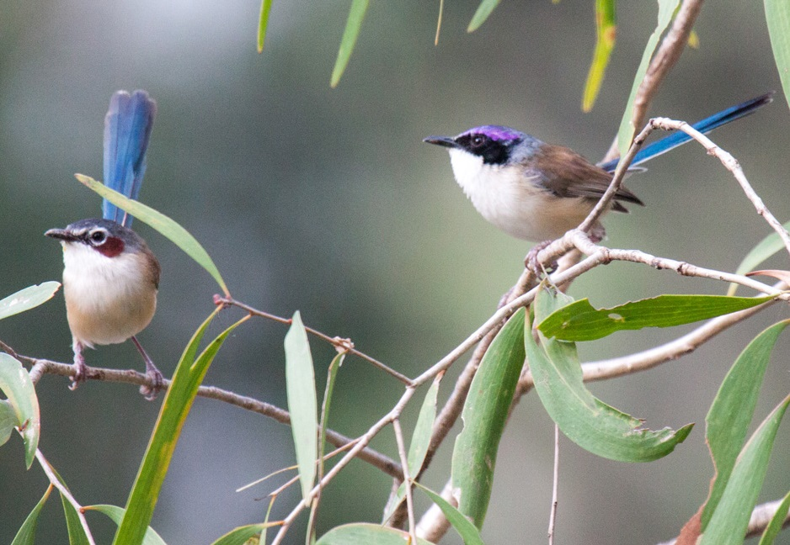
and all creatures sing of her fairness.
Notes:
Photo: Purple crowned fairywren by P Barden. CC BY 4.0, https://commons.wikimedia.org/w/index.php?curid=48323214

Slide 10
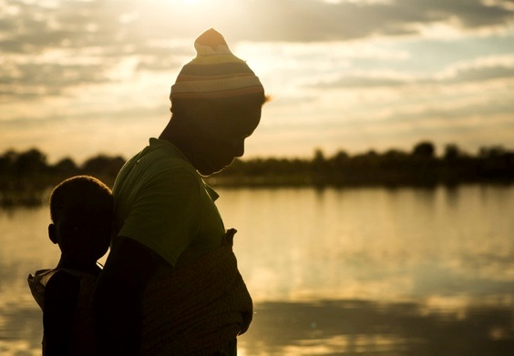
She is the Woman, “clothed in the sun, with the moon under her feet,
Notes:
Memory stands at Chiwashira Dam. CAFOD nutrition project, Zimbabwe
Photo: Thom Flint / CAFOD

Slide 11
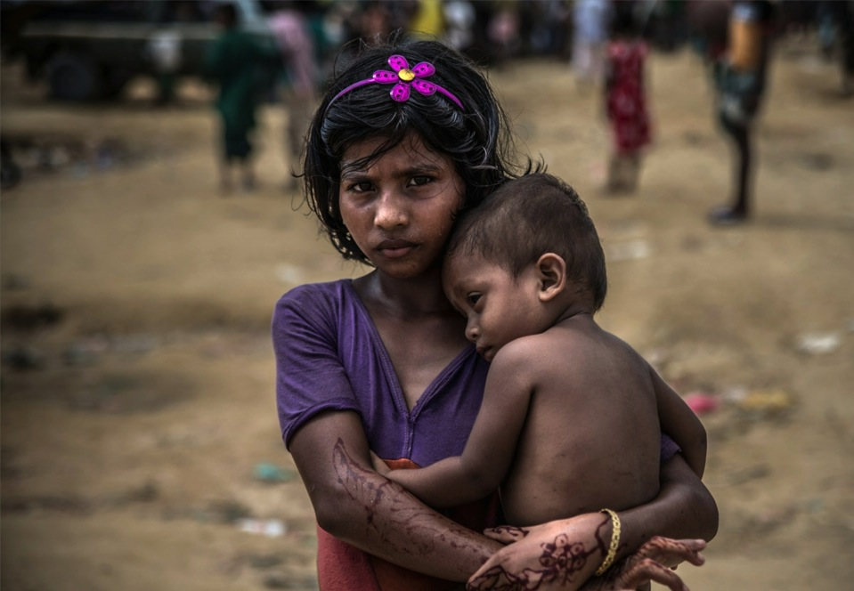
and on her head a crown of twelve stars”.
Notes:
Rohingya refugee children who have been forced from their homes in Myanmar to flee across the border into Bangladesh.
Photo: Aurélie Marrier d'Unienville

Slide 12
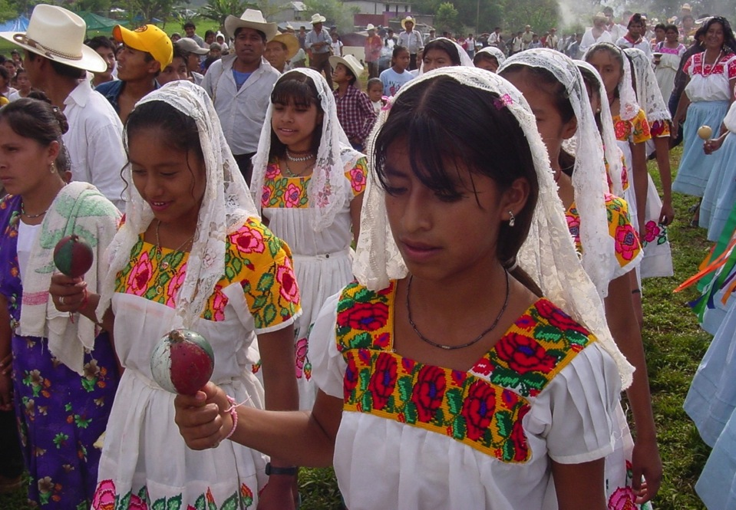
Carried up into heaven,
she is the Mother and Queen of all creation.
Notes:
Totonac indigenous community, Mexico.
Photo: Harriet Paterson

Slide 13
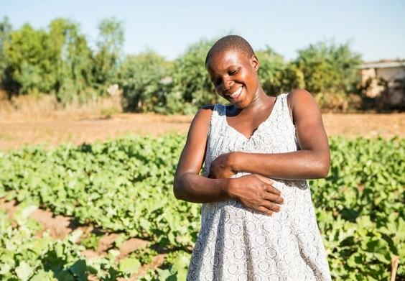
In her glorified body, together with the Risen Christ,
Notes:
Expectant mother Benhilda Hute, 22, in a CAFOD-funded vegetable garden in Mtora Mission hospital, Zimbabwe.
Photo: Thom Flint / CAFOD

Slide 14
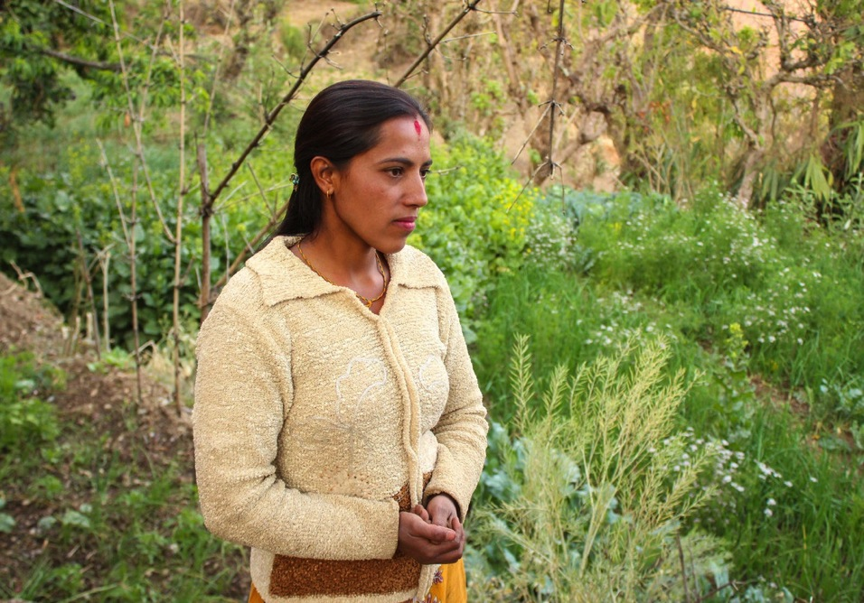
part of creation has reached the fullness of its beauty.
Notes:
Following a major earthquake in Nepal, Sumitra has been helped to grow and irrigate vegetables.
Photo: CORDAID and Parivartan Patra

Slide 15
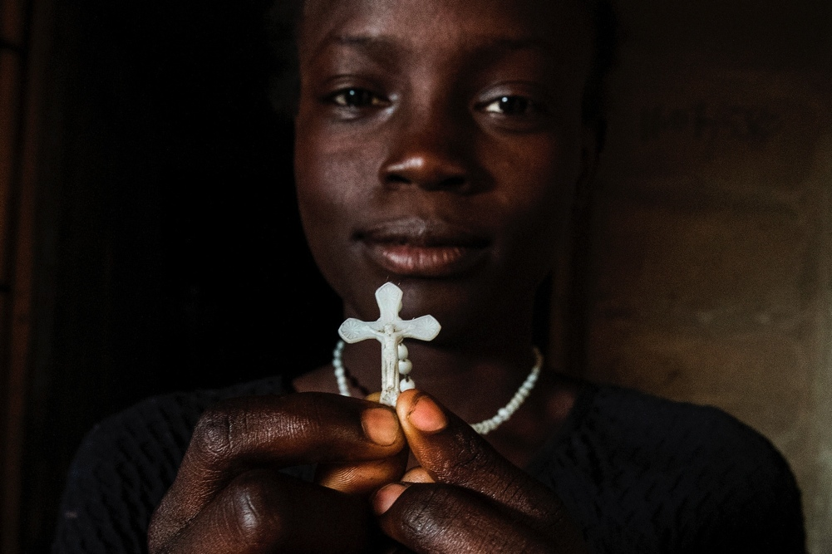
She treasures the entire life of Jesus in her heart
Notes:
CAFOD sister agency CRS project in Nigeria.
Photo: Michael Stulman/CRS

Slide 16
and now understands the meaning of all things.
Notes:
Bolivian farmer Vladimir holds hands with son Alex, rural livelihoods project.
Photo: Ben White / CAFOD

Slide 17
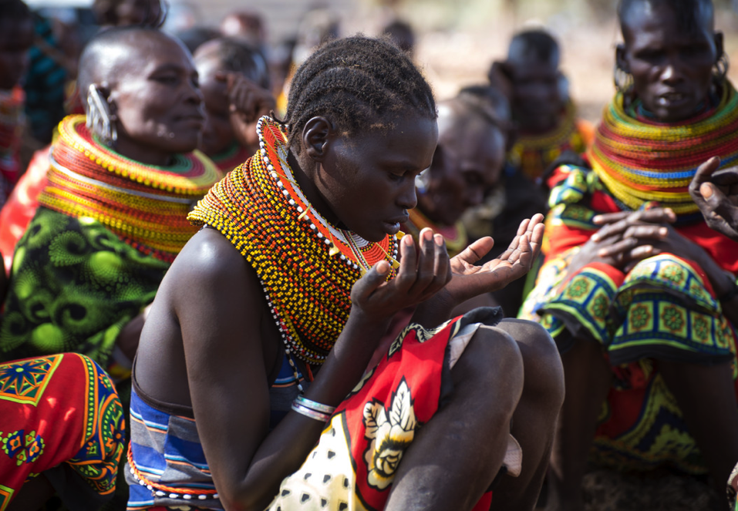
Hence, we can ask her to enable us
Notes:
Villagers in drought-affected Isiolo, northern Kenya, praying.
Photo: David Mutua / CAFOD

Slide 18
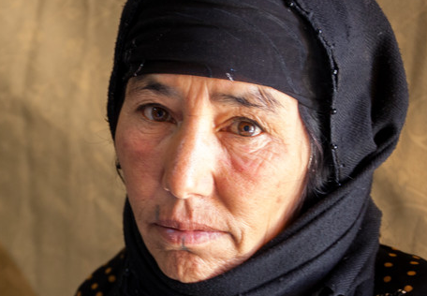
to look at this world with eyes of wisdom.
Notes:
Amouna’s son Abed, 21, was wounded during a missile attack on their home in Syria, and then disappeared. Amouna, in a refugee settlement in Lebanon, does not know if he is alive or dead.
Photo: Louise Norton / CAFOD

Slide 19
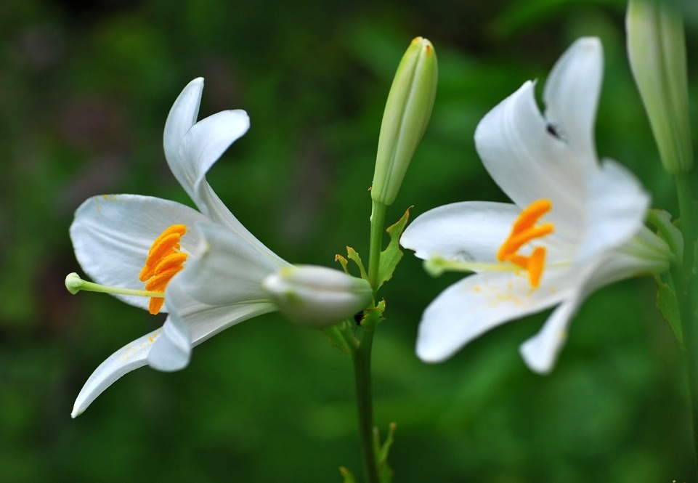
From the closing passage of Pope Francis’s encyclical
Laudato Sí, VIII
“On care for our common home”
Notes:
Music: A Tender Moment by Nigel Hess

