Slide 1

Notes:
Good morning/afternoon everyone and welcome to our World Gifts CAFOD assembly.
World Gifts are a great chance to learn about our global neighbours, and how we can help them by working together to build a better world.

Slide 2
Clean water
Enough food
Safe home
School
Doctor or nurse
Live in peace
Notes:
Here’s the CAFOD logo.
Who can remind me what CAFOD stands for?
CAFOD is the Catholic Agency for Overseas Development.
CAFOD believes a better world needs all of us.
CAFOD believe in a better world, where no one lives in poverty and each of us can become the best person we can be.
This means a world where people have clean, safe water to drink. They have enough food to eat every day. Everyone has a safe home, children can go to school, anyone who is sick can visit a doctor or nurse and everyone can live in peace.

Slide 3
What’s the best gift you ever received?
What’s the best gift you ever gave?
Notes:
Today we are going to think about gifts. Can anyone tell me what a gift or a present is?
I’d like you to think about the best gift you ever received. How did you feel?
Now, how about the best gift you ever gave to someone. How did that make you feel? Was it the same? Or better? (Tell the person next to you/the other person on your table).

Slide 4
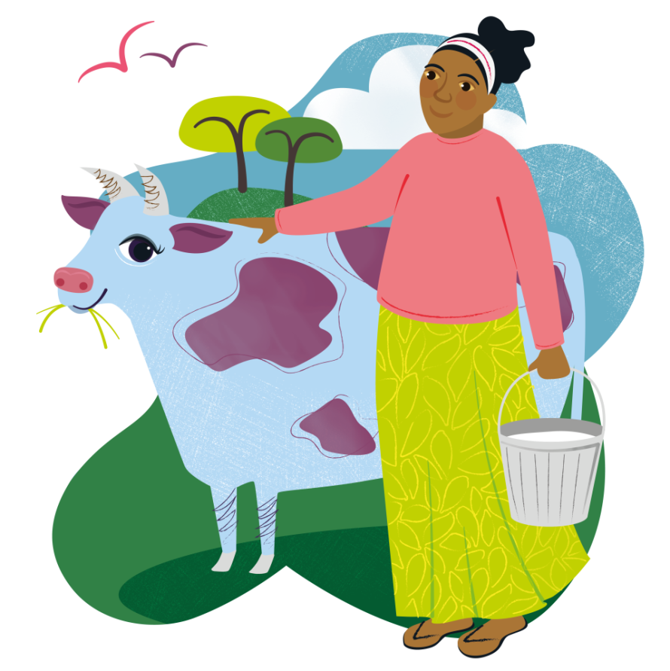
Notes:
Has anyone ever given or received a cow?! This Marvellous Moo Cow is one of CAFOD’s World Gifts, that you can give to someone in another part of the world.

Slide 5
“For God loved the world so much that he gave his only Son.”
John 3:16
Notes:
World Gifts help to support our global neighbours.
As we know ‘God so loved the world so much that he gave his only Son’.
God gave us the most precious gift of his son Jesus.
We make a difference too to help build a better world. Let’s find out how.

Slide 6
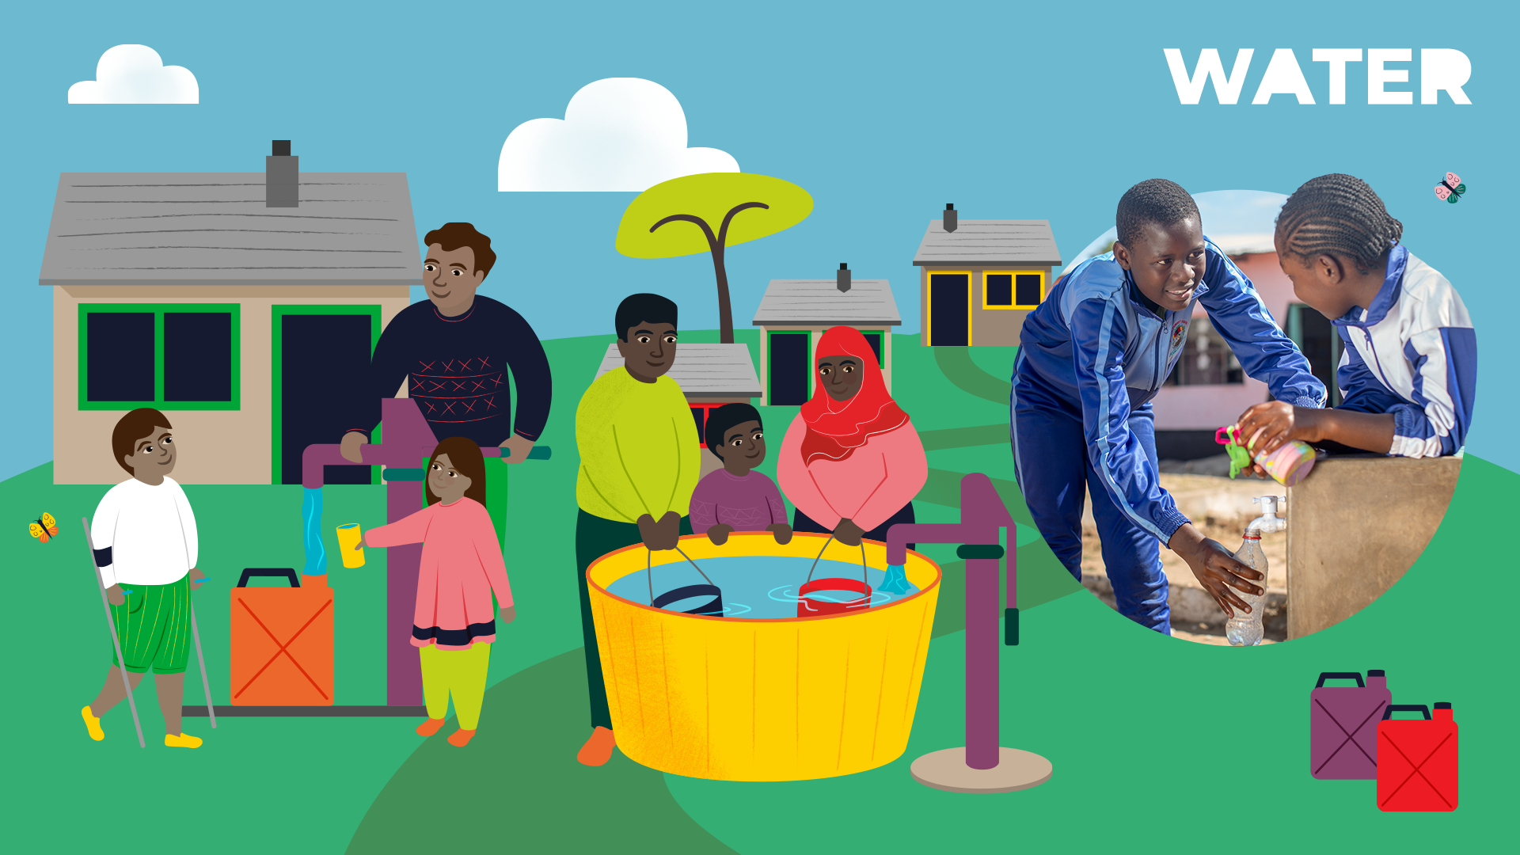
Notes:
Did you know that a quarter of all people around the world don’t have access to safe drinking water? CAFOD’s Water World Gifts helps to provide communities with this basic human right.

Slide 7
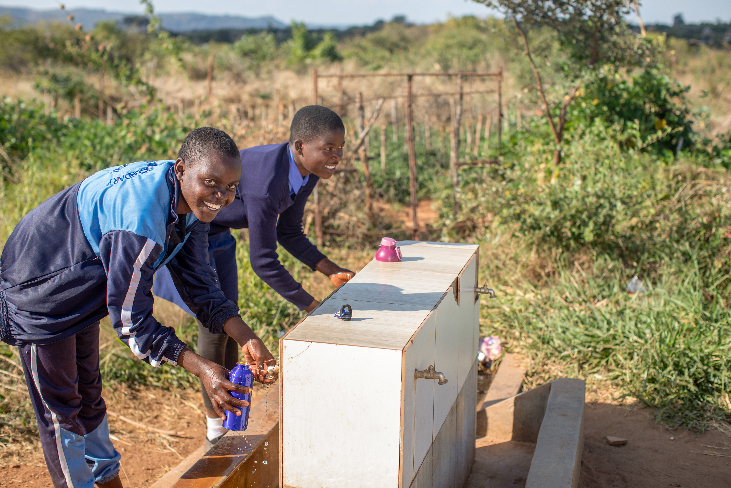
Notes:
Photo credit: Thom Flint
This is Maggie. She lives in Zimbabwe. Having to fetch water before school meant schoolgirls like Maggie in Zimbabwe often missed lessons. With CAFOD’s help, taps and showers were installed at school and gender clubs set up to teach health, hygiene and self-confidence. Maggie says: “Now we have water – and confidence!”

Slide 8
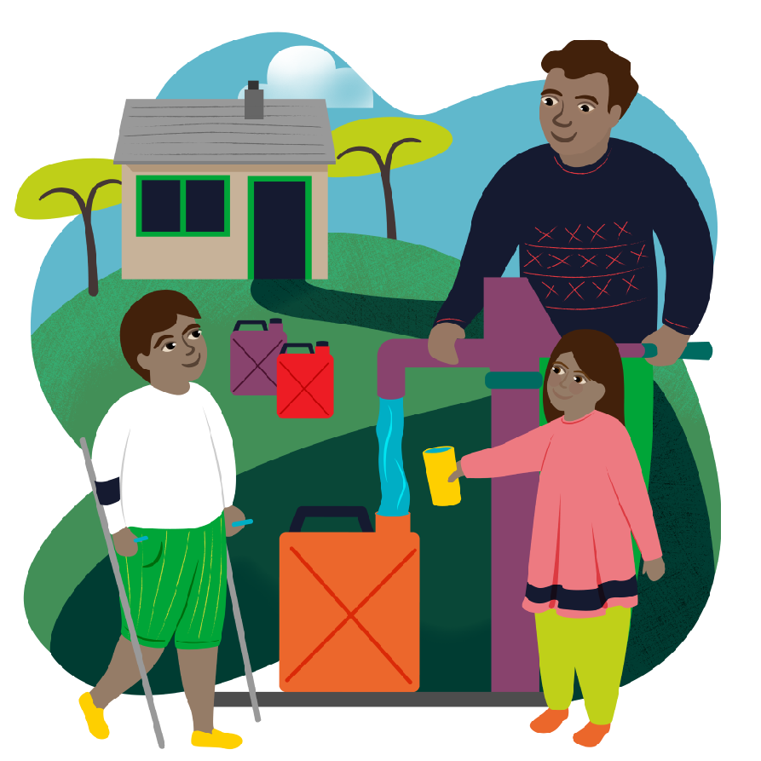
Water World Gifts
Water for a family: £35
Terrific Toilet: £89
Community water supply: £750
Notes:
Give the gift of water!
A terrific toilet costs £89 and are the best way to stop the spread of serious diseases, keeping communities healthy and safe.
£35 Water for a Family gift provides access to safe water for drinking, cooking and washing.
By fundraising together to raise £750, this incredible gift can help a remote community establish their own supply of clean, safe water. By providing materials and training, local experts can work with communities to build and maintain new hand pumps and water tanks, meaning fewer diseases and fuller crops! provides water for a whole community!

Slide 9
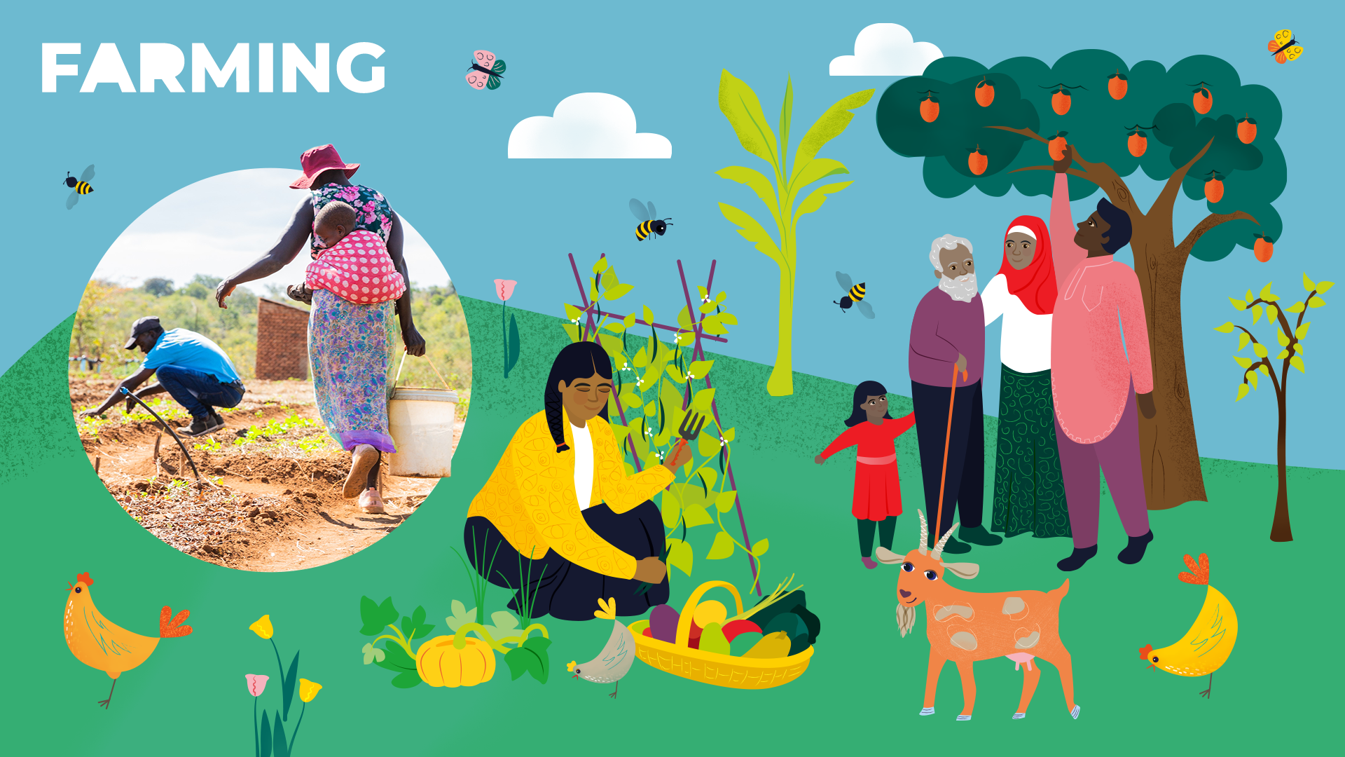
Notes:
Around the world, farmers and fisherfolk face extreme challenges related to the climate crisis. Food and Farming World Gifts provide communities with tools and techniques to farm and fish sustainably, so they can safely supply food to their community.

Slide 10
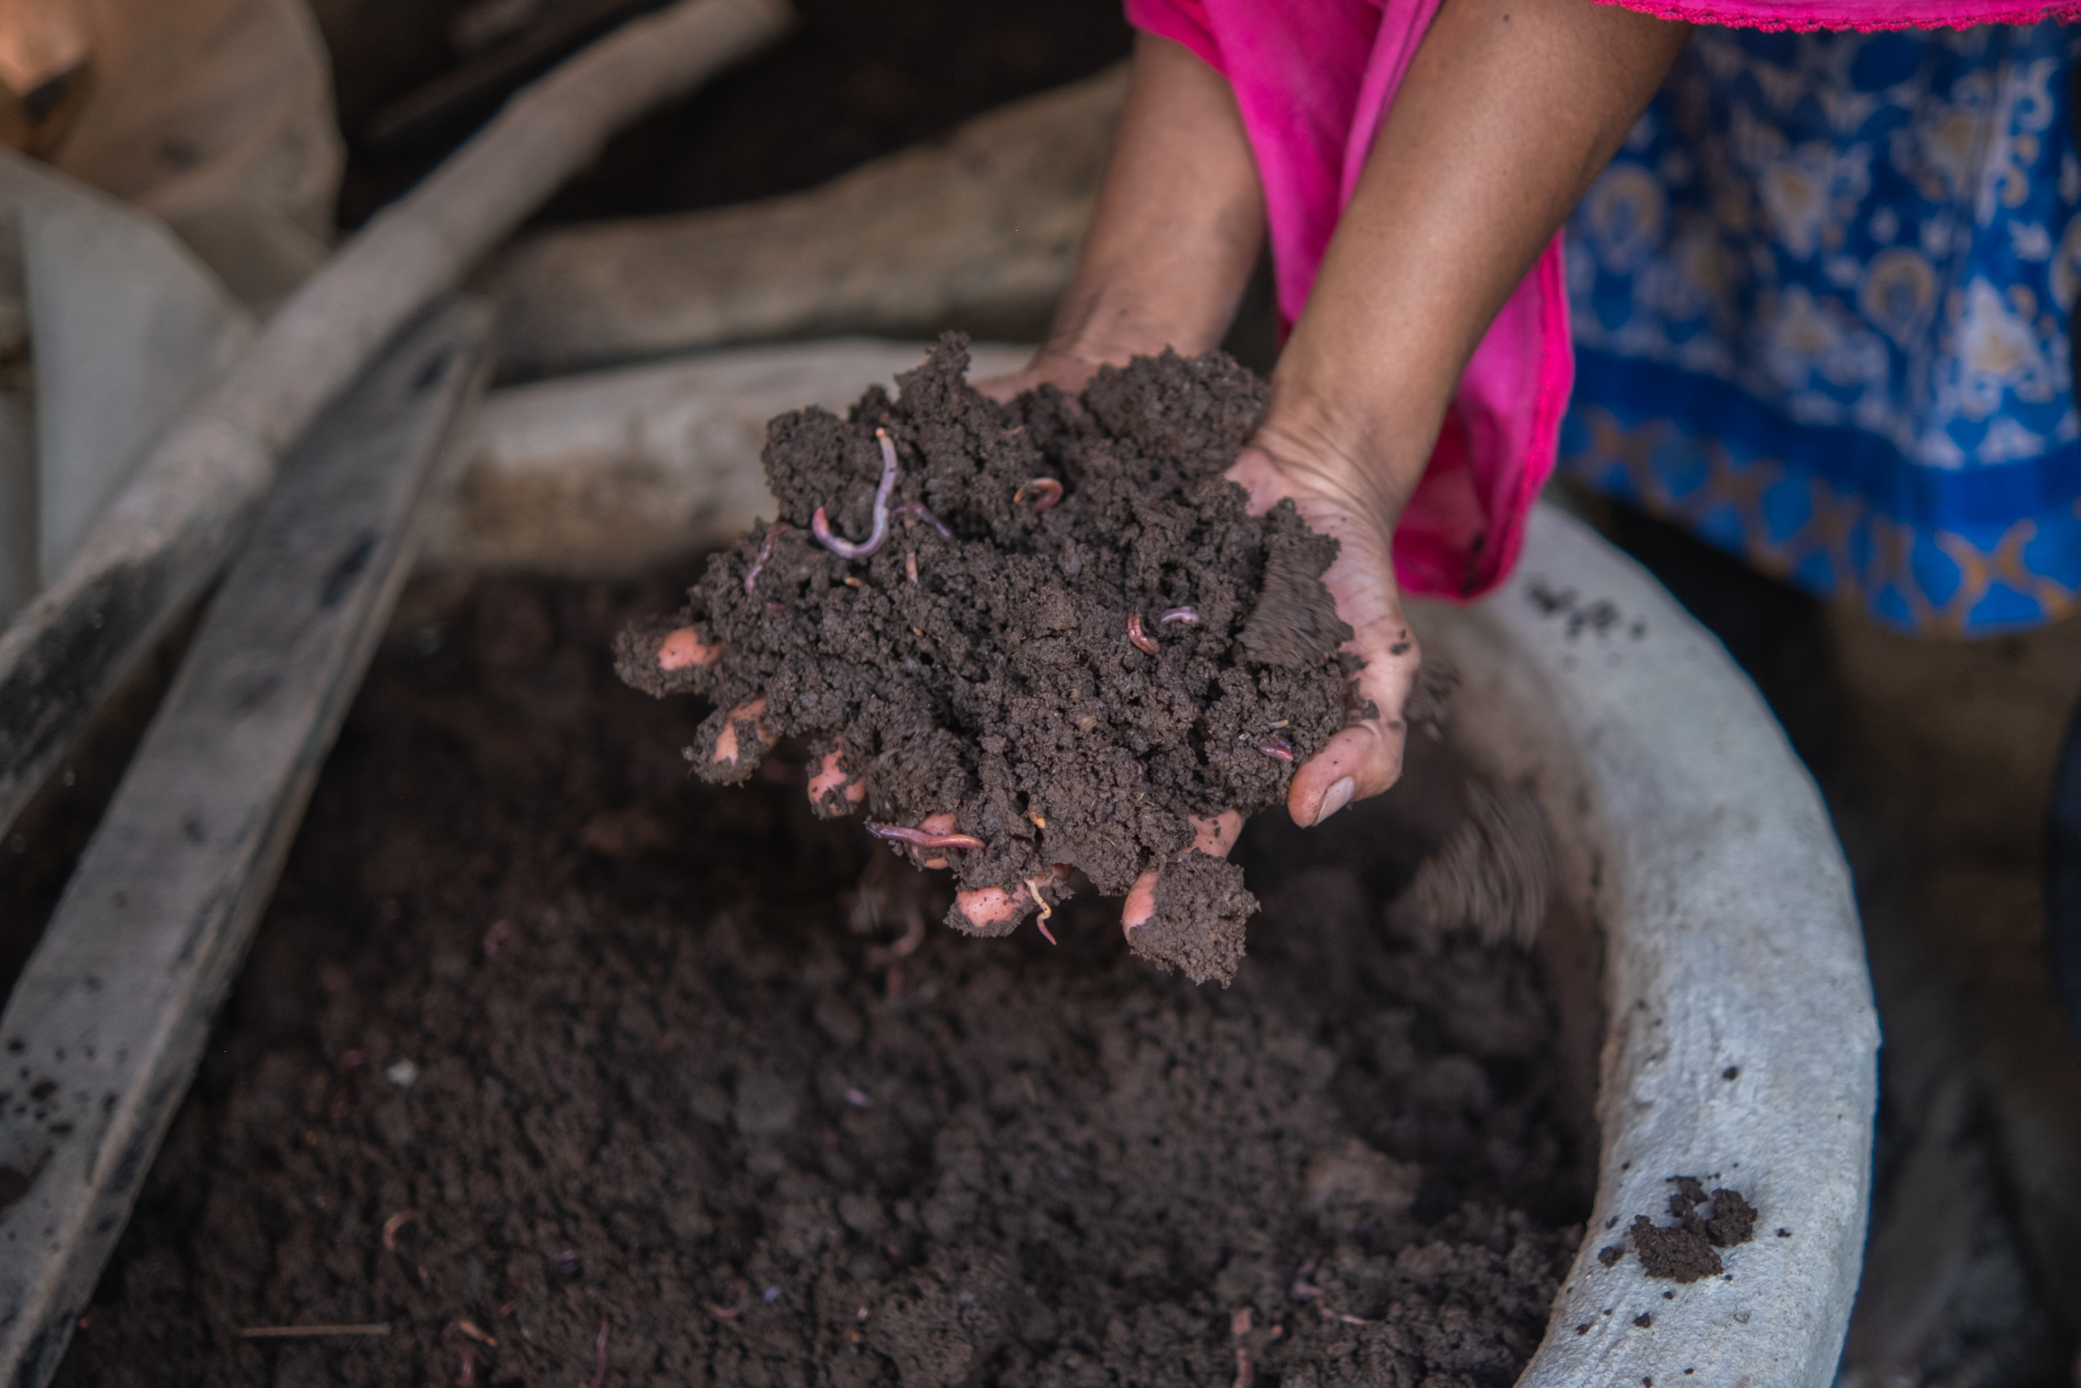
Notes:
Photo credit: Amrit Rudro
A gift of worms may sound a little funny, but these wiggling wonders are no joke!
That’s what Obayedul found out. The soil on his land, in Bangladesh, was poor, and he struggled to grow enough for his family. CAFOD partners gave him earthworms, and trained him to use them to turn barren soil into nutrient-rich organic fertiliser.
Now Obayedul’s land is rich and fertile, and his worms make so much rich compost he is able to sell what he doesn’t need for extra income.
He says: “I have found an alternative source of income and improved my family’s life."
It just goes to show, a better world needs all God’s creatures – even the slimy ones.

Slide 11
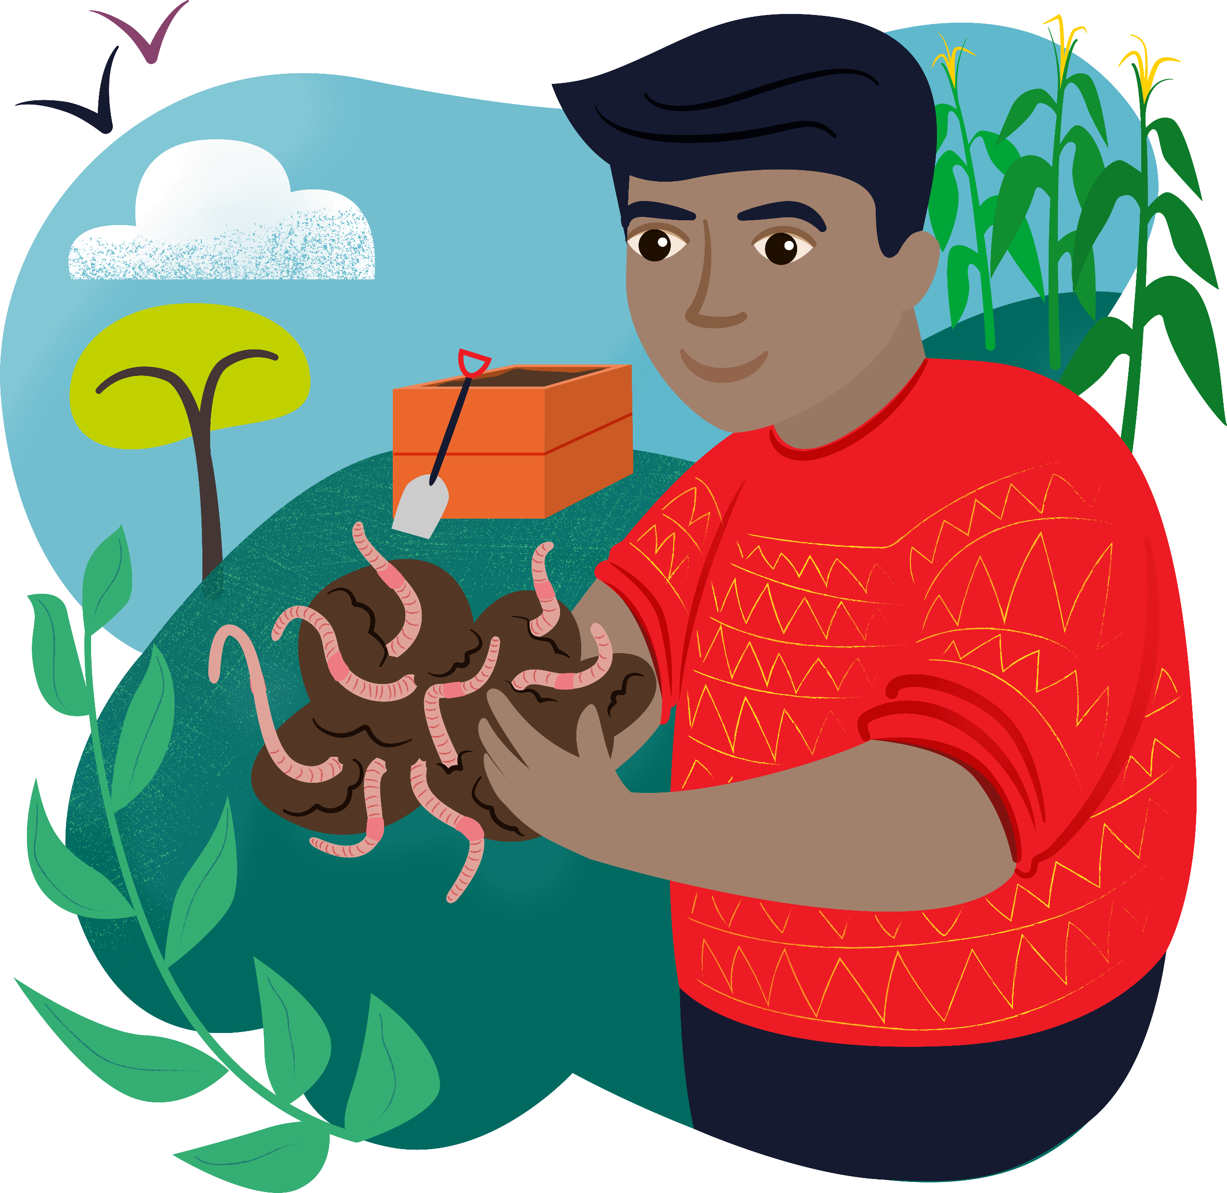
Farming World Gifts
Wonderful Worms: £11
Floating Gardens: £77
Marvellous Moo Cow: £155
Notes:
Give the gift of food!
You can provide worms and training in vermi-composting for families in rural communities with the £11 Wonderful Worms gift.
Floating Gardens cost £77 and help communities affected by flooding to grown crops
This udderly fantastic Marvellous Moo Cow for £155 provides a locally sourced cow (along with all the training needed to care for it) which can help plough farmland and provide nutritious milk to drink, as well as extra milk to sell at local markets.

Slide 12

Notes:
Photo Credit: Women Now
CAFOD’s education World Gifts give people of all ages the chance to learn, fulfil their potential and work towards a more secure, brighter future.

Slide 13
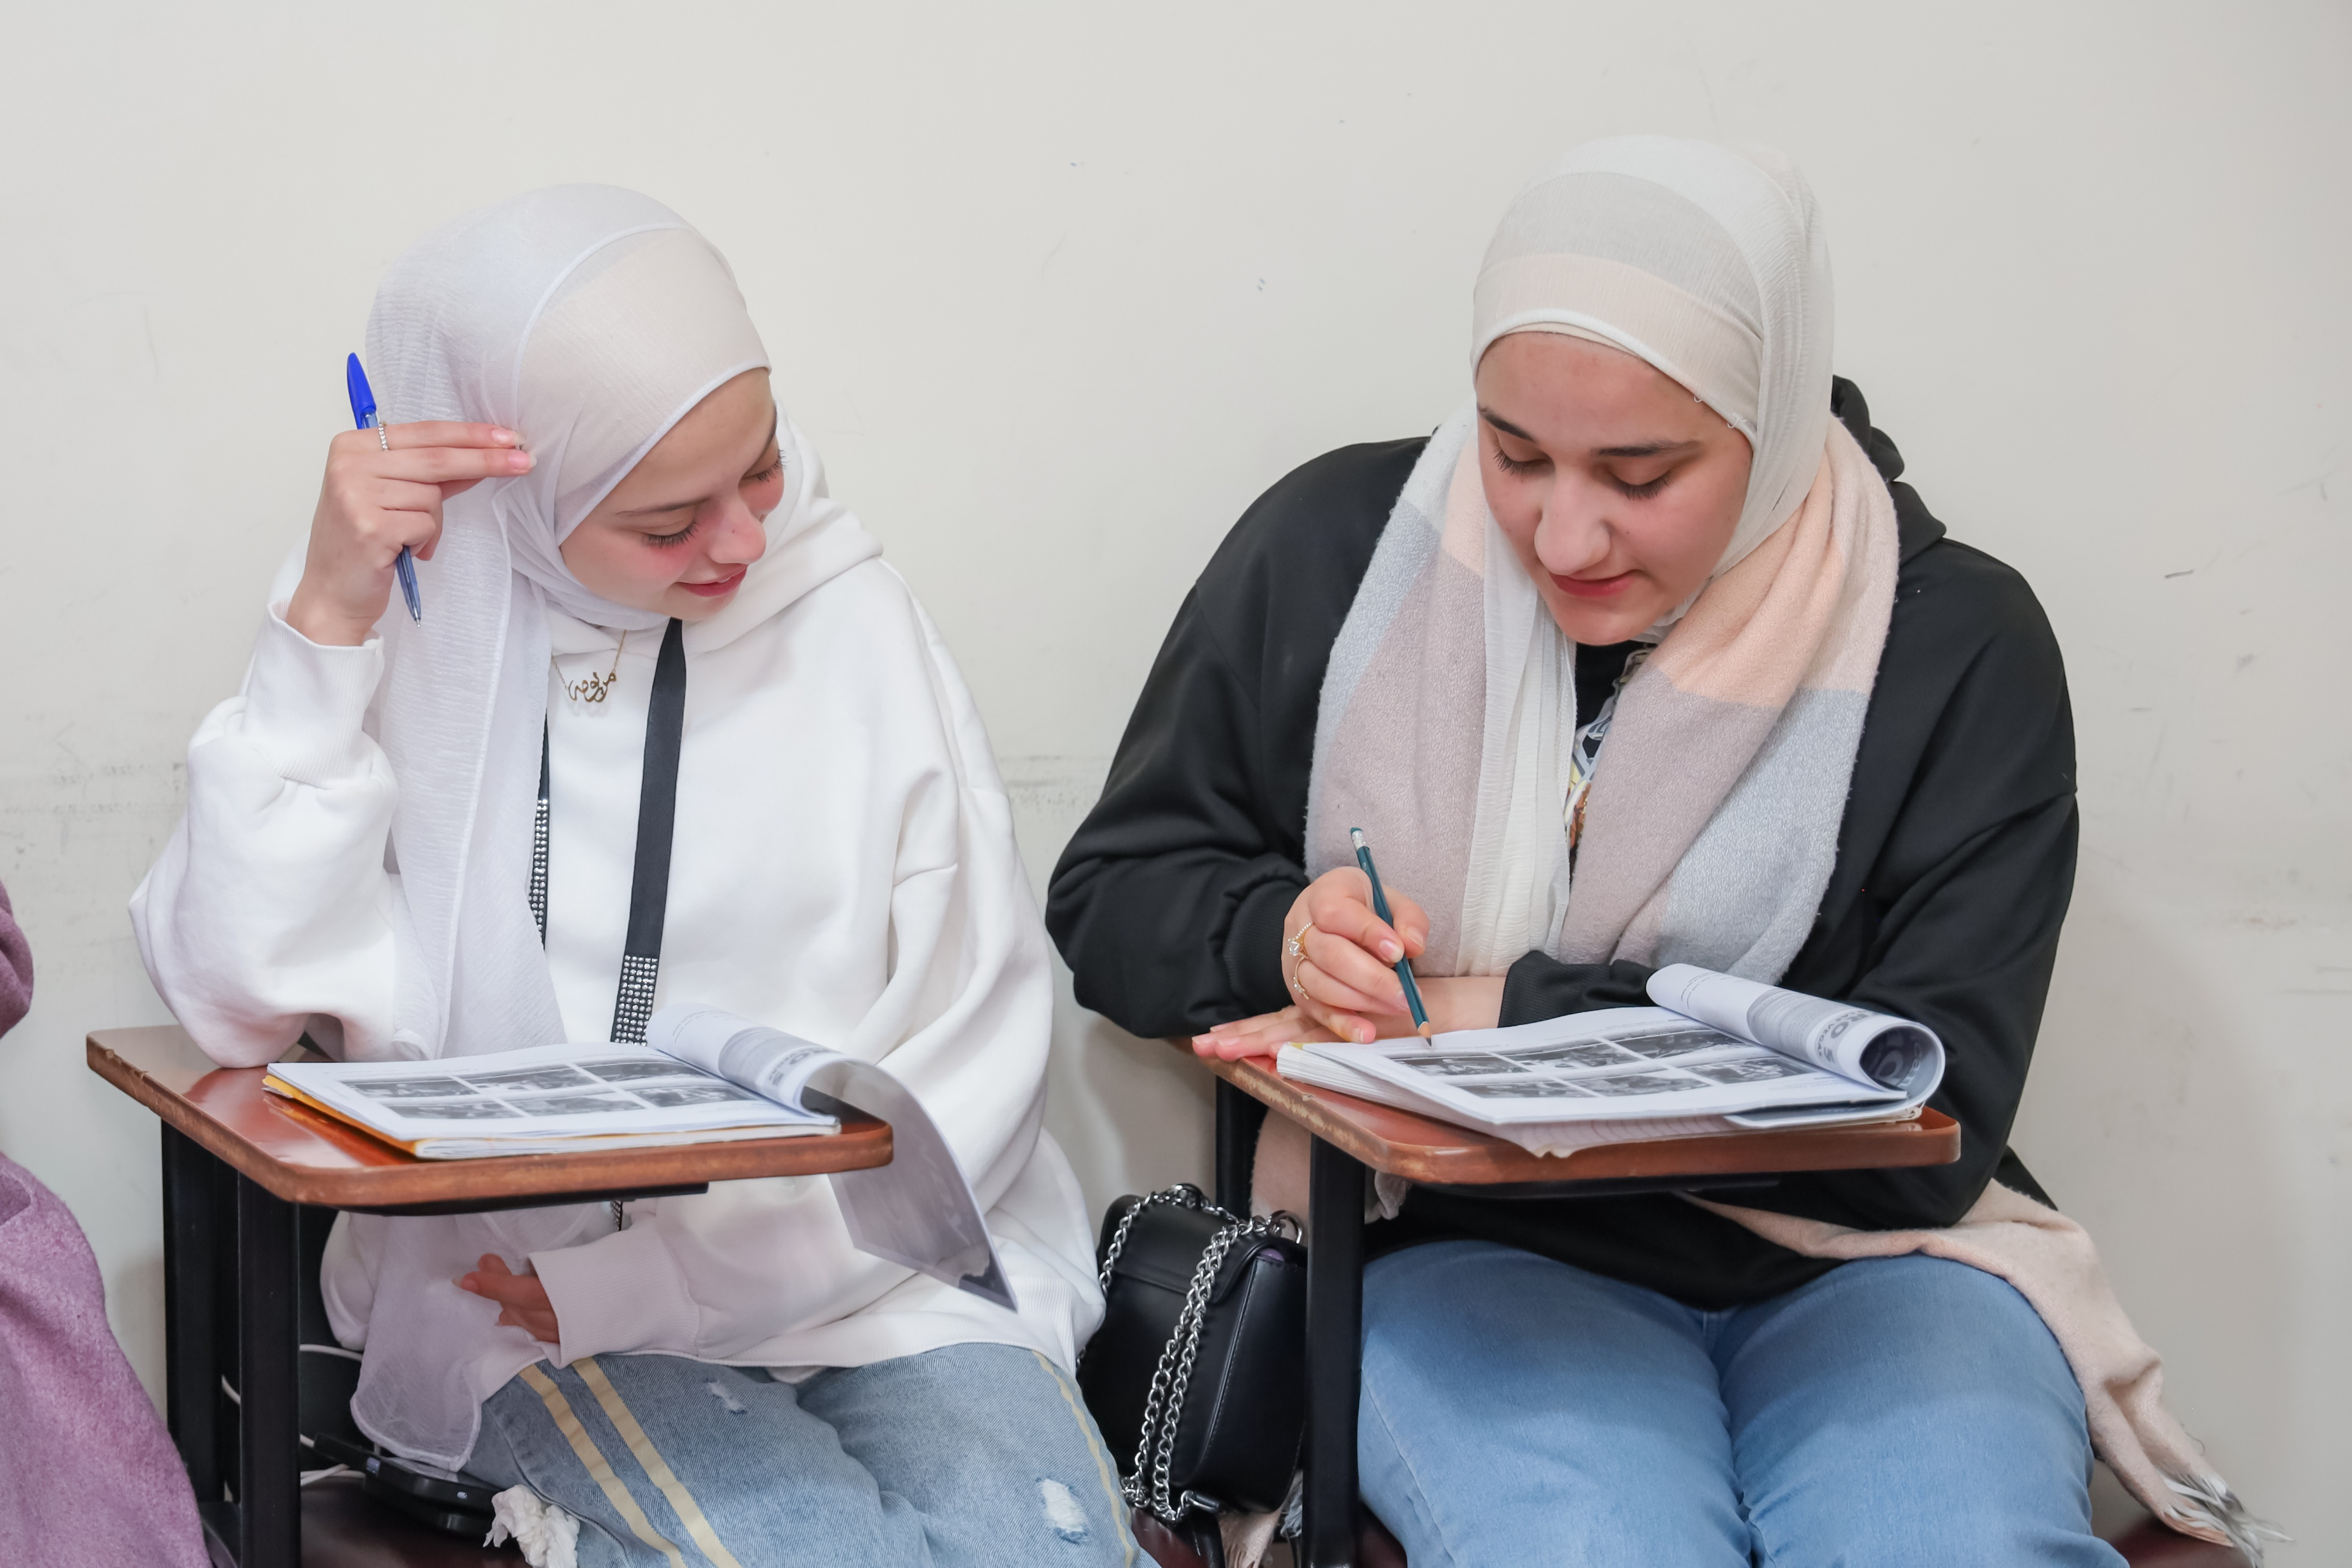
Notes:
Meet Akilah. The war in Syria forced Akilah to flee her home. When she arrived in Lebanon with her four sons, she didn't understand any English—the language they were taught at school. As a refugee mother, Akilah felt isolated and unable to help her children with their schoolwork.
Akilah soon signed up for CAFOD-funded English classes, so she could support her sons with their education and make new friends in her community.
Now Akilah feels confident speaking and writing in English. She can help her sons with their homework and answer their questions about English.
"I am now more confident and more connected," Akilah said.

Slide 14
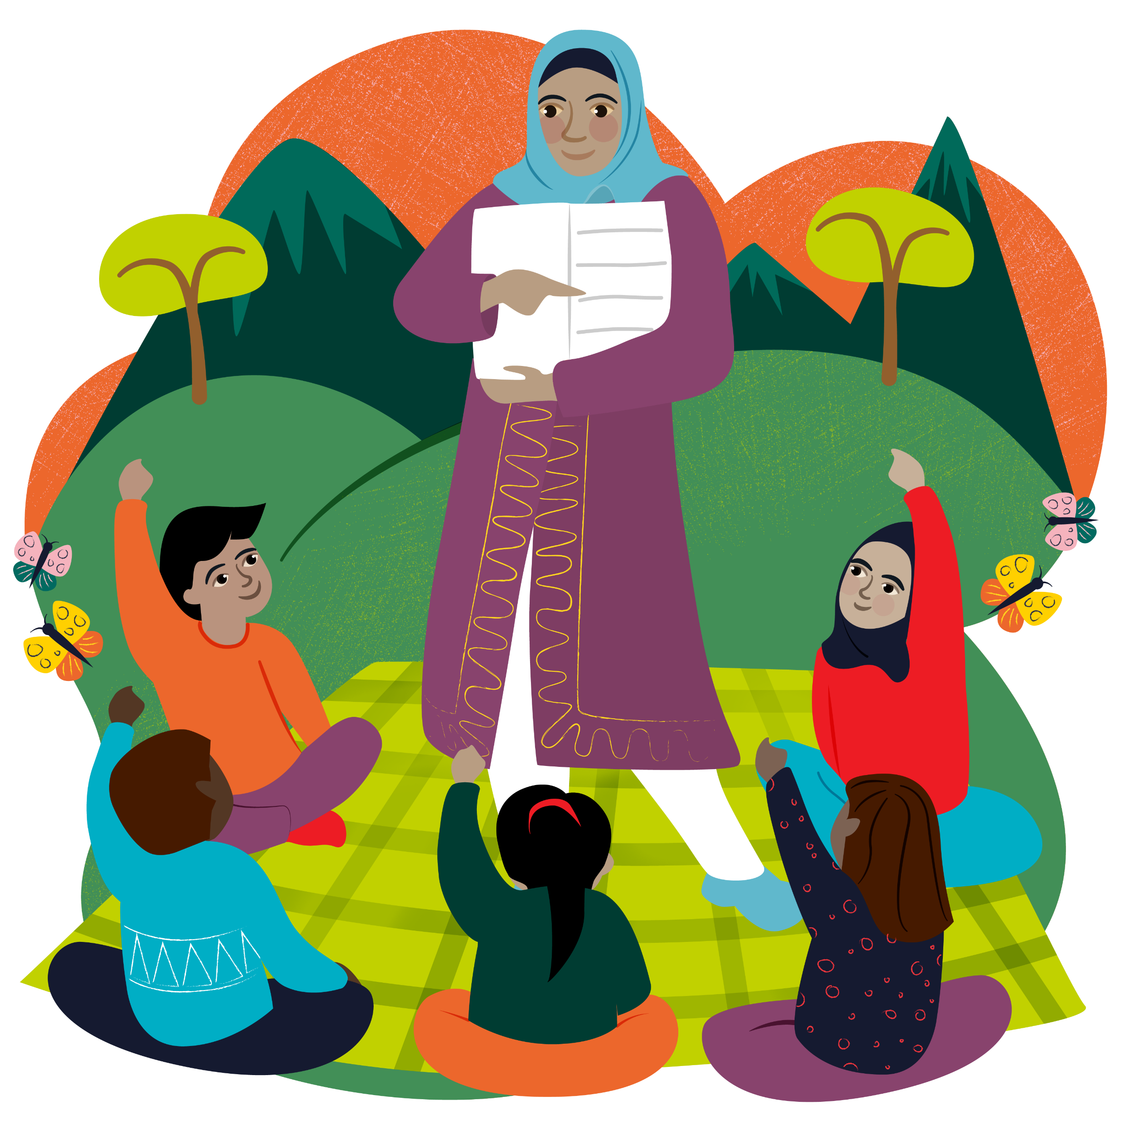
Education World Gifts
Teach Someone to Read: £12
Back to School: £63
Notes:
Give the gift of learning!
You can provide literacy classes, materials, and training to Teach Someone to Read for £12.
Or provide education and vocational training to transform young lives with the Back to School Gift for £63.

Slide 15
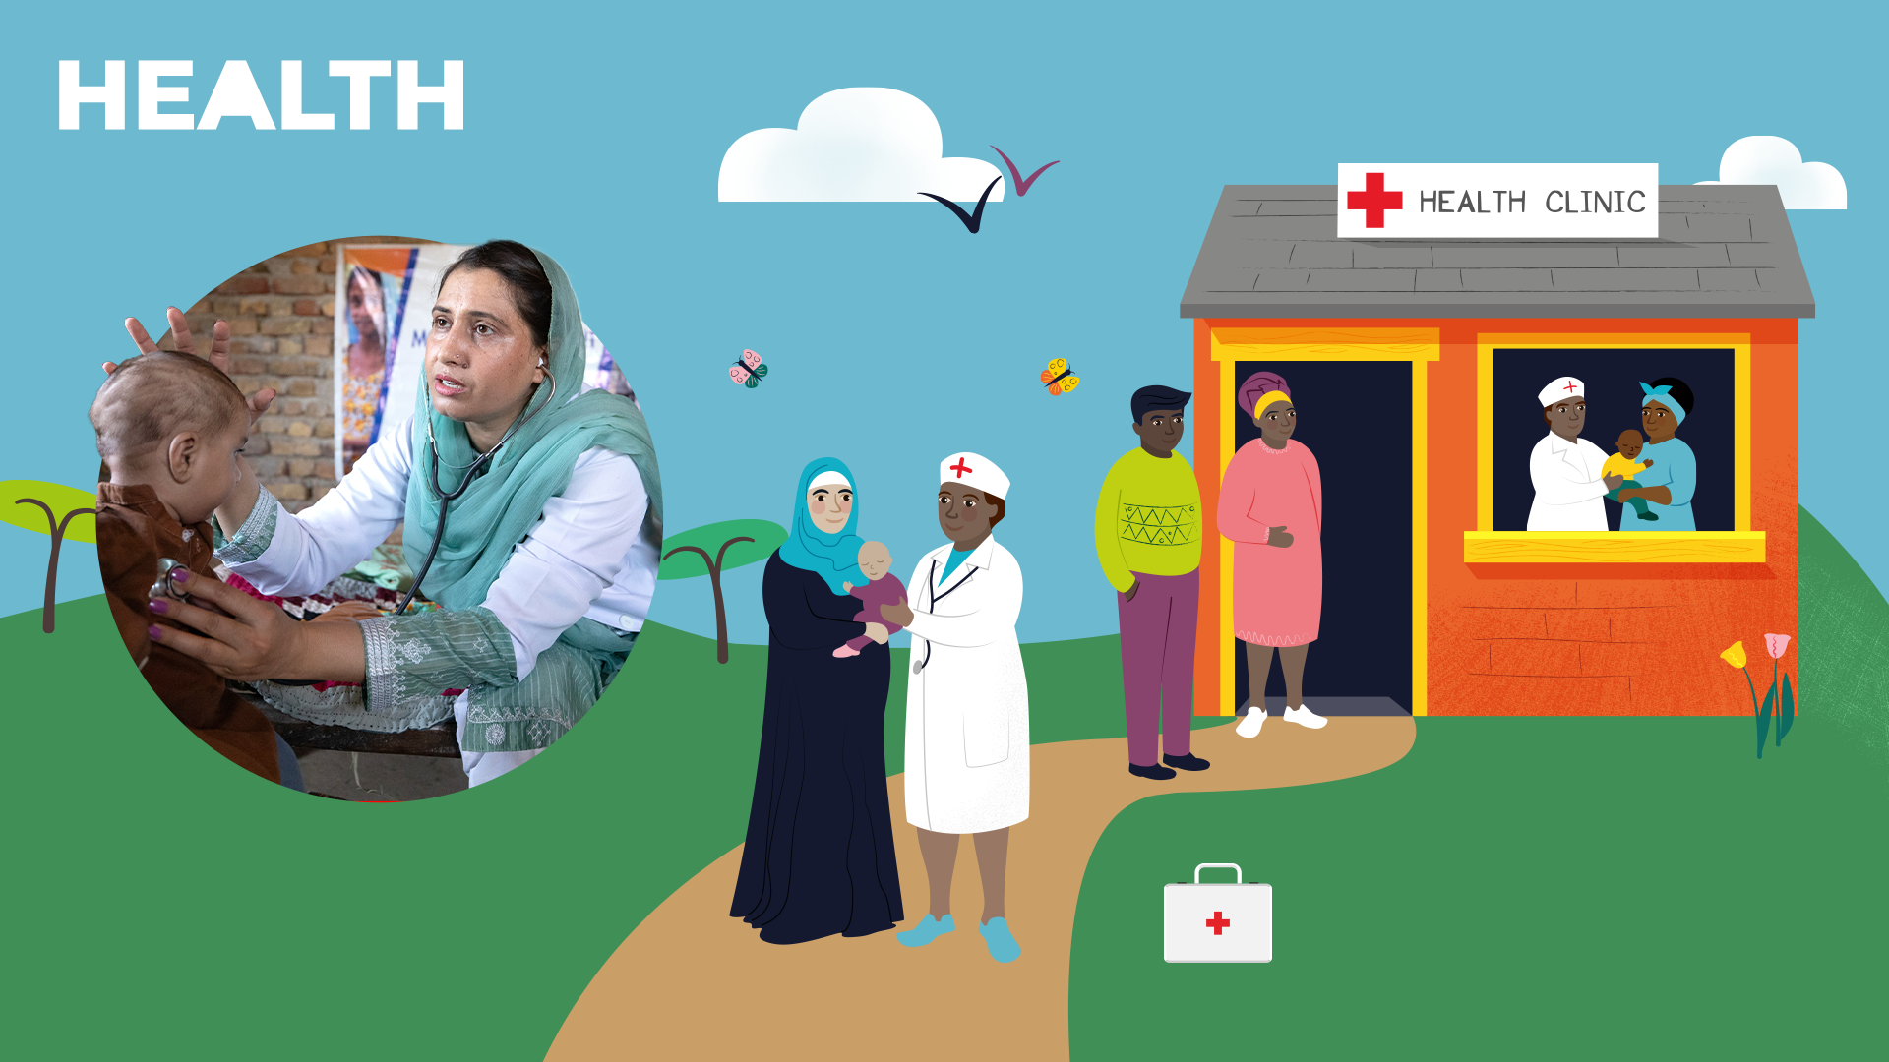
Notes:
CAFOD’s Health and Hygiene gifts improve health, hygiene and help people receive vital medical attention.

Slide 16
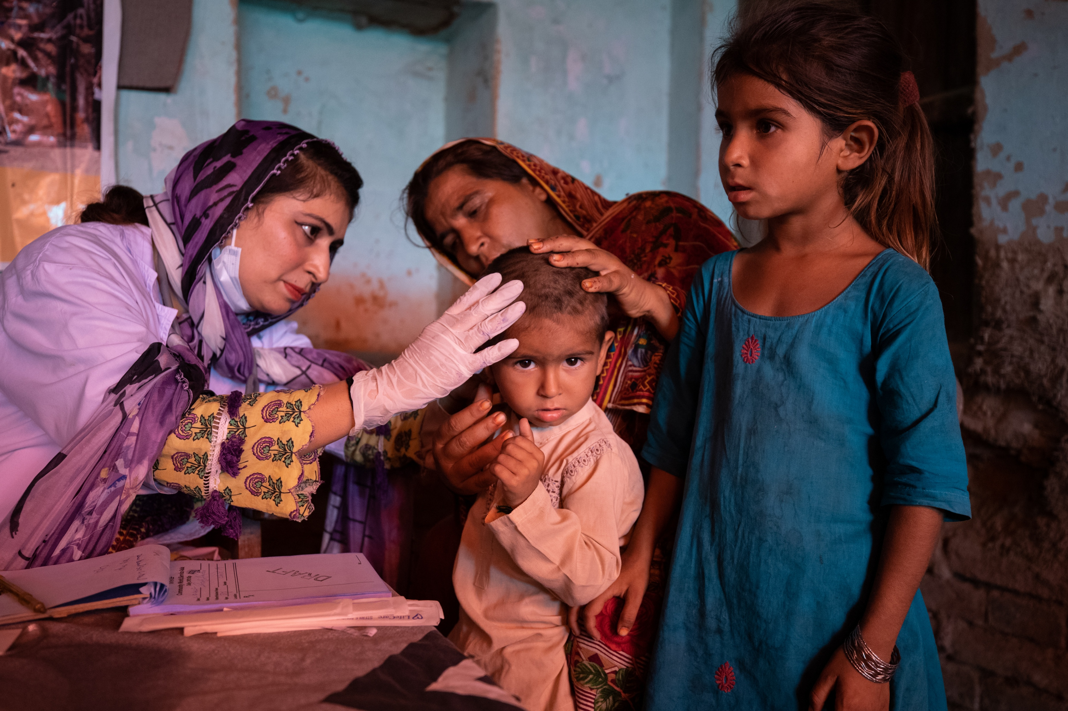
Notes:
Photo credit: Khaula Jamil/ CWSA
After devastating floods in Pakistan, Sultana and her family lost their home. Water surrounded their village and there were lots of mosquitoes. Their daughter Ayra (dressed in blue) contracted malaria.
Ayra’s mum had to carry her to a CAFOD-supported medical clinic. "The doctor at the clinic gave a medicine that she needed to take for three months, and she slowly became better and recovered her strength," Sultana told us.
The clinic provided life-saving free medicine to both Ayra and her son. Sultana said: "We didn't care about any possessions – we just wanted to keep our children safe."

Slide 17
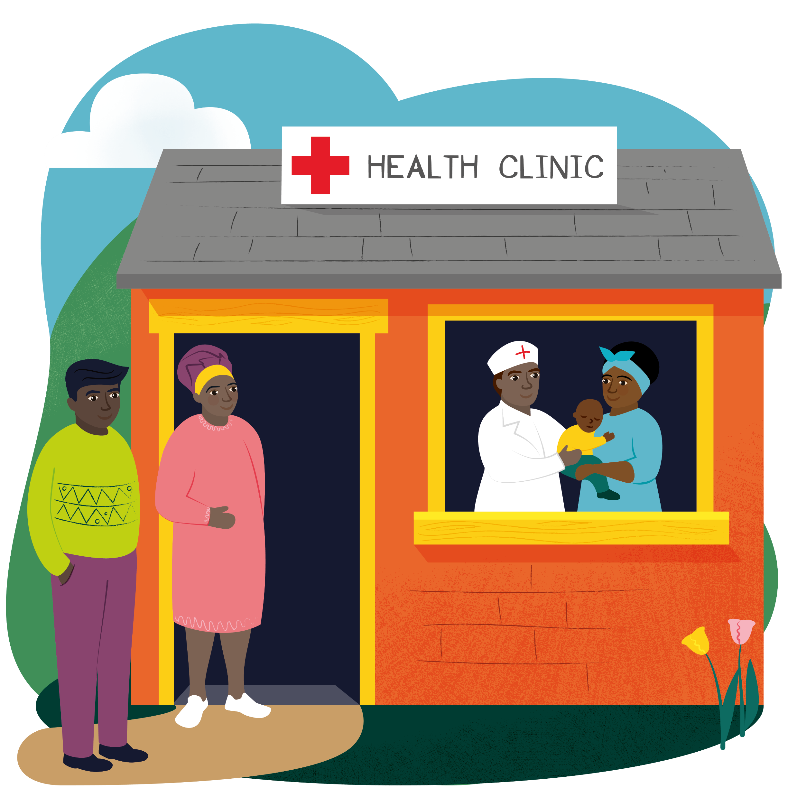
Health World Gifts
Healthy Mum and Baby: £43
Medical Outreach Team: £300
Health Clinic: £4,000
Notes:
Give the gift of health!
A Healthy Mum and Baby gift costs £43 and provides medical care, nutrition, and support for mothers and newborns.
A Medical Outreach Team for £300 funds a mobile medical team bringing life-saving care to remote communities.
Or set a big challenge to raise £4,000 for The Health Clinic gift to keep a clinic in a remote or conflict affected area stocked with medicines, medical equipment and even petrol for the clinic ambulance.

Slide 18
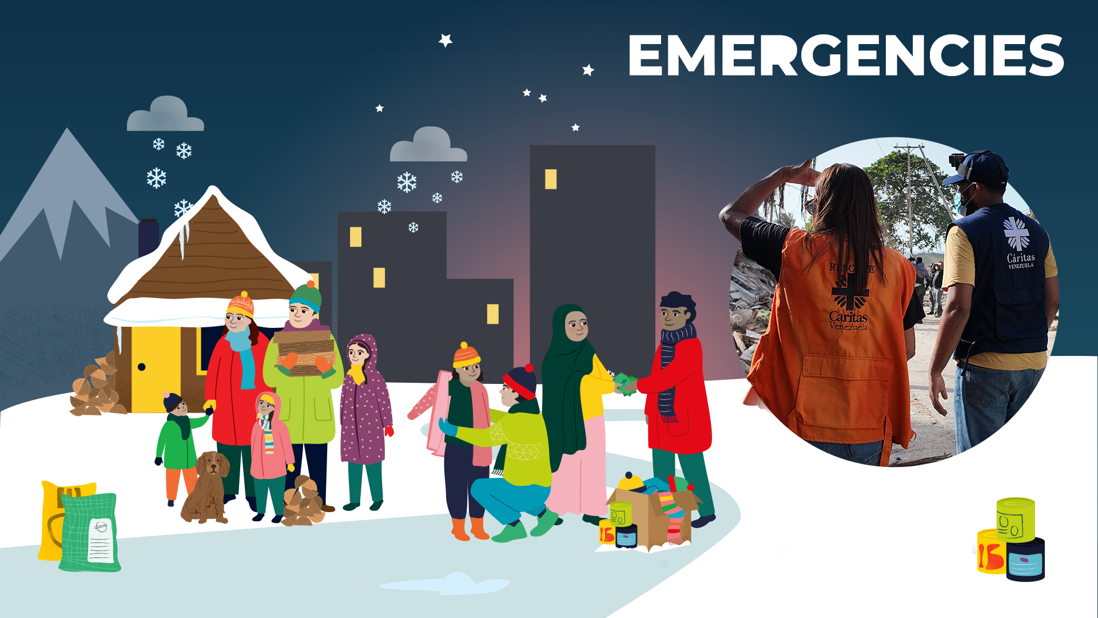
Notes:
CAFOD’s World Gifts for emergencies helps provide immediate, vital aid when disasters strike, such as water, food and shelter. The gits help CAFOD’s local experts to respond quickly in times of emergency.

Slide 19
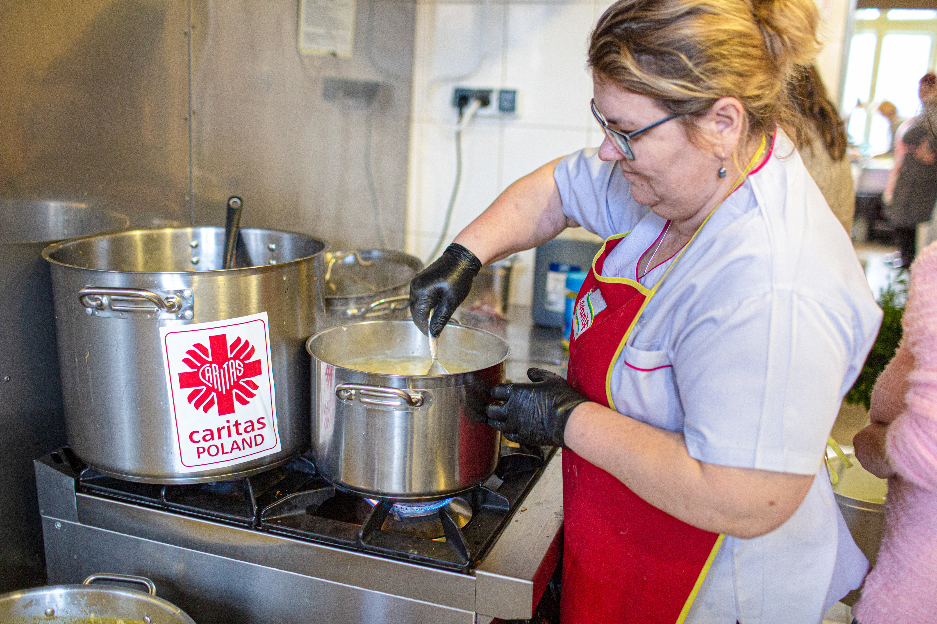
Notes:
Photo credit: Philipp Spalek / Caritas Germany
Veronica lived in Ukraine when the war started. She spent days in a bomb shelter and in the corridors of her building before deciding to flee her home.
She travelled for days before reaching the Polish border. At that point, she hadn't eaten for nearly 20 hours. When she finally crossed the border, she reached a meeting point run by CAFOD's local partners. She received a warm meal and was offered shelter.
The soup kitchen produces 1,800 litres of soup daily and provides clothing and a safe place to rest to those fleeing their homes due to conflict.

Slide 20
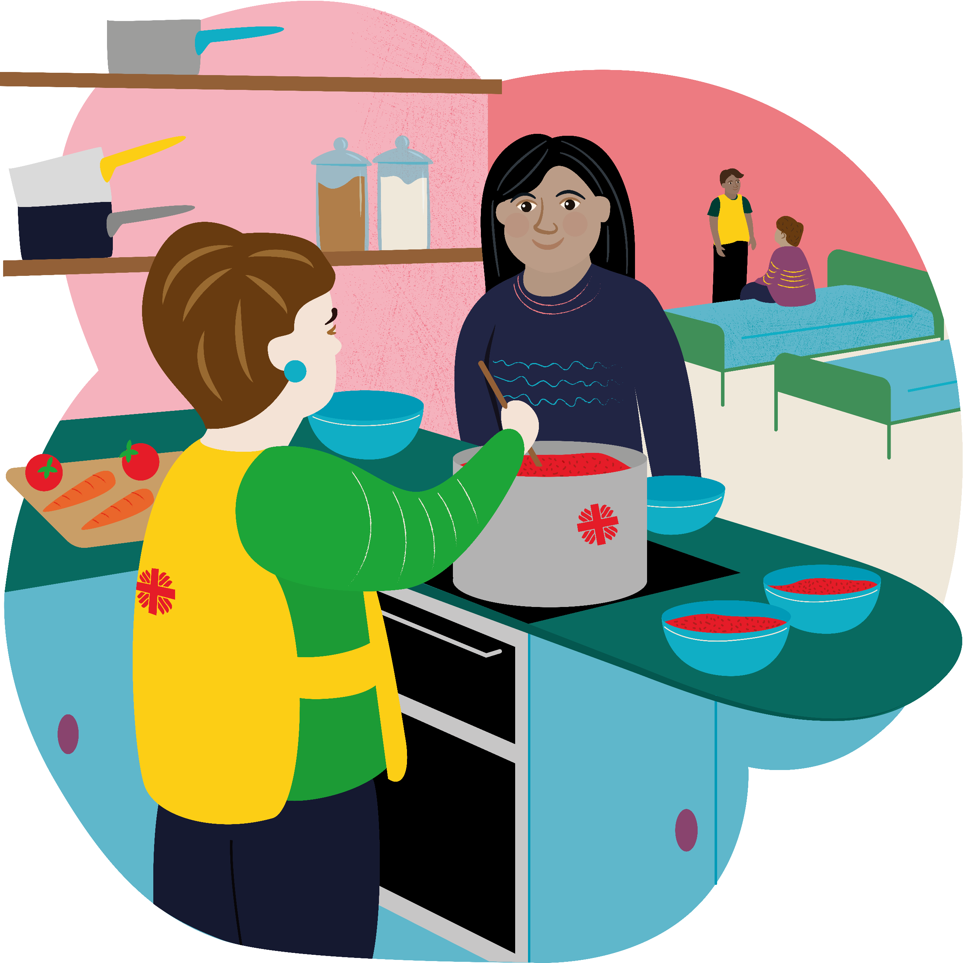
Emergency World Gifts
Super Soup Kitchen: £10
Winter Warmth: £33
Notes:
Give an Emergency support gift to help refugees find hope and safety.
£10 will buy a Super Soup Kitchen providing warm meals, shelter, and essential items to refugees fleeing conflict.
£33 will buy a Winter Warmth gift, providing heating fuel and cash support in winter for families fleeing conflict.

Slide 21
"Dear young people, aspire to great things, to holiness, wherever you are. Do not settle for less. Then you will see the light of the Gospel grow every day, within you and around you.’’
Pope Leo XIV
Notes:
Pope Leo encourages us to aspire to great things, to holiness. At CAFOD we put our faith into action through World Gifts and as do we see the light of the Gospel grow around us!

Slide 22
Loving God,
Your Son was the greatest gift ever for the world.
Help us to remember all that He taught us
About loving our brothers and sisters,
Wherever they live in your world.
Amen.
Notes:
Let’s finish with a prayer.
Loving God,
Your Son was the greatest gift ever for the world.
Help us to remember all that He taught us
About loving our brothers and sisters,
Wherever they live in your world.
Amen.

