Slide 1

Notes:
Welcome to the World Gifts Assembly 2025!

Slide 2

Notes:
Who can remind me what CAFOD stands for?
[Invite responses from the children.]
At CAFOD, we believe in a better world, where no one lives in poverty and each of us can become the best person we can be.

Slide 3






Clean water
Enough food
Safe home
School
Doctor or nurse
Live in peace
Notes:
This means a world where people have clean, safe water to drink. They have enough food to eat every day. Everyone has a safe home, children can go to school, anyone who is sick can visit a doctor or nurse and everyone can live in peace.

Slide 4
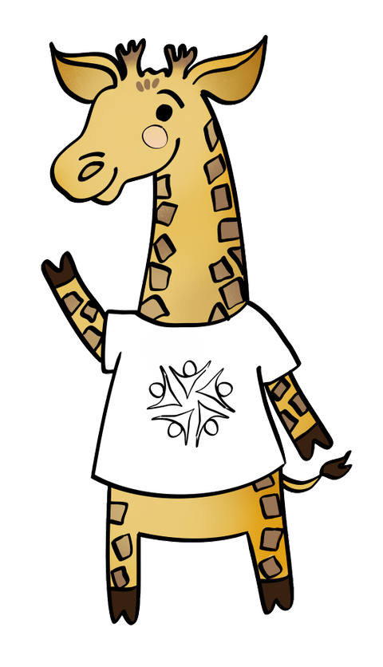
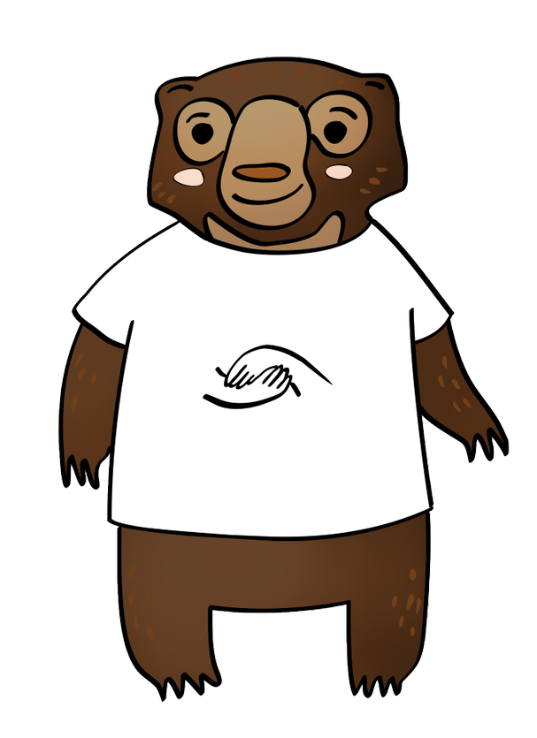
Common Good
Solidarity
Thinking of everyone
Showing we care
Notes:
Catholic Social Teaching, or CST, is at the heart of what we do and who we are. Today we will be thinking about two of the principles in particular: the Common Good (or thinking of everyone, as Chikondi the Giraffe says) and Solidarity (or showing we care, as Shristi the Sun Bear says).

Slide 5


What’s the best gift you ever received?
What’s the best gift you ever gave?
Notes:
Today we are going to think about gifts. Can anyone tell me what a gift or a present is?
I’d like you to think about the best gift you ever received. How did you feel?
Now, how about the best gift you ever gave to someone. How did that make you feel? Was it the same? Or better? (Tell the person next to you/the other person on your table).

Slide 6
“For God loved the world so much that he gave his only Son.”
John 3:16
Notes:
World Gifts help to support our global neighbours.
As we know ‘God so loved the world so much that he gave his only Son’.
God gave us the most precious gift of his son Jesus. We make a difference too, by having fun together and raising money for a world gift.

Slide 7


2.2 billion people (nearly a third of the world’s population) are not able to wash their hands at home
Notes:
World Gifts help to support our global neighbours.
As we know ‘God so loved the world so much that he gave his only Son’.
God gave us the most precious gift of his son Jesus. We make a difference too, by having fun together and raising money for a world gift.

Slide 8
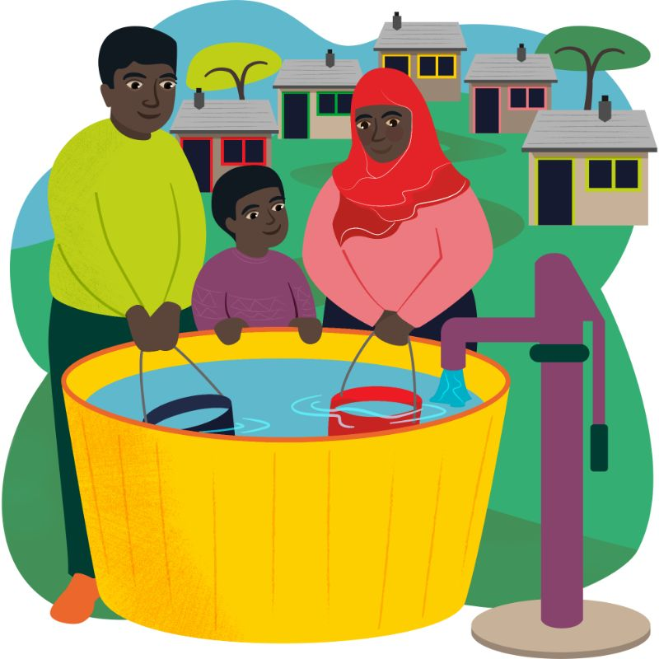
Community water supply
£750

Slide 9

Notes:
You can learn more about this project by watching our new Autumn film. Autumn 2025 film for young people: A better world needs all of us | CAFOD

Slide 10
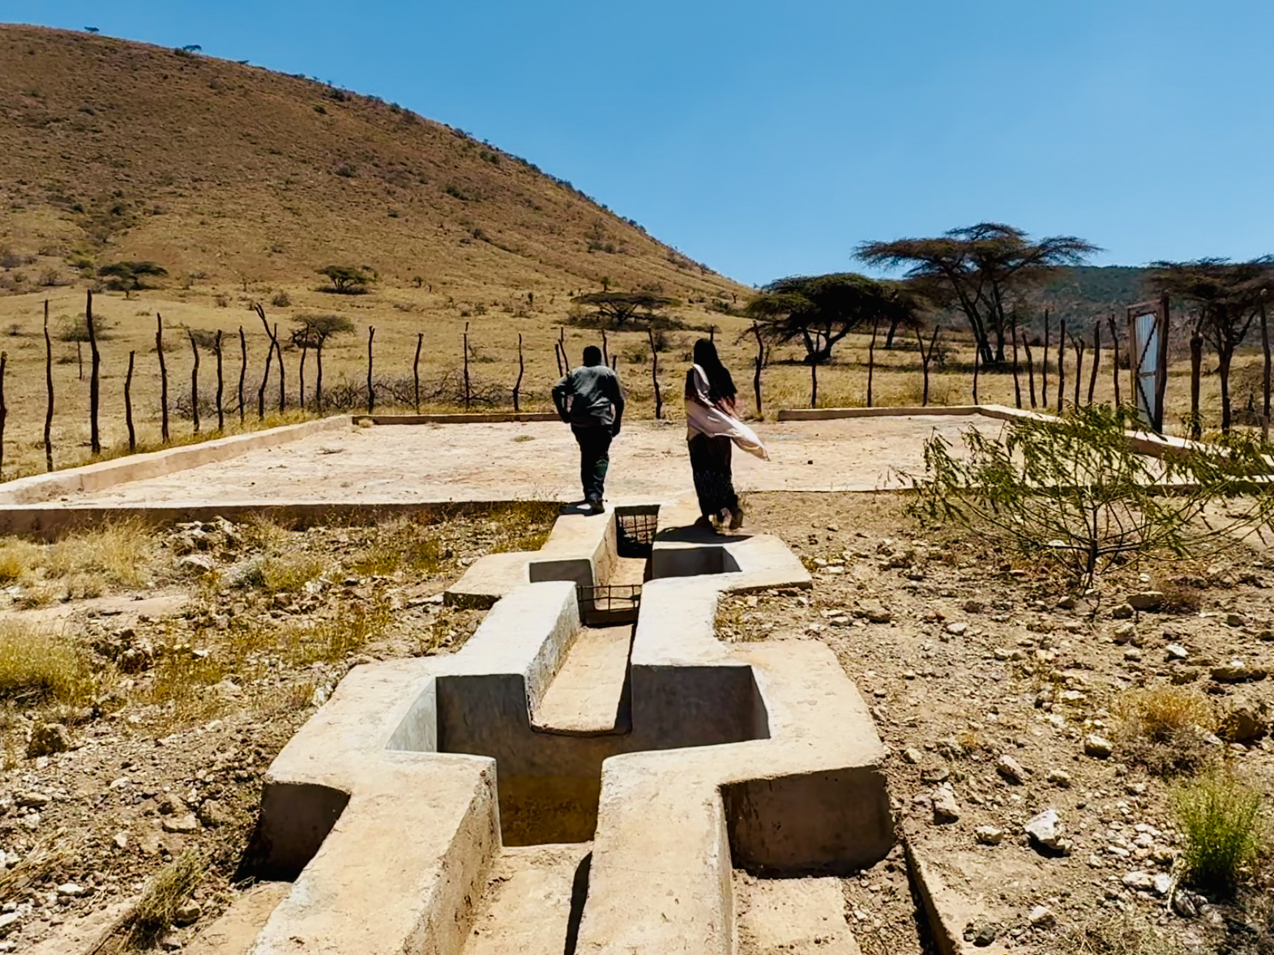
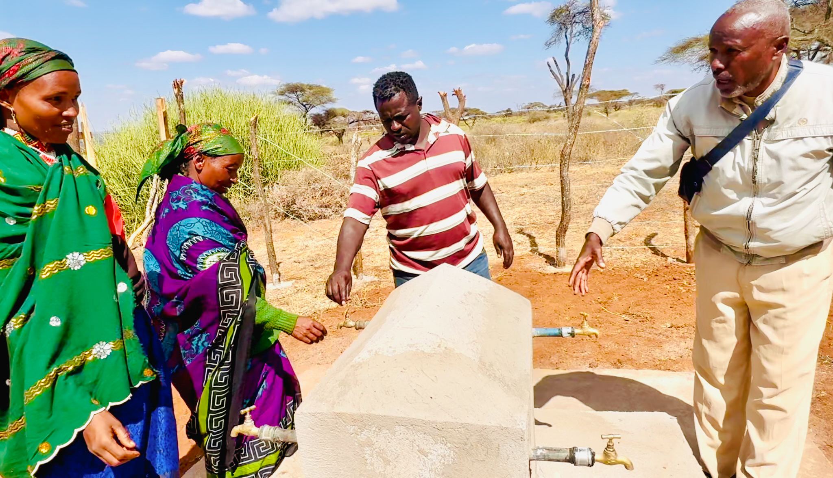
Ethiopia
Notes:
Abbiott is a Climate Change officer in Ethiopia. Here he shows Adi and other community members how to care for the underground water tank. Your gift can help support water tank projects so communities have clean, safe drinking water even through a drought. This water tank will provide 3 months drinking water for the community.

Slide 11
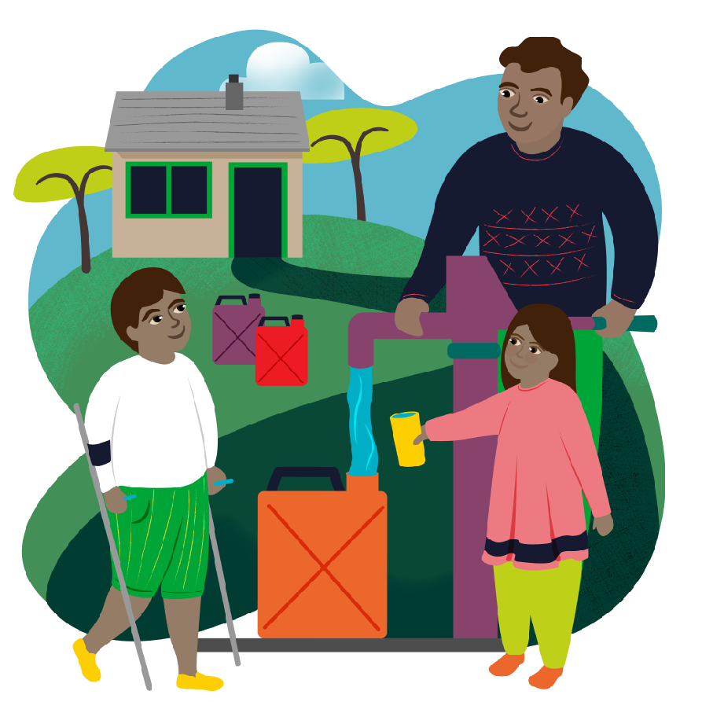
Water for a family

Slide 12
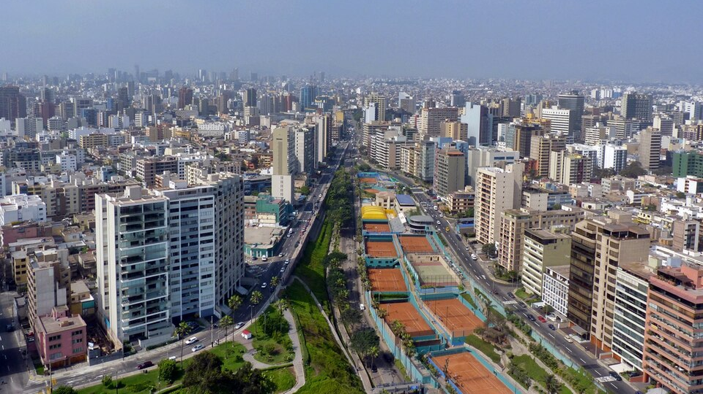
Lima, Peru
Notes:
On the outskirts of Lima, Peru, a group of neighbours and volunteers banded together to tackle their issue of limited access to safe drinking water. For four years, Lizbeth was part of the team that collected evidence that the poorest communities were paying more for poor-quality water.

Slide 13
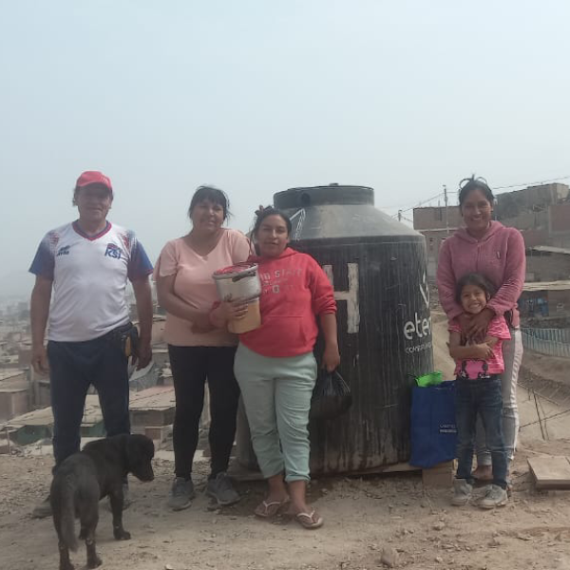
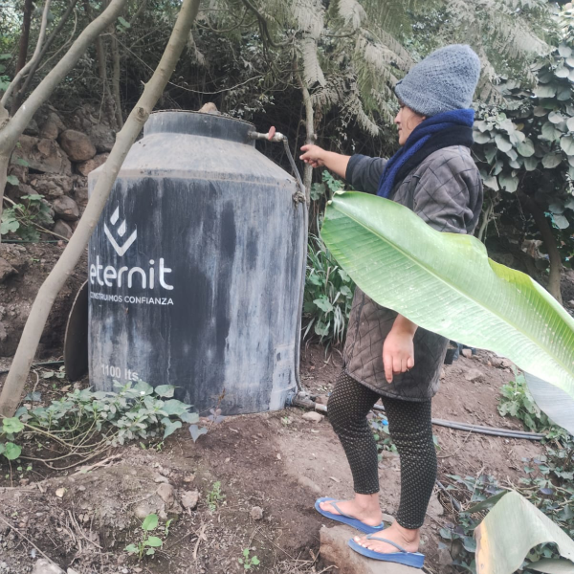
Notes:
With support from CAFOD, Lizbeth and her community took the report to the government and spoke in citizen forums in Lima. As a result, they were supplied with tanks and equipment that improved their water quality!
Everyone worked together to install the tanks. Lizbeth told us: ‘The most important thing is [water] has brought together all neighbours in the district.’

Slide 14
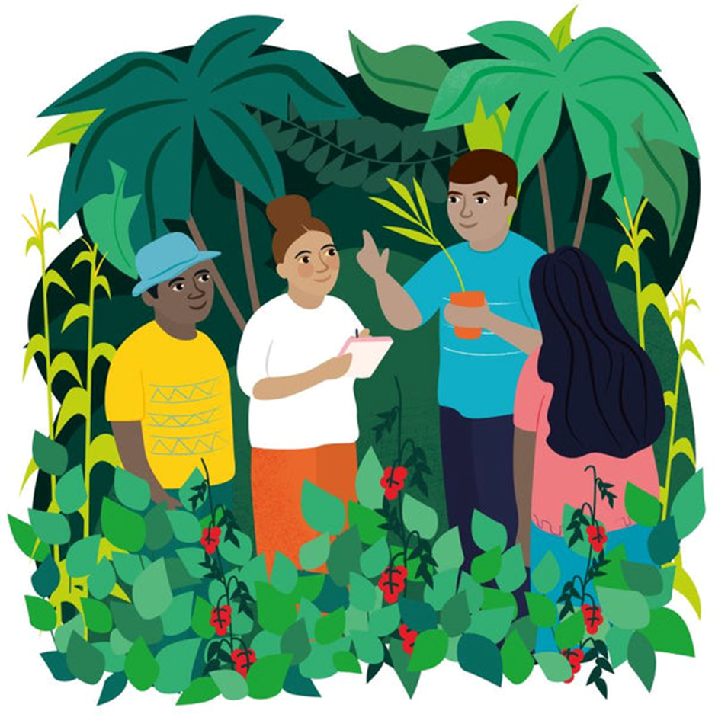
Forest school
£40
Notes:
£40 can provide a year of help showing people how to grow fruit and vegetables, while also helping the rainforest to recover and flourish.

Slide 15




Deforestation and damaged land keeps growing.
Notes:
In the past 20 years, more than 100 million hectares of forest has been chopped down – similar to the size of 100 million football pitches. This, and other types of pollution, damage the land and make it hard to grow crops.

Slide 16
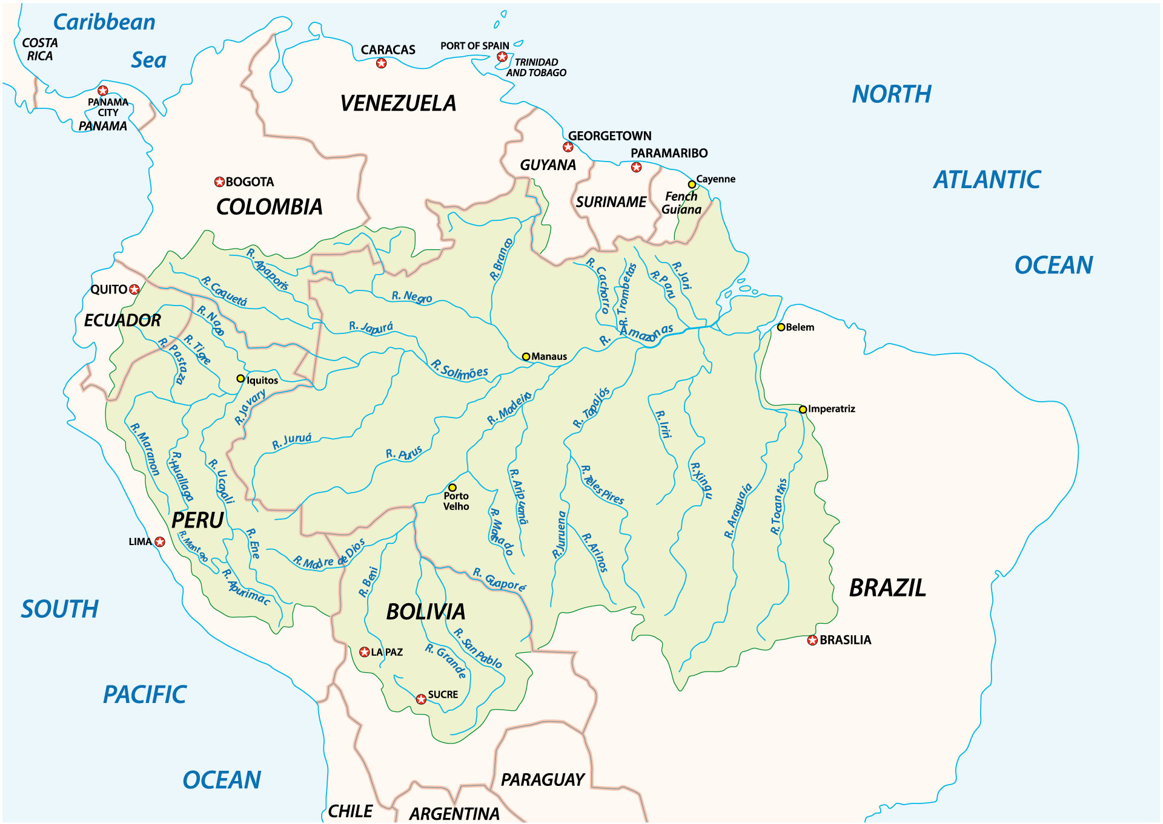
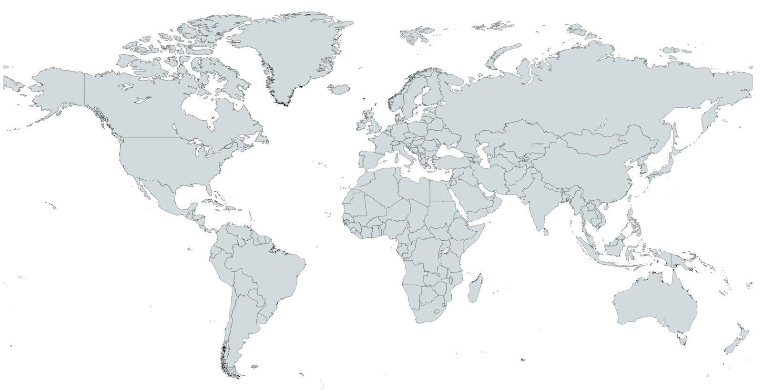
The Amazon Rainforest
Notes:
One of the worst areas of deforestation is in the Amazon rainforest. The rainforest covers 9 countries, the largest of which is Brazil.

Slide 17
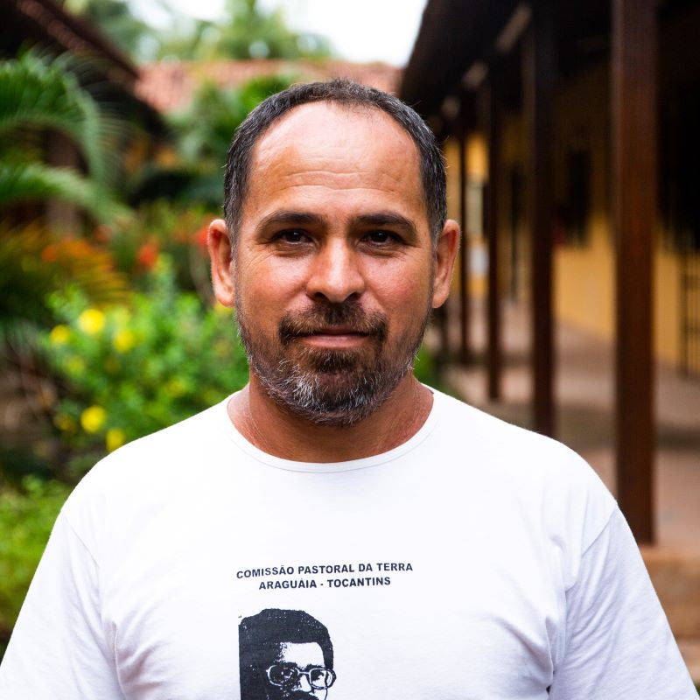
Chiquinho
Notes:
Chiquinho lives in Brazil.
He is an expert in eco-friendly forest farming that helps with the health of the Amazon rainforest and helps families grow enough food to eat.
With so much deforestation and even smaller farms damaging the forest around them, it’s very important for people to continue to learn and use these farming techniques.

Slide 18
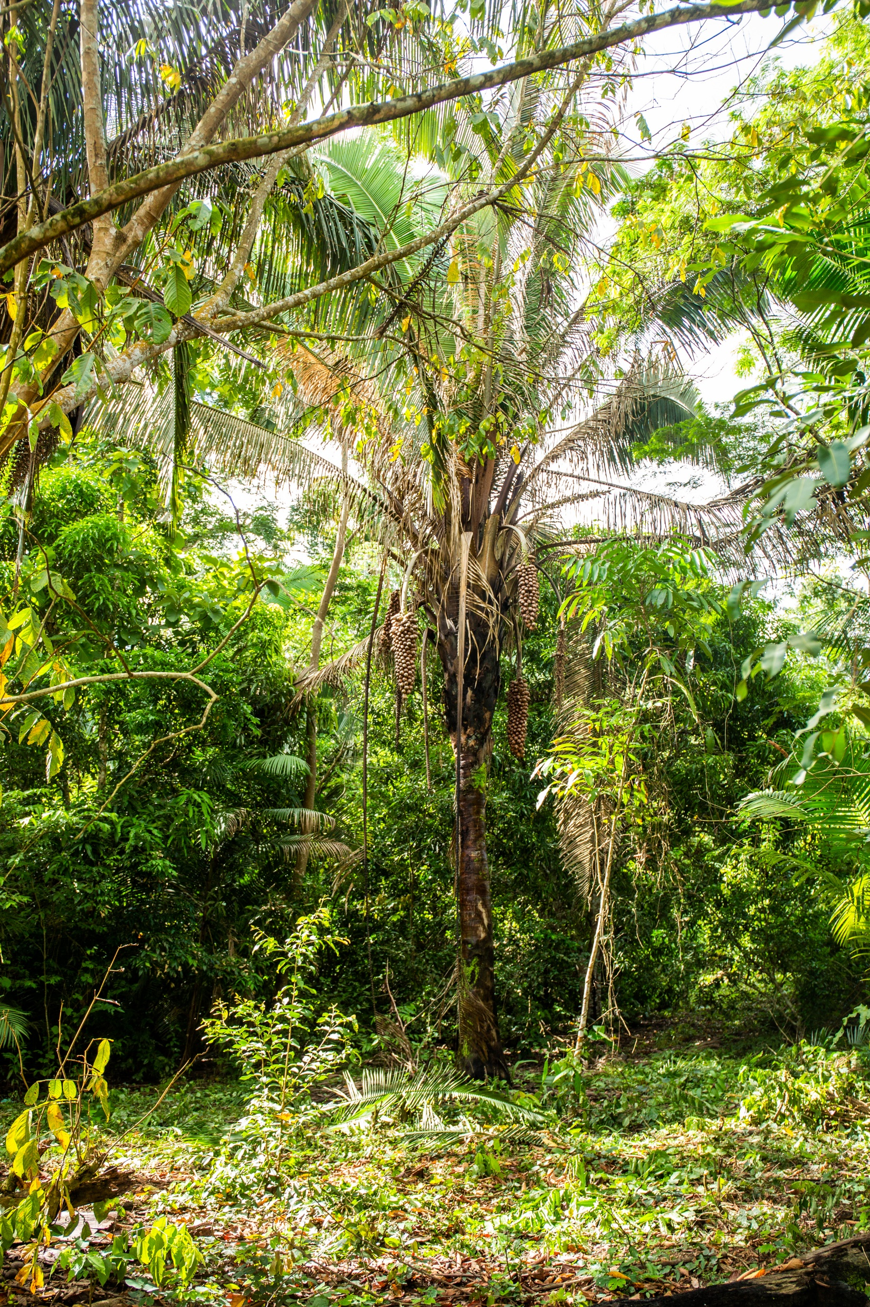
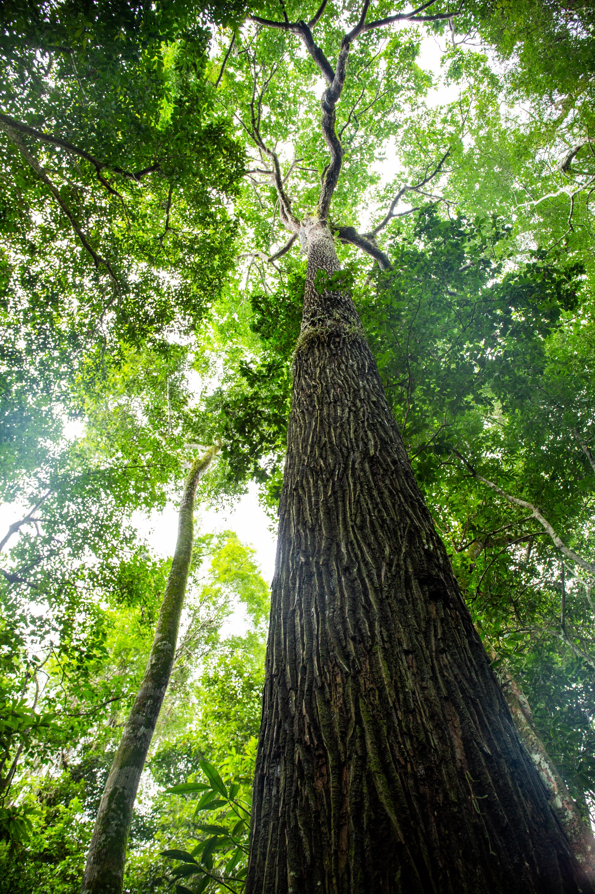
Notes:
Chiquinho works with local communities to encourage and teach them how to grow fruits and vegetables without using chemicals.
This way of farming produces a more varied and bigger harvest. It also enables the soil, water, plants and animals of the Amazon to recover and flourish.

Slide 19
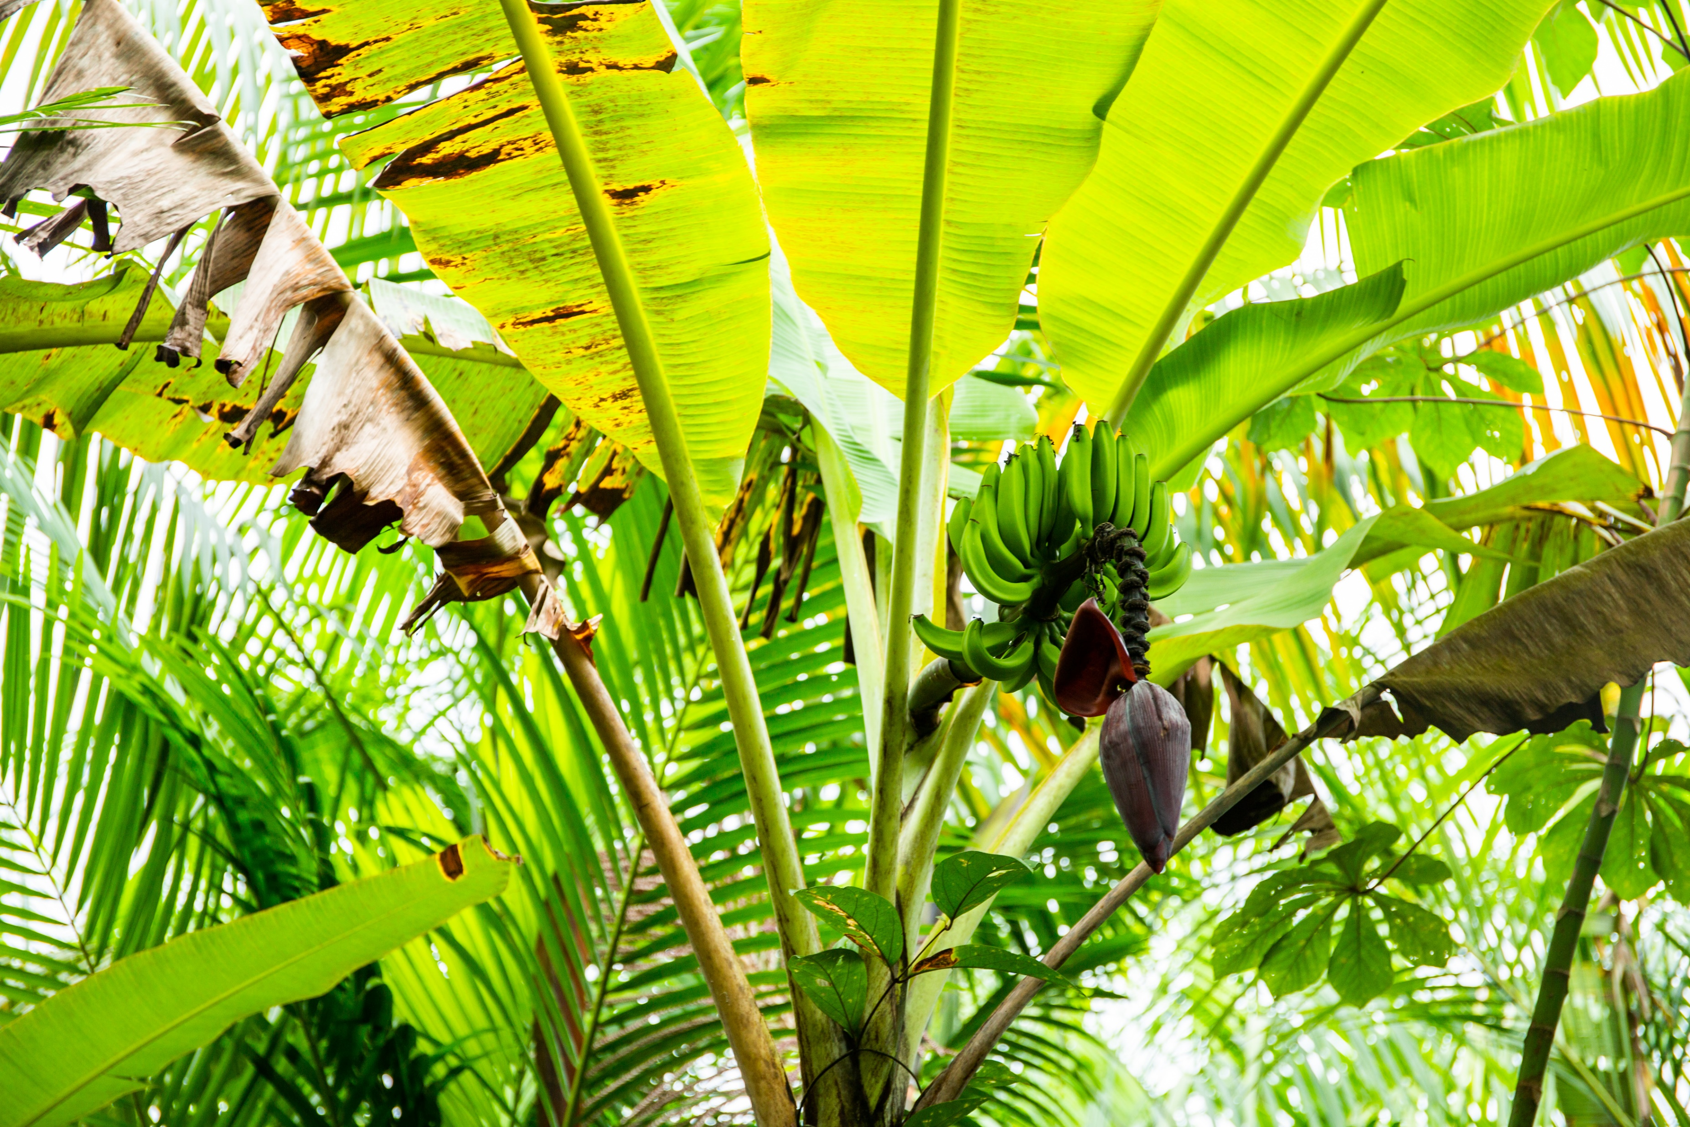
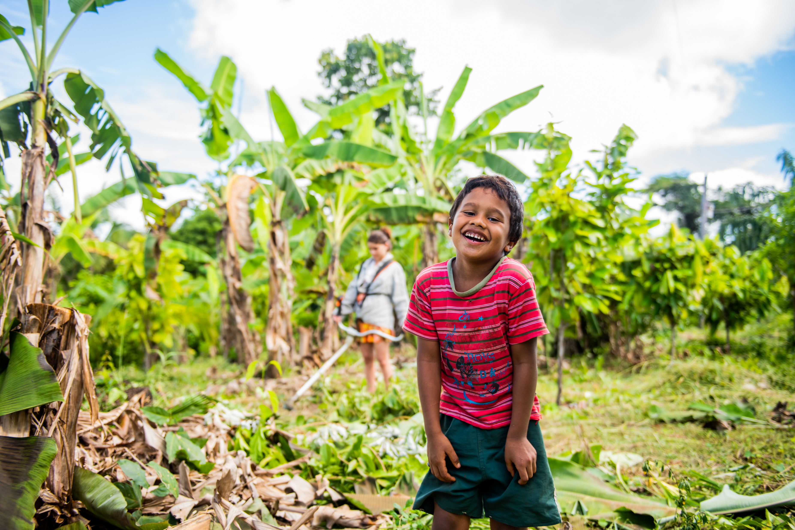
Notes:
The communities he works with are often living under threat of powerful groups who use violence and fraud to grab the land away.
Chiquinho says,“The forest can be used by humans in a way that humans don’t dominate nature and nature doesn’t dominate humans. We work together. Neither one excludes the other.”

Slide 20
2.4 billion people are without food or unable to eat a healthy balanced diet on a regular basis
Notes:
2.4 billion people are without food or unable to eat a healthy balanced diet on a regular basis – that’s about 3 people out of every 10 around the world. We’ve already talked about how emergencies affect people’s access to food, but we can support our global neighbours for the longer term as well.

Slide 21
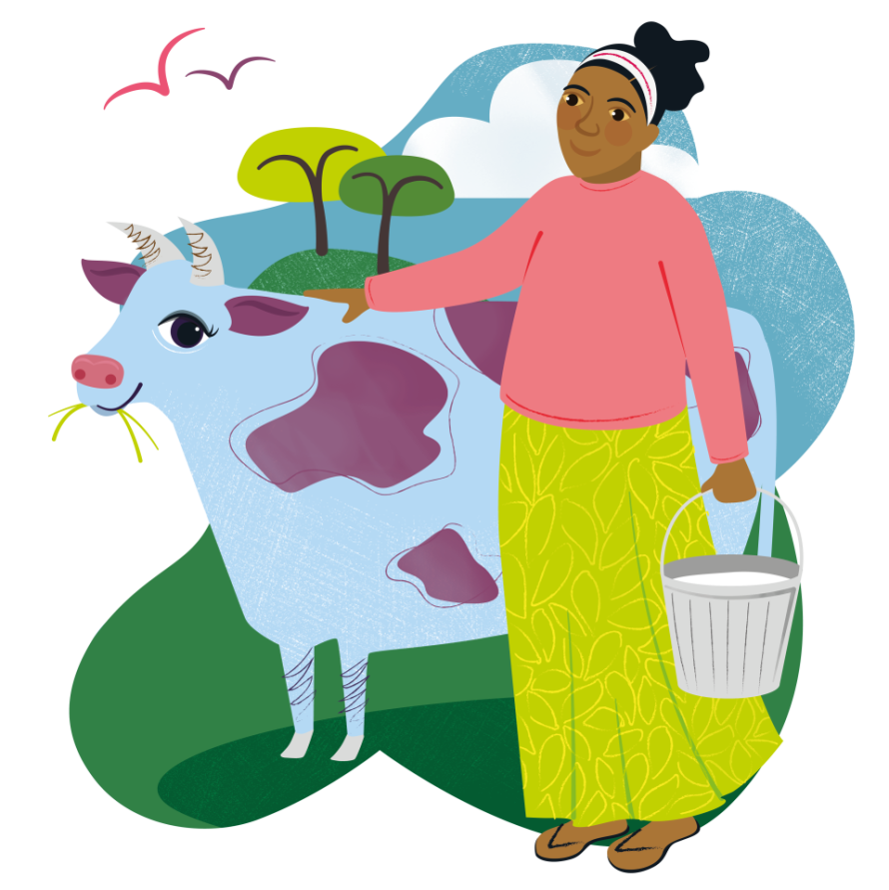
Marvellous moo cow
£150

Slide 22
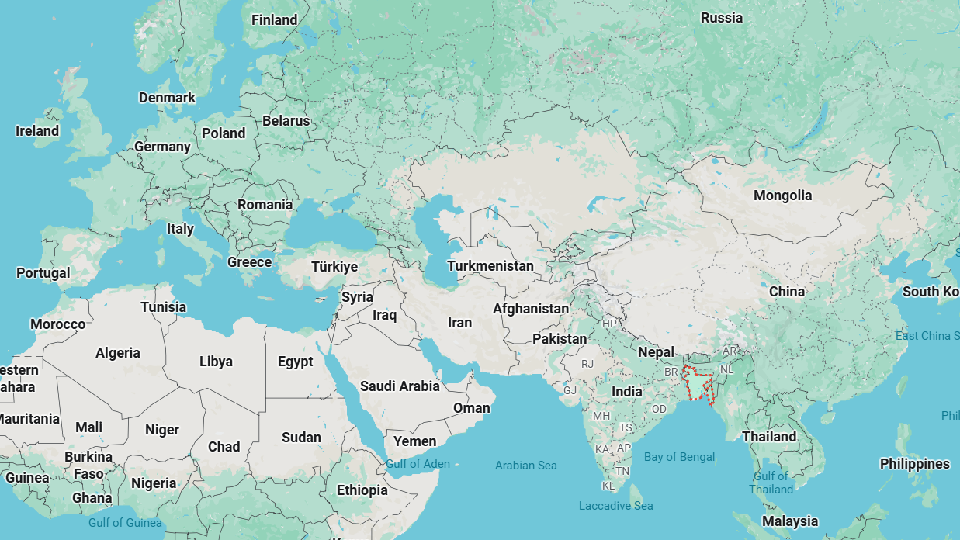
Bangladesh
Notes:
Finally we are going to Bangladesh.
Picture source: Google Maps

Slide 23
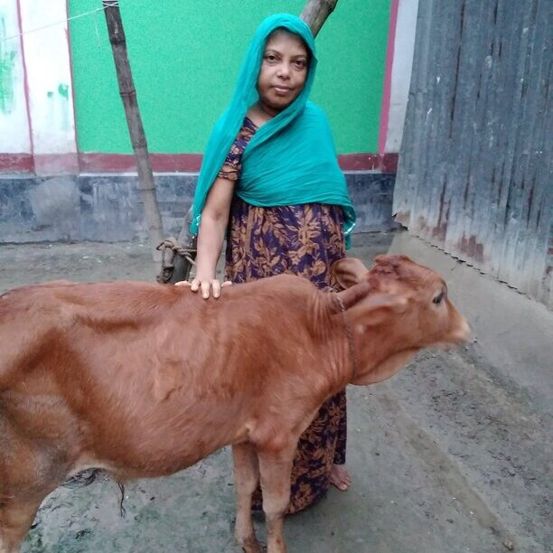
Rahda
Notes:
Radha is from Bangladesh and has five daughters. After her husband, a farmer, became unwell and was unable to support their family, she had no choice but to leave her home country in search of work.
She travelled to Lebanon where she got a job as a domestic worker. Radha was forced to work long hours, for little pay.
After her health started to worsen, she decided to return home to Bangladesh. Upon her return, CAFOD’s local partners supported Radha with the provision of counselling and medical treatment. Radha also received business training, which encouraged her to get a cow.
With this support, Radha hopes to be self-sufficient. She now lives with one of her daughters and her health is stable. She says she is now ‘confident enough’ and is hopeful for the future.

Slide 24
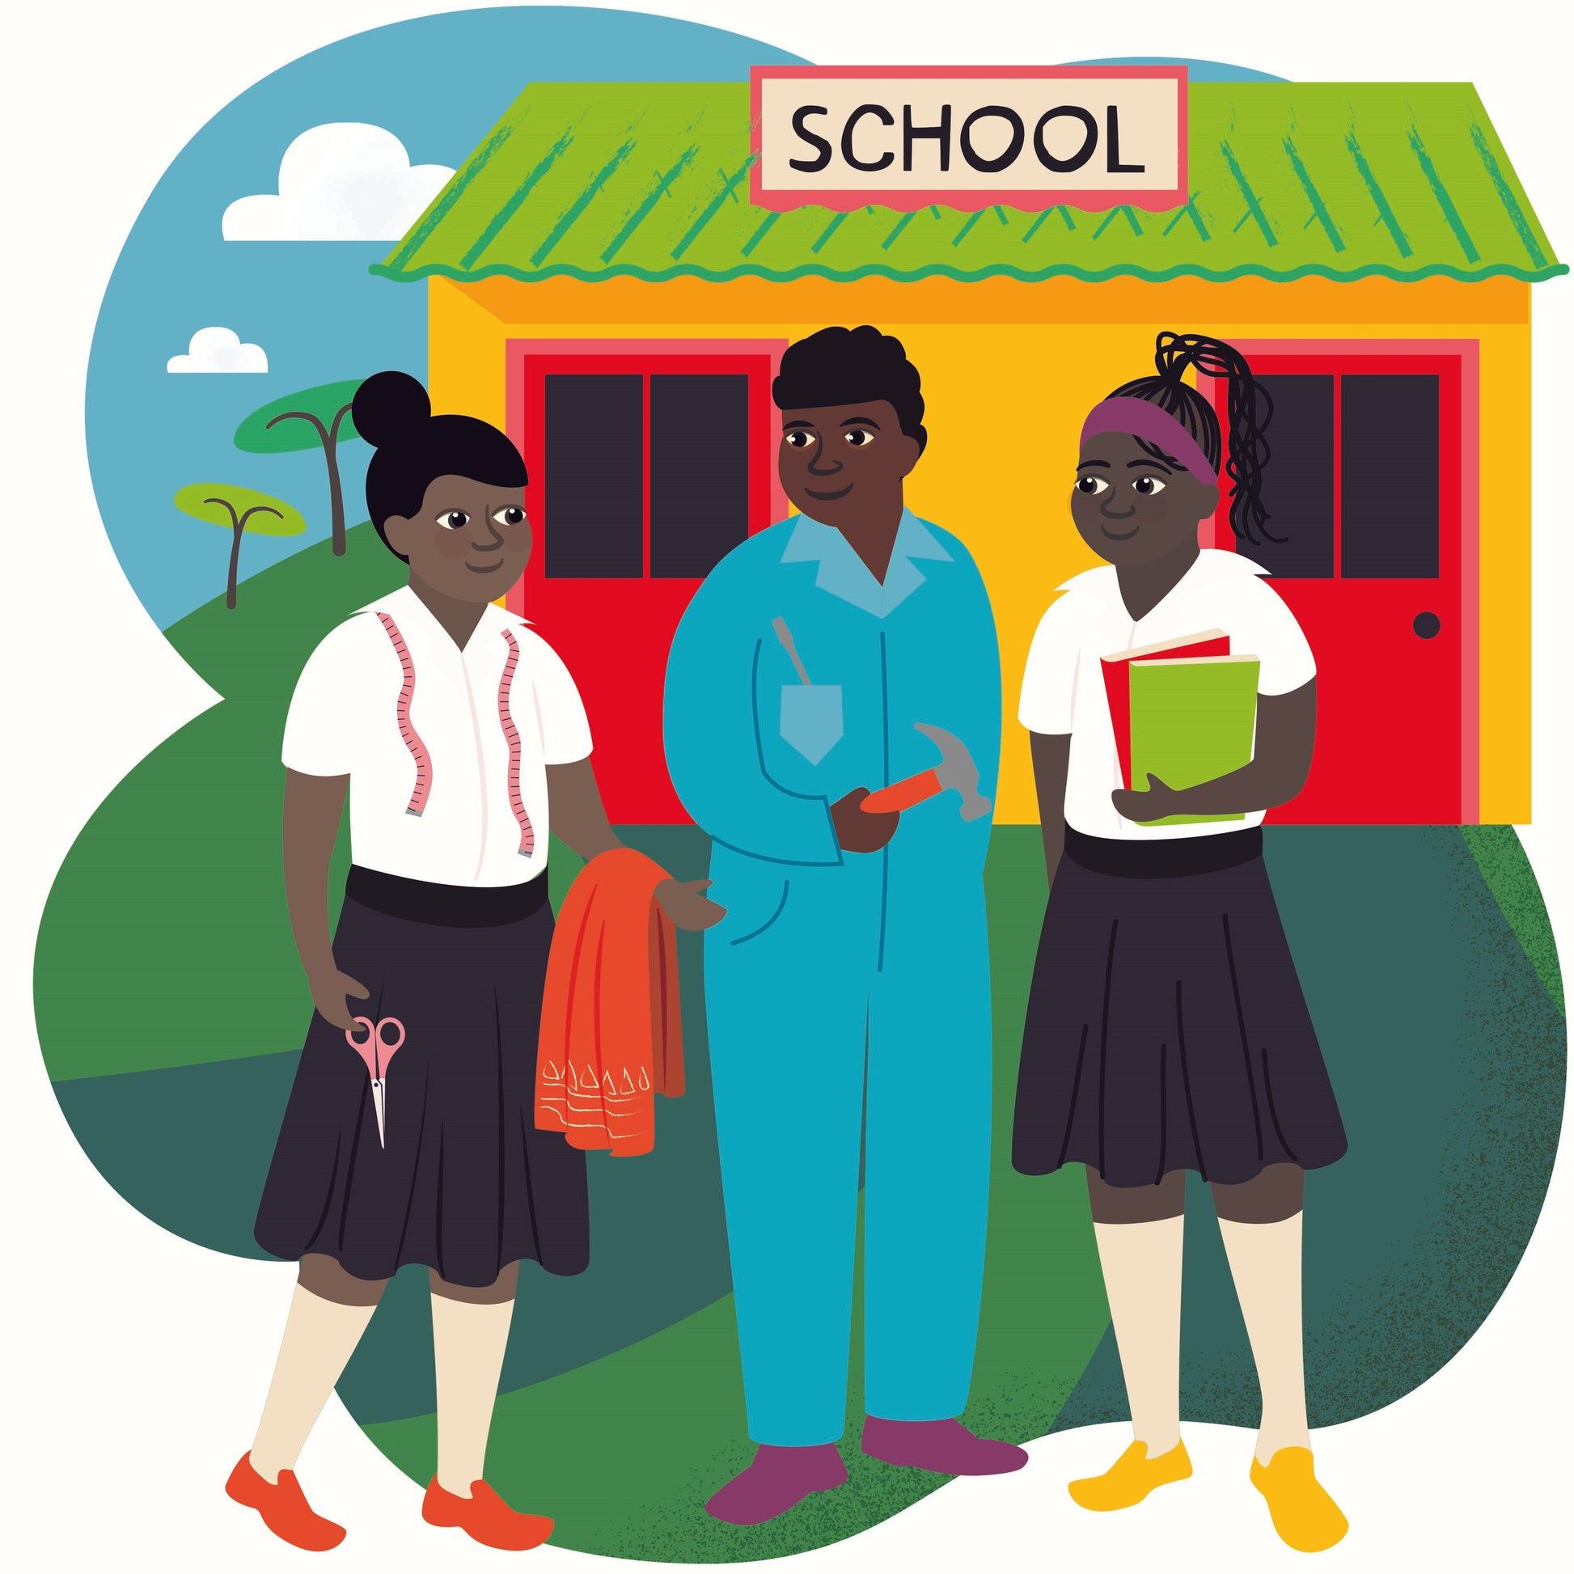
Back to School
£63

Slide 25
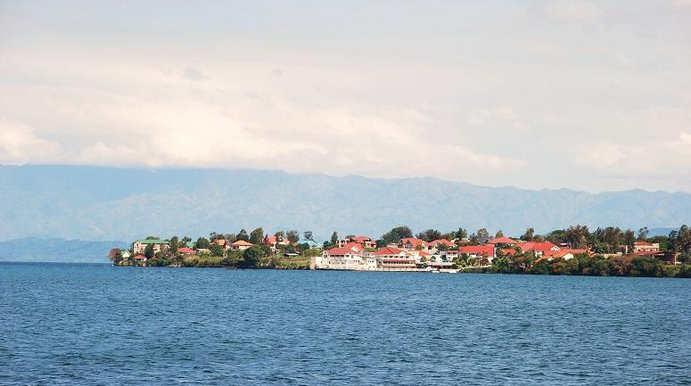
Goma, DRC
Notes:
Goma is in the Democratic Republic of Congo on the edge of Lake Kivu.
Photo credit: Wikipedia Commons

Slide 26
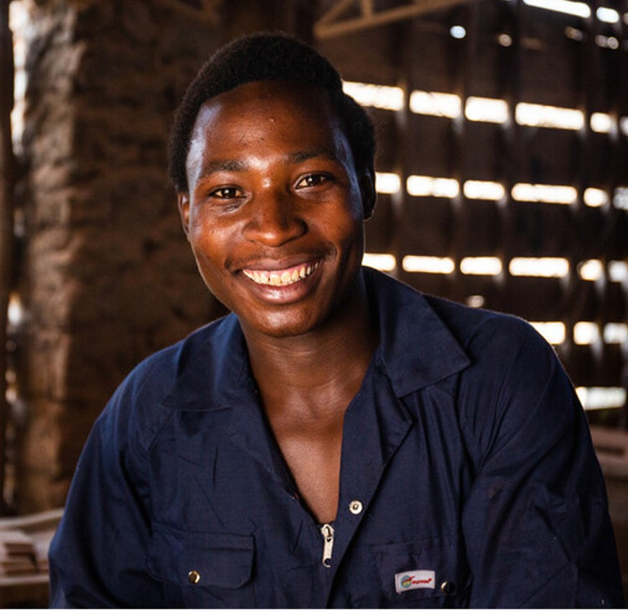
Daniel
Notes:
Growing up Daniel wasn’t able to go to school in Goma, as his parents couldn't afford the fees, and when he became a young adult, he struggled to find work.
Thanks to CAFOD’s local carpentry workshops, Daniel received an education, learnt new skills, and with the money he earnt, he was able to support his family.
Now, he’s a skilled carpenter with his own workshop and hopes to be able to train other young people from disadvantaged backgrounds. He told us: ‘The thing I’m most proud of is this work that I’m doing.’

Slide 27
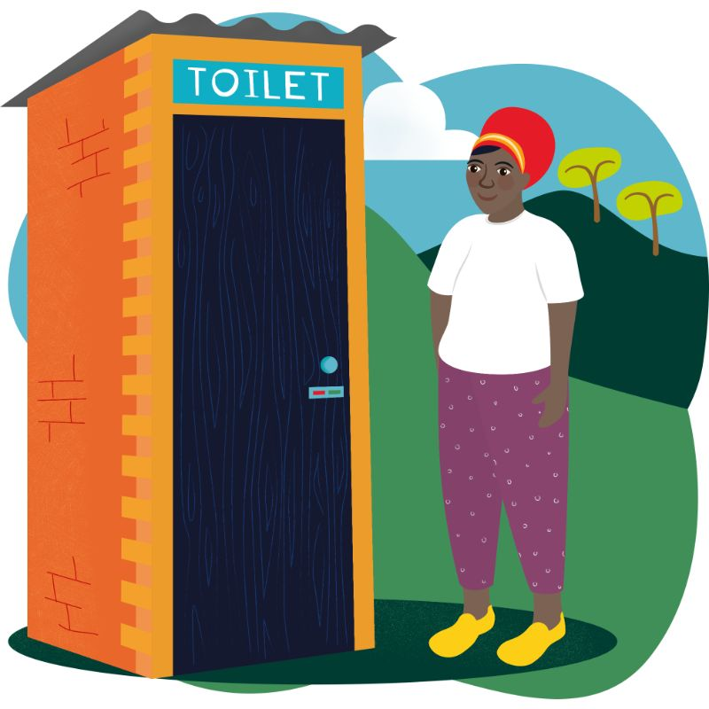
Terrific Toilet
£89

Slide 28
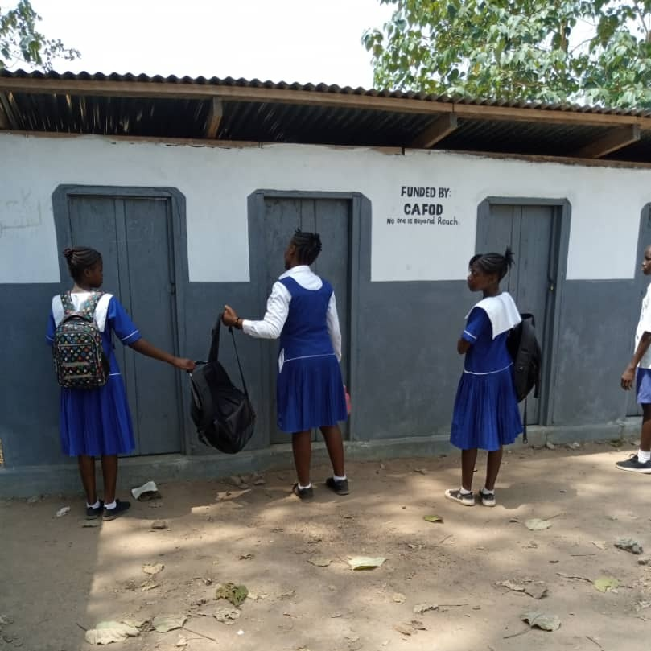
Sierra Leone
Notes:
These lovely loos are the best way to stop the spread of serious diseases, keeping whole communities healthy and safe. This gift can help build toilet facilities and promote better hygiene practices in schools and communities.

Slide 29
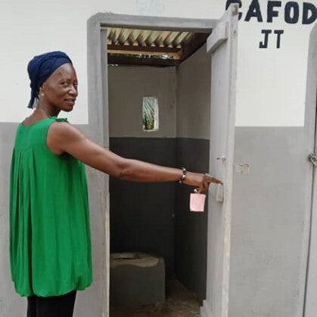
Toma
Notes:
Toma is a teacher at a remote rural school in Sierra Leone. Without a toilet in the school, Toma’s students were forced into the bushes when they needed the loo. Toma was deeply concerned about her student’s wellbeing and started appealing for support.
With the help of CAFOD and local experts, the school was able to build a new toilet facility and promote better hygiene practices. Now, children are able to stay in school for longer and get the education they need and deserve.

Slide 30
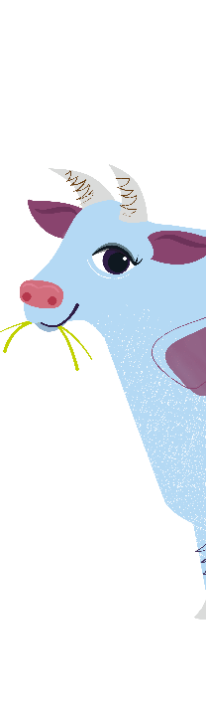

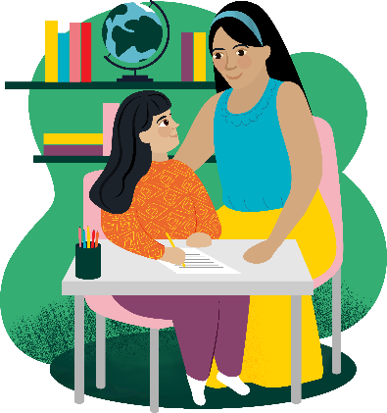
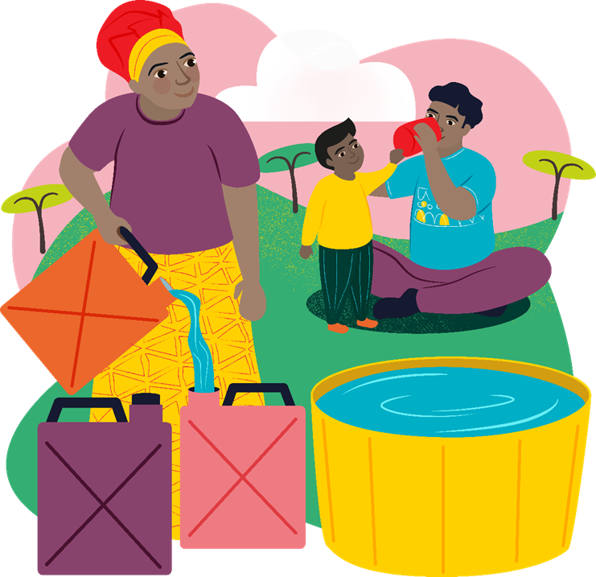
Make a
of difference!
Notes:
So you can see how much difference you can make to our global neighbours. There are even more available at worldgifts.cafod.org.uk
These gifts can change lives.
There are lots of ways you can work together to raise money for a World Gift. You could do a Brighten Up fundraiser. You could do sponsored events. Or you could collect money over the weeks, or the even the whole term to save up for a big gift.
Grid posters to track progress available at cafod.org.uk/primary or cafod.org.uk/schoolfundraising

Slide 31
"Dear young people, aspire to great things, to holiness, wherever you are. Do not settle for less. Then you will see the light of the Gospel grow every day, within you and around you.’’ – Pope Leo XIV
Notes:
Pope Leo encourages us to aspire to great things, to holiness. At CAFOD we put our faith into action through World Gifts and as do we see the light of the Gospel grow around us!

Slide 32
Loving God,
Your Son was the greatest gift ever for the world.
Help us to remember all that He taught us
About loving our brothers and sisters,
Wherever they live in your world.
Amen.
Notes:
Loving God,
Your Son was the greatest gift ever for the world.
Help us to remember all that He taught us
About loving our brothers and sisters,
Wherever they live in your world.
Amen.

